Slide 1
Summary
Kevin L. Duel
Primary Vacuum Preliminary Design Review
March 10, 2020

Slide 2
Installation Area of Vacuum System Overview – Primary Beamline Enclosure and LBNF-5
Vehicle Access Corridor (MVA)
LBNF-5 Service Building Controls Room & Pump Room (for compressed air, N₂)
DS End: Primary Beam Window
MI10 Alcove
Beamline Components
US Start: MI Kickers at Q100

Slide 3
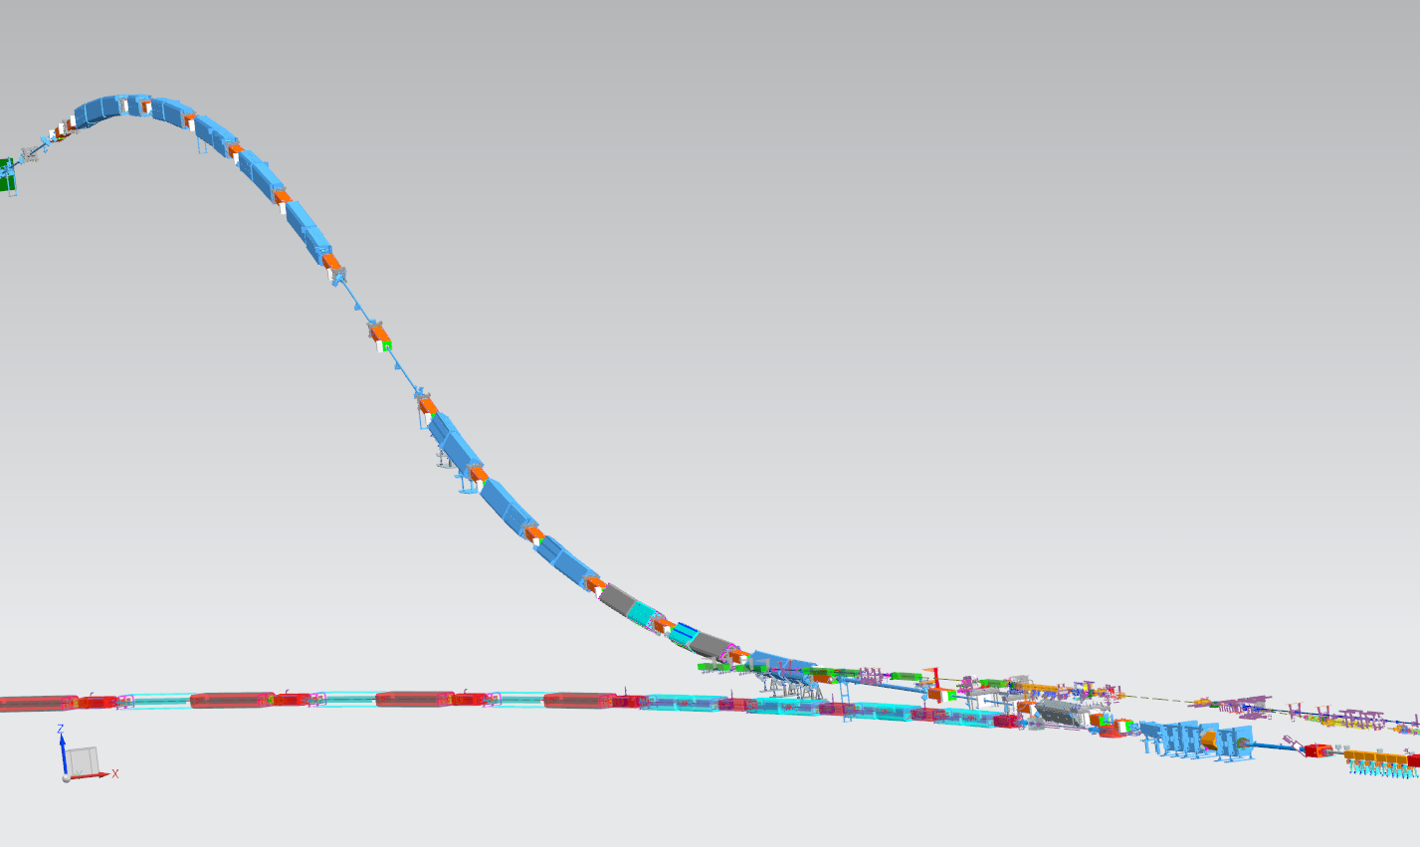
Primary Beamline Magnets and Vacuum
25 dipoles
21 quads
23 correctors
Vehicle Access Corridor Junction (MVA)
DS End: Primary Beam Window
MI Wall Penetration
Lambertsons
US Start: MI Kickers at Q100

Slide 4
Remaining Work
Final design activities
Update vacuum drawings with latest beamline model
Finalize dipole & kicker beam tube, stands, & turbocart designs
Create and finalize vacuum specifications (handling, certification, etc.)

Slide 5
Review Charge
Review Emphasis:
The focus of this review is primarily technical in nature and a brief review of cost and schedule will be given.
Does the design meet the technical requirements?
Are all interfaces adequately identified and defined?
Are Fermilab standard vacuum practices adequately applied to the design together with any applicable codes/standards?
Have ES&H issues been identified and analyzed appropriately?
Have long lead procurement items been identified?
Have all major risks been identified and does a mitigation strategy exist?

Slide 6
Review Charge
Is the design maturity at a satisfactory level giving confidence for the Primary Vacuum sub-system to be recommended to proceed to CD-2/CD-3a and Director’s readiness review?
Based on acceptable progress for preliminary design as a minimum of 50 to 60% at the time of this review, with 100% equal to “ready for procurement”.
Is there an adequate confidence level on cost and schedule estimates?
Is the final design schedule start date appropriate when taking considerations such as the design maturity of interfacing systems?
In addition to the charge questions, please comment and offer recommendations on other aspects of the vacuum design.

Slide 7
Questions & Discussion?

