Slide 1
Cost & Schedule
Kevin L. Duel
Primary Vacuum Preliminary Design Review
March 10, 2020

Slide 2
M&S Cost
WBS Total | WBS Description
$205,605 | Pumps
$236,906 | Beam Tubes
$63,189 | Valves/Gauges
$153,967 | Vacuum Instrumentation & Controls
$13,622 | Baking/Cleaning Equipment
$199,282 | Ceramic Beam Tubes Procurement
$105,538 | Ceramic Beam Tubes Fabrication
$978,108 | Total for non-labor M&S
Subcontracted crew labor expressed as M&S
$78,970 | Cable installation crew - electrical crew
$22,080 | Compressed air and N₂ system installation - pipeftter crew
$4,216 | Lambertson bake electrical installation - electrical crew
$51,840 | Beam tube installation - welder
$157,106 | Total for labor M&S
Increase of ~$125k by going with outside vendor
Savings of ~$116k in FNAL labor and welding
Some increase due to EVAC flanges between dipoles

Slide 3
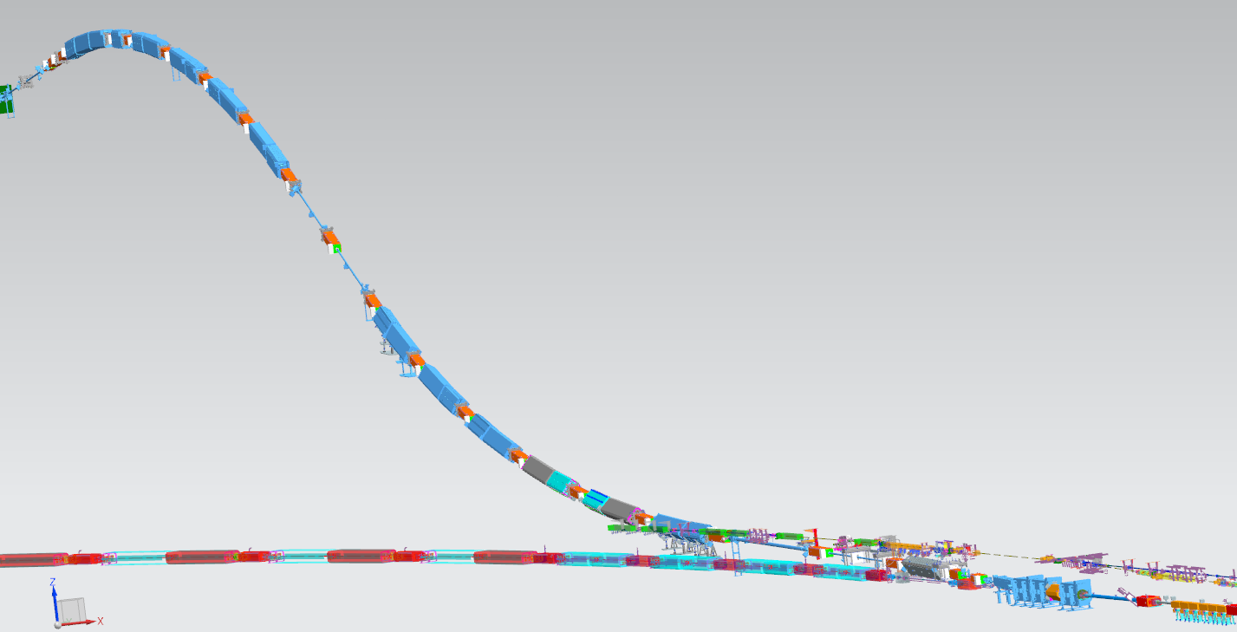
Primary Beamline
Target Hall Wall
Temporary Shield Wall (not shown)
MI Wall Penetration
Lambertsons
Kickers
Main Injector
Primary Beamline layout of magnets and vacuum

Slide 4
Beamline Schedule Summary
Beamline Preliminary Design
TC –Final Design – Remote Handling
DP&AC Final Design – Hadron Monitor
Beamline Final Design
SI Final Design – interlocks
PB Final Design - Instrumentation
Material Purchase Constraint
Magnets
Procurement/ Assembly
Production Horns A, B, C
Target Shield Pile
Extraction Enclosure (Long Shut Down)
Disassemble MI Components
Conventional Construction
Install New / Re-install Existing Components
Upstream of Shield Wall
Primary Beam Enclosure
Target Complex Authorization for Use and Possession
Downstream of Shield Wall
Near Site Critical Path
Install Target Shield Pile/ Battlement/Cooing Panel Install
Remote Handling Installation & Commissioning
A B C
Target Complex
Decay and Absorber Complex Authorization for Use and Possession
Mechanical and Electrical Rough-in
Install Horn A, B, C and initial Power-up/ Leak Check chase
Absorber Component Installation
Decay and Absorber Complex
DOE and Non-DOE Activity
Decay Pipe Upstream Window, Muon System - Install
Mechanical and Electrical Rough-in
Beamline Checkout Period
FY19
FY20
FY21
FY22
FY23
FY24
FY25
FY26
FY27
FY28
FY29
FY30
FY31
Material Purchase Constraint
Main injector – Second Shutdown Begins
Absorber Complex
Beamline Complete
Target Complex
Authorization for Use and Possession

Slide 5
Design Schedule
Preliminary design ramped up around March 2019
March 2020 – June 2020
Dipole Beam Tube Design and Specification Updates
150 hrs eng, 80 drafting
Final Design of Turbocart
120 hrs eng, 160 drafting
Final design of beam tube, ion pump, and gate valve stands
92 hrs engineering, 160 drafting

Slide 6
Design Schedule
June 2020 – September 2020
Final design of beam tubes and connections
190 hrs engineering, 260 drafting
Develop cleaning, handling, & certification procedures
80 hrs engineering, 40 technician
September 2020 – December 2020
Final design of instrumentation & controls
190 hrs engineering, 200 drafting
Finalization of cleaning, handling & certification procedures
40 hrs engineering, 20 technician

Slide 7
Design Schedule
December 2020 – February 2021
Final vacuum installation drawings
75 hrs engineering, 120 drafting
March 2021
Final Design Review
December 2022 – January 2023
Final revisions to beam tubes for BPM final design
50 hrs engineering, 80 drafting
~ 1 year of final design activities

Slide 8
Design Schedule Kicker Beam Tubes
Now through May 2020
SEY testing of kicker beam tubes
12 hrs engineering, 22 engineering physicist
May 2020 – June 2020
Update kicker beam tube flanges and bellows design
80 hrs engineering, 80 hrs drafting

Slide 9
Procurement Schedule
October 2025 – October 2026
Turbocarts
Ion pumps
Beam tube assemblies
Instrumentation
Compressed air & nitrogen
October 2026 – January 2027
Component vacuum certification

Slide 10
Procurement Schedule Kicker Beam Tube*
July 2024 – June 2025
Cut, lap, and braze
July 2025 – January 2026
Apply resistance coating (Aerodag)
Includes baking, leak checking, inspection, etc
January 2026 – June 2026
Custom bellows welding
July 2026
Production kicker assembly (Magnets BOE)
*Marked for early procurement – will start earlier than shown

Slide 11
Installation Schedule
February 2027
Install cabling, compressed air, nitrogen upstream of shield wall & MI
March 2027 – May 2027
Install beam tubes upstream of shield wall & MI
Install ion pumps, valves, gauges upstream of shield wall & MI
December 2027
Install cabling, compressed air, nitrogen downstream of shield wall
July 2028 – August 2028
Install beam tubes downstream of shield wall
Install ion pumps, valves, gauges downstream of shield wall

