Slide 1
IOTA/FAST Startup/Run Report
Darren Crawford

Slide 2
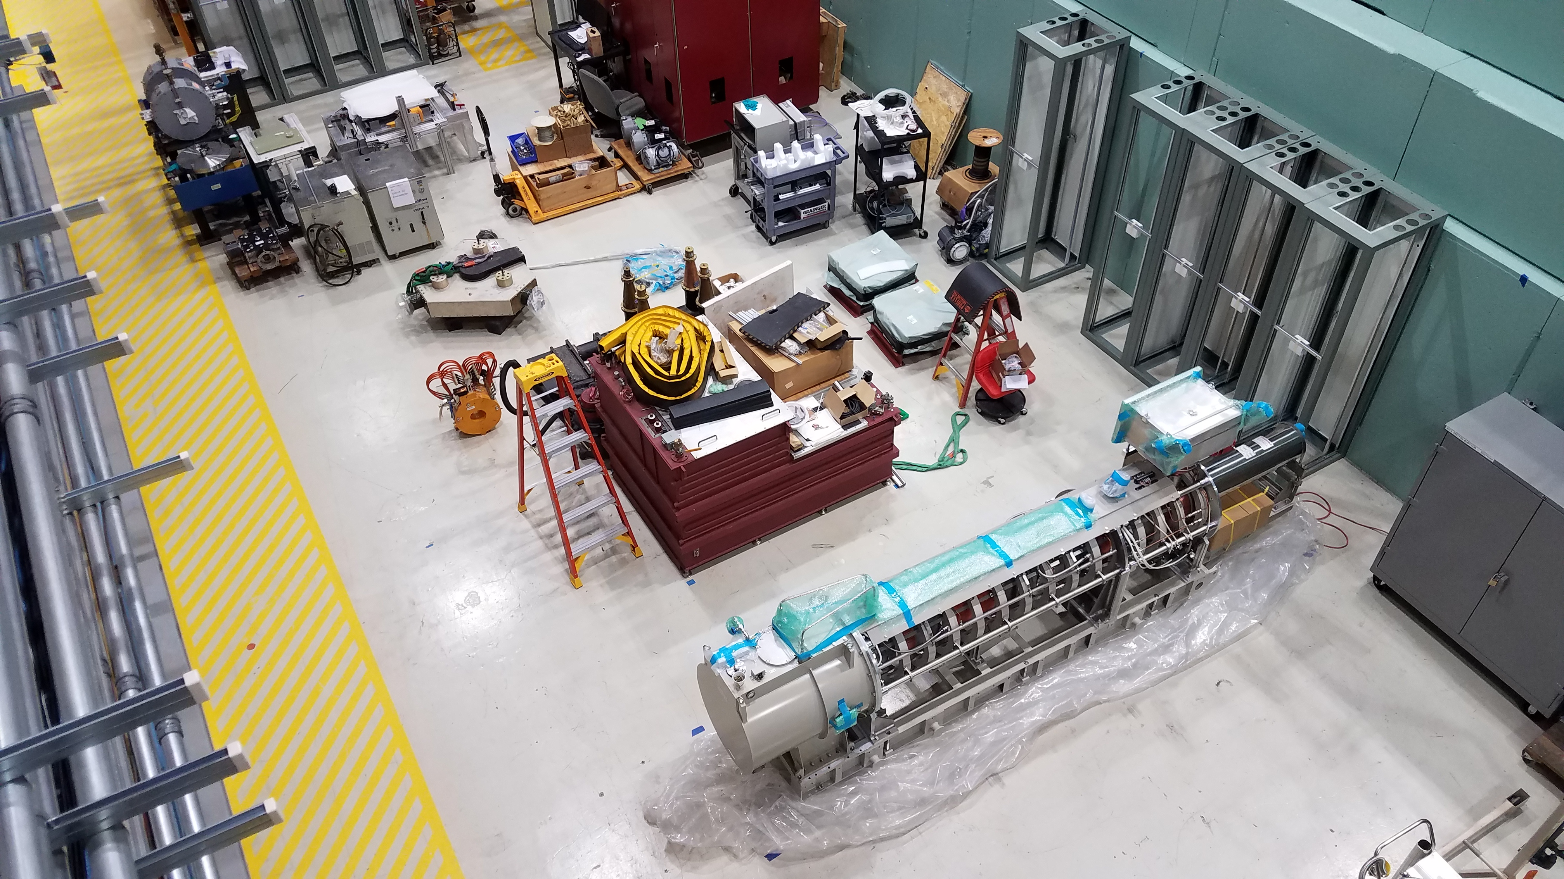
This week
Proton Source klystron arrival
Commissioning of FAST beamline and IOTA Ring
MagBeam studies
LRW/SRW studies
Cable pulls in ESB and power supply installation
IBEND issue
IOTA introductory training

Slide 3
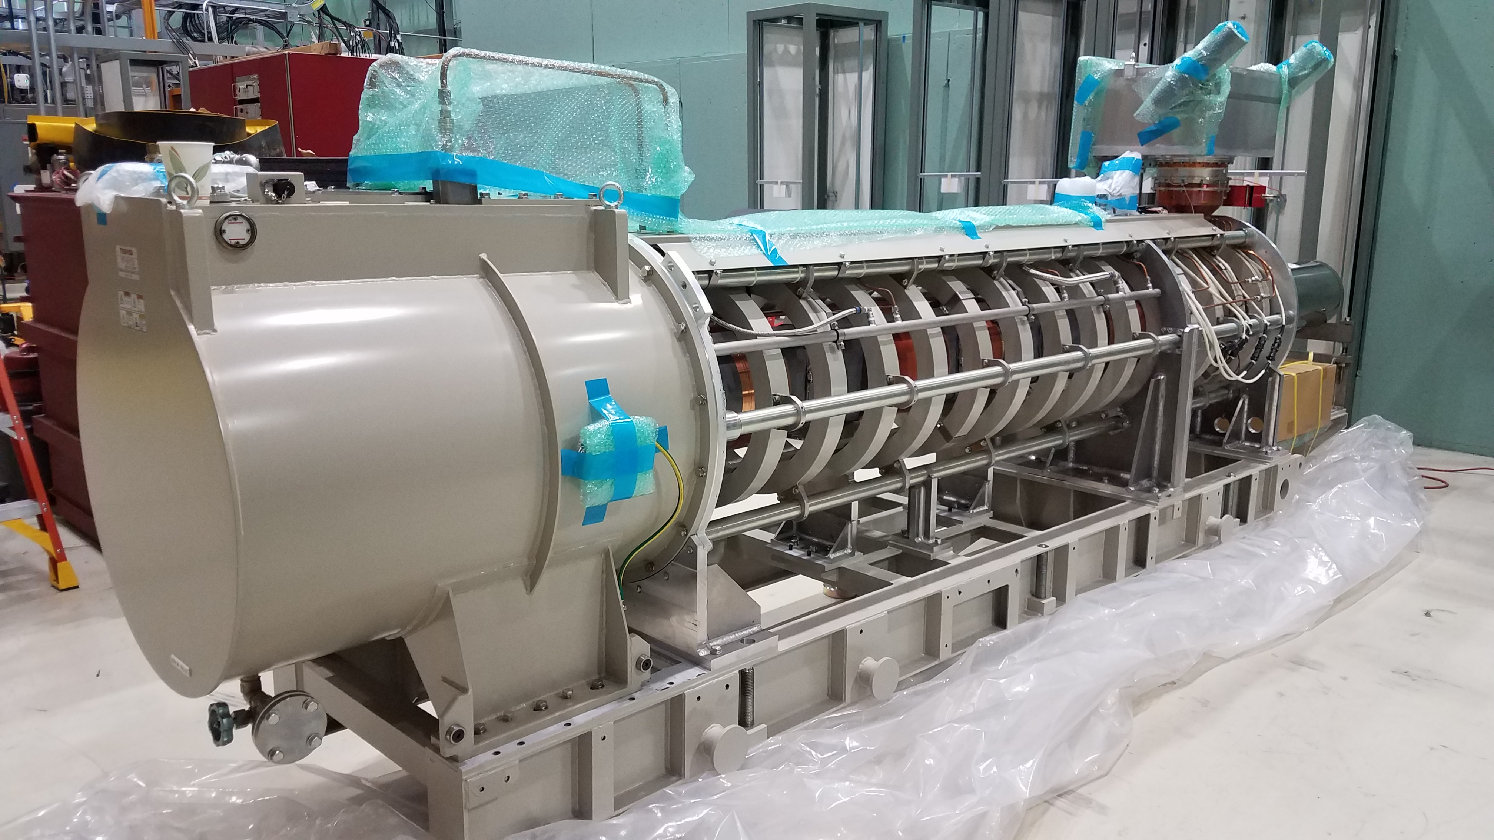
Proton Source 325 MHz Klystron

Slide 4
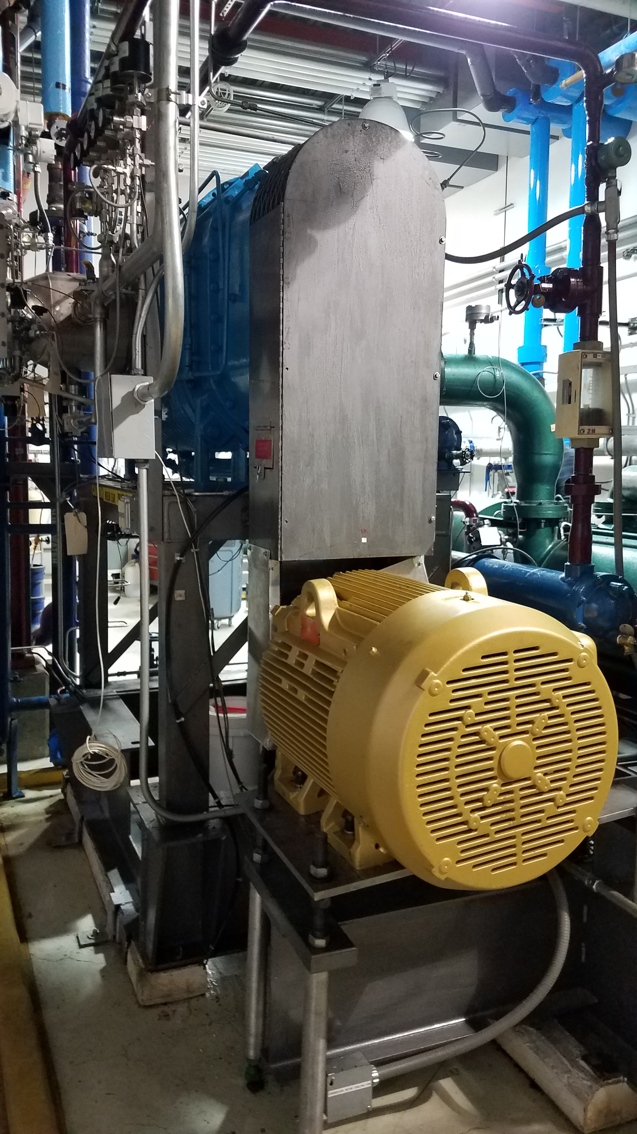
Kinney Skid Booster Pump
Tuesday January 7 at 07:14 the Kinney booster pump tripped on low oil and high vibration. When inspecting the unit locally, a waterfall was discovered coming out of the belt guard. Best guess is a bearing failure.
Final connections made on Friday
Cooldown to 2 K completed by 12:00 on Saturday
Soaked cavities for 24 hours
CC2 and CM2 systems turned on Sunday
CC1 possible ESECON LLRF failure
CC1 200 W solid state amplifier failed and replaced with 400 W amp
Sign of things to come – Booster motor is making a noise

Slide 5
February schedule

Slide 6
March schedule

Slide 7
Current Status
Cable pulls and power supply installation at ESB
LRW/SRW studies to begin at noon

