Slide 1
IOTA Run-2 Commissioning Status
Alexander Valishev
IOTA/FAST Meeting
February 21, 2020

Slide 2
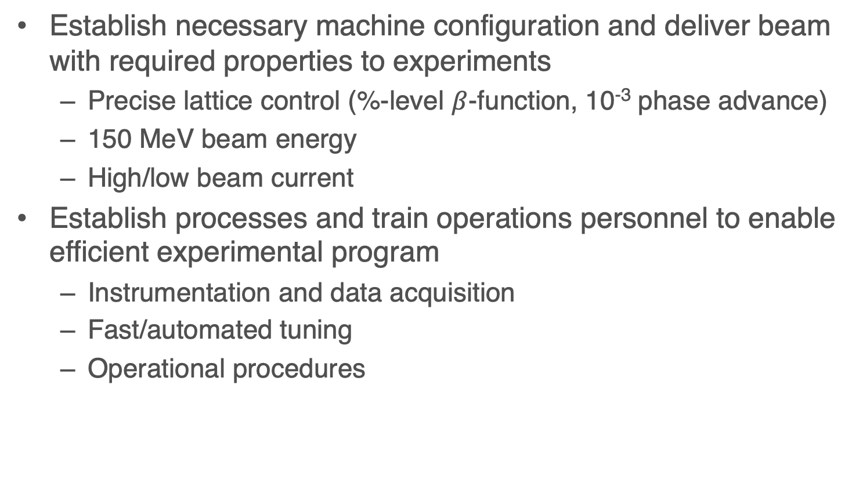
Commissioning Goals and Objectives
Establish necessary machine configuration and deliver beam with required properties to experiments
  Precise lattice control (%-level $β$-function, 10⁻³ phase advance)
  150 MeV beam energy
  High/low beam current
Establish processes and train operations personnel to enable efficient experimental program
  Instrumentation and data acquisition
  Fast/automated tuning
  Operational procedures

Slide 3
Main Commissioning Aspects after Run-1
Linac/injector – no/minimal changes
  Plan to implement D600 NMR probe for energy calibration
  Increased number of BPMs
IOTA
  IBEND PS filter
  BPM system upgrade
  Main bending dipole edge field correctors
  Synclight automation upgrade
  Octupole string rebuild
  Undulator motion control automation
Combined
  New timing/synchronization

Slide 4
Progress in December
Verified IOTA BPM operation in closed-orbit mode
  linearity, resolution
Verified IOTA BPM TBT operation
  linearity, resolution, readout
Tuned synclight cameras
  All but 1 online. Verified ACNET connectivity
Installed dipole edge field correctors
  RF frequency now 30.008MHz = ring circumference within 6mm of design!

Slide 5
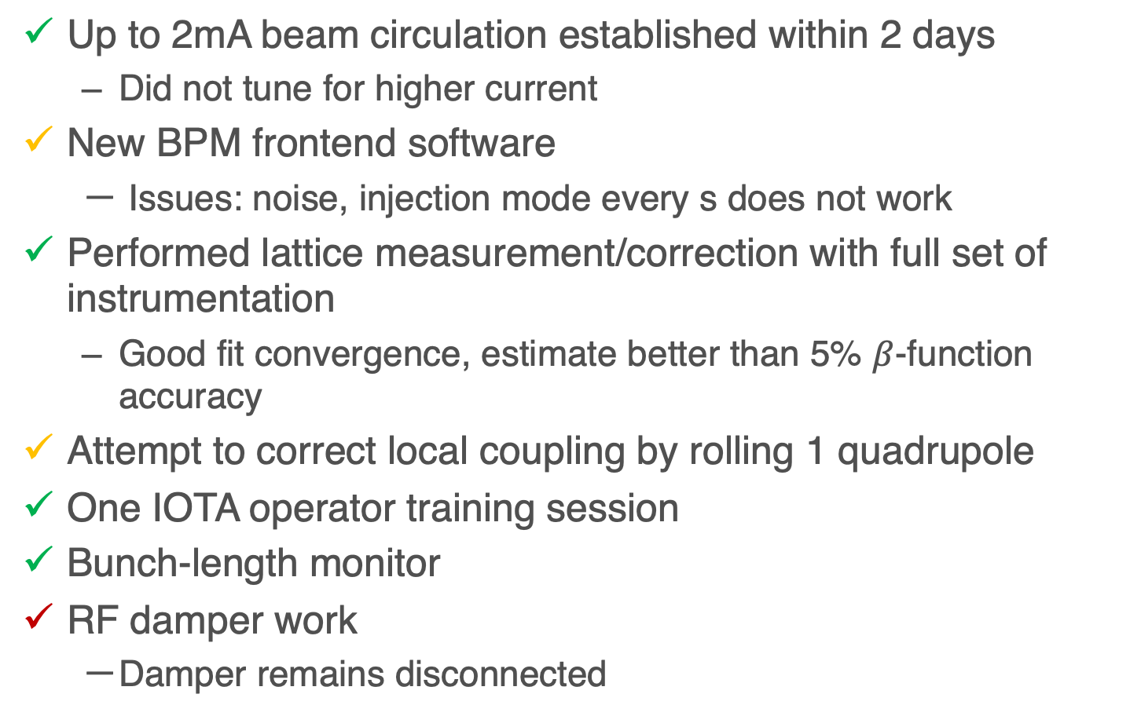
Progress and Issues this week
Up to 2mA beam circulation established within 2 days
  Did not tune for higher current
New BPM frontend software
  Issues: noise, injection mode every s does not work
Performed lattice measurement/correction with full set of instrumentation
  Good fit convergence, estimate better than 5% $β$-function accuracy
Attempt to correct local coupling by rolling 1 quadrupole
One IOTA operator training session
Bunch-length monitor
RF damper work
  Damper remains disconnected

Slide 6
Remaining Commissioning Tasks
H/V kicker operation in small-amplitude mode
Octupole string performance
Verification of IBEND stability
Measurement of orbit stability (quad and trim power supplies)
Software tools
  Improve stability of Java software: 6DSim, ECS and BPMServerCommon
  Implement fast IOTA configuration save/restore and transitions between modes
  Displays: trajectory in linac, orbit in IOTA, IOTA beam lifetime
Realign selected quadrupoles aiming to reduce local coupling in BR → lower skew corrector current
Commission 150MeV operation

