Slide 1
650 MHz RF Distribution for PIP2IT
Preliminary Design Review
Elvin Harms
L2 Manager, Accelerator Systems
28 May 2020

Slide 2
Welcome
Purpose
Logistics & Schedule
Introductions
Outcome

Slide 3
Purpose/Charge
The review committee is requested to perform an independent evaluation of the Preliminary Design of the RF power distribution system for testing low and high beta (650 MHz) cryomodules at PIP2IT. This scope of this review is limited to RF Distribution (Circulators, directional couplers, RF transmission media) and does not include the amplifiers nor the fundamental power couplers/cryomodules.
The committee is asked to respond to the following questions:
Is the 650 MHz RF distribution design at the preliminary design level (30-50%)?
Is the design consistent with system and project requirements?
Are the available technical drawings and documentation consistent with this level of design maturity?
Are the budget, schedule, identified interfaces and risks, and procurement and quality control plans consistent with this level of design maturity?
Are there any impediments to initiating final design work?

Slide 4
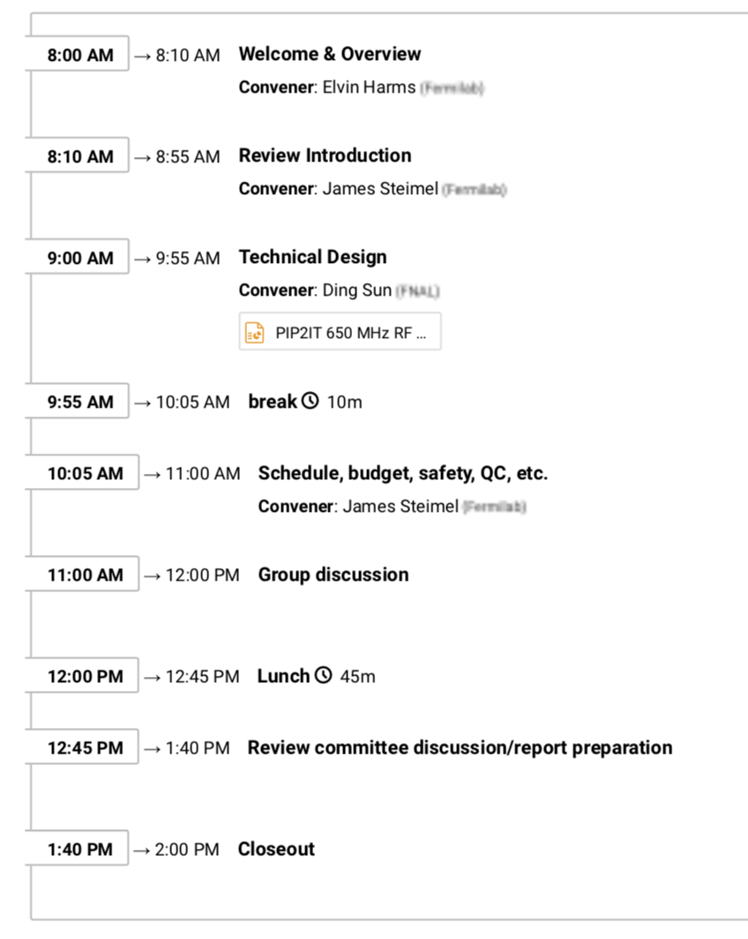
Logistics & Schedule
2 Presentations
Technical by Ding Sun
Budget, schedule, etc. by Jim Steimel
Documents to look over (list provided)
One break at 0955
Lunch break at noon
Closeout at 1340 or review committee discretion
Formal committee report within 2 weeks
Safety
Be aware of your surroundings
Identify alerts and exits in case of emergency

Slide 5
Introductions
Invited participants include
Review committee:
Curt Hovater (chair, Jlab)
Doug Horan (ANL)
John Reid (Fermilab)
PIP-II project management
Partners
RF colleagues

Slide 6
Outcome
Formal Committee Report - 2 weeks from now
Response to Report, Initiate review closeout – 2 to 3 weeks from now

Slide 7
Thank you!
Grazie
धन्यवाद
Merci
650 MHz 40 kW Amplifier Requirements

