Slide 1
Storage Services
Robert Illingworth
FCRSG
4 May 2020

Slide 2
Scope
Scientific Data Services department
Covers storage, data management, and scientific database applications
Storage service
Bulk disk
dCache, EOS (CMS only)
Tape/archival storage
Data management service
Transitioning data management to Rucio
Maintain legacy DM support for ongoing Fermilab experiments until transition is complete
Not part of SDS department, but I will also cover the NAS disk
Used for home directories, applications, etc
Managed by Core Computing Division

Slide 3
Resources - disk
FNAL dCache (disk) and Enstore (tape) systems are split into two pieces – CMS and “Public” (everything else)
I will not be discussing CMS in this presentation.
CMS
EOS
7 PB
Tape dCache
Tape: 68 PB
dCache 24 PB
2 PB
Public
Tape: 109 PB
NAS
Tape dCache
2 PB
Dedicated dCache
8.5 PB
(6 PB shared)
2.5 PB
Shared scratch dCache
2 PB

Slide 4
Resources - disk
Public dCache disk
17.5 PB available
7 PB out of warranty
Last year’s purchase is not sufficient to replace the already out of warranty disk
3 PB further leaving warranty in 2020
Aim to transfer some old disk to R&D purposes
Investigate non-dCache options

Slide 5
Resources - disk
Main cache is backed by tape; data staged on access
6.3 PB – aim to maintain 30 day lifetime
Past years asking experiments to estimate usage didn’t prove very useful
Scratch is another shared resource; LRU file removal, but not tape backed
2.3 PB – similarly aim for 30 day lifetime
Dedicated tape areas are primarily for raw & production data
2.1 PB
Persistent space management is permanently resident under experiment control
2.5 PB

Slide 6
Resources - tape
Tape complex changes since last year
Added one new IBM TS4500 library to public; decommissioned two more SL8500 (one public, one CMS)
The Fujifilm/Sony patent battle has ended; LTO8 tapes are available and the price has dropped
Expect to purchase only LTO8 (12 TB) tapes going forward
Still more expensive than M8 (9TB) per-TB, but closer when slot usage is considered
Now
3 x TS4500 (100 PB capacity w/ LTO8) – 2 public; 1 CMS
3 x SL8500 – 2 public; 1 CMS – retire as data is migrated to new media

Slide 7
Resources - NAS
The NAS system is used for home directories, user code, and similar things
Do not plan to expand it further.
Several experiments have old data on there; exhortations to clean up old junk have had limited effect
Total volume of files on NAS by age bin

Slide 8
Resources
In order of effort
Tape operations
Disk operations
Data Management (mainly Rucio for DUNE)
Storage development < 1 FTE
The technology transition caused a significant additional workload for tape ops. This has finally been reducing over the last six months
Operations is effort constrained (for example, tape migration is effort limited)
There is very little capacity for storage R&D

Slide 9
Requests from experiments – persistent dCache
Experiment | 2020 request | 2021 request | 2022 request
DES | 538 | 538 | 538
DUNE | 400 | 600 | 800
MicroBooNE | 151 | 151 | 151
Mu2e | 150 | 200 | 200
g-2 | 96 | 150 | 200
NOvA | 330 | 360 | 360
SBN | 200 | 250 | 300
MINERVA | 250 | 250 | 250
MINOS | 55 | 55 | 55
Other | 399 | 399 | 399
Total | 2170 | 2554 | 2854

Slide 10
Requests from experiments – dedicated dCache
Experiment | 2020 request | 2021 request | 2022 request
DUNE | 500 | 1600 | 2000
SBN | 1000 | 1000 | 1000
g-2 | 41 | 60 | 60
NOvA | 143 | 143 | 143
MINERVA | 125 | 125 | 125
MINOS | 41 | 41 | 41
Other | 589 | 589 | 589
Total | 1850 | 2969 | 3369
The dedicated space is primarily required to ensure raw data can be uploaded fast enough
I am not sure these large increases are properly justified

Slide 11
Requests from experiments - tape
Last year’s requests were not a very good guide to actual usage
Most experiments are not considering significant deletion of data on tape
Exception is SBN – but they are still asking for large net increases

Slide 12
Costs and limitations
Fulfilling all the tape requests would cause a significant increase in costs (factor ~2) by 2022
Resources for disk purchases are likely to be limited
Additions have often been unpredictable; we often have no idea what money is available until the end of the year
Not keeping up with warranty expirations; growth has meant increasing server age
Also hard to find the resources to test potential alternatives to existing dCache

Slide 13
Where should effort be directed?
Migration to new media is primarily effort limited
Serious concern that we will be perpetually migrating data
Scope for automation, if we had the effort available to implement it
The current approach is not viable in the long term
Where we’d like experiments to improve
Experiments should be required to set a lifetime policy for all their data (and follow through on it)
Small files are inefficient to store on tape; likely to get worse with each media generation
Move away from automated staging from tape – requires more organized approach
Storage R&D
Rucio & Data Management
Data lakes – Multi-tiered storage/Quality of service
Object stores – particularly for DUNE
Potential alternatives to dCache
User analysis data – EOS? CEPHFS?
Enstore replacement

Slide 14
Conclusions
Tape requests are on a potentially unaffordable trajectory
Disk requests are less extravagant, but growing the total capacity will be difficult
Majority of storage effort goes into operations; most of the available development effort is spent on keeping the existing system working
We don’t have enough effort to do much R&D, which means that we aren’t able to properly investigate changes which might be easier/cheaper in the long run

Slide 15
Backup slides

Slide 16
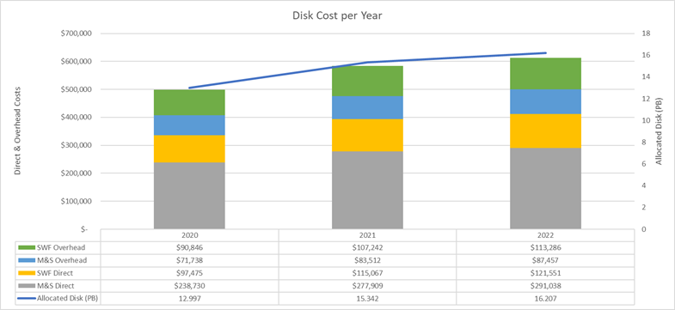
Disk cost breakdown
Direct hardware purchase costs are ~50% of overall costs (amortized over 5 years)

Slide 17
Tape costs over time for data added up to 2022

