Slide 1
Mu2e FCRSG 2020
Mu2e-doc-32668-v3
Rob Kutschke (FNAL SCD)
FCRSG Meeting
May 4, 2020
Notes:
New this year - think in calendar year, not fiscal year.
Presenting experiments *only* need fill out presentation - no spreadsheet.
Is SCD providing partially completed .pptx files?

Slide 2
Mu2e Organization Chart for Offline Computing
Co-Spokespersons
Jim Miller (BU),
Bob Bernstein (FNAL)
Computing and Software WG
Rob Kutschke (FNAL),
Dave Brown (LBL)
Simulation WG
Pasha Murat (FNAL),
Stefano Di Falco(INFN Pisa)
Calibration WG
Dave Brown (LBL)
Geometry Czar
Michael MacKenzie (NU)
Backgrounds and Sensitivity WG
Andrei Gaponenko (FNAL)
Neutrons WG
Yuri Oksuzian (ANL),
Dave Hedin (NIU)
Other roles will be formalized within the next year.
Currently filled transiently as needed.
Notes:
Is computing an afterthought or an integral part of the experiement.
Where is the R&D managed for moving to HPC, incorporating machine learning as needed, etc
The shift to HEPClould require more diligence on production teams to run an operations team to ensure Cloud and HPC hours are not wasted. We have not success with that in the past.
Is their build and release model supported, and are they evolving in a sustainable way? Lynn is retiring at the end of 2020. The division won’t be building specialized packages anymore. There are several legacy experiments that are still using NAS areas for builds instead of CVMFS. They don’t have the resources to modernize and the division dosen’t have the resources to support them as is.

Slide 3
Important Dates to Remember – Calendar Year
2020
2021
2022
Operations Start
Q1
Q2
Q3
Q4
Q1
Q2
Q3
Q4
Q1
Q2
Q3
Q4
Support detectors during assembly and pre-ops
Candidate time for Operational Readiness Review
Cosmic ray run to satisfy detector KPP
Intermittent cosmic ray runs during final assembly
Commissioning with Beam Oct 2023 →
First Physics data Feb 2024 →
Notes:
Optional one slide prior to this slide commenting on your major computing activities; define abbreviations to be used in this slide
EG, data taking periods, campaigns, reviews, conference deadlines. This is the slide that will show your physics goals in terms of computing.

Slide 4
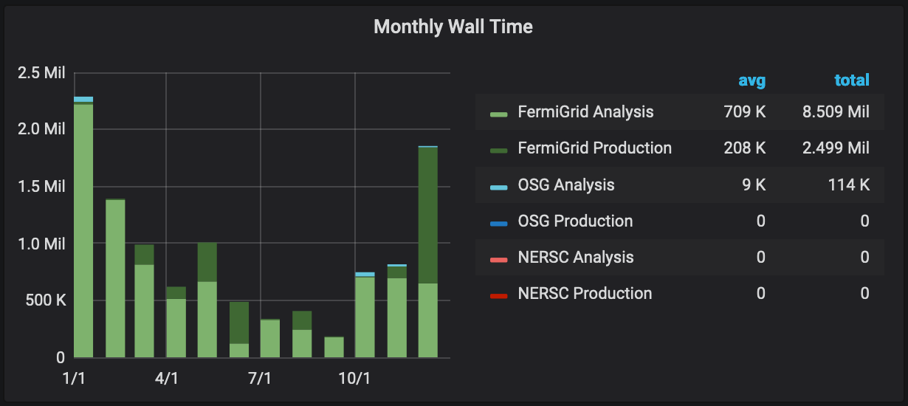
CPU - Experiment Usage Over the Last Year
Have used OSG, NERSC heavily in previous years
~10 Mil KNL-core-hours at ANL in last year (generator+G4)
Notes:
If you aren’t running offsite, why not?
Do you understand the peaks? What would have been the implications if the peak levels were not attainable? Can you use HEPCloud resources for future peaks?

Slide 5
Memory Footprint Over the Last Year
Jobs > 2 GiB understood
Strategies being developed to reduce most below 2 GiB
Jobs < 1 GiB are MARS and G4beamline jobs
Notes:
Is the memory footprint contained? Does it restrict the availability of offsite resources?
Compares slots vs weighted slots. Give an indication of what kind of offsite resources your experiment may need.
These plots are difficult to interpret. Is there something better that shows something like requested memory distributions?

Slide 6
CPU and Memory Efficiency Over the Last Year
Some red is very high IO jobs; we are redesigning workflows and data products.
A small residual may be irreducible, ~500k-hours/y
Some red is dCache issues unrelated to Mu2e
All red is people doing jobs that need 1 < GiB
Most are MARS and G4beamline.
Normalization is odd in this plot: only ~20% of total CPU hours < 50% memory efficiency.
Notes:
What are they

Slide 7
CPU - Prediction Going Forward and Accuracy of Your Predictions [units of Million (1 CPU, 2GB) wall hours per CY]
 | 2017 | 2018 | 2019 | 2020 | 2021 | 2022
Requested | 10.0 | 11.0 | 15.0 | 11 | 11 | 11
Actual Used | 11.2 | 12.1 | 11.0 | 1.7 (Thru 2/29) | N/A | N/A
Efficiency | 90% | 65% | 86% | 89% | N/A | N/A
Peaks usage as code is ready; timing not predictable
Notes:
In units of Million (1 CPU, 2GB) hours per CY.

Slide 8
CPU Adaptations Going Forward
We have used OSG heavily in the past and will use it again.
Have used NERSC (CORI I and II) in early days of proto-HEPCloud
Generator+G4+filters only; no reco or analysis.
Have run ~20 Million KNL core-hours of generator+G4MT+filters
G4MT using “Tom LeCompte hack” to work around MT limitations of art v2
THETA and BEBOP at ANL
Using native ANL workflow tools and hand copying files back to FNAL.
We look forward to using ANL HPC resources via HEPCloud
Implemented G4MT in art v3; no more hack; expect ~30% efficiency increase
Ready to start testing at scale
Notes:
Are you talking to other experiments have done this successfully?
Can we list here what HEPCloud needs an experiment to specify?

Slide 9
Disk: dCache Usage and Predictions (in TB)
 | Analysis (Persistent) | Other Dedicated (Write)
Current | 142 TB (actual) | 0
2020 | 150 TB | 0
2021 | 200 TB | 0
2022 | 200 TB | 100
Totals of available space (all experiments):
Total r/w (tape backed): 5858 TB
Total scratch: 2225 TB
Total persistent: 2739 TB
Total other: 2942 TB

Slide 10
Tape - Usage and Predictions (in PB)
 | Total Added By End of Year
At end 2019 | 1162 TB (actual)
2020 | 400 TB
2021 | 400 TB
2022 | 1400 TB
About 1PiB on T10K media; most of these files do not need to be migrated to LTO8 so long as T10K media remains readable for another year or so.
After that, files on T10K media can be deleted.

Slide 11
Disk: NAS Usage and Predictions (in TB Units)
 | App | Data
2020 | 3 | 100
2021 | 4 | 100
2022 | 5 | 100
The requested (modest) growth in app space will be important
The 100 TB for data matches what we put into the WBS sent to DOE for operations planning.
Notes:
Why are /grid items repeated? Are the /grid items here showing only the experiment’s usage within? If so, we need more columns in the table.

Slide 12
Age of files in NAS
Mu2e is aware that we have a lot of old files on NAS.

Slide 13
Data Lifetimes
Pre-CD3 era datasets ( 20 to 30 TB )
Likely will not free-up many whole tapes
We can authorize deletion when needed
CD3-era and early MDC2018 era datasets ( ~880 TB)
Expect to need these into 2021
Many on older media and do not need to be migrated to LT08
Should free-up many whole tapes
We have not formally specified review or deletion dates at creation
We are aware of the issue and have talked about what can be deleted about once a year for the past few years.
Expect to establish formal procedures during transition to operations.

Slide 14
What Do You Want to Achieve in Computing Over Next Three Years – (1)
Goals | Where does the experiment need to contribute | Where does SCD need to contribute
Develop datalogging workflow | Requirements, joint effort on design, implementation | Request joint effort on design; POMS is a candidate.
Upgrade data processing workflows | Requirements, joint effort on design, implementation | POMS is a candidate. We may request new features.
Finalize art v3 G4MT | Joint effort. | Joint effort.
Event display | Requirements, design, evaluate options, implementation | If SCD is offering support event displays we are interested.
Notes:
These are just examples. Please fill in the needs for your experiment. Looking for things that the experiment will be focused on and the things you need SCD to focus on.
This doesn’t have to fit all on one slide - use as many as you need.

Slide 15
What Do You Want to Achieve in Computing Over Next Three Years - (2)
Goals | Where does the experiment need to contribute | Where does SCD need to contribute
Offline DQM System | Requirements, design, implementation | May need some db support. May want a web site with a lot of archived content available (CCD?).
We will continue to want ongoing consulting from SCD on design issues, best practices, better use of profiling tools, code reviews etc on both code development and workflow development. See next page for a list.
Notes:
These are just examples. Please fill in the needs for your experiment. Looking for things that the experiment will be focused on and the things you need SCD to focus on.
This doesn’t have to fit all on one slide - use as many as you need.

Slide 16
What Do You Want to Achieve in Computing Over Next Three Years; asking for incidental consulting.
Reconstruction, alignment, calibration for all subsystems
Many, many projects, large and small, within this scope
On-board all subsystems to the conditions system.
Modify all code to support long event windows for off-spill running
Improved detailed modeling of detector response and electronics response
Develop digi level event mixing ( current done at G4Step level )
Evolve and optimize the reconstruction and simulation data payloads
Commission new versions of G4, CRY, CORSIKA as needed
Develop and implement blinding procedure
Profile code to discover and fix excessive resource use
Notes:
These are just examples. Please fill in the needs for your experiment. Looking for things that the experiment will be focused on and the things you need SCD to focus on.
This doesn’t have to fit all on one slide - use as many as you need.

Slide 17
Anything else?
There remain ongoing dCache reliability issues; we would like them addressed.
We have been using CMS BOT; the support status is “incidental consulting”.
We would like it, or it’s successor to have official support
We have colleagues at ANL who have access to cycles on ANL HPC
We look forward to THETA and BEBOP being onboarded to HEPCloud
Notes:
Eg, unusual DB needs, online needs, etc.

Slide 18
Summary of Facility Costs
 | CPU | Tape | Cache Disk | NAS Storage
FY20 (Current) | 72 | 17 | 8 | 10
FY21 | 72 | 21 | 10 | 10
FY22 | 72 | 45 | 14 | 10

