Slide 1
Muon g-2 FCRSG 2020
Notes:
New this year - think in calendar year, not fiscal year.
Presenting experiments *only* need fill out presentation - no spreadsheet.
Is SCD providing partially completed .pptx files?

Slide 2
Experiment Organization Chart for Offline Computing
Spokes
Lancaster (MCR)/Polly (FNAL)
Operations Managers Flay (UMass) / Nguyen (FNAL)
PPD Ops Liaison
Casey (FNAL)
Analysis Coordinator
Hertzog (UW)
DAQ/Online Ops Chislett (UCL)/Hong (UKy)
Offline Computing & Simulations Liang Li (Shanghai)/Walton (FNAL)
SCD Liaison
Lyon (FNAL)
Release Manager
Stapleton (FNAL)
Simulations
Fatemi (FNAL)
Data Quality
Gray (Regis)
Production Manager
Welty-Reiger (FNAL)
Notes:
Is computing an afterthought or an integral part of the experiement.
Where is the R&D managed for moving to HPC, incorporating machine learning as needed, etc
The shift to HEPClould require more diligence on production teams to run an operations team to ensure Cloud and HPC hours are not wasted. We have not success with that in the past.
Is their build and release model supported, and are they evolving in a sustainable way? Lynn is retiring at the end of 2020. The division won’t be building specialized packages anymore. There are several legacy experiments that are still using NAS areas for builds instead of CVMFS. They don’t have the resources to modernize and the division dosen’t have the resources to support them as is.

Slide 3
Organization
We have instituted production shifters (receive experiment shift points)
Our bench of software experts is not deep
We are not staffed enough to engage in R&D
Looking to replace the rotating-out release manager

Slide 4
Important Dates to Remember We are not working to specific dates, rather…
Notes:
Optional one slide prior to this slide commenting on your major computing activities; define abbreviations to be used in this slide
EG, data taking periods, campaigns, reviews, conference deadlines. This is the slide that will show your physics goals in terms of computing.

Slide 5
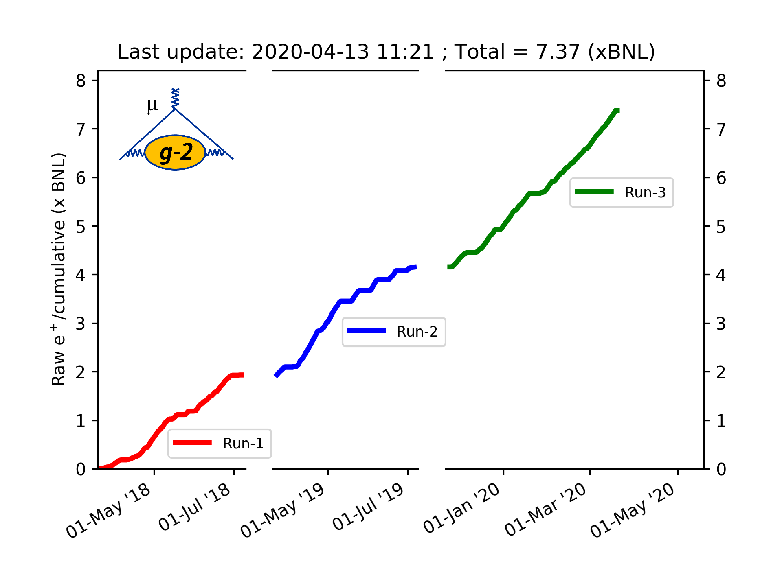
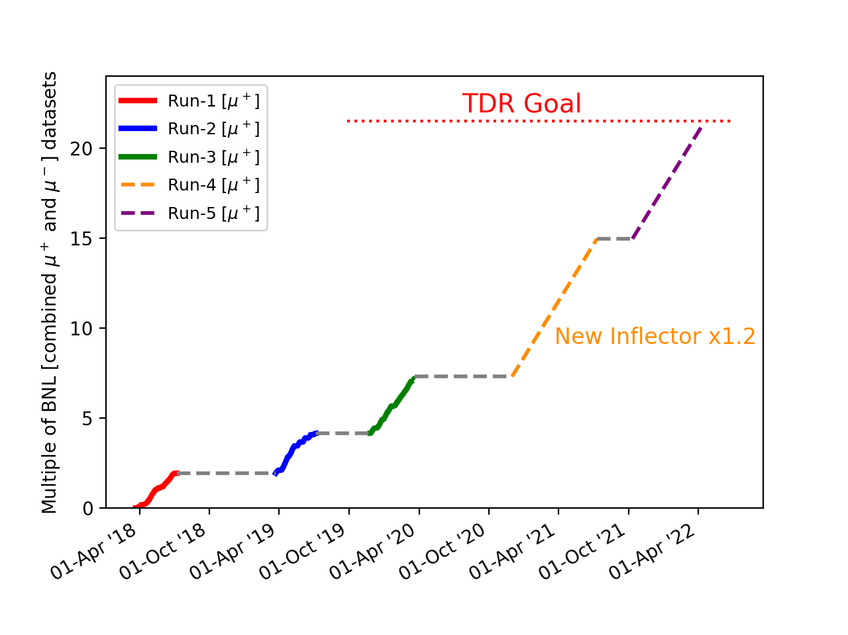
The current plan
The FY20 run has completed (Run3) Planning two much larger runs

Slide 6
The current plan
Unit of measurement, BNL, is # of positrons seen in the Brookhaven experiment
FY18-20 (Runs 1-3) Collected 7.3 BNL over past three FYs
FY21 (Run 4) Collect another 7.7 BNL ** A big FY **
FY22 (Run 5) Collect another 5 BNL → Reach goal of 20 BNL
We have completely processed the Run 1 data – reprocessed many times
We have just started to process the Run 2 data
We will process Run 3 data concurrently with Run 2
By the end of FY20, we aim to have all of Run 2 & 3 completely processed
Hopefully little or no reprocessing

Slide 7
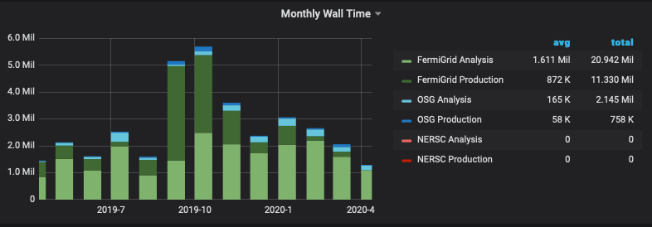
CPU - Experiment Usage Over the Last Year
Analysis jobs are starting to dominate our CPU usage
Notes:
If you aren’t running offsite, why not?
Do you understand the peaks? What would have been the implications if the peak levels were not attainable? Can you use HEPCloud resources for future peaks?

Slide 8
Memory Footprint Over the Last Year
With a few exceptions, our jobs run < 2 GiB
Notes:
Is the memory footprint contained? Does it restrict the availability of offsite resources?
Compares slots vs weighted slots. Give an indication of what kind of offsite resources your experiment may need.
These plots are difficult to interpret. Is there something better that shows something like requested memory distributions?

Slide 9
CPU and Memory Efficiency Over the Last Year
Inefficiencies are from tape access
because we were not pre-staging
We’re pre-staging production files
now, but still have less than optimal
efficiency due to time waiting for files to be delivered
We nearly always ask for 2 GB, even if we need less.
2 GB = 1 node
Asking for less causes jobs to get held when a rogue event needs more
Notes:
What are they

Slide 10
CPU - Prediction Going Forward and Accuracy of Your Predictions [units of Million (1 CPU, 2GB) wall hours per CY] --
 | 2017 | 2018 | 2019 | 2020 | 2021 | 2022
Requested | 10.7 | 17.34 | 21.0 | 33.0 Becoming dominated by analysis jobs. Expect these to grow… | 45 We should look into better organization of analysis jobs to avoid this getting so high | 50
Actual Used | 2.59 | 13.0 | 29.20 | 10.4 to date | N/A | N/A
Efficiency | 52% | 54% | 79% | 91%. onsite only through mid March – doesn’t seem to match plots on previous page (weighting?); more recent efficiency very poor due to waiting for tape (now pre-staging!) | N/A | N/A
Notes:
In units of Million (1 CPU, 2GB) hours per CY.

Slide 11
CPU Adaptations Going Forward
Plan to move tracking reconstruction to UK Grid (~ 2M CPU hours for Runs 2 & 3 with reprocessing)
Investigating running simulation on HPC – need a simulation task that does not need to return much data
We routinely run on OSG
Production is now using the constants database application (Igor/Vladimir) Adds a new source of inefficiency when we need to wait for the DB
We use POMS extensively – very good interaction with SCD
Very difficult to get analysis jobs through when FermiGrid is very busy. Two groups are purchasing very-many-core CPU boxes and large RAID arrays for easier running of analysis jobs and interactive analyses. We’ve had SCD support for this and hardware is purchased according to SCD advice, but placing these machines at the lab seems to have become an issue. Need more guidance and clarity from SCD. These resources are needed on a very short timescale. Could alleviate some pressure on FermiGrid from our analysis jobs
Notes:
Are you talking to other experiments have done this successfully?
Can we list here what HEPCloud needs an experiment to specify?

Slide 12
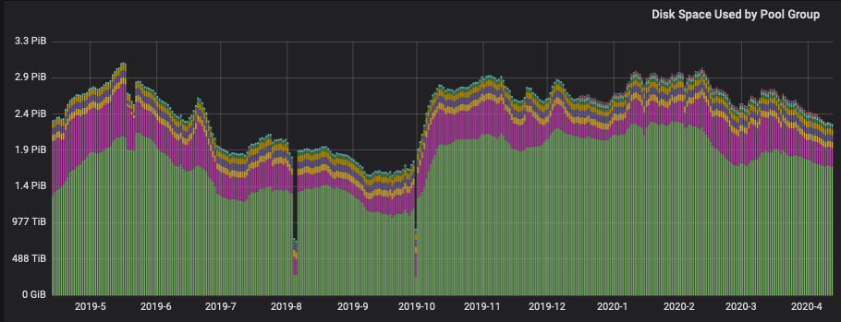
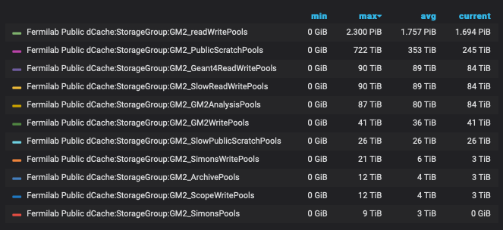
Disk: dCache Usage and Predictions (in TB)
 | Analysis (Persistent) | Other Dedicated (Write)
Current | 90 TB (actual) | 41 TB (actual)
2020 | 90 TB | 41TB
2021 | 150 TB (bigger datasets and more analyzers) | 60 TB (to accommodate faster rate)
2022 | 200 TB | 60 TB

Slide 13
Tape - Usage and Predictions (in PB)
 | Total Added By End of Year
At end 2019 | +4.625 PB (actual)
2020 | +5.3 PB (Run 2 processing + Run 3 raw & proc)
2021 | +8.4 PB (Run 4 raw & proc)
2022 | +6.1 PB (Run 5 raw & proc)
One copy of raw at Fermilab If reprocessing we recycle previous tapes
I added a bit for MC and analyses

Slide 14
Disk: NAS Usage and Predictions (in TB Units)
 | App | Data
2020 | 10 | 21
2021 | 20 | 50
2022 | 20 | 50
Would like these to increase a bit for larger datasets
and more analyses
Notes:
Why are /grid items repeated? Are the /grid items here showing only the experiment’s usage within? If so, we need more columns in the table.

Slide 15
Age of files in NAS

Slide 16
Data Lifetimes
We put production campaigns into their own file families so they can be deleted if we reprocess
We can likely delete some obsolete Run 1 processed data
Data will need to live at least 5 years past end of data taking for final analyses
Note we only have one copy of our raw and processed data Prior SCMPT said Fermilab keeps one copy of raw Plan for INFN to host a second copy of raw data did not get funded
We will copy ”DSTs” to other sites

Slide 17
What Do You Want to Achieve in Computing Over Next Three Years
Goals | Where does the experiment need to contribute | Where does SCD need to contribute
Run Simulation at NERSC | Design of “data light” simulation | HEPCloud access
Upgrade to SL7 (this summer) | Effort | --
Run Tracking reconstruction at UK | Effort | May need framework help to correlate calo & tracking files
Migrate to GitHub/Spack (low priority) | Effort | Effort and Expertise
Notes:
These are just examples. Please fill in the needs for your experiment. Looking for things that the experiment will be focused on and the things you need SCD to focus on.
This doesn’t have to fit all on one slide - use as many as you need.

Slide 18
Summary of Facility Costs
Facility Costs (K$) for Muon g-2 (“Amazon equivalent” service)
 | CPU | Tape | dCache Disk | NAS Storage
2020 | 214 | 174 | 61 | 3
2021 | 292 | 273 | 64 | 7
2022 | 325 | 385 | 66 | 7

