Slide 1
MINOS SCPMT 2020
Notes:
New this year - think in calendar year, not fiscal year.
Presenting experiments *only* need fill out presentation - no spreadsheet.
Is SCD providing partially completed .pptx files?

Slide 2
Experiment Organization Chart for Offline Computing
Computing Coordinator
Tom Carroll
CS Liaision
Arthur Kreymer
Historian
Robert Hatcher
Notes:
Is computing an afterthought or an integral part of the experiement.
Where is the R&D managed for moving to HPC, incorporating machine learning as needed, etc
The shift to HEPClould require more diligence on production teams to run an operations team to ensure Cloud and HPC hours are not wasted. We have not success with that in the past.
Is their build and release model supported, and are they evolving in a sustainable way? Lynn is retiring at the end of 2020. The division won’t be building specialized packages anymore. There are several legacy experiments that are still using NAS areas for builds instead of CVMFS. They don’t have the resources to modernize and the division dosen’t have the resources to support them as is.

Slide 3
Important Dates to Remember
2020
2021
2022
Q1
Q2
Q3
Q4
Q1
Q2
Q3
Q4
Q1
Q2
Q3
Q4
LOREM
Notes:
Optional one slide prior to this slide commenting on your major computing activities; define abbreviations to be used in this slide
EG, data taking periods, campaigns, reviews, conference deadlines. This is the slide that will show your physics goals in terms of computing.

Slide 4
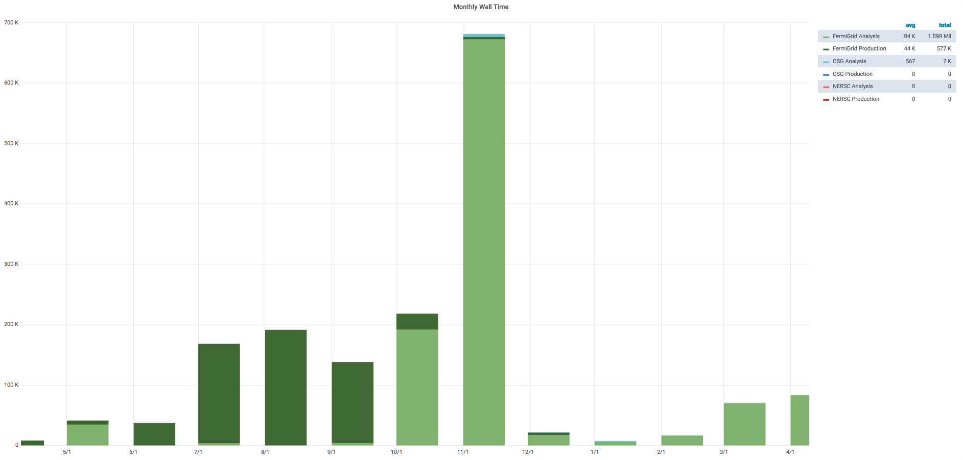
CPU - Experiment Usage Over the Last Year
Notes:
If you aren’t running offsite, why not?
Do you understand the peaks? What would have been the implications if the peak levels were not attainable? Can you use HEPCloud resources for future peaks?

Slide 5
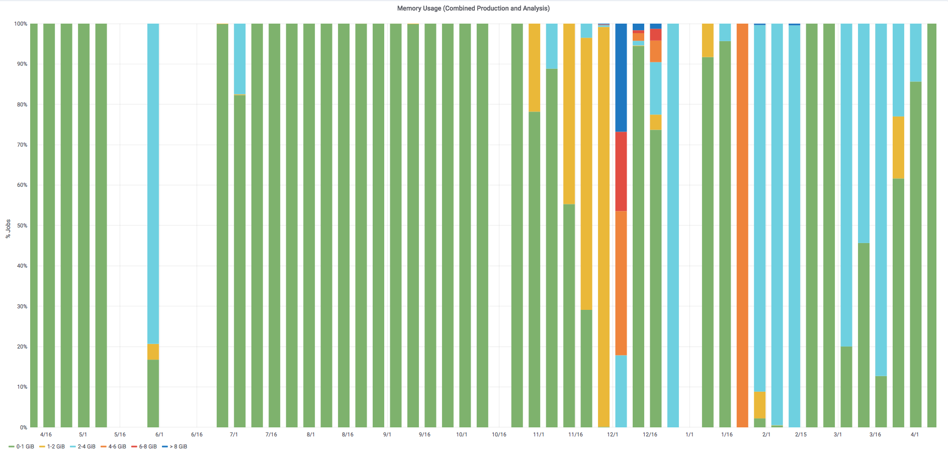
Memory Footprint Over the Last Year
Notes:
Is the memory footprint contained? Does it restrict the availability of offsite resources?
Compares slots vs weighted slots. Give an indication of what kind of offsite resources your experiment may need.
These plots are difficult to interpret. Is there something better that shows something like requested memory distributions?

Slide 6
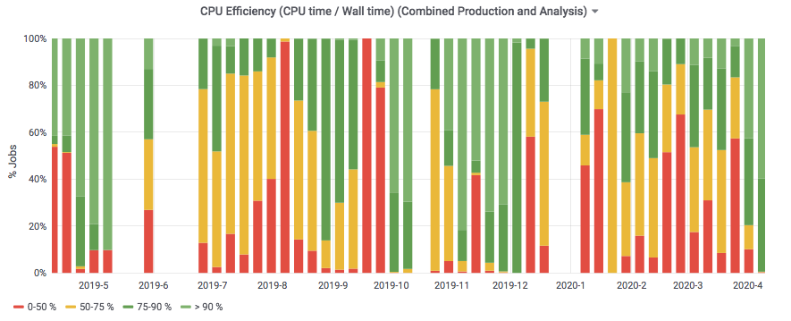
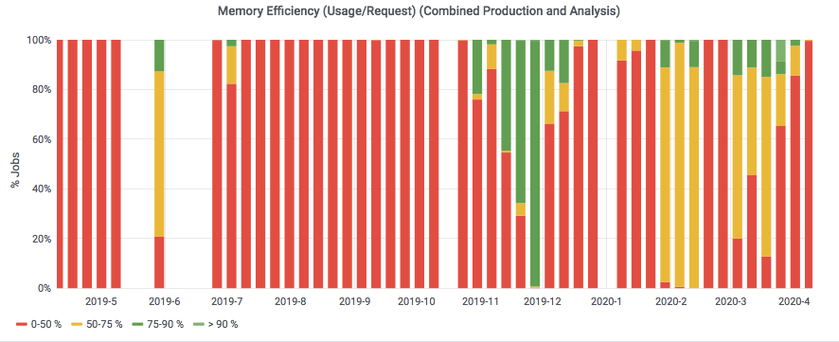
CPU and Memory Efficiency Over the Last Year
Notes:
What are they

Slide 7
CPU - Prediction Going Forward and Accuracy of Your Predictions [units of Million (1 CPU, 2GB) wall hours per CY]
 | 2017 | 2018 | 2019 | 2020 | 2021 | 2022
Requested |  |  | 6 | 6 | 2 | 1
Actual Used | 15.51 | 5.8 | 3.63 | thru Feb | N/A | N/A
Efficiency | 83% | 93% | 85% | To date: | N/A | N/A
Notes:
In units of Million (1 CPU, 2GB) hours per CY.

Slide 8
CPU Adaptations Going Forward
Currently using OSG and HEP cloud
We don’t plan to use HPC resources
Notes:
Are you talking to other experiments have done this successfully?
Can we list here what HEPCloud needs an experiment to specify?

Slide 9
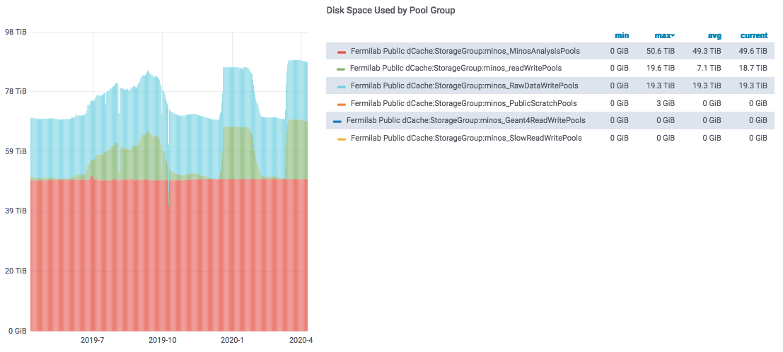
Disk: dCache Usage and Predictions (in TB)
 | Analysis (Persistent) | Other Dedicated (Write)
Current | 55 TB (actual) | 22 TB (actual)
2020 | 55 | 22
2021 | 55 | 22
2022 | 55 | 22
Total r/w (tape backed): 6264 TB
Total scratch: 2333 TB
Total persistent: 2576 TB
Total other: 2131 TB
Will not track cache usage,
but need to know of unusual requests

Slide 10
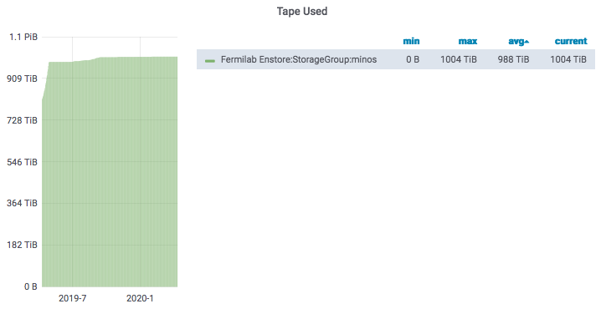
Tape - Usage and Predictions (in PB)
 | Total Added By End of Year
At end 2019 | 1.1 (actual)
2020 | 0.05
2021 | 0.05
2022 | 0.05
Note: due to data migration from old to new tape the current total is double the true usage

Slide 11
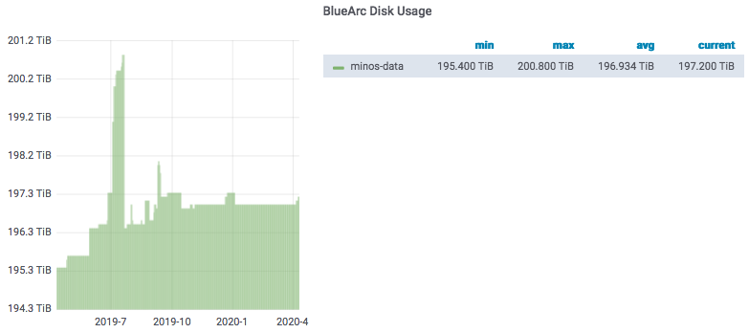
Disk: NAS Usage and Predictions (in TB Units)
 | App | Data
2020 | 8 | 206
2021 | 5 | 150
2022 | 5 | 100
Notes:
Why are /grid items repeated? Are the /grid items here showing only the experiment’s usage within? If so, we need more columns in the table.

Slide 12
Age of files in NAS

Slide 13
Data Lifetimes
MINOS is reviewing datasets for data preservation

Slide 14
What Do You Want to Achieve in Computing Over Next Three Years
Goals | Where does the experiment need to contribute | Where does SCD need to contribute
Ongoing final analysis
Data preservation | Formal planning and execution | Joint effort
Migrating to SLF7 as needed
Notes:
These are just examples. Please fill in the needs for your experiment. Looking for things that the experiment will be focused on and the things you need SCD to focus on.
This doesn’t have to fit all on one slide - use as many as you need.

Slide 15
Anything else?
Notes:
Eg, unusual DB needs, online needs, etc.

Slide 16
Summary of Facility Costs
Facility Costs (K$) for MINOS (“Amazon equivalent” service)
 | CPU | Tape | dCache Disk | NAS Storage
2020 | 39 | 10 | 4 | 21
2021 | 13 | 11 | 4 | 16
2022 | 6 | 15 | 4 | 10

