Slide 1
Proposal for MQXFA03 Preload Targets & Preloading Sequence following Mini-workshop on MQXF Assembly, Preload & Simulations
Giorgio Ambrosio, Daniel Cheng, Paolo Ferracin, Heng Pan, Soren Prestemon, Eelis Takala, Giorgio Vallone
July 1st-2nd, 2019
LBNL

Slide 2
Plans for MQXFA03
Radial shim (see next slide for nominal shim plan)
As done in previous short models, the plan is to remove 0.125 mm of radial shim with respect to nominal shim plan
This has always been done since LQ to improve coil to collar contact based on
Fuji paper results
Strain gauge data during bolting of collar pack—avoid initial tension in pole strain
In MQXFS4 an additional layer of kapton was removed, for a total of 0.250 mm of missing radial shim, since the Fuji paper test was not satisfactory and first loading was showing the LQ effect

Slide 3
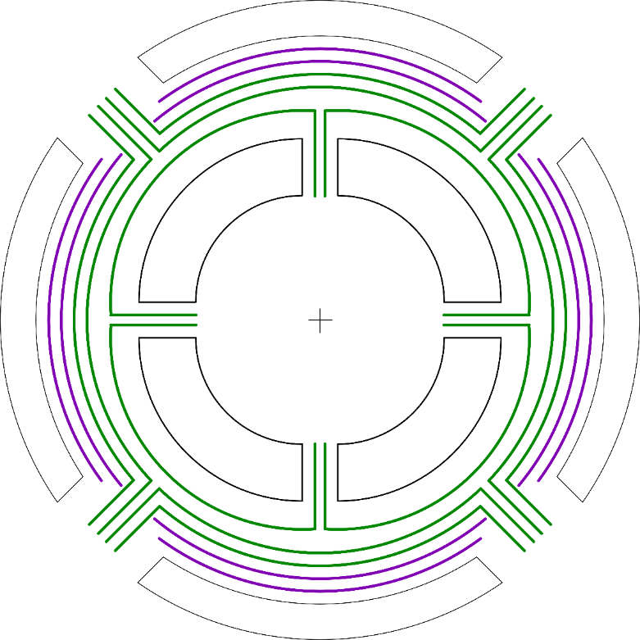
Nominal Shim Plan
Impreg. Radius:
113.376 mm
Collar Radius:
114 mm
Kapton Shims:
125 µm
GPI, Kapton:
125 µm

Slide 4
Plans for MQXFA03
Pole key clearance
Two options were considered
MQXFS1a case
Pole key with fiber in the radial direction → high thermal contraction and low modulus
A pole key gap per side of ~3 mils
This value is larger than in MQXFS1a, where the target was zero gap → as a results we expect less force intercepted by the pole key than in MQXFS1a
MQXFS4 case
Pole key with fiber in the azimuthal direction → low thermal contraction and high modulus
Key machined to have ~8 mils of pole key gap per side
These correspond to the same conditions as MQXFS4
The MQXFS4 case is the selected one

Slide 5
Plans for MQXFA03
Azimuthal pre-load (see next slide for summary)
The target is MQXFS4, with a reduction of 10 MPa to account for possible larger spread due to the longer length
Therefore, target pre-stress at cold is: 100 MPa
This means pre-stress at warm of about 80 MPa after creep
Assume 5-10 MPa of creep
We set as maximum coil stress to 110 MPa during loading

Slide 6
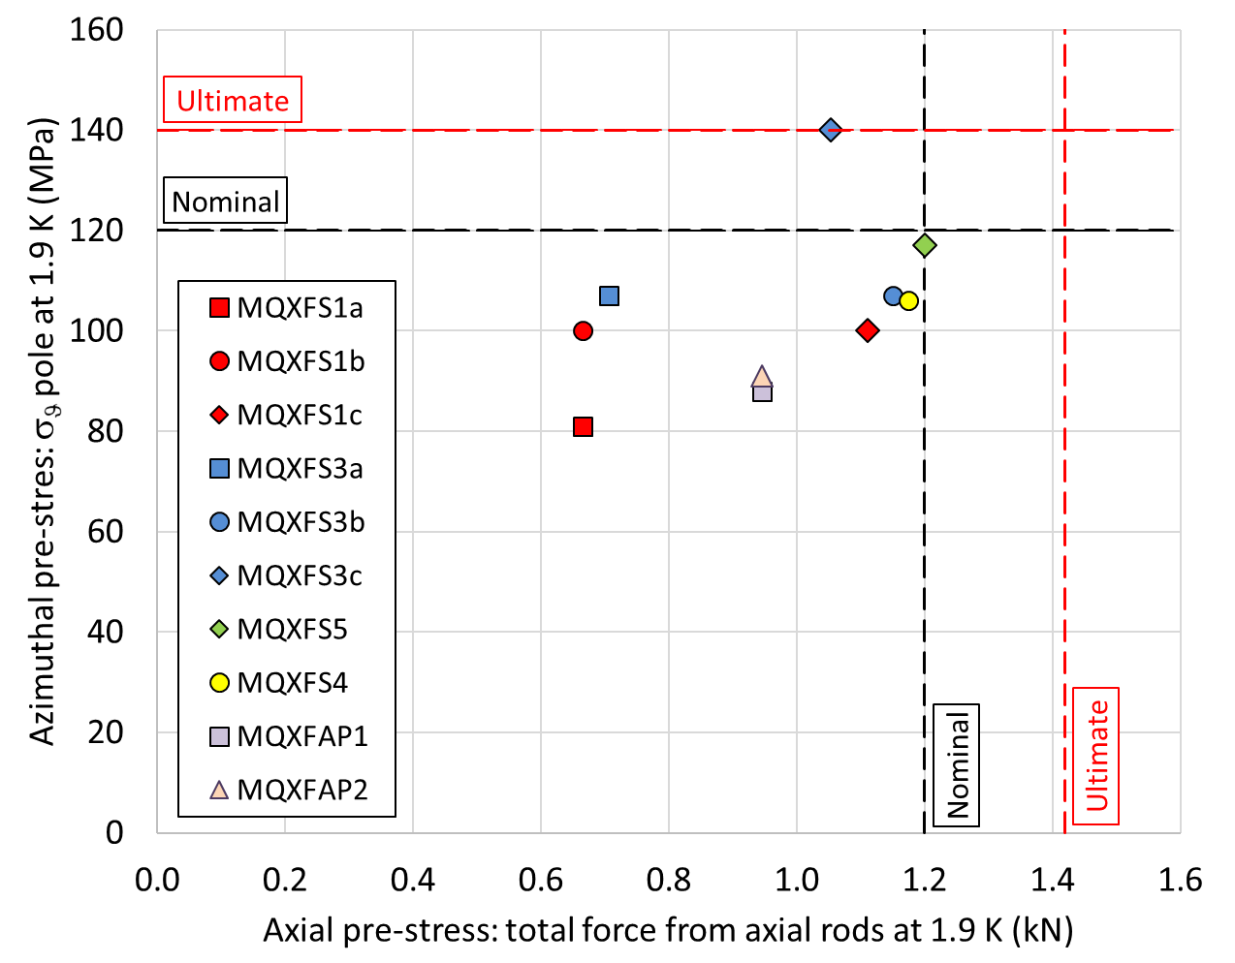

Slide 7
Plans for MQXFA03
Axial pre-load (see next slide for summary)
The target is MQXFS4, with a reduction of 0.2 MN to limit the rod stress at room temperature and meet the design criteria
MQXFA has rods with smaller radius than MQXFB (33 vs 31 mm)
Therefore, the total force at cold is: 1.0 MN
This means that the total force after cool-down (and at room temperature) will be 0.1 MN higher than in MQXFAP1/P2

Slide 9
Plans for MQXFA03
Pre-load sequence
The plan is to adopt the MQXFS4 sequence
Coil pack centering (13.1-13.2 mm interference keys)
Pre-load axial rods with ~50-100 microstrain
50% azimuthal pre-load (0.250 mm added shim)
50% axial pre-load (about 300 micro-strain)
100% azimuthal pre-load
100% axial pre-load
FEM computations indicate lower axial strain in the coil pole during pre-load with this sequence with respect to “100% azimuthal then 100% axial” pre-load
Further investigation with FE model is in progress

Slide 10
Action items
Extract the pole keys (fiber in the azimuthal directions) from MQXFA03 coils
and machine them in order to have ~8 mils of pole key gap on each side
In parallel, continue with shell-yoke sub-assembly
Once keys are machined, proceed with coil-pack assembly (no Fuji test)

