Slide 1
Magnet Fabrication Travelers, Non-Conformities and Resolution
Katherine Ray – LBNL (QA)
Mike Solis – LBNL (Procurement Technical Contact)
March 12, 2020 – MQXFA05 Structure and Loading Review

Slide 2
Overview
State of the Magnet Fabrication Travelers
Non-Conformances on MQXFA05

Slide 3
Magnet Fabrication Travelers Overview
# | Title | Revision | ID
1 | Coil Acceptance WI | A | SU-1011-5294
2 | Yoke Pre-Stack WI | B | SU-1008-8072
3 | Yoke Half Stack WI | C | SU-1009-7829
4 | Shell Instrumentation WI | D | SU-1009-3745
5 | Shell-Yoke Assy WI | B | SU-1008-2169
6 | Loadpad Pre-Stack WI | B | SU-1008-8075
7 | Dressed Coil WI | E | SU-1008-8073
8 | Pad-Collar Assy WI | A | SU-1010-1610
9 | Coil Pack Subassy WI | B | SU-1008-8074
10 | Magnet Electrical QA at LBNL | C | SU-1010-1903
11 | Magnetic Measurements | A | SU-1010-2018
12 | Integration and Loading WI (based on 2 other WI, both @ Rev B) | B | SU-1011-5637
13 | Axial Rods Instrumented WI | C | SU-1008-8069
14 | Splice Box WI | B | SU-1008-8067
15 | Magnet Shipping WI | A | SU-1011-3284

Slide 4
Magnet Fabrication Travelers Overview
# | Title | Revision | ID
1 | Coil Acceptance WI | A | SU-1011-5294
2 | Yoke Pre-Stack WI | B | SU-1008-8072
3 | Yoke Half Stack WI | C | SU-1009-7829
4 | Shell Instrumentation WI | D | SU-1009-3745
5 | Shell-Yoke Assy WI | B | SU-1008-2169
6 | Loadpad Pre-Stack WI | B | SU-1008-8075
7 | Dressed Coil WI | E | SU-1008-8073
8 | Pad-Collar Assy WI | A | SU-1010-1610
9 | Coil Pack Subassy WI | B | SU-1008-8074
10 | Magnet Electrical QA at LBNL | C | SU-1010-1903
11 | Magnetic Measurements | A | SU-1010-2018
12 | Integration and Loading WI (based on 2 other WI, both @ Rev B) | B | SU-1011-5637
13 | Axial Rods Instrumented WI | C | SU-1008-8069
14 | Splice Box WI | B | SU-1008-8067
15 | Magnet Shipping WI | A | SU-1011-3284
We continue to update the travelers based on lessons learned
All travelers were used and signed off for MQXFA04

Slide 5
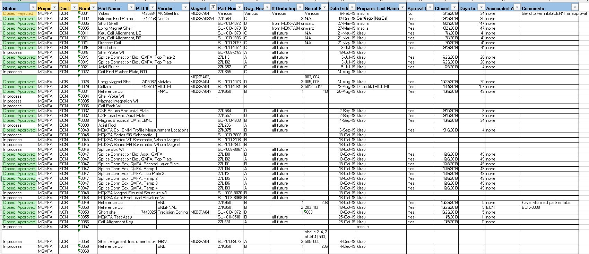
Change Records
We are tracking Non-Conformances, Deviations and Engineering Changes in one spreadsheet
These are currently communicated to Fermilab L2 on a monthly basis

Slide 6
MQXFA05 Change Records
The NCRs on A05 thus far include:
(#24) Minor collar dimension issues
(#43) Minor collar dimension issues
(#44) Shell thread damage
(#68) Sharp edges on wiring skirts, skirts made of 5052 Al
(#69) Cable support had hole in wrong location
(#80) Dents in Master Keys
(#83) ~60 yoke bushings were undersized

Slide 7
MQXFA05 Change Records Details
(#24) Minor collar dimension issues
(#43) Minor collar dimension issues
“Profile 0.03 at the 45° plane of the 25 or 45 mm scan” out of tolerance by 0.0002mm to 0.0047mm in 9 locations. We believe all are due them scanning over the engraved serial number (ACCEPT AS IS)
(#44) Shell thread damage
One M6 holes has 2-3 threads damaged (ACCEPT AS IS)
(#68) Sharp edges on wiring skirts, skirts made of 5052 Al
Need to discuss if 5052 Al is okay
(#69) Cable support had hole in wrong location
Vendor is sending new parts
(#83) ~60 yoke bushings were undersized
Undersized bushings did not fit over yoke tie-rod and were replaced. Decision about reworking or rejecting undersized bushings has not been made yet.

Slide 8
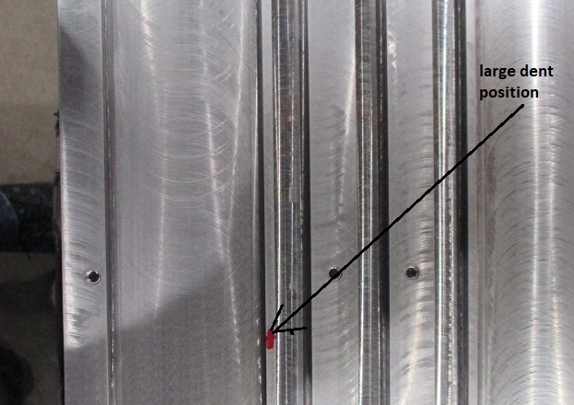
MQXFA05 Change Records Details
(#80) Dents in Master Keys
Largest dent was 3.5mm long and .13mm deep
Two more dents,
1.8mm long dent on 45 deg surface
Smaller dent over bladder

