Slide 1
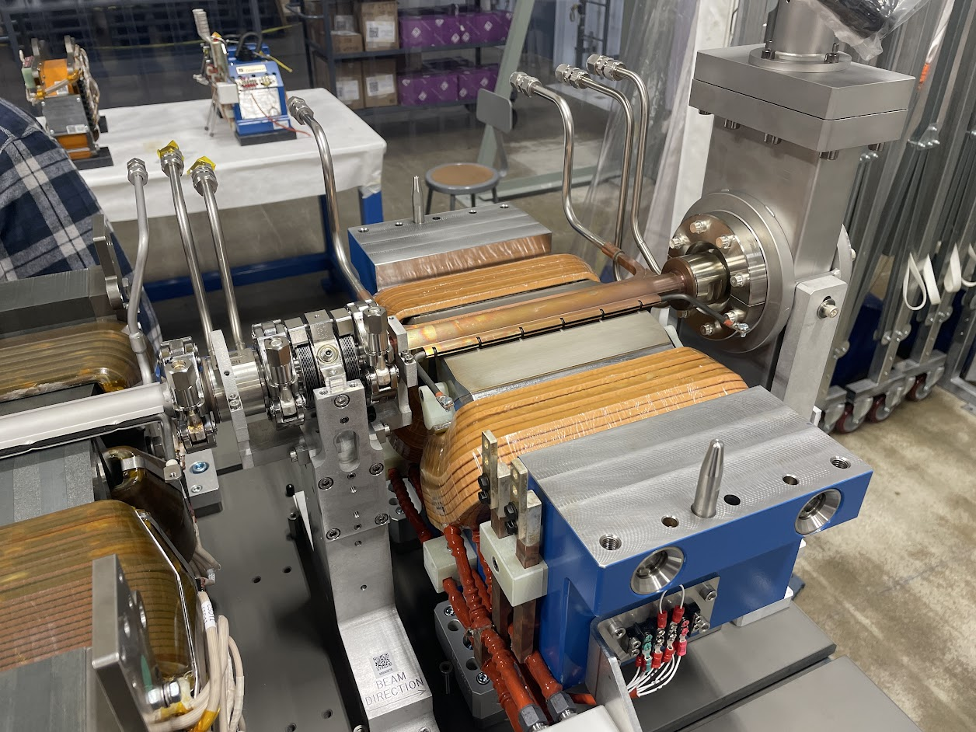
Installation of Vacuum Components for the APS-Upgrade
Tim Clute
Interim APSU Technician Group Section Lead
Advanced Photon Source
Argonne National Laboratory, Lemont, IL
OLAV-IV: 6th Workshop on the Operation of Large Vacuum Systems
April 17, 2024
Notes:
Univ of Chicago Review, Aug. 30, 2010
1

Slide 2
Agenda
Scope of installation
Harvesting of components from APS
Installation Plan
Vacuum Installation
Vacuum Certification
Conclusion

Slide 3
Scope of Installation
APS-U is composed of 40 Storage Ring Sectors that each contain:
5 modules
1 straight section
2 x-ray extraction lines (only 54 of them are used)
5 of the straight sections are unique
3 contain RF cavities
1 contains the Bunch Lengthening System
1 contains the septum magnet for injection

Slide 4
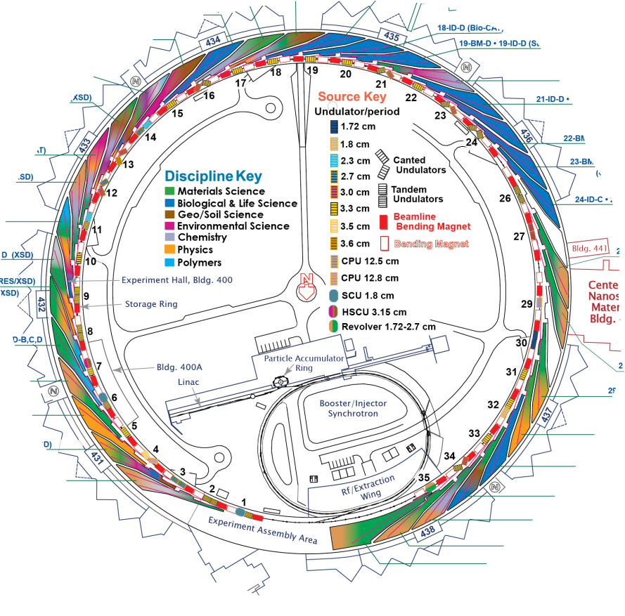
Scope of the Installation
In total this represents 192 unique vacuum sections up to the user beamlines
Each vacuum section underwent the following process.
Cable pull
Module/Table installation
Module/Table alignment
Vacuum connections and certification
Cable and water line landing
Test and Checkout

Slide 5
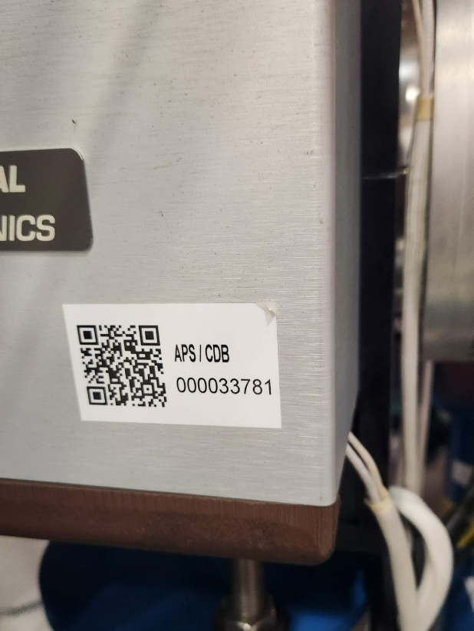
Harvesting of Components
Approximately 40% of the Front End systems were harvested during the removal process for use in the APS-U.
These components were carefully tagged prior to the removal process and moved to our offsite building for refurbishment.
New identifying QR codes were given to every component
List of tagged components were distributed to all stake holders
Removal team and receiving team compared lists daily to confirm all components accounted for

Slide 6
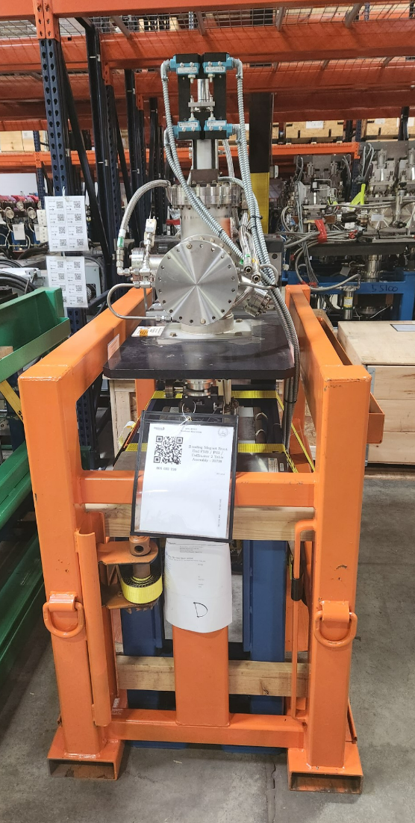
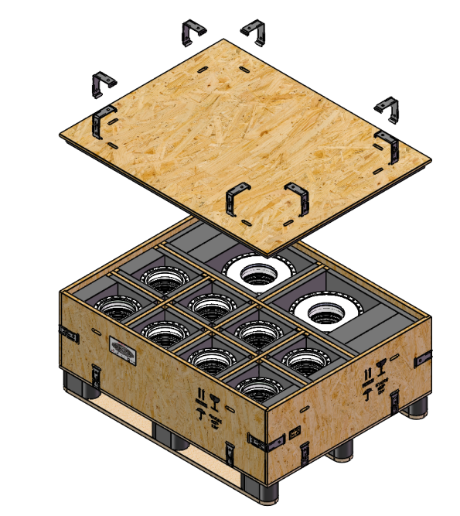
Harvesting of Components
Harvesting process:
Entire machine was vented to boil off N2
All gate valves closed
Bellows between assemblies were removed and wrapped in UHV foil, placed in special built crates
Table assemblies blanked and filled with high purity N2
Transported by truck for refurbishment in clean room
Unneeded components went with rest of ring to excess

Slide 7
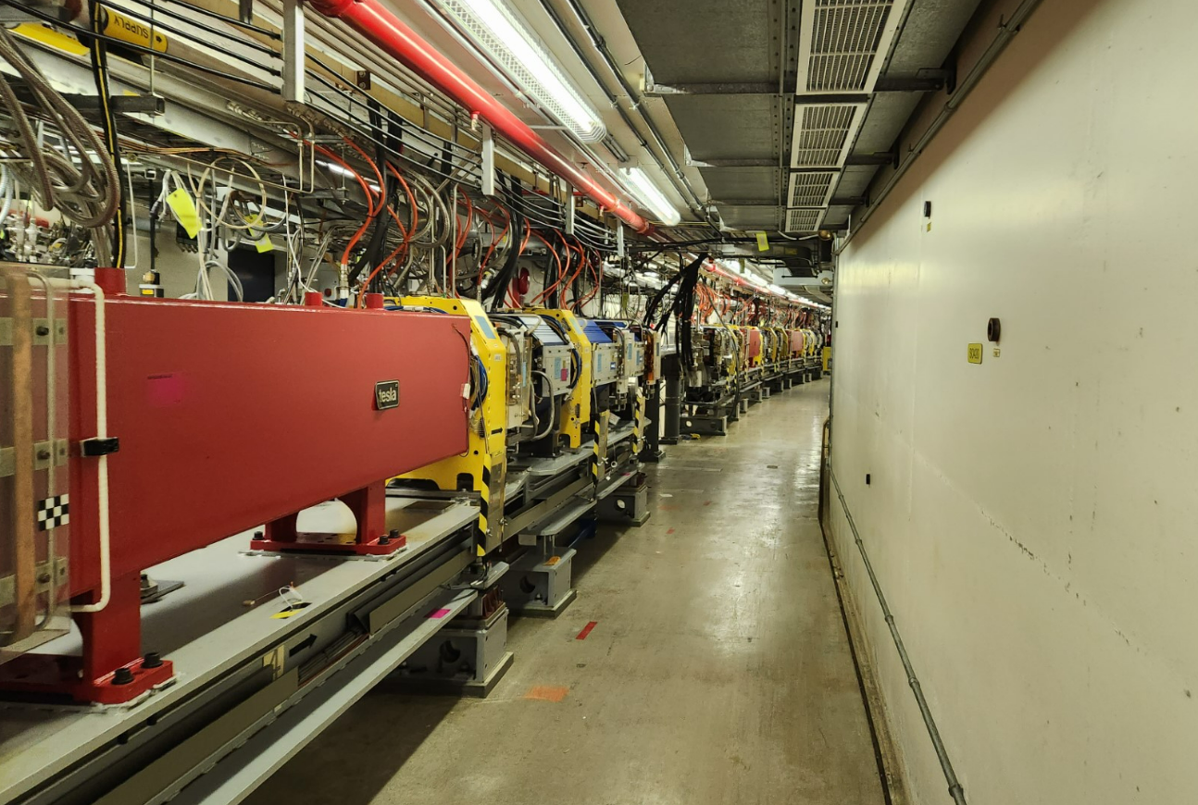
Logistics Plan
APS-U scheduled order of operation for each major component
Daily meetings for work to take place the next day
Multiple contractors to perform bulk of installation
Vacuum work scheduled for when area was clear of possible contamination
Daily reports of which sector, module, assembly was installed and ready for work

Slide 8
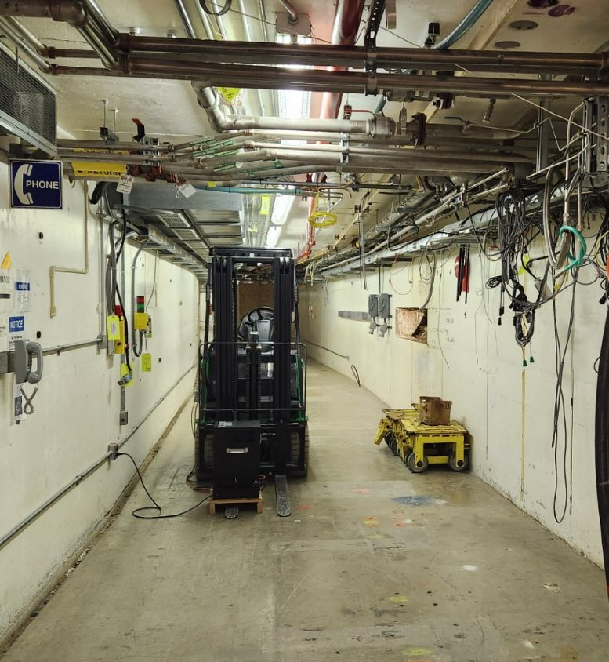
Logistics Plan
Installation Started at Sector 24 and worked counterclockwise to Sector 1 and back around to 25.
Specific team concentrated on injection area
This meant that technical teams had to be staggered so as not to overlap.
Fortunately, many jobs did not need to be done sequentially so teams could jump around if necessary.
Full installation took approximately 9 months
Full checkout of the system took another 6 to 8 weeks
Tunnel Video

Slide 9
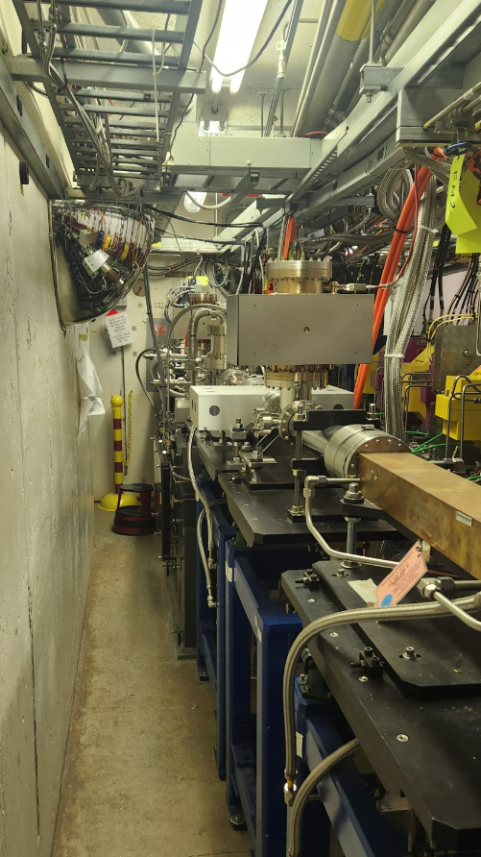
Vacuum Installation
Vacuum installation done according to APS vacuum standards
Component to join sections prepared
Work surfaces covered with UHV foil
Gloves worn
Shipping flanges removed
Joint cleaned with alcohol
Static component flanges removed
Wiped with alcohol
Joining component installed
Joints torqued

Slide 10
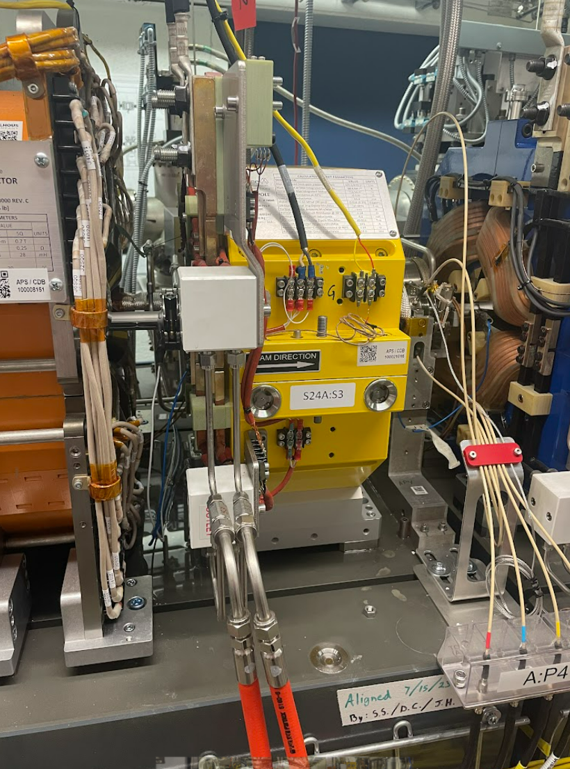
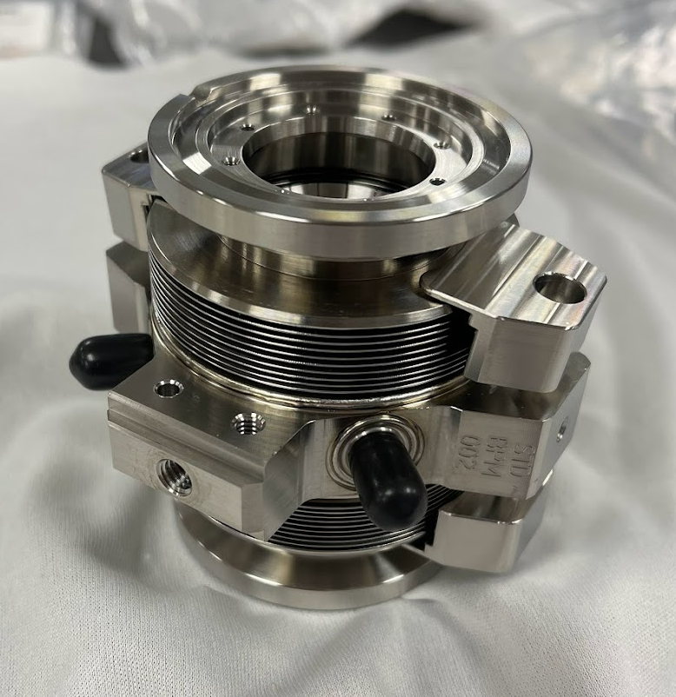
Vacuum Installation
Type of joints used at the APS
Several types of joints are used at the APS depending on requirements of space and material
This includes:
Aluminum Conflat Flanges
Stainless Conflat Flanges
Stainless QCF Flanges
Many of these joints required custom RF gaskets
Specific instruction sheets handed out for each type of joint

Slide 11
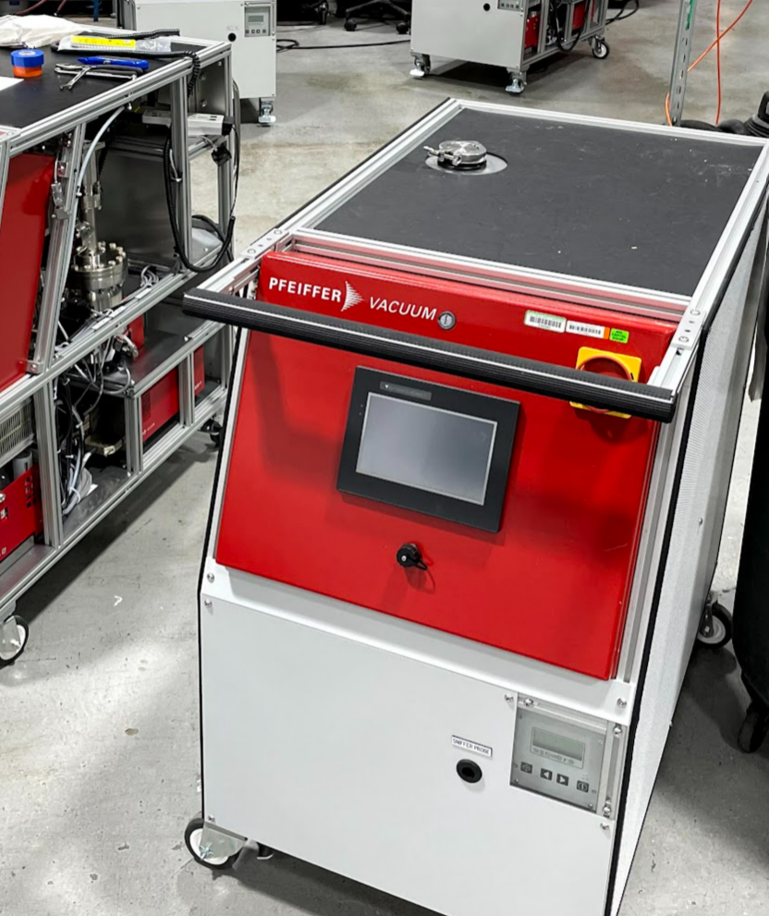
Vacuum Installation
Custom leak test carts built for the APS in order to handle pumping and fit in required spaces
Each vacuum section was independently pumped down to ~1e-5 torr before helium spray leak check performed
Standard for leak check was no response with a helium background of 5e-10 torr-L/sec or better
At this point the vacuum section is considered installed but not certified

Slide 12
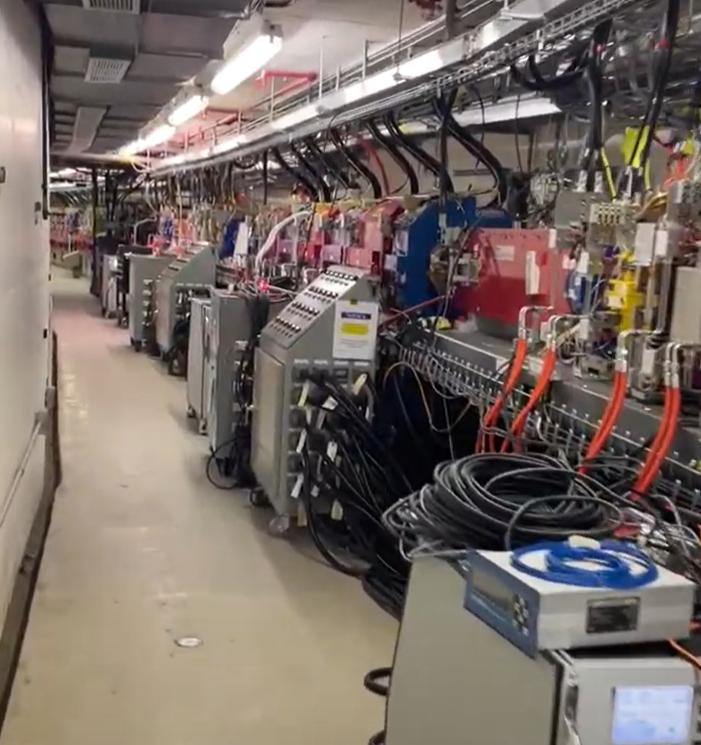
Vacuum Certification
Each vacuum section of the accelerator storage ring was vacuum baked
This included the 5 SR modules and any straight sections
Front Ends, Beamlines and Booster to Storage ring transport line were not baked unless minimum pressure requirement was not reached.
Target of 1e-9 torr vacuum
Once the bake out was complete an RGA scan was performed and compared to the APS standard

Slide 13
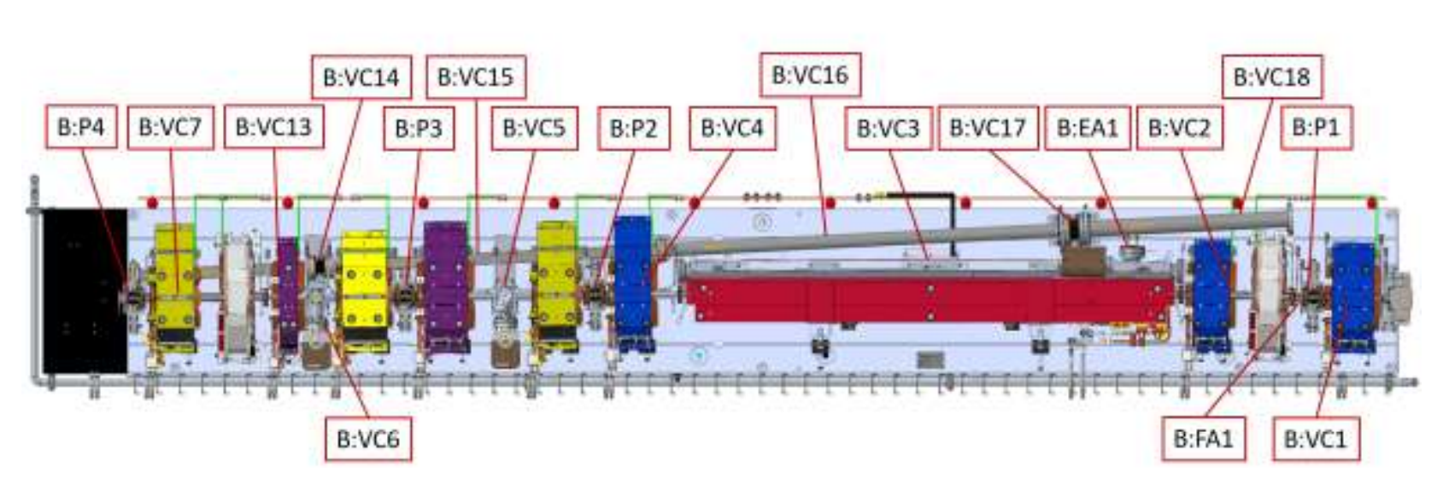
Vacuum Certification
Bake out was performed with electrical heaters
Chamber installed heaters
Heat tapes wrapped around unheated components
Heat plates on large flat chambers
Circuits were wired at build
Heaters were divided up into circuits run in either series or parallel to help balance the load and keep heating consistent.
Circuits needed to be checked prior to use

Slide 14
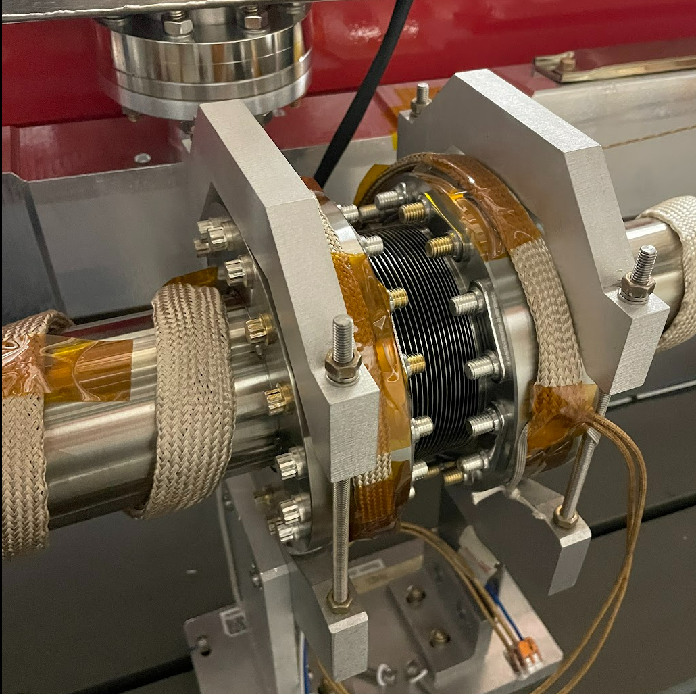
Vacuum Certification
Bake out procedure
System pumped down to 5e-6 torr
Heaters ramped at 20 C/hr to desired temperature
NEG coated to 100 C / Uncoated chambers to 130 C
Once temperature reached, dwelled for 16 hours
Crossover process
NEG coated to 130 C / Uncoated chambers to 100 C
NEG strips/cartridges conditioned
Dwelled for 16 hours
Cooled down while NEG systems activated
Isolated and Ion Pumps turned on

Slide 15
Vacuum Certification

Slide 16
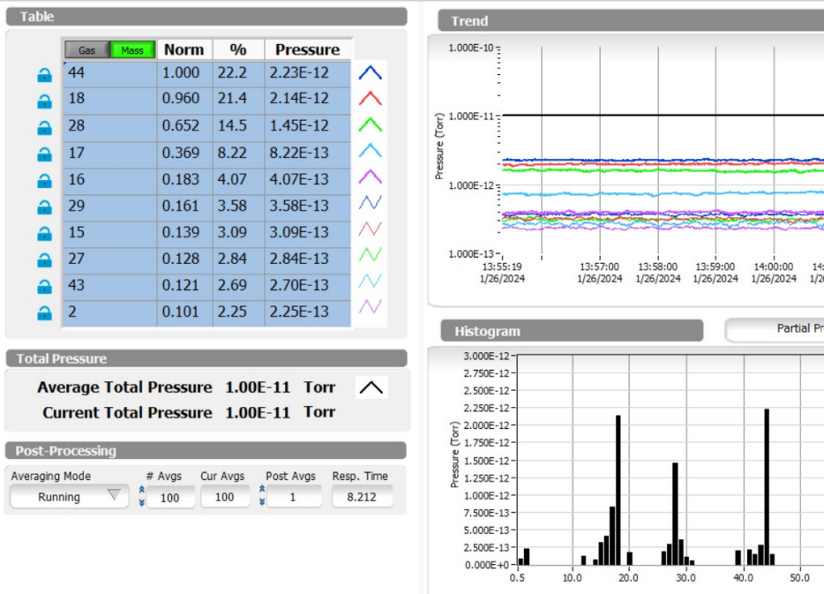
Vacuum Certification
Once the bake out was completed RGA and final leak check performed
Data stored in e-traveler system
Monitoring of ion pumps and vacuum gauge readings
Current vacuum levels ~5e-10 torr with clean RGAs throughout

Slide 17
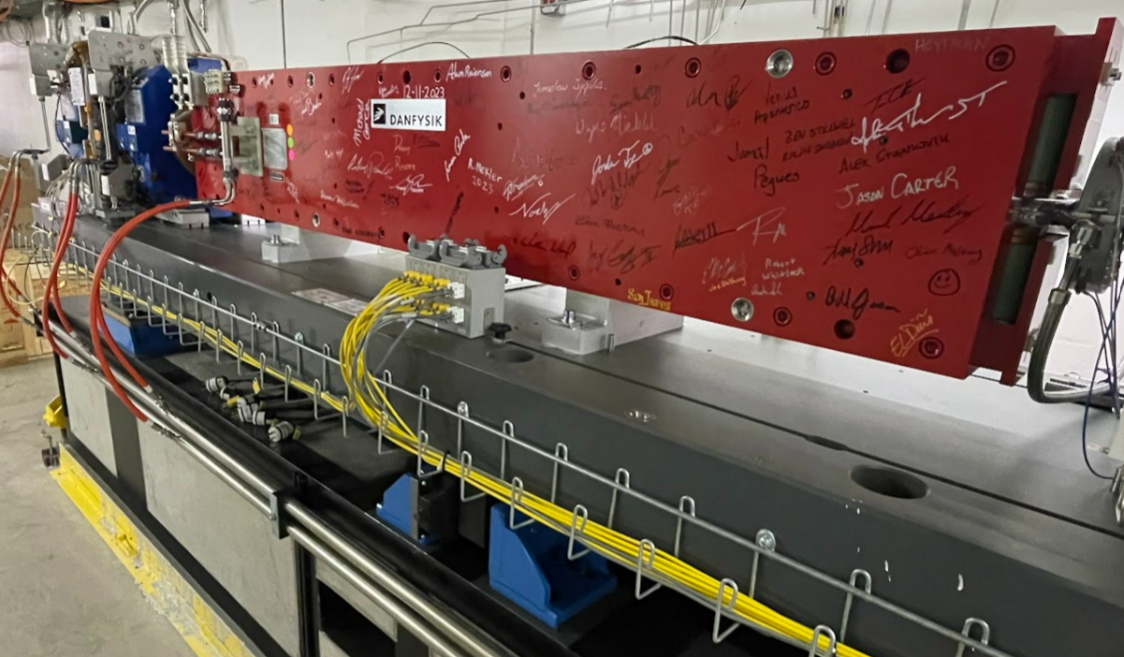
Conclusion
Challenges
Learning curve when it came to gasket installation
Adjustment of bake out heater circuits
Adjustment of NEG condition/activation procedures
Identification of leaks
Contamination
Lessons Learned
Practice makes better
Flexibility
Communication
Team did an amazing job completing this project

Slide 18
Questions?

