Slide 1
Impact of the 2024 Noto Peninsula Earthquake
on the Vacuum Equipment of KAGRA,
the Large Cryogenic Gravitational Wave Telescope
N. Kimura¹, T. Uchiyama¹,S. Miyoki¹, Y. Tanimoto² and Y. Saito^{1,2}
1 Institute for Cosmic Ray Research (ICRR), University of Tokyo
2 High Energy Accelerator Research Organization (KEK)
OLAV-VI: 6th Workshop on the Operation of Large Vacuum Systems
15–19 Apr 2024 Fermi National Accelerator Laboratory

Slide 2
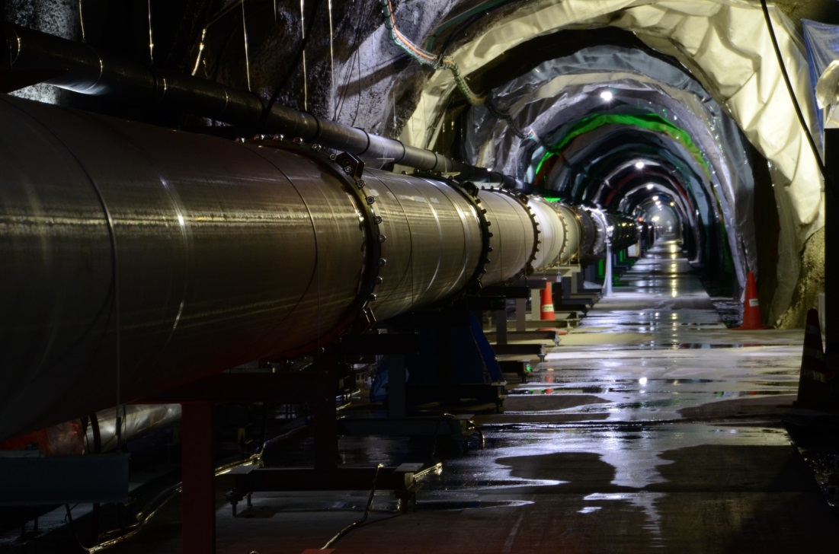
Content
Overview of the KAGRA vacuum system
Nine years of operation of the KAGRA vacuum system in the high humidity environment of an underground tunnel
Impact of the 2024 Noto Peninsula Earthquake* on the KAGRA vacuum system
Summary
* At 16:10 Japan time on January 1, 2024, an earthquake of an epicentral type
occurred 16 km beneath the Noto Peninsula in Ishikawa Prefecture.
Shaking of intensity level 3 was also observed in the tunnel where KAGRA
is installed in Kamioka-cho, Hida City, Gifu Prefecture.

Slide 3
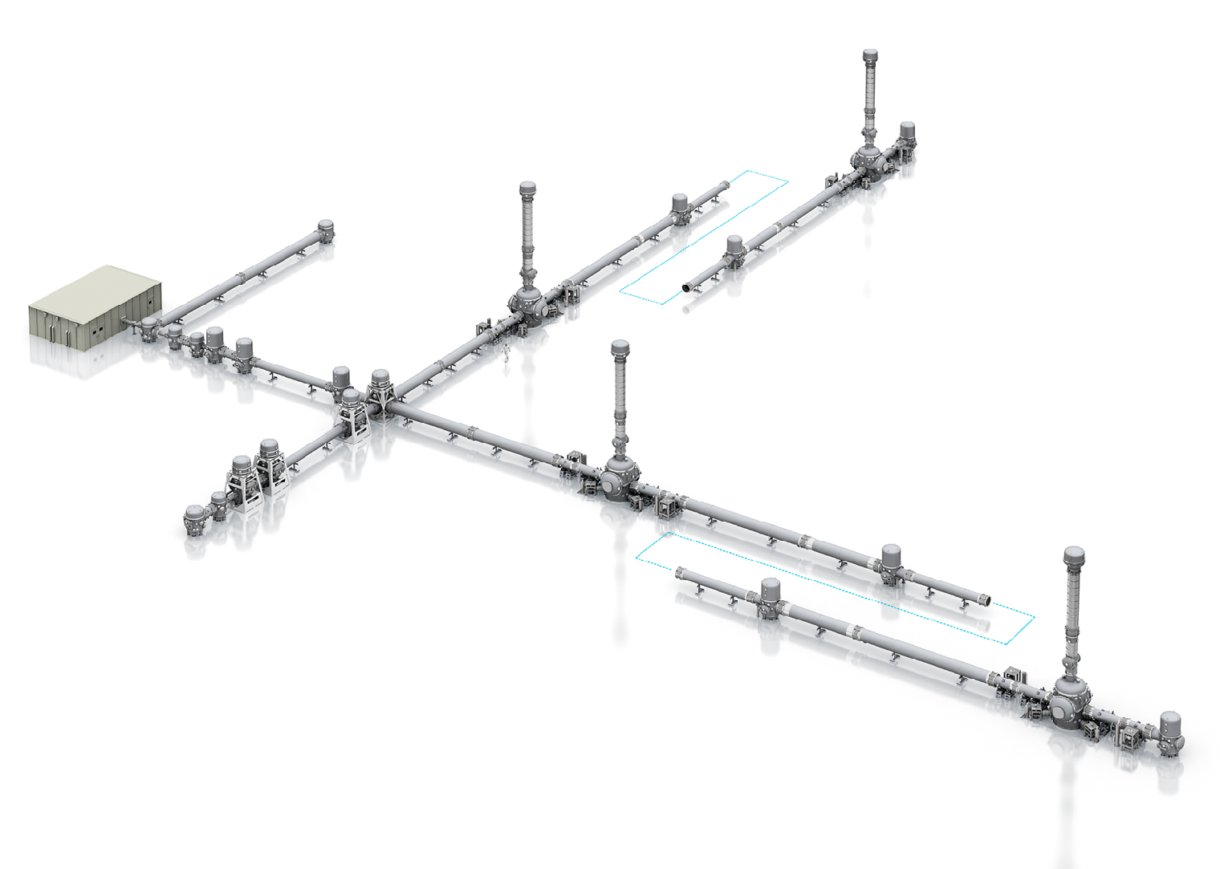
KAGRA Specification
2.5 Generation GWD
·Cryogenic Mirrors
·Deep Underground
Environment
200m deep underground
Wavelength: 1064 nm
Power: 180 W
NPRO + Fiber amp.
3km
Laser
Target Sensitivity
Ultra-high vacuum of 2 x 10⁻⁷ Pa (design)
3km x2 arm tubes
→ Φ800mm x L12m, 500 tubes
SS304L, Electrolytic polishing, No in-situ bake
10 Major Vacuum Tanks & 4 Main Cryostats
Inner Volume： ~ 3,000 m³
Surface Area： ~ 15,000 m²
50 Vacuum Pump Units (Roots+TMP+SIP) in design
Vacuum
Interferometer
3km
Dual Recycled Fabry-Perot Michelson Interferometer
Power Recycling Gain: 11
Signal Recycling Gain: 15
DC readout

Slide 4
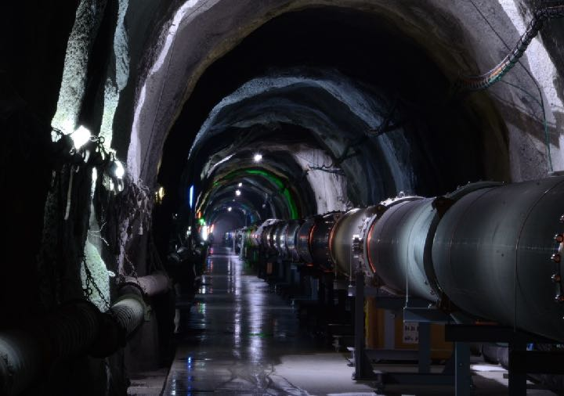
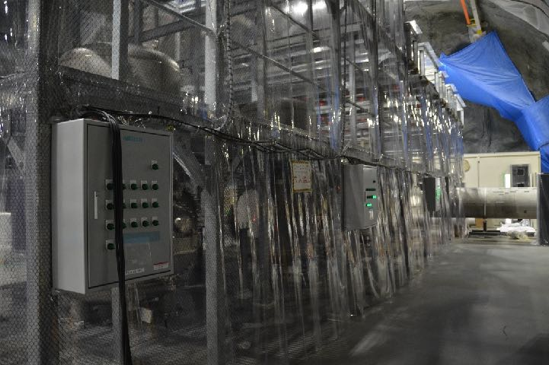
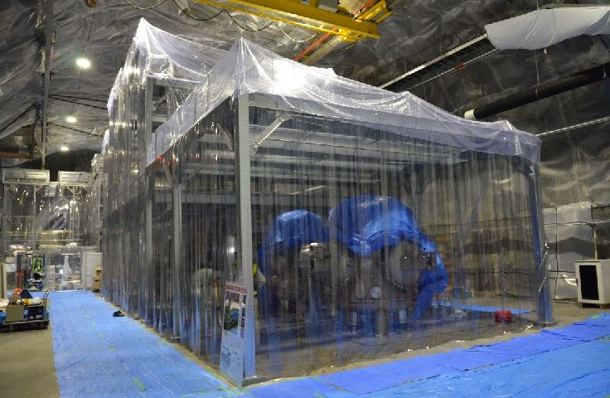
3km
Arms
~ 250 ducts (φ80cm x L12m) in one arm
Y arm tunnel and vacuum tubes
X arm tunnel and vacuum tubes
Corner
Station
Laser
Room
Signal Recycling
Tanks
Input Optics
Tanks

Slide 5
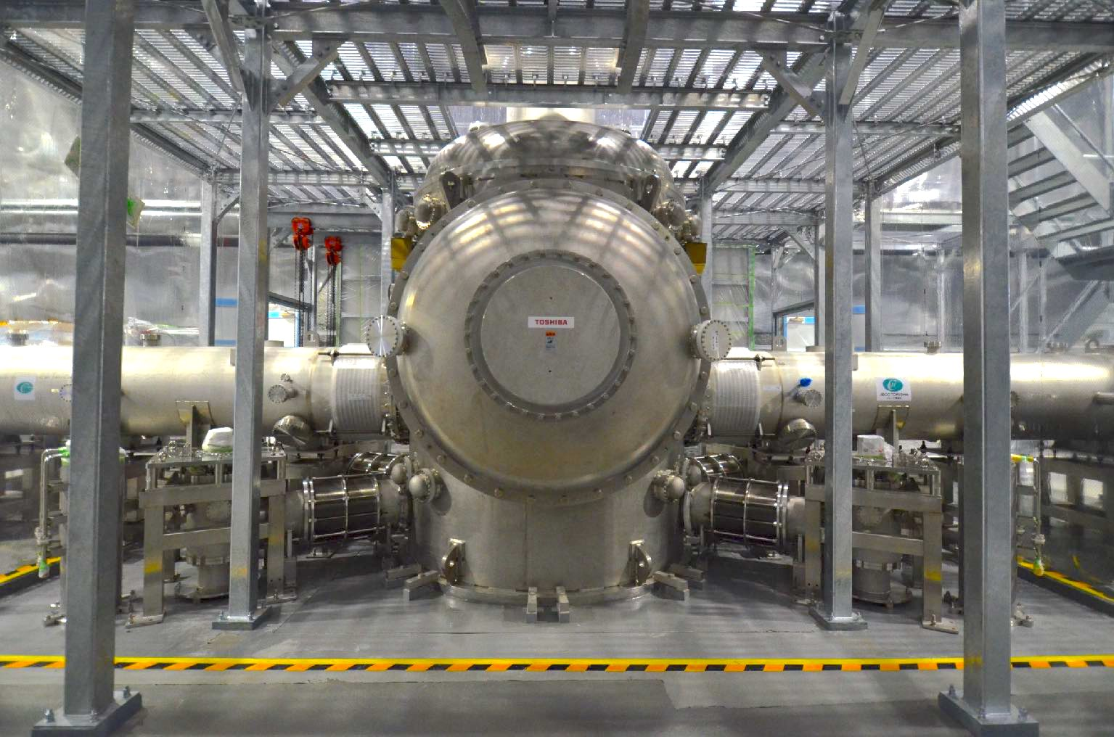
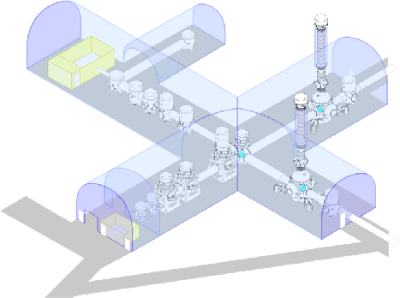
KAGRA
Cryostat
5-m Radiation Shield Duct
5-m Radiation Shield Duct
Cryostat Main Body
Cryo-Cooler
Cryo-Cooler

Slide 6
Vacuum Requirement: fluctuation of refractive index due to residual gas
** fluctuation of residual gas molecule density in the laser path causes fluctuation of the refractive index in the interferometer arms, inducing the horizontal displacement noise (δL),
P(x): probability of x molecules existing in volume v,
when the average density is <n>; Poisson distribution
** residual gas effects on the horizontal displacement noise (δL) is calculated by using a polarizability (α) of the residual gas molecule and a pressure (p),
** Based on the results of a direct measurement of residual gas effects in TAMA 300, the observed relation between noise and pressure agrees with these Eqs within a factor of 1.5.
** predicted noise of δL in KAGRA
1×10⁻²¹ m/√Hz @100 Hz (safety margin of 10),
when the pressure in the beam tubes is to be kept at 2×10⁻⁷ Pa.
Original of this slide prepared
and provided by Dr. Y. Saito

Slide 7
EYT
Mozumi side
KAGRA
Vacuum System Layout
[26]
[36]
Installed vacuum pumps in KAGRA
2300 L/s Turbo Molecular Pump X 37
500 L/s Turbo Molecular Pump X 2
Sputter Ion pump (1200 L/s) X 29
Roots Pump (10 L/s) X 39
EYV
EYC
[30]
[35]
[38]
Pumping units (50 in design) :
TMP+Roots+SIP 29 units
TMP+Roots 10 units
EYA
[34]
GVetmy
[21-25]
[43]
[42]
[40]
GVitmy
3000 m
IYA
[29]
[44]
[45]
[31]
[37]
MCE
[8]
[28]
IYV
IYC
[6]
IXV
TEE,GV,TMP,RP
305blank
現状:起動済
EXV
[1]
[9]
GVbsy
[41]
[16-20]
[32]
[33]
[13]
[11]
GVbsx
MCF
IFI
IMM
PRM
PR3
PR2
BS
IXC
IXA
EXA
EXC
EXT
GVmc
[12]
[7]
GVitmx
GVetmx
SR2
[3]
[5]
[39]
[10]
[2]
[4]
TEE,GV,TMP,RP
305blank
HeOK
[27]
MC: Mode Cleaner
BS: Beam Splitter
IXA, EXA, IYA, EYA: Auxiliary optical baffle
EXT, EYT: Transmitting telescope
IXC, EXC, IYC, EYC: Cryogenic Mirror
IXV, EXV, IYV, EYV: Vibration Isolation (2nd story)
GV: Gate valve
SR3
TMP
IP
Sakonishi side
[14]
solid mark = already installed
SRM
blank mark = additively to be installed
OMMT
[15]
Original of this slide prepared
and provided by Dr. Y. Saito
OMC
Atotsu side
gray mark = pending

Slide 8
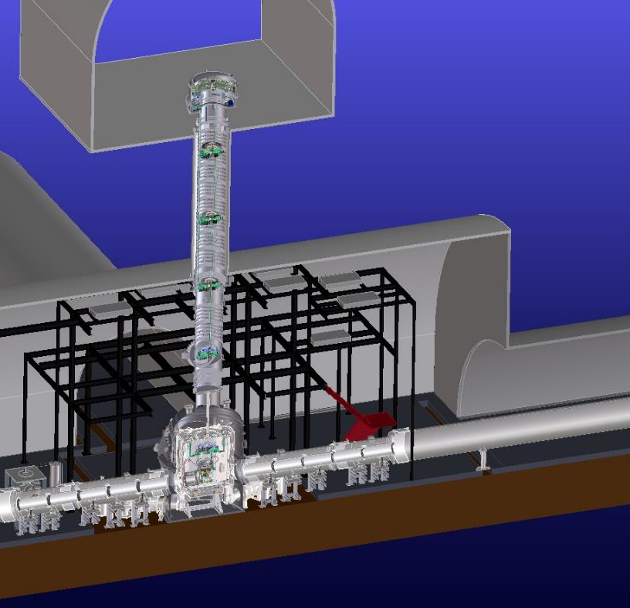
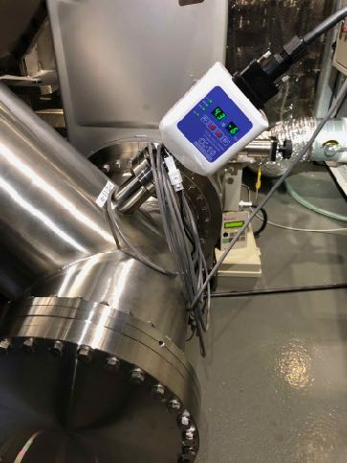
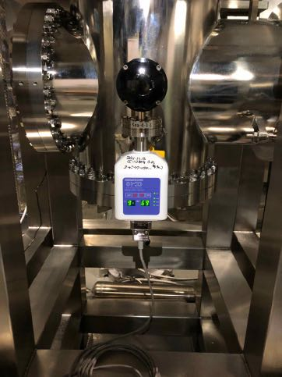
Example of the pressure distribution in the KAGRA cryostat
EXV: 4.0 x 10⁻⁶ Pa
When the radiation shield ducts were cooled down to an operational temperature, pressures in the EXC reached ~10⁻⁶ Pa.
EXA: 4.4 x 10⁻⁶ Pa
EXC: 3.0 x 10⁻⁶ Pa
EXC~EXA: 4.3 x10⁻⁶ Pa
Xea: 6.9 x 10⁻⁶ Pa
EXC~EXA: 4.3 x10⁻⁶ Pa
Xea: 6.9 x10⁻⁶ Pa
EXT~EXC: 4.8 x10⁻⁶ Pa

Slide 9
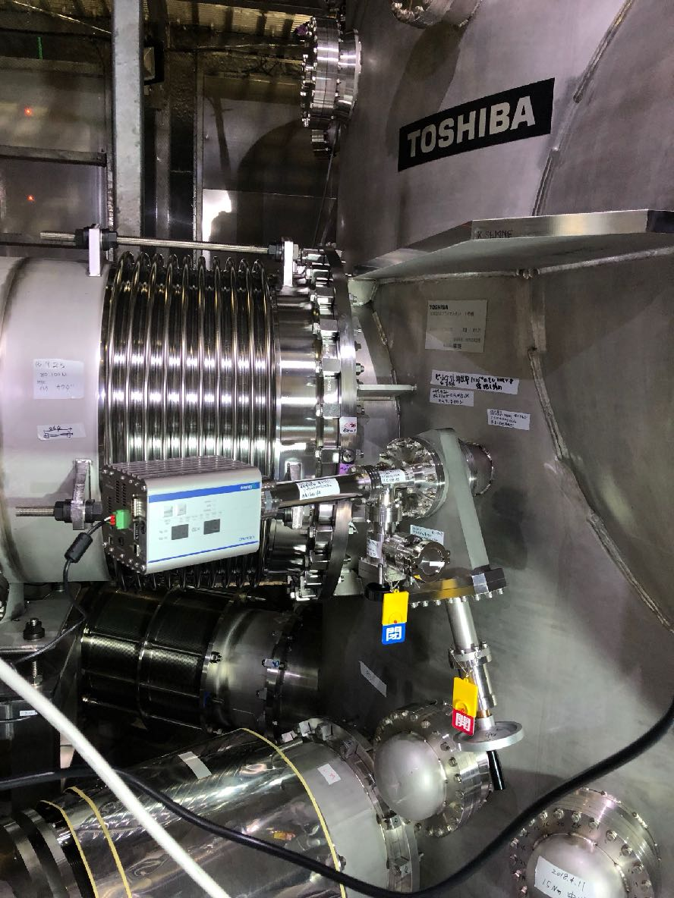
Residual Gas Measurement
To assess gas condensation on the surface of the cryogenic mirrors, residual gases in the vacuum tanks are monitored with 5 quadrupole mass spectrometers.
EXC Cryostat
EYC
IYC
Beam
Splitter
IXC
EXC

Slide 10
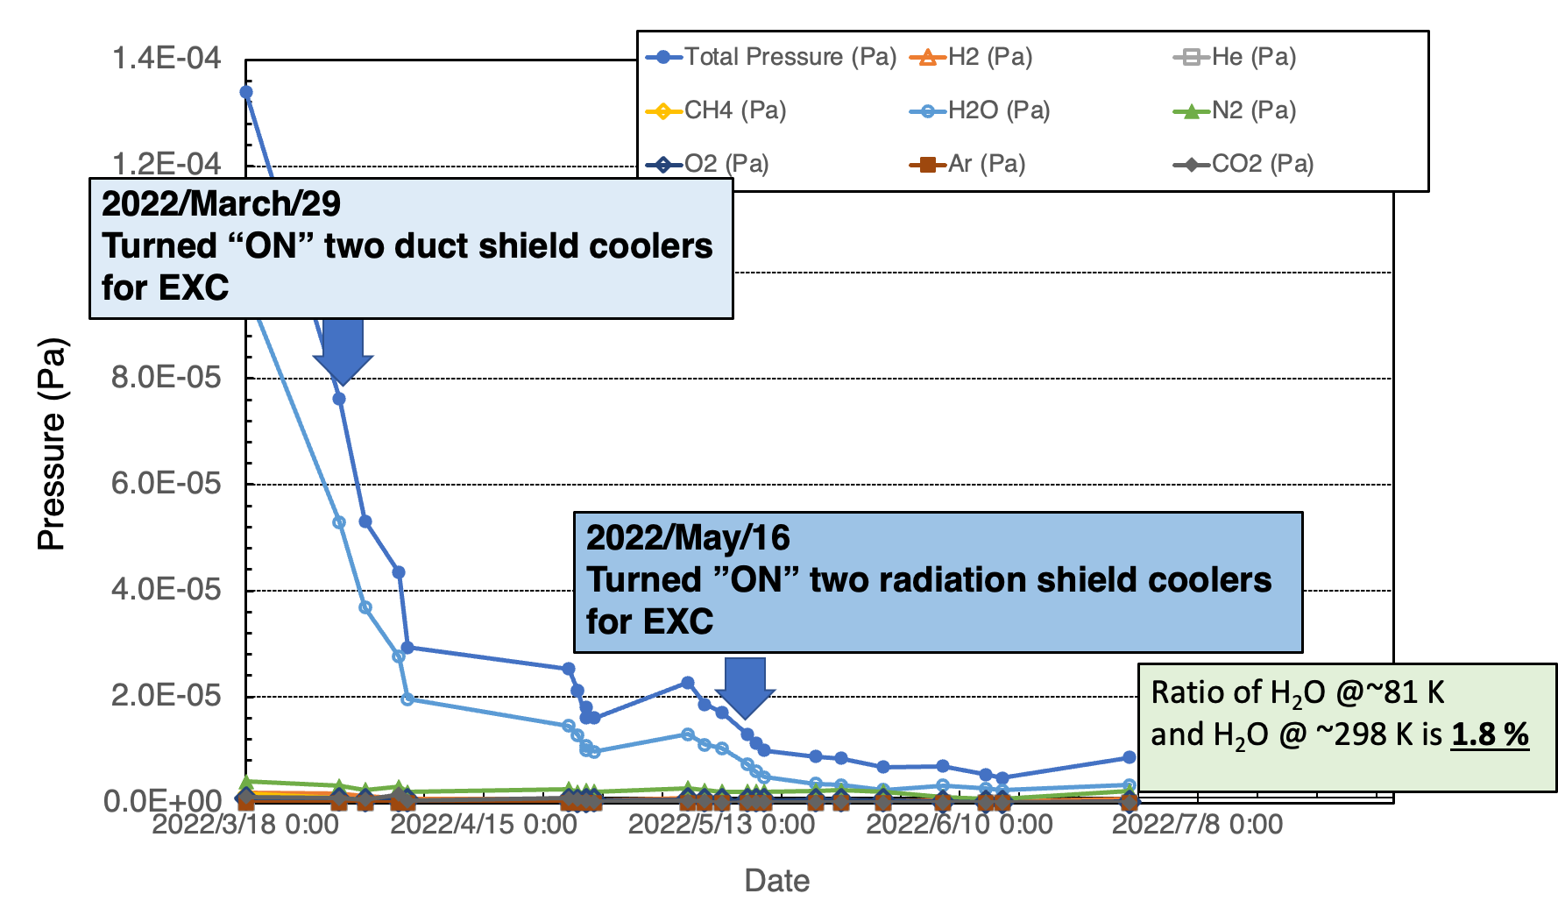
Tendency of decreasing residual gas components by the cooling of radiation shield in EXC
Water vapor in the cryostat was reduced by 98% from room temperature by cooling the radiation shield. This is primarily due to adsorption on the surface of the cooled radiation shield.
Notes:
The moisture component in the cryostat was reduced by 98% from room temperature by cooling the radiation shield. This is presumably due to adsorption on the surface of the cooled radiation shield.

Slide 11
Vacuum leak test of the KAGRA vacuum system
For Y front:
~400 flange connections
For Y-end:
~320 flange connections
X-front:
~400 flange connections
For Center:
~400 flange connections
~1800 flange connections in total were tested!
The acceptable value of leakage for the vacuum leak test
was not detected with a sensitivity of 1x10⁻¹¹ Pa m³/sec.
For X-end:
~320 flange connections

Slide 12
Outline
Overview of the KAGRA vacuum system
Nine years of operation of the KAGRA vacuum system in the high humidity environment of an underground tunnel
Impact of the 2024 Noto Peninsula Earthquake on the KAGRA vacuum system
Summary

Slide 13
Major failures of KAGRA vacuum system during 9 years of operation
Items | Number of failures
Turbo Molecular Pump (TMP) | 5
Sputter Ion Pump (SIP) | 10
Hermetic sealed connector | 4
TMP:
Touchdown of the bearing during atmospheric exposure: 2 cases
Failure of internal control circuit presumably due to condensation in high humidity environment: 1 case
Failure of communication due to water immersion of remote controller: 1 case
Failure of excessive shaft vibration due to the 2024 Noto Earthquake motion: 1 case
SIP:
Failure of high-voltage power supply: 3 cases
Disconnection of high-voltage cable: 4 cases
Damage to hermetic seals by electrical discharge: 3 cases
All these failures were presumably caused by condensation in the high-humidity environment.
Vacuum leak of hermetic sealed connectors:
D-sub type connectors: 3 cases
Burndy type connector: 1 cases
All these failures were presumably caused by stresses due to the cable weight applied to the hermetic seal.

Slide 14
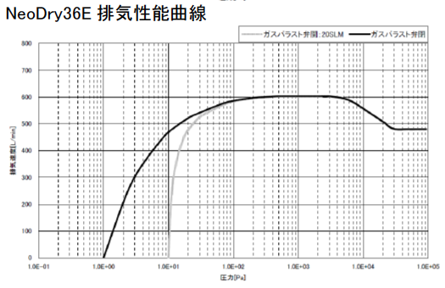
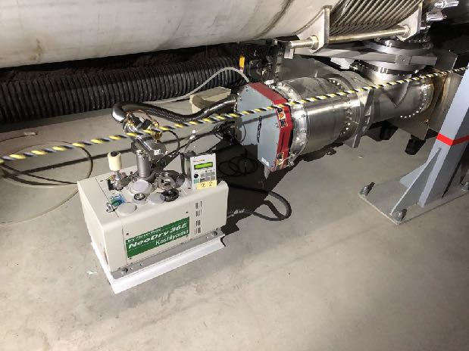
KAGRA vacuum pumping unit issues
Isolation
valve
TMP
Basic configuration of the oil-free vacuum pumping unit in KAGRA:
· Turbo Molecular Pump (TMP) with magnetic bearing
· Multistage Roots Pump
DC 24V
24V output when Roots pump is “ON”
-> Isolation valve is "open".
Roots pump
Since the Gate Valve above the TMP is manually operated, when the TMP stops, the Isolation Valve must be closed, otherwise the UHV in the arms degrades due to a reverse gas flow from the roots pump.
Roots pump pressures:
1 Pa (without gas ballast) ~ 10 Pa (with gas ballast, in reality)
Vacuum pumping characteristic curve of the roots pump
Manual GV
Without gas ballast
Isolation valve
TMP
With gas ballast
Roots pump
1 Pa
10 Pa

Slide 15
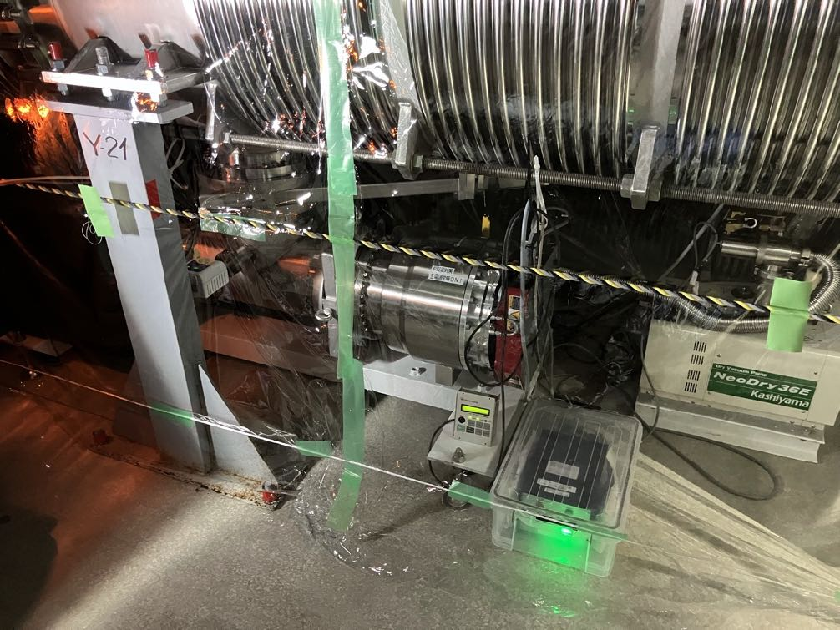
Extended protections with an additional interlock circuit
Item | Conditions | Isolation Valve | Corresponding Circuit | Control Logic
1 | TMP FAILURE | Close | By the added interlock circuit | “FAILURE contact output of TMP” and the added interlock circuit logic
2 | Roots pump FAILURE |  | By the roots pump control circuit | Self-diagnosis of the roots pump control circuit
3 | Power outage |  | By the added interlock circuit | “FAILURE contact output of TMP” and the added interlock circuit logic
4 | Momentary power outage |  |  | The added interlock circuit logic
5 | TMP NORMAL | Open
6 | TMP WARNING
Isolation valve
TMP
Roots
pump
Additional interlock circuit
Configuration of vacuum pumping unit with additional interlock circuit installed at KAGRA
Items 1 through 6, except item 2, have extended protection with the addition of an interlock circuit.

Slide 16
Results of long-term operation of the vacuum equipment and examples of equipment failures
Operating hours of vacuum pumps until March 2024
From the start of KAGRA vacuum duct pumping in
March 2015 through March 2024, the 10 TMPs for X & Y-arm vacuum duct pumping reached a maximum operating time of approximately 43,000 hours.
During this period, four TMPs were overhauled and the below-mentioned failure cases occurred.
The reason for the overhaul of the four TMPs was that the axial vibration of the rotor blades of the TMPs was close to the specified value.
The TMPs that were overhauled had a total operating time of approximately 33,000 hours.

Slide 17
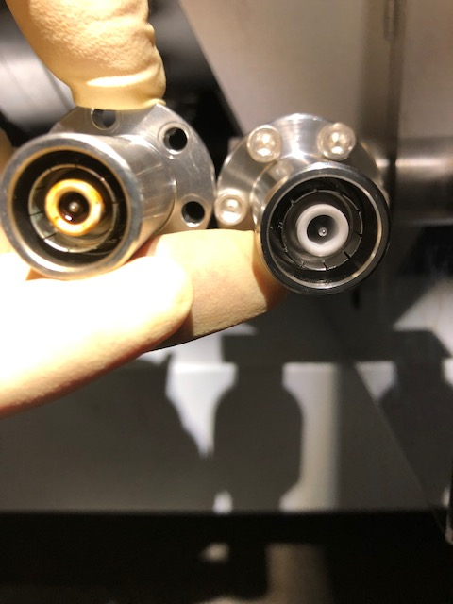
Example of the failure of the Ion pump at KAGRA vacuum system
SIP high-voltage connector
As a serious failure of the discharged hermetic seal,
the ceramic structure was damaged by the discharge,
resulting in a leakage of 1x10⁻³ Pam³/s in one case.
This leak caused the pressure in the Y-arm to increase rapidly.
The leaked ion pump was isolated from the Y-arm
by closing the gate valve.
Since the ion pump failures were mainly in the Y-arm,
operation of the ion pumps in the Y-arm were stopped
and the Y-arm was switched to TMP’s pumping.
Left: damaged and leaked
Right: after replaced

Slide 18
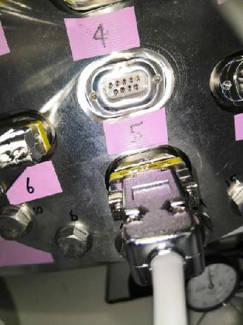
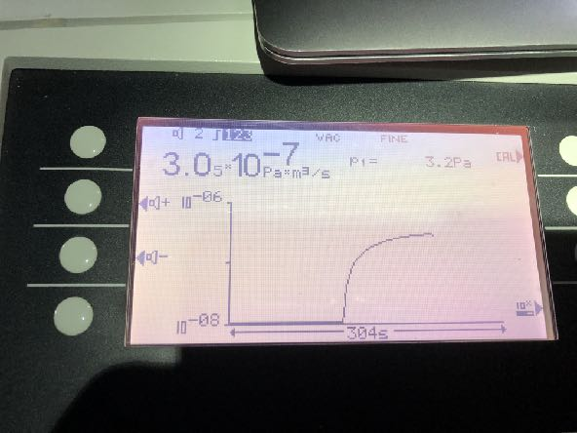
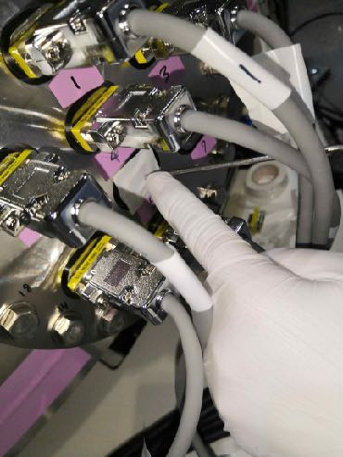
Example of the failure of the hermetic sealed connector at KAGRA vacuum system
Reaction of helium leak detector
Leaked D-sub type hermetic seal
Helium leak test
for the D-sub type hermetic seal
It is presumed that the weight of the cable was applied to the D-sub type hermetic seal,
causing damage to the ceramic sealing.
As a result, a leakage of 3x10⁻⁷ Pam³/s occurred at the ceramic sealing.

Slide 19
Outline
Overview of the KAGRA vacuum system
Nine years of operation of the KAGRA vacuum system in the high humidity environment of an underground tunnel
Impact of the 2024 Noto Peninsula Earthquake on the KAGRA vacuum system
Summary

Slide 20
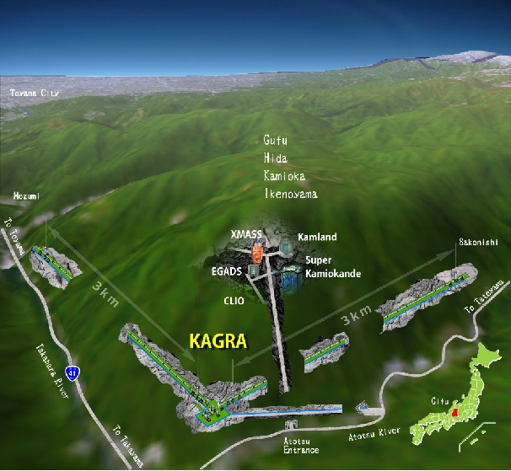
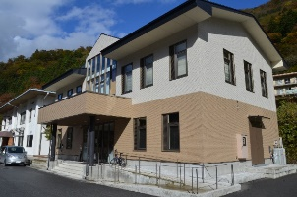
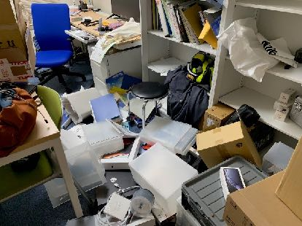
KAGRA Site Seismic Intensity Level 5 minus on the surface, level 3 in the KAGRA site (underground)
KAGRA site and Data analysis building
Data analysis building
Inside Room
Big Earthquakes around Hida/Takayama city
1909 Aug 14, M6.8【Anegawa】Lv.3
1944 Dec 7, M7.9【Tounankai】Lv.4
2011 Feb 17, M5.5【Hida area】Lv.3～4
2023 May 5, M6.5【Noto Peninsula】Lv.2～3
2024 Jan 1, M7.6【Reiwa 6 Noto Peninsula】 Lv. 5- (largest at least in the last 100 years)
(Red color means KAGRA was operated.)
4m altitude elevation happened around the source of the earthquake. Such phenomena is estimated to happen every 6000 years.
Original of this slide prepared
and provided by Prof. S. Miyoki

Slide 21
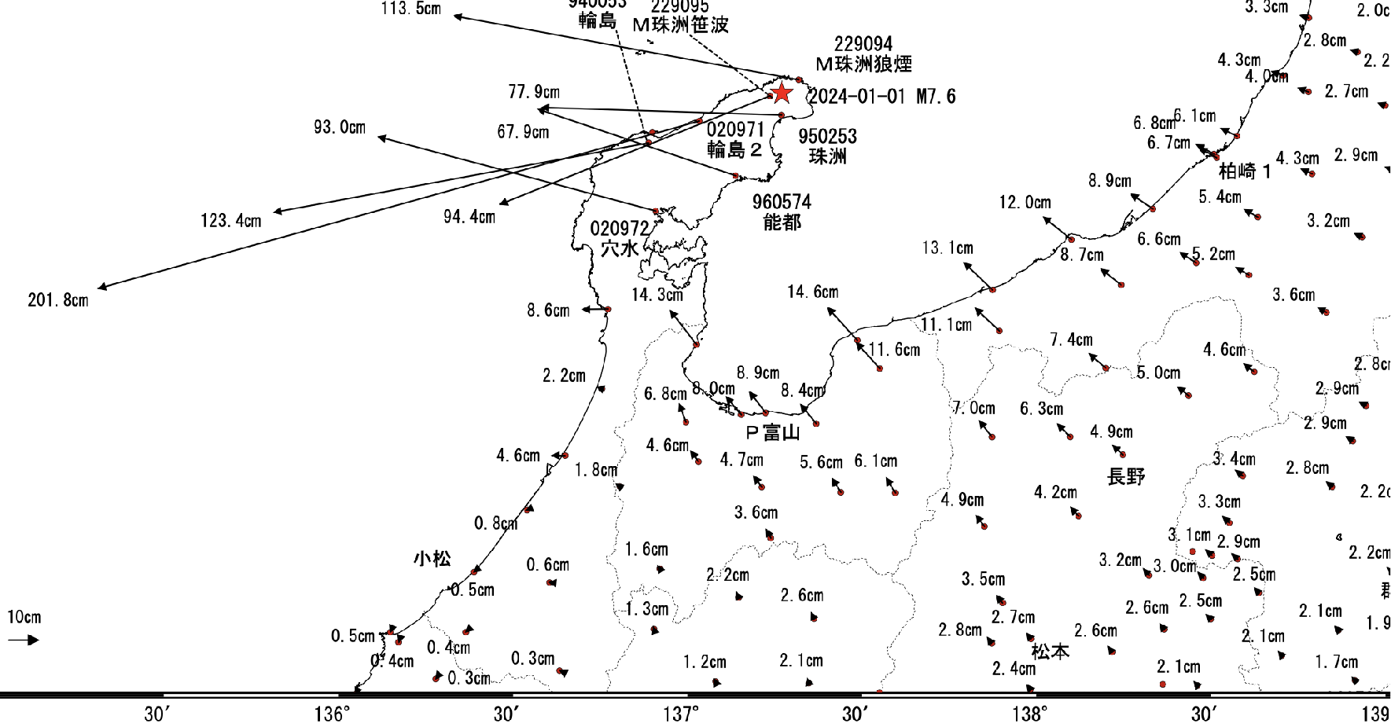
Diastrophism by the Noto Peninsula Earthquake (January 1, M7.6)
According to the Geospatial Information Authority of Japan (GSI) , the mountain that houses KAGRA moved 2~3 cm in the direction of Y-arm.
https://www.gsi.go.jp/common/000255675.pdf

Slide 22
Actual examples of shaking in KAGRA site (Aftershock shaking after the Noto earthquake)
Lv.1
Lv.2
The attached movie corresponds to M4.8 at 0:37-38 on 4th Jan.
The camera is able to show the shaking in the corner station even the Japanese earthquake level was 1 in the Mozumi area (Lv.1 cannot be sensed by most people).
The movie is for level 2 at KAGRA site due to M5.3 around 05:26 on the 6th, Jan.
The swing amplitude and duration are larger
and longer than Lv.1.
Original movies of this slide prepared
and provided by Prof. S. Miyoki

Slide 23
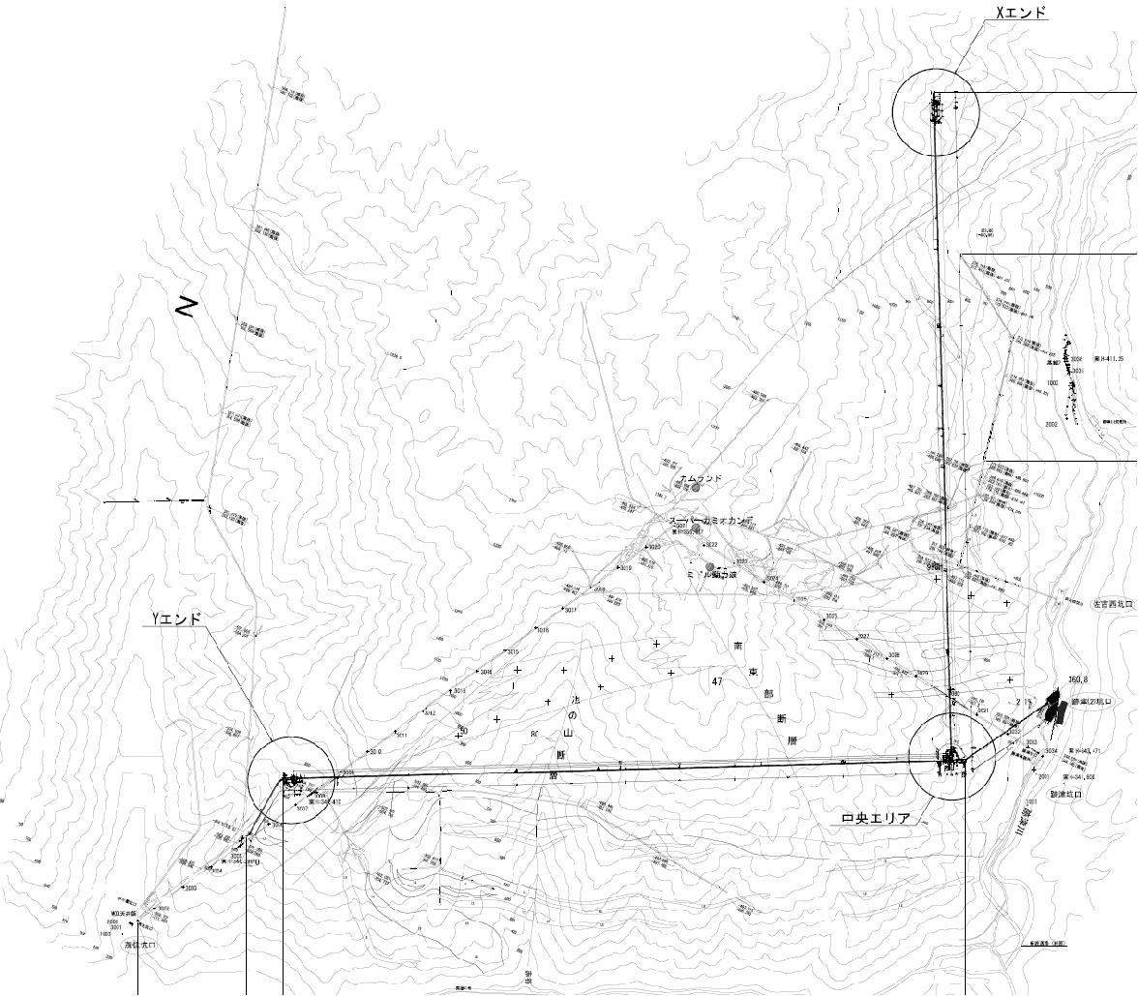
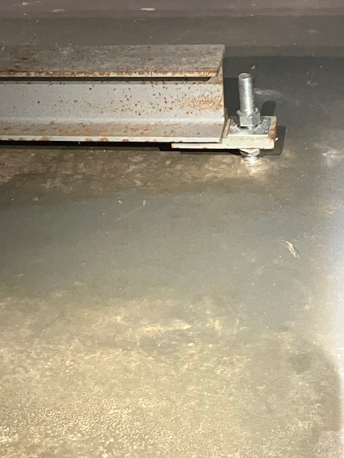
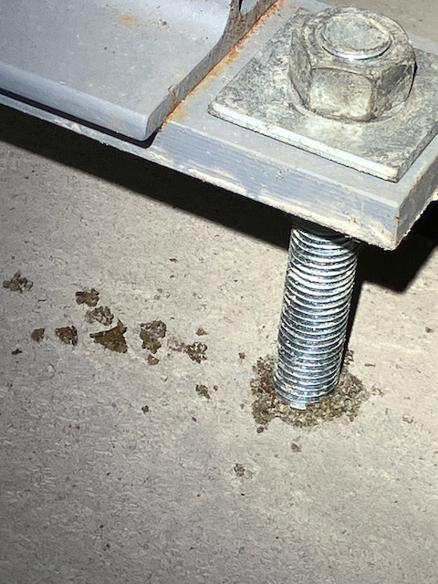
Stresses applied to the vacuum ducts in the X and Y axes of KAGRA
N
Y end
(~450m)
X
X-arm duct
Pull-out force acts
on base anchor bolt
SK
Y-arm 3 km
X-arm 3 km
Stress is applied in the direction perpendicular to the X-arm
Pull-out force acts on base anchor bolts
This cause damage to bolt fixing resin
Pieces of bolt fixing resin
Stress is applied parallel
to the Y-arm
No effect on base anchor bolts and fixing resin
Direction of Noto Peninsula

Slide 24
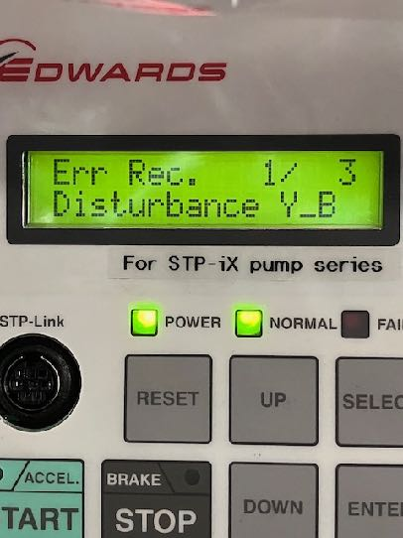
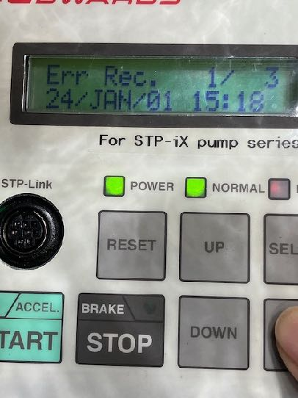
Stresses applied to the vacuum pump units in the X and Y axes of KAGRA
N
Y end
(~450m)
Location of the stopped TMP
SK
Y-arm 3 km
In this case, the protection circuit of the pumping unit
was activated and the vacuum degradation of the Y-arm was avoided.
At the time of the earthquake, the cryogenic mirrors in the cryostats
were cooling and surface condensation were avoided
by the operation of the protection circuit.
Stress is applied parallel to the Y-axis
Seismic motion was applied in axial direction to the rotational axis of the TMP.
One of the five Y-axis TMPs stopped due to excessive axial vibration “Disturbance Y-B”.
(The internal clock of the TMP is 52 minutes behind real time “16:10”, and the time when the TMP stopped has been identified as the time of the earthquake “2024/Jan./01 16:10”.)
X-arm 3 km
Direction of Noto Peninsula

Slide 25
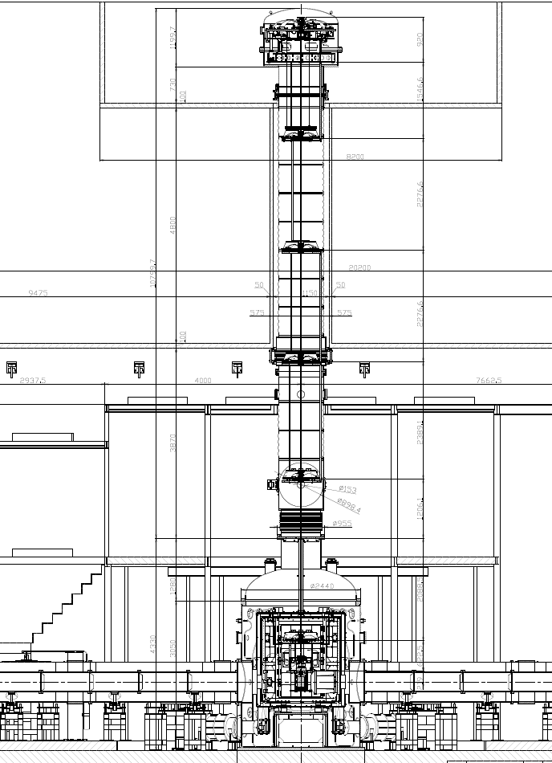
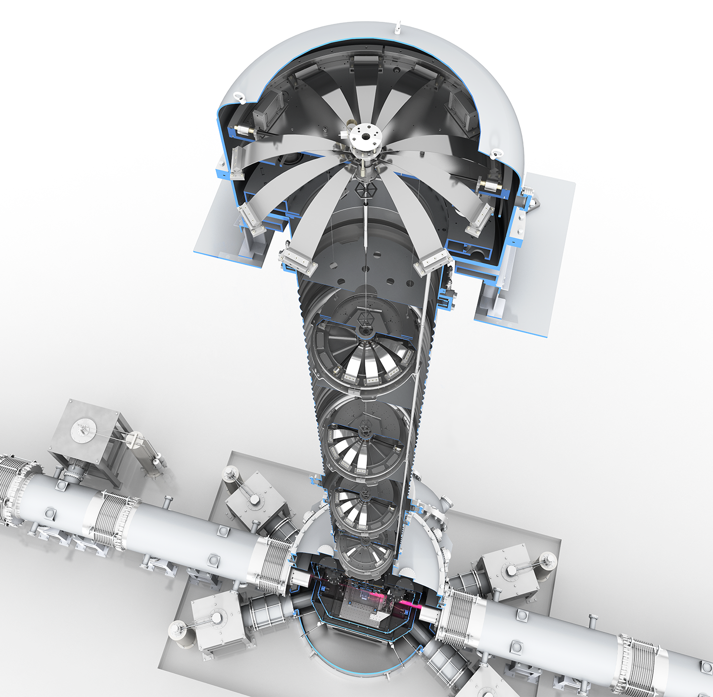
Effects of the earthquake on the vacuum vessel of the cryogenic mirror vibration isolation system
Vacuum vessel for supporting the vibration isolation system
Second story: 13 meters in height from base floor (the first floor)
Vibration Isolation System
Bedrock
We surveyed the vacuum vessel supporting the vibration isolation system to
verify the effects of the earthquake on the isolation system vacuum vessel.
The vertical changes in atmospheric pressure and vacuum inside the four vacuum vessels
with respect to the height reference point were as follows:
Average: 1.5 mm, Maximum: 1.9 mm, and minimum: 1 mm.
This is consistent with the pre-earthquake survey results and indicates that
there was no effect of the earthquake on the vacuum vessels of the seismic isolation system.
Cryogenic mirror
Effects of the earthquake
on the vacuum vessel
of the cryogenic mirror vibration isolation system
Duct tube
Beam line
1200 mm height

Slide 26
Summary
For long-term operation of the KAGRA vacuum system, maintenance and stable operation of the vacuum equipment are important issues.
There were 19 major equipment failures that occurred during the nine years of operation of the KAGRA vacuum system since 2015.
One of these failures was a vacuum leak that significantly affected the pressure of the KAGRA vacuum system.
The 2024 Noto Peninsula Earthquake caused some effects on the KAGRA vacuum system, but no vacuum leaks were found.
On the other hand, the vacuum ducts of the X-arm and Y-arm were observed to be affected by the fixing bolts of the base. A detailed investigation will be conducted in the future.

Slide 27
Thank you for your attention !

Slide 28
Backup

Slide 29
KAGRA Alignment in Mt. Ikenoyama
N
Original of this slide prepared
and provided by Prof. S. Miyoki
Mozumi Entrance
Direction of Noto Peninsula
Y end
(~450 m)
KAGRA
Data Analysis Building
X end
(~450 m)
SK
Y-arm 3 km
Impact on the Vacuum System
The first minimum investigation was done from 8th Jan because aftershocks around M7 would be expected for one week.
Vacuum system (X/Y 3km ducts, Vacuum chambers for each mirror suspension systems)
No leaks was confirmed by pressure monitoring via the Internet on January 2, immediately after the earthquake.
After visual inspection for the vacuum pump units, TMP at position of 2700 m at Y-arm was stopped.
X-arm 3 km
Corner
(~200m)
Atotsu Entrance

Slide 30
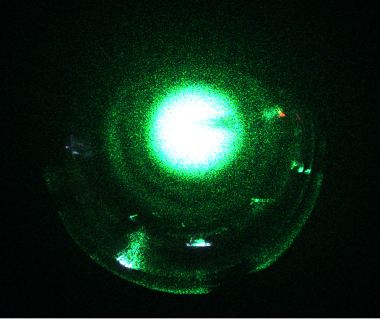
Example of frosted mirror and view port
Frosting
Mirror surface at cryo temp.
TM oplev QPD side

Slide 31
Pressure distribution in an arm tube (electrolytic polishing and pre-baked)
No of pumps | distributed distance | p_{max}/p_{min} | p_{min} (pump head) *
(in an arm) | [m]
 |  |  | [Pa] @50h | [Pa] @500h | [Pa] @5000h
30 | 100 | 1.1 | 1.2 10^-6 | 1.2 10^-7 | 1.2 10^-8
15 | 200 | 1.8 | 2.4 10^-6 | 2.4 10^-7 | 2.4 10^-8
10 | 300 | 2.2 | 3.6 10^-6 | 3.6 10^-7 | 3.6 10^-8
6 | 500 | 4.0 | 6.0 10^-6 | 6.0 10^-7 | 6.0 10^-8
3 | 1000 | 6.0 | 1.2 10^-5 | 1.2 10^-6 | 1.2 10^-7
* q: is assumed to go down on the order of 10-8 [Pa m3 s-1 m-2] for 50 hrs pumping, which was measured in the unit tube.
KAGRA installation performance (Mar 2015);
A base pressure for leak testing reached to,
1) the order of 10-5 Pa for pumping duration of around a week,
when 6 of turbo-molecular pumps were operated in the X arm (3 km).
2) the order of 10-6 Pa for pumping duration of around a week,
when 3 of turbo-molecular pumps were operated in the half of Y arm (1.5 km).
3) the order of 10-5 Pa for pumping duration of around a week,
when 9 of turbo-molecular pumps were operated in the Y arm (3 km).
The first few days by roughing pumps were necessary,
to reach the pressure at which turbo-molecular pumps can be operated in normal velocity.
q: outgassing rate per unit area [Pa m3 s-1 m-2]
L: total length of an arm tube [m]
A: total surface area of an arm tube [m2]
c: conductance per unit length [m3 s-1 m]
v: mean velocity of gas molecules [m s-1]
S: pumping speed of each pump [m3 s-1]
N: number of pumps distributed in equal interval
pressure
arm
Original of this slide prepared and provided by Dr. Y. Saito

Slide 32
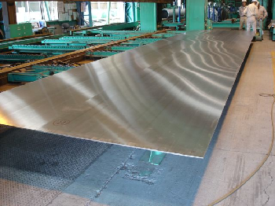
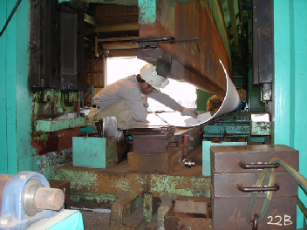
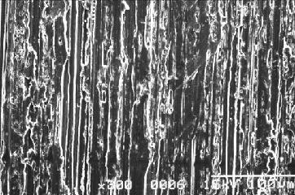
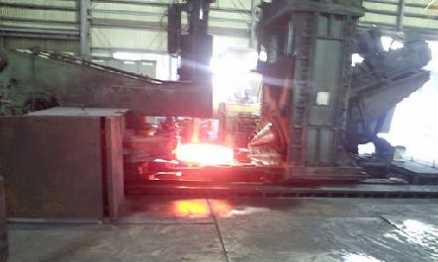
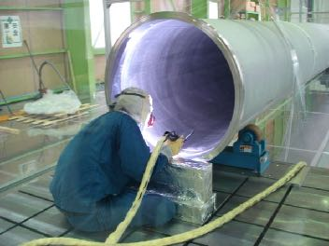
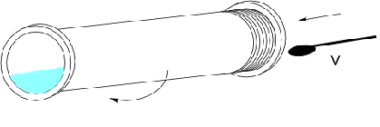
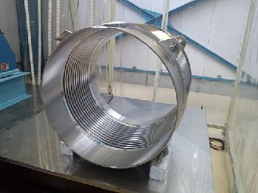
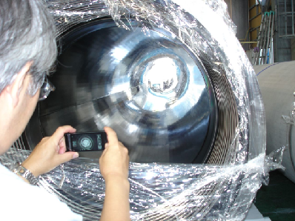
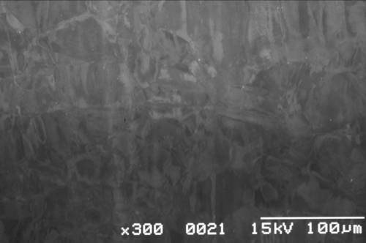
“KAGRA vacuum system of cryogenic interferometer”
Manufacturing Process: unit tube of 12 m long and 0.8 m in diameter
tube forming; SS304L, 8 mm thick, Rmax 8 μm finished
electrolytic polishing (EP) and
rinsing with ultra pure water;
Rmax 2.5 μm
flange; SS F304, Rotary forging
TIG-weld Assy
removing 25 μm of outermost layer
hydro-formed bellows;
SS316L, 0.6 mm thick, chemical polished

Slide 33
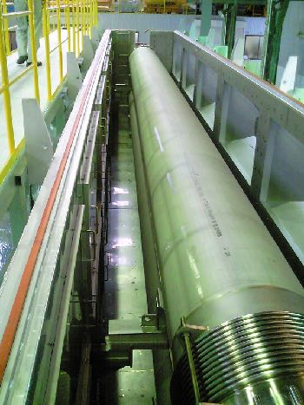
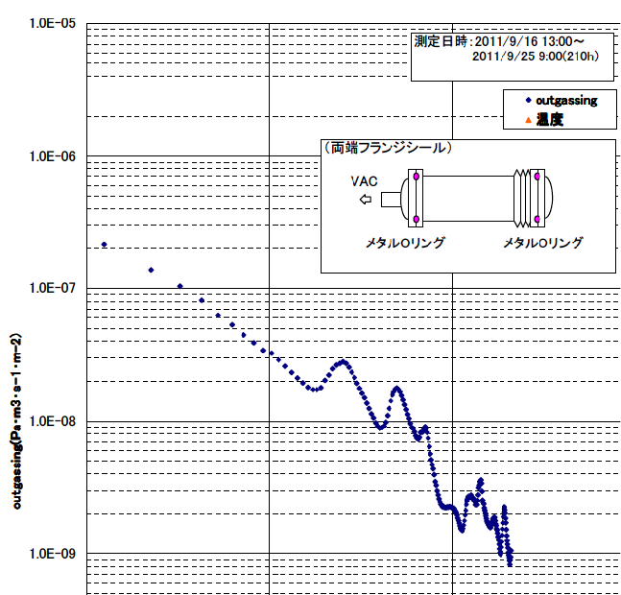
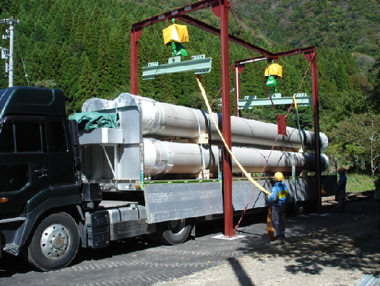
“KAGRA vacuum system of cryogenic interferometer”
Manufacturing Process: surface passivation by pre-baking then storage
vacuum baking at 200°C for 20 hrs;
*dry air venting (-40°C dew point)
*sealed with blank flange (EPDM gasket)
outgassing rate measured for a unit tube;
surface passivated tube shows
the rate of the order of 10⁻⁹ Pa m³ s⁻¹ m⁻²
for pumping time of 100 hours.
outgassing rate (Pa m³ s⁻¹ m⁻²)
storage in the tunnel of Kamioka mine railway
1 10 100 1000
pumping time (hour)

Slide 34
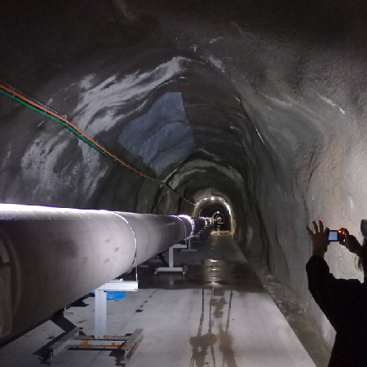
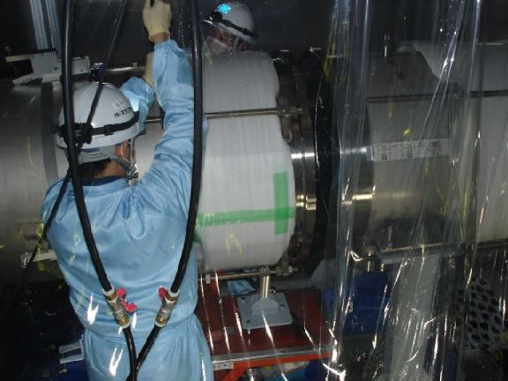
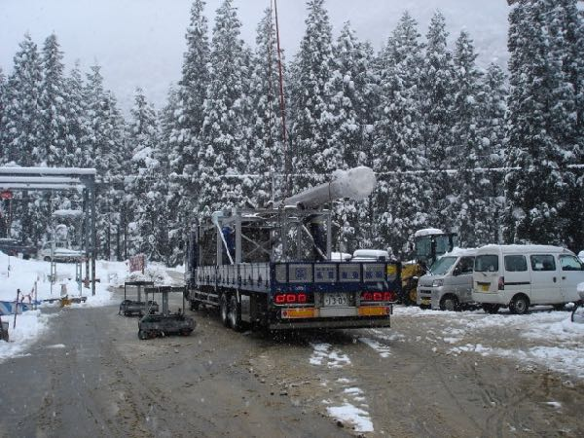
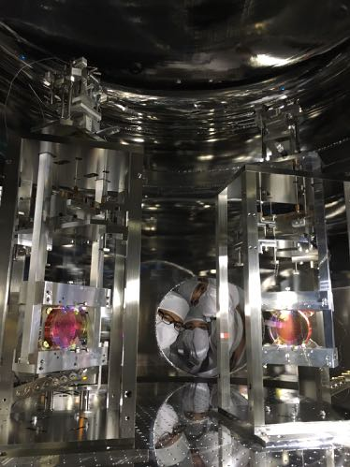
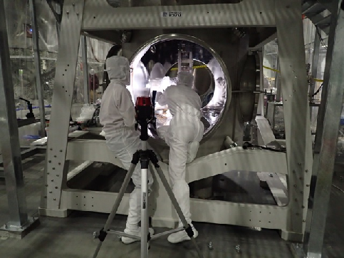
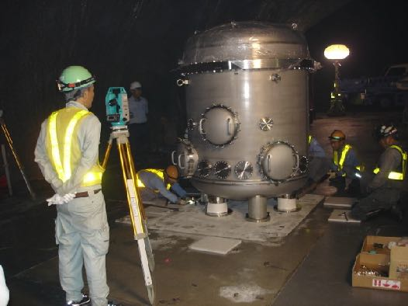
“KAGRA vacuum system of cryogenic interferometer”
Installation and Test Operation
Arm tubes installation; Sep 2014 – Mar 2015
Mirrors installation; Apr 2016 – Mar 2016

Slide 35
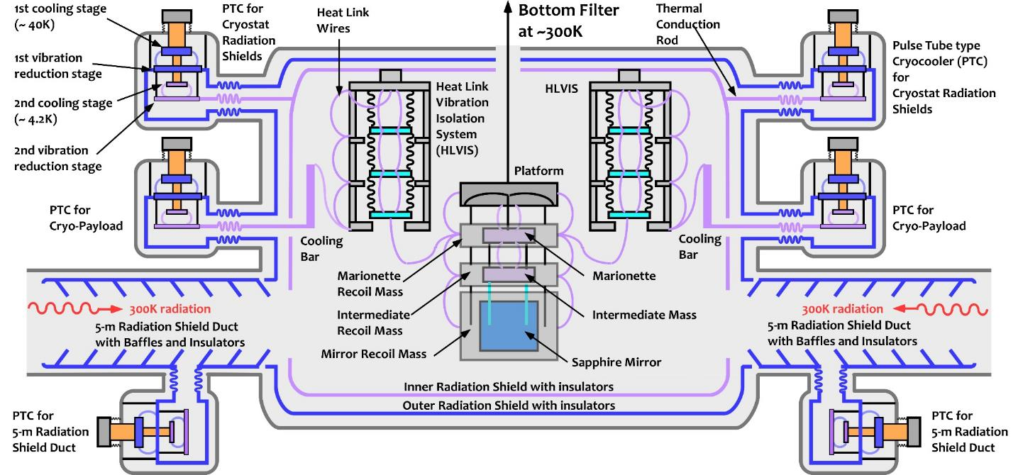
KAGRA Cryogenic System
Cryostat Chamber Dimensions:
Diameter: 2.4 m, Height: ~4.3 m, Mass: ~ 12 ton
I/O shields Mass: 8K: ~455 kg, 80 K: ~590 kg
Cryocoolers: 2 stage Pulse tube type
Cooling power: 0.9 W at 4K (2nd)
36 W at 50K (1st)
Cryogenic payloads:
SOLBLACK coating
－low cost, can be coated on large area
－some magnetism, higher outgas
5-m Radiation shield Duct :
Diamond Like Carbon (DLC) coatings
－low outgas, no magnetism
－only small area, expensive
A cryogenic payload is stored inside the cryostat with two-layer radiation shields (80 K shield and 8 K shield).
Both HR and AR side of a mirror, there are 5-m cryogenic duct shields for reducing the thermal radiation from the beam tubes.
PAB on 6th July 2022
CRY Group
Notes:
The internal structure of the cryostat looks like this.
Here is the sapphire mirror, which is suspended by a cryostat, which is suspended from the end of the Type-A suspension to isolate it from vibration.
The cryostat is thermally isolated by the double thermal radiation shield inside the cryostat and the duct radiation shield in front and behind the cryostat, and the cryostat including the mirror is cooled by heat conduction through the soft heat-link vibration isolator system. The cryogenic suspension system, including the mirror, is ultimately cooled by thermal conduction.

Slide 36
State-of-the-art cooling strategy: a 76-day journey
EY
IX
Turn On
2 coolers
EX
250 K
82 K
Step 1
250K
Step 2
Step 3
Final Step
Goal
IY
21 days
11 days
24 days
10 days
Vacuum pumping
Internal pressure
< 10⁻⁴ Pa
No leakage
> 10⁻¹⁰ Pam³/s
Cooling down
radiation shield
ducts
Radiation Temp.
90 K ~ 150 K
Trap H₂O
Cooling down
inner/outer
shields
Radiation Temp.
20 K ~ 30K
Trap O₂ and N₂
Cooling down
Test
Mass
T_{TM}=~20 K

