Slide 1
Vacuum system with turbomolecular pumps for high-power proton beam operation of the rapid cycling synchrotron
Junichiro KAMIYA, Ippei YAMADA
& RCS Vacuum group
Japan Atomic Energy Agency (JAEA) / J-PARC center
Summary of Phys. Rev. Accel. Beams 24, 083201 (2021)

Slide 2
Contents
Introduction
  J-PARC, Rapid Cycling Synchrotron (RCS)
Turbomolecular pump failure & improvements
Dynamic pressure & countermeasure
Summary

Slide 3
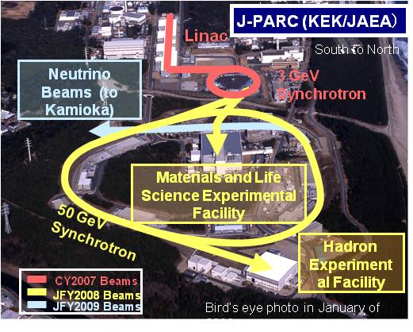
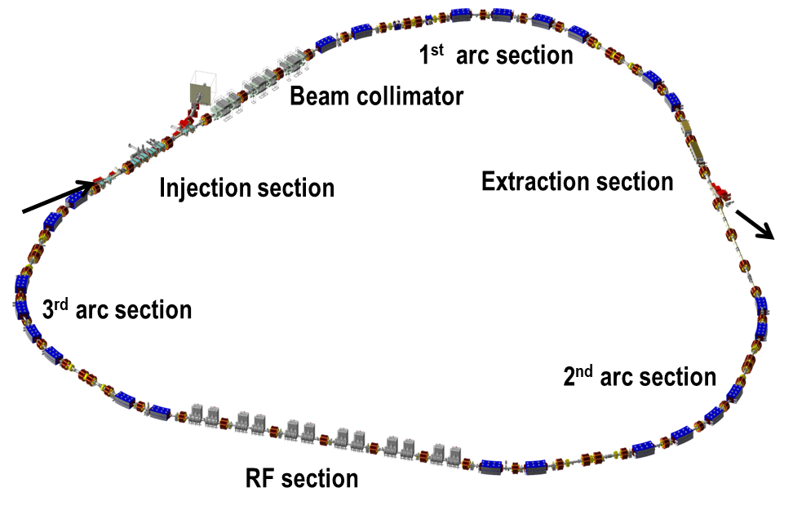
3 GeV Rapid Cycling Synchrotron (RCS) in J-PARC
J-PARC: Japan Proton Accelerator Research Complex
High intensity proton accelerators
Linac (400 MeV)
Rapid Cycling Synchrotron (3 GeV)
Main Ring (30 GeV)
Rapid Cycling Synchrotron (RCS)
circumference: 348 m
energy: Injection 400 MeV, Extraction 3 GeV
Extracted beam power: 1 MW
beam extracted to MR and
Materials & Life Science Experimental Facility
From LINAC
To MR/MLF

Slide 4
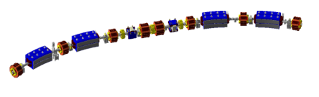
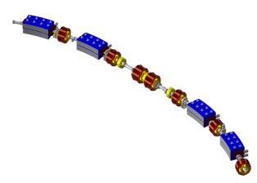
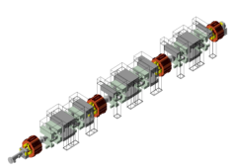
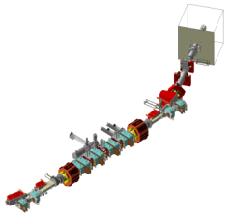
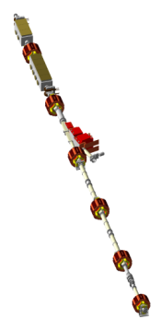
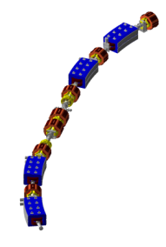
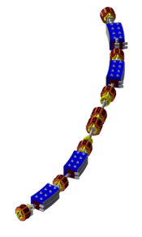
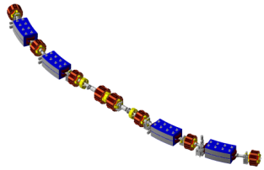
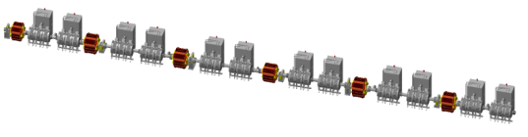
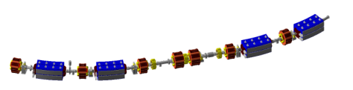
RCS : 3GeV rapid cycling synchrotron
The H0 dump is used to dump unstripped beams at the stripping foil. The capacity is 4kW.
The beams are extracted by kicker magnets and DC septum magnets at the extraction section and then transported either to MLF or to MR with a pulsed bending magnet placed in the 3NBT line.
H0 Dump
(4 kW)
The stripping foil in the injection section is used to convert H- beam from the linac into protons.
1st arc
section
Beam
Collimator
Design parameters
Circumferences | 348.3 m
Injection energy | 400 MeV
Extraction energy | 3 GeV
Repetition rate | 25 Hz
Acceleration time | 20 ms
Ramping pattern | Sinusoidal
Number of particle per pulse | 8.33×10¹³
Output beam power | 1 MW
from
LINAC
Extraction
section
Foil
Injection
section
RCS has a three-fold symmetric lattice
whose circumference is 348.3m.
to
MR&MLF
3rd arc
section
2nd arc
section
RF section
One of the three-fold symmetric lattice comprises two arc modules and a long straight insertion.
Each arc module has a missing-bend cell.

Slide 5
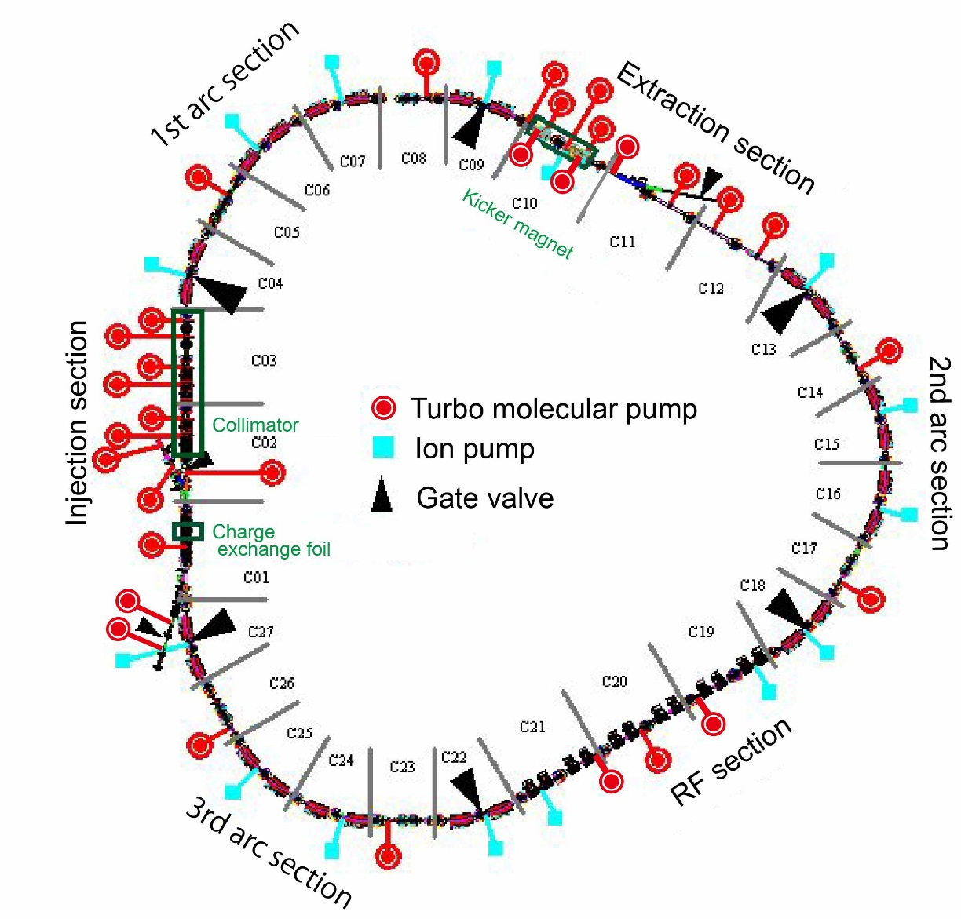
RCS vacuum system
Vacuum system components
Vacuum chambers
186 Titanium ducts & bellows
108 Ceramic ducts
Pumps
31 Turbo molecular pumps
(15 Spattering ion pumps, not used)
Gauges
40 Cold cathode gages
17 BA gages
52 Pirani gauges (beam line and back line of TMP)
. . .
To neutron source
& MR Synchrotron
3GeV
(not used)
Other vacuum devices
400MeV
Charge exchange foil
Beam collimators
Extraction kicker magnets (in vacuum)
. . .
From Linac
Outgassing sources…
Latest configuration is shown by I. Yamada.

Slide 6
Turbomolecular pump as main pump
High pumping speed from ~100 Pa to UHV
John F. O’Hanlon, “User’s Guide to Vac.Tech.”
TMP general pumping speed vs. Pressure
Ion pumps (IP)
TMP works from low vacuum to UHV without decreasing of pumping speed → - minimum time from maintenance to beam operation
- effective to pump the enormous static and dynamic outgassing
No Potential danger of release of entrapped molecules/ions
Gas instabilities actually occurred when the IP were used in the RCS in the beginning.

Slide 7
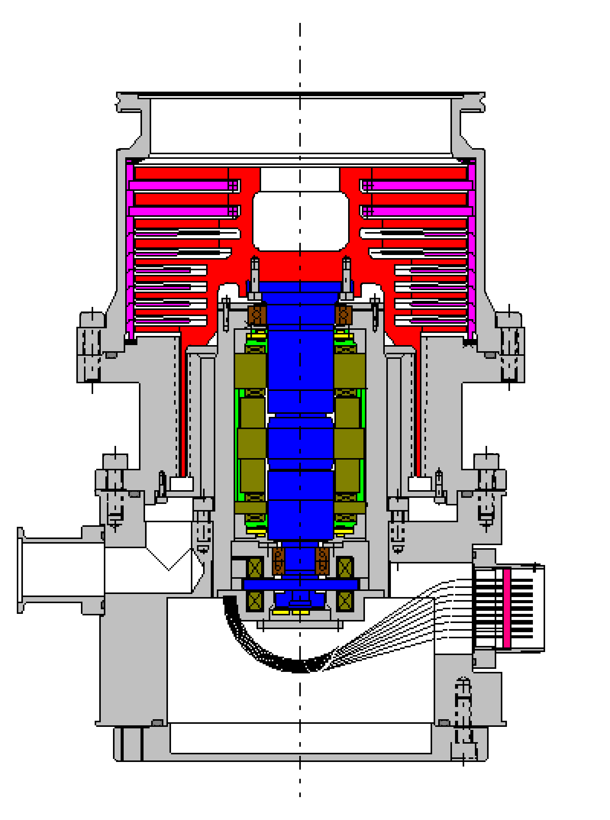
Turbo molecular pump with radiation resistance
Radiation-proof specification is necessary in the accelerator tunnel.
Usage of radiation-proof materials
1. Speed & location sensor :
Hall sensor → Pick-up coil
2. Seal :
elastomer → metal
3. Hermetic seal :
rubber, resin, etc. → ceramics
4. Sheath material :
Teflon → PEEK
K. Wada, Vacuum 84 (2010)
2
1
4
3
γ ray irradiation test for 3 years
- Good performance
with the absorbed dose > 75 MGy
Osaka vacuum Ltd., TG1300M MR

Slide 8
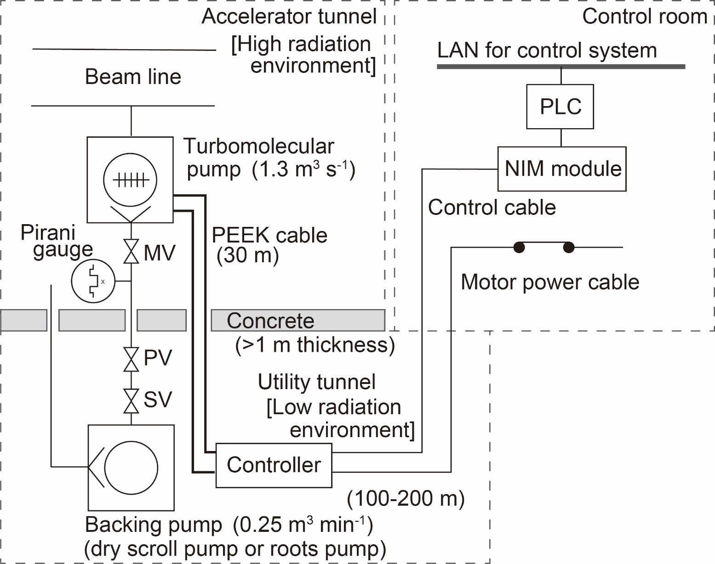
TMP system configuration in the RCS

Slide 9
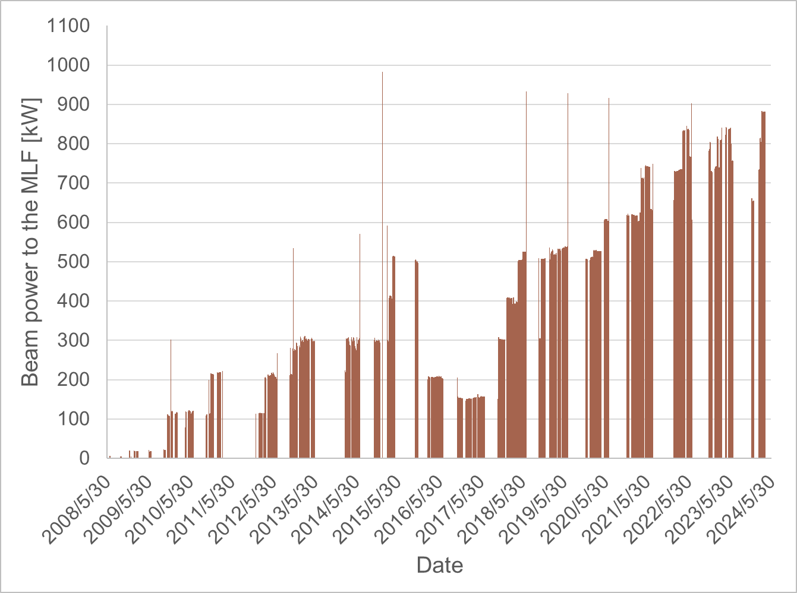
RCS output beam power history
1MW test
Designed beam power for the MLF target
1 MW= [3 GeV] ×[8.3×10¹³ protons] × [25 Hz]
Two major problems in the vacuum system caused by high intensity beam:
Turbomolecular pump failure
Dynamic pressure

Slide 10
TMP FRTD by high-intensity beam loss
A high-intensity single-shot beam is fully lost with a peak in the vicinity of C14.
The high-energy secondary particles pass through a more than 1 m thick concrete floor of the accelerator tunnel and destroy the digital signal processor in the controller, which is located in the utility tunnel.
The control signal and the motor power from the controller are lost. The rotor is touched-down from the magnetic levitation with a rated rotational speed. The brake is not applied after touch-down because the controller has been broken. This event is defined as a free-run touch-down (FRTD) as distinguished from normal touch-down with brake.
A large load by the bearing ball compresses the bearing rail by more than 1 mm. The normal gap spacing between the rotor and stator blade is 1 mm. Consequently, the rotor touches the stator blade, and they are deformed.

Slide 11
TMP damages
Damaged rotor and stator blade of the TMP. The diameter of the rotor and stator is about 220 mm. (a) Chipped edges of the rotor.
(b) Deformed stator blade.
Damaged bearing parts of the TMP.
Inner bearing rail with impressions by the balls.
Bearing ball with scuffs.

Slide 12
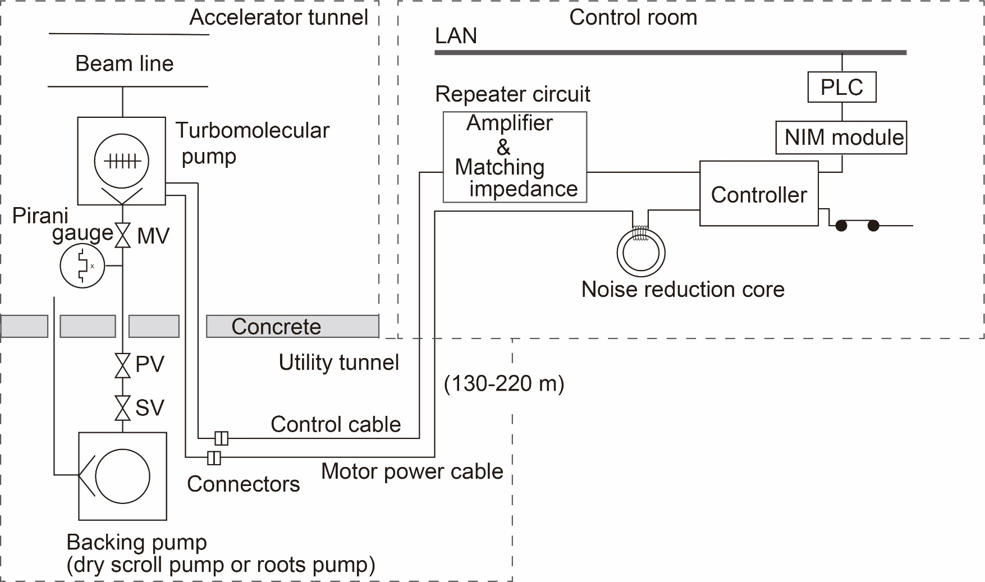
Countermeasure 1: TMP controller with long cable specification
TMP controller was developed, that can use long motor and control cables to install the controller in a distant area where there is no radiation influence.
Maximum cable length:
230 m for vertical mounting
180 m for horizontal mounting

Slide 13
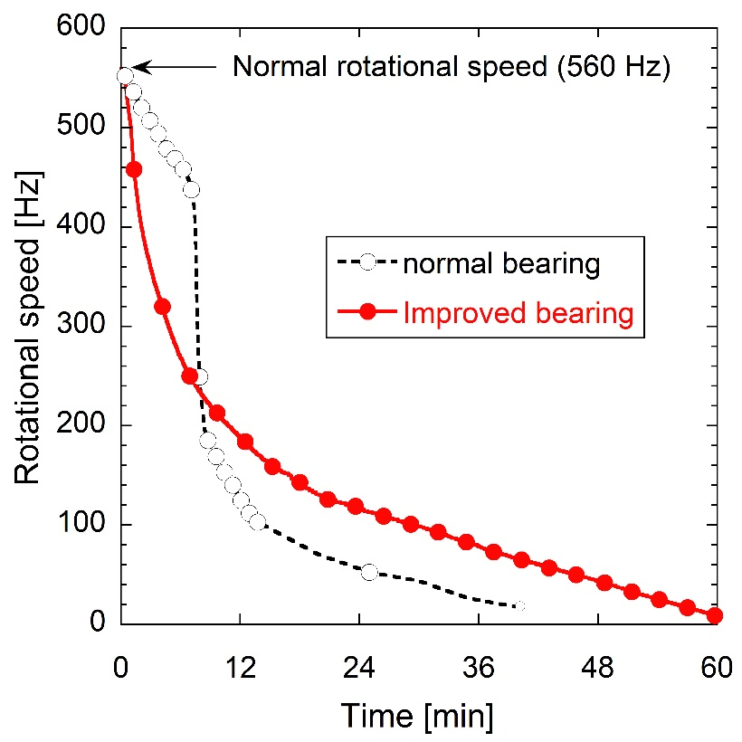
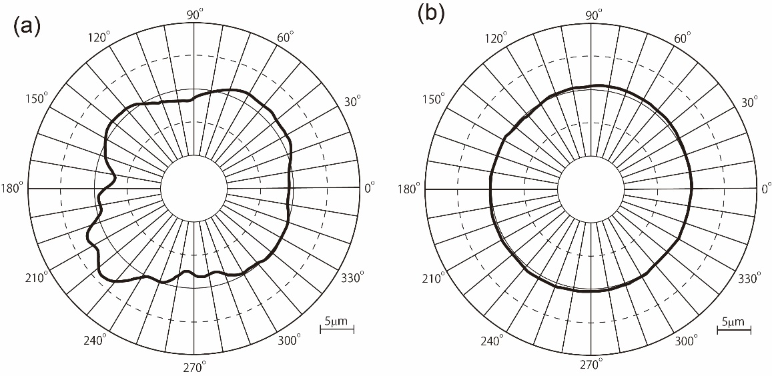
Countermeasure 2: TMP tolerant to FRTD
The number of bearing balls is decreased to prevent contact between the balls.
The ball with a smaller diameter is used to reduce the centrifugal force for decreasing the stress on the outer rail. Besides, the rail shape is changed to increase the contact area for the balls to decrease the stress on the rail.
The rail material is changed from stainless steel to tool steel with a high degree of hardness.
Sudden speed drop occurs due to increase of friction
Change of the rotor rotation speed in the FRTD test
The TMP with the improved bearing can restart after more than four times of FRTD.
Normal bearing
Improved bearing
Roundness distribution of the inner bearing rail after the FRTD test

Slide 14
Dynamic pressure and its effect on the beam loss
Typical pressure increase due to the high power beam operation
Typical relation between the pressure and beam loss monitor signal
Pressure increase during beam operation causes an increase in the beam loss monitor signal, which is an event that stops the operation of the accelerator. Thus, understanding dynamic pressure and countermeasures are important.

Slide 15
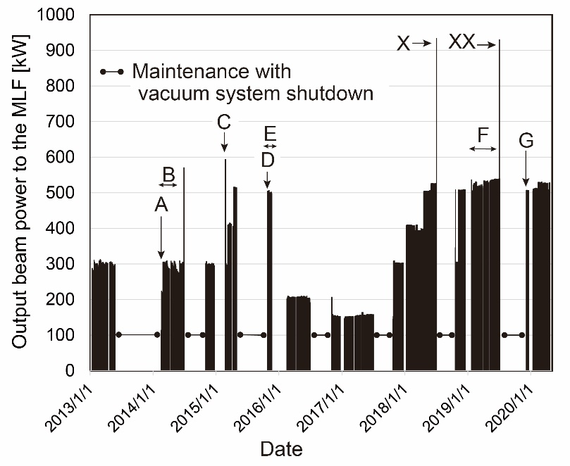
Dynamic pressure 1
After position alignment work of the beamline equipment. The beamlines in all sections have been purged by argon gas and opened to air during the work.
Pressure after vacuum system shutdown for maintenance. A few flanges in some sections (around C06) have been opened to air for a short time.
Pressure after suspension of the beam operation. The beamline has been kept to be evacuated by the TMPs during the suspension.
Pressure after vacuum system shutdown for maintenance. A few flanges in some sections (around C15) have been opened to air for a short time.

Slide 16
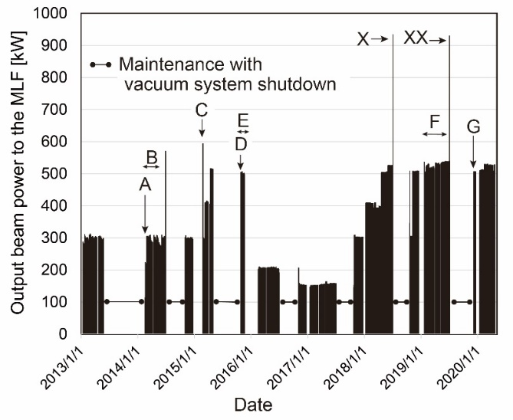
Dynamic pressure 1
Pressure in the 1 MW beam power test. TMP at C25 was not operated due to the touch-down trouble.
Pressure during the user operation.
Pressure after the long term user operation.

Slide 17
Beam power vs. dynamic pressure
The pressure increase is large during beam operation after the beamline maintenance period.
The pressure increase is large when the pumping speed is small.
The pressure increases nonlinearly with increasing beam power.
During continuous beam operation (user operation), a "conditioning effect" is observed, in which the pressure increase gradually decreases.
After opening the entire beamline to the air
After partially opening the beamline to the air
After beam operation shutdown without pump shutdown

Slide 18
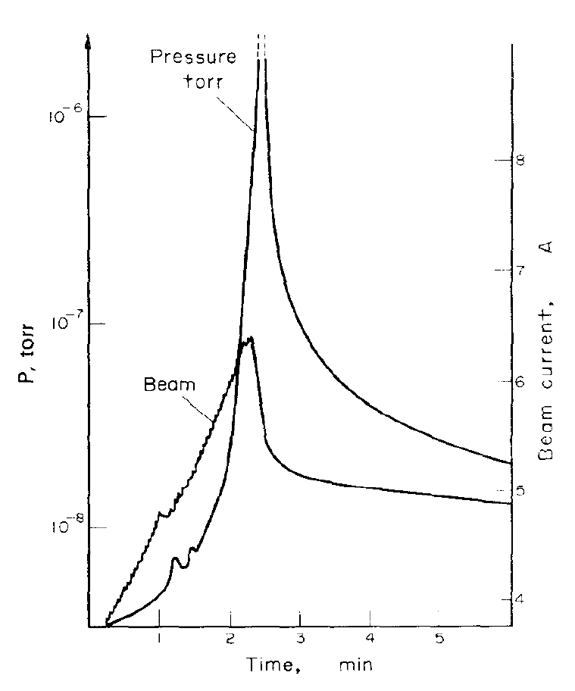
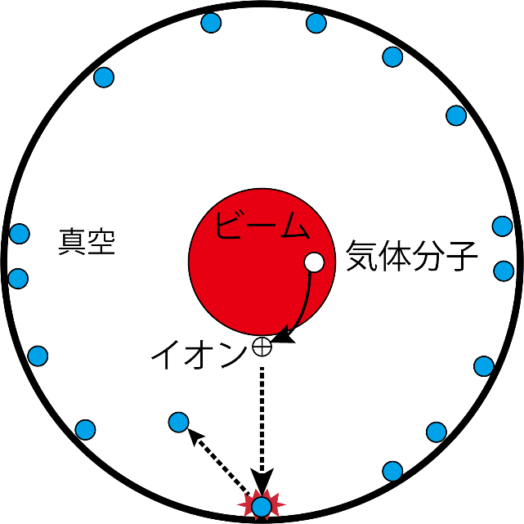
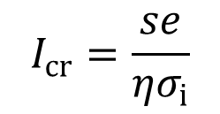
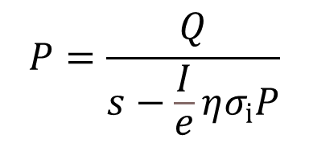
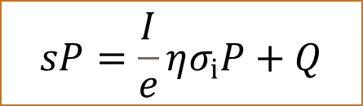
Understanding the dynamic pressure: CERN ISR
Dynamic pressure at CERN Intersecting Storage Rings
Ion stimulated desorption: ISD
$$sP=\frac{I}{e}ησ_{i}P+Q$$
R.S. Calder, Vacuum (1974)
s: pumping speed per unit length [m³ s⁻¹ m⁻¹]
P: pressure [Pa]
I: beam current [A]
e: elementary charge [C]
σ_{i}: ionization cross-section [m²]
η: ISD co-efficient [molec./ion]
Q: outgassing rate per unit length [Pa m³ s⁻¹ m⁻¹]
$$P=\frac{Q}{s−\frac{I}{e}ησ_{i}P}$$
$$I_{cr}=\frac{se}{ησ_{i}}$$
Critical current: P→∞

Slide 19
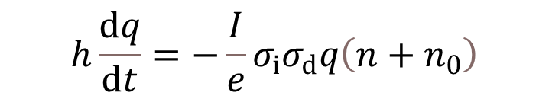
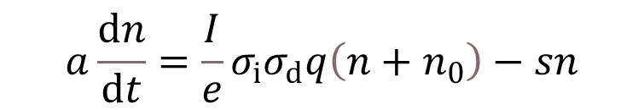
Understanding the dynamic pressure: time dependent model
K. Kanazawa (KEK), Vacuum (2014)
1 MW (2018.7.3)
$$a\frac{dn}{dt}=\frac{I}{e}σ_{i}σ_{d}q\left(n+n_{0}\right)−sn$$
$$h\frac{dq}{dt}=−\frac{I}{e}σ_{i}σ_{d}q\left(n+n_{0}\right)$$
Introduction of η= σ_{d}×q
σ_{d}: ISD cross-section [m²]
q: absorbed molecules per unit area [m⁻²]
a: cross-section of beam pipe [m²]
h: circumferential length of the beam pipe cross-section [m]
n₀: initial density of the gas phase molecules [m⁻³]
n: density of the gas phase molecules [m⁻³]
Variable in this analysis
500 kW (2019.12.6)

Slide 20
Beam power vs. dynamic pressure: analysis
s: pumping speed per unit length [m3 s-1 m-1]
q: absorbed molecules per unit area [m⁻²]
[m³ s⁻¹ m⁻¹], [m⁻³]
Present pumping speed
Converted beam power from I_{cr}
Large s and small q are necessary for dynamic pressure suppression.

Slide 21
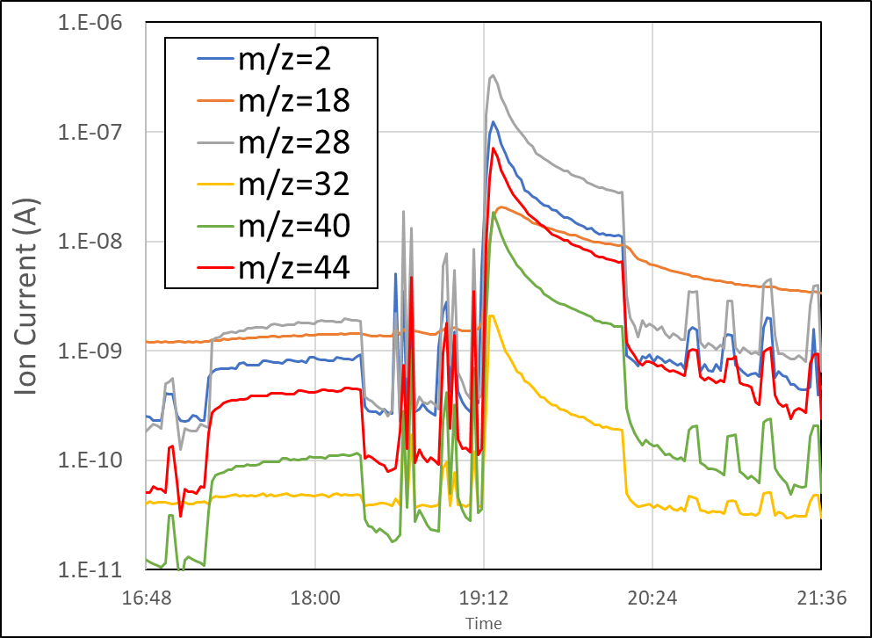
Dynamic pressure suppression
Increase of s by additional pumps:
NEG pumps with high pumping rates for CO
and H₂, which are main gas generated during
beam operation were selected.
Suppression of q increase:
Even if the TMP is stopped during maintenance, the NEG pump can maintain a good vacuum in the beamline (*in the case that the beamline is not opened to the atmosphere)
Additional NEG pumps
Residual gas in the beam operation
(unused)
CapaciTorr D(or Z) 3500
Pumping Speed (l/s): H₂ 3500, H₂O 2600, N2 900, CO 1600

Slide 22
Effect of NEG pumps: s increase
Molflow+ model
Install of NEG
Lower beamline pressure was achieved

Slide 23
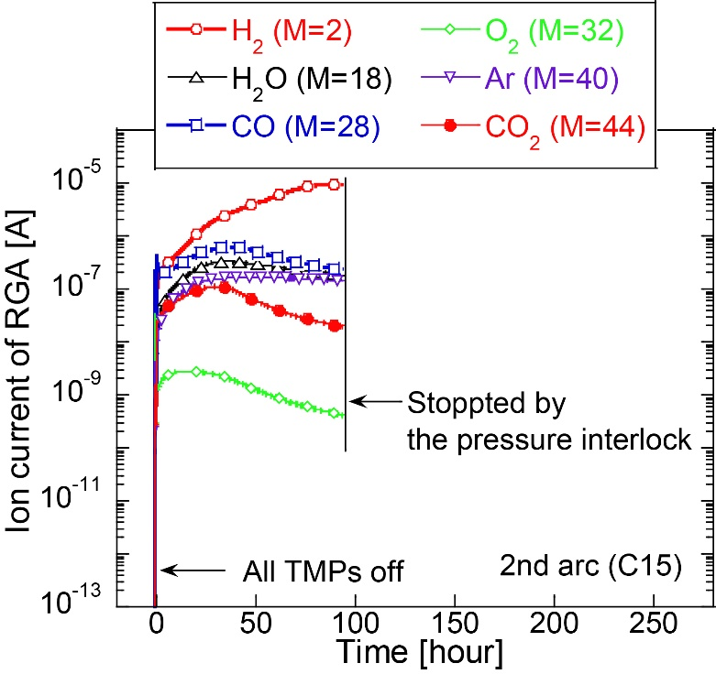
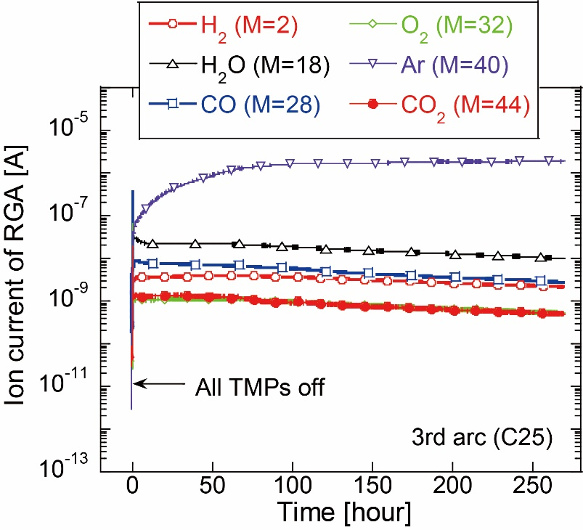
Effect of NEG pumps: q suppression
Without NEG
With NEG
Without NEG
With NEG
Lower build-up pressure
→Suppression of q increase during TMP off in the shutdown period

Slide 24
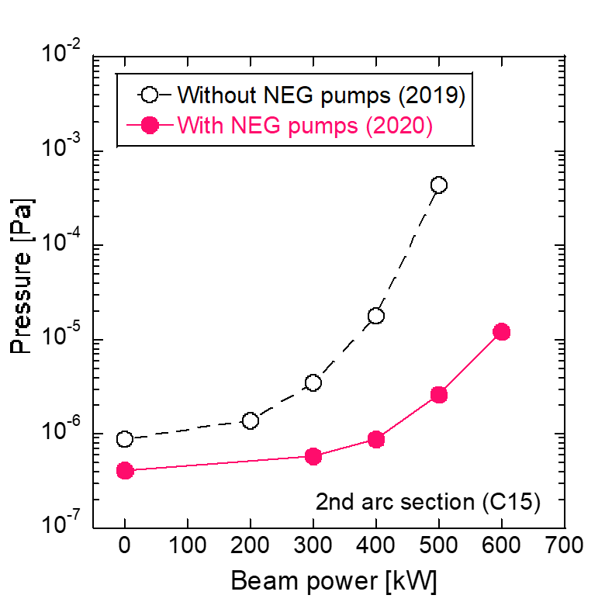
Dynamic pressure suppression
Dynamic pressure is suppressed by the additional NEG pumps.

Slide 25
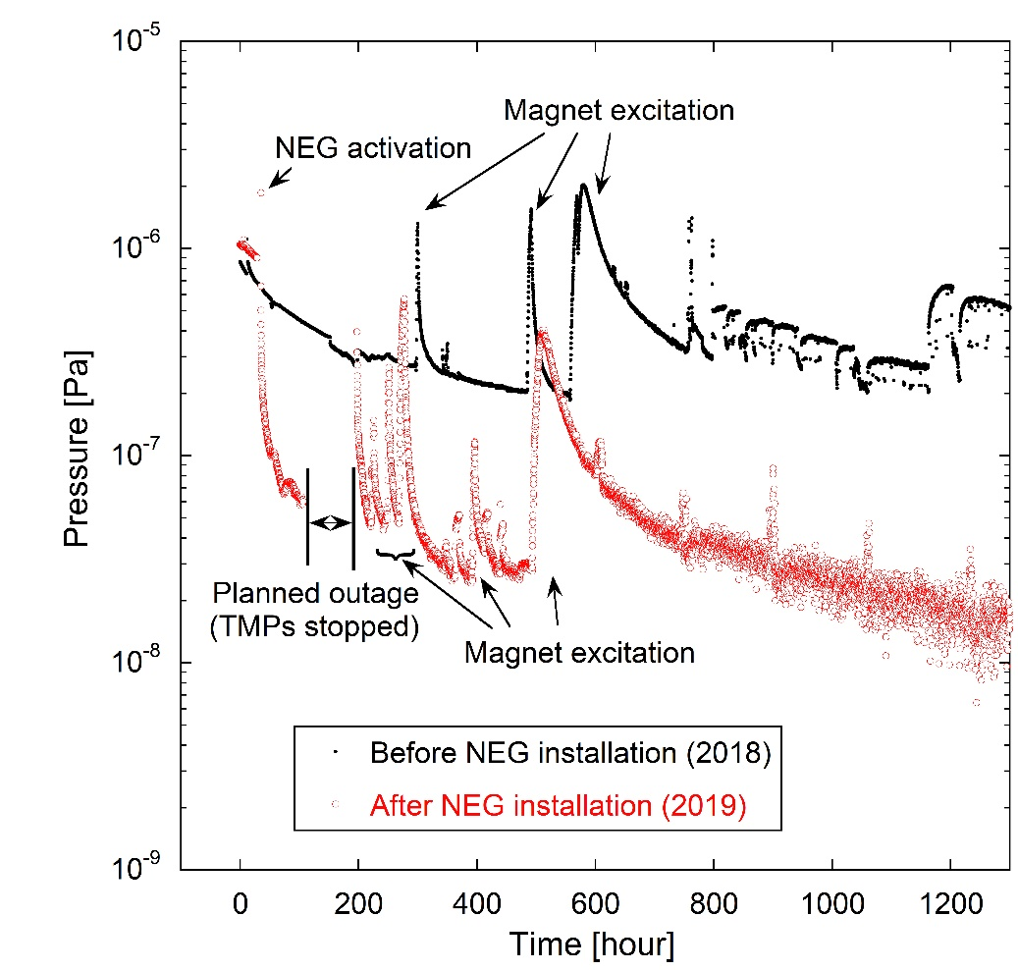
Pumping curve
10⁻⁸ Pa order is immediately obtained by activating the NEG pump.
10⁻⁸ Pa order is easily recovered from the vacuum system shutdown due to the planned outage.

Slide 26
Summary
The events beyond the design assumptions of the vacuum system have occurred in the high-power beam operation in the RCS in J-PARC.
  The failure of the TMP system
  Dynamic pressure
The new TMP controller with more than 200 m cables and TMP with FRTD tolerability has been developed.
The dynamic pressure has been caused by ISD.
NEG pumps were additionally installed and showed the effectiveness.

Slide 27
Thank you for your attention

