Slide 1
Overview and Status of ALS-U Project Vacuum Systems
Sol Omolayo
April 15th, 2024

Slide 2
Outline
ALS-U Project Overview
ALS-U Vacuum System Scope and Status
NEG Coating Development Status

Slide 3
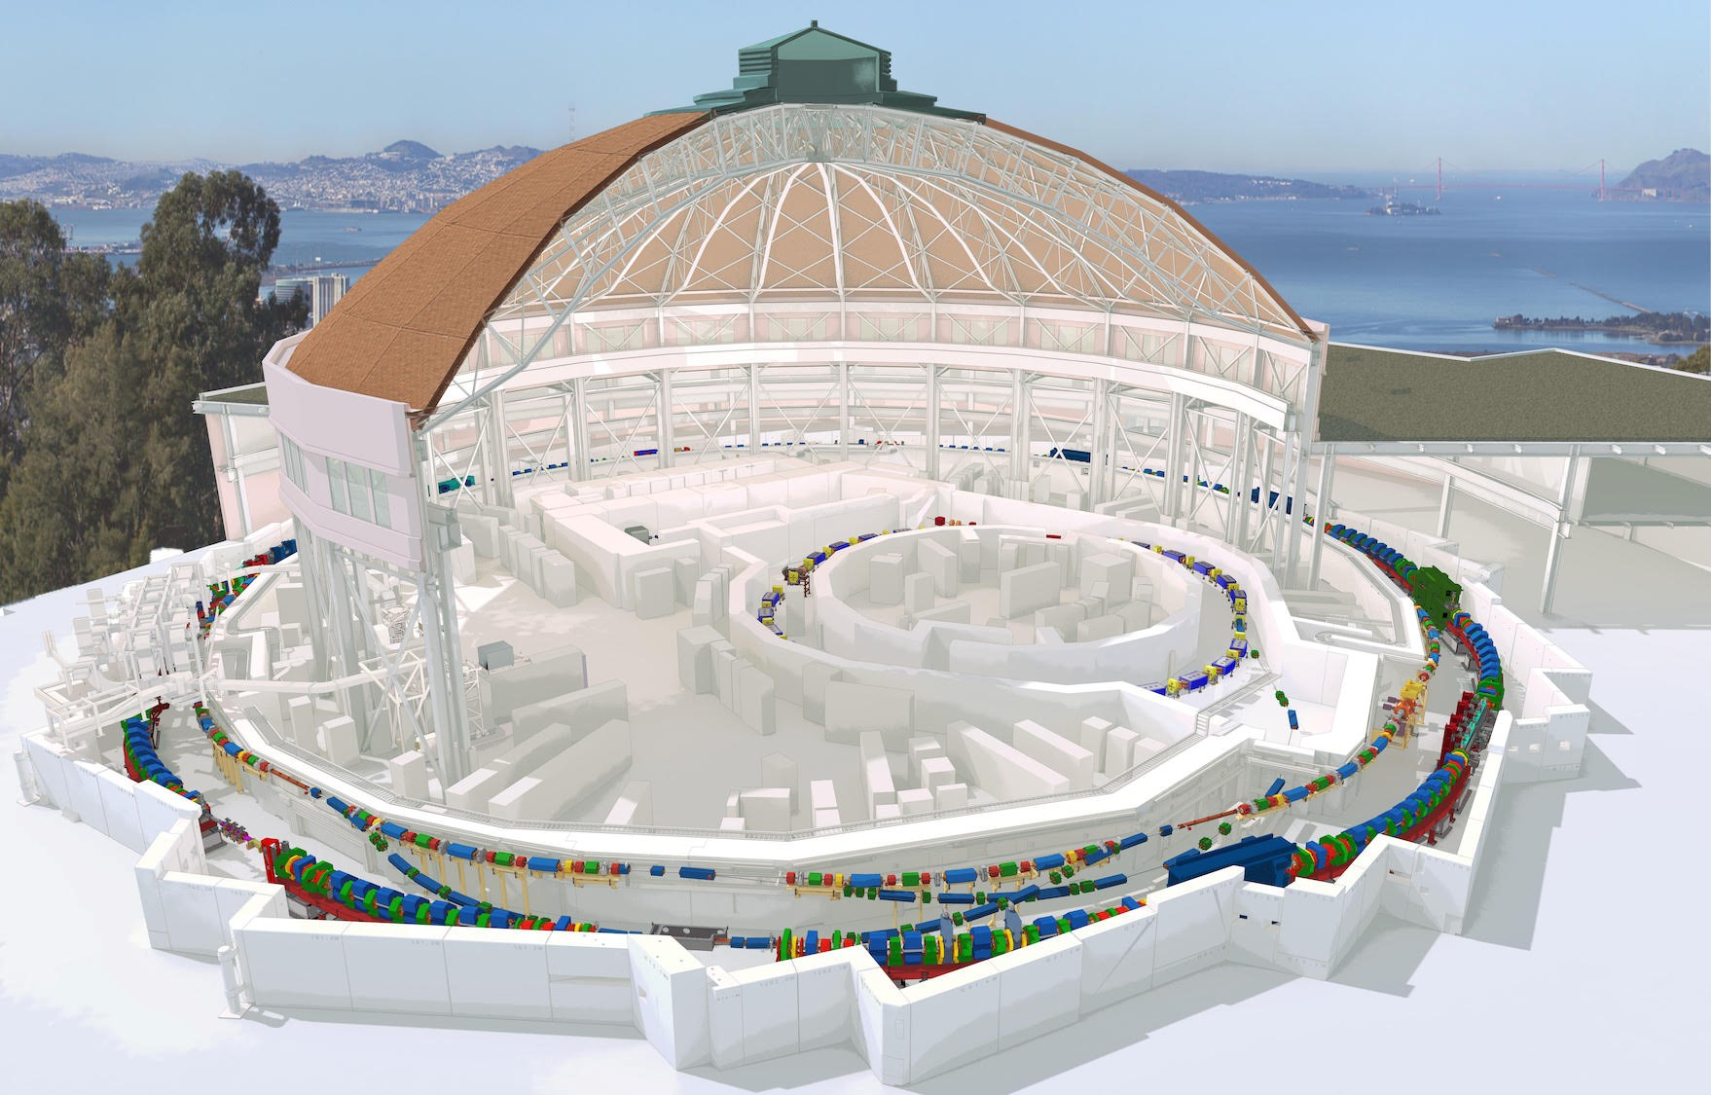
Advanced Light Source Upgrade at LBNL
Project Launch
2016
2018
Conceptual Design
2021
Preliminary Design
2022
Final Design
Accumulator Ring
(AR)
2023
AR Install
Dark time
(SR Install)
2026
Storage Ring
(SR)

Slide 4
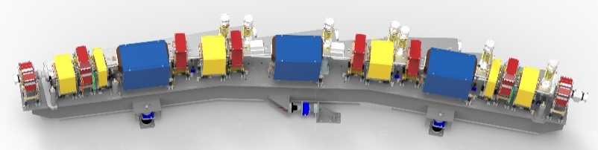
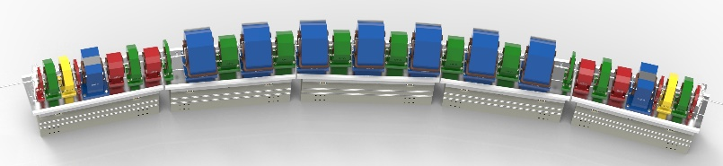
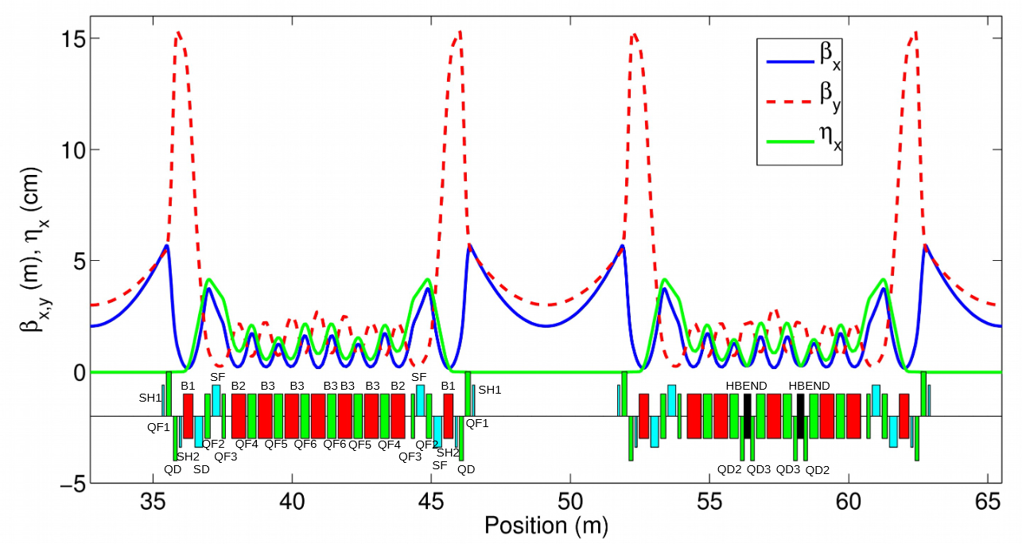
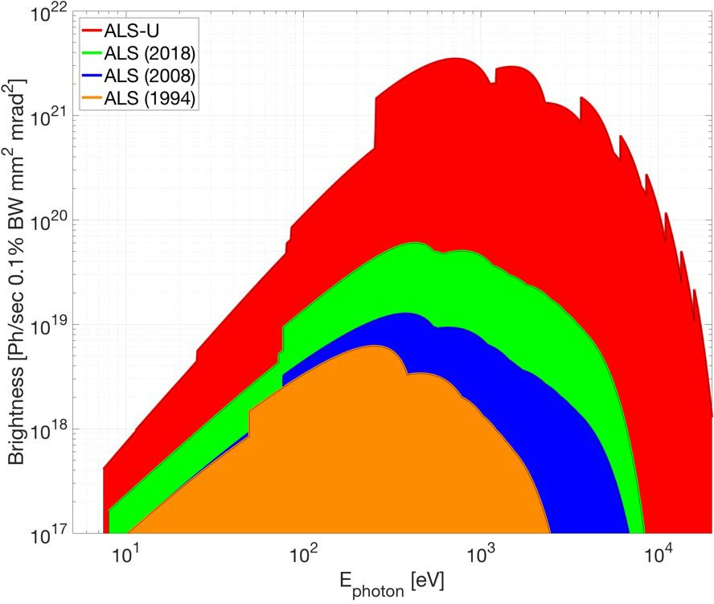
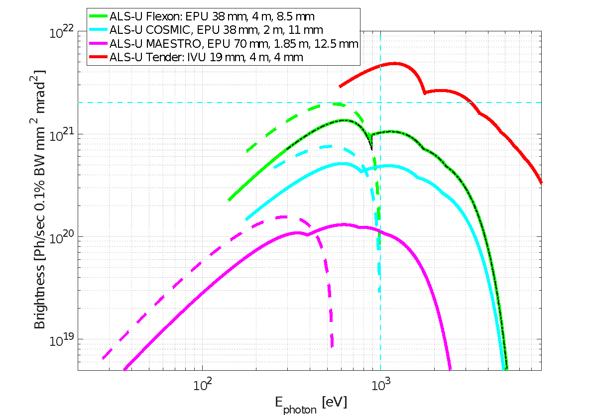
ALS-U Project: Motivation – Lower Emittance & Higher Brightness
Storage Ring Parameters | Value
Electron energy | 2.0 GeV
Average current | 500mA
Bunch Length (FWHM) | 110 ps
Total lifetime | >0.5h
Circumference | 196.510 m
ALS today : triple-bend achromat
ALS-U: nine-bend achromat with reverse bends
ALS-U 2028
71
ALS 1994
Large increase in coherent fraction due to lower emittance and smaller β-functions

Slide 5
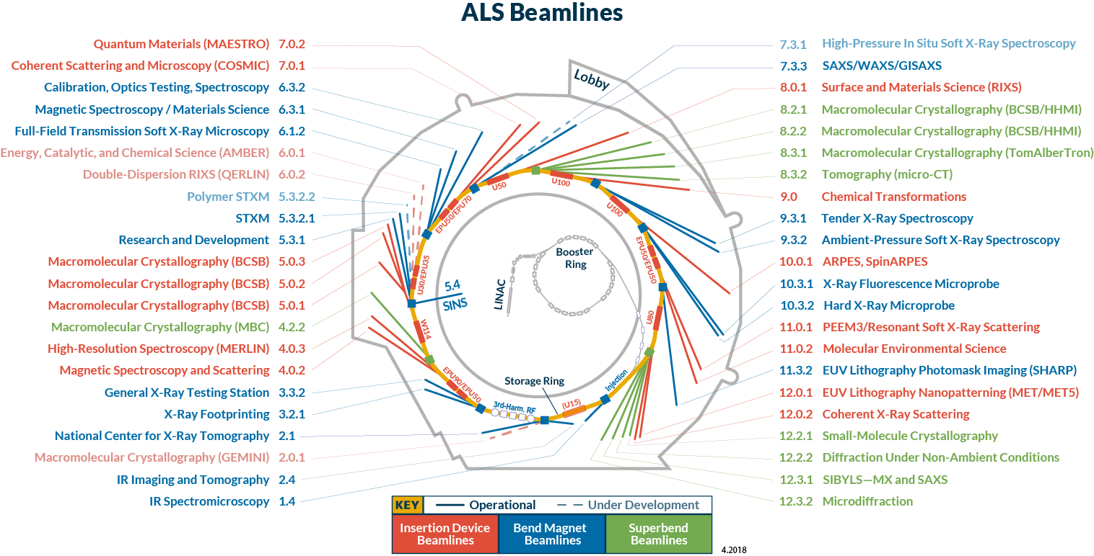
Enabling new science frontiers
Quantum Materials Research & Discovery
Multiscale Structure & Dynamics
Chemical Transformations
Earth, Environment & Biological Systems
Instrumentation Science
40 beamlines
2,100+ users/year
950+ pubs/year
20% in high-impact
journals
Infrared
VUV
Soft
Tender
Hard

Slide 6
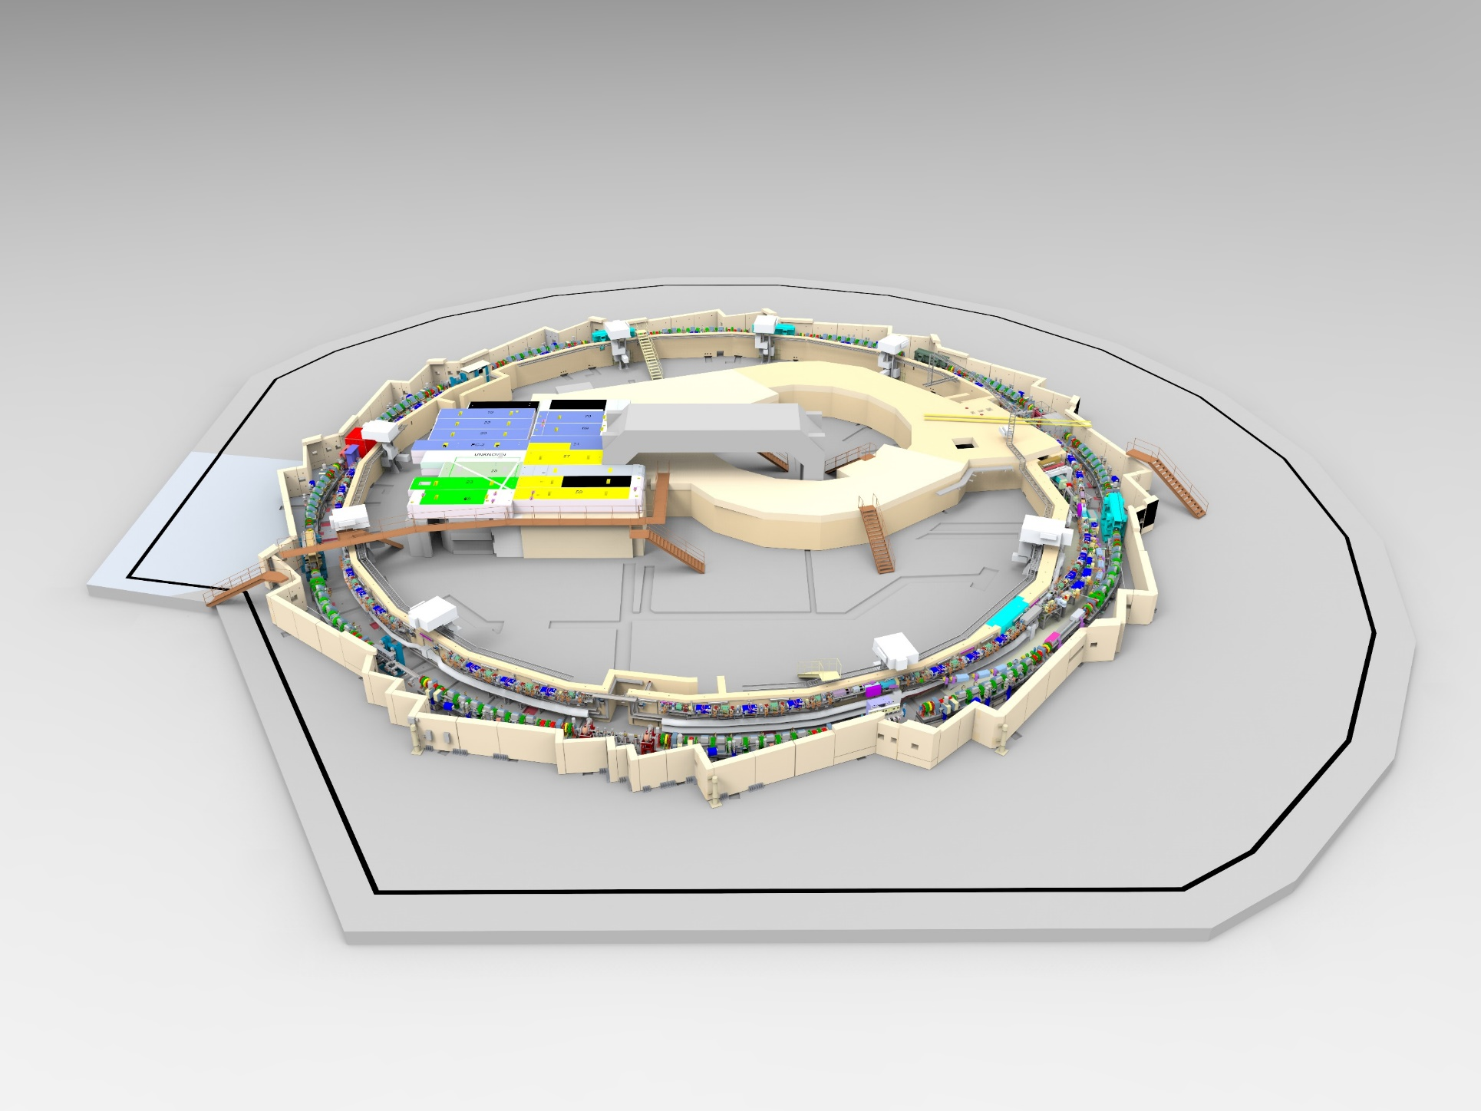
ALS-U Vacuum System Scope
BTA – Booster to Accumulator ring
ATS - Accumulator to Storage Ring
STA - Storage Ring to Accumulator Ring
Design, procurement and assembly of vacuum systems and components for the AR, BTA, SR, ATS and STA
Dynamic Pressures
  AR < 1e-8 Torr
  BTA, ATS, STA < 5e-8Torr
  SR <5e-9 Torr
Booster
ATS
STA
AR
BTA
SR

Slide 7
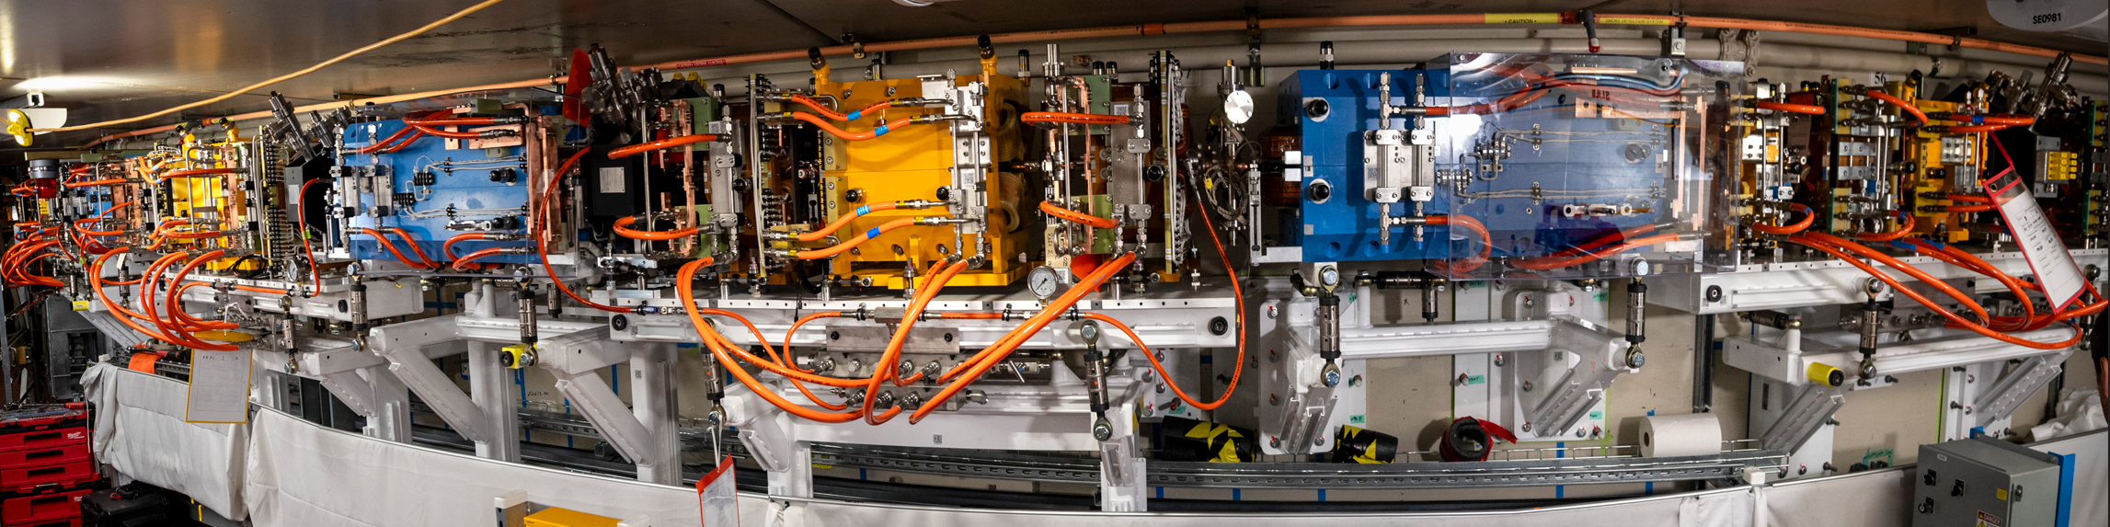
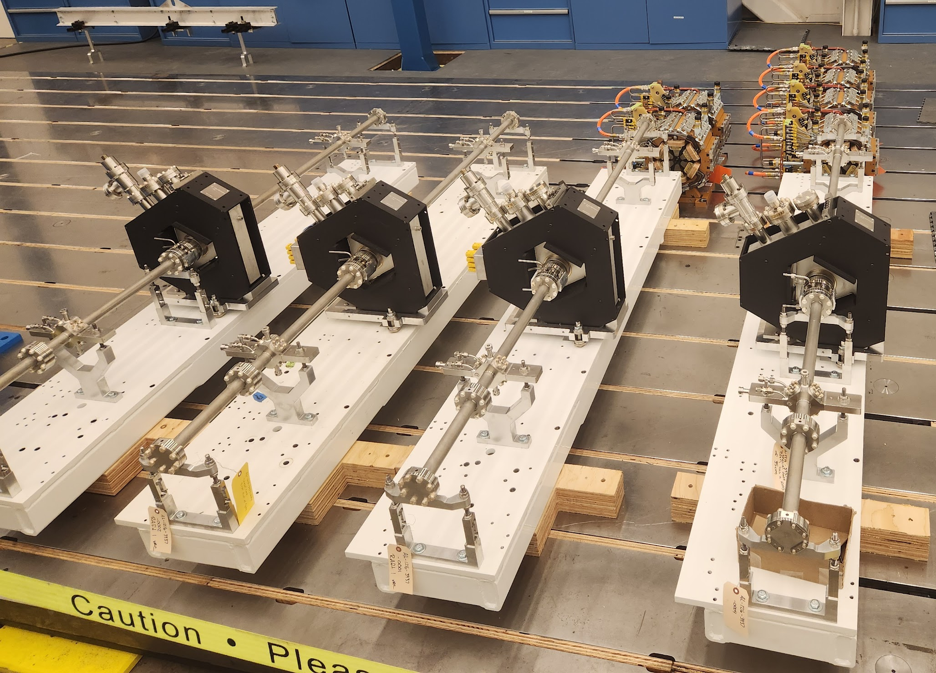
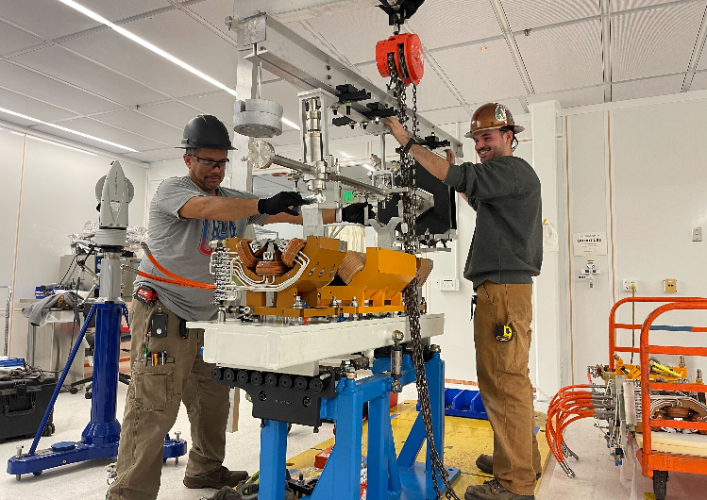
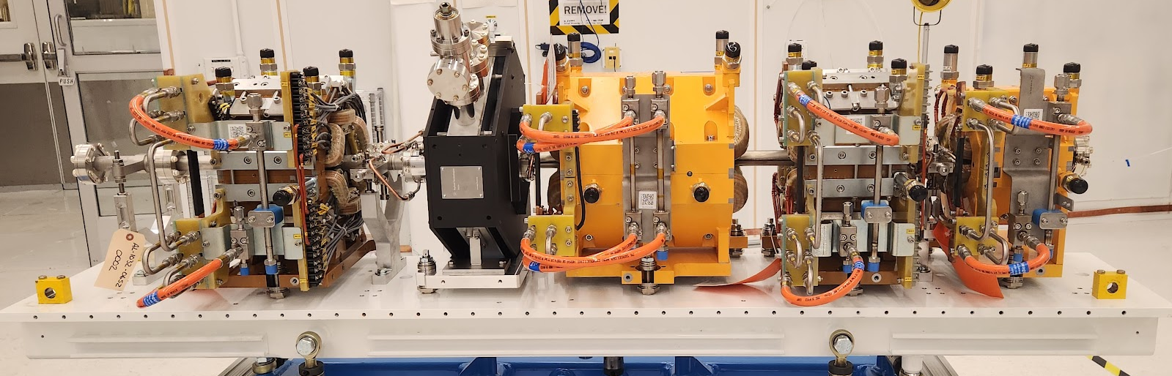
AR Assembly and Installation
84 Arc Modules
12 Straights
Modular
Pre-assembly
Installation
Commissioning
Component QA
Component
Pre-assembly

Slide 8
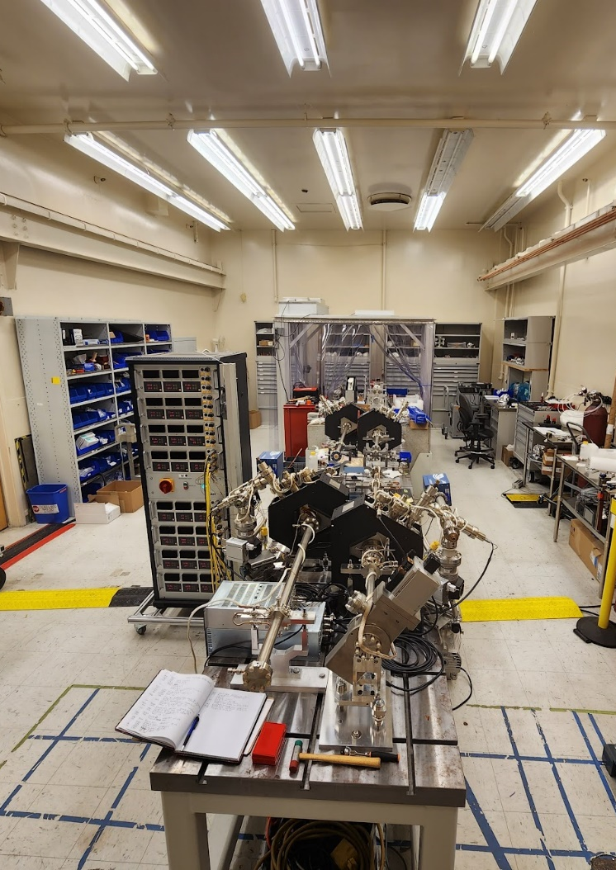
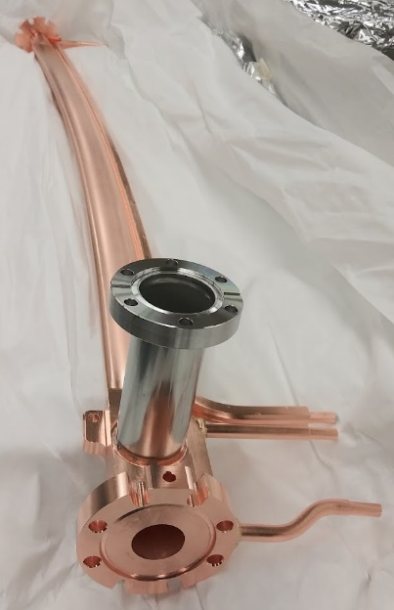
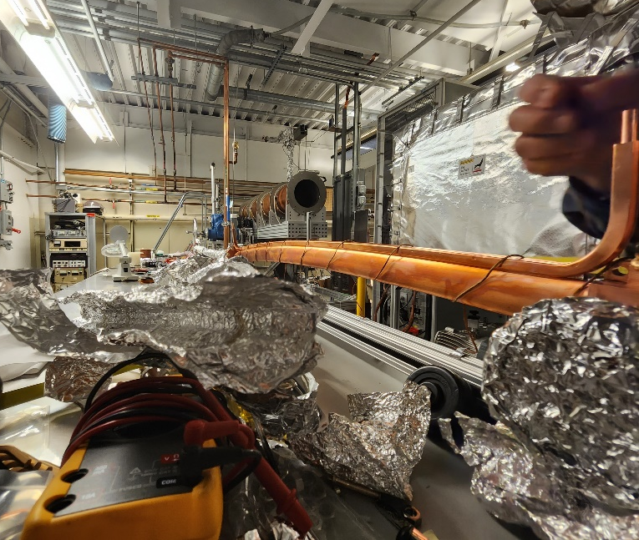
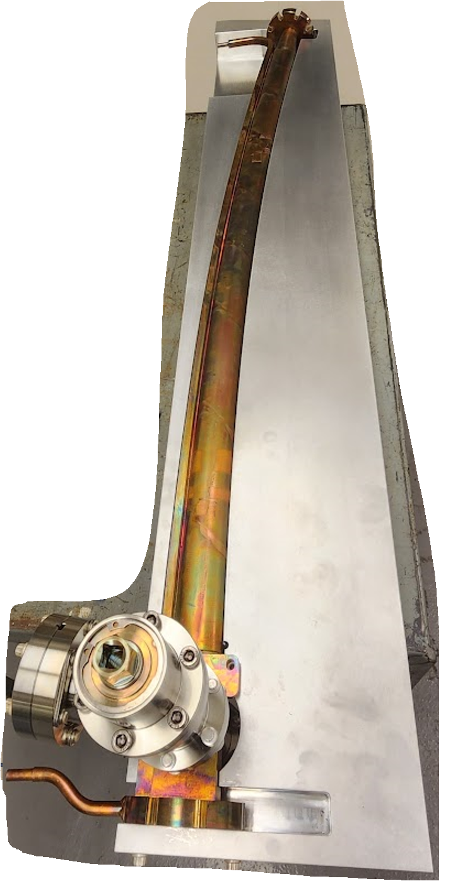
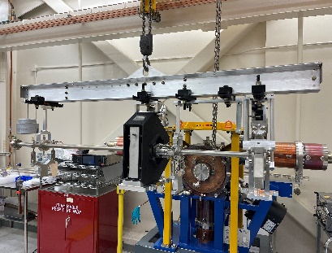
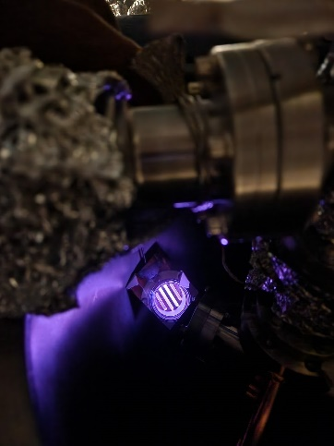
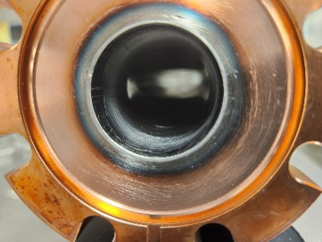
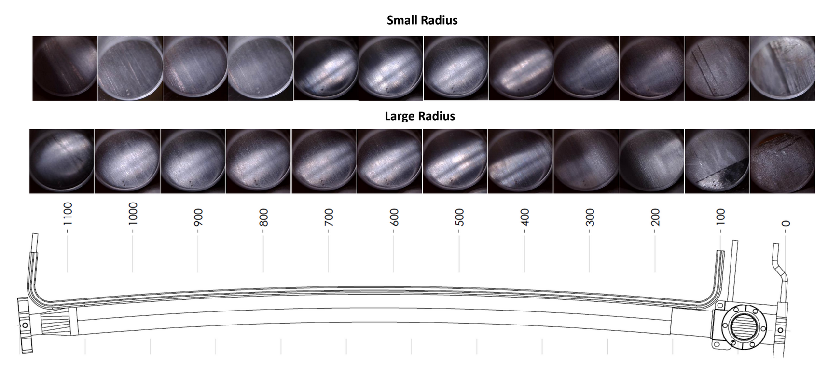
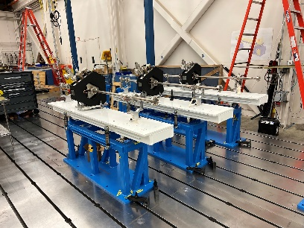
AR Vacuum System On-site Assembly and Production
Raft Vacuum Production
Dipole Production
Vacuum
Diagnostics
S&A
Pre-staging
Leak checking and pre-assembly
Assemble
BPM measurement
Alignment
Leak check
Prep for bakeout
Bakeout – 4days
Prep for removal
Stress relieving and Inspection
Leak check and cleaning
Prep NEG coating
Go-no-go gauge
Bakeout controller
4 x Raft 4s
Liftoff
Pre-staging
NEG coating
NEG Inspection
Assembly Table

Slide 9
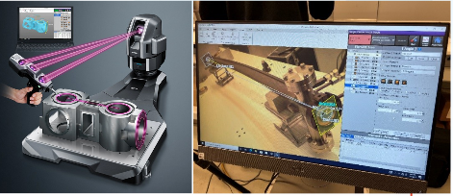
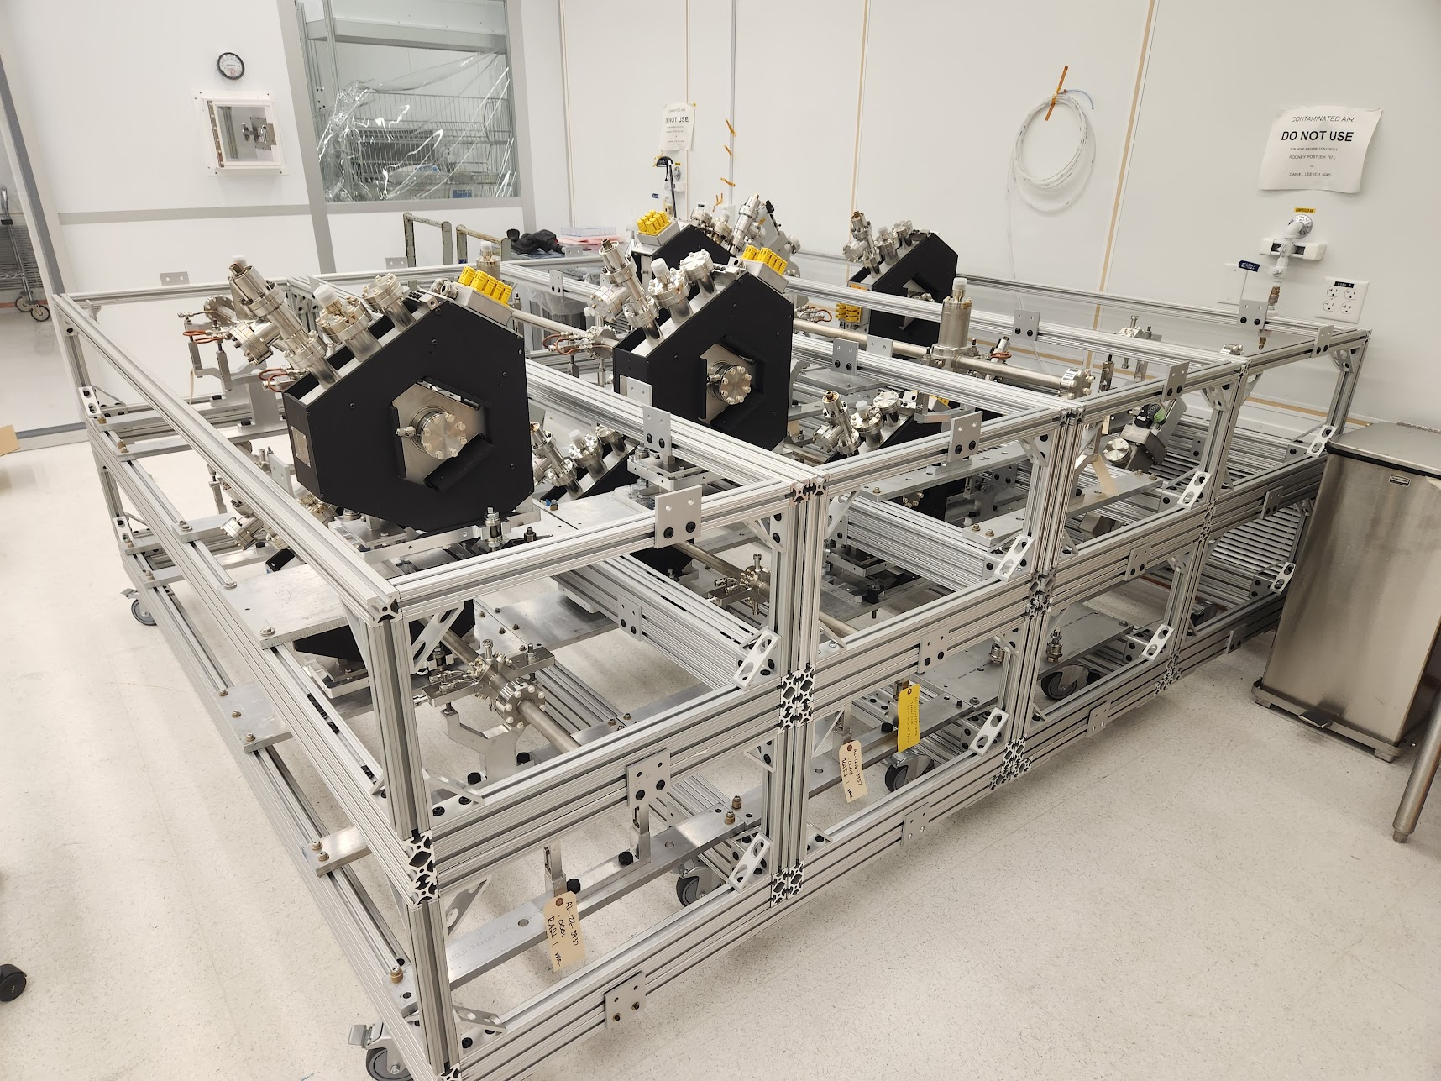
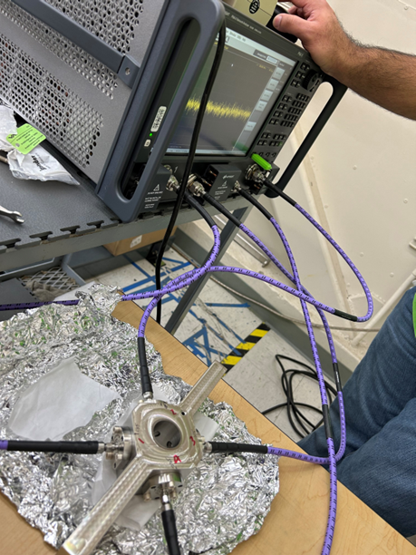
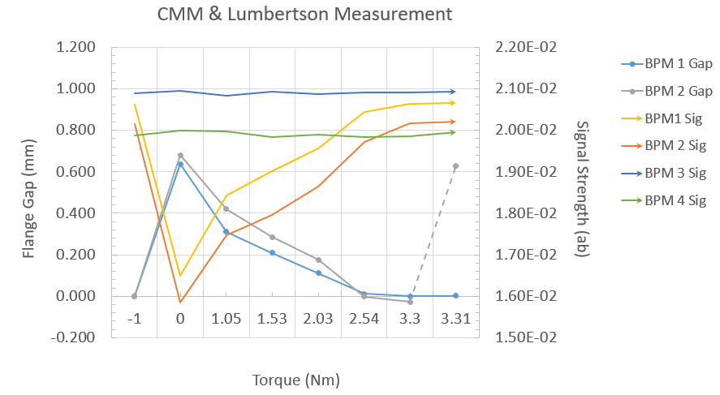
AR Vacuum System On-site Assembly and Production
High Density Vacuum Module Storage
Portable CMM dedicated to vacuum use
BPM Performance Tuning using Vacuum Flanges

Slide 10
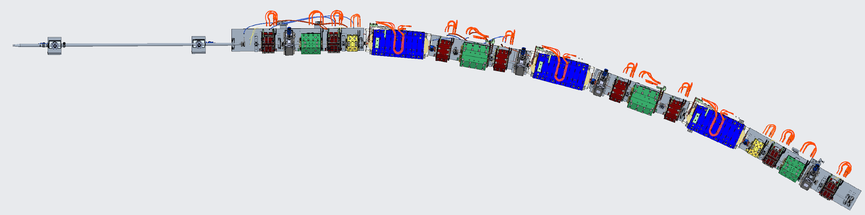
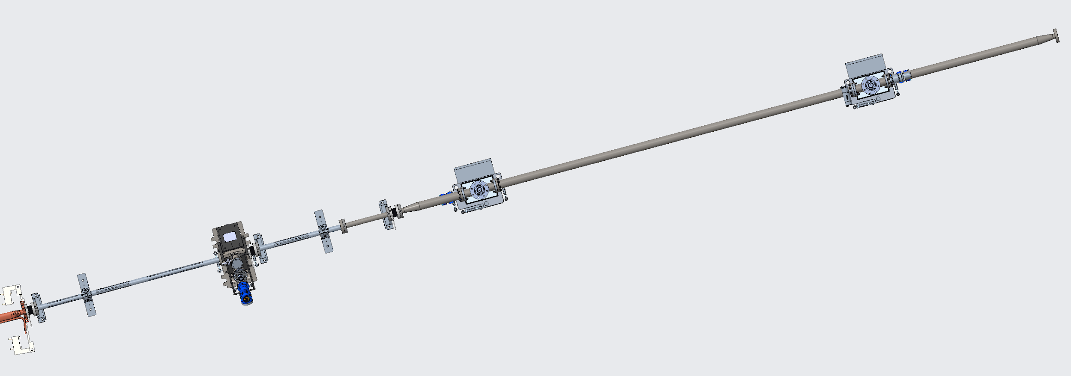
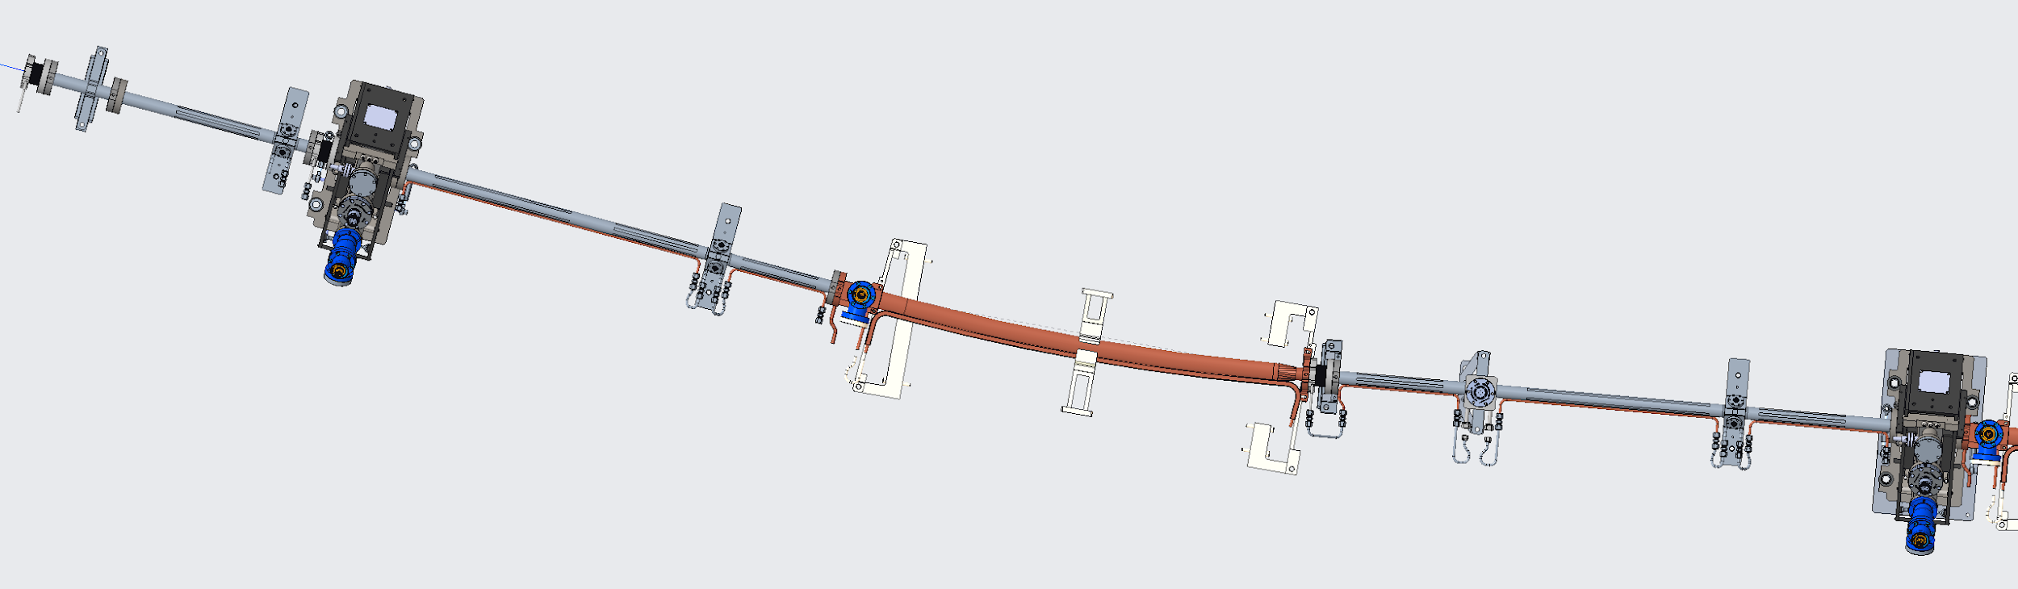
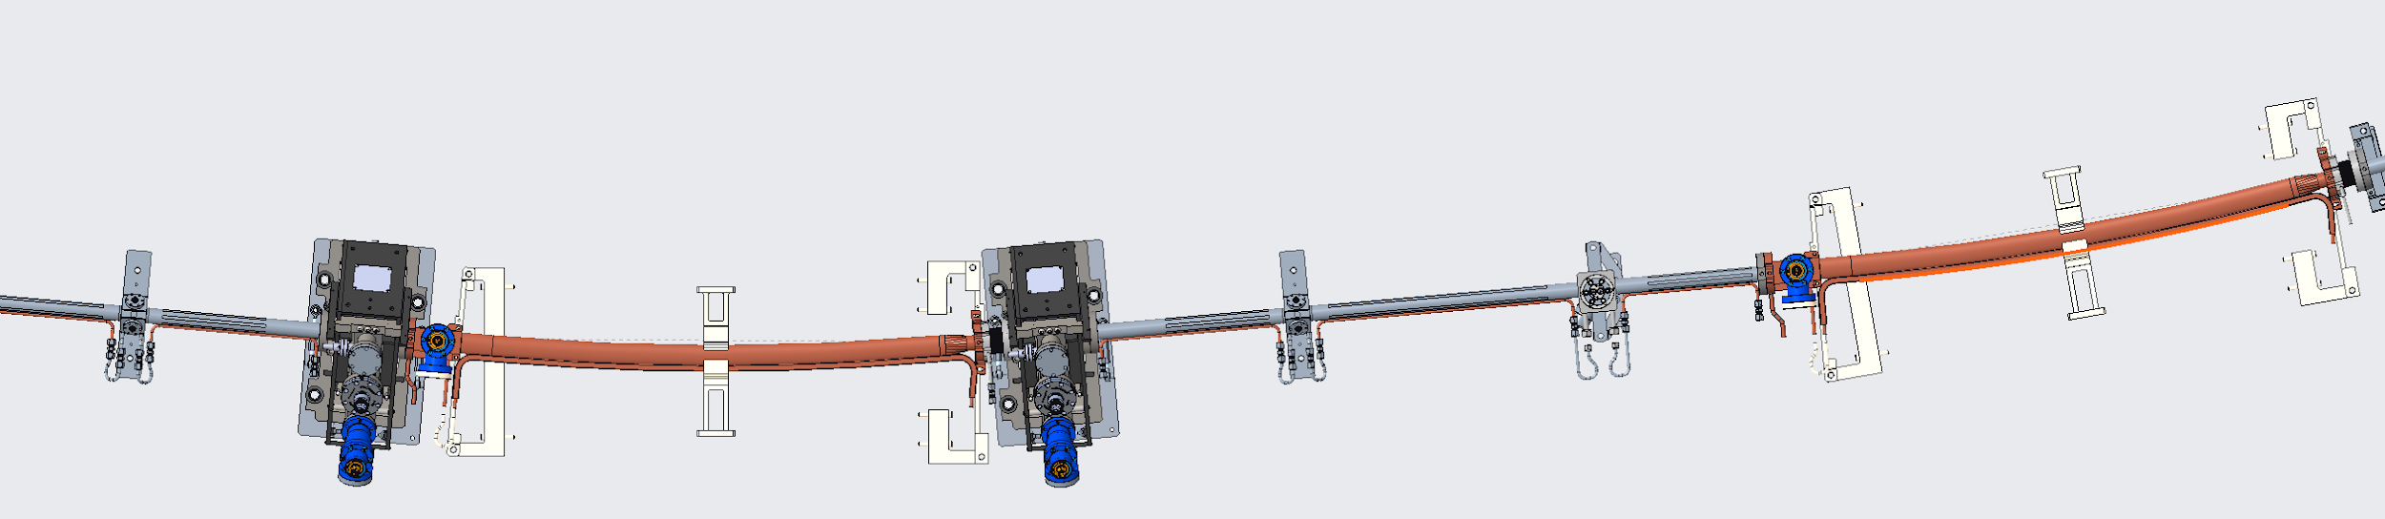
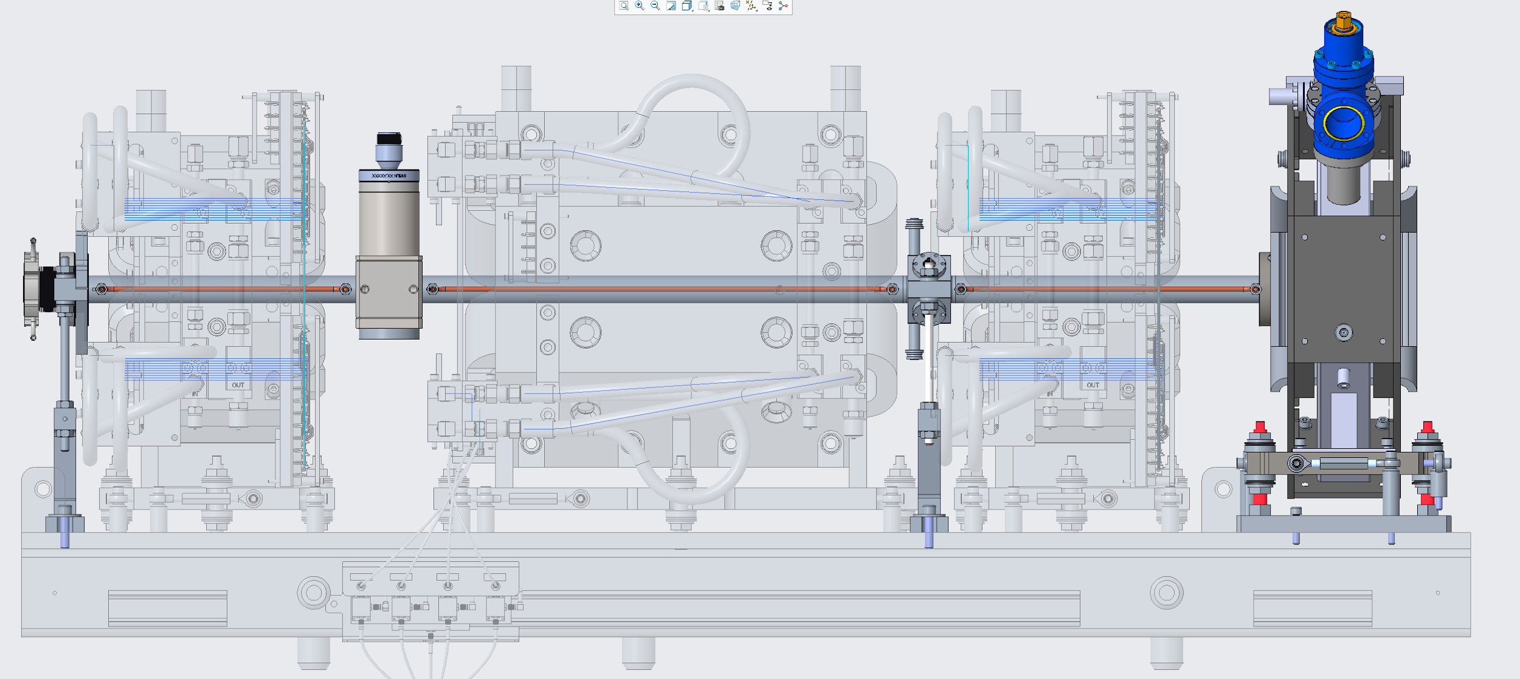
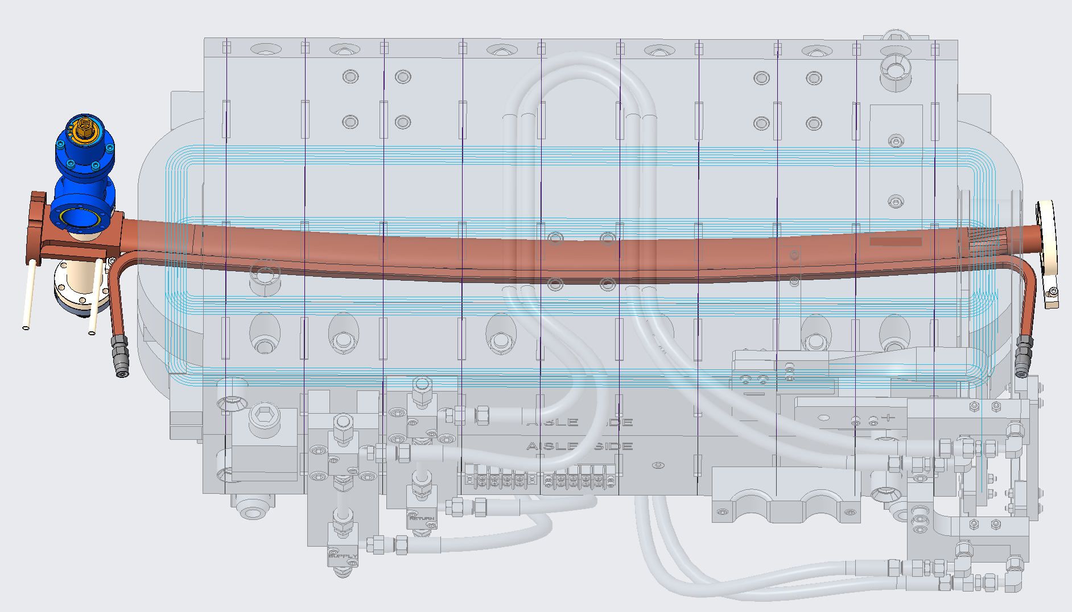
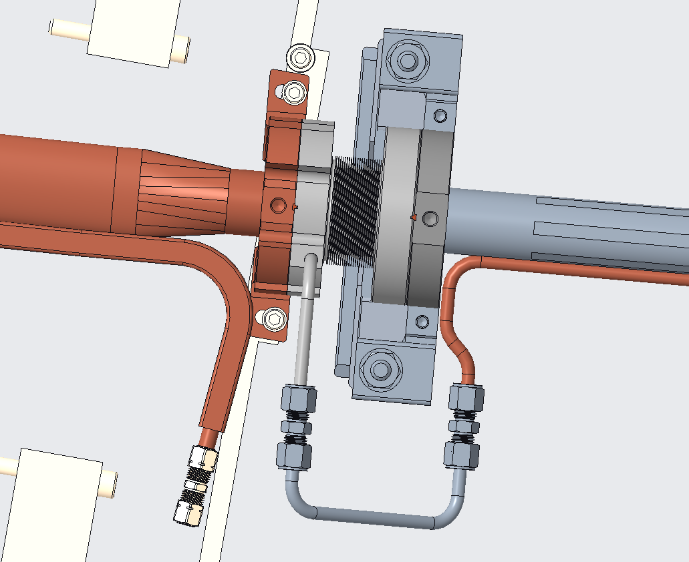
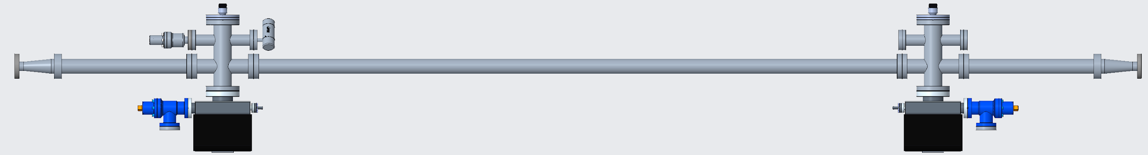
AR Sector Vacuum Layout
3 x Vacuum Assembly Types
Multipole Chamber Assembly
Dipole Chamber Assembly
Standard Straight Assembly
Raft#4
Beam Direction
Raft#1
Raft#3
Raft#2
Vacuum + Magnets
Vacuum Only
4 x In-line Ion Pump
9 x NEG Cartridges
6 x BPMs
7 x RF Bellows
Multipole Chamber Assemblies
Dipole Chamber
Standard Straights

Slide 11
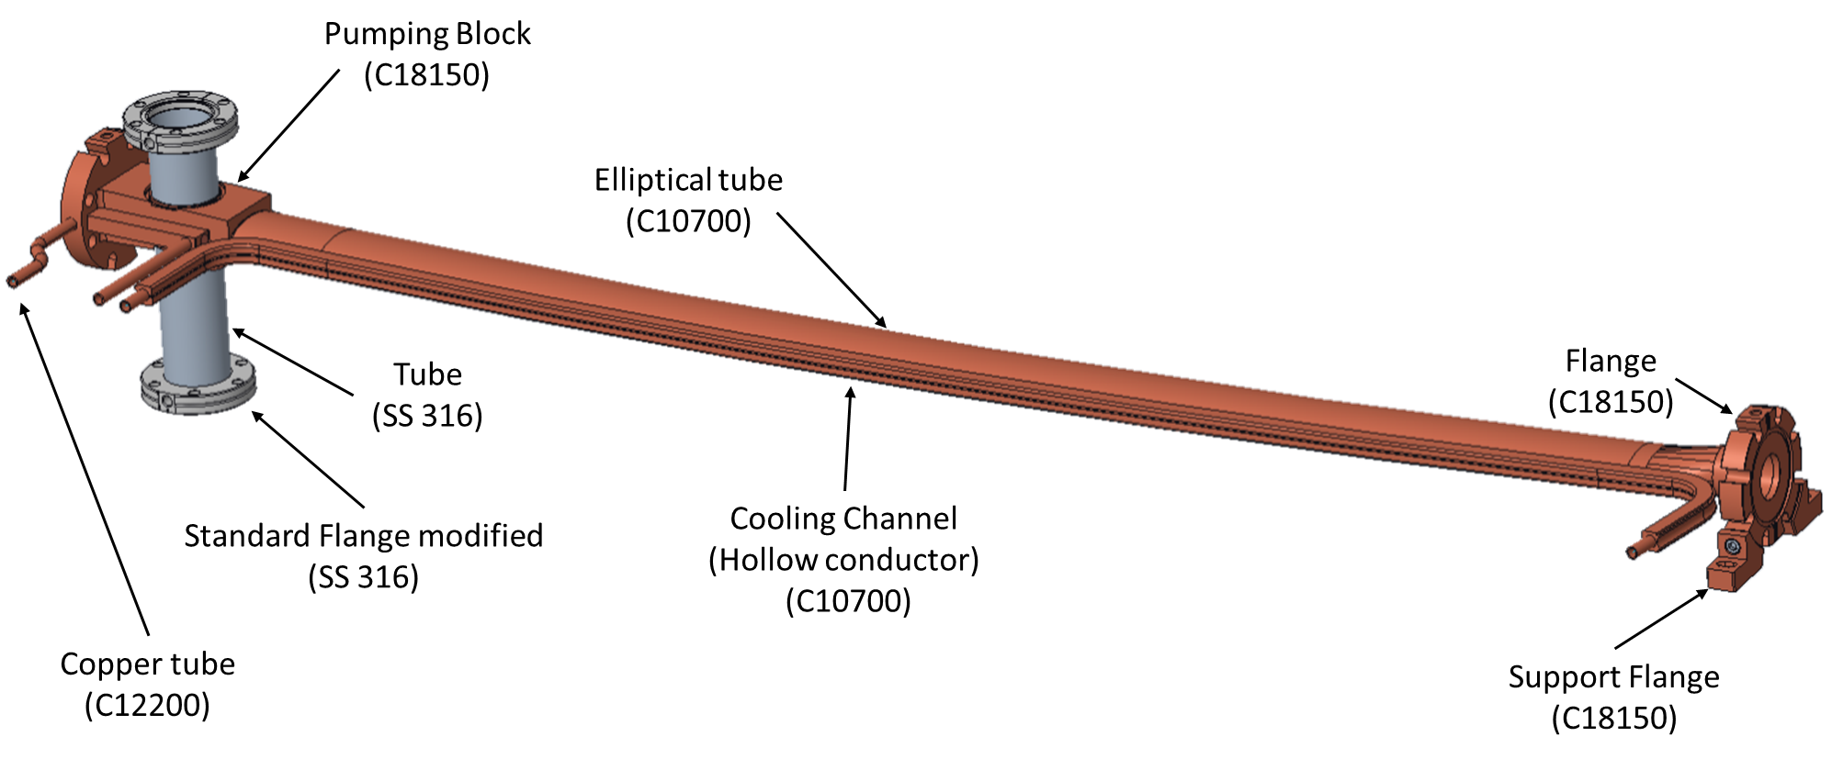
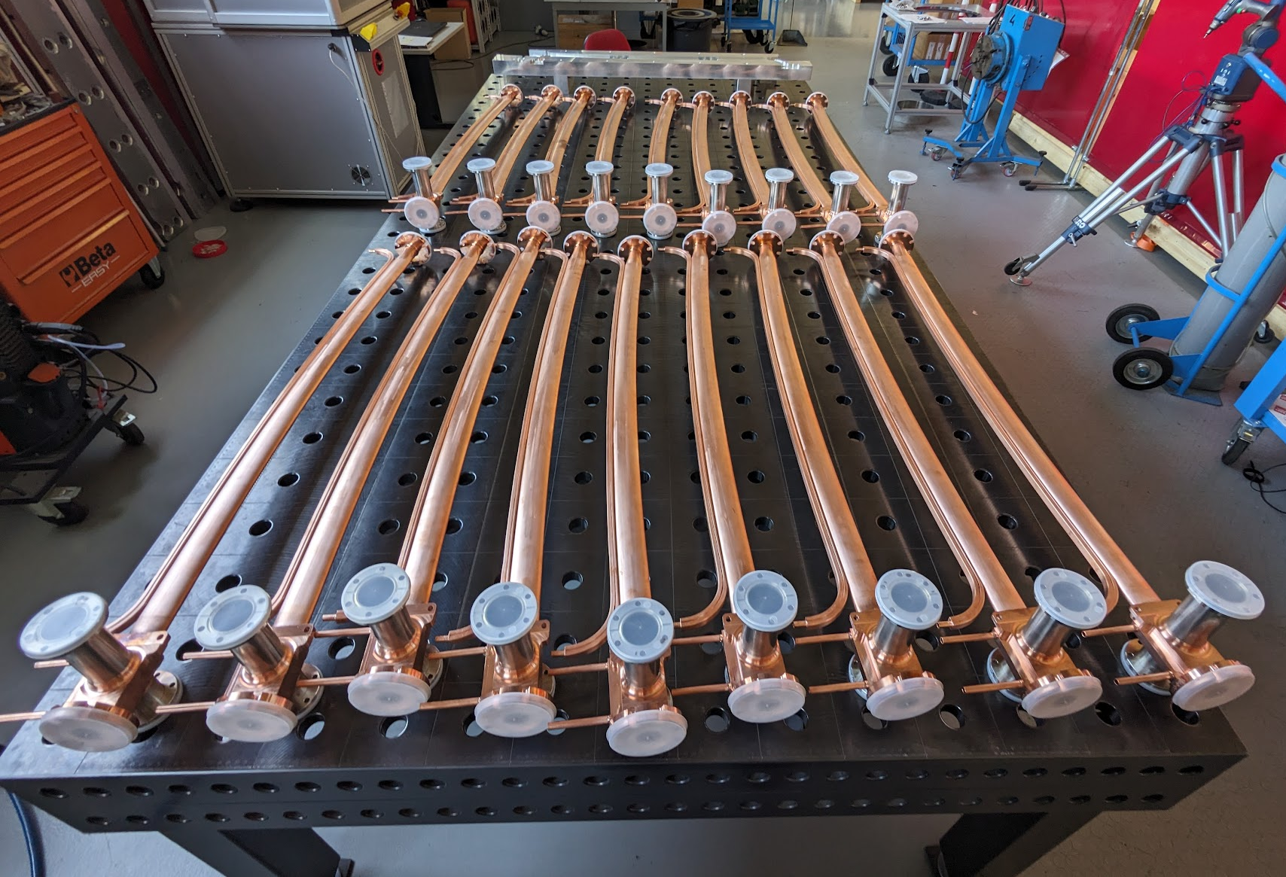
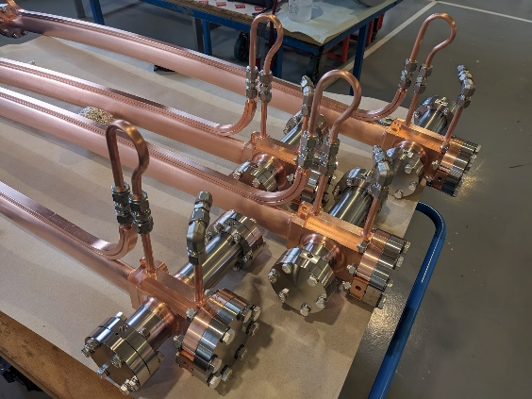
ALS-U AR Vacuum System Production
AR Vacuum systems in numbers
  1,152 vacuum components on AR (excl vacuum supports & electrical), 95% delivered
  494 awards (66>$10k) totaling $10M
  AR vacuum volume 384 liters.
  AR vacuum pumping 24k l/s H2, 10k l/s CO
  AR vacuum has 8,640 fasteners (excl vacuum supports)
Major outstanding item is AR dipole chamber
  2 parallel production paths (vendor, in-house)
  2 x first article received one from each production path
  4 production chambers expected this month
AR Dipole Design
Tube forming
EDM machining
Cu/SS Tig welding
Ebeam welding
NEG Coating
AR Dipole Production (Vendor)
ALS-U Project | OLAV-VI Workshop| April 16th 2024

Slide 12
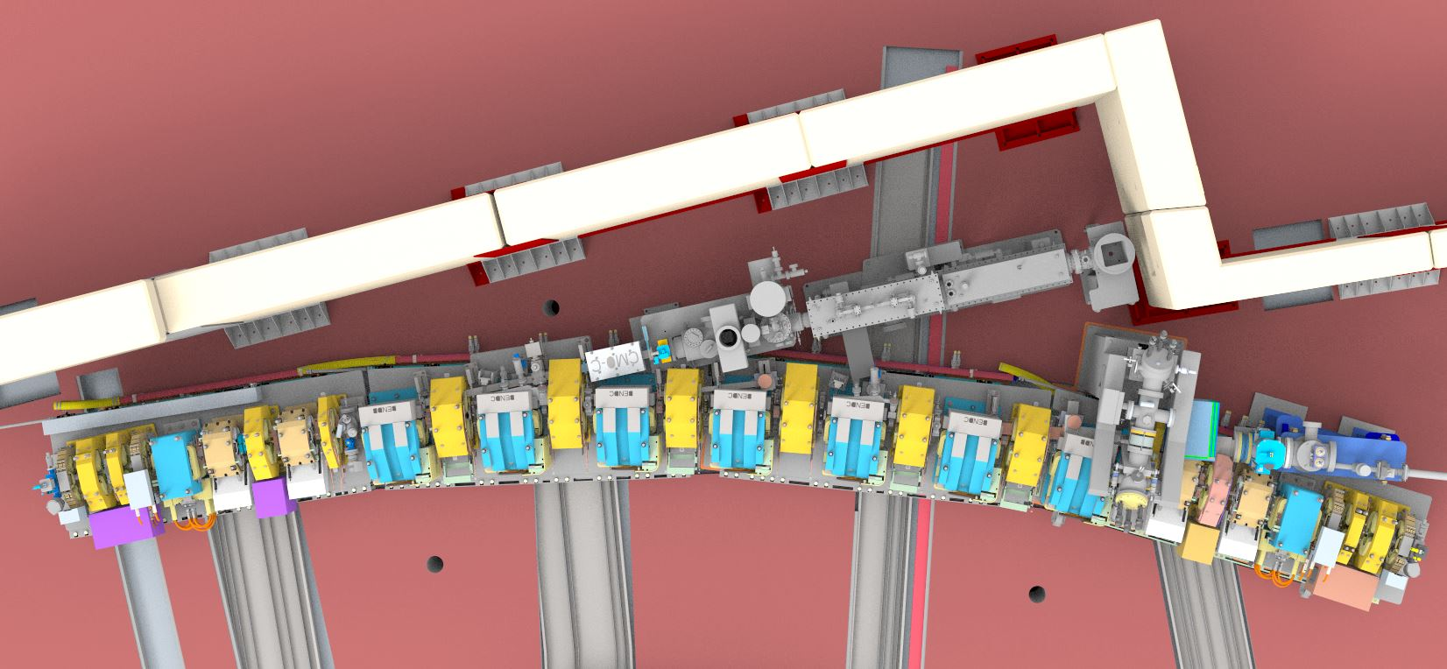
Storage Ring Sector Layout – Sector 5
First frontend gate valve
Photon Transport Line
Beamline
Vacuum
Beamline 5.0
Storage Ring
Vacuum
Sector Gate Valve
Frontend 5.0
Future 5.1 Frontend
Stop
Frontend Gate
Valve
Access
Frontend 5.4 - IR
Sector Gate Valve
Frontend 5.3
Clearing Magnets
ID Crotch
Typical:
Pole to Pole = 89mm
Yoke to Yoke = 128mm
Coil to Coil = 77mm

Slide 13
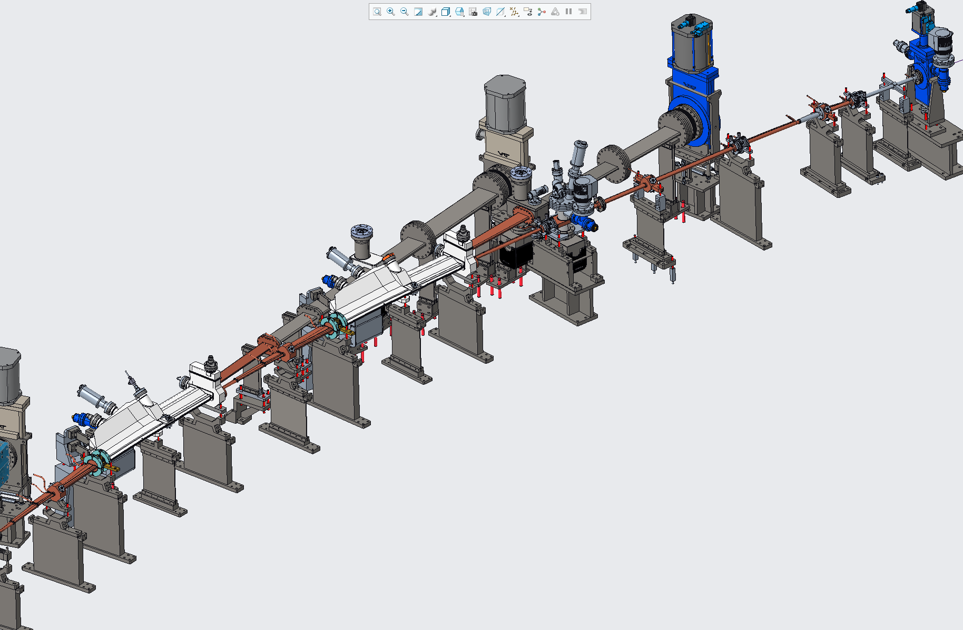
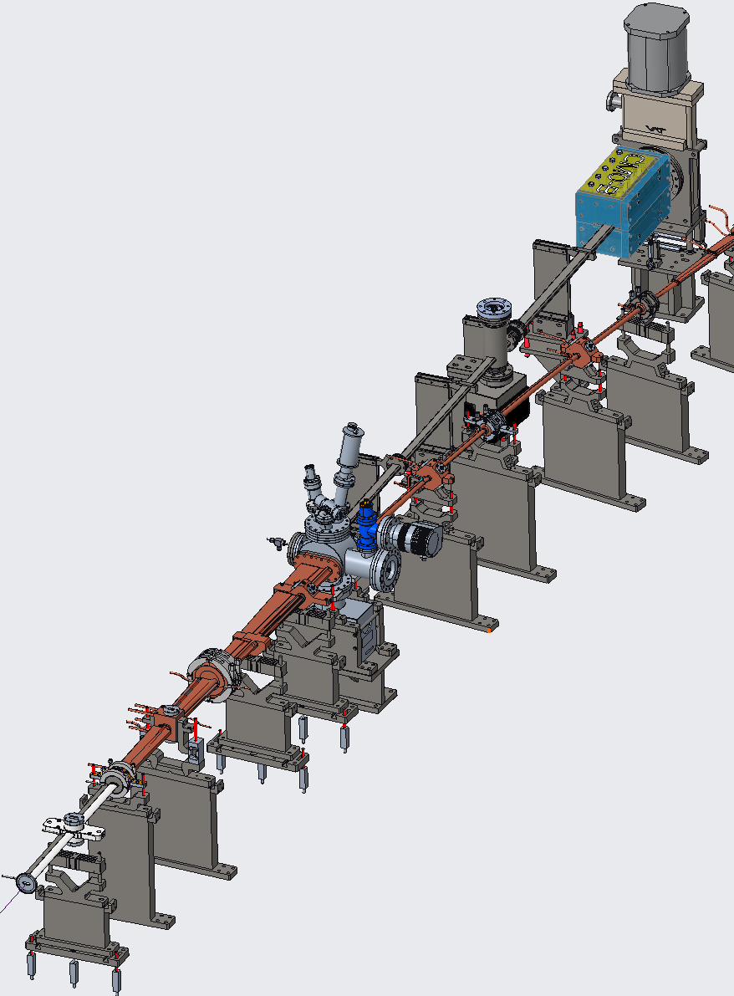
Key SR Vacuum Design Features Summary
60% NEG coating
Discrete pumping with ion pumps and NEG cartridge pumps in SR arcs.
Limited NEG coatings in straights and PTL.
In-situ bakeout and NEG activation with possibility of Neon venting
Combination of distributed and discrete absorbers
Modular design that conforms to magnet raft layout for ease of pre-assembly and installation

Slide 14
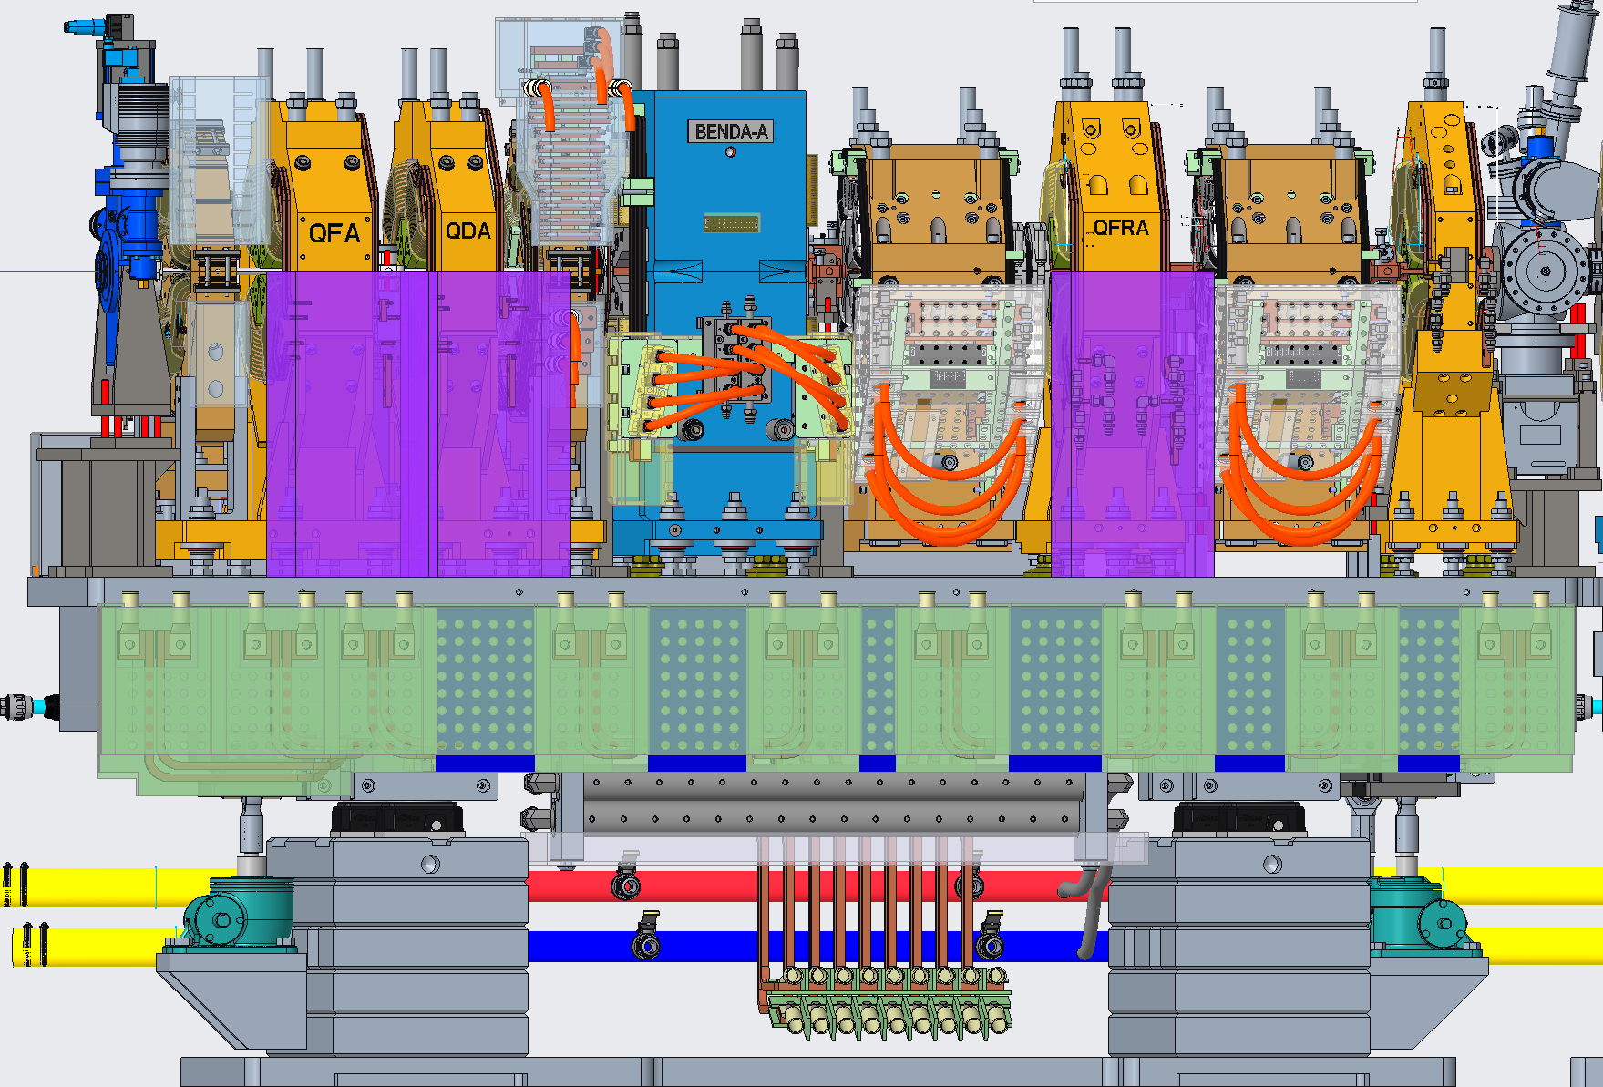
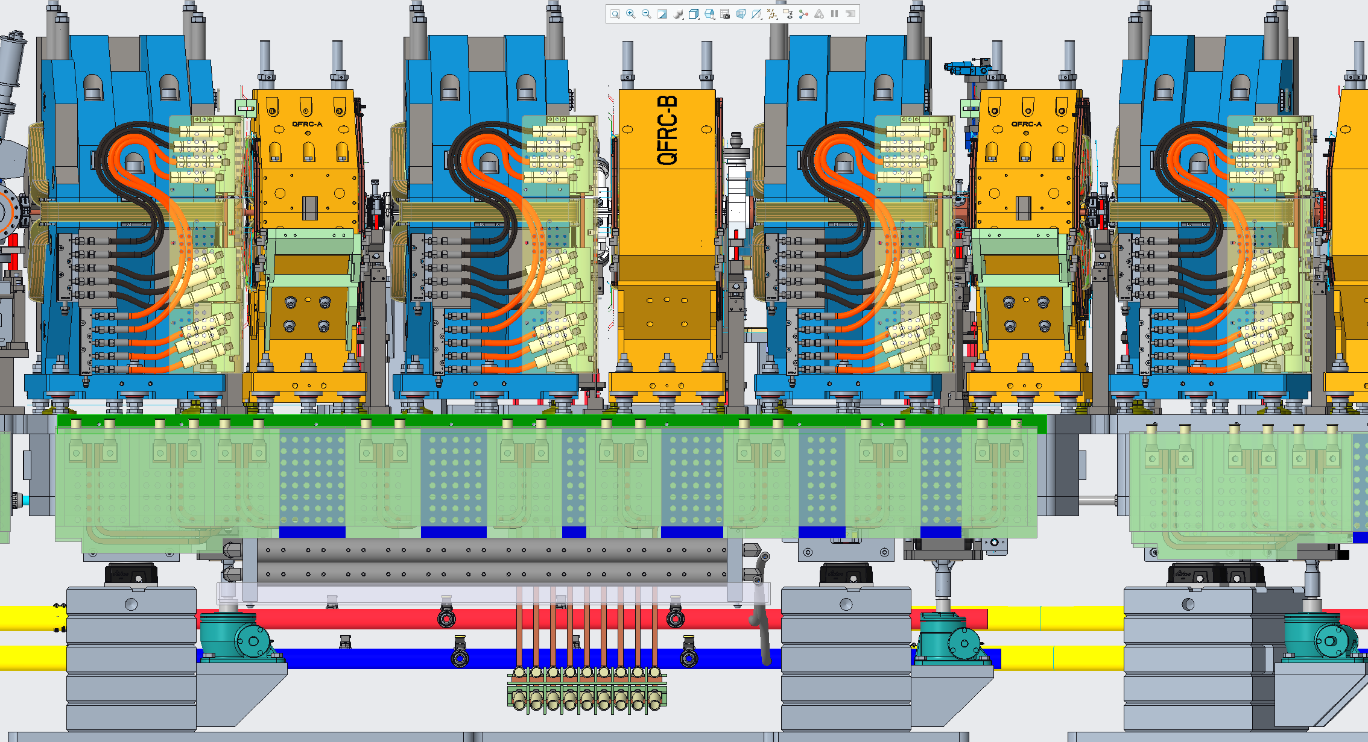
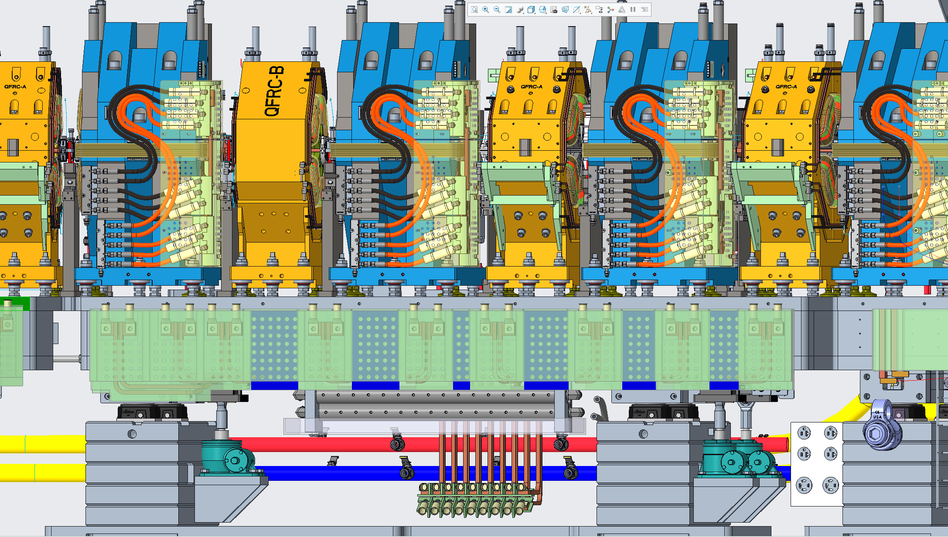
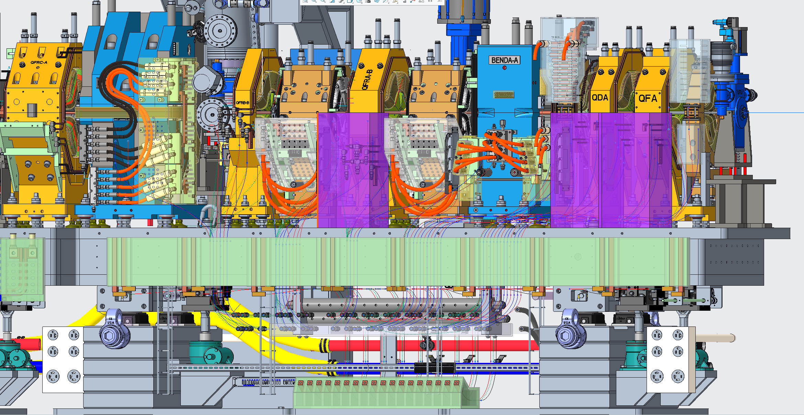
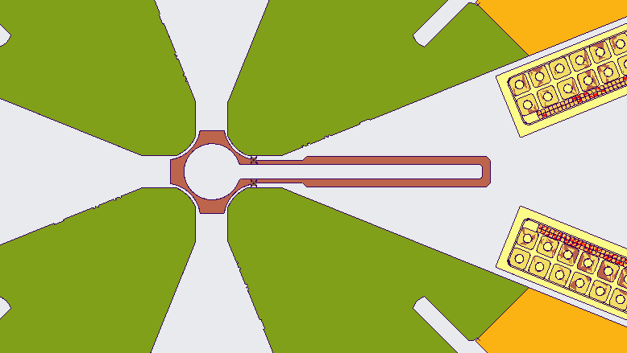
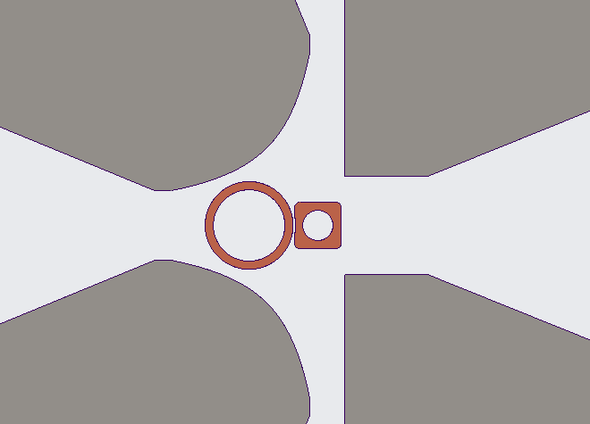
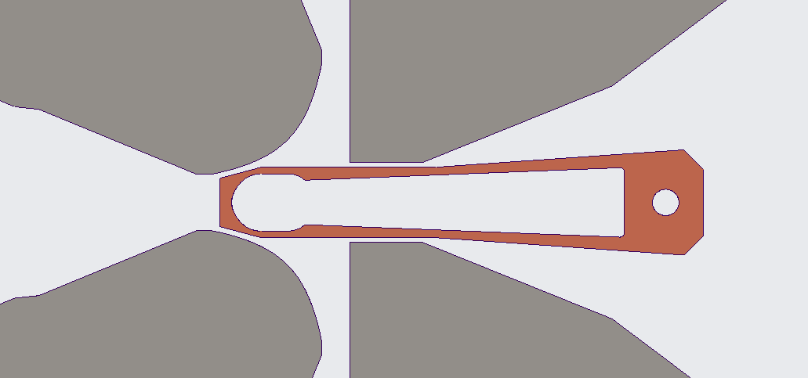
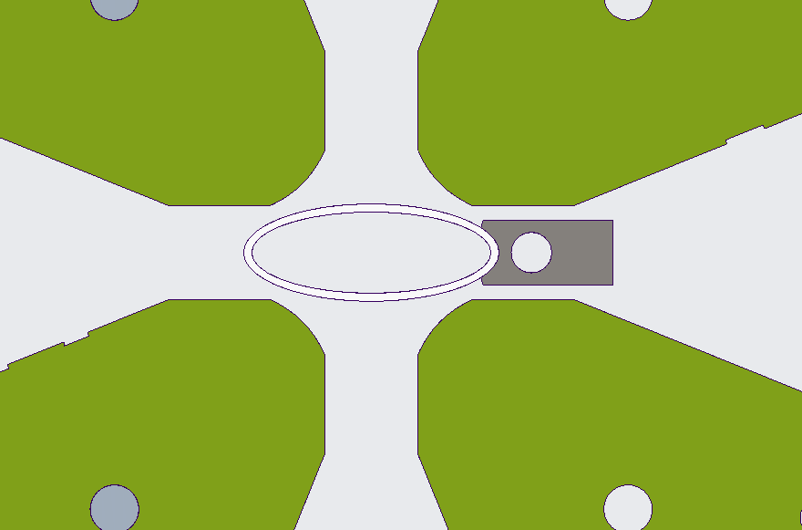
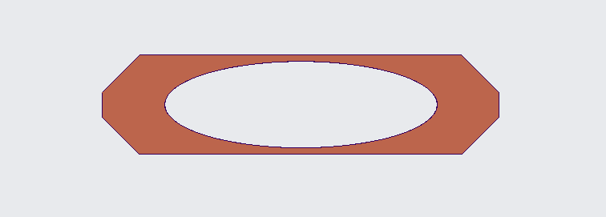
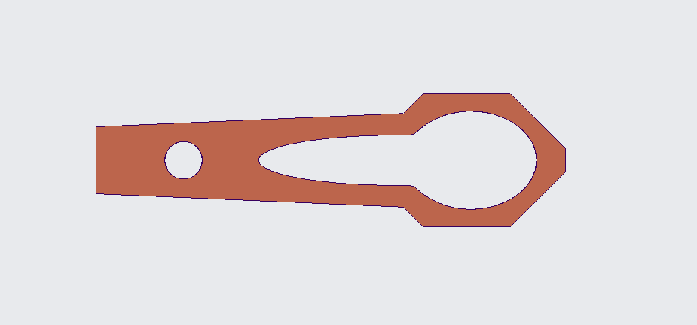

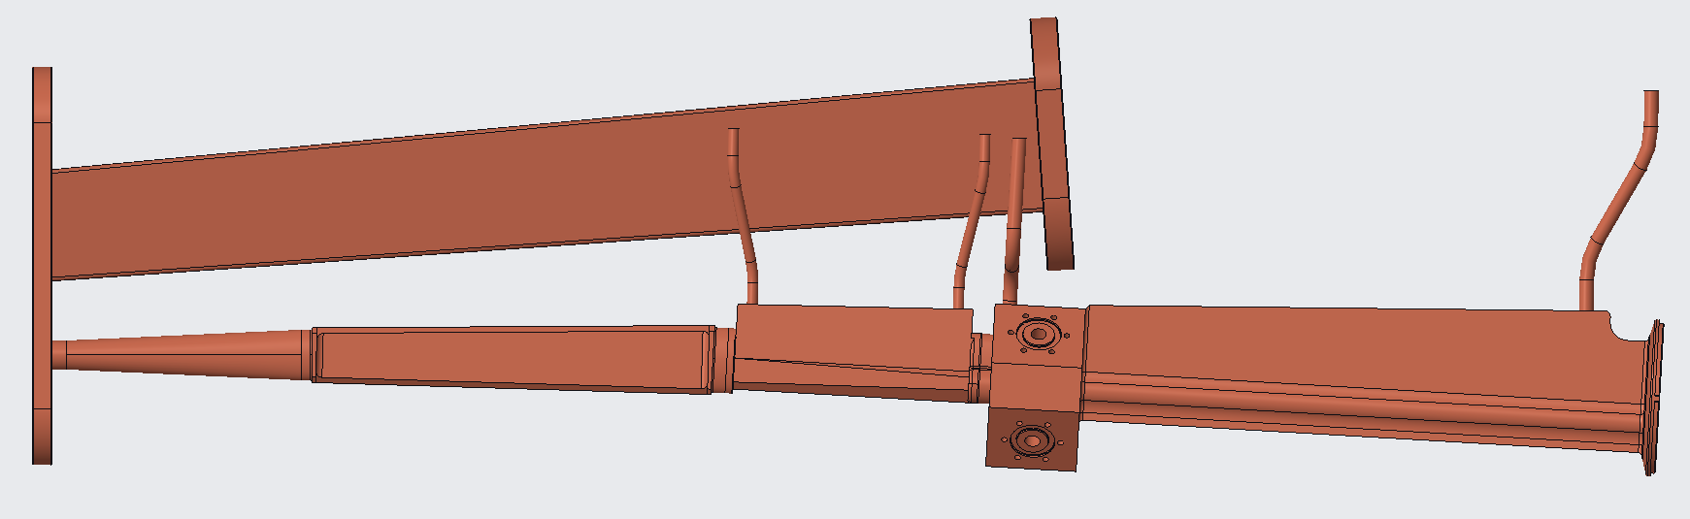

Vacuum chamber apertures
1 Arc Sector
10mm
20mm
5mm
13mm
29mm
100mm
13mm
100mm
7mm
13mm
High Field Magnet Chamber
7mm
13mm
ALS-U Project | OLAV-VI Workshop| April 16th 2024
900mm

Slide 15


















Vacuum Chamber Designs & Procurement
Keyhole & HHL Chamber
Stainless Steel Chamber
Broad array of vacuum chambers and components
Majority of the chambers are NEG coated
VC03
VC01
VC02
VC05
VC16
VC15
Crotch Chambers
VC11
VC04
VC12
RF Bellows
VC08
Beam Egress Chamber
VC10
VC07
VC13
VC06 and VC09

Slide 16






With 1000Ah conditioning, the total average lifetime is expected to be $∼$0.9h (‘post-LOCO’ corrected lattices)
Gas-pressures for 1000Ah, 100Ah, and 10Ah conditioning …
Beam partial and total average lifetime* (h): break-down by conditioning
 | 1000Ah | 100Ah | 10Ah
elastic | 9.4 | 2.4 | 0.68
inelastic | 74.7 | 20.7 | 6.2
total vacuum | 8.3 | 2.2 | 0.61
total** | 0.9 | 0.68 | 0.38
… and corresponding “post-LOCO” elastic-collision vacuum life
* Post-Loco DA assumed
** 1h Touschek lifetime assumed (not crediting overstretching)
ALS-U Project | OLAV-VI Workshop| April 16th 2024

Slide 17






SR Vacuum Prototyping
3D Printed CuCrZr
After post machining
VC-02 ID Egress Chamber
3D Printed CuCrZr
Conventional Machined
H-Bend Copper chamber NEG coating trials
H-Bend Chamber

Slide 18



SR Integrated Prototyping
SR Magnets – Vacuum Integrated Prototype
Integrated SR Raft Mockup
Magnet – vacuum assembly and alignment sequence, in-situ vacuum bakeout and NEG activation
Magnet cabling and LCW routing, raft assembly sequence, general cabling and controls integration

Slide 19



NEG Coating Development Objective
CERN, 2000s
Demonstrate current NEG coating technology is applicable to ALS-U relevant chambers
Explore/develop industry and research capability and partnerships – SOLEIL, STFC, ESRF, SAES, FMB
Develop in-house NEG coating capability
60mm
MAX-IV, SIRIUS, 2010s
20mm
ALS-U, SOLEIL, 2020s
10mm
ALS-U, 2020s
6mm
SIRIUS
MAX-IV

Slide 20






ALS-U NEG Coating Systems
PM Assembly
2m long X 300mm wide NEG coating rig
NEG coating for large complex chambers
4m long narrow NEG coating rig

Slide 21


Pumping performance
Sample | H2 Sticking Coeff. | CO Sticking Coeff. | CO Capacity
CERN Benchmark | 0.007 | 0.7 | 8e-14 [molecules/cm]
LBL 6 mm | 0.007 | 0.03 | Comparable to CERN
LBL 9 mm | 0.007 | 0.25 | Comparable to CERN
Vendor1 6 mm | 0.0025 | 0.003 | low
Vendor1 9 mm | 0.0065 | 0.015 | low
ESRF 6 mm | 0.003 | 0.004 | low
ESRF 9 mm | 0.005 | 0.01 | low
Vendor2 10 mm | 0.005 | 0.0015 | poor
Vendor1 9mm
Vendor1 6mm
Factor that impact pumping performance
Substrate temperature
Cathode voltage
Plasma power or deposition rate
Initial base pressure
Coating pressure
Tube ID
Findings
9mm samples consistently performs better than 6mm – aspect ration rules out
In-house coated sample out performs those sourced externally
Vendor and other labs struggle with coating 6mm. Some declined
NEG wire contamination content
Moving magnets vs full length solenoid
Gas purity
DC power vs pulsed-DC power
NEG wire degassing
Substrate roughness
ALS-U Project | OLAV-VI Workshop| April 16th 2024

Slide 22



Pumping comparison at SOLEIL
CERN-TS-2006-001(MME); Ti-Zr-V non-evaporable getter films: from development to large scale production for the Large Hadron Collider.
ALS-U Project | OLAV-VI Workshop| April 16th 2024

Slide 23





PSD Measurement at SOLEIL

Slide 24


SEM Analysis of NEG film morphology
Ti,Z,V
T = 120ºc
T = 100ºc
A.Anders, A structure zone diagram including plasma-based deposition and ion etching, Thin Solid Films, 2009
SEM samples
ALS-U Project | OLAV-VI Workshop| April 16th 2024

Slide 25
Thank you

