Slide 1
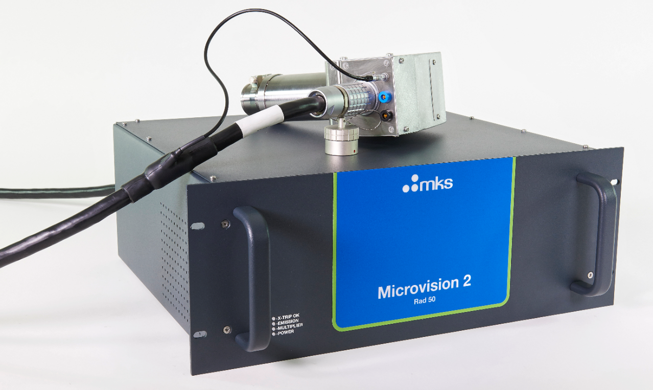
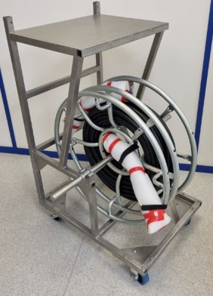
OLAV-VI: 6th Workshop on the Operation of Large Vacuum Systems April 2024
Remote RGA Operation via Ultra-long
(100 meters) Extender Cables
William Fletcher
Alex Nikitin
Daniel RioPousa
Mark Aitken
Jonathan Leslie
Stuart Johnson
George Jennings
Farnoush Salarzaei

Slide 2
Background
Residual Gas Analyzer (RGA) essential analytical tool for High Energy Physics (HEP) Vacuum System Installations.
HEP Vacuum Systems integral part of Neutron/Photon Sources, Accelerators, Synchrotrons and Reactors (Tokamak).
HEP applications pose unique challenges to RGA instrumentation:
  Ultra and Extreme-High Vacuum pressures require low detection limits for ion current measurement
  Meticulous cleaning and vacuum practices – gas and particulate
  Radiation environments (neutron and X-ray) dangerous to personnel and damaging to instrumentation
  Signal monitoring stations >50 meters away from the RGA sensor : far-away connectivity
Semiconductor components must be shielded or moved away from sources of hard radiation to avoid electronics failures
Extender Cable (EC) routinely used to place electronics away from sensor head

Slide 3
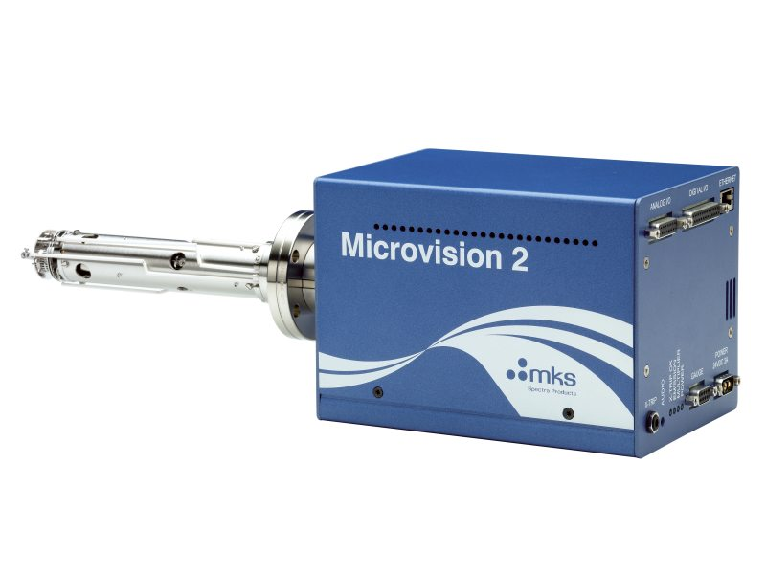
Problem Statement
RGA Electronics Control Unit (ECU) sensitive to hard radiation encountered in some HEP Vacuum System installations
Why? Semiconductor components on internal PCBAs damaged by hard radiation - instrument failure and operational downtime.
Service of damaged instrumentation is difficult and typically on a very strict maintenance schedule – 6 month downtime typical
ECU – w/Semiconductor
Sensor Head
Vacuum Port
Insensitive to Hard Radiation
Sensitive to Hard Radiation

Slide 4
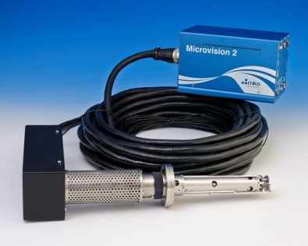
The solution: Extender Cables
Extender Cable connects RGA Sensor Head to ECU
Sensor head - insensitive to hard radiation - attached to vacuum system – i.e., accelerator tunnel.
ECU located in remote (shielded) location-i.e., safe control room.
Prior Art: Legacy RF Source
  3m EC enables position of smart head electronics in shielded enclosure (i.e., Lead-brick huts)
  15m EC enables position of smart head further from radiation source - in shielded monitoring location (i.e., safe location)
3m Extender cable
15m Extender cable

Slide 5
Job to be Done
Increasing demand for longer extender cables - beyond current 15 meter industry limit
Great opportunity for Technical Innovation by MKS
Technical Challenges: Not trivial!
  RF Delivery: High precision, high amplitude RF Voltage for quadrupole mass filter - 0.1% accuracy, 1.8MHz, ≈10V/amu
  Filament Heating Power: Large resistance drop across cable length
  Ion current Measurement: fA detection limits
  Radiation hardened construction materials: Polyurethane sleeving for cable, PEEK (PolyEther Ether Ketone) isolation, etc. Industry Guidelines + Legacy knowledge
  Transportation: Large size/weight of the cable

Slide 6
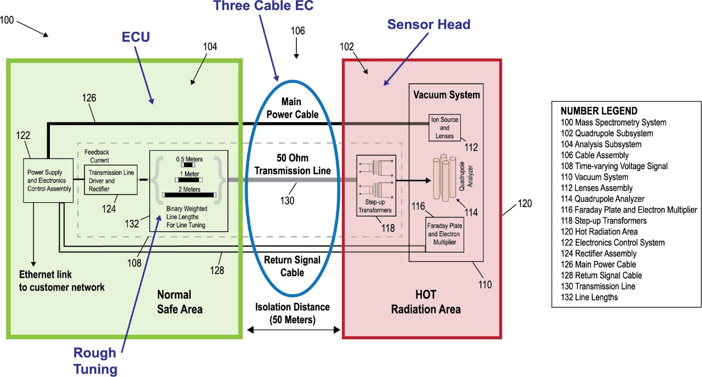
Three Cable EC design
Technical challenges addressed with Three Cable design (same for 50 and 100m) + redesigned ECU
RF Transmission Line (50 Ohm) Cable: Resonant Transmission Line
Main Power Cable: Filament power, ion source and electrode biases.
Return Signal Cable: Faraday Cup and Electron multiplier ion current readings
Hardened Materials: Same materials as 15m legacy cable w/30 years of robust service.

Slide 7
RF Transmission Line – Hard things first!
MKS committed to (1) ultra-long EC technology development and (2) delivery of MVPs to key customers requesting 50 and 100m EC proof-of-concept.
Biggest challenge: RF delivery (increased cable capacitance) - focus of MVP#1 and #2.
MVP#1: Legacy RF Power Supply. Assumption: It is possible to deliver RF across EC>15m with existing RF generator design (w/small mods) Failed!
  Brute force approach - failed fast! No surprise!
  RF did not reach sensor head with sufficient amplitude
  Similar limitations experienced by other commercial vendors
MVP#2: New RF Power source designed. Assumption: Resonant transmission Line delivers high accuracy and stable RF suitable for RGA control.

Slide 8
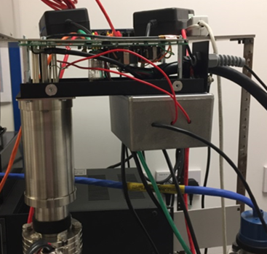
Resonant Transmission Line - Focus on RF Delivery
Resonant transmission line extends between (1) RGA sensor head and (2) ECU subsystem, resonant at RF frequency
Resonant transmission line with electrical length of one-half wavelength (λ/2), or integer multiples of λ/2, of RF frequency (@ 1.8432MHz and the propagation speed of wire) :
  λ is RF wavelength
  (λ/2×1)≈52 meters
  (λ/2×2) ≈104 meters
Standing wave mode -> cable behaves as tank circuit – stores RF energy
Tuning: Coarse (line length inserts, ECU) and fine (capacitive, sensor head) performed at the factory
MVP#2: Modified 15m EC system
RF driver
Step-up transformer
50m Cable
Extension tube (200°C bakeout)
RGA Probe
MKS Patent# US 10600628B1

Slide 9
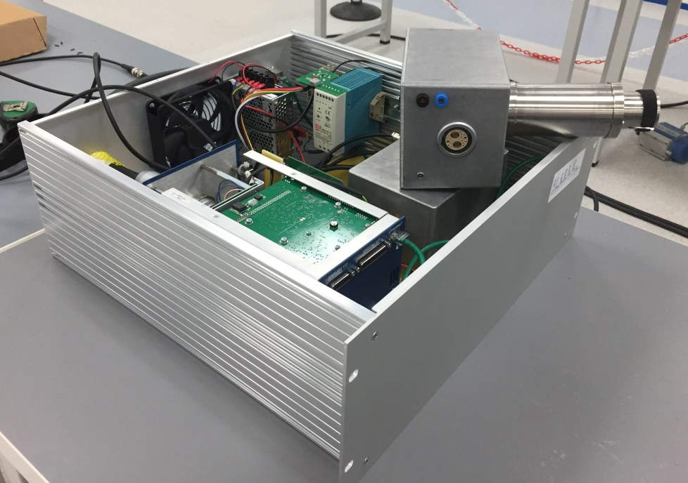
Main Power Cable – Focus on Filament Heating Power
MVP #3: Assumption: It is possible to provide 3-4 A filament current supply > 50m
  Verified!
  External power supply for initial current range characterization: Power requirement + Wire gauge
  Increased wire gage to compensate against resistive losses
  Power supply boost (DC/DC) for 100m cable
  High Quality Connectors
RGA Sensor Head Connection
Extension tube
200°C Bakeout
EC Connections

Slide 10
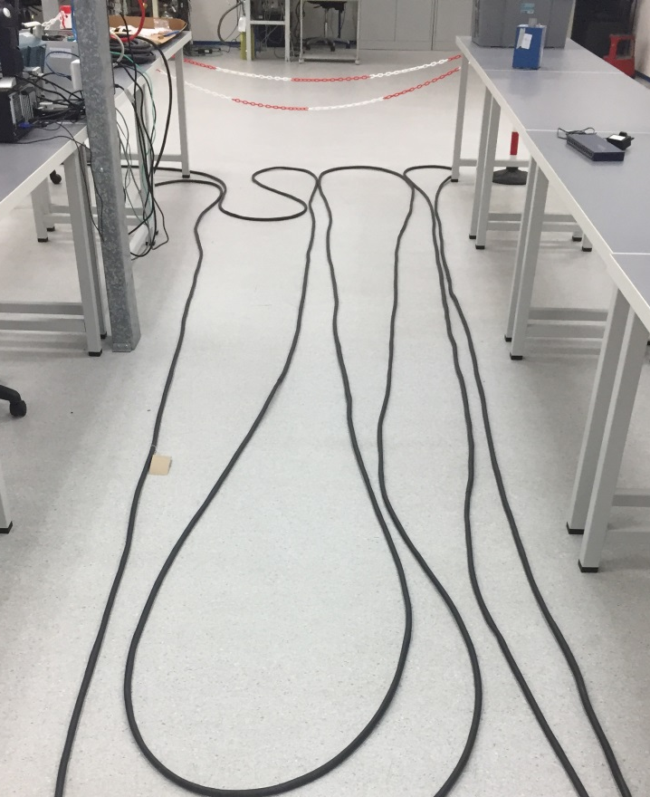
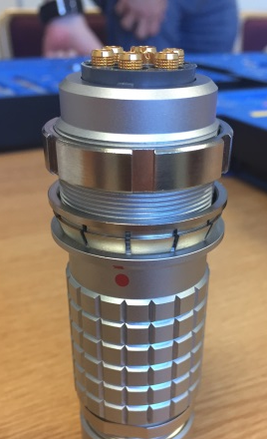
Return Signal Cable: Focus on Ion Current
MVP#4: Assumption: A tri-axial cable assembly minimizes signal losses over large distances and provides specified detection limits
  Triaxial cable (First prototype used heat shrink outer sleeve)
  Electrometer modified to adjust to new operating conditions
    Target: Ion current noise floor ≈ 3X of legacy RGA
  New connectors selected compatible with operation in radiation environments
High-quality gold-plated connections with PEEK insert.
MVP#4: testing signal to noise ratio is acceptable for measured signal

Slide 11
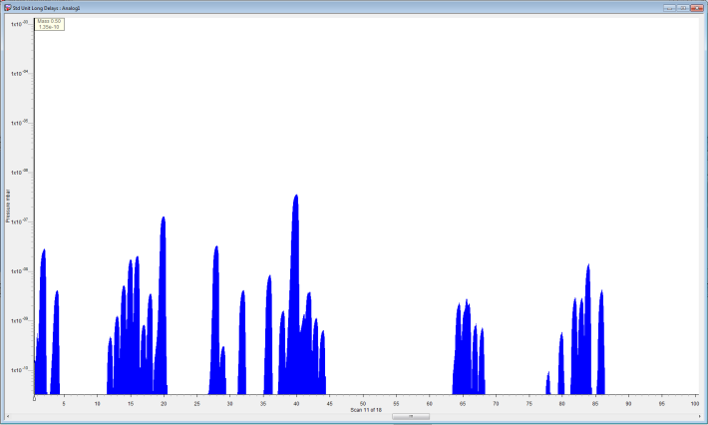
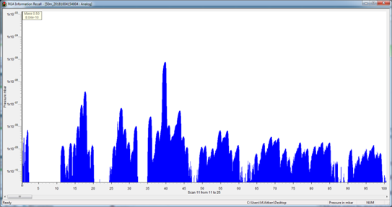
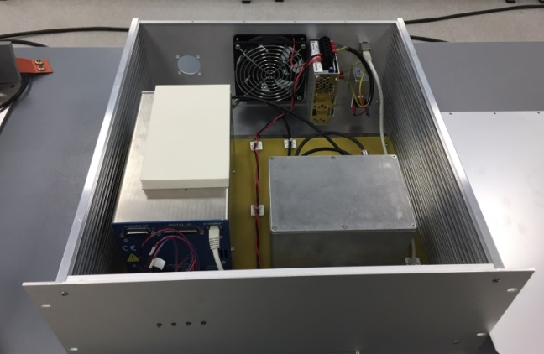
Field Tests & Success!
MVP#4: 50m EC Design Completed and Verified
  Patented RF Power Delivery (Resonant transmission line EC) delivers like-for-like performance against legacy 15m product
  First 50m EC Prototype out in the field-> Still running since April 2021 (waiting for 100m system)
MVP#5: 100m EC Design verified and completed (MKS Factory.) Shipped to customer (Alpha Release).
New “Radiation Hardened RGA” Product announced at AVS69
Legacy 15m Spectra
50m EC prototype evaluated by end user
50m EC Spectra obtained showing equivalent performance against legacy EC 15m - equivalent resolution, scan speed, and sensitivity

Slide 12
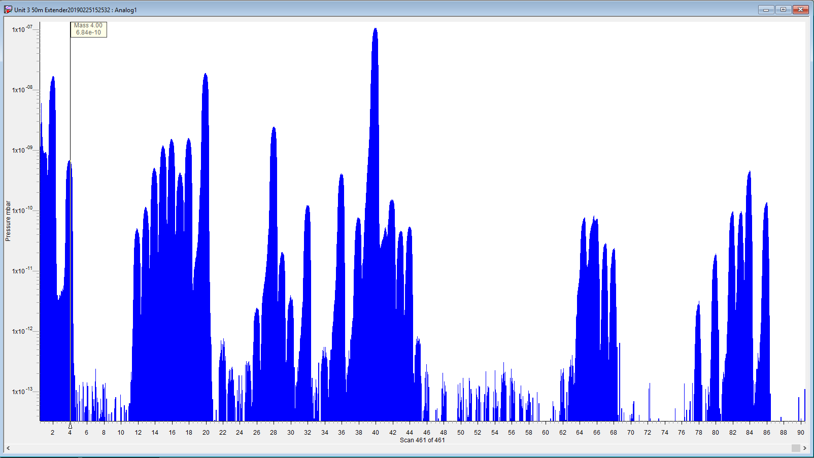
Analog scan using MV2 w/50m radiation hardened EC
Mass spectrum Factory test gas: 1000ppm He, N₂, Kr, Xe in Argon balance.
He
N₂
Ar
Kr
Legacy RGA Resolution
<10⁻¹³ Torr MDPP

Slide 13
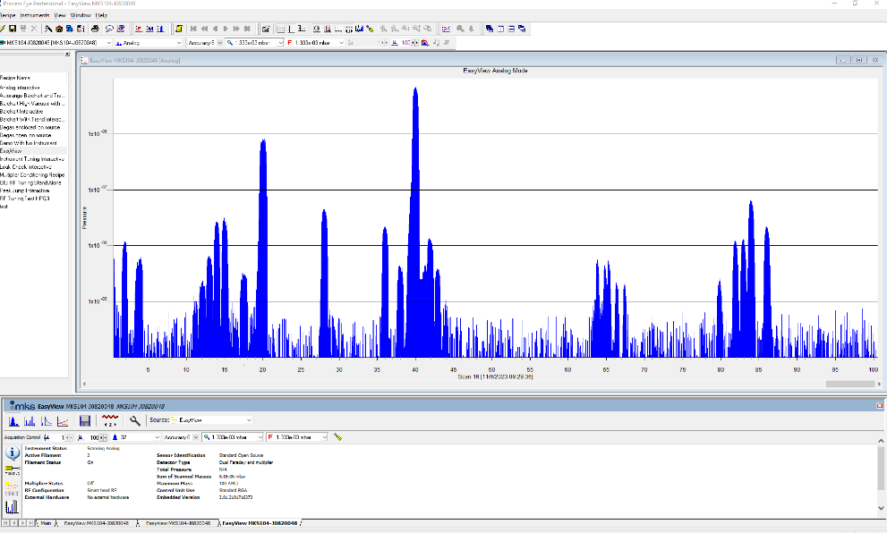
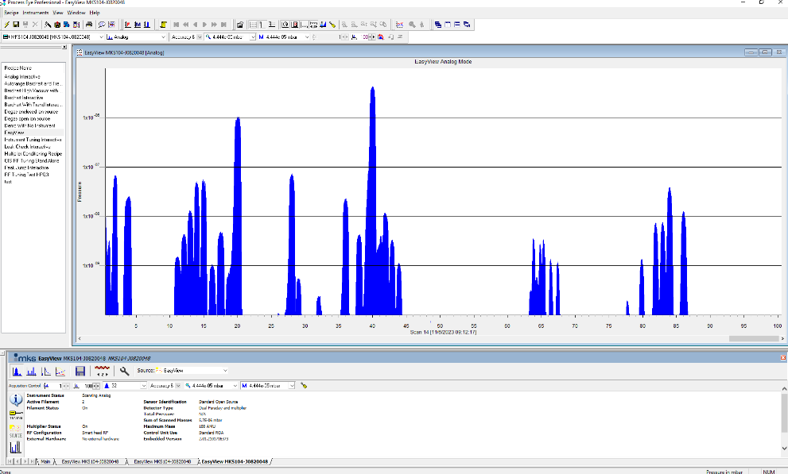
MVP#5: 100m EC validation
MVP#5: Assumption: Resonant transmission line + filament supply boost + Triax Signal cable can support remote operation up to 100m. Validated!
Faraday Cup
Electron Multiplier

Slide 14
Microvision™ 2 Residual Gas Analyzer with Radiation Resistance Cable
  Extender cable Lengths: 50 and 100m, shielded
  Material Hardening: 30 years approved technology and material for radiation environments
  High Temperature operation: 200 ºC Faraday detector or 150°C Electron Multiplier
  UHV compatibility
    W and ThO₂ Filaments
    Operate RGA during bakeouts
  Large scale distribution connectivity: Multisensor operation, centralized computer control, Ethernet CAT-5e
  ISO-20175 Test compatibility

Slide 15
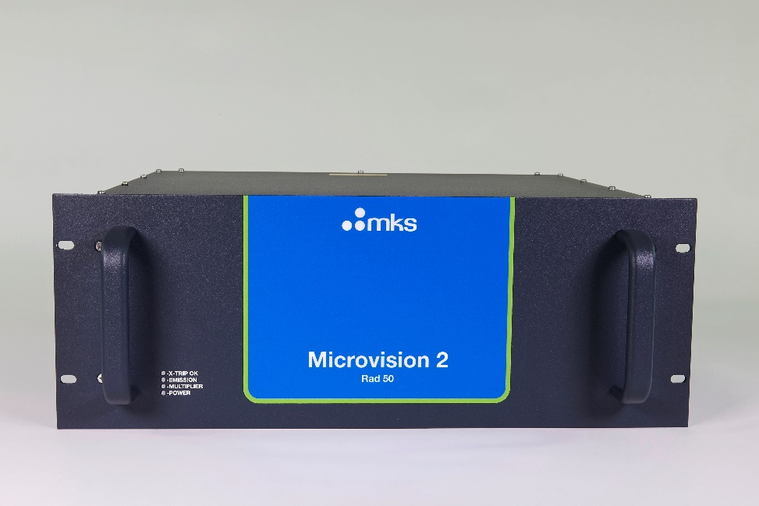
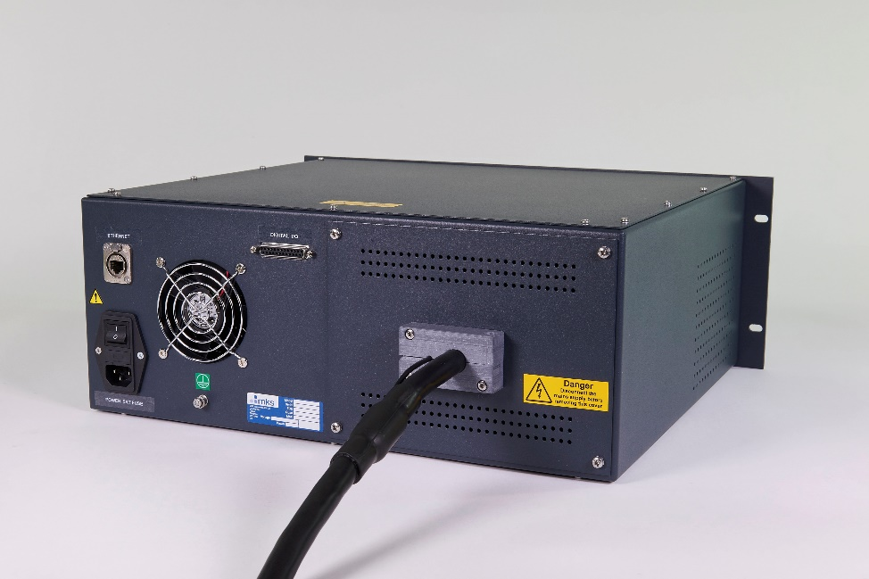
Microvision 2 Residual Gas Analyzer with Radiation Resistance Cable
Front View (Full Rack)
Back View

Slide 16
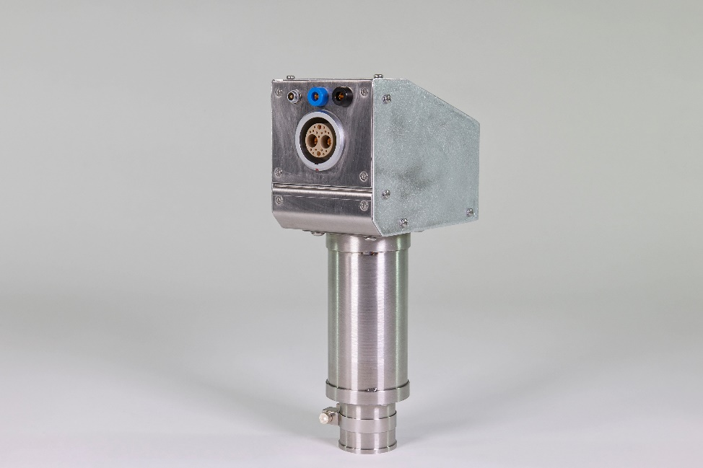
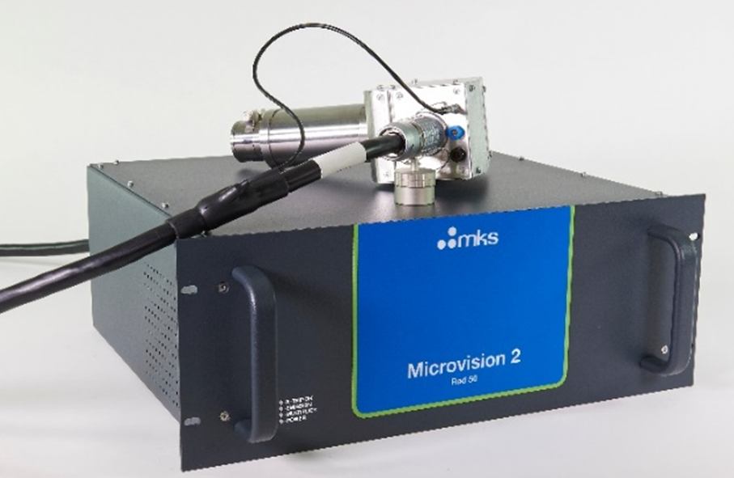
Microvision 2 Residual Gas Analyzer with Radiation Resistance Cable
RF Transmission + Main Power
Signal Return (Triax)
Return Cable: Ion Current
MVP Test Port
Main Power + RF Transmission Connector
Thermal Break
200°C Bakeout
RGA Connection

Slide 17
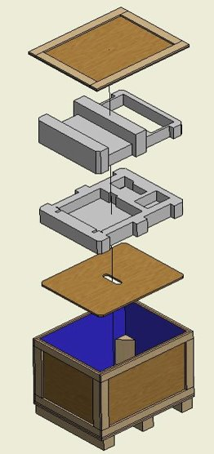
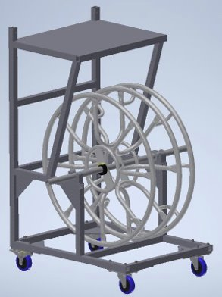
Shipping Crate and Reel
“Three Cable” MV2 with 50/100m Radiation Resistant Cable -> VERY heavy.
Shipping Crate specifically designed for MV2 with 50/100m Radiation Resistant EC .
Shippable Cable Reel specifically designed to coil/store EC and facilitate cable pulling during installation.
  50m -> 49 Lb
  100m -> 106 Lb

Slide 18
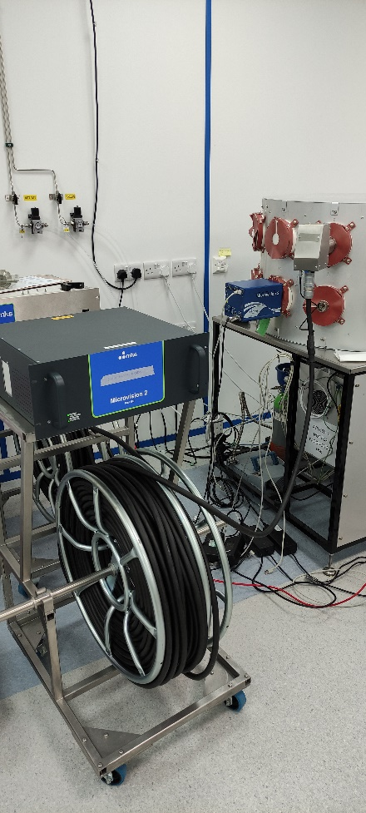
Complete System-Test Setup
Sensor Connector + Bakeable Interface
Electronics Control Unit
100m Cable
Test Rack
100m Cable Reel->100Lb!

Slide 19
Microvision 2 Residual Gas Analyzer with Radiation Resistance Cable
Mass Range | 1-100 amu
Cable Lengths | 50 and 100meters
Mass Range | 1-100amu
Detector System | Dual (Faraday and Electron multiplier)
Maximum Operating Pressure | 7.6e-5 Torr (1e-4 mbar)
Minimum Detectable Partial Pressure 50m only (RAD100 may be different) | Faraday 7.5e-11 Torr (1e-10 mbar) Electron multiplier 7.5e-14 Torr (1e-13 mbar)
Mass Stability | Better than ±0.2 amu over 8 hours at stable ambient temperature
Resolution | Better than 1AMU at 5% peaks of equal height throughout the mass range
Radiation Dose ( MTBF, hot zone components) | Estimated 10⁷ Rads (10⁵ Gray) using ITER recommendation materials and same technology of our 15m products
Estimated 10 years’ service life in radiation environment

Slide 20
Current Evaluations
Two Complete Systems under evaluation (100m, purchased):
ORNL:
  Originally shipped September 2023 – alpha level unit.
  Missed January 2024 install date.
  Needs retrofit from 50m to 100m (order mistake) – Fully tested 100m cable on its way.
  Scheduled for late April install
  Will include dose monitoring
ITER:
  Originally Shipped November 2023 – beta level unit
  100m System
  Installation date? April? May?

Slide 21
Next Steps
Product Development Process:
  Currently in Alpha mostly documentation.
    EMC Test passed
    Safety / Drop data coming April 29, 2024. Will cover all countries with KR and TW requiring separate testing.
  Beta stage starts May 15th – not much to do in terms of hardware!
  Product Release: End of June 2024.
  Inventory available: 2X50 m + 2X100m systems stocked with Crates and Reels – 6 week delivery target. Pricing Available.
  Manufacturing in place – automated system tuning + contract manufacturing secured and trained.
ANY-LENGTH Extender
  Starting IP process
  Looking for Candidates
>100m Extender Cable
    May require additional retrofits – filament power drive
    SNR penalty in MDPP – needs qualification
    Looking for candidates
Ultra-high Resolution RGA
    1-6 amu mass range
    Looking for Candidates

Slide 22
Thank you!
Microvision 2 Residual Gas Analyzer with Radiation Resistance Cable (50/100m) extends range of applications of RGAs in HEP
Innovations:
  Three cable design
  Resonant transmission line technology - MKS Patent# US 10600628B1
  Bakeable RGA Sensor Head connectivity
  Any Length Extender Cable
  Ultra-High Resolution RGA with 100m EC

