Slide 1
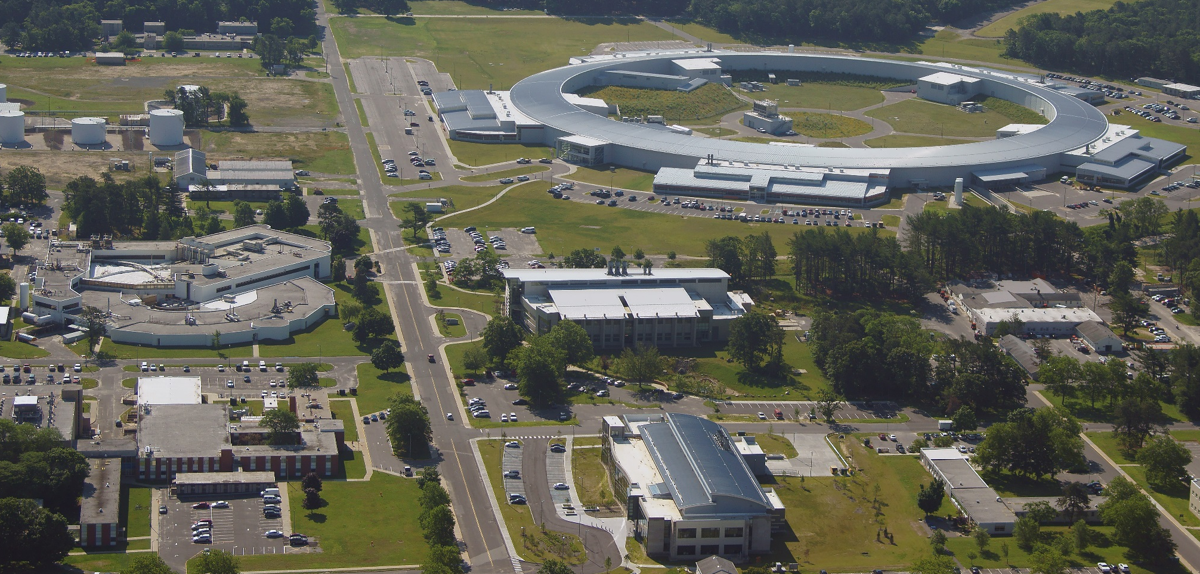
NSLS-II PSD (Photon Stimulated Desorption) Beamline
OLAV-VI 6th Workshop on the Operation of Large Vacuum Systems
R. Todd Brookhaven National Laboratory
April 15-19, 2024
“The research described herein is Fundamental Research as defined in the ITAR (22 CFR §120.34(a)(8)), EAR (15 CFR §734.8), or Part 810 (10 CFR §810.3), as applicable, and as described in the USD (AT&L) memoranda on Fundamental Research, dated May 24, 2010, and on Contracted Fundamental Research, dated June 26, 2008.”

Slide 2
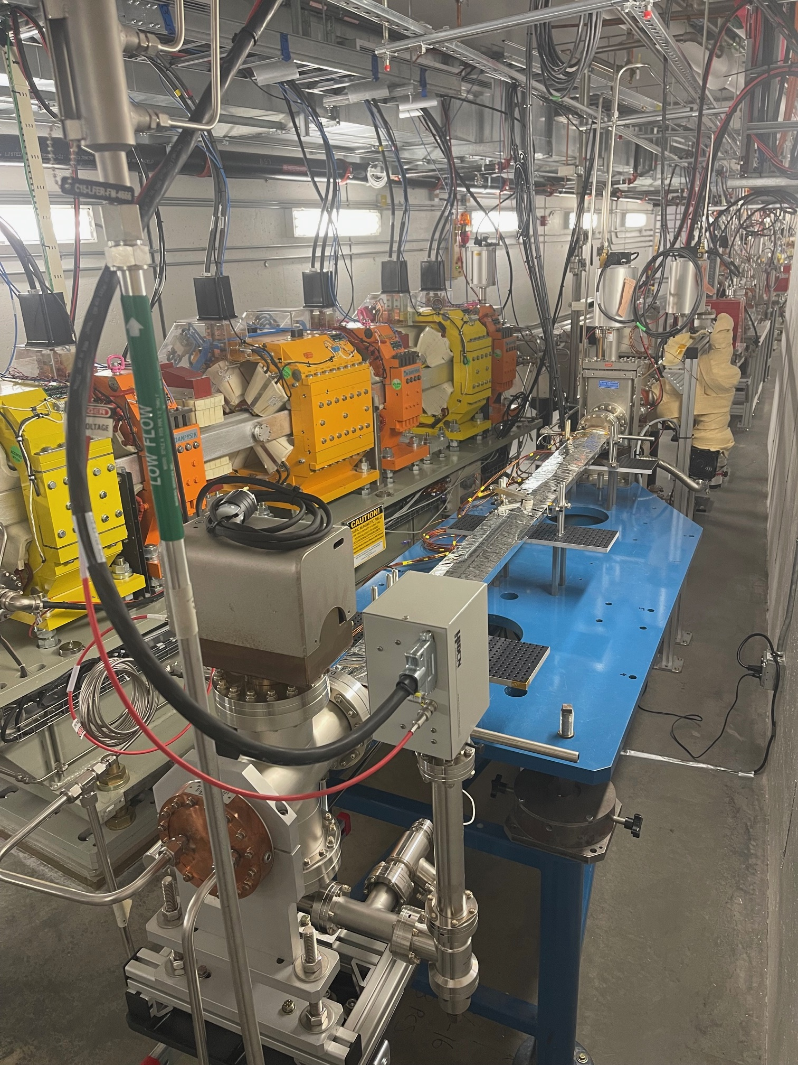
NSLSII PSD Team
R. Todd
P. Palecek
M. Seegitz
S. Hulbert
O. Tchoubar
C. Hetzel (BNL: EIC Project)
T. Shaftan
Entire NSLSII Vacuum Group

Slide 3
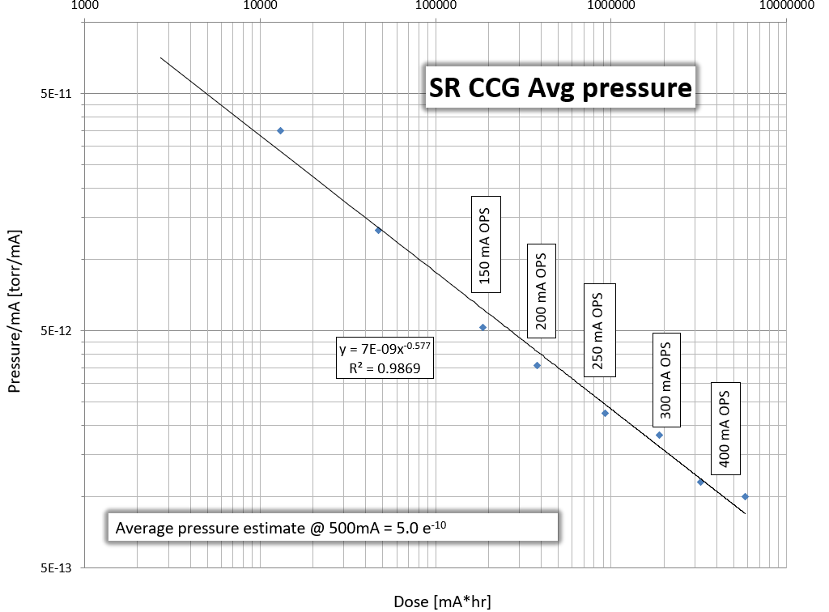
Beamline Motivation
Photon Stimulated Desorption (PSD)
  Gas liberated from walls
  Primary gas source in the storage ring
  Improves over time (dose)
  Varies with incidence angle, material, surface treatment, etc.
Electron Stimulated Desorption (ESD)
  Test different wall geometries
  Photoelectron production
  Varies with material, surface treatment, pre-condition etc.
Test new materials for new facilities
NSLSII-U
  NEG, CuCrZr
EIC
  Rapid Cycling Synchrotron
  Storage Ring NEG coated Cu beam-tube
  Hadron Ring Amorphous Carbon
Commissioning Data from NSLSII
Notes:
Photon Stimulated Desorption is a critical parameter required to understand the dynamic pressure behavior of an accelerator during commissioning and operation.
Graph showing conditioning in terms of change in pressure over beam current on the Y axis and dose on the X axis.
The PSD and other desorption mechanisms are used as inputs to Molflow and Synrad for accurate vacuum system modeling.

Slide 4
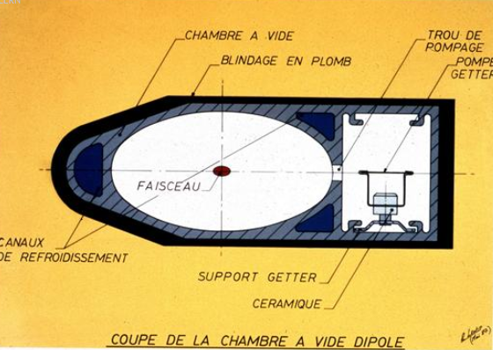
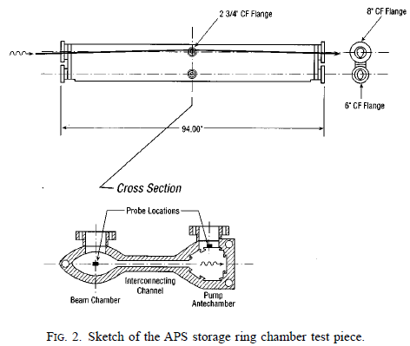
Past PSD Measurements
Much early work at CERN (1988)
  DCI at Orsay for the LEP chamber
NSLS (VUV and X-ray rings)
  APS aluminum chamber (1996)
  KEK chamber (3.5GeV positron and 8 GeV electron rings) (2000)
  SSC Nitronic 40 SS (1989)
  Be, TiN, Au, C thin films (sawtooth) (1992)
CERN (2003)
  St707 NEG cartridge for EPA ring
HLS (Hefei) (2012)
  TiZrVa NEG
KEK (photon factory) (2015)
  TiZrVa NEG coatings for Future circular collider
Notes:
Significant body of work exists, most since 1980 on accelerator materials. Measurements were made both on samples as well as actual chambers. Data from the prior work of Conrad Foerster at NSLS for both SS and C101 was used as comparison to our baseline results. The measurement method was largely replicated.

Slide 5
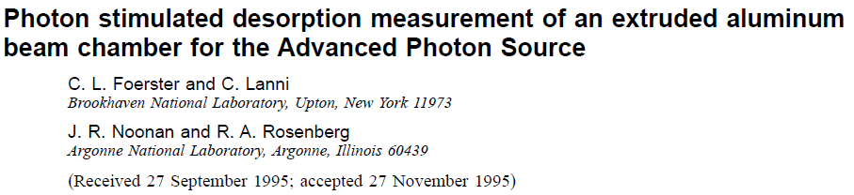
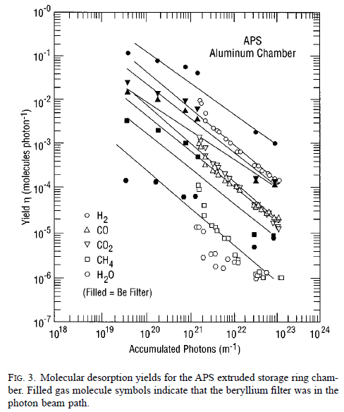
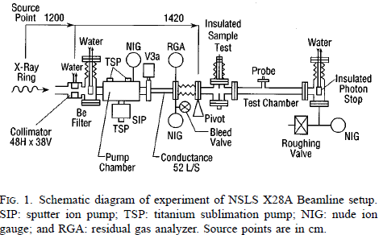
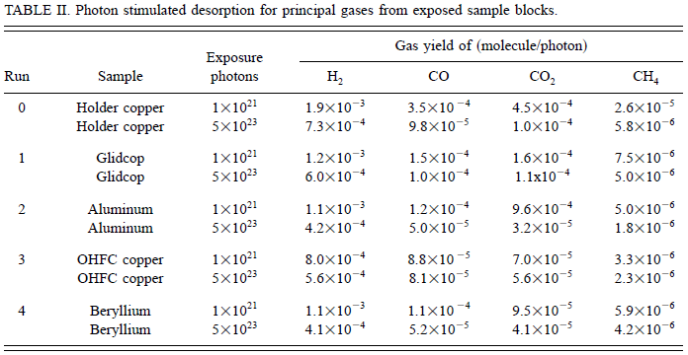
Design Inputs for NSLSII

Slide 6
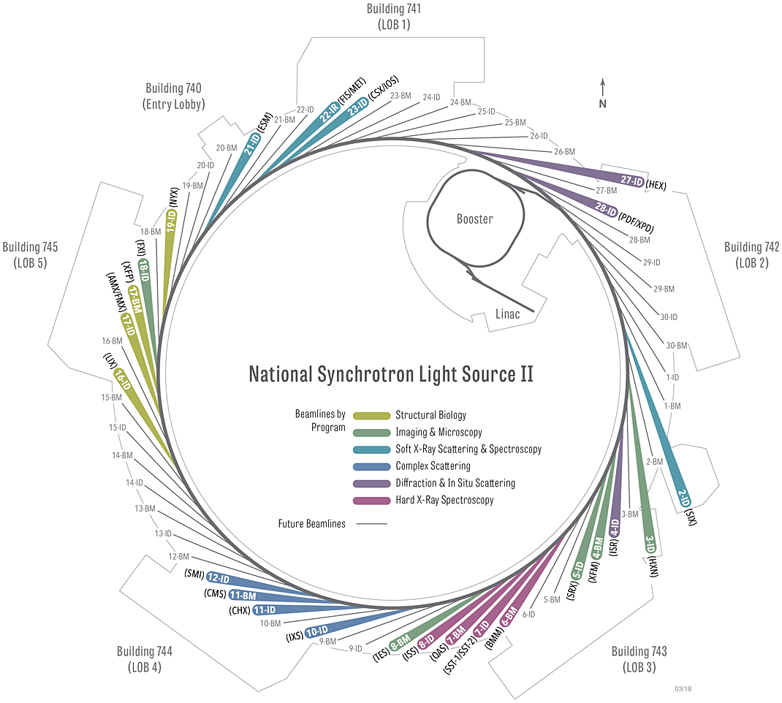
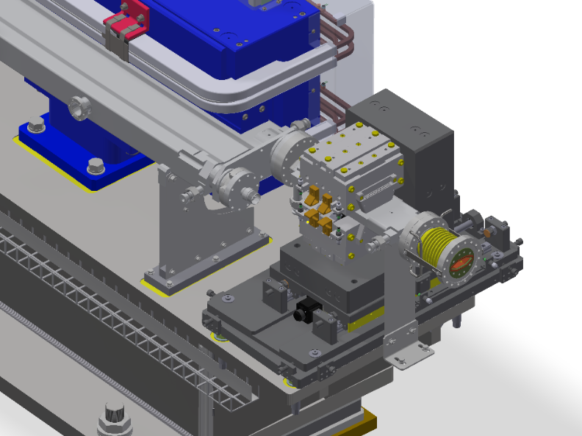
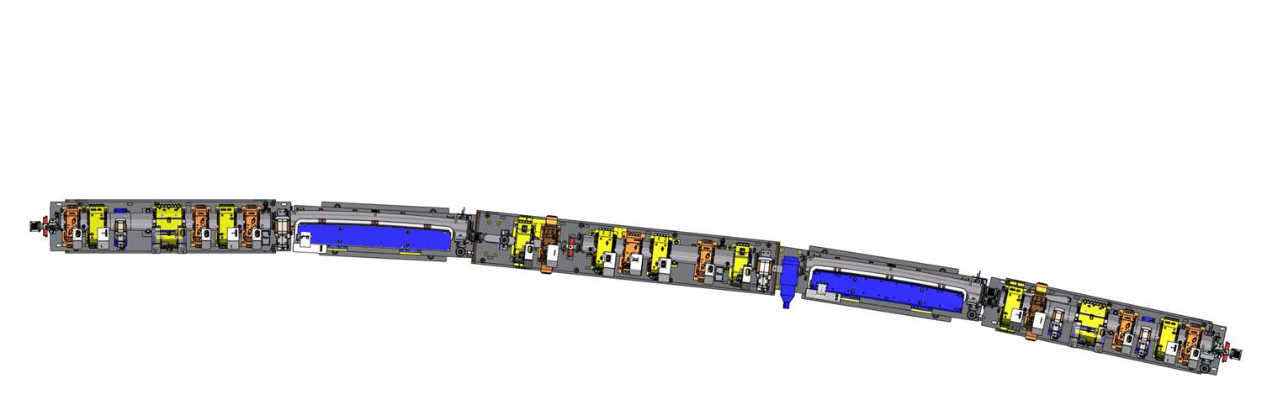
Beamline Location
Storage Ring
792m
3.0 GeV
0.5nm-rad H
8 pm-rad V
Convenient location in pendant 4
  Not closed for RF or injector studies
  No sources or FEs in the area
 | First Pole | Second Pole | Third Pole
Field Strength (T) | 0.35 | 1 | 0.35
Bending Radius (m) | 28.5714 | 10 | 28.5714
14-BM
Photon extraction
G2
Multipole
G3
Dipole
G4
Multipole
G5
Dipole
G6
Multipole
Source
3 pole wiggler (3PW)

Slide 7
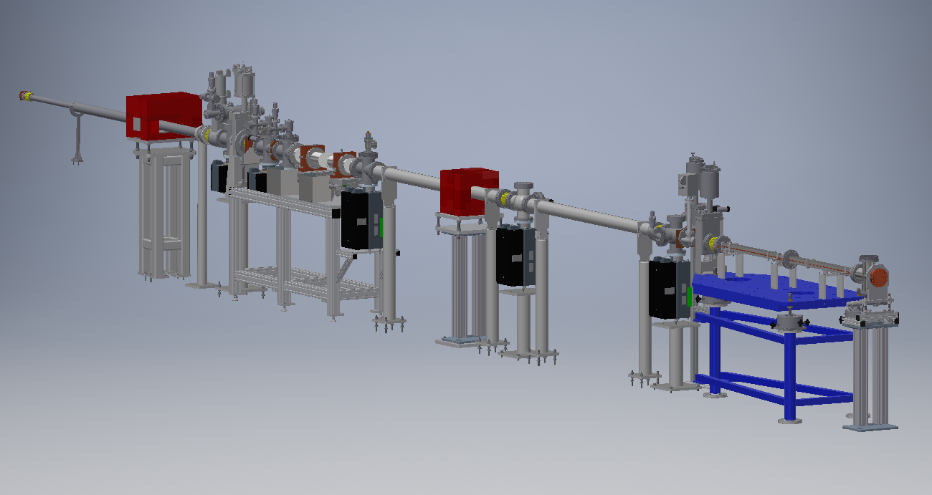
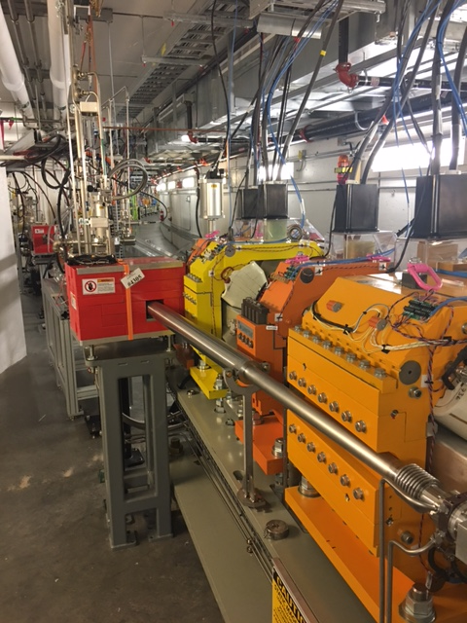
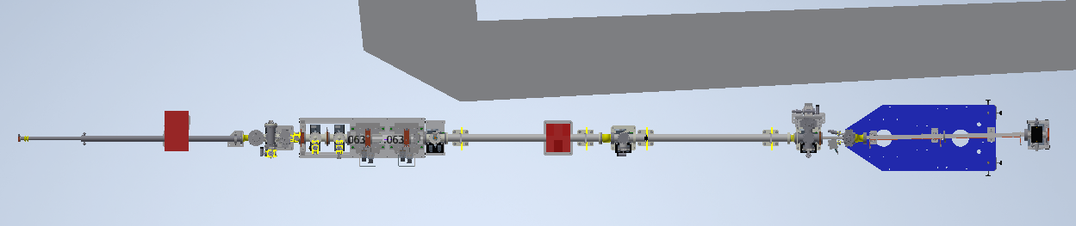
Beamline Layout
Notes:
3PW and BM light passes down our experimental line. The beamline is fully housed in the SR and prevents easy access.

Slide 8
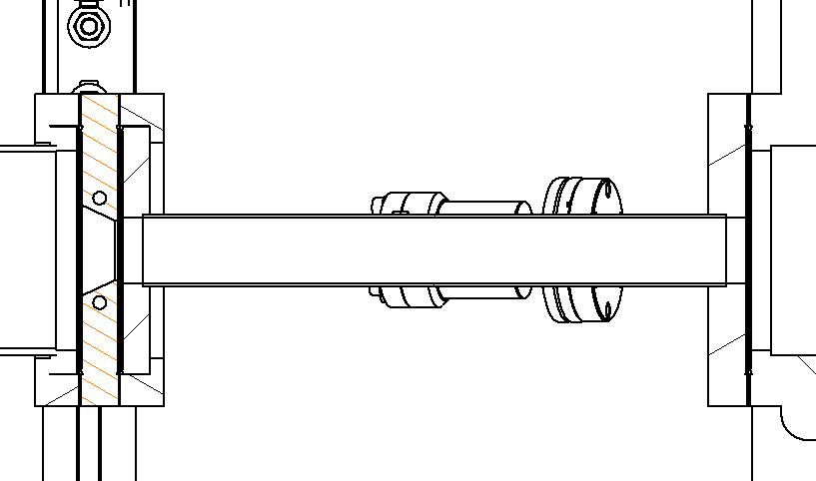
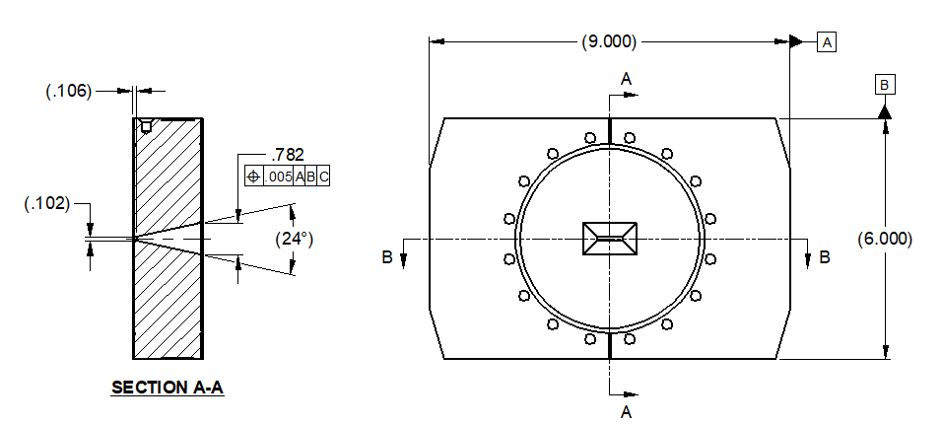
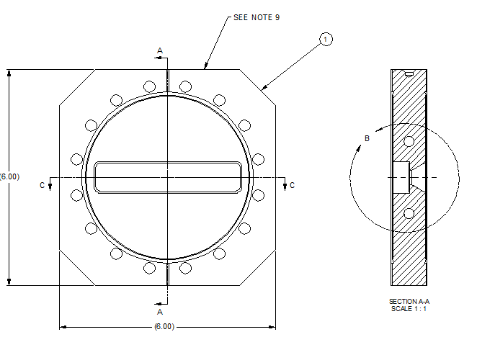
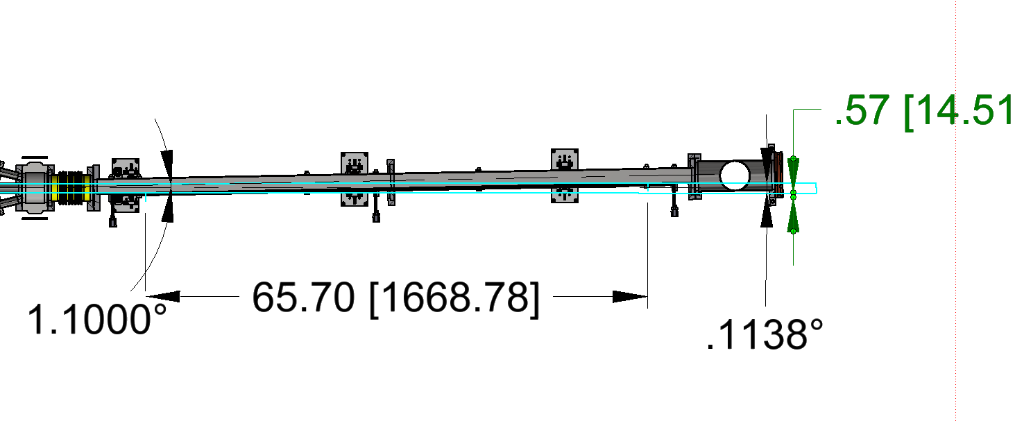
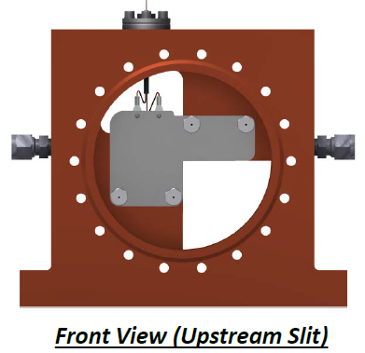
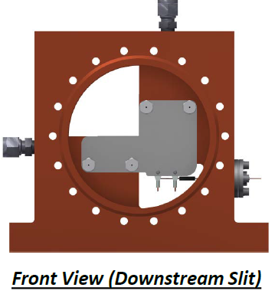
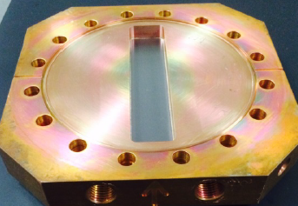
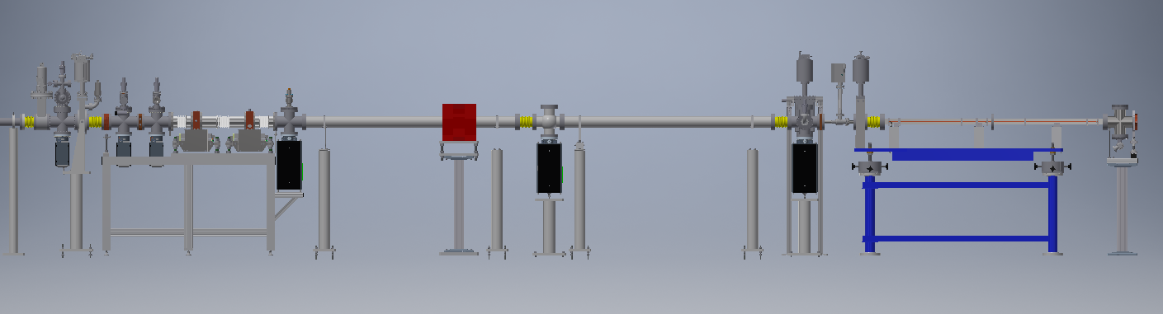
Beamline Layout Con’t
1.27” ID x 12” L
Conductance tube
Fixed mask: 16.74mm x 2.6mm
Be window 92mm x 10mm
X-Y slits
Notes:
From left to right:
BMPS and vacuum isolation valve.
Fixed mask
Be vacuum window
Slits to reduce the vertical and horizontal light. Tungsten blades and water cooled.
Conductance tube separating the sample from the beamline.
Sample table allowing various samples and incidence angles as desired.

Slide 9
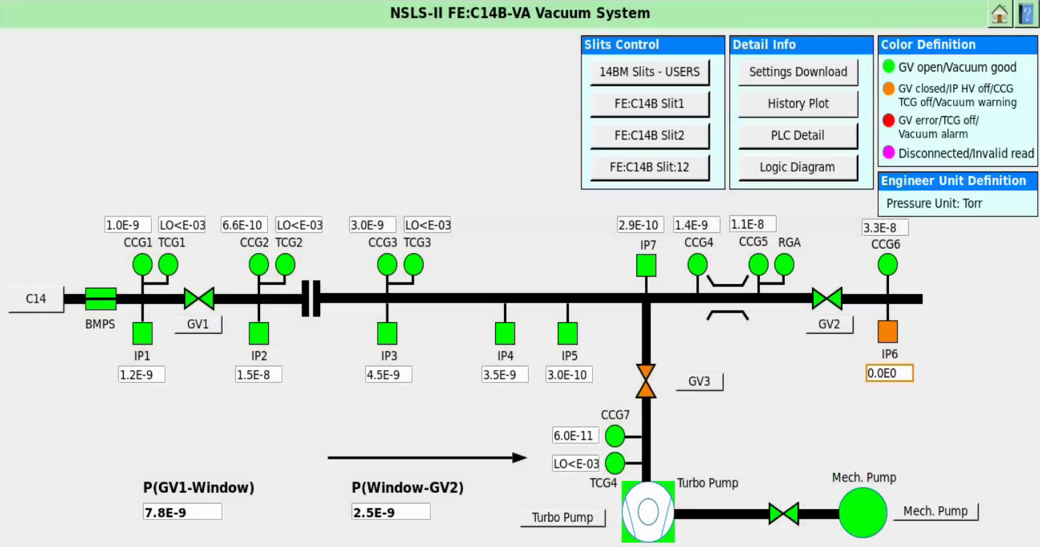
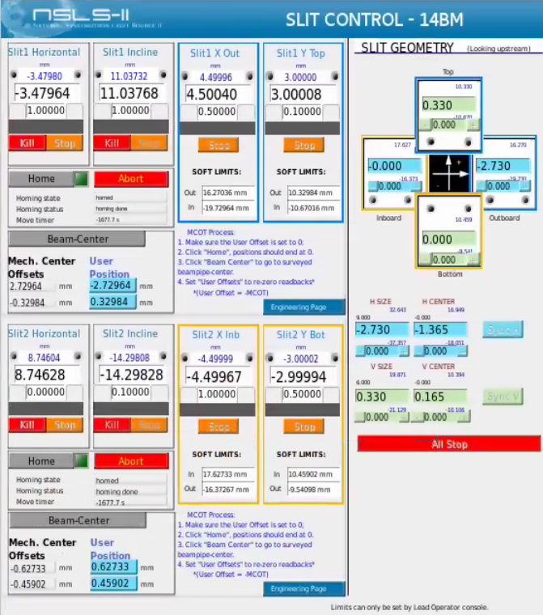
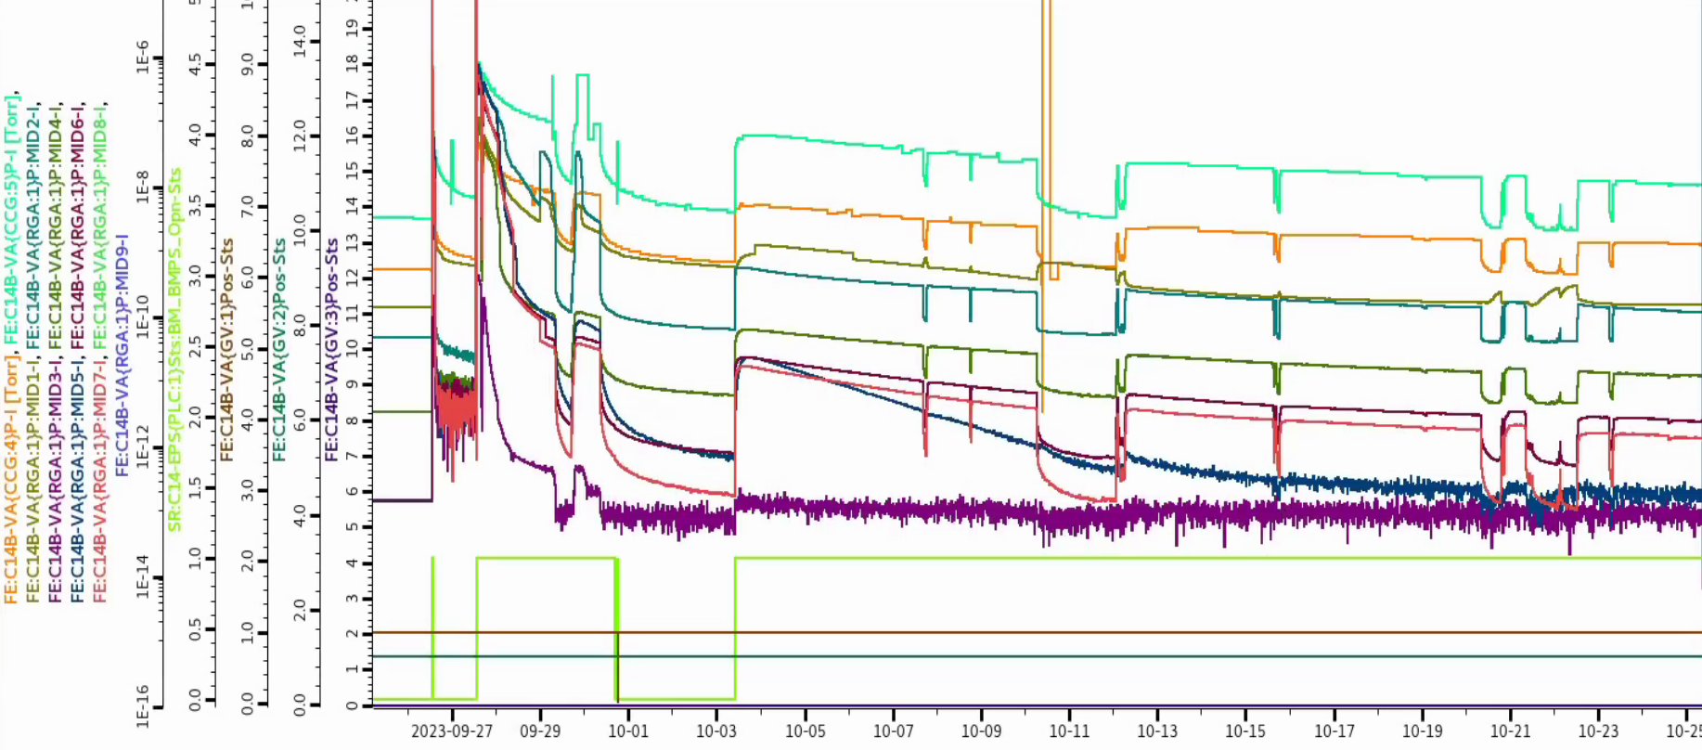
CSS Control
Notes:
EPICS control interface
EPS controlled with PLC and PVs (process values) collected serially through MOXA terminal servers to controls server.
CSS for collecting and presenting data
Raw PV data can be exported as a .csv to Excel

Slide 10
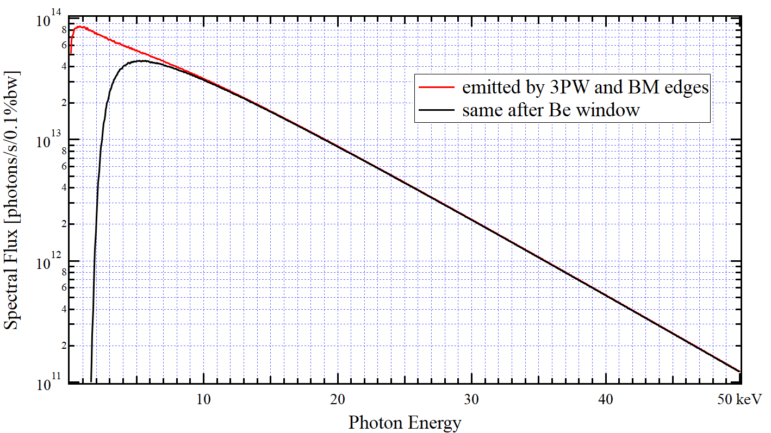
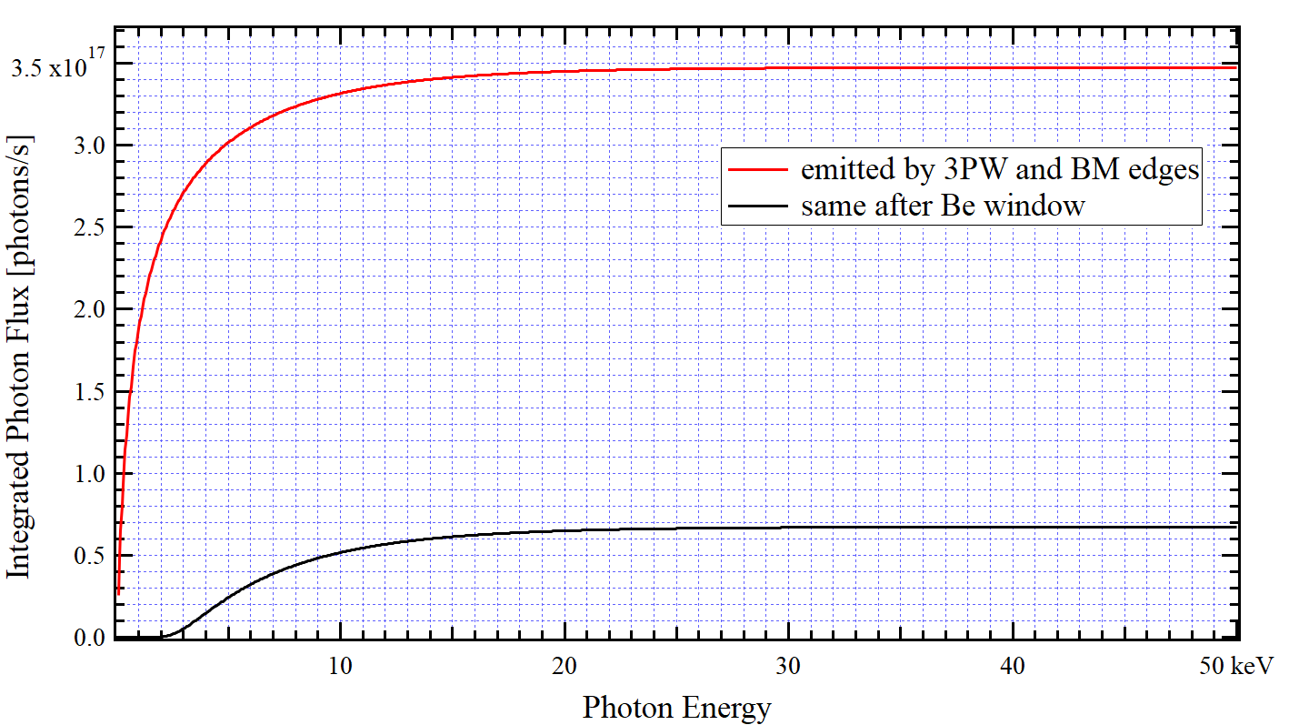
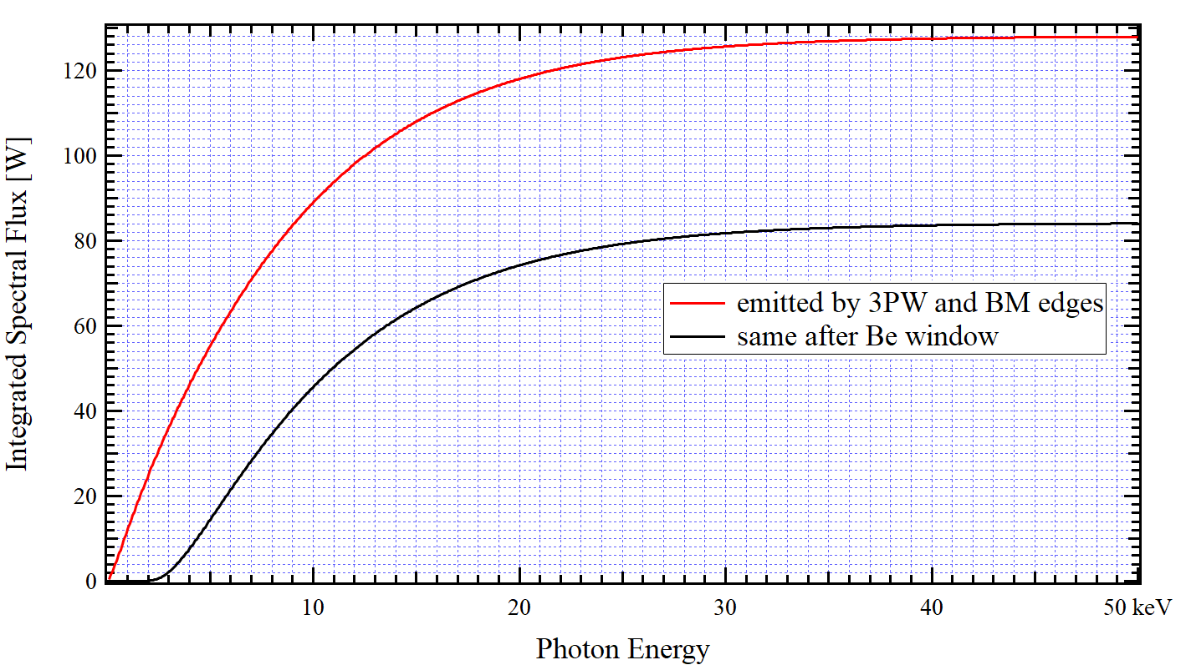
Spectral Flux and Derived Characteristics
of Radiation from 3PW and BM Edges
Spectral Flux of Radiation through 16.74 mm (H) x 2.6 mm (V) Aperture
at 8.18 m from 3PW Center
Courtesy: Oleg Choubar
Electron Current: 0.5 A
Be Window Thickness: 254 µm
Integrated Spectral Flux (with variable upper limit)
Number of Photons per Second
Watts
Notes:
Spectral flux with and without the Be window. The window cutoff is ~ 2keV and below and reduces the total flux ~ 5x, but there is still sufficient light to make desorption measurements in a reasonable time.
The total power is also reduced to a reasonable value to lessen the influence of thermal desorption on the samples even though water cooled.

Slide 11
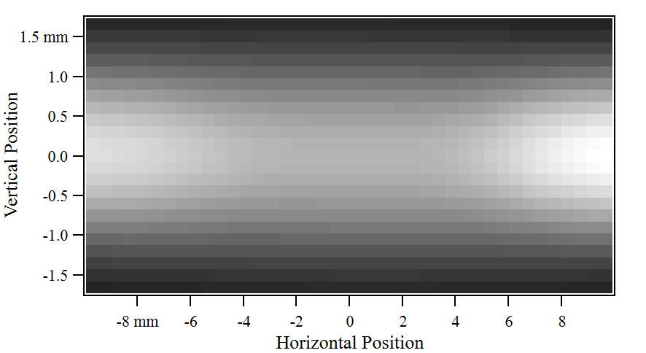
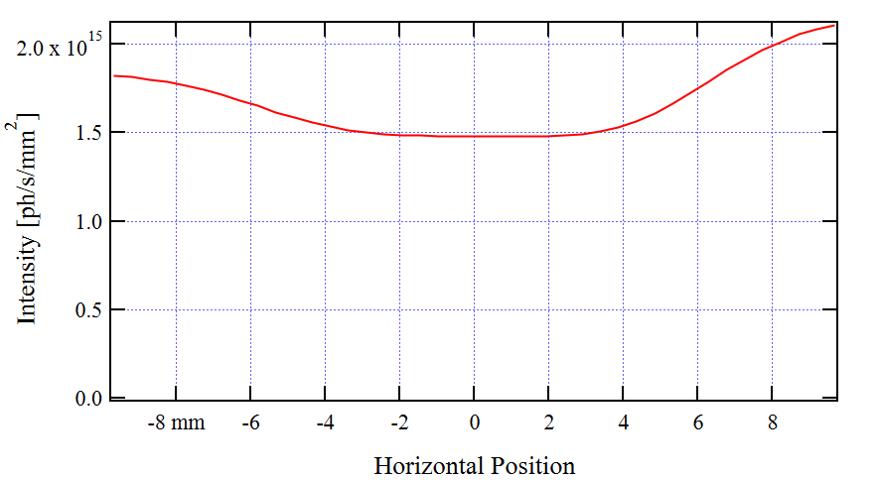
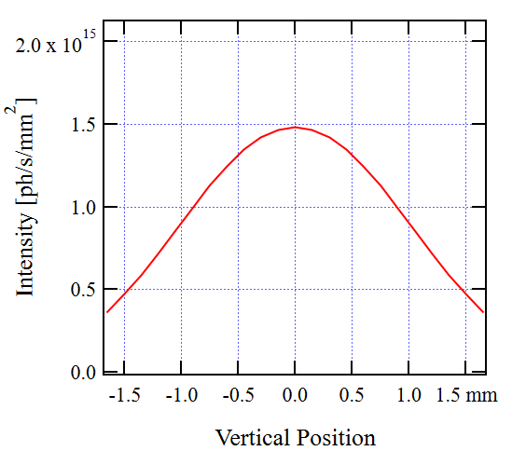
Photon Flux per Unit Surface Area
from 3PW (and BM Edges) at 14BM
Flux per Unit Surface Area at I_{e} = 500 mA
at 9.448 m from 3PW Center after 254 µm Thick Be Window
Cut by Horizontal Mid-Plane
Cut by Vertical Mid-Plane
Notes:
Source flux at the fixed mask location 9.5 meters from the source with the 250 micron beryllium window.
Reasonably constant across the horizontal midplane so the flux density is reasonably constant across the sample tube.
Vertical is trimmed at the mask, but the slits are left fully open.

Slide 12
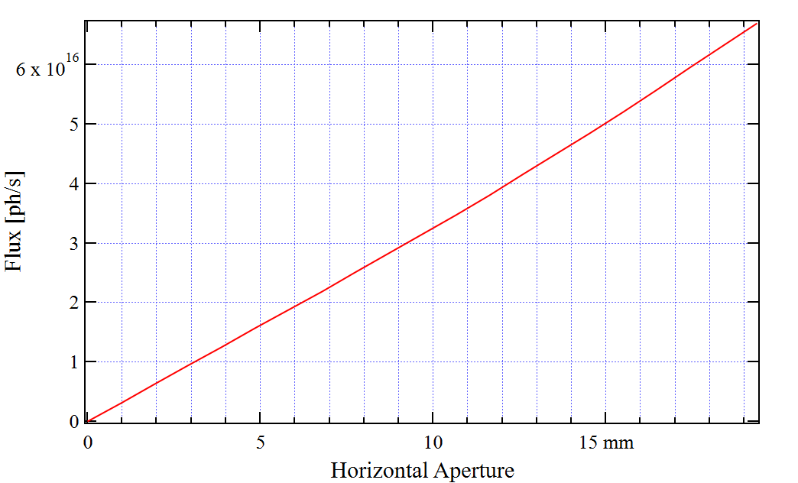
Photon Flux through Variable Size Horizontal Aperture
from 3PW (and BM Edges) at 14BM
Flux at I_{e} = 500 mA through Variable Centered Horizontal Aperture
at ~3.0 mm Vertical Aperture Located at 9.448 m from 3PW Center
after 254 µm Thick Be Window
Integrated Number of Photons:
Notes:
Due to the uniform horizontal photon distribution, the flux as a function of horizontal aperture (slit position) is linear.

Slide 13
Photon Flux (photons/sec) shares a linear relationship with beam current (mA) and full width aperture.
5x10¹⁶ photons/s @ 0.4 A
~10¹⁹ photons: ~3 min
~10²⁰ photons: ~30 min
~10²¹ photons: ~55 hours
~10²³ photons: ~23 days
Notes:
Flux increases linearly with beam current with and without window.

Slide 14
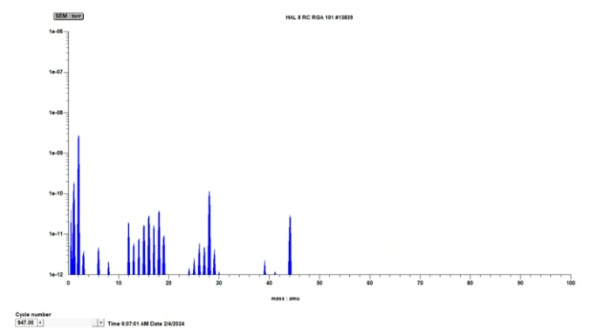
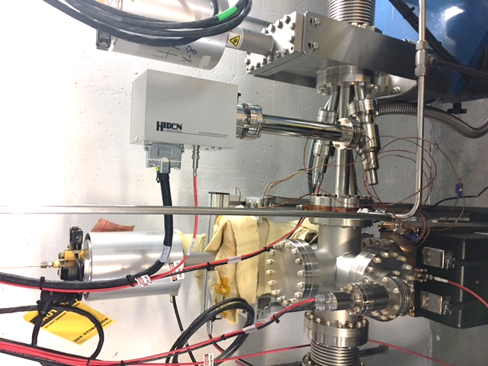
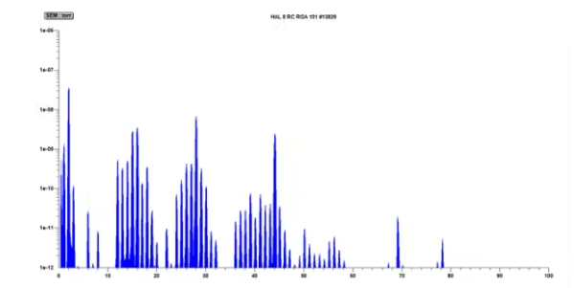
Desorption Measurement
NEG after 6e²¹ photons
Q = P₁-P₂ x C (Torr l/s)
No light
P₂
RGA
P₁
RGA
C
light
Notes:
We know precisely how to calculate the flux striking the sample tube.
We have the pressure on both sides of the known conductance tube.
We have RGA data to discern the constituents of the desorbed gas.
Depicted here are the installations of our sample tubes. SS, Cu and NEG coated Cu

Slide 15
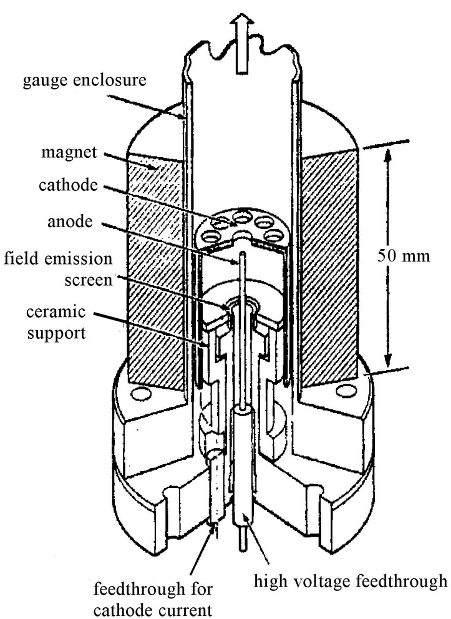
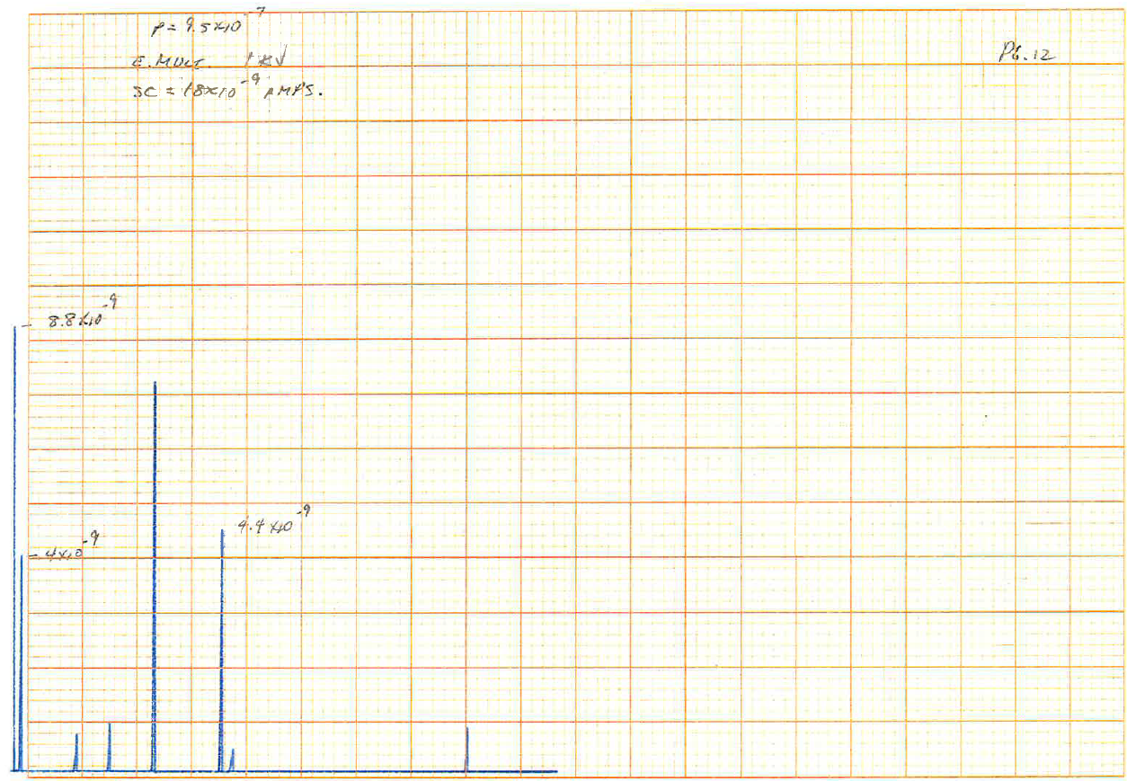
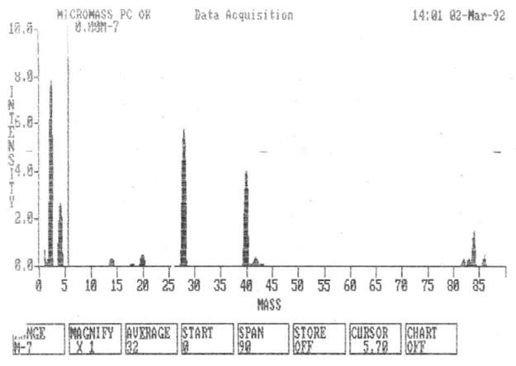
A word about calibration
Some concern the CCG is reading scattered photoelectrons. The CCG data was elevated when compared to the RGA data.
  * A photoelectron arriving at the anode is the same as an ion arriving at the cathode.
Prior to the NEG measurements, a second RGA was calibrated (against CCG gauge) for both Hydrogen and Nitrogen (bleed gas) with and without electron multiplier on a dedicated UHV system over 10⁻⁹ – 10⁻⁷. This RGA was located downstream and used to capture profile scans of the desorption.
The upstream data collection RGA was calibrated against the CCG gauge.
    *The CCG correction factor for H₂ and N₂ are well established at 2.4 and 1.0 respectively. (RGA SEM value 1025V)
Prior mix gas calibration on QRGAs show boost in lower mass with SEM.
NIST mix gas
2,4,28,40,84

Slide 16
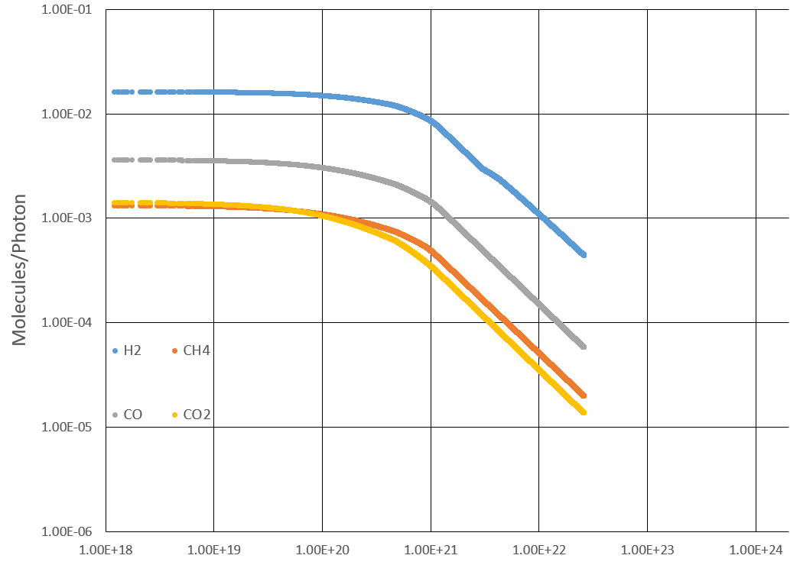
Experimental Data Manipulation
Using EPICS, the PV data (highlighted) can be extracted into a usable .csv file. Each point of data comes with a time stamp attached, and it is with this time stamp we can calculate the time interval between points and eventually use that to “integrate” the data with respect to time, otherwise known as the rectangular approximation method.
Notes:
We can now collect data over an extended period. We have our time stamp, partial pressures, our beam current and also our vacuum valve position.
We can extract the data as a .csv and import into excel.
We convert time into a delta T in seconds. For that time slice we calculate the photon flux and also calculate the throughput of gas in Torr-l /s of gas evolved from the surface, which is converted to number of molecules/photon for each time slice. The data is plotted as a function of total photons received on the surface.

Slide 17
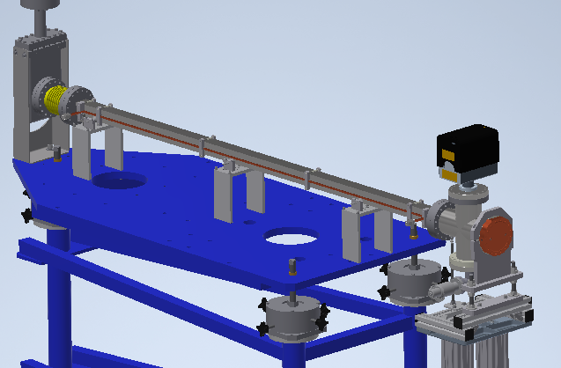
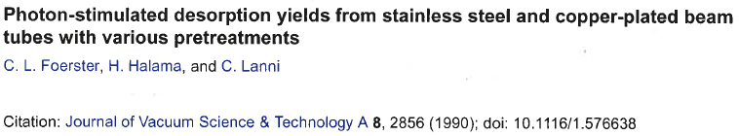
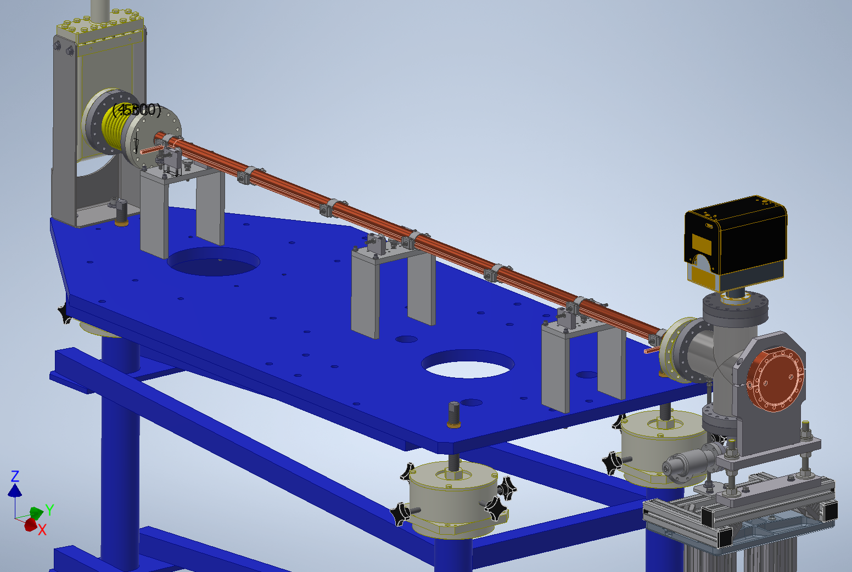
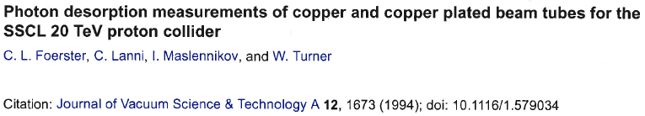
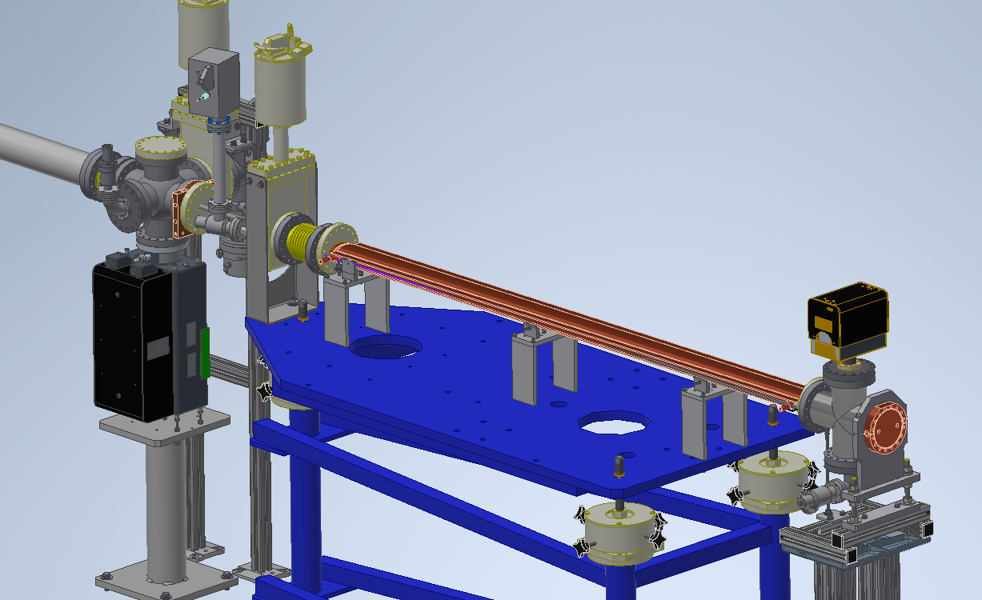
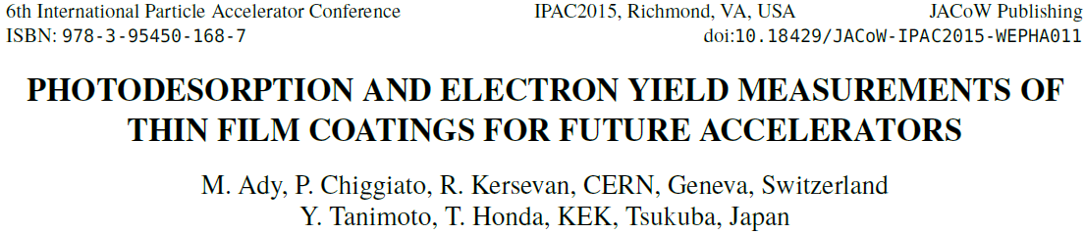
Experimental Runs
Reference Data
304L stainless steel
  Incidence 19 mrad
  Sample length
  Cleaned as per NSLSII cleaning specification. No in-situ bake
C101 copper
  Incidence 9 mrad
  Sample length
  Cleaned as per NSLSII cleaning specification No in-situ bake
NEG coated EIC copper storage ring beamtube
  Incidence 26 mrad
  Sample length
  Supplied by SAES, Standard activation into turbopump
10 mrad incidence, sample length 3m
12 mrad incidence, sample length 1m
10 mrad incidence, sample length 1.2m

Slide 18
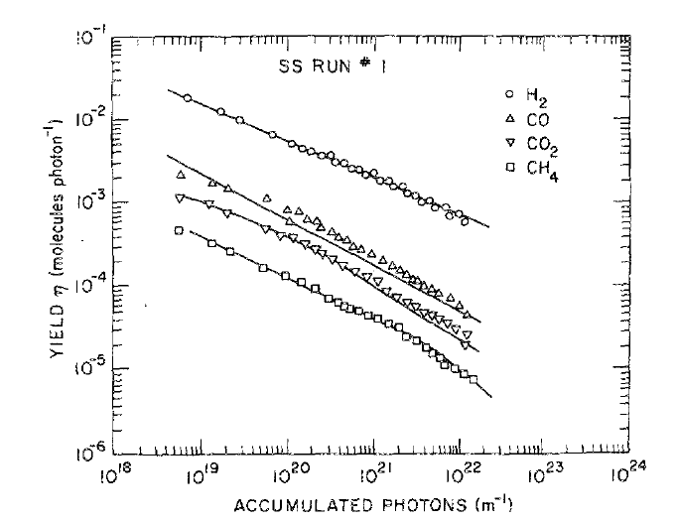
Baseline Results of Pre-Baked Stainless Steel
J.Vac. Sci Technol. A, Vol 8, No. 3, May/Jun 1990
3min
30 min
55 hr
23 day
Total photons (m⁻¹)
Notes:
The data for both our SS and Cu samples compare favorably to earlier work at NSLS. Our C101 water peak was lower than NSLS results. This could have been from putting the sample under storage vacuum several months before actual measurement.
We plan on measuring the NEG coated EIC SR pipe this winter.

Slide 19
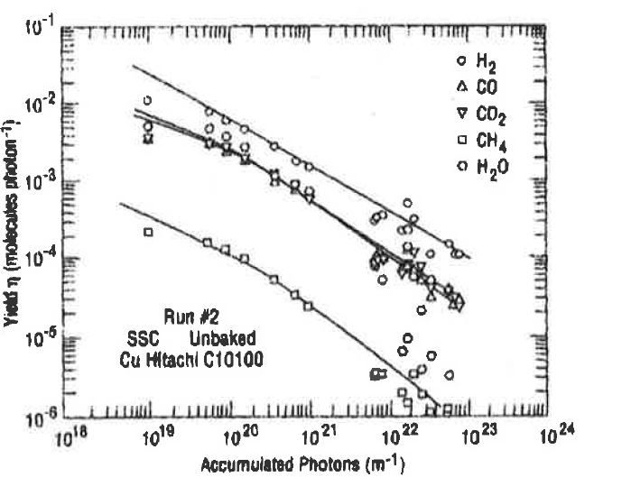
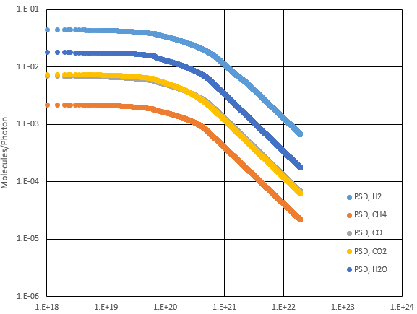
Baseline Results of Copper (C101 as received/no bake)
Elevated CH₄ indicates potential HC residual from cleaning process
Total photons (m⁻¹)
Notes:
The data for both our SS and Cu samples compare favorably to earlier work at NSLS. Our C101 water peak was lower than NSLS results. This could have been from putting the sample under storage vacuum several months before actual measurement.
We plan on measuring the NEG coated EIC SR pipe this winter.

Slide 20
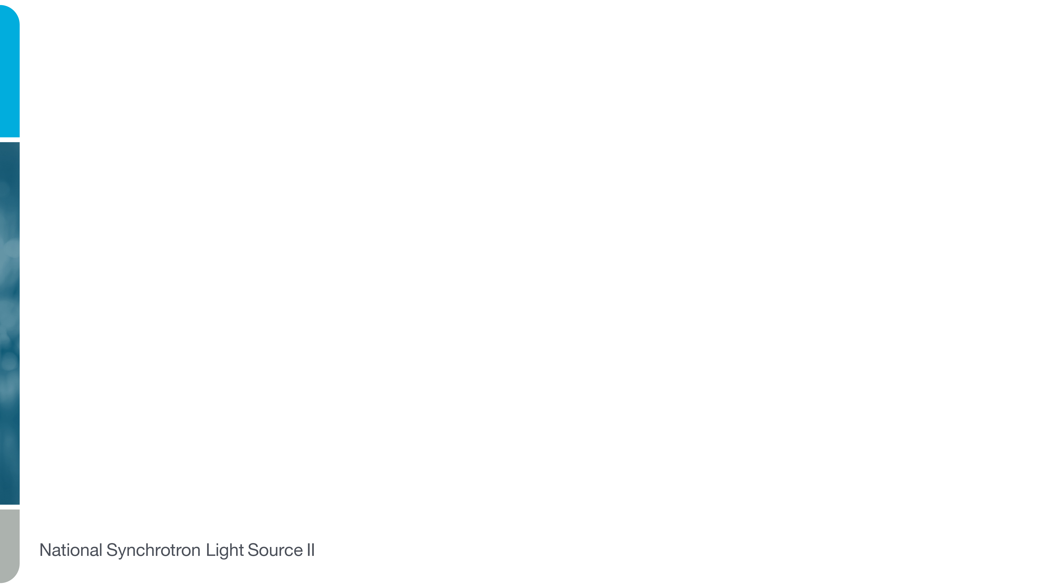


Baseline Results of NEG

Slide 21



NEG Data
CCG 6
No light (0 photons): 1.5e⁻¹⁰
With light (initial): 3.2e⁻⁸
(2.5e²¹ photons): 9.5e⁻⁹
(6e²¹ photons): 5.3e⁻⁹
(1e²³ photons): 1.2e⁻⁹
No light (e²³ photons): 2.0e⁻¹⁰
*Note:
RGA calibrated for H₂
Sensitivity correction for mass 16,28,44 not applied to data.
*Note:
Data is normalized with background subtracted. After e²², C0₂ background is higher without light than with light. Light is breaking the CO₂ bonds and pumped by NEG.

Slide 22


Photoelectron Production
Ion pump locations
Tremendous NEG and TSP pumping
IP currents rise and fall with beam current
CCG readings not influenced by beam current
Indication ion pumps are seeing and collecting photoelectrons.
  (Photoelectron arriving at pump anode is the same as ion arriving at the cathode)

Slide 23

Beam Study without Ion Pumps (M. Ferreira)
No impact on total pressure in the machine
Lifetime increased (pink line) due the blow up of the beam emittance (green), +ion trapping in the beam?
Evidence ion pumps help clearing photoelectrons and +ions
Any parallel with “clearing electrodes”?
The role of the ion pumps in producing stable beam needs further understanding and consideration for future upgrade.

Slide 24

Ion Pump and CCG readings with light (EIC NEG pipe)

Slide 25



Look Ahead NSLSII-U

Slide 26







Look Ahead Con’t (NSLSII-U)
Monte-Carlo codes MolFlow+ and SynRad+ M. Ady, R. Kersevan
Notes:
NSLSII-U will be some version of the so called complex bend. The PMQ and lattice configurations are under investigation. In parallel vacuum chamber development is taking place with the first prototype designed to fit the Halbach configured PMQs. The plan is to install in the PSD beamline and study not just the desorption on crotch absorber surfaces, but also the generation of photoelectrons and vacuum pumping configurations.

Slide 27






Look Ahead (NEG)
Upgraded coating system for NSLSII-U development
2m long to fit in PSD beamline
High 1.5 kG field for small apertures
Large diameter for larger apertures
Movable for any length chamber
Successfully coated 22.5mm x 32.5mm ceramic aperture
Fixed length solenoid unconfined discharge
Insufficient field (300g)
Notes:
Upgraded coating facility will allow for small aperture coatings on longer 2m samples. Higher field and larger aperture for larger chambers as well.

Slide 28
Summary
Complete
  Successfully measured stainless steel and compares well with prior measurements.
  Successfully measured EIC RCS Cu tube. Some evidence of improper cleaning.
  Meausred TiZrVa NEG coating for EIC Storage Ring beamtube with excellent performance.
Future Investigations
  In-house NEG coated small diameter beam-tubes for possible NSLSII-U applications (FY24-25)
  Develop methods and equipment for useful photoelectron measurements
  Studies on ion pump(s) as effective for both measuring and removing photoelectrons
  Measurements on prototype complex-bend vacuum chamber
Outside collaborators?
Notes:
Commissioning completed.
Meaningful measurements underway for EIC RCS and SR vacuum chambers
Look ahead is for NEG coatings and chamber measurements for NSLSII-U
Possible collaborations with other facilities

Slide 29
BACK UP SLIDES

Slide 30




Baseline Results of Stainless Steel
Baseline no light
After e²² Photons
With light
Initial light
After e²² Photons
No light

Slide 31




3PW and BM Magnetic Field, Electron Trajectory
and SR Power Density
Magnetic Field
Electron Trajectory
In Dispersion Straight Section
Horizontal Angle
Horizontal Position
Power Density
of Radiation from 3PW and BM Edges:
at 8.18 m from 3PW Center
within 16.74 mm (H) x
2.6 mm (V) Aperture
at 0.5 A Electron Current

Slide 32

14BM PSDFE
Slit table

Slide 33



14BM PSDFE

Slide 34

Look Ahead Con’t
Sample chamber
  Easier to develop small samples of various materials and surface treatments/finishes.
Varying incidence angle (remote)
Photoelectron measurements
Notes:
Possible future sample chamber allowing for changing incidence angle as well as photoelectron production and measurement.

