Slide 1
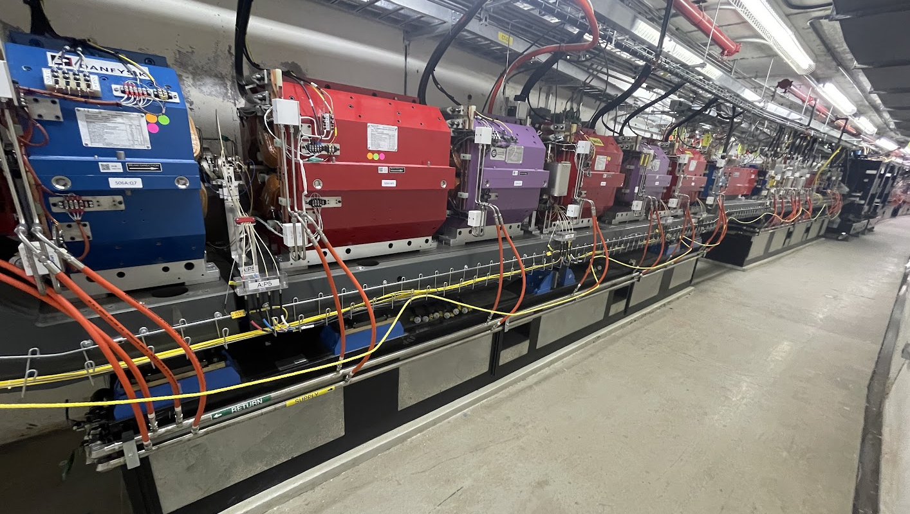
Fabrication of Vacuum Components for the
APS-Upgrade Storage Ring Vacuum System
Jason Carter
Lead Vacuum Engineer, APS-U Storage Ring Vacuum
Advanced Photon Source
Argonne National Laboratory, Lemont, IL
OLAV-IV: 6th Workshop on the Operation of Large Vacuum Systems
April 17, 2024
Notes:
Univ of Chicago Review, Aug. 30, 2010
1

Slide 2
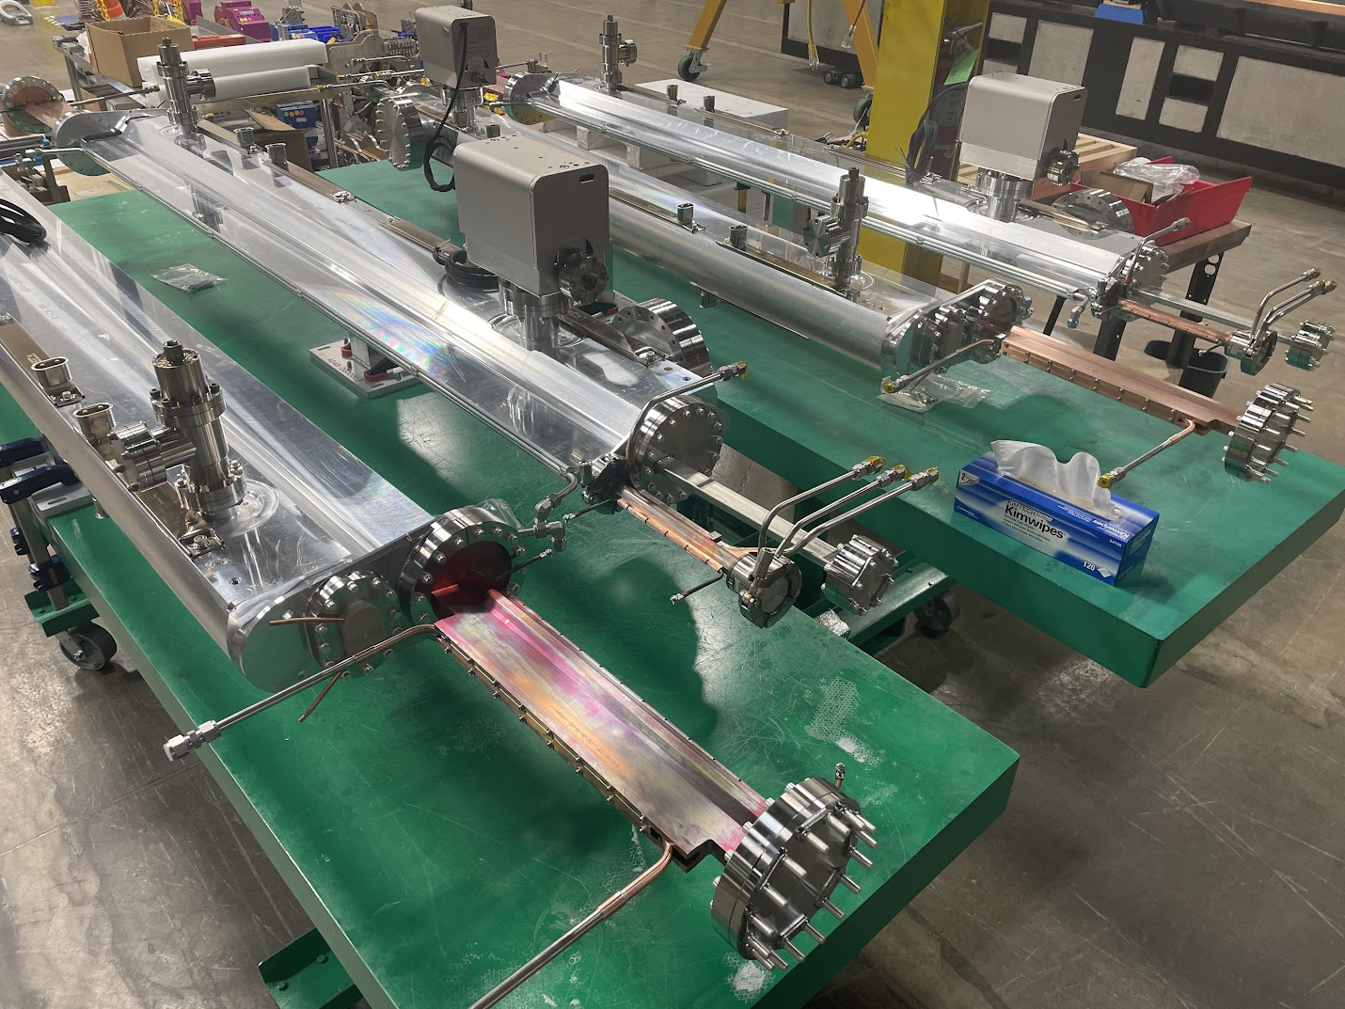
Agenda
APS-Upgrade project overview
Storage ring vacuum
overview & requirements
Vacuum chamber suppliers and delivery timeline
Production of APS-U vacuum chambers
Conclusions

Slide 3
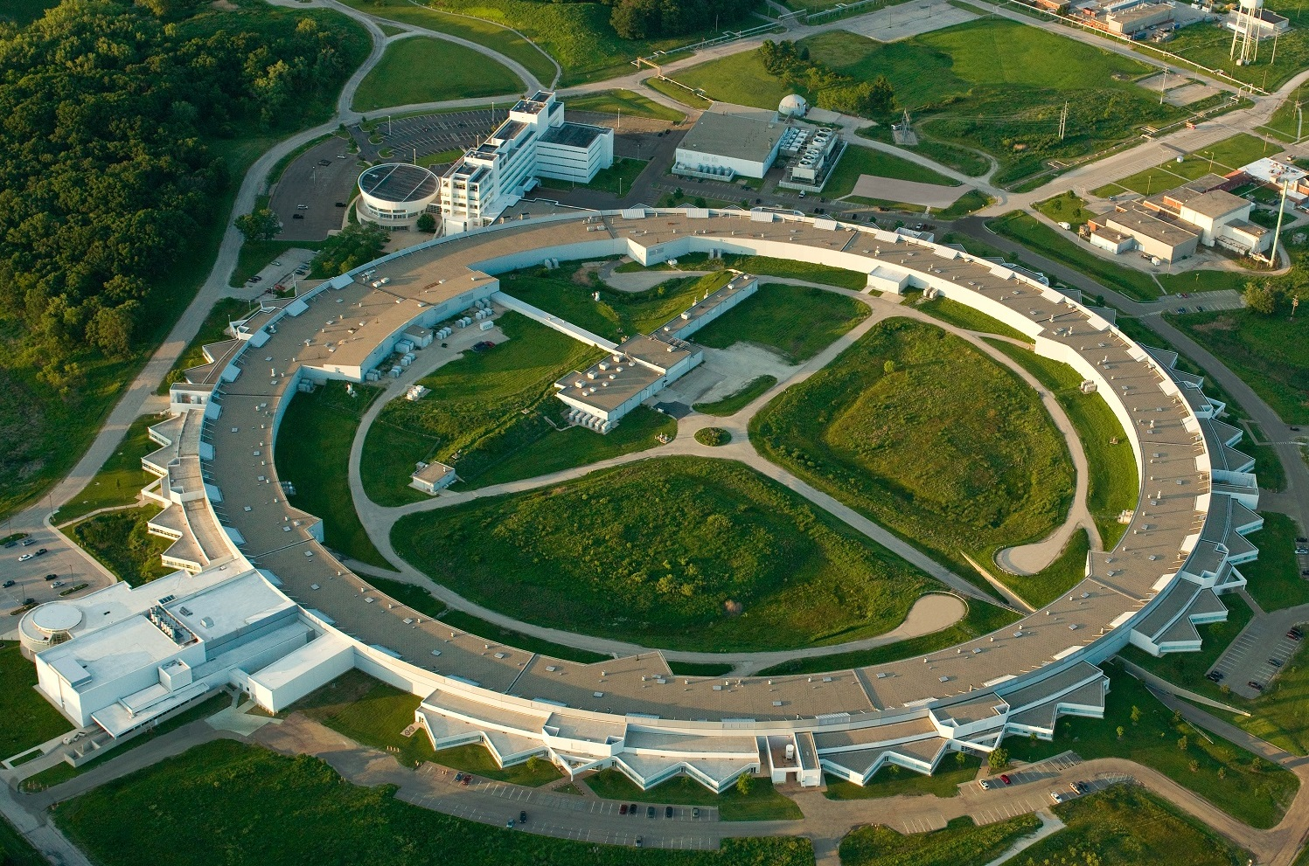
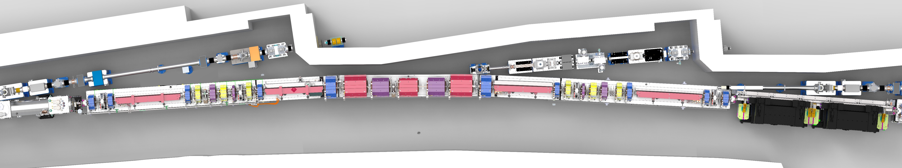
APS Upgrade Project - Overview
Advanced Photon Source (operated 1995 - 2023)
  7 GeV, 100 mA, 1104 m circumference synchrotron light source
  Shutdown in April 2023
APS Upgrade (commissioning starting April 2024)
  6 GeV, 200 mA retrofit
  Optimized for brightness above 4 keV
  Exceeds capabilities of today’s storage rings by 2 to 3 orders of magnitude in brightness, coherent flux, and nano-focused flux
  Deliver 5000 hrs / year of beam to users at 95% availability
  Powers entire beamline suit for APS’s >5000 users per year
APS
Advanced Photon Source (APS),
Argonne National Laboratory, Lemont, IL
Top view of typical 27.6 m length APS-U sector

Slide 4
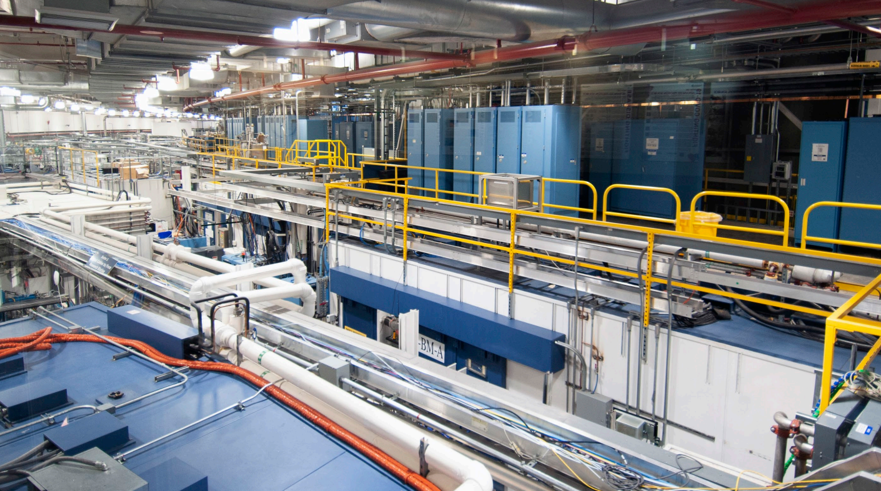
APS Upgrade Project - Overview
APS Experimental Hall Today
APS

Slide 5
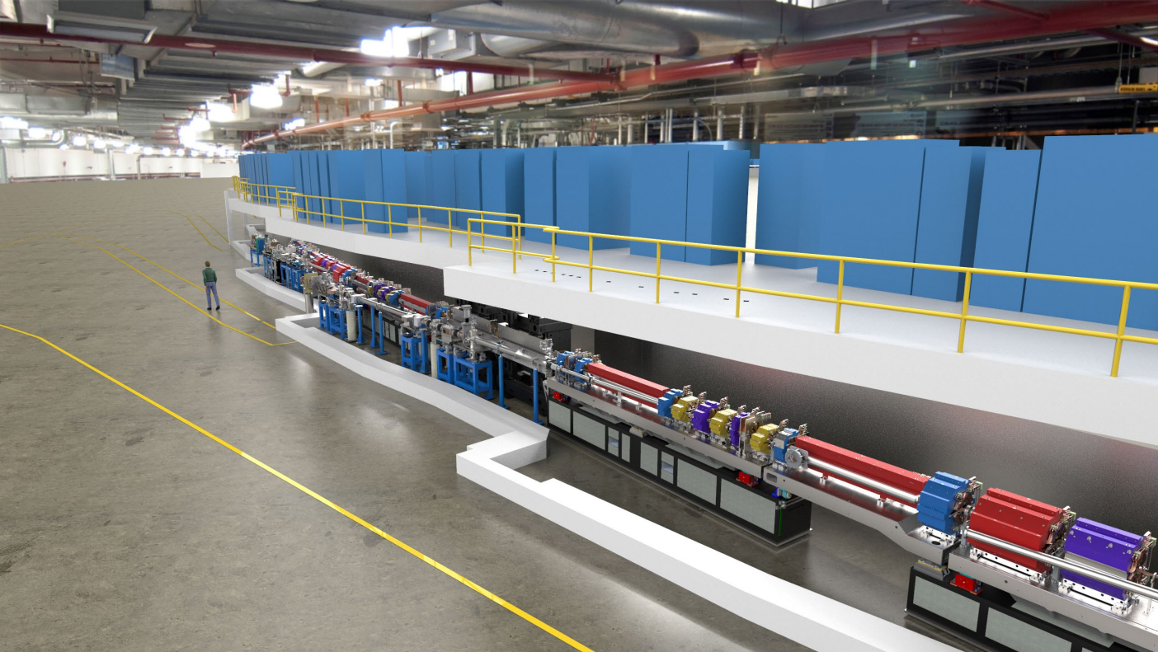
APS Upgrade Project - Overview
Rendering of APS-U Storage Ring
APS

Slide 6
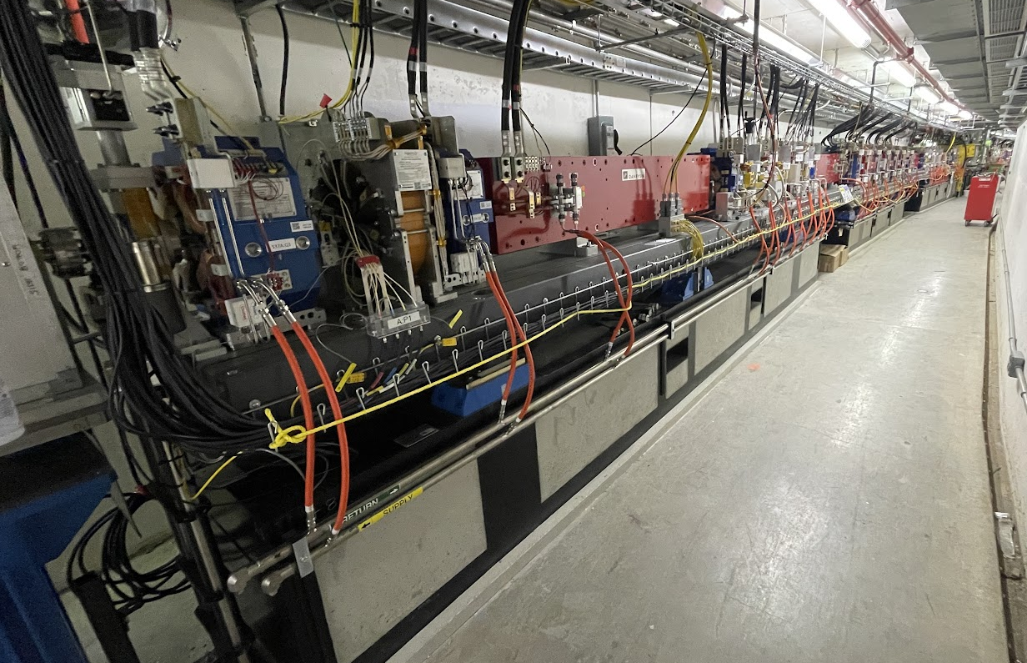
APS-U Storage Ring
40 sectors, 27.6 meters each in length, in the 1108-meter circumference storage ring
Sectors consist of arcs + straight section + front ends
This talk: Arcs divided into 5x
magnet-vacuum modules per sector
  Module = magnets + vacuum system on top of a base plinth, assembled during pre-installation phase (N. Bechtold talk)
  Modules installed in tunnel, vacuum baked during 1-year dark time
  (T. Clute talk), then machine commissioned (in progress!)
BEAM
FODO module
DLM-A module
DLM-A
QMQ-A
FODO
QMQ-B
DLM-B
Aisle-side view
of arcs only

Slide 7
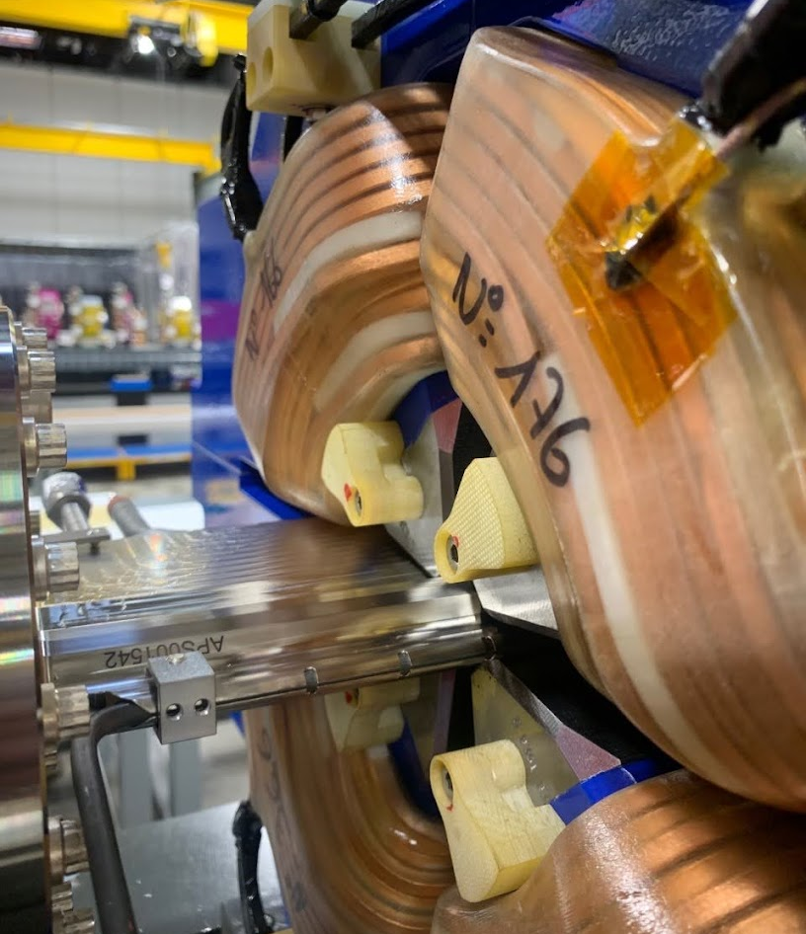
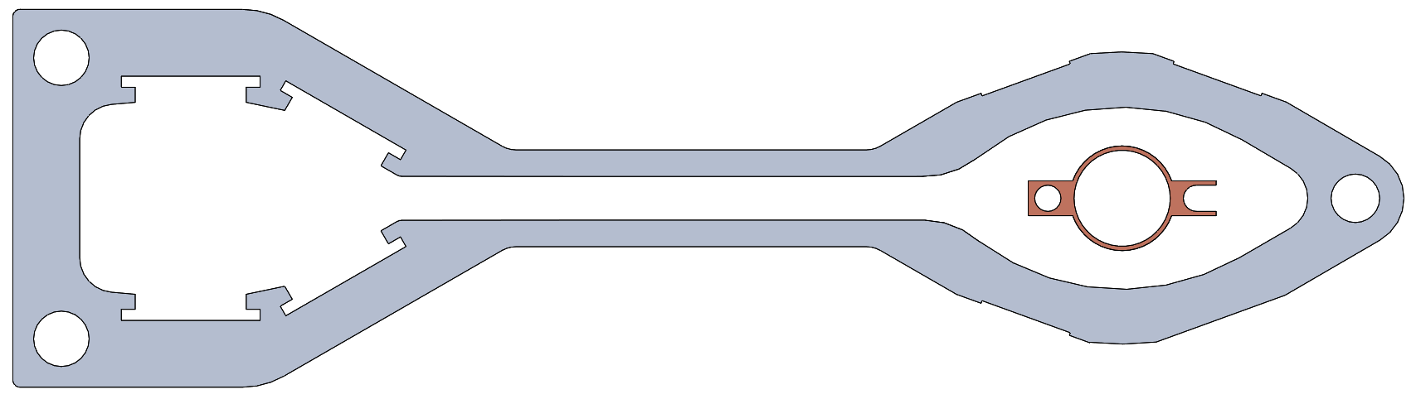
APS U Storage Ring Vacuum System
UHV pressures required for good beam lifetimes
  2E-9 Torr @ 200 mA by 1000 A*hrs conditioning (1E-11 Torr/mA)
22 mm ID, thin-walled chambers with ~0.5-1.0 mm gaps to magnet poles leads to conductance limited vacuum system
Hybrid use of common UHV pumping elements
  NEG-coated tubes across 40% of the ring
  9x discrete ion pump / NEG cartridge combos
  NEG strips across 2 m long chambers with antechambers
APS-U quadrupole magnet with ~0.5 mm gaps to chamber
Existing APS storage ring chamber compared to
new 22 mm ID APS-U style chamber

Slide 8
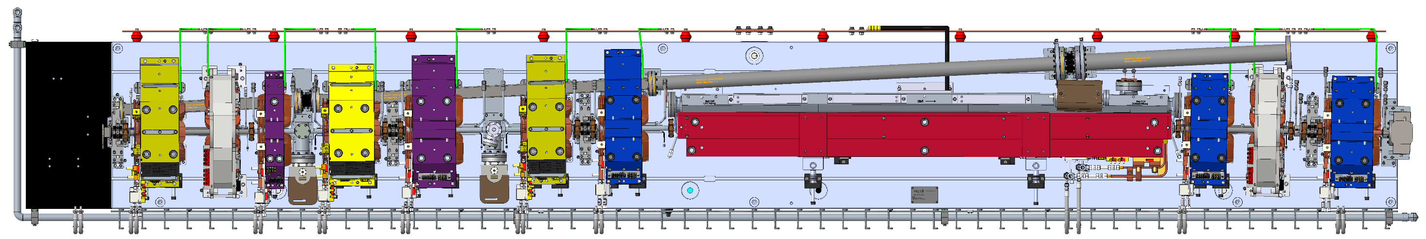
APS U Storage Ring Vacuum System
APS-U’s vacuum system features a variety of UHV vacuum chambers made from either aluminum, copper, inconel, or stainless steel
14 beam position monitor ‘BPM’ chambers per sector:
each BPM with 2 Rf-lined welded bellows for chamber growth
Vacuum system baked using variety of pre-installed electric heaters
B:P4
SST
BPM
B:VC7
INCONEL
CHAMBER
B:P3
SST
BPM
B:VC5
ALUMINUM
CHAMBER
B:P2
SST
BPM
B:VC4
ALUMINUM
CHAMBER
BEAM
B:EA1
COPPER
ABSORBER
B:VC2
INCONEL
CHAMBER
B:P1
SST BPM
B:VC6
ALUMINUM
CHAMBER
B:VC3
ALUMINUM
L-BEND CHAMBER
B:FA1
COPPER
ABSORBER
B:VC1
COPPER
CHAMBER
Top view of APS-U DLM-B Magnet-Vacuum Module
Vacuum chambers along electron beam path

Slide 9
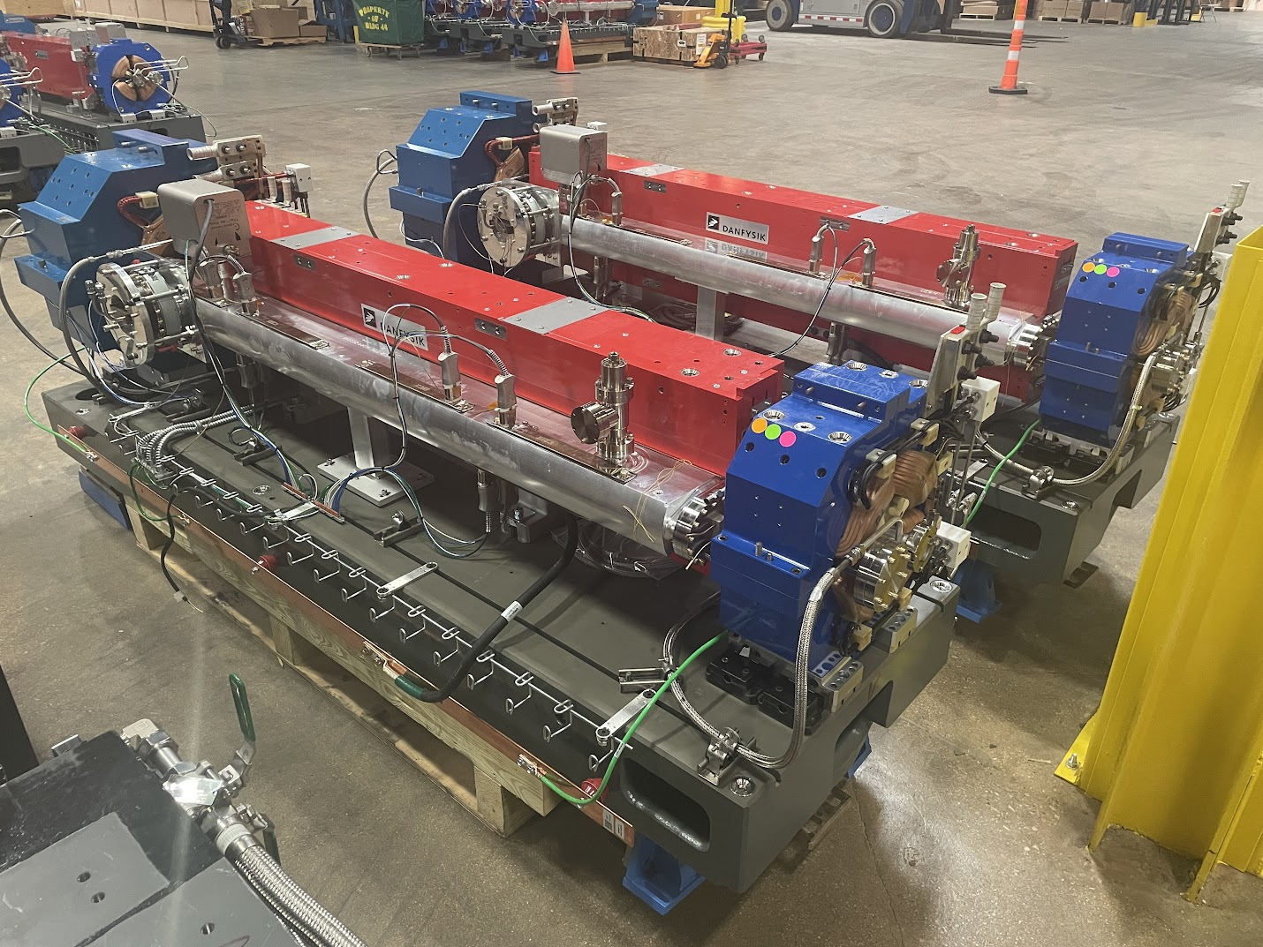
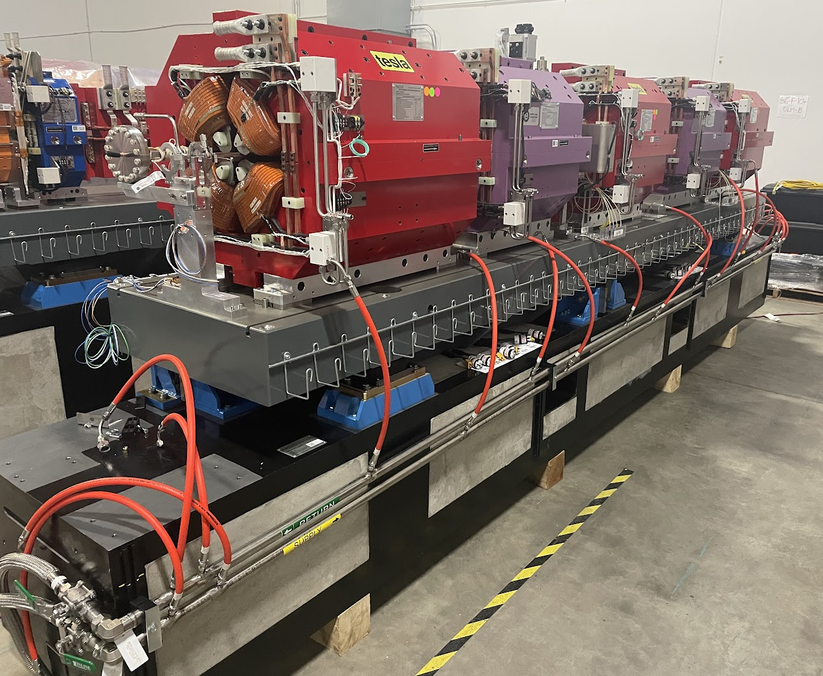
APS U Storage Ring Vacuum System
BEAM
BEAM
QMQ-A magnet-vacuum modules
FODO magnet-vacuum modules

Slide 10
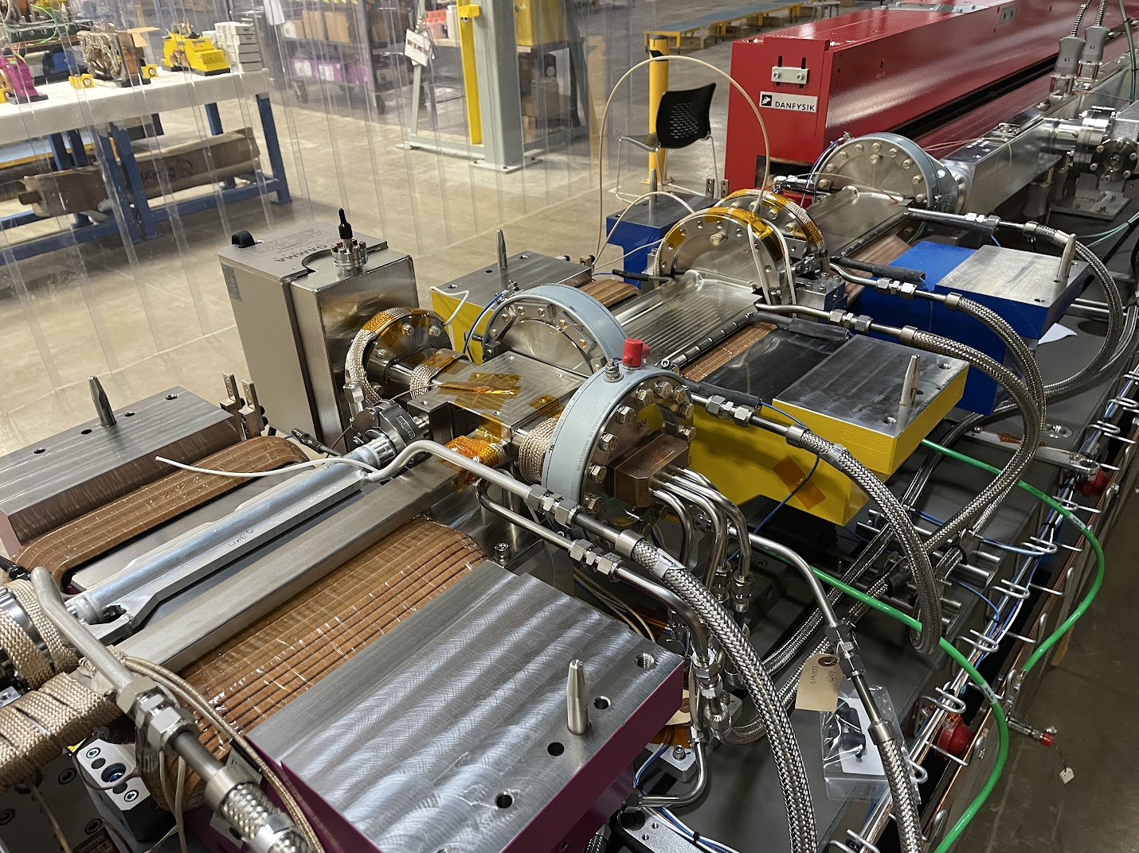
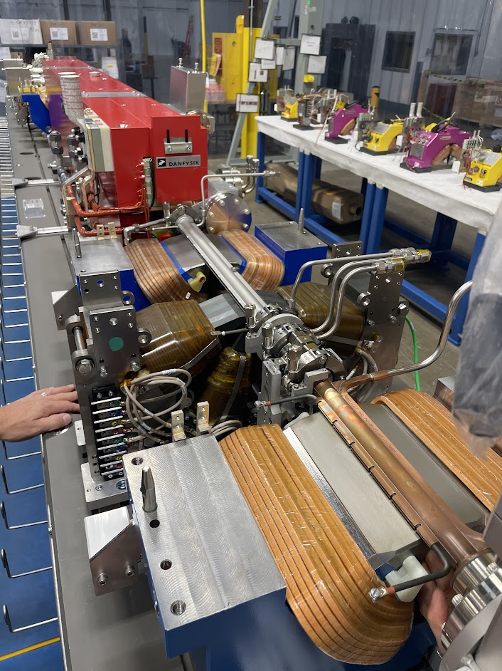
APS U Storage Ring Vacuum System
BEAM
BEAM
DLM-A magnet-vacuum module (above)
DLM-B magnet-vacuum module (right)

Slide 11
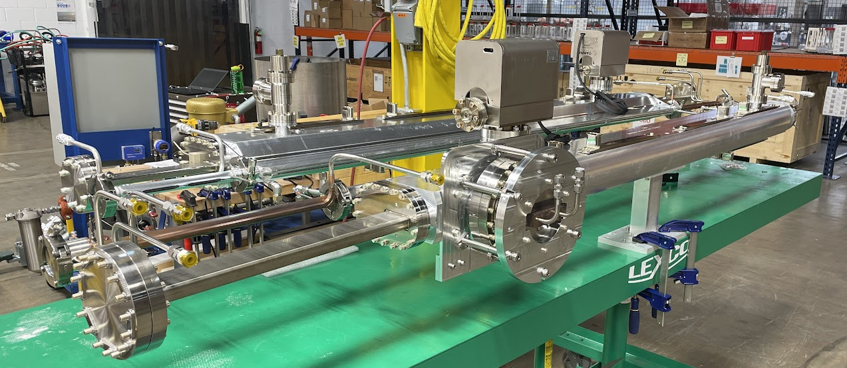
APS U Storage Ring Vacuum System
Subassembly of vacuum chambers for a QMQ-A magnet-vacuum module

Slide 12
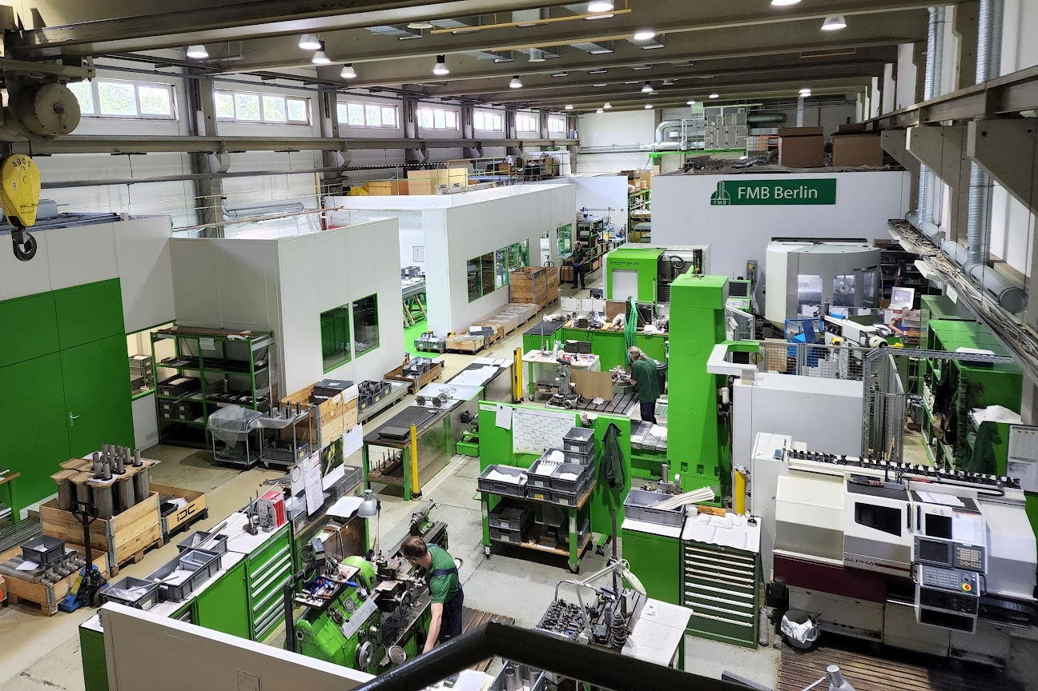
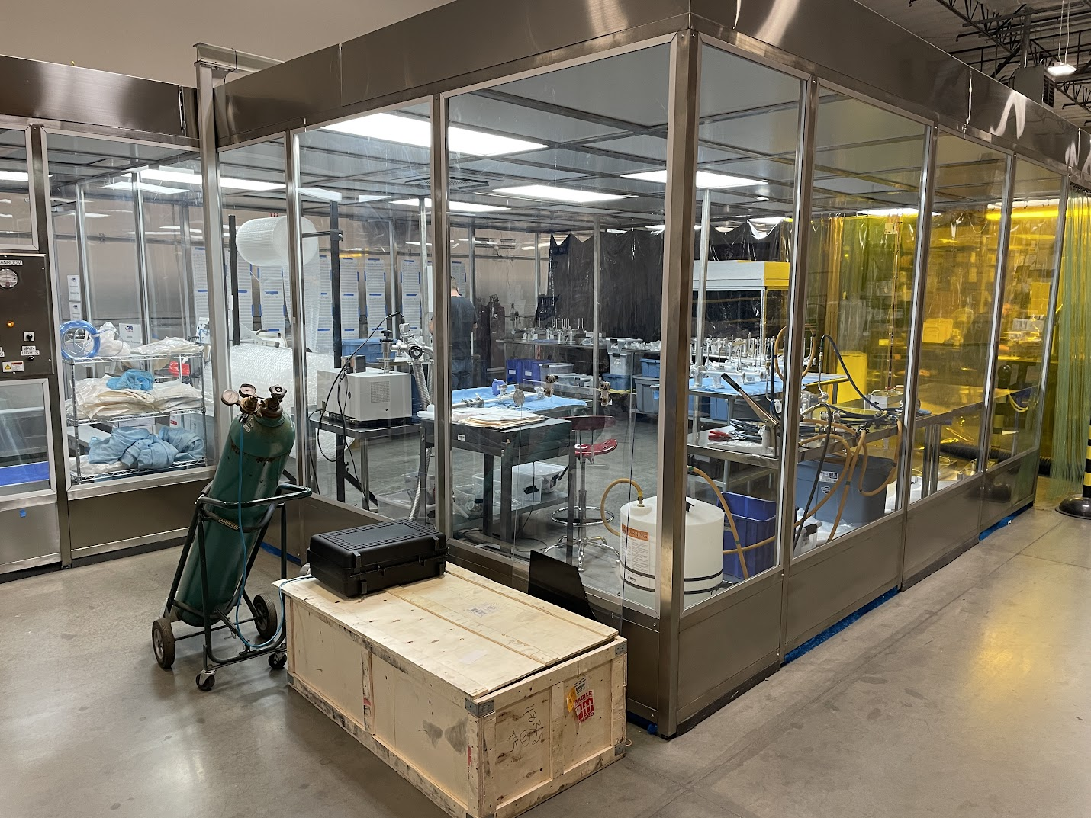
APS-U vacuum chamber suppliers
Vendor | Chamber type | QTY chambers
FMB Berlin | NEG-coated copper chambers Stainless-steel keyhole aperture & crosses Stainless-steel photon extraction chambers Photon absorbers | 312 208 396 220
SAES-Rial | NEG-coated Inconel chambers | 186
GNB Corp | NEG-coated Aluminum chambers (Chambers NEG coated by SAES-Rial) | 352
MDC | Beam Position Monitor (BPM) chambers Standard bellows | 616 176
CINEL | SST extraction chambers w/ additional electrode feedthroughs | 44
CECOM | Zone F absorbers | 14
L-BEND CHAMBER MATERIALS | Hannxi (Taiwan) – aluminum extrusions Stretch Forming Corp – extrusion forming ERA Industries – extrusion final machining High Energy Metals – bimetal ‘endplates’ | 176
 | TOTAL | 2700
FMB Berlin (Germany)
GNB Corp (California)

Slide 13
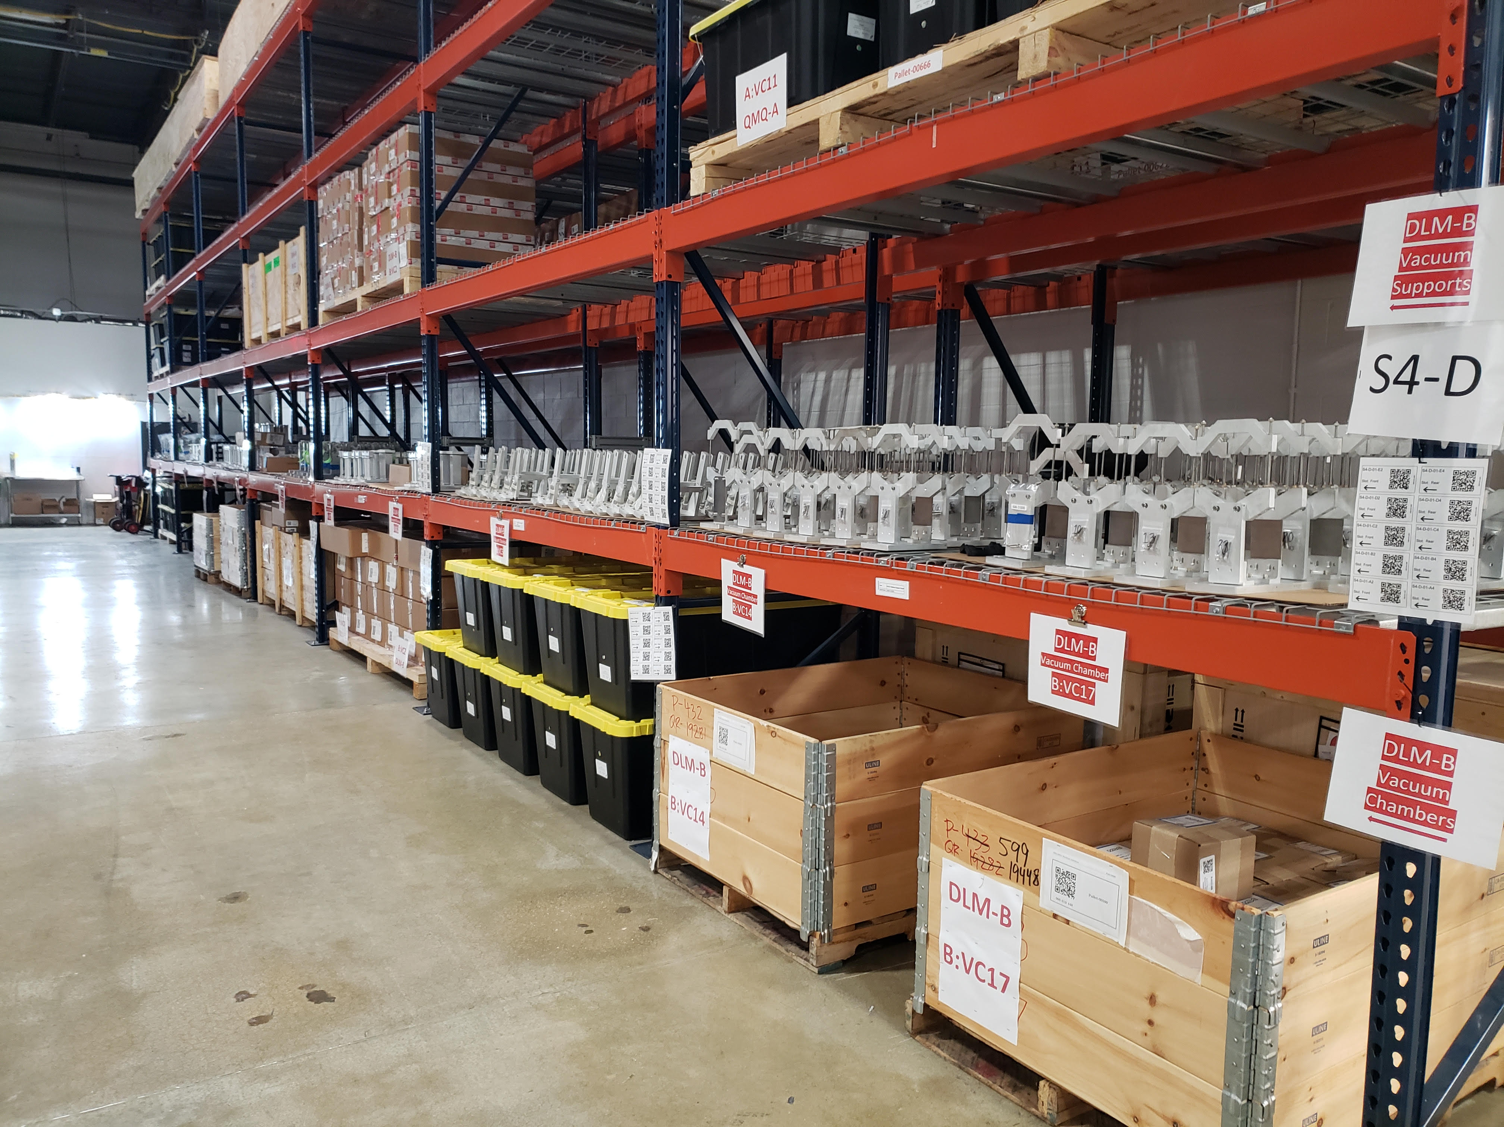
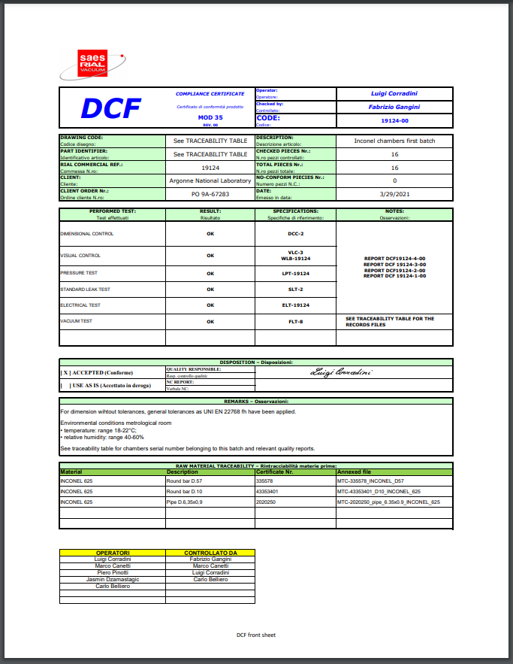
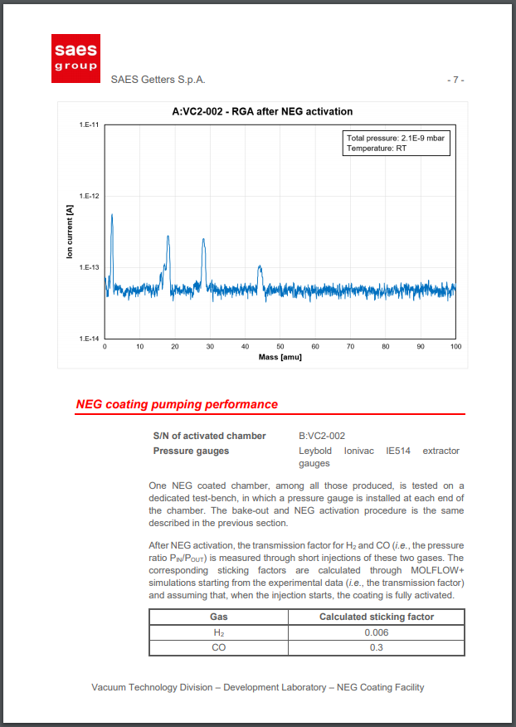
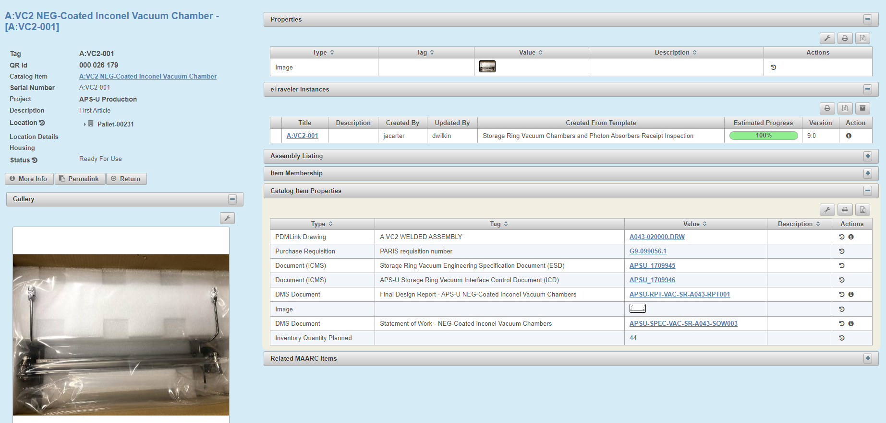
Documentation and QA
All vacuum chamber, components & hardware tracked with QR codes in APS-U ‘Component Database’
E-travelers record work, delivery inspection, and approval of QA data and deliveries
Majority of deliveries with ‘vendor certified QA data’ to help minimize APS-U’s follow-up inspection time
Incoming chambers verified with go/no-go gauges
All chambers, hardware, etc. QR coded and stored in off-site warehouse close to Argonne National Laboratory
Typical inventory item of a vacuum component in the APS-U component database (CDB)
Vendor QA reports with certification of materials, welding, dimensions, vacuum & more

Slide 14
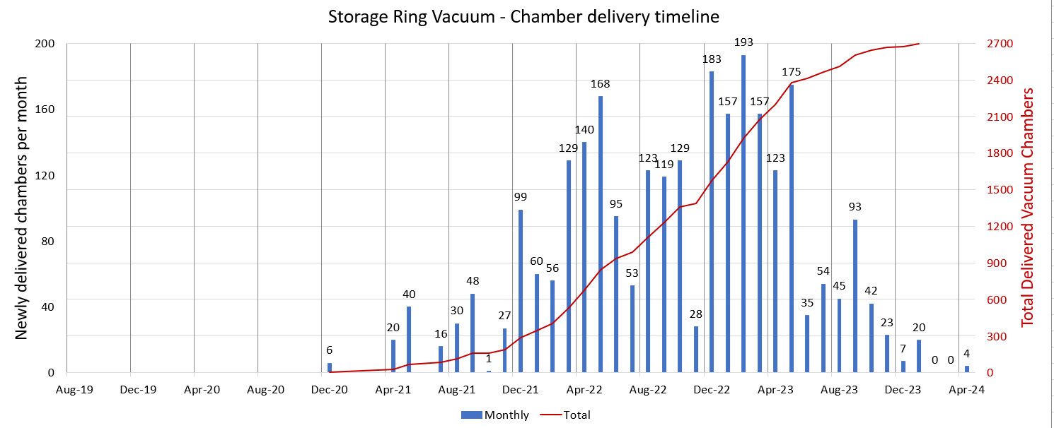
Vacuum chamber delivery schedule
2700 total vacuum chambers ordered with 2460 installed, ~10% spares
All contracts competitively bid for best value per DOE requirements
COVID-19 impacted all suppliers, subcontractors in various ways and at various times
1st phase August 2019:
1100 chambers deemed ‘long lead procurements’ (LLP) and ordered in August 2019 including L-bend type chambers & NEG-coated chambers (aluminum, copper & Inconel)
2nd phase Sep-Oct 2020:
1540 more chambers including absorbers, BPMs, extraction chambers, bellows
3rd phase Feb 2023:
60 specialty ‘Zone F’ straight section chambers
3 years of
production deliveries
Onset of COVID-19 Pandemic
1st phase:
Contracts for 1100 ‘LLP’ L-bend, NEG-coated Chambers
2nd phase: Contracts for 1540 BPMs, absorbers, extraction chambers
3rd phase:
Contracts for 60 Zone F straight section chambers

Slide 15
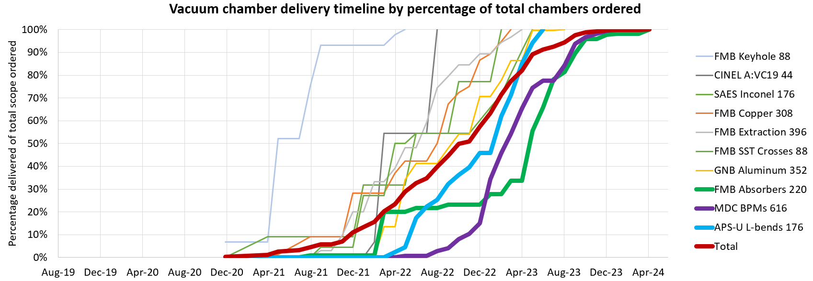
Vacuum chamber delivery schedule
CRITICAL PATH CHAMBERS
3 years
August ‘19
Contracts signed NEG-coated chambers, L-bend materials
October ‘20
Contracts signed for BPMs, absorbers
December ‘21
10% of chambers delivered
December ‘22
Start of Magnet-Vacuum Module Assembly
57% of chambers delivered
April ‘23
100th module / 50% assembled +
APS storage ring shutdown
Dec ‘23
Final Module Installed in Tunnel
Apr ‘24
Beginning of APS-U commissioning

Slide 16
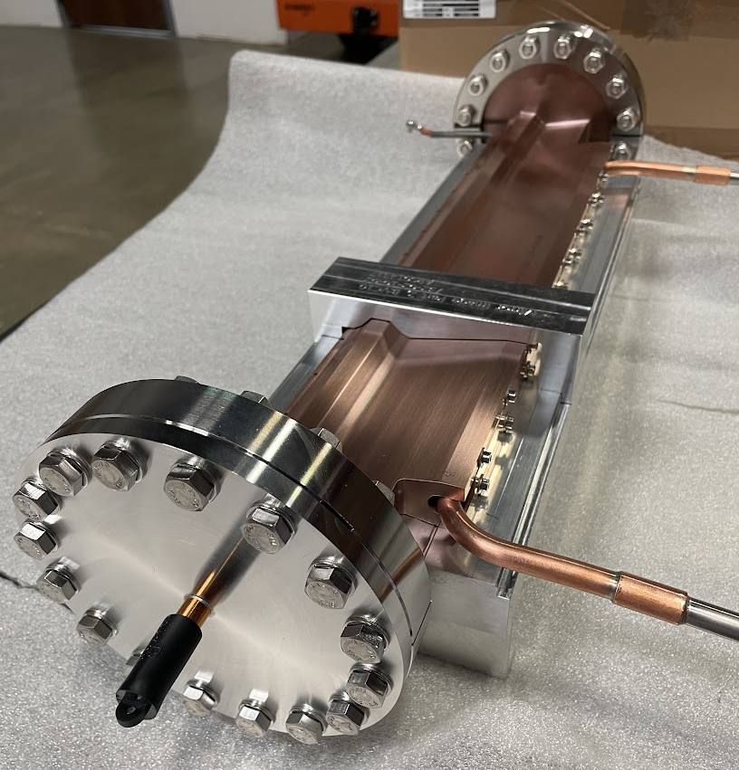
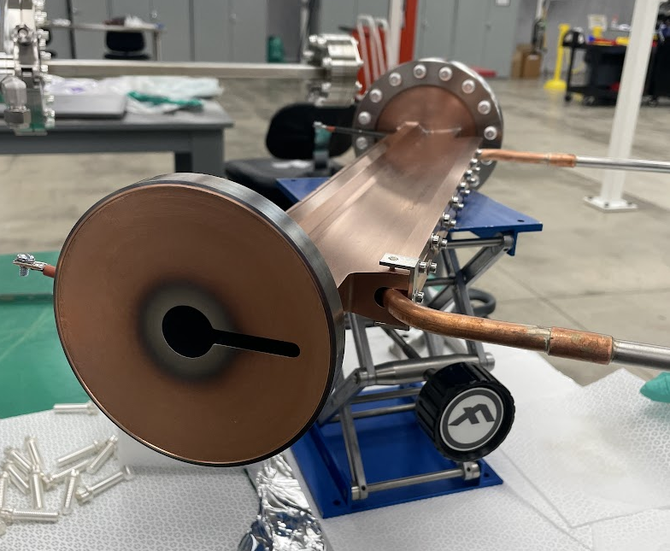
Vacuum Chambers
Copper chambers inspected by APS-U with machined ‘no-go’ gauge to ensure magnet fit
FMB Berlin NEG-coated copper chamber

Slide 17
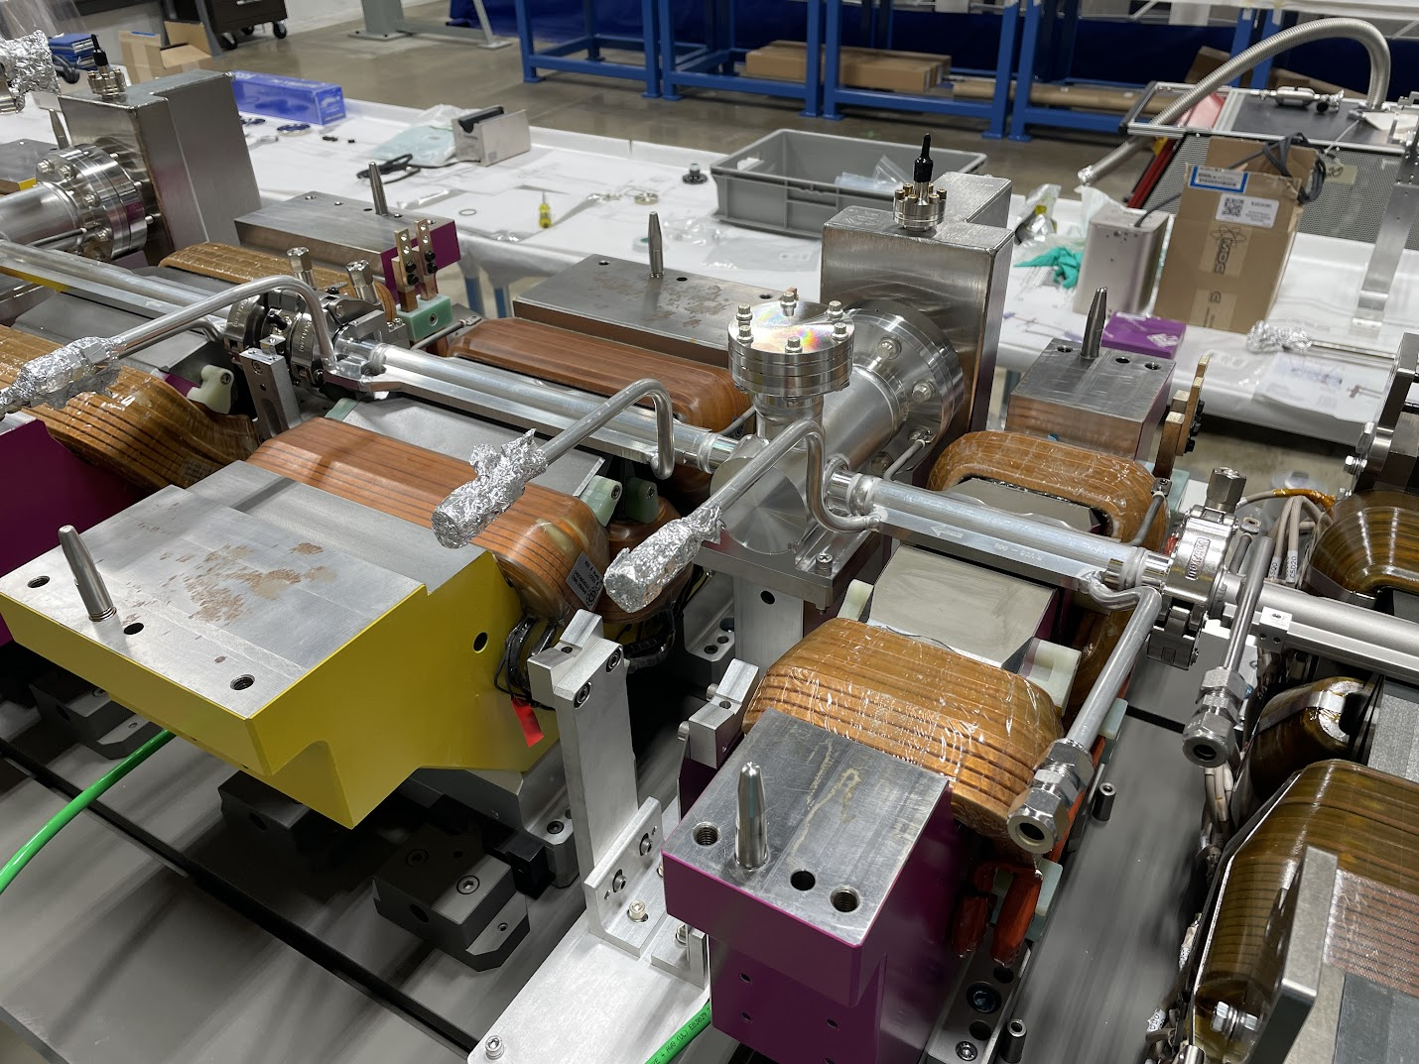
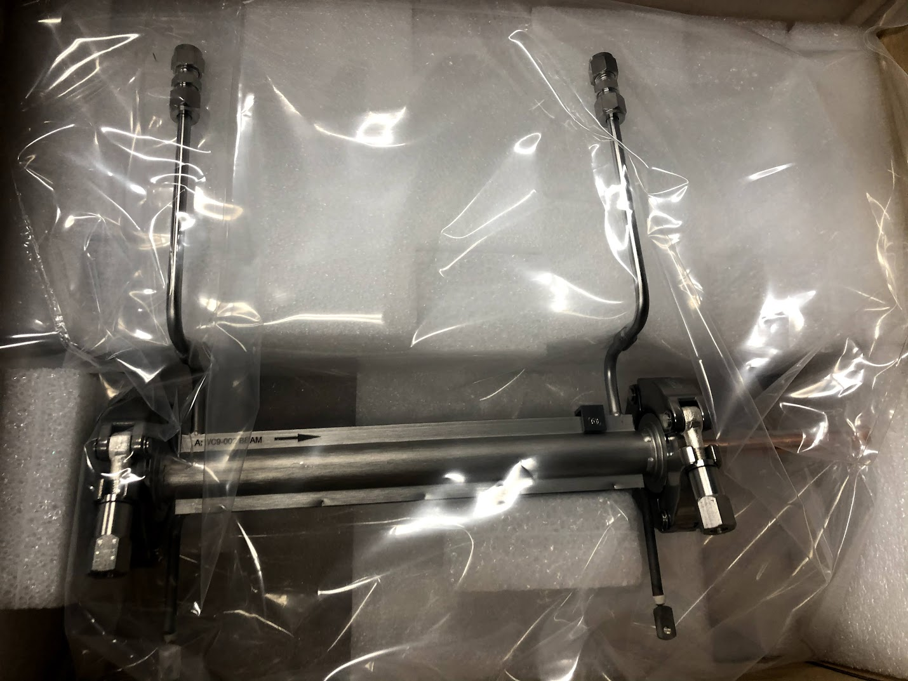
Vacuum Chambers
NEG-coated aluminum vacuum chamber by GNB Corp (NEG coating by SAES-Rial)
NEG-coated Inconel vacuum chamber by SAES Rial

Slide 18
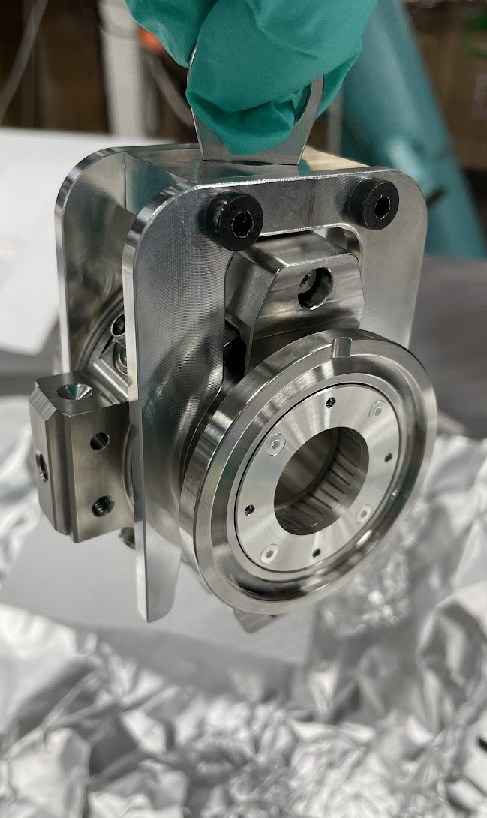
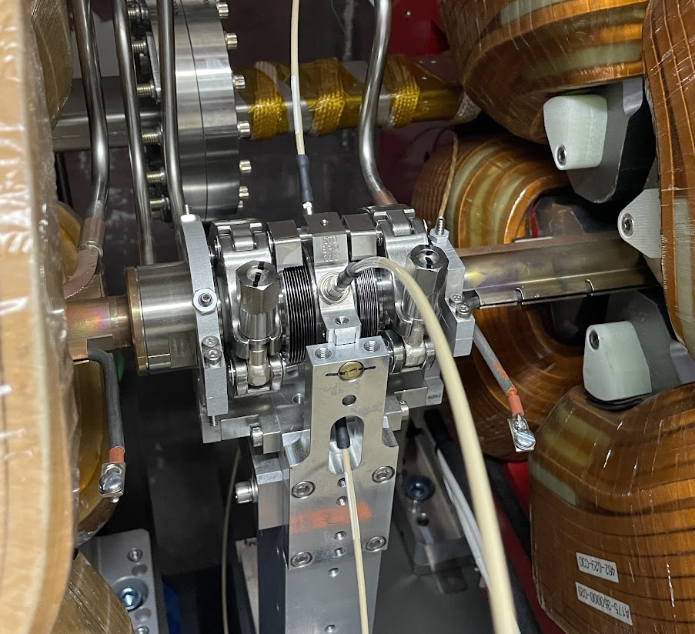
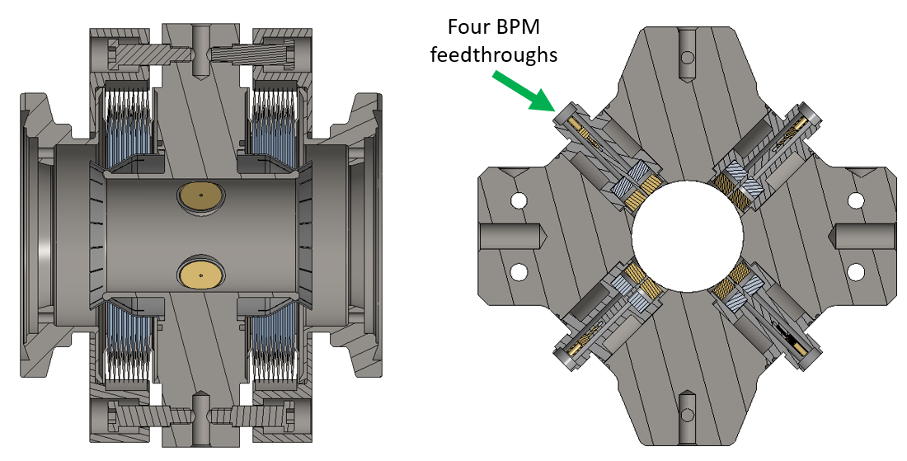
Beam Position Monitors
4x common, TIG welded electrode ‘feedthroughs’
BPMs central to APS-U vacuum assembly scheme
4 common ‘BPM electrode feedthroughs’ welded to central body
2 welded bellows per BPM allow bakeout growth, decouple BPM from chamber vibrations
Flexible ag-plated glidcop RF-liners (SAES-Rial) mounted on each side, assembled separately by APS-U
RF Liner
(Ag-plated GlidCop)
Standard-type APS-U BPM installed on FODO module
Cross sections of ‘standard’ type BPM

Slide 19
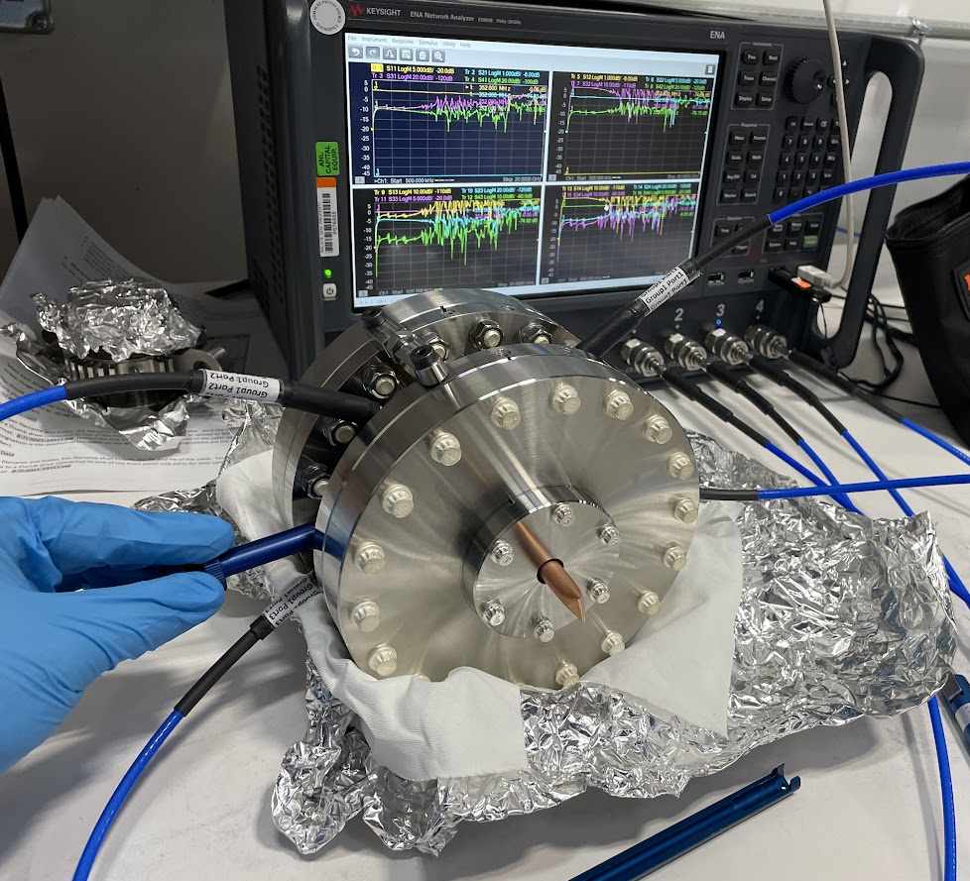
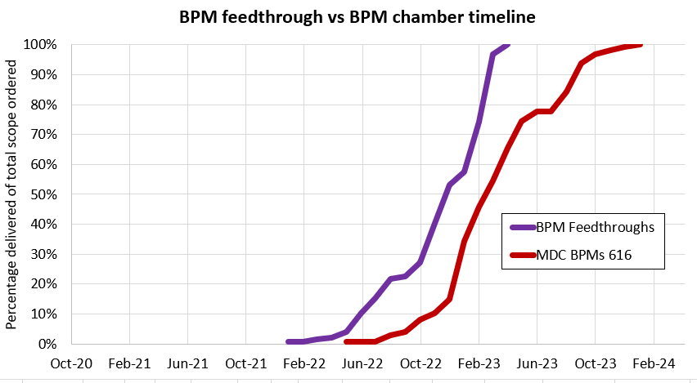
Beam Position Monitors – Fabrication Challenges
Common feedthrough design (4 per each of 616 total BPMs) developed by vendor per APS-U specifications prior to BPM vacuum chambers production
Feedthrough development a close collaboration between vendor, APS-U vacuum & diagnostics
Early stages of contract, feedthrough development impacted by COVID
Contract signed for BPMs
APS-U BPM vacuum chamber being evaluated by APS-U diagnostics with a network analyzer

Slide 20
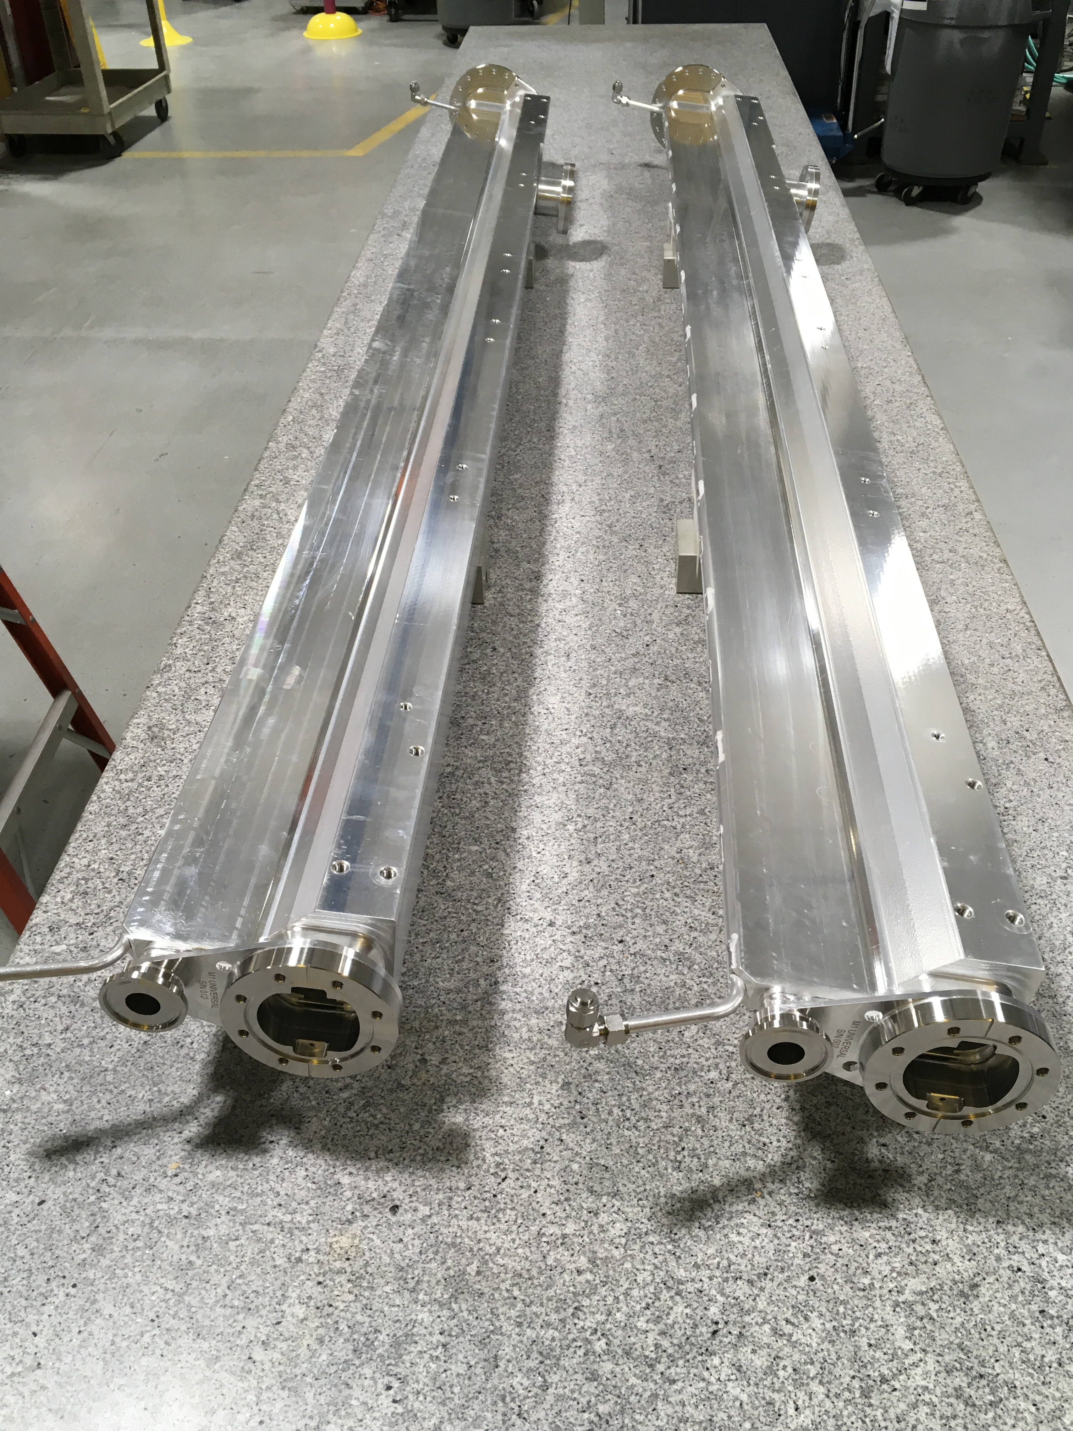
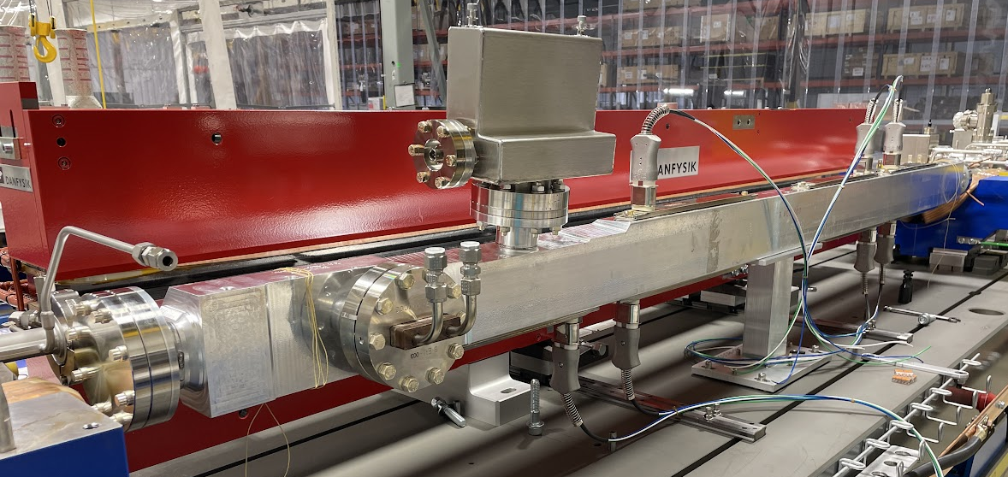
L-bend Vacuum Chambers
Aluminum-extrusion based vacuum chambers with SST-to-aluminum bimetal flanges welded by APS-U
Custom aperture extrusions proved to be long lead items
Extrusions ‘stretch-formed’ to follow bending path of beam through dipole magnets
Leak checking of custom bimetal ‘end flange plates’ at multiple stages of machining
Flanges welded to machined bodies with 5-axis welder
Endplates welded by APS-U to aluminum extrusion bodies at end of each chamber
‘L-bend’-type vacuum chamber with mounted absorbers and ion pump, internal NEG-strip pumping

Slide 21
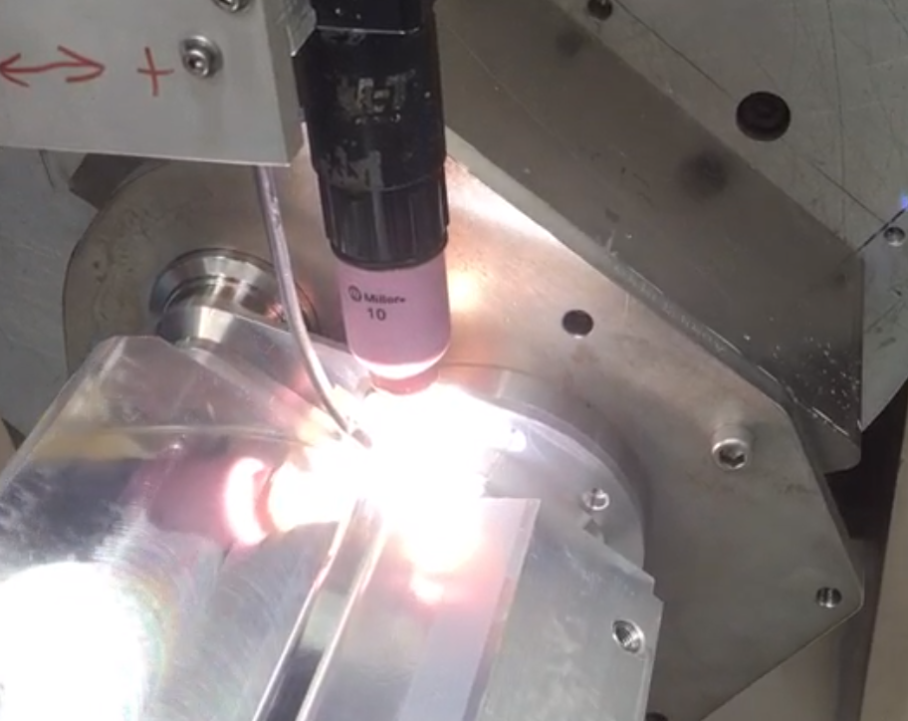
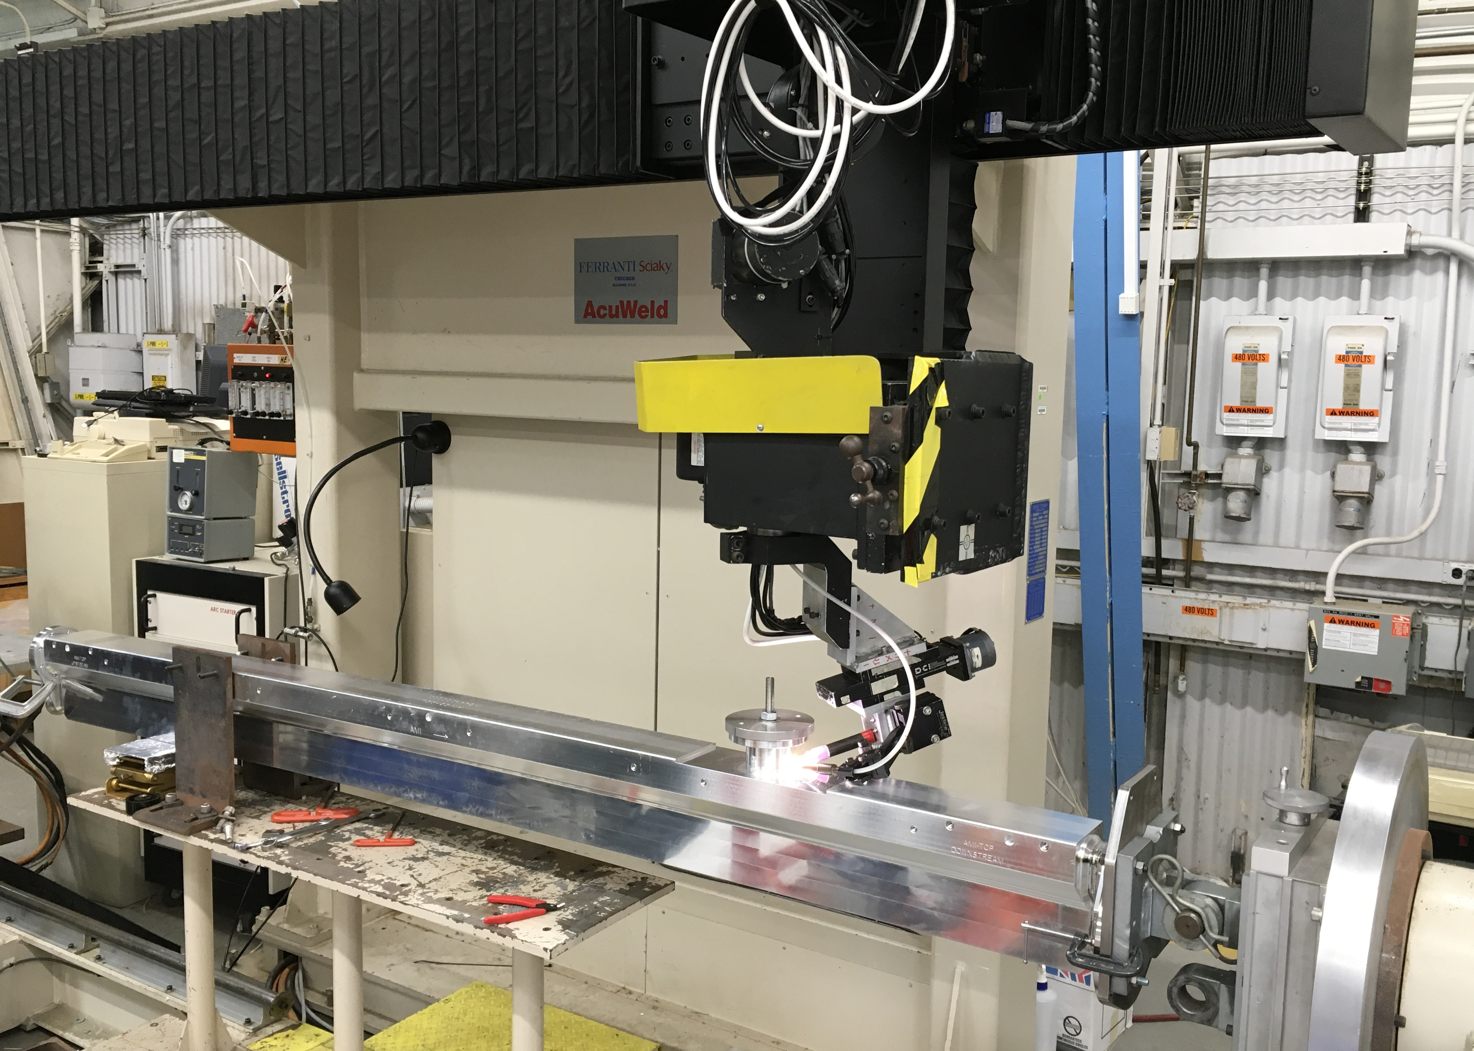
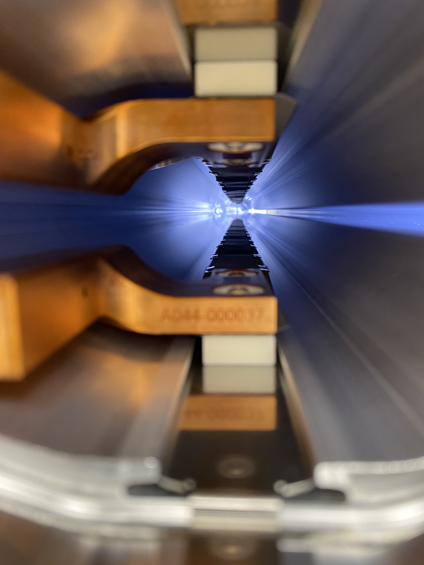
L-bend Vacuum Chambers
TIG welding L-bend vacuum chamber ports with 5-axis Sciaky welding machine
View looking downstream into L-bend chamber and at NEG strip assembly

Slide 22
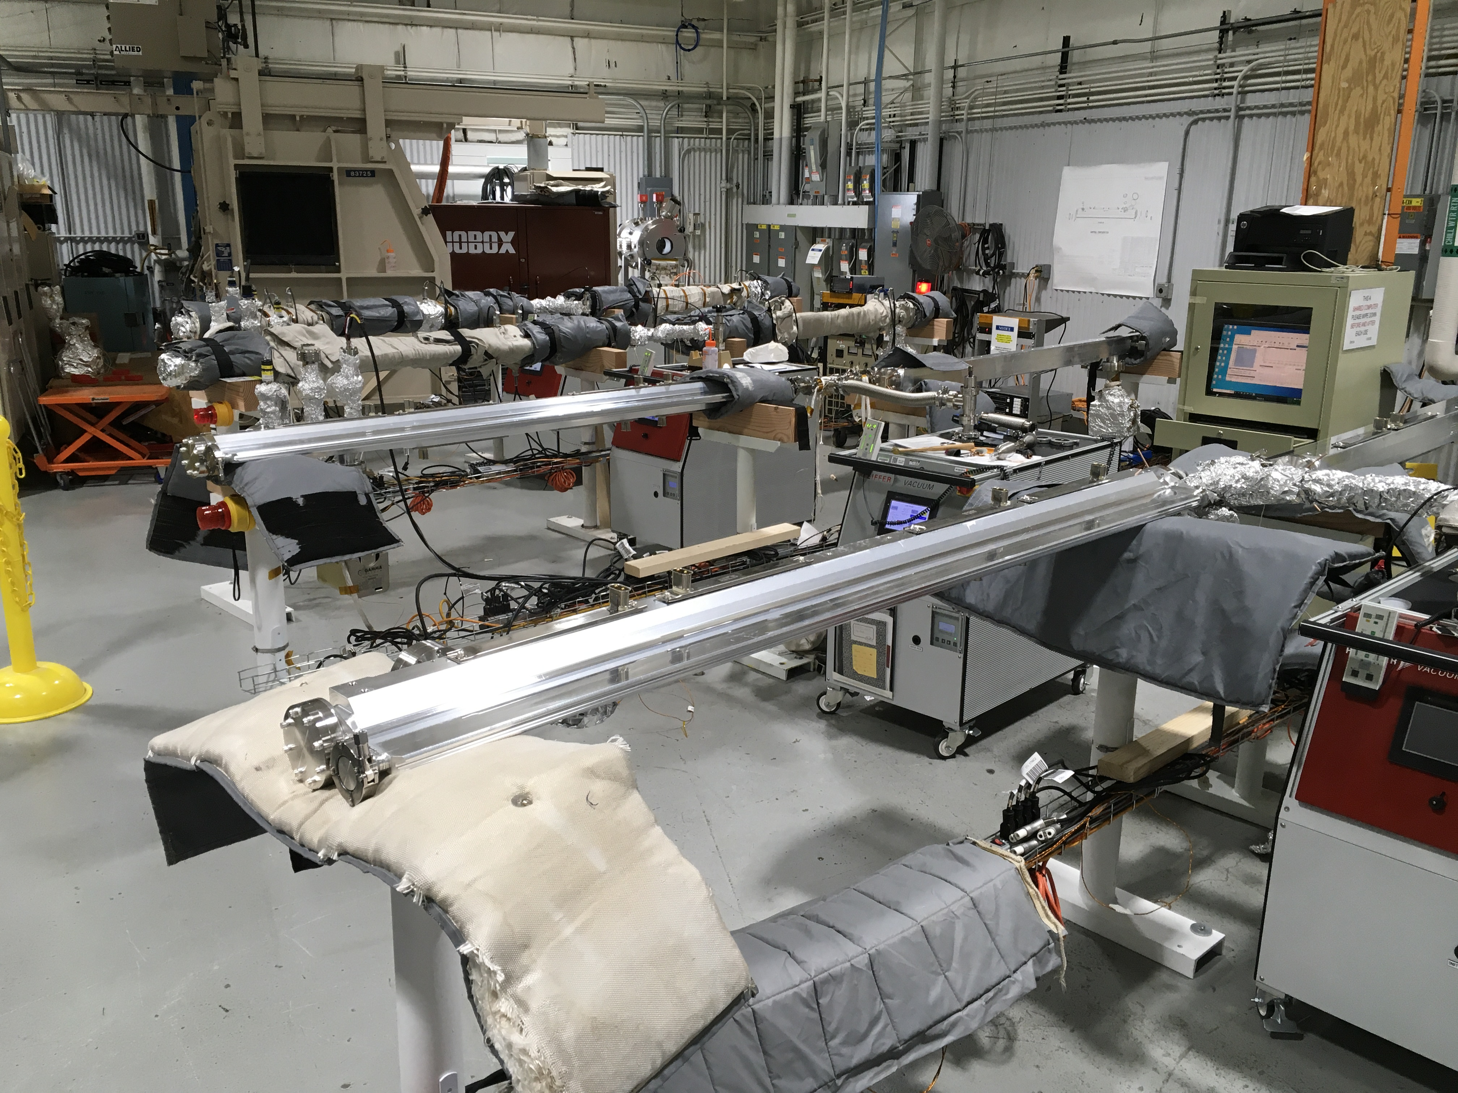
L-bend – Fabrication Challenges
Unexpected delays in finding vendors for relatively small batch, custom work
e.g. custom aluminum extrusions and NEG-strip related components
All L-bend parts, big and small, ordered and managed in house
Fabrication hurdles e.g. machining and assembly issues all had to be handled and managed in house
Critical path dictated by extrusions > forming > final machining > welding
4 types of L-bend chamber, 1 unique type per module
Only could fabricate 1 chamber type at time for a variety of reasons
COVID restrictions also impacted suppliers, availability of key APS-U personnel
Baking and certifying batches of L-bend vacuum chambers

Slide 23
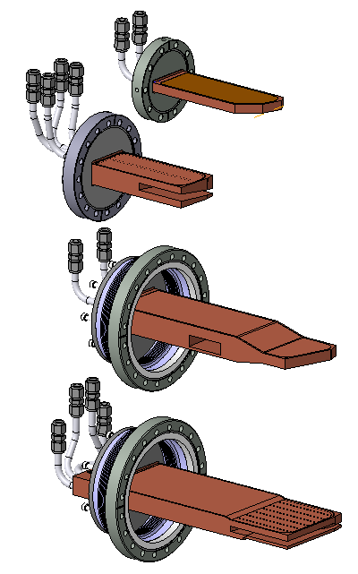
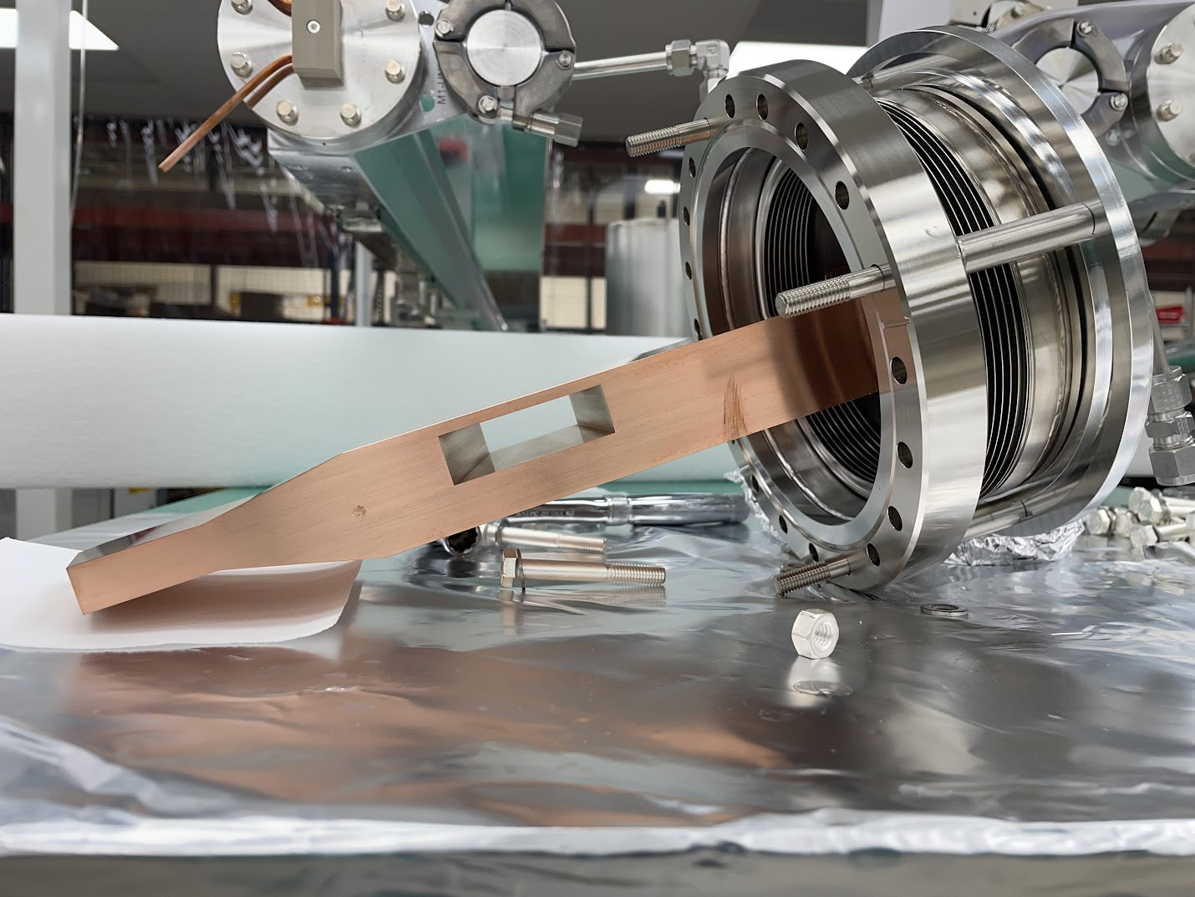
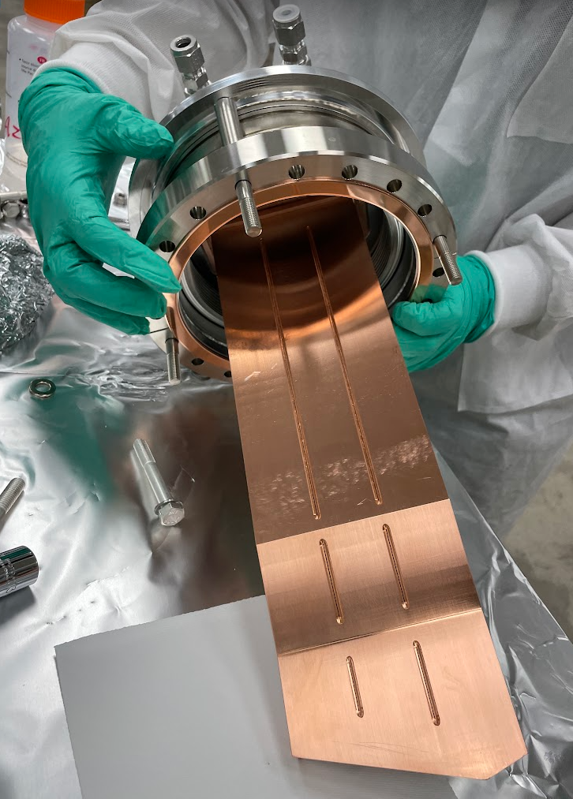
Absorbers
B:EA1
(DLM-B
Module)
Absorbers by FMB Berlin
GlidCop bodies with precision machined apertures to funnel synchrotron radiation downstream to front ends
Internal water-cooling to intercept unused radiation
Multiple stages of e-beam welding drove fabrication schedule
A:CA1
(DLM-A)
A:CA2
(QMQ-A)
B:CA1
(QMQ-B)
4 types of APS-U absorbers
A:CA2 absorber

Slide 24
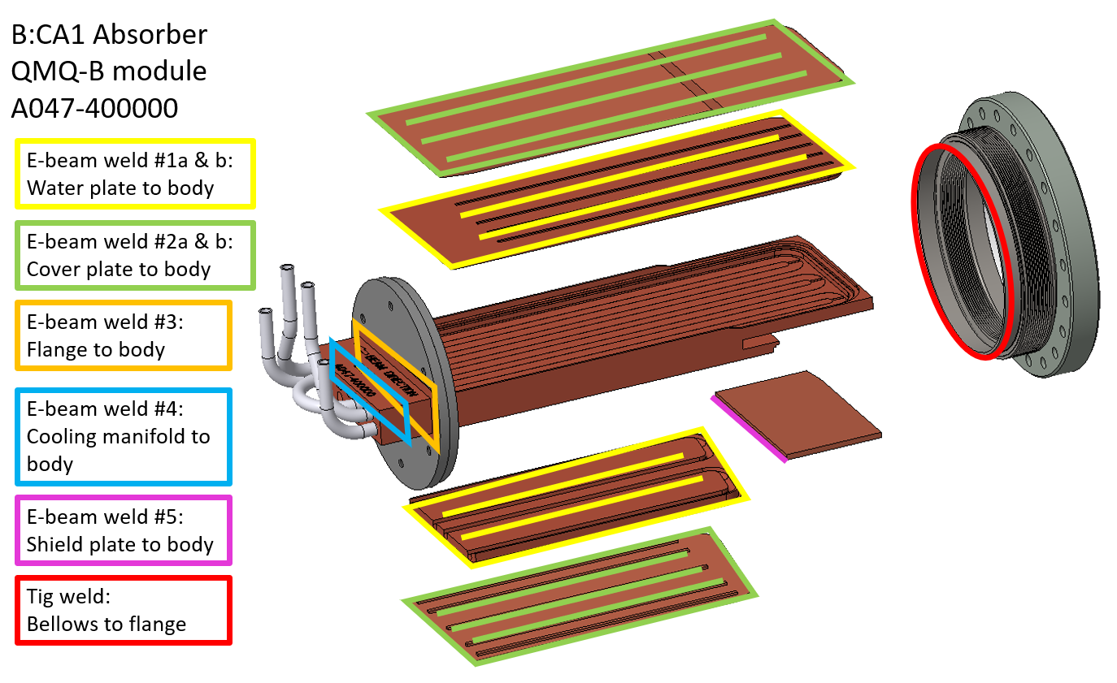
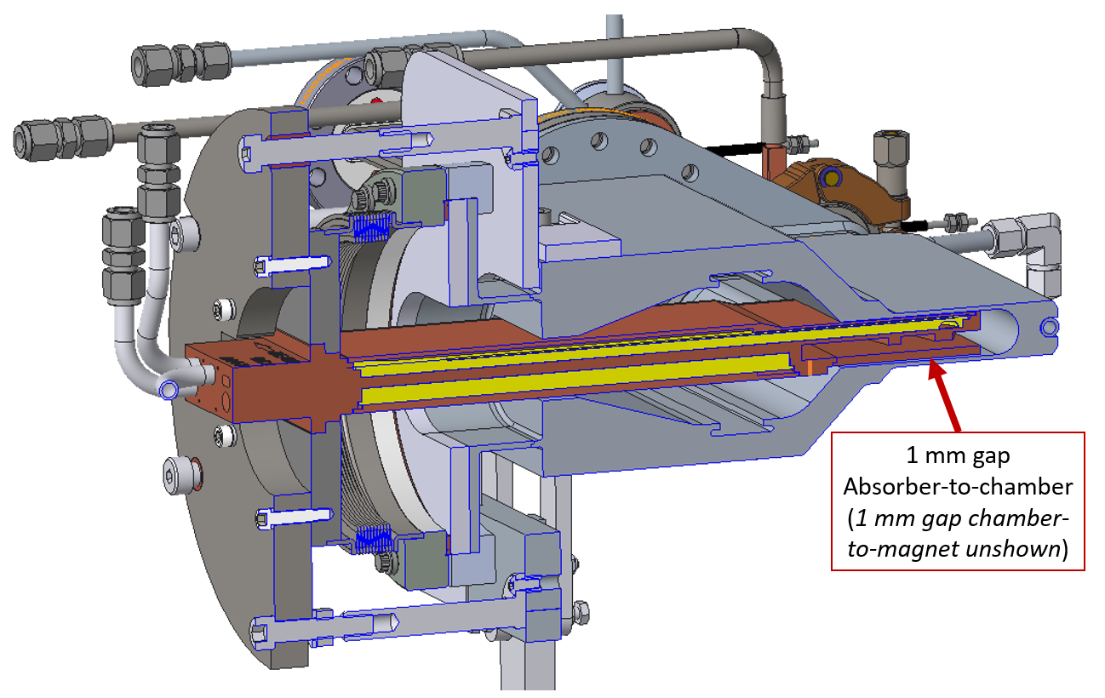
Absorbers – Fabrication Challenges
B:CA1 crotch absorber with highest heat load
(3400 W) of any storage ring component
Narrow magnet-to-chamber gap dictated limited design space
‘No direct water-to-vacuum joints’ dictated multiple- welded-plates approach which isolates cooling water line welds from vacuum welds
Limited subcontracted e-beam welding vendors in demand by competing industries
Diagram of welds required to complete B:CA1 fabrication (top) and cross section highlighting multiple internal cooling channels designed to mitigate 3400 W load (right)
Cross section of B:CA1 crotch absorber mounted onto L-bend vacuum chamber
(beam into page)

Slide 25
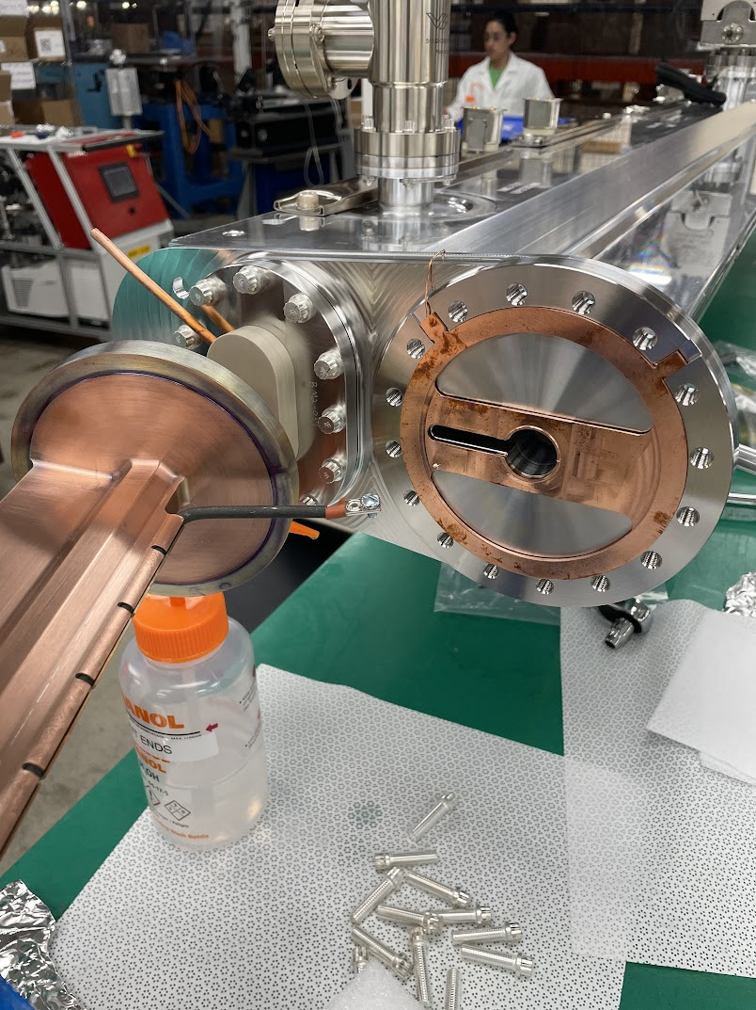
Vacuum Chambers
Prior to assembly all chambers certified water and vacuum leak tight, RGA clean, all BPM feedthroughs certified too
Out of 2700 chambers, ~50 chambers or ~2% pulled from assembly with issues including:
  19 vacuum leaks (knife edge knicks, pinhole leaks through bonded joints, BPM feedthrough leaks)
  6 water leaks, 3 absorbers with internal water clogging
  9 bellows damage
  Small amount of delicate, thin-walled chambers damaged during APS-U assembly
  Issues mostly random by type, no rampant root causes
  Some issues recovered in-house e.g. rewelding pinhole leaks
It was good that 10% spares were ordered!
  Most chambers ordered in sets of 44 = 40 installed + 4 spares, so along the assembly journey any single drop-off a cause for anxiety
  For a few specific, long lead chamber types a few more spares beyond 10% would have saved heartburn
Vacuum chamber sub-assembly with Rf-seals made using custom copper gaskets (MDC)

Slide 26
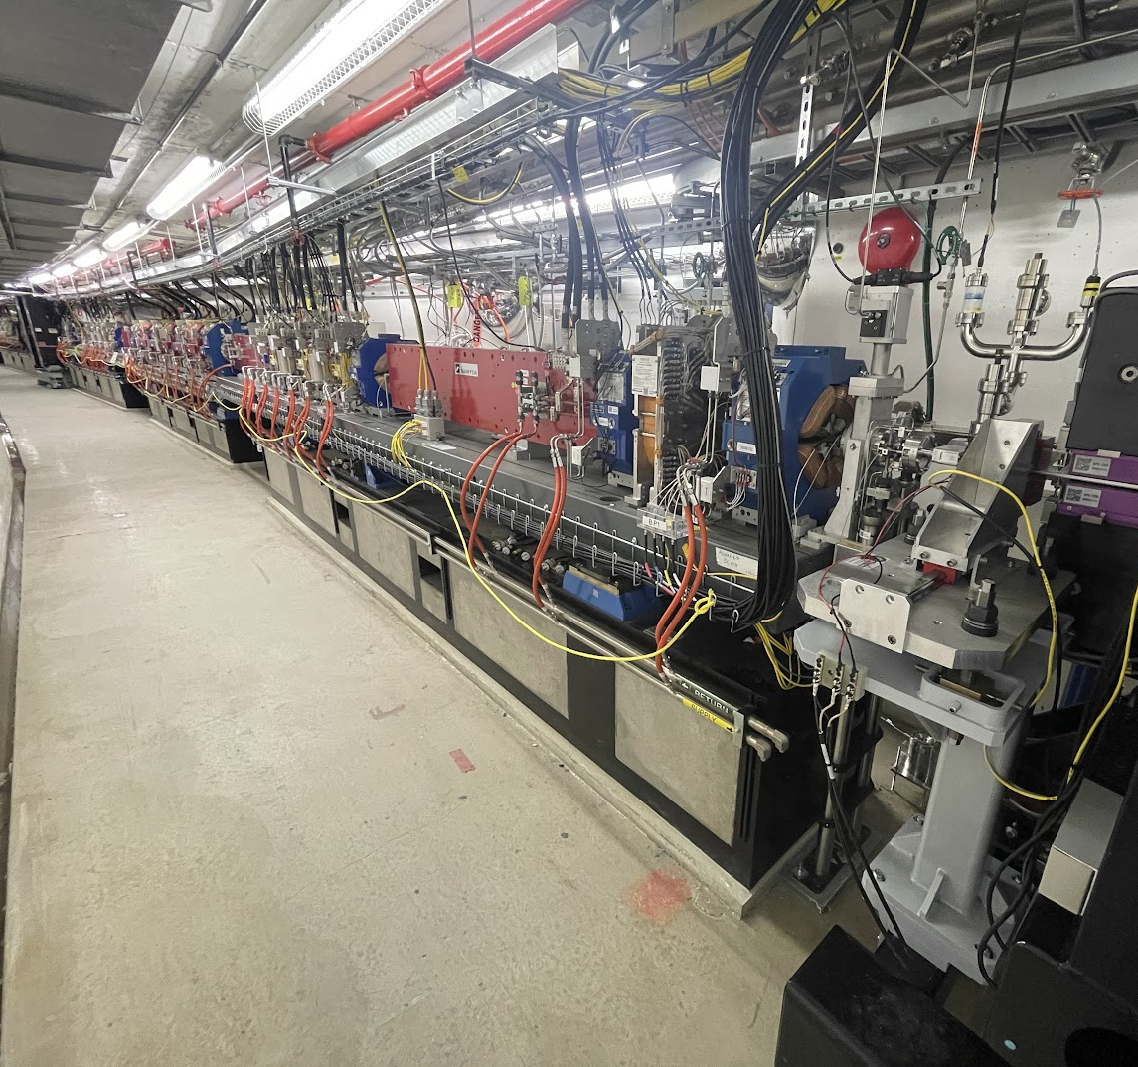
Conclusion
Lessons learned
  Early high level design decisions can dictate future fabrication challenges e.g. negotiating magnet-to-vacuum gaps
  Schedule drivers: attaining small batch custom material (extrusions, ceramics) and specialized fabrication processes e.gelectron beam welding and BPM ceramic brazing
  BPM and absorbers should have been included in long lead purchasing scope
  In-house L-bend chamber fabrication – every technical issue was ours to resolve vs contracting to a vendor
  10% vacuum chamber spares recommended as a minimum
Things that went well!
  Resolve, ingenuity, and collaborations by both vendors and
  APS-U in face of COVID pandemic
  Majority of 2700 vacuum chambers ‘vacuum certified’ by
  vendors taking burden off limited in-house resources
  Good communication of requirements and tolerances lead to ‘ready for use’ delivered chambers, minimal rejections
  Component database & storage warehouse – no chambers lost!

Slide 27
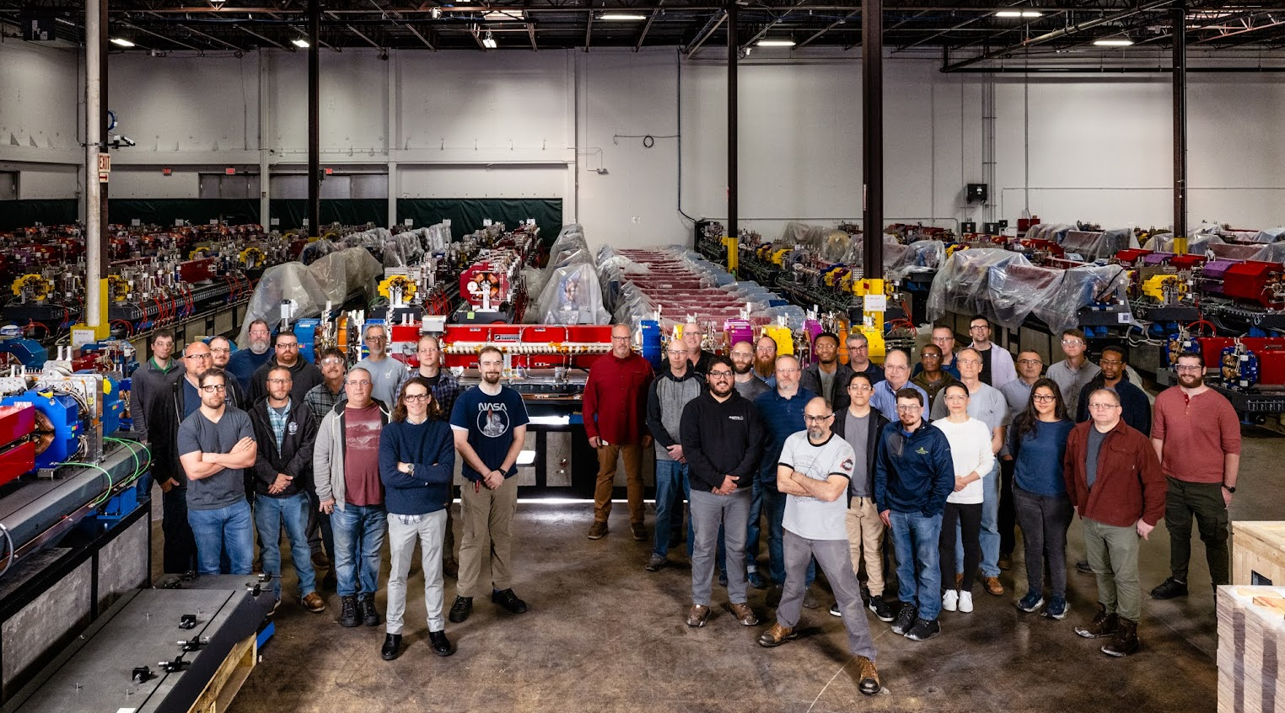
Conclusion
Many vendors to thank
  Vacuum chambers: FMB Berlin, SAES-Rial, GNB Corp, MDC, CINEL, CECOM
  Vacuum pumps, gauges, valves: Gamma Vacuum, VAT, Kurt Lesker, Pfeiffer, Leybold, MKS Instruments,
  Fredericks / Televac, Vacuum One
  Machined parts & vacuum hardware: ERA industries, Dial Machine, Hannxi / Hodaka, Stretch Forming Corp., James Fisher Technologies, Vacuum Technology Inc., Rhinestahl, Windlass, Instrument Associates, VACOM, Microtech, UC Components, ATLAS UHV, High Energy Metals, PMB Alcen, Bellowstech
  Bakeout equipment: Briskheat, JNT Technical Services, Ash Equipment Co., DCX
Many people to thank
  APS-U Vacuum Team: Greg Wiemerslage, Scott Izzo, Eric Jin, John Zientek, Weixing Cheng, Xiang Sun, Brian Billett, Maria O’Neill, Nate Poindexter, and more
  APS-U assembly teams: Nick Bechtold, Tim Clute, Mark Erdmann, John Hoyt, Kevin Knoerzer, Ralph Bechtold, and many great vacuum technicians
  Alex Stankovik, APS-U warehouse manager
  APS-U project management & support
  Former team members: Oliver Mulvany, Bran Brajuskovic, Austin McElderry, Jeremy Nudell
  This accelerator vacuum community!

Slide 28
Questions?

