Slide 1
Vacuum simulation of the Korea 4th Generation Storage Ring
Pohang Accelerator Laboratory, Postech
4GSR Project Headquarters
Hosun Choi
OLAV-VI
Apr. 17, 2024

Slide 2
Contents
The Korea 4th Generation Storage ring
The Korea 4GSR vacuum system
Estimation of outgassing rate for the storage ring
Vacuum simulation using the Synrad and Molflow+
Summary

Slide 3
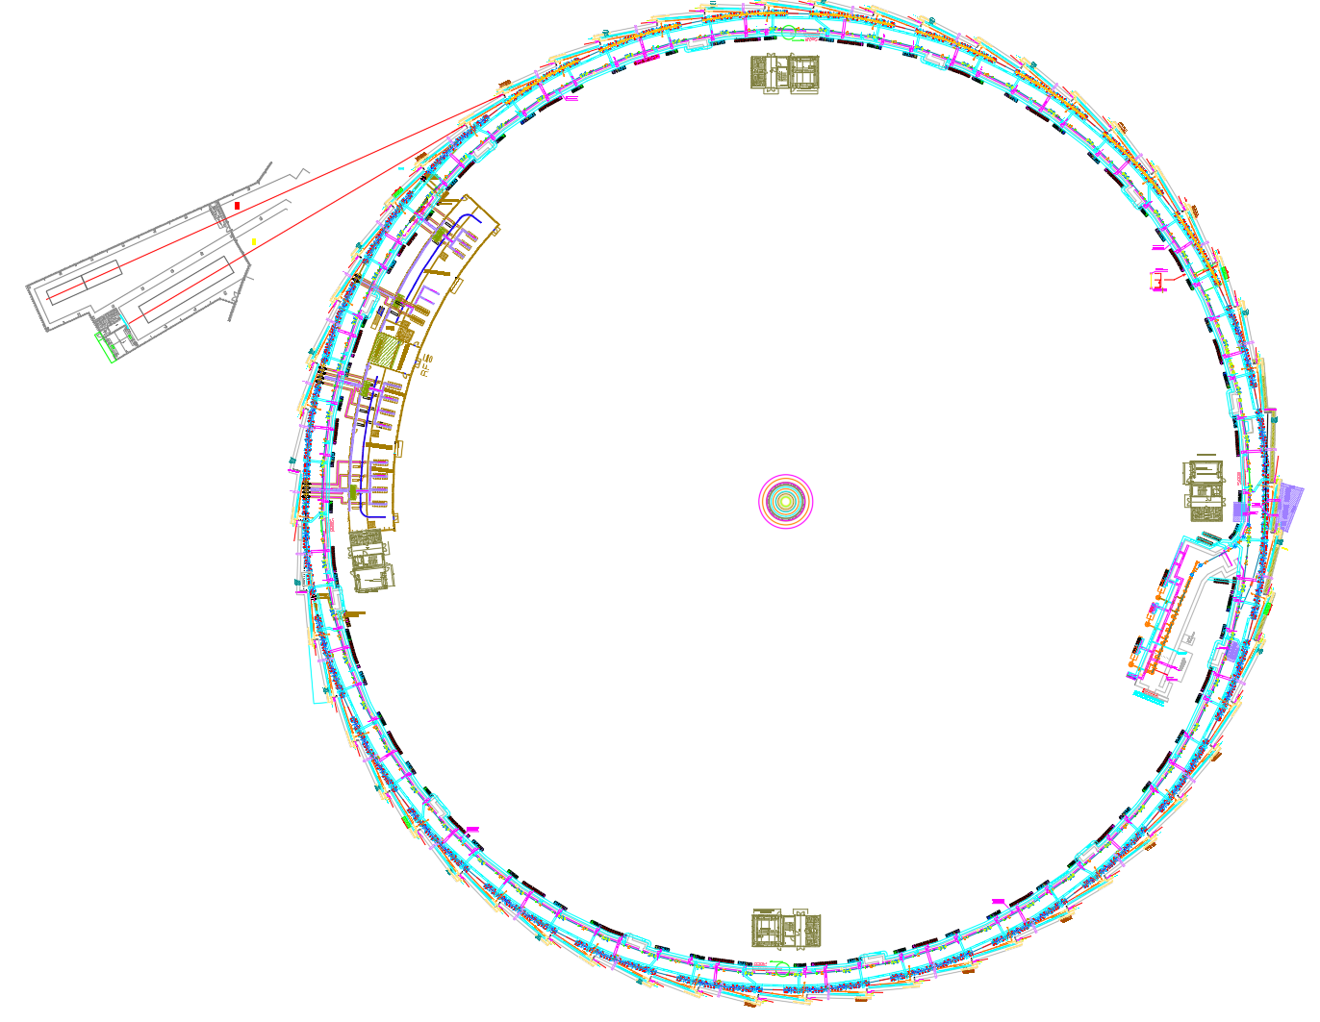
The Korea 4th generation storage ring
Layout of the 4GSR
The Korea 4th generation storage ring
The storage ring circumference : 800 m (with 28 cells)
Beam energy : 4 GeV
Beam current : 400 mA
1 cell length (normal cell) : ~28 m
Acr-section : 21 m
Straight section : 7 m
800 m
1 cell 3D model
Arc-section
Straight section

Slide 4
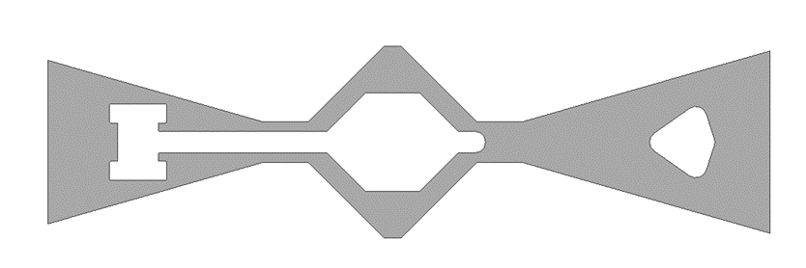
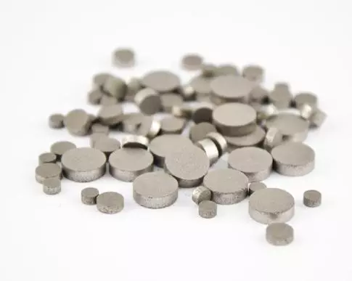
The Korea 4GSR vacuum system
Cross-section of the SR vacuum chamber
Storage ring vacuum system of the arc-section for storage ring
Beam channel internal cross-section size: 24 mm (H) x 18 mm(V) , Octagon
11 EA of SIP and 8 EA of NEG pumps are installed
Total pumping speed : 4300 L/s (H₂)
Comprised of 13 vacuum chambers
6 EA aluminum extrude type chambers
2 EA aluminum machine type chambers
5 EA stainless steel chambers
Cooling water
e⁻
SR
4 mm
Beam chamber
24(H) x 18(V)
Sheath-type heater
Vacuum device of the arc-section
Pill-type getter
Photon beam (ID)
CH04
CH03
CH02
CH01
Photon beam (BM)
CH08
CH07
CH06
CH05
CH10
CH09
CH12
CH11
Stainless steel (5 ea)
Aluminum (6 ea, extruded)
Aluminum (2 ea, machined)
Sputter Ion Pump (11 ea, 60 L/s)
NEG Pump (8 ea, 400 L/s)
NEG Pump(1.33”) (3 ea, 30 L/s)
CH13

Slide 5
The Korea 4GSR vacuum system
Cross-section of the SR vacuum chamber
Storage ring vacuum system of the straight section for storage ring
Beam channel internal cross-section size: 24 mm (H) x 18 mm(V) , Octagon
2 EA of SIP and pill type NEG pumps are installed
Comprised of a total of 3 vacuum chambers
1 EA aluminum extrude type chamber
2 EA stainless steel chambers
Total pumping speed : 300 L/s (H₂)
One Rf-shielded GV per cell are installed
Cooling water
e⁻
SR
4 mm
Beam chamber
24(H) x 18(V)
Sheath-type heater
Pill-type getter
Pill-type getter
Vacuum device of the straight section
CH15
CH16
Sputter Ion Pump (11 ea, 60 L/s)
Gate Valve (1 ea, All metal Rf-shielded)
CH14
Stainless steel (2 ea)
Aluminum (1 ea, extruded)

Slide 6
After sufficient commissioning, estimation of effective pumping speed per cell
Photon linear density of the 4GSR
Parameters | Value
Energy (GeV) | 4
Circumference (m) | 800
Beam current (mA) | 400
N(ph·s⁻¹·m⁻¹) = 8.08 x 10²⁰ · 4[GeV]· 0.4[A]/ 800[m]
=1.62 x 10¹⁸ ph·s⁻¹·m⁻¹
If PSD yield η = 1 x 10⁻⁶ mol/ph (After sufficient commissioning)
ή (mol · s⁻¹ · m⁻¹) = 1.62 x 10¹⁸ x 1 x 10⁻⁶
=1.62 x 10¹² mol·s⁻¹·m⁻¹
The average line gas desorption rate along the storage ring
Q_{lin} (mbar·l ·s⁻¹ ·m⁻¹) = ή x K = 1.62 x 10¹² x 4.04 x 10⁻²⁰
= 6.53 x 10⁻⁸ mbar·L · s⁻¹· m⁻¹
K- converts number of mol to pressure units 4.04x10⁻²⁰ [mbar·L/mol], (PV=N_{mol}k_{B}T)
The required effective pumping speed (1 cell) to meet the average pressure level <1 x 10⁻⁹ mbar (when η = 1 x 10⁻⁶ mol/ph)
Q_{cell} (mbar·L/s) = 6.53 x 10⁻⁸ x 28 m (1 cell length) = 1.82 x 10⁻⁶ mbar·L/s S_{(eff·1cell)} = 1.82 x 10⁻⁶ / (1 x 10⁻⁹)= 1800 L/s
After sufficient commissioning(η = 1 x 10⁻⁶), achieving 1 x 10⁻⁹ mbar requires an effective pumping speed of 1800 L/s per cell

Slide 7
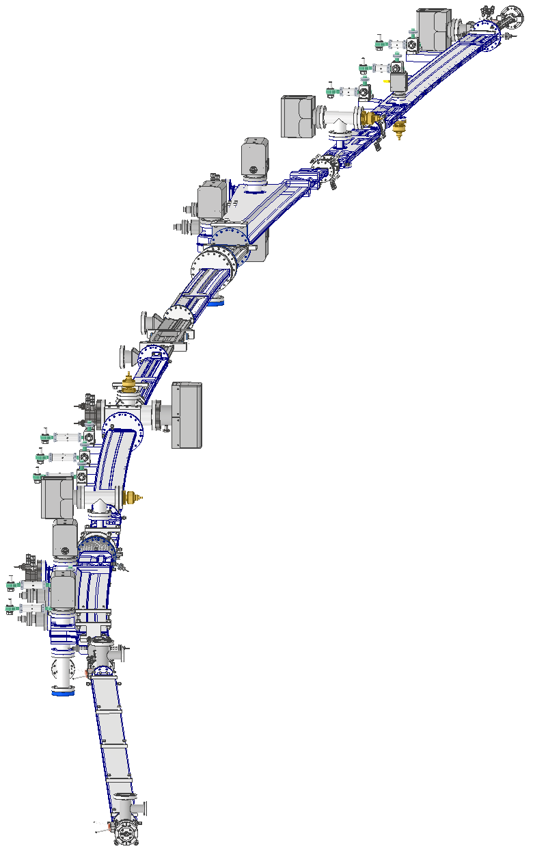
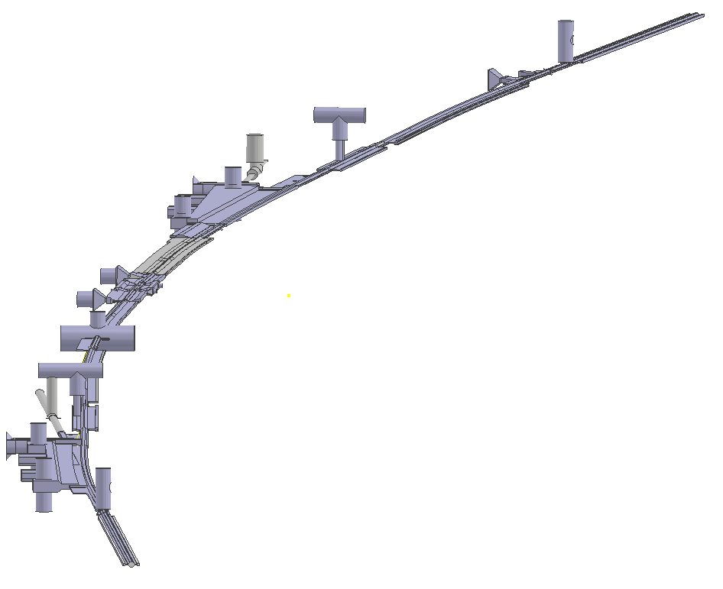
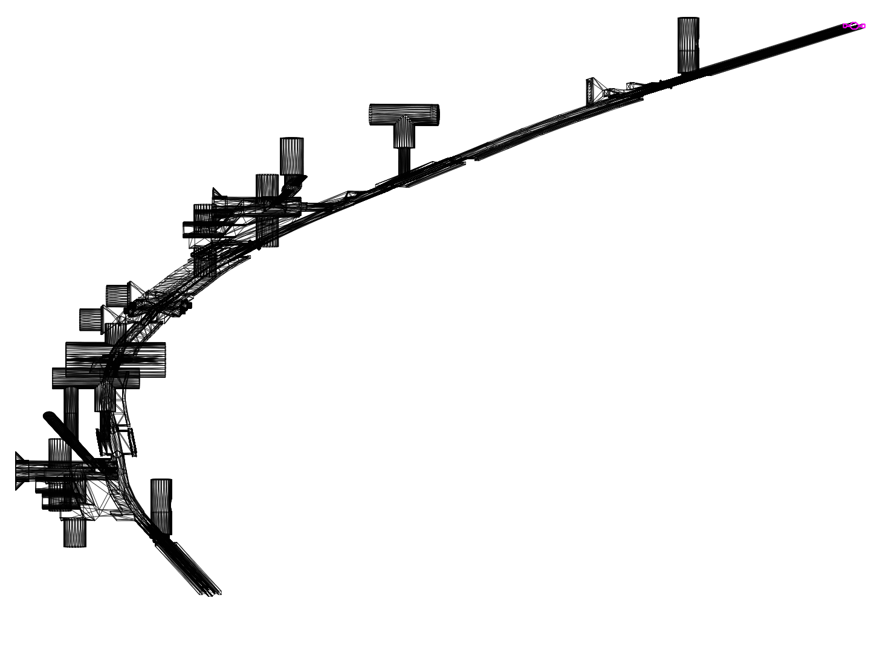
Building a 3D model for simulation (Molflow+ and Synrad)
Utilized the volume extractor feature of the Ansys program to create the internal modeling
Modeling of the vacuum chamber(Inventor)
Internal modeling of the vacuum chamber(Ansys)
Simulation modeling (Synrad & Molflow+)
Modeling vacuum chamber using the Inventor
The ansys program into “Spaceclaim”
Loading the .STL file
Bulind a 3D simulation model
Import the vacuum chamber modeling from the Ansys program into SpaceClaim (STP)
Use the “volume extractor” feature within SpaceClaim to generate the internal space of the vacuum chamber
Convert the generated modeling into an STL

Slide 8
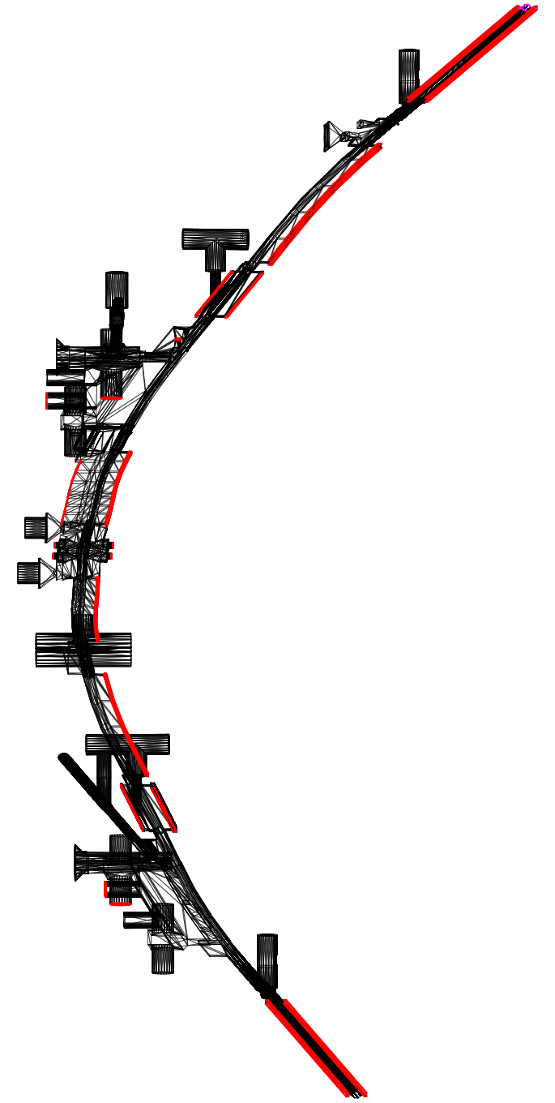
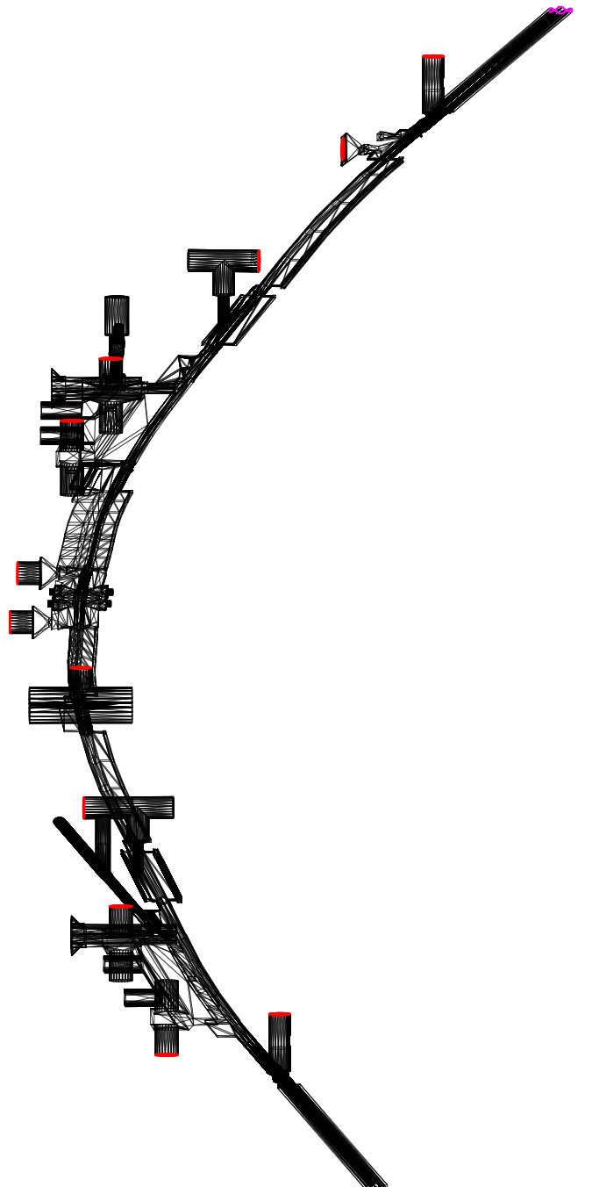
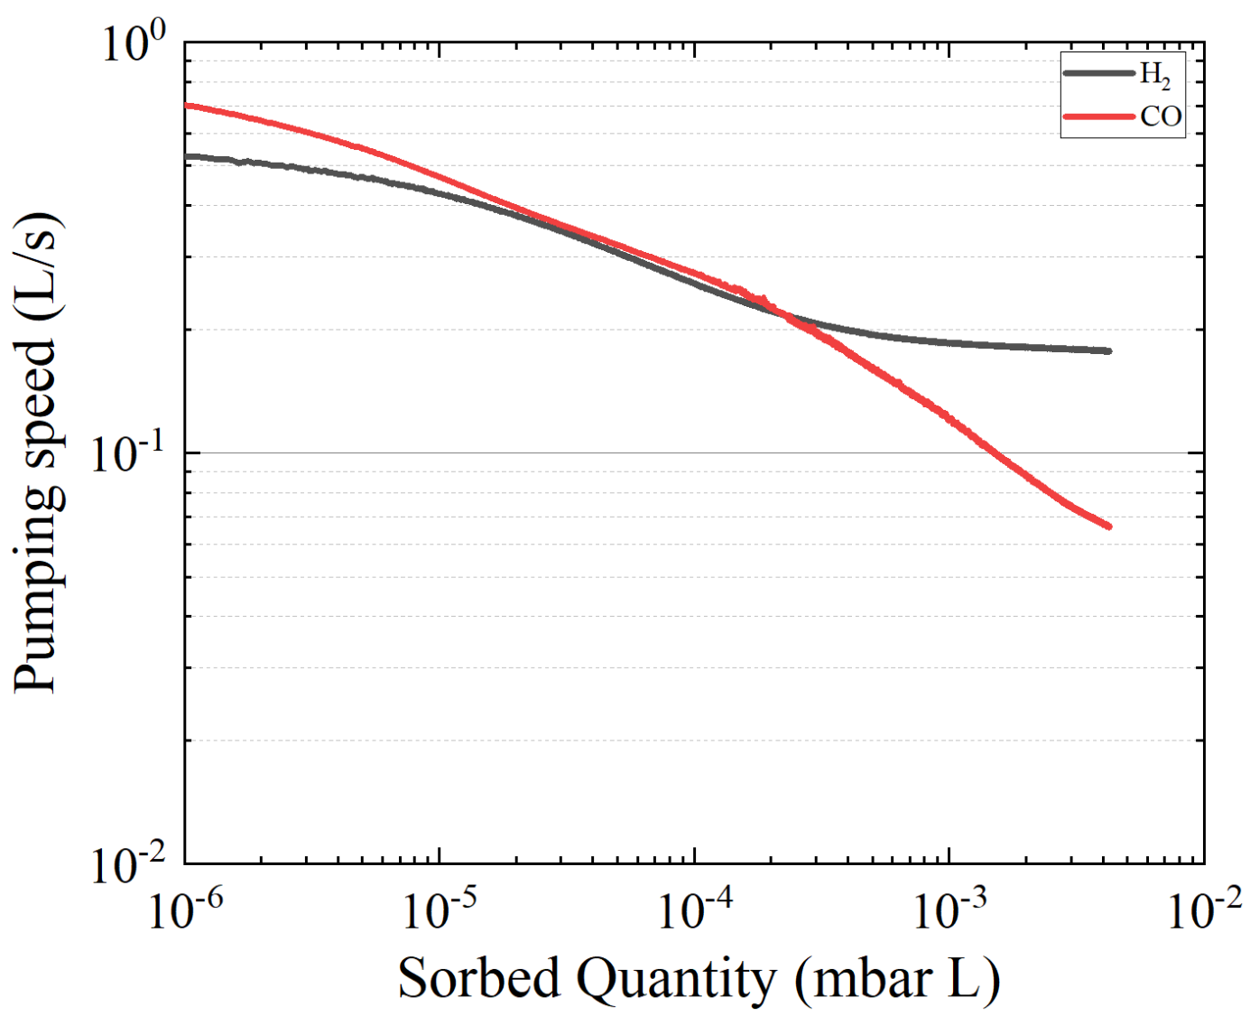
Vacuum simulation using Synrad and Molflow+
NEG pump coverage
SIP coverage
Pumping speed setup for Molflow+
The module type NEG pump and SIP apply pumping speed
The pill type NEG pump apply measured data (PAL)
Activation condition : 180 ℃, 24 hr
the pressure along the beam path
Pumping speed vs adsorption capacity of the Pill type NEG pump
Activation condition : 180 ℃, 24 hr
NEG pump (5 ea, 30 L/s, H₂)
NEG Pump (10 ea, 400 L/s, H₂)
Pill type NEG
Sputter Ion Pump (12 ea, 60 L/s, H₂)

Slide 9
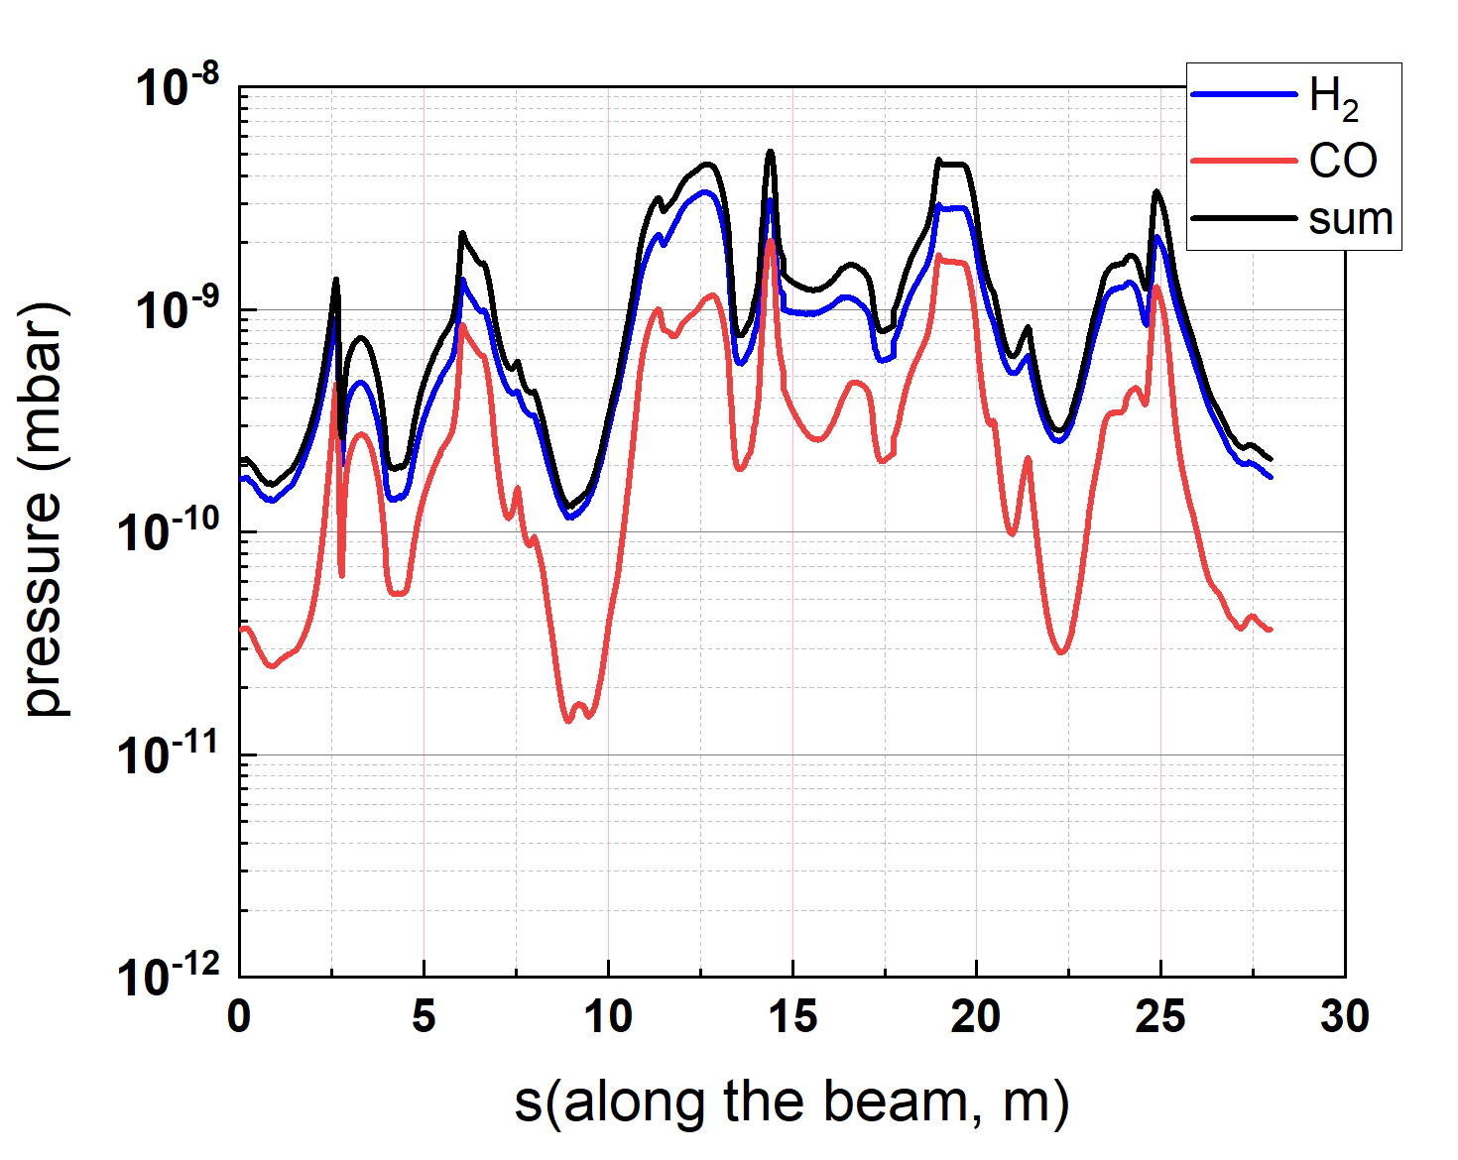
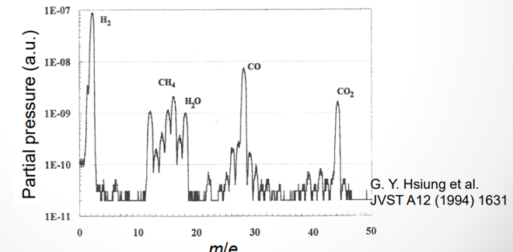
Vacuum simulation using Synrad and Molflow+
Dynamic pressure profile of the storage ring according to the gas type
Calculating the dynamic pressure of the storage ring
Calculating the vacuum profile during operation for the major residual gases, H₂ and CO
After the storage ring vacuum system has undergone sufficient commissioning
PSD values (mol/ph)
H₂ : 1 x 10⁻⁶
CO : 2 x 10⁻⁷
Average pressure (1.38 x 10⁻⁹ mbar)
Partial pressures of gases in ultra-high vacuum
88%
10%
2%

Slide 10
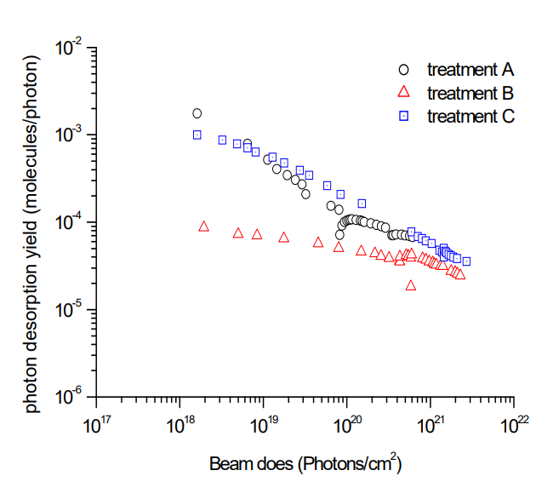
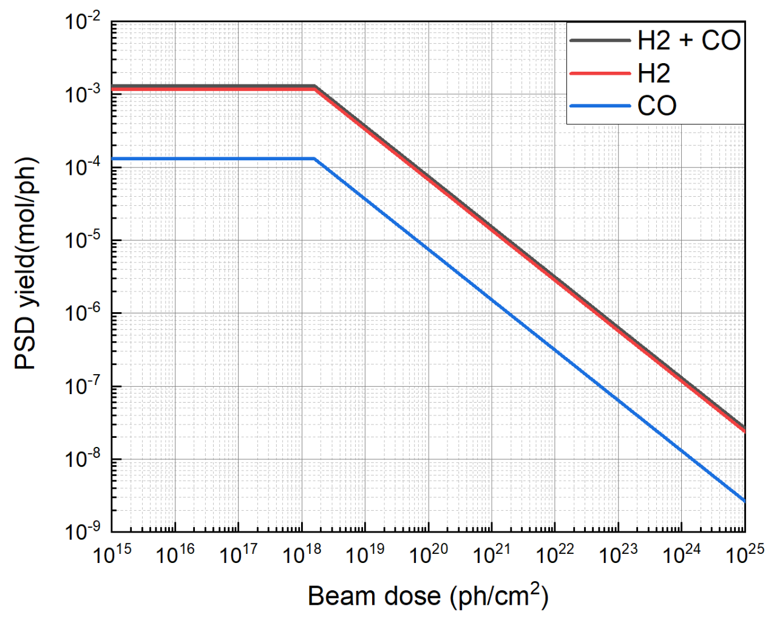
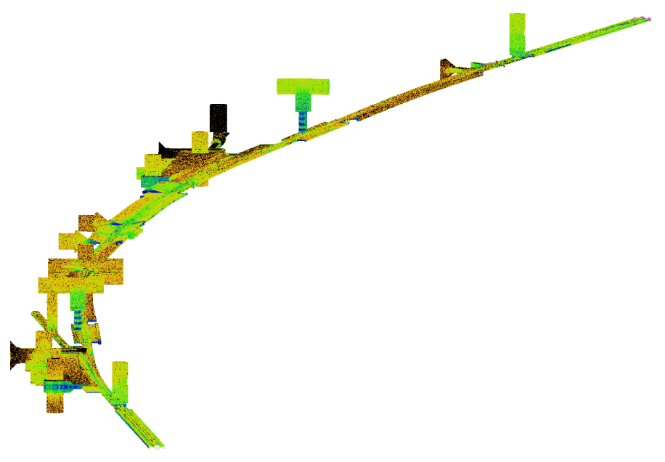
Re-fitting of the Photon stimulated desorption value
PSD yield vs beam dose for Aluminum
Photon stimulated desorption gas loads
To perform beam dose-dependent simulations, the PSD measurements are required
We have fitted the data based on literature references as we don’t have experience in the PSD measurements
treatment A : Oil machining and chemical cleaning
Ref.
C K Chan et al 2008 J. Phys.: Conf. Ser. 100 092025
We re-fitted using the “A” data selected from the graph
Photon flux distribution in Synrad
Molflow+
e⁻

Slide 11
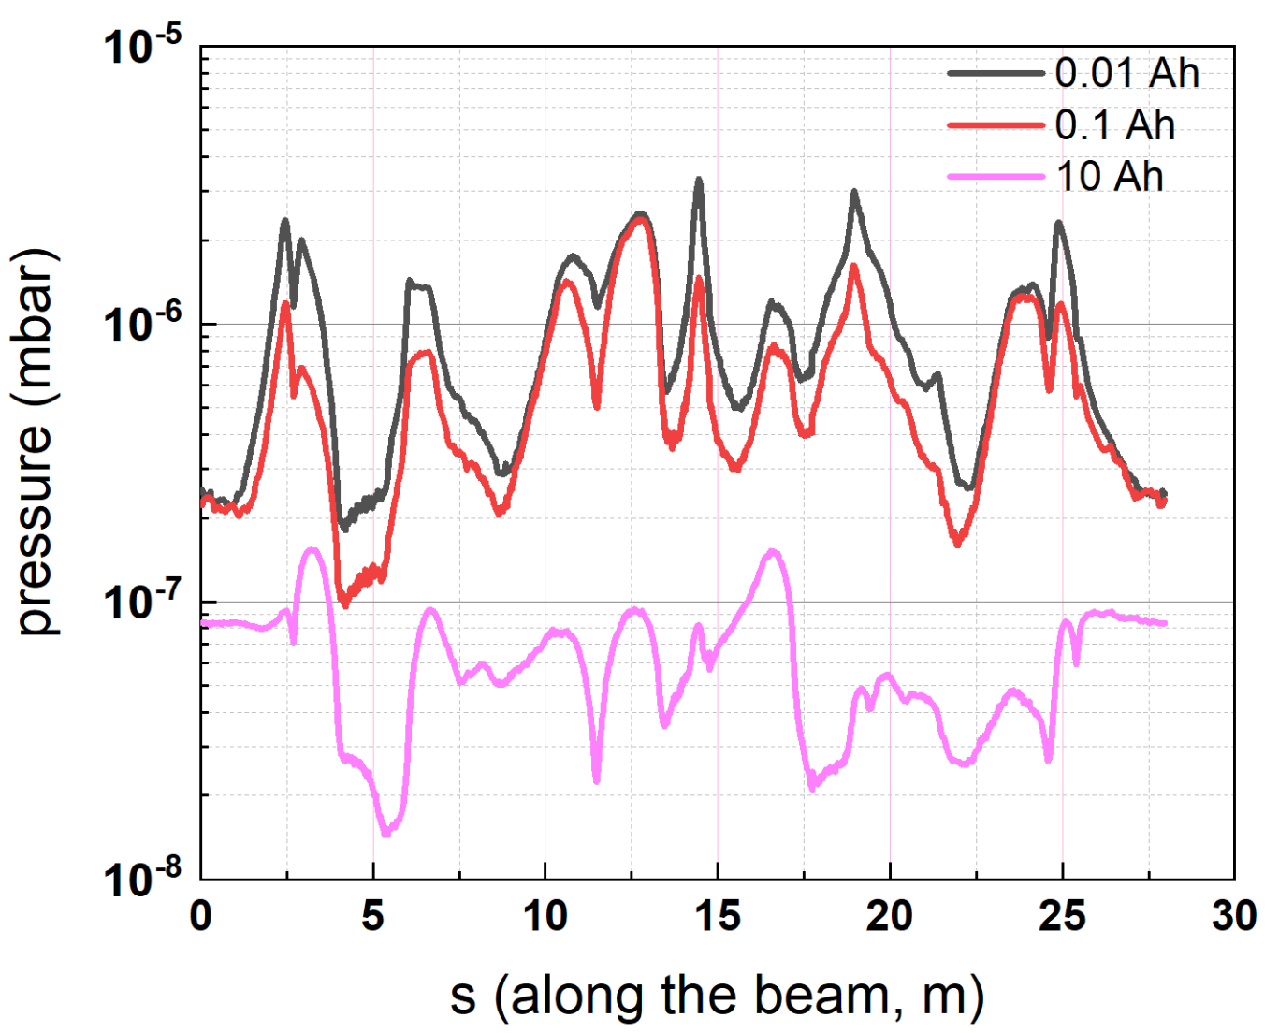
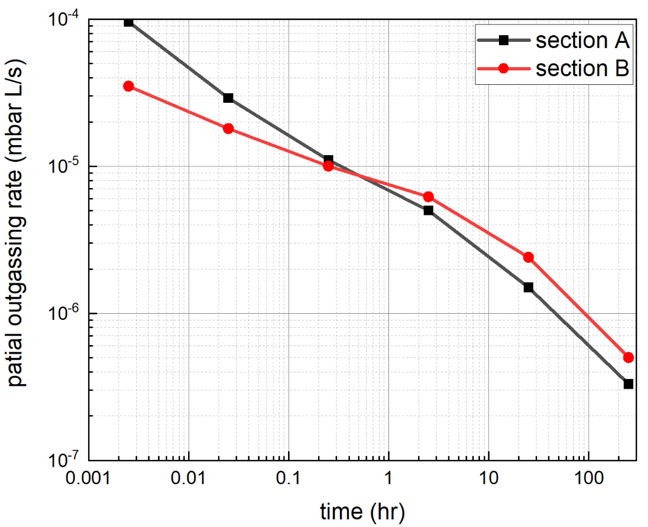
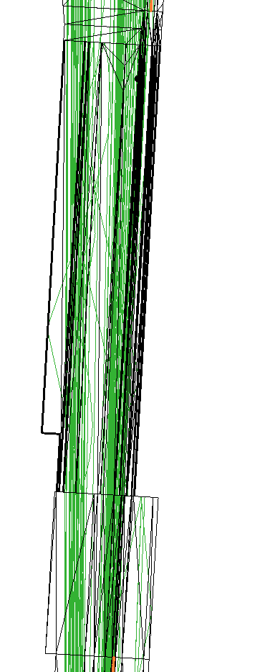
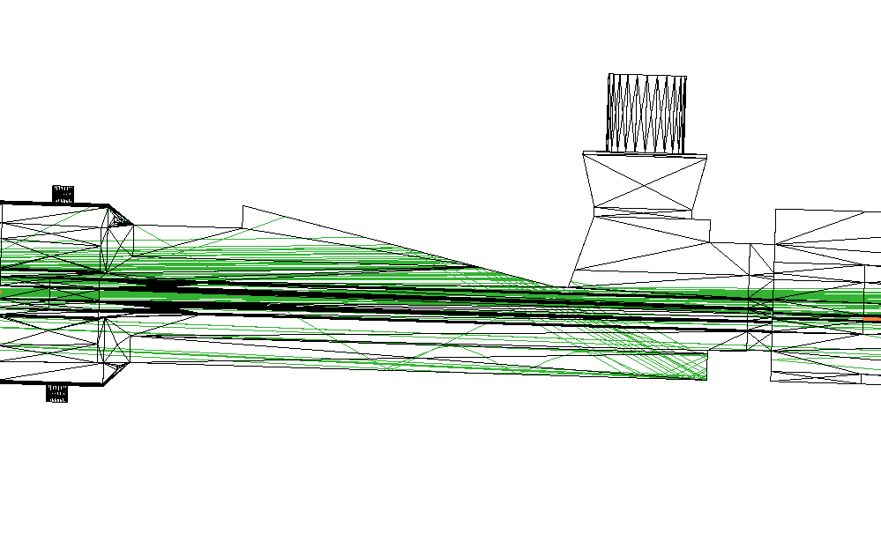
Evolution pressure in Molflow+ (H₂)
Pressure profile by beam dose
A
B
Evolution pressure calculations per beam dose during the early stage (400 mA)
Pressure profile per beam dose of 0.01, 0.1, and 10 Ah at the storage ring
The 4GSR directly absorbs some of the photon beam in the chamber. If handled carefully in the early stages, it is expected to achieve better pressure levels after a sufficient beam dose
@ 400 mA
The time-dependent outgassing rate of section A and B
@ 400 mA
e⁻
Section A
Section B
Incident area
In the initial stages, the area directly exposed the photon beam experiences a faster decrease in gas desorption rate compared to the area not directly exposed to the photon beam.

Slide 12
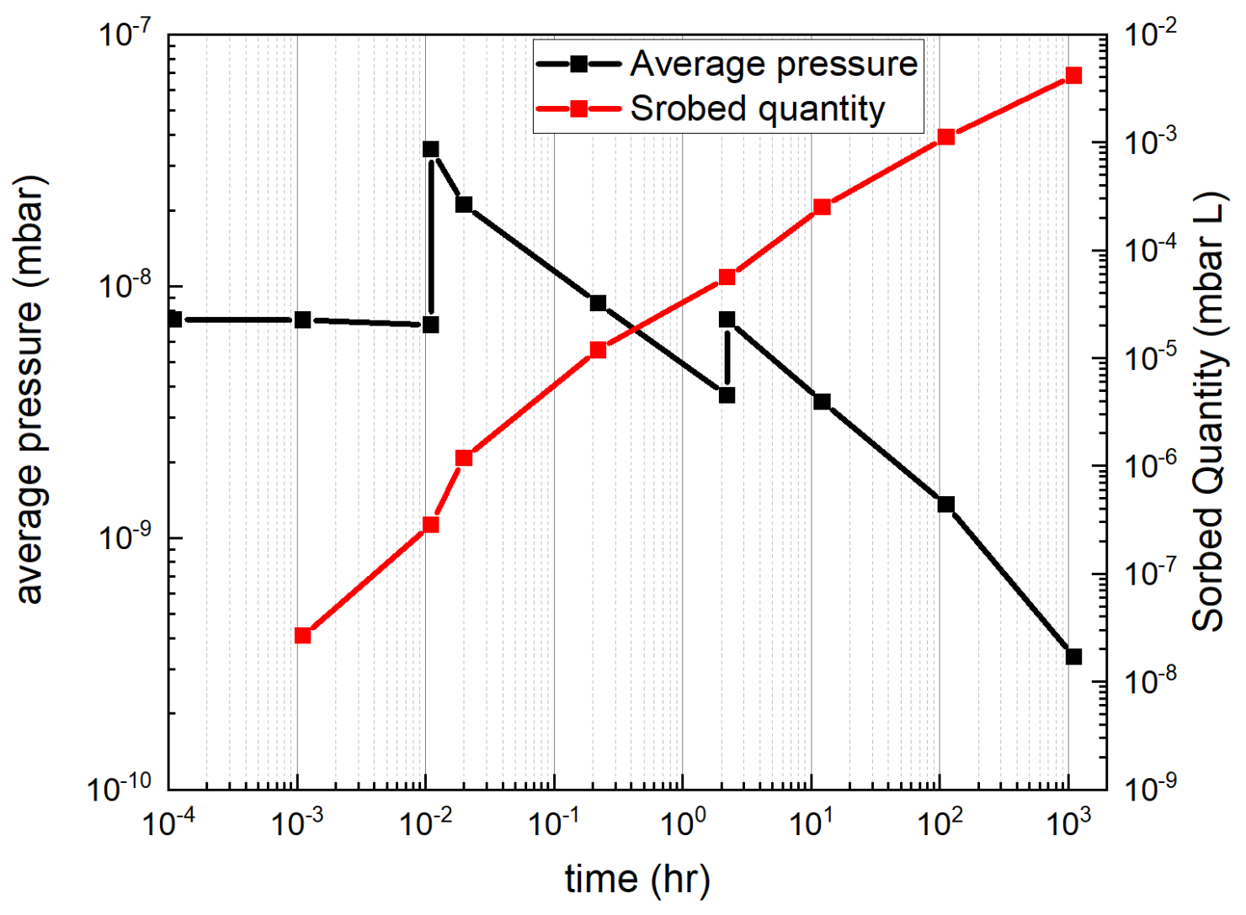
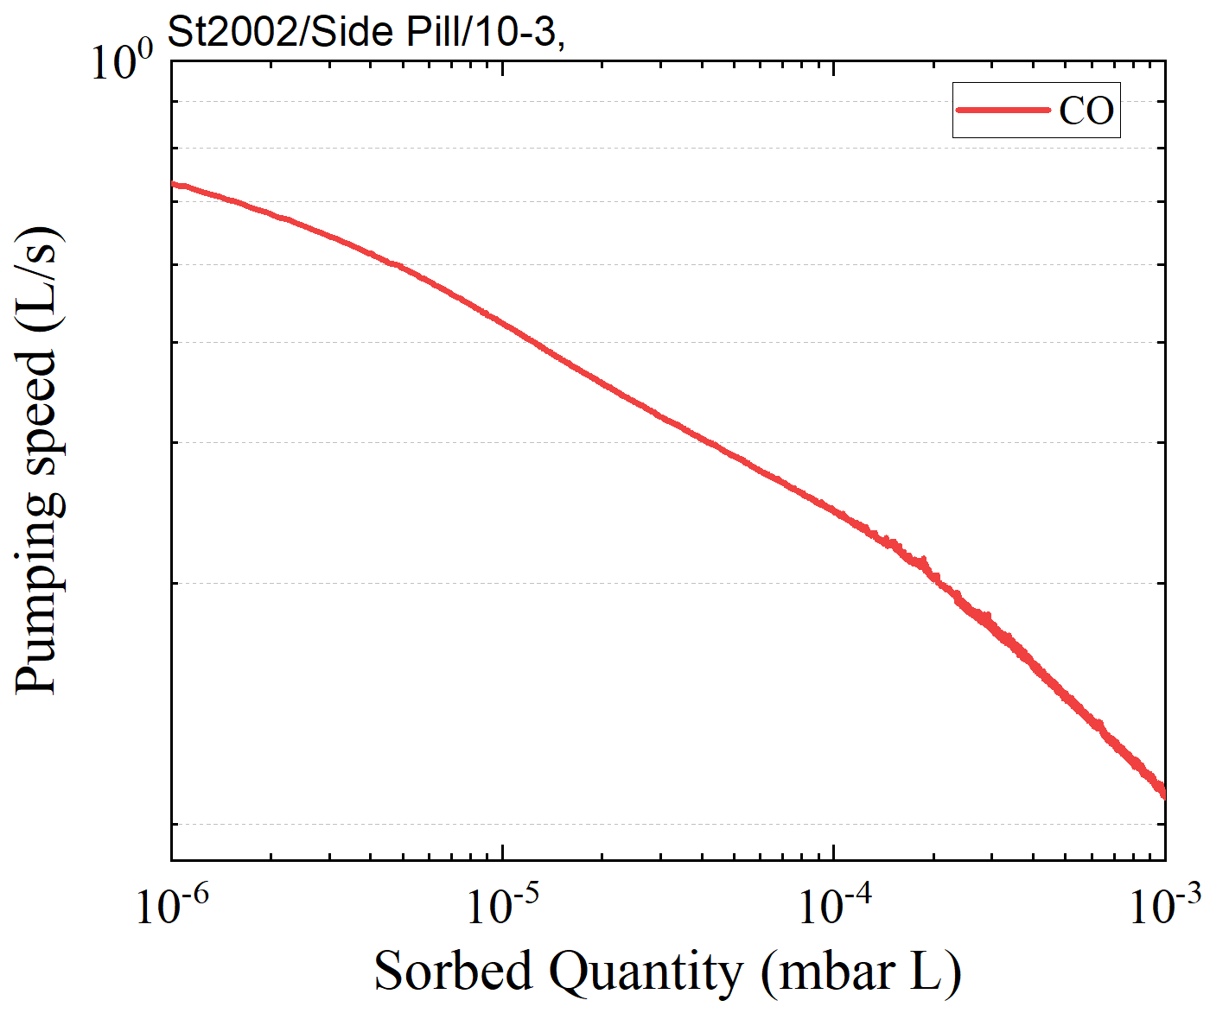
Estimation of the re-activation timing for the Pill type NEG
Calculated the adsorption capacity of the Pill type getter pump during the early stage
Apply the CO adsorption capacity measured by PAL
Activation condition : 180 ℃, 24 hr
Average pressure and sorbed quantity as a function of commissioning time for CO
In-situ baking condition for 4GSR
Pumping speed VS Sorbed quantity (CO)
per pill
10 mA
50 mA
100 mA
The re-activation timing of the pill type getter pump is required 100 hours, about 4 days, later
Pill-type getter
Apply the Saturation point

Slide 13
Summary
We conducted the vacuum simulation of the 4GSR using Molflow+ and Synrad
When the beam operation has run for a while, the average total pressure is about 10⁻⁹ mbar (H₂+CO)
Initially, the areas directly impacted by the photon beam have higher pressure, but over time, the pressure decreases relatively due to the beam cleaning effect
When the early stages of commissioning, we predicted the re-activation timing of the NEG pump by calculating the pressure and CO adsorption during operation
Thank you for listening

Slide 14
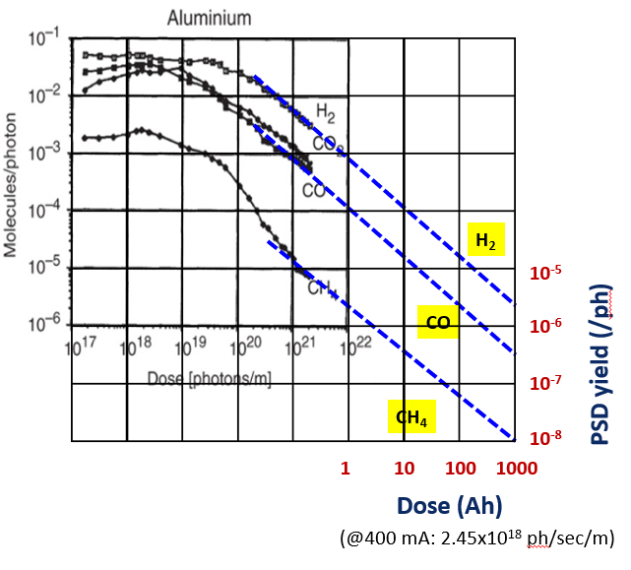
@400 mA: 1.62 x 10¹⁸ ph/sec/m

