Slide 1


HL-LHC Vacuum Upgrade
15-19 April 2024 - Fermilab
6th Workshop on the Operation of Large Vacuum Systems
OLAV
G. Bregliozzi – CERN – TE-VSC-Beam Vacuum Operation Section

Slide 2
Outline
HL-LHC Project
New Beam Screen
New Room Temperature Layout
Beam Screen Treatments (BST) Project

Slide 3
High Luminosity LHC Goals
From LHC Design Study application of 2010
The main objective of HiLumi LHC Design Study is to extend the LHC lifetime by another decade and to determine a hardware configuration and a set of beam parameters that will allow the LHC to reach the following targets:
A peak luminosity of L_{peak} = 5×10³⁴ cm⁻²s⁻¹ with levelling, allowing:
An integrated luminosity of 250 fb⁻¹ per year, enabling the goal of L_{int} = 3000 fb⁻¹ twelve years after the upgrade.
This luminosity is more than ten times the luminosity reach of the first 10 years of the LHC lifetime.
Ultimate performance established 2015-2016: with same hardware
and same beam parameters: use of engineering margins:
L_{peak ult} ≅ 7.5 10³⁴ cm⁻²s⁻¹ and Ultimate Integrated L_{int ult} ∼ 4000 fb⁻¹
LHC should not be the limit, would Physics require more than nominal
O. Brüning

Slide 4
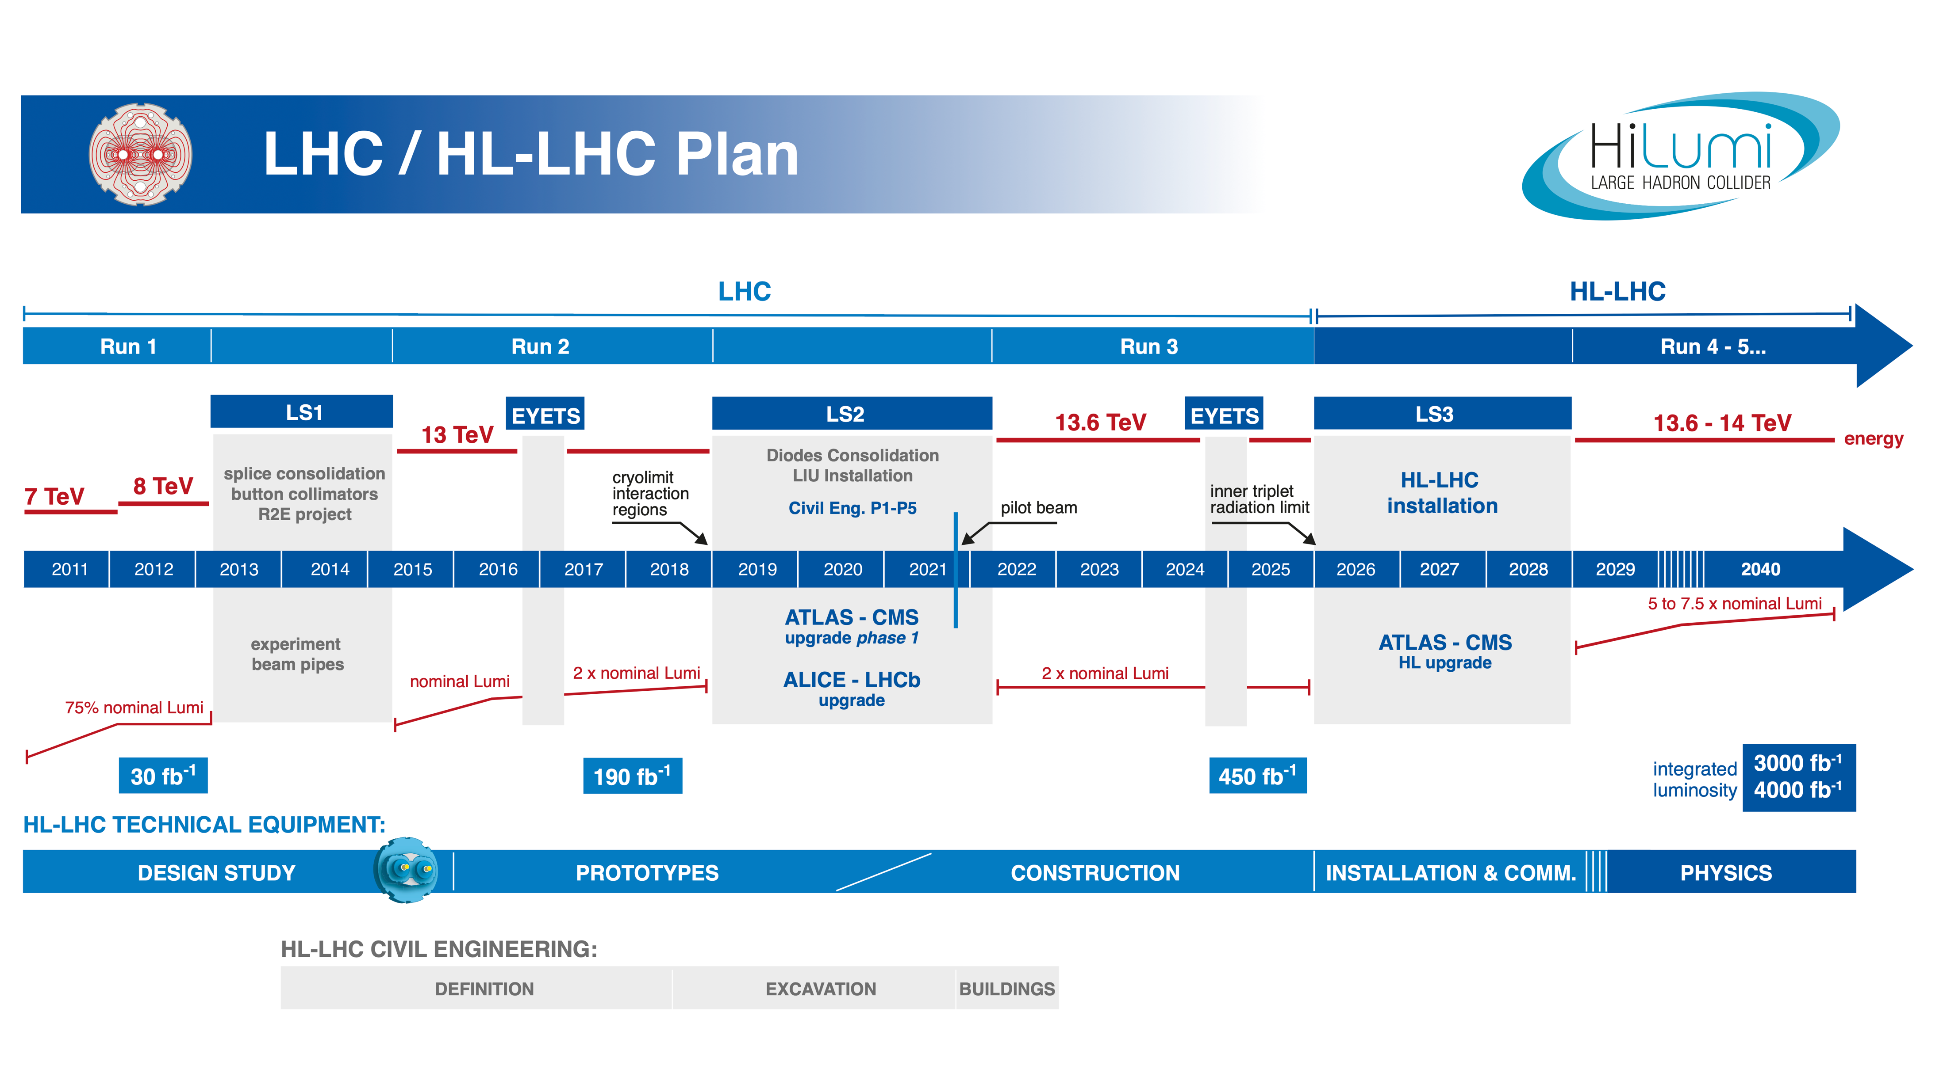
O. Brüning

Slide 5
HL-LHC Baseline Parameters
Parameter | Nominal LHC (design report) | LHC 2018 | HL-LHC 25ns​ (standard)
Beam energy in collision [TeV] | 7 | 6.5 | 7
N_{b} | 1.15 10¹¹ | ​1.15 10¹¹ | ​2.2 10¹¹
n_{b} | ​2808 | ​2556 | 2760
Number of collisions in IP1 and IP5 | 2808 | 2544 | 2748
N_{tot} | 3.2 10¹⁴ | 2.9 10¹⁴ | 6.1 10¹⁴
Beam current [A] | ​0.58 | ​0.52 | 1.1
Half Crossing angle [μrad]​ ¹⁴ | 142.5 | 130 | 250
Minimum β* [m] | 0.55 | 0.25 | ​0.15
ε_{n} [μm]​ | 3.75 | 2.5 | ​2.50
ε_{L} [eVs]​ | 2.5 | 2.5 | 3.03
R.M.S. bunch length [cm]​ (FWHM equiv. Gaussian) | ​7.55 | ​8.25 | 9.00
Peak Luminosity without crab-cavity [cm⁻² s⁻¹] | 1.0 10³⁴ | 2.0 10³⁴ | 8.1 10³⁴
Events / crossing (without levelling and crab-cavity) | 27 | 55 | 212
Levelled Luminosity [cm⁻² s⁻¹] | - | - | ​5.0 10³⁴
Events / crossing (with levelling and crab-cavities) | 27 | 55 | 131
Levelling time [h] (assuming no emittance growth) | - | - | 7.2
n_{b} / injection | 288 | 288 | 288
Integrated luminosity [fb⁻¹/year] | 45 | 65 | 250
WP2
LS2=
LIU
LS3=
New IT Quads & ATS
+
Crab Cavity with levelling

Slide 6
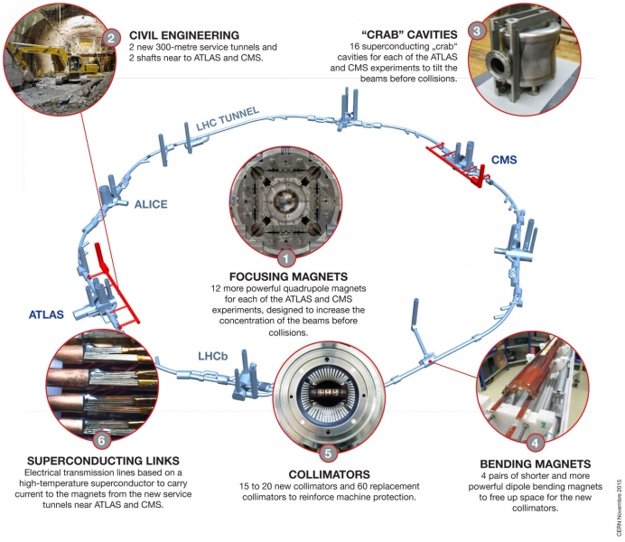
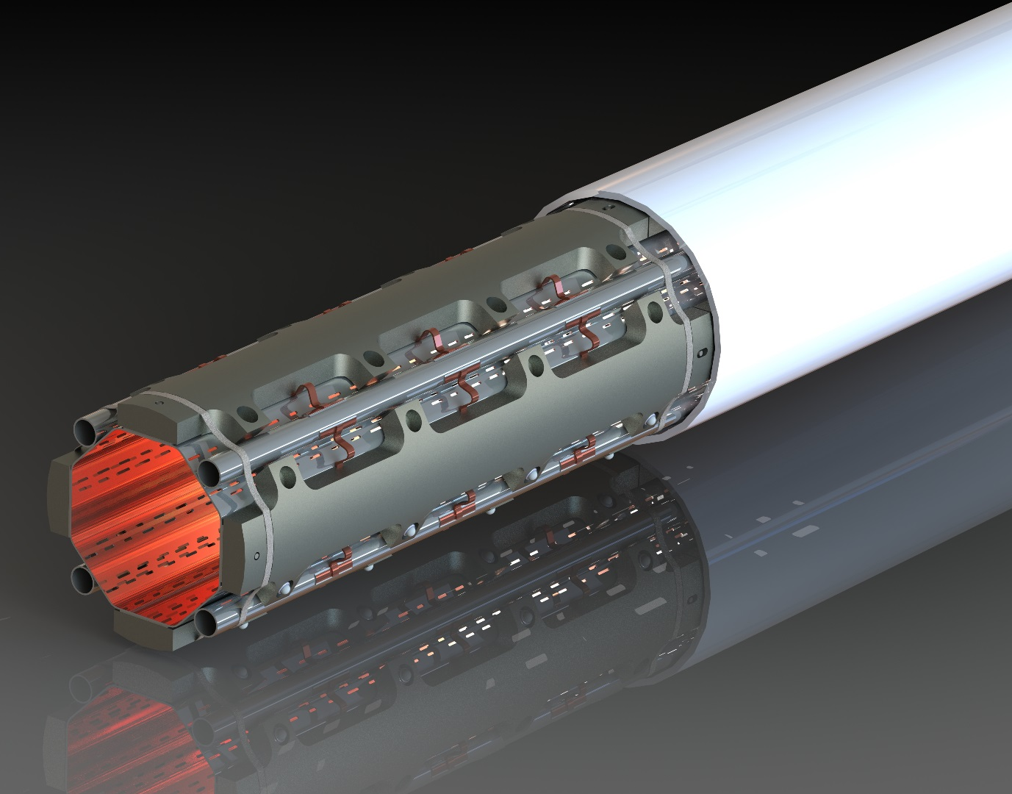
The HL-LHC Upgrade in a nutshell
H
SHIELDED BEAM SCREEN

Slide 7
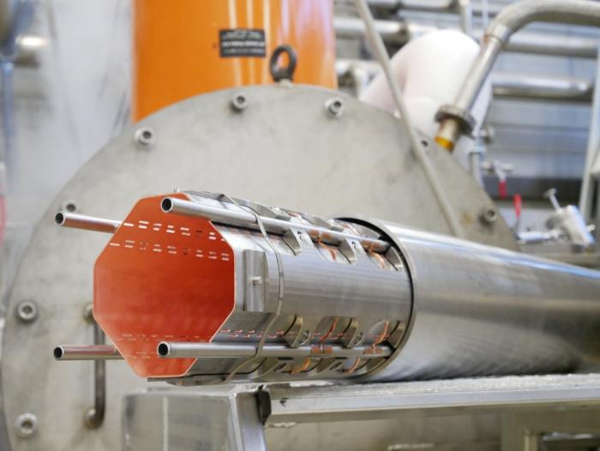
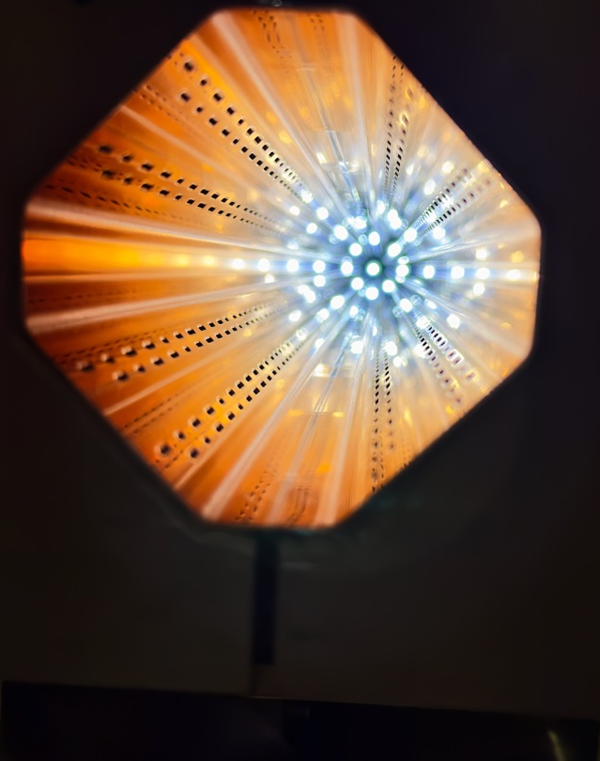
New Beam Screen

Slide 8
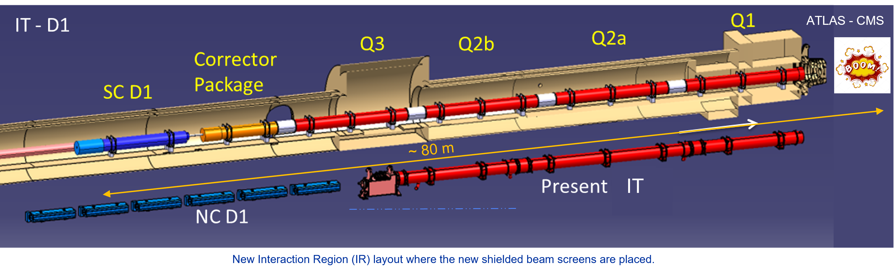
HL-LHC Beam Screen Functional requirements
The HiLumi-LHC (HL-LHC) upgrade calls for a new tungsten-based shielding system to lower the debris coming from atomic collisions towards the cold masses of the superconducting triplet magnets from ATLAS and CMS
Main functional requirements
Fulfilling the beam vacuum requirements;
Shielding the cryogenic system from beam-induced heating-> 1 W of heat on CB = 1kW of cooling energy.
The shielded beam screen has to withstand the Lorentz forces induced during a fast decay of the magnetic field (magnet quench): 50 cycles at a high field;
The temperature of the shielded beam screen must be actively controlled in a given temperature range: 60-80 K;
The assembly must be compatible with impedance performances and machine aperture;
The assembly does not have to modify the magnetic field.

Slide 9
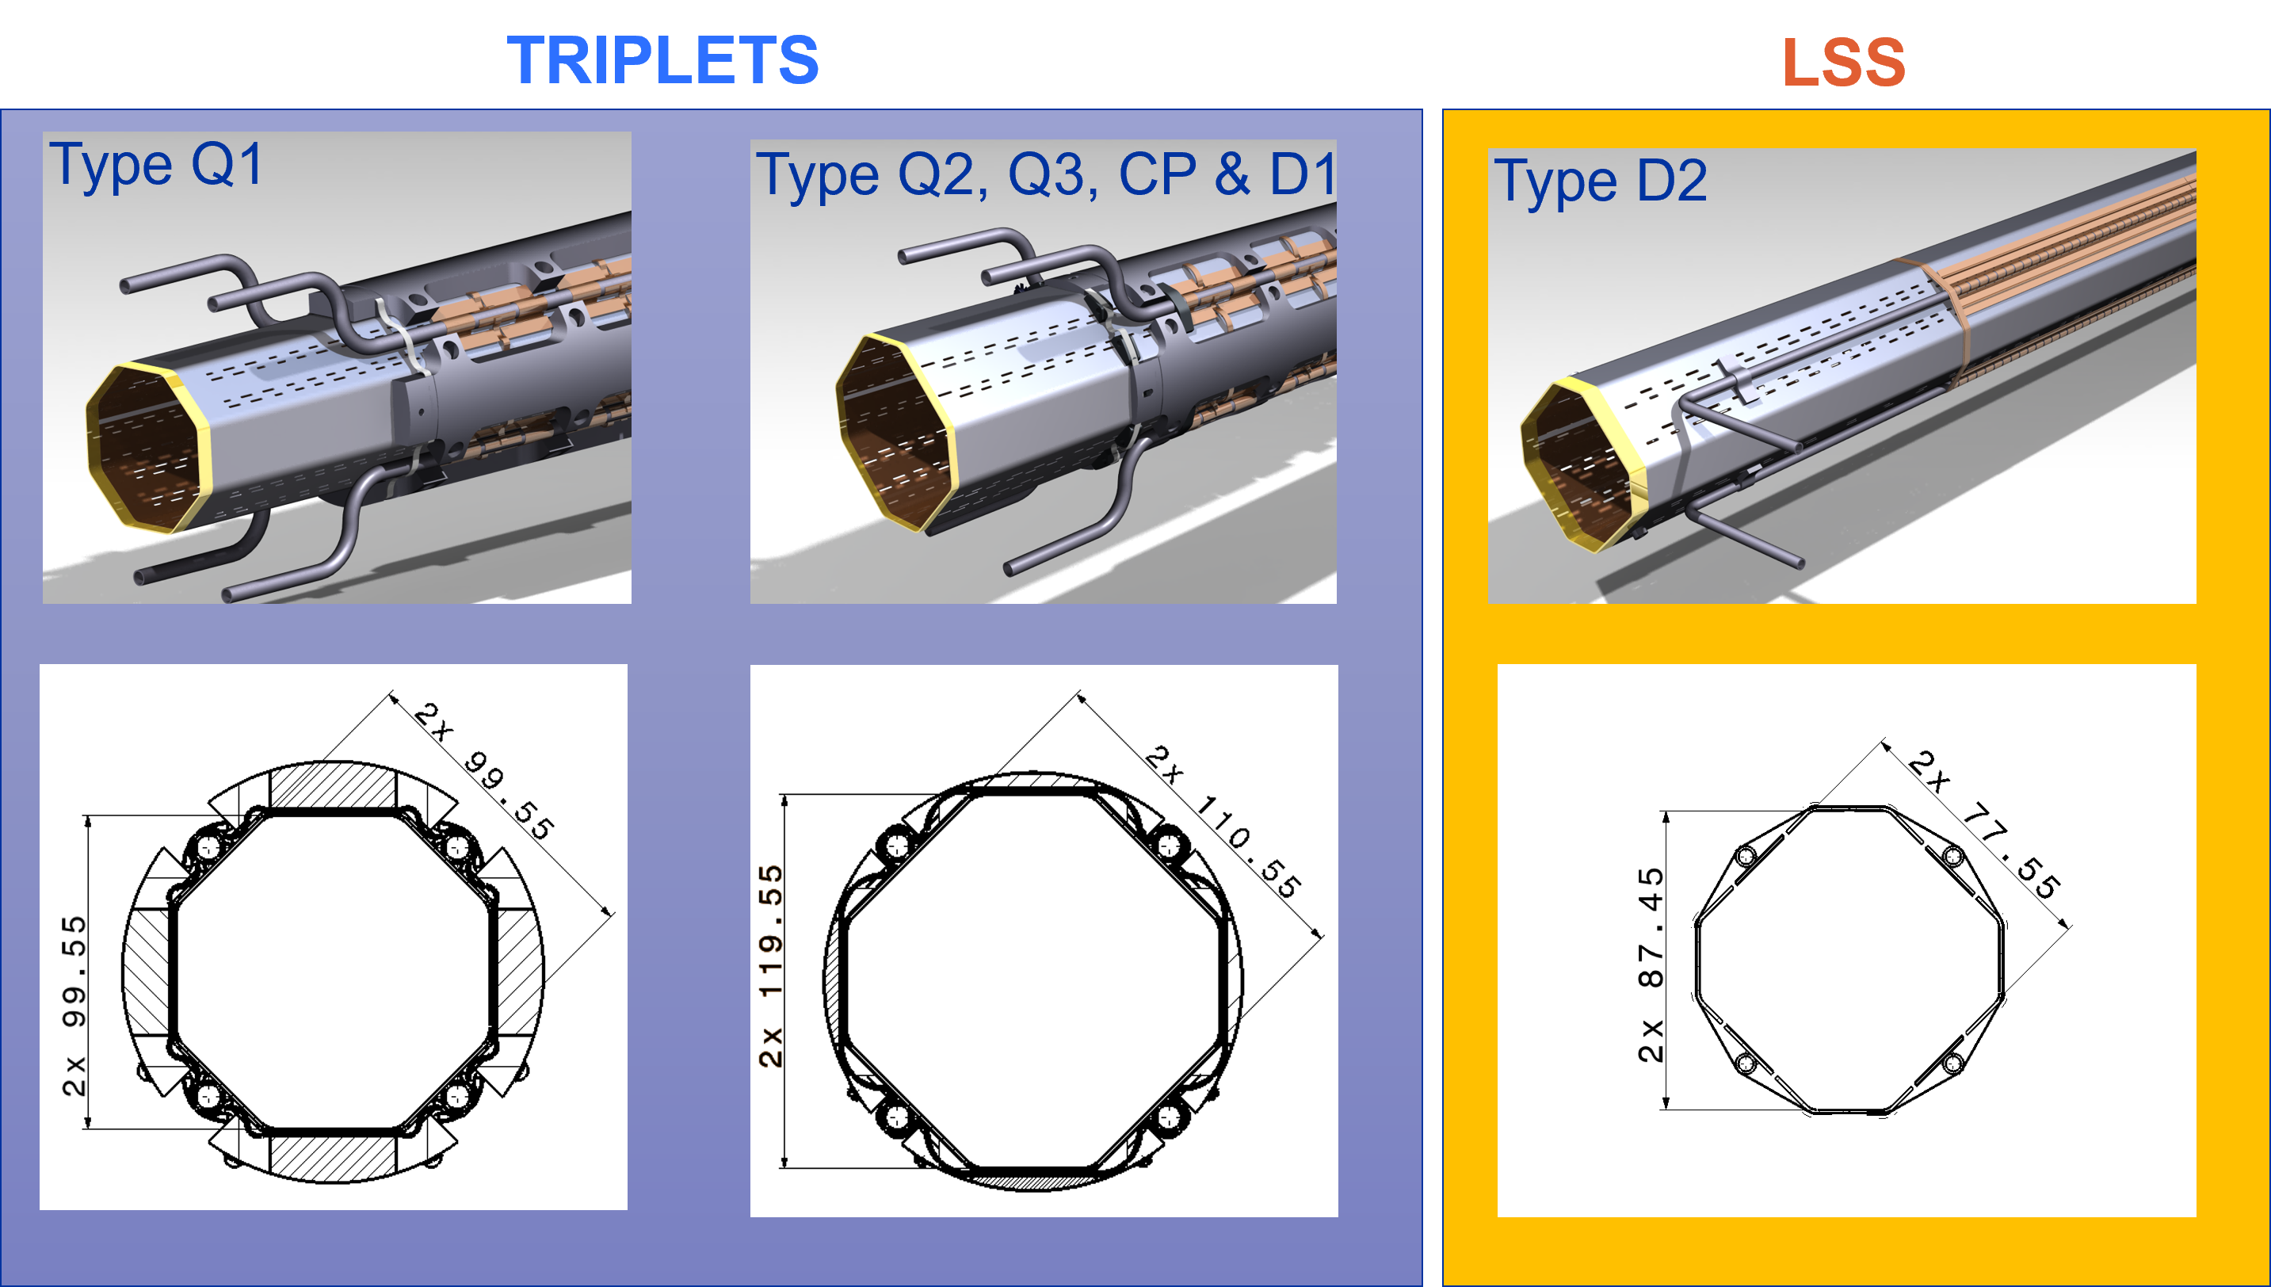
HL-LHC Beam Screen: Some numbers
Complex design and “only” 65 units to be produced.
Industry did not want to take part in the project: too expensive to produce by lamination/pushback (only one offer, very expensive!).
In total, 65x beam screens to be produced:
29x SHIELDED beam screens with W blocs
  4 + 1 Q1 type
  20 + 4 Q2 type (including Q2, Q3, CP & D1)
10x D2 NON-SHIELDED beam screens
10x Q4 NON-SHIELDED beam screens
8x Q10 beam screens identical to LHC ones
8x Q5 beam screens identical to LHC but surface treatment to be decided by end 2024
Length: 10721,3mm
Weight: 522,9kg

Slide 10
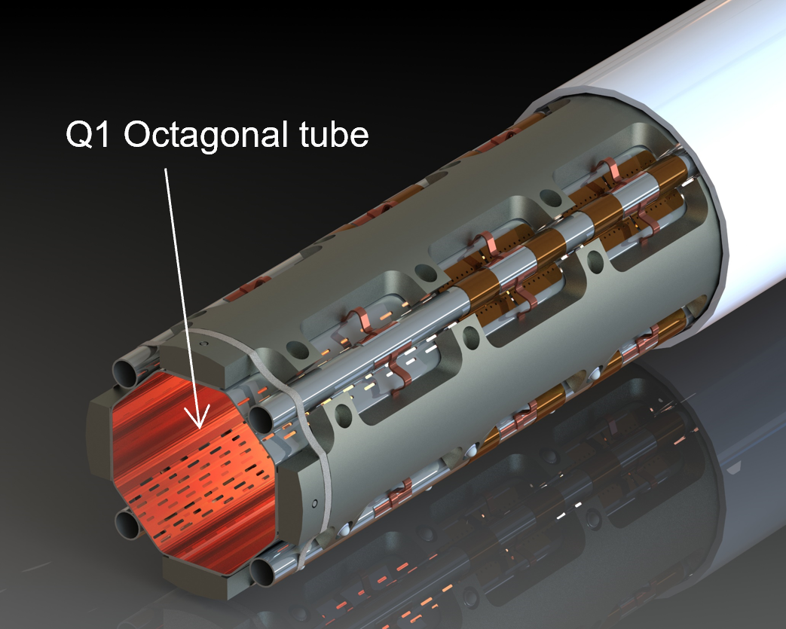
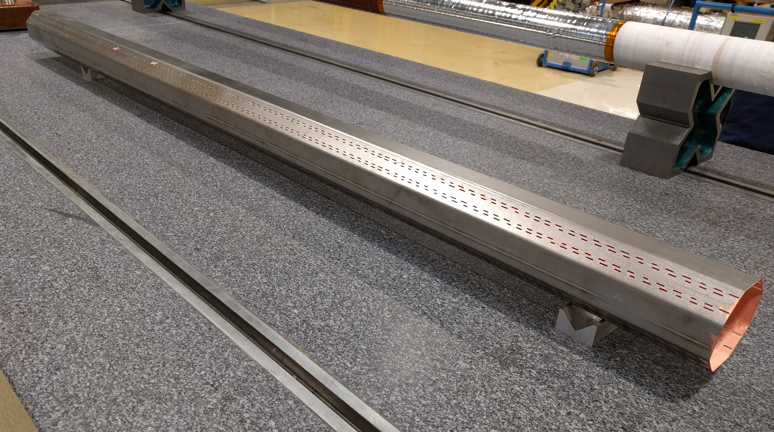
Octagonal tube
Q1 octagonal tube
Shell
aC coating
Pumping holes
Inner copper layer
Shell (P506 - high-nitrogen, high-manganese steel), 1 mm thick
High mechanical strength and low relative magnetic permeability at cryogenic temperatures to do not interfere with the magnetic field.
Inner copper layer (Oxigen Free Electronic -OFE- copper), 75 μm thick
Low electrical resistivity to reduce the impedance seen by the beam and the power dissipated by the beam image currents.
Amorphous carbon coating < 1 μm thick
Lowers the Secondary Electron Yield (SEY) to avoid excessive electron cloud, a limiting phenomenon for particle accelerators.
Pumping holes
Enable particles to be cryo-pumped at 1.9 K.

Slide 11
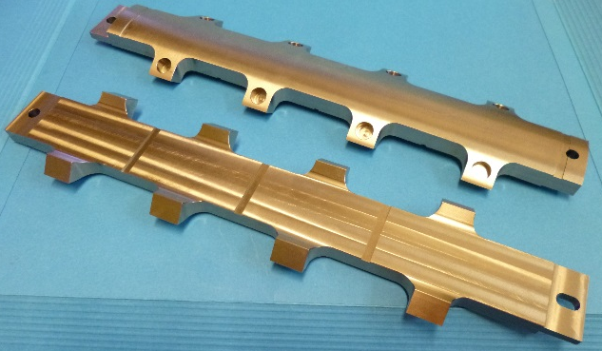
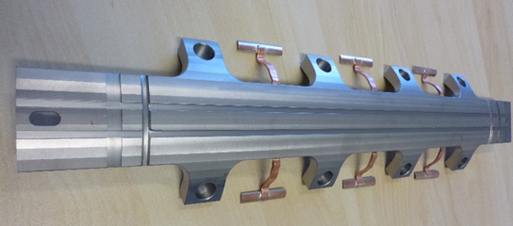
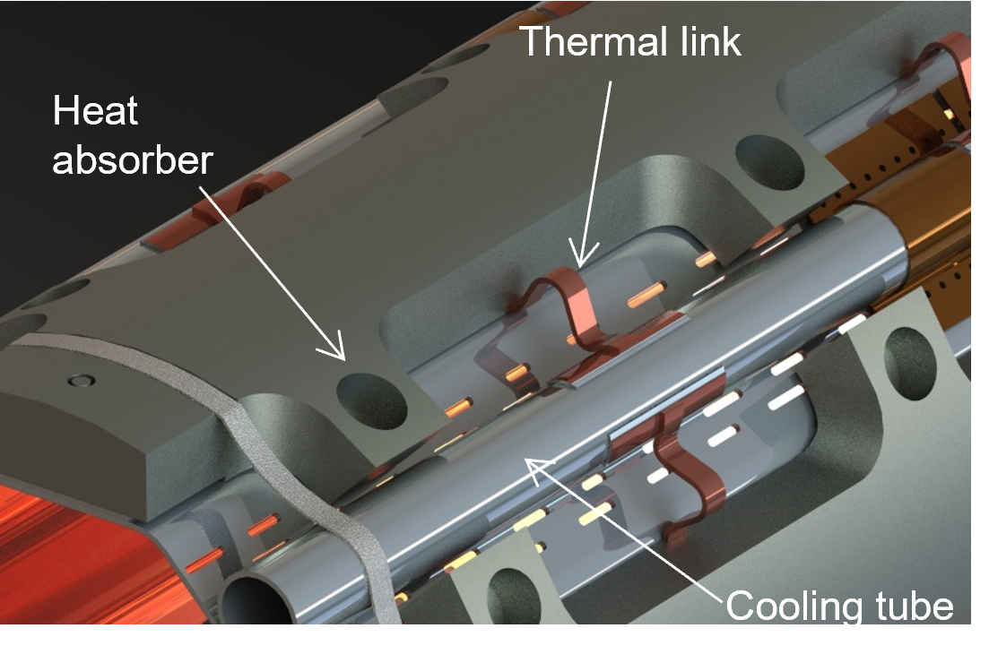
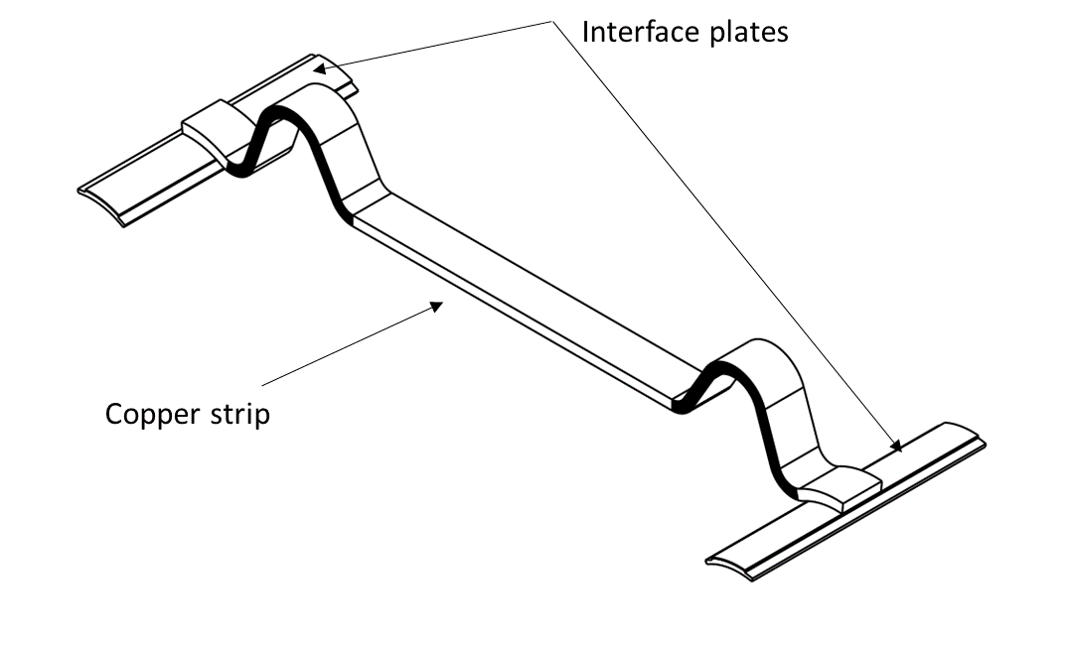
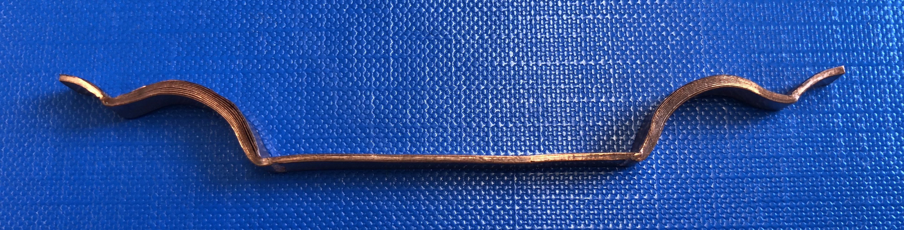

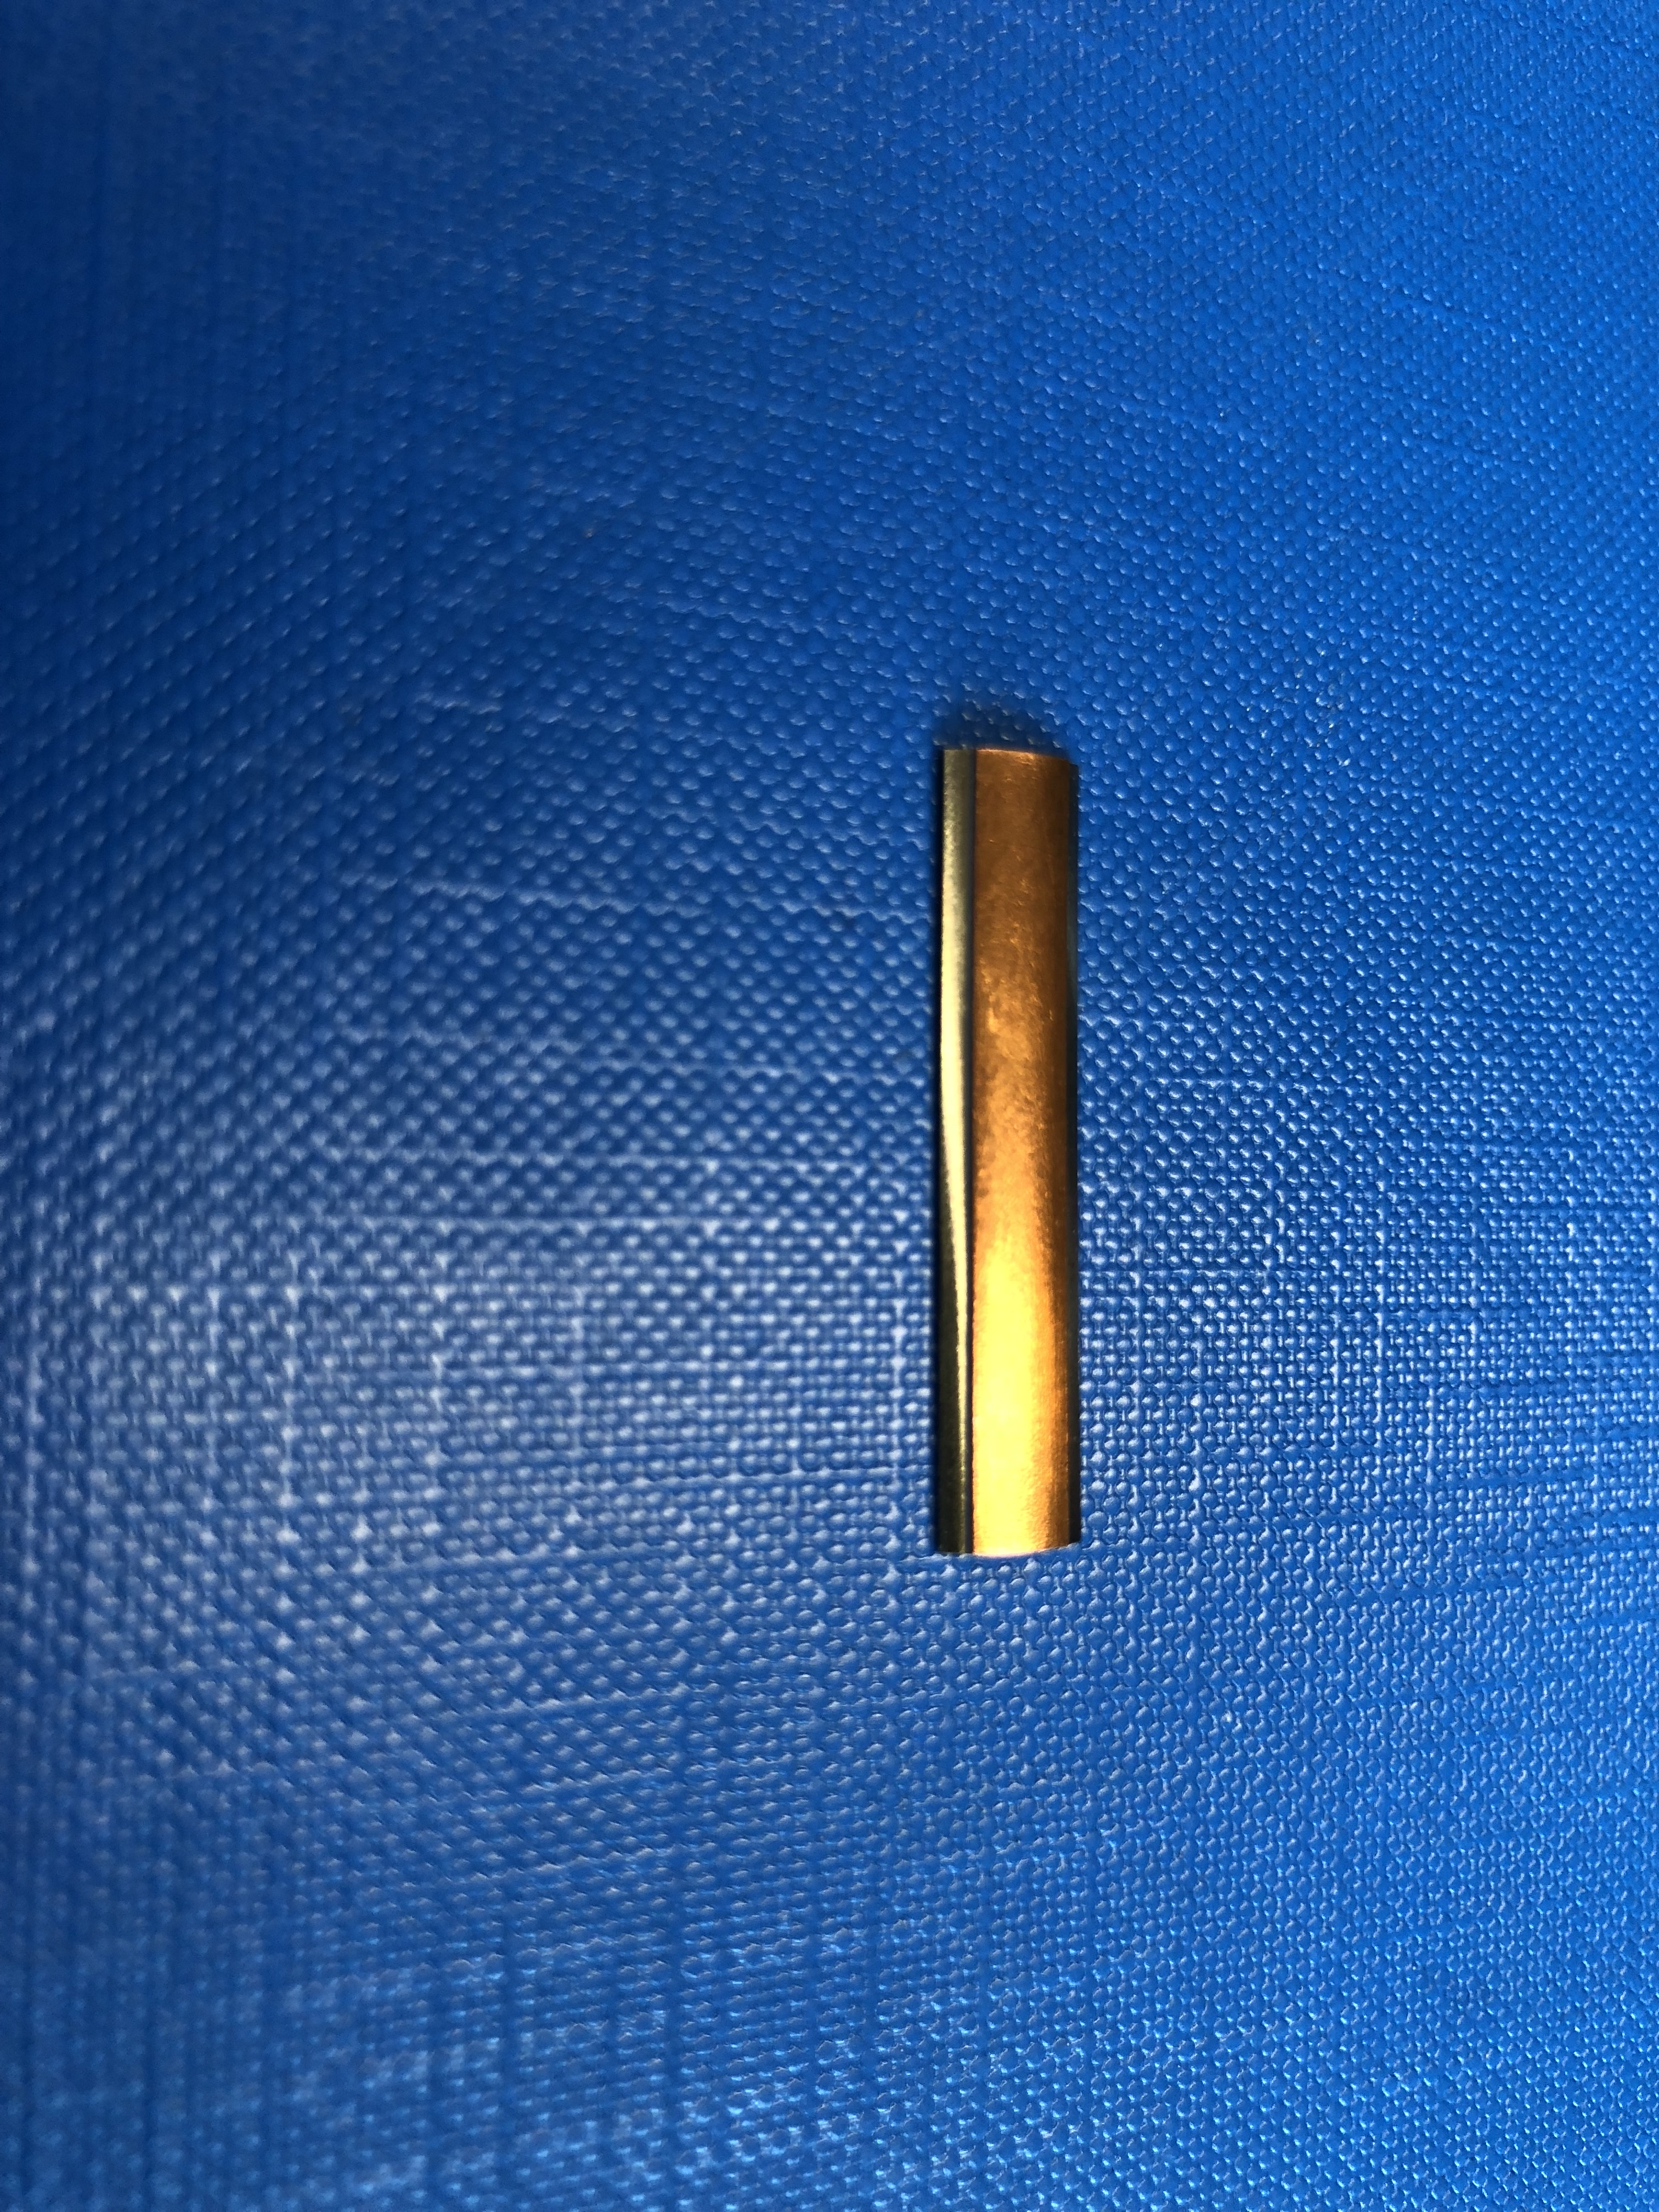
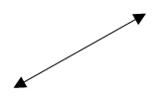
Heat absorber, thermal links, cooling tubes
Heat absorbers
P506
16 mm thick for Q1
6 mm thick for Q2,Q3,CP, D1
Thermal link
5 mm
Copper strip
1 mm
OFE copper
30 mm
Interface plate
Heat absorbers (tungsten alloy)
Absorb collision debris due to the alloy high density. Not welded on the octagonal tube. 25 W/m for Q1 and 15 W/m for Q2, Q3,CP,D1.
Thermal links = copper strip (OFE) + interface plate (P506, OFE)
Transfer the heat from the absorbers to the cooling tubes. The copper strip is brazed to the absorber (Cu +W) and interface plate (Cu+ Cu)
Cooling tubes (P506), O.D. 10 mm, I.D. 8 mm
Keep the beam screen between 60 K and 80 K (supercritical He). Laser spot welded on the octagonal tube.

Slide 12
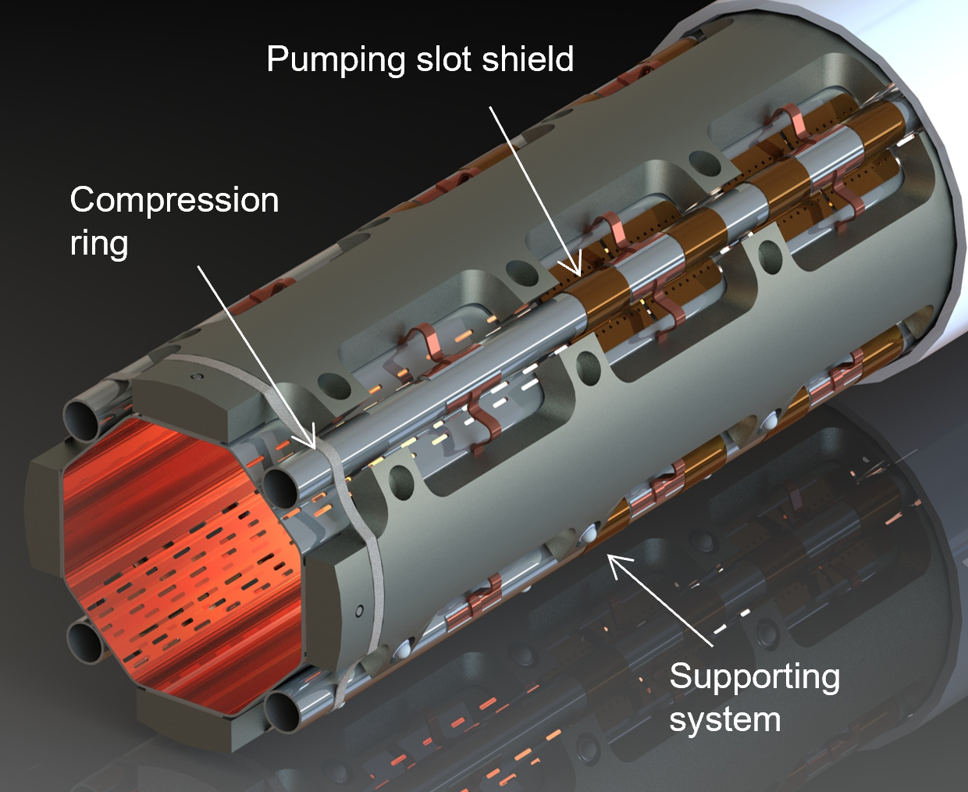
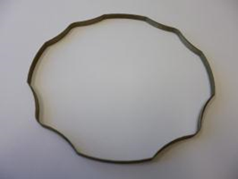
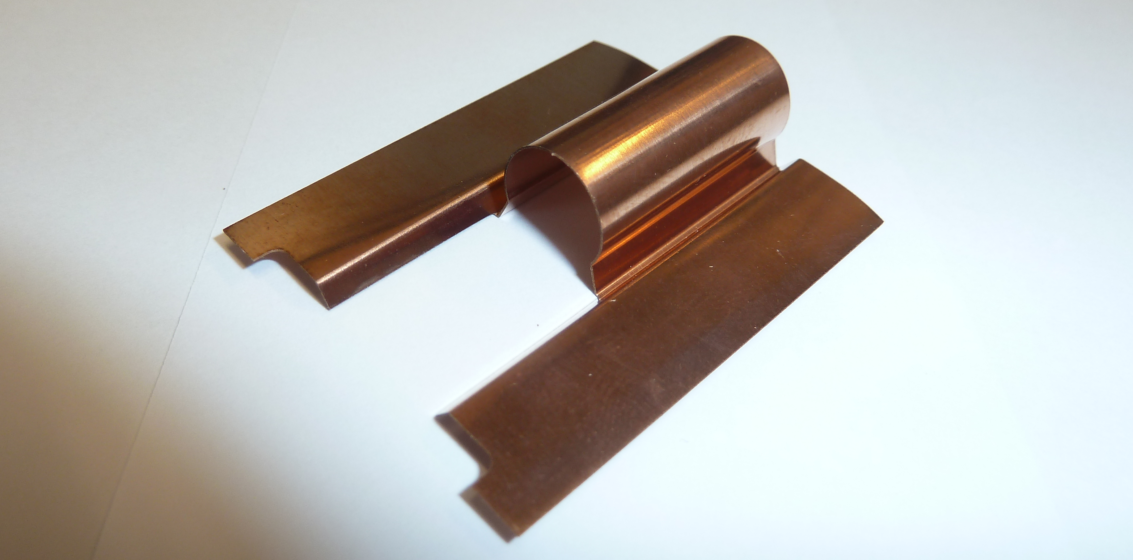
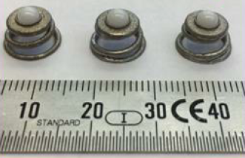
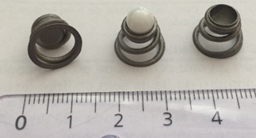


Compression ring, pumping slot shield & supporting system
Q1 Compression ring
Pumping slot shield
5 mm
0.5 mm
P506
0.2 mm
Supporting system
1.5 mm
Cold bore
OFE copper
Q2 - D1 system
Q1 system
System cross section
Compression rings (titanium alloy)
Keep the absorbers tight on the octagonal tube while providing enough flexibility for the absorbers.
Pumping slot shields (Copper Beryllium)
Reduce the transmission to the cold bore of electrons and beam induced radiation.
Supporting system = spring (titanium alloy) +ball (ceramic)
Centres the beam screen in the cold bore while limiting the heat transfer to the cold mass.

Slide 13
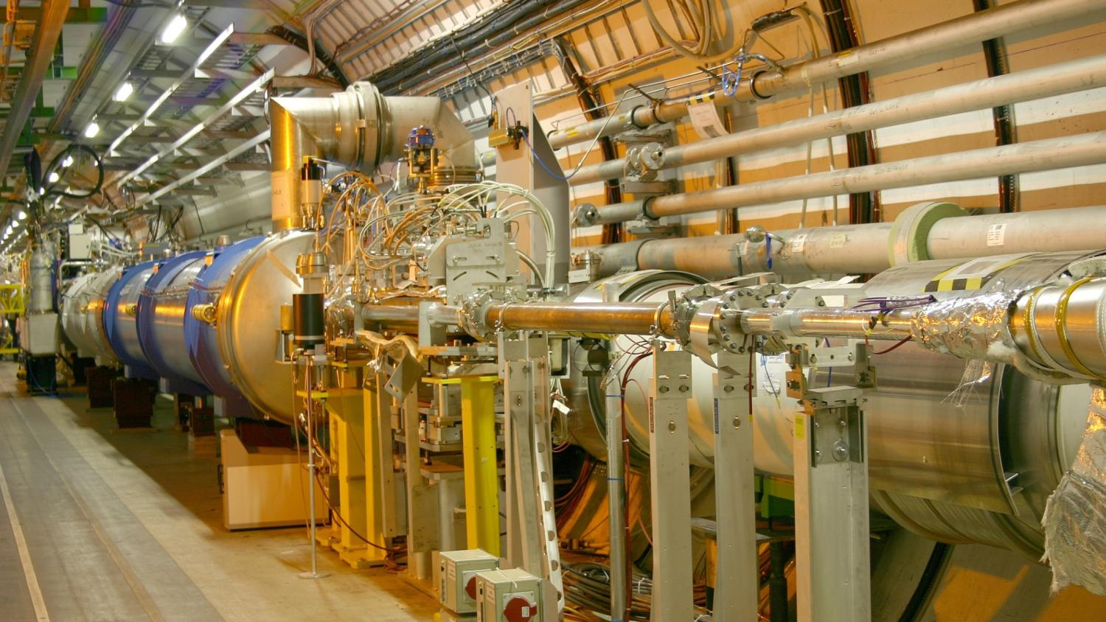
New Room Temperature Layout

Slide 14
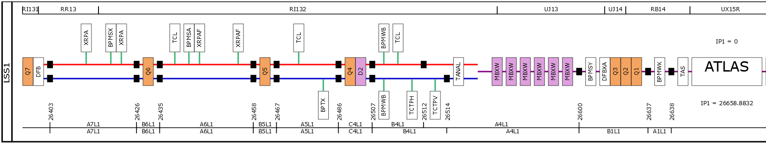
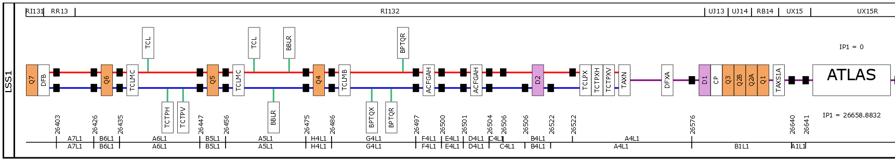
HL Installation in the LHC during LS3 @ P1 & P5
LSSL1 before LS3
EN-ACE synoptics (Victor Ronfaut, Samy Chemli, Estrella Vergara Fernandez): https://accelerator-synoptics.web.cern.ch
1km of new layout!
LSSL1 after LS3

Slide 15
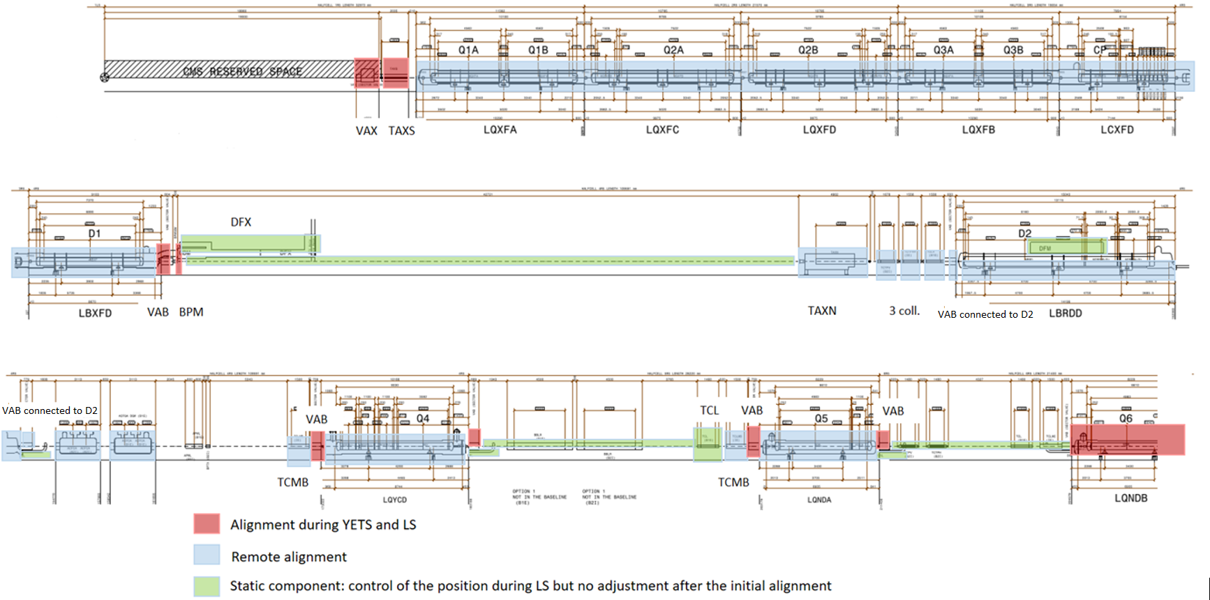
Full Remote Alignment System (FRAS)
Alignment during YETS & LS
FRAS
Static
The Full Remote Alignment System (FRAS) will allow aligning rigidly as a block, simultaneously and remotely from the CERN Control Centre (CCC), all the components from Q1 to Q5 on each side of the Interaction Point (IP), within ± 2.5 mm
It will also allow to move independently the components within the stroke of the corresponding bellows
Big impact on the choice of vacuum warm modules
IP
Q6

Slide 16

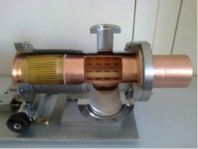
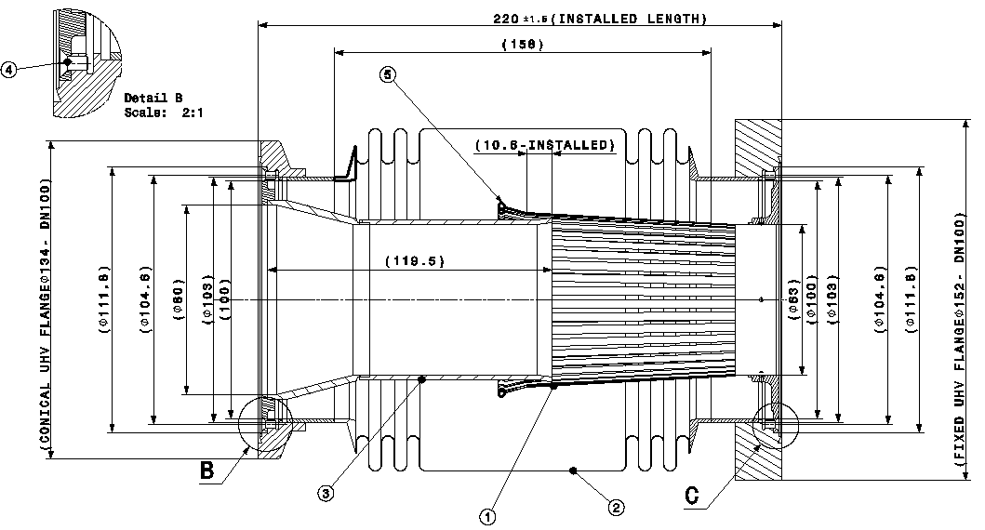
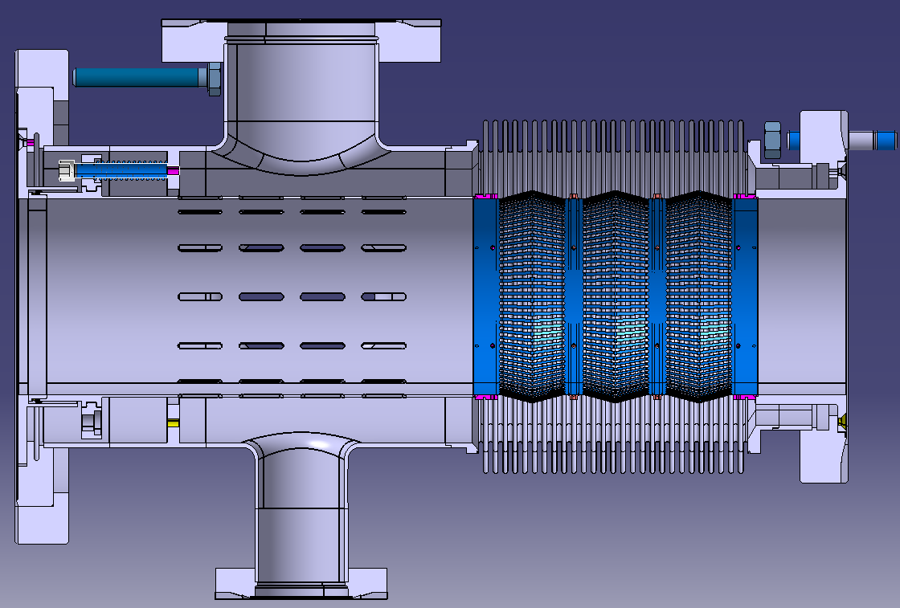
FRAS v.s. Warm Modules:
Which Choice do we have?
A
Standard RF Bellow
B
Large radial movement (LRM)
C
DRF
Cheapest
Main risk: loose RF fingers contact
Most used in the LHC today
Main risk: lose RF fingers contact
Highest radial movement
Already used in the LHC
Expensive
Complex assembly
Very safe

Slide 17
FRAS v.s. Warm Modules:
Which Choice do we have?
The final choice for all the recombination areas with beam offset
(See Eric Page Talk)
A
Standard RF Bellow
B
Large radial movement (LRM)
C
DRF
Axial stroke ± 20 mm
Radial offset in free length ± 5 mm
Radial offset in max compression ± 2.5 mm
Maximum torsion: 1 mrad
Axial stroke ± 20 mm
Radial offset ± 2 mm
Maximum torsion: 1 mrad
Axial stroke ± 20 mm
Radial offset ± 10 mm
Maximum torsion: 1 mrad
Maximum radial and axial stroke possible at free length

Slide 18
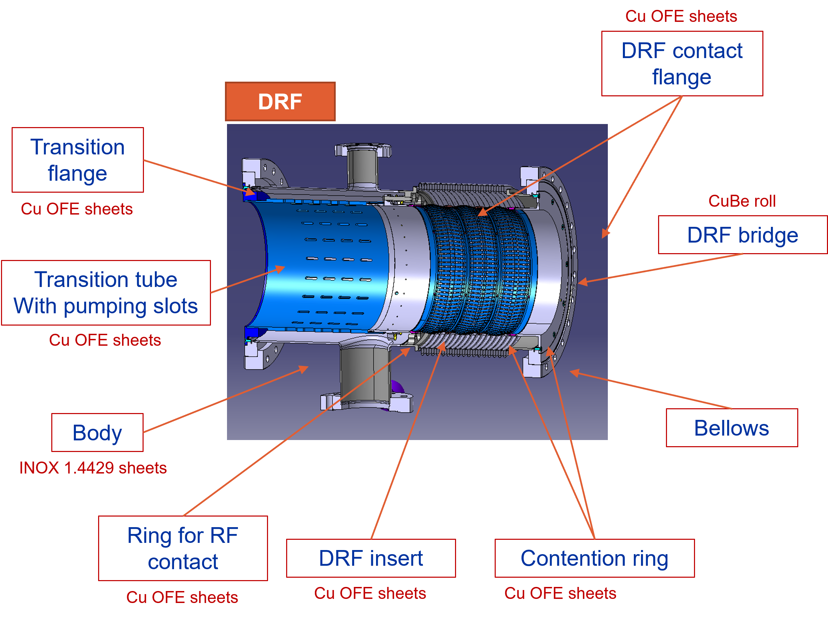
Warm Modules Production: Limit
280 New warm vacuum modules required
  3 different types: DRF, LRM and RF
  Size ranging from DN63 to DN250
  Try to recover as many as possible components from the machine: dealing with RP components adds complexity to the process.
Long delay for raw materials -> Mainly 316LN 3D forged
Series was started partially internally at CERN and partially outsourced with additional delays.
  Put on hold due to OP problems in 2023 -> See presentation of Eric Page
Subcomponent | Production needs LSS1&5
Body | ≈171
Transition tube | ≈185
Inserts | ≈173
Bellows and collars | ≈234

Slide 19
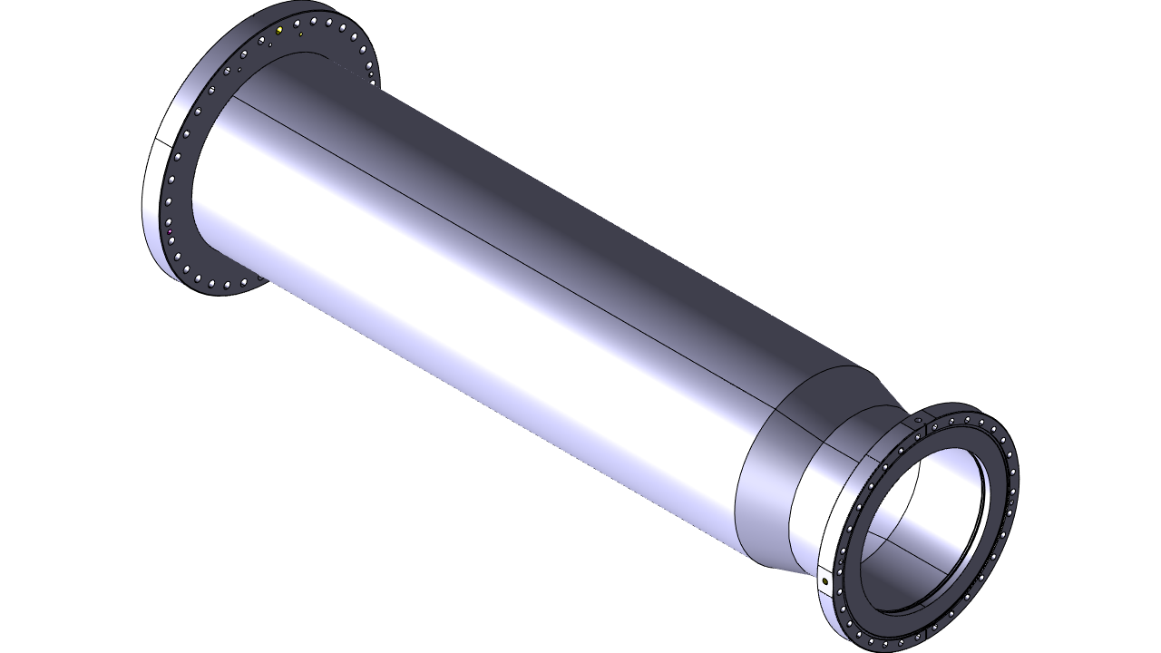
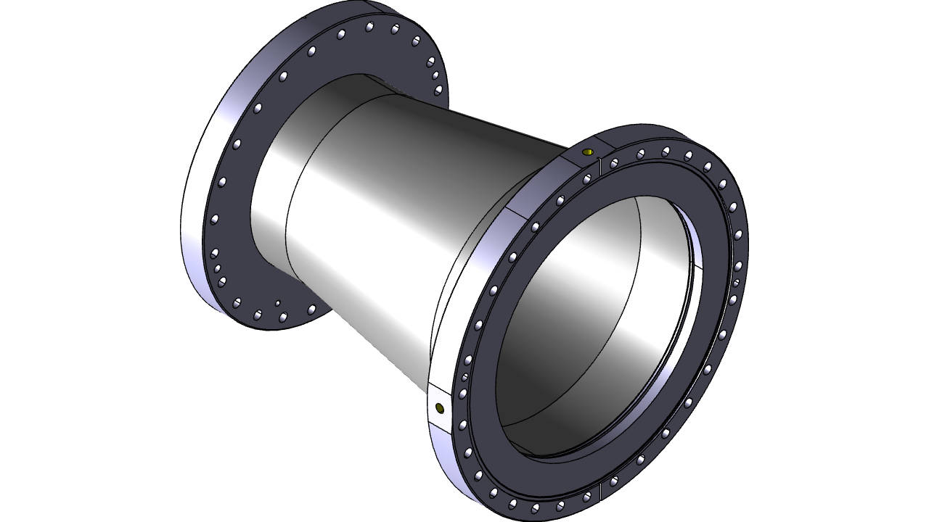
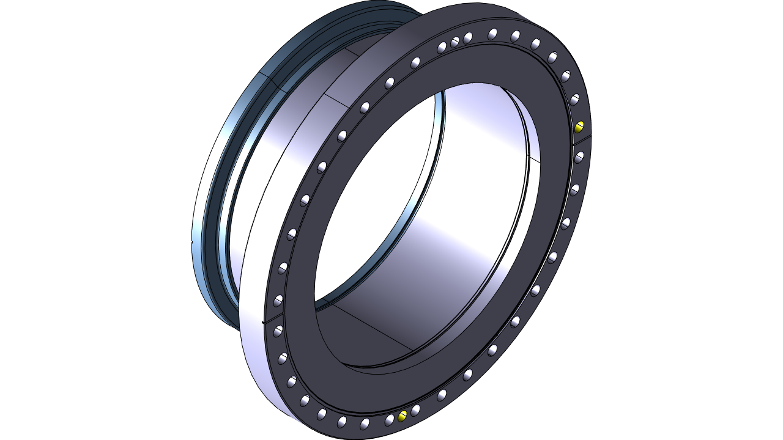
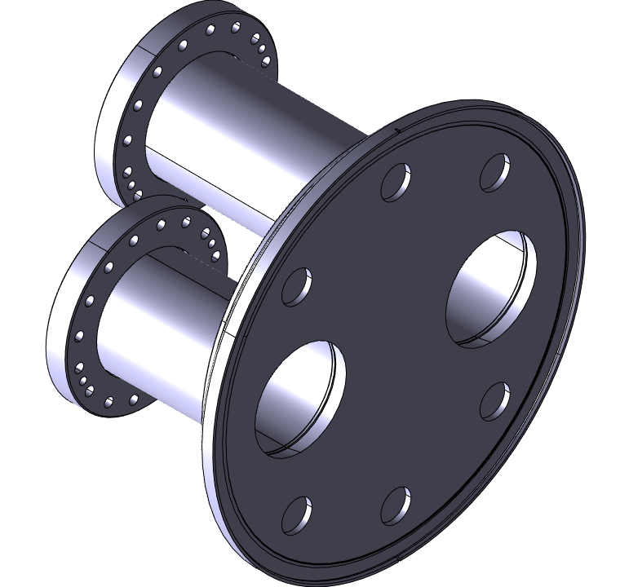
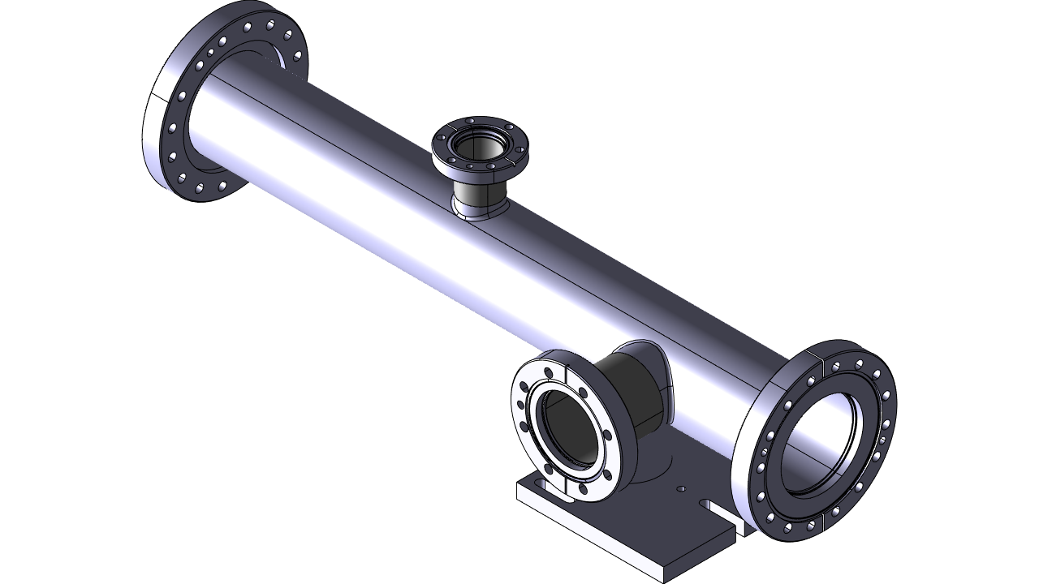
Vacuum chambers: Impedance Consideration
125 vacuum chambers are needed for the HL-LHC upgrade
  New aperture vacuum chambers -> DN250 NEG coated
  A lot of special/transition types: NEG and a-C coated
Long delay for raw materials -> Mainly 316LN 3D forged for the DN250 CF flanges
Also in this case try to re-use as many as possible already installed components: dealing with RP components -> Machining & vacuum acceptance tests
Coating specifications for SS chambers with φ < 130 mm
NEG or a-C Coating
Stainless steel
Copper Plating
Gold Adhesion layer
Adhesion layer in Gold: ≤1 μm
Copper plating: ≥10 μm
NEG coating ≈ 1-2 μm
a-C coating ≈ 0.5-1 μm

Slide 20
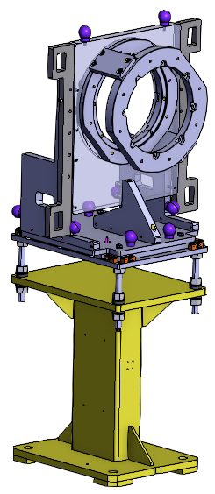
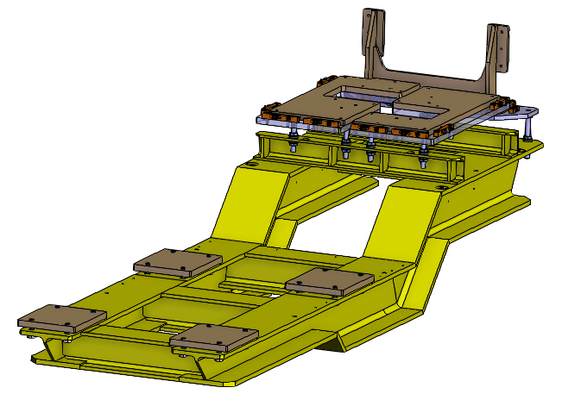
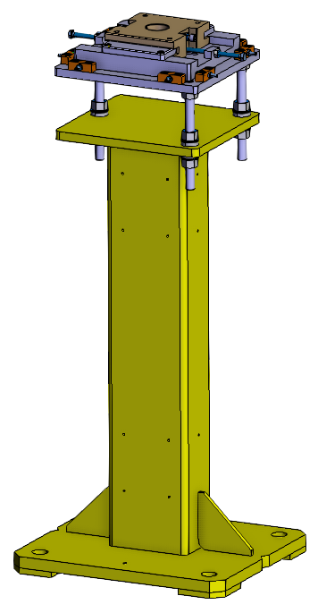
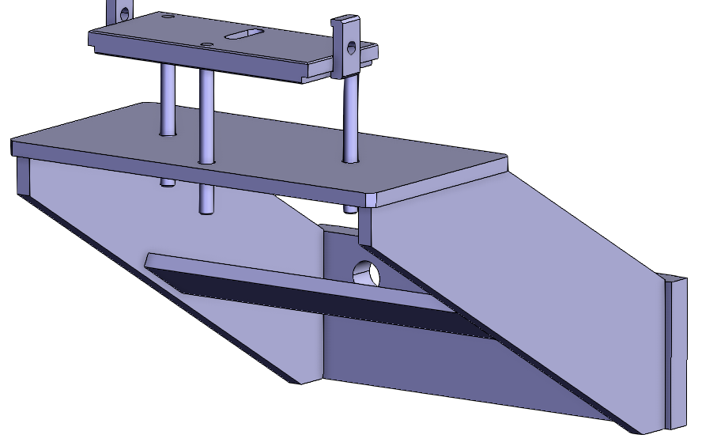
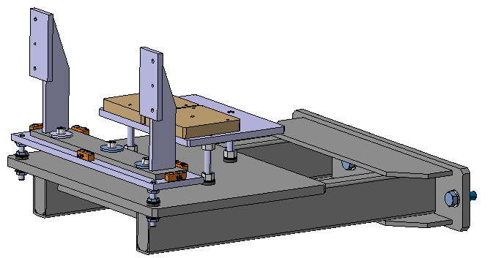
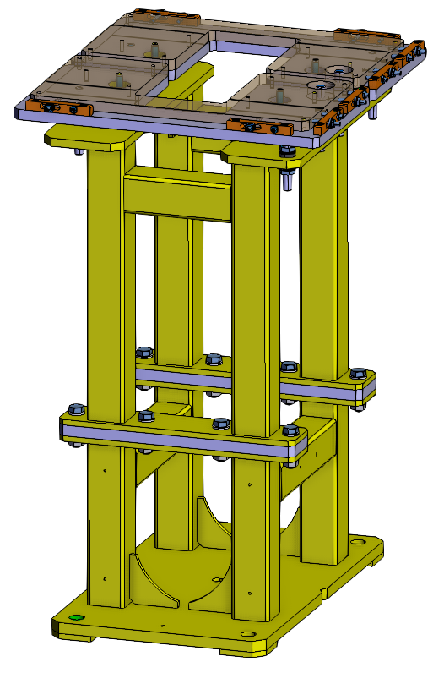
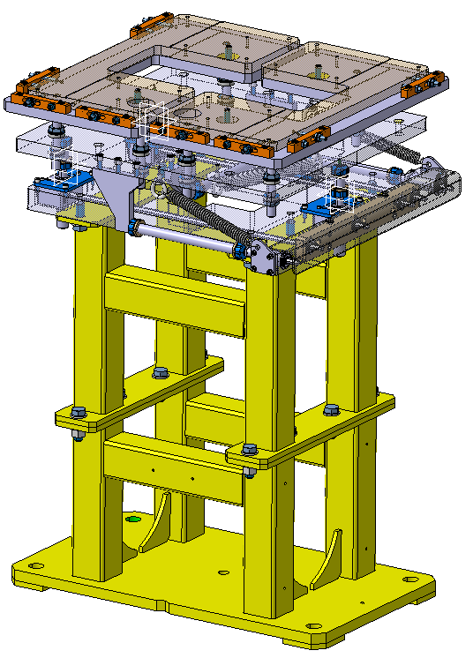
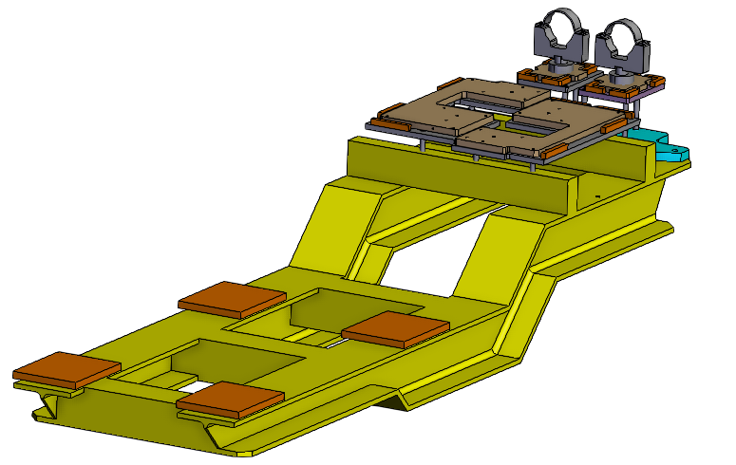
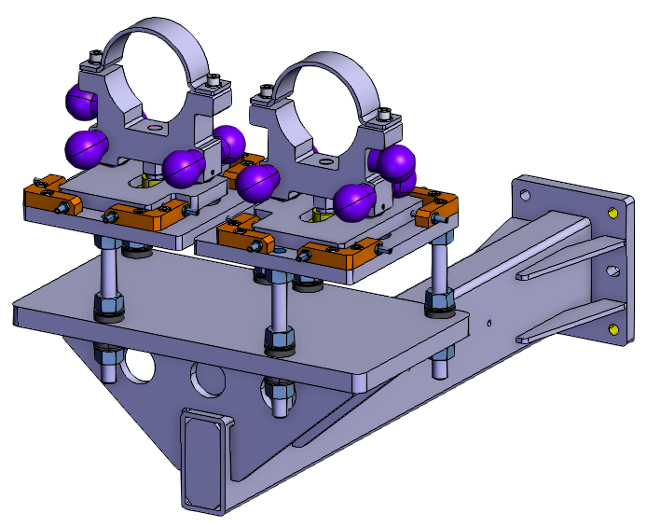
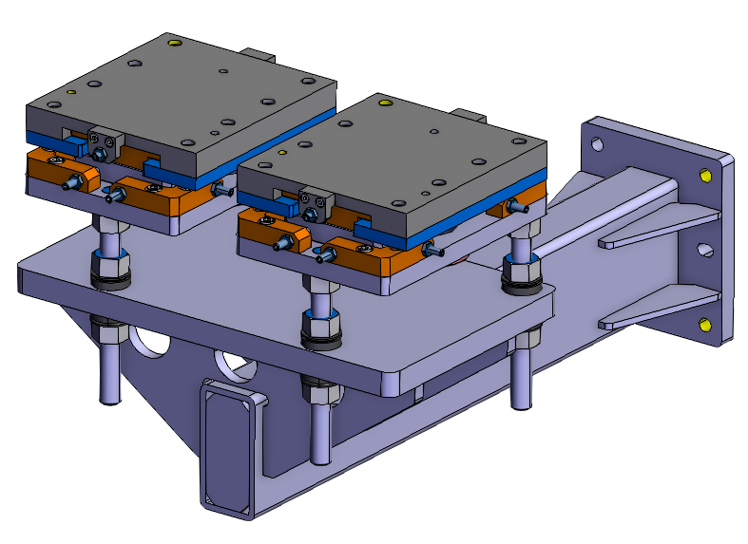
New Support System: Prototypes and series production
Prototype received
In validation
Q2 2024
Prototype received
In validation
Q2 2024
Validated
Validated
Series in production
Q3 2024
No prototype
Validated
Validated
Prototype received
In validation
Q2 2024
Prototype received
In validation
Q2 2024
Prototype received
In validation
Q2 2024
Design completed
10 types of supports
116 supports in production
T. Da Silva

Slide 21
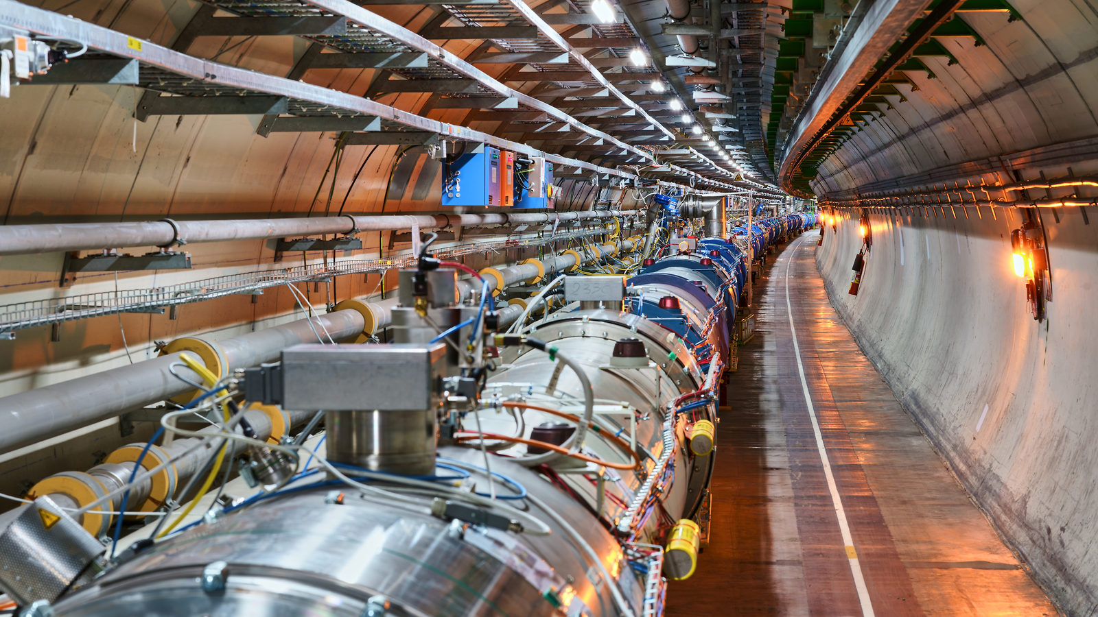
Beam Screen Treatments (BST) Project

Slide 22
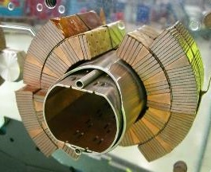
Electron cloud in accelerators
Primary electrons
Residual gas ionization
Photoelectric effect
Acceleration by proton
beam potential
Thermal load
Sec. e⁻
p⁺
p⁺
p⁺
p⁺
Beam
Prim. e⁻
hν
Electron Stimulated Desorption
Superconducting
coil - 1.9 K
Emission of
secondary electrons
Secondary Electron Yield
Collisions with vacuum chamber walls
Beam vacuum
system
P ≈ 10⁻¹² mbar
The electron cloud is:
a limitation to the accelerator performance (beam instabilities, pressure rise, heat load…)
responsible for a conditioning effect: adverse cloud effects decrease with beam operation time
  → ‘Beam scrubbing’ is used to ensure the stability of LHC operation against electron cloud
V. Petit

Slide 23
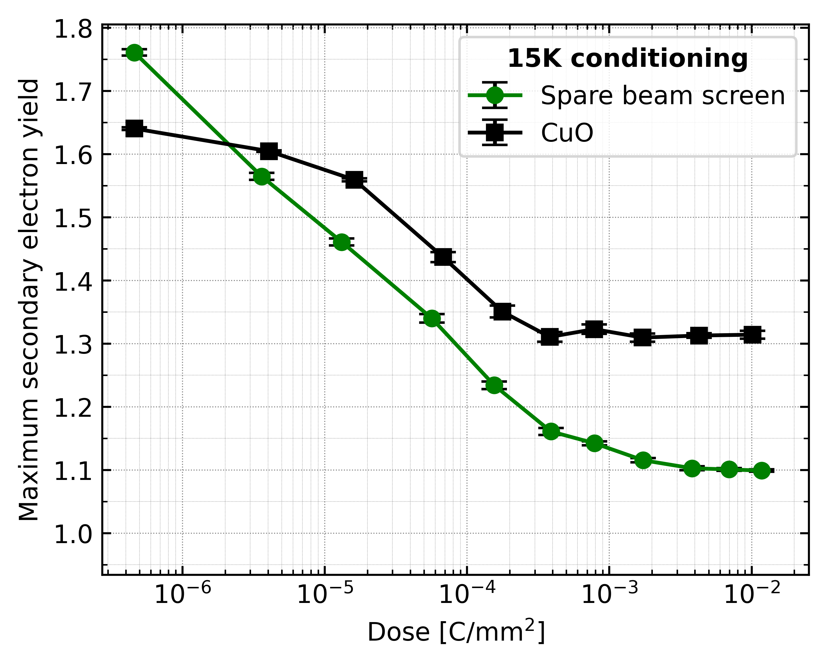
Problematic
Airborne Cu Hydroxide [Cu(OH)2] and venting of the apertures during Long Shutdowns have been identified as the root cause for this degradation
Non-uniform heat load along the LHC arcs
Important scattering within arcs, cells, and magnets.
Degradation during each Long Shutdown
Origin
Presence of CuO layer – Max SEY > e⁻ cloud threshold
Low carbon concentration – limited surface graphitization -> required for scrubbing.
Objectives
Remove CuO and/or increase surface carbon concentration on selected Beam Screen (BS)
BS surface passivation (robustness against re-oxidation)
V. Petit
V. Petit’s PhD thesis: https://cds.cern.ch/record/2721533

Slide 24
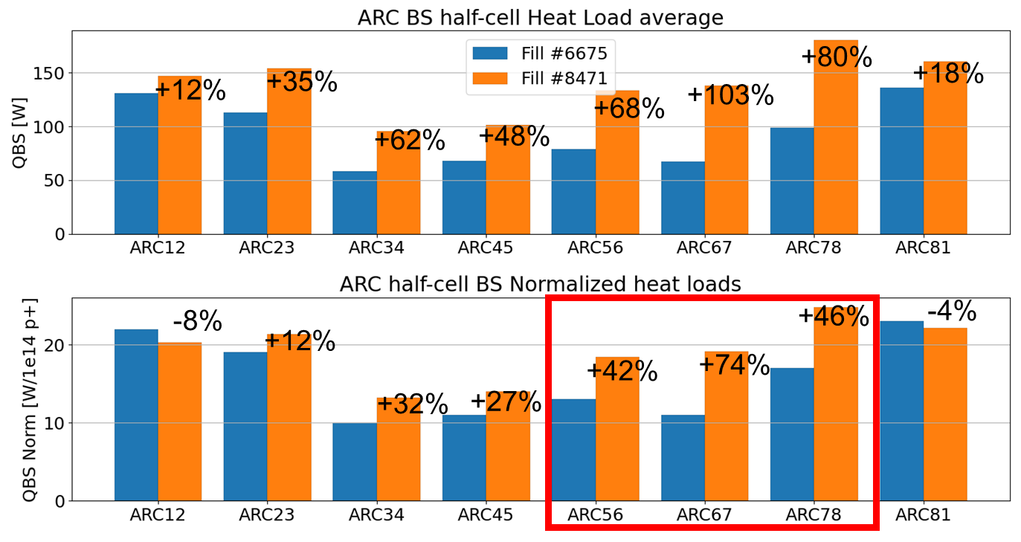
e⁻ cloud heat load: Cryogenic cooling capacity
LS1
  Provoked significant degradation of heat loads in S12 & S23 & S78 & S81
DR
85 W/hc
LS2
  Provoked significant degradation of heat loads in S56 & S67 & S78
Thanks to the hybrid filling scheme (mixture of 8b4e and 36 bunch trains), the heat load is under control for Run 3
B. Bradu

Slide 25
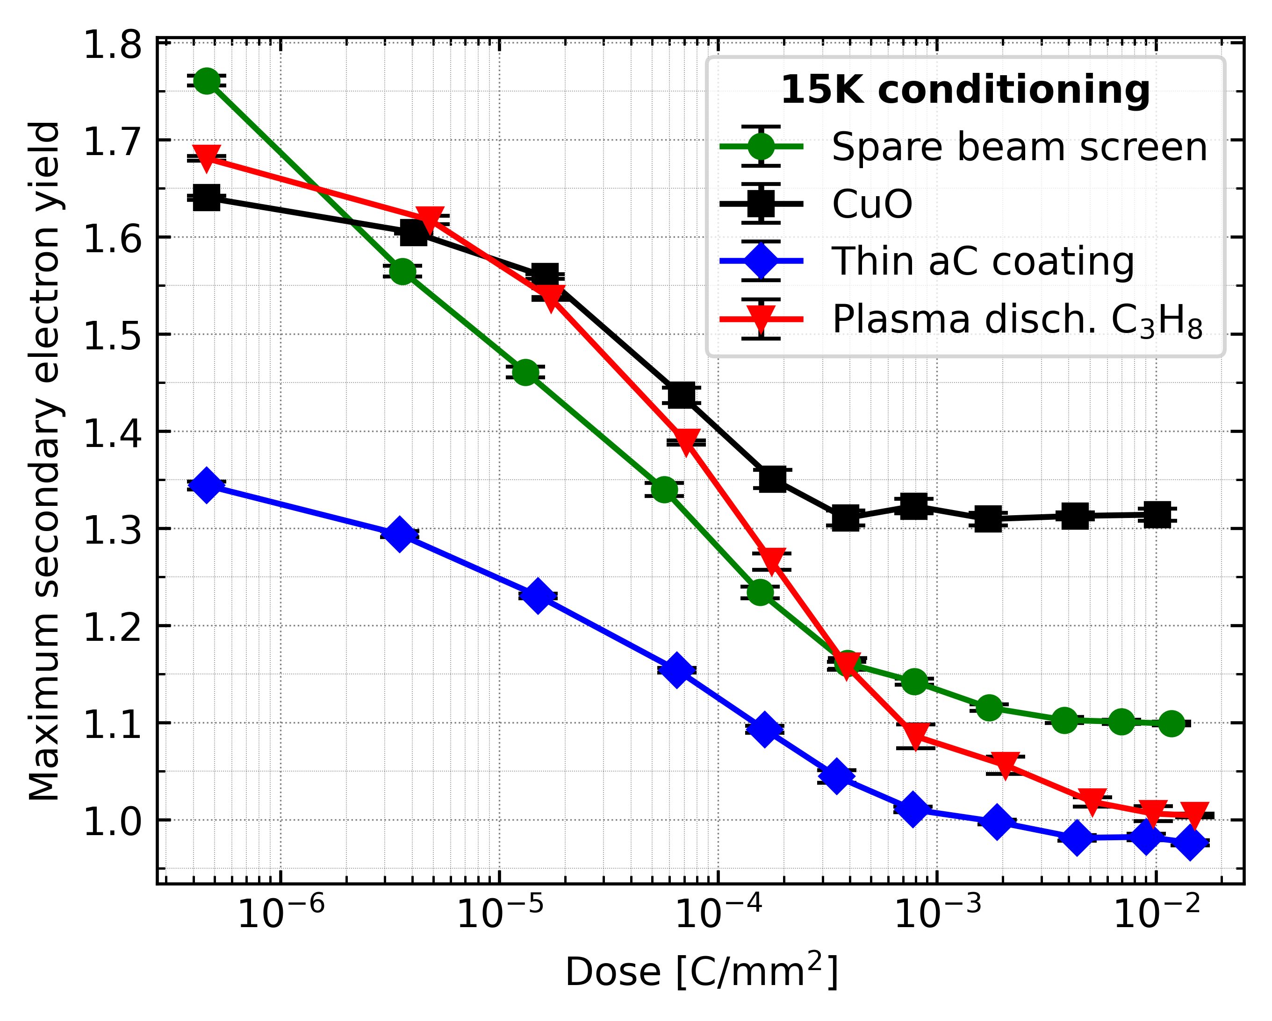
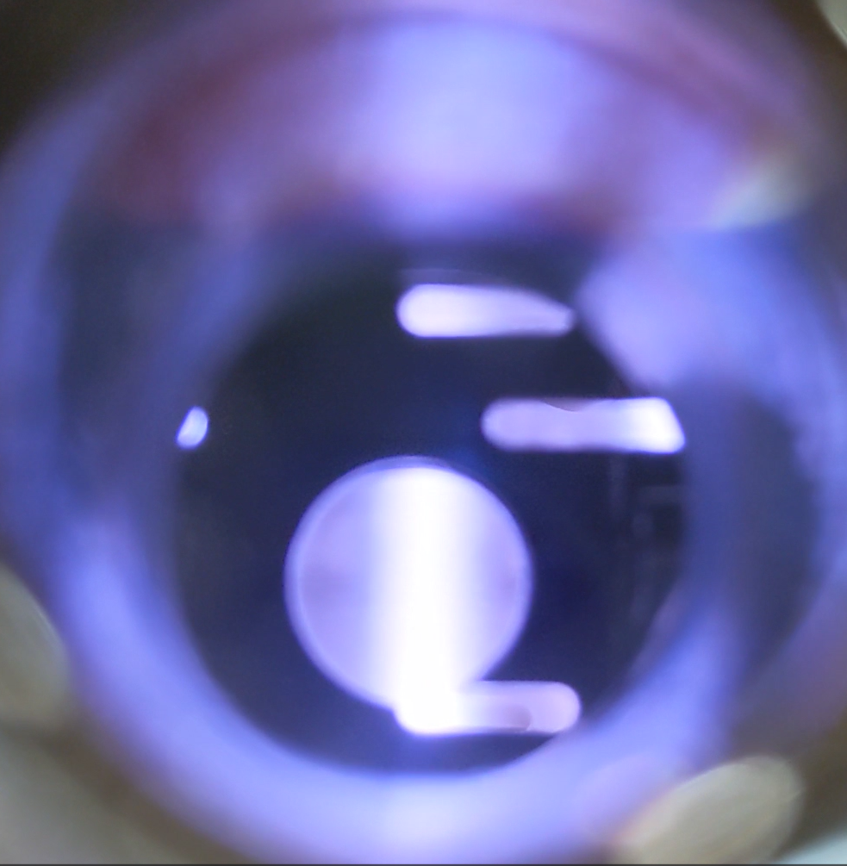

e⁻ cloud: Mitigation Options for HL-LHC
Thin a-C coating vs Plasma discharge in C_{x}H_{y}
Samples qualification
  SEY quantification on samples
  Photo-Electron Yield quantification on samples
  Ageing (multiple 15K conditioning + Air exposure cycles)
  Adhesion
  Electron Stimulated Desorption
PVD discharge
PE-CVD discharge
V. Petit
V. Petit

Slide 26
e⁻ cloud beam screen treatment: Planning for LS3
BST ~ 4 days per half-cell (≈ 54 m) of beam screen for both beam-lines.
ARC sequence determined by LS3 coordination.
Coating device mounting/dismounting on weekdays.
No treatment initiation during weekends.
3 setups used in parallel.
2 teams manage the 3 setups across 3 different half-cells.
Available time for BST ≈ 400 working days
Estimate of ≈ 100 half-cells
Correspond to ≈ 11 km of coated beam pipes
25 % of the LHC ARC beam vacuum system
G. Rosaz

Slide 27




HL-LHC during LS3: More to come!!
Experiments and other activities than P1 & P5
WP5
WP8
WP12
WP13
WP14
WP8: VAX installation at CMS
(VAX/TAXS installation: boundary conditions due also by CMS Schedule; under discussion with CMS management)
WP13: Beam Gas Curtain
WP13: Synchrotron Light Diagnostics (BSR) TBC
WP13: Beam Gas Ionisation (BGI)
VAX mock-up
WP14: TDE Dump at TD62 and TD68
WP14: TCDS absorbers
WP12: In situ a-C coating on IT
WP14: 4 MKI cool at P2/P8
WP14: Mask D1 at P2 and P8
WP5: 10 TCSPM secondary collimator
WP12: In situ a-C coating on IT
WP8: VAX installation at ATLAS
(VAX/TAXS installation: boundary conditions due also by ATLAS Schedule; under discussion with ATLAS management)
WP14: 4 MKI cool at P2/P8
WP14: Mask D1 at P2 and P8
MKI cool
TCSPM 3D jaw layout

Slide 28



LS2
Run3
LS3
YETS
2021-22
YETS
2017/2018
YETS
2022/2023
EYETS
2023/2024
EYETS
2024/2025
EYETS
2016/2017
YETS
2015/2016

Slide 29




Once upon a time …1954!
CERN Science Gateway
Happy birthday CERN!
Higgs boson

Slide 30
Thank you

Slide 31
SPARE SLIDES

Slide 32





Surface analysis of LHC-extracted beam screen during LS2
Surface analysis at RT of low and high heat load beam screens extracted from the LHC during LS2 suggest CuO (Cu II oxide or cupric oxide) and low carbon amount as responsible for high heat loads
Cu2p
CuO signature
at RT

Slide 33

Option 1: Plasma-assisted CuO reduction and carbon recovery (PE-CVD)
+ Efficient CuO reduction and carbon deposition obtained in 10⁻¹ mbar of C₃H₈ (propane)
+ Several cm/min → ≈ 1 day/53m/beam line
+ No significant warm-up (≤ 50 W)
- ”as-produced” SEY is high (≈ 1.5 - 2) due to presence of hydrogen in C_{x}H_{y} gas
To be further investigated:
  → Optimize gas type, pressure, time…
PE-CVD : Plasma Enhanced Chemical Vapor Deposition

Slide 34

Option 2: Very thin amorphous carbon coating by sputtering (PVD)
+ CERN has expertise (SPS campaign, HL-LHC: in-situ a-C coating of IT2&8 + new IP1&5 beam screens)
+ Compatibility with LHC beam pipe environment already assessed (Q5L8 a-C coated during LS2)
+ Lower “as-produced” SEY achieved than with PE-CVD
- “as-produced” SEY is still high (≈ 1.3) due to the absence of H₂ pumping during the process (performed without Ti sputtering) and due to lower coating thickness as compared to HL-LHC base line (<10 nm vs 50-100 nm)
- ≈ 4 days/53m/beam line
To be further investigated:
  → Evaluate effect of degraded vacuum quality during coating onto SEY
P. Costa Pinto
PVD : Physical Vapor Deposition

Slide 35


Phase 1 - Activities
BPMs : not to be coated
In case of accidental coating?
Full 4-port S-matrix measurement (standalone magnets)
  >200nm of Ti/a-C
  No impact on BPM behavior
  (10nm in our case!)
S44 on the left flange

Slide 36
Phase 1 - Activities
BPMs : not to be coated
In case of accidental coating?
Full 4-port S-matrix measurement (standalone magnets)
  >200nm of Ti/a-C
  No impact on BPM behavior
  (10nm in our case!)
Mechanical impact?
Risk assessment to be addressed between TE/VSC and SY/BI
Multiple coating train transits in BPM
Quantify the failure rate
Feedback to LS3 planning
S44 on the left flange

Slide 37

Phase 2 - Activities
Objective
Demonstrate 1:1 scale continous process on a full 53m long half-cell with real geometric constraints
coating train capable of passing PIM and BPM, cable management, arc curvature, space constraints of interconnection
Personnel training
Coating train
3-train assembly under test, to adress the motion/power cables in curved beam line

Slide 38

Phase 2 - Activities
Objective
Demonstrate 1:1 scale continous process on a full 53m long half-cell with real geometric constraints
coating train capable of passing PIM and BPM, cable management, arc curvature, space constraints of interconnection
Personnel training
Coating train
3-train assembly under test, to adress the motion/power cables in curved beam line
New design proposed for crossing the PIM and BPM

Slide 39

Phase 2 - Activities
Mock-up
Reproducing one half-cell beam line (53 m),
  Cold bore
  Beam-screen
  PIMS, BPMs
  Curvature : Survey support needed
  IC space hindrance
Ensure safe cable managment
Qualify the coating system interface with LHC beam line

Slide 40

DRF Working Length
Nominal height 2.7 mm (11° angle) is considered for nominal operation position.
Angle (°) | Theoretical H from 3D model (mm) | DRF Length (mm) | Working Range from DRF length (mm)
3 | 0.74 | 137.64 | 8.29
4 | 0.98 | 137.56 | 6.71
6 | 1.47 | 137.32 | 3.97
8 | 1.96 | 136.98 | 1.33
9 | 2.20 | 136.78 | 0.68
10 | 2.44 | 136.55 | 0.35
11 | 2.68 | 136.30 | 0.00 – nominal position
12 | 2.92 | 136.03 | -0.28
14 | 3.40 | 135.41 | -0.90
16 | 3.88 | 134.69 | -1.61
18 | 4.35 | 133.89 | -2.42
20 | 4.81 | 132.99 | -3.31
21 | 5.04 | 132.51 | -3.80
22 | 5.27 | 132.00 | -4.30
24 | 5.73 | 130.92 | -5.38
26 | 6.18 | 129.76 | -6.55
28 | 6.62 | 128.50 | -7.80
29 | 6.84 | 127.84 | -8.46
30 | 7.05 | 127.16 | -9.14
Free length position
Operation length goal is < 5 mm
Maximum height of the convolutions
<3.5 mm (<15° angle)
Values in Catia

Slide 41



IN-HOUSE PRODUCTION (@CERN)
In-house production with the support of main workshop @ CERN
Why?
Complex design
“Only” 65x beam screens
Industry did not want to take part in the project for this component, as it was too expensive to produce by lamination/pushback (only one offer, very expensive!).
EN/MME manufacturing of 3000mm hexagonal sections with longitudinal laser welding.
Collaboration with EN/MME:
Colaminated sheet for machining to width
Punching (sub-contracting)
Bending and welding of 3000mm hexagonal sections
Laser welding of beam screen
Cooling tubes welding (x4)
Thermal links and W blocs brazing
Laser welding of thermal links, studs, cooling tube supports, end rings, etc…)
Metrology controls (3D measurements)

Slide 42
L:10291,6mm – 210,5kg – Q2
L:10606,6mm – 209kg – Q3
L:7460,6mm – 146kg – CP
L:8498,6mm – 170kg – D1
Length: 10721,3mm
Weight: 522,9kg
TE/VSC Seminar – Tuesday 3rd October 2023
Assembly of HL-LHC beam screens

Slide 43

Some numbers…
3 types but many variants are needed!
In total, 65x beam screens (29+10+10+8+8) to be produced.
29x (24 + 5) SHIELDED beam screens (W blocs)
  4 + 1 Q1 type
  20 + 4 Q2 type (including Q2, Q3, CP & D1)
10x (8 + 2) D2 NON-SHIELDED beam screens
10x (8 + 2) Q4 NON-SHIELDED beam screens (Existing LHC parts)
8x Q10 beam screens identical to LHC ones
8x Q5 beam screens identical to LHC but surface treatment to be decided by end 2024
Budget of 18,5 MCHF (WP12)!
W bloc (Q1 type)
TE/VSC Seminar – Tuesday 3rd October 2023
Assembly of HL-LHC beam screens

Slide 44

Functional requirements - concept
Cold mass
Proton beam

Slide 45

Functional requirements - concept
Tungsten block
Thermal links
Thermal links
Pumping holes
Titanium ring
Capillary
Copper layer
Courtesy of R.F Gomez

Slide 46







Functional requirements – design criteria
Normal operation conditions
Worst-case scenario
Vacuum stability
Thermal
Magnet quench
Fourier Law 1D
Resistive transition of the magnet
Cross section
thermal link
Temperature
difference
Magnetic gradient
$$Q=λS\frac{ΔT}{L}$$
Specific force
$$\vec{f}∝\frac{G\dot{G}}{ρ}$$
Electrical resistivity
Heat flux
Thermal
conductivity
Thermal link length
Courtesy of V. Baglin
Q = 2W/ tungsten block of 40cm
$λ$ = 1000 W/K/m
$ΔT$= 5 K
L $≅$25 mm
Holes = 4% surface coverage
Considering 4 links
Courtesy of E. Todesco
$S=10{ mm}^{2}$/ link
dim= 20 * 0.5 mm
Lorentz forces are maximum after 0.5 ÷ 0.6 s.
Maximum GG’ = 140000 T²/m²/s

Slide 47

Functional requirements - concept
Beam screen as interface between:

Slide 48




The HL-LHC beam screen
ATLAS - CMS
~ 80 m
IT
New Interaction Region (IR) layout where the new shielded beam screens are placed.
HL-LHC
HL-LHC
HL-LHC shielded beam screens cross section. The dimension are reported in mm.

Slide 49



The HL-LHC beam screen
-Q2 type-
LHC beam screen
~ 1 kg/m
shielding elements
~50 mm
Q2: ~ 20 kg/m
larger aperture
~120 mm
Notes:
Two main differences can be highlighted with respect to the LHC beam screen:
- The HL-LHC beam screen aperture is larger than that of the corresponding LHC beam screen. The increase of luminosity calls for a stronger focusing of the beam and therefore more space is required. Consequently, the new Nb3Sn superconducting magnets have a larger aperture to house the HL-LHC beam screens [ref].
- Tungsten-based elements, known as absorbers, are placed around the new beam screen tube to shield the cryo-mass. The higher luminosity results in more particle debris around the collision region. The debris are highly energetic and need to be intercepted to reduce the heat load to the 1.9K cryogenic mass and to preserve the magnet coils.

Slide 50




Vacuum controls
Improved cables layout with less radiation and better access during operation
Upgraded documentation and integration with detailed definition of cables, racks, powering and communication needs
Ongoing procurement, testing and storage of gauges, ion pumps controllers , PLC masters crates, radiation tolerant electronics etc
PLC masters ready for tests
RadTol power supplies
TPG crates tested and ready for storage

Slide 51







VAX area
M1 and M3 drawings completed (LHCVAXH_0001 & 5)
M2 detail designs and prototyping ongoing
VAX sector valves shielding study ongoing
TAXS side
IP side
aC and NEG coatings tests on bellows
The plan:
  2024-2025: series supply and assembly
  2026: validations and tests during LS3
500 cycles
1000 cycles

Slide 52


NEW scope (Sep 23): VAX connection to Expt.
ATLAS VC1JX chamber upgraded for LS1 and adapted to the present LHC VAX
In the context of HL-LHC, upgrade of LHC VAX to minimised radiation to the personnel
CMS VA5FF forward assembly modified and partially adapted to the HL VAX during LS2
Today, new WP12 scope with:
  Adaptation to ATLAS beampipes and supporting system
  Completion of adaptation to CMS beampipes
ATLAS
CMS
DMR 2938377

Slide 53

The HL-LHC beam screen Q1 type

Slide 54

HL-LHC: Pushing the technology!
Notes:
Si el LHC fue un reto tecnologico el HL-LHC lo es aun mas. … explicacion tecnologias

Slide 55







Prototypes head for old aluminum supports
-Design finished of two variants.
-2 x 3 prototypes ordered delivery Q1 2024.
-To be tested in B113.

Slide 56




Vacuum supports
Design completed;
  10 types of supports
  116 supports
Prototyping ongoing
The plan:
  2024: complete prototyping, launch external production
  2025: delivery
D2 – Crab cryomodules
D2 – sector valves

Slide 57

HL-LHC performance estimates
450 fb⁻¹ at the end of RUN3
120 days RUN4, 180 days RUN5 and 185 days RUN6
3’000 fb⁻¹ is reached in 2042
WP2

