Slide 1
Magnet-Vacuum Module Assembly of the APS-Upgrade Storage Ring Vacuum System
April 17th, 2024
Nicholas Bechtold
Module Assembly CAM
Mechanical Engineering and Design Group

Slide 2
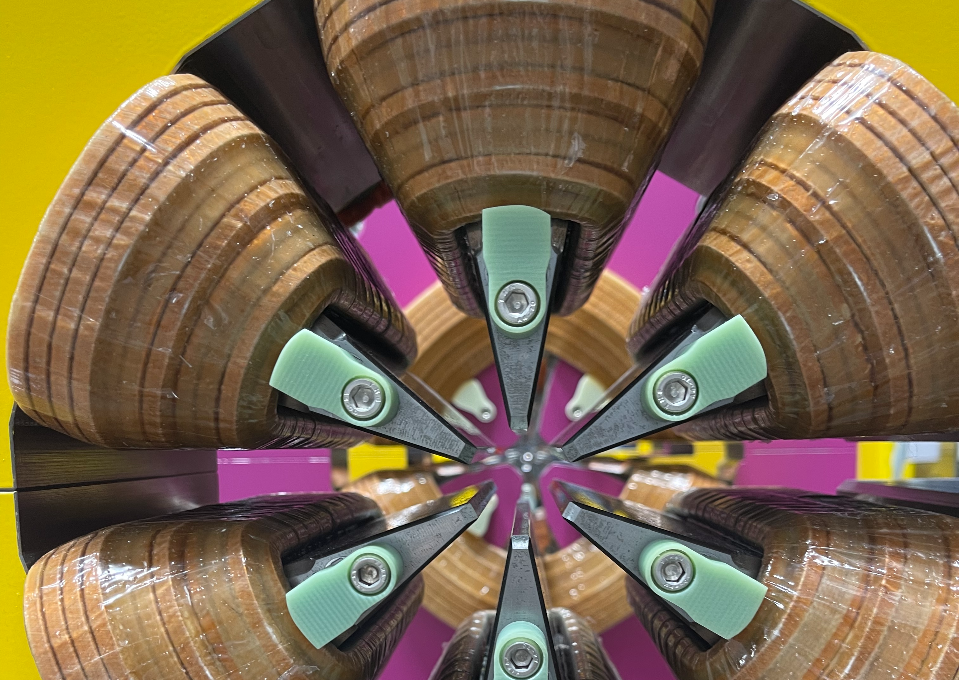
Outline
APS-Upgrade Overview
Facilities for Inventory Storage and Assembly
Scope
Inventory Management
Work Planning and Control
Timeline

Slide 3
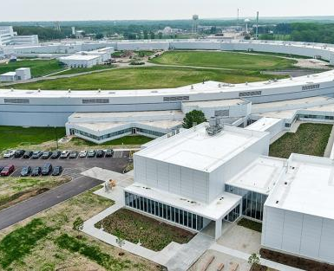
APS-U high level requirements
40 sectors (each sector consists of 5 modules)
Beam Energy = 6 GeV
Beam Current: > 200 mA
Max. single bunch current: > 4.2 mA
Circumference: 1103.608 meters

Slide 4
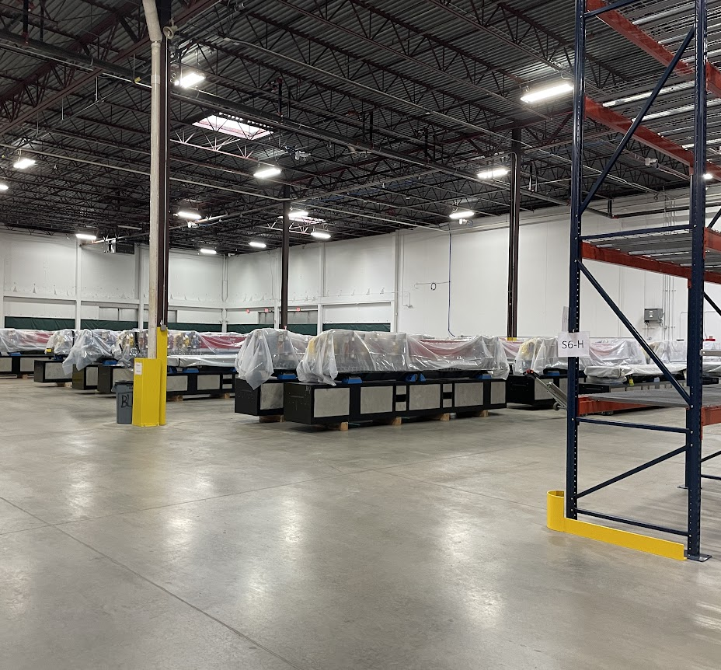
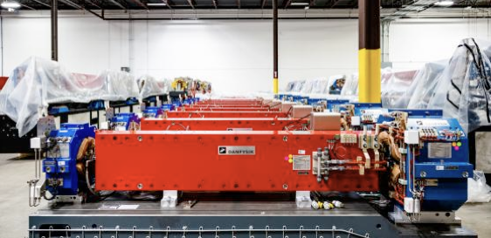
Facilities for assembly and inventory storage
100,000 sq ft warehouse

Slide 5
Modules in storage
https://youtu.be/LltYSncc0JI?list=PL994D8197DEEFCC59

Slide 6
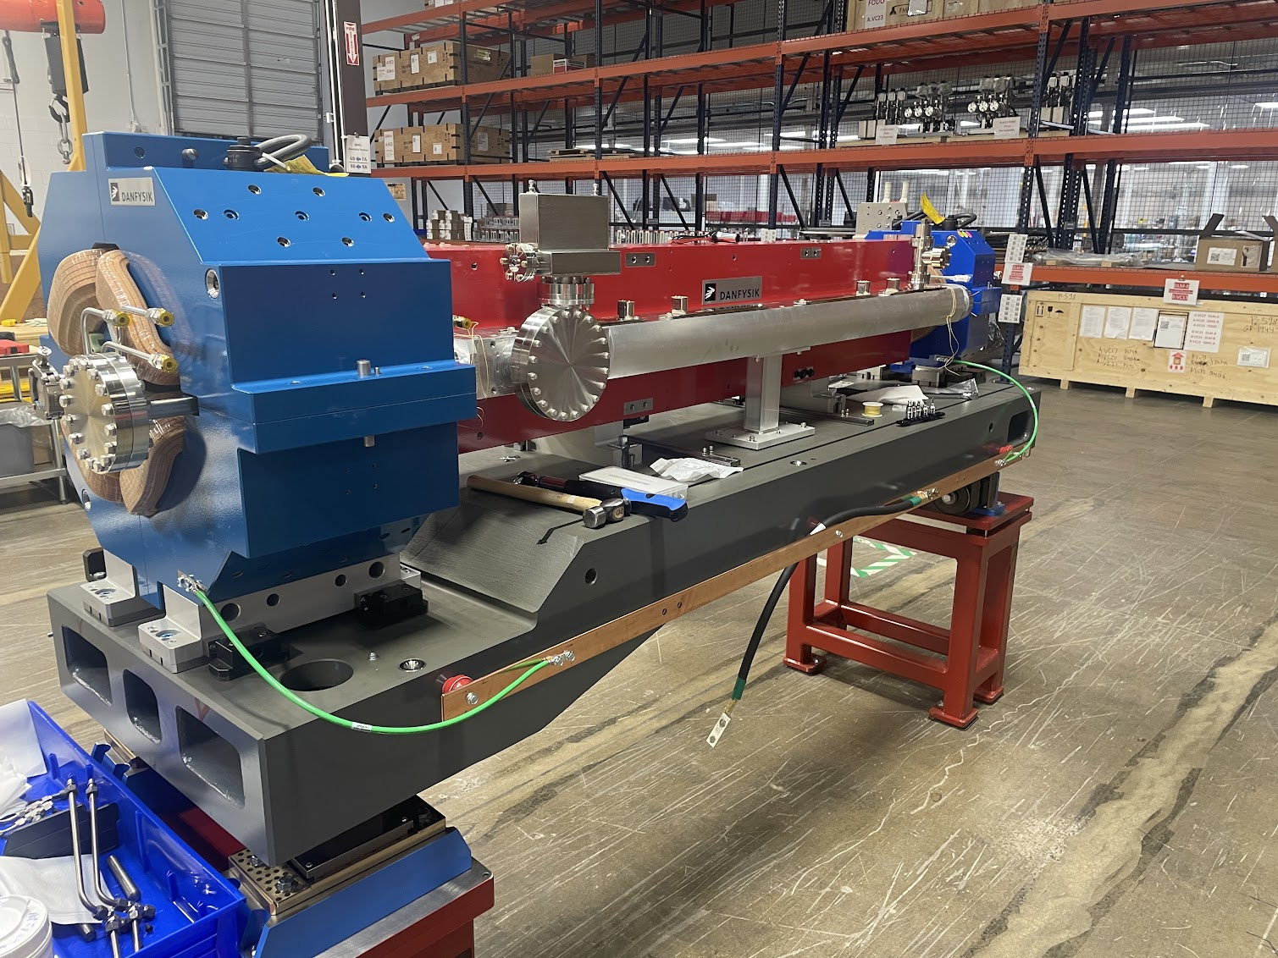
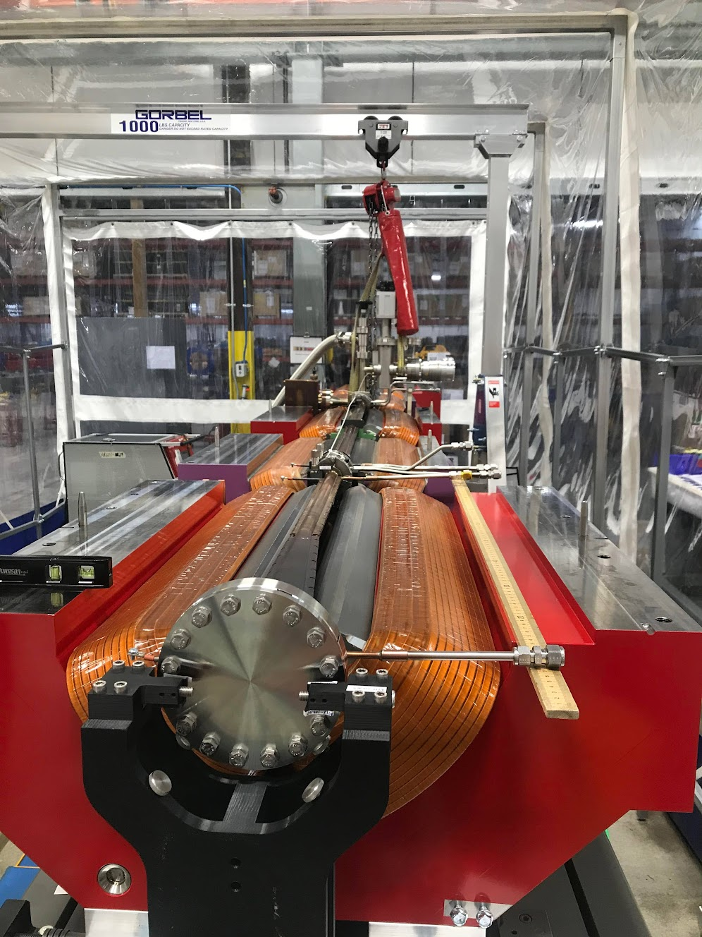
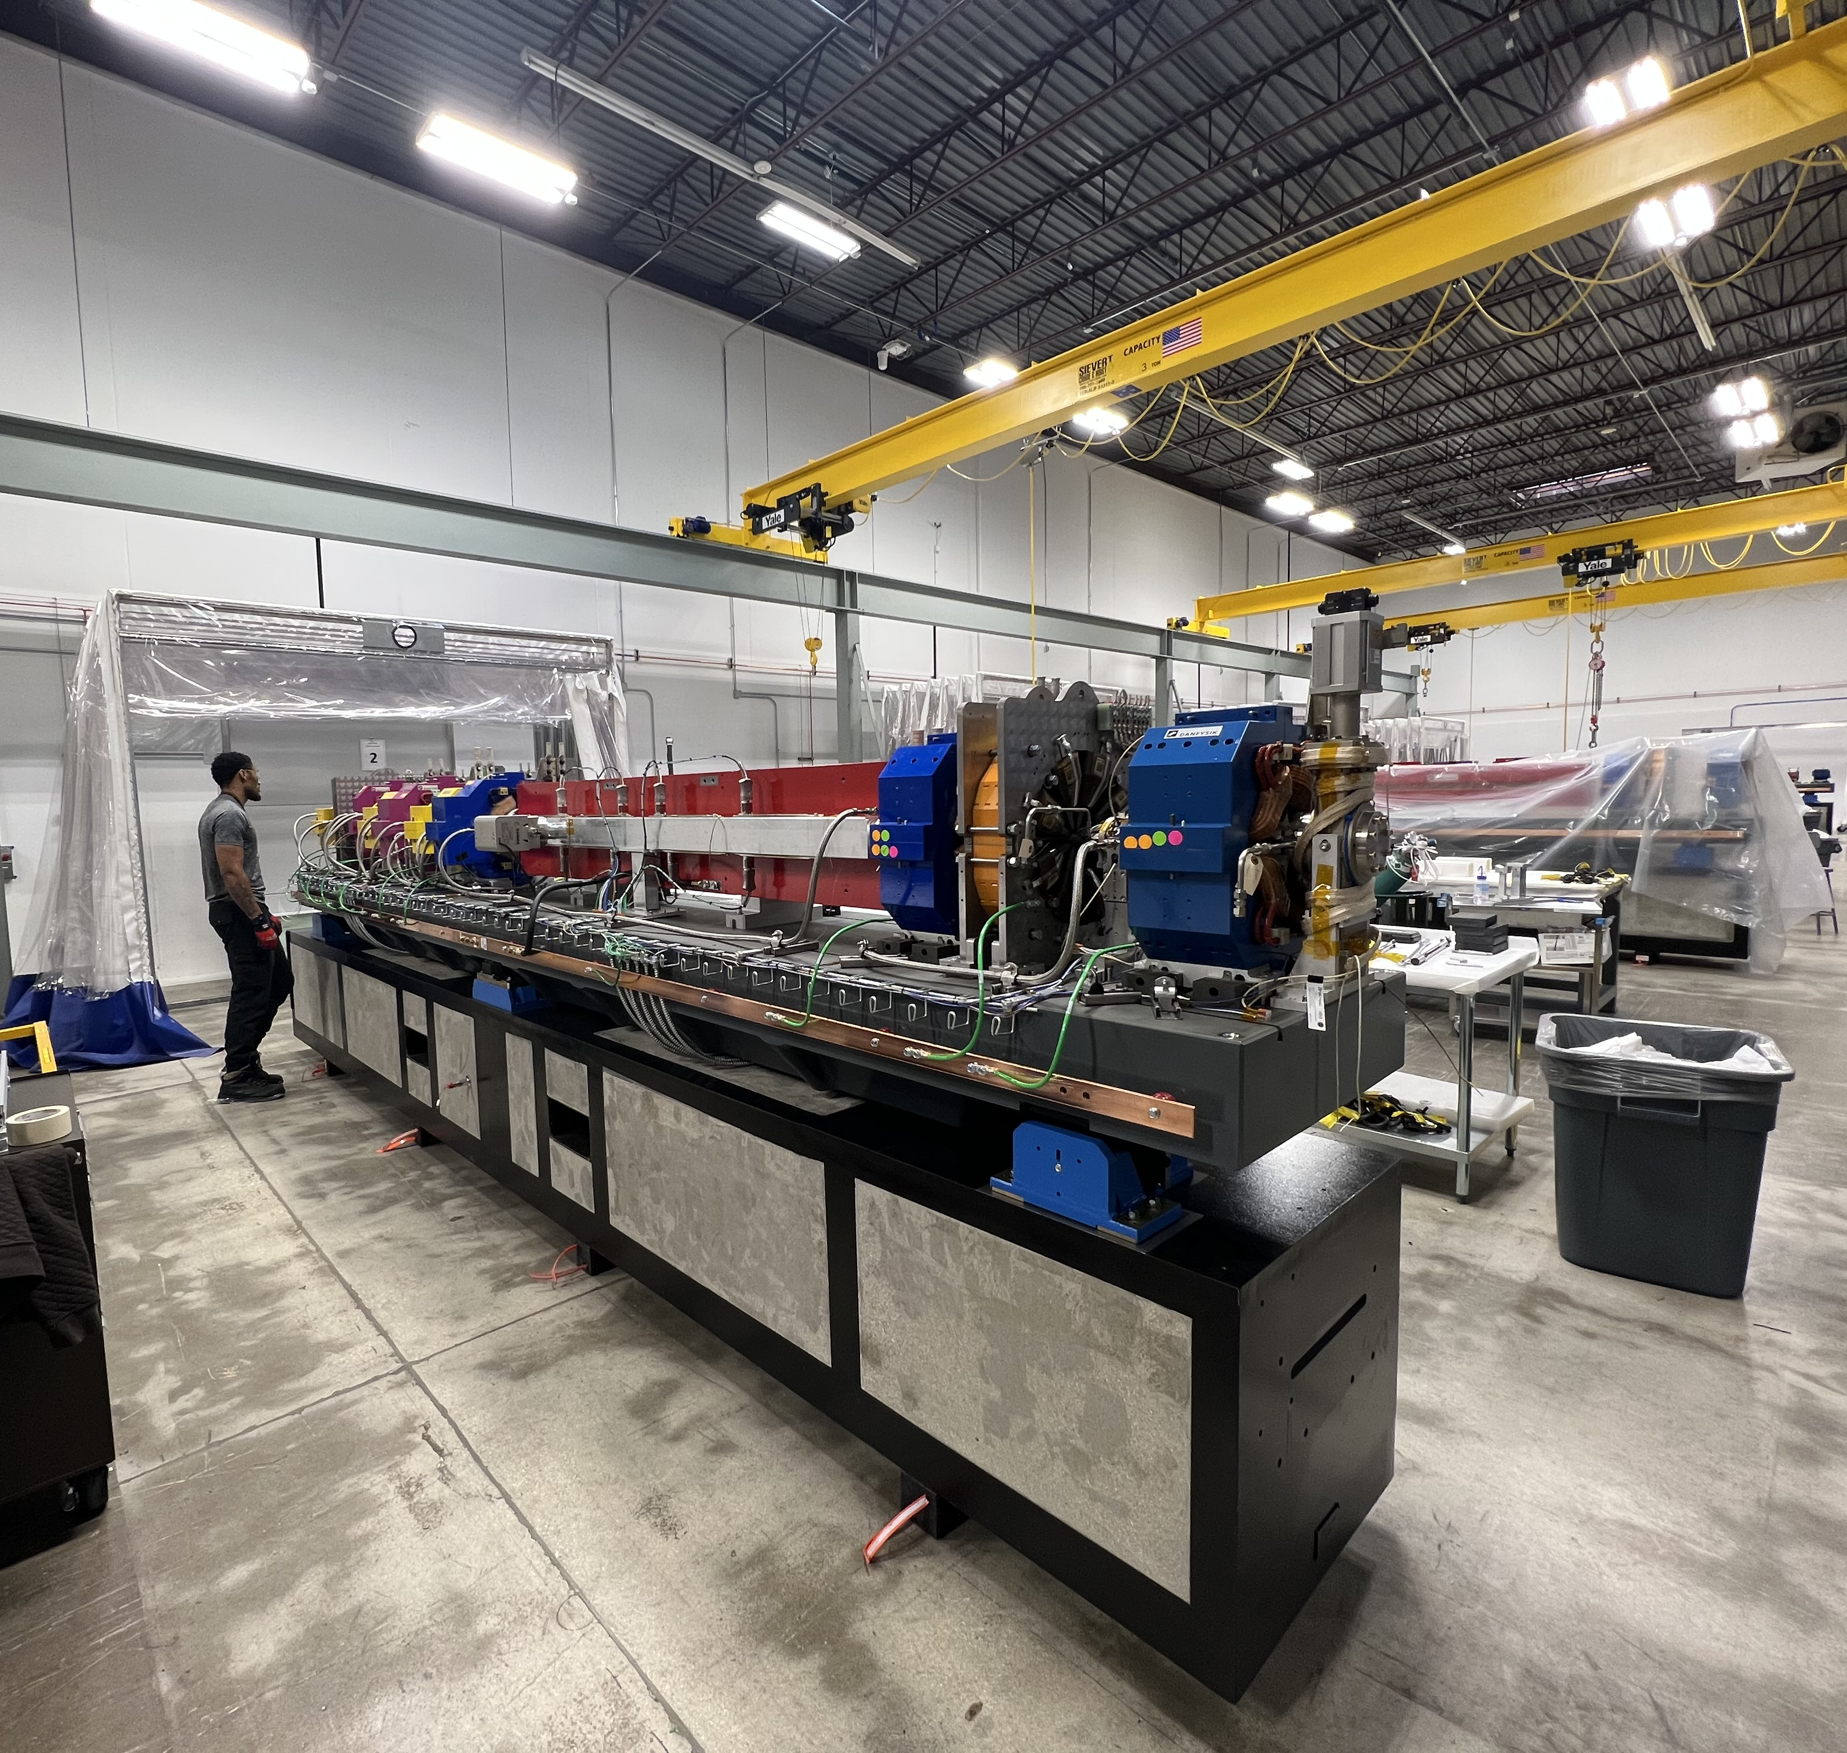
Assembly bays
5 bays for large modules
4 bays for QMQ Bridges

Slide 7
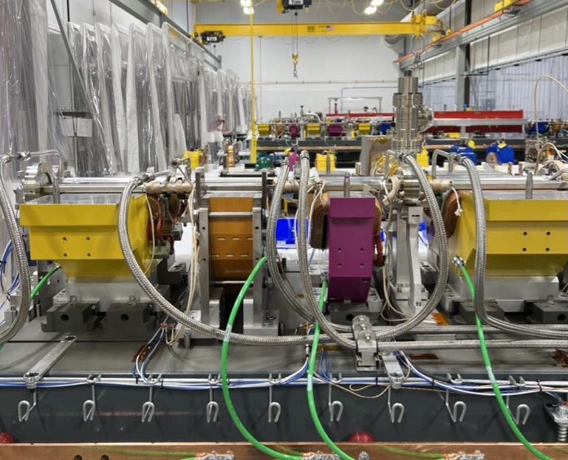
Scope
Incoming inspection of parts from suppliers
Mount and align magnets
Install and align vacuum chambers
Leak check vacuum chambers
Bake-out wiring
Magnet Re-assembly
Hipot and Hydrostatic testing
Sector Mockup

Slide 8
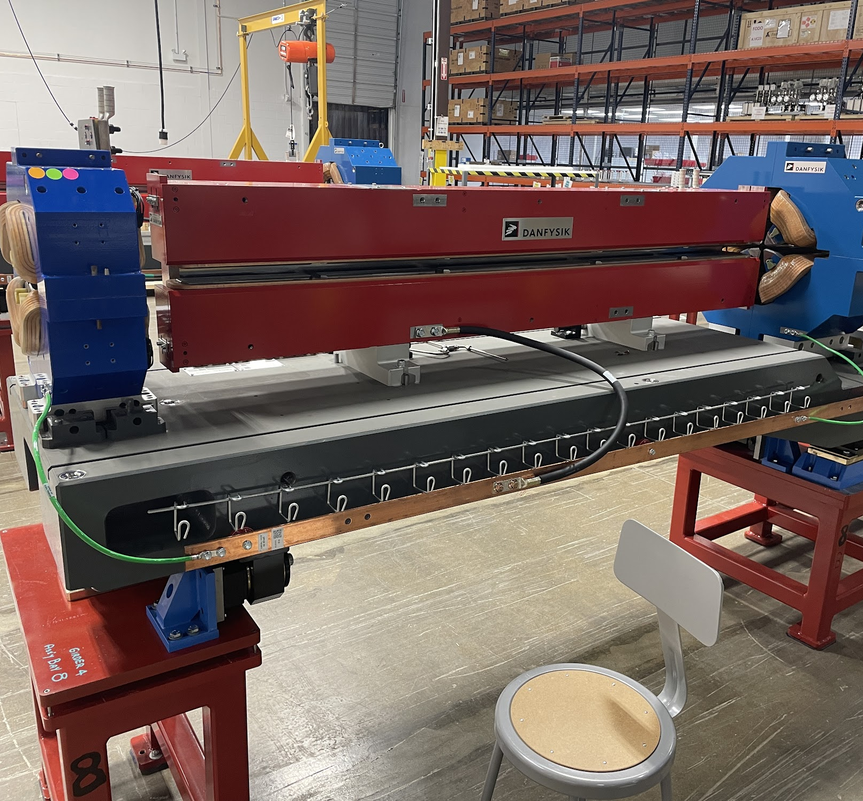
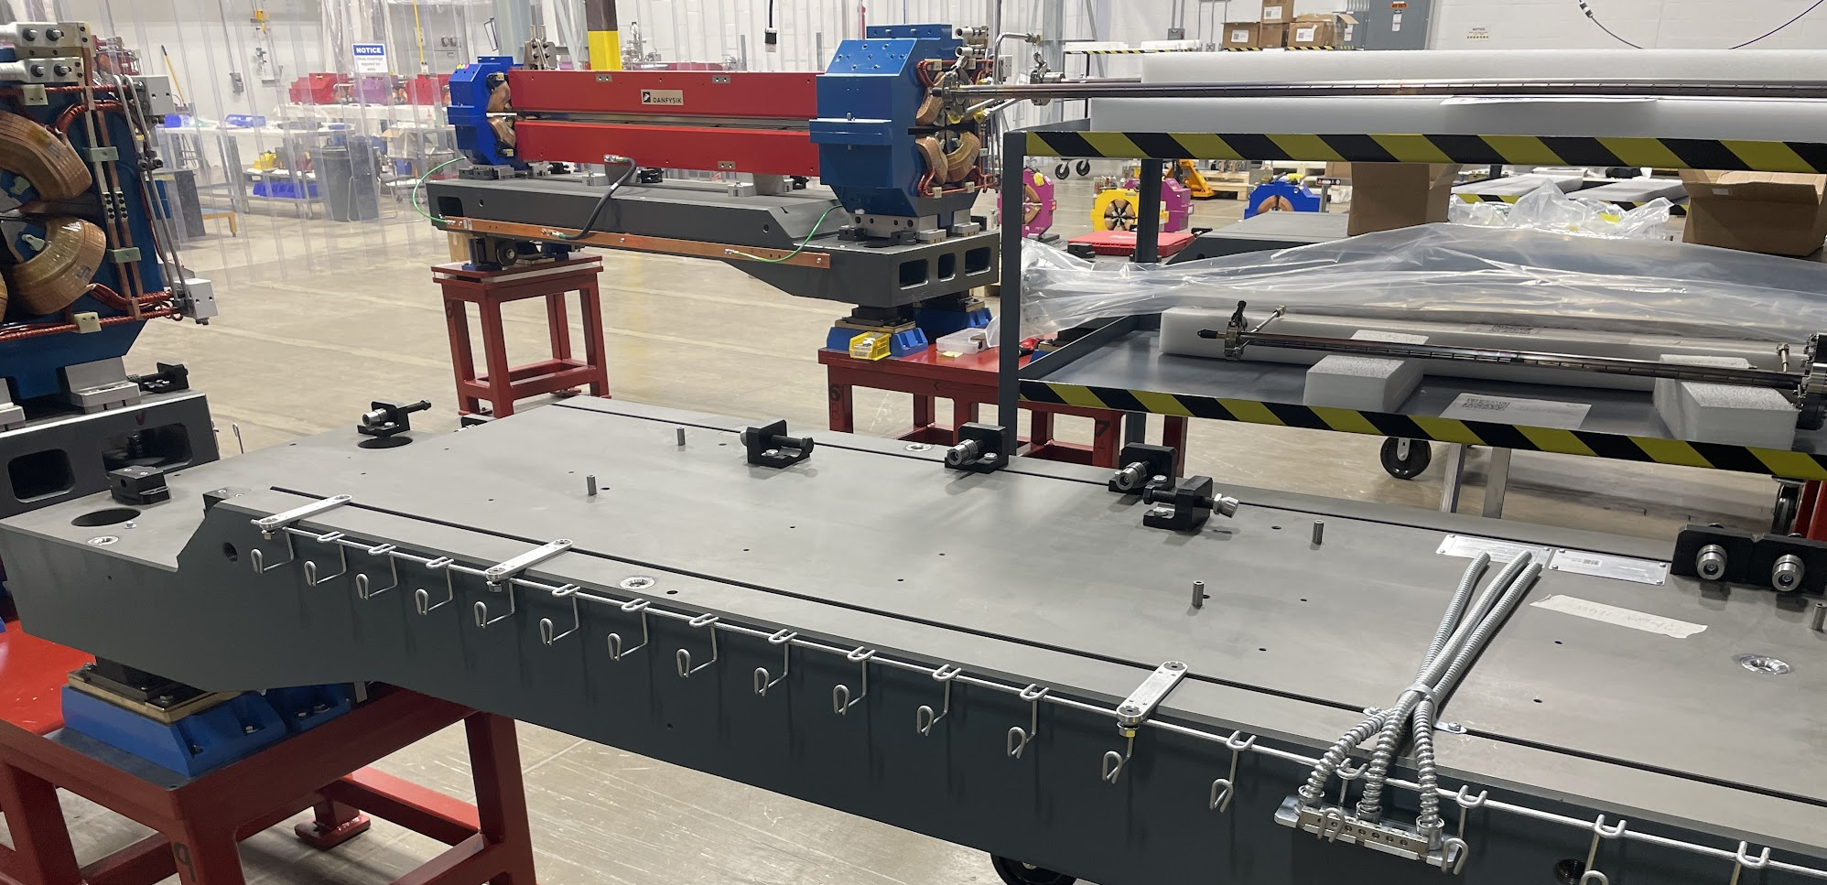
Mount and align magnets
Bottle jacks used to position girder
Magnets mounted in location
Survey and alignment determine shim pack for each magnet

Slide 9
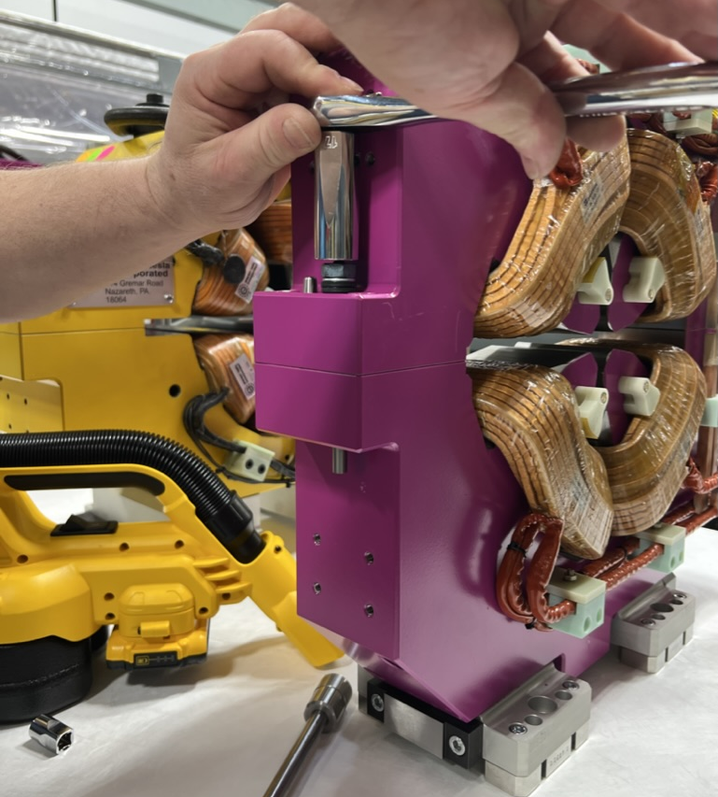
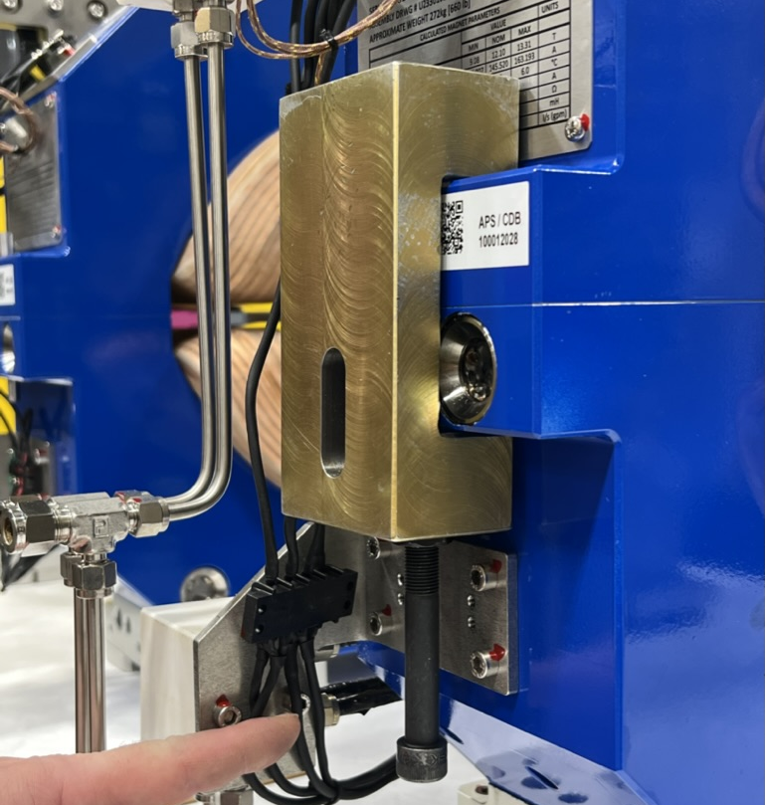
Split magnets
Flange bolts, rough locating pins, and taper dowel pins are used to locate top half of magnet
Custom tooling was used, but soft pins lead to issues
All taper pins replaced with custom hardened pins

Slide 10
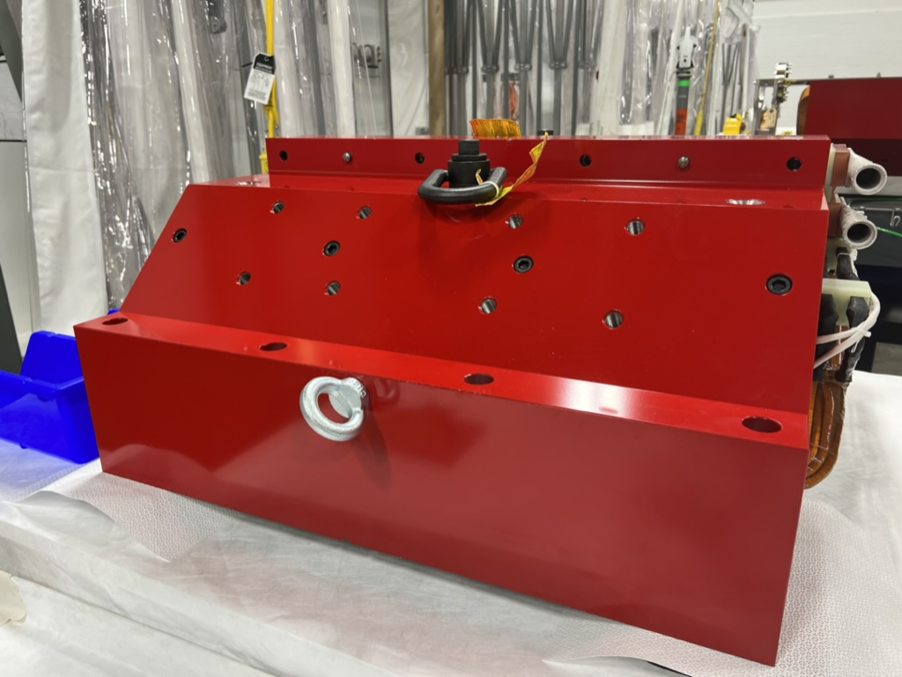
Split magnets
Swivel hooks, shackles and overhead cranes used to split magnets
Top half of magnets set on cribbing to avoid damaging mating surfaces

Slide 11
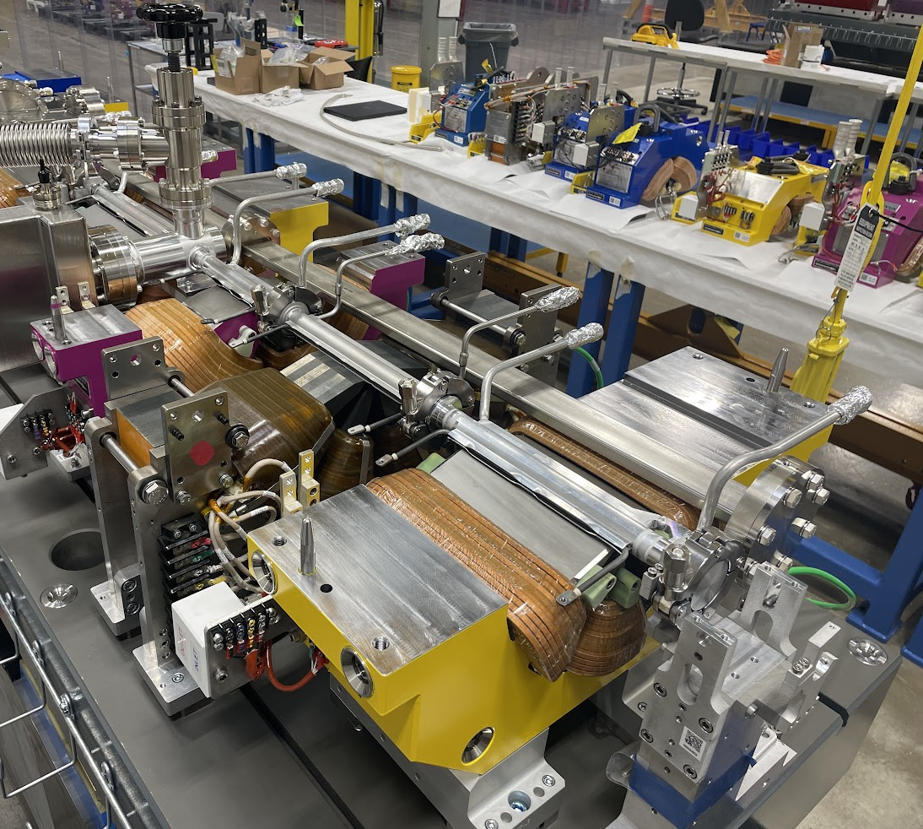
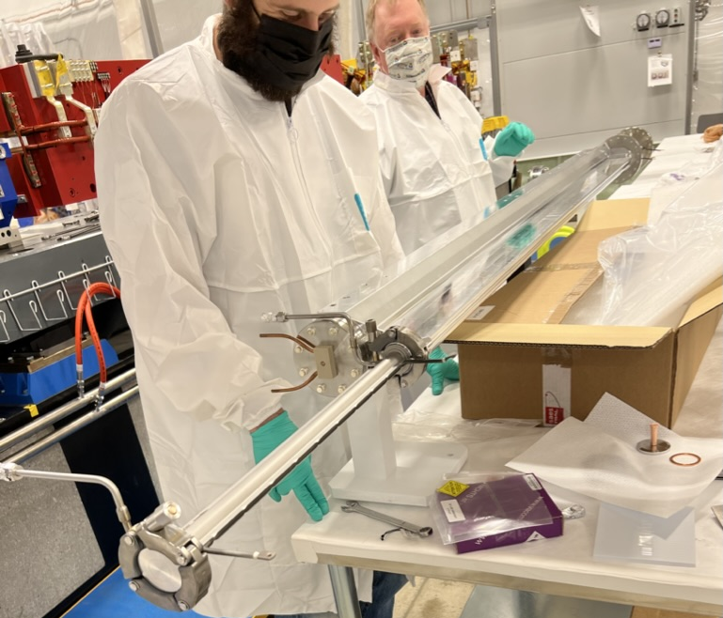
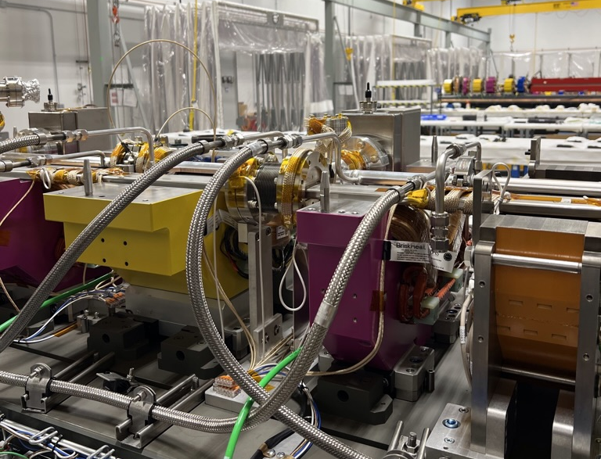
install vacuum chambers
Space between adjacent magnets is limited
Chain clamps used to save space - need to be retorqued as they relax over time
Annealed gaskets used
Leak check
Survey and Alignment

Slide 12
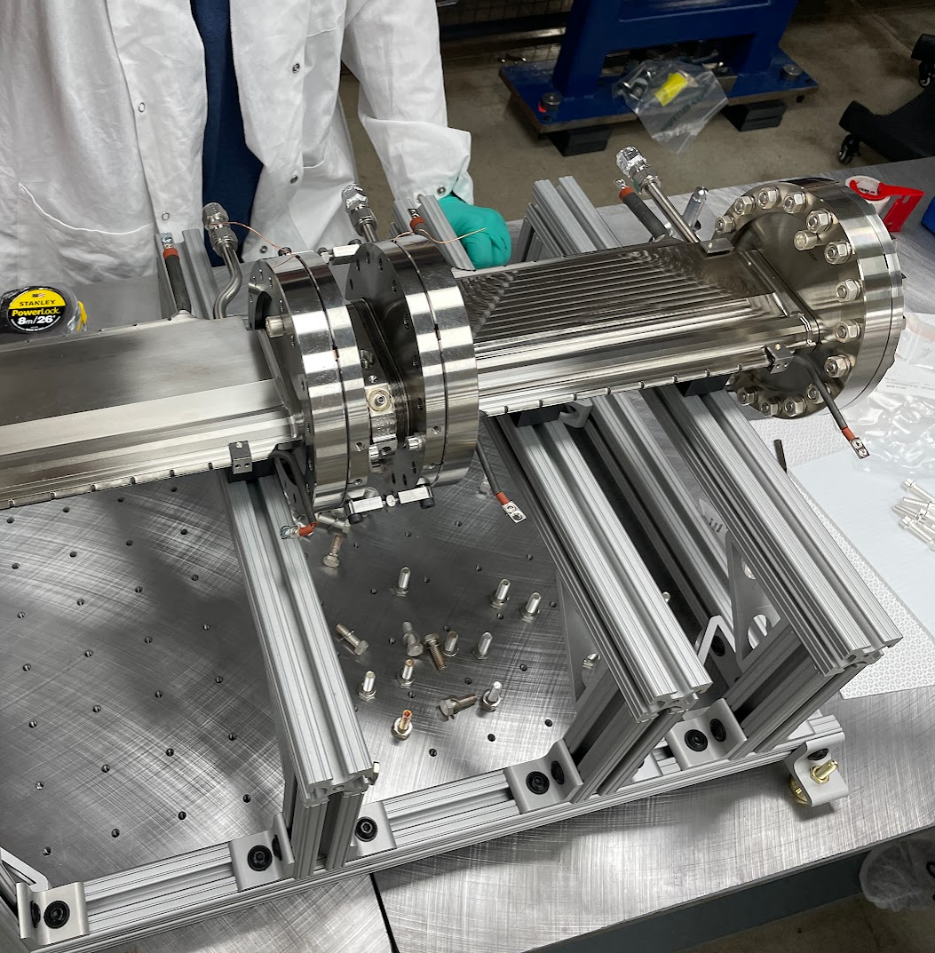
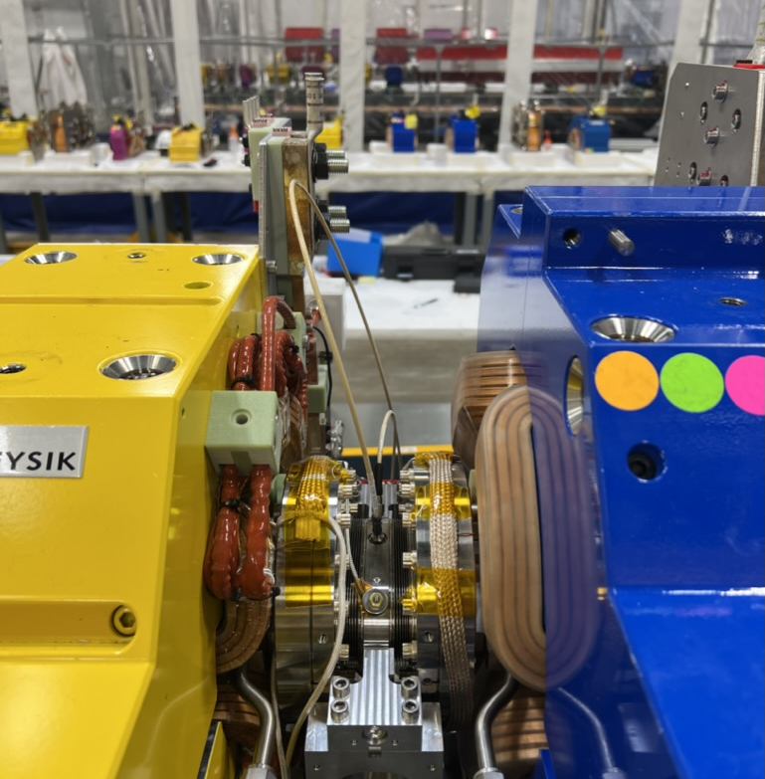
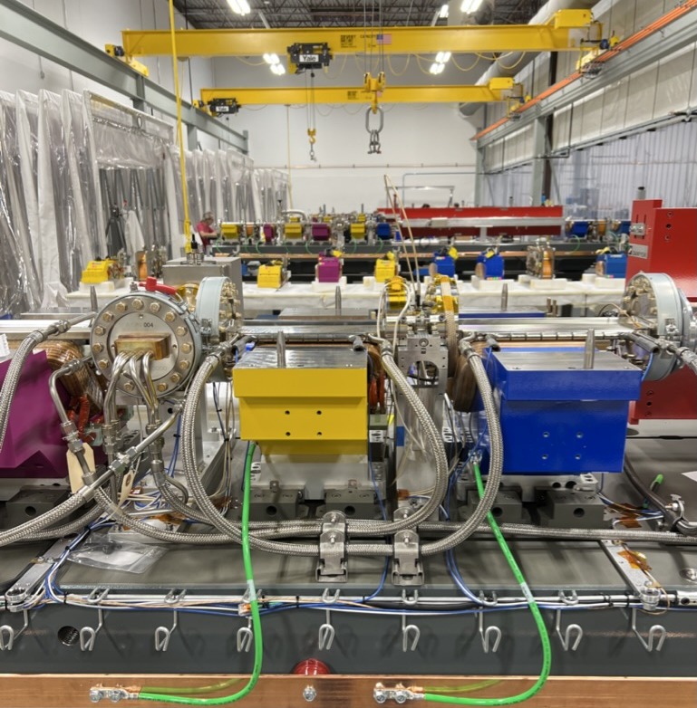
preassemblies
Keyhole chamber trio
Space limited, bottom bolts inaccessible in-situ due to magnets
Custom assembly and lifting fixture (next slide)

Slide 13
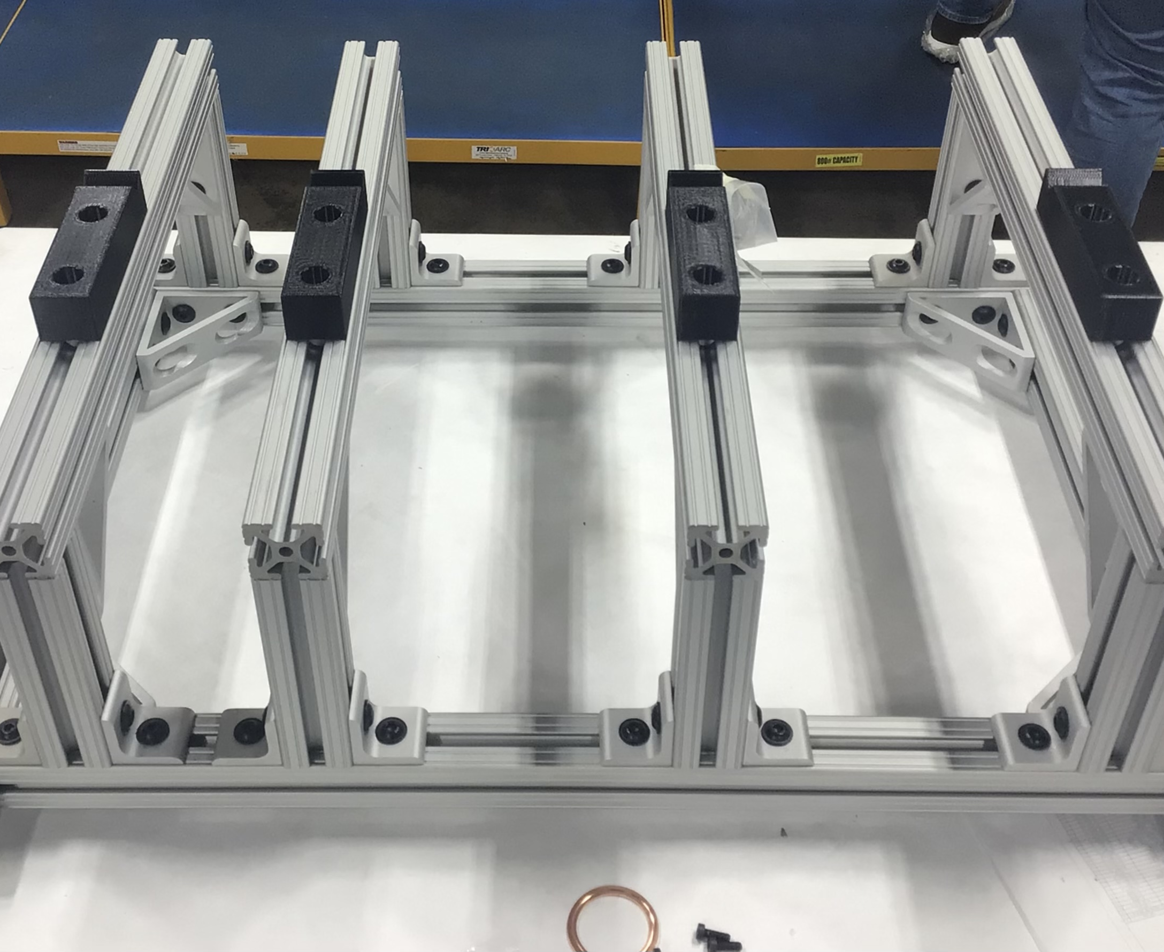
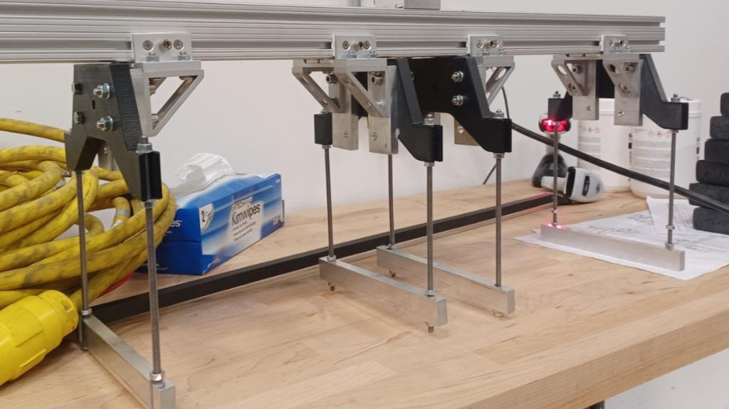
Custom tooling and fixtures
Chamber trio assembly and lifting fixture
Made from 3D print and off-the-shelf materials as much as possible
80/20 cut to length by Argonne shops with fairly tight tolerances to ensure flat assembly

Slide 14
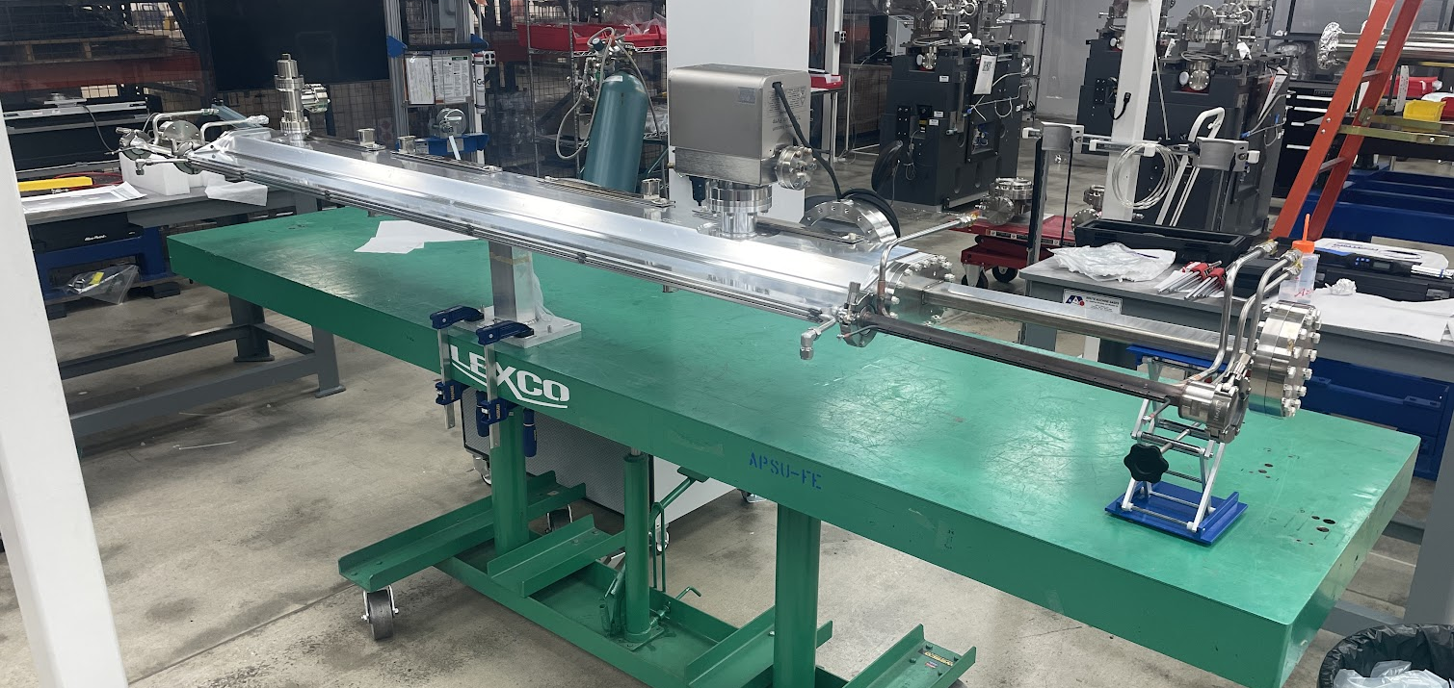
QMQ Chambers
Assembled and leak checked prior to being installed in module.
Spreader bar used for dipoles and dipole chambers

Slide 15
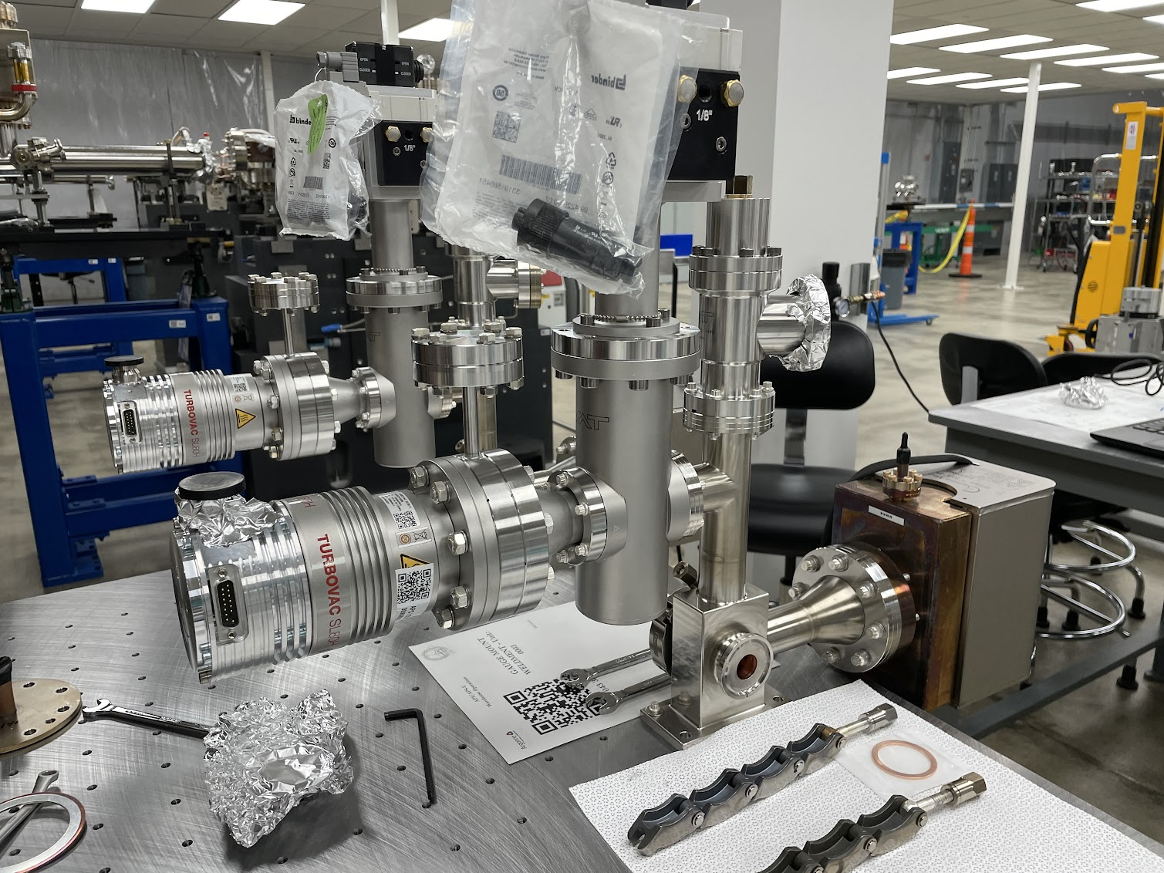
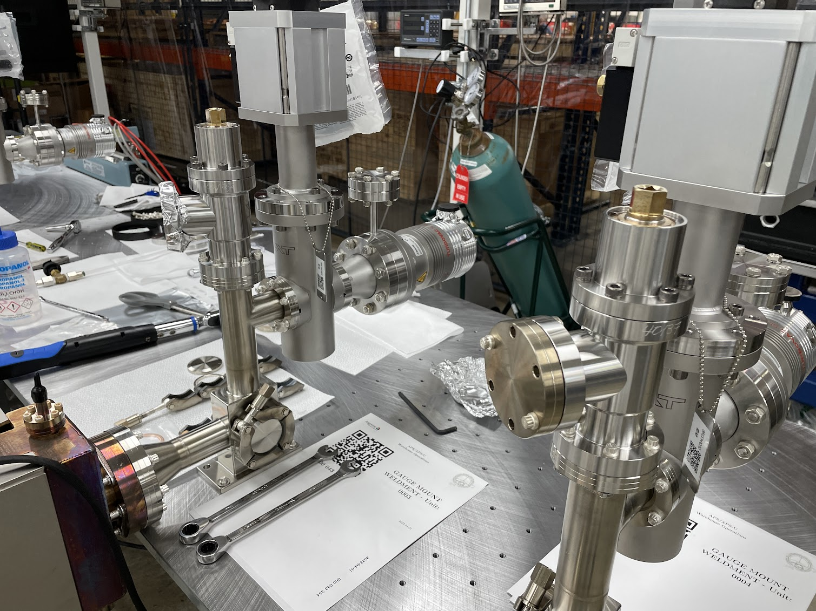
FODO Cross
Preassembled cross

Slide 16
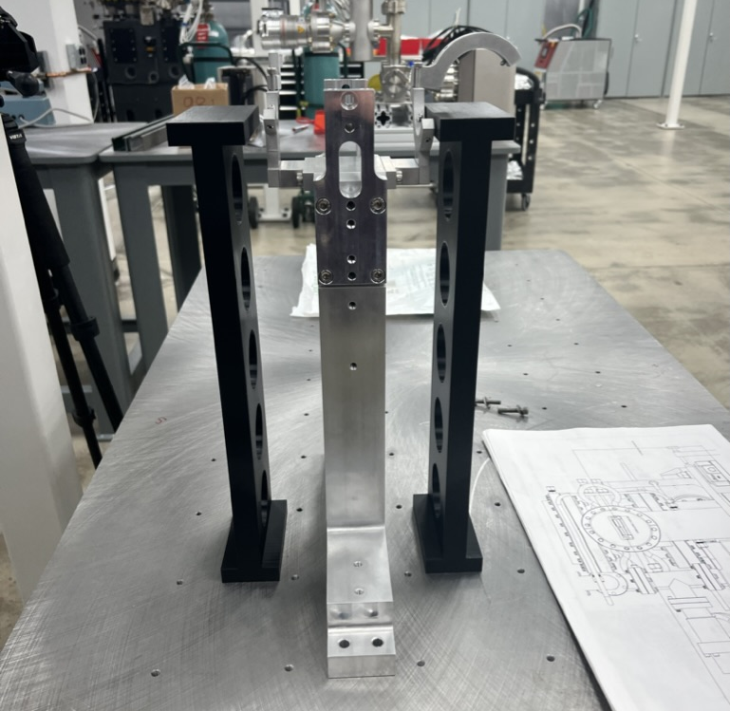
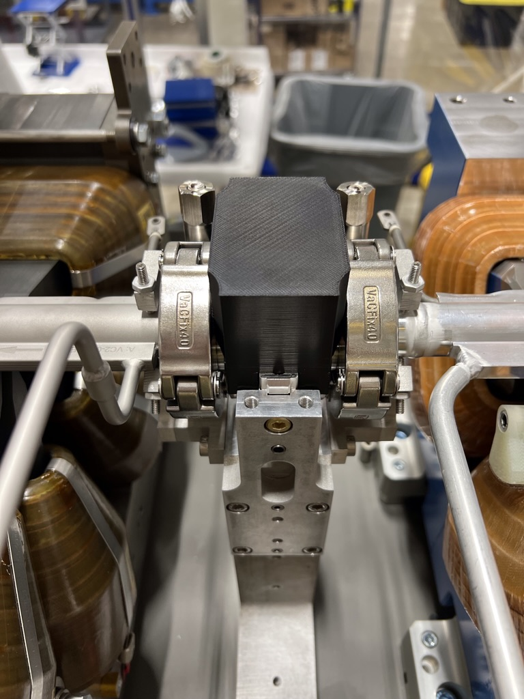
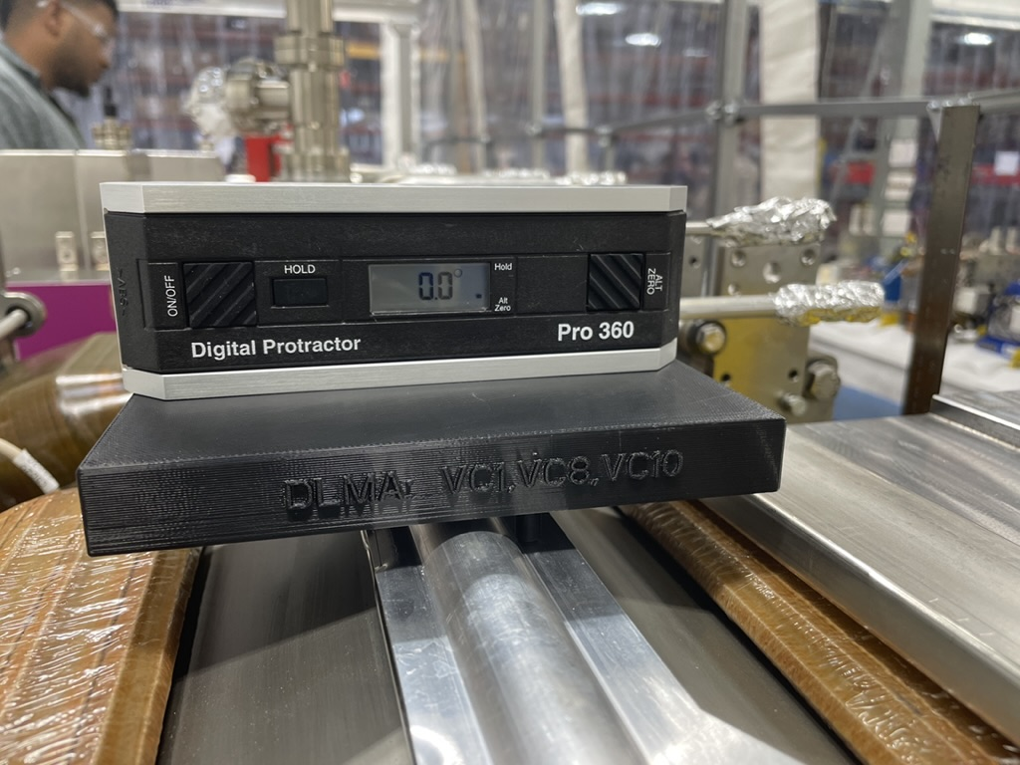
3D Printed fixtures
BPM Bellows setting – 3 types, nominal, minimum bellows length and maximum bellows length
Chamber height
Measuring chamber roll – water chamber and heater not same thickness
Parts of fixtures to limit machined components

Slide 17
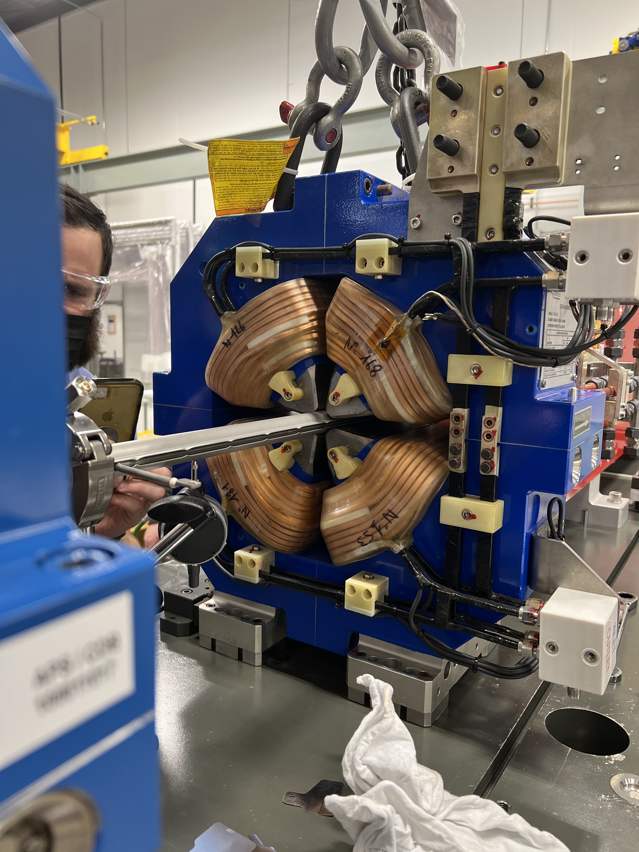
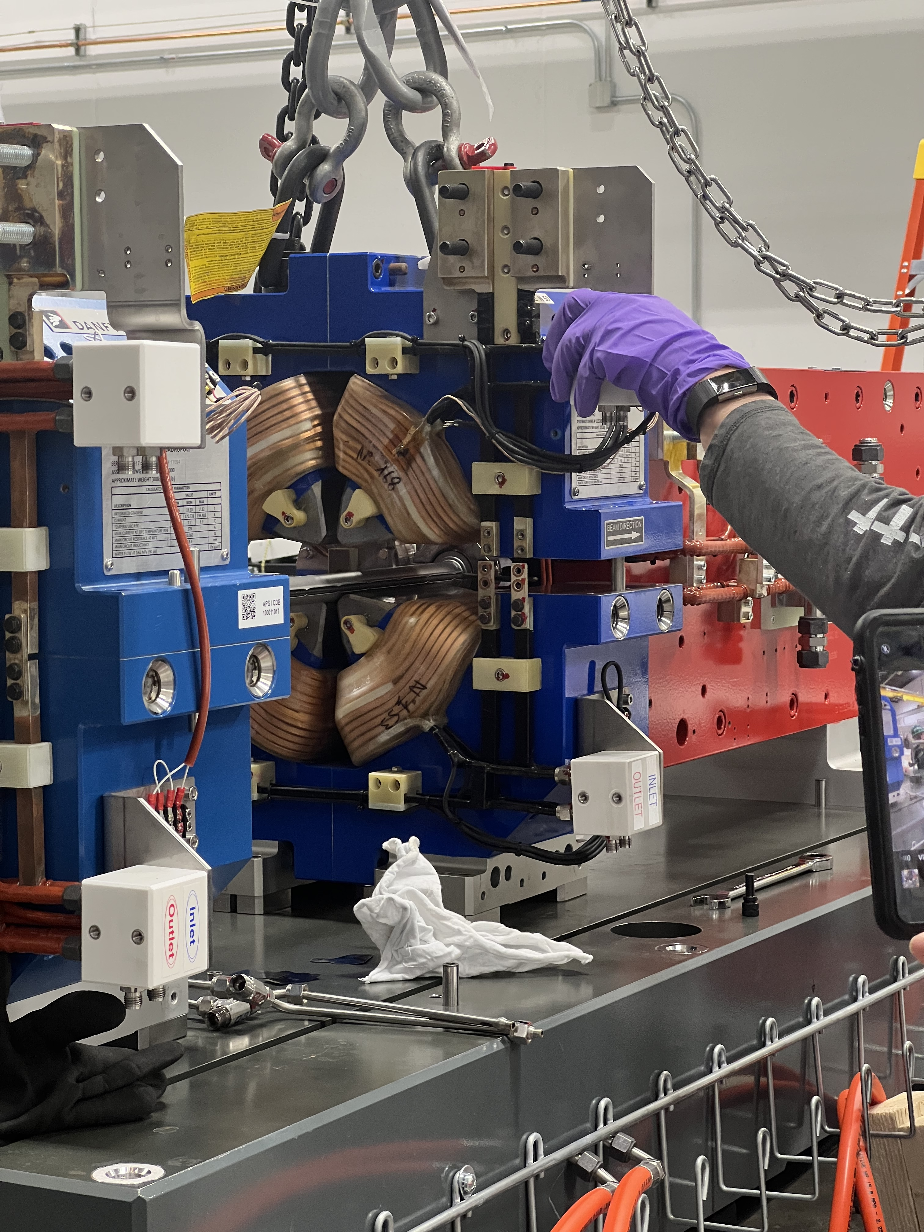
Reassemble magnets
Tight tolerances – pole tips and chambers
Roll control during assembly important

Slide 18
Split magnet and install vacuum chambers
Video of Q5 pole gap to chamber

Slide 19
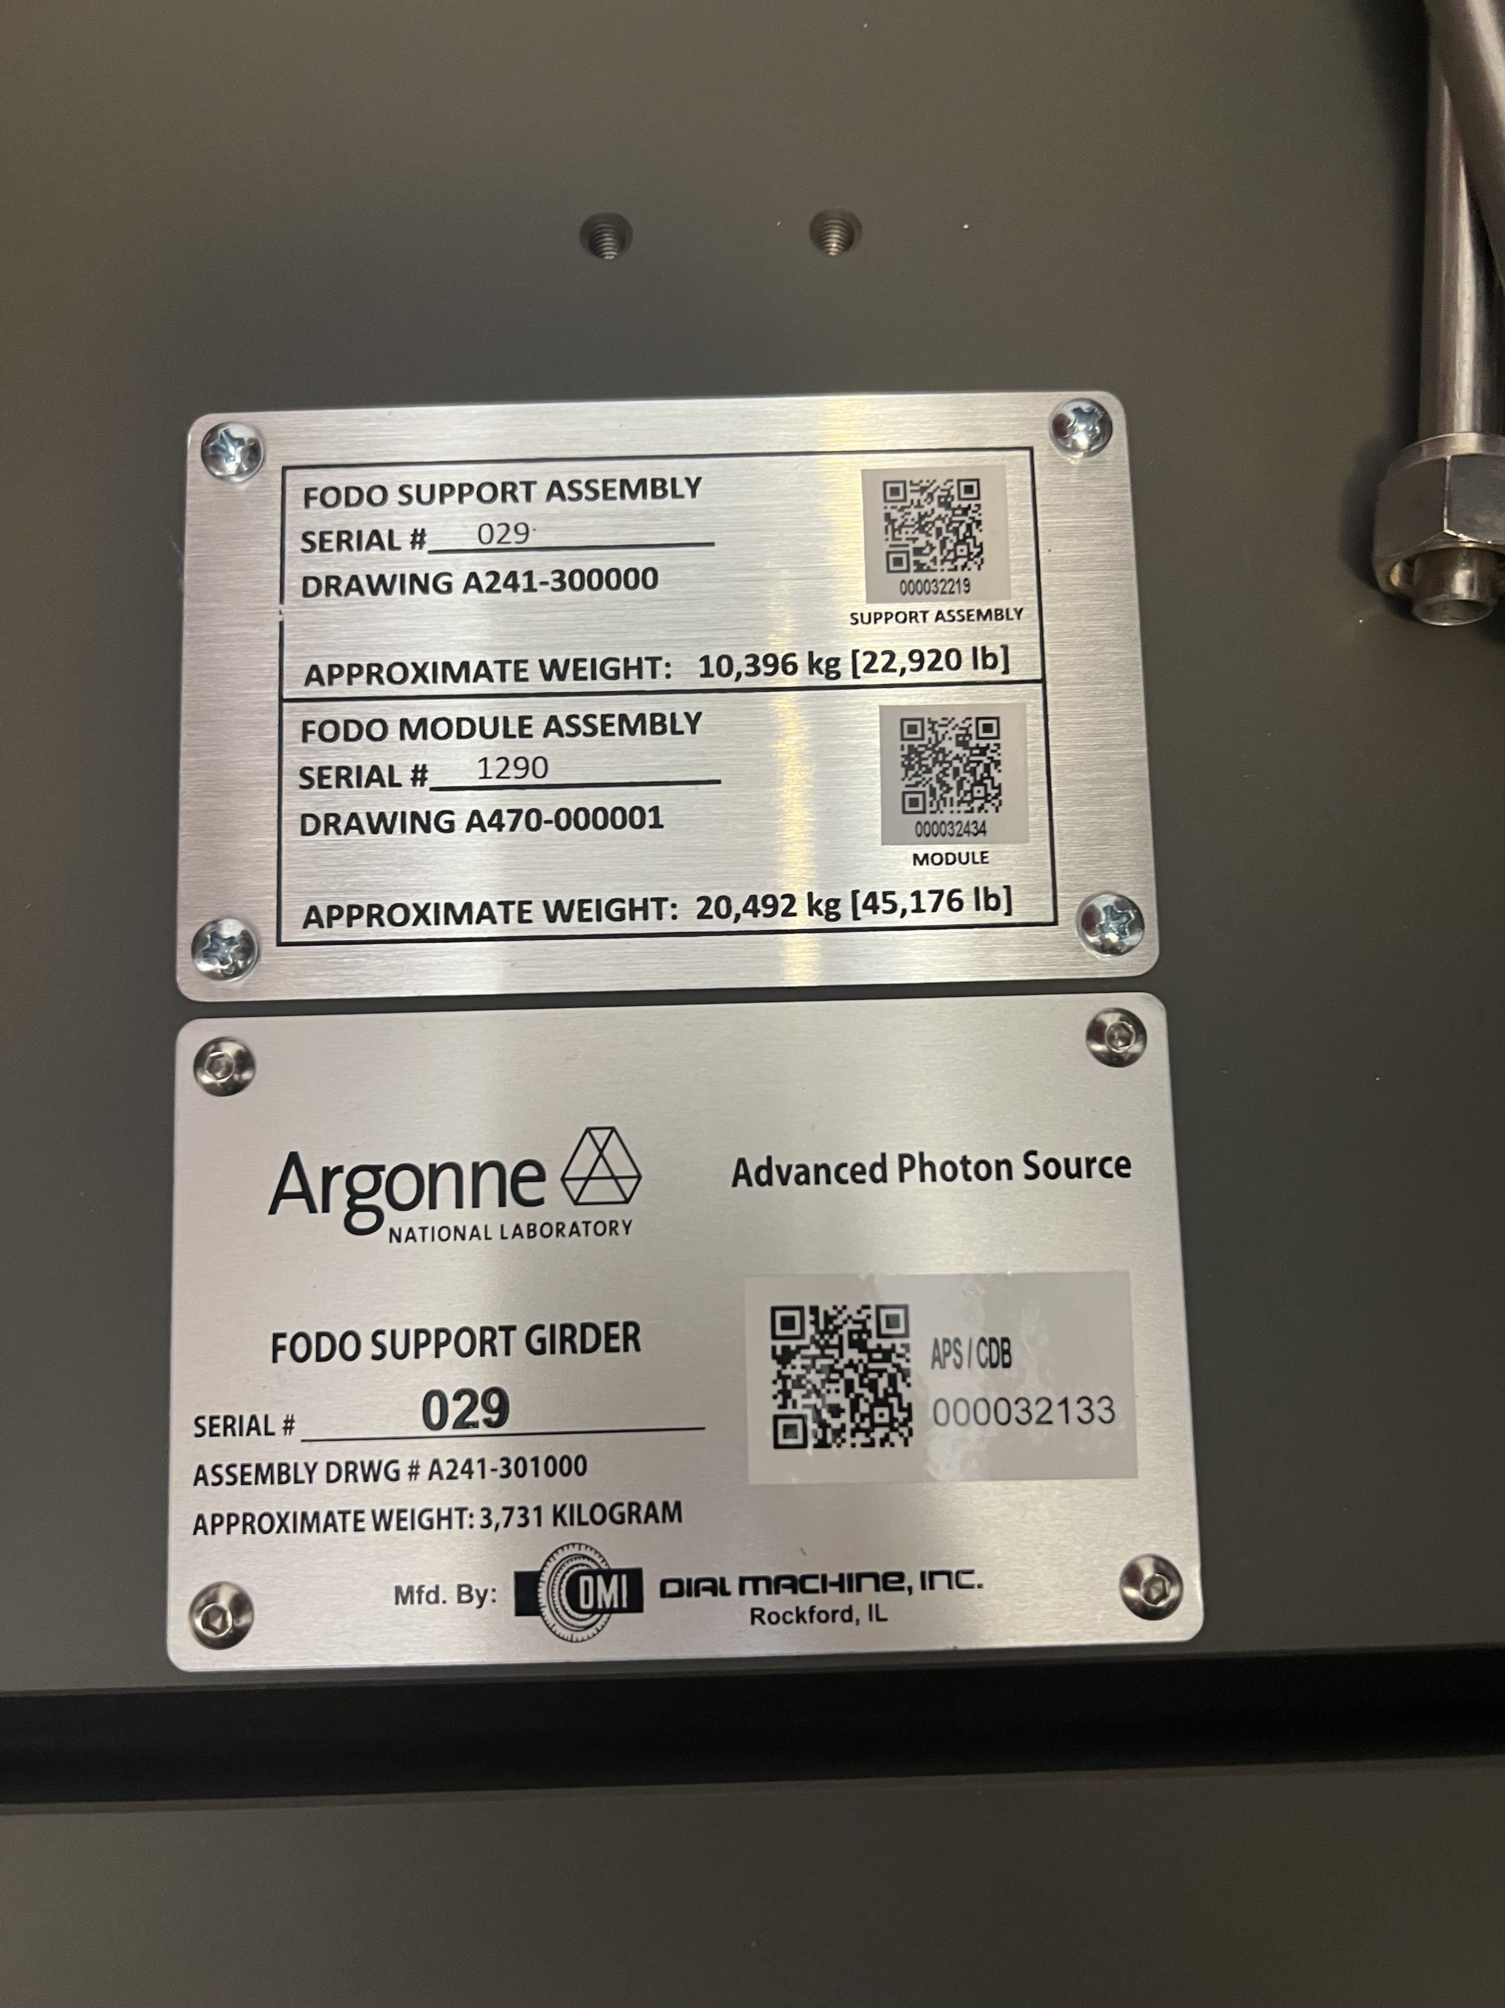
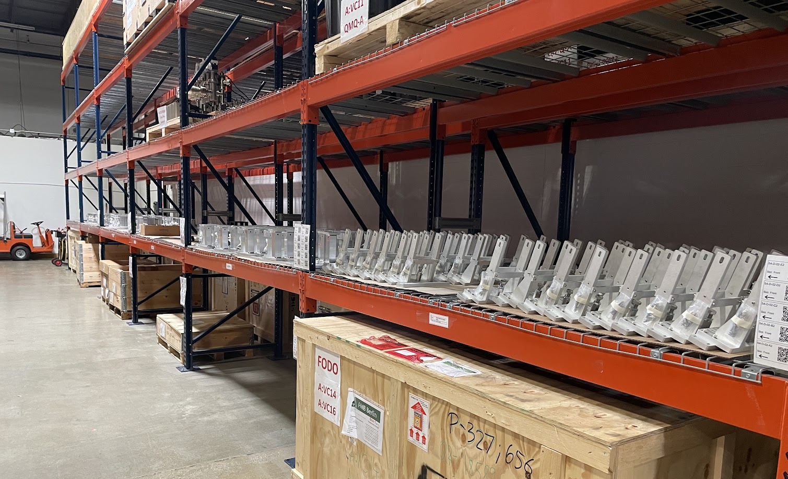
Inventory management
All materials entered in the Component Database
CDB items have QR Code applied
All storage/assembly locations also have QR Code

Slide 20
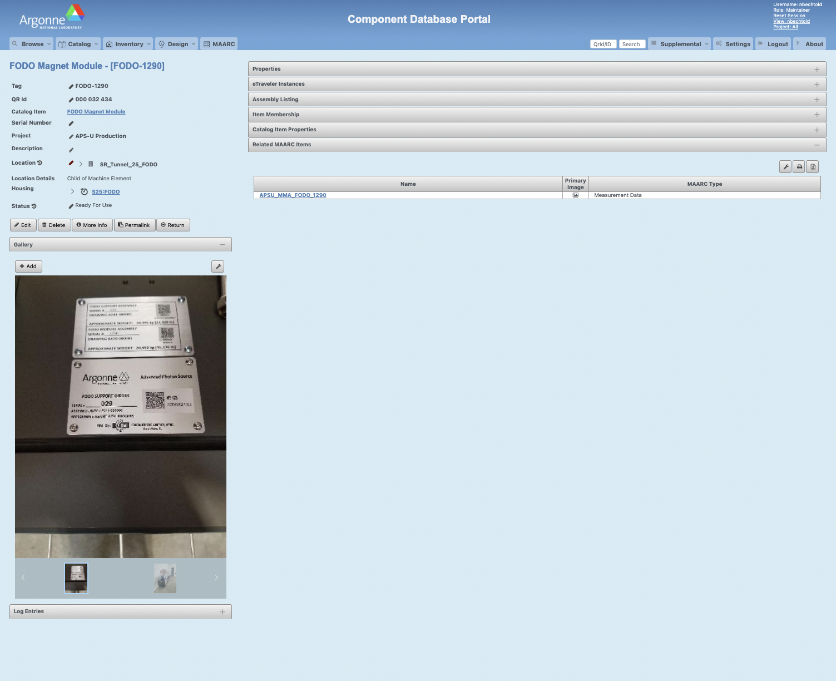
Component database
Scanned QR code brings you to inventory page
Status
Location
Housing
Notes:
Each tab on the right is expandable to see more information

Slide 21
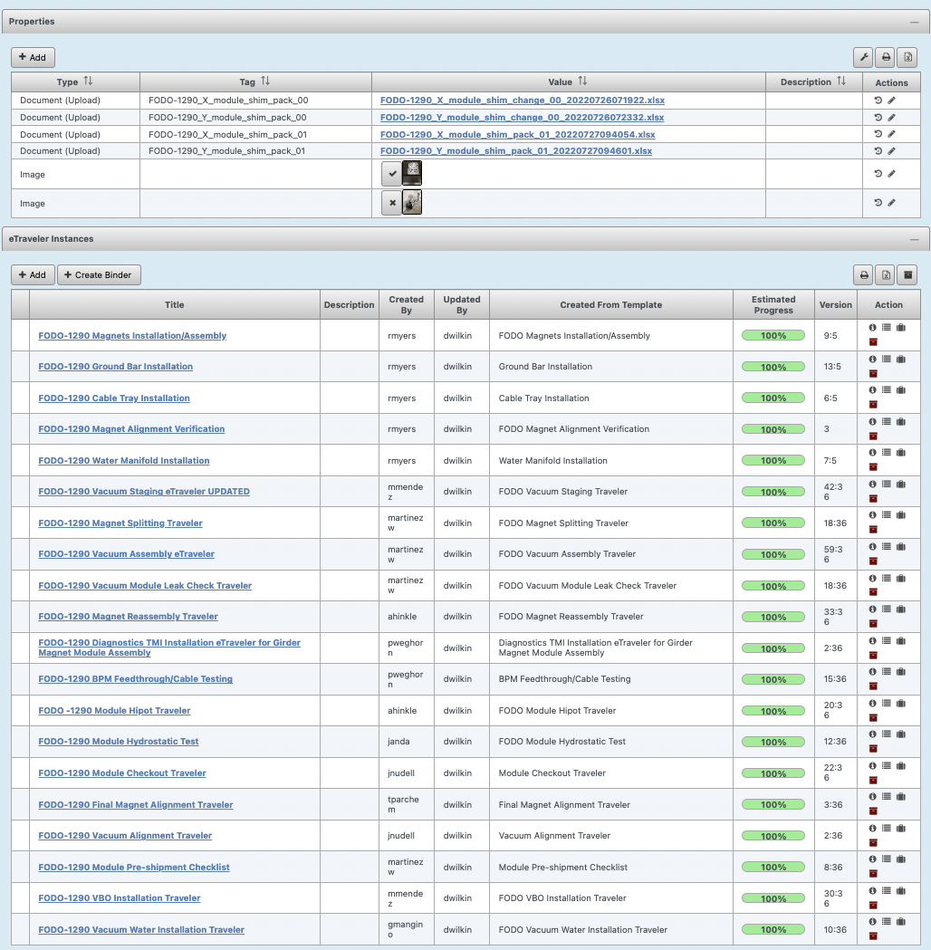
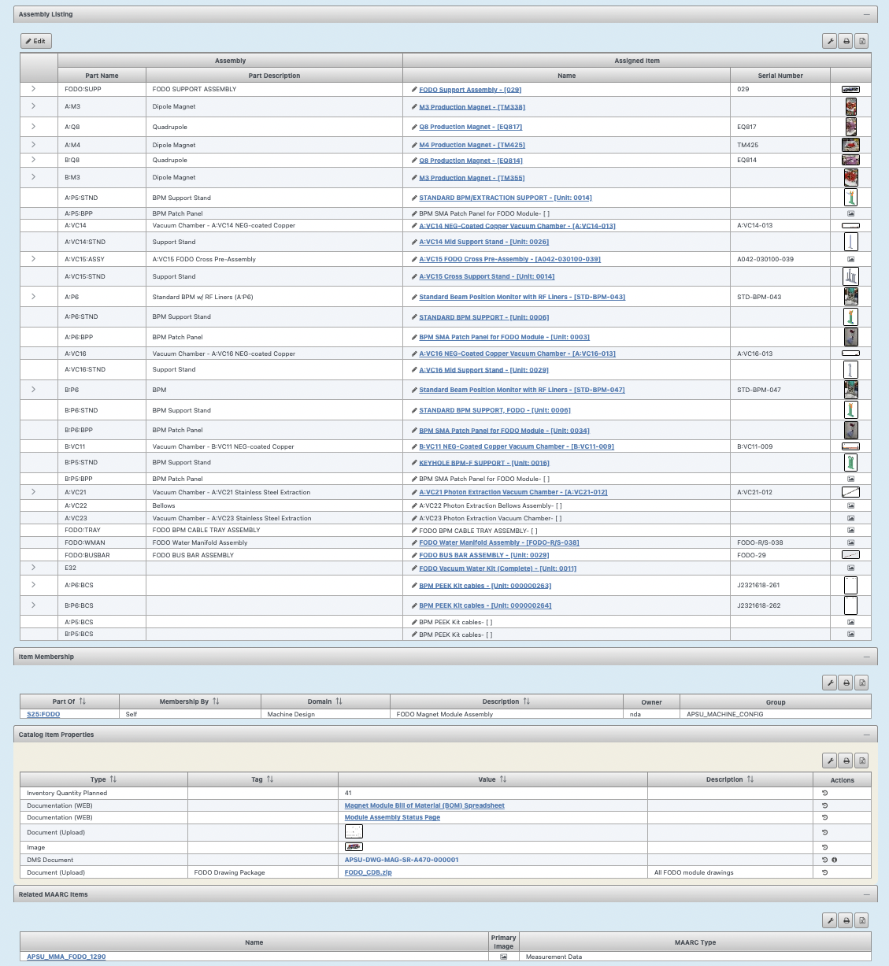
Notes:
Associated eTravelers and components installed on the module

Slide 22
Etravelers
Document and track any/all work performed
QA and process steps
Discrepancy reporting
Data collected during work
Signed off by responsible engineer

Slide 23
Inter-group handoffs
Trello - Quick Status
Checklist and Automation
Email notifications
Exports can be used for reporting
eTraveler feedback

Slide 24
Checklist and Automation
Each checkbox correlates to work performed on module – labels for which group is responsible
Checked box triggers automation to move card into correct list and send email notification to the group performing next task

Slide 25
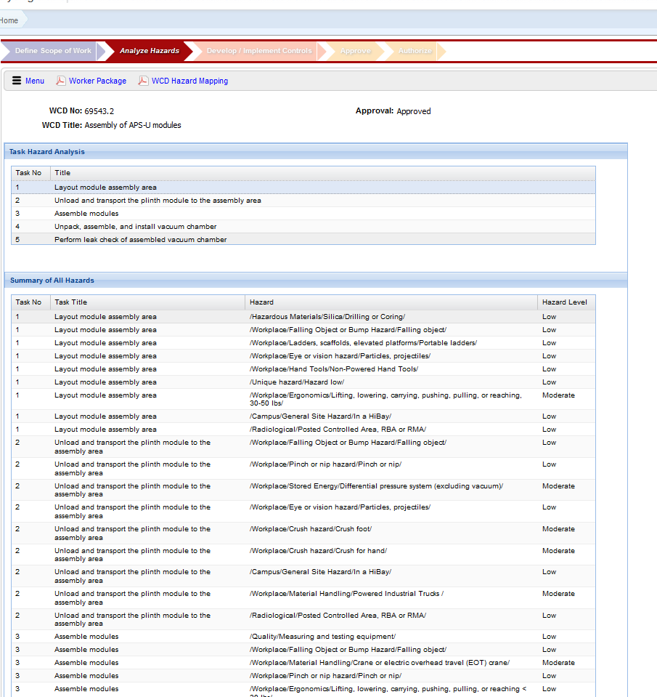
Work planning and control
Assembly WCD
All work is covered under a Work Control Document (WCD)
Establishes scope of work
Limits of scope
Planned start and end dates of work
Documenting tasks to be performed under the scope of work
Location work is to be performed
Training required to perform work covered under WCD

Slide 26
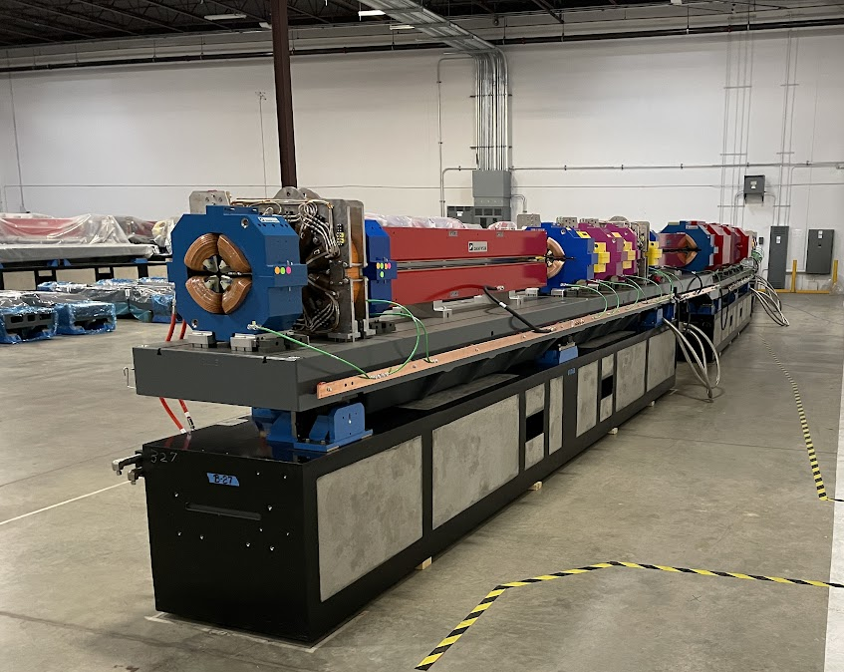
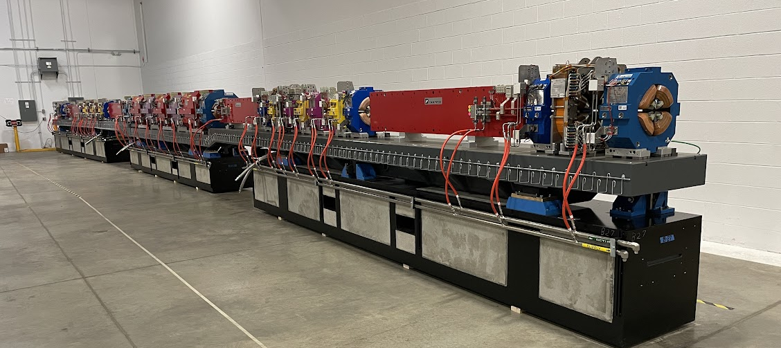
Sector Mockup
Used to practice QMQ install
Inter-module vacuum connections
Bakeout wiring connections between modules

Slide 27
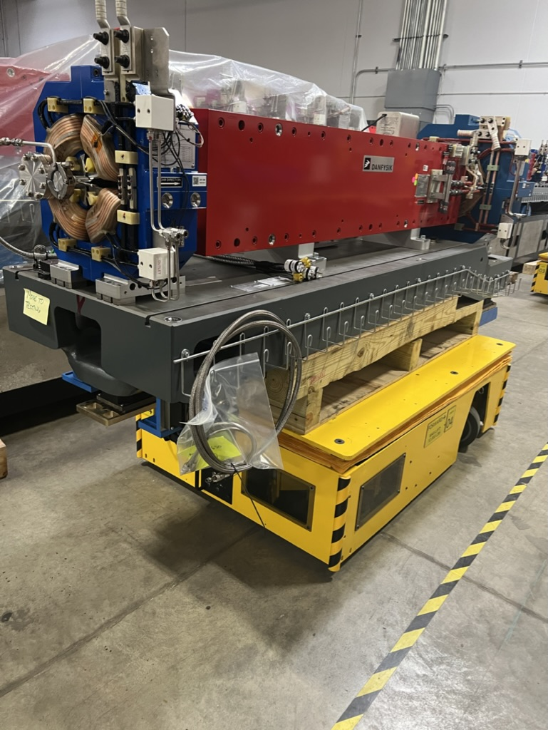
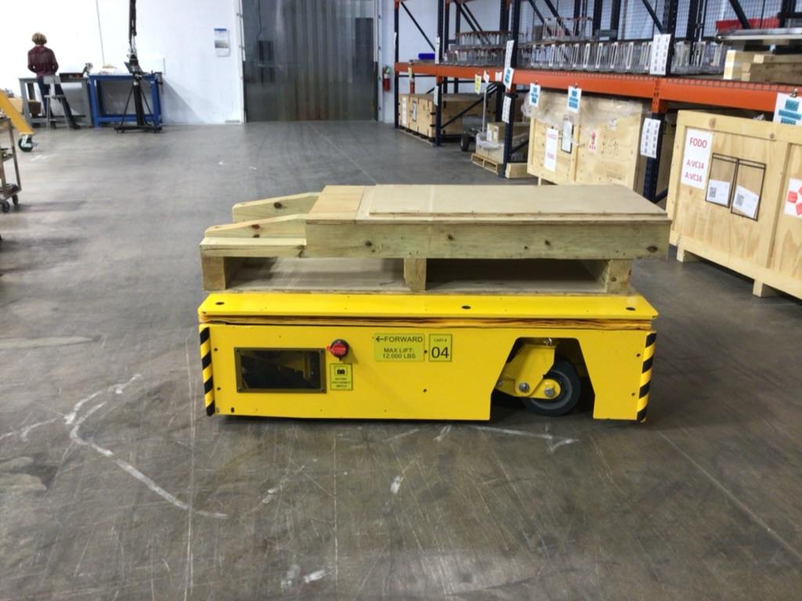
Moving modules - QMQs
Move in any direction
Can be raised and lowered

Slide 28
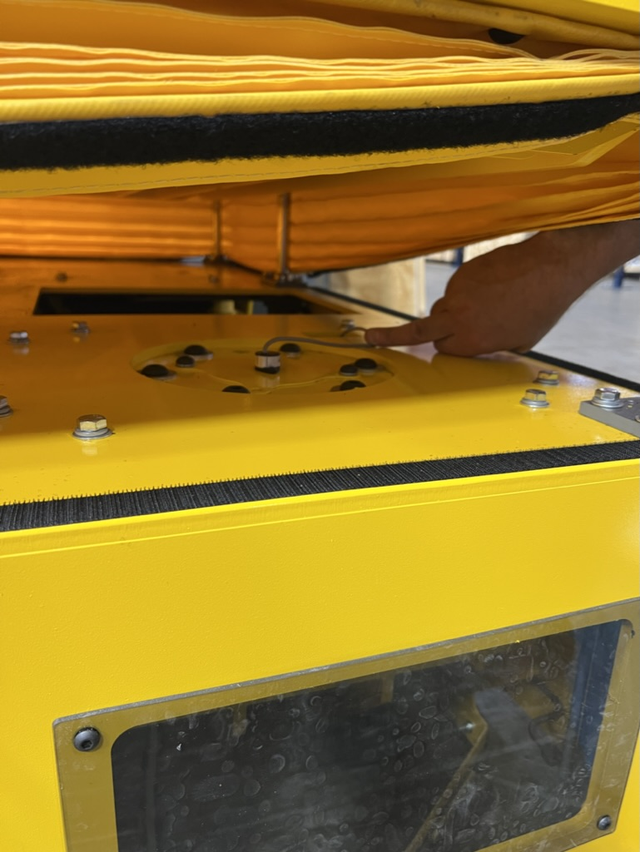
QMQ Cart issues
Wire routing caused pinching, lead to intermittent responding to commands
Ground flatness – drive wheels need to contact ground
Move in any direction
Can be raised and lowered

Slide 29
Assembly progress over time

Slide 30
Timeline
Fall 2021
Moved into offsite warehouse
Jan. 2022
Magnet-Vacuum module assembly starts
*vacuum deliveries on critical path, all magnets mounted and aligned
Jan 2023
First module completed
Dec. 2023
Final production module completed
Apr 2023
Storage Ring enters Dark Time
Vacuum component availability became a schedule driver

Slide 31
Lessons learned
Scope:
Establish handoffs between working groups and processes
Explicitly state who is responsible for each necessary task so gaps can be identified
Documentation
We improved our processes as we progressed
Documentation needs to be updated to reflect refinement.
Repetitive Tasks
Can lead to complacency
Identify trends – small mistakes can be a precursor to larger issues

Slide 32
Questions

