Slide 1
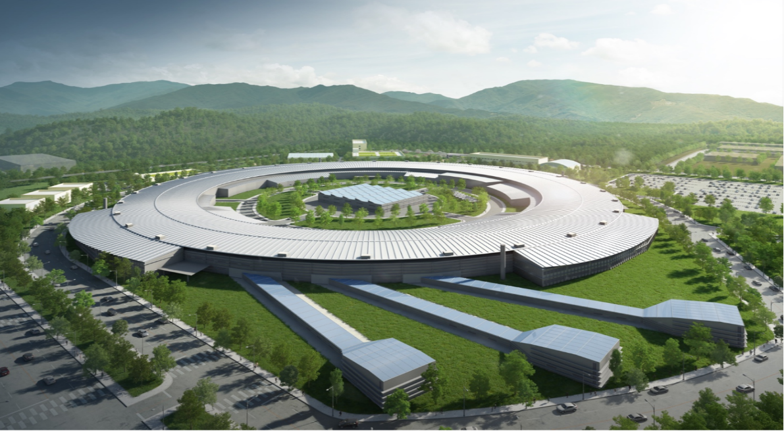
OLAV-VI Workshop (April 15 – 19, 2024)
Design Status of Vacuum System for the Korea-4GSR
Taekyun Ha (on behalf of PAL vacuum group)
Vacuum & RF Team Leader
Pohang Accelerator Laboratory (PAL)
POSTECH, Korea
April 17, 2024

Slide 2
OLAV-VI Workshop (April 15 – 19, 2024)
Contents
Overview of the Korea-4GSR Project
Brief Introduction of Linac & Booster Vacuum System
Storage Ring Vacuum System
Design Philosophy
Overview
Change Log of Chamber Design
Impedance Budget
Photon Fan and Beam Branch Chamber
ID Beam Opening
Thermal Analysis of the Main Photon Absorbers
Vacuum Simulation
Vacuum Chamber Prototyping
Pressure Measurement after NEG Activation
Fabrication schedule
Summary
→ See Hosun Choi’s Talk
→ See Sehyun Kim’s Talk

Slide 3
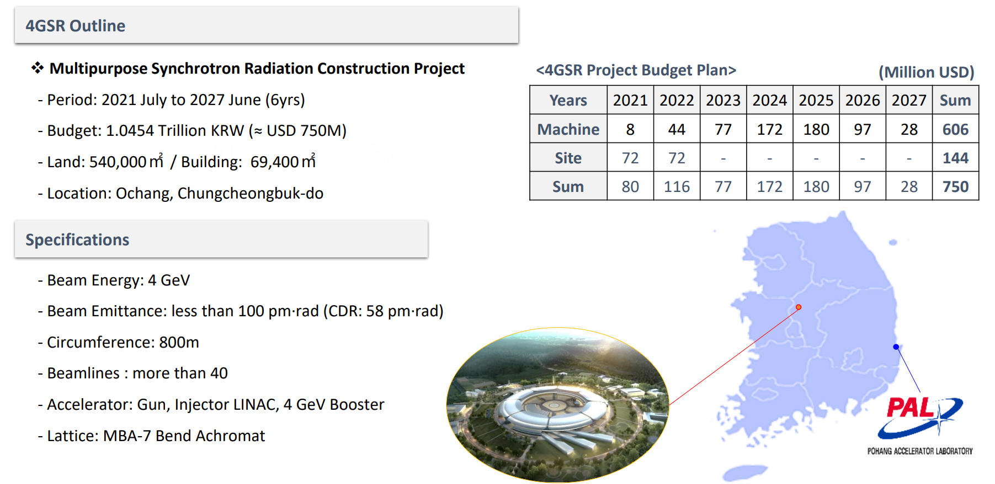
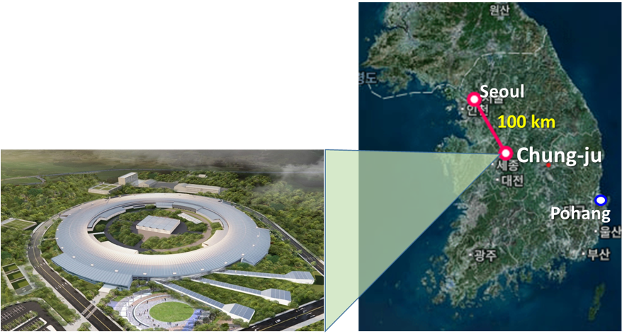
OLAV-VI Workshop (April 15 – 19, 2024)
Chung-ju, Chungcheongbuk-do
(10 at the initial stage)

Slide 4
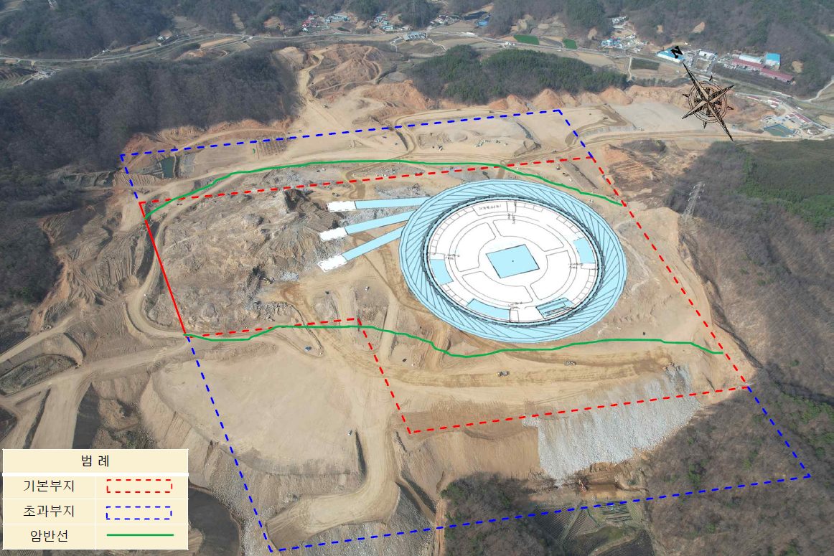
OLAV-VI Workshop (April 15 – 19, 2024)
Construction Site

Slide 5
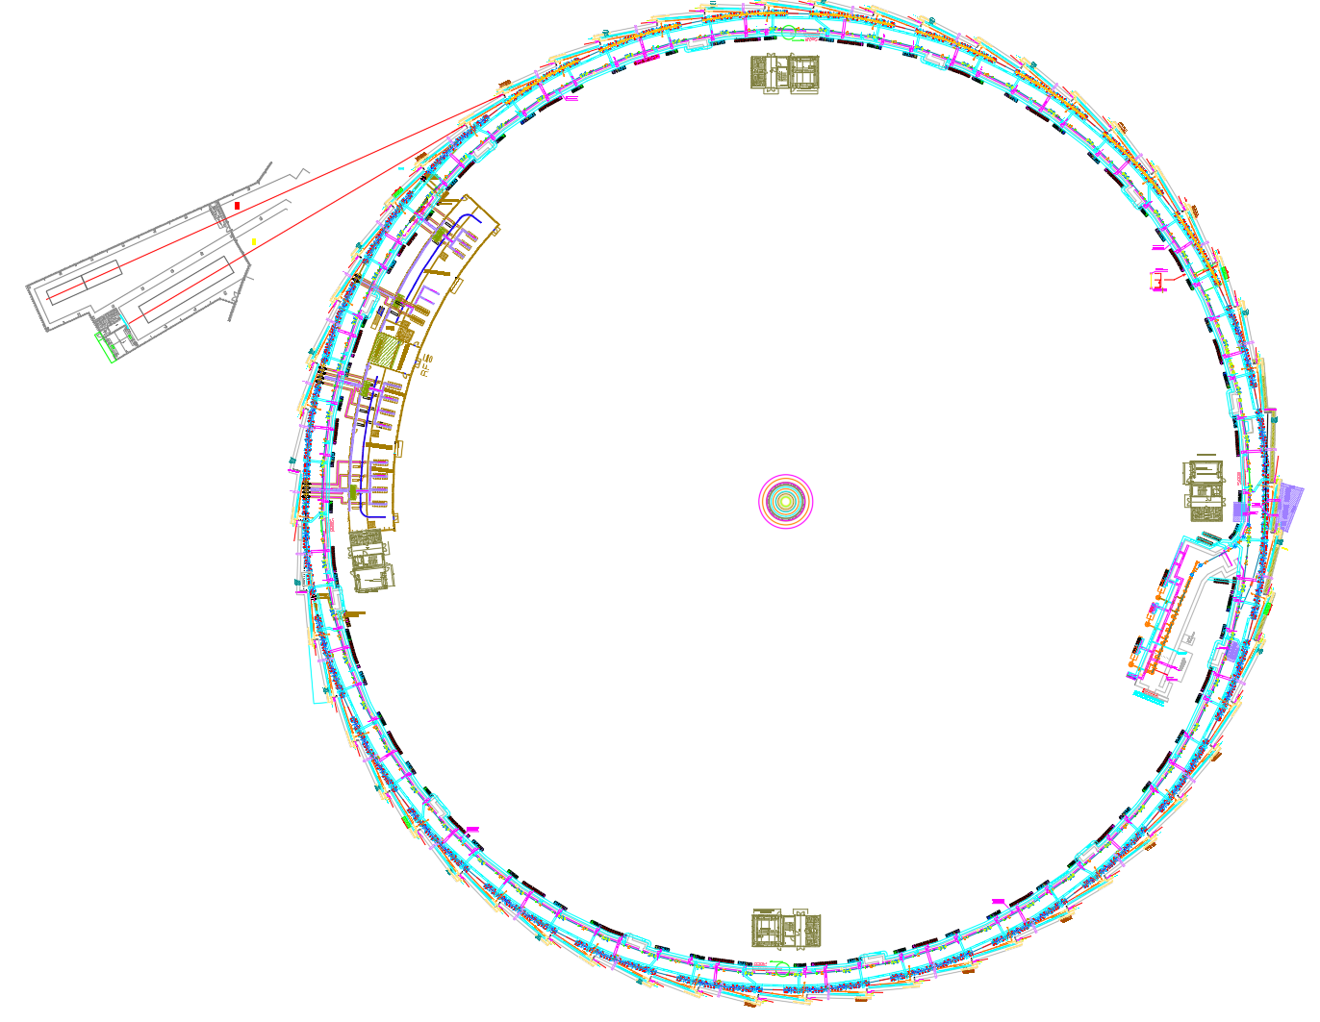
OLAV-VI Workshop (April 15 – 19, 2024)
Accelerator Vacuum System
Linac vacuum
Electron beam energy 0 → 200 MeV
Photo-cathode E-gun (~10⁻¹¹ mbar), AC and wave guide (~10⁻⁸ mbar)
Successfully being operated in PLS-II & PAL-XFEL
Booster vacuum
Electron beam energy 200 MeV → 4 GeV
Circumference ~770 m with 30 cells
Beam duct OD ∅24~32 mm, thickness 0.7 mm (low eddy current)
Vacuum requirement ~10⁻⁸ mbar
Beam transfer system vacuum
Transfer line length ~ 40 m
Special chambers for the injection system
(Ceramic kicker chamber, In-vacuum septum chamber, …)
Storage ring vacuum
Electron beam energy 4 GeV & beam current 400 mA
Circumference ~800 m with 28 cells
Beam duct Inner diameter ∅18(V) x 24(H) mm
Vacuum requirement during operation ~10⁻⁹ mbar
Storage Ring
Booster
4 | GeV
400 | mA
800 | m Ring
LINAC

Slide 6
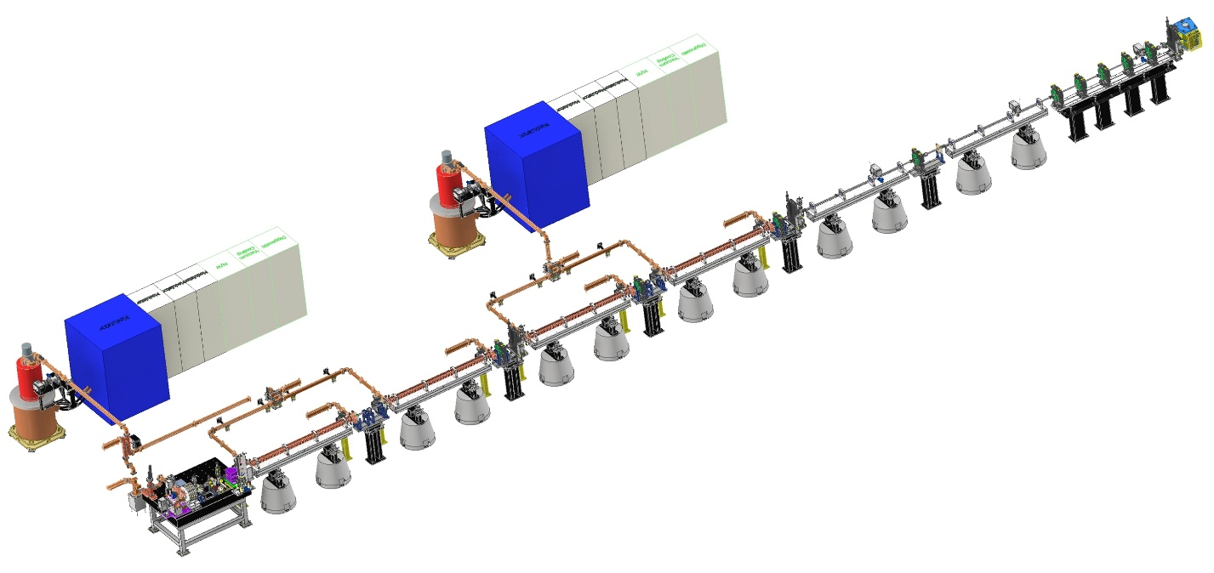
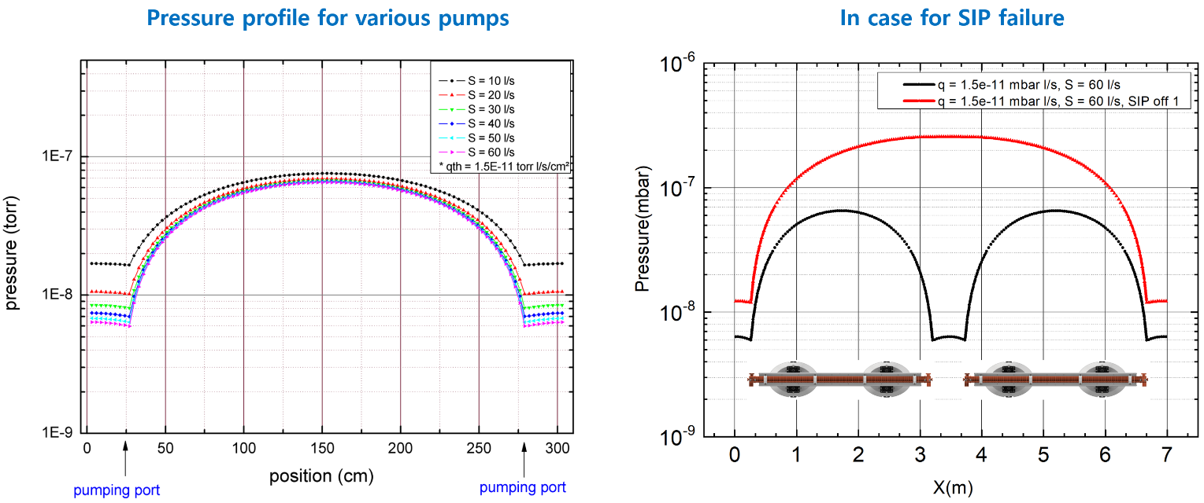
OLAV-VI Workshop (April 15 – 19, 2024)
Linac Vacuum System
Photo-cathode E-gun:
Vacuum requirement during operation ~ 10⁻¹¹ mbar
Low outgassing vacuum chamber with SIP(1 ea, 60 L/s), NEG cartridges(2 ea, 400 L/s)
Accelerating columns and wave guides
Four S-band accelerating columns with two modulator-klystron stations
Vacuum requirement during operation ~ 10⁻⁸ mbar
Five SIPs per module (60 L/s), vacuum interlock with CCG signal
Linac to Booster (LTB): Vacuum requirement during operation ~ 10⁻⁸ mbar

Slide 7
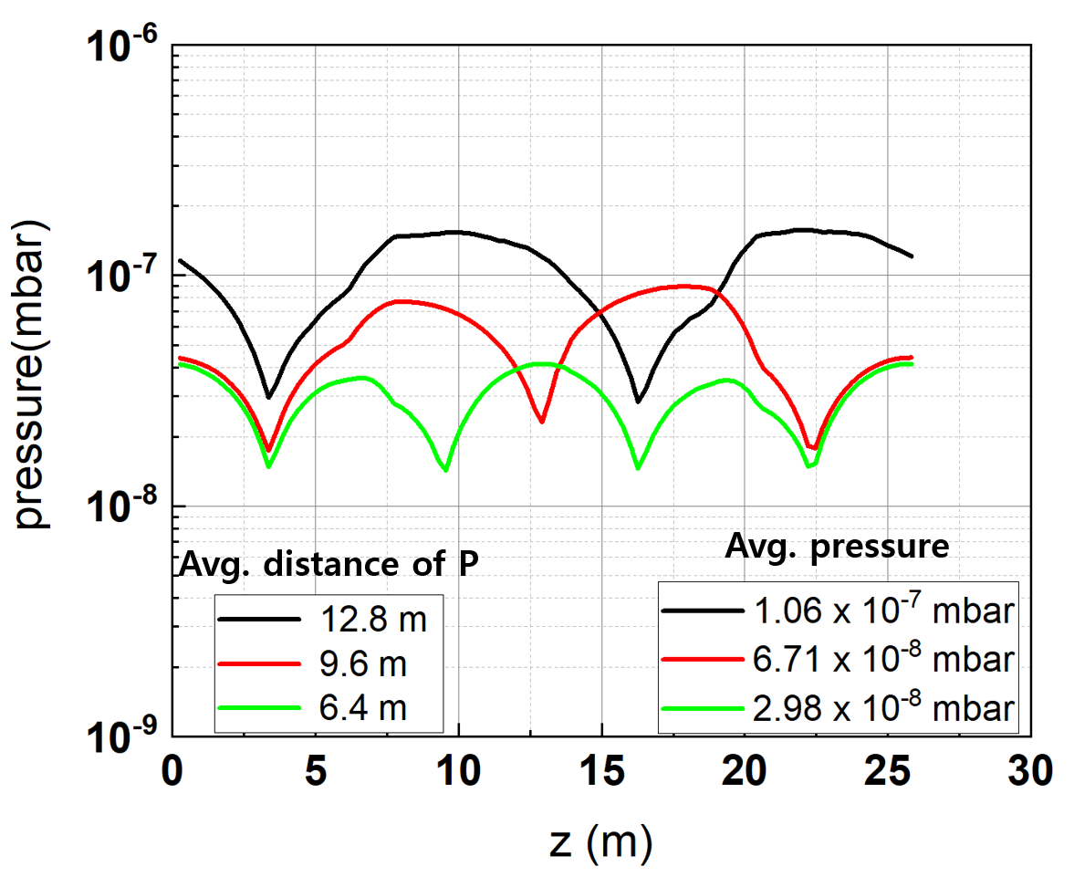
OLAV-VI Workshop (April 15 – 19, 2024)
Booster Vacuum System
Circumference ~770 m with 30 cells
Circular beam duct with OD ∅24 mm (dipole magnet), ∅32 mm (multipole magnet)
Chamber materials: SS316L (0.7 mm-thick) → Max. stress < 2.5 MPa
Eddy current heating effect < 1 mW/cm² → Negligible temperature rise
Outgassing rate < 1.5x10⁻¹⁰ mbar l/s cm² → Avg. pressure < 5x10⁻⁸ mbar
※ Pressure distribution w.r.t. pump distance

Slide 8
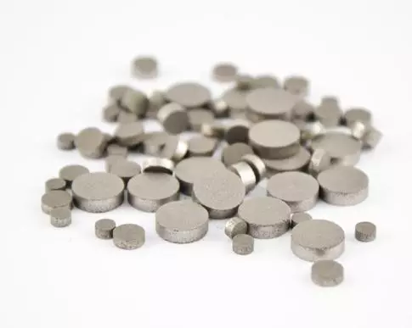
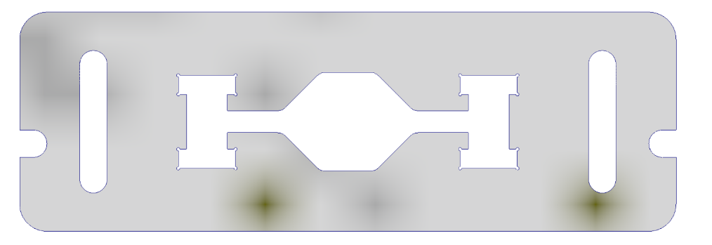
OLAV-VI Workshop (April 15 – 19, 2024)
Design Philosophy of the Storage Ring Vacuum System
Pill-NEG
Cooling water
e⁻
SR
Distributed pumping system using “Pill-type Getters”
Bake-out & NEG activation in the tunnel (“In-situ bake-out”)
Maximize the exposure of the chamber wall to synchrotron radiation for rapid beam cleaning
Two step installation:
Pre-assemble magnets and vacuum chambers on a girder outside the tunnel
Connect the chamber between the two girders using bellows in the tunnel
Low impedance design:
24x18 octagon-shaped e-beam channel with 4 mm high winglet for synchrotron radiation handling
Try to make the transition angle less than 1:10
Bellows and gate valve having RF-shielded finger which is made of thin copper plate with slots
No components penetrate into the beam channel (cross section change only in the winglet)
Sheath heater

Slide 9
OLAV-VI Workshop (April 15 – 19, 2024)
Overview of the Storage Ring Vacuum System
SR one cell diagram
e⁻
Photon beam (ID)
Photon beam (BM)
※ Arc-section length: 22.3 m
※ Bending angle (1 Cell): 12.857°
※ 28 cells (800 m)
<Hybrid 7BA Lattice>
Bending magnet
SR one cell vacuum system
e⁻
Photon beam (ID)
CH04
CH03
CH02
CH01
Photon beam (BM)
CH07
CH06
CH05
CH09
CH08
Beam chamber
24(H)×18(V)
CH10
Cooling water
CH11
e⁻
SR
CH12
Vacuum chamber cross-section
CH13
※ 13 vacuum chambers per arc-section
Pill-NEG

Slide 10
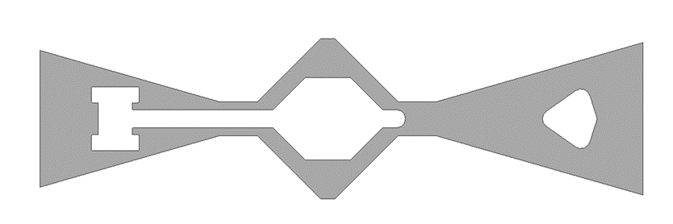
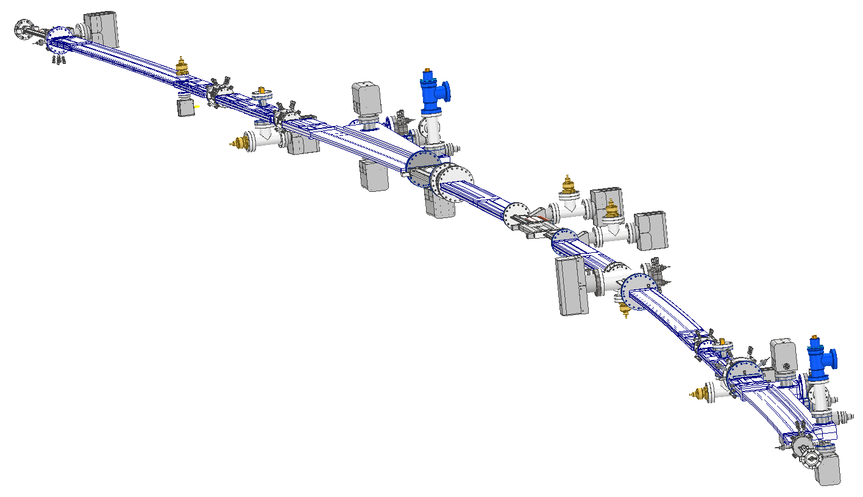
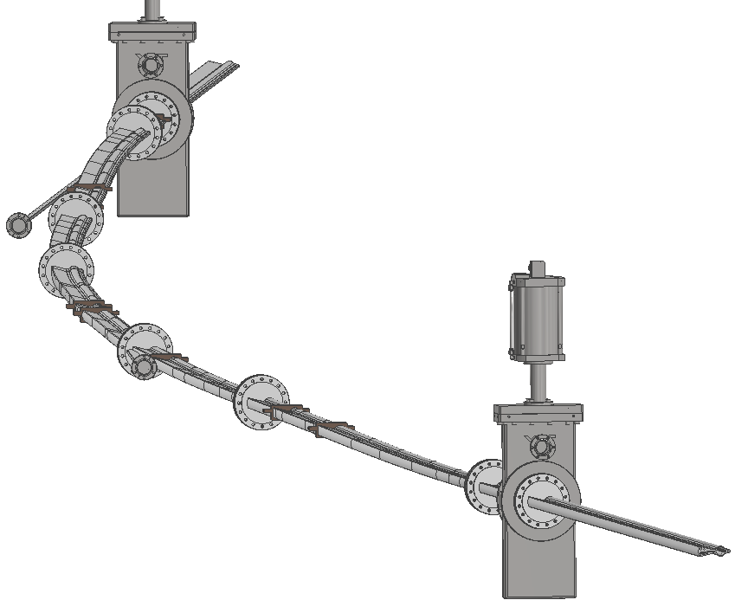
OLAV-VI Workshop (April 15 – 19, 2024)
Design Change of the Vacuum Chamber
e⁻
SR
Beam chamber
24(H)×18(V)
Cooling water
e⁻
SR
Pill-NEG
Cooling water
Sheath heater
Pill-NEG
Sheath heater
e⁻
SR
Bending magnet beam port
ID beam port
ID beam port
Bending magnet beam port
Conceptual Design
Current Design

Slide 11
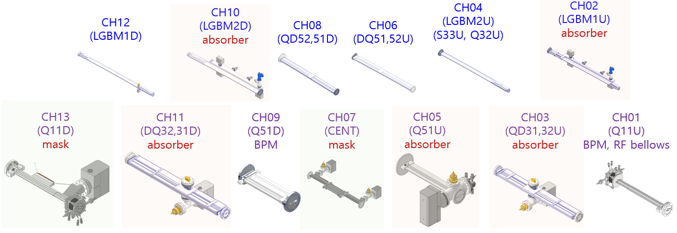
OLAV-VI Workshop (April 15 – 19, 2024)
Main Components of the SR Vacuum System
Arc section vacuum system
CH04
CH03
CH02
CH01
CH08
CH07
CH06
CH05
Sputter Ion Pump (11 ea, 60 L/s)
NEG Pump (10 ea, 400 L/s)
Ion Gauge (5 ea)
RGA (2ea)
All-metal Angle Valve (2 ea)
RF-shielded Gate Valve (1 ea)
CH10
CH09
BPM (10 ea, STS316)
RF-shielded Bellow (10 ea)
Photon absorber (4 ea, OFHC)
Photon mask (3 ea, OFHC)
CH12
CH11
Stainless steel (5 ea)
Aluminum (5 ea, extruded)
Aluminum (3 ea, machined)
CH13

Slide 12
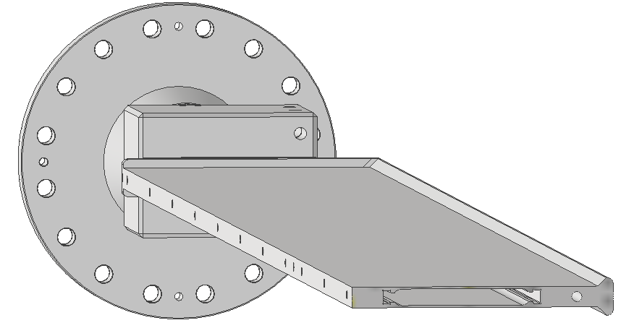
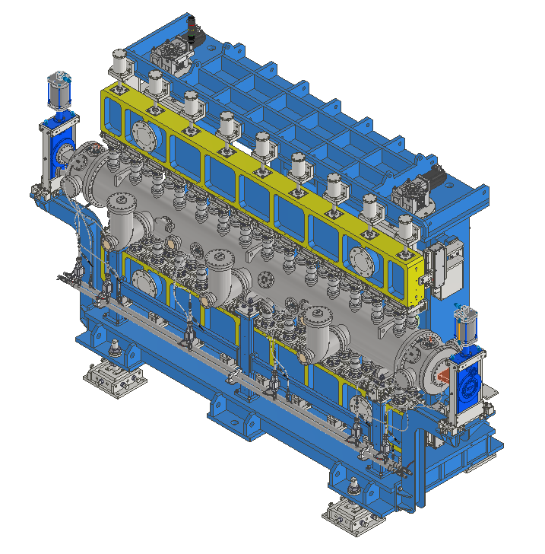
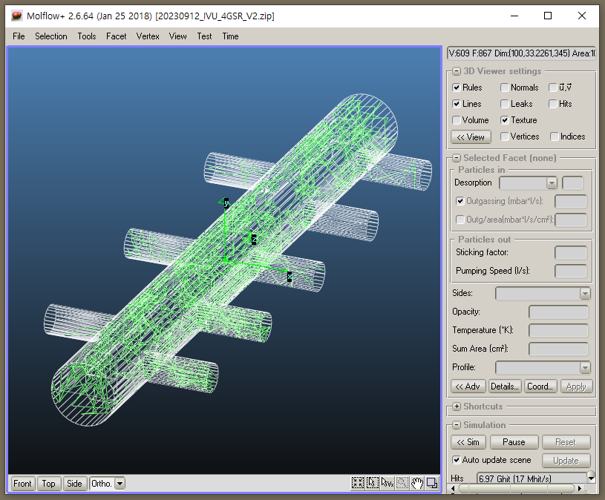
OLAV-VI Workshop (April 15 – 19, 2024)
Main Components of the SR Vacuum System
Straight section vacuum system
Photon mask
Pill-NEG
OVU Chamber
IVU Chamber (3 m)

Slide 13
OLAV-VI Workshop (April 15 – 19, 2024)
Impedance Budget
 |  | Single Component |  | Sum
Components | Number | k_{z} [V/pC] | Zn_{z} [mOhm] | k_{z}T [V/pC] | Zn_{z}T [mOhm] | Zn_{z}T [mOhm]
Resistive Wall | 1 | 14.78 | 158.20 | 14.78 | 158.2 | 158.2
Main RF cavity | 10 | 1.17 | 5.98 | 11.65 | 59.80 | 59.80
LGBM1U chamber | 28 | 2.34E-02 | 0.16 | 0.65 | 4.37 | 4.37
LGBM2D chamber | 28 | 3.42E-02 | 0.34 | 0.96 | 9.39 | 9.39
BPM | 176 | 2.30E-02 | 0.17 | 4.05 | 30.62 | 30.62
Gate valve | 112 | 3.38E-02 | 0.30 | 3.79 | 33.82 | 33.82
ID taper | 26 | 2.56E-03 | 0.89 | 0.07 | 23.17 | 23.17
Bellows | 224 | 7.09E-03 | 0.07 | 1.59 | 15.19 | 15.19
BPM-Bellows 1 | 56 | 2.72E-02 | 0.23 | 1.52 | 12.94 | 12.94
BPM-Bellows 2 | 56 | 2.50E-02 | 0.23 | 1.40 | 12.94 | 12.94
Flange | 840 | 3.00E-05 | 0.02 | 0.03 | 15.96 | 15.96
RF taper | 6 | 7.70E-02 | 1.89 | 0.46 | 11.32 | 11.32
LFS | 1 | 1.58E+00 | 6.30 | 1.58 | 6.30 | 6.30
RF transition chamber | 5 | 8.50E-02 | 0.75 | 0.43 | 3.76 | 3.76
Pump tee | 56 | 5.16E-03 | 0.13 | 0.29 | 7.45 | 7.45
TFS (vert-) | 1 | 1.82E-01 | 0.67 | 0.18 | 0.67 | 0.67
TFS (hori-) | 1 | 1.82E-01 | 0.67 | 0.18 | 0.67 | 0.67
Center bend chamber | 28 | 3.52E-03 | 0.21 | 0.10 | 5.88 | 5.88
CH08 entrance | 56 | 7.90E-04 | 0.03 | 0.04 | 1.68 | 1.68
CH08 exit | 56 | 1.82E-04 | 0.01 | 0.01 | 0.73 | 0.73
Collimator | 4 | TBD |  | TBD
Total |  |  |  | 44 | 415
Loss factor Effective
impedance

Slide 14
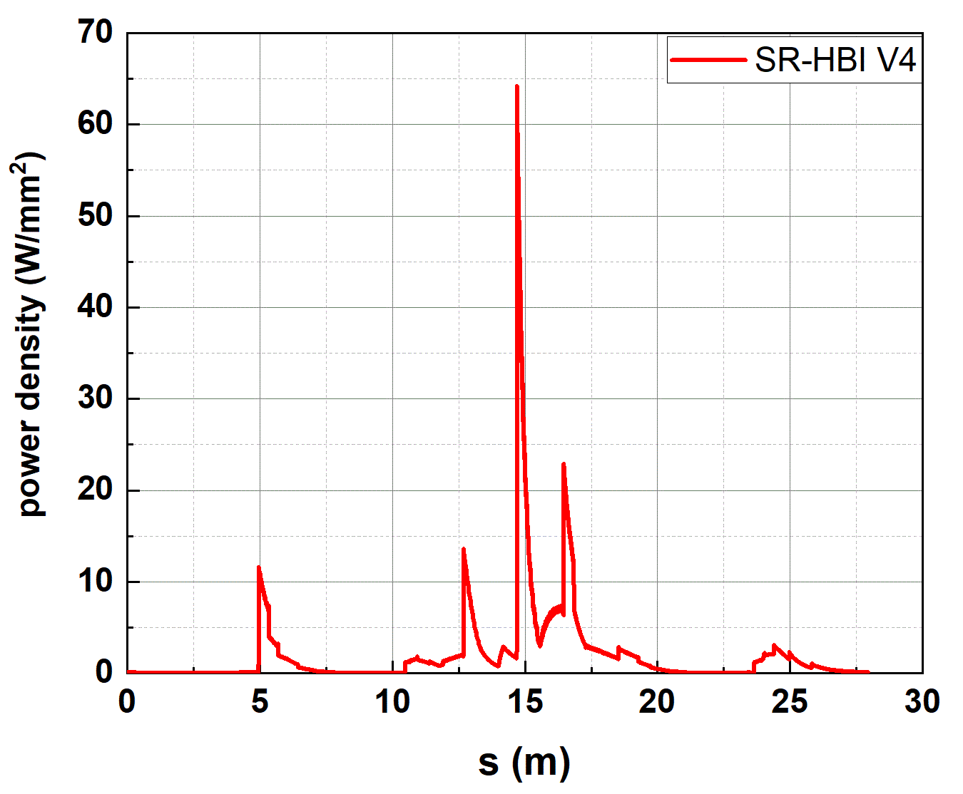
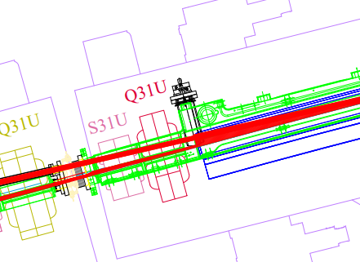
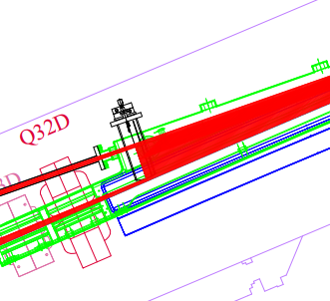
OLAV-VI Workshop (April 15 – 19, 2024)
Photon Fan and Beam Branch Chambers
Photon absorber (mask)
※ SR power density along the ring
(for Φ24 mm uniform beam pipe)
Crotch absorber for the bending beamline
Crotch absorber for the ID beamline

Slide 15
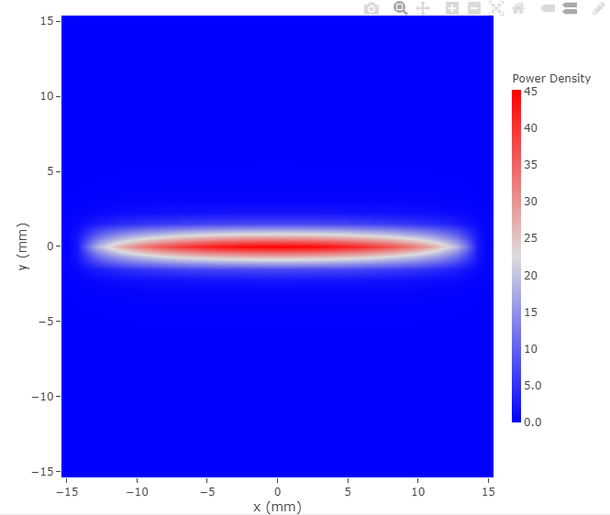
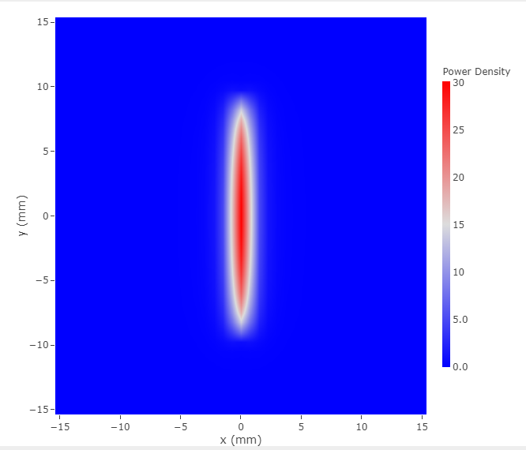
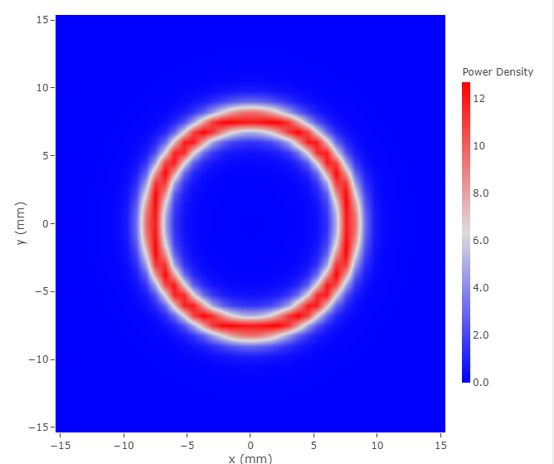
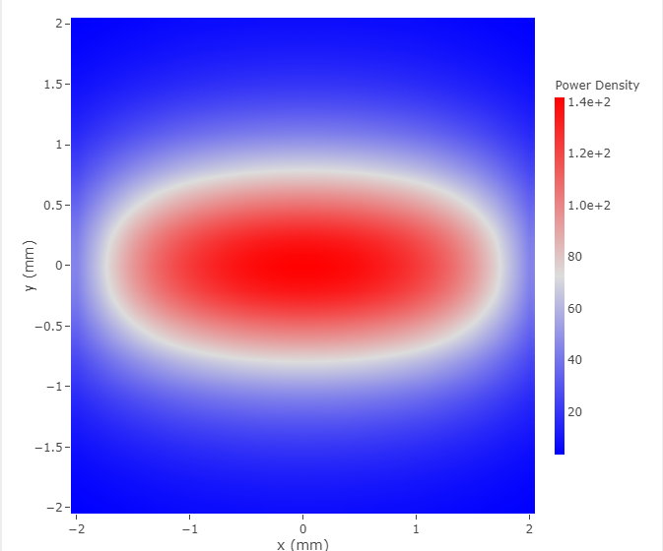
OLAV-VI Workshop (April 15 – 19, 2024)
ID Beam Parameters & Orbit Interlock Tolerance
※ Parameters for typical IDs
ID | Gap (mm) | λ_{u} (mm) | L (m) | B [x/y] (T) | K [x/y/⊥] | Max. Power density (kW/mrad²) | Max. Divergence (mrad)
IVU20 | 5 | 20 | 3 | 0.8867 | 1.6558 | 142 | ± 0.2 (H)
EPU98 | 15 | 98 | 3.6 | H: 0/1.2020 | 0/11/11 | 45 | ± 1.5 (H)
 |  |  |  | V: 0.8015/0 | 7.335/0/7.335 | 30 | ± 1.0 (V)
 |  |  |  | C: 0.6667/0.6675 | 6.1/6.108/8.633 | 12 | ± 0.8 (H,V)
※ Orbit interlock condition of e-BPMs for the ID
±0.1 mrad ± 400 μm offset
(Rms orbit error ~ 150 μm)
※ Power density profile @ 10 m from the ID center
IVU20
EPU98 (H mode)
EPU98 (V mode)
EPU98 (C mode)
± 1.0 mrad
± 0.8 mrad
± 0.2 mrad
± 1.5 mrad
± 0.8 mrad

Slide 16
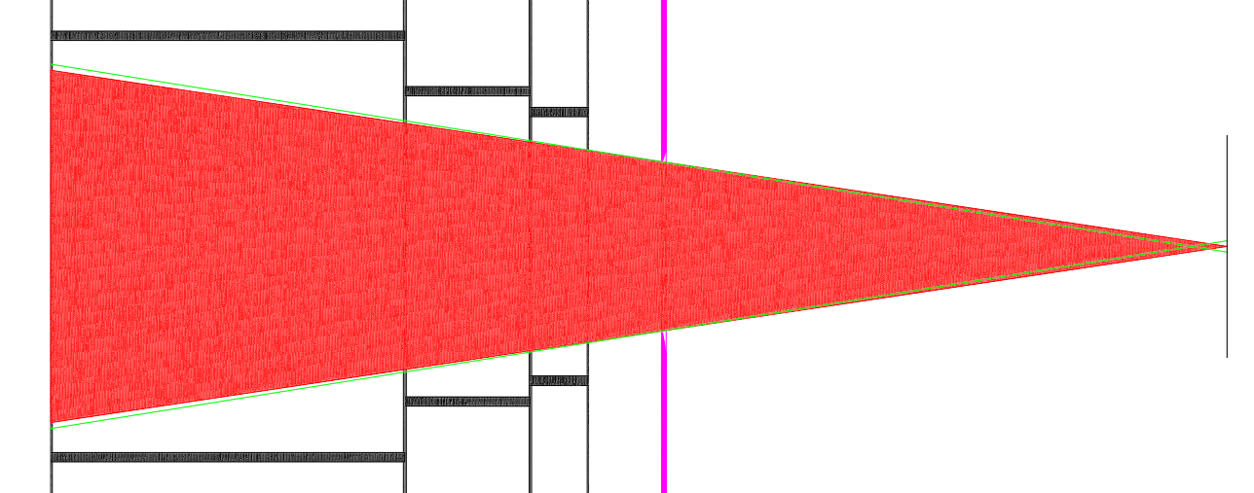
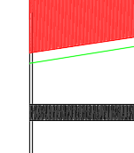
OLAV-VI Workshop (April 15 – 19, 2024)
ID Photon Beam Opening & Clearance
EPU98 (H mode), Top view
Beam pipe #3
Beam
pipe #2
Beam
pipe #1
Crotch absorber
※ Scale X : Y = 1 : 100
Pivot
ID center
44.5 mm
Mis-steered case
: 3.2 mrad
Beam opening
: 3 mrad
Beam clearance
3.0 mm
3.3 mm
2.6 mm
Beam clearance
2.8 mm
±0.1 mrad±600 μm
mis-steered beam
(green lines)
Green line:
mis-steered beam
Beam clearance
3.3 mm
12.67 m
EPU98 (V mode), Side view
Beam
pipe #2
Beam
pipe #1
Beam pipe #3
Crotch absorber
※ Scale X : Y = 1 : 100
32 mm
Pivot
ID center
Mis-steered case
: 2.2 mrad
Beam opening
: 2 mrad
Beam clearance
2.9 mm
3.4 mm
2.7 mm
Beam clearance
2.7 mm
±0.1 mrad±600 μm
mis-steered beam
(green lines)
Beam clearance
3.4 mm
Green line:
mis-steered beam
12.67 m

Slide 17
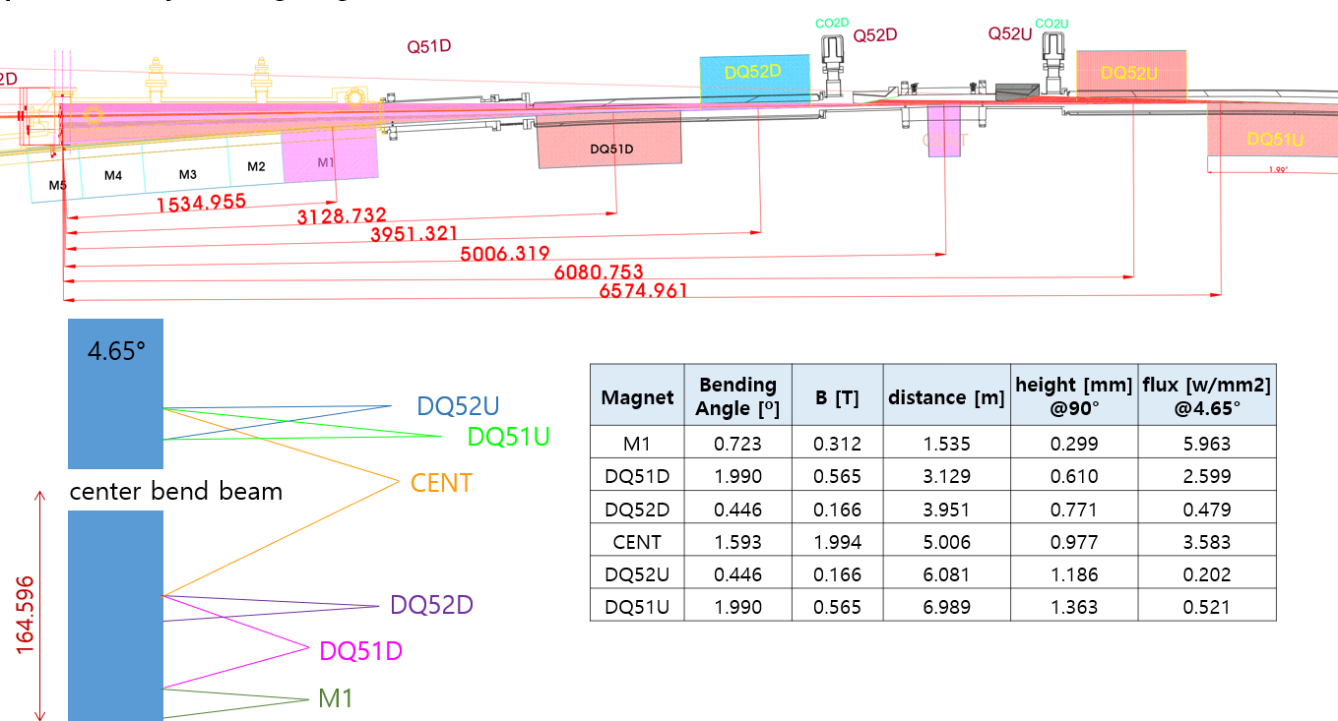
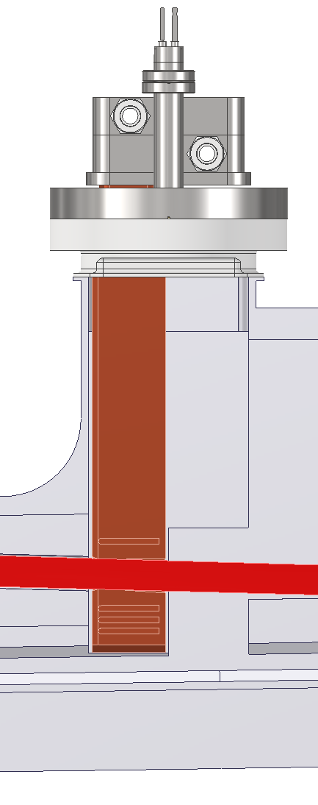
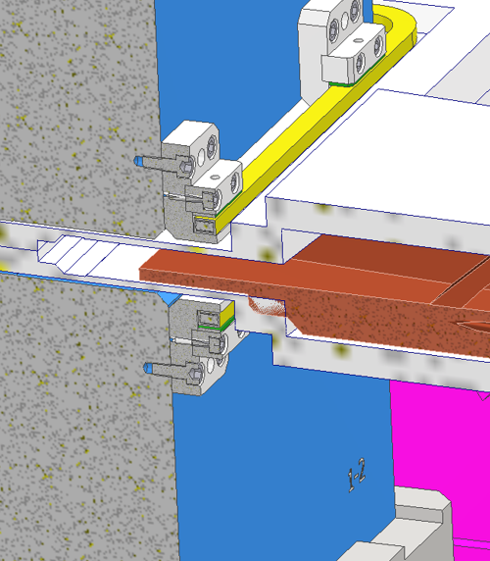
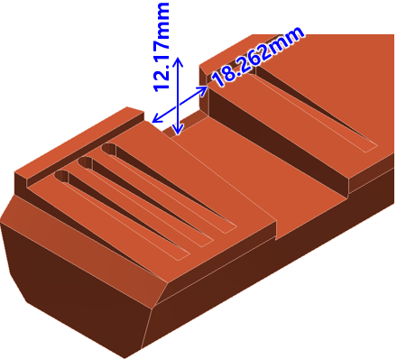
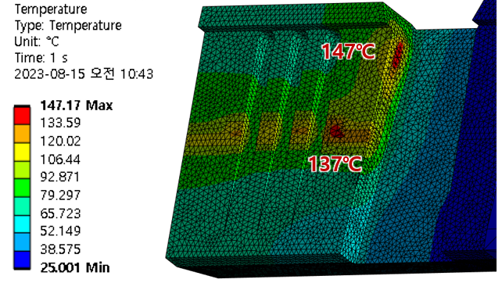
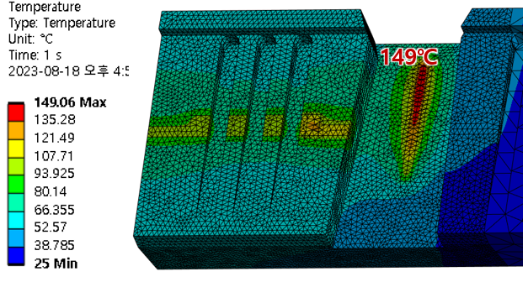
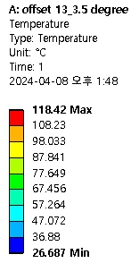
OLAV-VI Workshop (April 15 – 19, 2024)
Thermo-mechanical Analysis
Crotch absorber 1 (for the ID beamline)
Crotch absorber 2 (for the bending beamline)
[Beam opening]
±1.0 mrad (H)
SD = 6 m
EPU98 beam
[PA LGBM1U]
[Beam opening]
±1.5 × ±1.0 mrad (H×V)
[Photon fan from upstream bending magnets]
[Photon fan from upstream bending magnets]
118℃
[Max. Temperature for EPU98 (Hor. mode)]
[Max. Temperature for EPU98 (Ver. mode)]
[Max. Temperature]
※ Max stress ~ 70 MPa

Slide 18
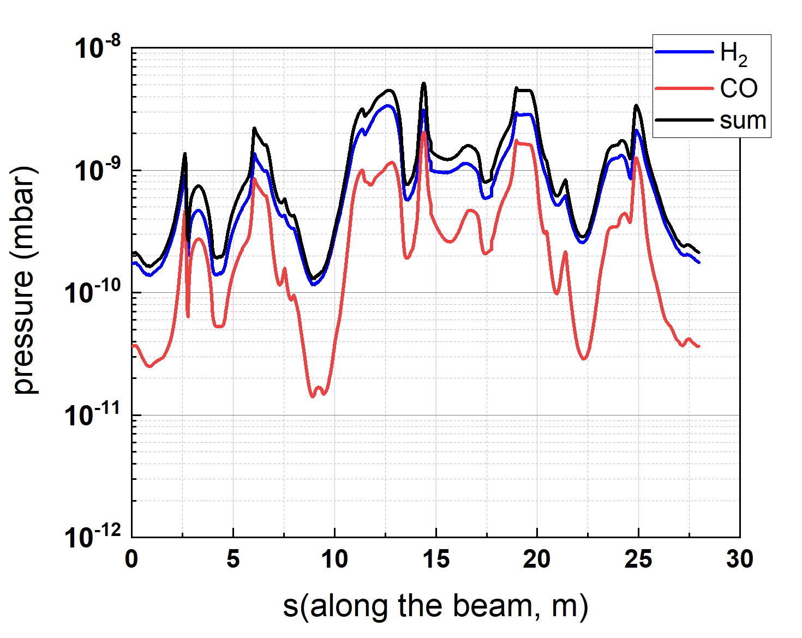
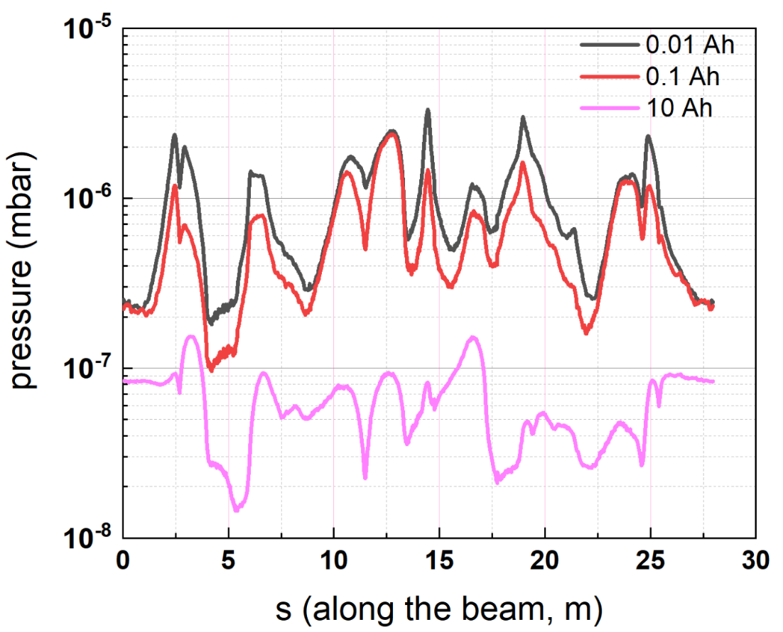
OLAV-VI Workshop (April 15 – 19, 2024)
Vacuum Profile Simulation
※ See Hosun Choi’s Talk
Synrad & Molflow simulation
We assumed the PSD yield of 1E-6 (H₂) and 2E-7 (CO)
Average pressure after fully cleaned ~1×10⁻⁹ mbar
Commisioning stage
Fully cleaned stage
Average pressure (1.38 x 10⁻⁹ mbar)

Slide 19
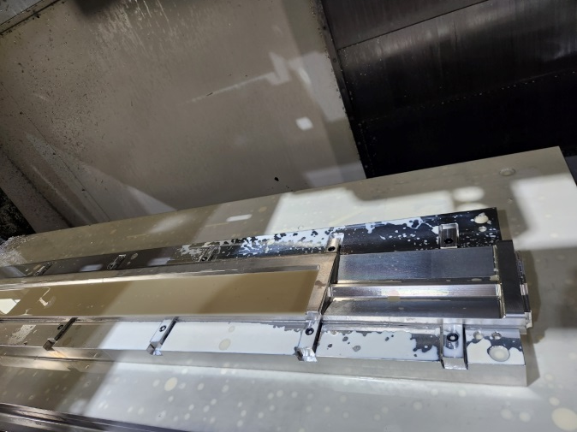
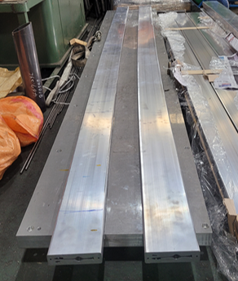
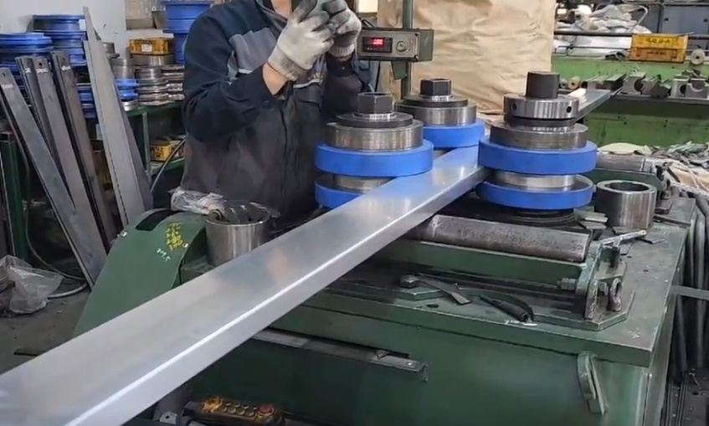
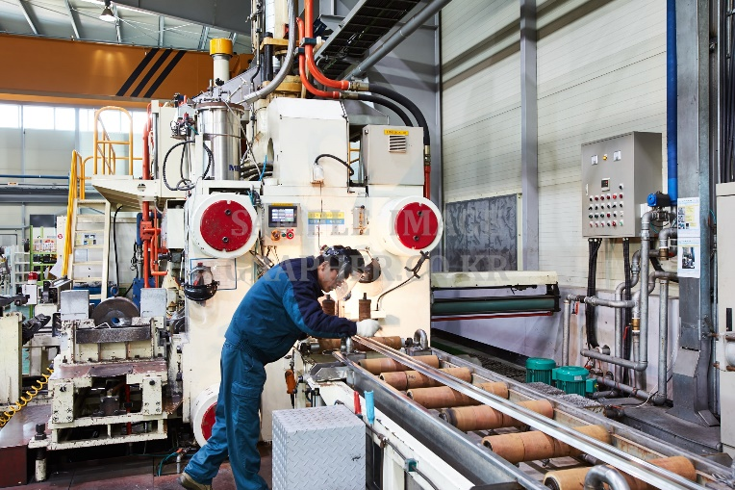
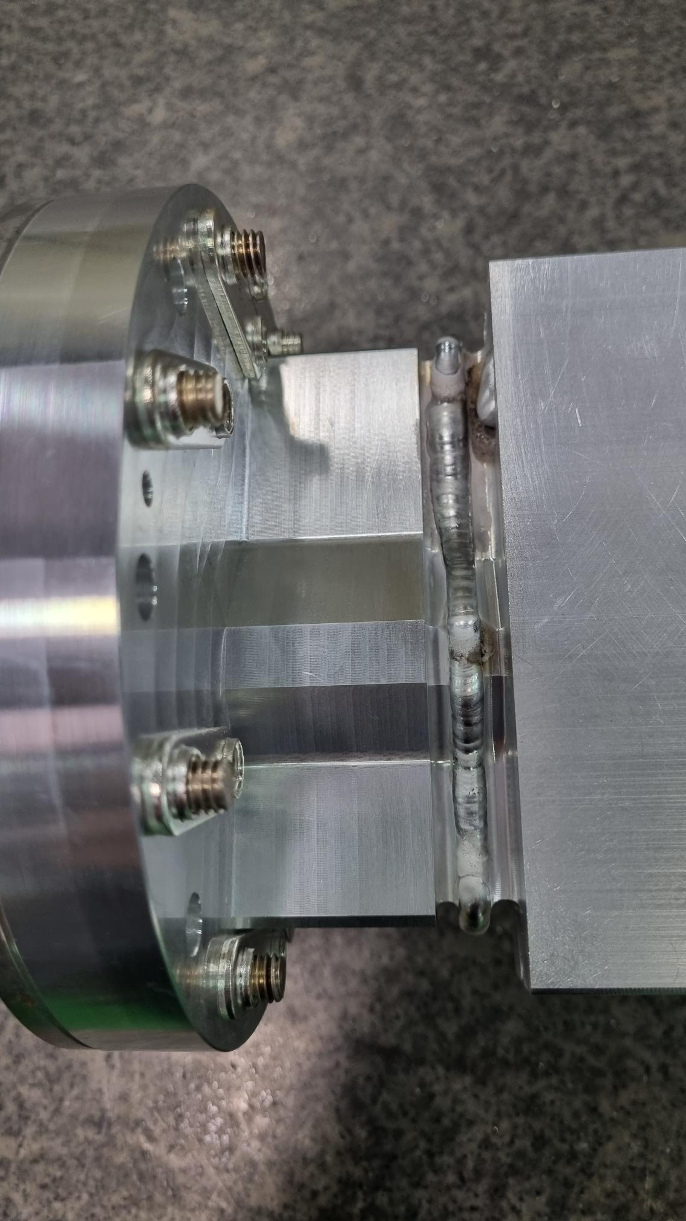
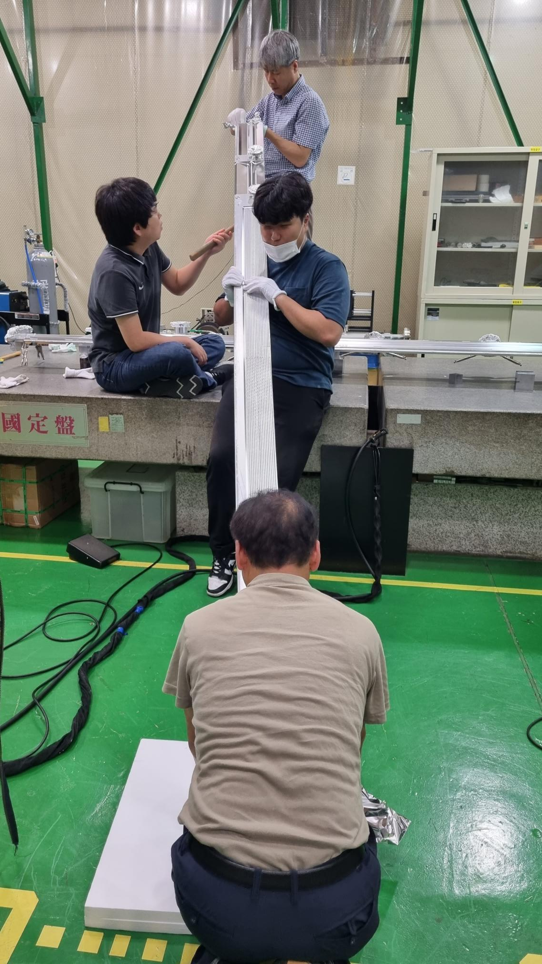
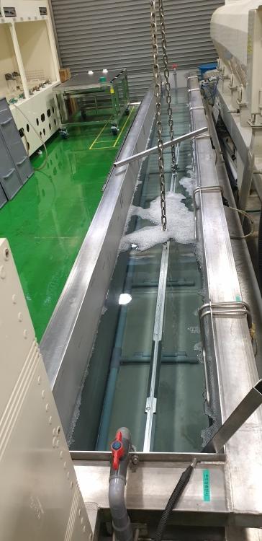
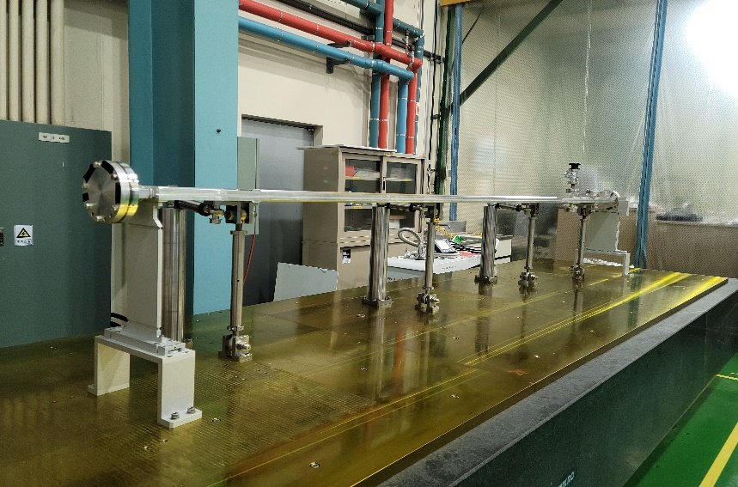
OLAV-VI Workshop (April 15 – 19, 2024)
Vacuum Chamber Prototyping (1)
※ See Sehyun Kim’s Talk
3. Curvature test
4. Machining
Dipole magnet chamber (extruded type, CH12)
2. Bending
1. Extrusion
※ Error < ±0.5 mm
5. Chemical cleaning
7. Welding
6. NEG insertion
8. Assemble & alignment
※ He leak rate < 10⁻¹⁰ mbar l/s
19

Slide 20
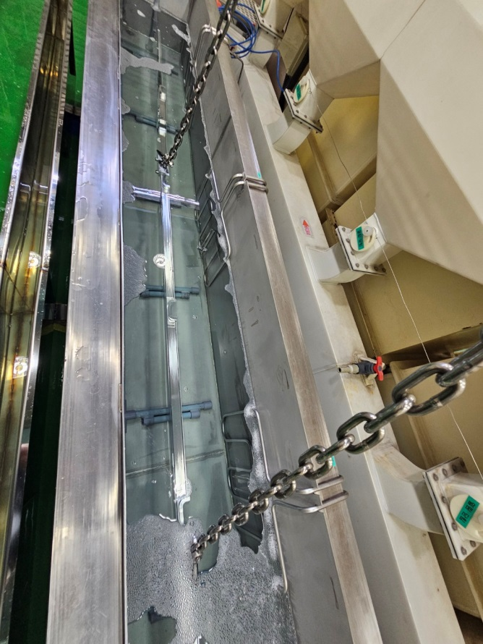
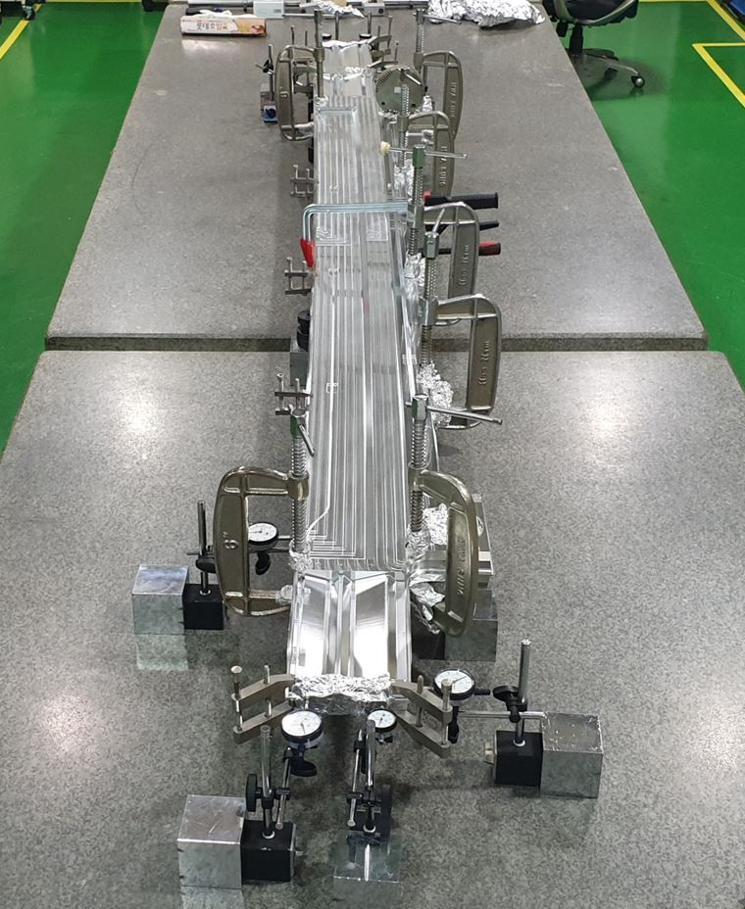
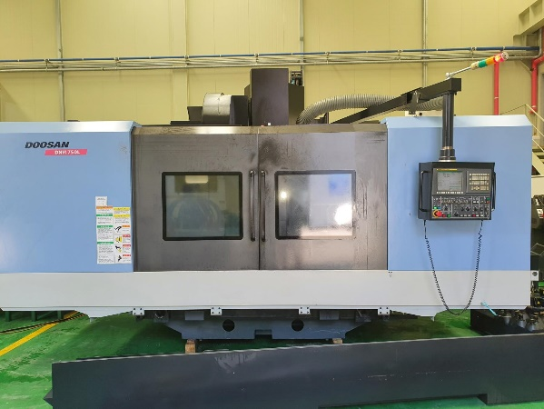
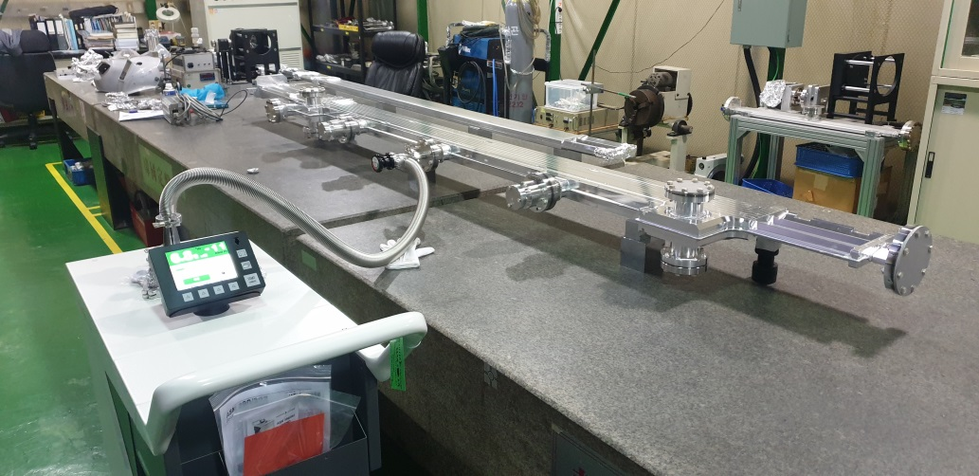
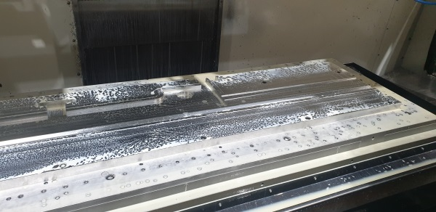
OLAV-VI Workshop (April 15 – 19, 2024)
Vacuum Chamber Prototyping (2)
Beamline branch chamber (machined type, CH02)
2. Chemical cleaning
3. Welding
1. Machining
4. Assemble & vacuum test
※ He leak rate < 10⁻¹⁰ mbar l/s
20

Slide 21
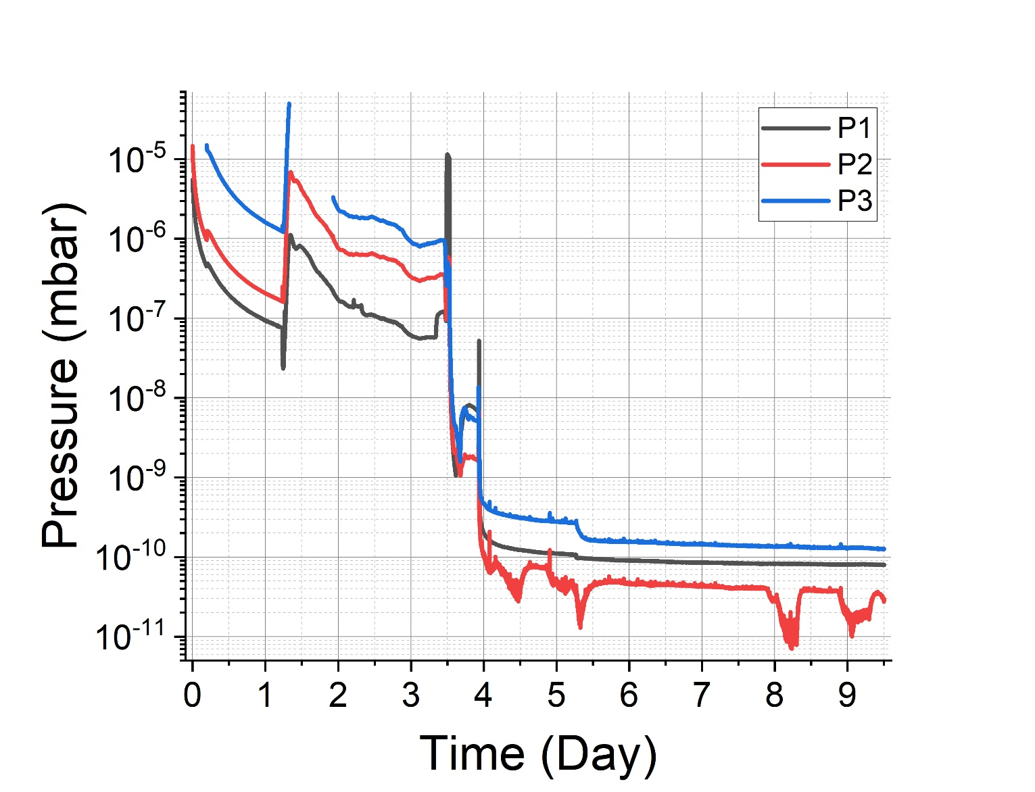
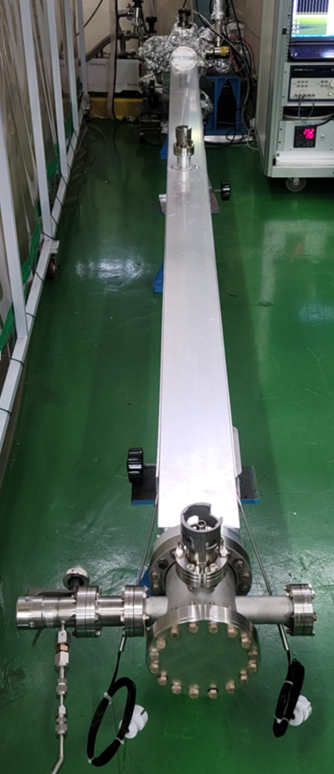
OLAV-VI Workshop (April 15 – 19, 2024)
Vacuum Test of the Prototype Chamber
Measurement of the ultimate pressure
Al extruded chamber with Pill-NEGs (2 lines)
Baking at 180℃ for 48 h
Base pressure measured at 3 points
Base pressure at the center of the chamber
P2 < 5×10⁻¹¹ mbar
P3
P2
Sheath heaters
P1
Measurement set-up
21

Slide 22
OLAV-VI Workshop (April 15 – 19, 2024)
Fabrication Schedule (Aluminum Chambers)
22

Slide 23
OLAV-VI Workshop (April 15 – 19, 2024)
Summary
Design Status
- Deign optimization of vacuum system is done
- Vacuum profile estimation completed (average pressure = 1E-9 mbar)
- Thermal analysis of photon absorbers completed
- Vacuum chamber prototyping and performance test are done
Future schedule
- Completion of manufacturing drawing: ~ 1/2 of 2024
- Vacuum chambers prototyping: ~ 1/2 of 2024
- Purchase order of vacuum chambers: 2/2 of 2024
- Purchase order of commercial components : 2025
- Assembly and vacuum test: 3/4 of 2024 ~

Slide 24
OLAV-VI Workshop (April 15 – 19, 2024)
Thank you for your attention

Slide 25
Photon Beam Opening & Clearance Issue
Photon beam pipe #3
※ Beam opening
±1.5 × ±1.0 mrad (H×V)
Photon beam pipe #1
Crotch absorber for ID beams
Photon beam pipe #2
SD = 6.086 m

Slide 26
EPU98 Power Density @ the Crotch Absorber
※ Source distance = 6.1 m
Photon absorber
Photon absorber
Photon absorber
Photon absorber
± 1.0 mrad
± 1.5 mrad

Slide 27
Synchrotron Radiation Power on 1 cell
Location | CH02 |  | CH03 | CH05 | CH07 | CH10 | CH11 | CH13
Type | absorber |  | absorber | absorber | mask | absorber | absorber | mask
power [W] | ID horizontal mode | ID vertical mode | 168 | 593 | 1,090 | 9,213 | 229 | 311
 | 1,312 | 1,834

Slide 28
Cold forged oxygen free copper
The yield strength of the cold forged OFHC is enhanced up to 240 MPa.

Slide 29
RF-shielded bellows and BPM module
29

