Slide 1
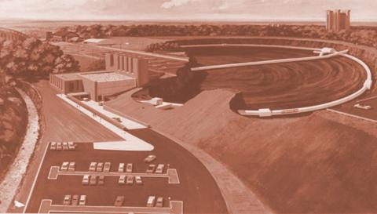
Operational Experiences of NEG Dominated Pumping System at CHESS-U
Leila Aboharb
Mechanical Systems Engineer
Cornell Laboratory of Accelerator-based ScienceS and Education (CLASSE)
Special Audience Guest:
Yulin Li
Xianghong Liu
Gregg McElwee
Chris Whiting
Notes:
800-m-diameter ring 60 feet below the surface

Slide 2
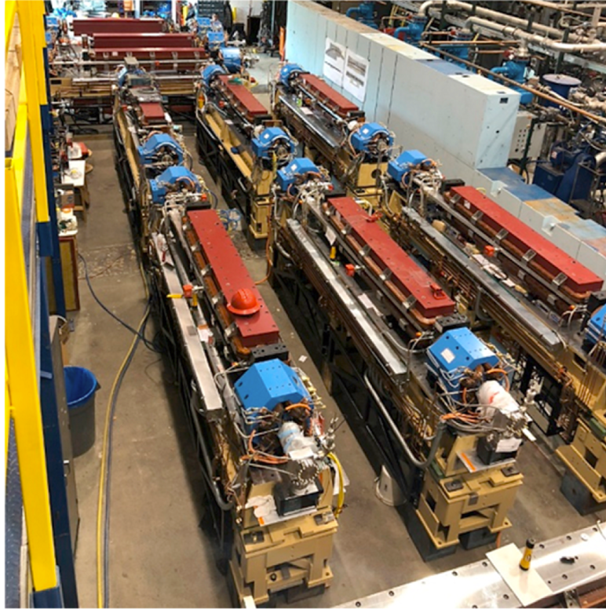
Purpose/Outline
Purpose: Provide examples of proven service of NEG-dominated pumping system through CHESS-U experience
Layout/Equipment
Performance
Failure(s)
Recovery
Consequences
Corrective Actions
Notes:
Staging done during operations off-site and then stored on-site for quick instllation

Slide 3
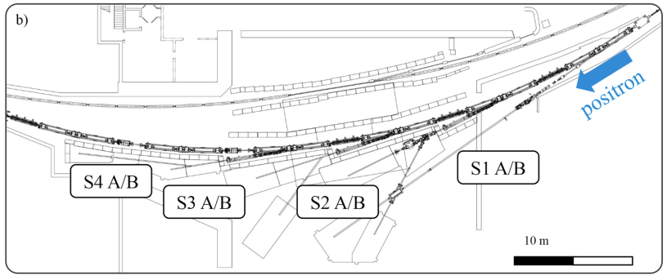
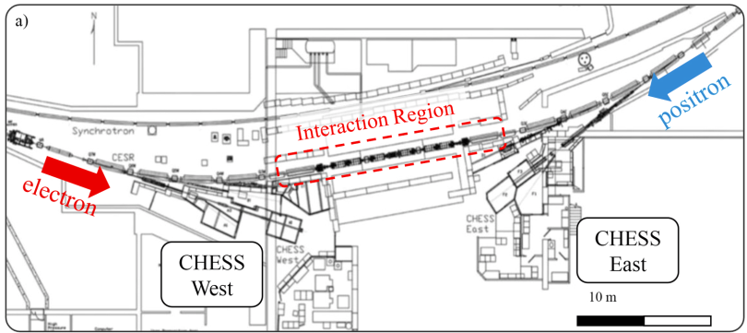
CHESS-U Recent Layout Changes (2018)
Pre 2008: Electron-positron collider
2008-2018: Counter-rotating beams operation for CHESS/CesrTA
Post 2018: High brightness X-ray source utilizing a single beam
Notes:
80 meter makeover

Slide 4
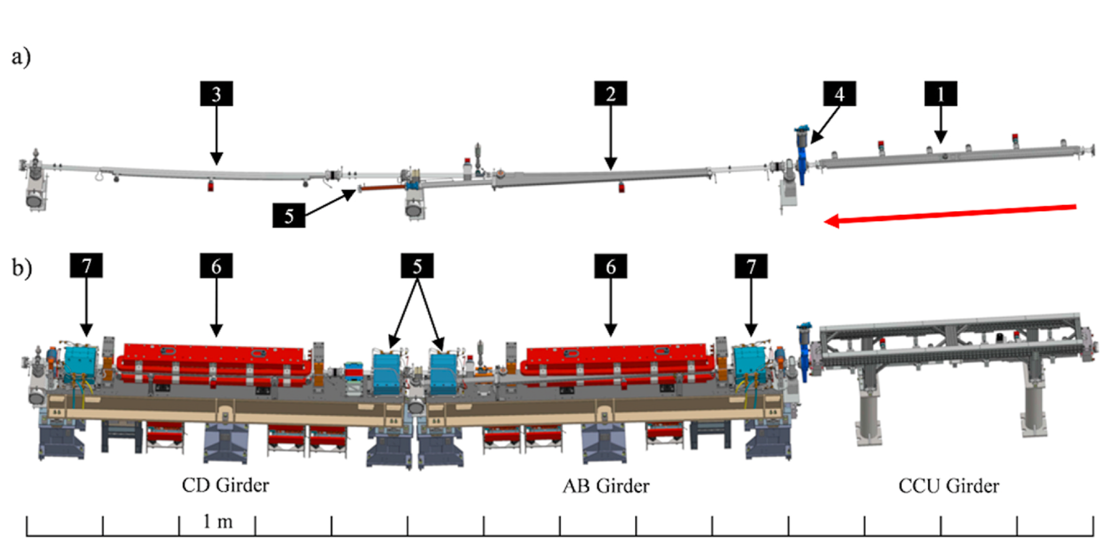
CHESS-U Equipment per Cell (6 Cell)
3 Chambers per Cell : Undulator Chamber, Dipole A Chamber, Dipole C Chamber
2 Cells per Gate valve Section (~28 meters)

Slide 5
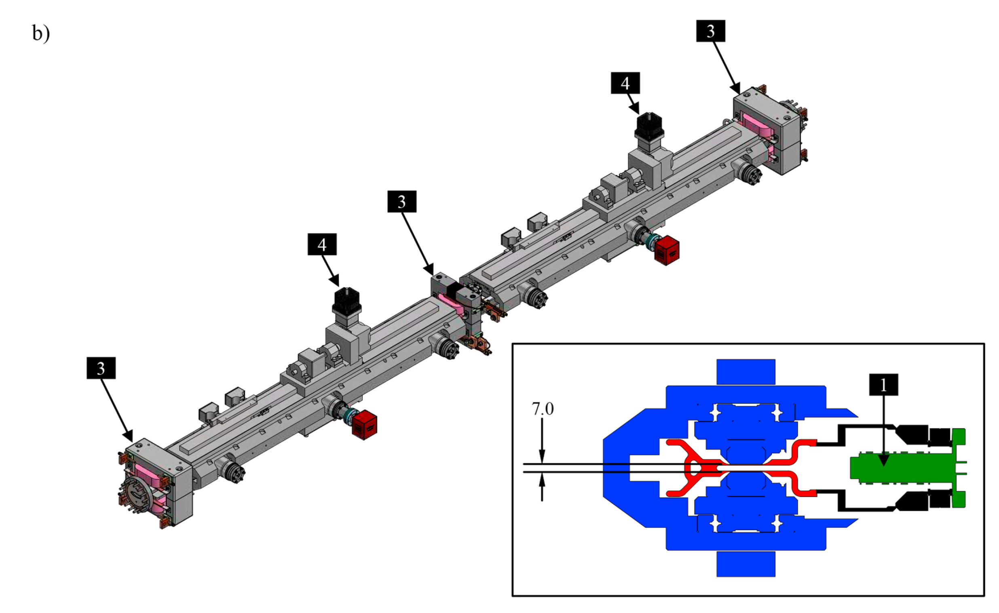
ID Chamber– Aggressive Design
Accommodate small gap magnets (Compact Undulator) – 7mm
Provide required beam aperture – 5mm
0.6mm wall thickness each side
Thin-wall design validated to be mechanical sound

Slide 6
Pumping System Requirements & Setup per Cell
Achieve 1 nTorr dynamic pressure
Quick beam conditioning (weeks) with any vacuum intervention
11 Modular Pumps (+ 3 ion pumps)+ 2 NEG Strips for distributed pumping
500 l s−1 NEG-ion pump, (x1)
100 l s−1 NEG-ion pumps (x4)
200 l s−1 NEG pumps (x6)
Noble-diode Ion pumps (x3)
NEG Strips – 3.5m length (30mm wide) (x2)
Notes:
[with stored beam, as oppose to base pressure (no beam)]

Slide 7
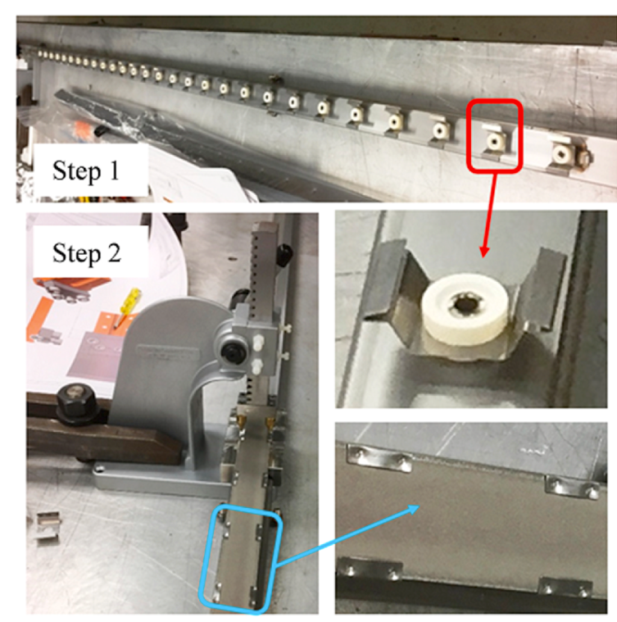
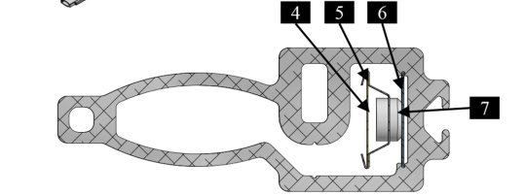
NEG Strip Construction
Step 1: stainless steel clips riveted onto the carrier strip with ceramic spacers.
Step 2: NEG strip mounted and secured by crimping press.
Notes:
Allows resistive activation with heating. Argonne National Laboratory

Slide 8
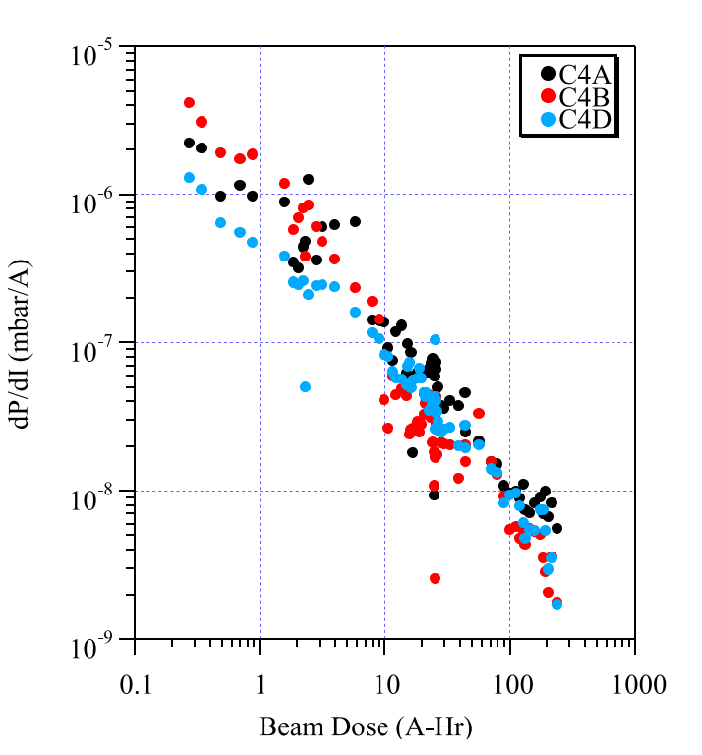
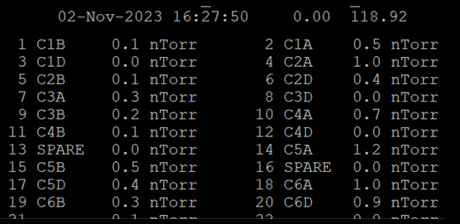
Performance: Going Great! For 3 Years!

Slide 9
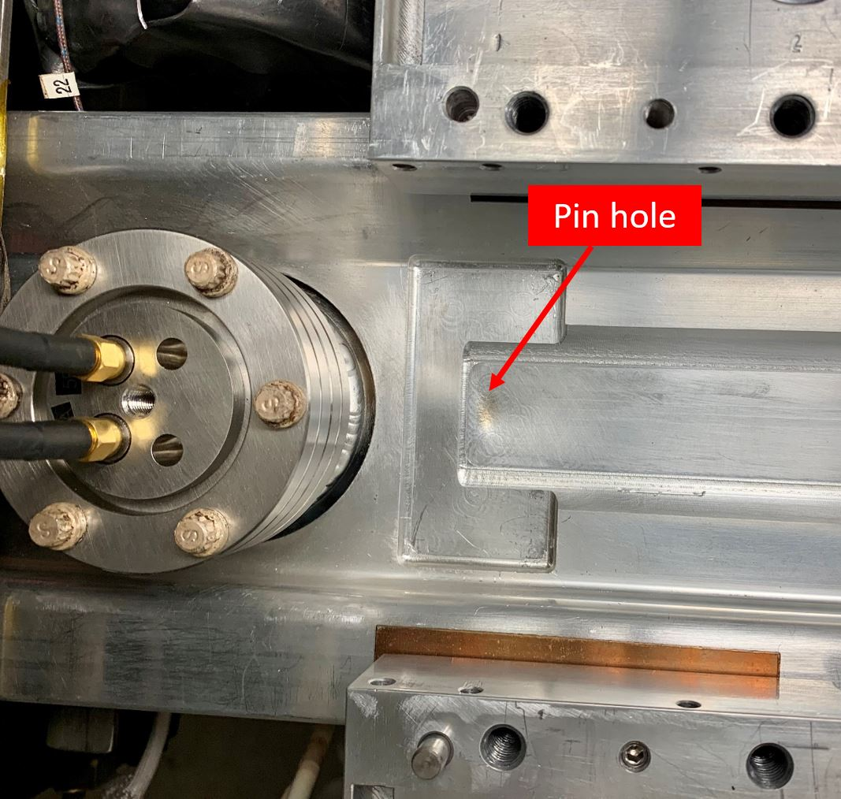
Tragic Beam Steering Failure – March2022
Missteering event resulted in high power impact (synchrotron radiation) on the thin wall ID chamber
Gross leak apparent with Pirani gauges reading over 24Torr within minutes! Hard to locate a leak this large, but easy to see!
Machine protection system successfully isolated the sector (2 cells)
Further investigation revealed two additional locations with signs of damage

Slide 10
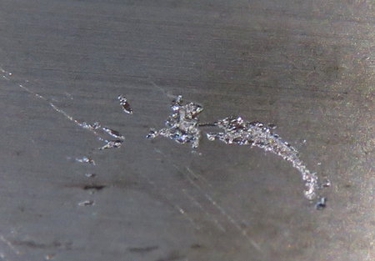
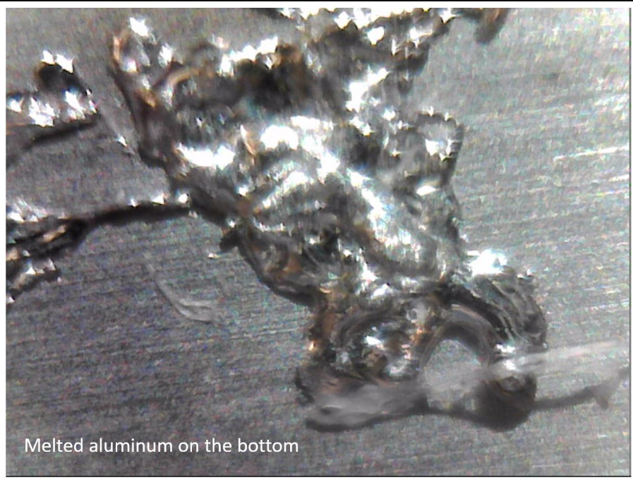
Notes:
3 chambers replaced in total after this incident

Slide 11
How Did This Happen?!
Thin wall deflection from ambient pressure (0.25mm top + bottom) caused additional loss in clearance
Orbitry controlled and monitored at the Undulator, but not upstream. Ongoing orbitry correction for CHESS-U can progressively missteer the beam (vertically)
Upstream dipole-quad was able to be mis-steered enough to cause synchrotron radiation through the undulator thin wall. This was not understood.

Slide 12
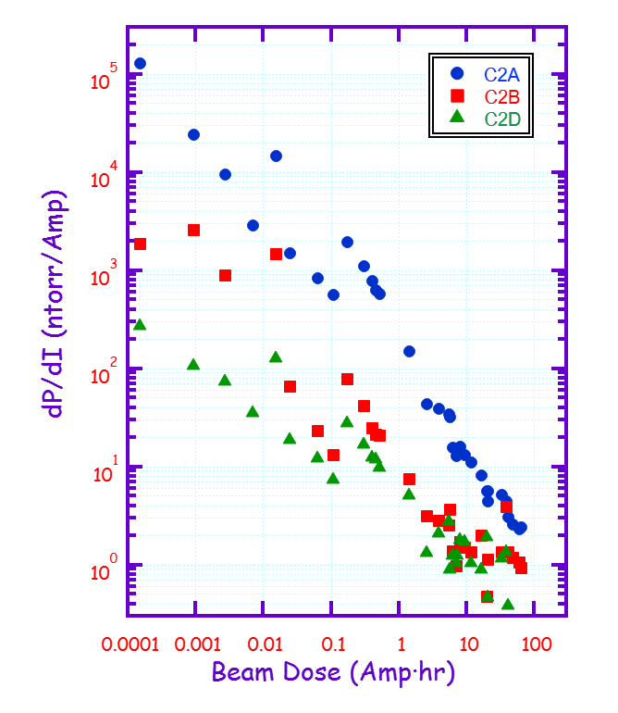
Recovery Timeline
New chamber fabricated and baked
Deconstruction of Insertion Device
Venting + removal of damaged chamber
Installed, pumped down
NEG Pump + Strip Activated
Survey, cooling and power
Resumed CHESS User operations within a week
NEGs were re-activated in following weeks as a precaution, but data shows this to be redundant

Slide 13
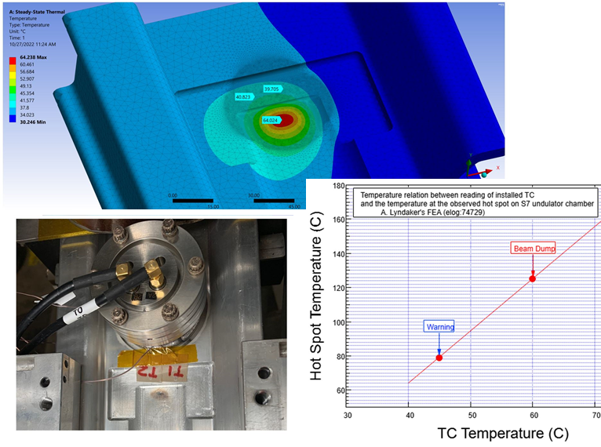
Corrective Actions
Additional thermal monitoring added
FEA to deduce thermal relation to the monitored area vs. thin wall
Machine protection automatically dumps the beam if “WARNING” limit surpassed
6061-T6 aluminum should have sufficient strength up to 150C for long exposure period (>100 hours). Thus we should be able to detect any unintended heating with thermocouples (TCs).
New BPM orbitry interlock system currently being implemented. This will add significant position interlocking
Steering magnet commands (v_iron)

Slide 14
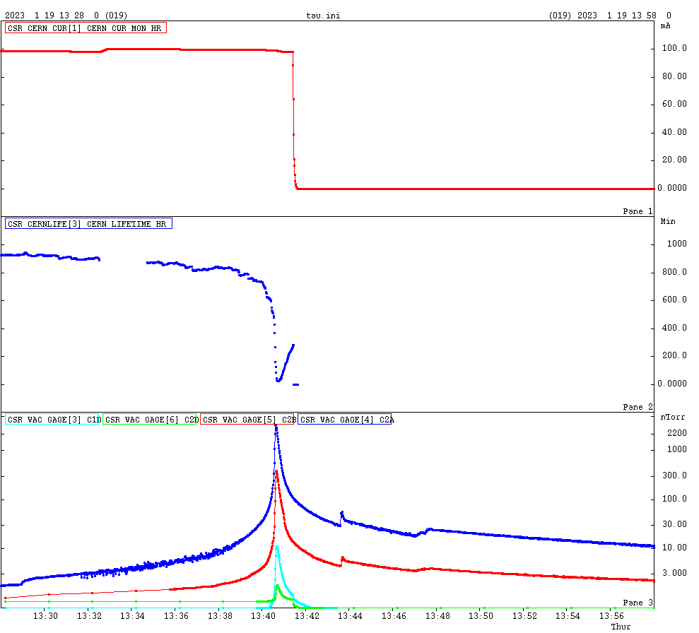
Argon Instability
Notes:
Argon burst that induced beam lifetime dip, and then beam loss due to radiation trip.

Slide 15
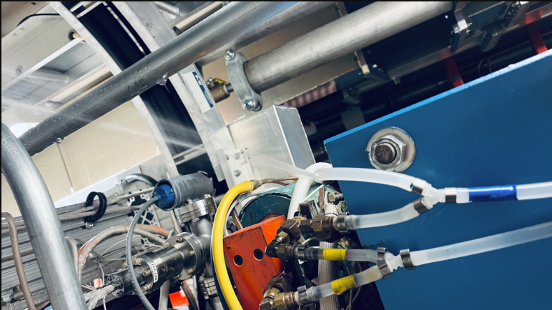
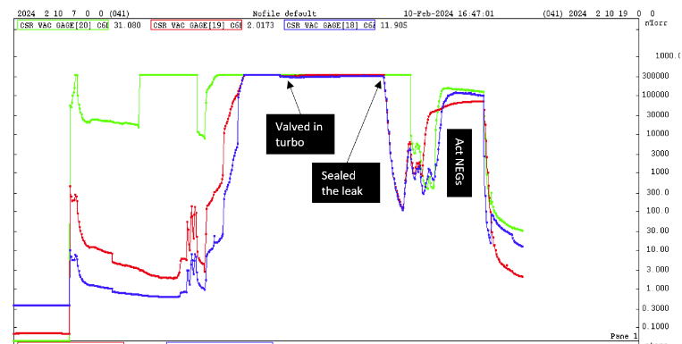
Next: Tragic Infrastructure Failure (Feb2024)
A water leak caused flooding around all Undulator Equipment including chambers, magnets, and cabling. (3AM)
Discovered by quad bus PS tripping on ground fault. Hose/fuse replaced, tried to run the SW bus back up manually. (6AM)
Vacuum suffered immensely and continued deteriorating. Vacuum pressure 10⁻² torr, and the leak rate was to be on the order of 10⁻³ torr-l/sec. (8AM-11AM)
Alarms were silenced after Lake Source Cooling Project. Water leak ~1000 gallons over ~2 days.
Directly upstream from our (incredibly old) SRF cavities

Slide 16
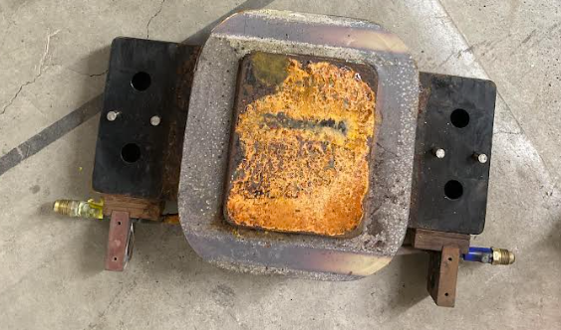
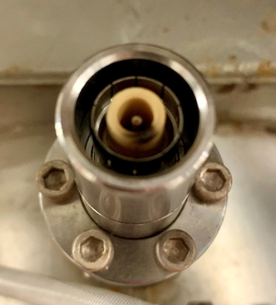
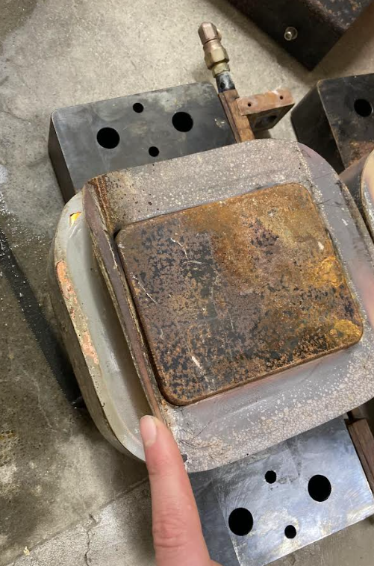
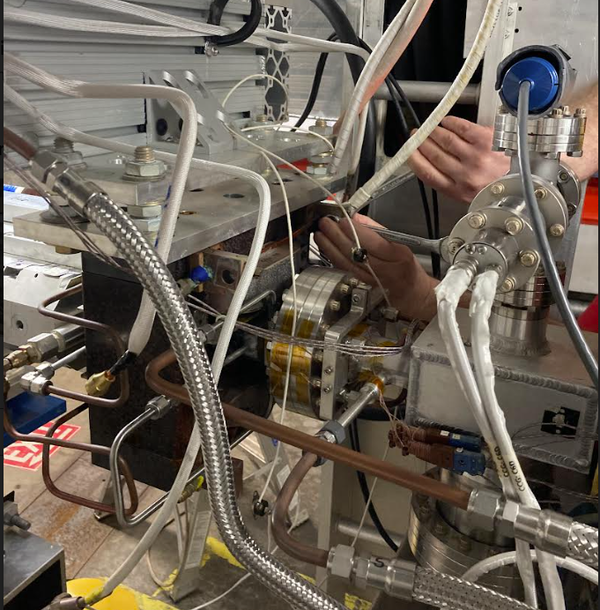
Damage: As-expected
HV Feedthrough for ion pump
Canting Magnet coils and iron
Coil shorted
Magnet corroded
Chamber – Deionized water on Aluminum
Leak on thin-wall
Undulator Magnet array also corroded

Slide 17
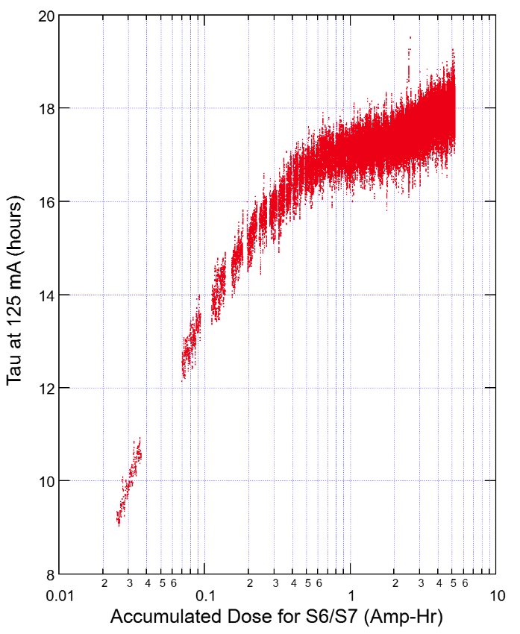
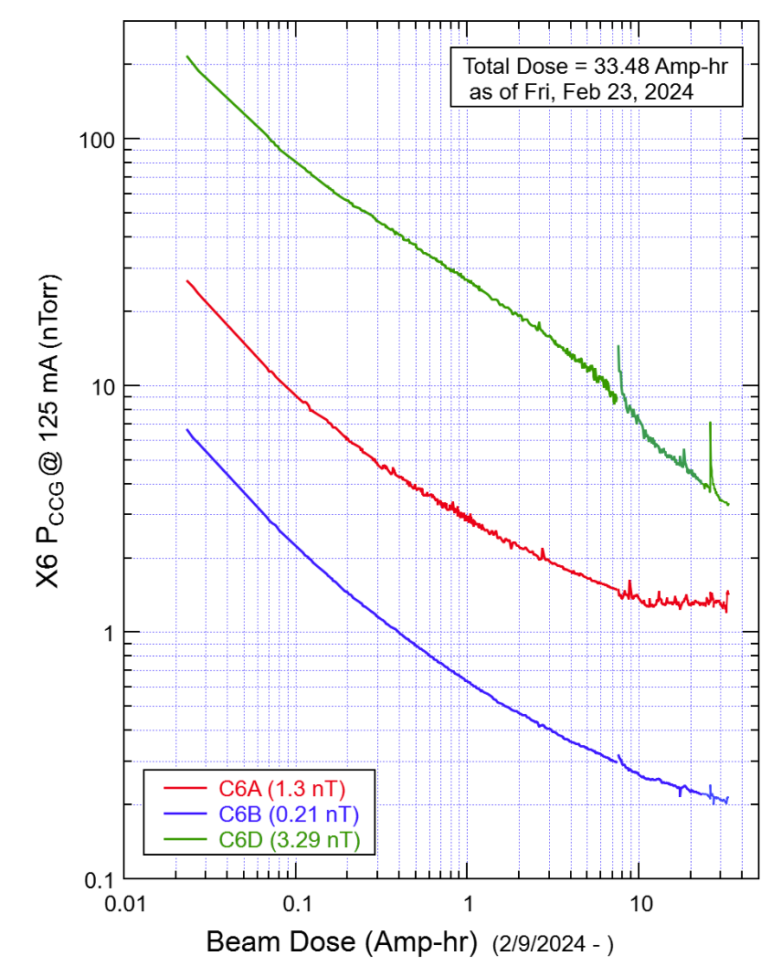
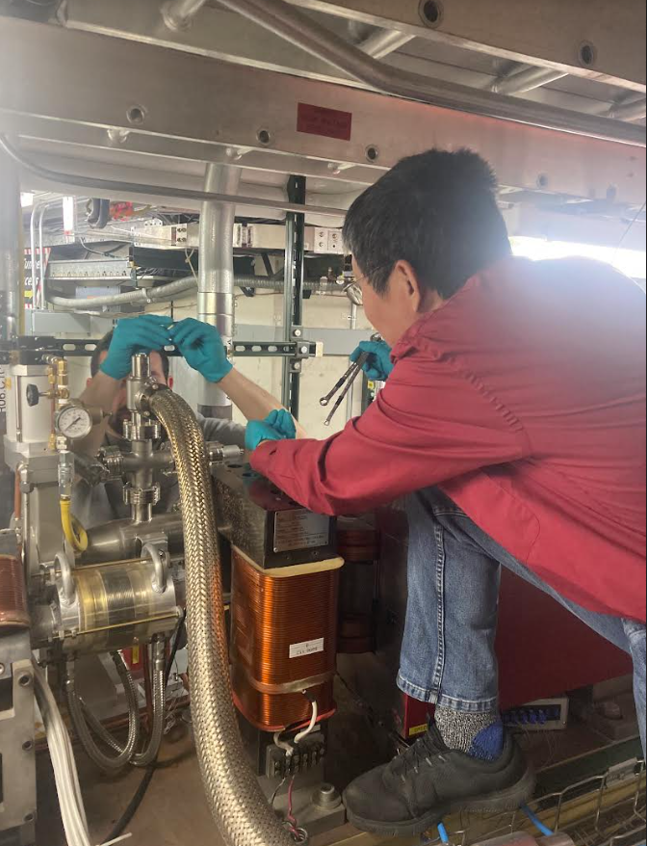
Recovery
Magnet assembly replaced
Insertion Device magnet array removed
Leak sealed with Vac-Seal, and all NEGs in the sector were conditioned and activated. (16 hr life after 8 hrs) despite loss ion pump
Alarms enabled!
Same-day Operations

Slide 18
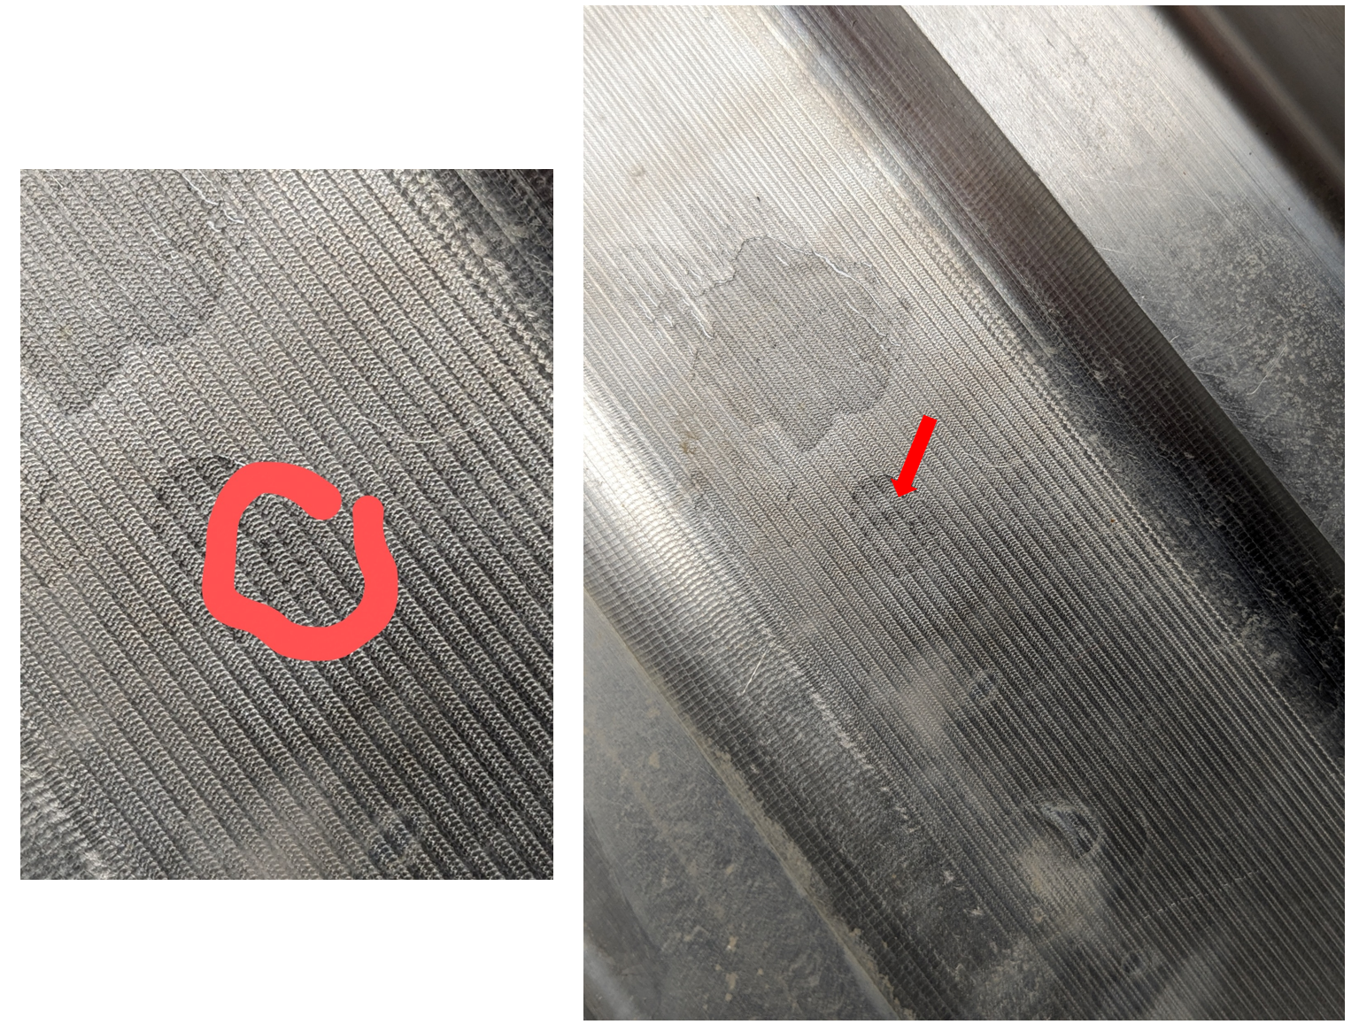
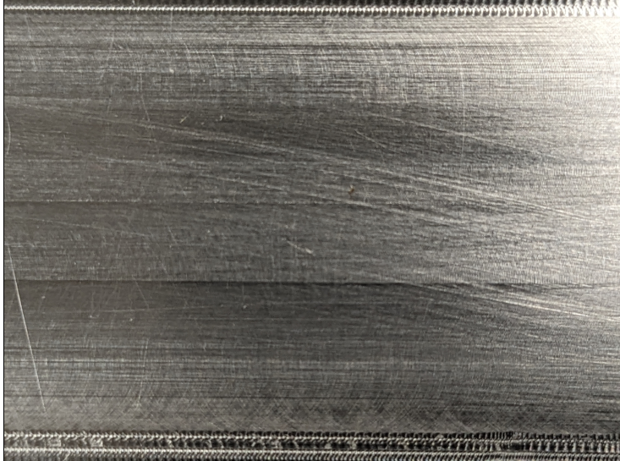
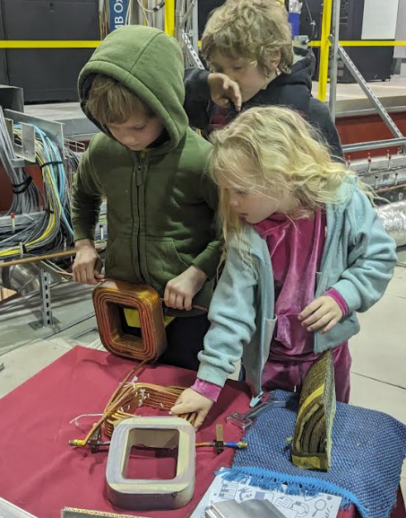
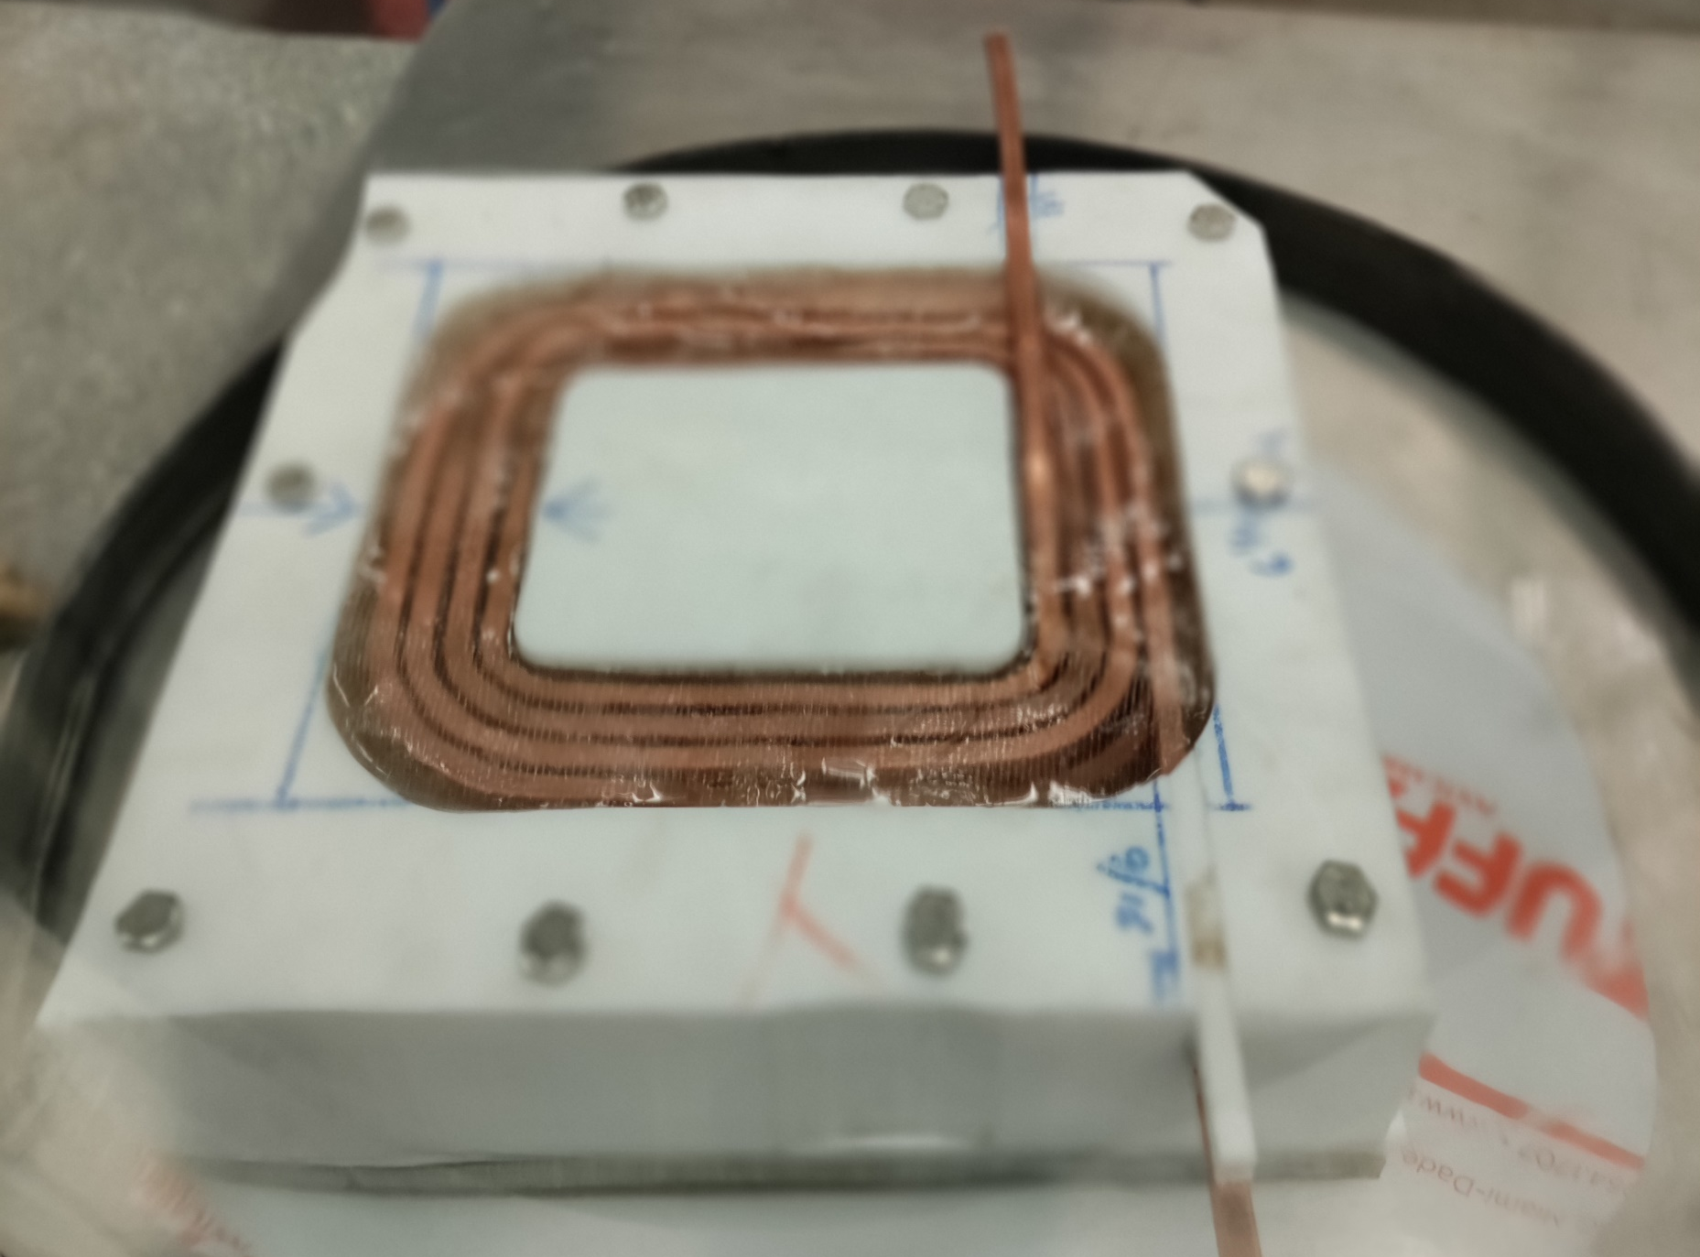
Corrective Actions
More instrumentation (water sensors)
Protective Covers
Improved Canting Magnet Design
Epoxy encapsulated
Independent alarm system for cooling system (not server/internet reliant)
Updated Start-up Procedures
Improved Machining Finish – (very rough surface finish, with many pitted area)

Slide 19
Conclusion
NEG distributed pumping has proved to be effective even under catastrophic vacuum failure
Quick recovery to Research Operations is possible
Aggressive chamber designs should be “over-protected” (with safety margin of 0.6-mm!)

Slide 20
Thanks for your attention!

