Slide 1
Vacuum System of RAON
Installation & operating experience
Hyungjoo Son
2024. 04. 17
Institute for Rare Isotope Science
1
OLAV VI / April 2024 / Fermi National Accelerator Laboratory
Notes:
Hello Everyone
I’m Hyungjoo Son from Institute for Rate Isotope Science Laboratory of Korea
At the previous OLAV-5 Workshop. I presented on the ‘Design of RAON vacuum system’
RAON is the name of the heavy ion accelerator constructed in Daejeon South Korea. We have installed and operated the RAON vacuum system based on that design.
I’d like to talk about current status of RAON vacuum system

Slide 2
Outlines
Introduction of IRIS
Configuration of RAON
RAON Vacuum System
Status and Plan
2
OLAV VI / April 2024 / Fermi National Accelerator Laboratory
Notes:
This is outlines of the presentation. Firstly, I’d like to talk about IRIS simply.
And I will present about configuration of RAON and the RAON Vacuum System.
Lastly. I will conclude my presentation with current status and plan

Slide 3

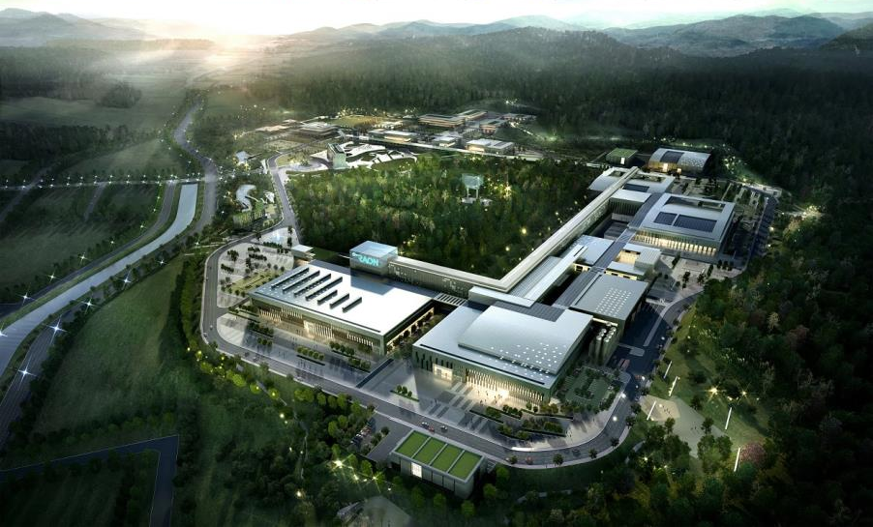
Introduction
Institute for Rare Isotope Science is a new name of Rare Isotope Science Project (2012-2022).
RISP complete the 1st step project for low energy experiments of RAON.
- IRIS was launched as a heavy ion accelerator research institute in Aug 2022 at Daejeon.
IRIS
PAL
3
OLAV VI / April 2024 / Fermi National Accelerator Laboratory
Notes:
RIS is a new name of Rare Isotope Science Project.
RISP complete the first step project for low energy experiments of RAON
IRIS was launched a heavy ion accelerator research institute in Aug 2022 at Daejeo.

Slide 4
Configuration of RAON
SCL (200 MeV/u, 8.3 pμA for U⁺⁷⁹)
(600MeV, 660 μA for p)
Driver LINAC
SCL2(Super Conducting LINAC 2)
ISOL
Target
IF Target
MEBT
RFQ
CB
HRMS
SCL3(Super Conducting LINAC 3)
μSR,
Bio-medical
Post Accelerator
RF Cooler
Cyclotron
(p, 70 MeV, 1mA)
ECR-IS
High-precision
Mass Measurement
IF Separator
ISOL system
IF system
Low Energy Experiments
Nuclear Astrophysics
1st step project
High Energy Experiments
Nuclear Structure/
Symmetry Energy
CB : Charge Breeder
HRMS : High Resolution Mass Separator
4
OLAV VI / April 2024 / Fermi National Accelerator Laboratory
Notes:
Our original plan was construct the entire heavy ion accelerator facility during the project period. But some reason like budget and manpower and technical capabilities, project has been delayed twice.
We have ultimately finalized the first step goal to transfer the beam to the low-energy experimental facility. And the high energy accelerator and high experimental facility construction has become second step goal has bee.
The construction of the low energy section has been completed at 2022.

Slide 5
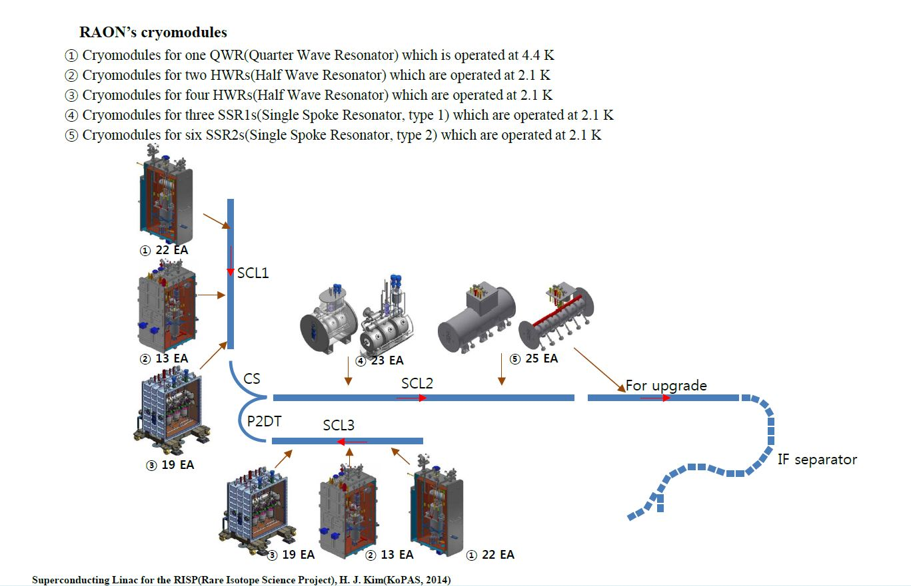
Super Conducting LINAC
Not yet finalized
In R&D to 2027
5
OLAV VI / April 2024 / Fermi National Accelerator Laboratory
Notes:
Next, I will talk about the SCL3 of RAON. SCL3 consist of 54 cryo-modules and 53 warm section vacuum chambers. End of the SCL3, the beam energy is reached 18.5MeV / nucleus.
At the first beam commissioning, the beam energy was reached 16.5MeV / nucleus.
The type of SCL2 cavity has not yet been finalized. We are considering 2 types cavity for SCL2 section. There are SSR and HWR types.

Slide 6
RAON Vacuum System
SCL3 vacuum system
Warm section vacuum pump
NEG 400 L/s (Z400, SAES) + SIP 5L/s , NEXTORR 300-5
Using portable cart to pump down to 10⁻⁷ mbar
(Slow pump down to 10⁻¹ mbar with MFC)
CCG
CCG
CCG
CCG
Insulation vacuum system of Cryo module
TMP (250L/s, OSAKA), DRY pump (500L/min, OSAKA)
Redundancy & String structure for cost and maintenance
CCG
CCG
CCG
CCG
CCG
PG
V
P
V
e
V
f
c
MFC
250L/S
250L/S
V
a
micro
filter
TMP
G
He Leak
A
Detector
V
b
S
V
d
500L/min
500L/min
Dry
Portable
Pumping System
6
OLAV VI / April 2024 / Fermi National Accelerator Laboratory
Notes:
This picture is the configuration of SCL3 vacuum system. Main pump of warm section chamber is the NEG. And small Ion pump installed auxiliary pump.
The Cavity and warm section vacuum chamber are pumped to 10-1 mbar by slow pumping separately using portable pumping system.
The cryo-module’s insulation vacuum consist of string line for cost and maintenance and redundancy.
The insulation vacuum is pumped down to the 10-4 mbar before the cooldown. The insulation vacuum is maintained at 10-8mbar after the cooldown.
During 1 year operation, many dry pumps were malfunctioned. There are no pictures in this presentation. We confirmed that the dry pump mulfunctioned by water.
So, now we are considering replacing them with a water resistant pump.

Slide 7
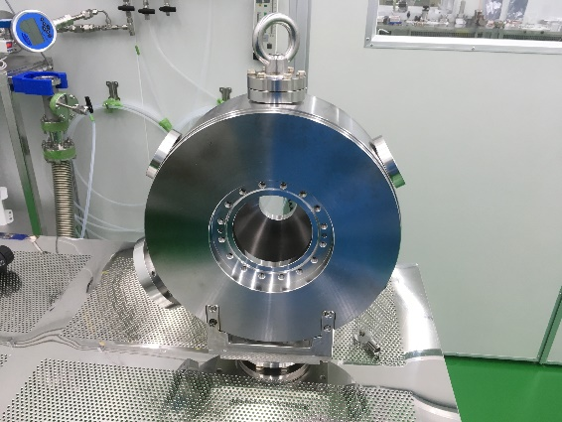
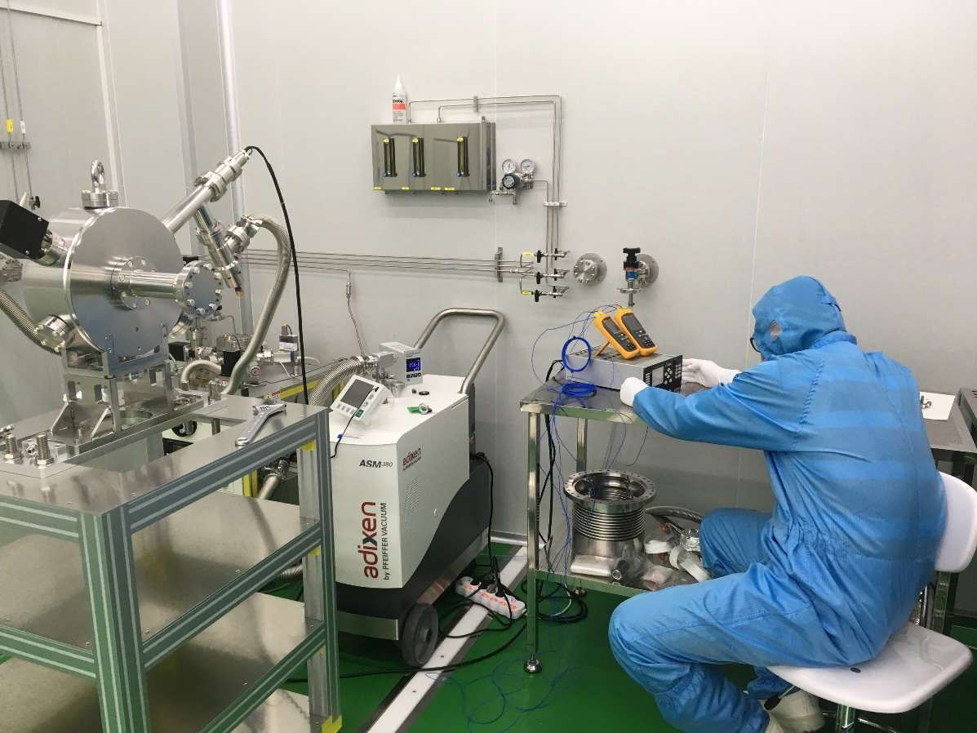
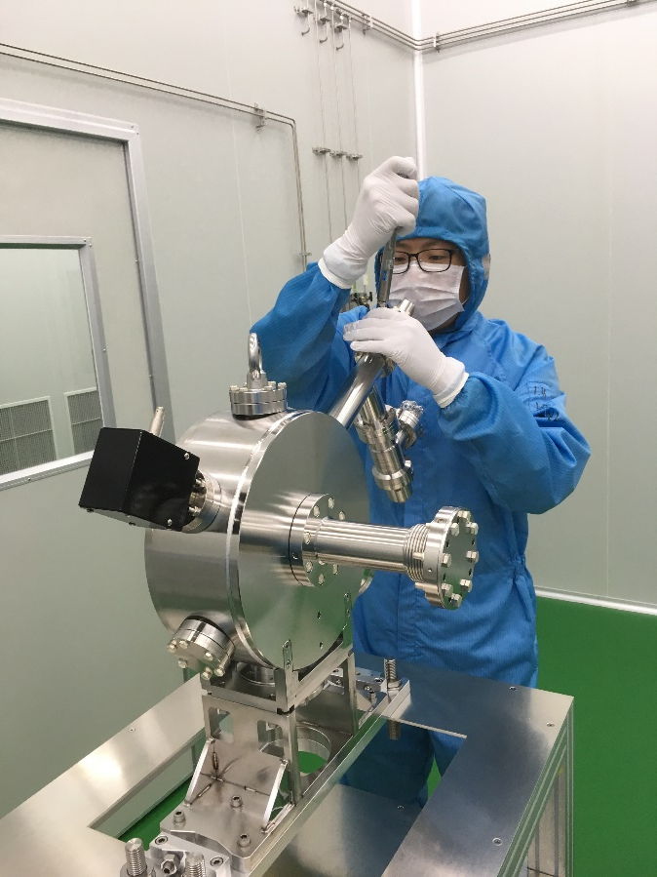
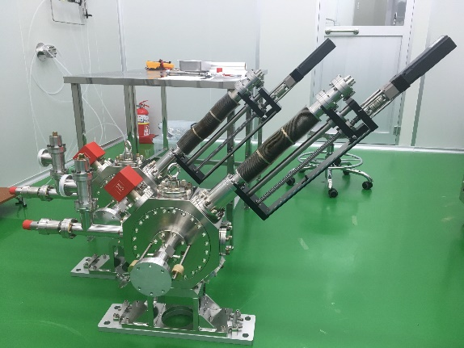
RAON Vacuum System
SCL3 vacuum system (Cleaning / Assembly / conditioning / Installation)
JUN 2019
Warm section chambers are composed of vacuum chamber(38ea) and Beam Diagnostic Chamber(15ea)
Assembly and Conditioning of chambers performed in Clean Room (class 10)
7
OLAV VI / April 2024 / Fermi National Accelerator Laboratory
Notes:
Next I will talk about the clean assembly procedure and conditioning of the vacuum chamber.
The warm section vacuum chambers are composed of two types. 38 Vacuum chambers and 15 beam diagnostic chambers.y
All vacuum chambers assemblies and conditioning were performed in a class 10 cleanroom.

Slide 8
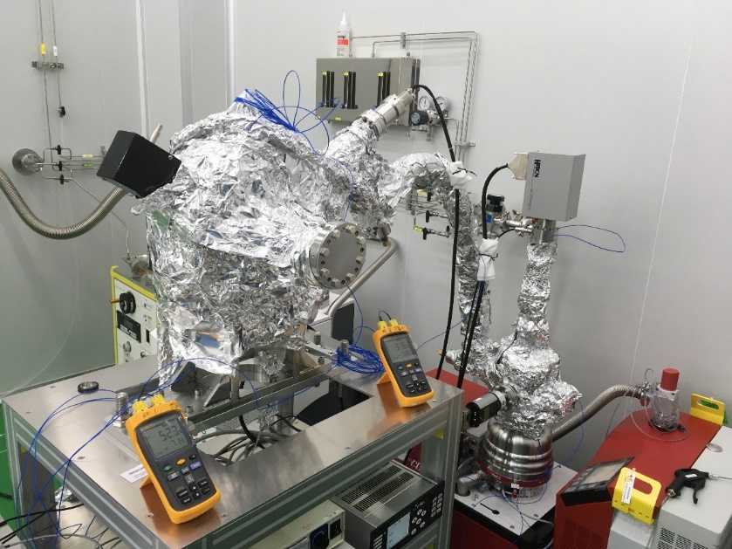
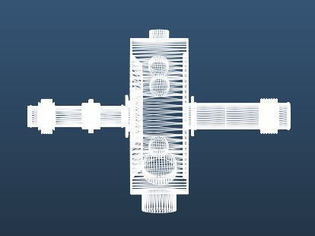
RAON Vacuum System
SCL3 vacuum system (Cleaning / Assembly / conditioning / Installation)
JUN 2019
- To verify the vacuum performance of the chamber, a vacuum exhaust test performed without a NEG.
- No additional cleaning after manufacturing (Just cleaning by manufacturer)
- Chamber A, B, Bellows, SIP are baked-out with 150°C, 2 weeks
cold cathode gauge
Effective pumping speed
SIP 5L/s
G1
A
AV 1
After bake-out Pressure of A : 3.3E-7 mbar
q = 3.3 x 10⁻¹⁰ mbar l s⁻¹ cm⁻²
Chamber Volume : 8 liter
KF40
Bellows
AV 2
Full range gauge
G2
B
RGA
pumping system
Cross-section excluding BPM : about 4,000 cm²
8
OLAV VI / April 2024 / Fermi National Accelerator Laboratory
Notes:
And the vacuum test was performed without NEG pump to verify the vacuum performance of the chamber. The vacuum chamber was delivered from the manufacturer with cleaning processes already completed.
So, The vacuum test was proceeded without additional cleaning procedures. I briefly calculate the outgassing rates of the chamber. After 2 weeks bake-out. The outgassing rates measured too high,
Since I thought the chamber’s condition was abnormal and my test method was not collect. So, I asked for assistance to the Pohang accelerator laboratory vacuum group to more accurately measure the chamber’s condition.

Slide 9
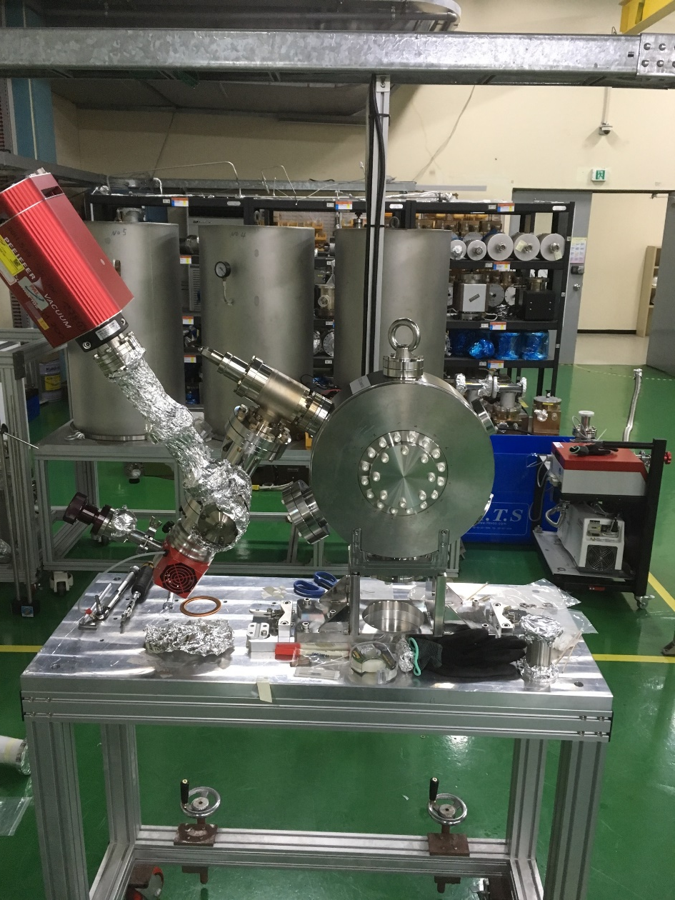
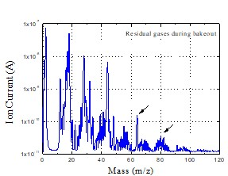
RAON Vacuum System
SCL3 vacuum system (Cleaning / Assembly / conditioning / Installation)
chamber
Orifice
- Performing RGA measurements during bake-out
SEP 2019
PAL
- To remove contaminants and reduce H2 outgassing
RGA
Cleaning & Vacuum Firing at 600°C for 36 h
TMP
contamination peak
9
OLAV VI / April 2024 / Fermi National Accelerator Laboratory
Notes:
The vacuum chamber was installed with an orifice and RGA to conduct measurements for precise experiments. In this experiment, We were able to observe contamination peaks and hydrogen level.
To remove contaminants and reduce the release of hydrogen, We decided to perform cleaning and vacuum firing.

Slide 10
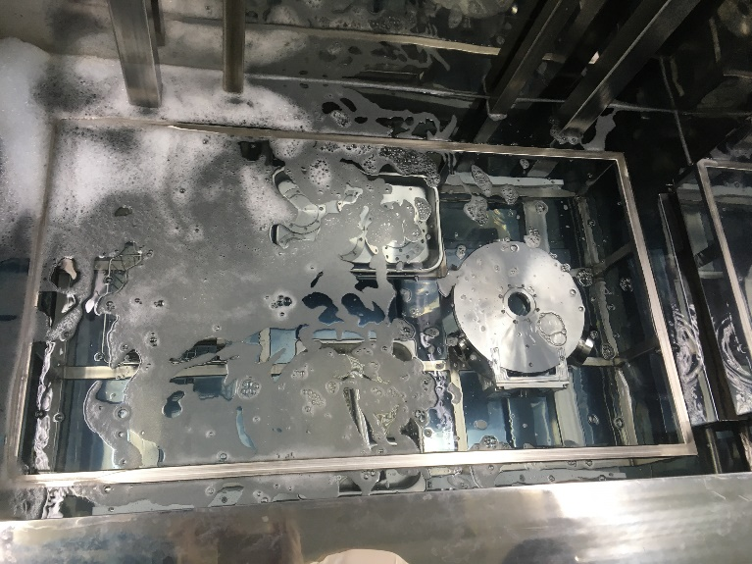
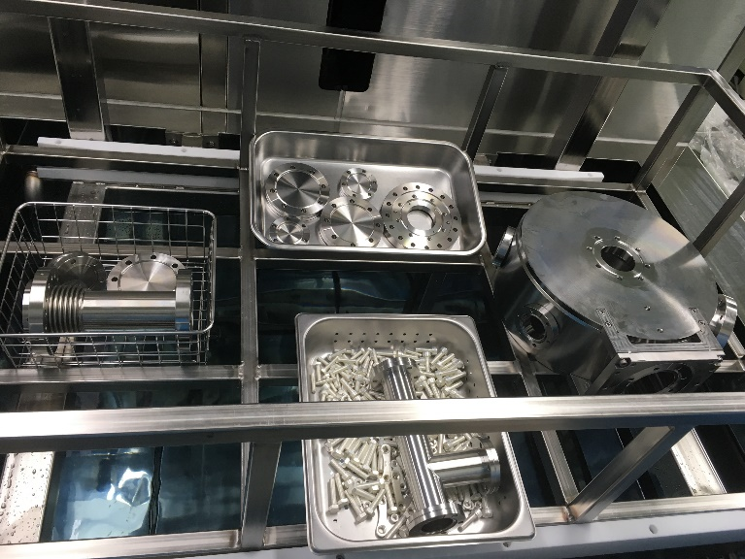
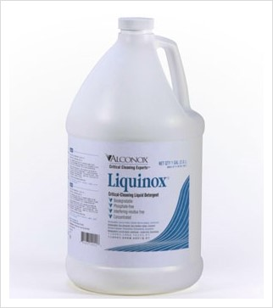
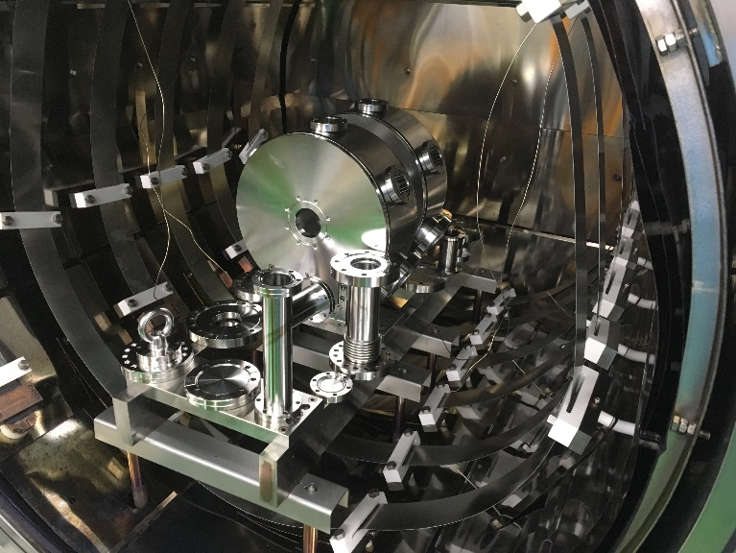
RAON Vacuum System
SCL3 vacuum system (Cleaning / Assembly / conditioning / Installation)
Ultra Sonic Cleaning
- Cleaning performed for 1 hour with Liquinox 1% solution
- Rinsing performed for 1 hour with DI water
Vacuum firing (600°C for 36 h)
- 4 TCs were in contact with the chamber components.
- Base pressure of VF chamber was ~10⁻⁸ mbar at RT.
- Firing performed 36hours at 600°C
10
OLAV VI / April 2024 / Fermi National Accelerator Laboratory
Notes:
The vacuum chamber cleaning was performed for 1 hour with 1% Liquinox solution. And rinsing was performed 1 hour with DI water.
Vacuum firing was performed for 36 hours at 600 degree C considering chamber thickness.

Slide 11
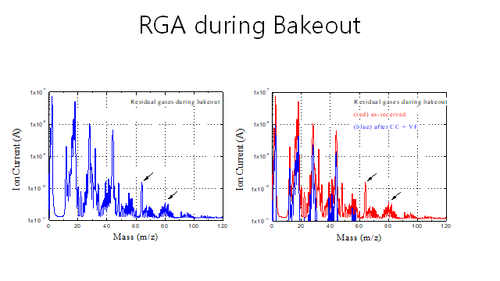
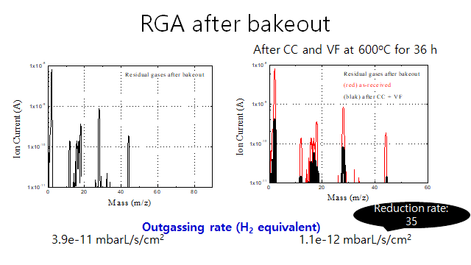
RAON Vacuum System
SCL3 vacuum system (Cleaning / Assembly / conditioning / Installation)
09 SEP , 2019
Vacuum chamber Assembly & conditioning process
1. Chamber entry
2. Vacuum firing
3. Cleaning & Rinsing
4. Chamber Dry(48h, class 10)
5. Chamber assembly (class 10)
6. Slow pumping to 1mbar with MFC
7. Pumping to ~10⁻⁷ mbar
8. NEG degassing & chamber bake-out
9. N₂ slow venting up to 1.2 bar
11
OLAV VI / April 2024 / Fermi National Accelerator Laboratory
Notes:
After that procedure, We confirmed that the contaminants were removed and the outgassing rates of hydrogen were reduced. Based on these results, we established assembly and conditioning procedures for the vacuum chamber.
After the conditioning, the vacuum chambers are moved to tunnel with 1.2bar nitrogen charging.

Slide 12
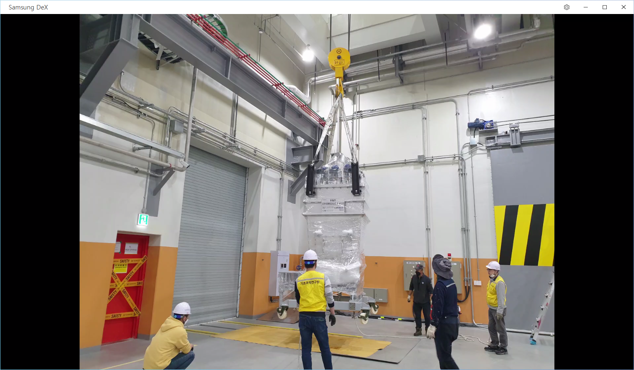
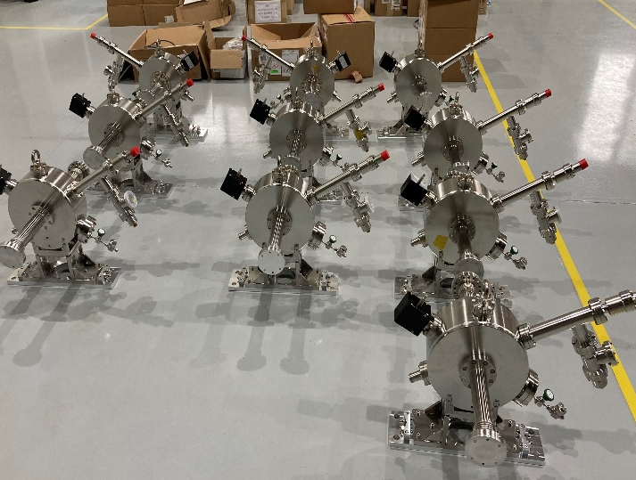
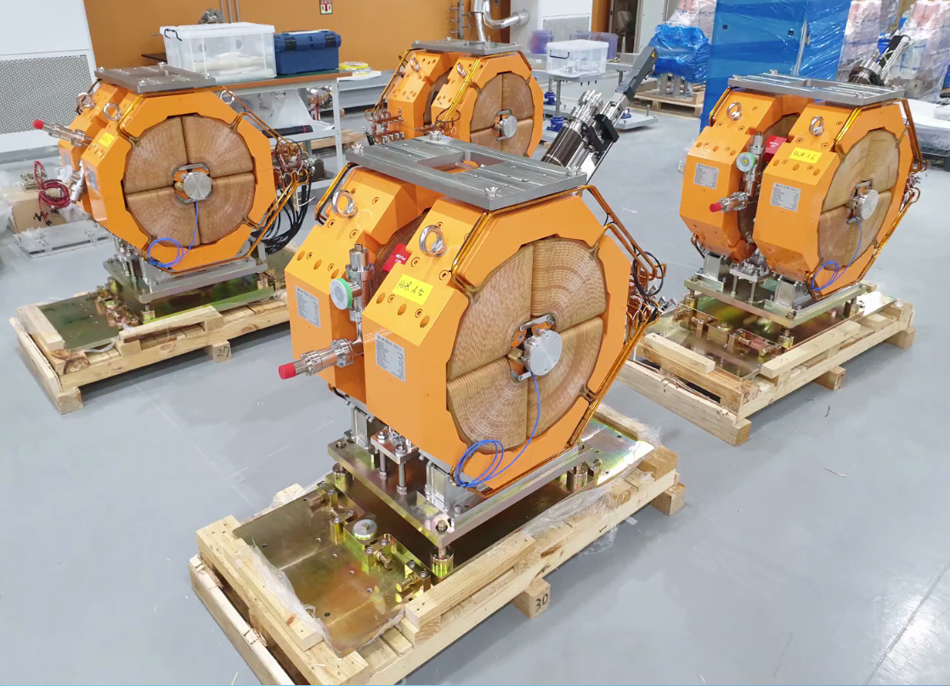
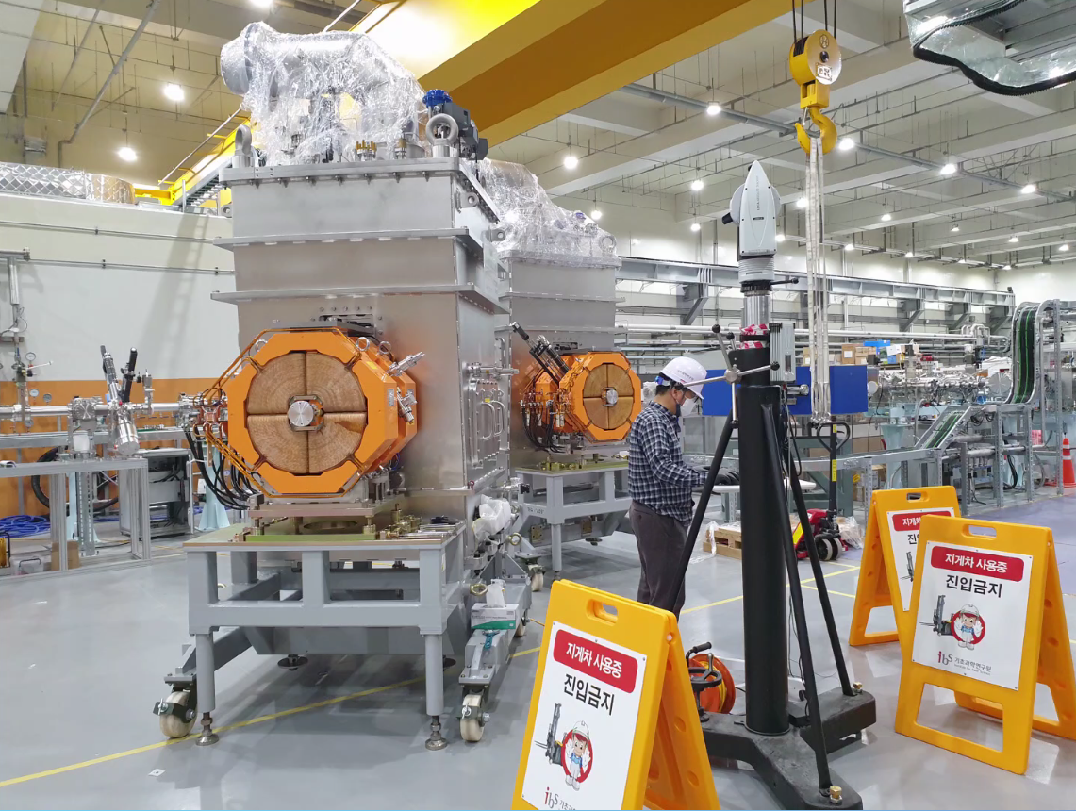
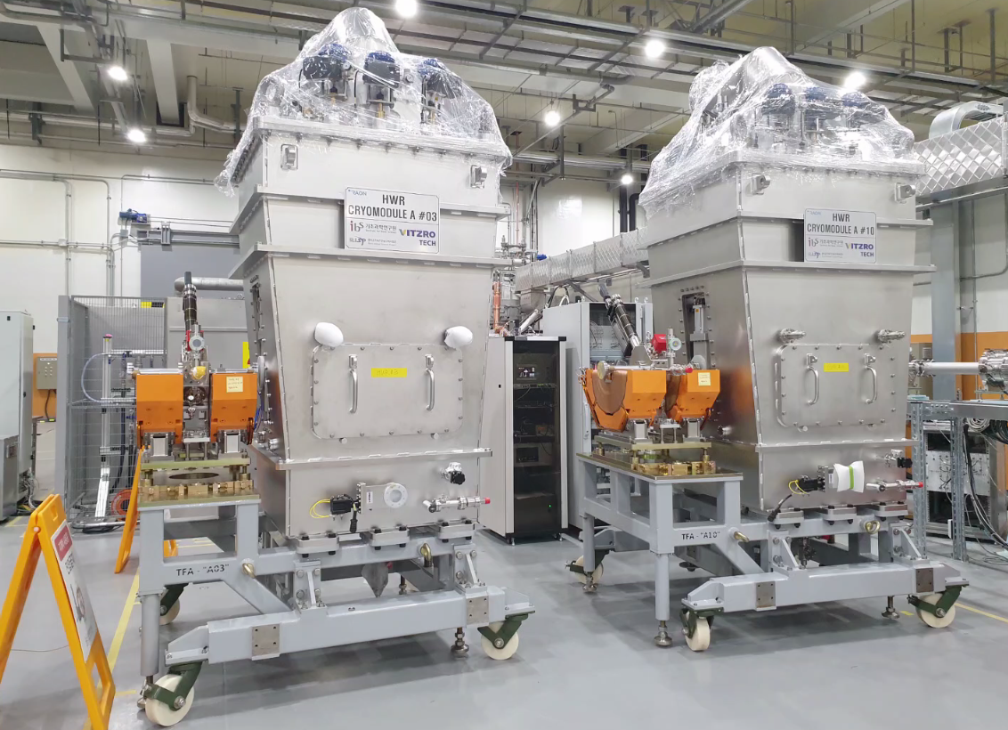
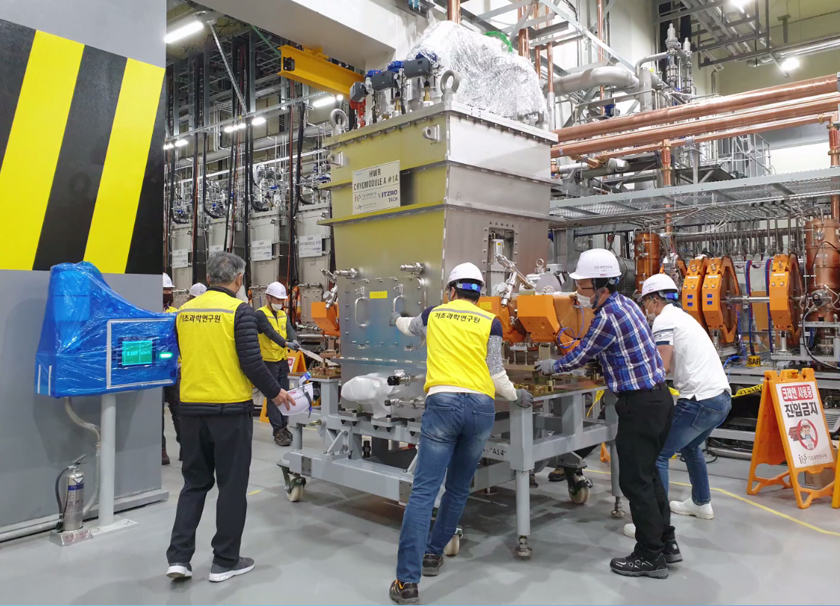
RAON Vacuum System
SCL3 vacuum system (Cleaning / Assembly / conditioning / Installation)
CM carried in ISOL building
Warm section chamber carried in tunnel
Magnet + vacuum(beam diagnostic) chamber assembly/alignment
Alignment between warm sections and Cryo module
upper magnet separation
Moving CM into the SCL3 tunnel
12
OLAV VI / April 2024 / Fermi National Accelerator Laboratory
Notes:
These pictures shows the process of the transporting the cryo-modules with warm secion. The vacuum chambers are installed onto the cryo-module after assembling with the quadrupole magnet.
After the chamber installing process, Cryo-module is moved to SCL3 tunnel.

Slide 13
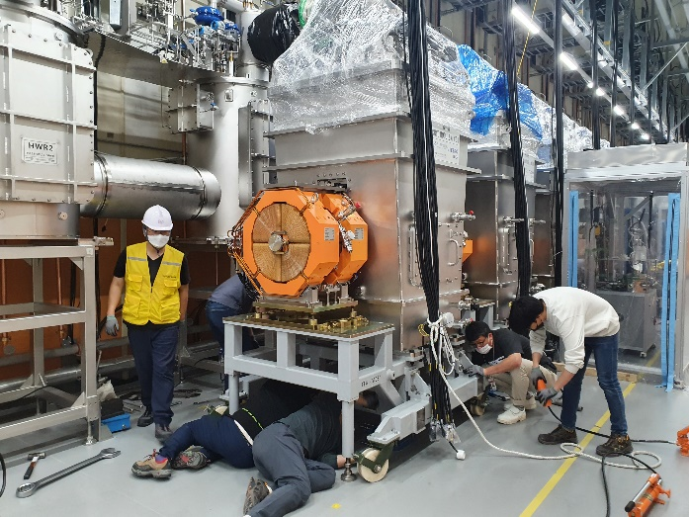
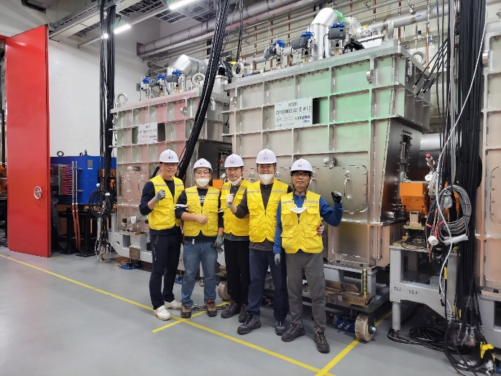
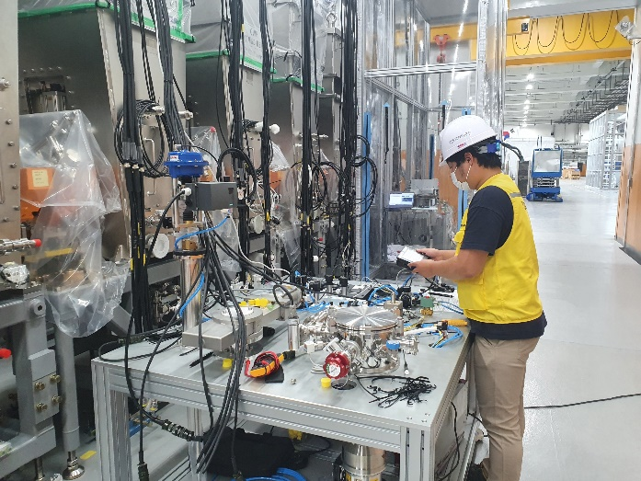
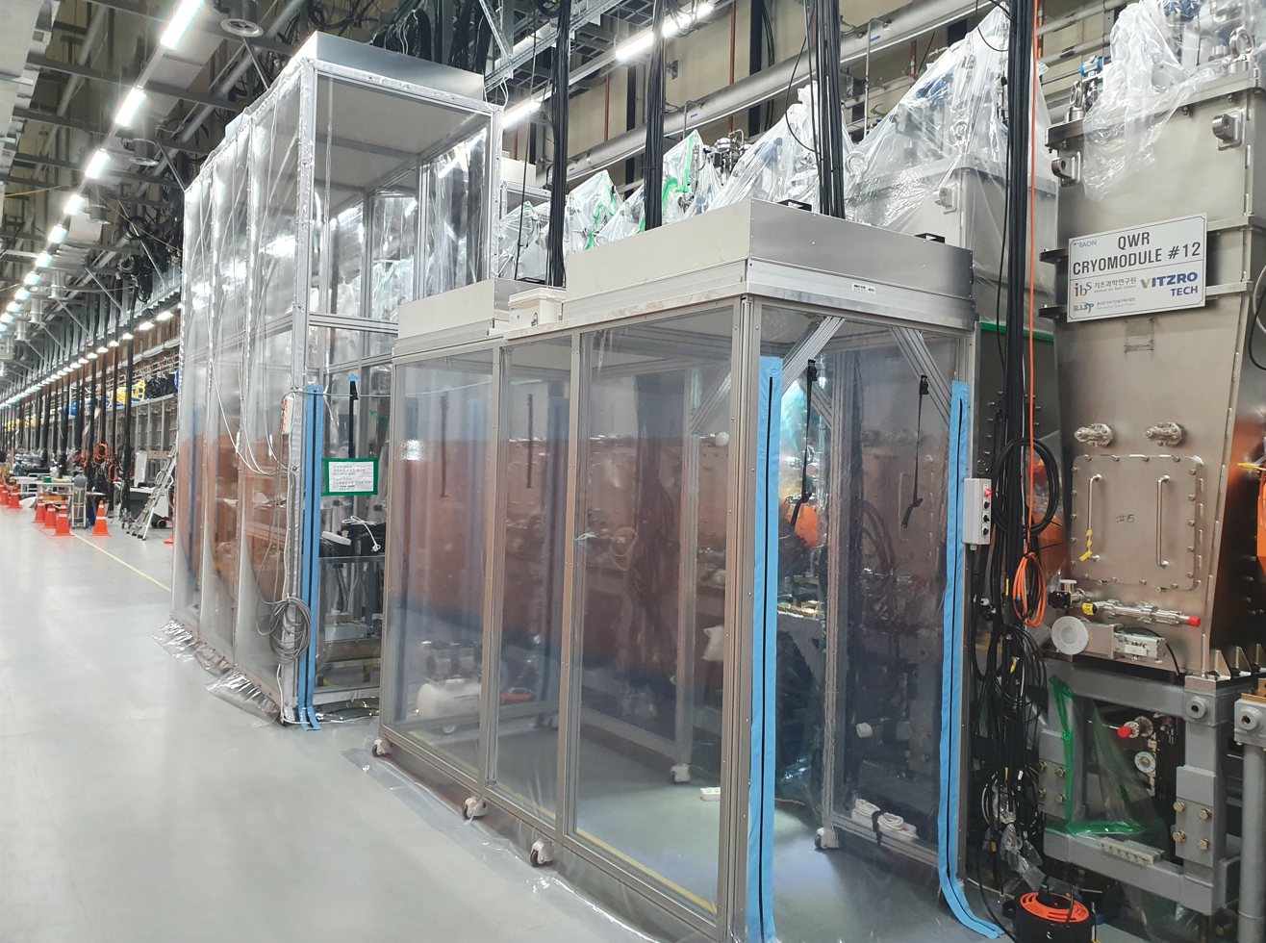
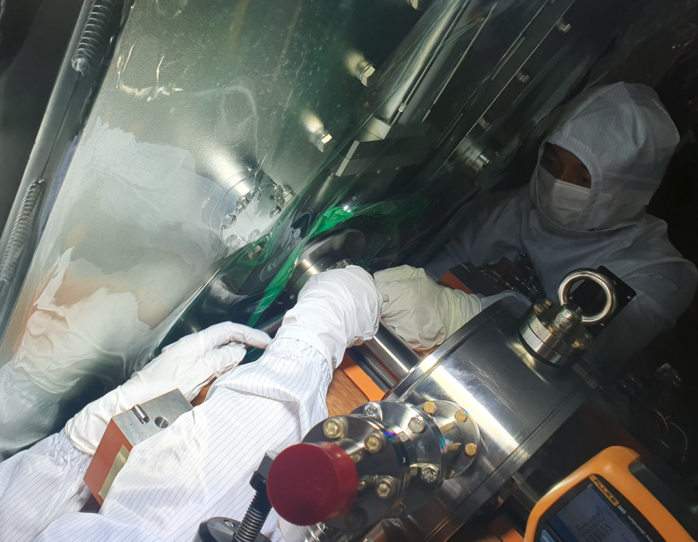
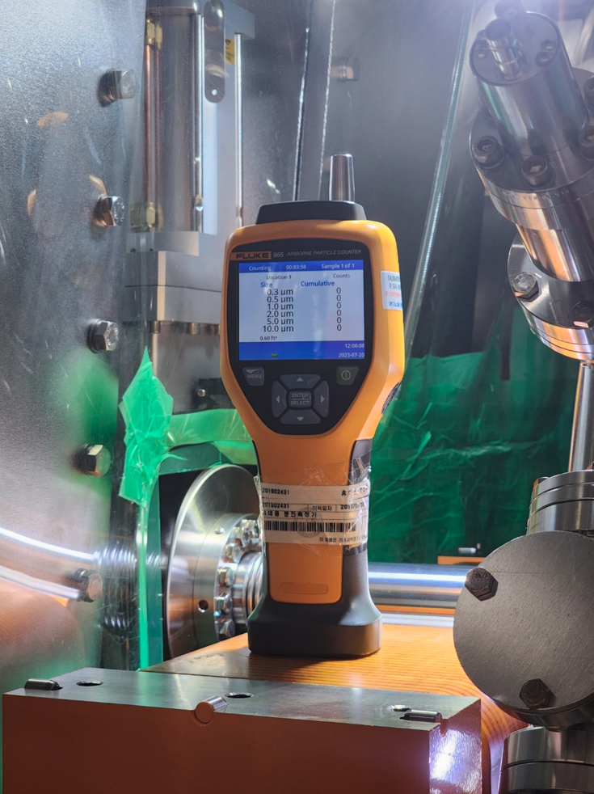
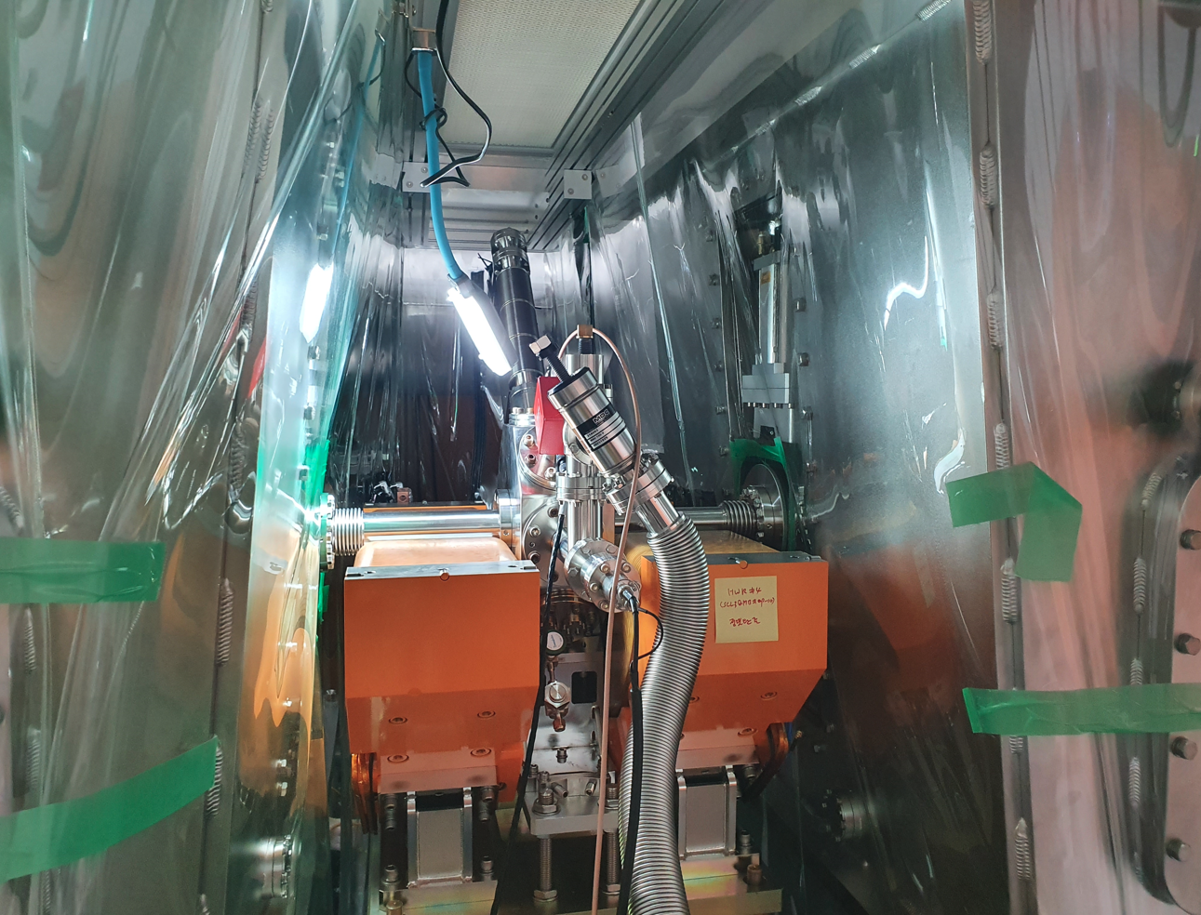
RAON Vacuum System
SCL3 vacuum system (Cleaning / Assembly / conditioning / Installation)
Dec 07, 2022
CM is seated on the foot base
Installation of CMs were completed on Dec 07, 2022
Signal & Power cable inspection
Portable clean booth
Clean assembly
Slow pumping Line connecting
13
OLAV VI / April 2024 / Fermi National Accelerator Laboratory

Slide 14
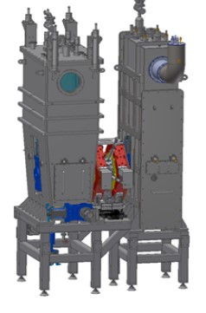
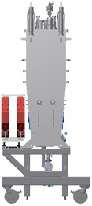
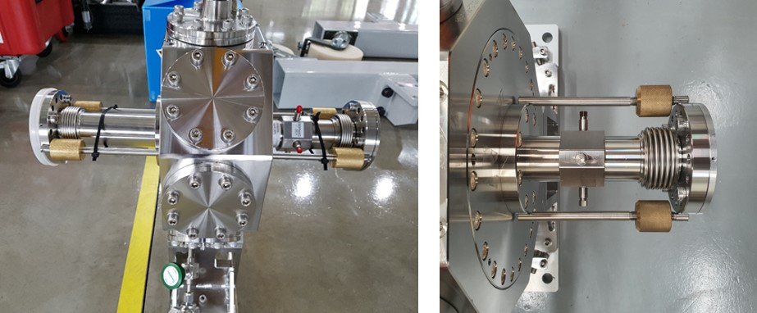
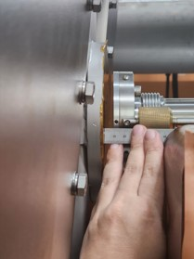
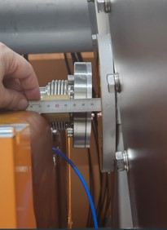
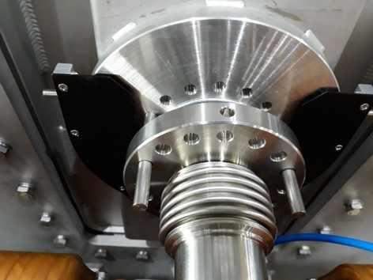
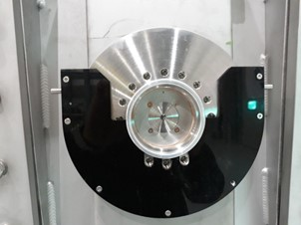
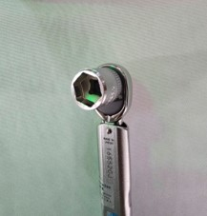
RAON Vacuum System
SCL3 vacuum system (Cleaning / Assembly / conditioning / Installation)
shrinking
Very narrow gap
expanding
Length adjuster
10mm between parts
Helcoflex seal
socket cutting
10cm working area
Seal guide
14
OLAV VI / April 2024 / Fermi National Accelerator Laboratory

Slide 15
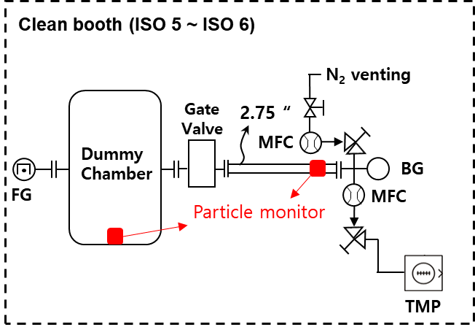
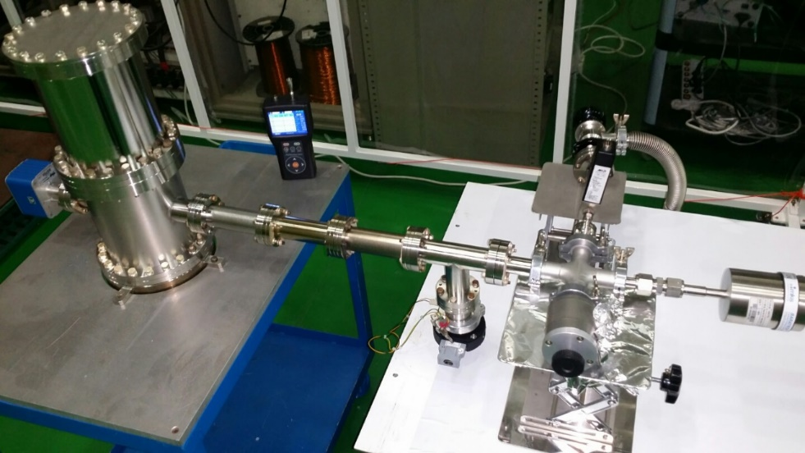
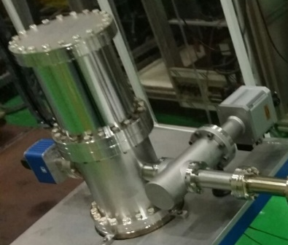
RAON Vacuum System
SCL3 vacuum system (Research for particle movement)
1. Slow pumping /venting test
2. Gate valve operation test
Particle monitor : SHIMAZ (ISPM-P-NW)
BG : Baratron Gauge
MFC : Mass Flow Controller
FG : Full range Gauge
TMP : Turbo Molecular Pump
15
OLAV VI / April 2024 / Fermi National Accelerator Laboratory

Slide 16
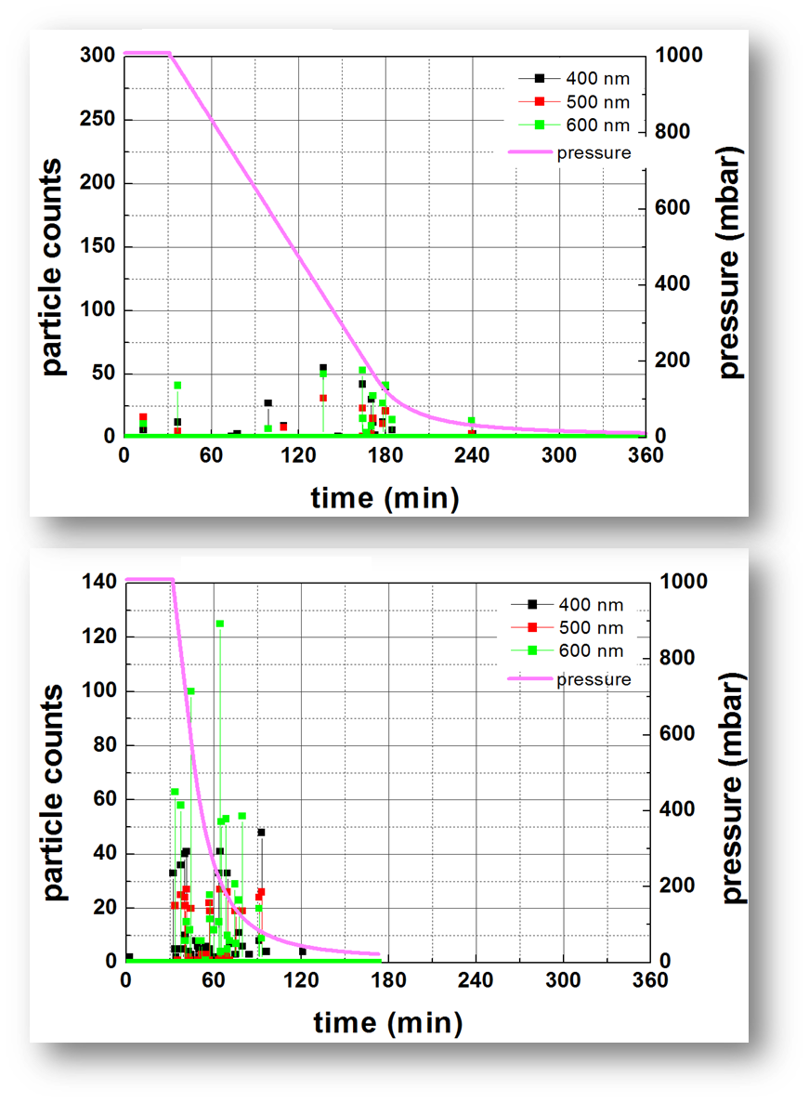
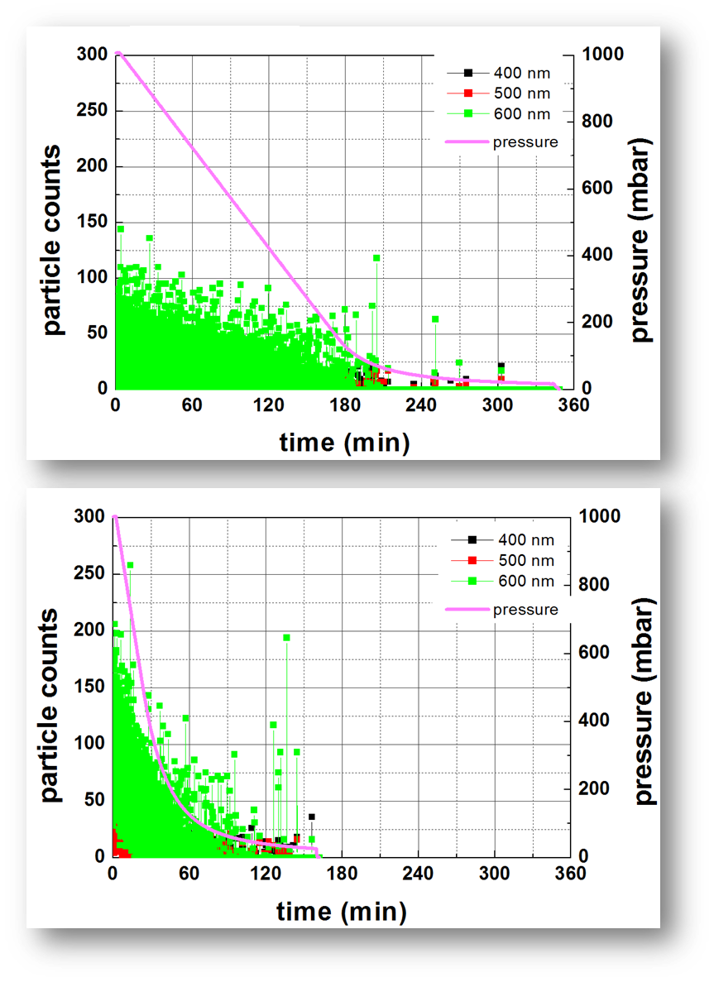
RAON Vacuum System
SCL3 vacuum system (Research for particle movement)
Particle contamination by Assembly condition (pumping)
6 mbar / min
Background
12 mbar / min
Class 100 ~ 1000
Class > 100,000
16
OLAV VI / April 2024 / Fermi National Accelerator Laboratory

Slide 17
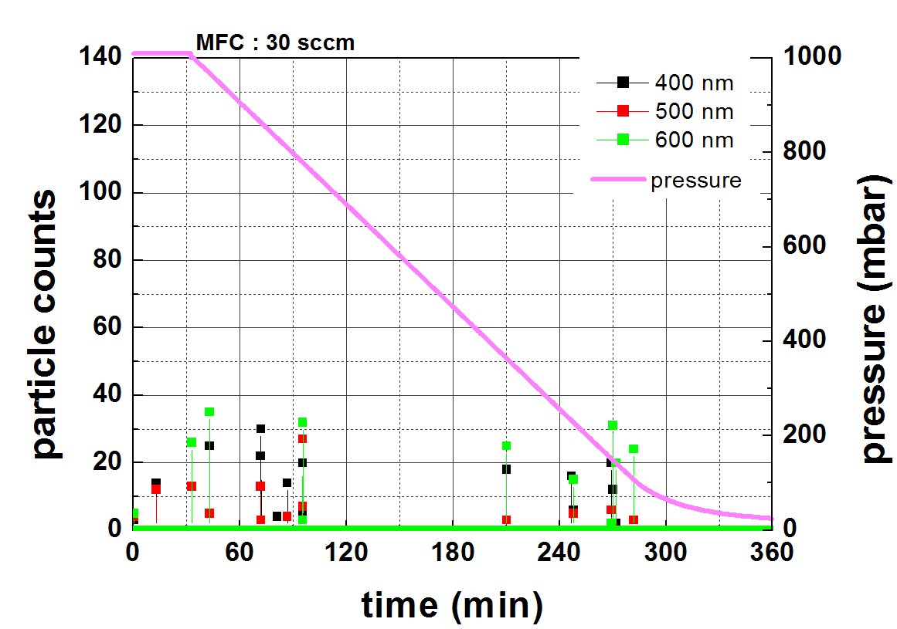
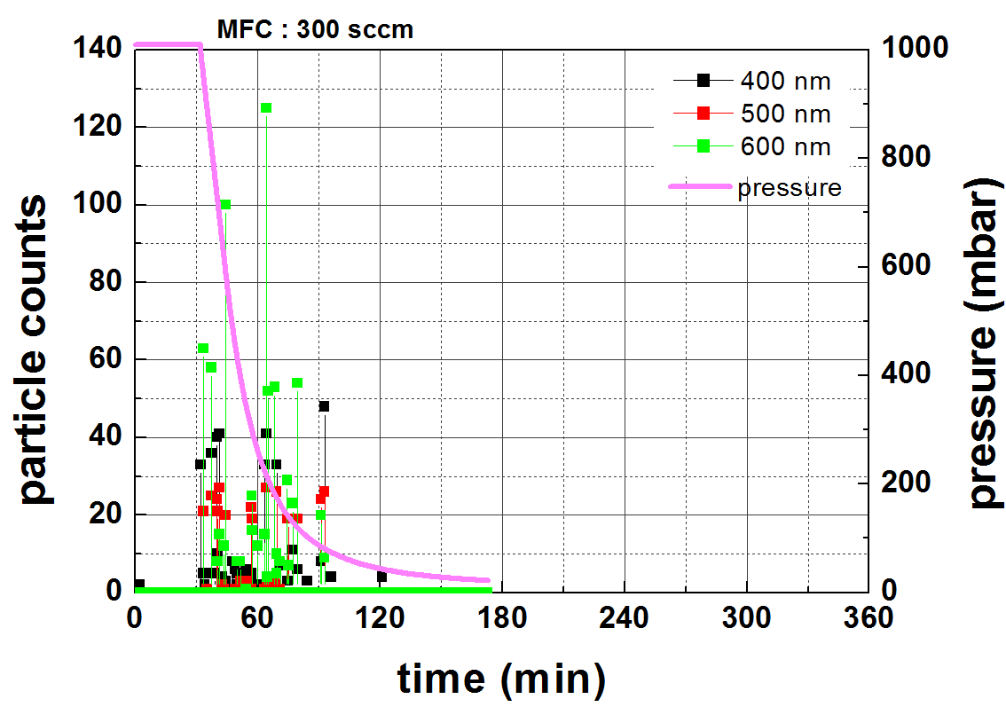
RAON Vacuum System
SCL3 vacuum system (Research for particle movement)
Particle contamination by flow speed
3L/min
16L/min
Class 100 ~ 1000
17
OLAV VI / April 2024 / Fermi National Accelerator Laboratory

Slide 18
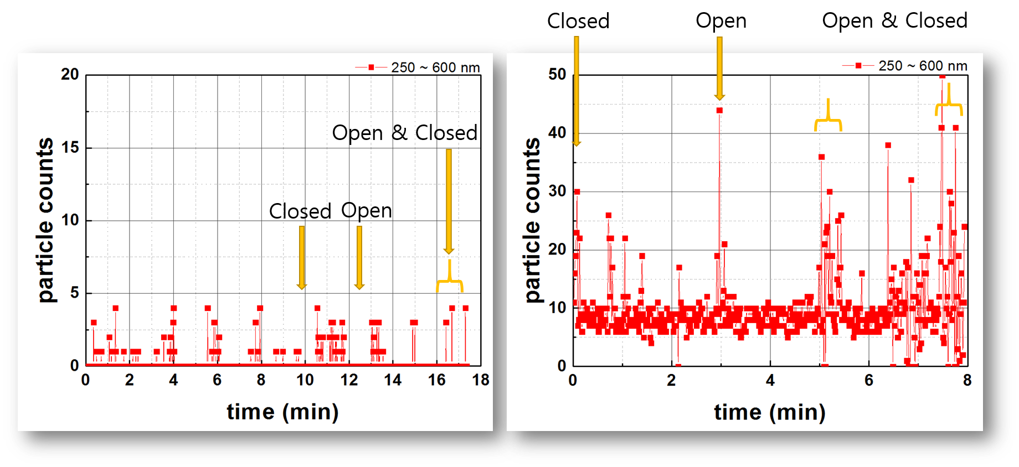
RAON Vacuum System
SCL3 vacuum system (Research for particle movement)
Particle movement by Gate valve operation
Pressure: < 1x10⁻² mbar
Pressure: 1013 mbar
18
OLAV VI / April 2024 / Fermi National Accelerator Laboratory

Slide 19
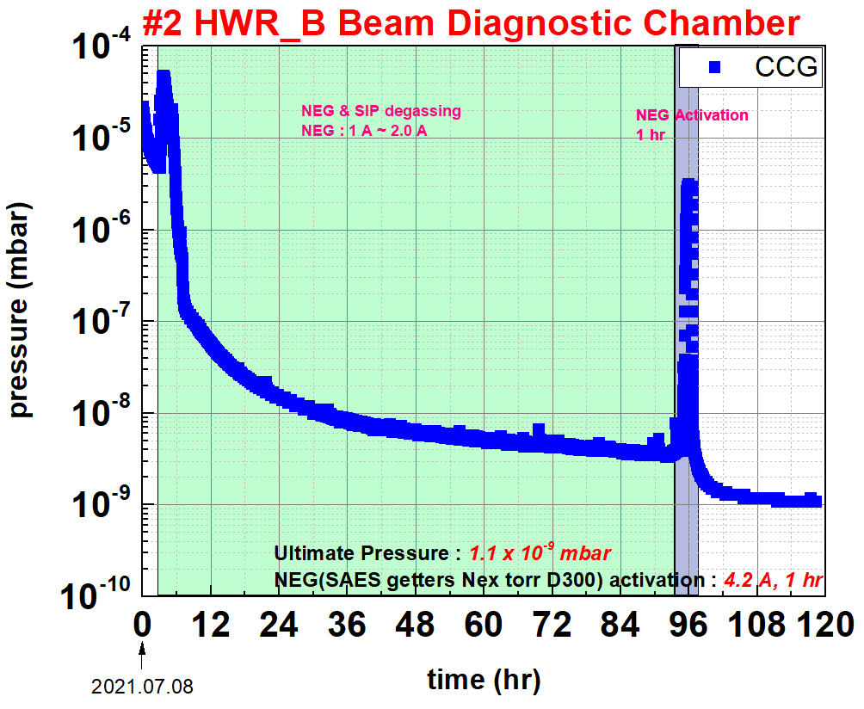
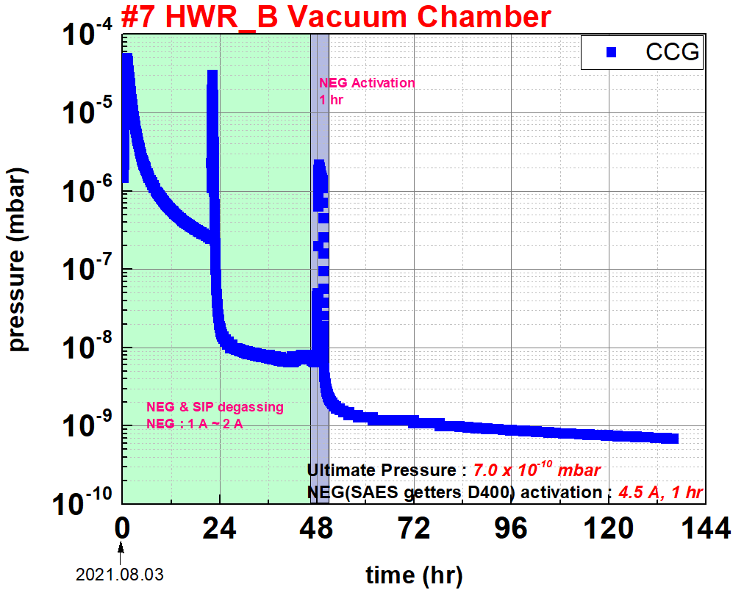
RAON Vacuum System
SCL3 vacuum system (Degassing & NEG Activation)
Vacuum requirement of warm section : 5E-9mbar (After cavity cool-down)
19
OLAV VI / April 2024 / Fermi National Accelerator Laboratory

Slide 20
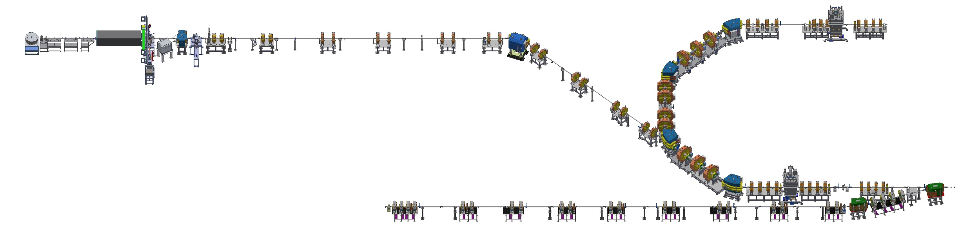
RAON Vacuum System
SCL3 to KOBRA vacuum system (Configuration)
NDPS : Nuclear Data Production System
SCL2 connection point
Vacuum device | Spctification | Q'ty | Manufacture / Model
Ion Pump | 125L/s(N2) | 7 | Agilent/ VacIon Plus 150
Turbo Pump | 355L/s, | 3 | Agilent / Twistorr 404FS
Dry pump | 600L/min | 3 | Laybold / Eco Dry
CCG | 1E-3~5E-10 | 10 | MKS / 422
Gate valve | UHV | 10 | VAT / UHV gate valve
P2DT(Post Accelerator to Distribution Transfer Line)
NDPS beam Line
End of SCL3
KOBRA experimental facility
wall
KOBRA : KOrea Broad acceptance Recoil spectrometer and Apparatus
20
OLAV VI / April 2024 / Fermi National Accelerator Laboratory

Slide 21
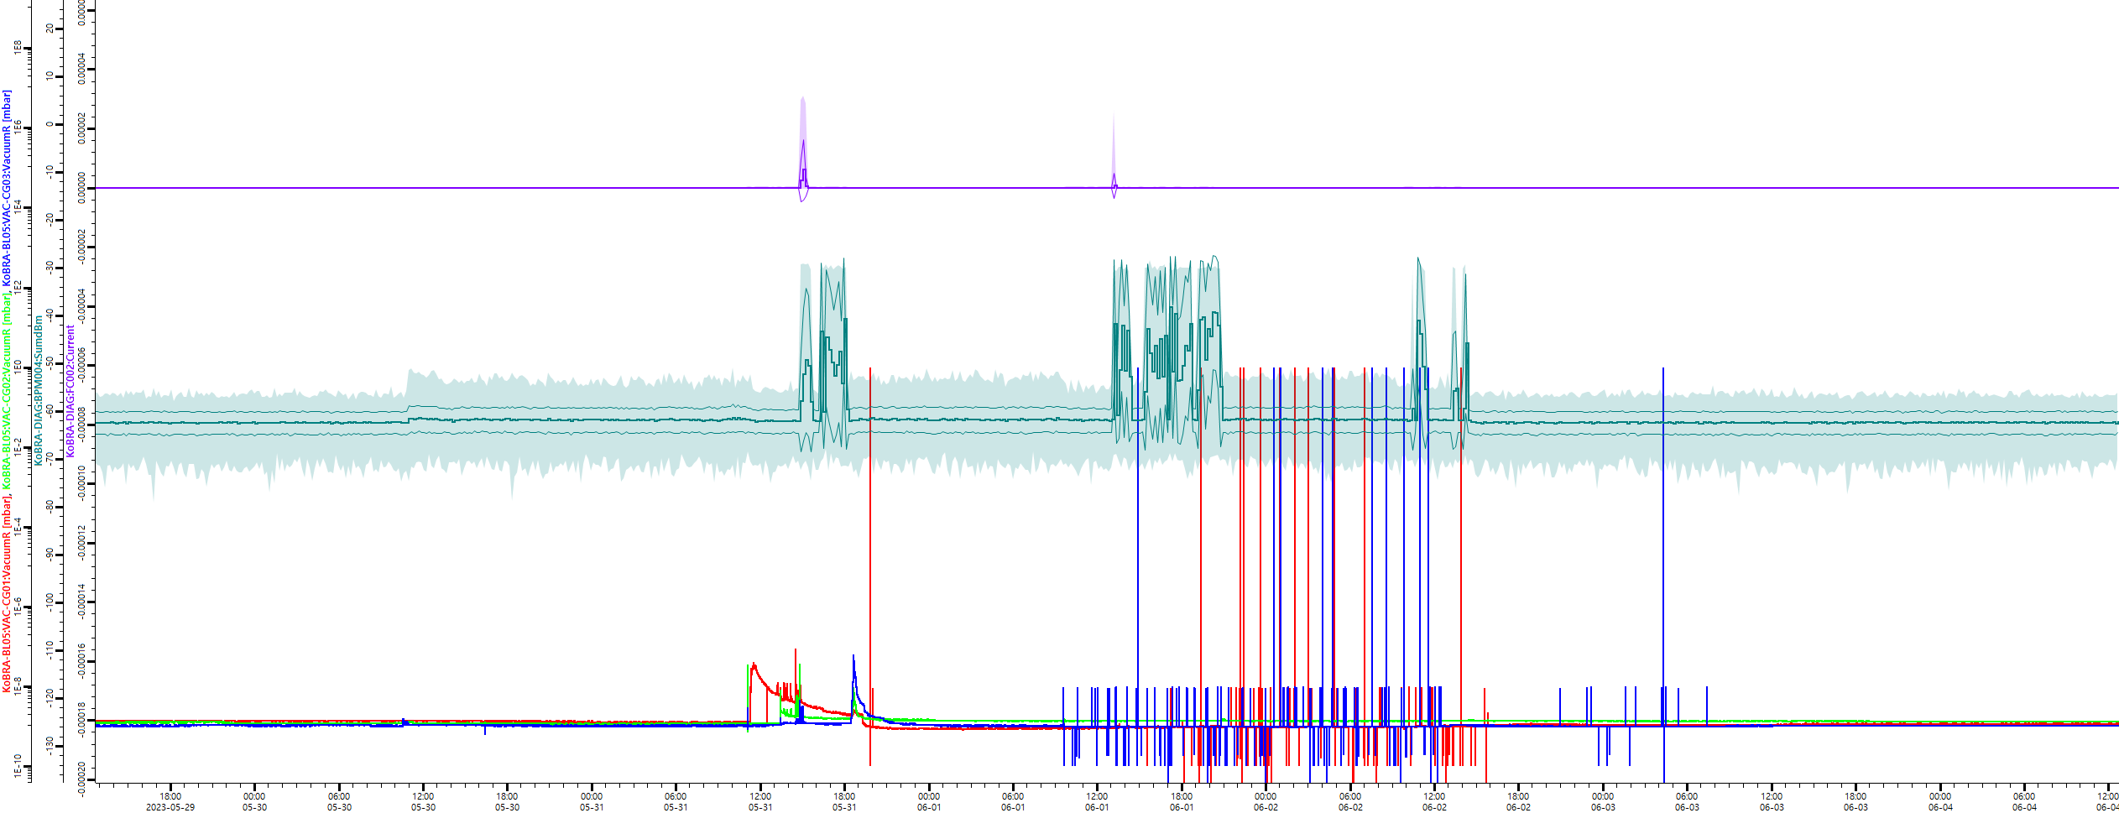
RAON Vacuum System
SCL3 to KoBRA vacuum system (Operation)
Ar⁺⁹ beam existing in SCL3 to KOBRA section
(The faraday cup at the end of the KOBRA beam line is in the down position)
CCG1
CCG3
21
OLAV VI / April 2024 / Fermi National Accelerator Laboratory

Slide 22
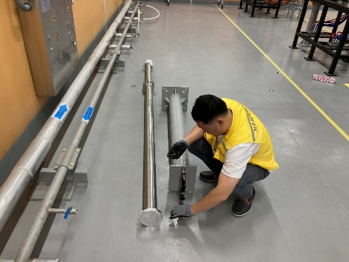





RAON Vacuum System
SCL3 to KoBRA vacuum system (Malfunction & Maintenance)
CG1
GV1
BM
CG
10
CG9
CG8
CG7
CG6
CG5
CG
4
CG
3
CG
2
GV2
SIP1
GV10
GV8
GV7
GV6
GV
GV
GV5
CSK
4
SIP7
CSK
3
SIP6
SIP5
SIP4
Rebuncher
CSK
2
SIP3
SIP2
CSK
1
BM
MAV
GV
11
GV
9
GV
3
To be replaced with NEG
MAV
CG
MAV
MAV
MAV
MAV
MAV
TMP1
TMP3
NEG
AV3
AV1
DRY3
MAV
DRY1
Replaced with NEG
★ For 1 year, 3 TMP malfunctioned
Because of the long storage time ???
22
OLAV VI / April 2024 / Fermi National Accelerator Laboratory

Slide 23
Status & Plan
IRIS successfully transmitted the Ar⁺⁹ beam to the KOBRA (Nov. 2022)
IRIS is Preparing for the second beam commissioning (Apr ~ Jun. 2024)
High energy accelerator (SCL2) is under R&D to 2027
The vacuum system for NDPS & P2DT are under vacuum pumping procedure.
Ar⁺⁸ beam will be provided to the KOBRA experimental facility. (July. 2024)
SCL2(R&D)
NDPS beam Line
P2DT(Post Accelerator to Distribution Transfer Line)
KOBRA experimental facility
23
OLAV VI / April 2024 / Fermi National Accelerator Laboratory

Slide 24

Thank You
24
OLAV VI / April 2024 / Fermi National Accelerator Laboratory

