Slide 2
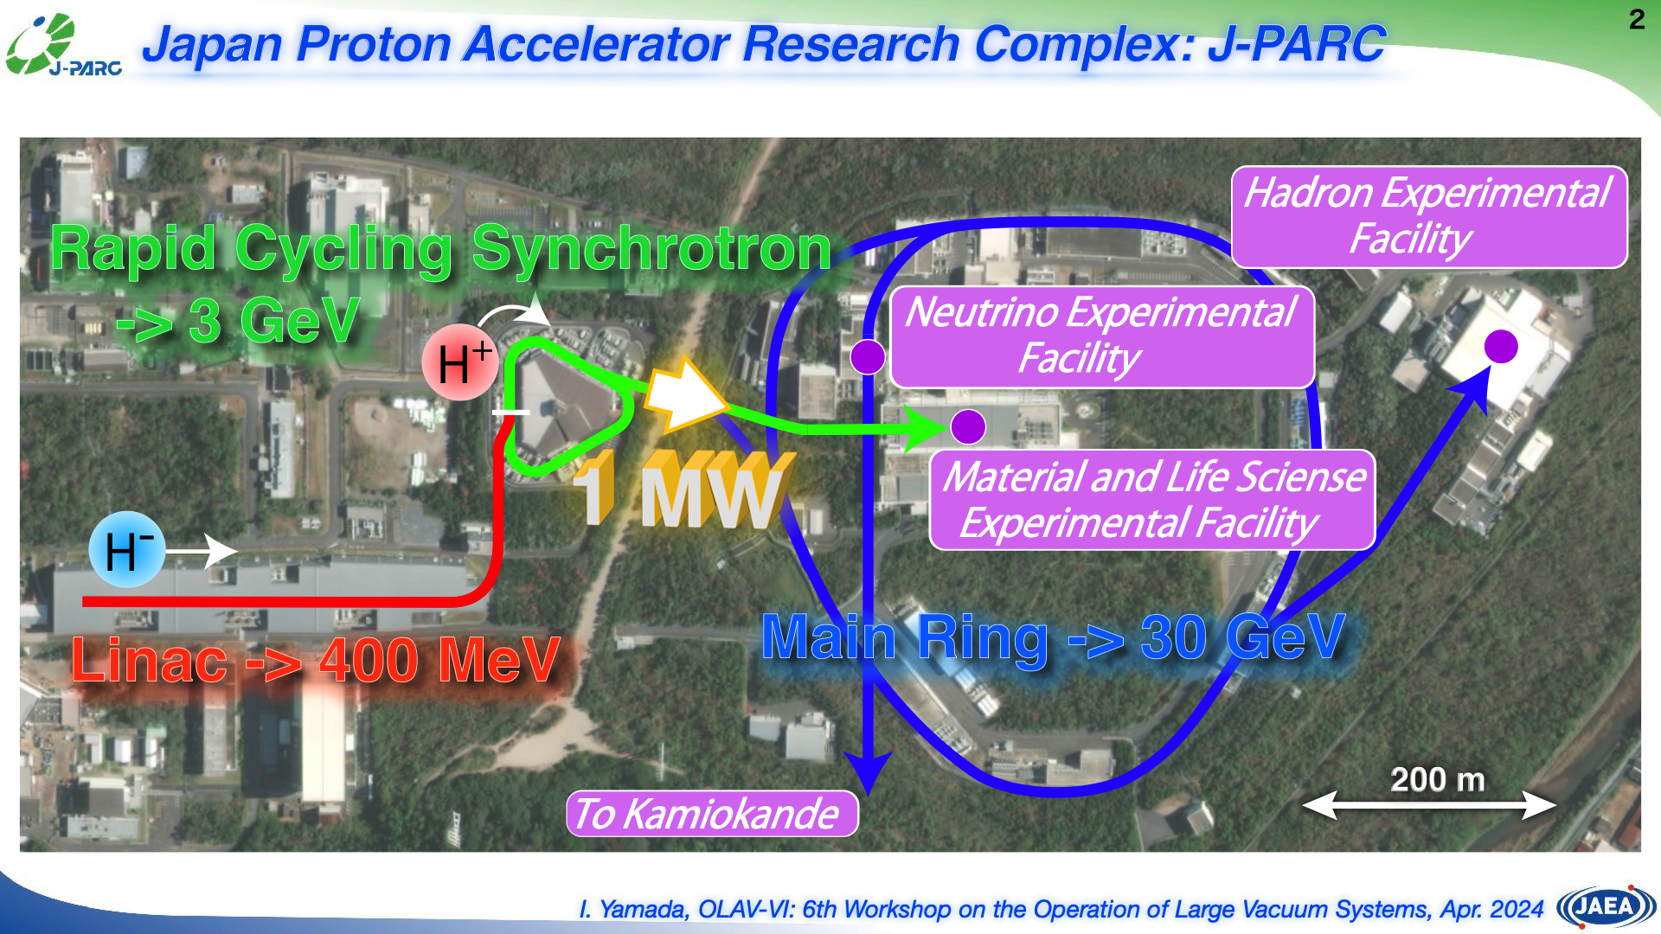

Slide 10
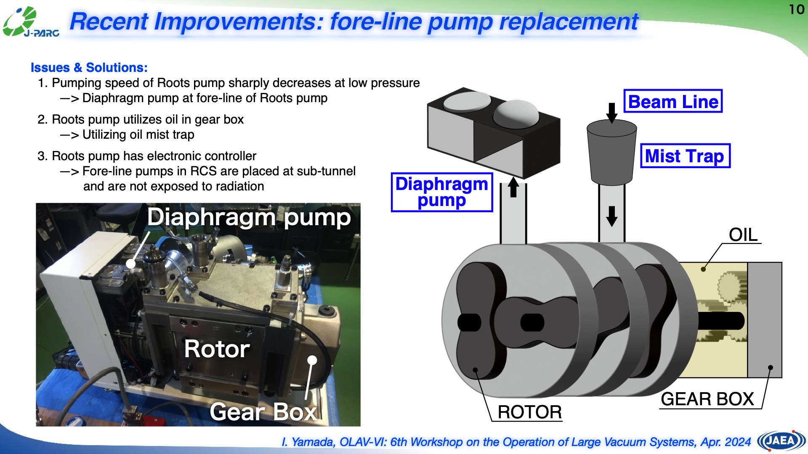

Slide 11
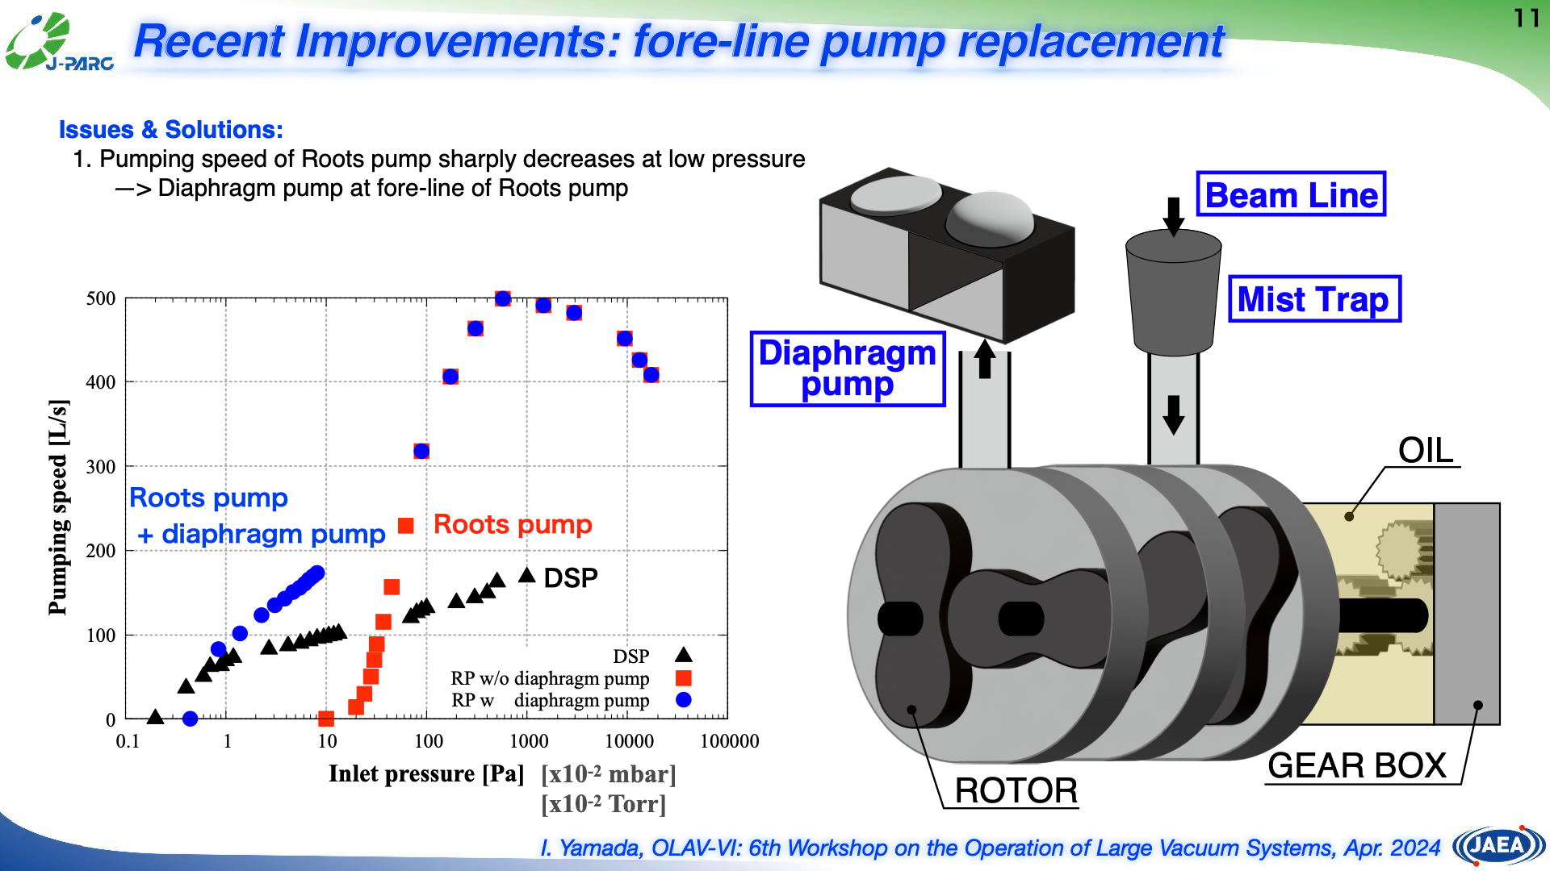

Slide 12


Slide 20
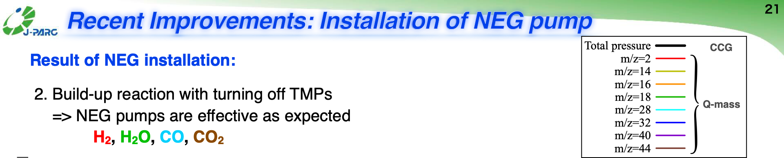
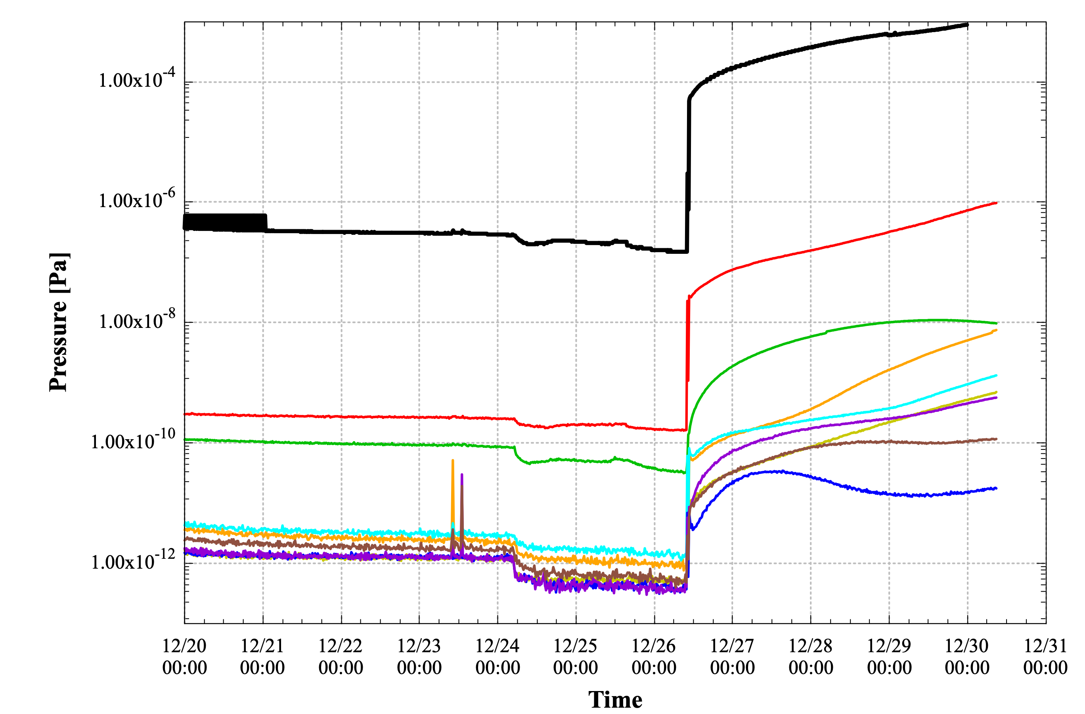
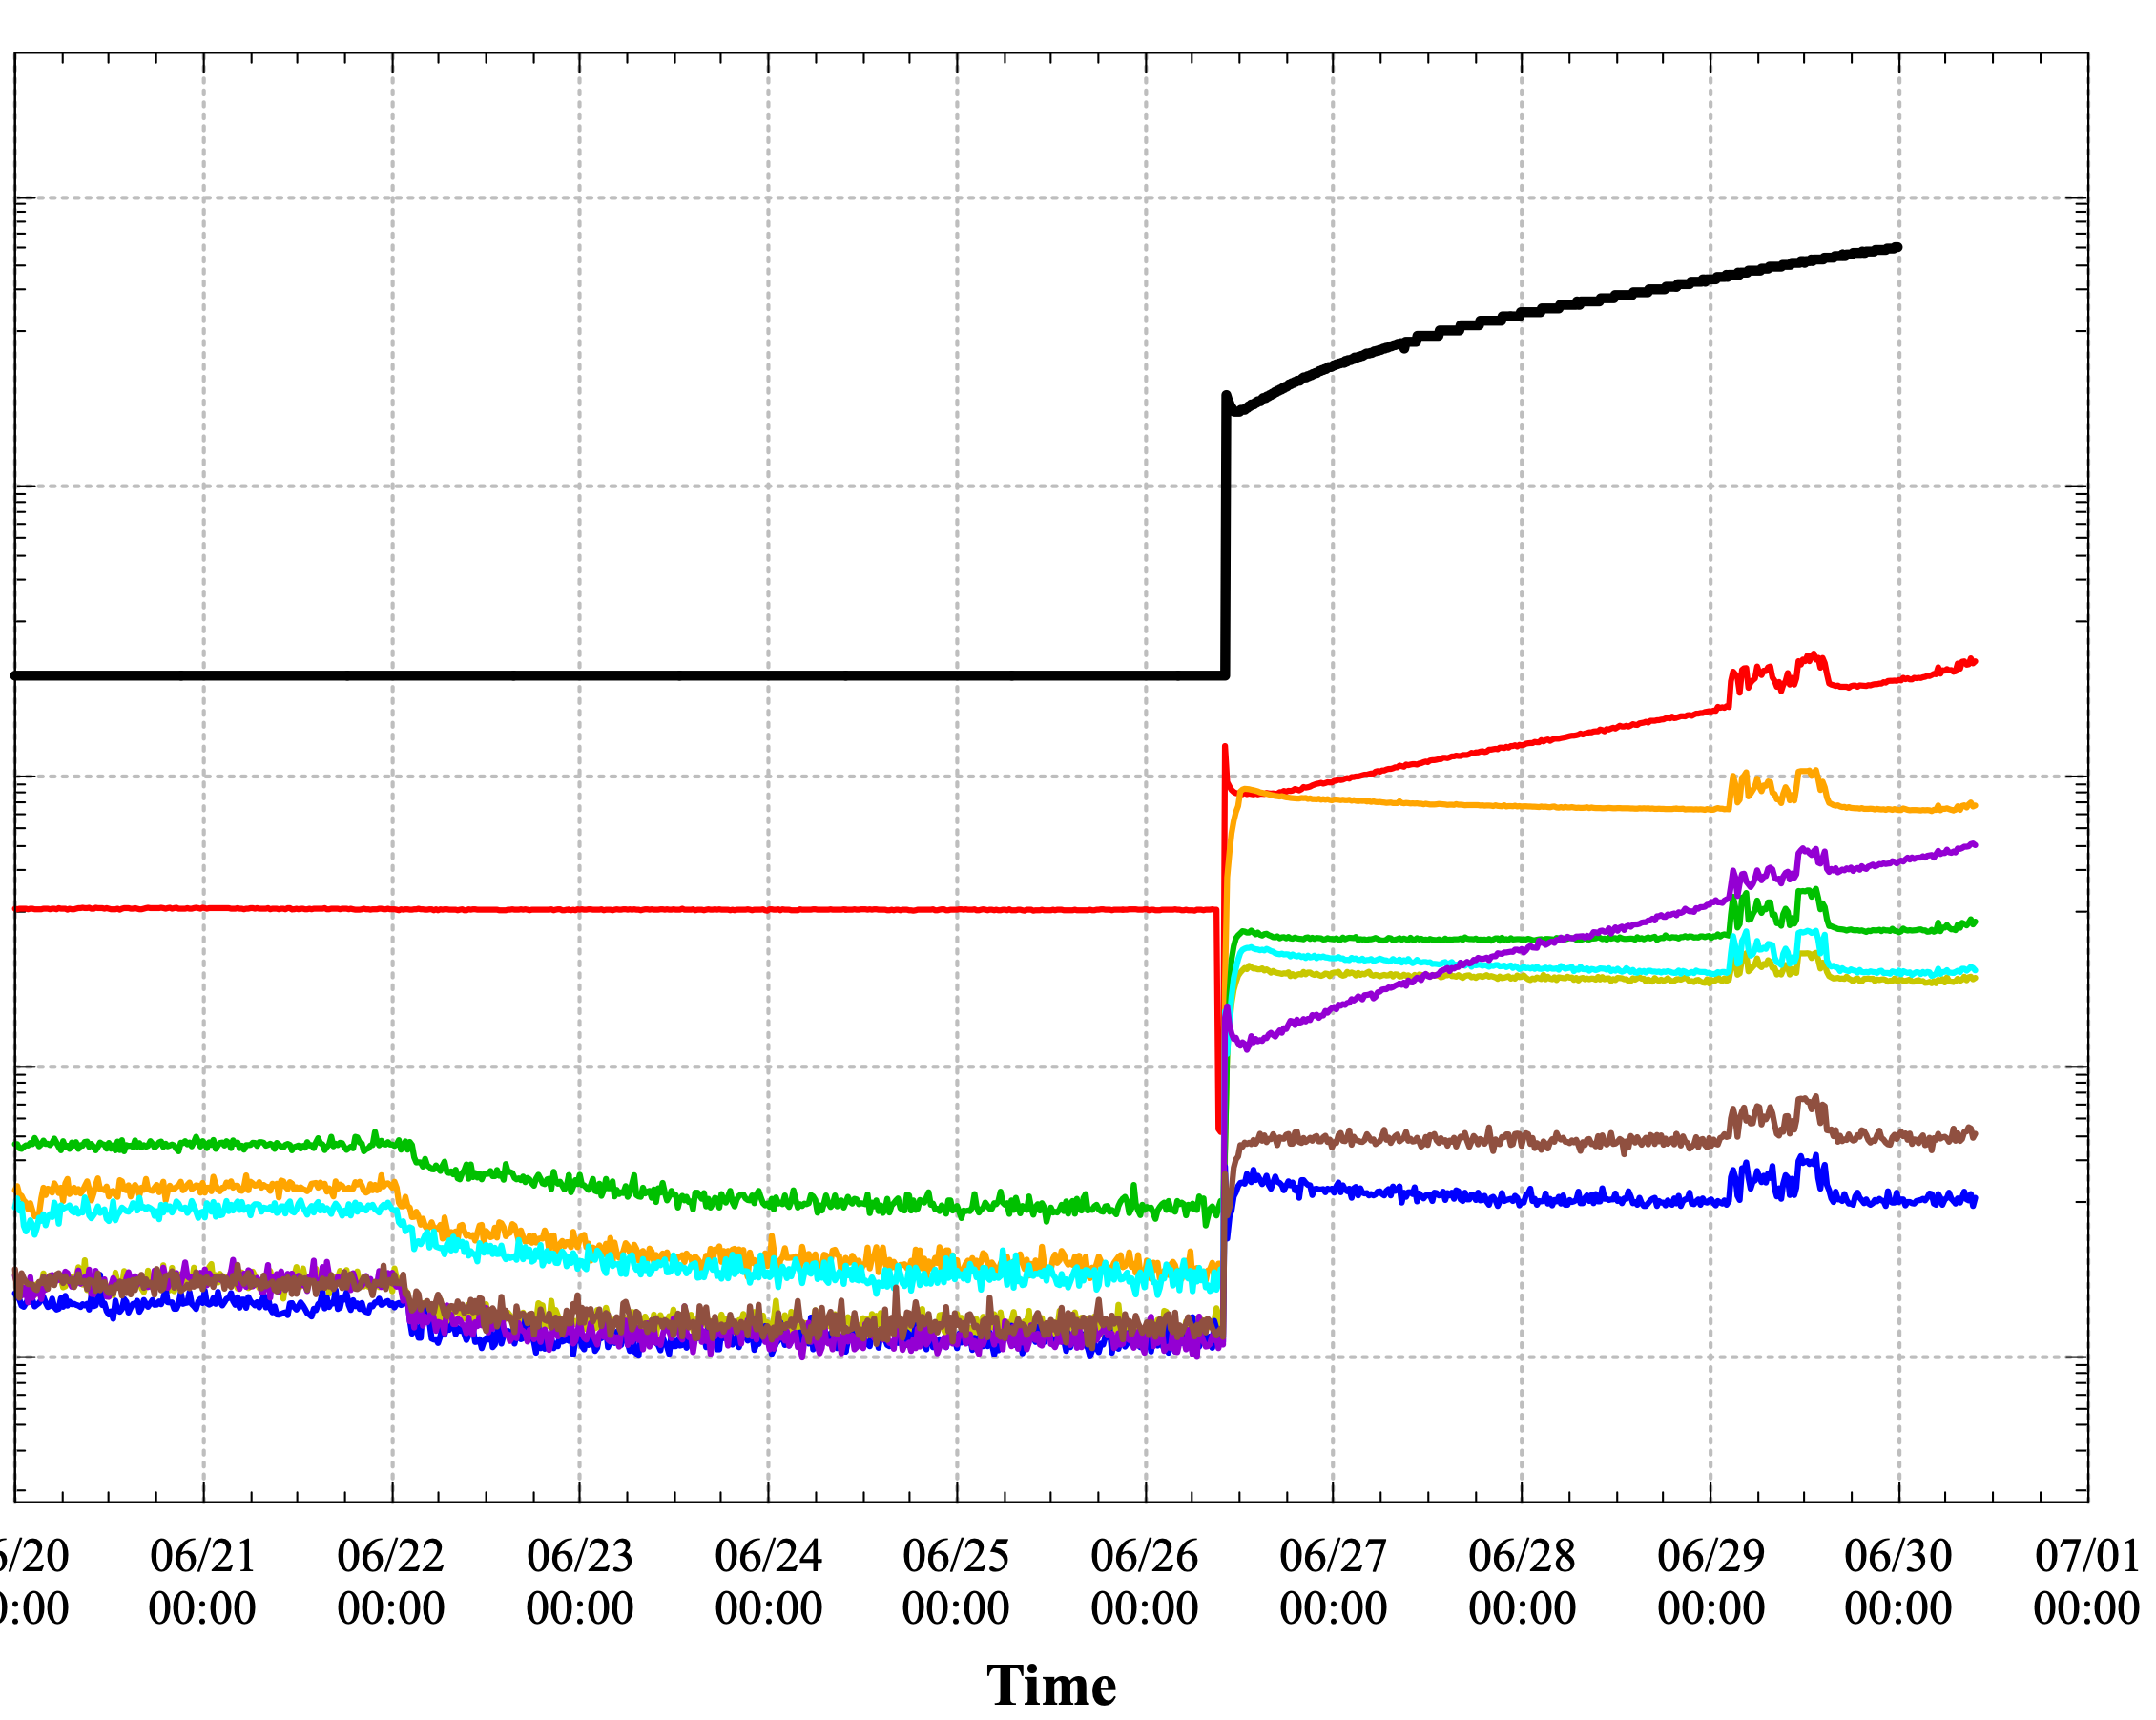
Build-up ratio
[x10⁻² mbar]
[x10⁻² Torr]
Only TMPs
TMPs + NEGs
10⁻⁴
Less than 5x10⁻⁸ Pa
10⁻⁶
H2
H2O
H2
Pressure [Pa]
Ion current [A]
O, O2²⁺
O, O2²⁺
10⁻⁸
N2, CO
Ar
Ar
N2, CO
CO2
10⁻¹⁰
O2
O2
CO2
N, N2²⁺
10⁻¹²
H2O
TMP on
TMP off
TMP on
N, N2²⁺
TMP off
11 days
11 days
I. Yamada, OLAV-VI: 6th Workshop on the Operation of Large Vacuum Systems, Apr. 2024

