Slide 1
Vacuum firing effect on stainless steel & titanium
Junichiro Kamiya
on behalf of the RCS vacuum group
Japan Atomic Energy Agency (JAEA) / J-PARC center
This presentation is the summary of the articles on the e-Journal of Surface Science and Nanotechnology (eJSSNT).
J. Kamiya, et. al, “Evaluation of Titanium Vacuum Chamber as Getter Pump”, eJSSNT 2023.
J. Kamiya, et. al, “Evaluation of Vacuum Firing Effect on Stainless Steel from Vacuum and Surface Point of View”, eJSSNT 2023.

Slide 2
Vacuum firing
Residual gas in the vacuum chamber in an ultra-high vacuum region is known to be dominated by desorbed gas molecules adsorbed on the surface and diffused atoms (such as hydrogen) from inside the bulk that recombine and desorb.
Vacuum in Particle Accelerators, Oleg B. Malyshev © 2019 Wiley‐VCH Verlag GmbH & Co. KGaA.
High-temperature heating of vacuum chambers or vacuum materials in a HV furnace “vacuum firing” has been known as the process of reducing the amount of dissolved hydrogen in the bulk.
EX1) Stainless steel, 950 ℃ for a few hours: CERN recipe
EX2) Titanium, 650 ℃ -850 ℃ for 10 hours: J-PARC recipe

Slide 3
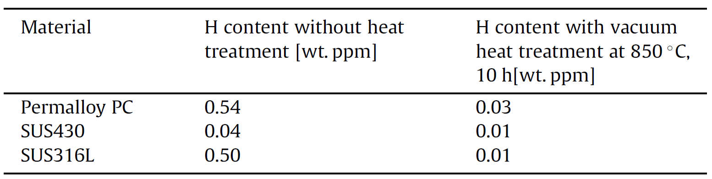
Vacuum firing effect: hydrogen content
Vacuum firing temperature vs. H content for pure Ti grade 2
H content before and after vacuum firing
Kamiya et al., Vacuum chamber made of soft magnetic material with high permeability, Vacuum 98 (2013)
Vacuum firing reduces the hydrogen concentration in the bulk.
Ogiwara et al., Reduction of hydrogen content in pure Ti, J. of Phys.: Conf. Ser. 100 (2008) IVC-17/ICSS-13 and ICN+T2007

Slide 4
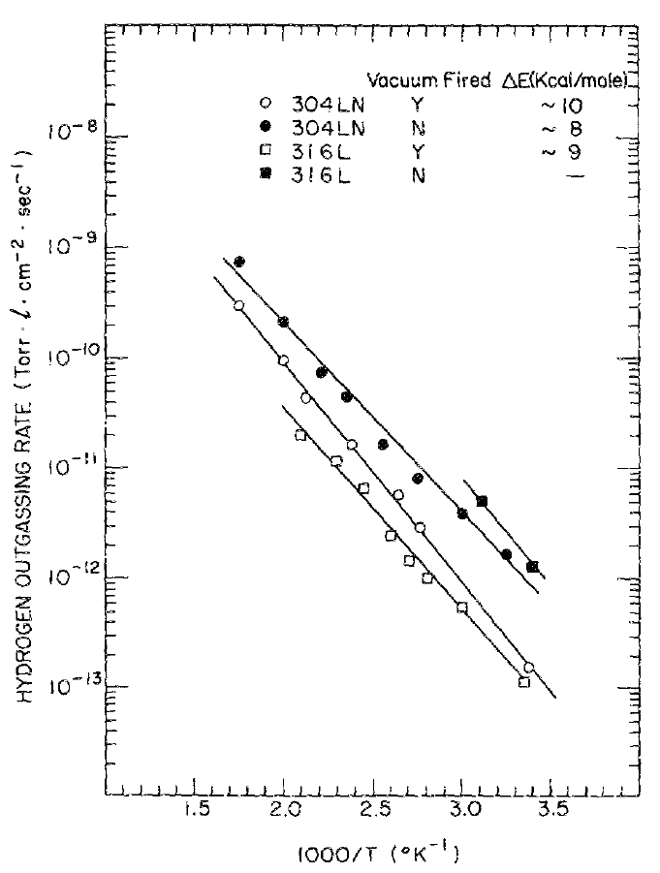
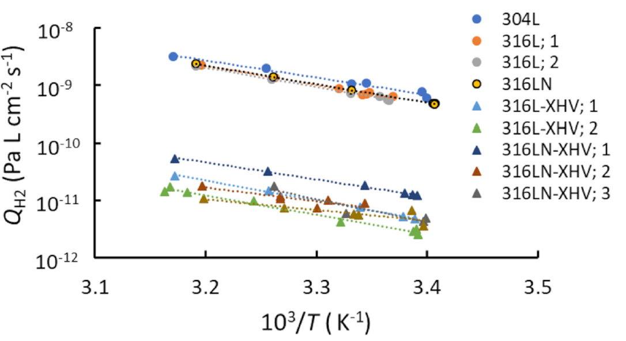
Vacuum firing effect: outgassing
SS chamber with and w/o vacuum firing (aft. 200 ℃ 48h baking)
SS chamber with and w/o vacuum firing (aft. 150 ℃ 3days baking)
×10 [Pa m³/(s m²)]
Vacuum firing 950℃24H
×1.3e3 Pa m³/(s m²)
Vacuum firing 950℃2H
Fedchak et al., Outgassing rate comparison of seven
geometrically similar vacuum chambers of
different materials and heat treatments, JVSTB (2021)
Hseuh and Cul, Outgassing and desorption of the stainless-steel beam tubes after different degassing treatments, JVSTA (1989)

Slide 5
Study purpose
Only a few research compares the outgassing rate of vacuum-fired material with non-vacuum-fired one in the same experimental condition.
There is almost no research about detailed mechanism for the low outgassing rate by vacuum firing.
Systematic research for the outgassing characteristics of the vacuum-fired vacuum material.
Understanding the mechanism of the vacuum firing effect from surface microscopic point of view.

Slide 6
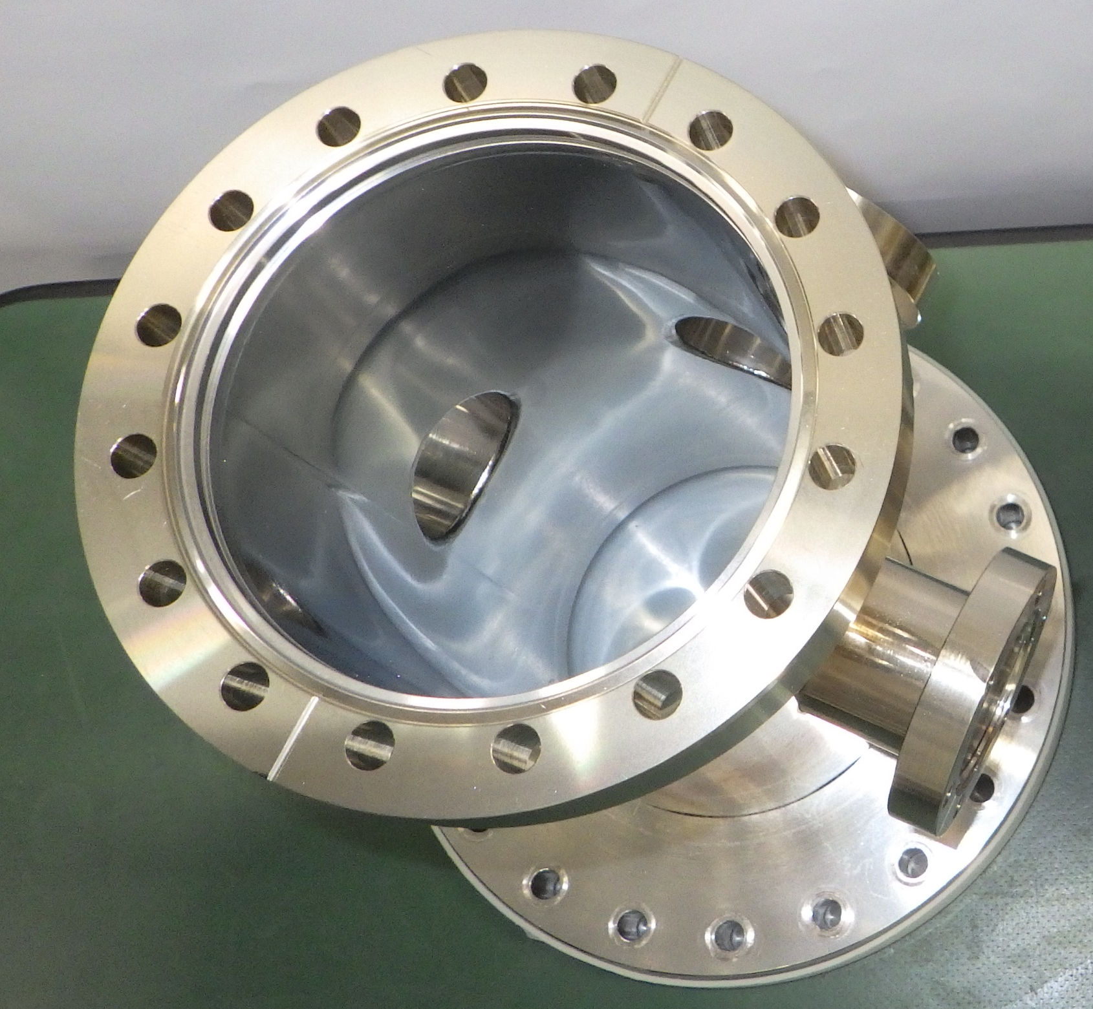
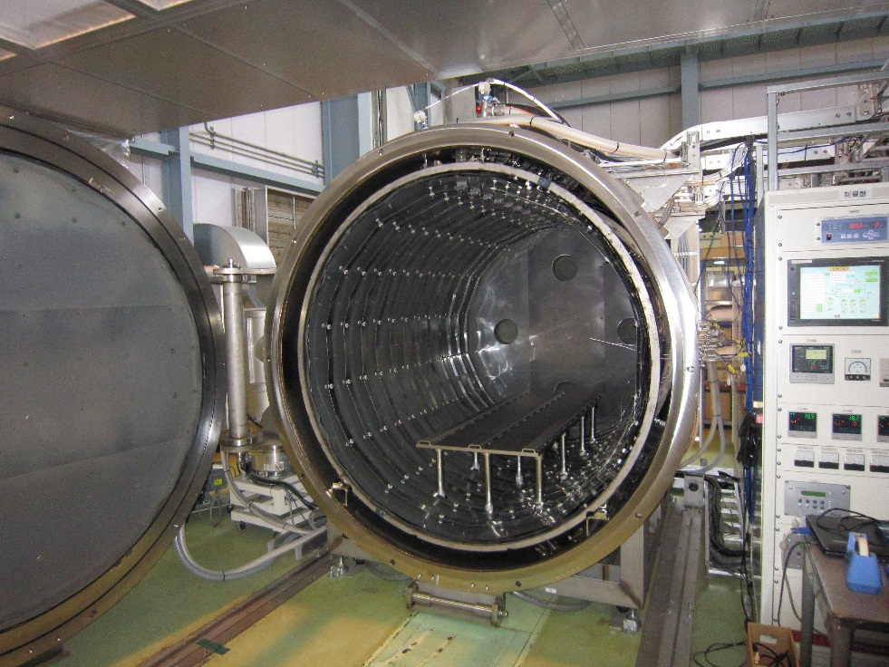
Experimental
Test chamber
V: 0.00255 m³, A: 0.10 m²
 | Material | Surface polish | V.F.
Stainless steel chamber | SS304L | #400 buff+EP | Non/ 850℃ 10H
Titanium chamber | Pipe: pure Ti grade-2 Flange: Ti-6Al-4V | #400 buff+CP | Non/ 850℃ 10H
100CF
J-PARC HV furnace
Max temp. 1000 ℃
Work space: 1 m×1 m × ~2 m
TMP 3200 l/s×3, Cryopump 10000 l/s×1
Mo heater, Mo+SS refrector
Pressure at 850℃: ≤1×10⁻³ Pa
Pressure at RT: ~1×10⁻⁶ Pa

Slide 7
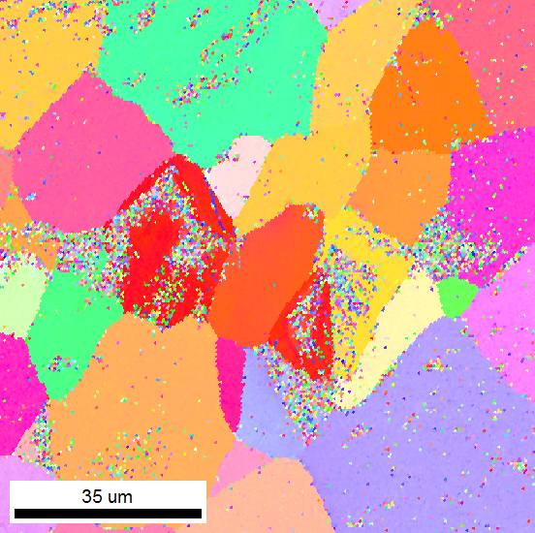
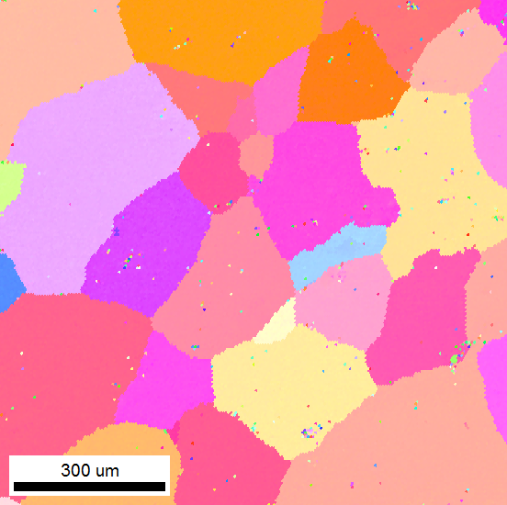
Surface morphology: titanium
Non-vacuum-fired Ti
Ra: 0.05 um
Rz: 0.4 um
Vacuum-fired Ti
Ra: 0.2 um
Rz: 1.1 um
Larger grain size, larger roughness for vacuum-fired Ti

Slide 8
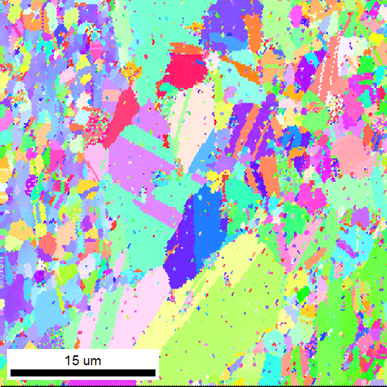
Surface morphology: stainless steel
Non-vacuum-fired SS
Too small grain size to detect
Ra: 0.009 um
Rz: 0.06 um
Vacuum-fired SS
Ra: 0.02 um
Rz: 0.17 um
Larger grain size, larger roughness for vacuum-fired SS

Slide 9
Buildup test
Buildup test procedure
Evacuation
MV close
~1day
Buildup
@Room Temperature
MV open
200℃ 8H bake
MV close
cooling
Buildup
@RT
MV open
300℃ 3.5 H bake
cooling
MV close
Buildup
@RT
MV open
350℃ 3.5 bake
Other surface analyses with sample peace
cooling
Thermal desorption spectroscopy (TDS):
To see the effect on the absorbed & desorbed gas on the surface
X-ray photoelectron spectroscopy (XPS):
To see the surface modification
MV close
Buildup
@RT
MV open
400℃ 3.5 bake
cooling
MV close
Buildup
@RT

Slide 10
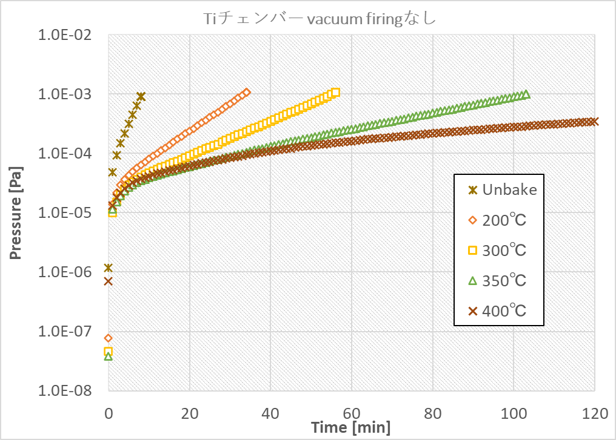
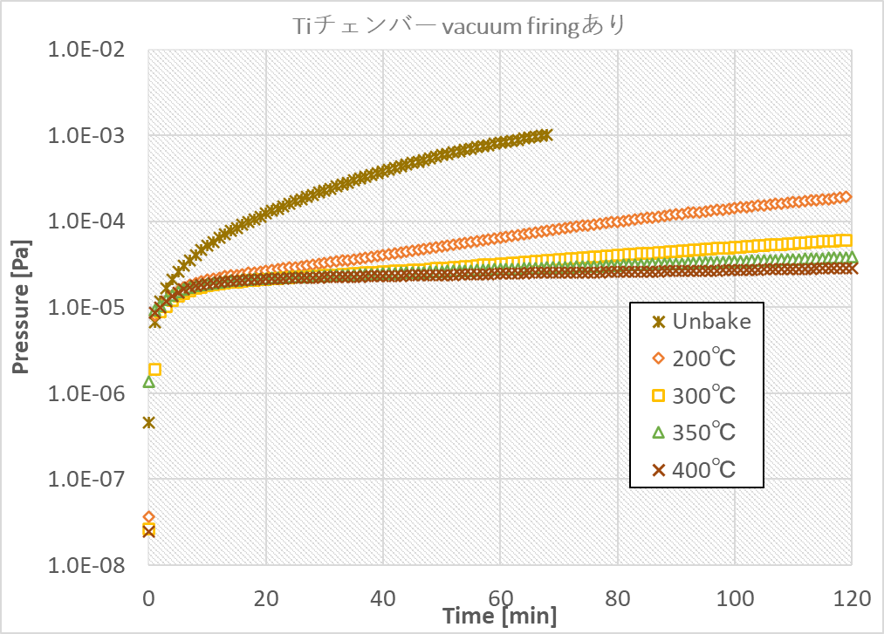
Vacuum firing on titanium: build-up results
Non-vacuum-fired Ti chamber
Vacuum-fired Ti chamber
Vacuum firing clearly reduced outgassing of a titanium chamber.
Baking of the vacuum fired titanium chamber is very effective to achieve low outgassing rate.

Slide 11
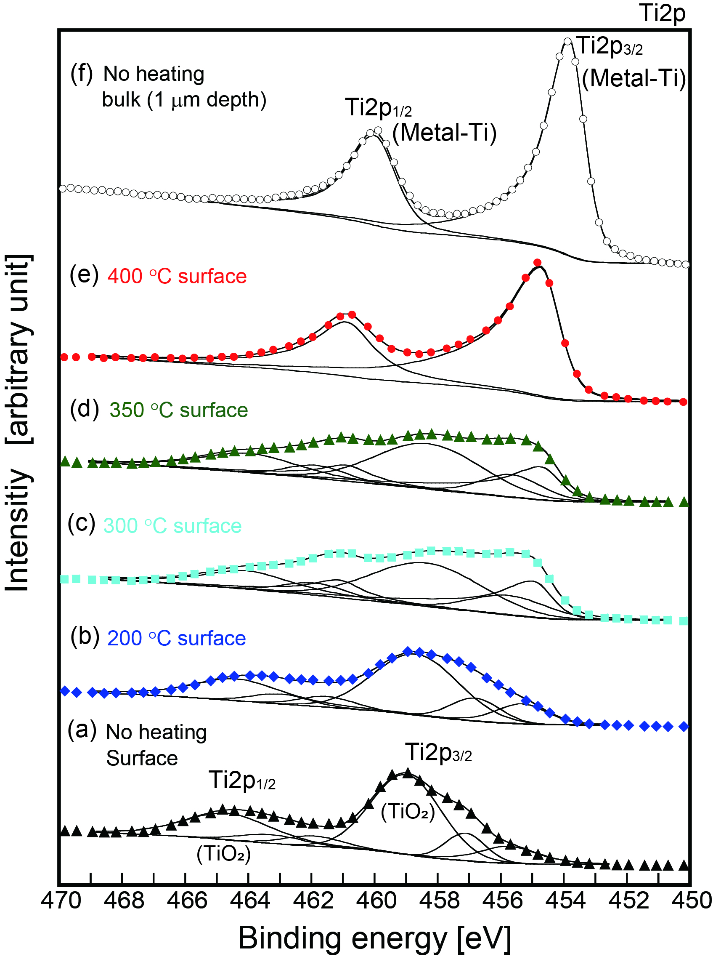
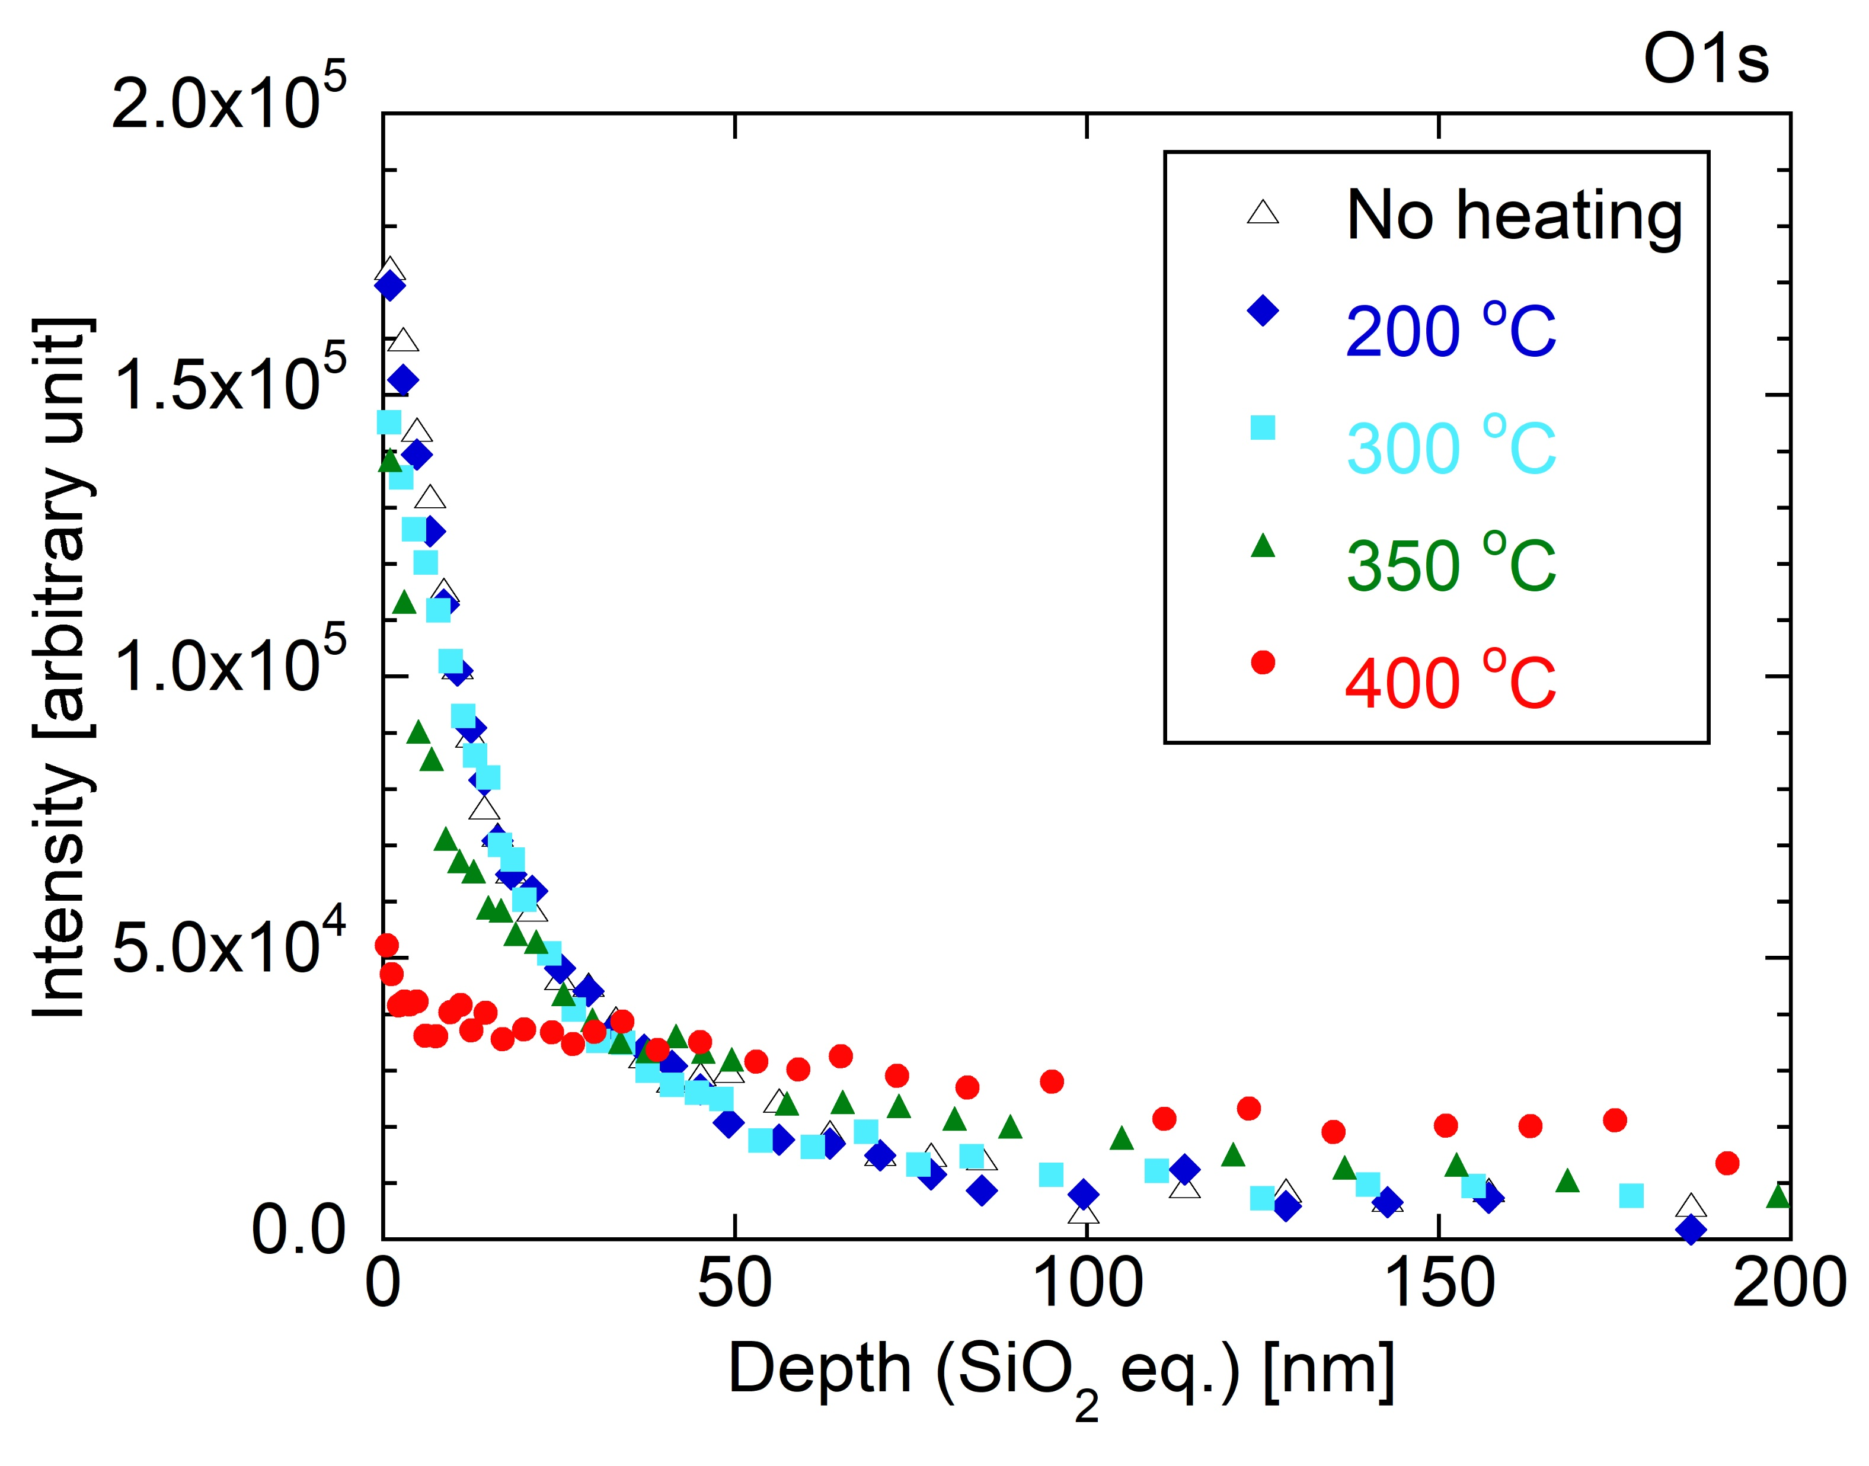
Vacuum firing on titanium: mechanism
XPS result
Titanium sample w/o vacuum firing O1s depth profile
400℃
350℃
300℃
200℃
Non heating
Increasing baking temperature allows oxides to diffuse into the interior.
Above 300 ℃, surface of the titanium is partially metallized and becomes getter.

Slide 12
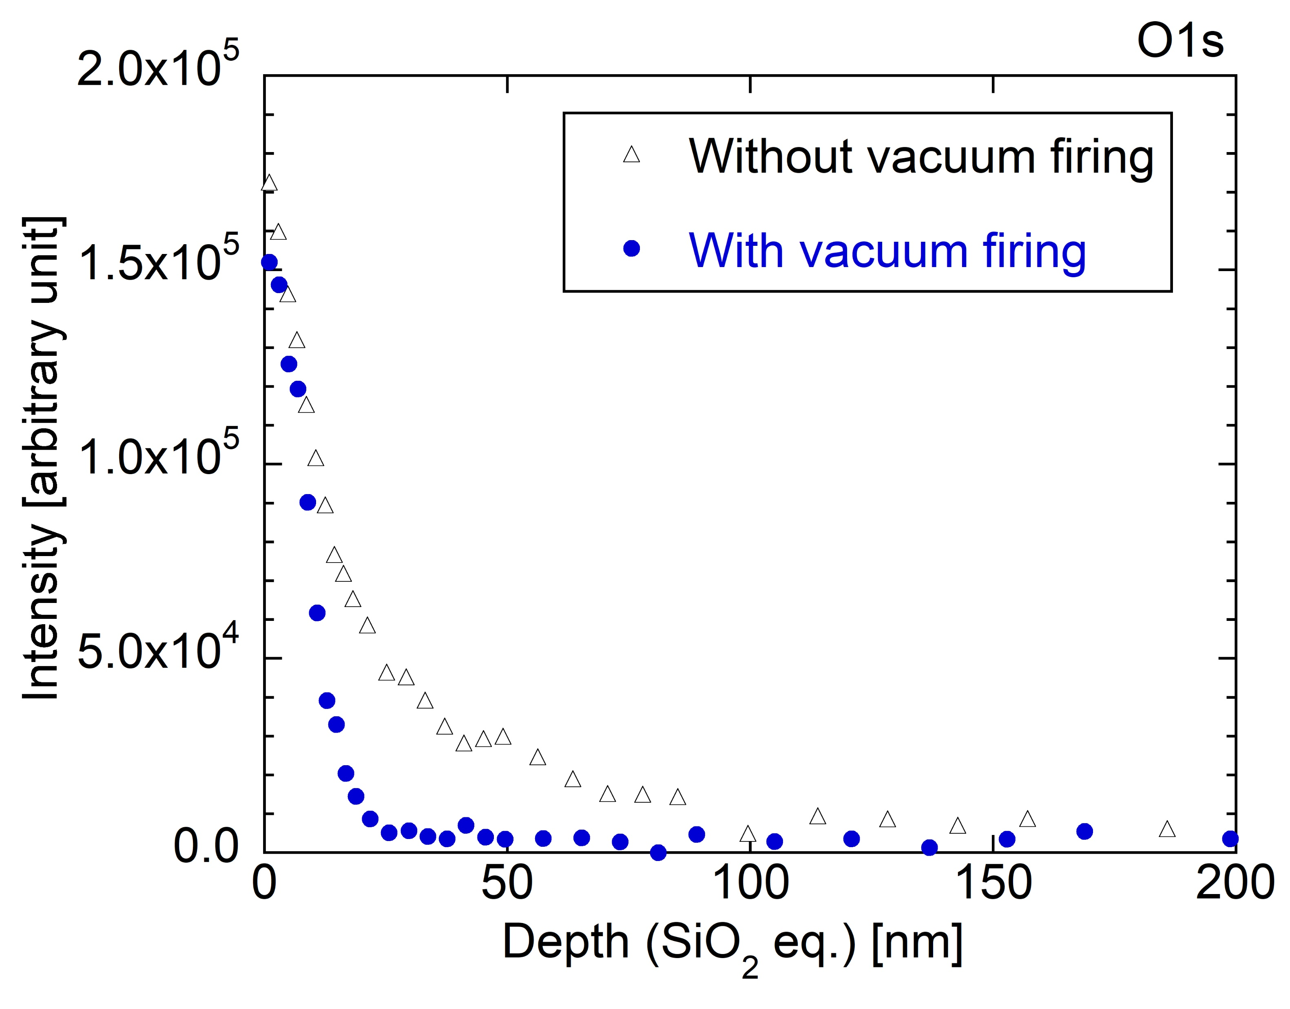
Vacuum firing on titanium: mechanism
Findings on Vacuum firing of titanium
Vacuum-fired titanium has thinner surface oxide layer.
Surface O is easy to diffuse into the bulk by baking, resulting metalization of surface Ti.
Surface getter function of Ti-metal contributes to the low outgassing.

Slide 13
Vacuum firing on stainless steel: build-up results
Non-vacuum-fired SUS chamber
Vacuum-fired SUS chamber
(2 hors)
(2 hors)
Vacuum firing clearly reduced outgassing of a SS chamber.
Baking of the vacuum fired SS chamber is very effective to achieve low outgassing rate.

Slide 14
Long-term buildup result of SS chamber
(8 days)
(8 days)
For a vacuum-fired chamber, especially hydrogen outgassing, which is the main component after baking, is much reduced.

Slide 15
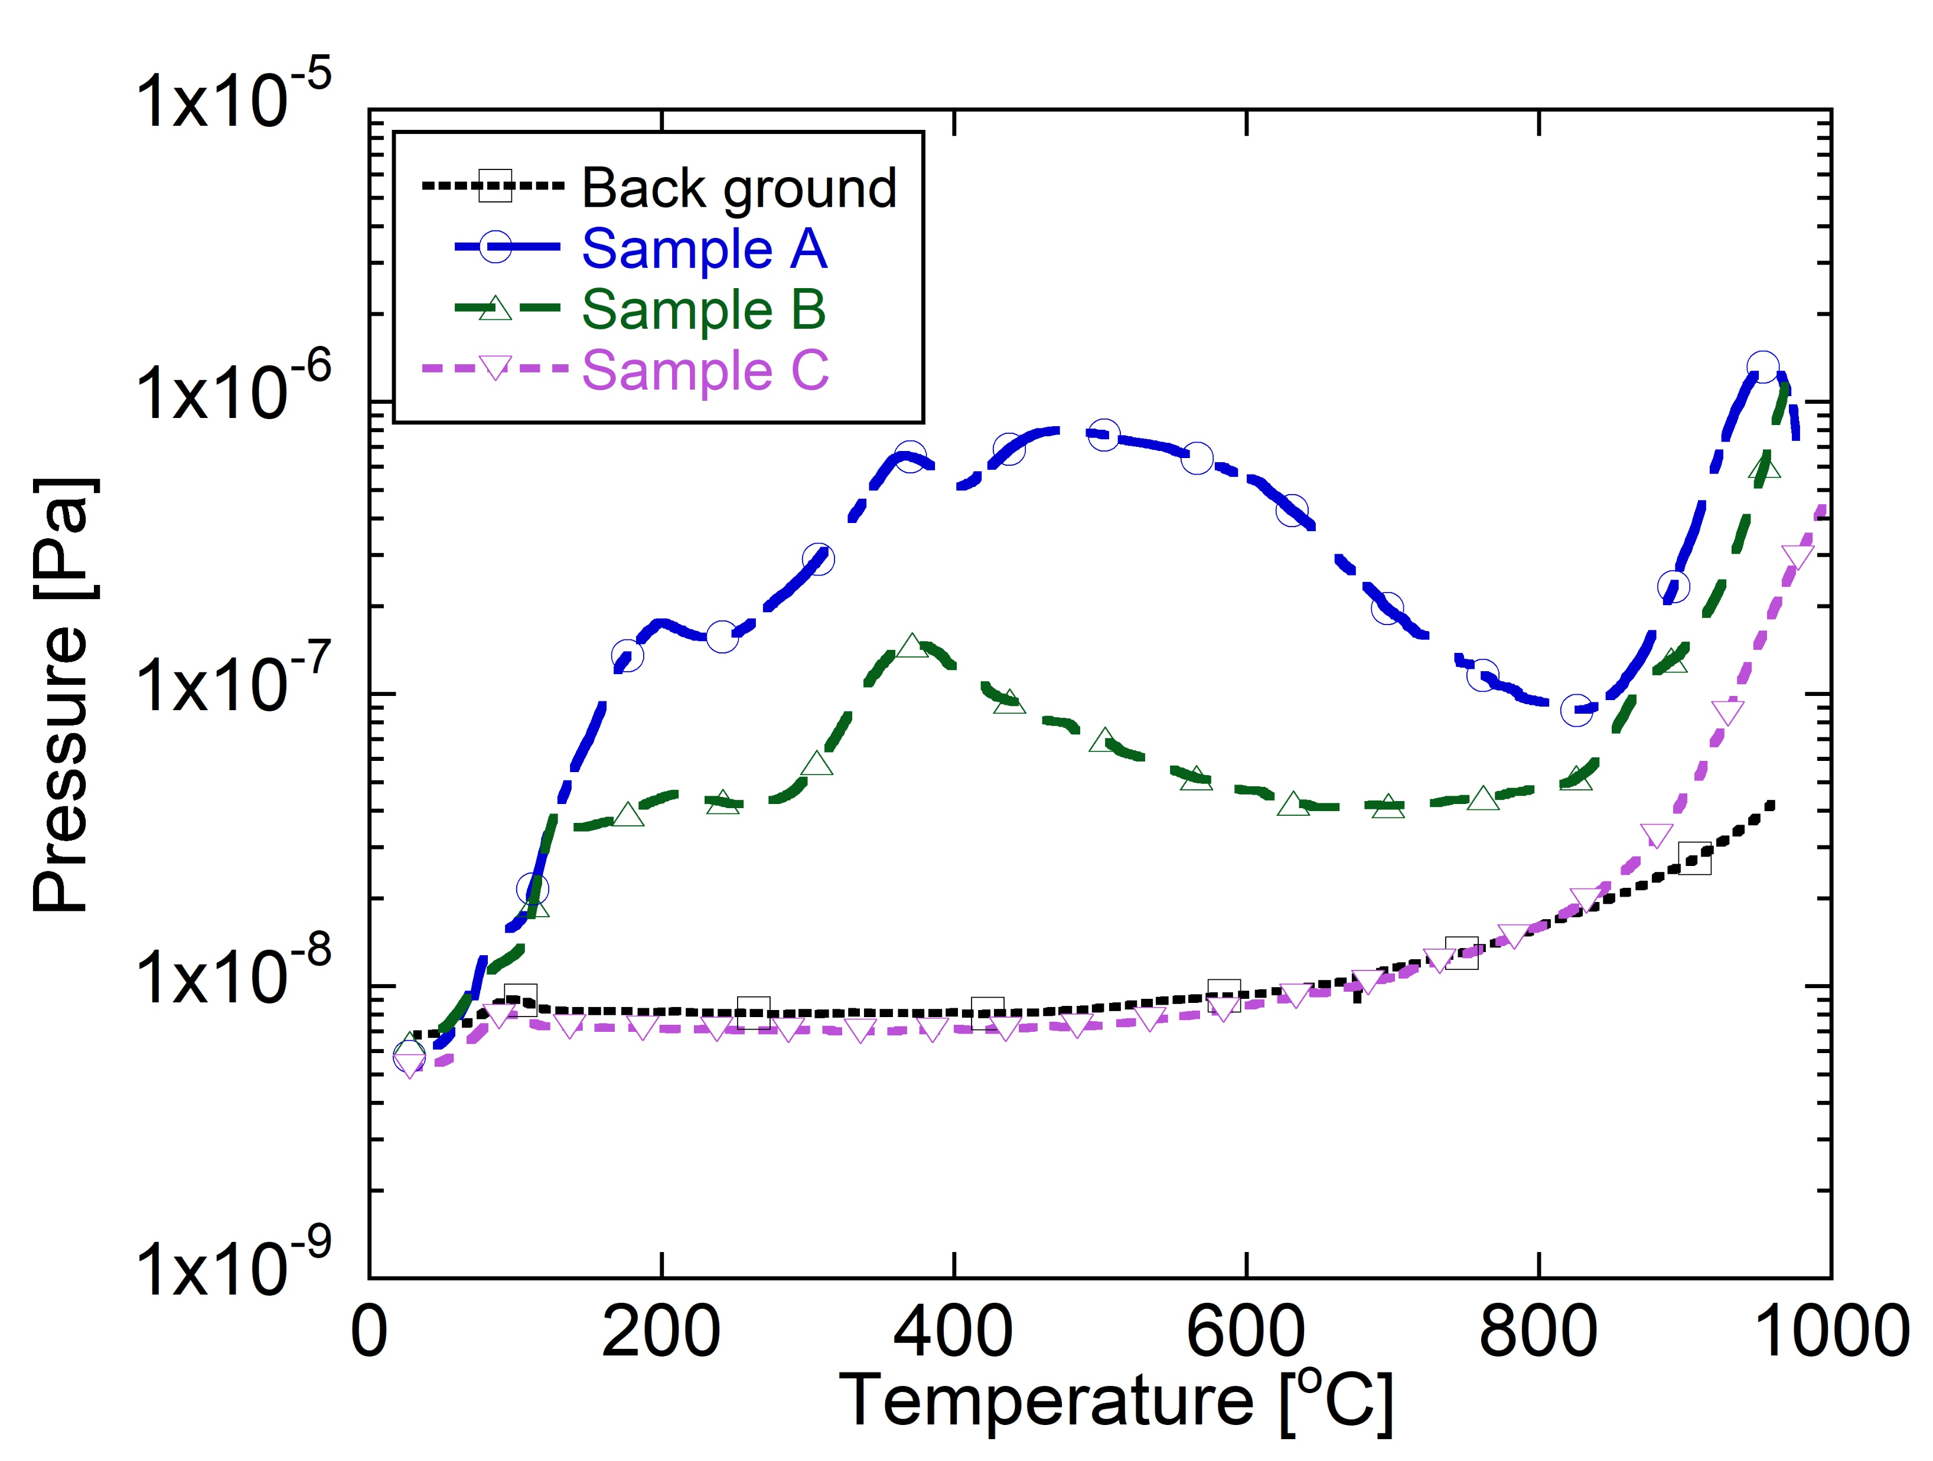
TDS result of SS samples: surface molecules
Sample: size 10 mm×10 mm ×^{t}1 mm
Comparison:
Background
Sample A: Non-vacuum-fired SUS
Sample B: Vacuum-fired SUS (air-exposed):
850℃ 10 H in TDS apparatus → Exposed to atmosphere more than a week → TDS measurement
Sample C: Vacuum-fired SUS (in-situ):
850℃ 10 H in TDS apparatus → TDS measurement
Vacuum-fired SUS (in-situ) is almost background level.
Outgassing is suppressed by the vacuum firing even after air exposure.

Slide 16
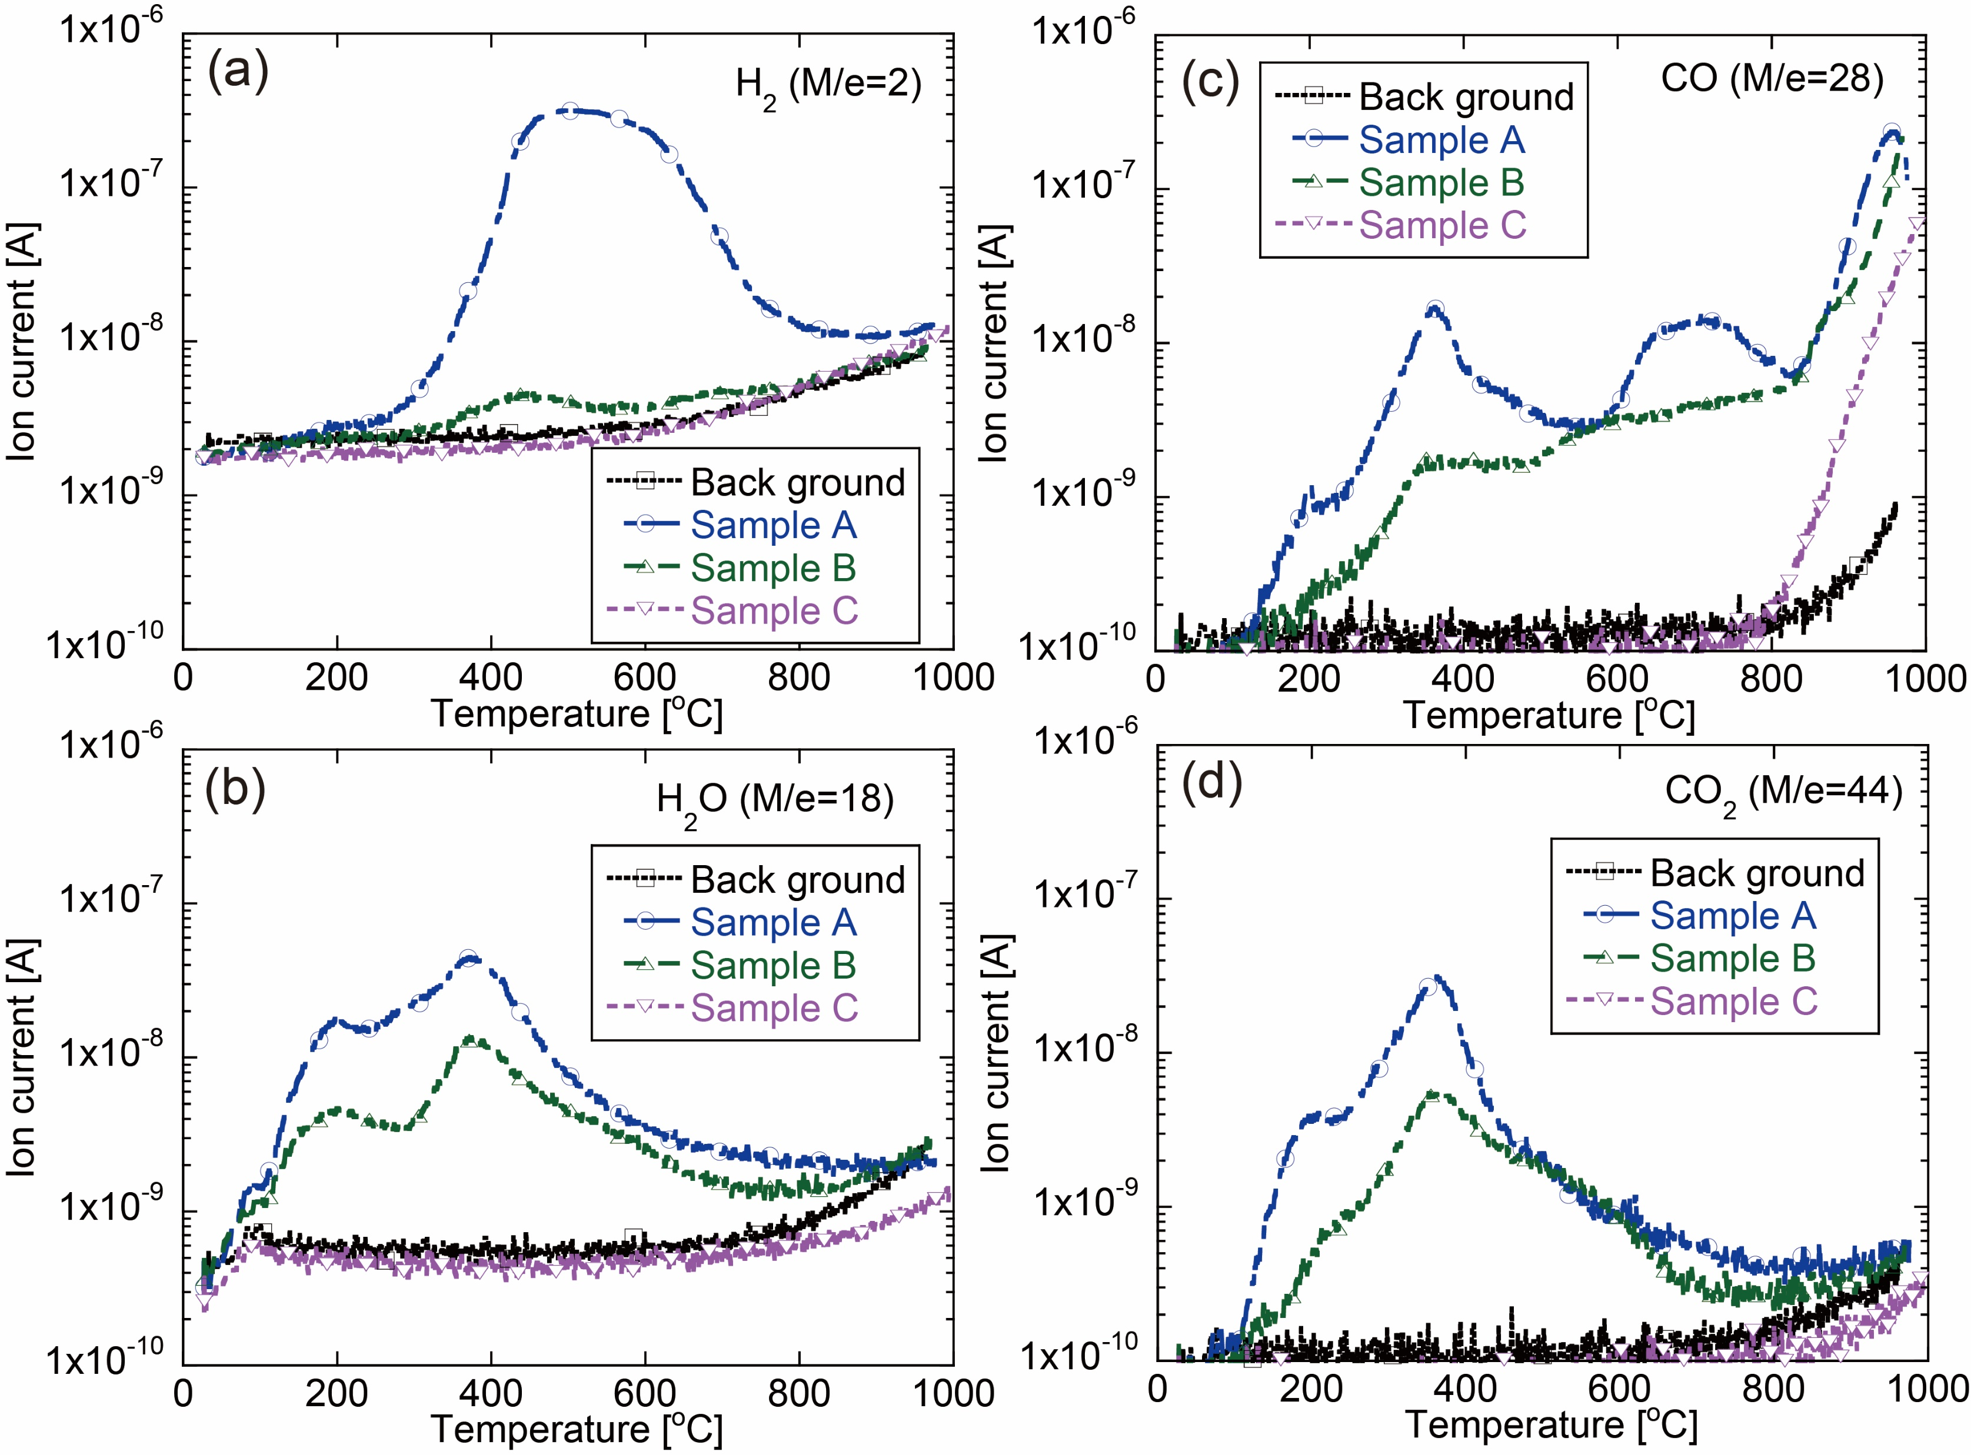
TDS result of SS samples: surface molecules
Background
Sample A: Non-vacuum-fired SUS
Sample B: Vacuum-fired SUS (air-exposed)
Sample C: Vacuum-fired SUS (in-situ)
Hydrogen of a vacuum-fired SUS is near background level even after air exposure.
H diffused to vacuum from bulk by vacuum firing and reabsorption in atmosphere is little.
Other gases reabsorb by air exposure, but degassing effect by the vacuum firing partially remains.
Resistant surface to gas adsorption would have been formed.

Slide 17
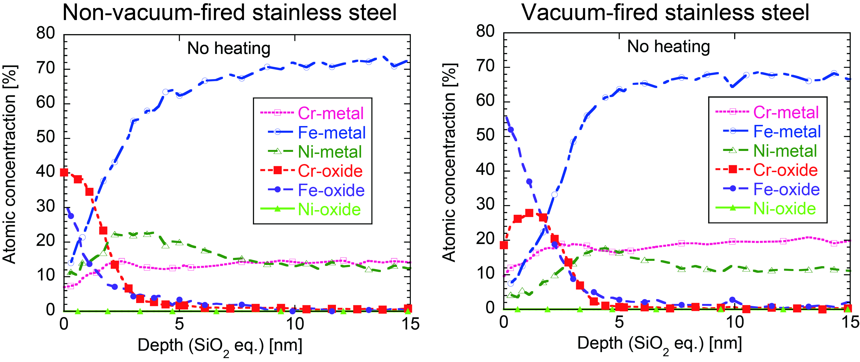
XPS result of SS samples: surface modification
XPS measurement was performed for SS samples without and with vacuum firing.
While non-vacuum-fired SS surface was mainly Cr-oxide, vacuum-fired SS surface was covered by Fe-oxide.
Fe-oxide
Cr-oxide

Slide 18
Surface Fe-oxide layer formation
200℃
Previous research by Sugimoto et. al revealed that the adsorbed water on Cr-oxide surface largely contributes the outgassing of the stainless steel.
300℃
T. Sugimoto, K. Takeyasu, K. Fukutani, “Gas behavior in the vacuum chamber with a single adsorption site on the chamber wall: Origin of the exponential pressure decay with the time constant of sub-kilo seconds. “ J. Vac. Soc. Jpn. 2013.
400℃
Cr
Fe
Auger electron spectroscopy (Achard et al. 1979, VACUUM):
Fe peak increases in higher temperature up to 900℃.
500℃
600℃
During vacuum firing, Fe-metal becomes main surface composition.
700℃
Fe-oxide surface was formed by the air exposure after vacuum firing.
800℃
900℃
Fe-oxide surface layer has an important role for outgassing reduction.

Slide 19
Summary
Mechanism of outgassing reduction by vacuum firing
Titanium:
  Formation of very thin Ti-oxide layer is formed by the Ti metalization during the vacuum firing and Ti oxidation by following air exposure
    as a getter by the high temperature baking
Stainless steel:
  Formation of the surface Fe-oxide layer, which is formed by the Fe metalization during vacuum firing and Fe oxidation by following air exposure
    as a diffusion barrier from the gas phase to the bulk
    as a gas readsorption resistant surface.

Slide 20
Backup

Slide 21
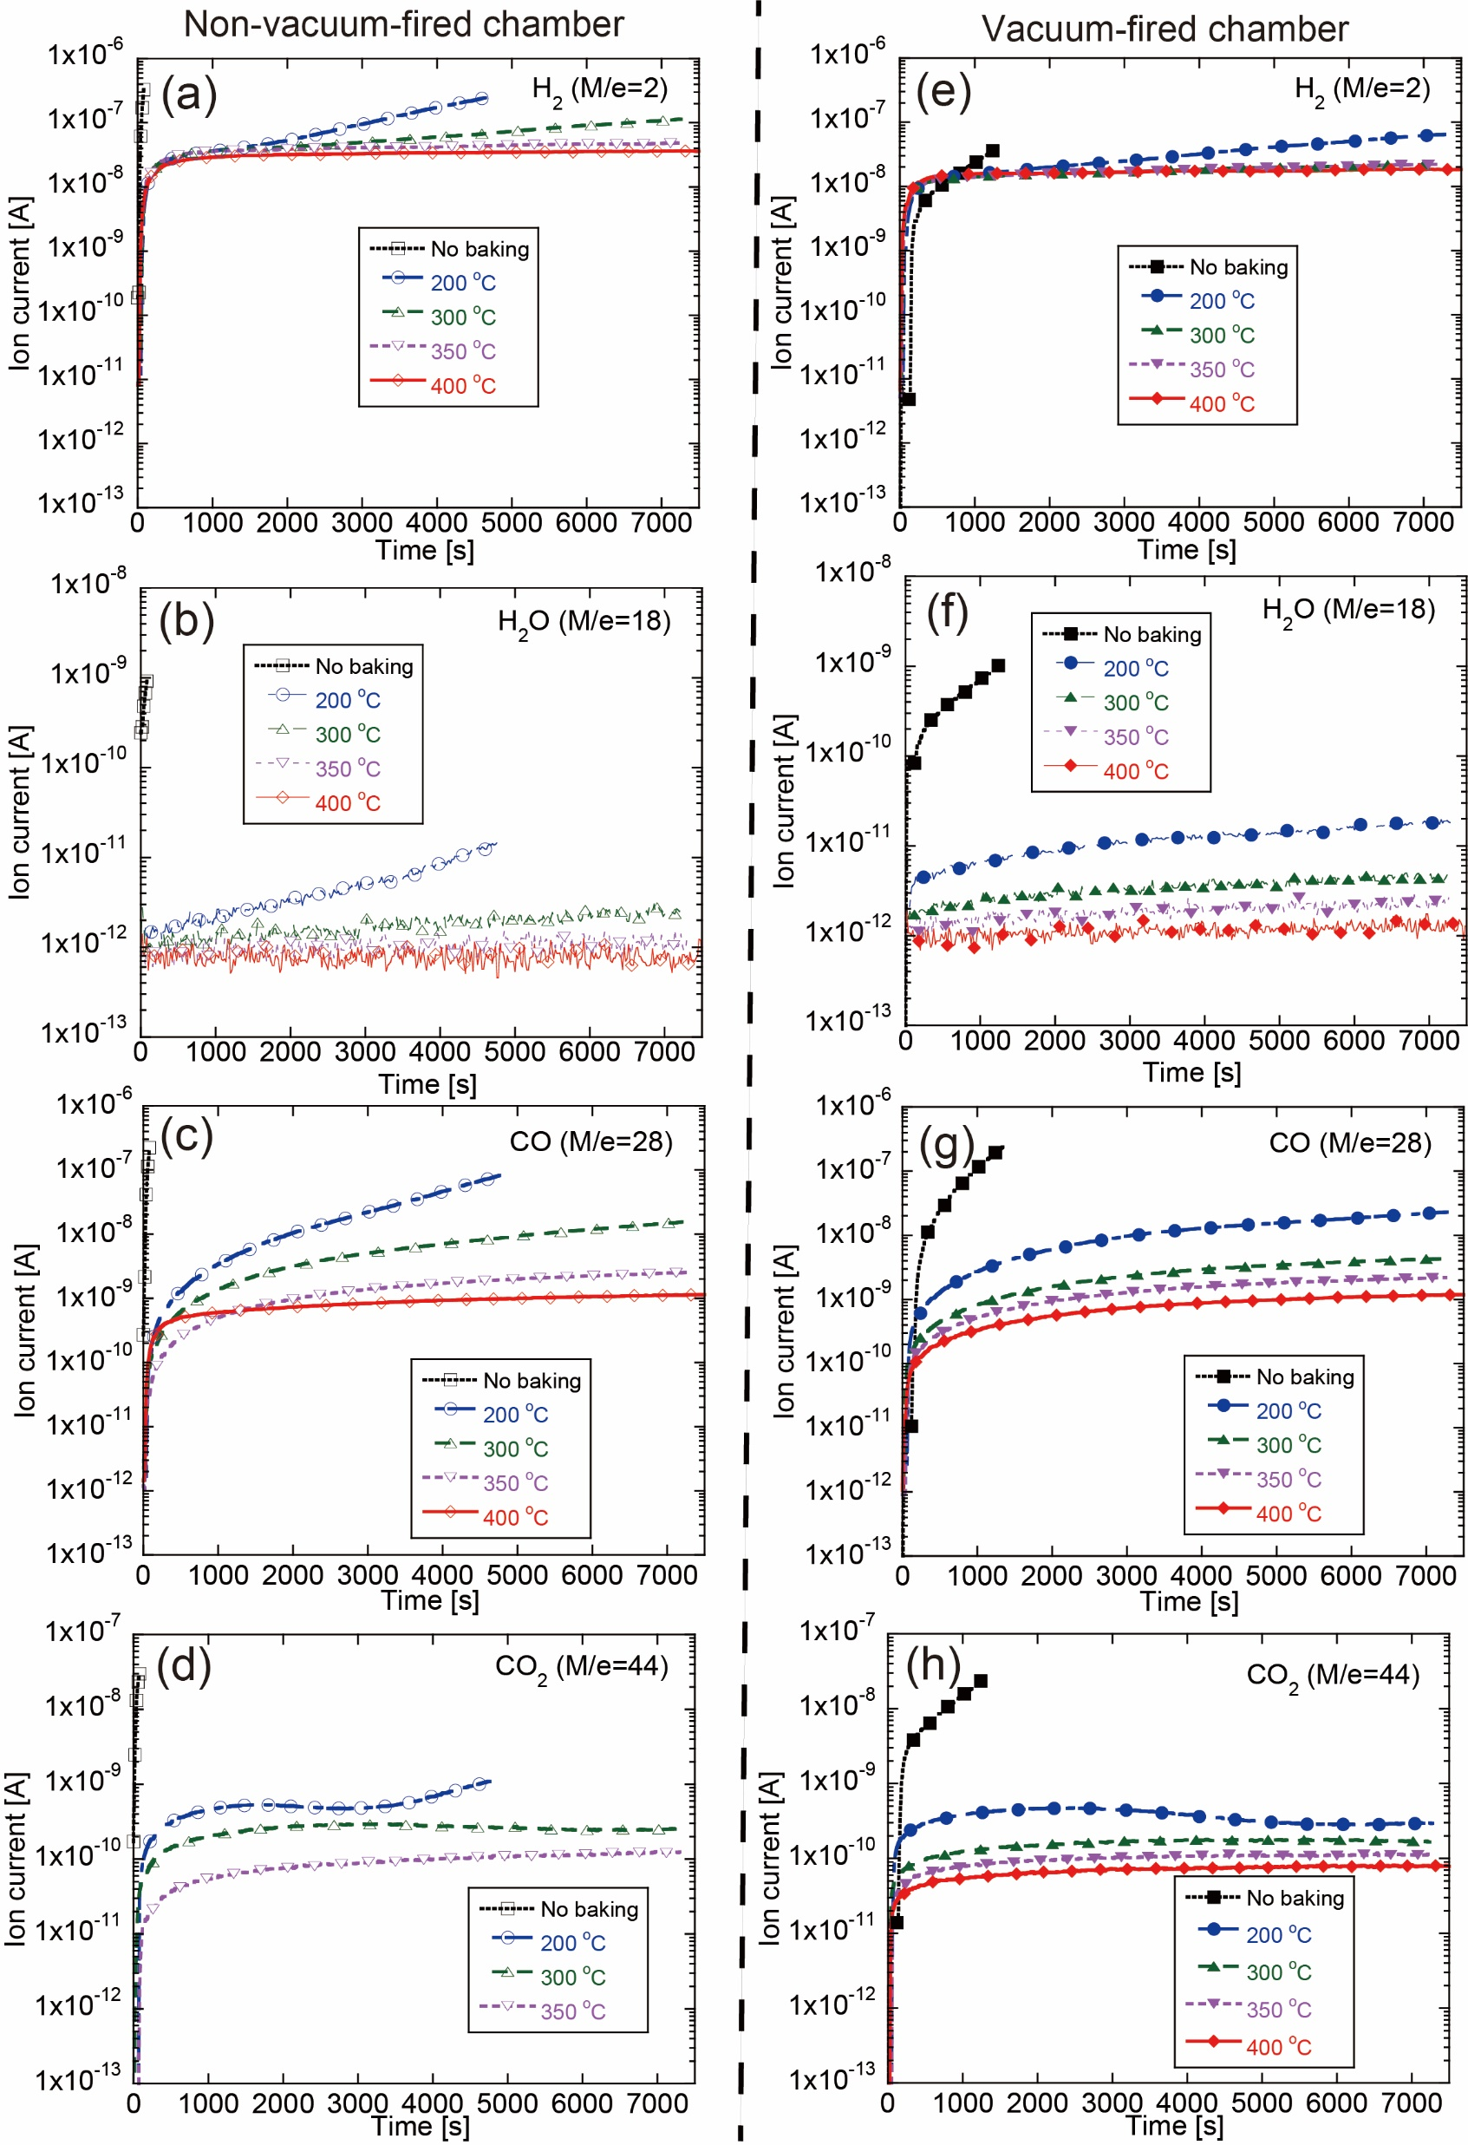
Build-up results: residual gas components
Vacuum firing reduced all the residual gas components.

Slide 22
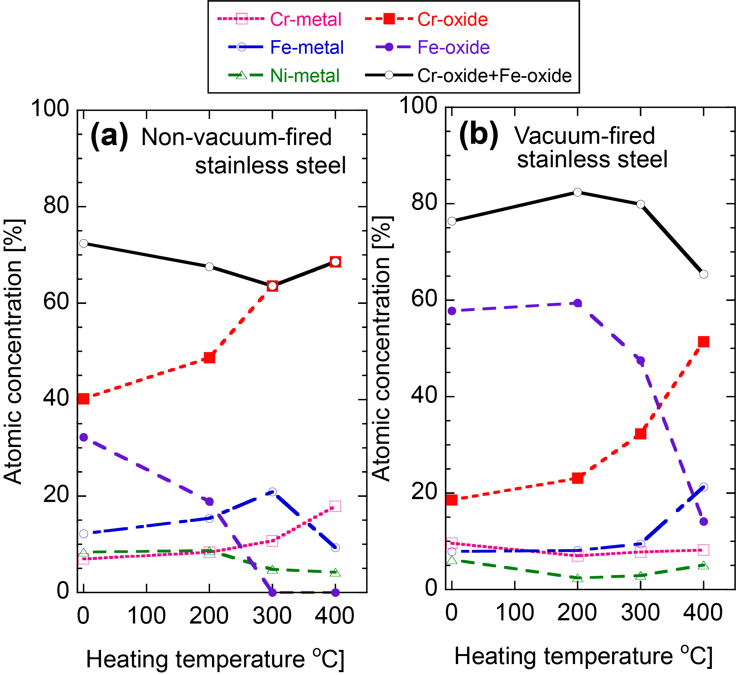
Surface modification process by heating
Clear dependence of Cr-oxide and F-oxide values on the heating temperature.
Non-vacuum-fired SS:
Cr-oxide increase at 300 & 400℃.
Vacuum-fired SS:
Fe-oxide decreases and Cr-oxide increase at 300 & 400℃.

