Slide 1
Latest Development at CLASSE
Yulin Li
Cornell Laboratory of Accelerator-based Sciences and Education (CLASSE)

Slide 2
Outline
Overview of CLASSE Research Activities
CESR and CHESS
CHESS-U
New CHESS Beamlines (HMF and XLEAP)

Slide 3
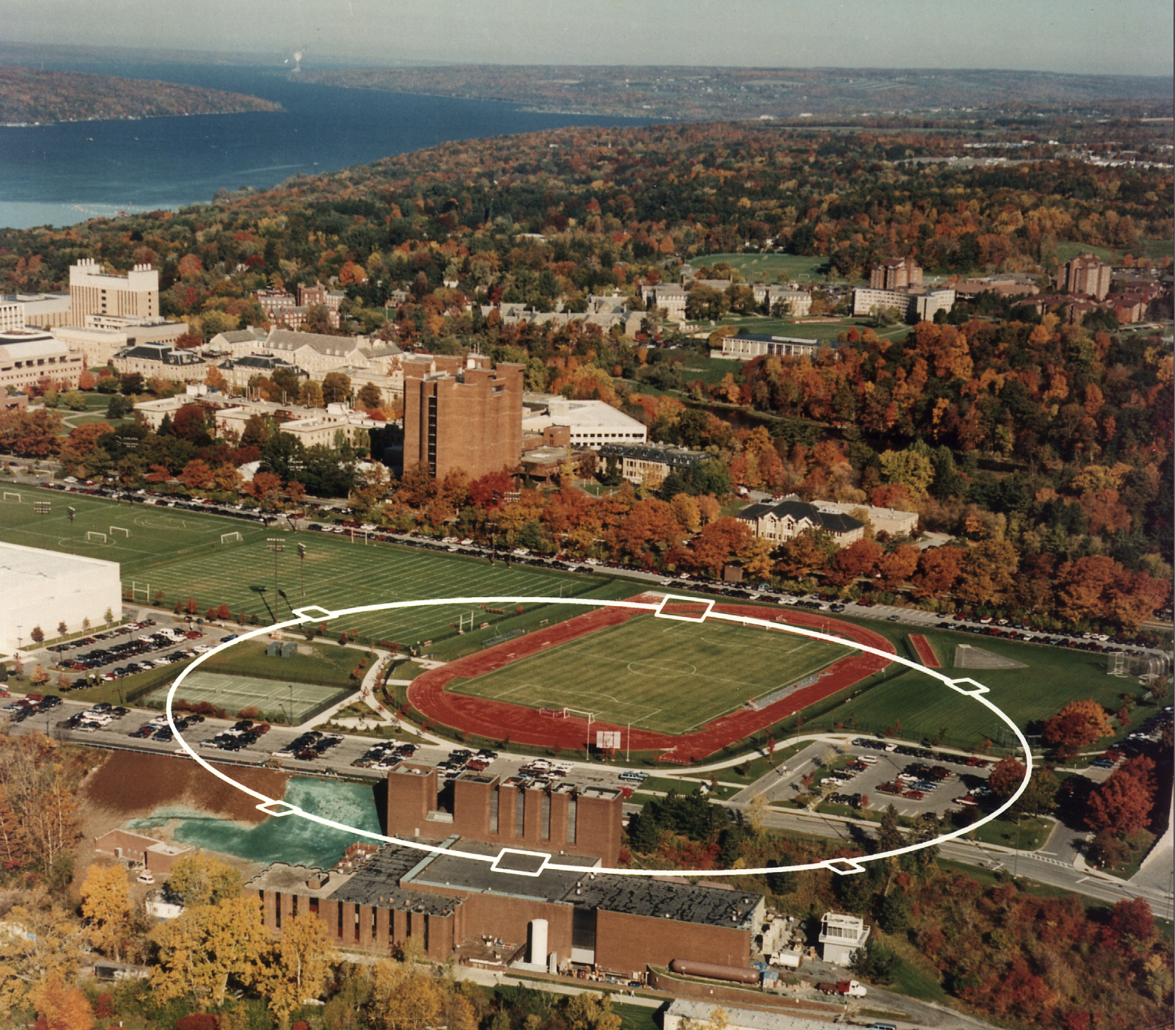
Overview of Research Activities at CLASSE
https://www.classe.cornell.edu
Laboratory of Elementary Particle Physics (LEPP)
We are cooled by the Lake !
Accelerator R&D
Center for Bright Beams (CBB)
Detectors R&D
(LHC-CMS)
(X-ray detectors)
Particle Physics
Cosmology
Cornell High Energy Synchrotron Sources (CHESS)
The Center for High-Energy X-ray Sciences (CHEXS) – NSF funded. High-energy X-ray science in biological sciences, engineering and materials research.
Materials Solutions Network at CHESS (MSN-C) – AFRL funded. Manufacturing processes improvement, material failure characterization, etc.
Macromolecular X-ray science (MacCHESS) – NIH funded. Insights of fundamental biological processes (signaling across membranes, enzyme catalysis, and gene expression, etc.)
Cornell Electron Storage Ring (CESR) Tunnel (~40-ft underground)

Slide 4

https://cbb.cornell.edu
A NSF S&T Center, with 8 universities and 3 National Labs as partners
Beam Productions
→ Photocathodes for high peak intensity beam generation with <5 meV MTE
→ Long-lived cathodes in extreme electric fields and at high averge beam current
Beam Accelerations
→ Advanced SRF material growth: improved methods and impact of realistic surfaces on performances
→ Multi-layers and inhomogeneous layers: increasing RF performance via surfaces by design
→ High efficiency and higher fields in SRF cavities
Beam Dynamics and Control
→ Preservation of low MTE photocathode injector in the presence of collective effects
→ Develop beam cooling using optical stochastic cooling (OSC)

Slide 5
CHESS Upgrade (CHESS-U)
(2018-2019)

Slide 6
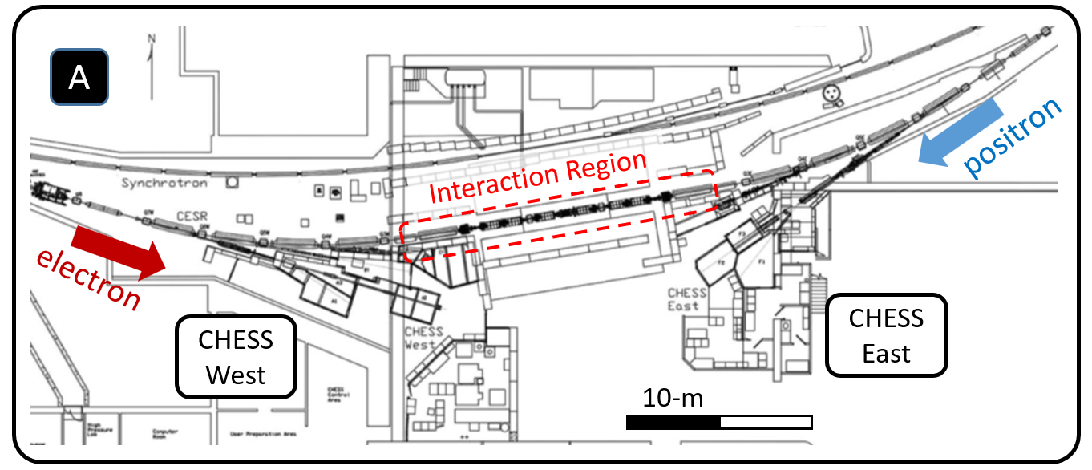
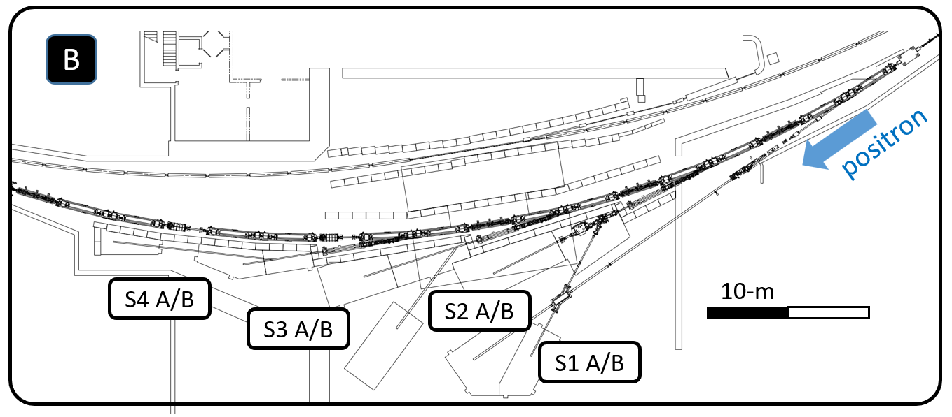
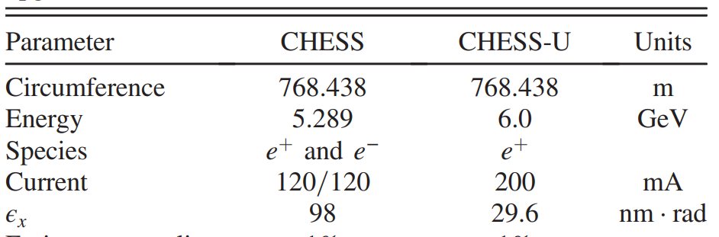
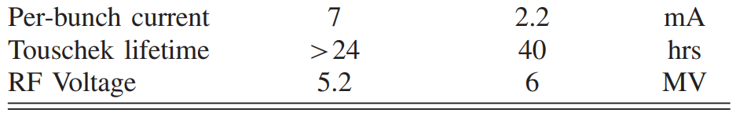
CHESS Upgrade (CHESS-U)
Prior to 2008, CESR supported both HEP (CLEO) and X-ray (CHESS) operations simultaneously.
2008 – 2018, Cesr-TA (ILC-DR) and CHESS operated in a time-share mode.
A major upgrade (CHESS-U) was accomplished in 2018-2019, with a 20+M$ from Empire State Development Agency (ESDA), and additional supplement funding from Cornell Univ. The CESR South Arc (~ 80m) was replaced with new magnets, vacuum system, IDs and X-ray beamlines.

Slide 7
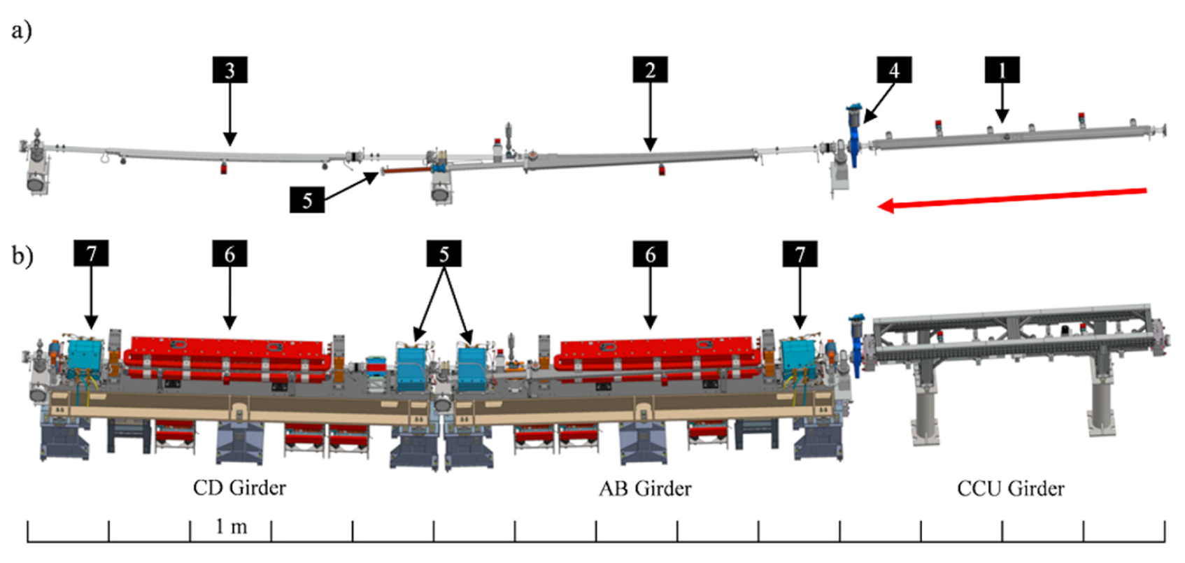
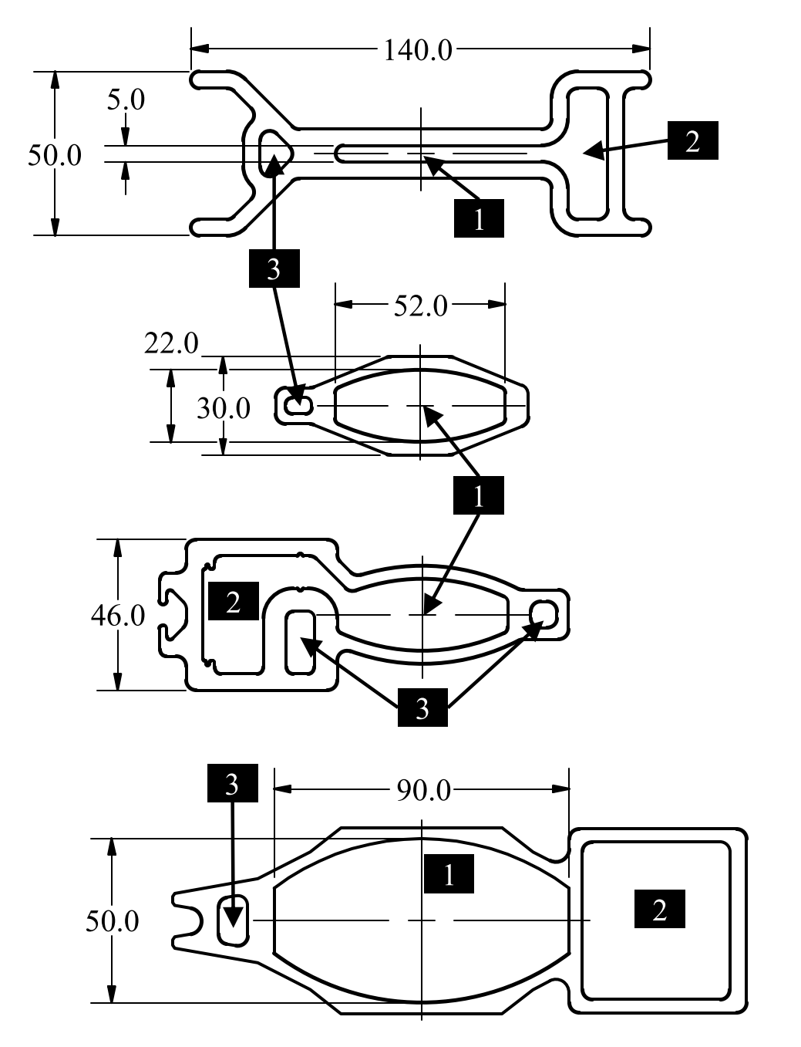
CHESS-U Vacuum Chambers
Undulator Chamber
Dipole C Chamber
Dipole A Chamber w/ X-ray egress
S Arc consists of 6 achromat cells, each made of two girders and an ID
To minimize vacuum system foot-print, a single long vacuum chamber was constructed for each girder

Slide 8
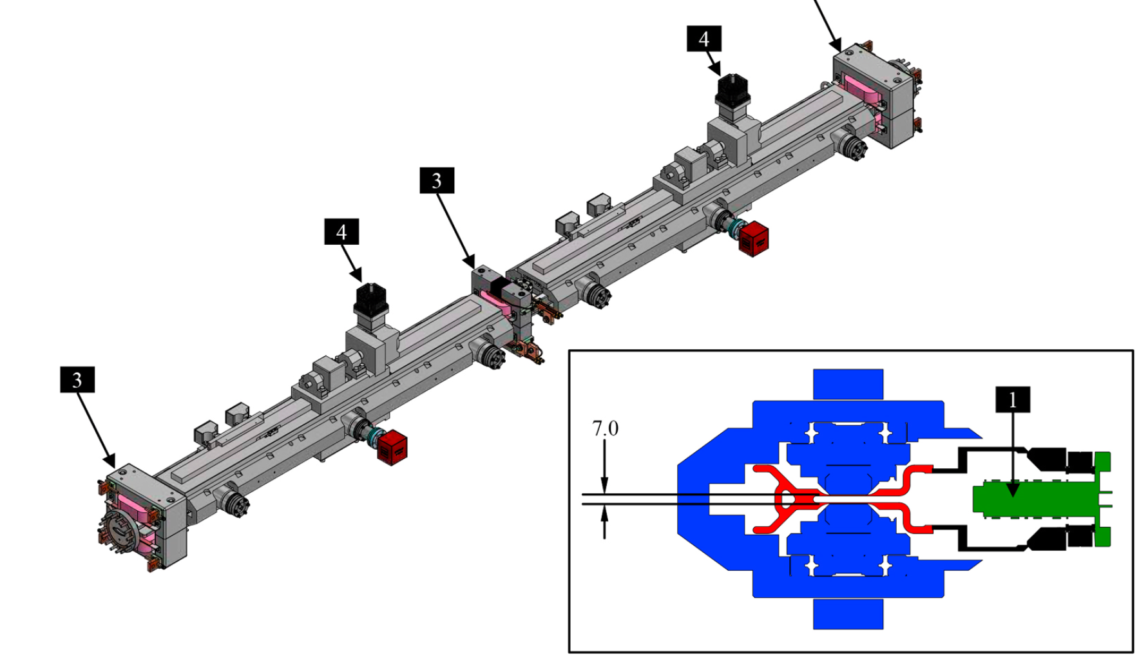
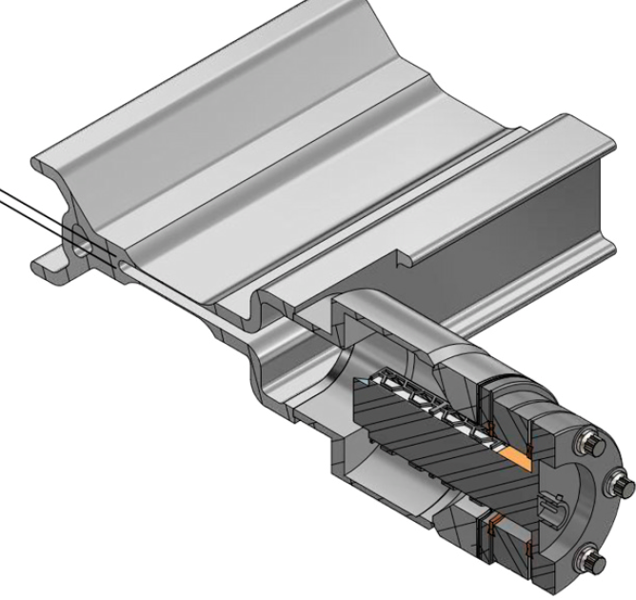
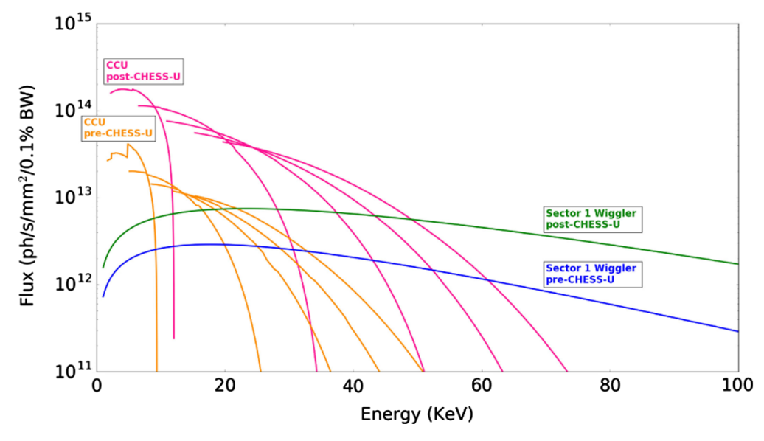
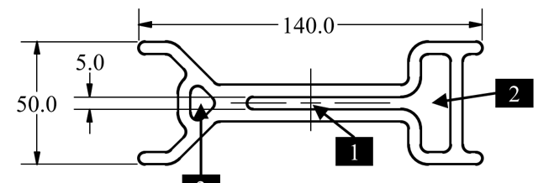
CHESS-U Undulator Chambers
Cornell Compact Undulators (CCUs) are the primary insertion devices (IDs) for the CHESS-U, producing very high photon flux at very high photon energy.
Each ID vacuum chamber need to accommodate two canted CCUs.
To allow 6.5~7.0-mm CCU gap, the central portion of the 6061-T6 extrusions is machined to a thickness of ~0.6-mm, resulting 0.12-mm deflection under vacuum.
Though the thin-wall ID chambers are mechanically sound, we have experienced 4 failures from the beam mis-steering (see presentation by Leila Aboharb).

Slide 9
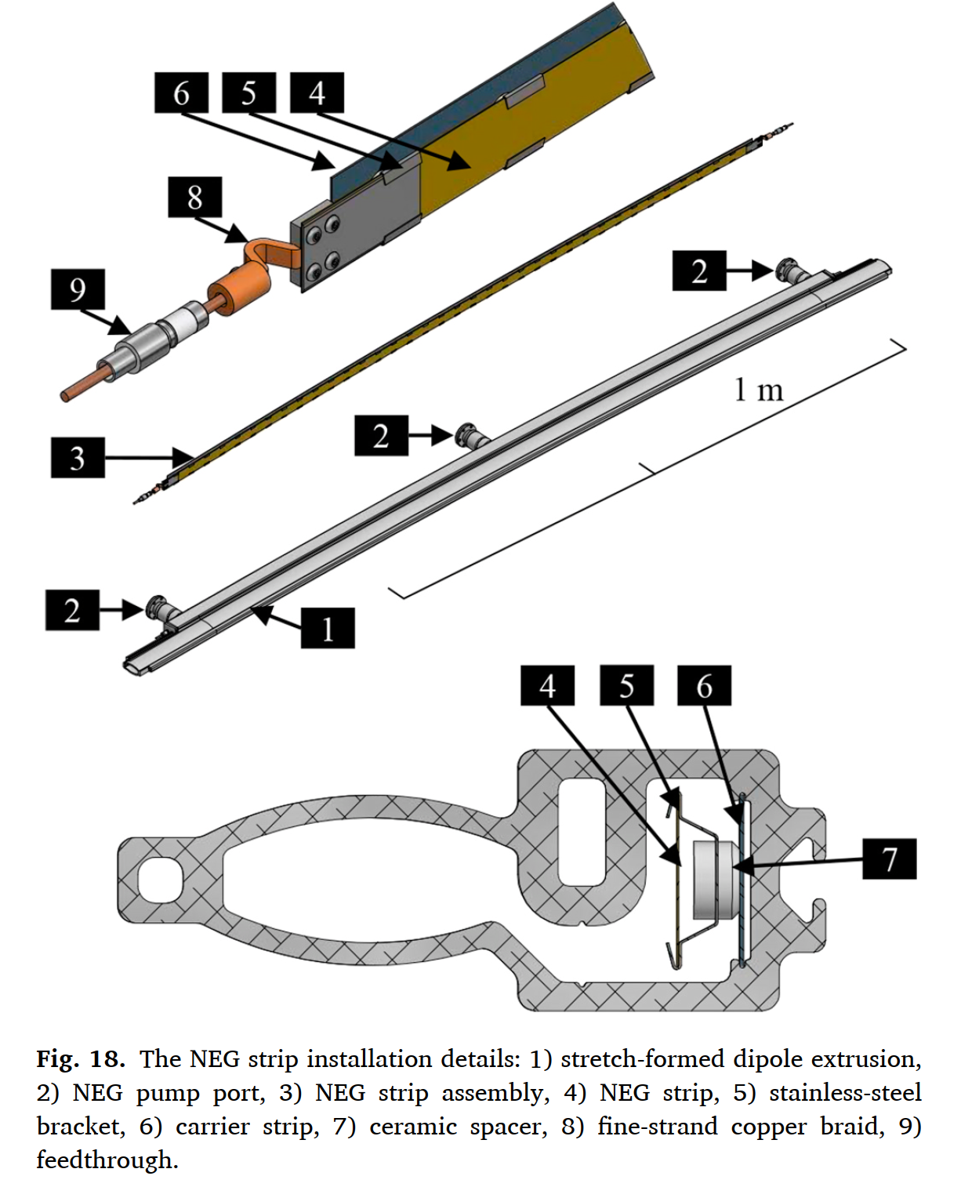
CHESS-U Vacuum Pumping and Instrumentation
NEG strip (SAES’ st-707) assemblies are deployed in the Dipole Chambers to provide main distributed pumping
One noble-diode ion pump and two high capacity modular NEG pumps (SAES’ CapaciTorr and NexTorr) are installed per dipole chamber to aid efficient vacuum beam conditioning after any vacuum intervention.
ID chambers are pumped by 6 modular NEG pumps, due to temperature sensitivities of the CCUs
Vacuum performance are monitored with 3 cold-cathode gauges per achromat cell, and a RGA every two cells.

Slide 10
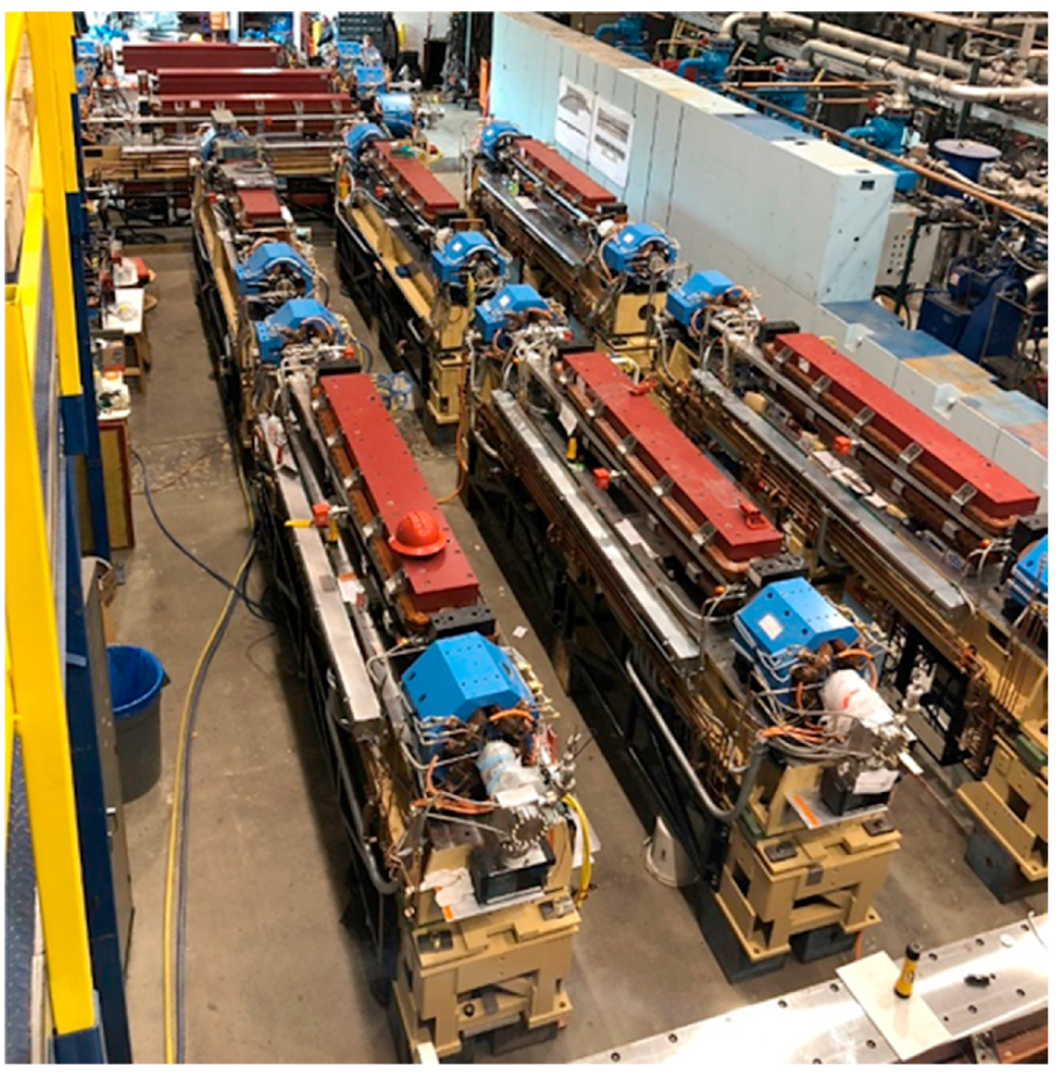
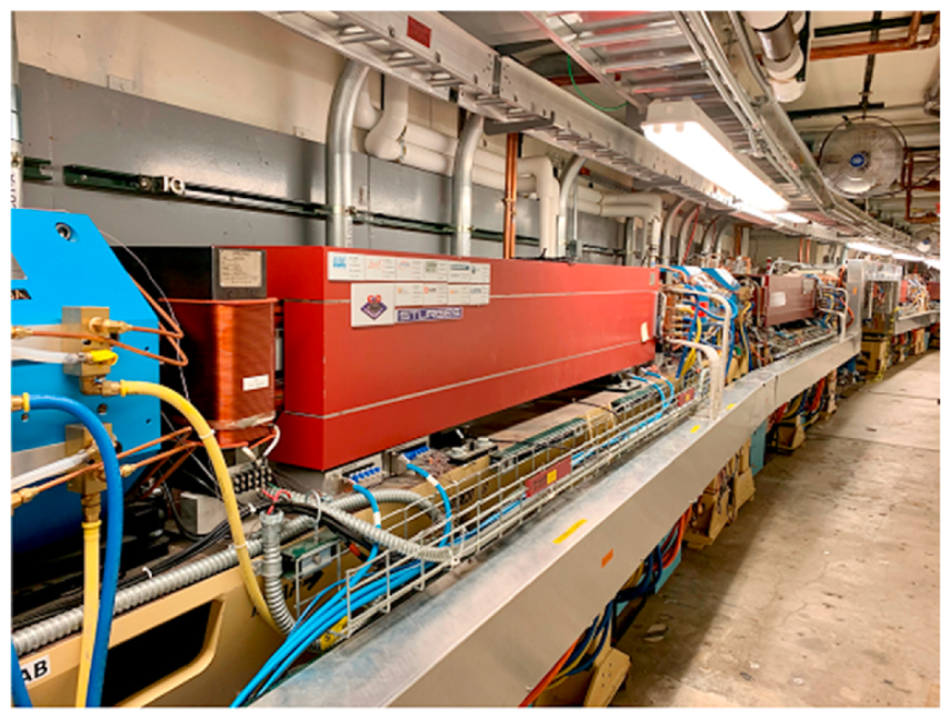
Girder Fabrication and Installation – 1 Year ‘Dark-Time’
Girders Installed 2019
Girders Staging 2018

Slide 11
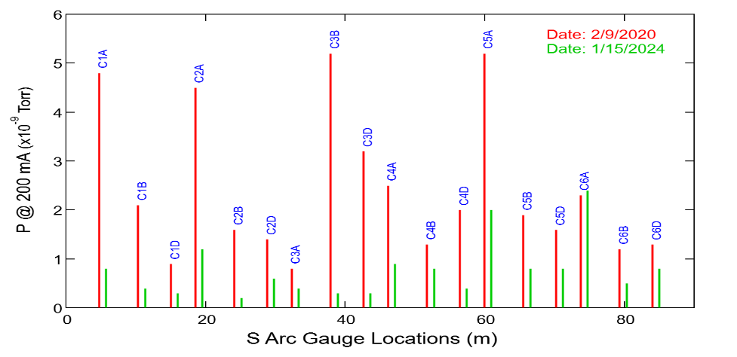
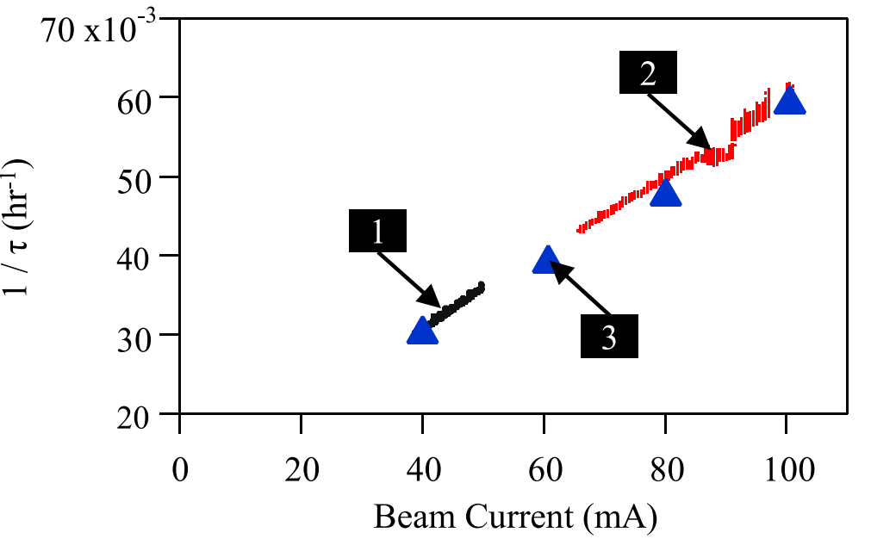
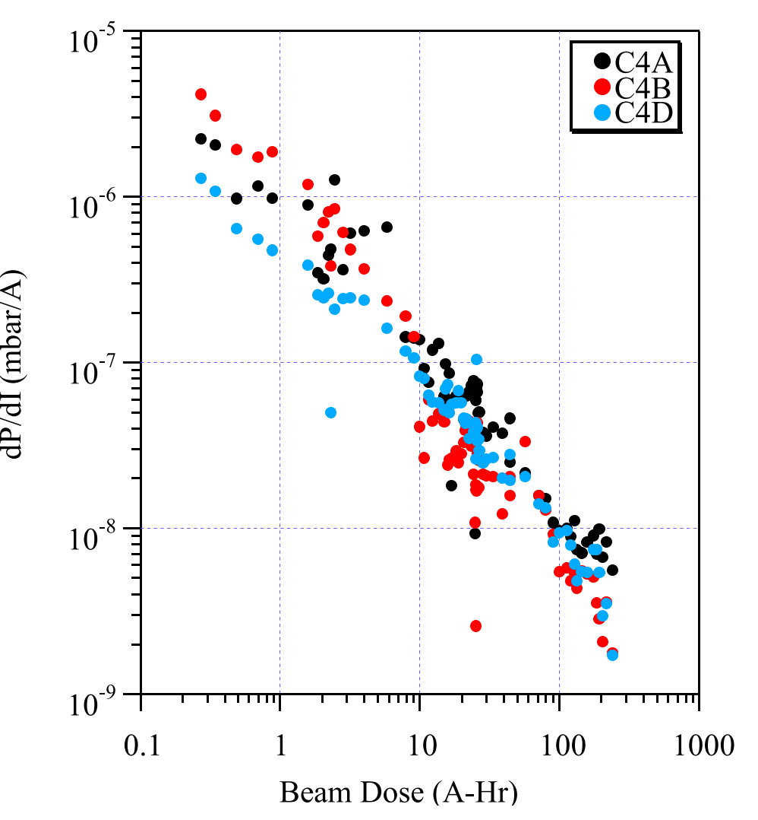
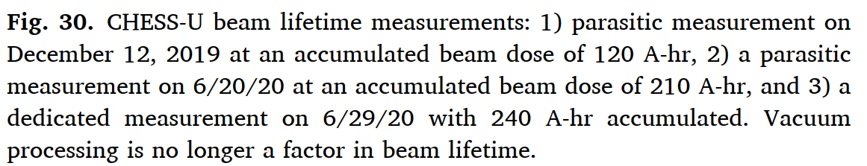
CHESS-U Vacuum Conditioning and Performance
CHESS-U vacuum system performed well.
Installed NEG-dominated pumping system provided sufficient pumping speed and capacity to handle initial beam conditioning, as well as many scheduled and unscheduled vacuum interventions.
Beam lifetime no longer limited by vacuum with >100 A-hr beam dose in the initial conditioning during CHESS-U commissioning, and with >1 A-hr for partial (unplanned) interventions.
CESR has reached designed 200-mA stored beam, but operating for X-ray users at 125-mA

Slide 12
High Magnetic Field Beamline Project at CHESS (2021-2025)
With partners of Nat. MagLab and Univ. Puerto Rico

Slide 13
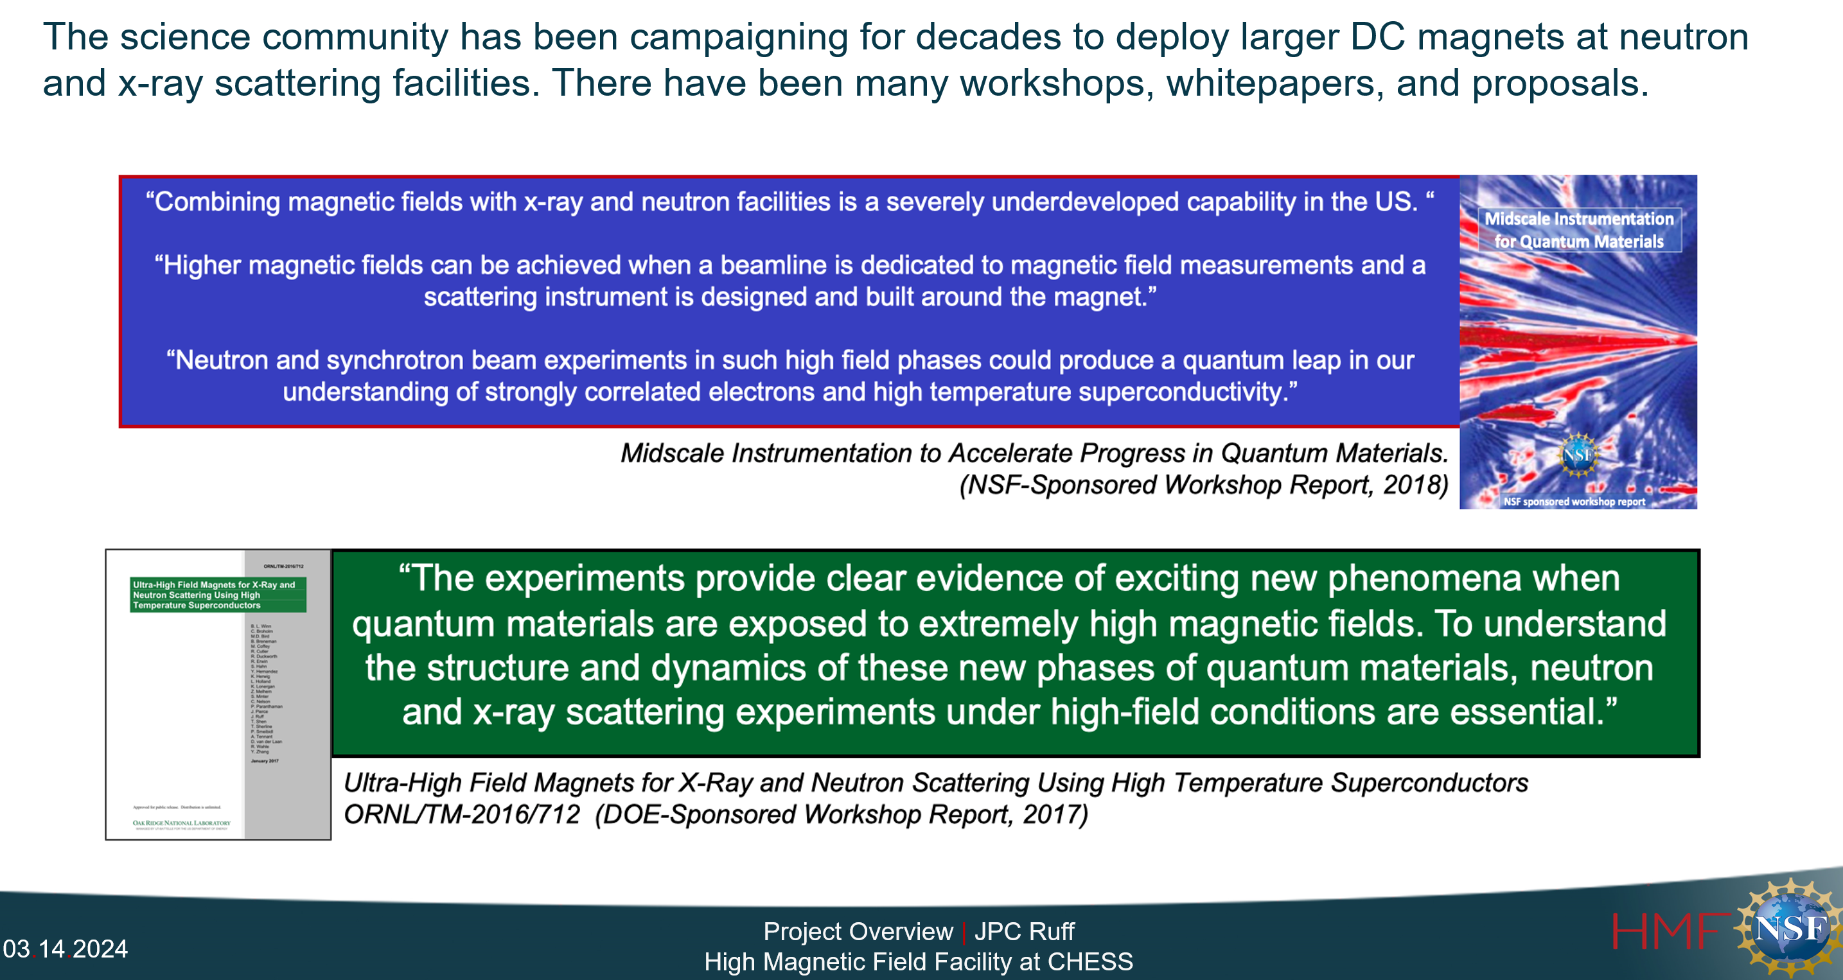
HMF Beamline – Science Cases

Slide 14
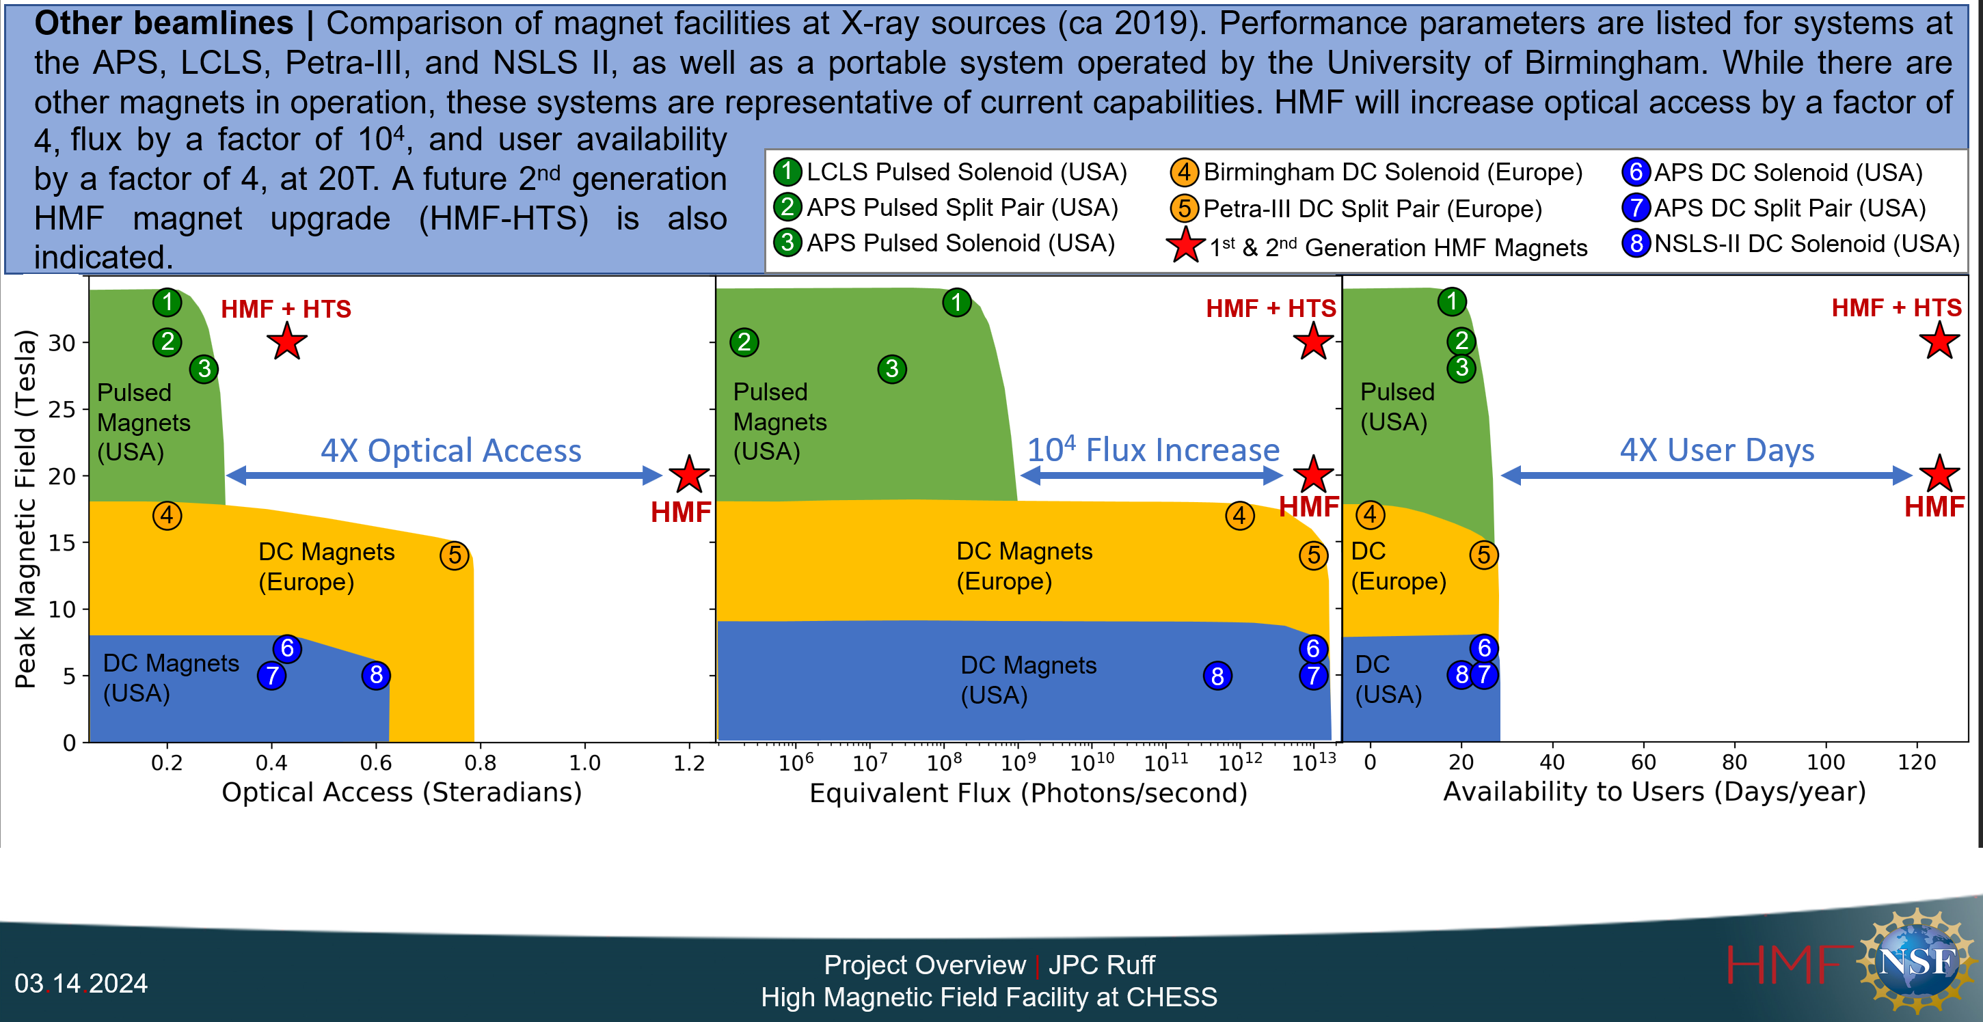
HMF at CHESS – Advantages

Slide 15
HMF Project – Timeline
MSRI-2 Proposal to NSF (08/2019)
Award ($32M) announced by NSF 10/2020 (with bridging funds from NYS and Cornell)
Project began (01/2021)
→ HMF beampipes (accel and BL) design and fabrication
→ New Experiment Hall construction (03/2022-12/2023)
→ Accelerator vacuum modification (Summer 2022)
→ HMF beamline Front End installation (Summer 2024)
→ HMF beamline and End Station installation (12/2023 – 06/2025)
Commissioning experiments to begin 06/2025
HMF begins user operations in 01/2026

Slide 16
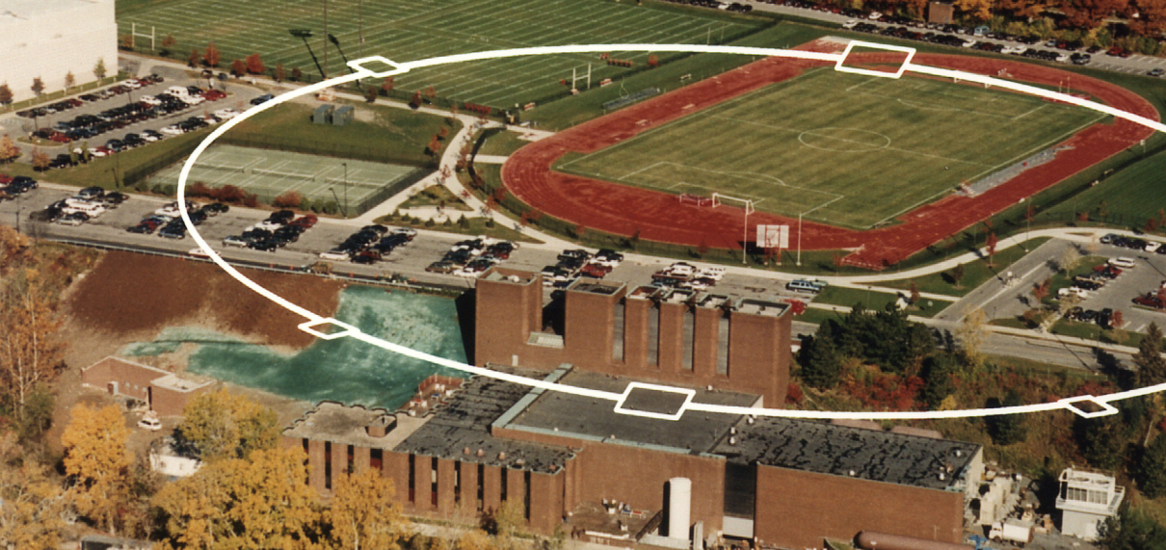
Wilson West – the New Experimental Hall
S7 Station
HMF (S5) Station

Slide 17
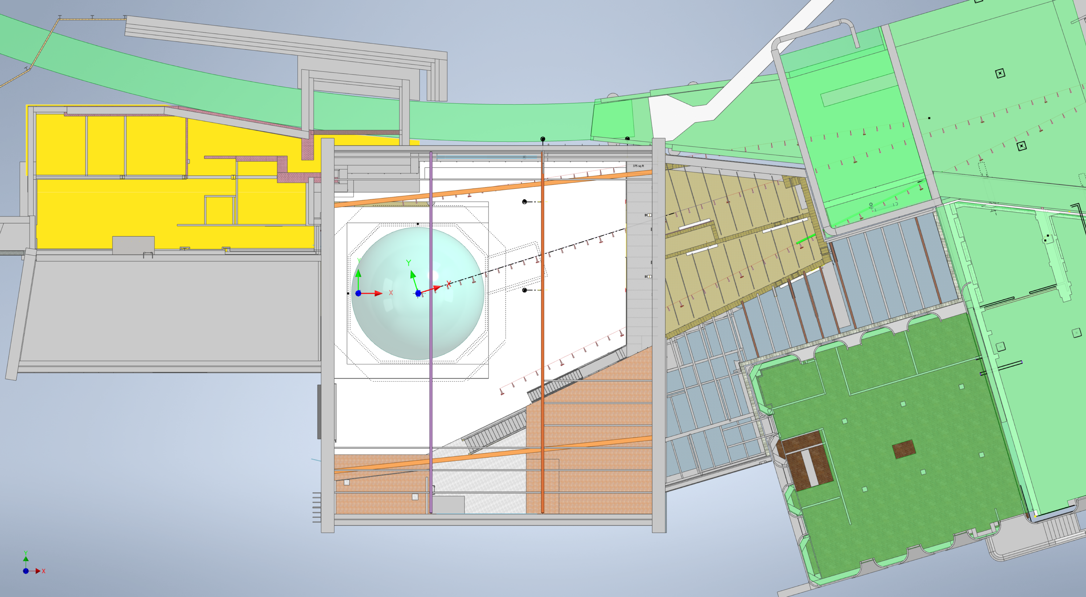
Wilson West Overview
GREEN – Wilson and Tunnel
Existing S7 Station
HMF S5 Station
Funding: $20M (ESDA)
$8M (Cornell)
Added Space ~15000 sq.ft
Courtesy: Dave Spurgin

Slide 18
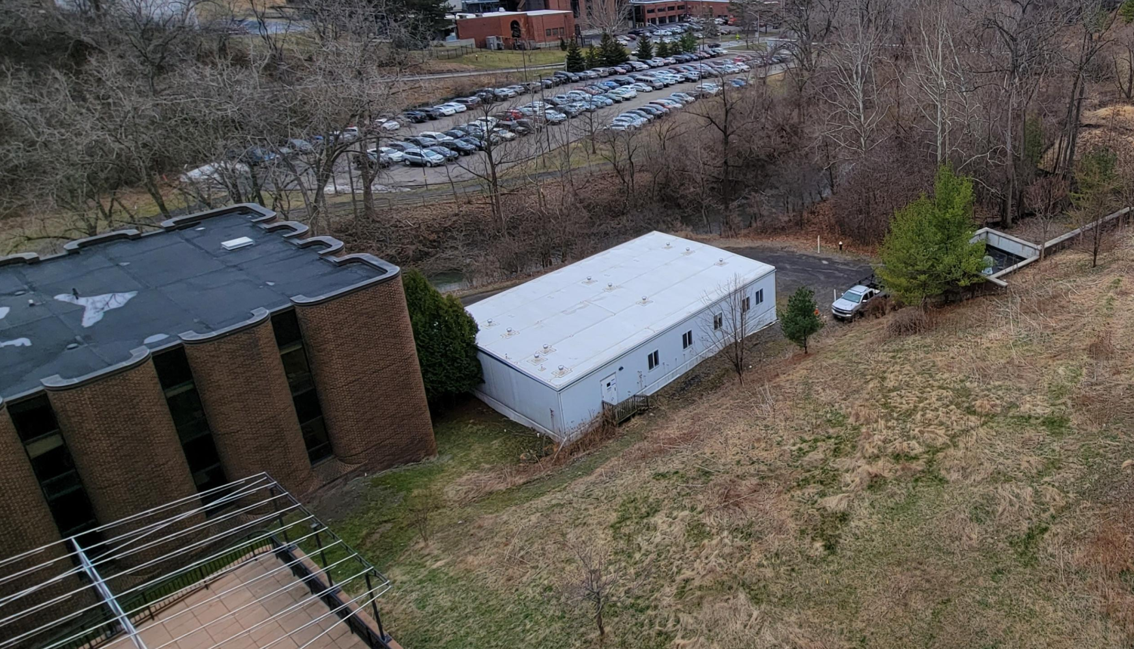
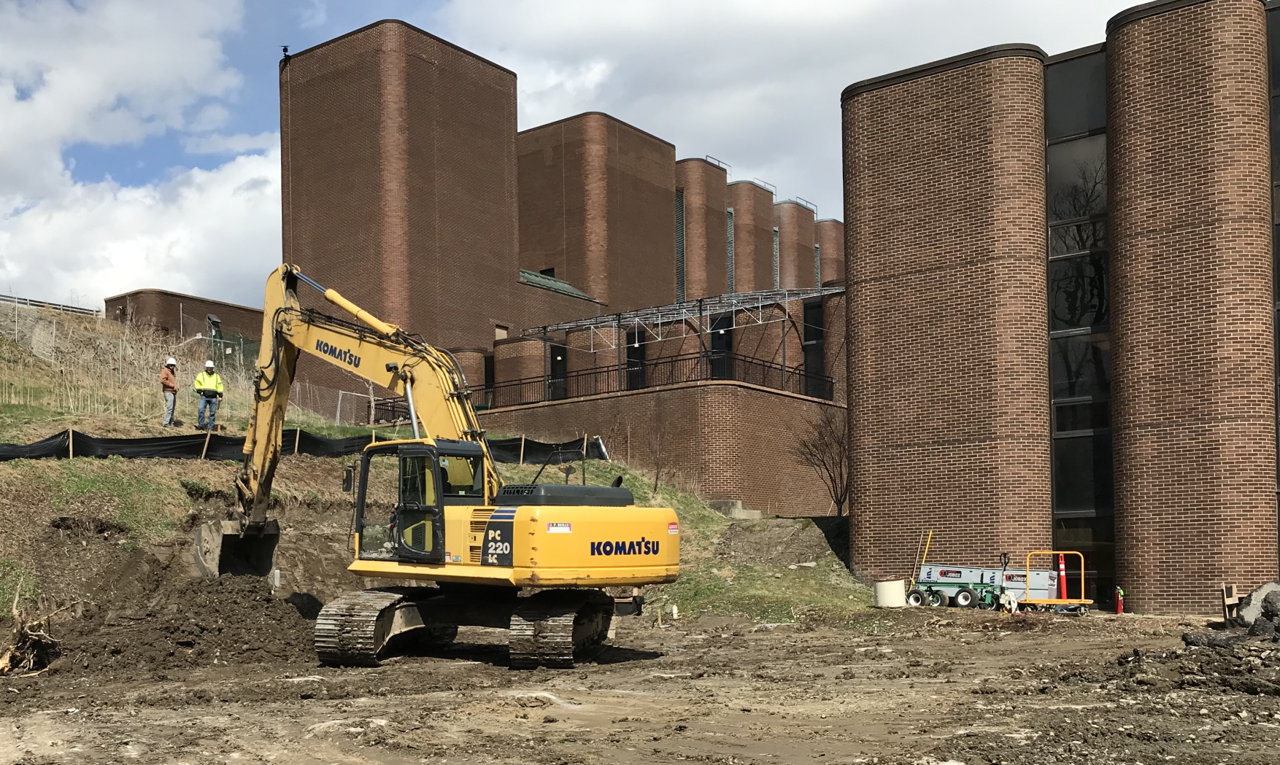
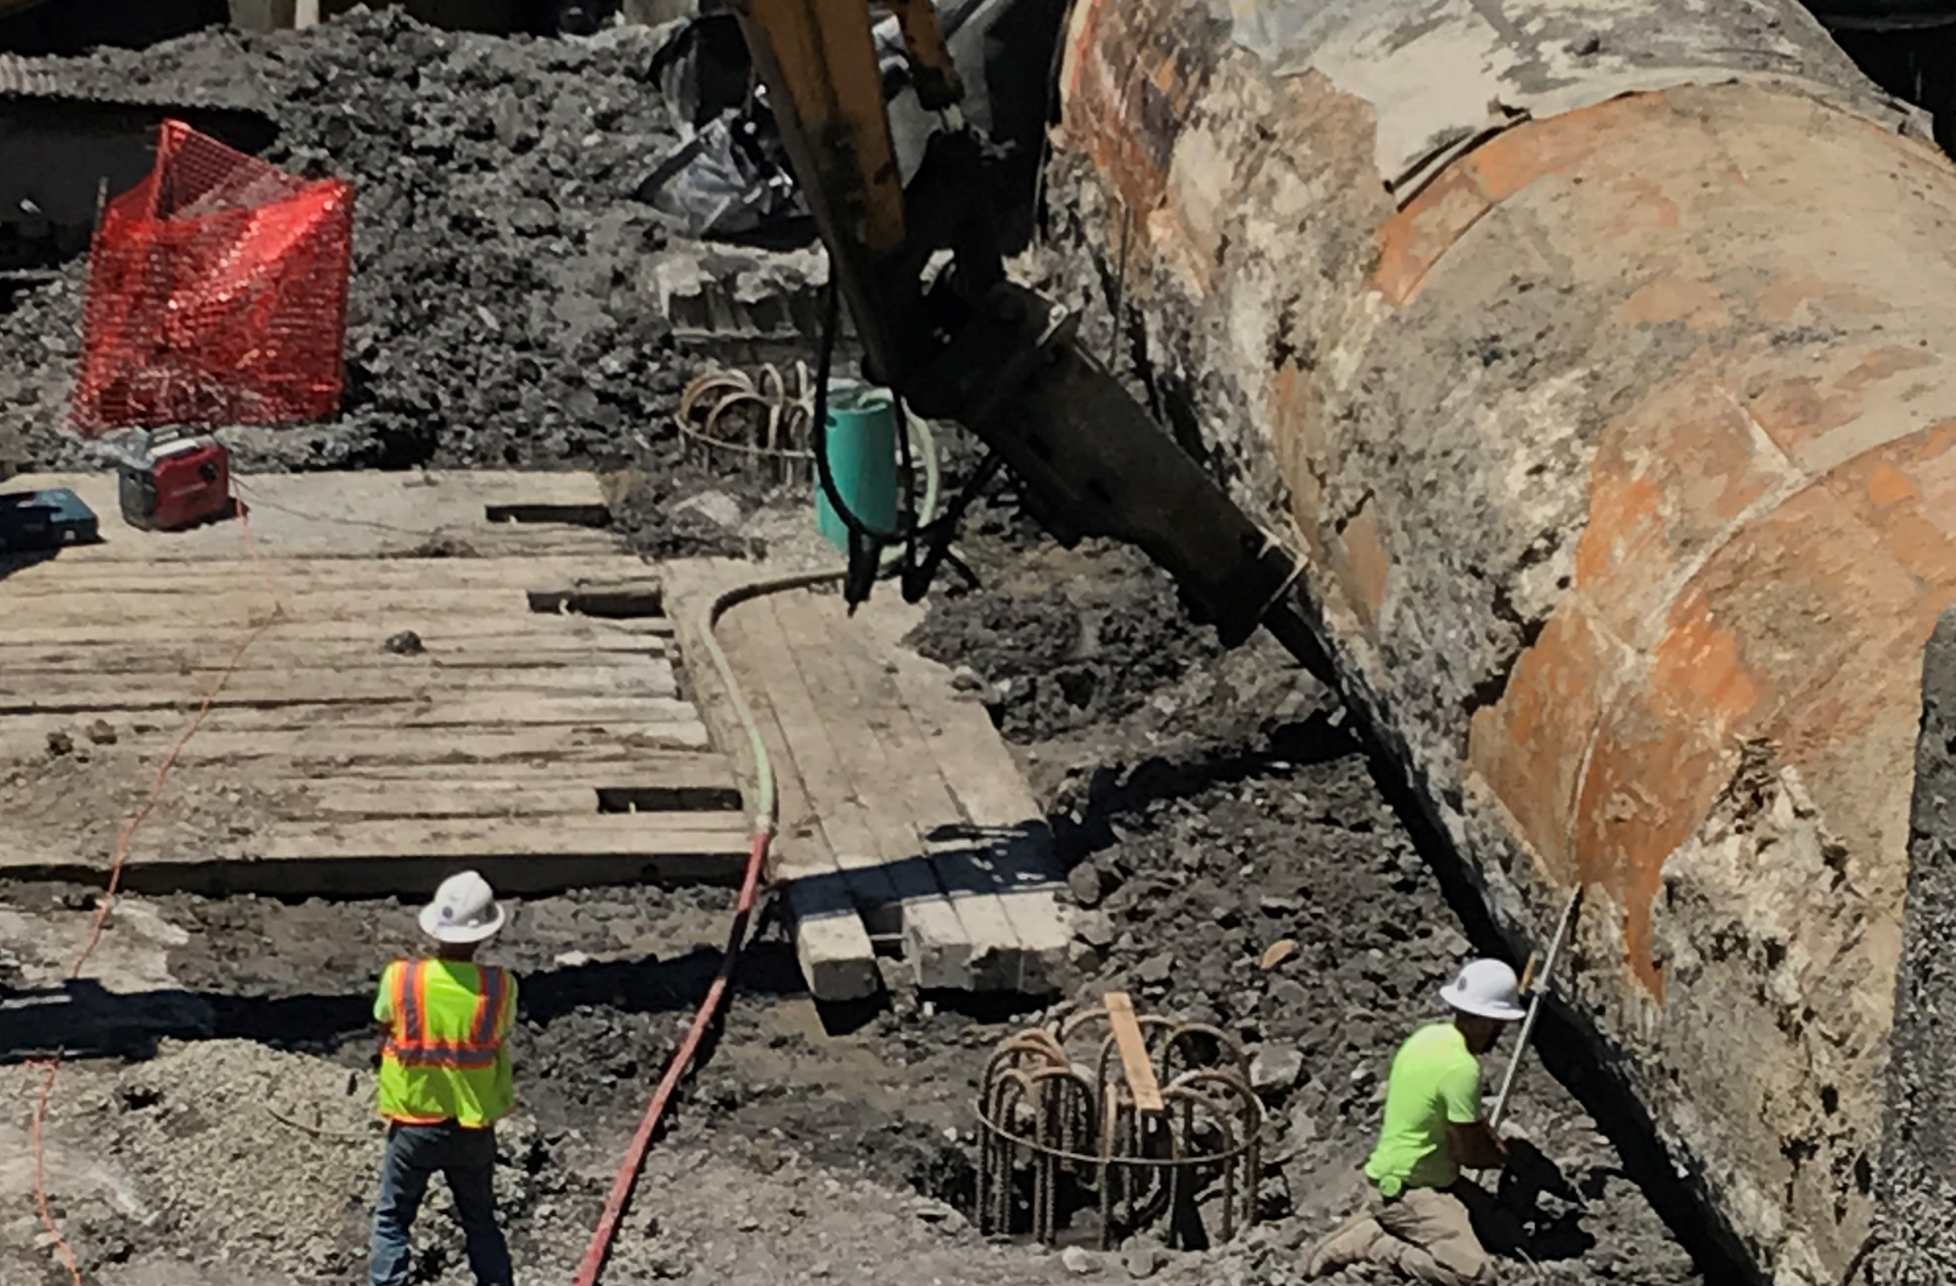
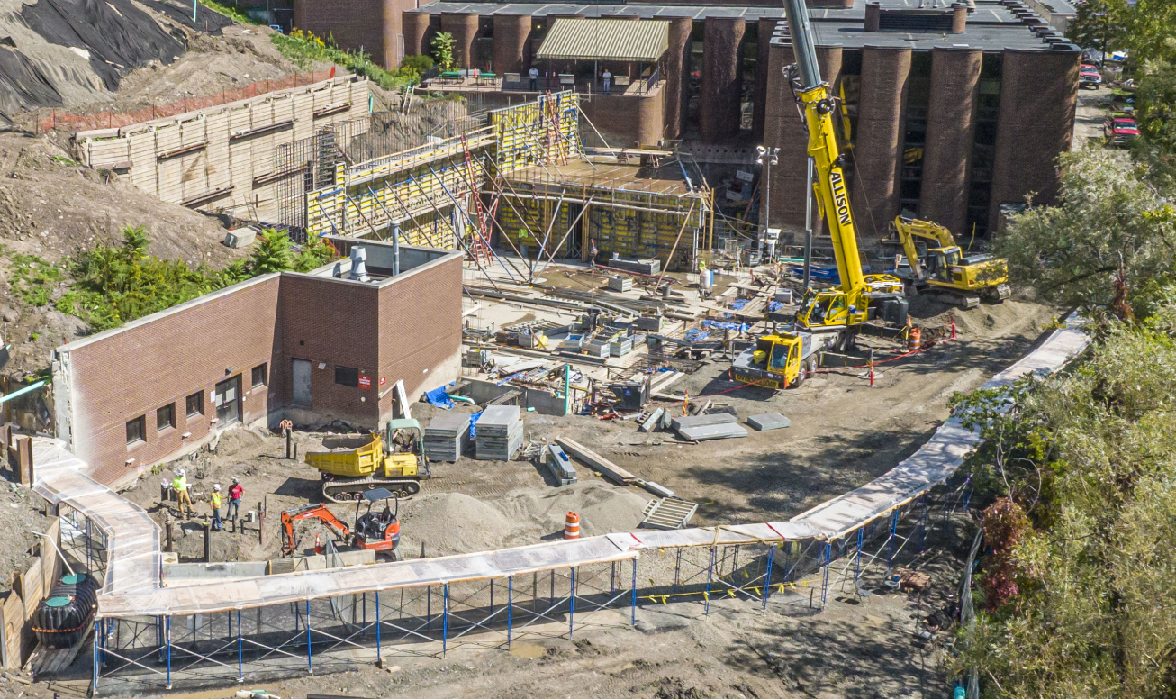
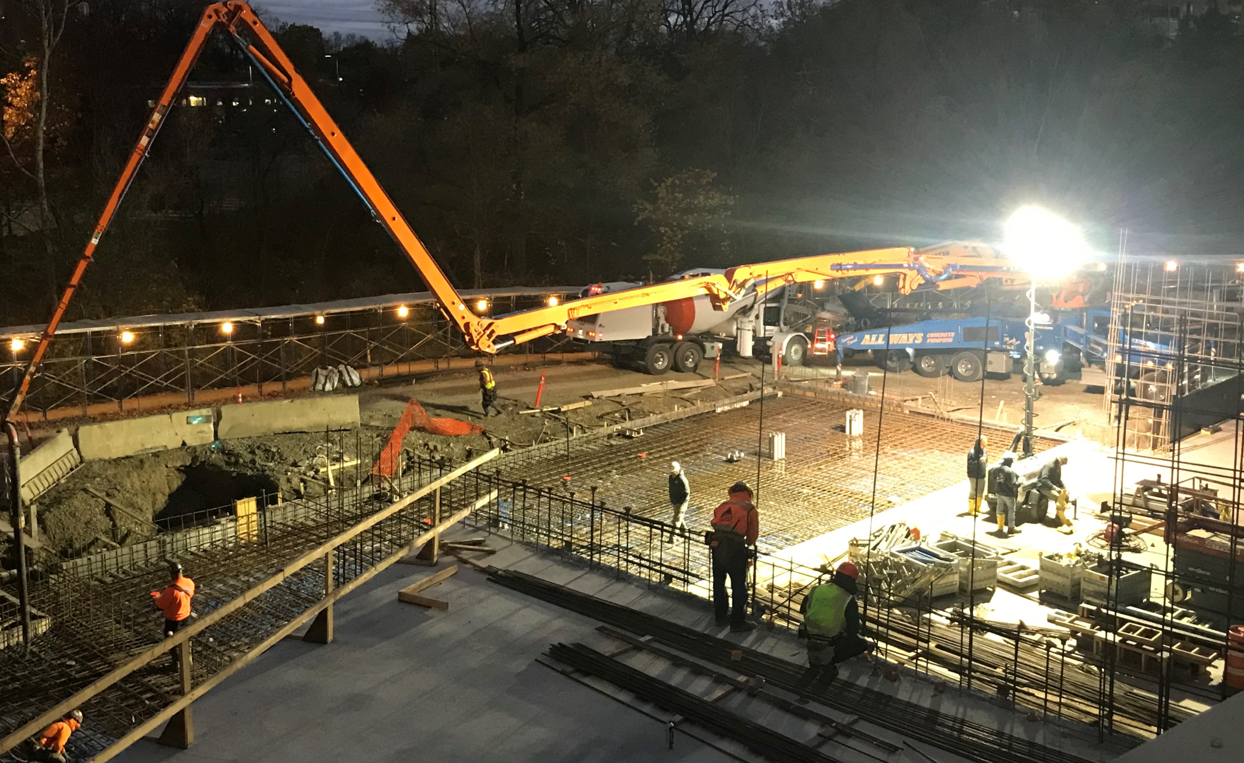
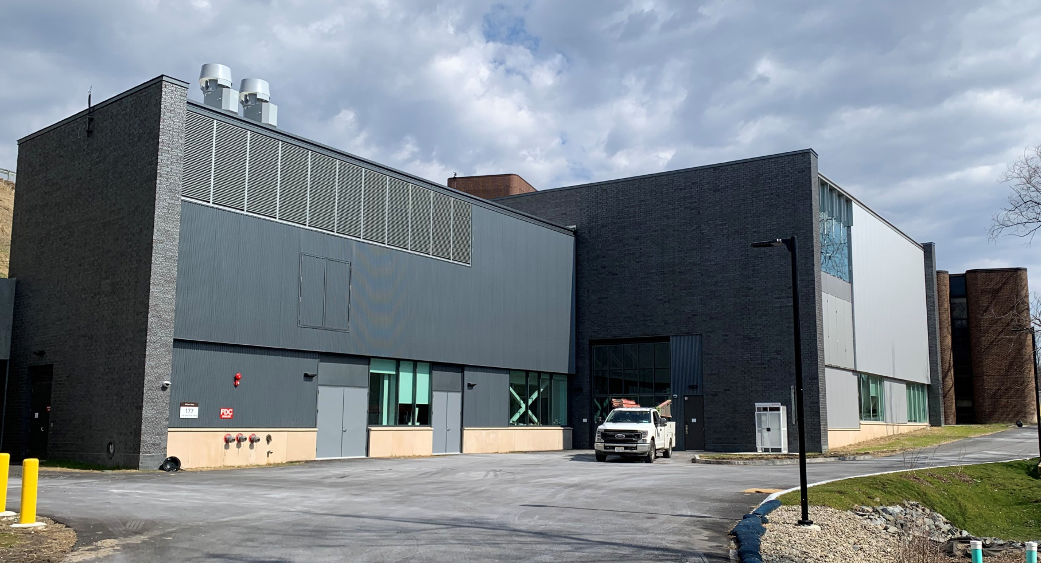
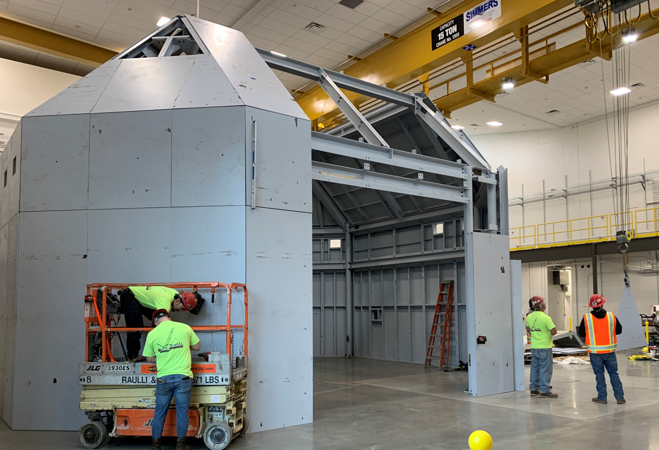
Wilson West Construction (4/2022 – 12/2023)
7/7/2022
9/27/2022
3/30/2022
4/8/2022
10/22/2022
3/2/2024
3/20/2024
Photo Credit: Rich Gallagher
Wilson West construction started in an extended Summer 2022 Shutdown
A construction milestone was achieved in 10/2022to resume CESR operations: (1)with adequate radiation shield to the site; and (2)no construction activities causing vibrations to the user operation.
Building Occupancy Certificate was issued by Town of Ithaca in 11/14/2023, to allow HMF End Station construction.

Slide 19
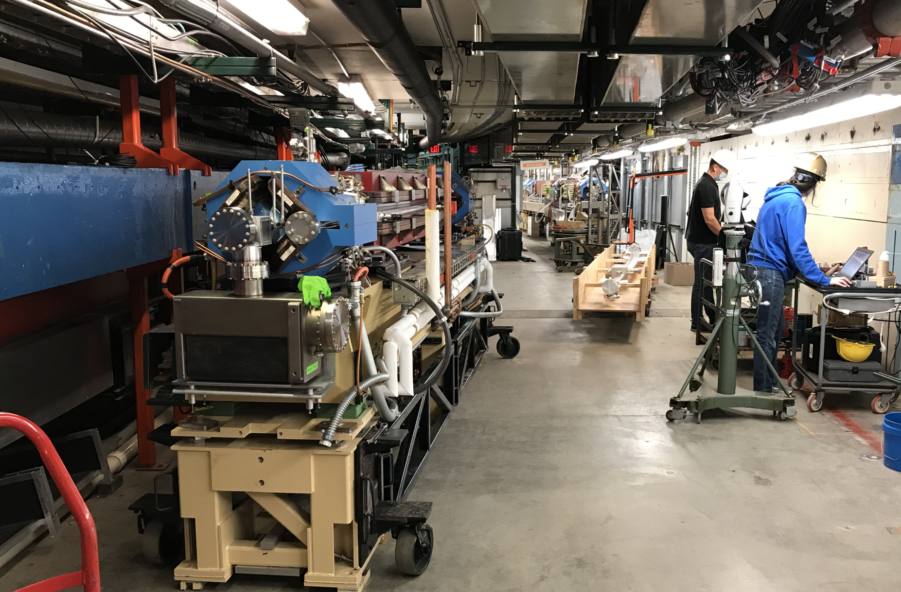
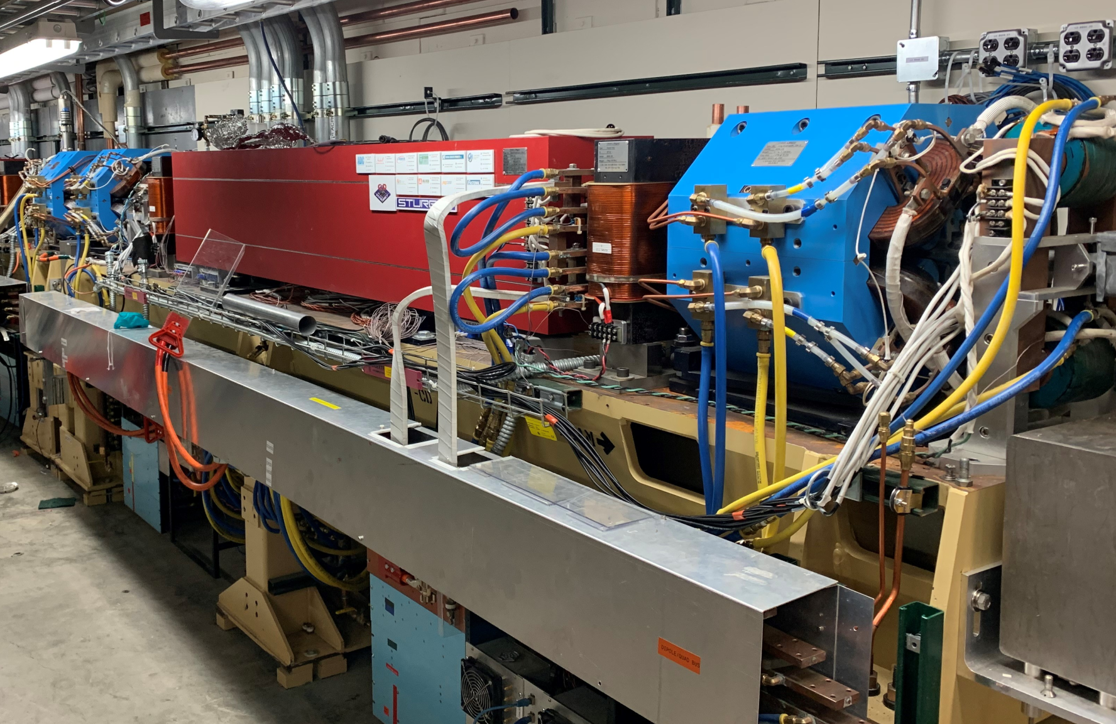
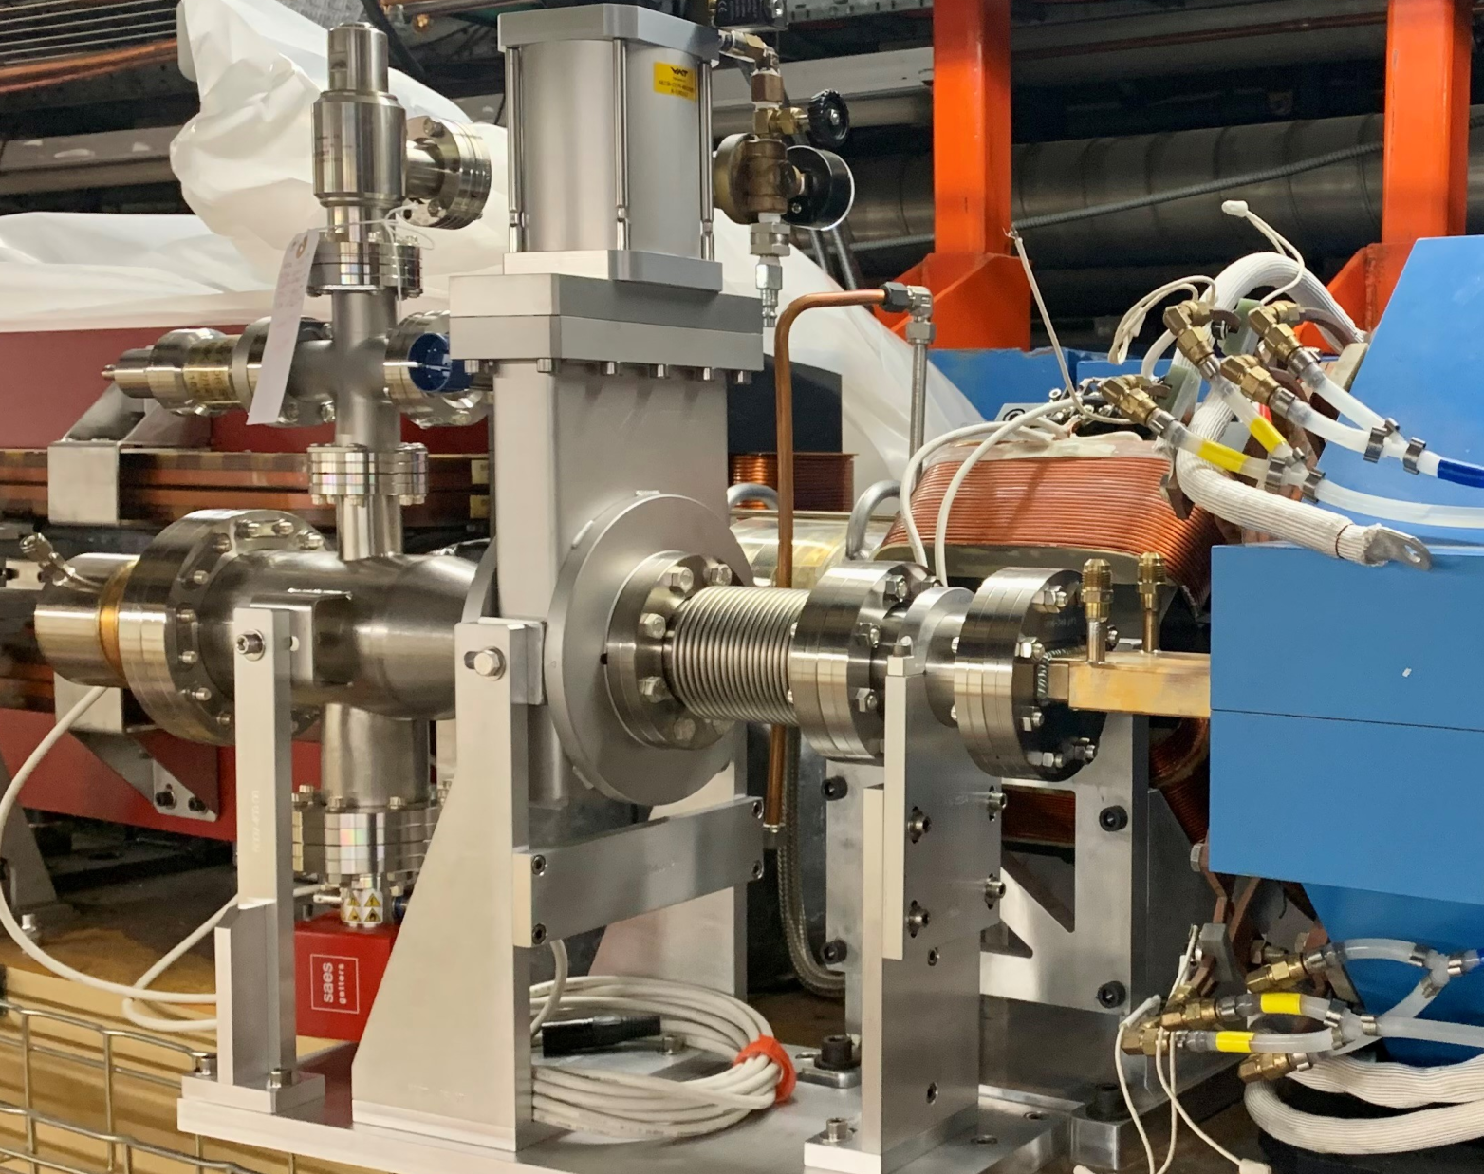
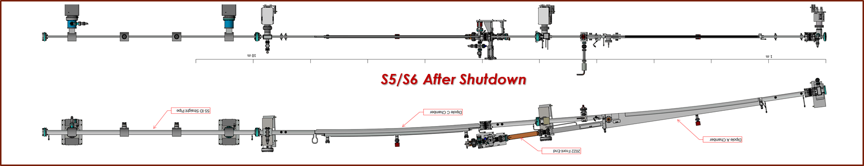
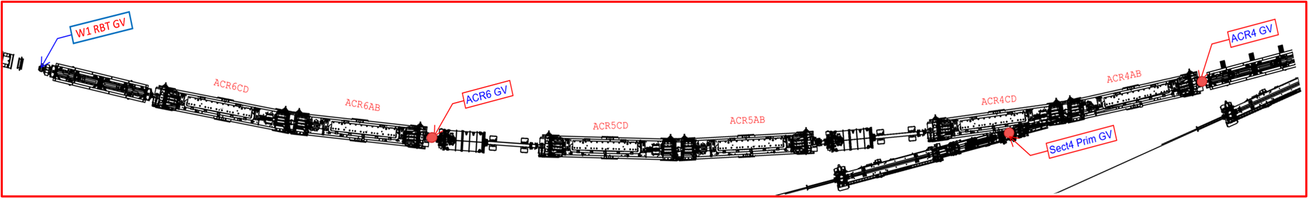
CESR S Arc Modification for HMF – Summer 2022
Displace two achromat girders for wall penetrations and new radiation shield.
Replacing two new dipole chambers to X-ray egresses (S5 – HMF and S6 – XLEAP BLs)
Install minimal
Front-End
components for
HMF and XLEAP
BLs.
S4/S5/S6 Layout Before 2022 Sumer Down

Slide 20
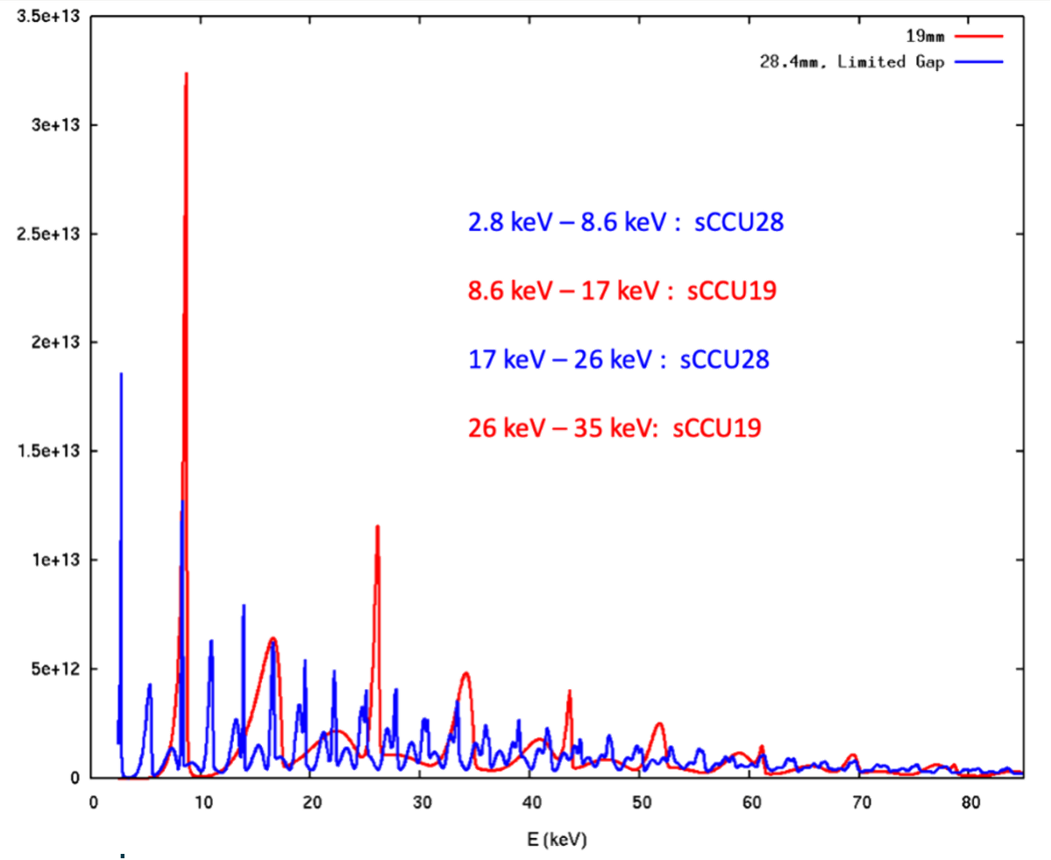
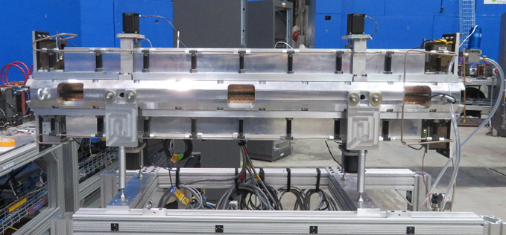
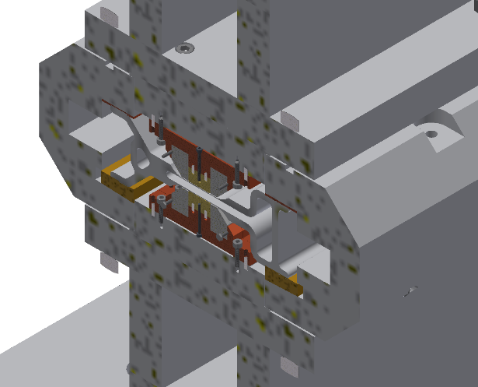
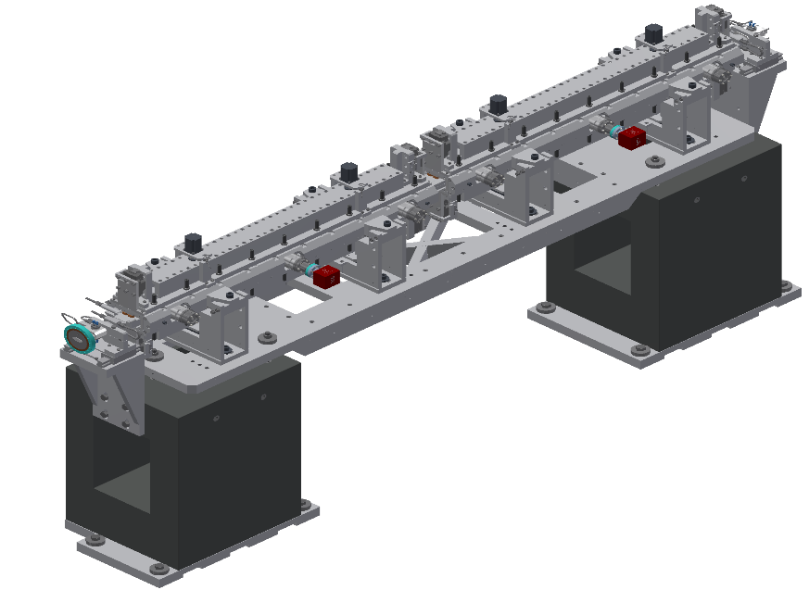
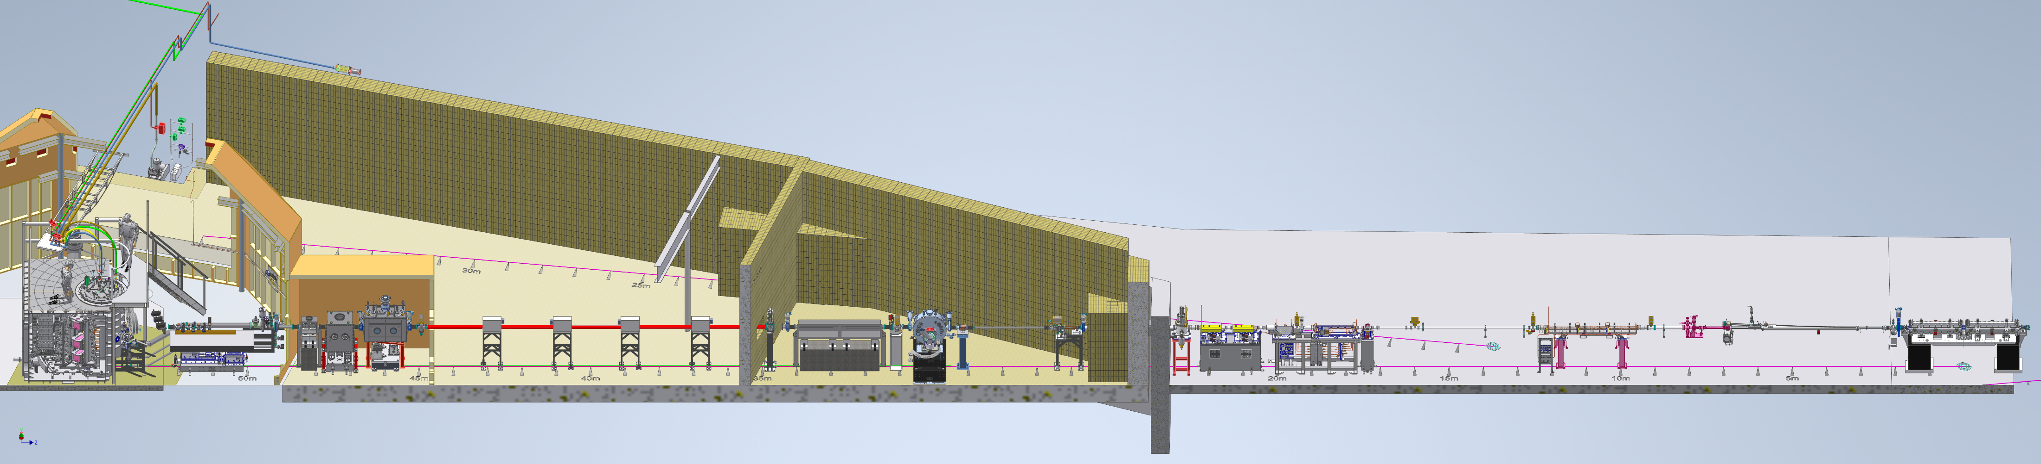
HMF ID and Beamline
HMF beamline ID will be two in-line ‘Super-CCU’, with 19-mm and 28-mm period for different photon energy coverages.
Similar ID chamber under fabrication in-house
Front end beamline under fabrication at AVS | US
The ID and full FE vacuum chambers will be installed in 2024 Summer Down.

Slide 21
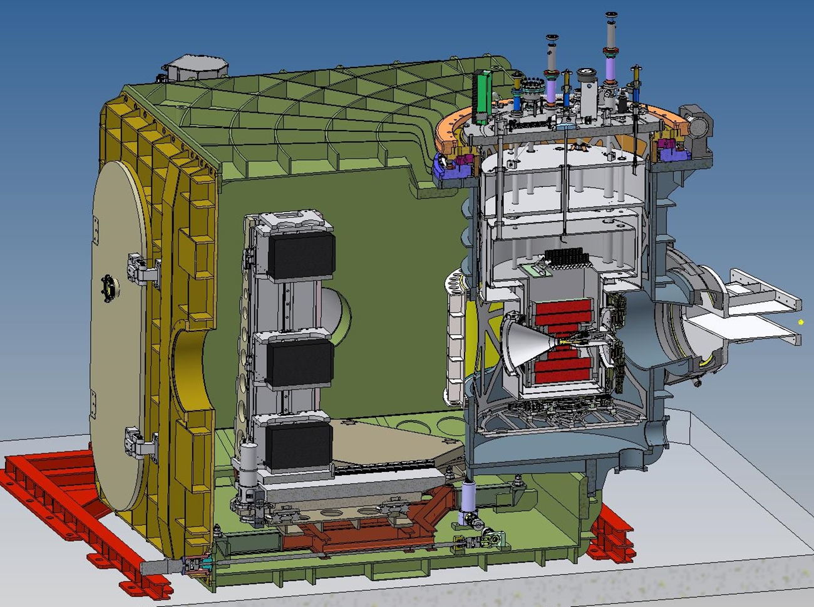
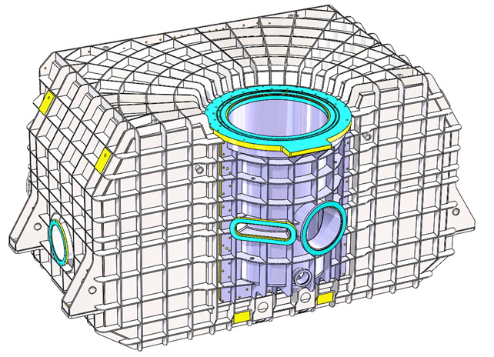
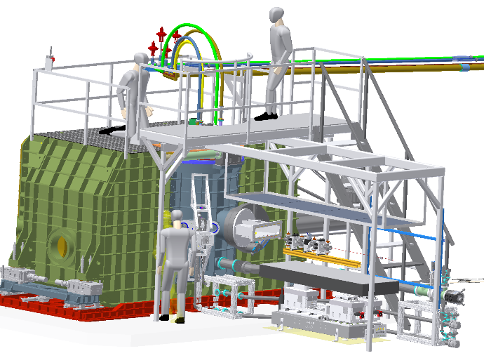
Vacuum End Station and Sample Environment
A very large vacuum chamber to host the SC magnet rotary stage, scanning detectors, 2-K sample dock with load-lock
The end station vacuum vessel is being designed and fabricated by AVS|US
The 20-T SC magnet is contracted to Cryogenic Ltd, with National MagLab as the project partner.
The load-lock system is under design and prototyping in-house.
Installation in Summer 2025
Upgrade to 30-T HTC magnet is planned.
Scanning Detectors
20-T SC Magnet
Beam
Courtesy: Jacob Ruff

Slide 22
The X-rays for Life, Environmental, Agriculture and Plant sciences
(XLEAP) at CHESS (2024-2028)

Slide 23
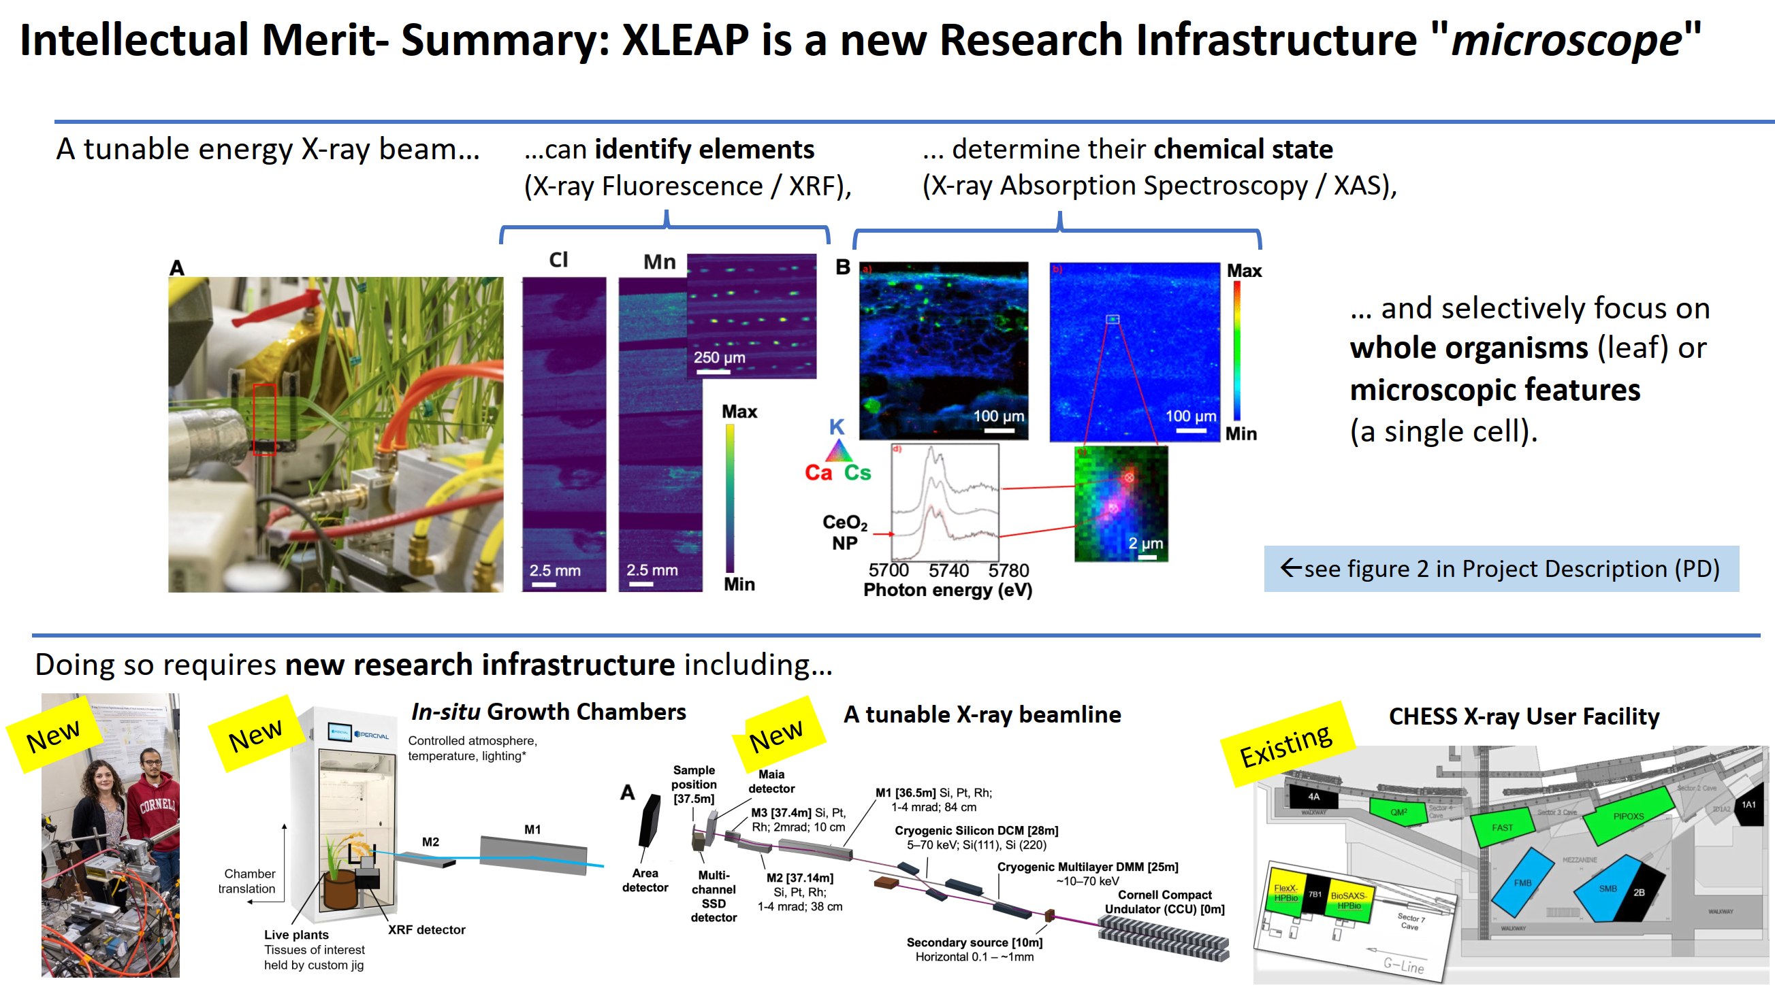
Courtesy: Louisa Smieska

Slide 24
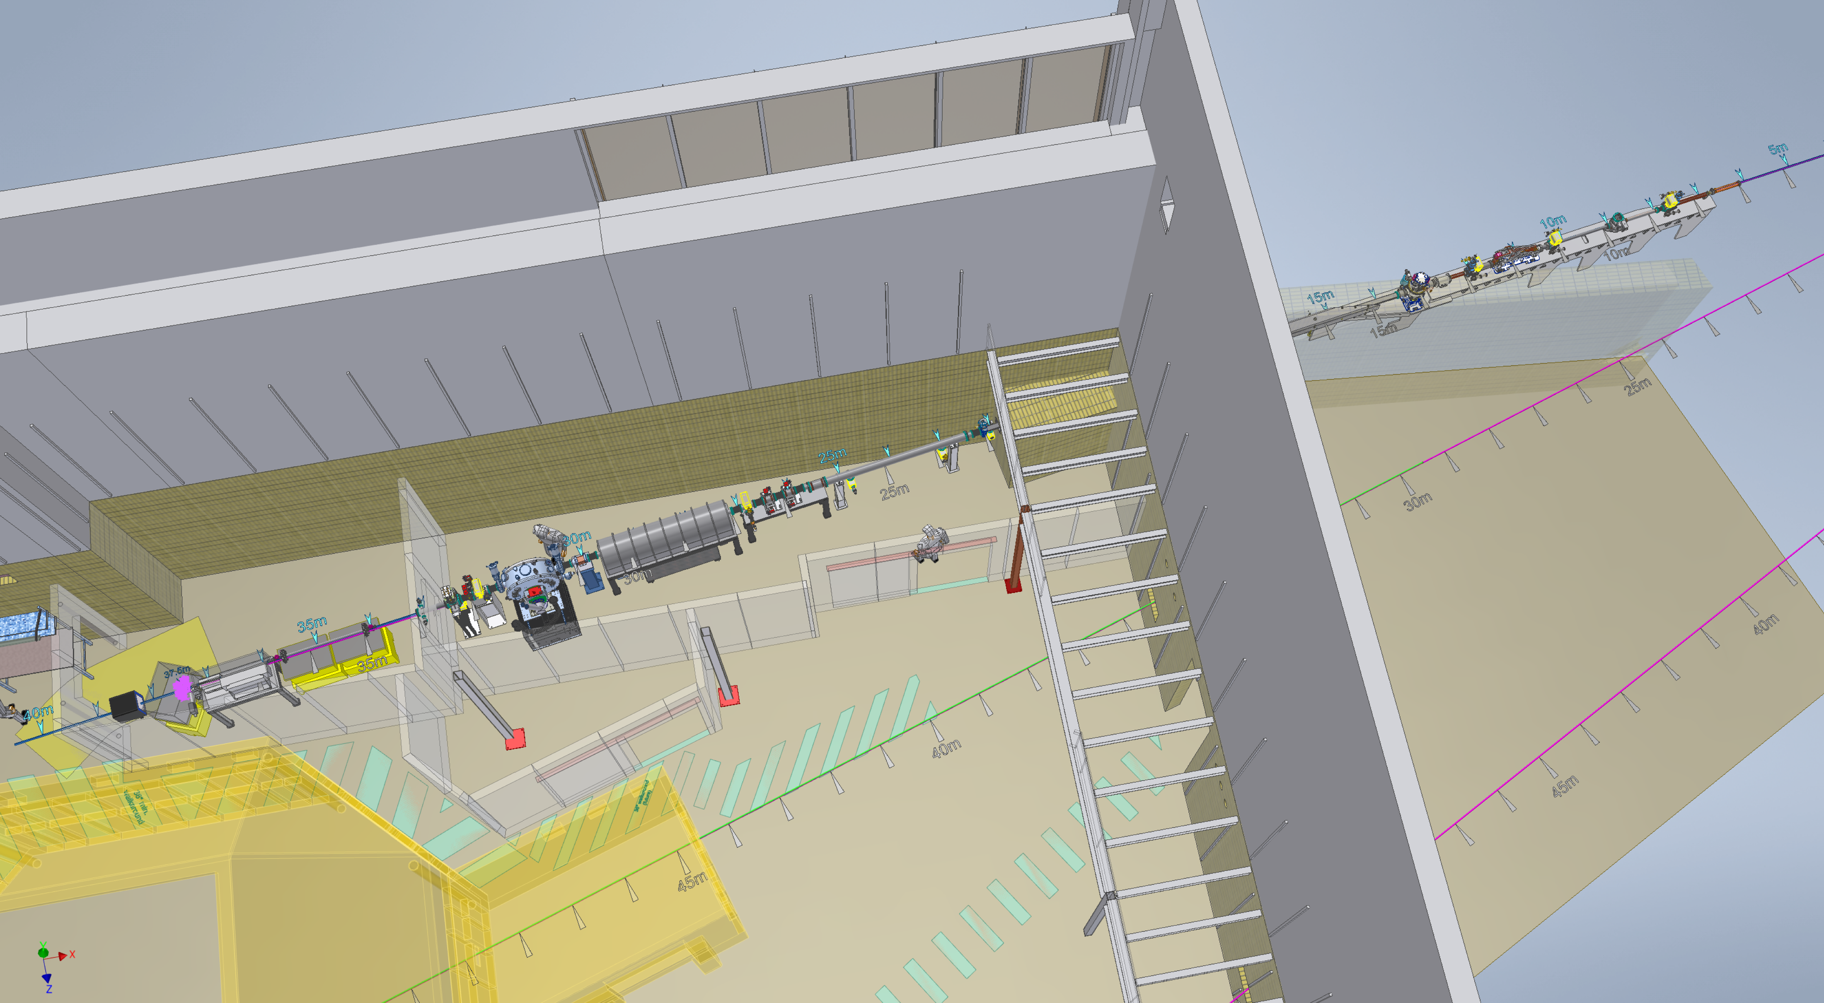
XLEAP Beamline – NSF Awarded $20M (Feb 2024)
The new Wilson West Experimental Hall will site the XLEAP Beamline
Courtesy: Dave Spurgin

Slide 25
Conclusion Remarks
With the CHESS-U project, CHESS becomes the premier synchrotron source in the US for high-energy, high-flux x-ray studies.
The CHESS-U vacuum system in the CESR S Arc performed very well.
Dedicated High Magnetic Field (HMF) X-ray Beamline greatly enhanced CHESS’s scientific capabilities.
The newly funded The X-rays for Life, Environmental, Agriculture and Plant sciences (XLEAP) project will be an important resource for the U.S. scientific community for biological and biogeochemical research.
Thank You For Your Attention

