Slide 1
Complex Bend Vacuum Chamber for NSLSIIU
P. Palecek, M. Seegitz, R. Todd, M.J. Ferreira, A. Khan, S. Sharma
April 17, 2024
OLAV-VI: 6th Workshop on the Operation of Large Vacuum Systems
“The research described herein is Fundamental Research as defined in the ITAR (22 CFR §120.34(a)(8)), EAR (15 CFR §734.8), or Part 810 (10 CFR §810.3), as applicable, and as described in the USD (AT&L) memoranda on Fundamental Research, dated May 24, 2010, and on Contracted Fundamental Research, dated June 26, 2008.”

Slide 2
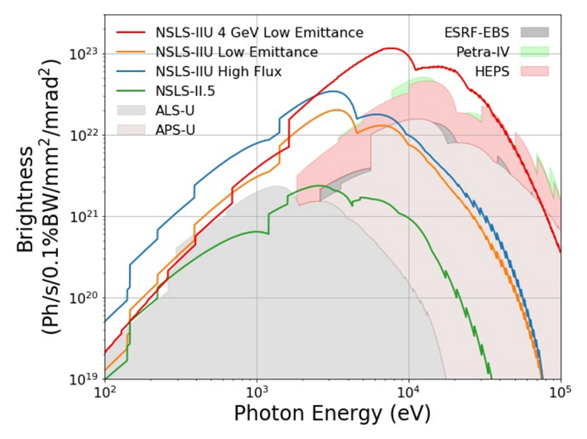
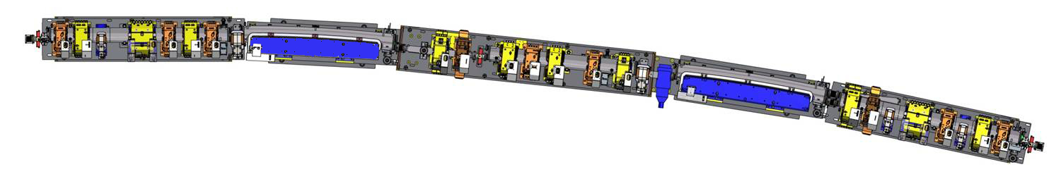
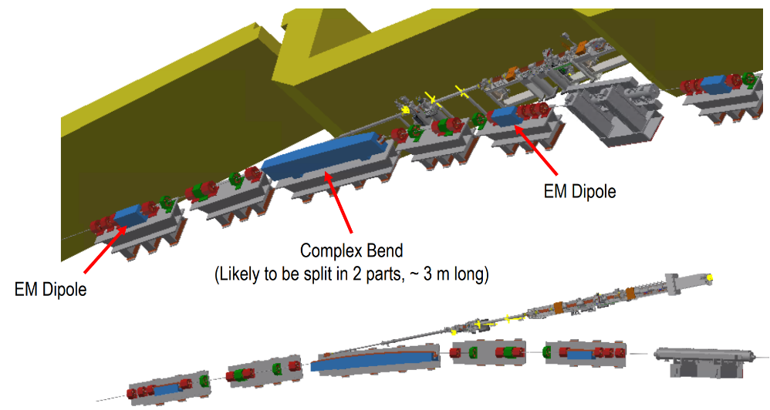
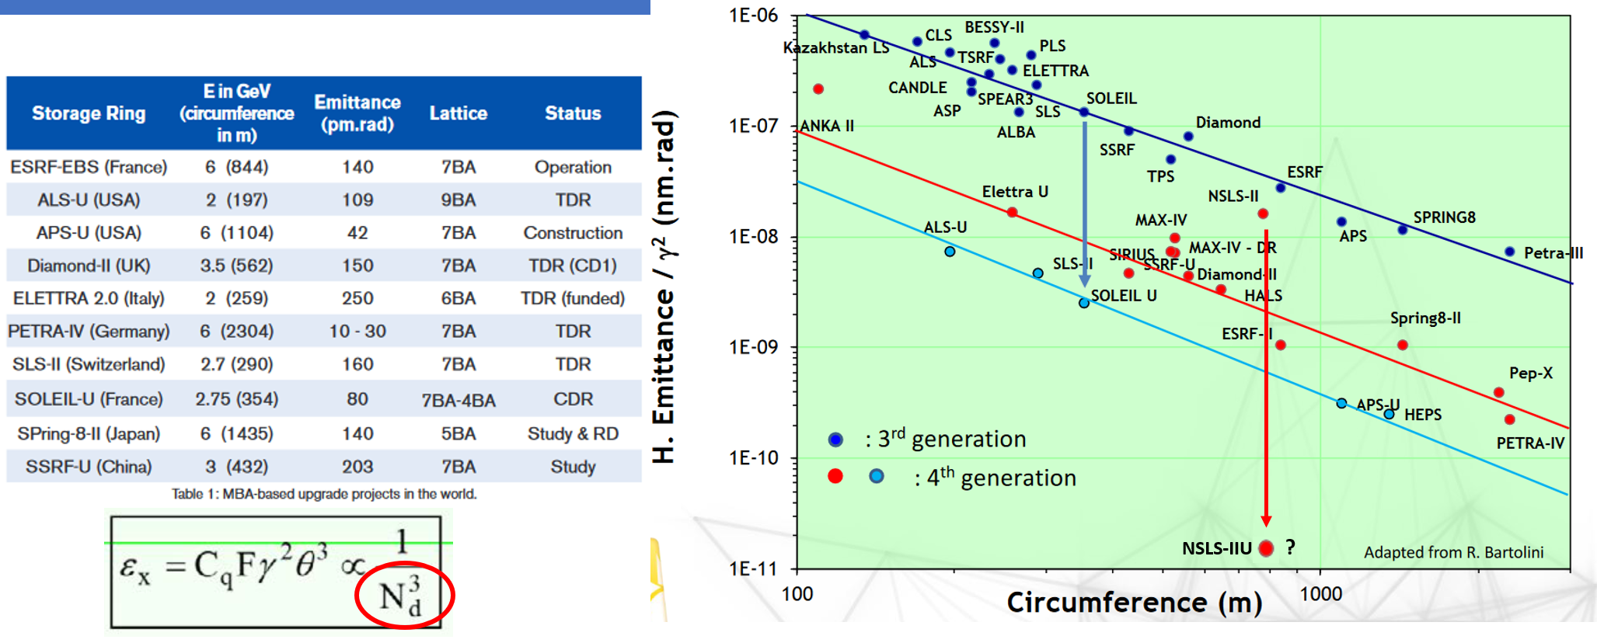
Look Ahead NSLSII-U
Existing NSLSII Double Bend Achromat
Future NSLSII-U Complex Bend
Notes:
NSLSII-U is the future vision of NSLSII.
It looks to move to the so-called 4th generation design and beyond with world leading emittance beyond current or upgraded machines.
There are variations under investigation maintaining the existing 3GeV or moving to 4GeV design.
Emittance is reduced by increasing the number of dipoles.
Shown here is one lattice under consideration.

Slide 3
Outline
Assembly Overview
Chamber Design
Structural Analysis – Can It Survive Vacuum?
Optics Builder – Lattice Parameters
SynRad – Define Beam Path and Photon Parameters
Molflow – Can You Achieve Required Base Pressure?
Thermal Analysis
Fabrication Techniques
Survey + Alignment

Slide 4
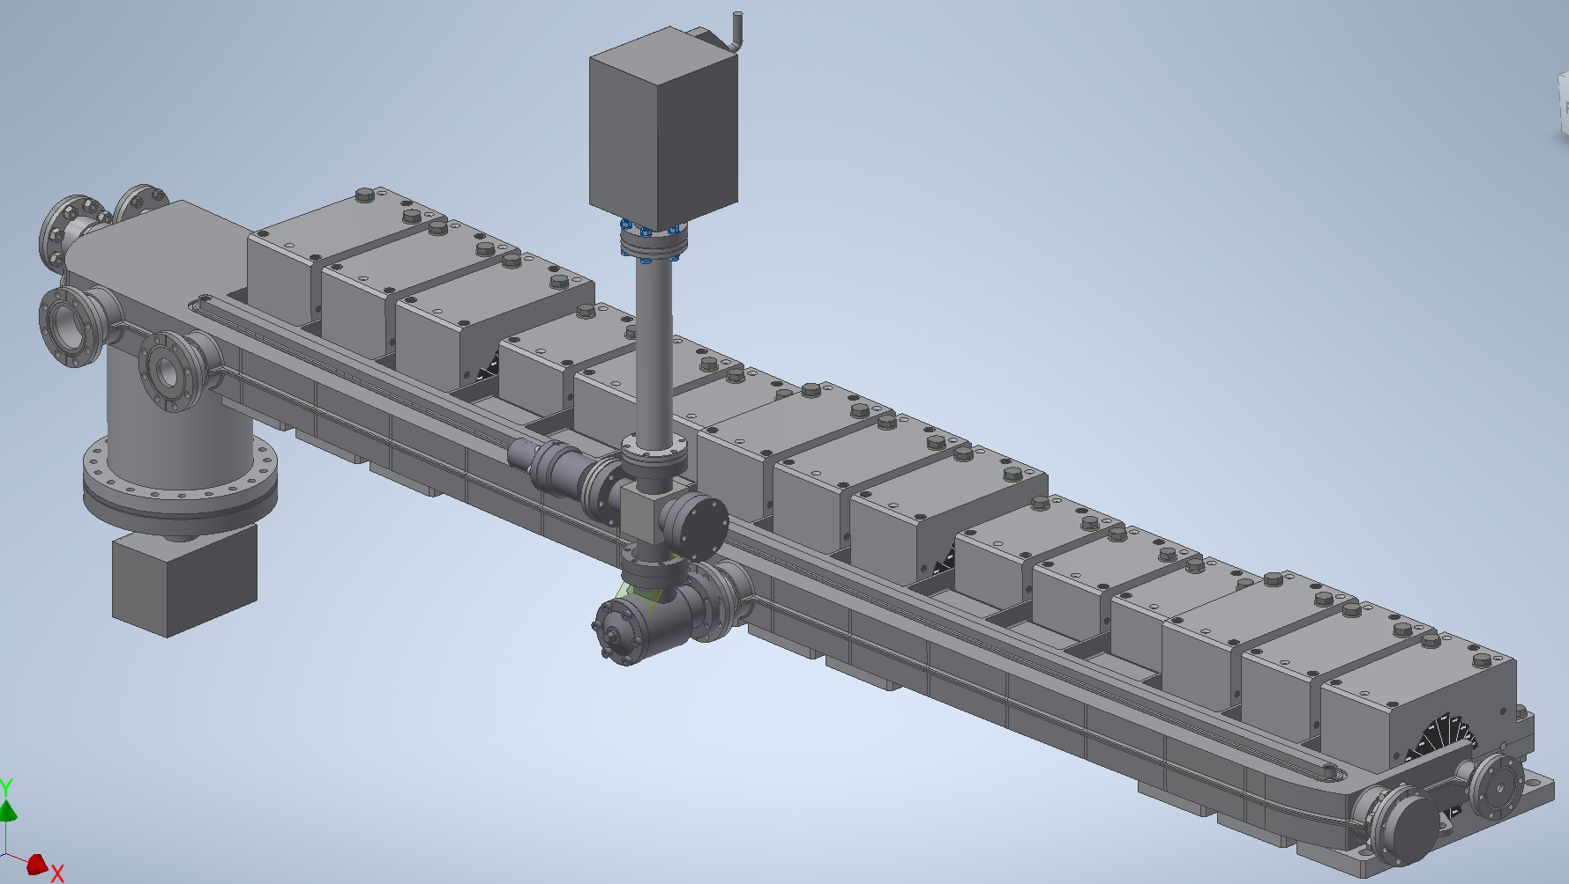
ASSEMBLY OVERVIEW
Chamber
Defocusing Magnets
Focusing Magnets
Absorber
Down Stream Pump
Gauge Tree
Up Stream Pump

Slide 5
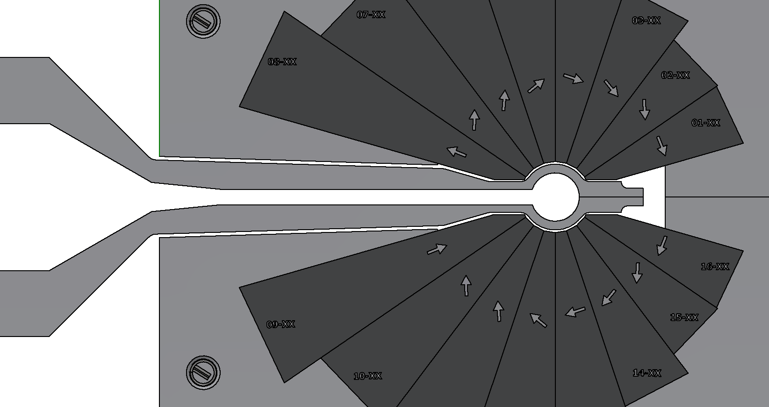
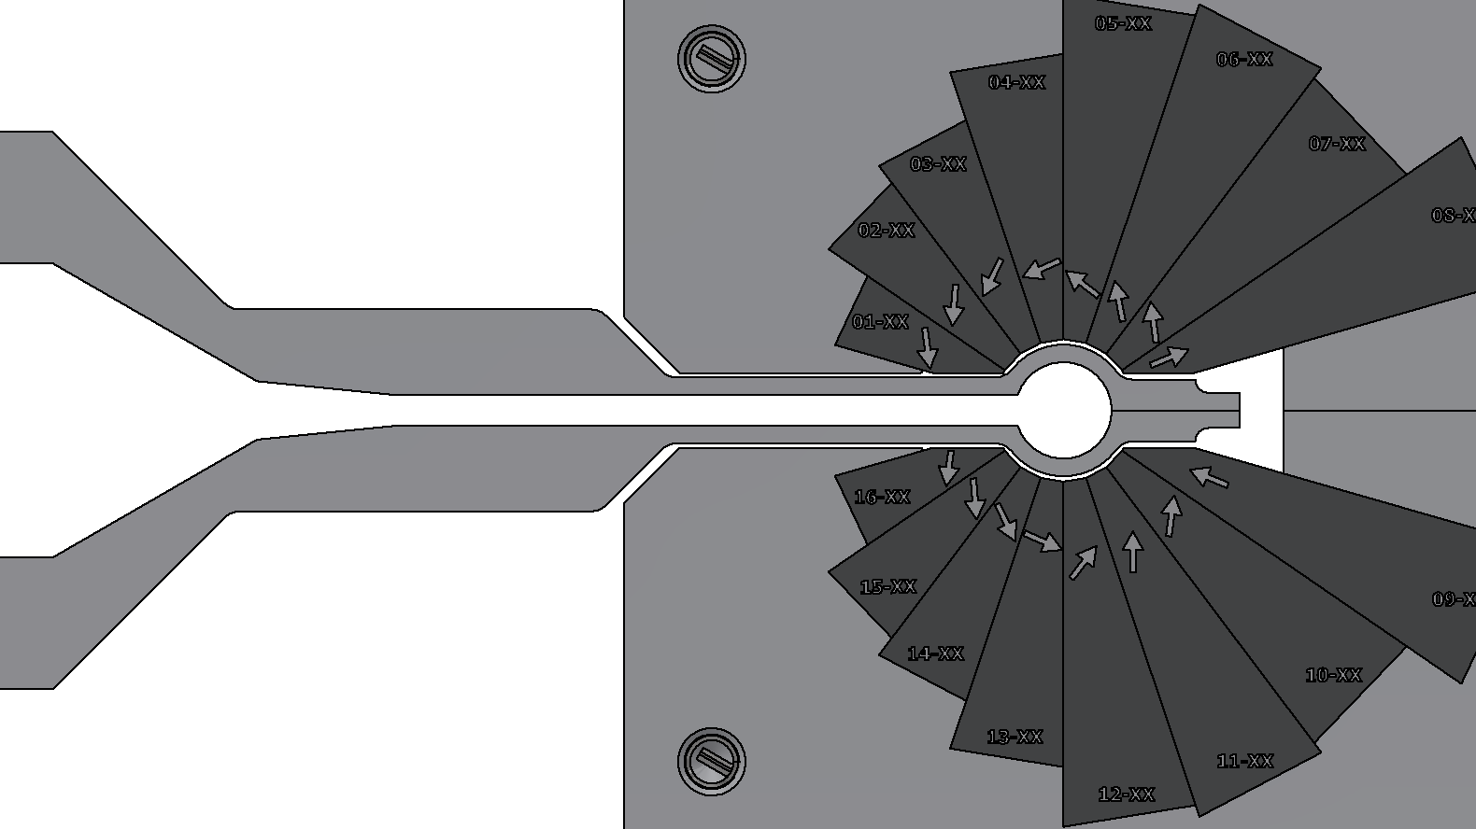
Chamber Design
TYPICAL CLEARANCE0.5mm
3.5mm exit slot
Ø11mm Internal Beam Aperture
DEFOCUS MAGNET
FOCUS MAGNET
Inputs: Two different permanent magnet geometries + Ø11mm internal beam aperture
Consider the following design constraints
  vacuum chamber geometries must fit within both magnet styles with appropriate clearances
    meet minimum vacuum requirement of average base pressure < 1E-09 Torr
      smooth/continuous internal beam channel of a certain size (Ø11mm)
        must include exit slot for beam extraction
          structurally be able to sustain vacuum

Slide 6
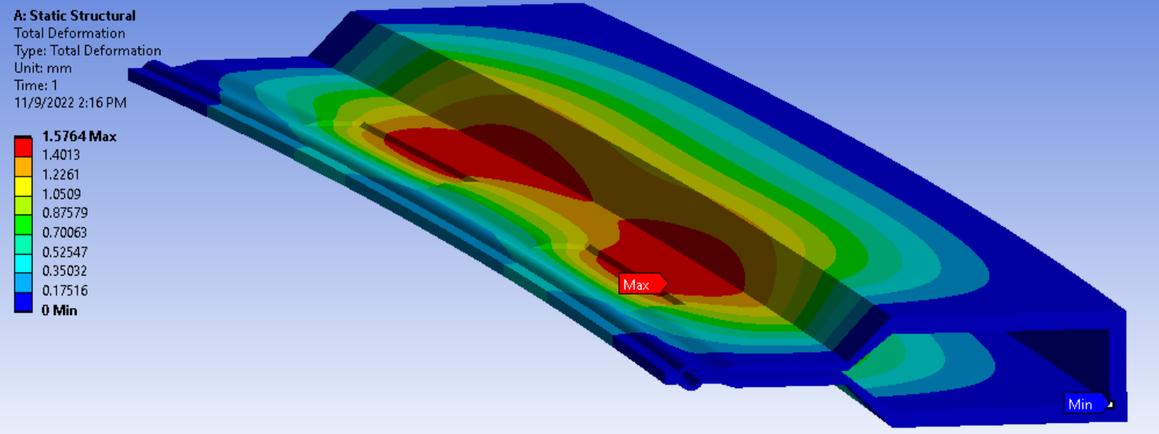
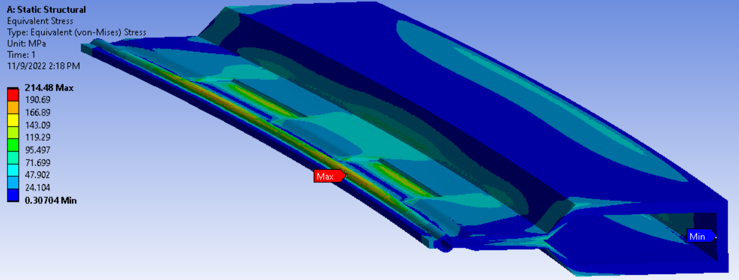
STRUCTURAL ANALYSIS – STRESS + DEFORMATION
NO RIBS or Internal Support
Input:
0.1 MPa on all outside surface (atmosphere) + standard earth gravity (weight of chamber)
Deflection per side: 1.58mm
Stress: 215Mpa
Effective Exit Slot Height
3.5mm – 1.58mm – 1.58mm = 0.34mm

Slide 7
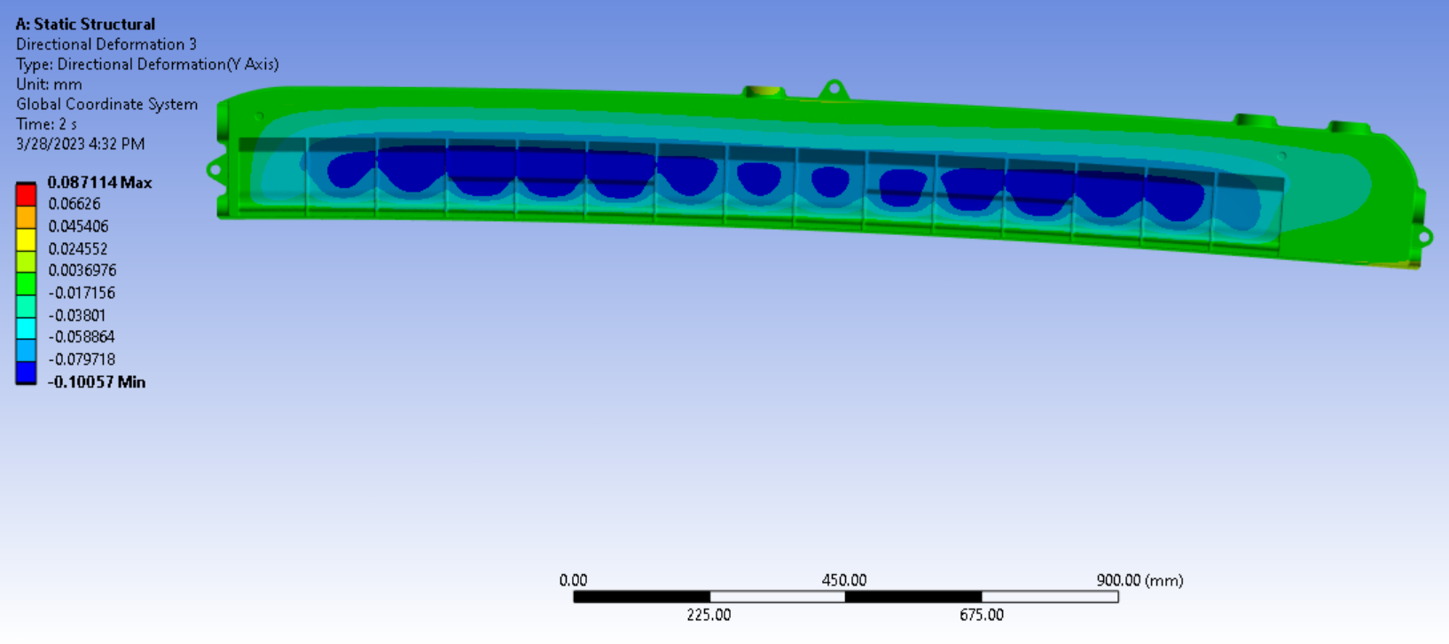
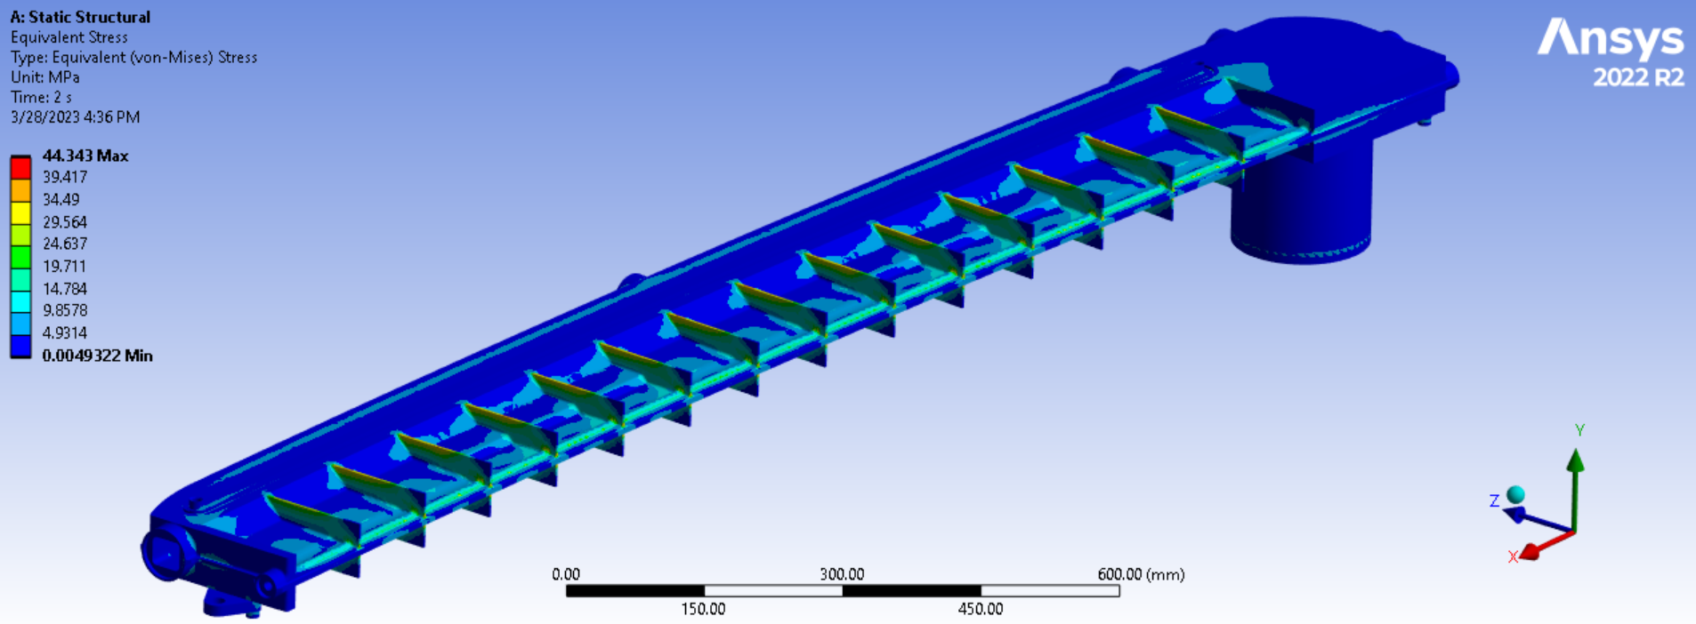
STRUCTURAL ANALYSIS – STRESS + DEFORMATION
Effective Exit Slot Height 3.5mm - .10mm - .09mm = 3.31mm
Top View
Input:
0.1 MPa on all outside surface (atmosphere) + standard earth gravity (weight of chamber)
External Ribs added
(no internal supports)
Deflection per side: 0.10mm
Stress: 44mpa

Slide 8
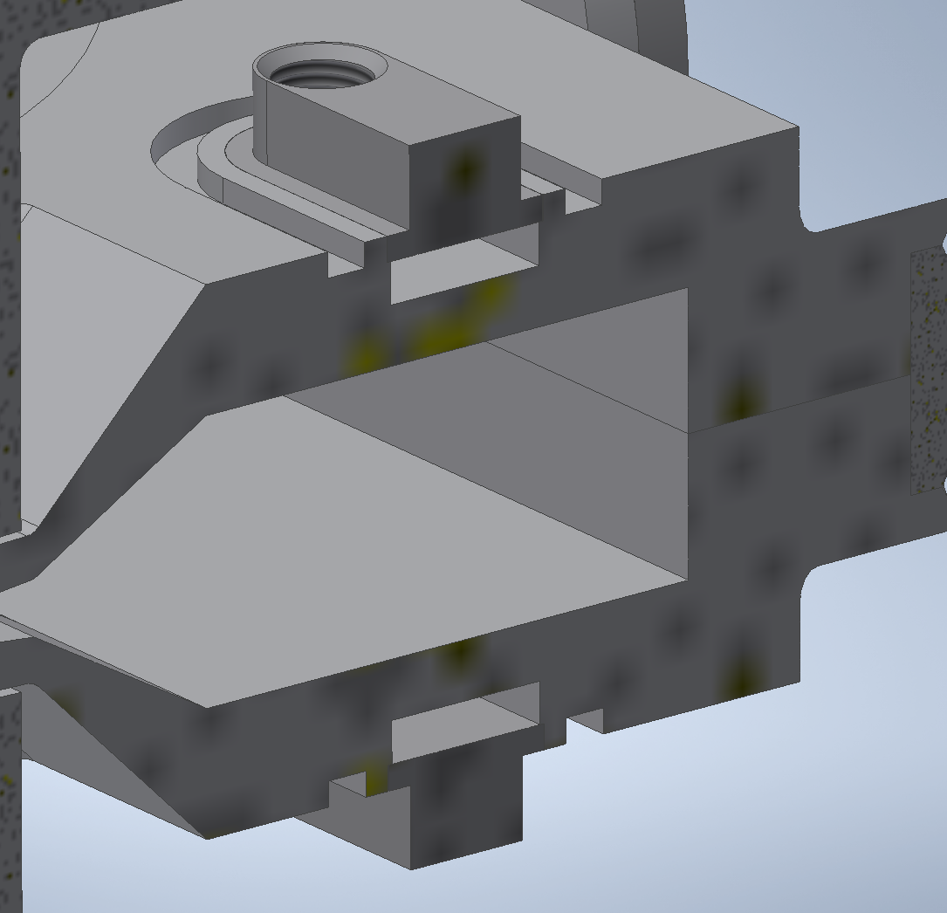
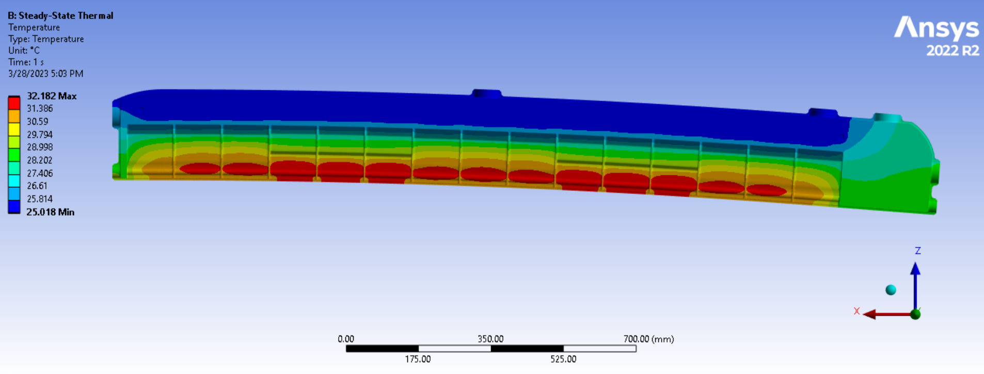
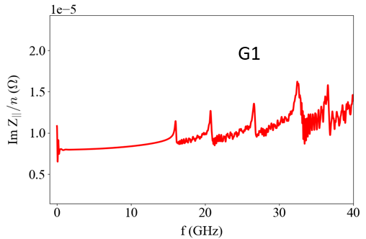
THERMAL
Resistive wall heating is acceptably low, 13 W/m (assuming 3mm bunch length).
Power loss from geometric impedance is negligible (<1 W/m) resonance peaks occur at > 15 GHZ
Geometric Wakepotential
Water cooling top + bottom along length of chamber to remove heat from image current.
Note:
G1/001 – simple straight extrusion of chamber.
Normalized Impedance
Max Temp: 32C

Slide 9
Design Process for New Lattice Iterations
Inventor
Optics Builder
(MAD-X file)
MolFlow
SynRad
ANSYS
OSCARS
(Open Source Code for Advanced Radiation Simulation: Dean Hidas ID Group)
-Necessary to have system in place for when changes are made to the lattice to quickly update existing models.
Recent developments of Monte-Carlo codes MolFlow+ and SynRad+
M. Ady, R. Kersevan

Slide 10
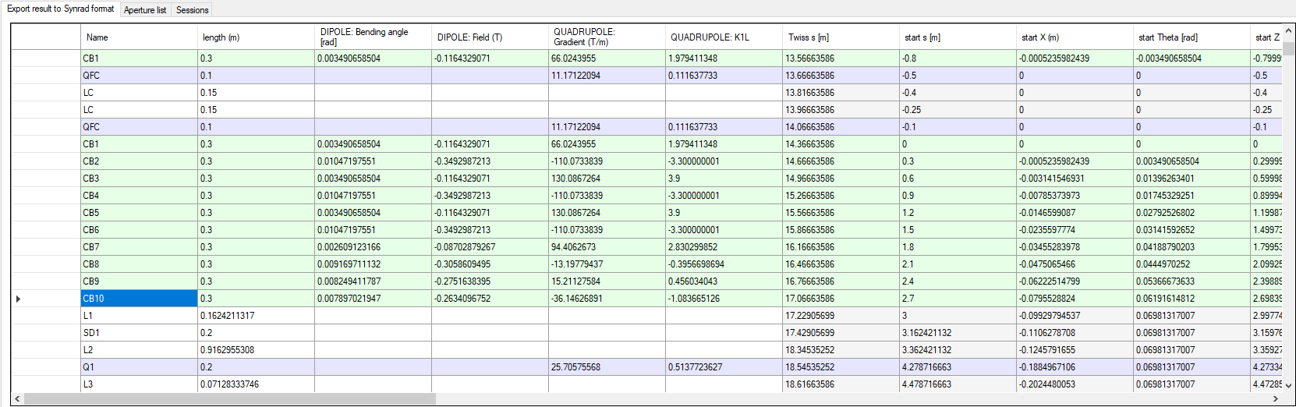
Survey File (MAD-X) to Inventor/SynRad
-Small section of total MAD-X file, CB1-10 represent a series of PMQs that make up one total dipole, which are then selected and exported for use in calculations/simulations.

Slide 11
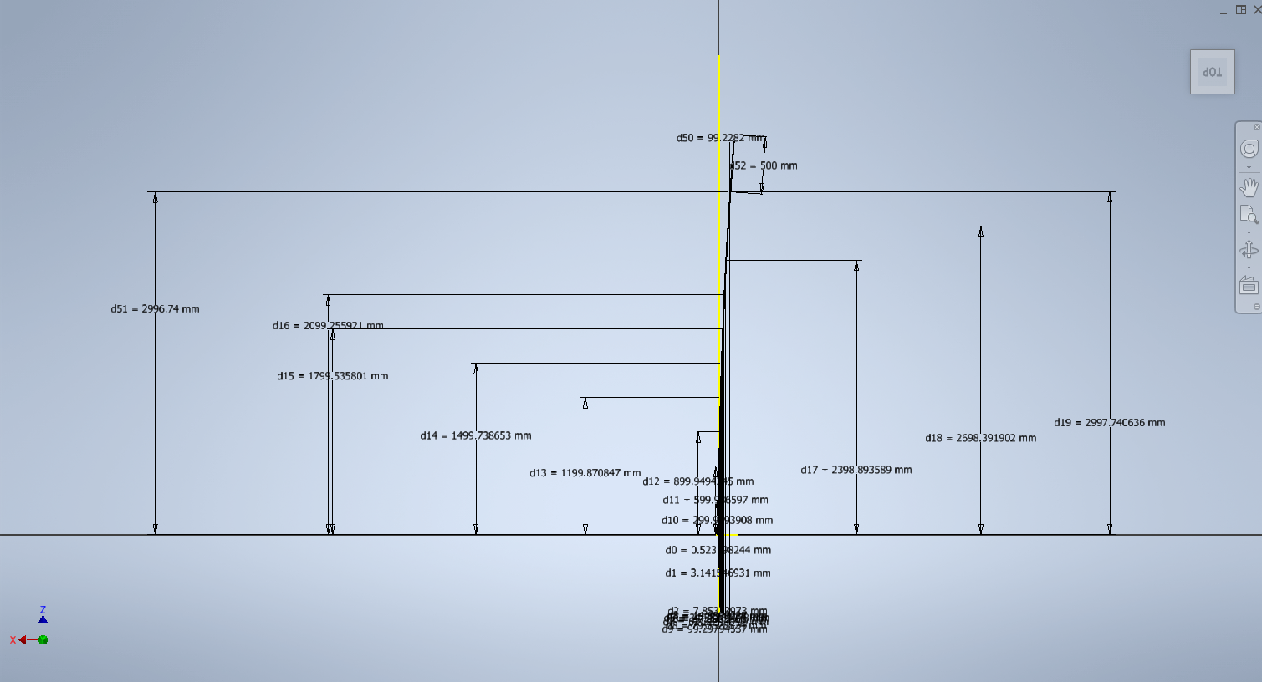
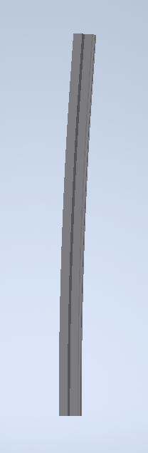
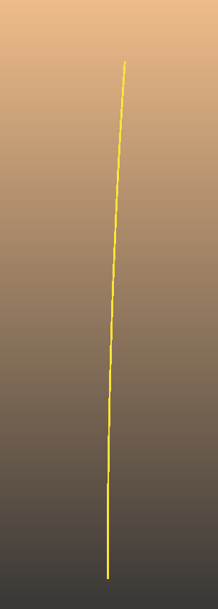
Survey File (MAD-X) to Inventor/SynRad
-MAD-X file used to model start/stop points of beam trajectory, along which a sweep function can be done to model internal volume of vacuum chamber.
-MAD-X file also used to export magnetic regions and beam properties to SynRad.

Slide 12
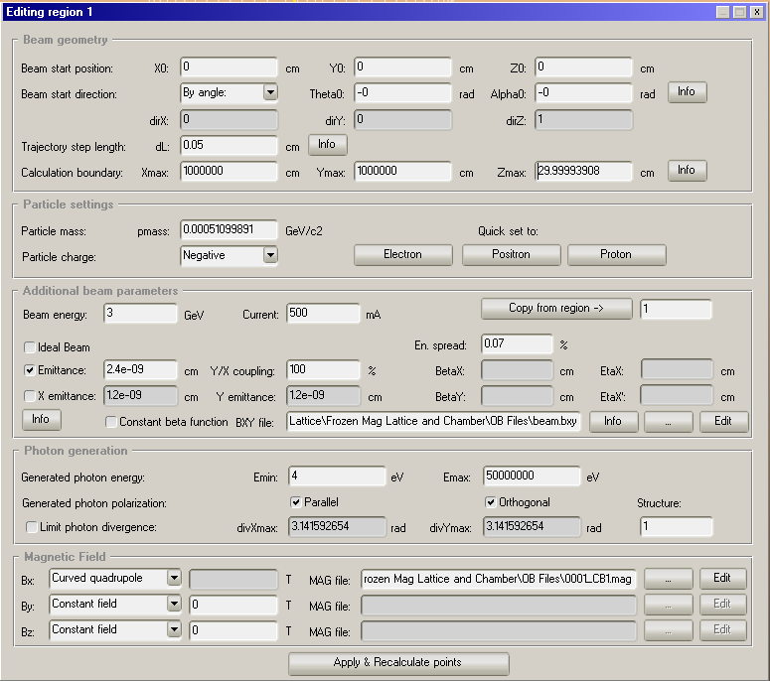
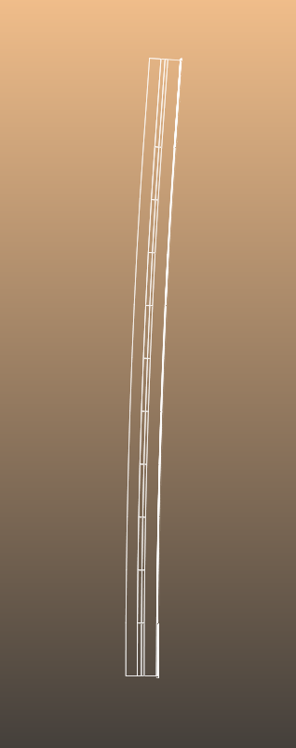
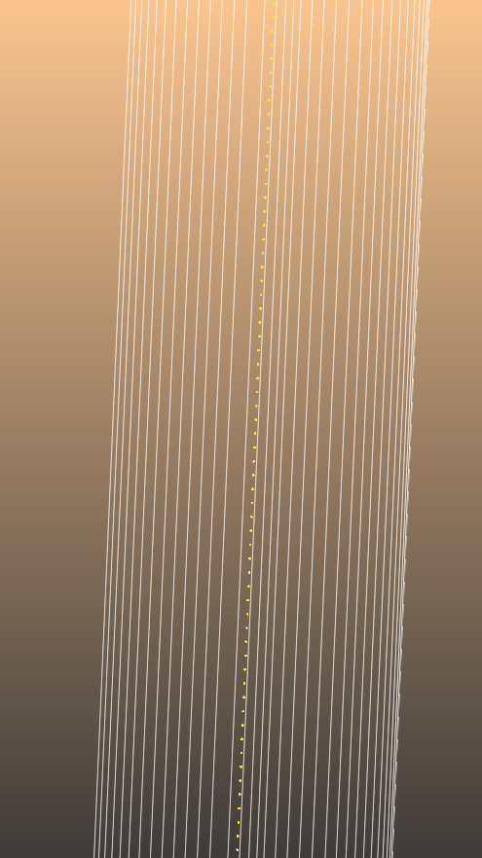
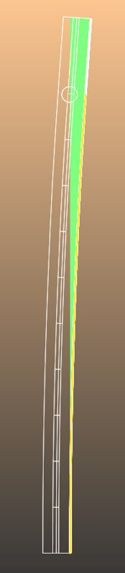
SynRad Modeling
-Swept volume then imported into SynRad and overlaid onto the beam trajectory. The close up shows each trajectory step along the beam path inside the beam channel.

Slide 13
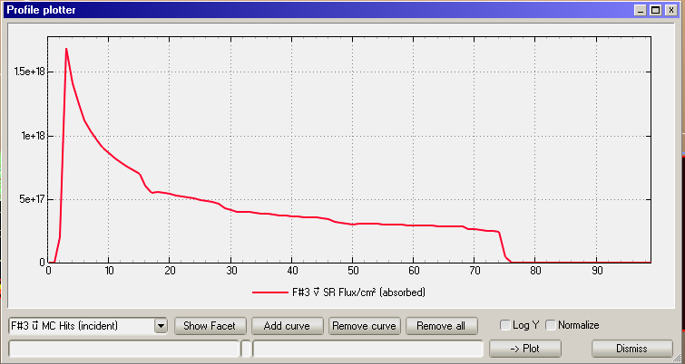
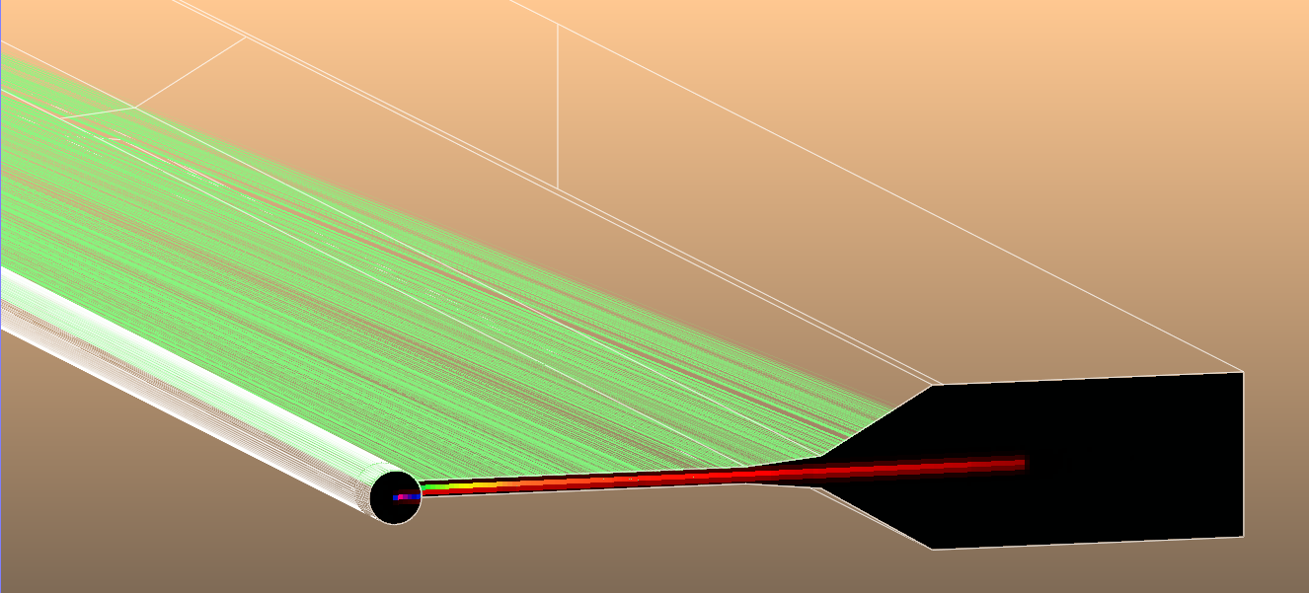
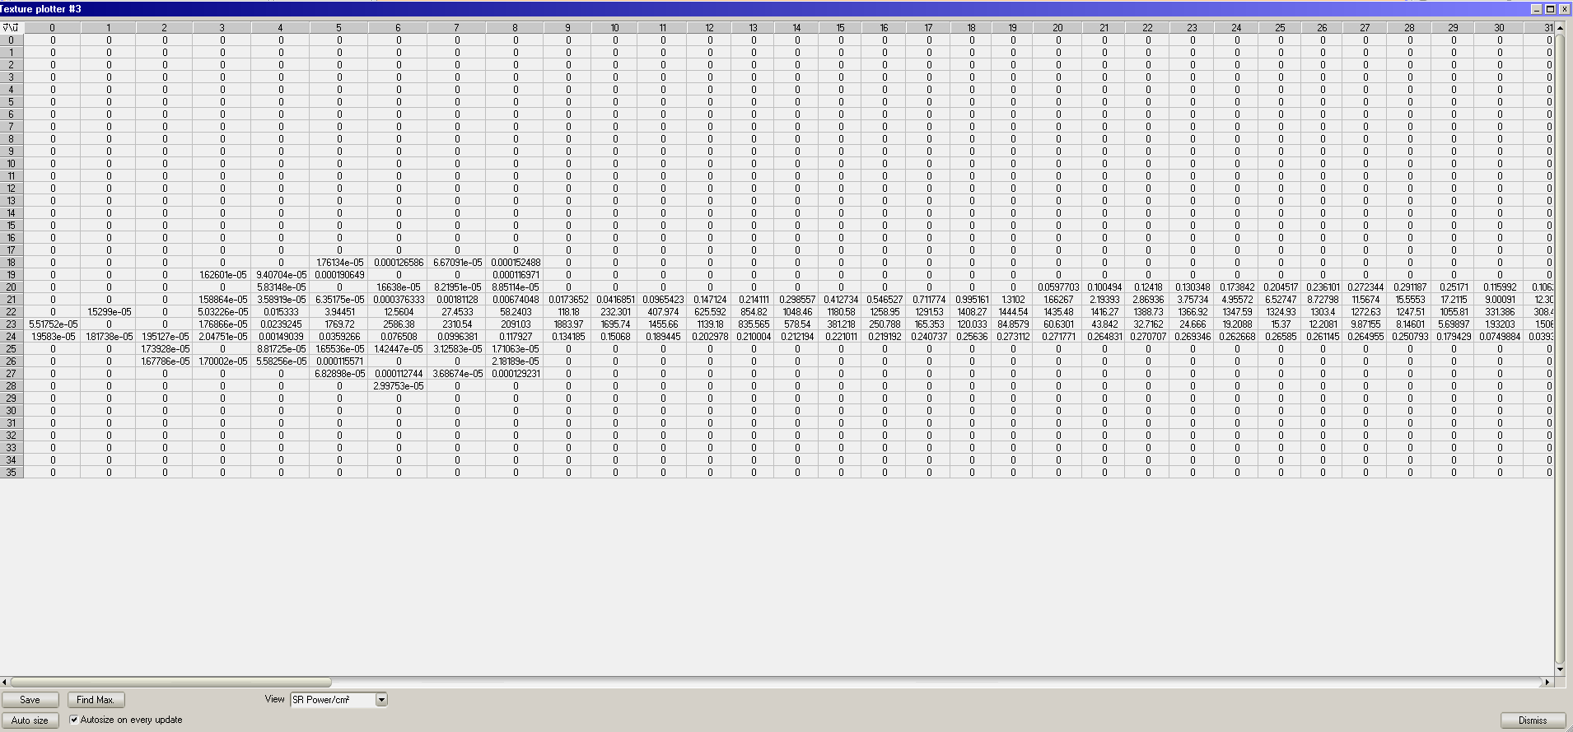
SynRad Output
-After applying relevant feature information, power and flux from beam can be charted/plotted. Relevant for desorption and power mapping.
-This information can be exported to MolFlow for use in vacuum simulations.

Slide 14
Vacuum Simulations
Initial parameters
Parameters estimation for vacuum use only:
Energy: 3 GeV Current: 500 mA Bending radius: 25 m (aprox.)
Total number of photons: 1.6x10⁺²¹ photons/s (TBC by OSCAR/SynRad)
Desorption coef. (at 100Ah): 2.0x10⁻⁷ molecules/photon (same value NSLS-II, APS, APS2… TBC by 14BM)
Photon Stimulated Desorption (PSD): 2.9x10⁺¹² molecules/s per chamber (TBC by 14BM)
Gas load by PSD: 8.6x10⁻⁸ Torr.l/sec per chamber (total PSD machine 2x10⁻⁵ Torr.l/sec) (TBC by 14BM)
Thermal outgassing (Al 150C@24h, N₂ vented, pumped 10h): 2x10⁻¹² Torr.l/s.cm² (TBC by prototype)
Chamber total thermal outgassing: 2x10⁻⁸ Torr.l/sec
Total gas load per chamber: 1.02x10⁻⁷ Torr.l/s
Credit: M. Ferreira

Slide 15
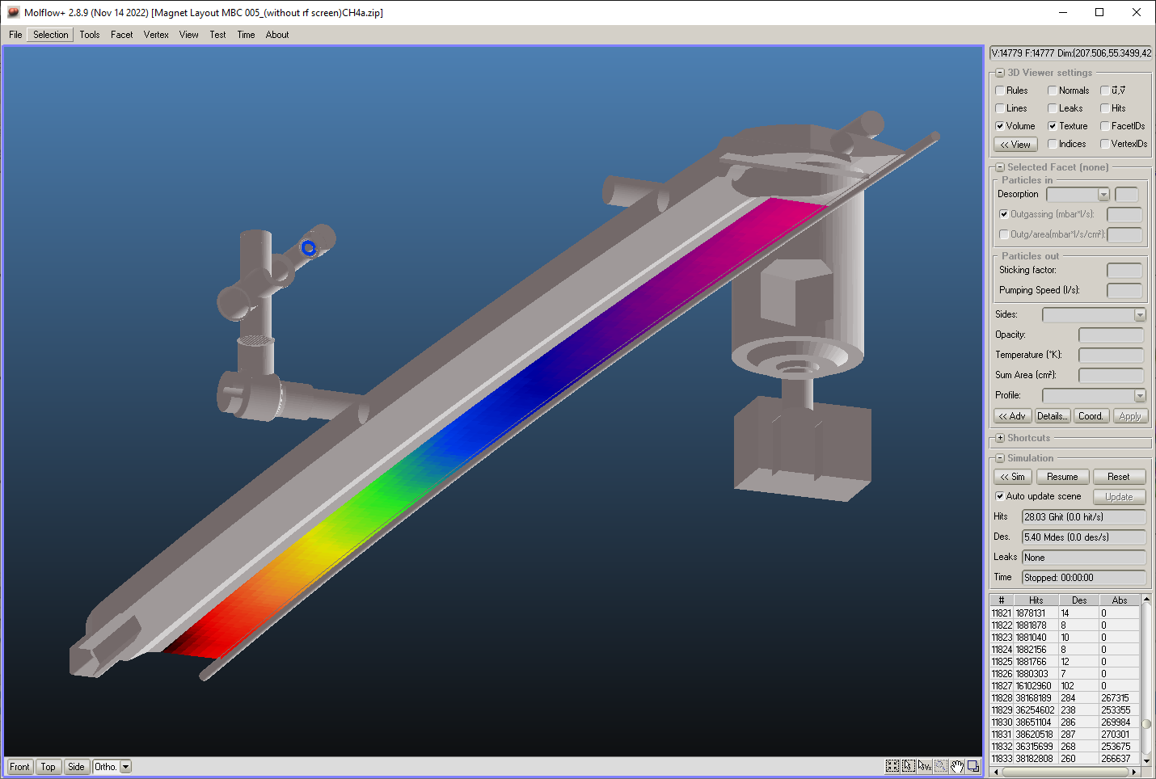
MolFlow
Gas Composition (taken from NSLS2):
43% H2
25% CO
16% CO2, CH4
NOTE: Will get actual composition from PSD data from NSLS2 14BM Beamline in future
Pumps Used:
NexTorr Z1000 Diode
NexTorr Z300 Diode
Average Pressure:
Beam path ≈ 8.8 x10⁻¹⁰ Torr
CCG gauge ≈ 8.7 x10⁻¹⁰ Torr
Credit: M. Ferreira

Slide 16
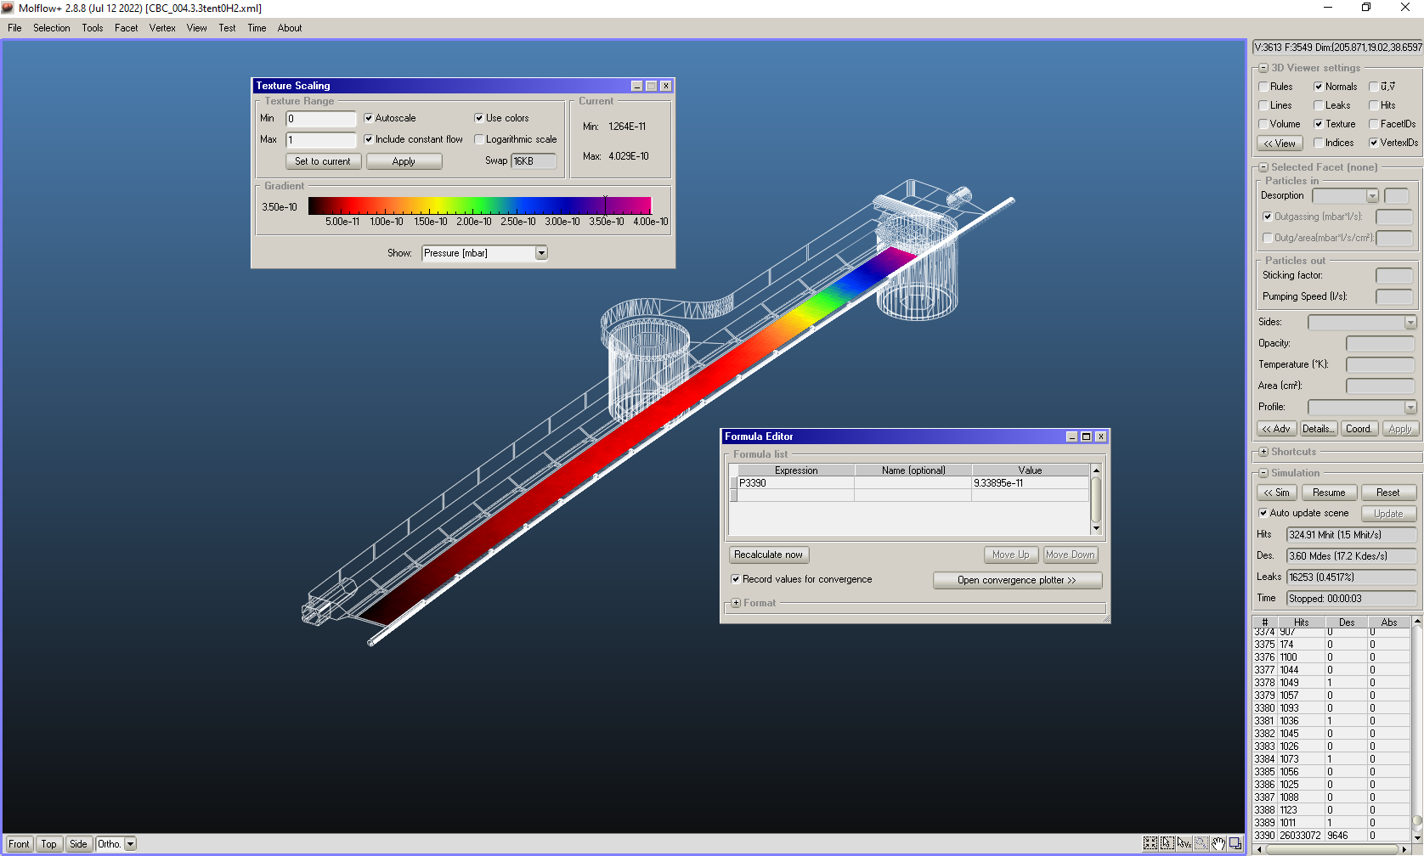
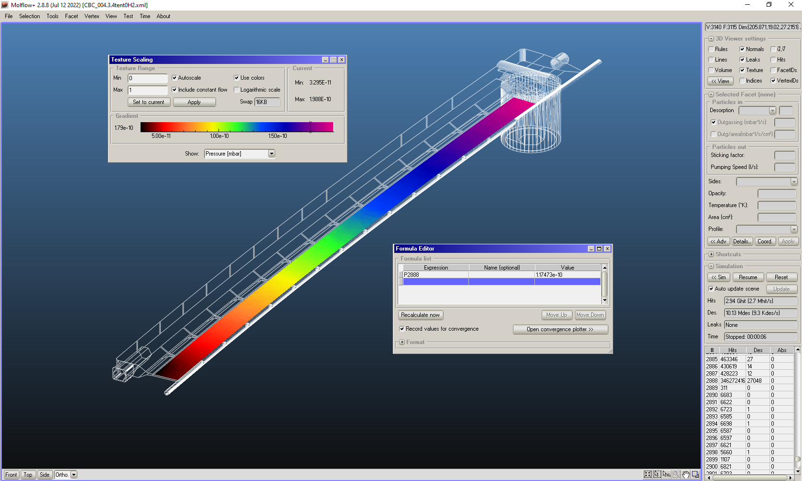
Pump Placements
2x NEXTorr D500, 1x CapaciTorr Z 400
Average Pressure H2 = 9.34E-11 Torr
1x NEXTorr D1000, 1x CapaciTorr Z 400
Average Pressure H2 = 1.17E-10 Torr
Credit: M. Ferreira

Slide 17
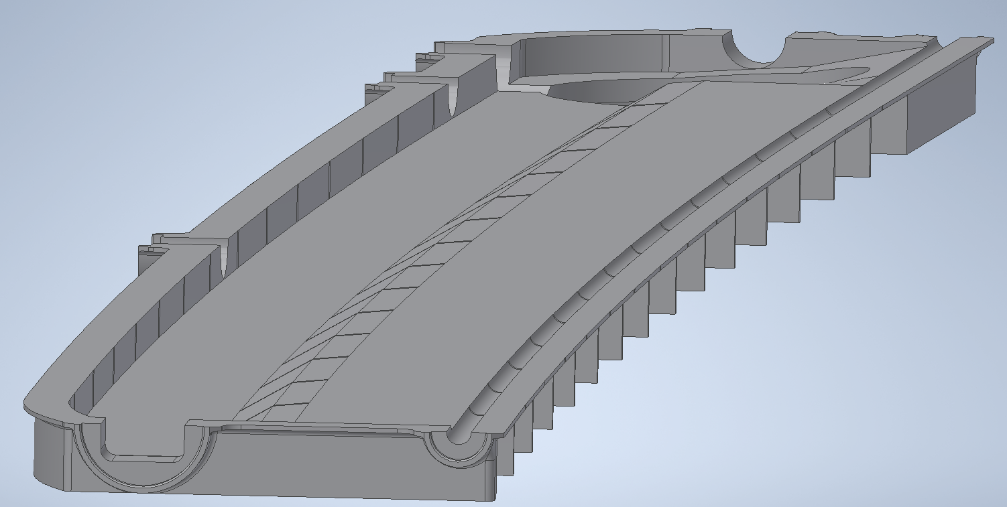
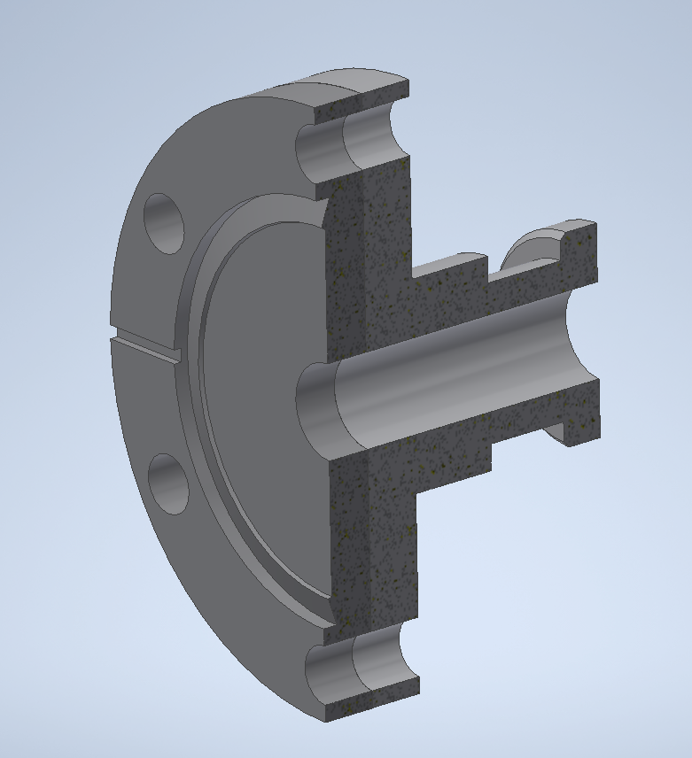
MATERIAL SELECTION
The chamber is to be fabricated from machined Aluminum 6082 halves and welded together.
  Similar designs exist
  Sufficiently low electrical resistivity
  Economical raw material cost
  Excellent machinability
  Weldable
Bi-metallic flanges to be used
17

Slide 18
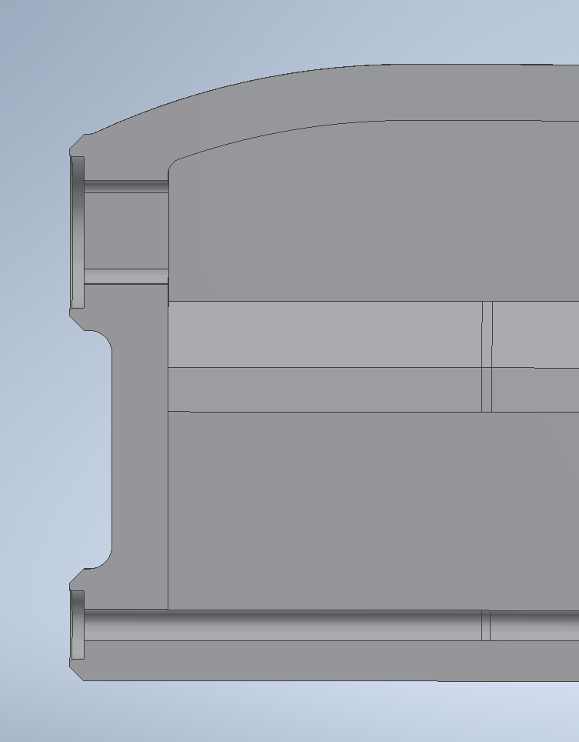
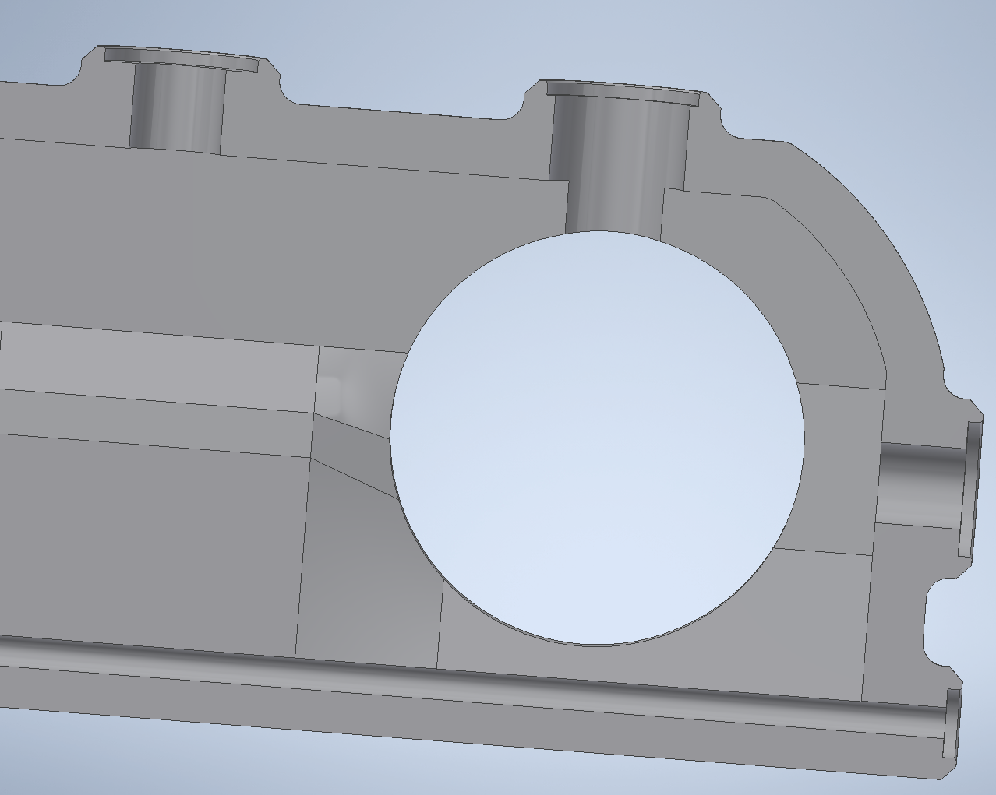
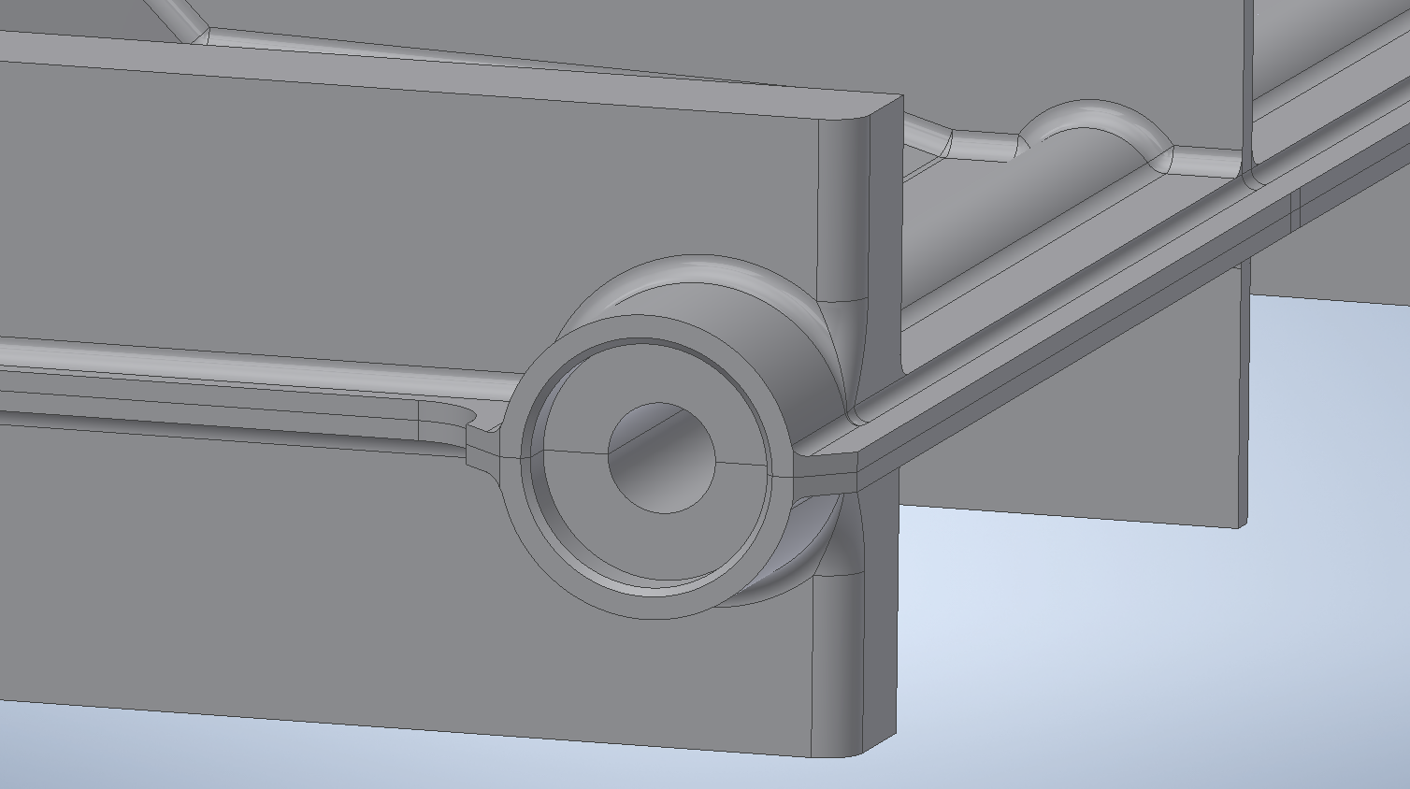
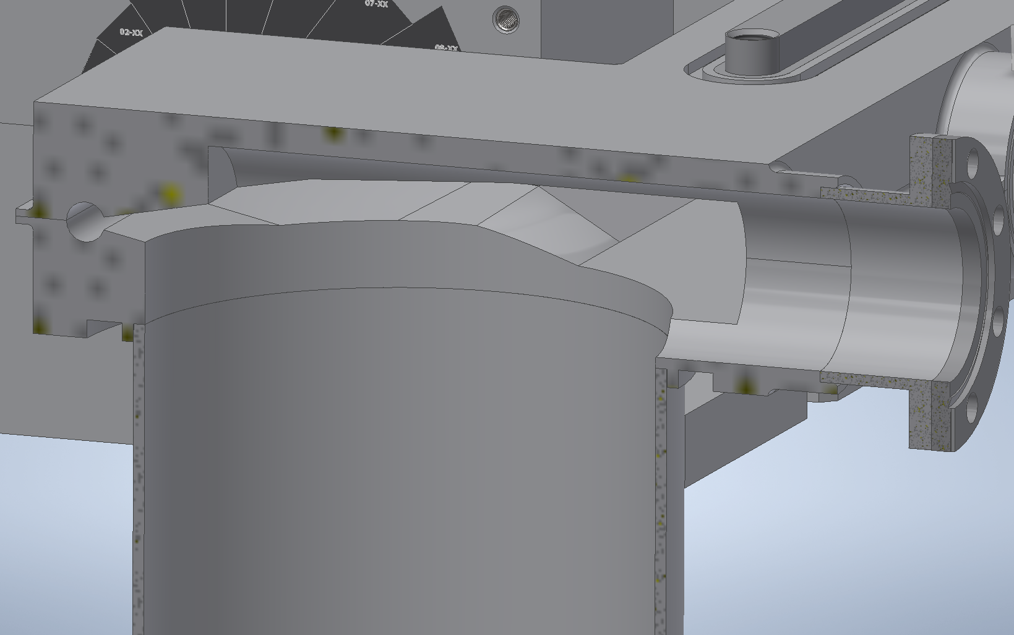
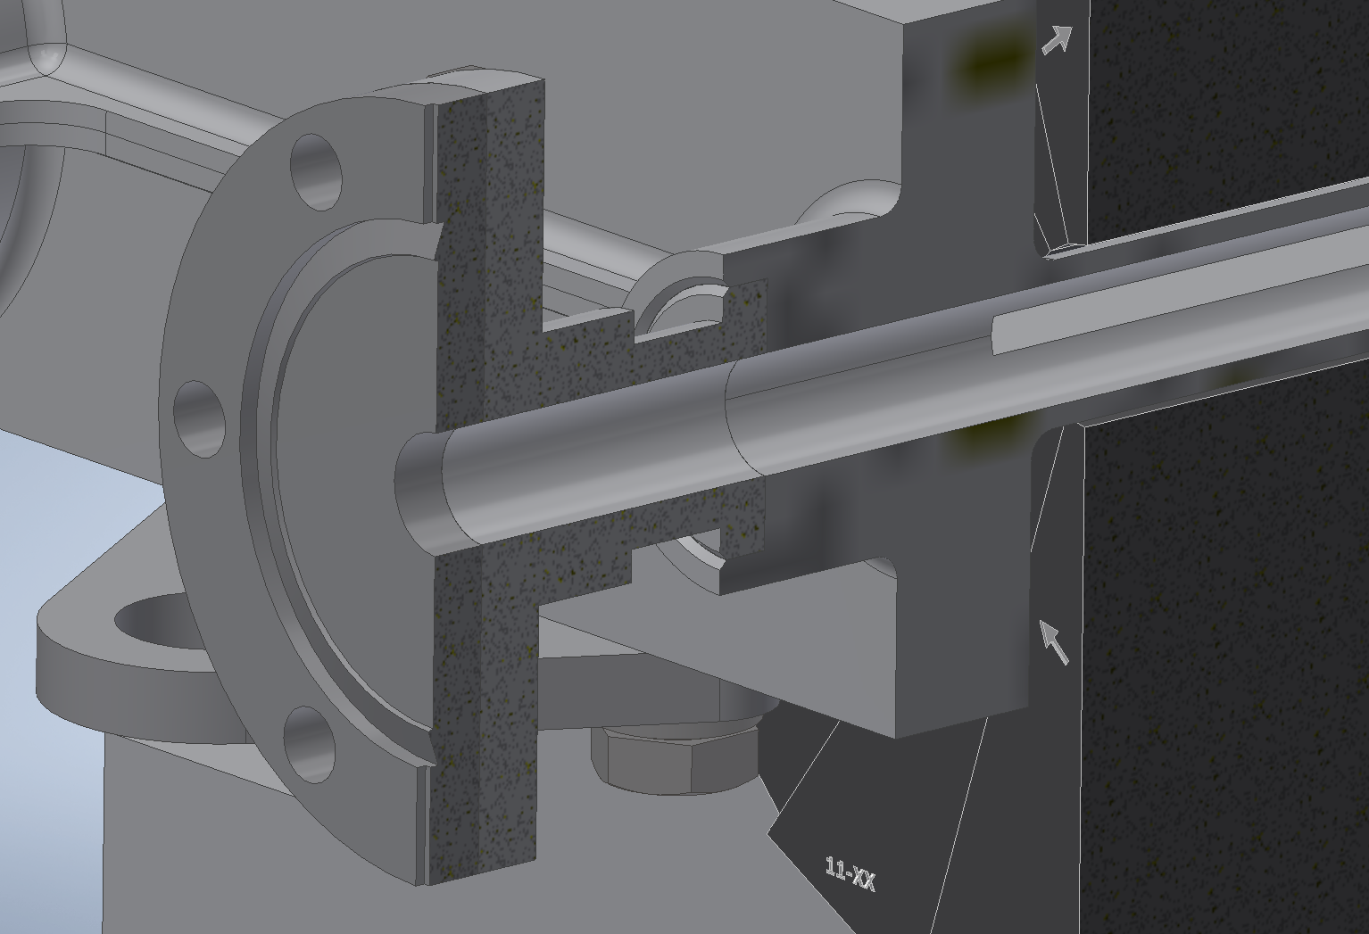
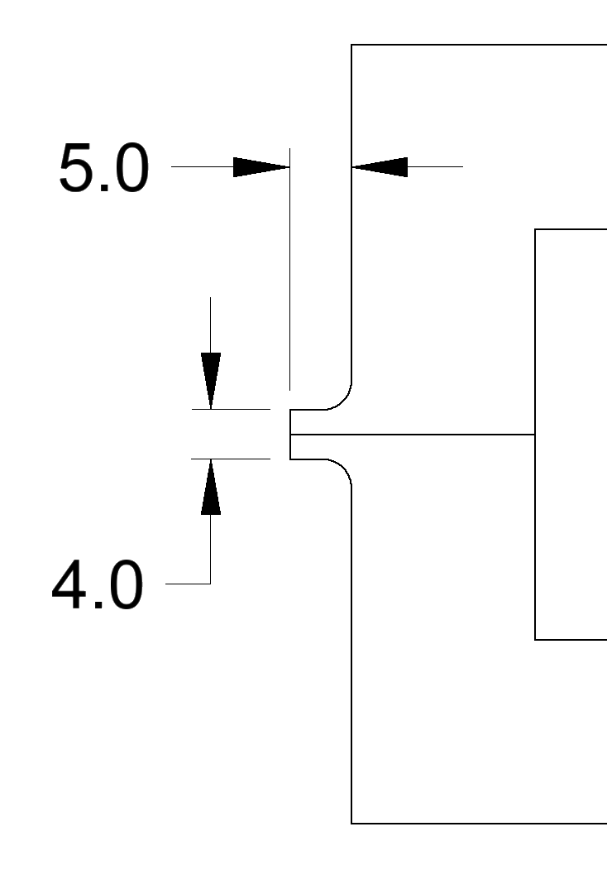
FABRICATION – WELDING
*Design avoids large heat affected zones + overlapping welds
No welding sharp corners
Peripheral weld
Typical weld prep
Flange weld
18

Slide 19
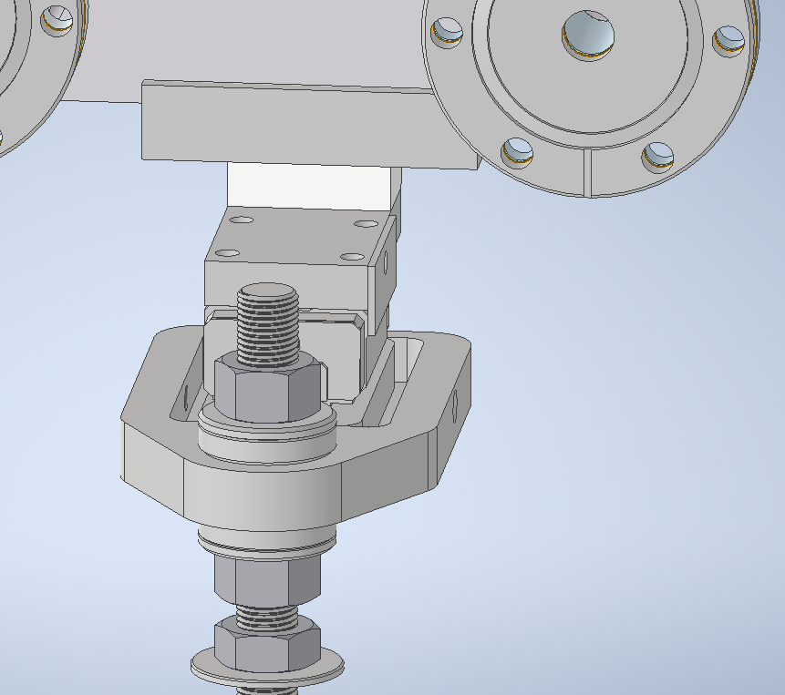
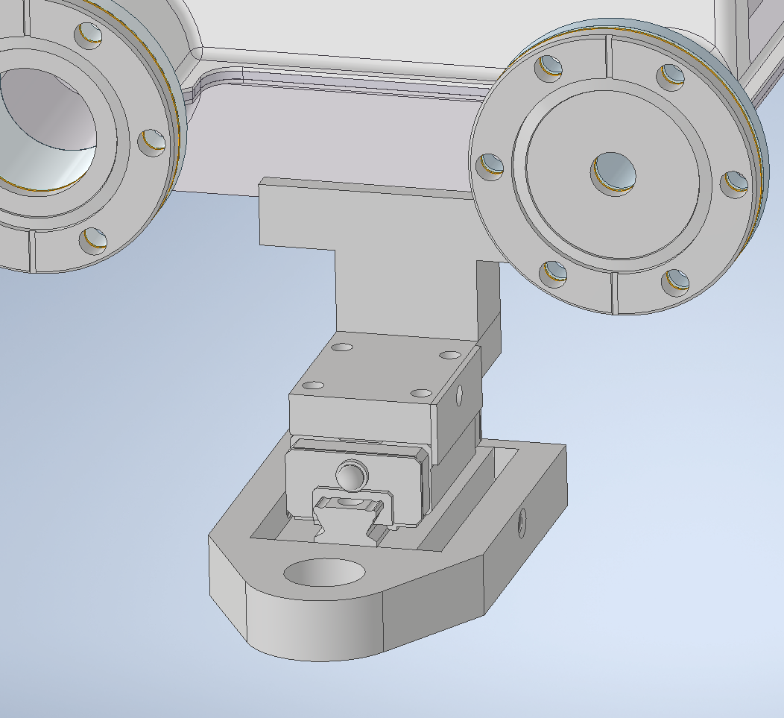
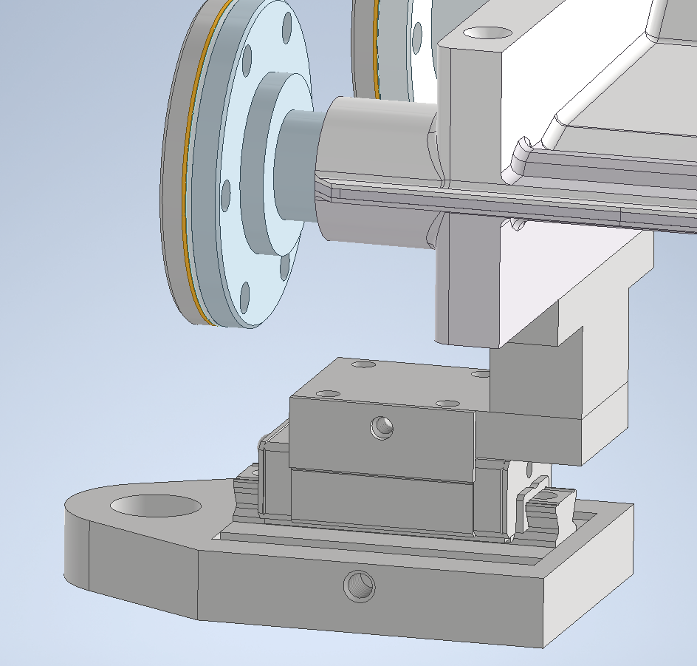
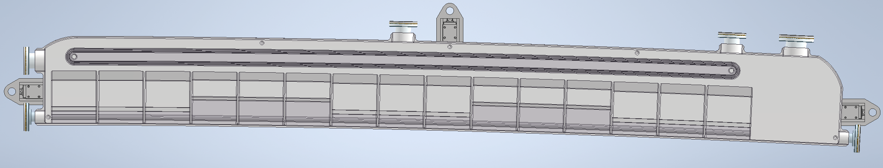
SURVEY + ALIGNMENT
*Nominal clearance between chamber + magnets ~ 0.5mm

Slide 20
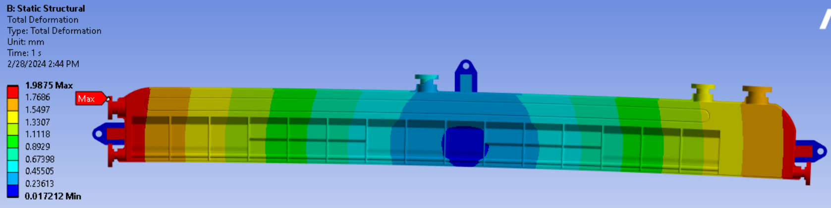
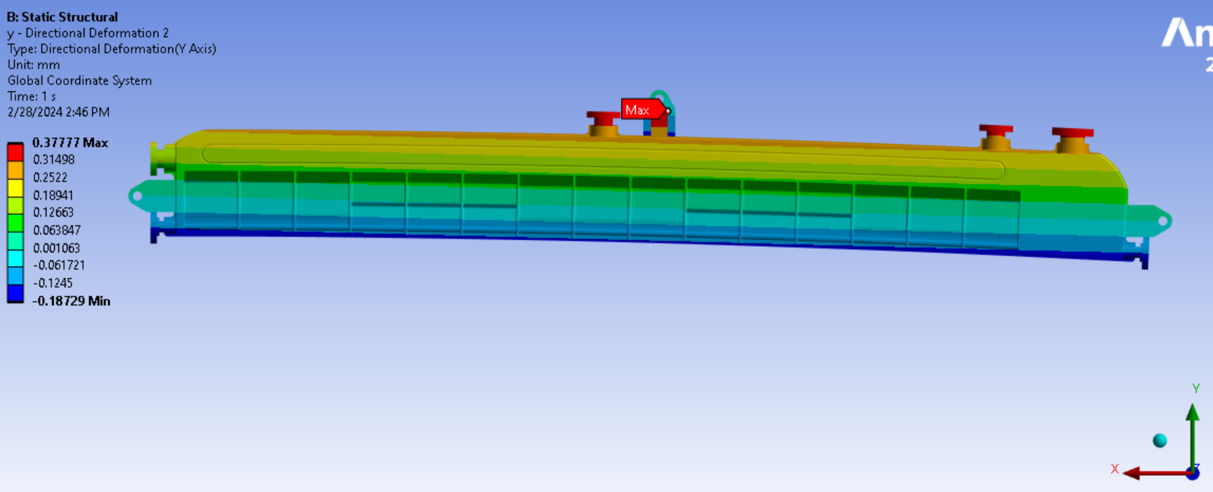
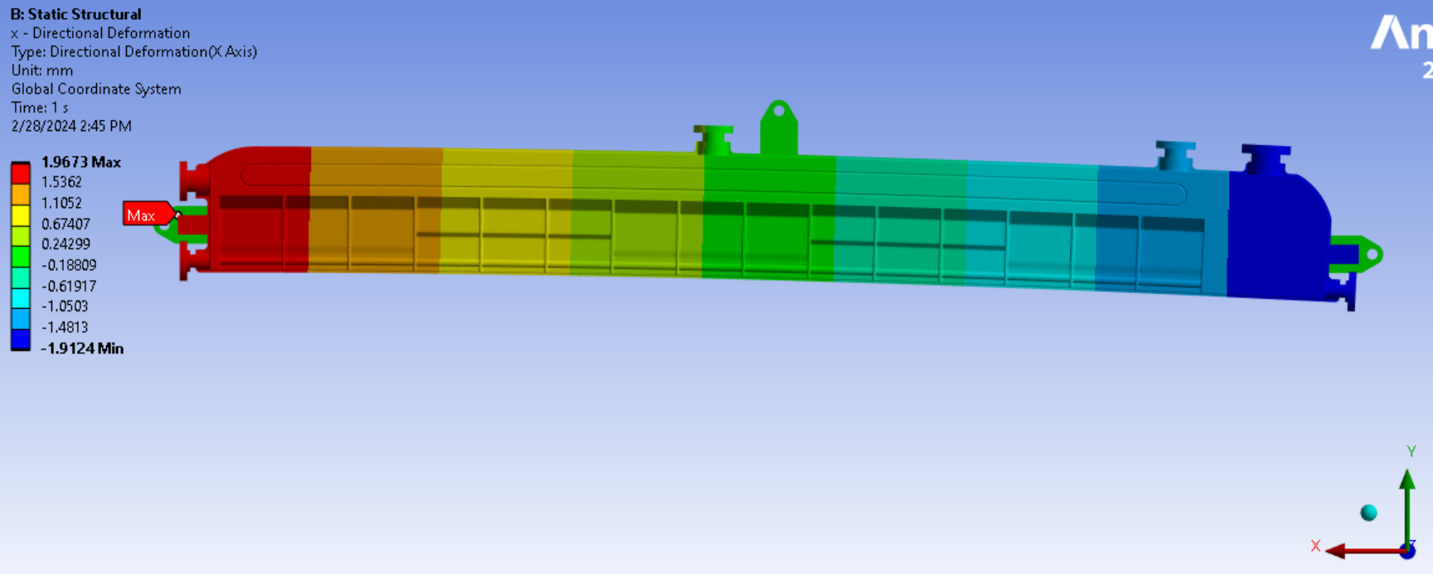
▲T = 75C
SURVEY + ALIGNMENT
Total Deformation
Anchoring occurs in center of chamber toward beam channel
60µmm of lateral movement towards magnets
Deformation in Y
2mm of longitudinal movement per side
Deformation in X

Slide 21
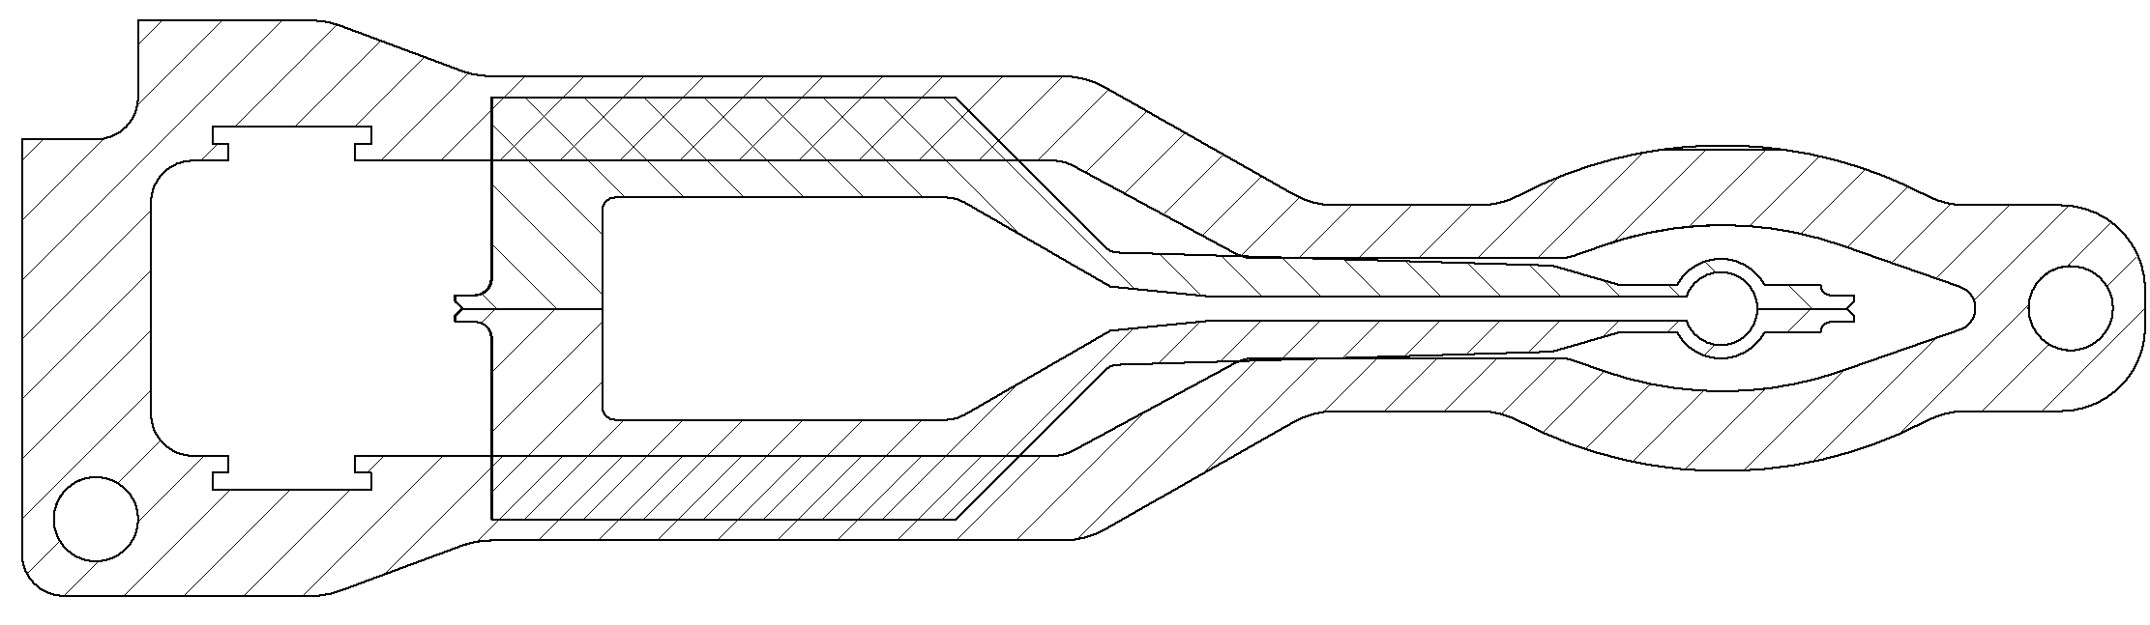
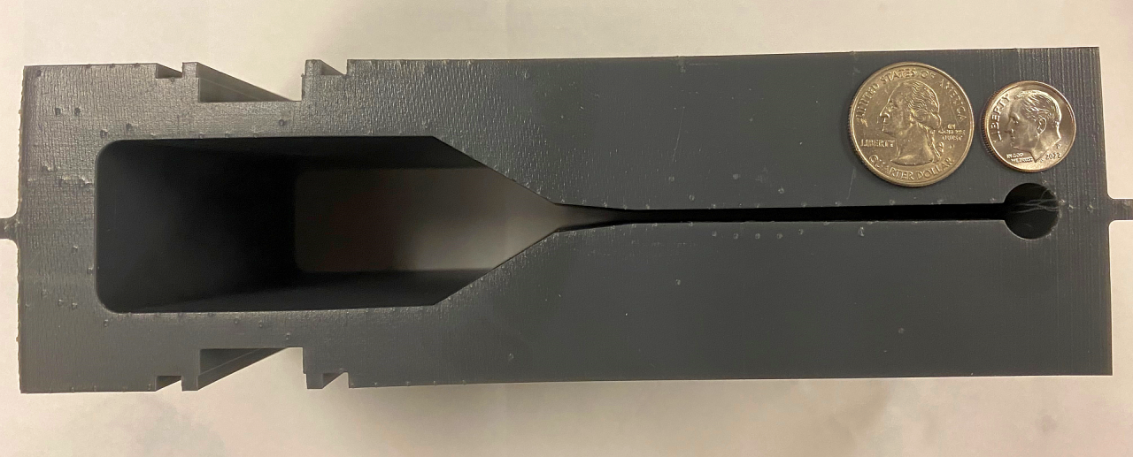
Thank you - Questions?

Slide 22
BACK UP SLIDES

Slide 23
Design Process for New Lattice Iterations
Inventor
Optics Builder
(MAD-X file)
MolFlow
SynRad
ANSYS
OSCARS
(Open Source Code for Advanced Radiation Simulation: Dean Hidas ID Group)
-Necessary to have system in place for when changes are made to the lattice to quickly update existing models.
Recent developments of Monte-Carlo codes MolFlow+ and SynRad+
M. Ady, R. Kersevan

Slide 24
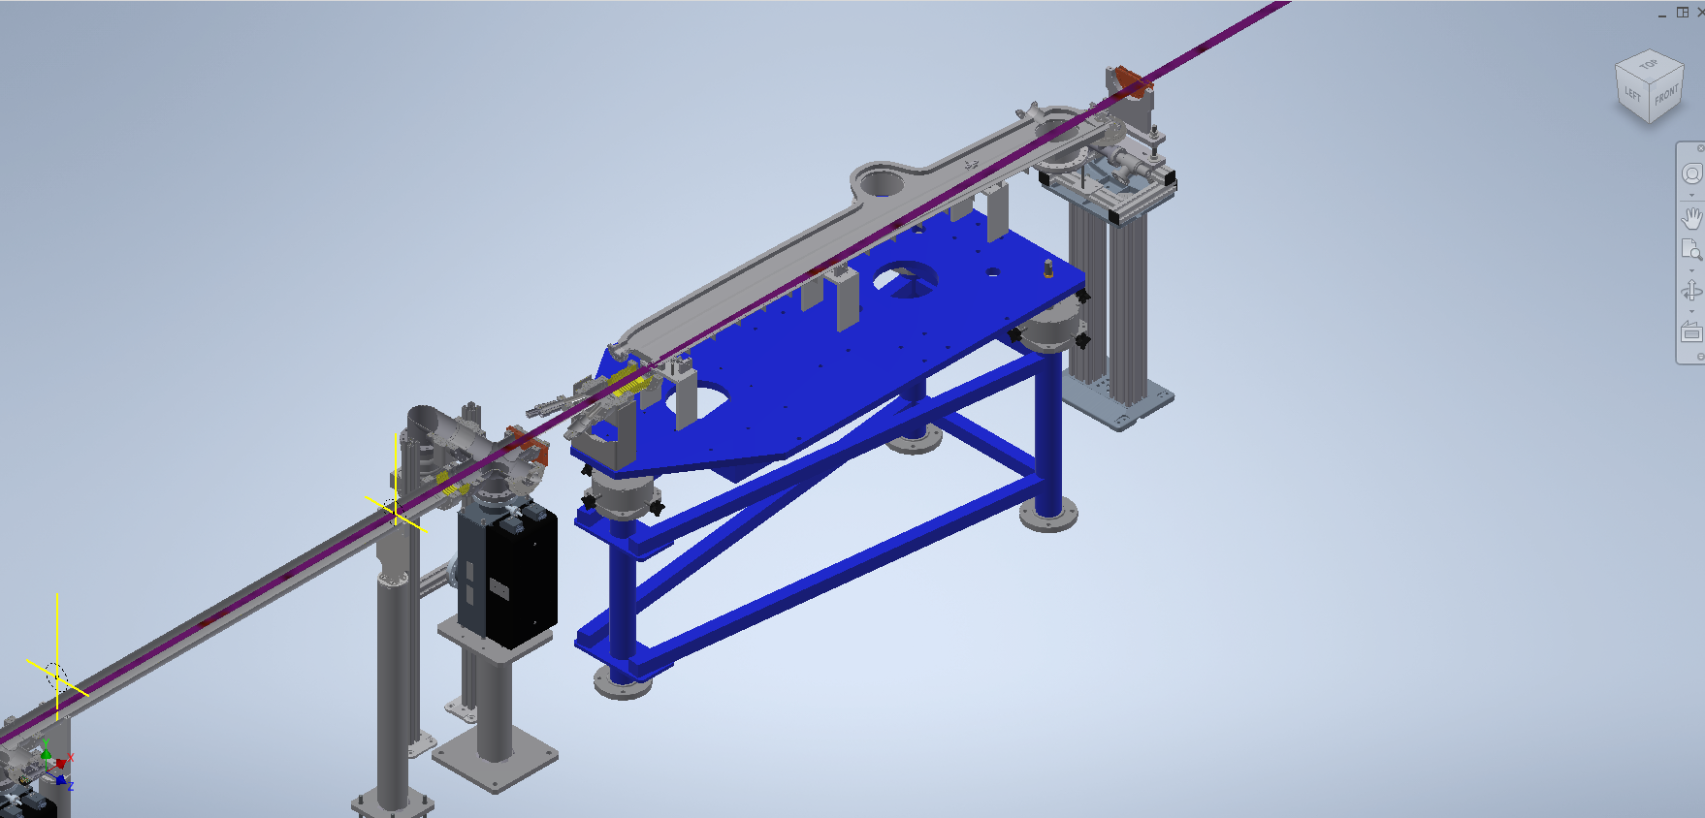
NSLS2-U Prototype Chamber at 14BM
-Prototype chamber can eventually be installed at 14BM Beamline for testing. Can experimentally determine PSD yield and confirm variables used for simulations.

Slide 25
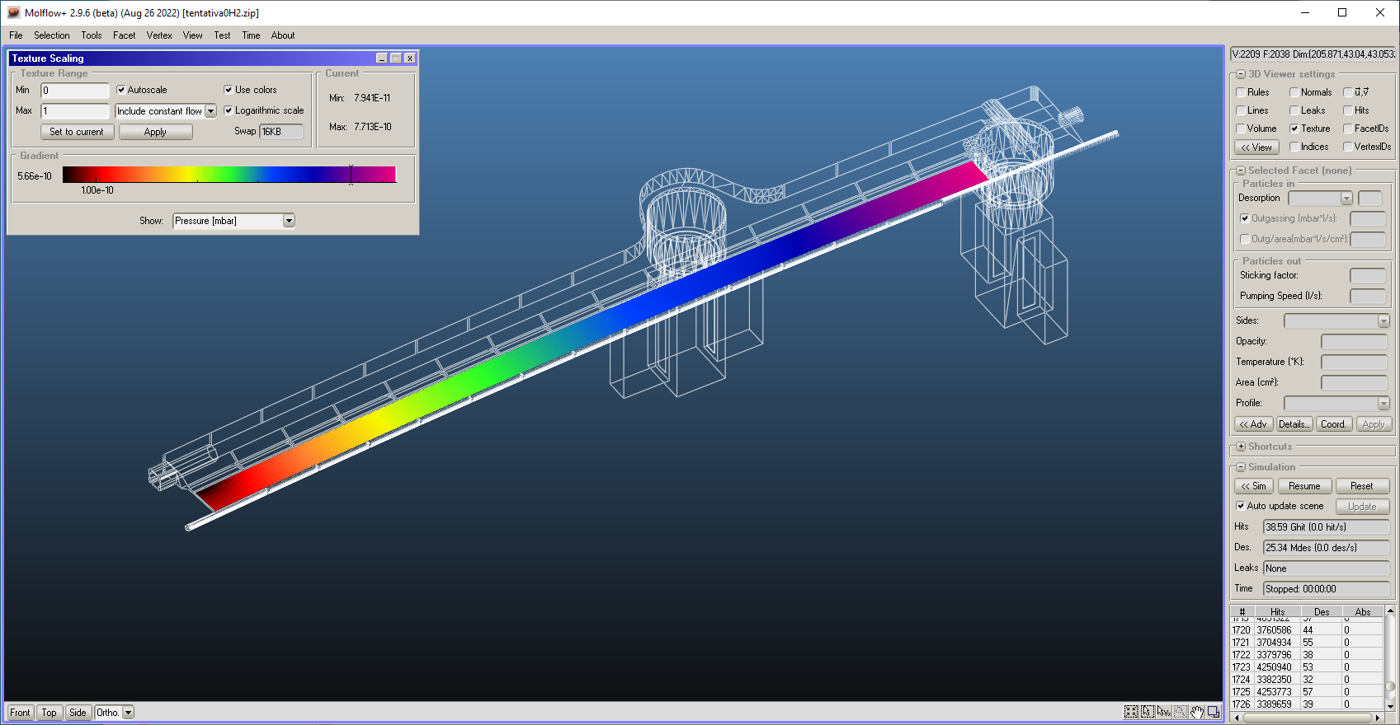
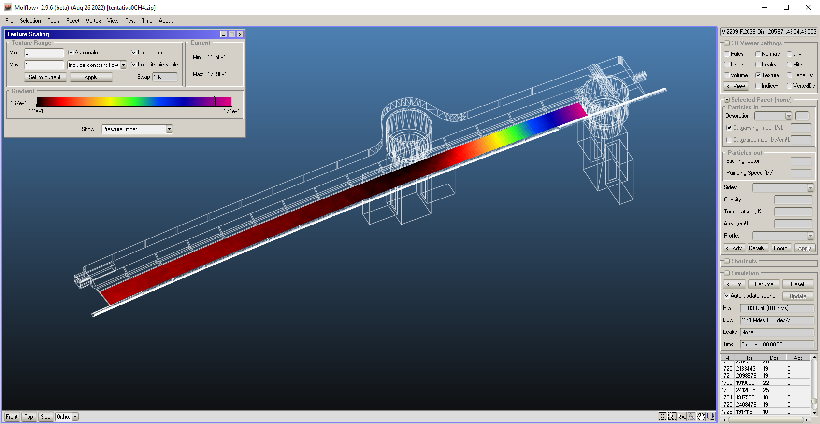

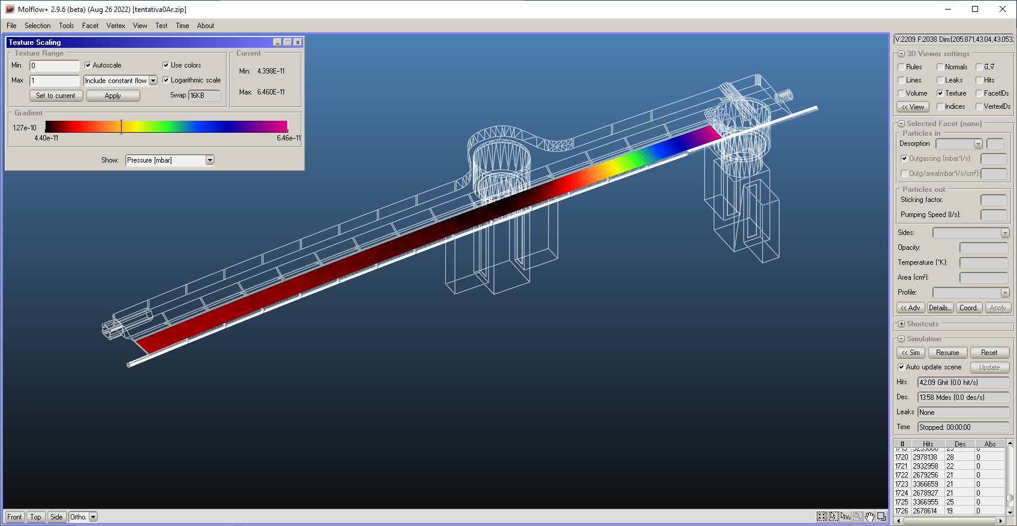
Vacuum Simulations
Average Pressure:
H2 ≈ 4.1x10⁻¹⁰ Torr
Average Pressure:
CH4 ≈ 1.5x10⁻¹⁰ Torr
Average Pressure:
Total ≈ 8.3x10⁻¹⁰ Torr
Average Pressure:
CO ≈ 2.1x10⁻¹⁰ Torr
Average Pressure:
Ar ≈ 5.8x10⁻⁹ Torr
-Modelled using 2x Gamma 100L DI, 1x CapaciTorr Z400
-Estimated gas composition: 85

Slide 26
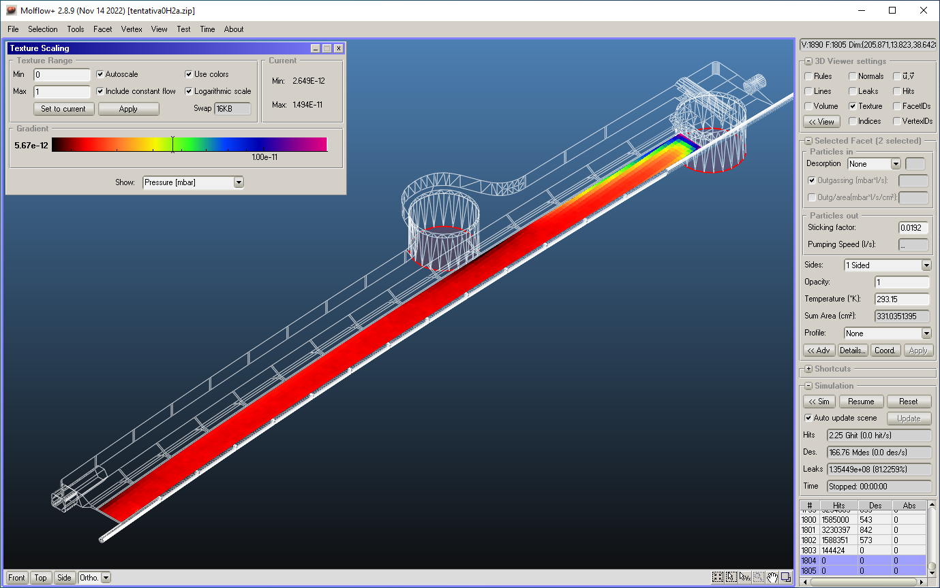

Pumps: To Model or Not?
Pump Facet
Pump Model
Average Pressure:
H2 ≈ 3.7x10⁻¹⁰ Torr
Average Pressure:
H2 ≈ 3.7x10⁻¹² Torr

Slide 27
Charge Questions
Technical scope:
1. Is the scope well defined?
2. Are all requirements documents sufficiently mature?
3. Is the design sufficiently mature and technically sound so as to meet the performance requirements ?
4. Have all known major interfaces been identified and incorporated into the design?
5. Is the development of associated CAD models sufficiently mature?
Design management:
6. Have all of the major risks been identified?
7. Have recommendations from previous reviews been addressed?
8. Is the general procurement strategy sound?
9. Have related EH&S and QA aspects been identified, and is the strategy to address them appropriate?
Overall questions:
10.Are there any other issues that the committee has identified?
l l.Overall readiness: Is the design maturity at a sufficient level for PDR approval?

Slide 28
Slide Contents to Include
  Material selection (Mike)
    Fabrication / Machinability
    Physics requirements / resistive wall
  Geometry (Mike)
    Physical envelope
      Aperture
      Exit slot
      Impedance (GdfdL) losses
      Beam path based on lattice and synrad optics.
  Tolerances (Mike)
    flatness
  Mounting provisions (Mike)
    Tapped holes for mounting to girder independent of PMQ assemblies.
  Stress analysis(Mike)
    Ansys stress and deformation
  Thermal analysis (Mike)
    Cooling provisions to remove heat and preserve stability.
  Pumping provisions (Marcelo)
  Molflow simulations (Marcelo)
    Machine parameters and expected desorption from existing literature.
    Molflow simulation showing expected beam channel pressure and gas constituents.
  Synrad simulations (Paul)
    Preliminary Synrad model. Develop desorption maps for exit slot and crotch absorber face and import into Molflow. Check against Marcelo’s Molflow simulation.
  Procurement Strategy (Mike)
    Meetings held with two reputable vendors. Both have provided budgetary quotes and made recommendations for improvement. Seeking a third manufacturer.
    Finalize beam path based on final PMQ fields. Complete the drawing package with vendor recommendations.
    Go out to bid with build to print drawings with allowances for improvements in design prior to fabrication.

Slide 29
Vacuum Simulations Study
Simulation goal:
Average pressure on the beam path <1x10⁻⁹ Torr
Design parameters for a cost-effective model
Explore design process beam physics -> vacuum engineering
Method:
Simulation per gas composition: H₂, CH₄, CO, and Ar,
Result include pressure distribution analysis and sum all partial pressures,
Include pump models: same approach for Vacuum and Impedance,
Results: beam in nominal position and worst case (Decision maker: worst case)

Slide 30
Vacuum Simulations Study
Conclusion:
Chamber with one pump port, average pressure < 1 x 10⁻⁹ Torr (N₂ equivalent),
Pressure at the CCG gauge location is equivalent to the average pressure at the beam path,
Actual thermal outgassing value can be obtained from the prototype and feedback to the simulations,
SR conversation factors for photons and photoelectrons can be measured from the prototype chamber at 14BM using a simplified crotchet (numbers can be scaled up to final power/photons),
Use of NEG coating material can mitigate e-cloud (even without activation just SR scrubbing),

Slide 31
Vacuum Simulations Study
Initial parameters
Parameters estimation for vacuum use only:
Energy: 3 GeV Current: 500 mA Bending radius: 25 m (aprox.)
Total number of photons: 3.6x10⁺²¹ photons/s (TBC by OSCAR/SynRad)
Desorption coef. (at 100Ah): 2.0x10⁻⁷ molecules/photon (same value NSLS-II, APS, APS2… TBC by 14BM)
Photon Stimulated Desorption (PSD): 8.0x10⁺¹² molecules/s per chamber (TBC by 14BM)
Gas load by PSD: 2.3x10⁻⁷ Torr.l/sec per chamber (total PSD machine 2x10⁻⁵ Torr.l/sec) (TBC by 14BM)
Thermal outgassing (Al 150C@24h, N₂ vented, pumped 10h): 5x10⁻¹³ Torr.l/s.cm² (TBC by prototype)
Chamber total thermal outgassing: 5x10⁻⁹ Torr.l/sec
Total gas load per chamber: 2.3x10⁻⁷ Torr.l/s

Slide 32


Vacuum Simulations Study
Simulation of 100 l/s ion pump
GOAL:
Check best pump model for simulation:
i. flat surface with gas specific pump speed (factory data);
ii. pump body assuming pump speed reported from factory for 1 cell (proprietary data from Gamma).
Both models will assume normal operation, and the usual reported conversion factor N2 -> specific gas for ion pumps speed (100% CO2; 220% H2; 85% N2)

Slide 33
Sample Pump Curves

Slide 34

Vacuum Simulations Study
Model: Tentativa1
Model :
x2 Gamma 100L DI, x1 CapaciTorr Z 400
Worst case 80% Abs 20% dipole gap,
Average Pressure:
H2 ≈ 4.1x10⁻¹⁰ Torr
Average Pressure:
CH4 ≈ 1.5x10⁻¹⁰ Torr
Average Pressure:
Total ≈ 8.3x10⁻¹⁰ Torr
Average Pressure:
CO ≈ 2.1x10⁻¹⁰ Torr
Average Pressure:
Ar ≈ 5.8x10⁻⁹ Torr

Slide 35
Vacuum Simulations Study
Simulation of 100 l/s ion pump
Average Pressure:
H2 ≈ 3.7x10⁻¹⁰ Torr
Model parameters:
Flat surface
- Pump speed of a Gamma 100L DI@1x10-9 Torr = 55 l/s, converted to H2 (220/85) ≈ 140 l/s
Pump body
- Pump speed of 1 cell @ 1x10-9 Torr = 39 l/s; x2 cells converted to H2 (220/85) ≈ 200 l/s
Average Pressure:
H2 ≈ 3.7x10⁻¹² Torr
RESULTS:
The simulations should reflect the usual practice in the lab,
Simulated pressure for the model with the pump body included in low e-10 Torr,
Simulated pressure for the model with the flat surface is very optimistic < e-11 Torr ,
From vacuum or RF perspective the chambers port and vacuum pumps body should be included to reflect the real practice.

Slide 36
Vacuum Simulations Study
Model: MBC 005 w/o RF screen
Model :
x1 NEXTorr Z 1000 Diode,
x1 NEXTorr Z 300 Diode,
Worst case 80% Abs 20% dipole gap,
Impedance G2 geometry,
Average Pressure:
Beam path ≈ 8.8 x10⁻¹⁰ Torr
CCG gauge ≈ 8.7 x10⁻¹⁰ Torr

Slide 37


Vacuum Simulations Study
Beam physics –> Vacuum engineering (Vacuum/thermal/mechanical)
Beam ray-tracing (RT) is the major input.
SynRad can do the SR (flux/power) and the chamber mechanical input needs to fit RT!!
Example NSLS-II;
Sagitta (gap between the formal radius and the real beam ray-tracing), 3 - 5 mm off the central line of the chamber,
Dipole radius doesn’t follow beam RT, but the horizontal aperture allow big excursions (74 mm)
NSLS-IIU has much smaller tolerance on that!!!

