Slide 1
FRIB Fragment Separator Vacuum Operational Experience
Brandon Ewert Vacuum Operation Group Leader ewert@frib.msu.edu
April 2024

Slide 2
Outline
Overview of Facility
ARIS Vacuum Systems
Commissioning
Operation
Upgrades
Current Projects

Slide 3
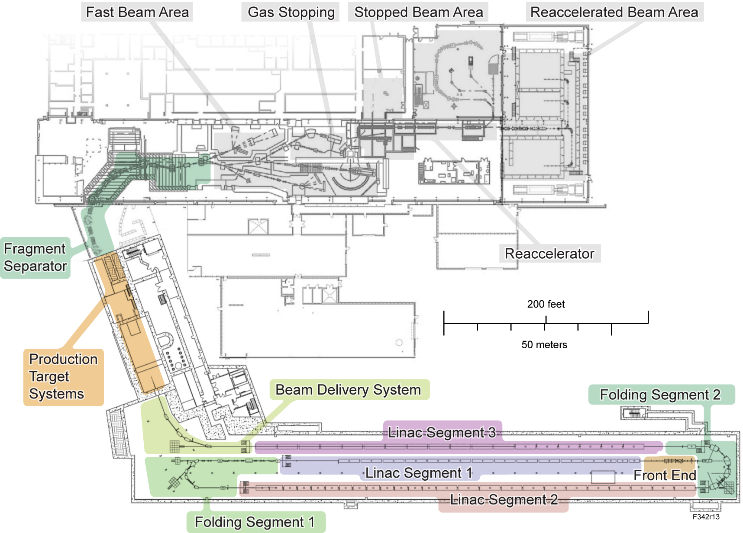
Overview of Facility
Facility for Rare Isotope Beams
National Superconducting Cyclotron Laboratory merged in 2020
A1900 Reconfigured 2020-2021
LINAC BDS completed in 2021
DOE User Facility
Operating user experiments since 2022 at 4000+ hrs/yr
Capabilities:
2 Ion sources
200MeV/u from O-16 to U-238
Planned upgrade to 400MeV/u
10kW CW
20kW planned for late 2024, ramp up to 400kW over 5 years
Beam stopping and Reacceleration up to 6MeV/u
Planned upgrade up to 12MeV/u

Slide 4
Vacuum Group Structure
Linac Vacuum & SRF Processing – Lead by K. Elliot
Operate and maintain particle-free UHV in LINAC
Support Front End vacuum system operation & maintenance
Process cold masses for cyromodules
Maintain insulating vacuum on cryostats
Vacuum Operation Group – Lead by B. Ewert
Operate and maintain Fragment Separator & Experimental vacuum
Operate and maintain detector gas handling systems
Design and build new warm beamlines
Component servicing and processing
Operation
(Trying to reduce!!)
Processing
Procurement
Maintenance
Design

Slide 5
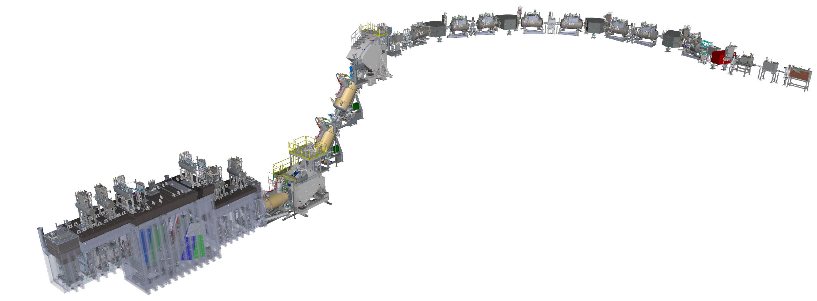
Overview of ARIS Vacuum System
Advanced Rare Isotope Separator (ARIS) – 110m beam path
Reconfigured A1900 – 5 550L/s TMP stations, 5 segments
P < 2E-6 Torr, V ~ 2500L
Transfer Lines – 5 300L/s TMP stations, 5 segments
P < 2E-7 Torr, V ~ 1000L
Vertical Preseparator – 3 700L/sTMP stations, 3 segments
P < 2E-6 Torr, V ~ 4000L
Target Hall – 6 700L/s TMP stations
P < 2E-5 Torr, V ~ 15200L
BDS (LINAC) – 1 550L/s TMP, 4 70L/s IP
P from 1E-7 to 1E-10 Torr, V ~ 300L

Slide 6
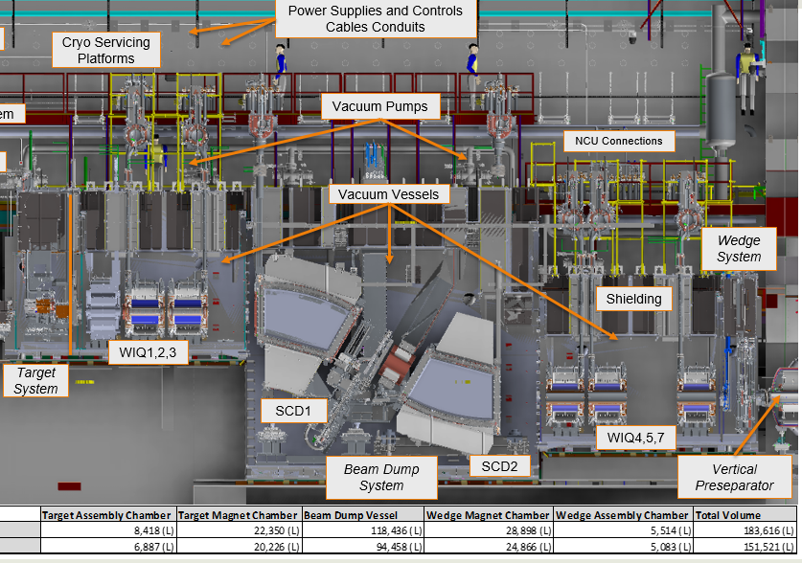
Target Hall Vacuum System
Target Vessel houses:
Rotating carbon target
~1% of beam interacts and fragments
Dual warm-iron quad-triplets
Focusing before and after separation
Superconducting dipoles 1, 2
1st order separation from primary beam
Stationary beam dump
Higher power requires rotating design
Wedge & viewer system
Reduces momentum spread from target interaction
Allows feedback for beam tuning
Reentrant steel shielding
1.5m thick, Ni-plated

Slide 7
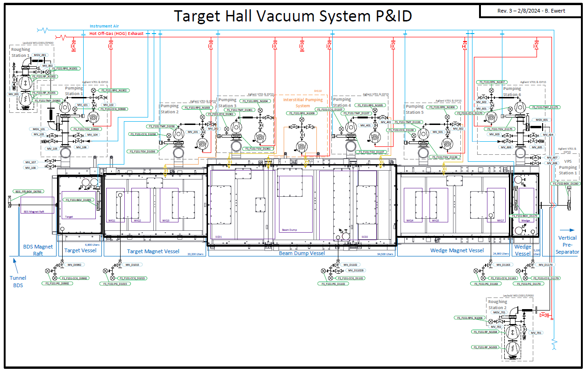
Target Hall Vacuum System Specifications
6 700L/s TMP Stations
2 650m^3/hr RB/Screw Pumps
2 custom all-metal gate valves
Allow isolation of Target, Wedge chambers from Beam Dump
1E-6 Torr base pressure (2E-4 Torr “Beam On”)
Atm -> 2E-4:
Entire vessel – 2hrs
Target/Wedge vessel – 5 / 7min
Dual o-ring seals on chamber lids with interstitial pumping
Fully remotely operable

Slide 8
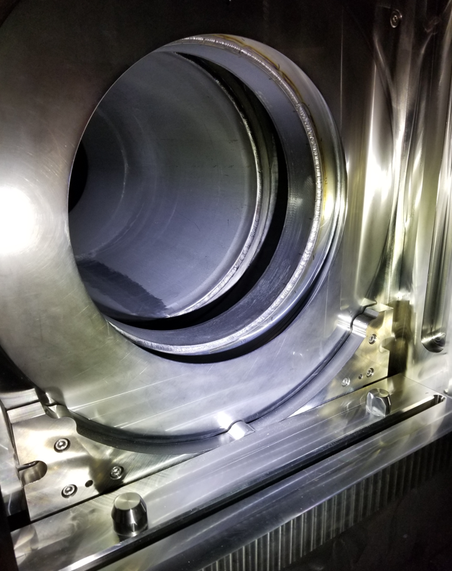
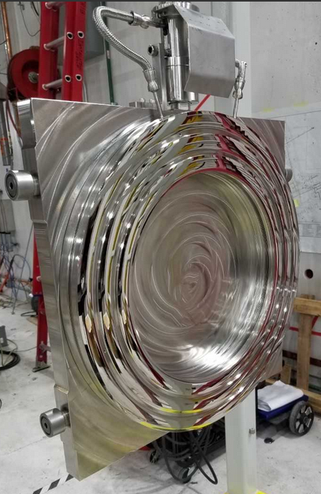
Target & Wedge Isolation Valves
Commissioned late 2023
Developed with Mewasa
All stainless steel
Sealed via inflation of bellows to 20psia
3 concentric pillows inflated to 45psig
Interstitial areas pumped
Through-leak rate beats design of 1E-4 TorrL/s

Slide 9
Vertical Preseparator
2 Dipoles, 4 Quad Triplets
1 Viewer station
3 700L/s TMP Stations
2 ISO400 Gate Valves
5E-8 Torr base pressure (2E-5 Torr “Beam On”)
Remotely operable, except venting
Beamline access rarely needed

Slide 10
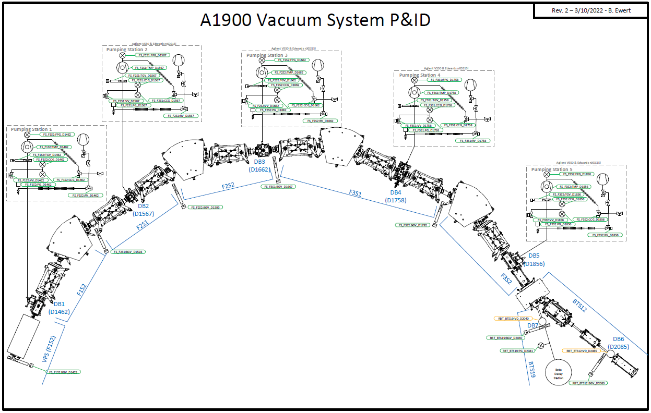
Reconfigured A1900
4 Dipoles, 8 Quad Triplets
5 Diagnostic boxes
Viewers
PPAC Tracking Detectors (limit venting rates)
Wedges
Timing detectors
5 550L/s TMP Stations
5 ISO250 Gate Valves
5E-7 Torr base pressure (2E-5 Torr “Beam On”)
2E-6 Torr typical with detectors filled
Remotely operable, partially automated

Slide 11
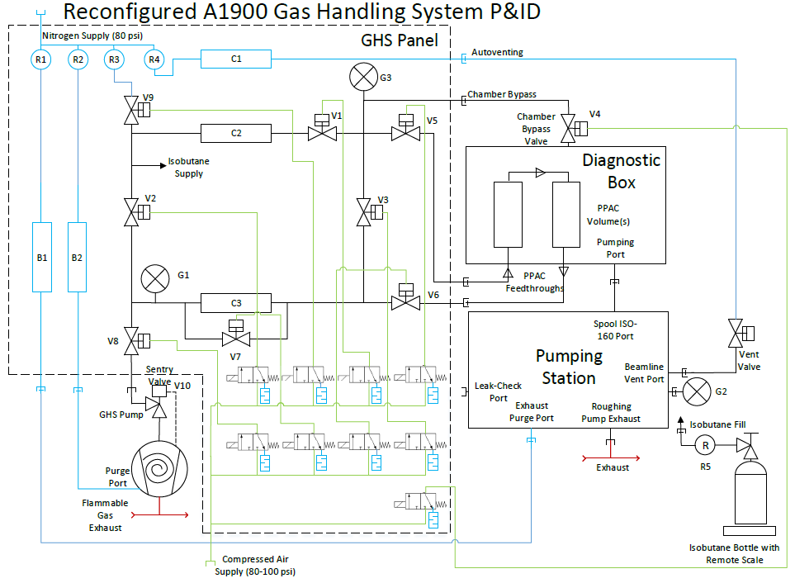
Gas Handling Systems
4 in Reconfigured A1900
More planned for upgrades and future beamlines
Supplies 5-15 Torr at 0-10sccm
Process gas iC4H10 or CF4
Downstream PID pressure control
Stability mainly temperature dependent
Detector windows are 30um Aluminized Mylar
Can usually withstand ~20 Torr dP
New systems in development with similar architecture
Special considerations for flammable gases
ATEX rated scroll pumps
Interlocks
Exhaust dilution with N2

Slide 12
Assembly and Commissioning
Acceptance Testing
Leak Checking
Cleaning
Pre-assembly
Assembly
Pumpdown/Leak Check
Controls Integration
Issues
Isolation valve “slinky”
Spring solution
Leaks in BNC, SHV feedthroughs
Replacement with o-ring sealed versions
Cold Cathode Gauge spikes causing nuisance
Use of averaging in areas with redundant gauges
Helico-flex seals with chain clamps leak after initial torque
Re-torquing after 24hrs and leak checking
Largest time-savers! Service valves on forelines proved invaluable

Slide 13
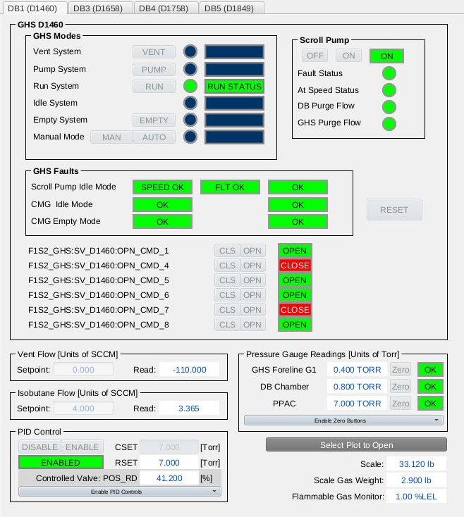
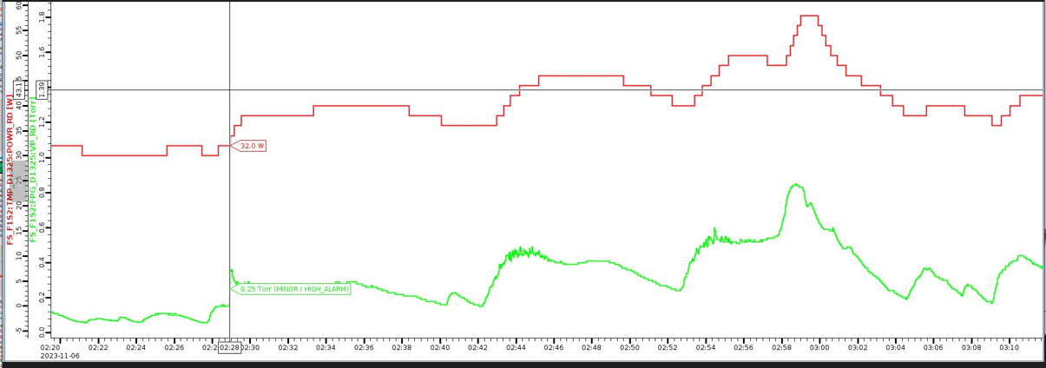
System Operation
Pumping/venting
Access to beamline requested by Maintenance Group
Vacuum Operation Group (VOG) performs vent/pump
Working to simplify, automate
System monitoring
EPICS based controls with CS-Studio UI
FRIB Operators contact VOG after first level of troubleshooting
Minor/major alarms
Minor alarms detect abnormal conditions
50mT on foreline gauges signal tip seal wear
50W on TMP may indicate bearing wear
Major alarms usually ~50% of interlock threshold
Allow decision and intervention prior to failure
Voice alarms
Sound when human intervention required
“UOF” valued at $35,000/hr

Slide 14
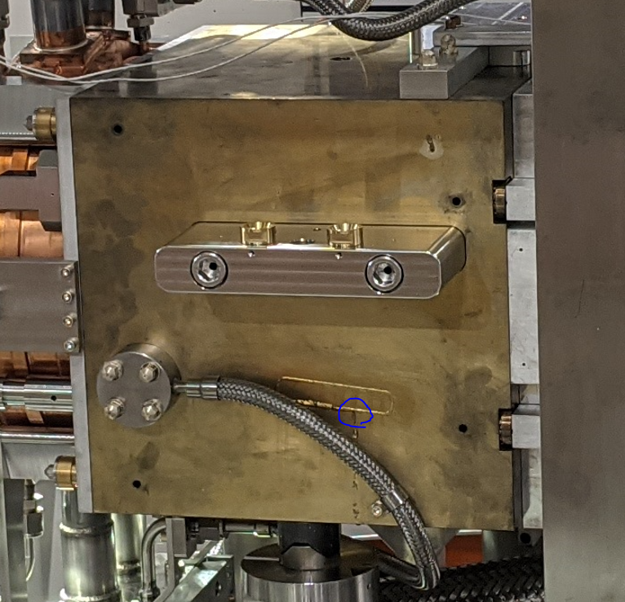
Operational Issues
PPACs leaking – windows, fittings, feedthroughs
Assembly-level validation exists, vetting method for in-situ sniff testing
Long-stroke edge welded bellows with internal guides
Internal guides dislodged and tore convolutions
New design from Mewasa procured
Target Water Leaks 1E0 TorrL/s
Pinhole leak on Cu e-beam weld
Cut out, welded by hand
Pinhole leak in Cu to SS braze
Rebrazed
Beam Dump Water Leak – 1E-2 TorrL/s
Leak on spring-energized seal after dump head swap
Pressure decay test used – not sensitive enough
Decision made to continue operation – leak is stable
Current base pressure ~1.5E-5 Torr

Slide 15
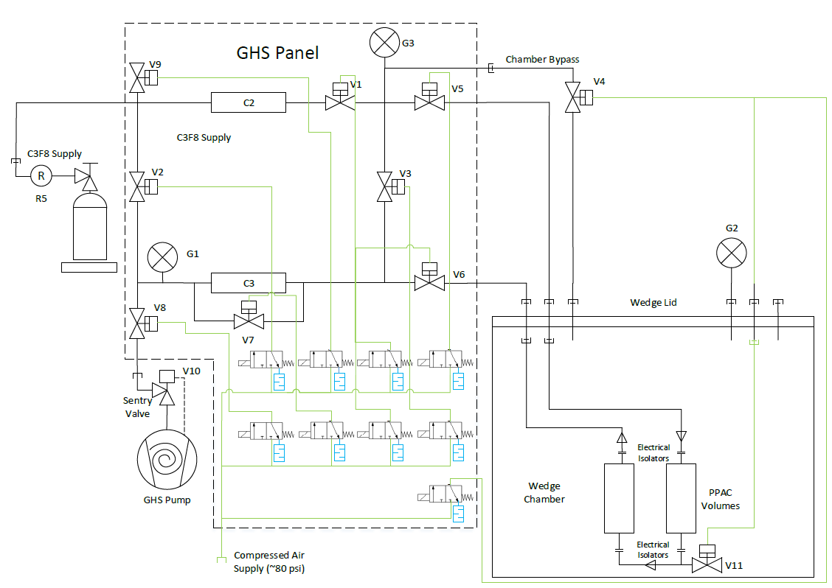
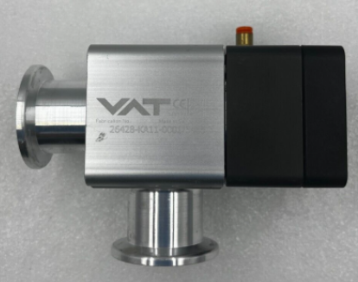
System Upgrades
High-vacuum quick disconnects
Currently being vetted via limited beamline use
Automated pumpdown/venting
“One-click” pumpdown validated and in use on A1900 diagnostic boxes
Limit switches for chamber doors
Extra layer of safety
In-vacuum bypass valve for GHSs
Validated use of modified poppet valves in-vacuum for low conductance bypass

Slide 16
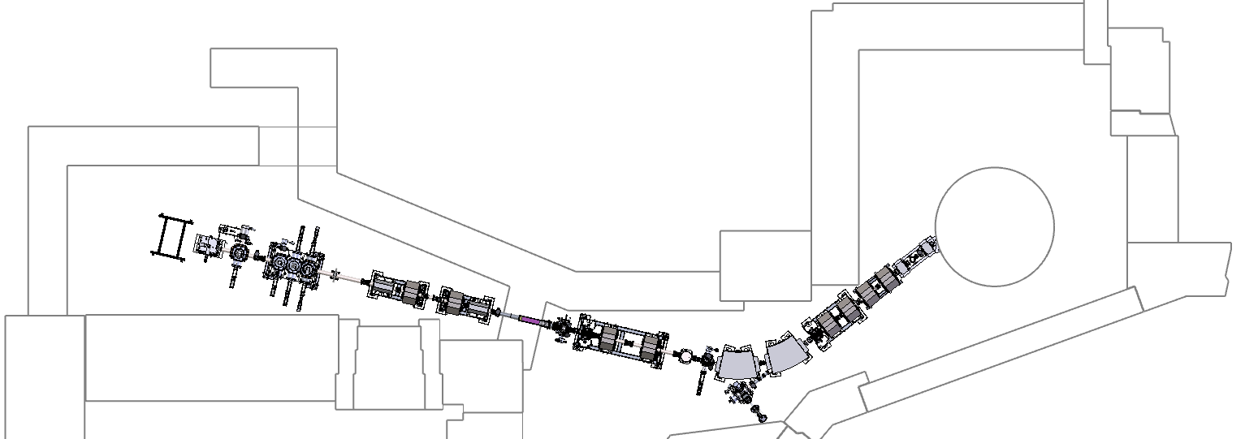
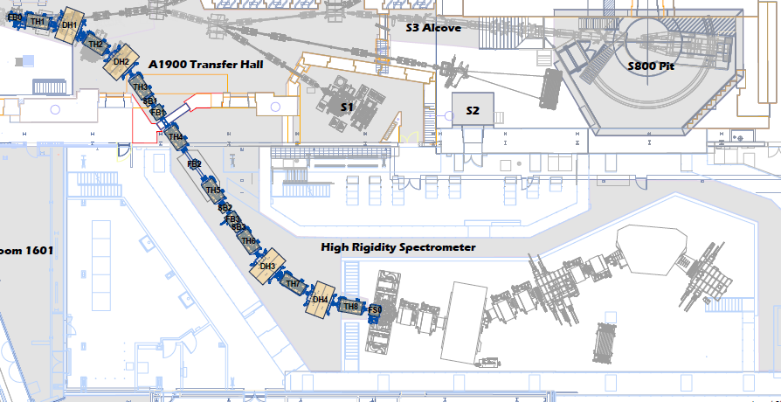
Other Projects
K500 SEE Facility
Refurbishment of 1978 K500 Cyclotron and RT ion source
Standalone beamline & user vault
High Rigidity Spectrometer (HRS)
Expansion of ARIS, similar scope to VPS/A1900
Vacuum calculations based heavily on empirical data from A1900
S1/S2 Beamlines
ELOSS Gas Handling System
~200sL gas detector at 1200Torr Xenon
Xenon recapture & recompression
K500

