Slide 1
LBNF Kicker Ceramic Beam Tube Coatings
Jason Morin
OLAV
18 April 2024

Slide 2
LBNF Project

Slide 3
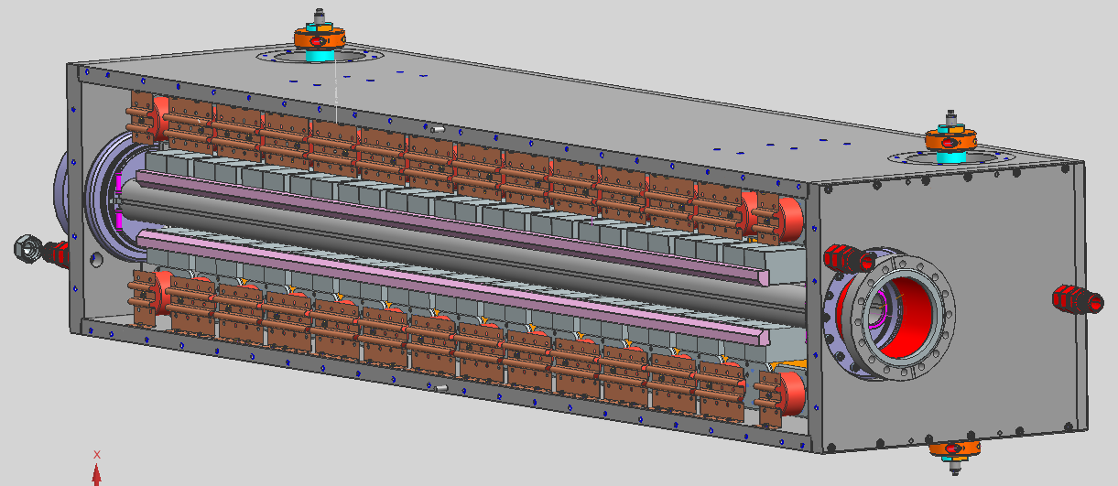
LBNF Kicker Beam Tubes
Long Baseline Neutrino Project (LBNF/DUNE) requires 6 new extraction kickers
Project requirements call for the use of ceramic beam tubes
High permeability to magnetic fields
Will build up static electric charge
Unwanted Secondary Electron Yield (SEY)
Surface coatings can improve both the electrical and SEY performance

Slide 4
LBNF Kicker Beam Tubes

Slide 5
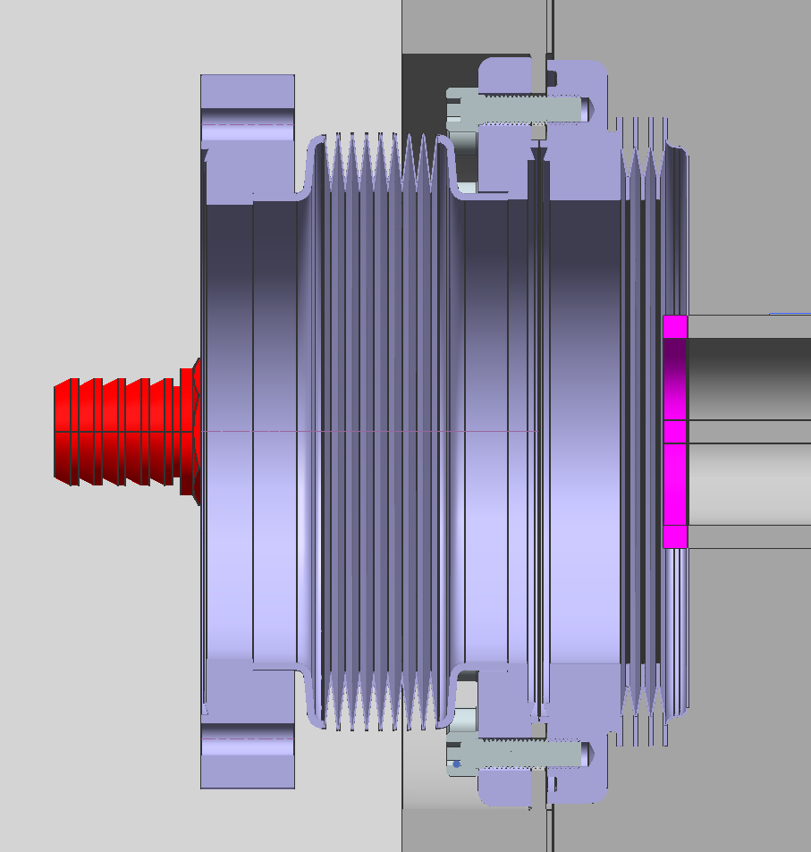
Kicker End Cross Section
Details of beam tube to magnet case interface
Magnet case end plate
Conflat flange vacuum seal
Metal bellows
Ceramic beam tube

Slide 6
Beam Tube Coating Technical Requirements
Coating must be even and defect free
Low outgassing rate: <1x10⁻¹⁰ Torr Liters/second/cm²
Ultimate vacuum pressures: <10⁻⁸ Torr
Electrical resistivity of coating: 1-10 kOhm/square
End to end electrical resistance: 10-40 kOhms
Low SEY: <1.37
Subject to > 1MRad of Gamma radiation during lifetime
Operating temperature 10-100° C
Free of hazardous materials like lead
Compatible with Kovar
Can survive at brazing temp: 900-1200°C
OR safe to coat a previously brazed joint (coating application temperature <400° C)

Slide 7
Previously Used Coating- Aerodag
From past project experience, coating with Aerodag (amorphous graphite “paint”) is effective but problematic:
Technical challenge to achieve suitable coating in a consistent and repeatable manner
Requires significant labor resources
Risk of damage to assembled tubes, especially if repeated attempts at coating are required
Technician expertise not retained due to the infrequency of need (>10 years since last produced in house)
Loss of processing equipment

Slide 8
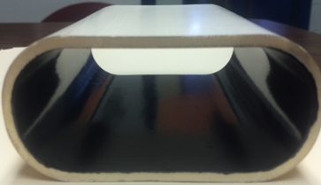
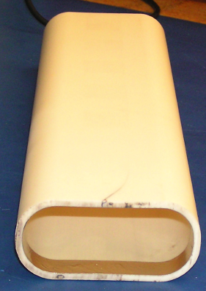
Previously Researched Coatings
Cermet
Metal/ceramic composite
Resistance was too high
Contained lead
Indium Tin Oxide
Met electrical and vacuum requirements
SEY too high

Slide 9
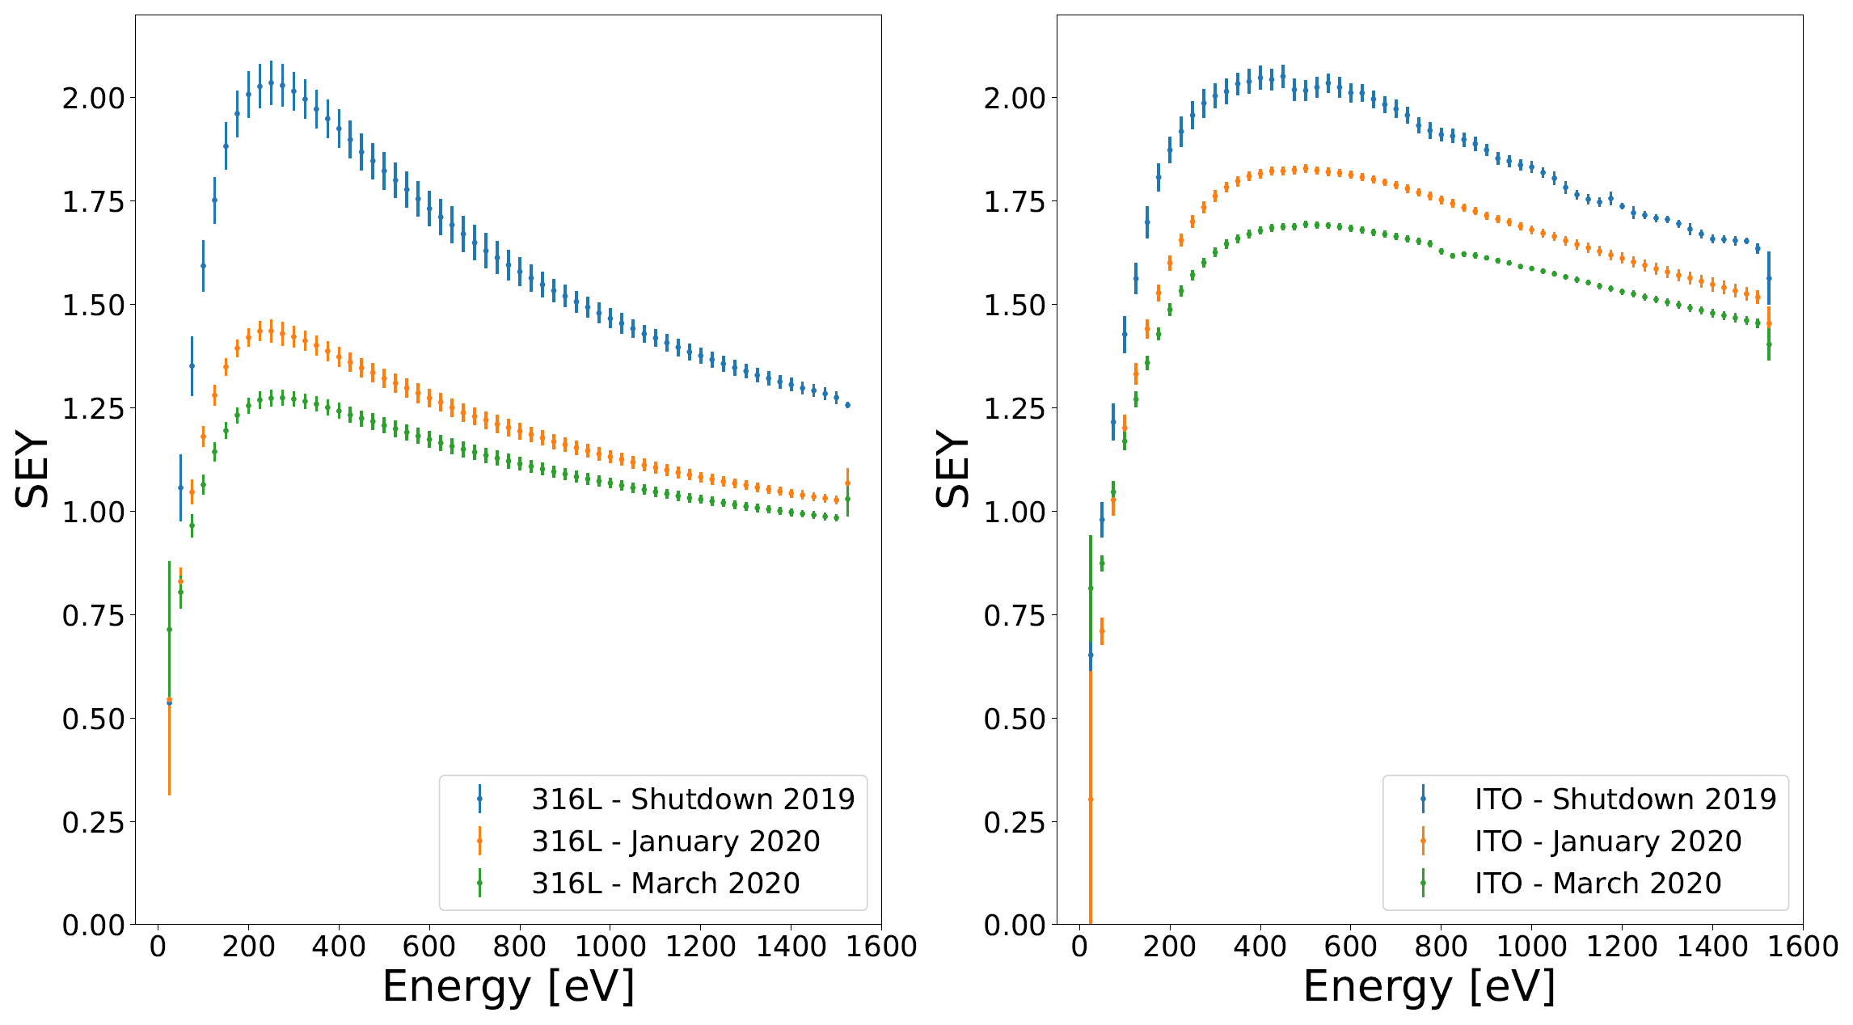
SEY Testing of Indium Tin Oxide (ITO) Coating in FNAL Main Injector
Studies conclude 1.37 SEY is required threshold to avoid issues
ITO did not condition below this value
316L Control Sample
ITO Sample
~1.65 peak
~1.25 peak

Slide 10
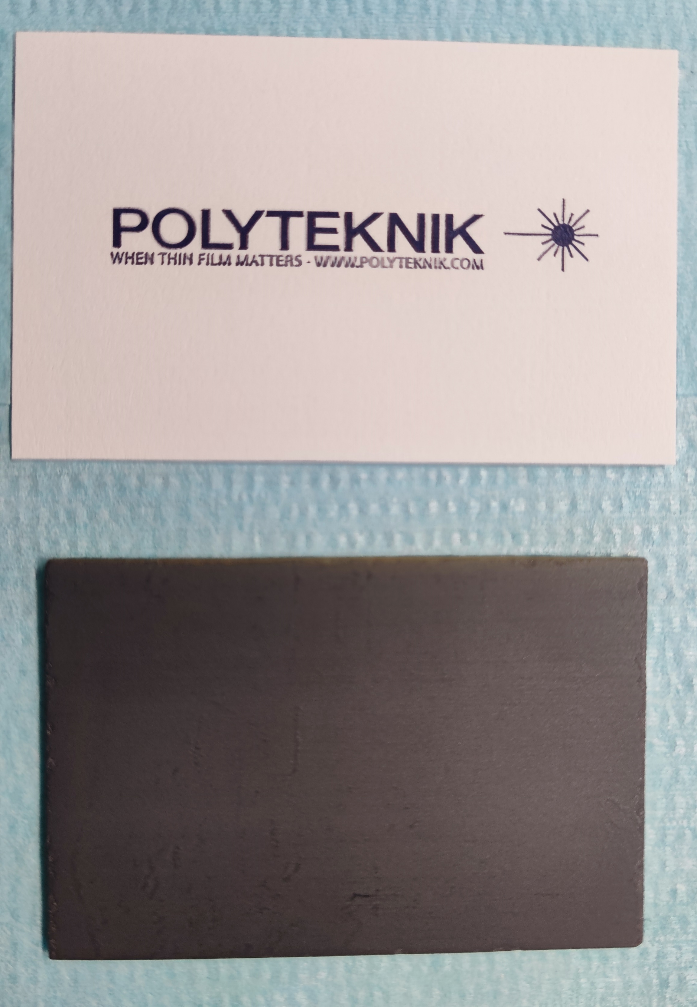
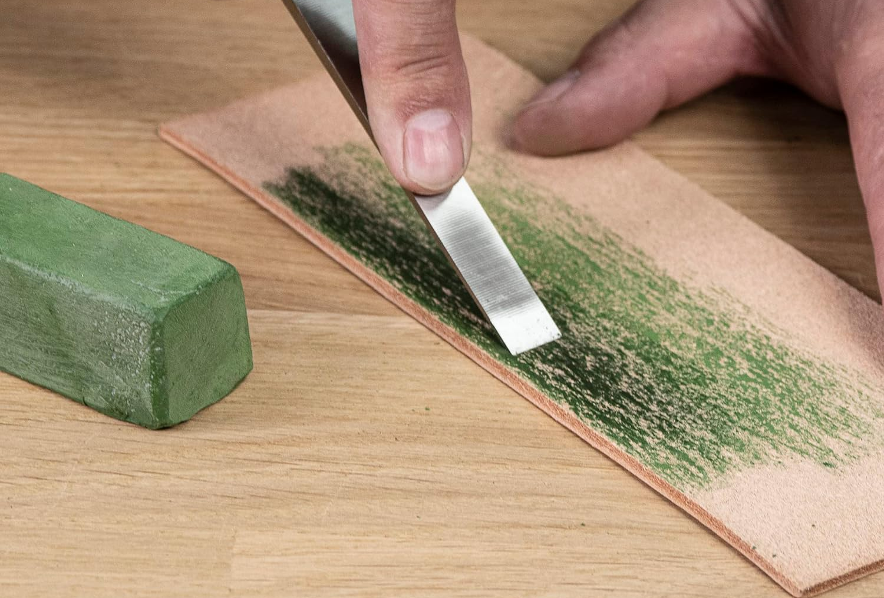
Most Recent Coating Investigation
Polyteknik, Denmark
Only vendor found with both suitable coating and ability to apply it to inside surface of tubes
Has worked with many European labs
Coatings applied with magnetron sputtering
Chromium Oxide
Cr₂O₃ (may be green or gray)
Used at several European labs
Titanium Nitride
TiN (may be gold or gray)
Used at J-PARC

Slide 11
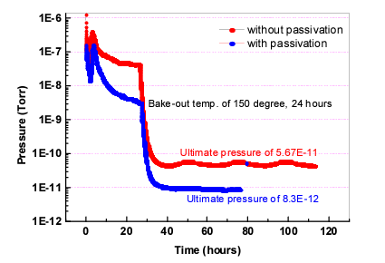
Chromium Oxide Literature Search
Outgassing rate: Better than stainless
Kim, K. R. et al. “UTILIZATION OF Cr2O3 PASSIVATION PROCESS ON STAINLESS-STEEL CHAMBER FOR XHV ENVIRONMENT*.” (2004).
S.E.Y. vs Energy
Barnes, Michael & Adraktas, A & Bregliozzi, G & Goddard, Bethany & Ducimetiere, L. & Salvant, B & Sestak, Josef & Vega, Lorena & Weterings, W & Yin Vallgren, Christina. (2017). Operational experience of the upgraded LHC injection kicker magnets during Run 2 and future plans. Journal of Physics: Conference Series. 874. 012101. 10.1088/1742-6596/874/1/012101.

Slide 12
Chromium Oxide- More S.E.Y.
Conditioning after heating to 850C
As received values are similar to those on previous slide

Slide 13
Titanium Nitride Literature Search
S.E.Y. vs Energy
Outgassing rate: 10⁻⁹ Pa m³/s /m² (after baking at 420 K in 23h) ~10⁻¹² Torr L/S /cm²
(Vacuum components in J-PARC RCS & Application of vacuum engineering to beam profile measurement. Annual US-Japan collaboration meeting for “Accelerator and Beamline Research and Technology Development for High-Power Neutrino Beams” 1, Feb. 2023)
Note: Colors are NOT consistent between figures
Ji, Yichen. Electron Cloud Studies at Fermilab. United States. https://doi.org/10.2172/1594127

Slide 14
Titanium Nitride- S.E.Y. Testing at FNAL
SS316L and TiN
Ji, Yichen. Electron Cloud Studies at Fermilab. United States. https://doi.org/10.2172/1594127

Slide 15
Additional In-House Testing
Electrical Resistivity:
TiN:
10 k ohm/square
Point to point resistance consistent
Cr₂O₃:
1 M ohm/square (way too high)
Point to point resistance varied wildly

Slide 16
TiN Outgassing Verification Testing at FNAL
Outgassing rate measured by throughput method
q=(P₁ –P₂ )C/A
Initial results are promising but inconclusive:
3.62 x 10⁻¹⁰ Torr Liters/second/cm² after 24 hours
Anomalous reading at 48 hours
Retesting underway soon
Redhead, P.A., “Recommended practices for measuring and reporting outgassing data”, Journal of Vacuum Science & Technology A20, 1667-1675 (2002)

Slide 17
Questions?

