Slide 1
Status of the Vacuum Systems of the FAIR Accelerator Complex
Andreas Kraemer
GSI Helmholtzzentrum für Schwerionenforschung GmbH
15th of April 2024

Slide 2
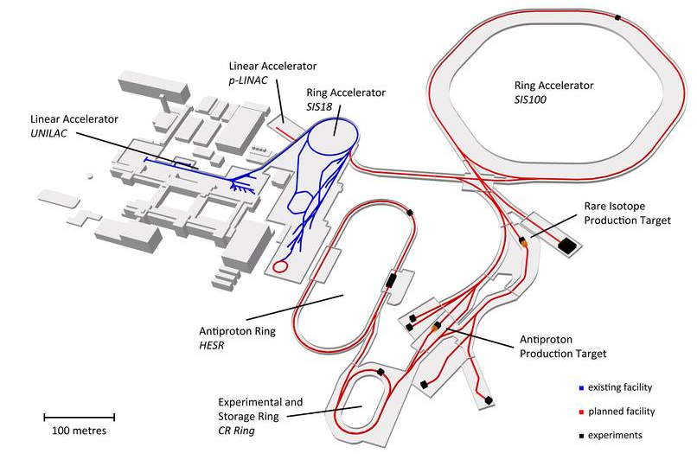
FAIR – Facility for Antiproton and Ion Research Beam Parameters and Intensities
Primary Beams
5x10¹¹/spill; 2 GeV/u; ²³⁸U²⁸⁺
Factor 10-100 over present in intensity
2x10¹³/cycle 29 GeV protons
Secondary Beams
Broad range of radioactive beams up to 1.5 - 2 GeV/u
up to factor 10 000 in intensity over present
Antiprotons 3 GeV
Storage and Cooler Rings
The system of storage and cooler rings allows to drastically improving the quality – e. g. energy spread and emittance - of the secondary beams in order to use them for high precision experiments. Moreover, in connection with the SIS100 synchrotron an efficient parallel operation of all four scientific programs can be realised.
Radioactive beams
10¹¹ stored and cooled 0.8 - 14 GeV antiprotons

Slide 3
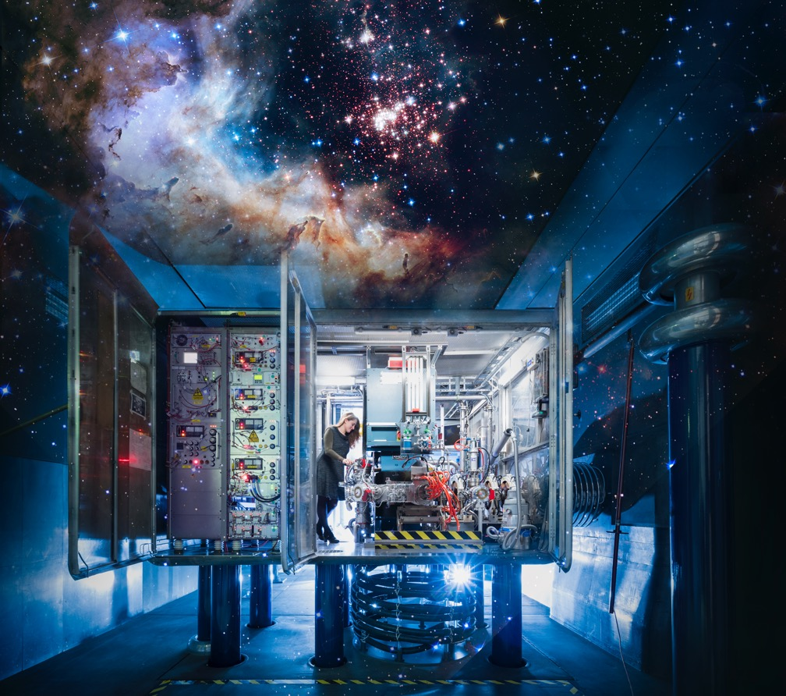
What do we do at GSI/FAIR?
We explore the universe…
…in the lab.
Photo: J. Hosan/GSI/FAIR, “NASA, ESA, the Hubble Heritage Team (STScl/AURA), A. Nota (ESA/STScl), and the Westerlund 2 Science Team”
A world-wide unique particle accelerator
Exotic forms of matter occurring in the universe can be produced and investigated in the laboratory
Basic research and the development of applications for materials research, radiobiology, space travel, etc.
Collaboration between several teams of internationally leading researchers (more than 3,000 scientists)
Milestone in the European research roadmap (ESFRI)
Top priority in the European nuclear physics community

Slide 4
The four scientific pillars at FAIR
NUSTAR Nuclear Structure, Astrophysics and Reactions: Stars and nuclei (850 scientists)
CBM Compressed Baryonic Matter: Inside a neutron star (500 scientists)
PANDA Antiproton-Annihilation at Darmstadt: Antimatter research (500 scientists)
APPA Atomic, Plasma Physics and Applications: From atoms to planets to cancer research (720 scientists)

Slide 5
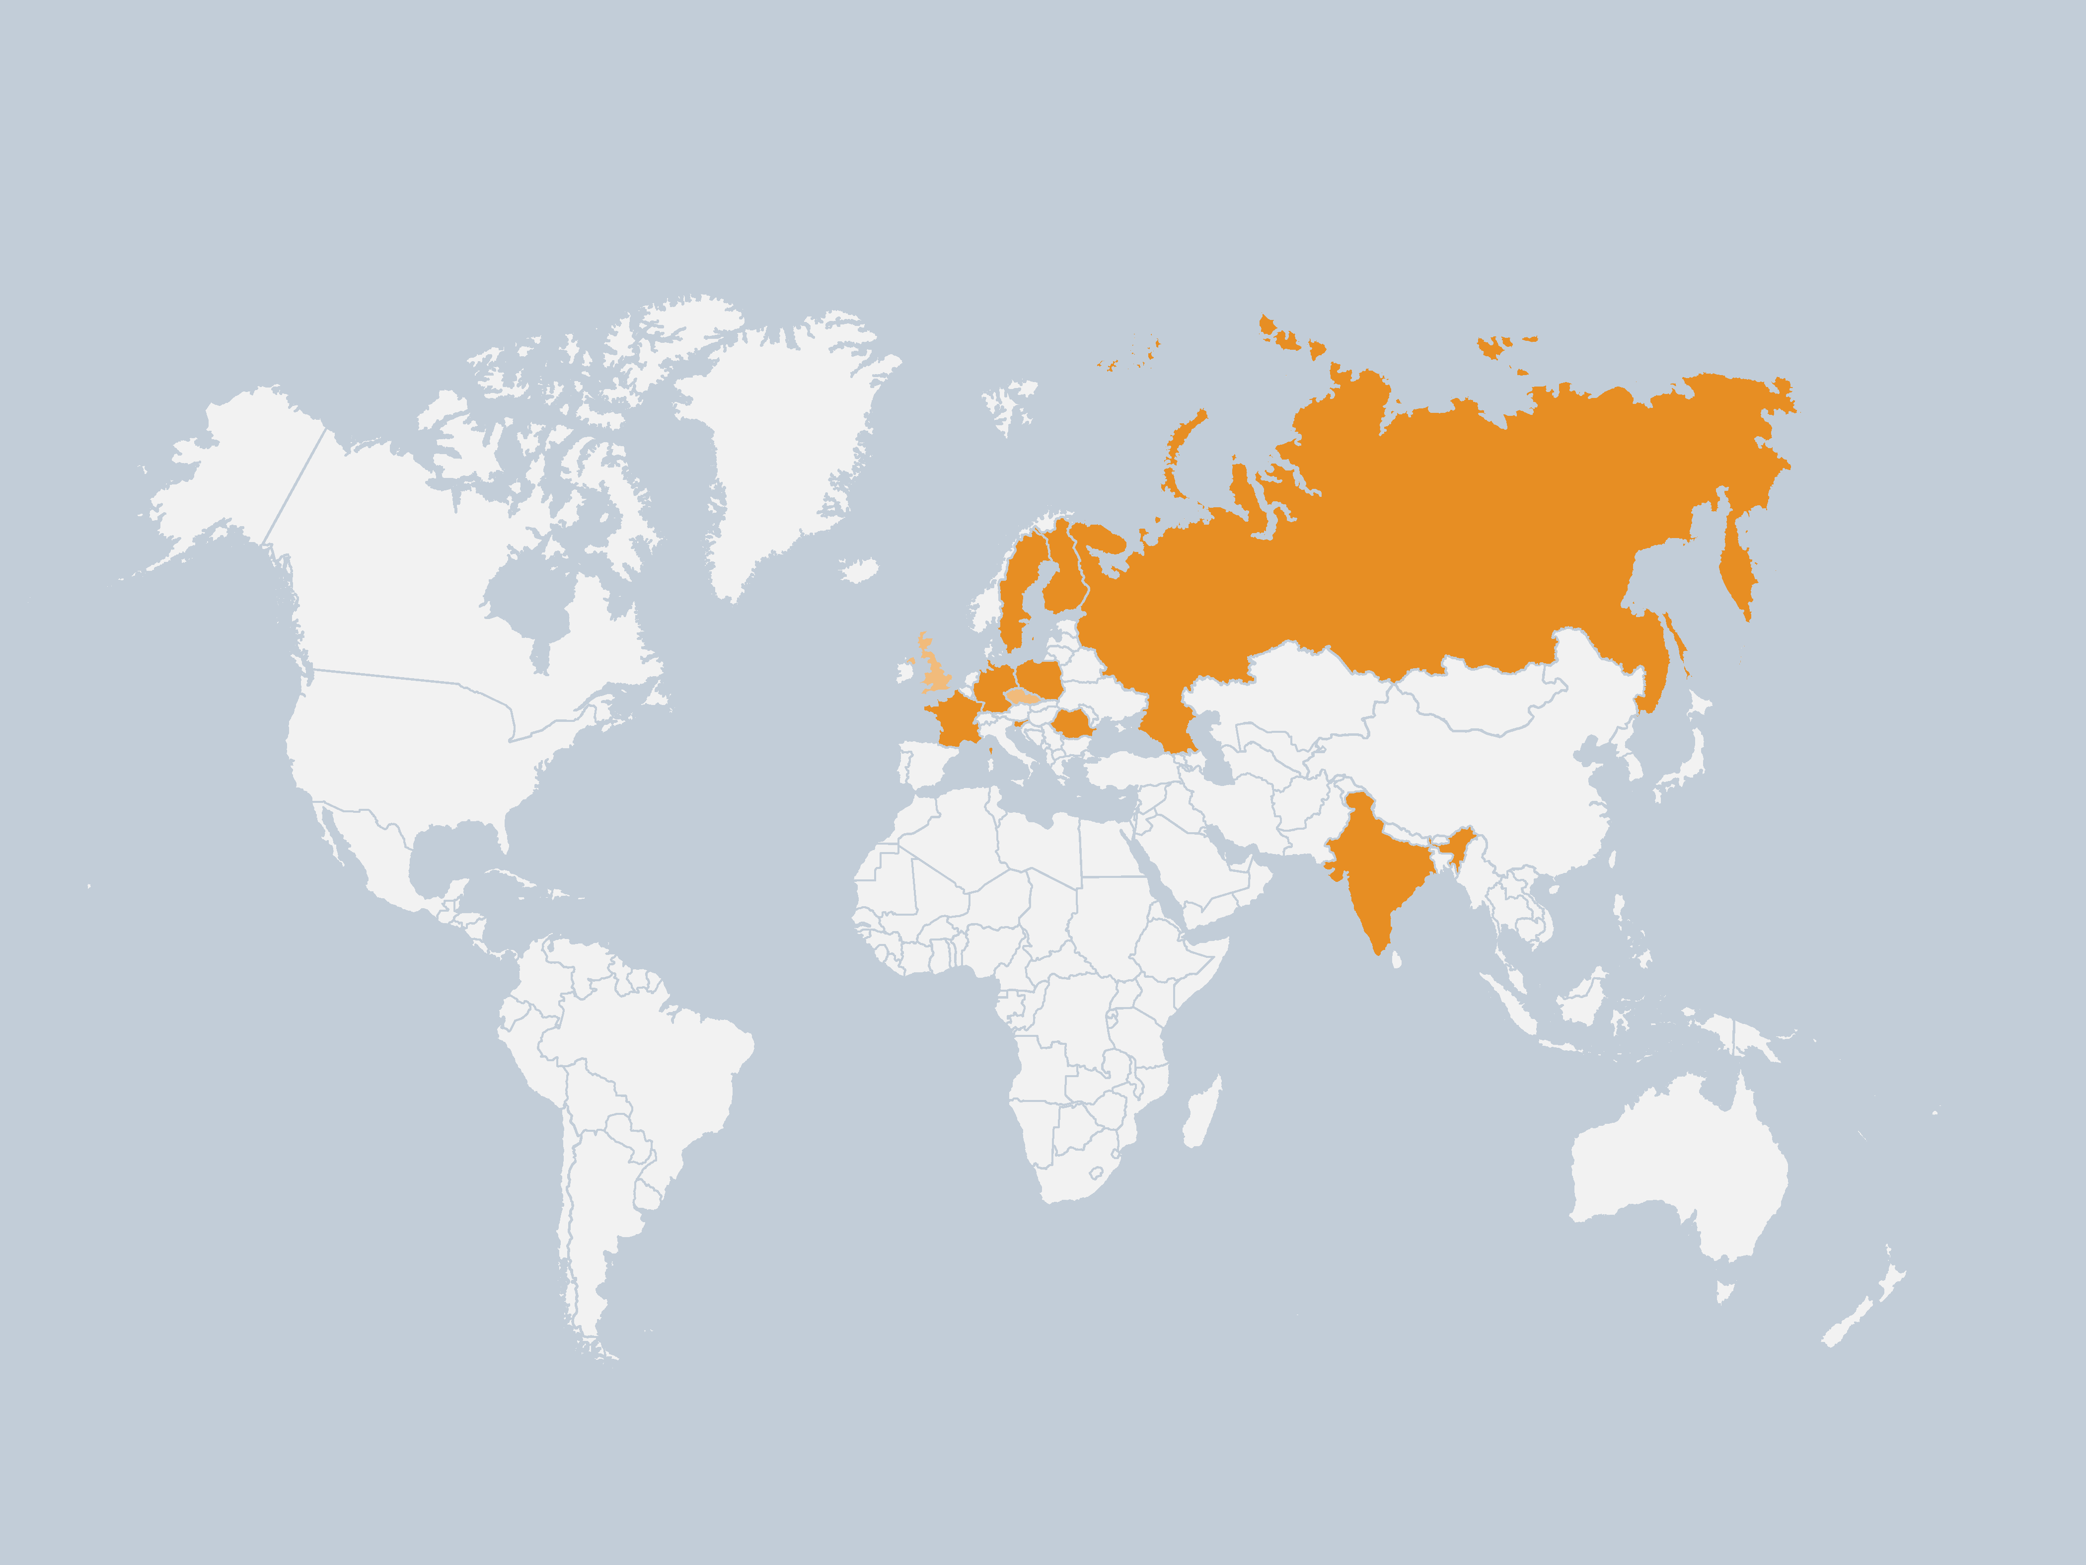
FAIR Shareholders worldwide
Shareholders
Germany (70,2%)
Finland (0,5%)
France (2,7%)
India (3,5%)
Poland (2,3%)
Romania (1,2%)
Russia* (17,4%)
Sweden (1,0%)
Slovenia (1,2%)
Graph: GSI/FAIR
Associated
United Kingdom
Aspirant
Czech Republic
*Russian contracts/collaboration
on hold
Realization and operation with international cooperation's
Cooperation with around 400 institutes in more than 50 countries
1,580 employees on the FAIR/GSI campus in Darmstadt

Slide 6
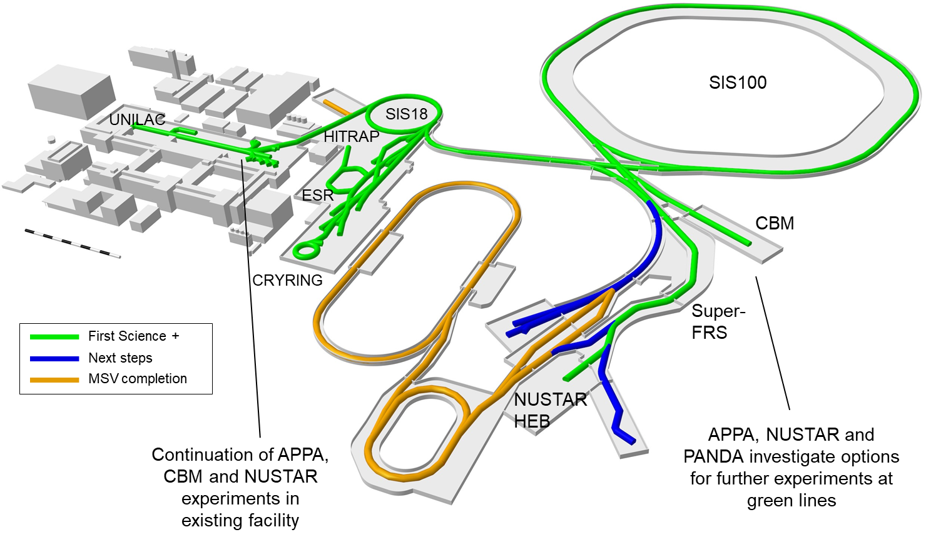
FAIR stepwise approach towards MSV
till 2028
after 2028

Slide 7
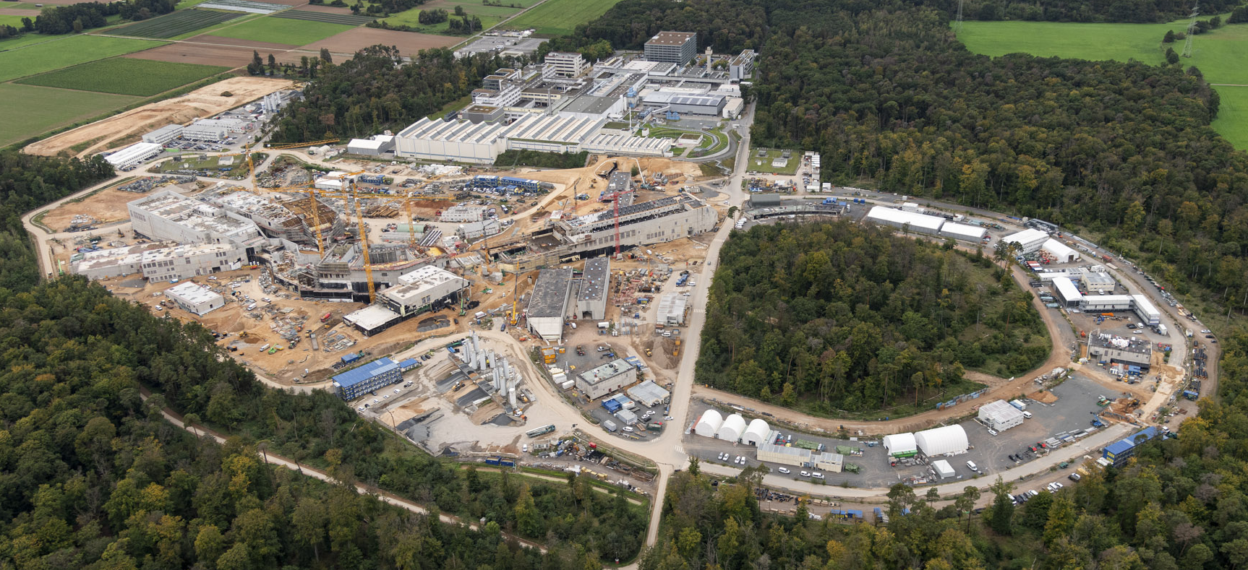
Areal View of Construction Site - October 2023
© D. Fehrenz (GSI/FAIR)
Photos and videos of the FAIR construction site
https://www.gsi.de/en/researchaccelerators/fair/fair_civil_construction/photos_and_videos
Latest video: https://www.youtube.com/watch?v=AfeGI4JkQlE
7

Slide 8
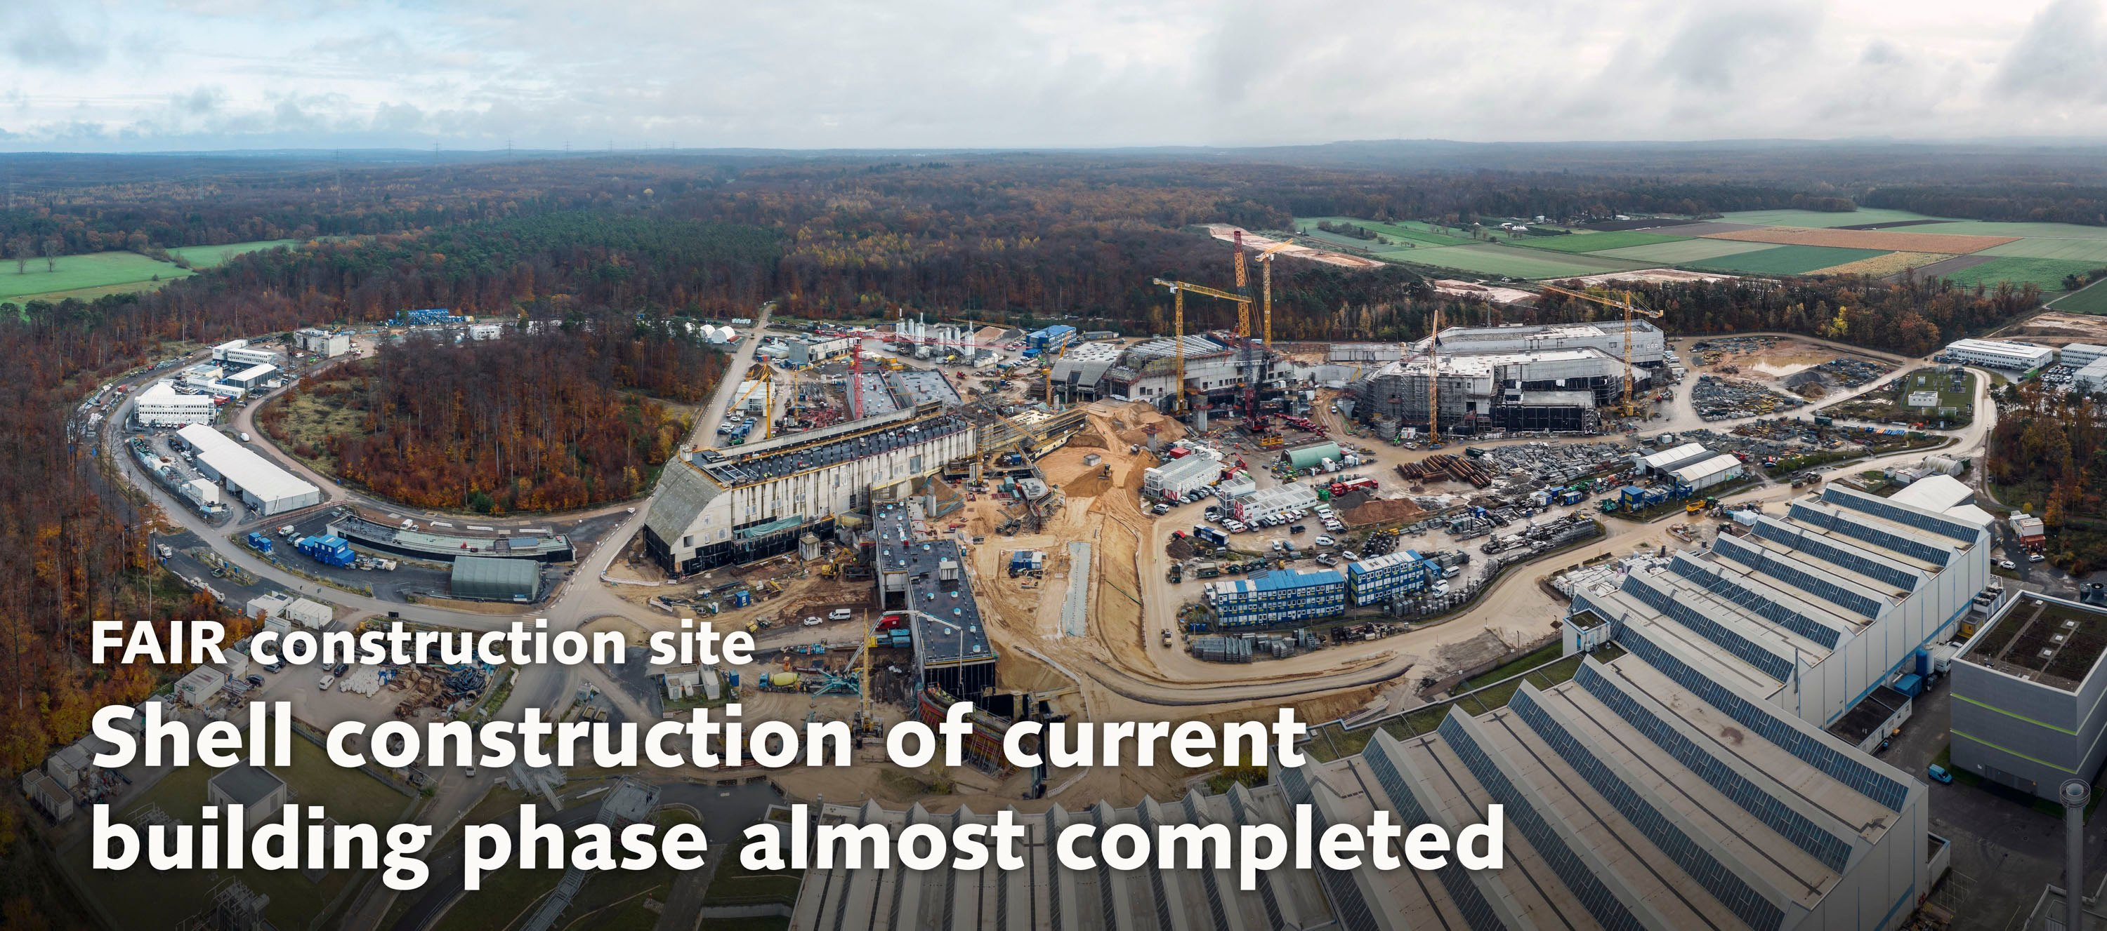
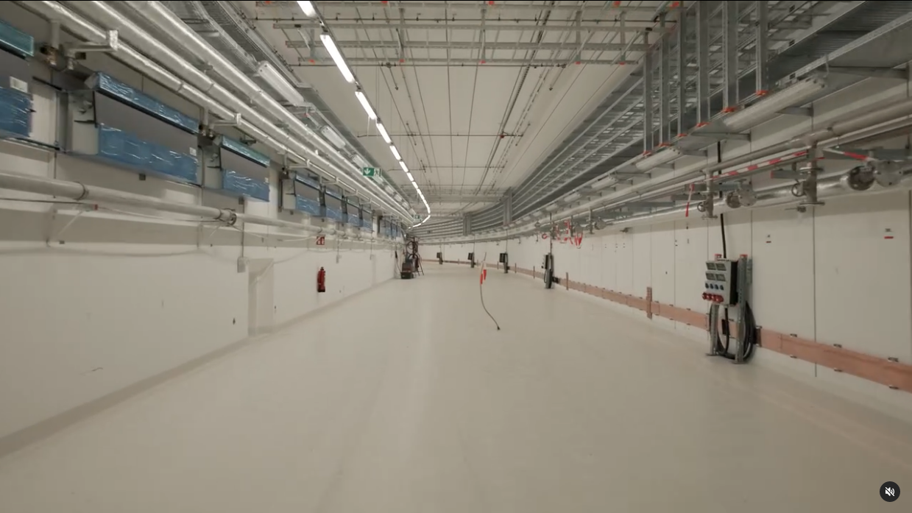
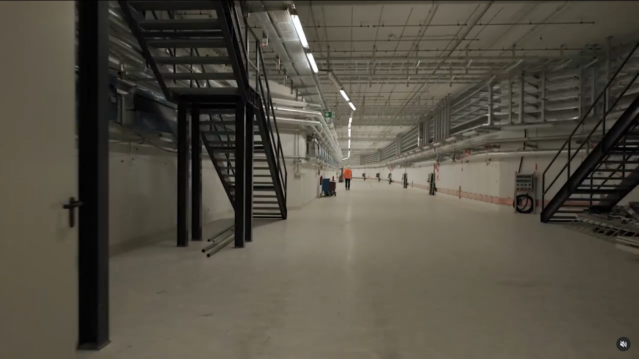
Status Civil Construction
SIS100 Tunnel
© GSI/FAIR, L. Möller/Zeitrausch
8

Slide 9
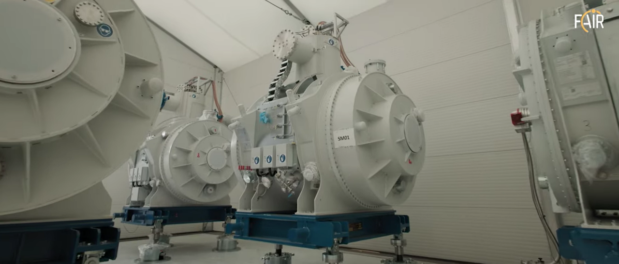
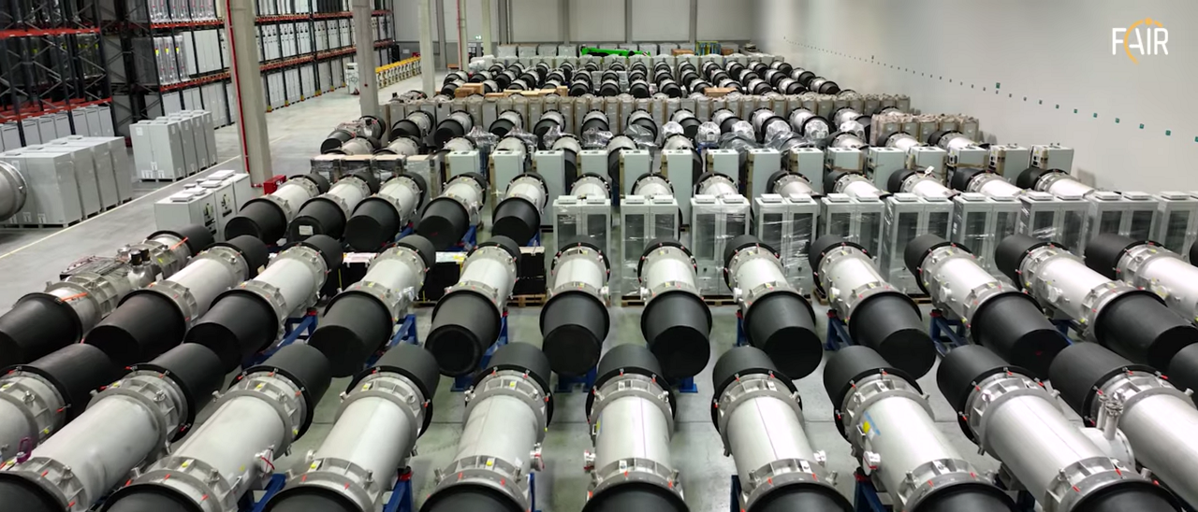
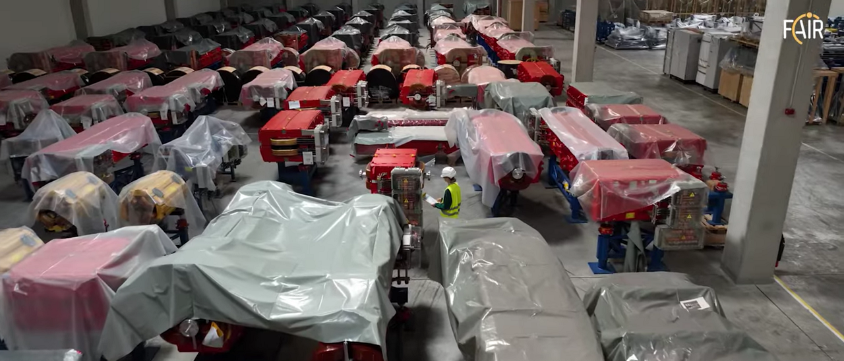
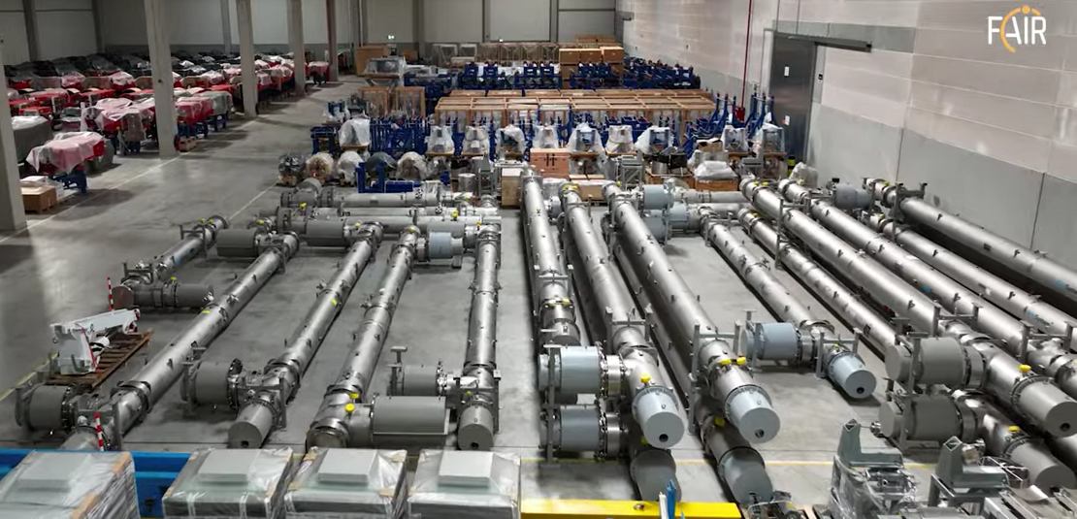
Impression of the Warehouse
SIS100 SC Dipole Modules
Super-FRS SC Multiplets
HEBT
NC Magnets
SIS100 Cryogenic Lines
9

Slide 10
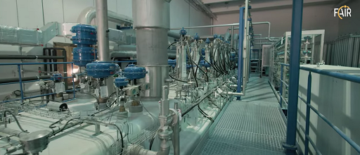
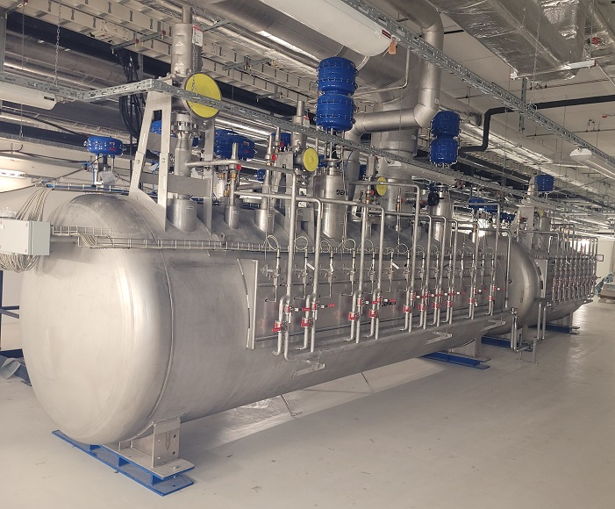
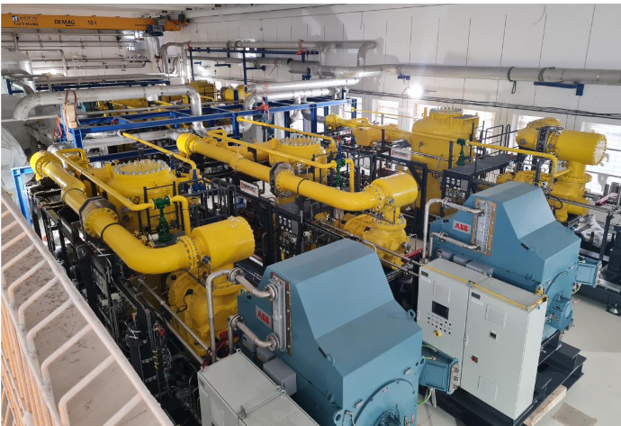
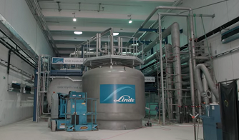
Installation of Cryogenic Infrastructure
Main Cold Box CRYO2
(supplied by Linde Kryotechnik)
Warm Compressor Station
(supplied by Linde Kryotechnik)
SIS100 Valve Box
(supplied by Demaco)

Slide 11
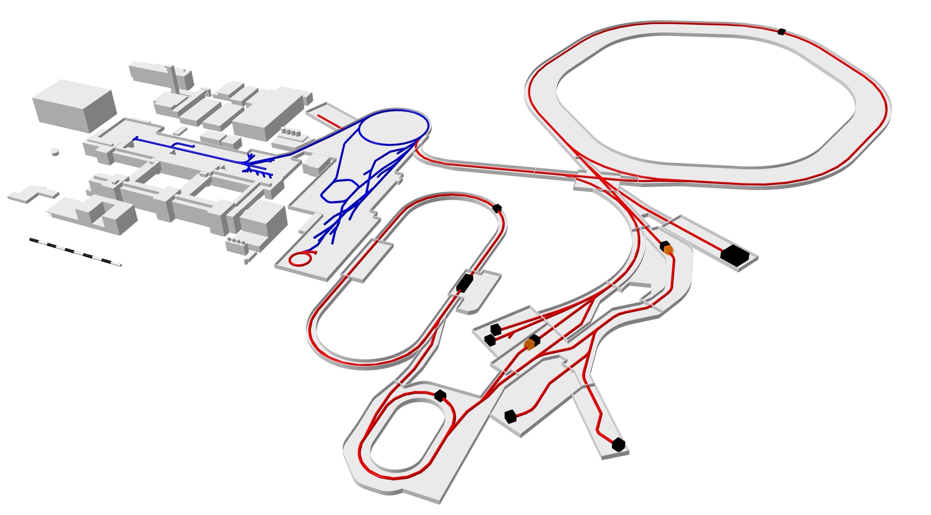
FAIR Vacuum Requirements
Beam Vacuum System:
Total length: ~ 3.9 km
Volume: ~ 65 m³
Vacuum: 10⁻⁶ – 10⁻¹² mbar
Cryogenic sections with operating temperatures of 5-20 K
Bakeable sections (up to 300°C) operated at room temperature
Insulation Vacuum System
for superconducting magnets in SIS100 & SuperFRS and
cryogenic transfer & bypass lines
Total length: 2.8 km
Volume: ~ 300 m³
Vacuum: <10⁻⁶ mbar
Linear Accelerator UNILAC
HEBT
10⁻¹¹mbar < p < 10⁻⁸ mbar
p = 10⁻⁷ mbar
Linear Accelerator
p-Linac
p = 10⁻⁸ mbar
Ring Accelerator SIS18
Ring Accelerator
SIS100
p < 10⁻¹¹mbar
p ≈ 5·10⁻¹² mbar
Production
of new nuclei
Production
of antiprotons
CBM
Panda
Antiproton Ring
HESR
Super-FRS,
p ≈ 10⁻⁶ – 10⁻⁸ mbar
Graph: GSI/FAIR
p < 10⁻¹⁰ mbar
Low & High-Energy Cave
Existing facility
Experimental and
storage ring CR
Planned facility
p ≈ 10⁻⁹ mbar
Experimental setups

Slide 12
Principles and Status of System Design
Use of standard components (catalogue items) for pumps, gauges and valves, no further development from manufacturer needed (only adaption of interface for vacuum controls)
In UHV systems with very low gas load, only capture pumps for keeping up the vacuum.
The concept for the design of the vacuum system is based on the operation experience with existing GSI accelerators.
Keep all electronics out of the accelerator tunnel and install racks for controllers and controls racks (PLC) in dedicated electronic/supply rooms.
use of passive gauges with dedicated controllers
controllers for pumps located in supply rooms
valves will be controlled and monitored from supply rooms
In case of a failure of the electronics the controller can be changed without access to the tunnel
long cables (power and signal) for all devices
Status:
The system design 95% finalized, procurement for vacuum chambers and standard components ongoing, large parts already contracted and delivered.

Slide 13
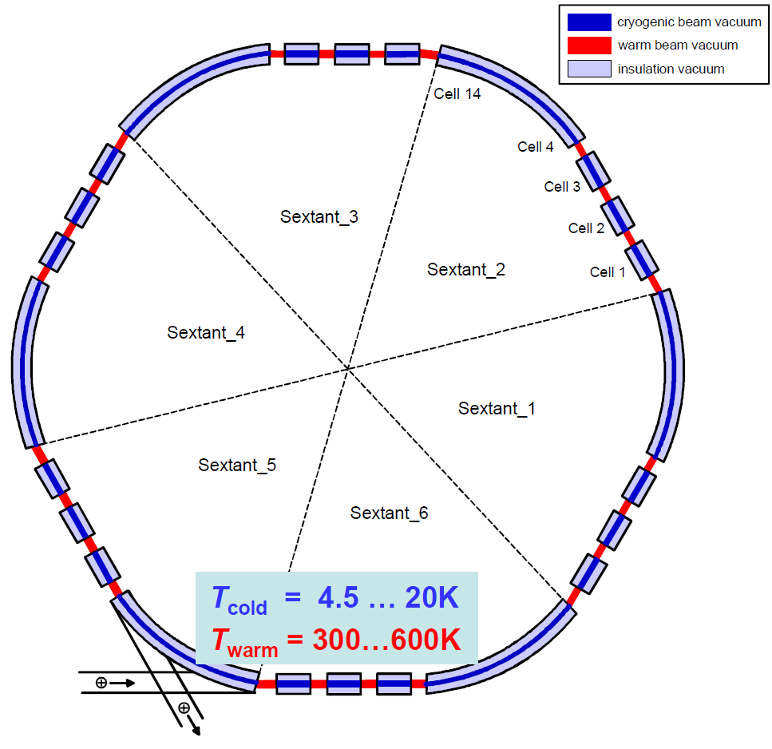
The UHV System of SIS100 – Basic Requirements
Circumference: 1083.6 m
~1000 vacuum chambers, ~600 vacuum components (pumps, gauges, valves, …)
~82% at cryogenic temperatures: ~890 m; p_{cold} < 1·10⁻¹² mbar
~18% at room temperature: ~194 m; p_{warm} < 3·10⁻¹¹ mbar
average H₂ particle density: N_{max} < 8·10¹¹ m⁻³ (with 2% beam loss @ 2.7 GeV U²⁸⁺)
46 Ion getter pumps
48 NEG catridge pumps
94 NEG/IGP pumps
NEG coating
Cryogenic wall pumping
53 gauges extractor type
48 cold cathode gauges
52 all-metal gate valves
Basic Requirements for FAT / SAT for each UHV chamber and component:
Ultimate pressure p < 3·10⁻¹¹ mbar (if required per Detailed Specification)
Integral leak rate Q < 1·10⁻¹⁰ mbar l/s
Outgassing rate q < 1·10⁻¹² mbar l/s/cm² after bake-out to max. 300 °C
Outgassing rate q < 5·10⁻¹⁰ mbar l/s/cm² without bake-out
clean RGA spectrum without any C_{x}H_{y} and other residues

Slide 14
SIS100: Dipole & Quadrupole Chamber Design
The dipole and quadrupole chambers represent 81% of the total surface in the cryogenic sectors.
Chamber design was optimized in terms of:
Low wall temperatures during magnet ramping to assure effective H₂ cryopumping
field quality (additional harmonics)
beam dynamic aspects (e.g. impedances)
Problem:
Fast ramping of the magnets induces eddy currents
The chamber walls are heated up.
Generation of additional harmonics in field.
Solution:
Thin-walled chamber (d = 0.3 mm) with ribs for stiffening
Special stainless steel Böhler P506 (X 2 Cr Mn Ni Mo N 19 12 11 1) with μ_{r} = 1.002 at 4.2 K [also used for LHC beam screen]
Cooling of chamber with supplementary cooling tubes
14

Slide 15
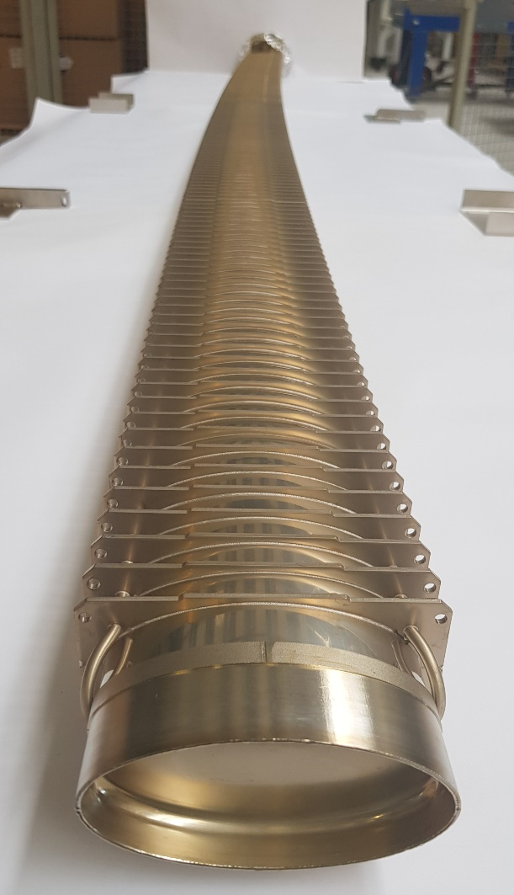
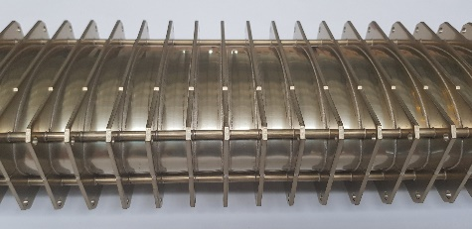
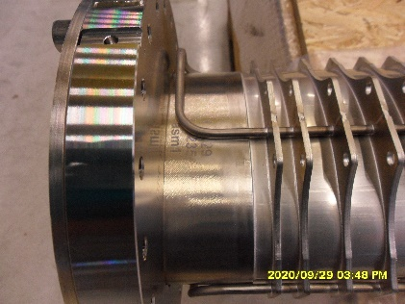
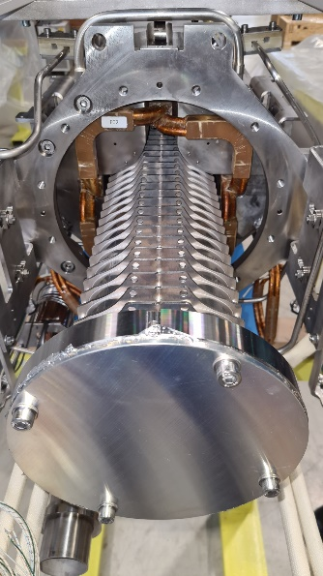
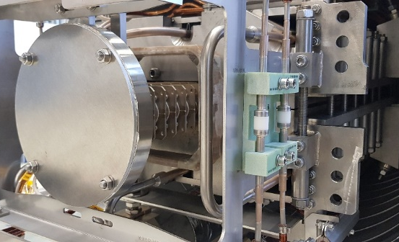
SIS100: Thin-walled Dipole & Quadrupole Chambers
cooling tubes
Dipole Chamber
Length ~3,4m
Aperture: 120x60mm²
Bending angle 3.33°
Quadrupole chambers:
11 different types (short and long)
Length: between ~1.3m and ~2.7m
Aperture: 133x65mm²
stiffening ribs
Status Dipole Chambers
Series production by Pink Vakuumtechnik.
All 115 chambers delivered and integrated into dipole magnets
Status Quadrupole Chambers
Series production finished by Research Instruments
Integration into quadrupole module by Babcock Noell (BNG) finished

Slide 16
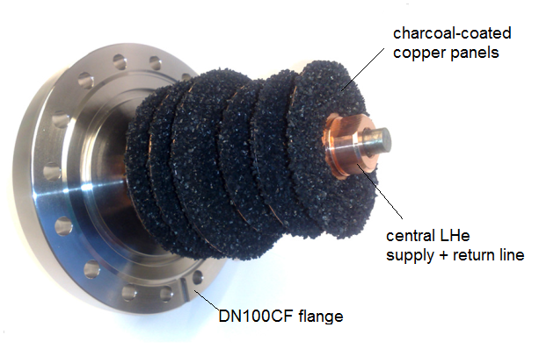
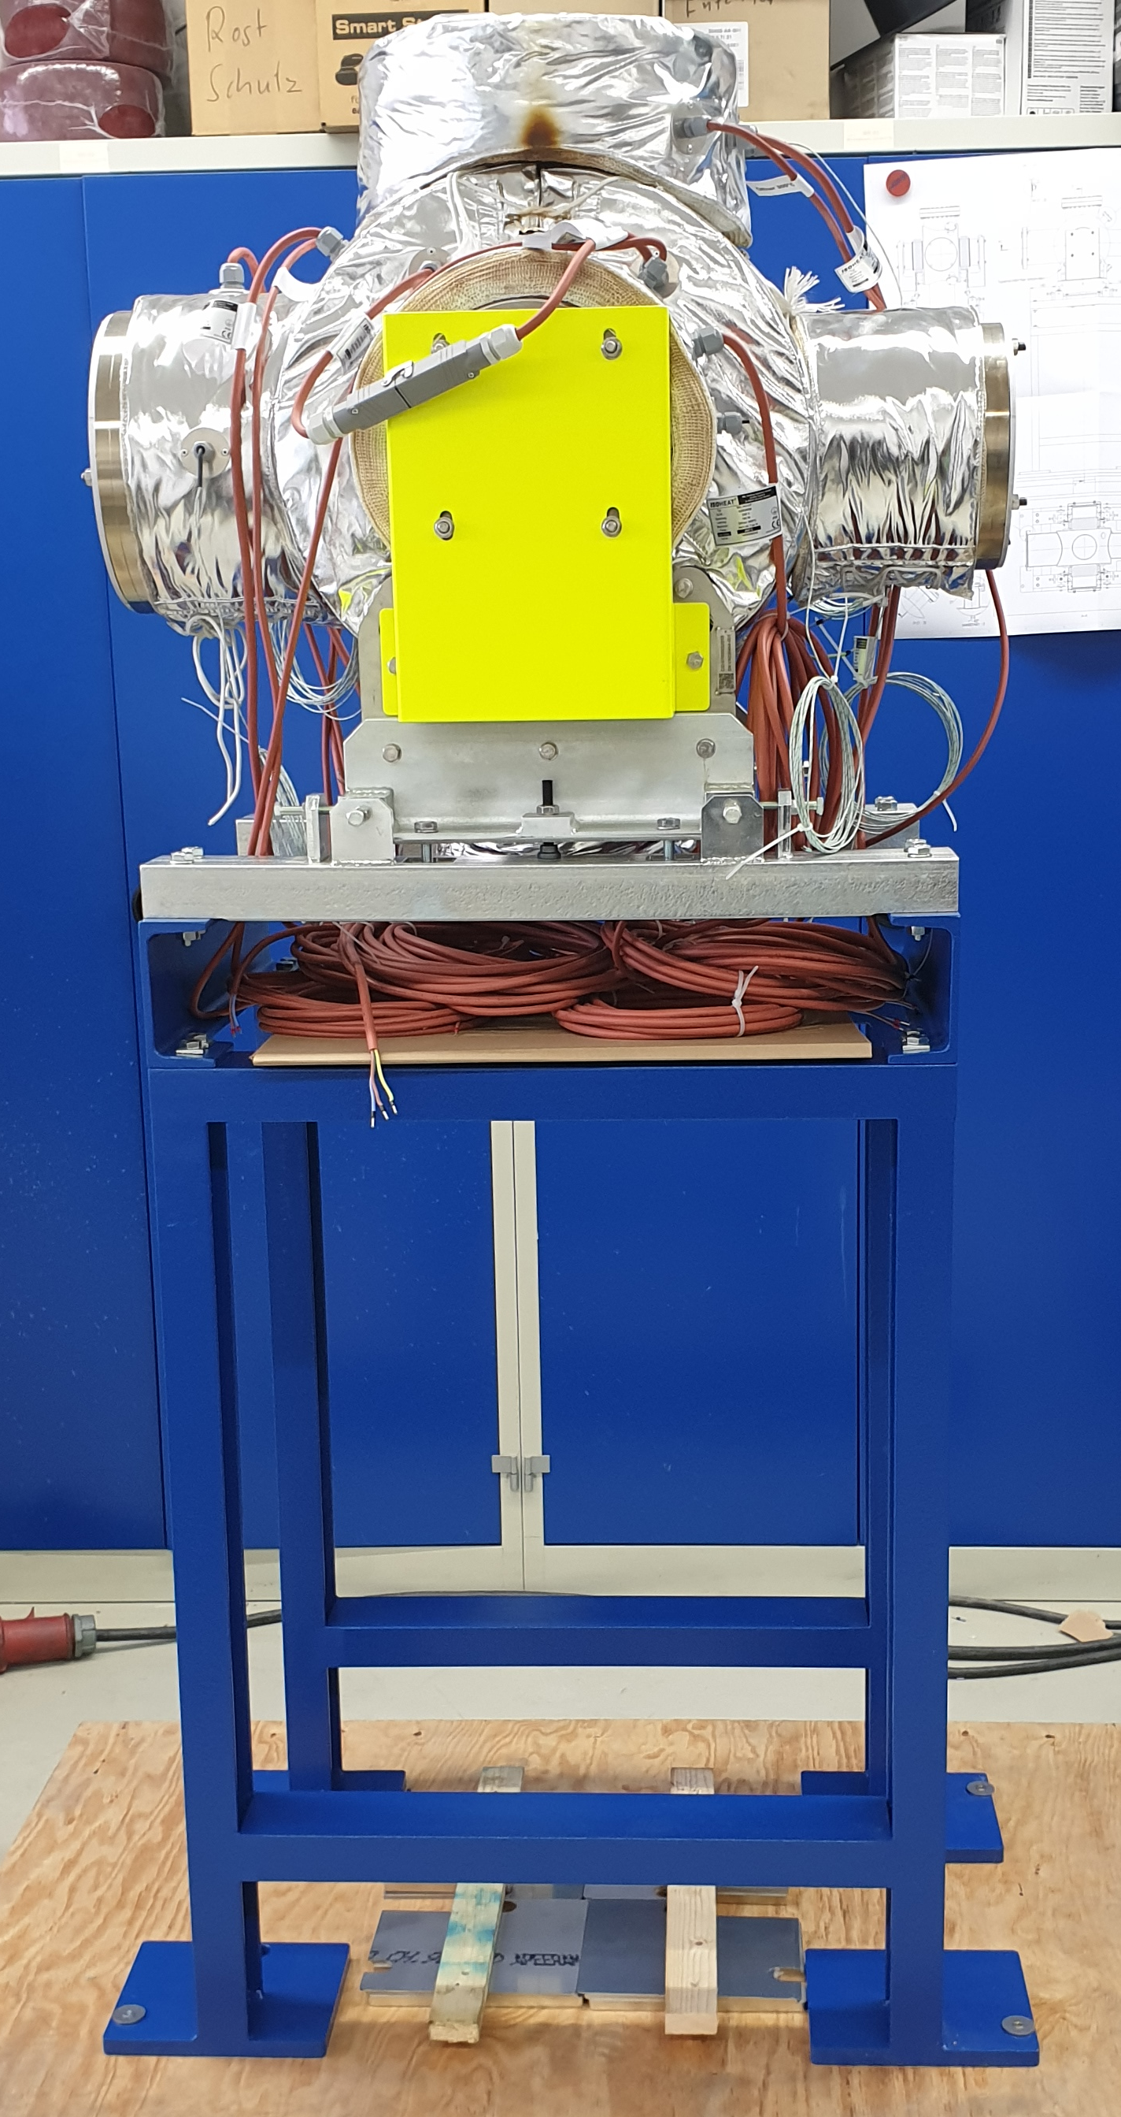
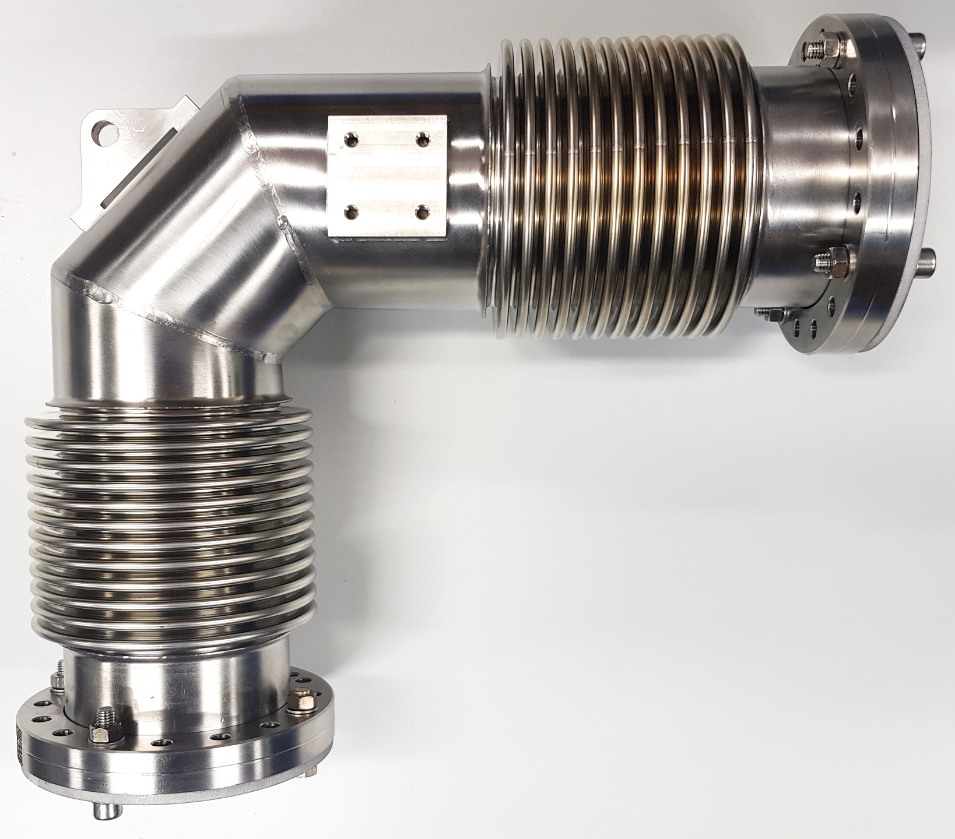
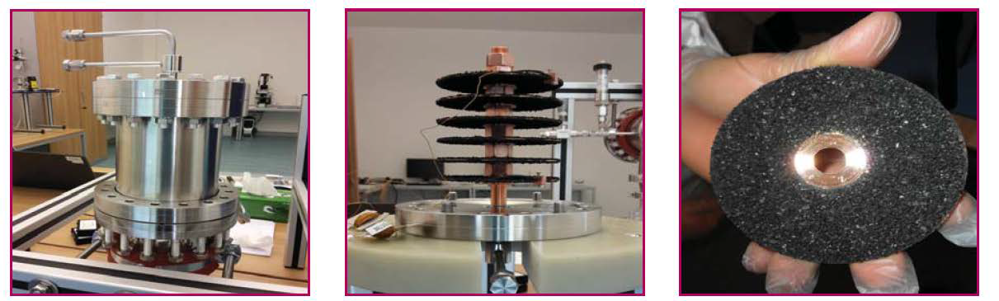
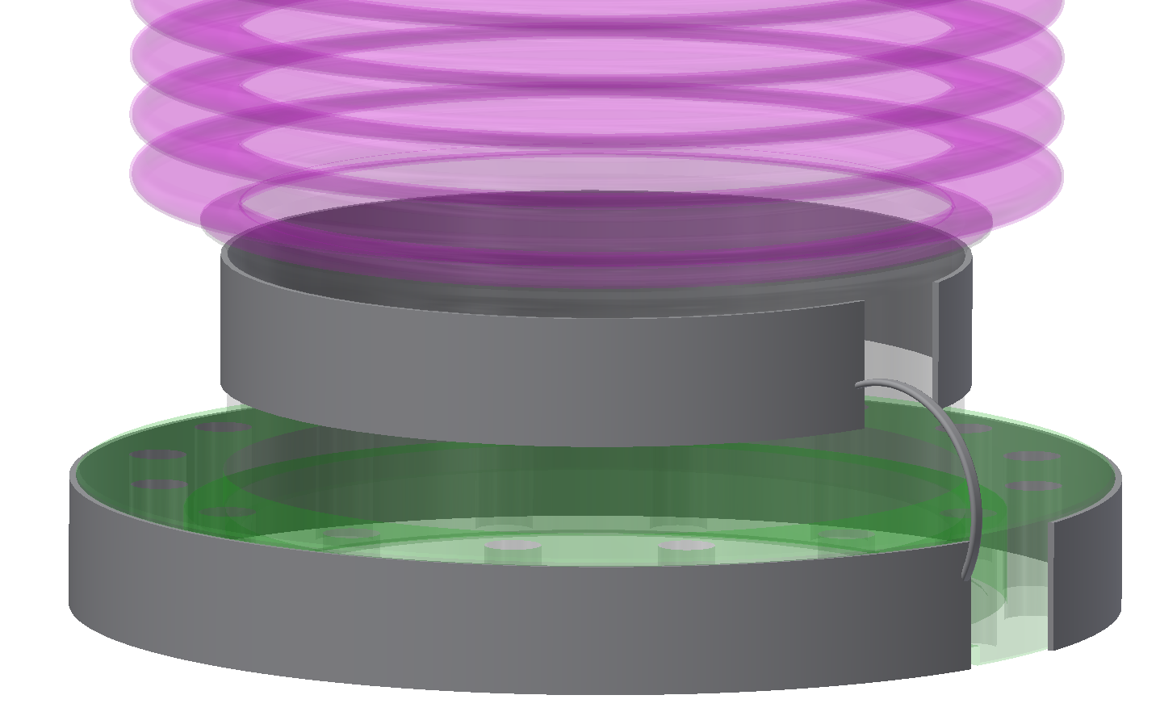
SIS100: Further Vacuum Components
Cryosorption Pumps
Roughing Cold-Warm Transitions (RCWT)
Standard Pumping Chamber
Series production of 50 pcs at Pfeiffer Vacuum
R-CWT polyimide foil
heater (design: St. Zeller)
In-house development of a pump prototype with charcoal
Contract with ILK Dresden
All 87 pumps delivered and tested
Manufacturer:
Series production of 31pcs by VA-TEC
Assembly with pumps and gauges started

Slide 17
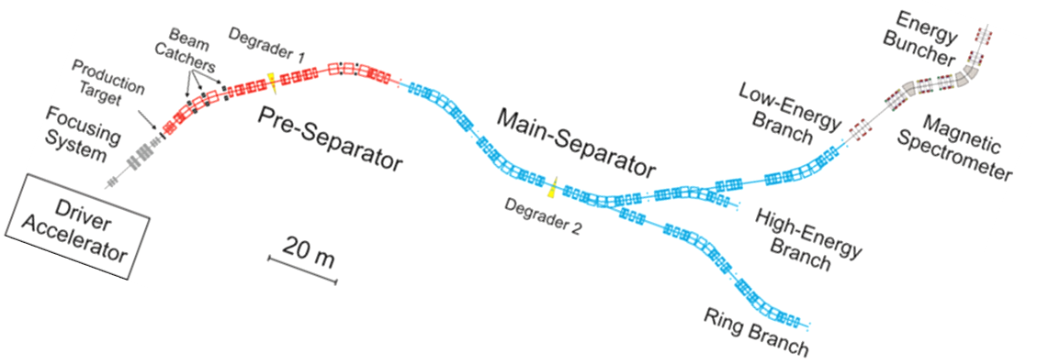
Schematic Layout of the
Super-FRagment Separator (Super-FRS)
High radiation at target area and first separator stage
Large aperture vacuum chambers, normal conducting and superferric magnets (insulation vacuum)
Total length: ~350 mof DN400 beamline, 35 SC multiplets, 27 SC dipoles, 5 NC radiation hard dipoles, 20 focal-plane chambers, target chamber and 3 beam stopper chambers.
Required vacuum: ~ 1x10⁻⁶ - 1x10⁻⁷ mbar
Complex vacuum system due to remote handling in target area (pillow seals and inflatable bellows) and large number of focal plane chambers (20 pcs) with a lot of insertions for the experiments

Slide 18
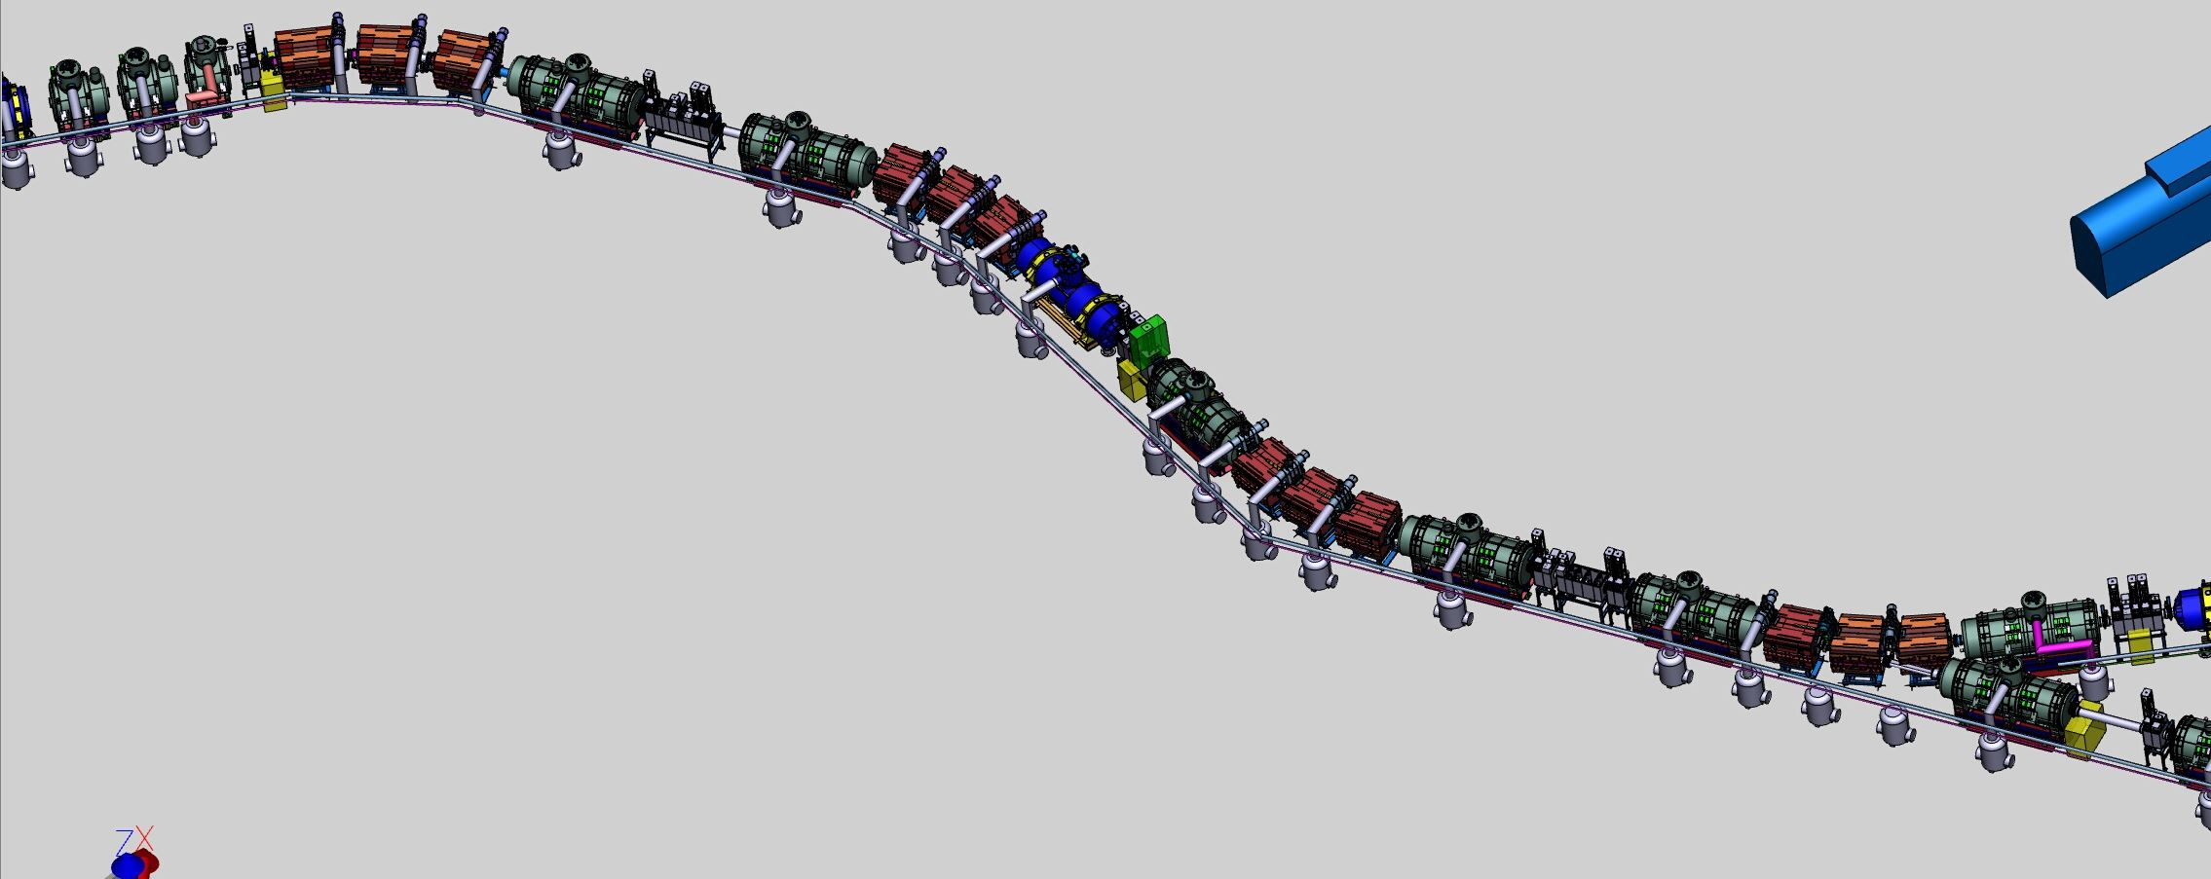
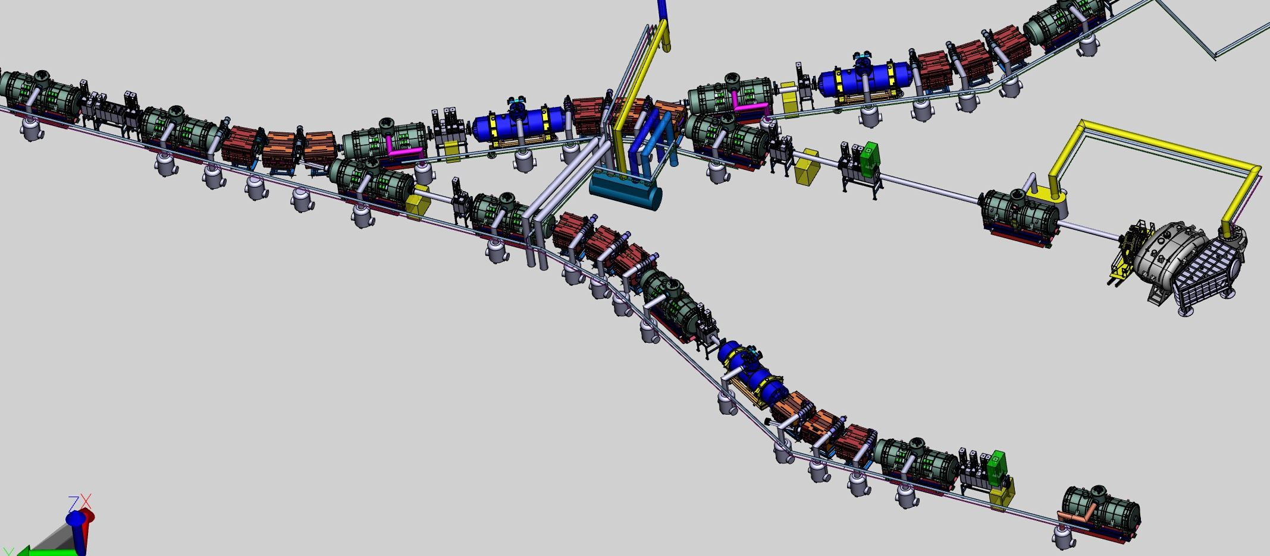
Super-FRS: 3D Model
rad. res. Dipole
SC Dipole
SC Dipole
Target Chamber
SC Dipole
SC Dipole
SC Multiplet
SC Multiplet
SC Multiplet
SC Multiplet

Slide 19
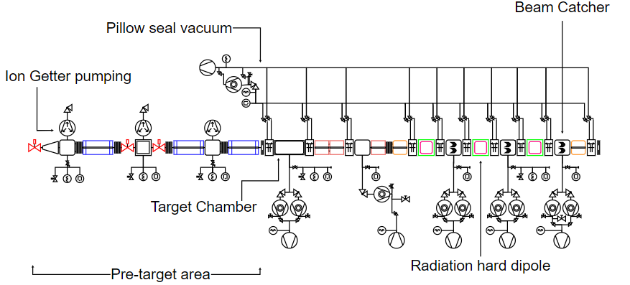
Super-FRS: Vacuum Schemes
57 Ion Getter Pumps (150 – 800l/s)
29 Turbo molecular pumps (850 – 1350l/s)
39 beam vacuum sectors separated by 38 DN400CF gate valves (Viton and EPDM).
64 Penning gauges, 46 Pirani gauges
81 TMP stations for generating the insulation vacuum.
19

Slide 20
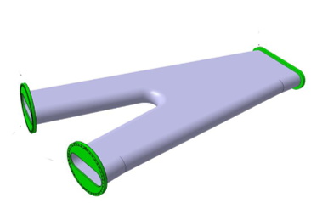
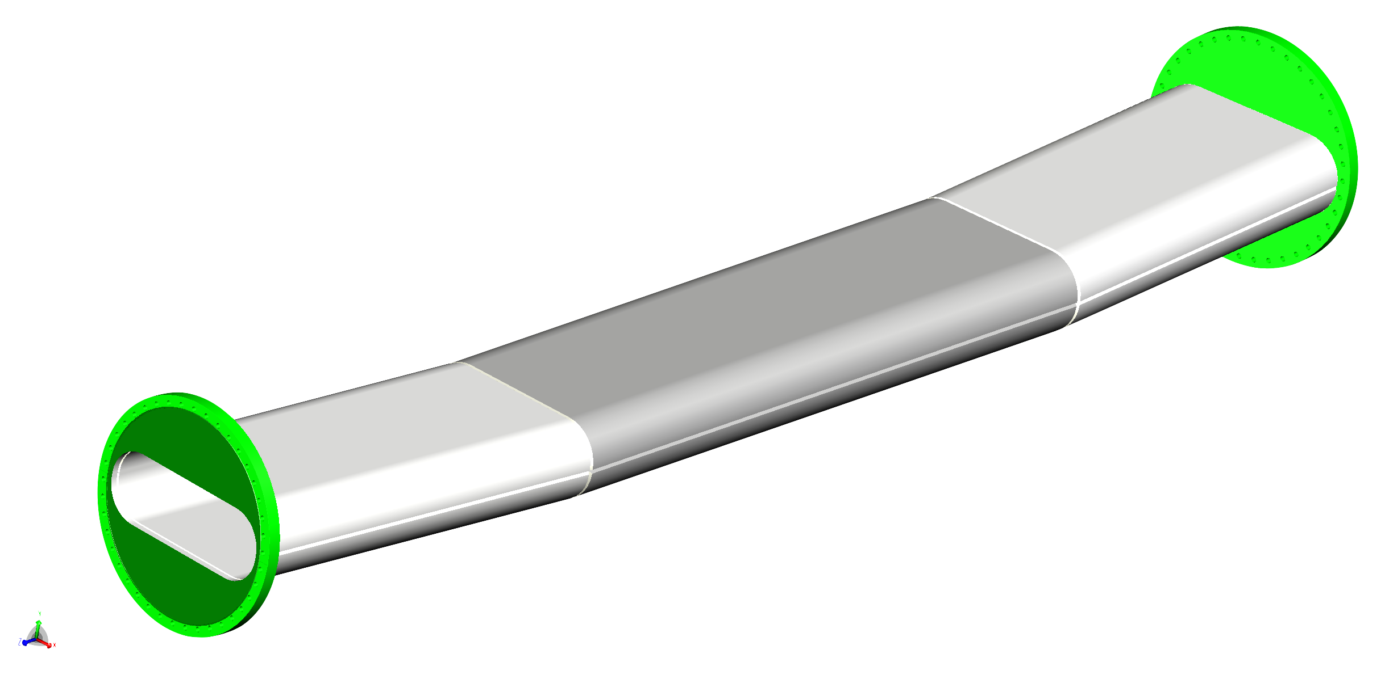
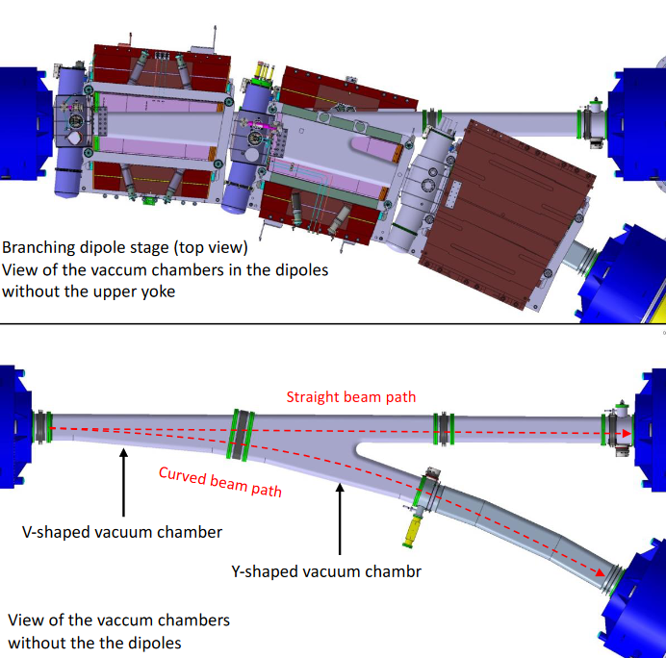
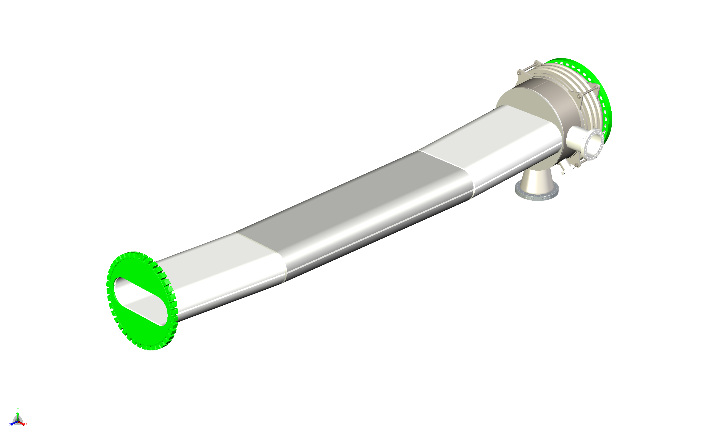
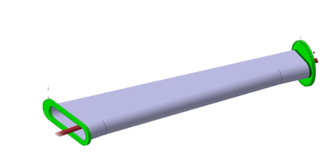
Super-FRS: SC Dipole Chambers
Standard Dipole Stage
Branching Dipole Stage
Bending angle type 1: 11° & 9.75°
Length= 3 - 3.2m
Aperture: 38x14cm²
Wall thickness: 6 – 11mm
Flanges DN400CF
Call for tender open
length 2.8m
aperture: 38x14 (resp 68x14)cm²
wall thickness max 11mm
flanges DN400CF or racetrack/rectangular for metallic sealing ( e.g. HELICOFLEX)
Contract to be awarded soon
outgassing rate 1x10⁻⁹mbar l/s cm²
leak rate 1x10⁻⁹mbar l/s
special RGA acceptance criteria
Required relative magnetic permeability: ≤1.01
Material: DIN EN10088: 1.4306, 14307 or higher quality

Slide 21
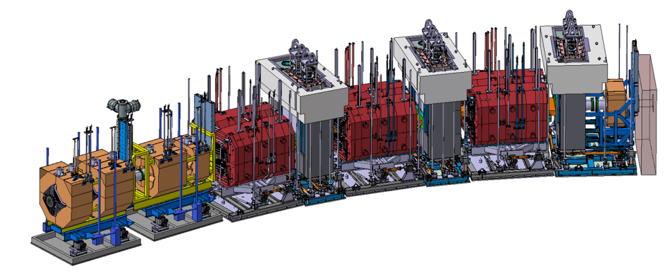
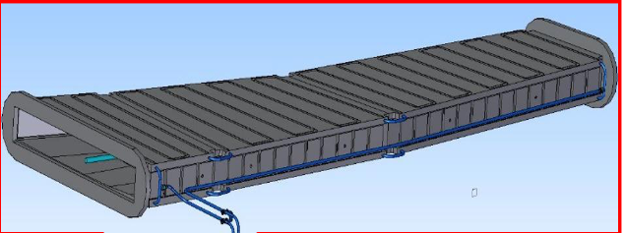
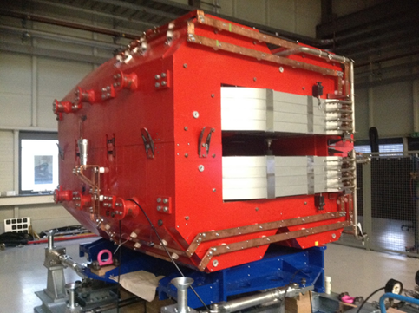
Super-FRS: Chambers for Radiation Resistant Dipole Magnets in Target Area
Dipole chamber will absorb P = 3 W/cm², Energy 4.5 J per pulse
Chamber to be produced out of Titanium Ti6Al4V (3.7165)
Length: ~365cm
aperture entrance: 50x14cm²
aperture exit: 120x14cm²
Quadrupoles & Sextupole
Dipoles
Magnet:
weight ≈ 95 tons
aperture of yoke: 1200x180mm
overall length of magnet: 3.2m
Contract signed with: CNIM Systèmes Industriels
Under construction
21

Slide 22
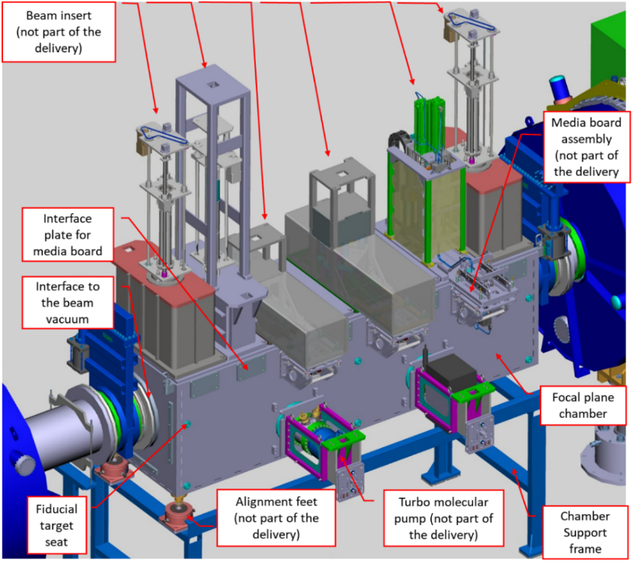
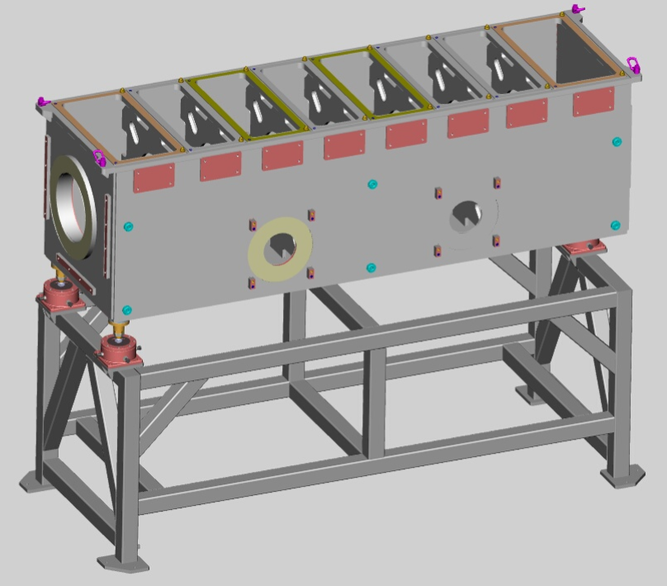
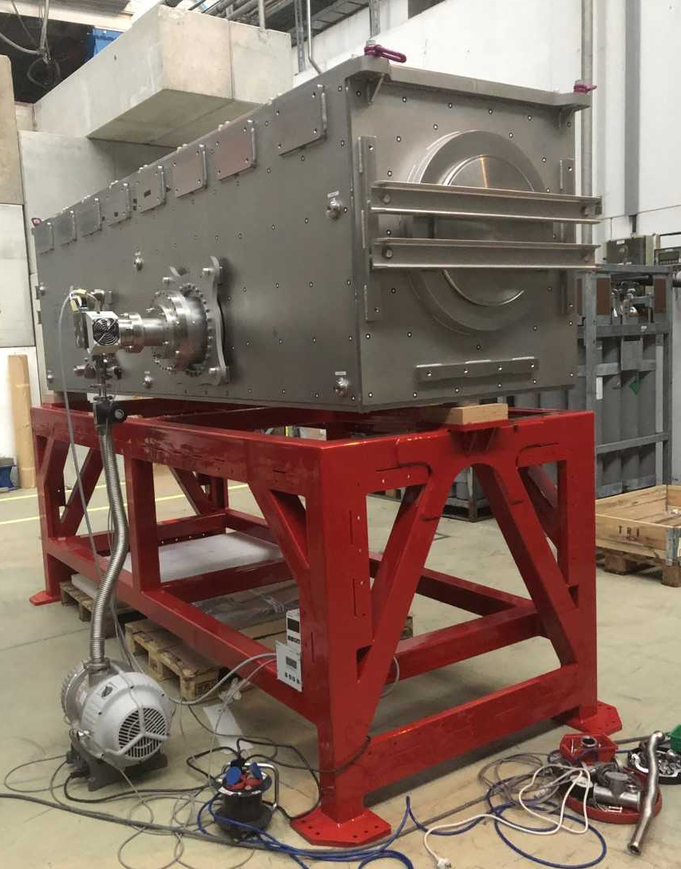
S-FRS: Diagnostic Chambers
Protoype by Pfeiffer Vacuum
Dimensions of the chambers: max 460 x 100 x100 cm³
Thick top plate required: approximately 40 mm
High requirements on overall flatness of the top plate (0.1 mm)
stainless steel grade according to DIN EN 10088: 1.4301, 1.4306, 1.4307, 1.4404, 1.4435 or 1.4429
outgassing rate 1x10⁻⁹ mbar l/s cm2
leak rate 1x10⁻⁹ mbar l/s
special RGA acceptance criteria
22

Slide 23
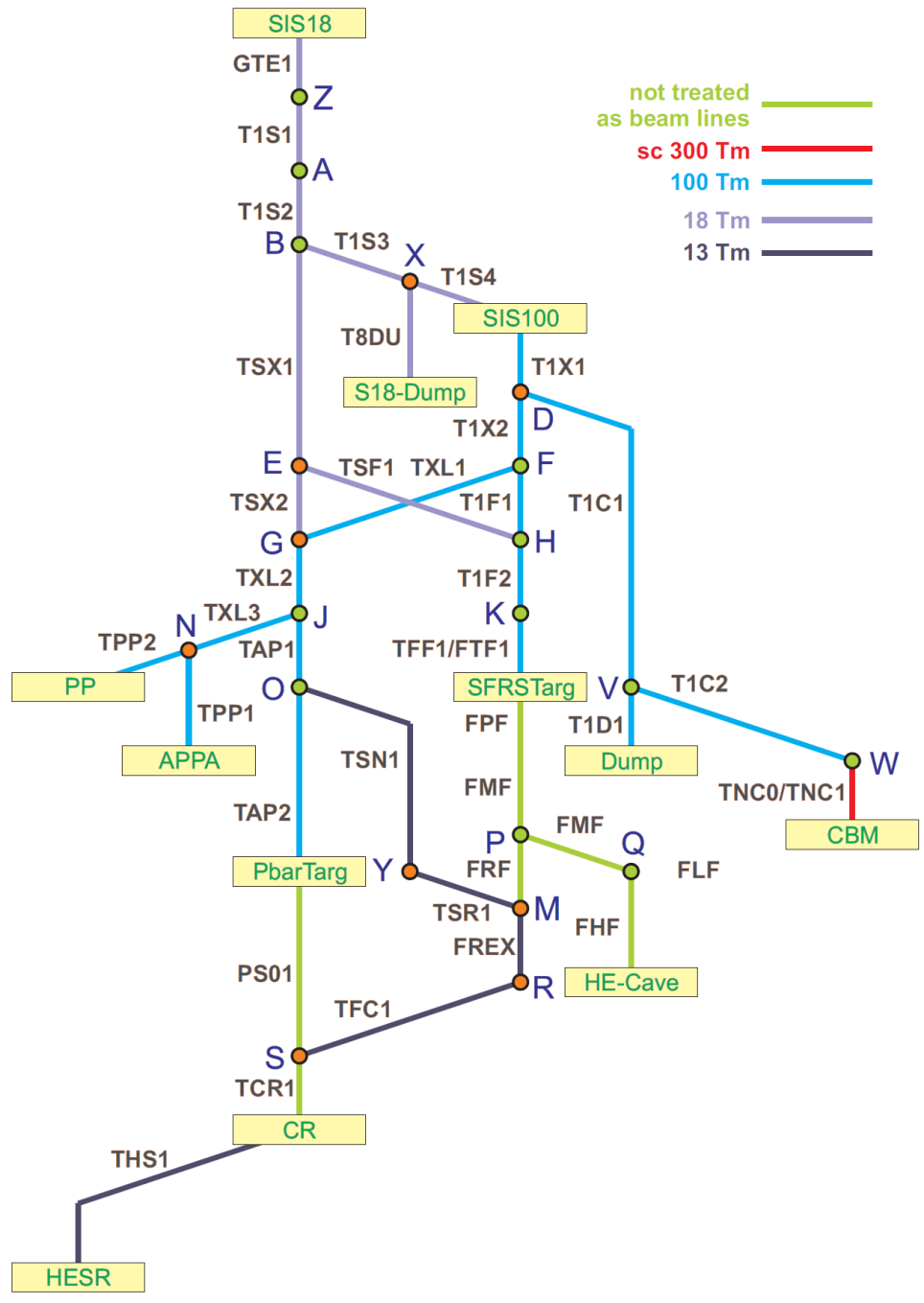
HEBT: Schematic Layout
Beam line length: about 1500 m
p ≈ 1x10⁻⁸ mbar, non bakeable
only sections directly connected to SIS100, will be baked up to 300°C to achieve a vacuum of 1x10⁻¹⁰ to 1x10⁻¹¹ mbar
46 vacuum sectors, length between 10 and 50 m
55 gate valves (Viton and all-metal)
Beam Pipe Aperture DN100CF – DN400CF
Pumped by ion getter pumps
Passive Penning and Pirani gauges
Vacuum chamber stainless steel grades EN 10088: 1.4301, 1.4306, 1.4429 or 1.4435
Integral leak rate ≤ 1x10⁻¹⁰ mbar l/s
Outgassing rate ≤ 5x10⁻¹⁰ mbar l/(s cm²)
Residual gas composition as acceptance criteria
Most vacuum chambers were supposed to be produced by Budker Institute of Nuclear Physics BINP, Russia. Due to Russian war in Ukraine collaboration is stopped. Procurements of chambers for FS+ via calls for tender.
23

Slide 24
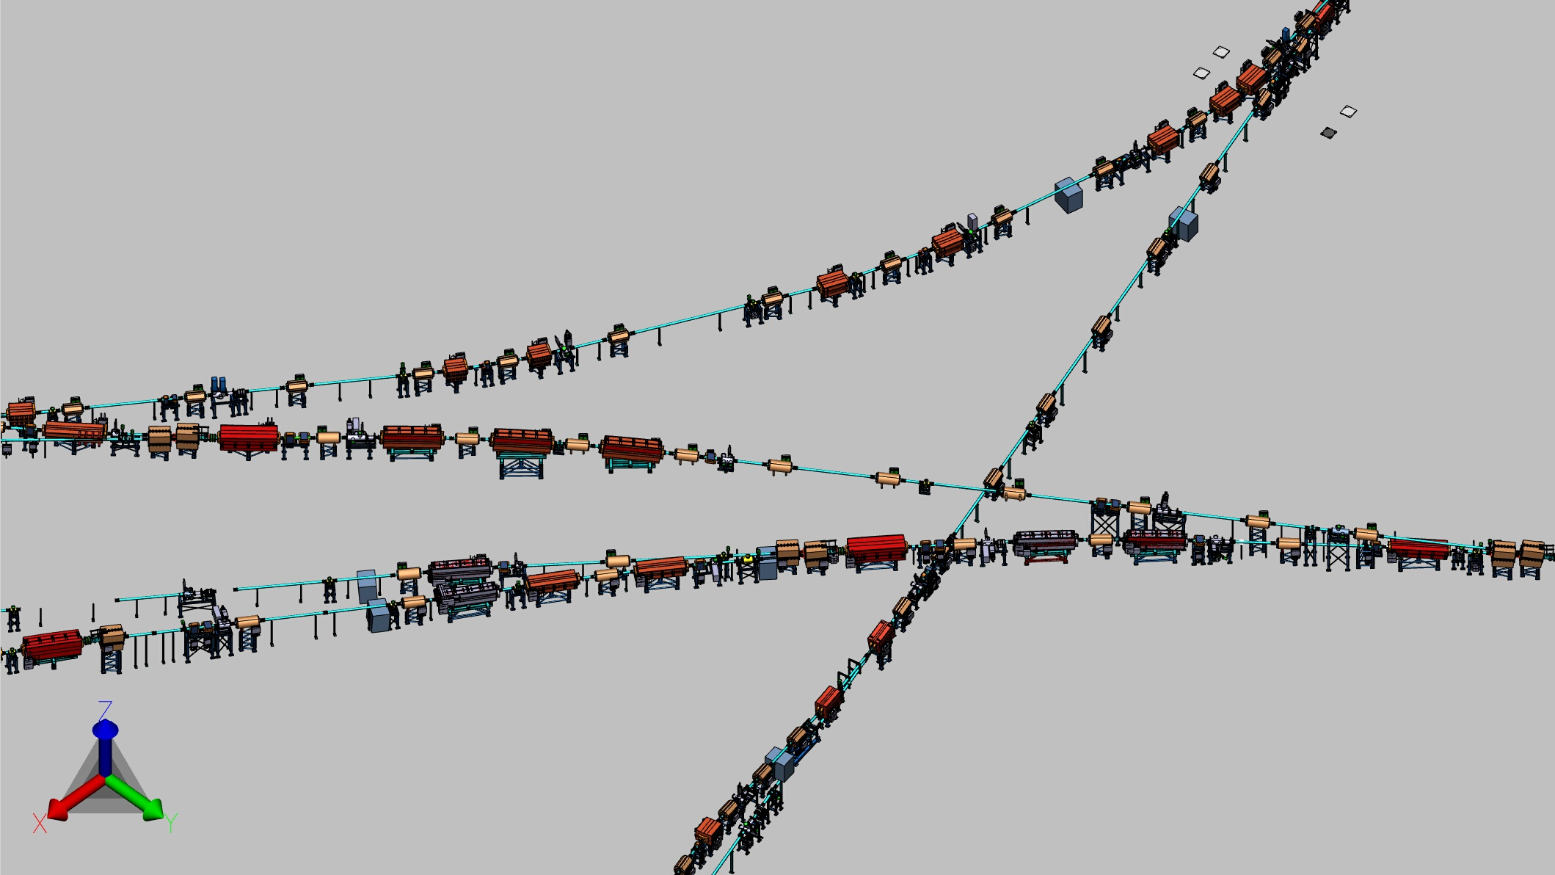
HEBT: 3D Model of part of HEBT
from SIS18
to pbar/APPA/
Super-FRS
from SIS100
to CBM
to SIS100
24

Slide 25
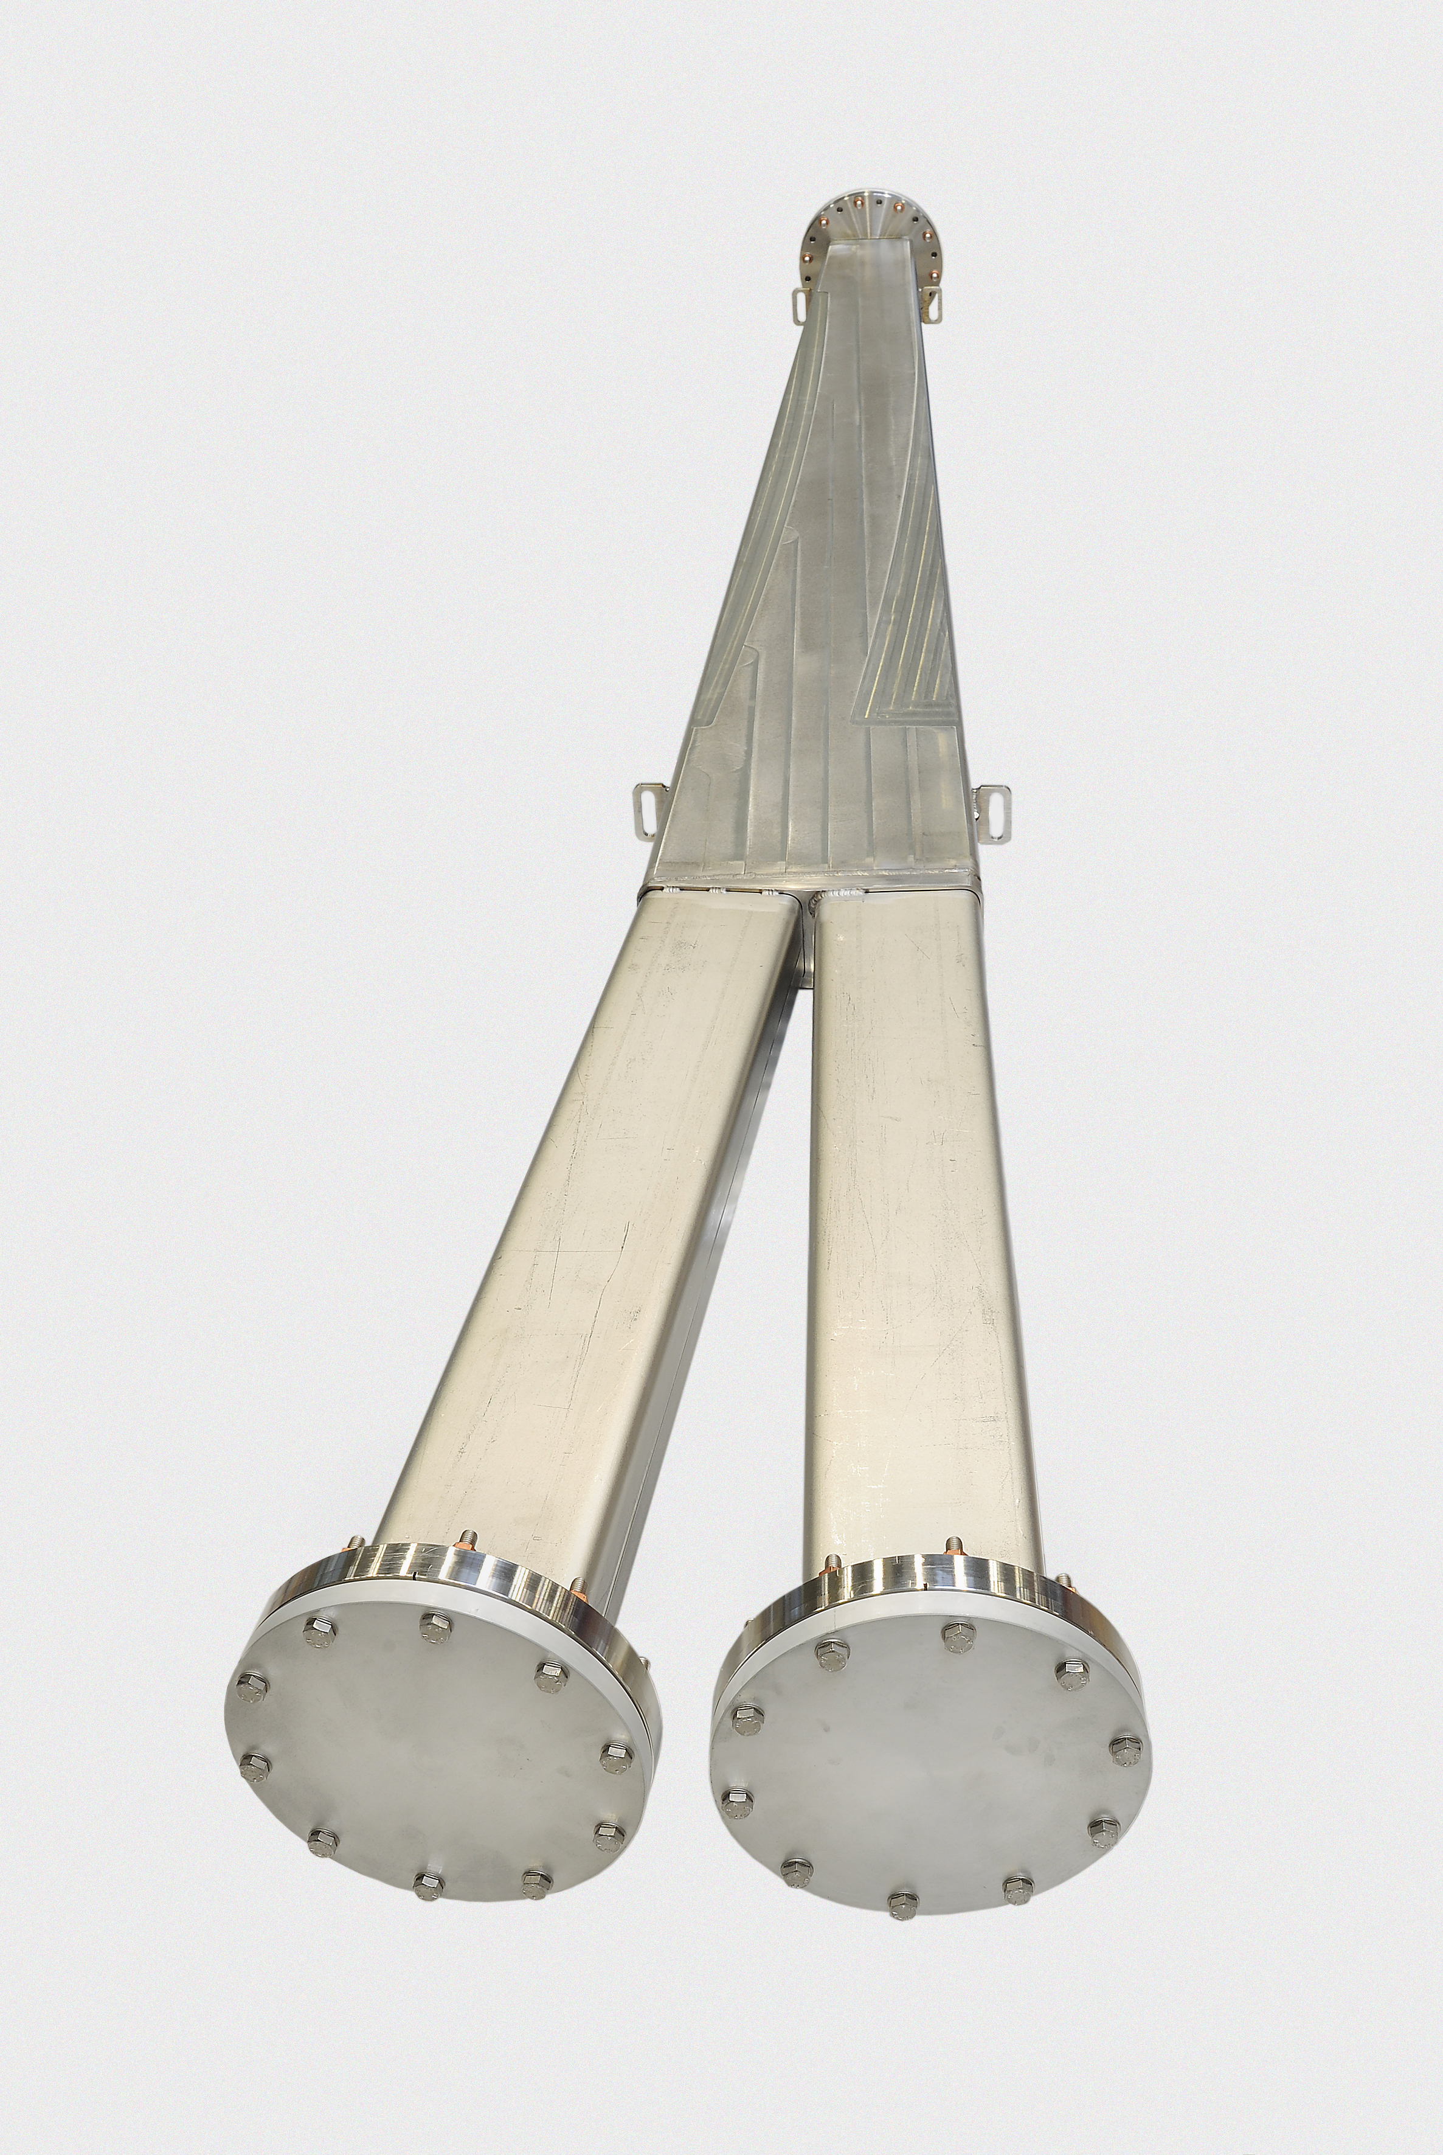
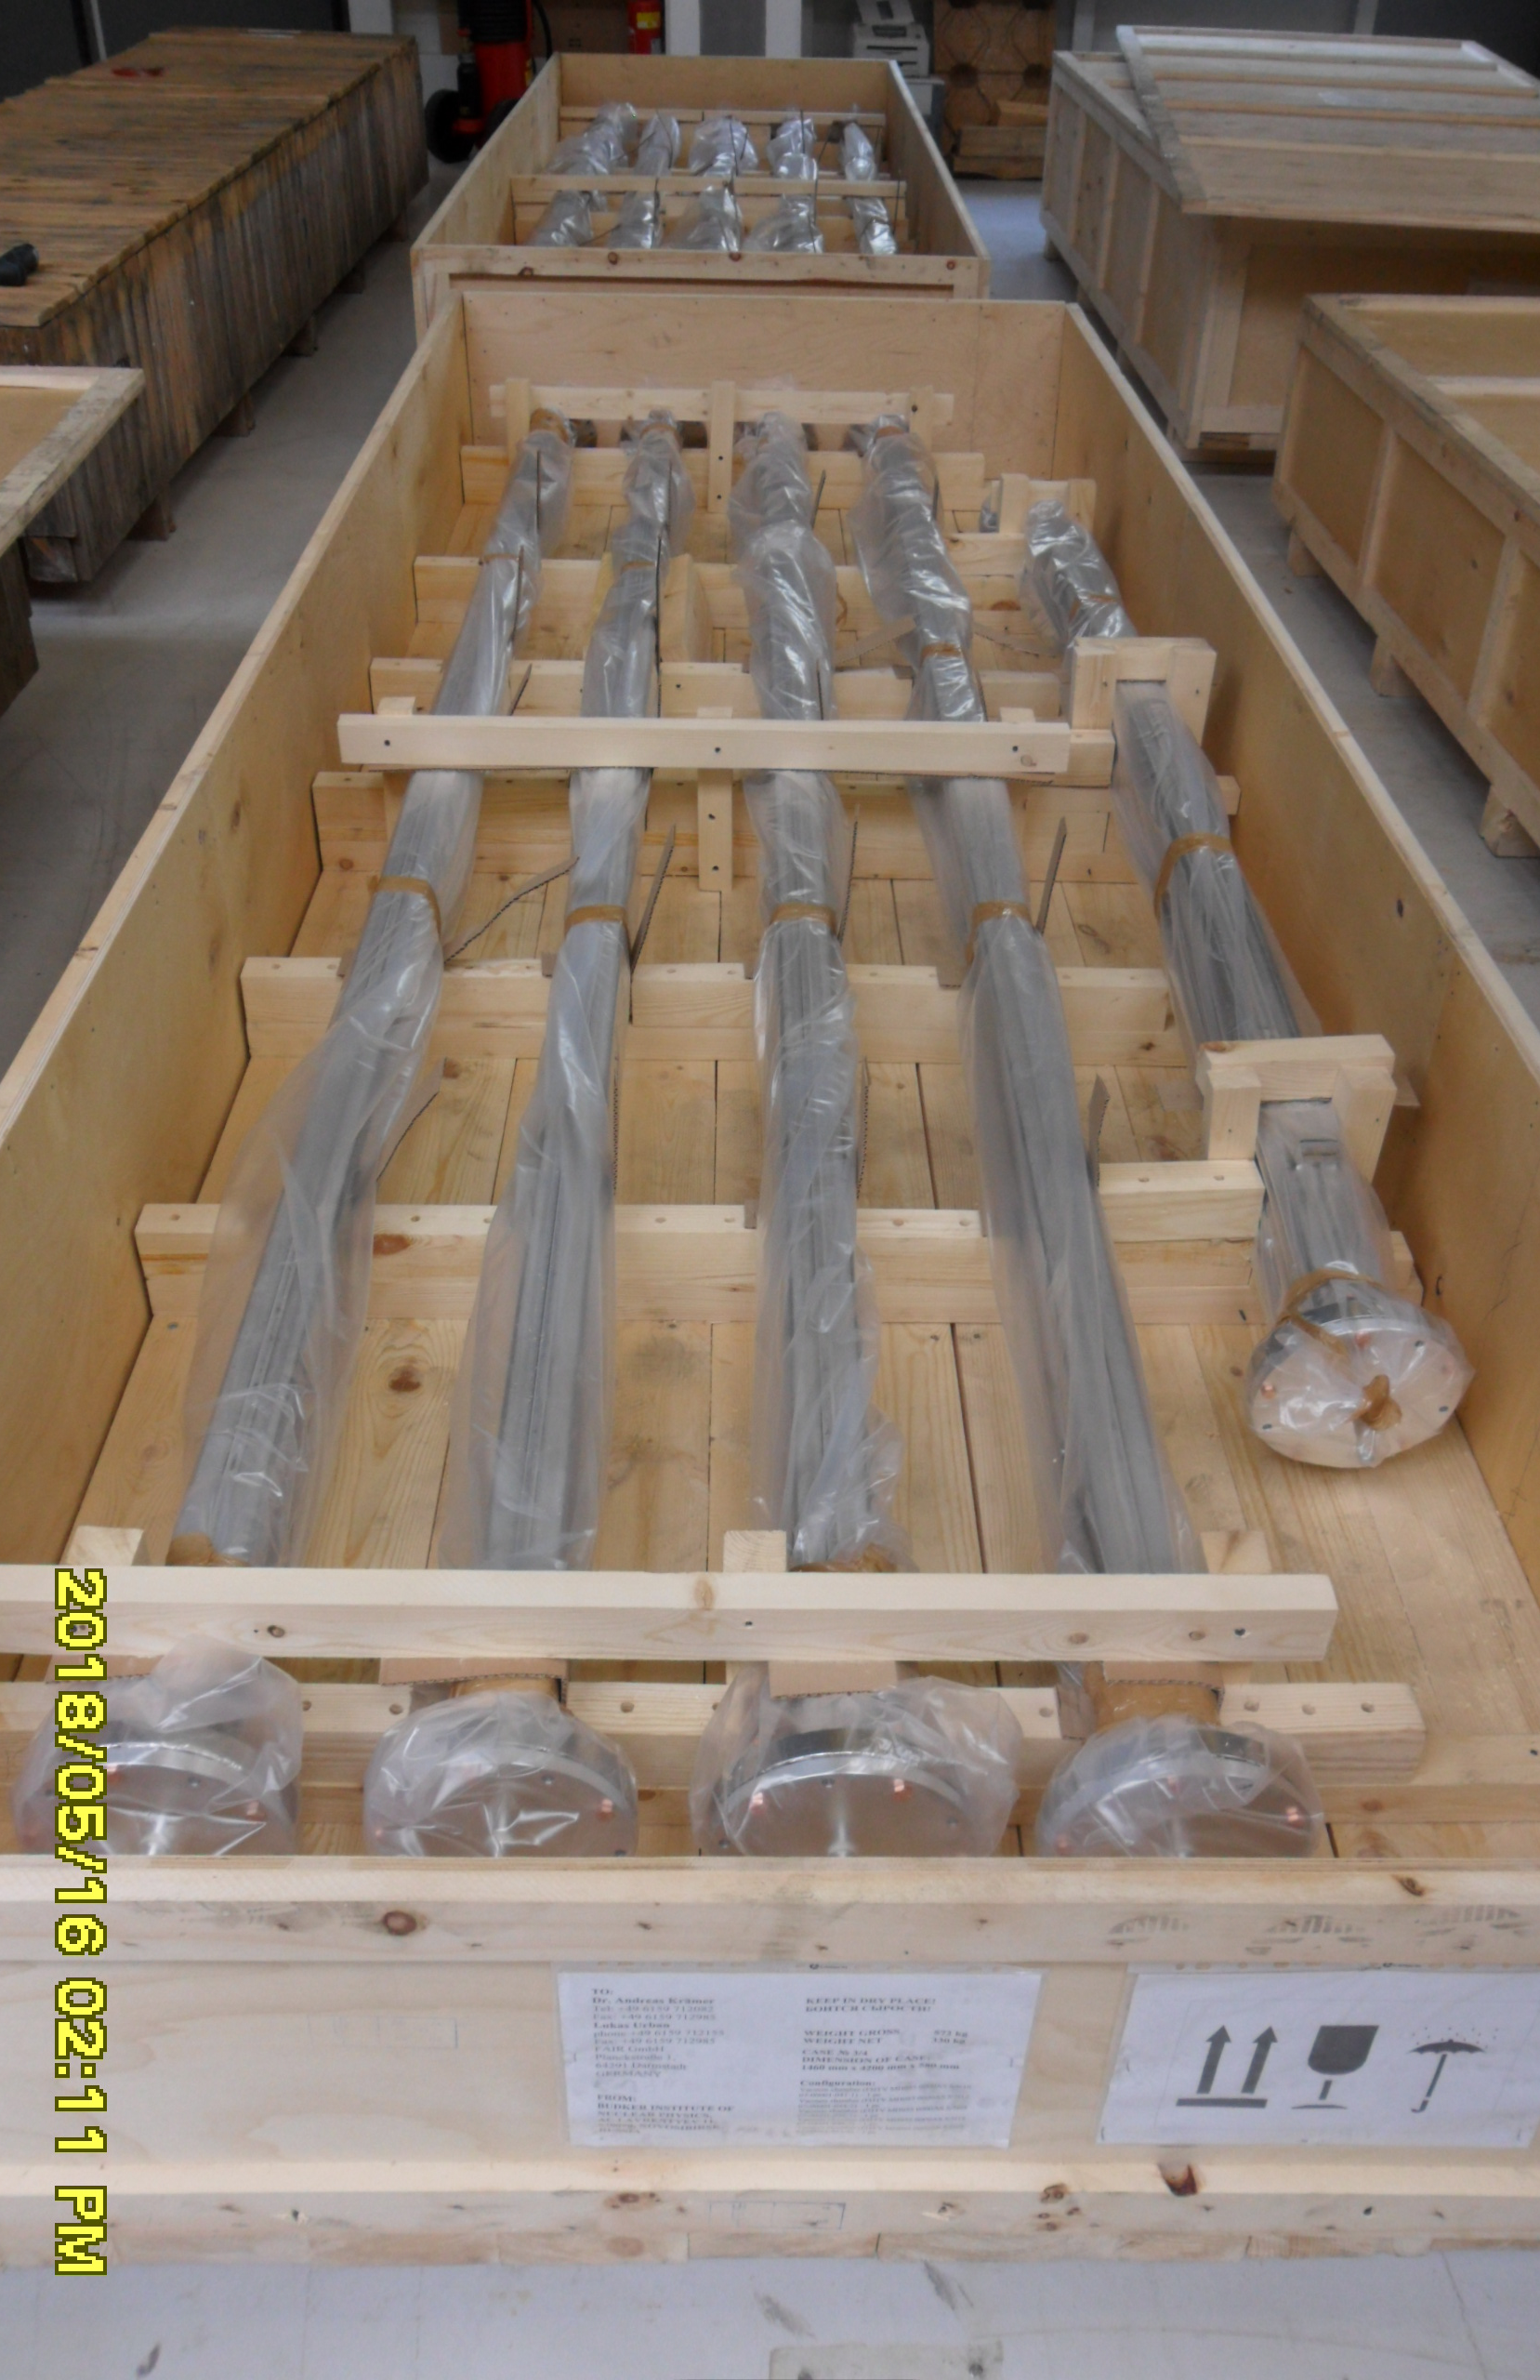
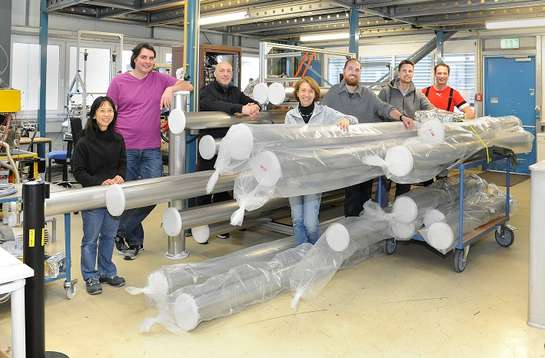
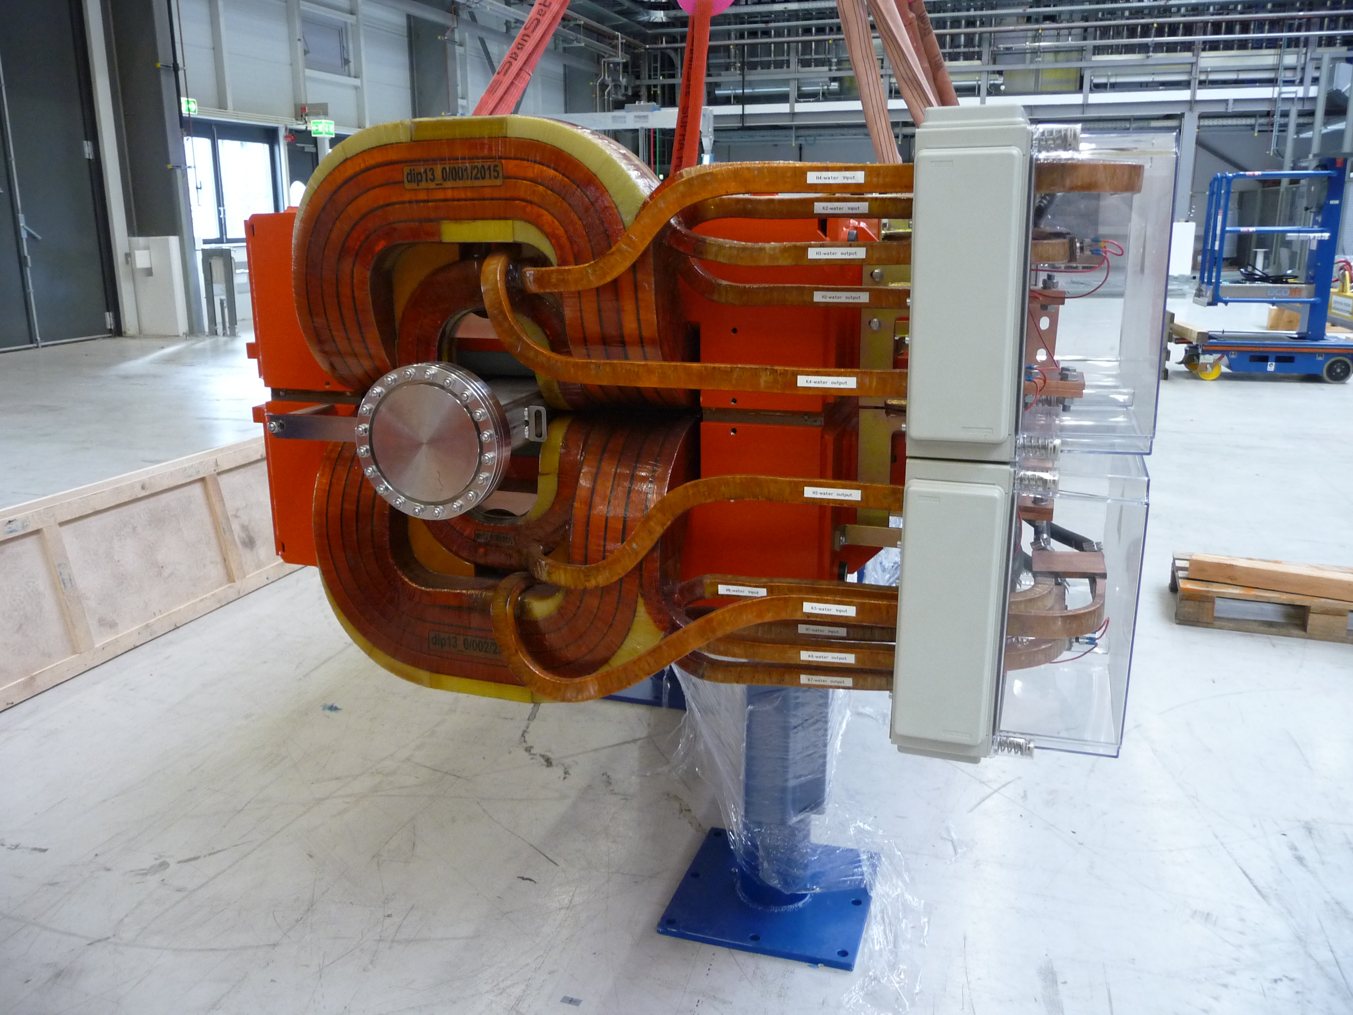
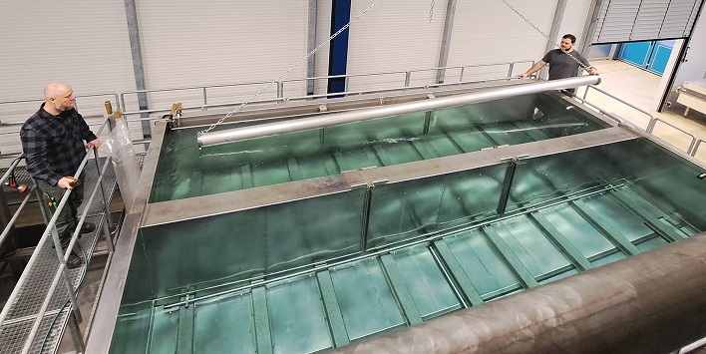
HEBT: Vacuum Chambers
51 Dipole Chambers produced by Budker Institute of Nuclear Physics (BINP) Russia and installed in magnets
In-house production and cleaning of 73pcs round chambers at GSI
©Gaby Otto (GSI)

Slide 26
HEBT: Vacuum Chambers
Pumping Cambers
Quadrupole Chambers & Steerer Chambers
Bellows
Quadrupole Chambers: 93pcs
Steerer Chambers: 45pcs
length 0.5 – 2m
aperture: 100mm, 120mm, 150mm
Contract signed with SAES Rial Vacuum
Partially delivered and under construction
309 pcs
length: ~186mm, aperture: 154mm
Contract signed with SAES Rial Vacuum
Partially delivered and under construction
38 pcs
length ~400-800mm
diameter ~160mm
height ~650mm
Flanges: 5x DN160CF, 1x DN40CF
Contract signed with SAES Rial Vacuum
under construction
Dipole Chambers
15 pcs
length: 2.5 – 3.8m
aperture: 110x67mm², 120x60mm², 120-200x60mm²
wall thickness: ~4-6mm
Contract signed with Fantini S.p.A.
under construction

Slide 27
Vacuum Supply Areas (Electronic rooms) Beam Vacuum
3+1x HEBT (incl. bake-out in one)
2+1x Super-FRS
10x SIS100 (incl. bake-out)
1x p-Linac
1x CR
1x pbar
2x HESR (incl. bake-out)
Vacuum controls and controllers for beam vacuum and bake-out are
distributed over 22 different electronic rooms at FAIR to keep cables „short“.

Slide 28
Status Vacuum Standard Components
Procurement via frame work contracts
NEG Pumps SAES Getters: CapaciTorr Z3500, NexTorr D500, …
Controllers for NEG pumps SAES Getters: NEG Power C4
Ion Getter Pumps: Agilent Technologies: StarCell (from 75 – 1000l/s)
Controllers for Ion Getter Pumps Agilent Technologies 4UHV (neg polarity)
Extractor type gauges: Leybold IE514
Controllers gauges extractor type PREVAC MG15
Passive Penning & Pirani gauges & controllers: INFICON PSG018, MAG070, VGC094
Passive cold cathode gauges MKS Instruments 422
Turbo pumps and controller Leybold TurboVAC iR (300 – 1200l/s) & TurboDrive 500e
Gate and Angle valves VAT Viton/EPDM/all-metal gate & angle valves DN100 – DN400
Primary pumps: call for tender in progress
28

Slide 29
Schematic Setup of Vacuum Controls
PLC Cabinet
(Slovenian In-Kind)
Supply Area
PLC & Communication Module
ET200M
ET200M
ProfiBus DP
ET200M
per channel
1x AI
per Channel
1x AI
1x DO
2x DI
1x DO
ProfiNet
Controller Cabinet
ProfiNet
4x HV
4x
Long cables up to 200m
Tunnel
Roughing pump
Schütz-steuerung
Ion Getter Pump
Gauges
Turbo molecular pump
Gate- & Angle Valves

Slide 30
Controller and PLC Cabinets for Vacuum Control System
Controller Cabinets
PLC Controls Cabinets
@Björn Mai (GSI)
All delivered by NATUS Industrial Solution Systems
SIS100, HEBT & SFRS (40 pcs)
Design/software development by COSYLAB Slovenia as In-Kind
Manufacturing by INEA d.o.o

Slide 31
Schematics of Bake-Out Control System
Terminal Box
Connection of power for bake-out jackets, thermocouple, thermal cut-out device (thermos switch)
Temperature Compensation (transition from thermocouple to Cu wire)
8 Channels, max 7 heating jackets per channel
Solid State Rack
Cabinet with Solid State Relais & Fuses
deliver Power to bake-out jackets
24 channels (supplies three Terminal Boxes)
PLC Cabinet
contains PLC & PID controllers, I/O modules
controls six Power Controls Racks
with max 144 control circuits each
Power & Thermal
Cut-Out
2 cables
Digital I/Os:
Status on thermal cut-out devices, fuses, on/off switch, fast stop,...
5 cables
Thermo switch
Thermocouple
Power
Power
Thermocouple
Tunnel
Supply Area

Slide 32
Hardware Bake-out System (HEBT & SIS100)
PLC Cabinet
16 PLC cabinets
91 Solid State Racks
273 Terminal Boxes
contract signed with NATUS Industrial Solution Systems
under construction and partially delivered.
Solid State Rack
Terminal Box

Slide 33
Installation of First Components at FAIR in March 2024
SIS100 Standard Pumping Chambers before transport
to tunnel © GSI/FAIR I. Pongrac
© FAIR
Beam Diagnostic Chambers HEBT
Quadrupole Magnets with Chambers HEBT
RF Components in SIS100 tunnel
33

Slide 34
Graph: ion42/FAIR
Thank you for
your attention!
Acknowledgements: Thanks to I. Pongrac, S. Purushothaman, P.M. Suherman, L. Urban, S. Wilfert, S. Zeller

