Slide 1
Low Particulates Vacuum Operation in SRF Cavity and String Assembly at Fermilab
Genfa Wu on behalf of Fermilab SRF Team
6th Workshop on the Operation of Large Vacuum Systems
16 April 2024

Slide 2
Outline
Introduction
Evacuation
Backfill
Purging
Summary

Slide 3
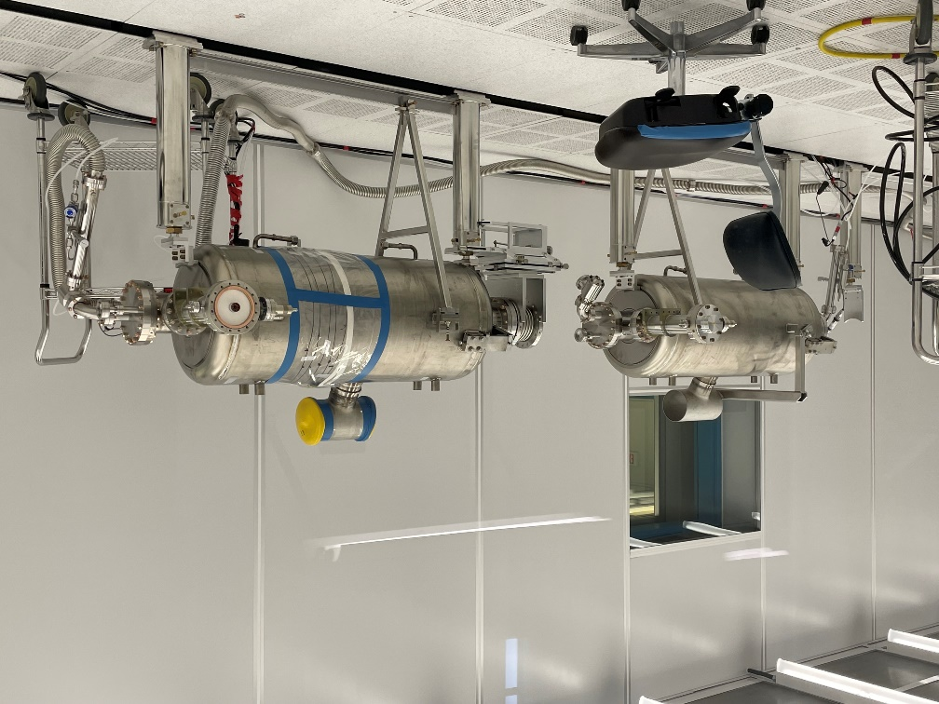
Introduction – Particle Sources
Parts
Valves
Fasteners
Seals
Tooling
Processes and Assembly
Chemistry
Water rinsing
Assembly
Evacuation, backfill, and purging
Operators
Environment

Slide 4
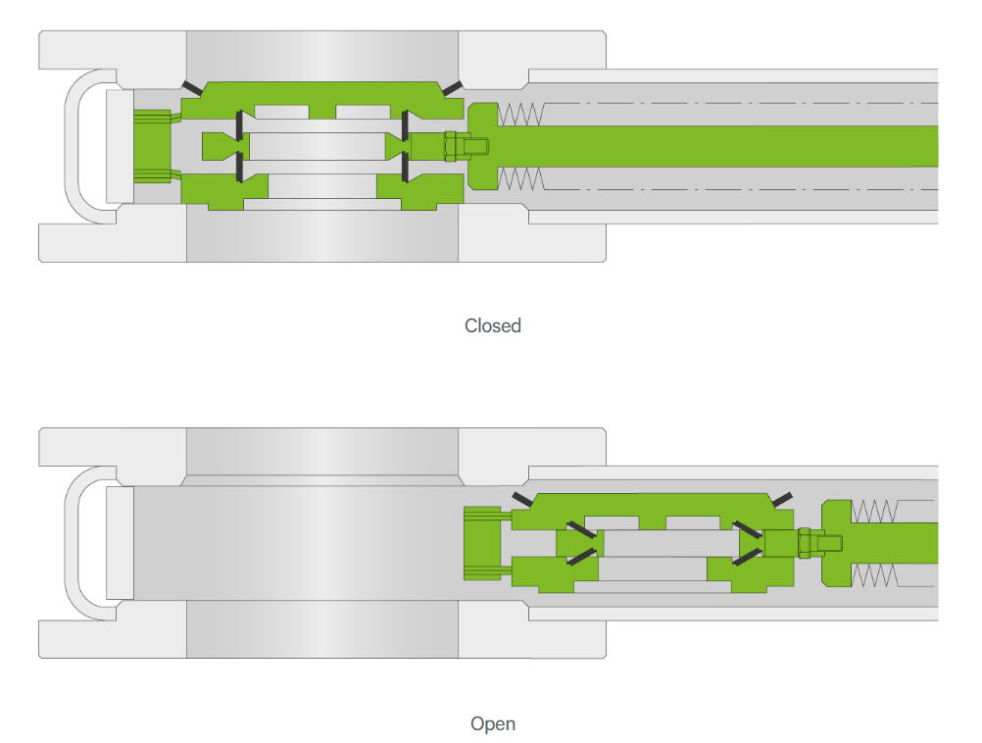
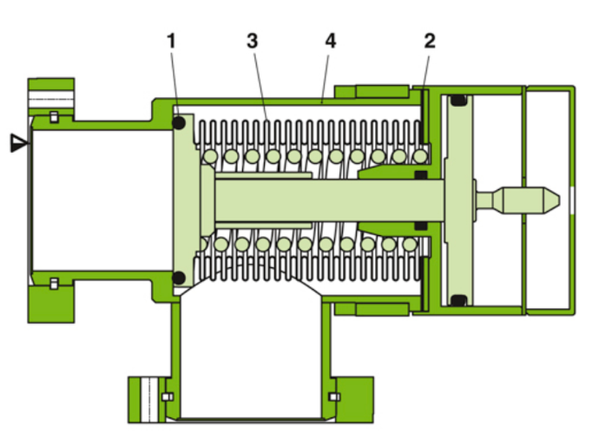
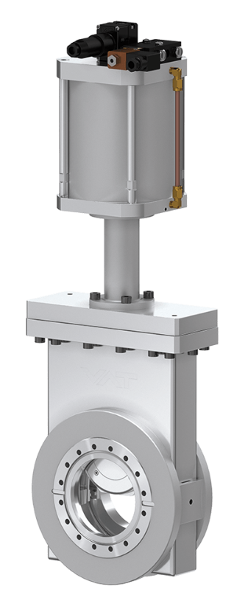
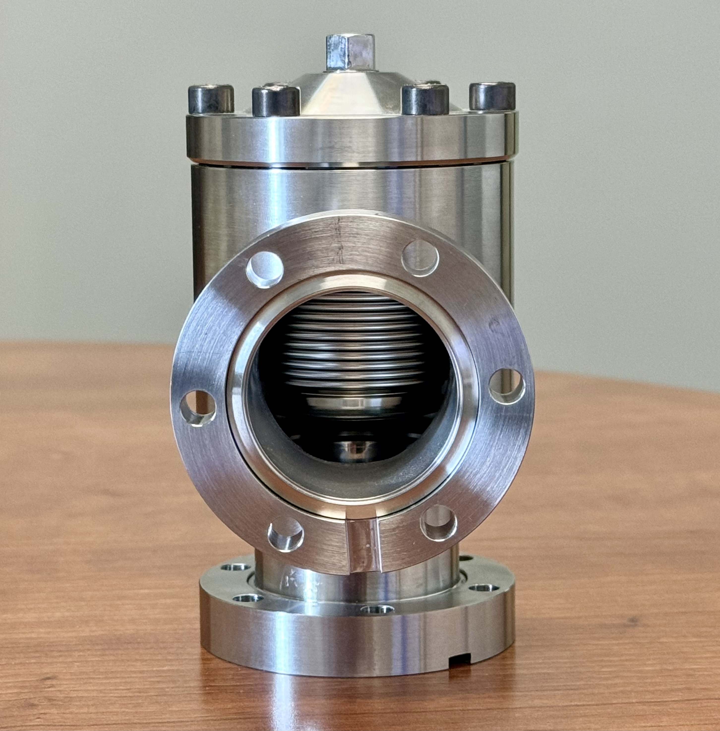
Particle source – valves
Legend
▼ - valve seat side 1 - plate seal 2 - bonnet seal 3 - bellows 4 - body
Cycling the valve generates particulates
https://www.vatvalve.com/

Slide 5
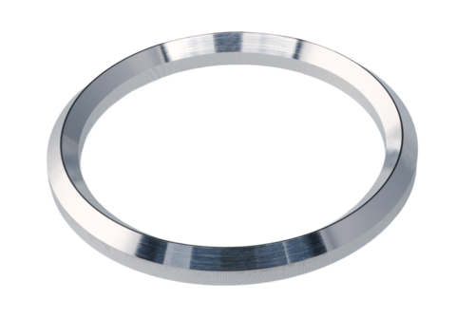
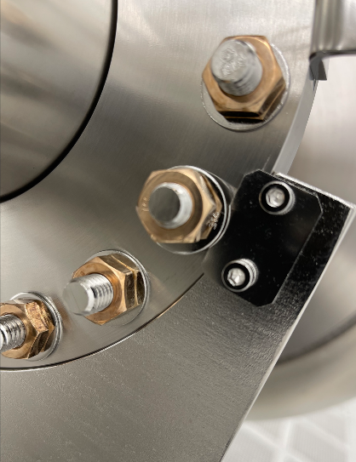
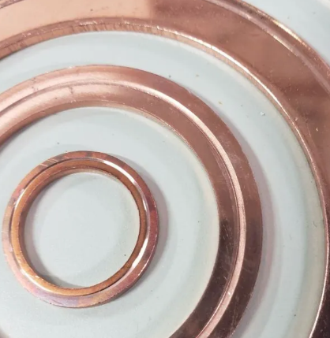
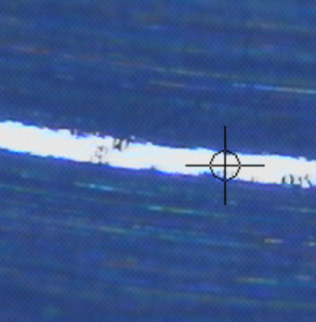
Particle source – Fasteners and Seals
Fastener torquing and seal crush/cutting generate particulates

Slide 6
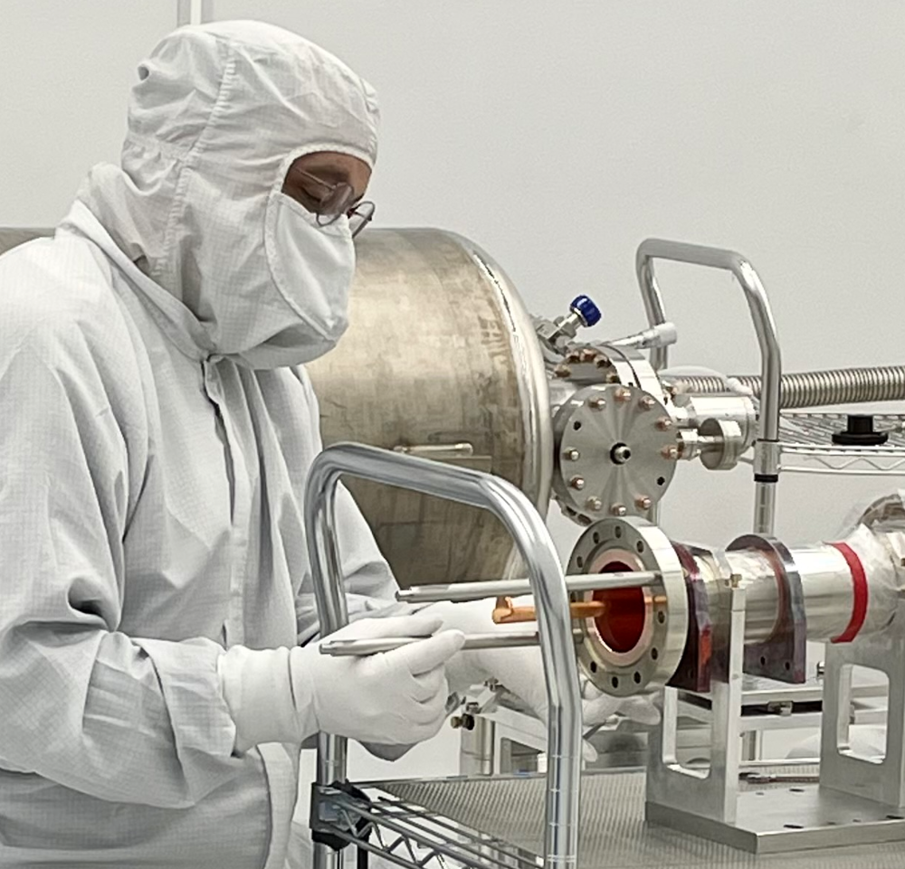
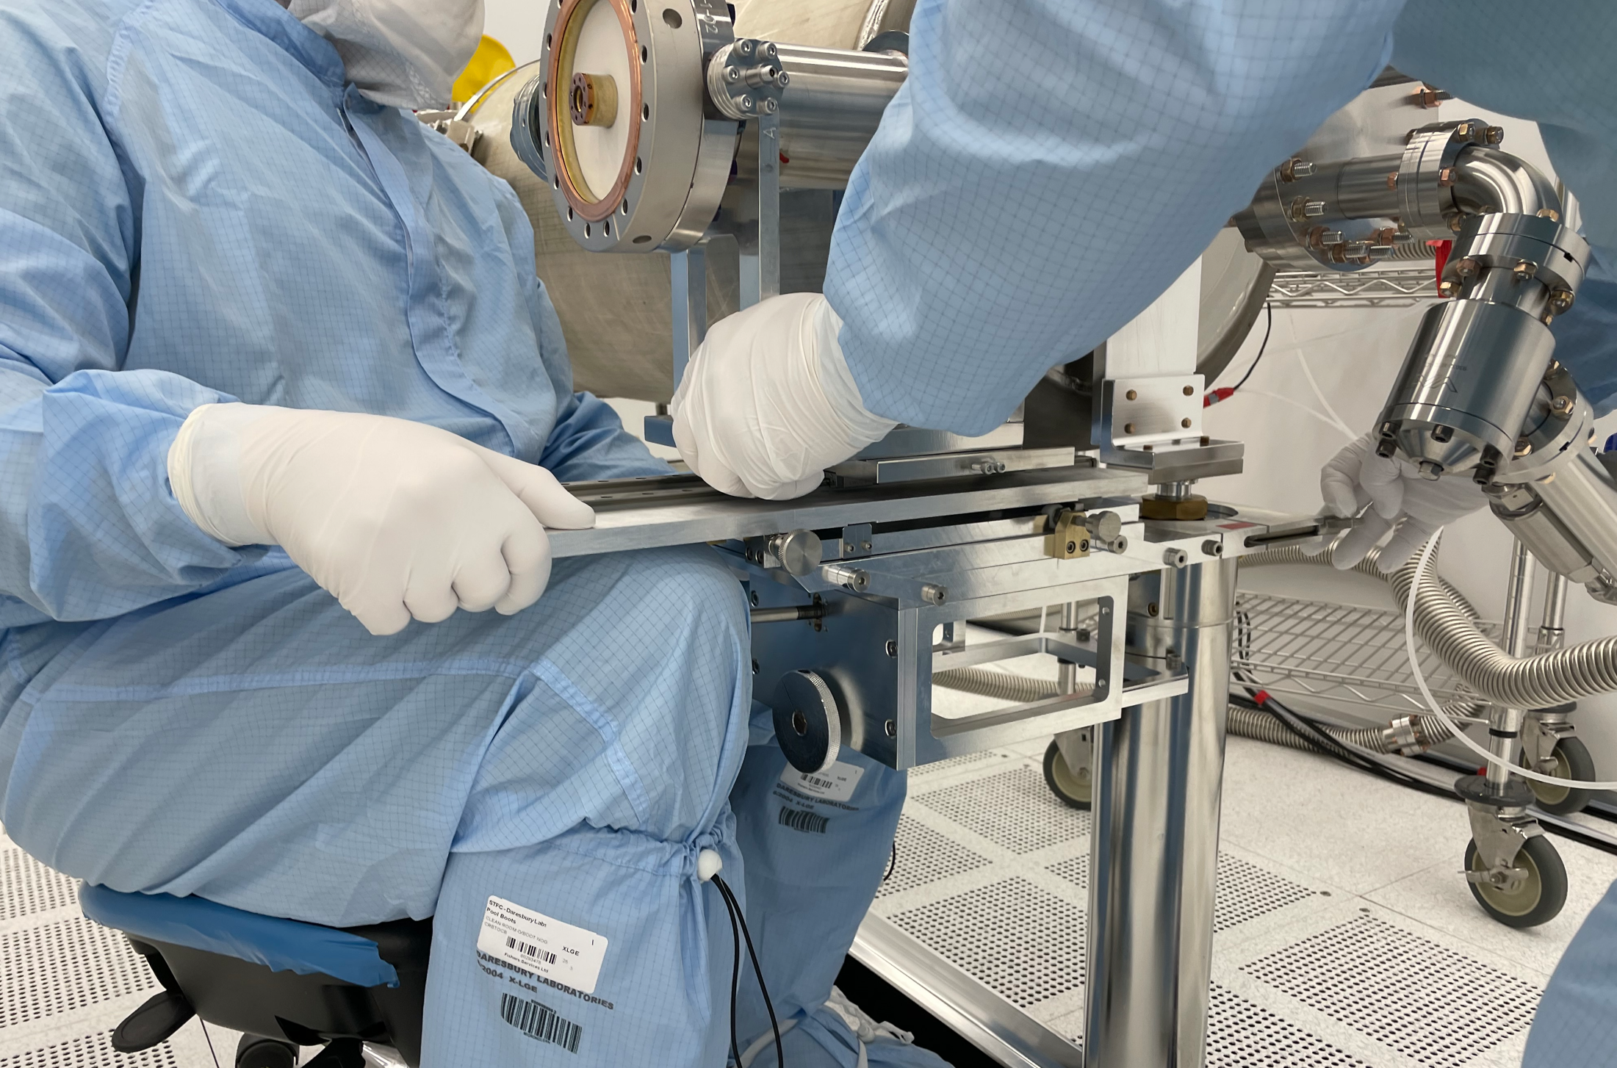
Particle source – Tooling
Tooling movement generates particulates

Slide 7
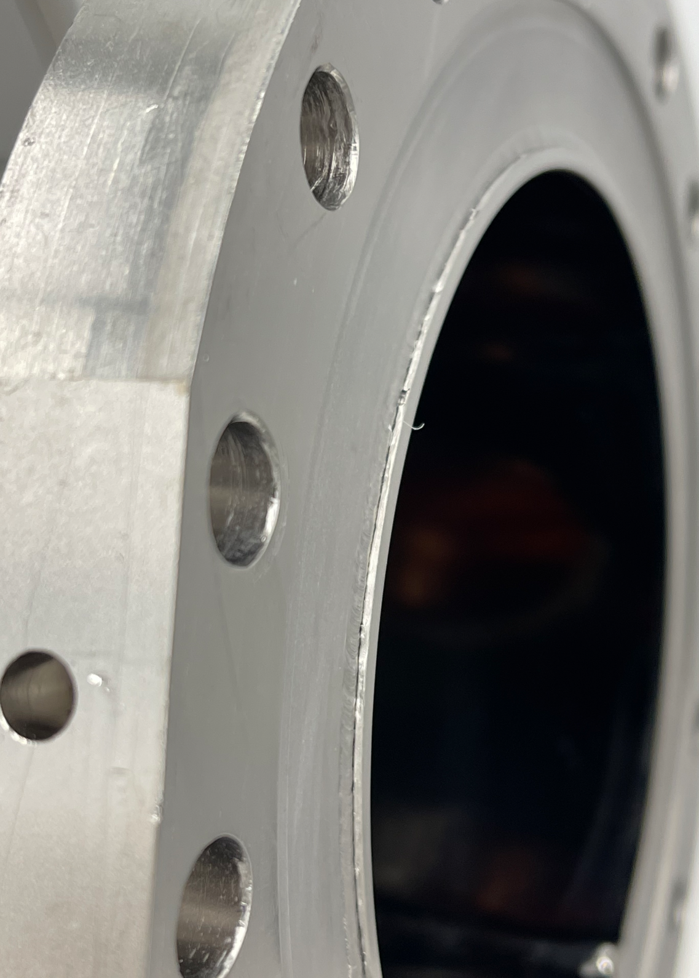
Particle source – Processing and Assembly
Chemical residuals
High-pressure water rinsing
Assembly
Evacuation, Backfill, and Purging
Flexible vacuum hose a challenge to clean
Vacuum pumps
Particle movement can be hard to mitigate

Slide 8
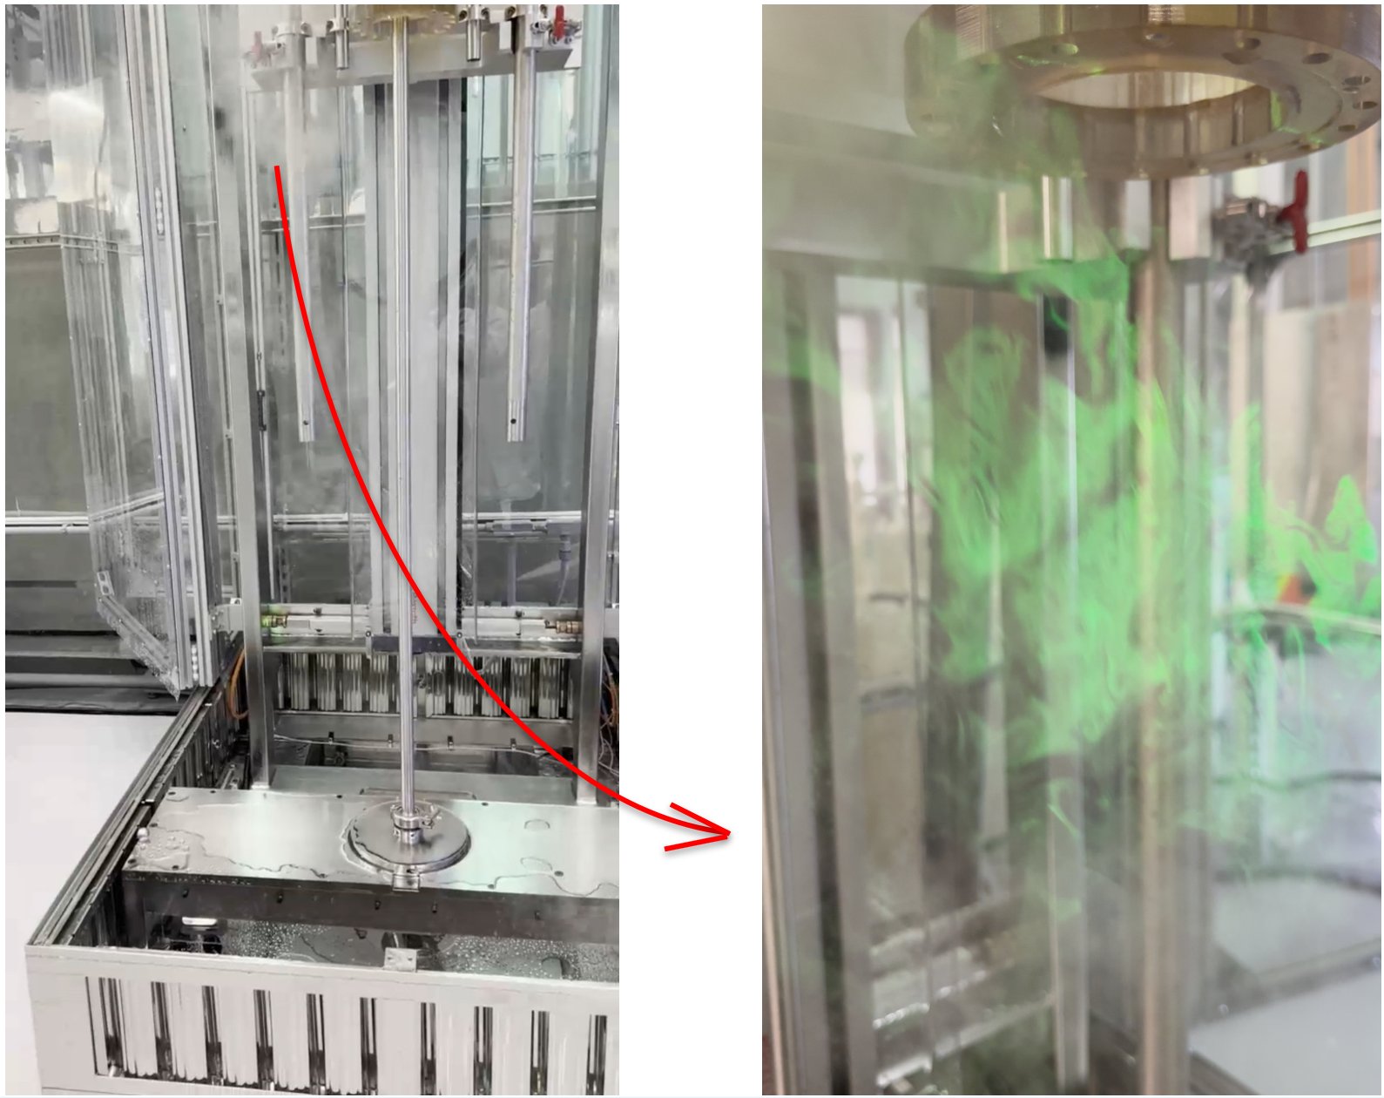
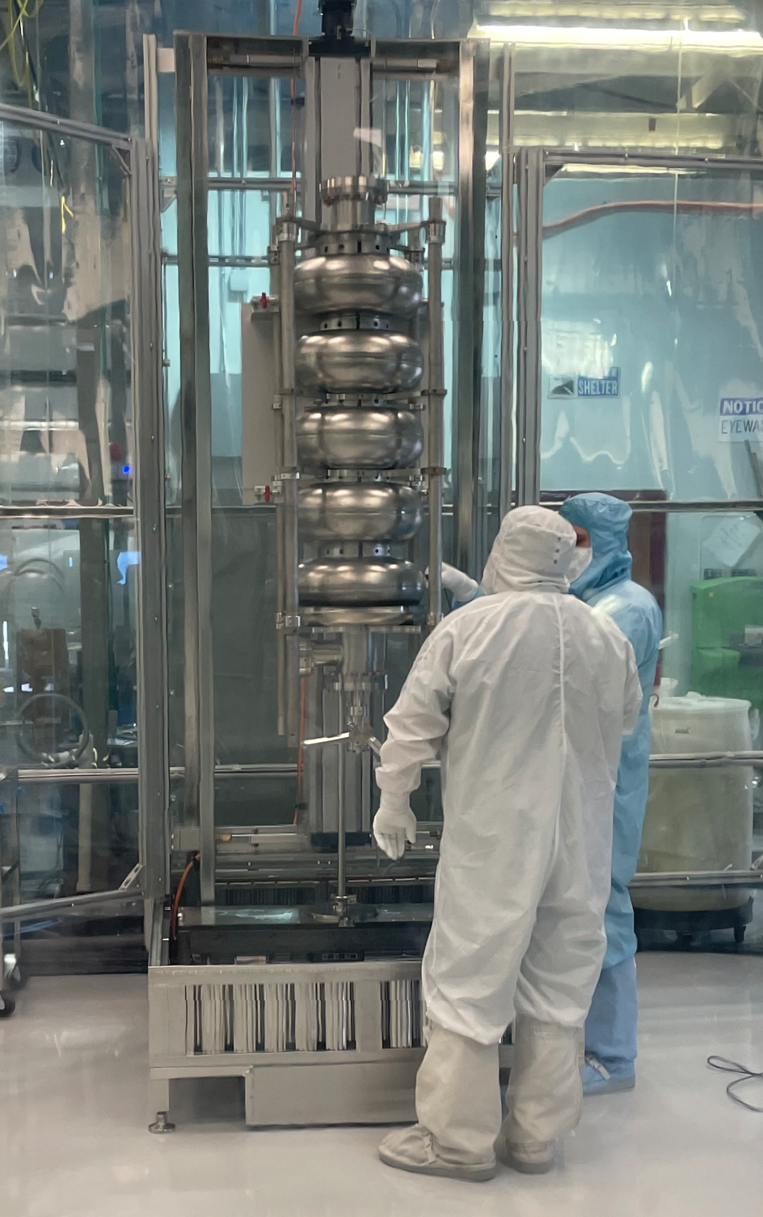
Particle source – Operator and Environment
Operator in an unfavorable airflow exacerbates the particle moving into the cavity

Slide 9
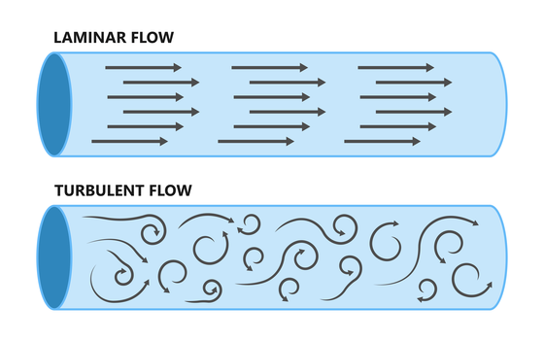
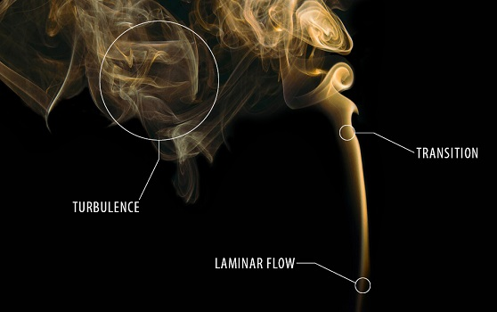
Laminar and turbulent flow
https://www.bronkhorst.com/

Slide 10
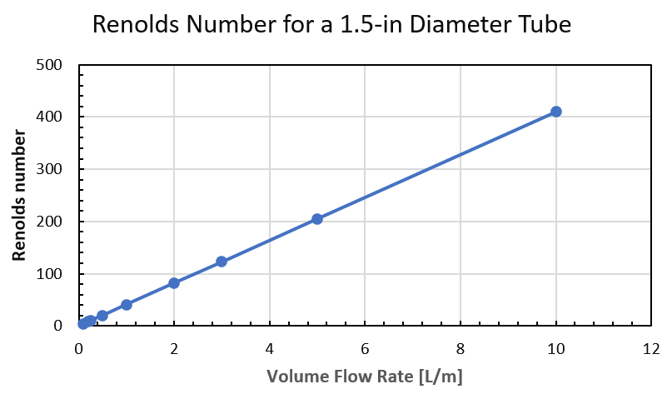
Slow evacuation
Much lower flow rate for a laminar flow
0.25 L/m std.

Slide 11
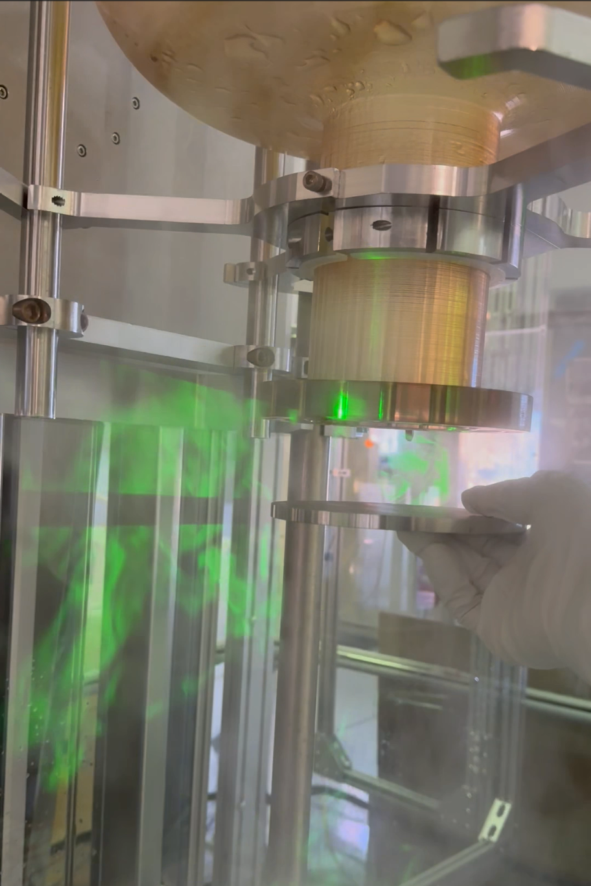
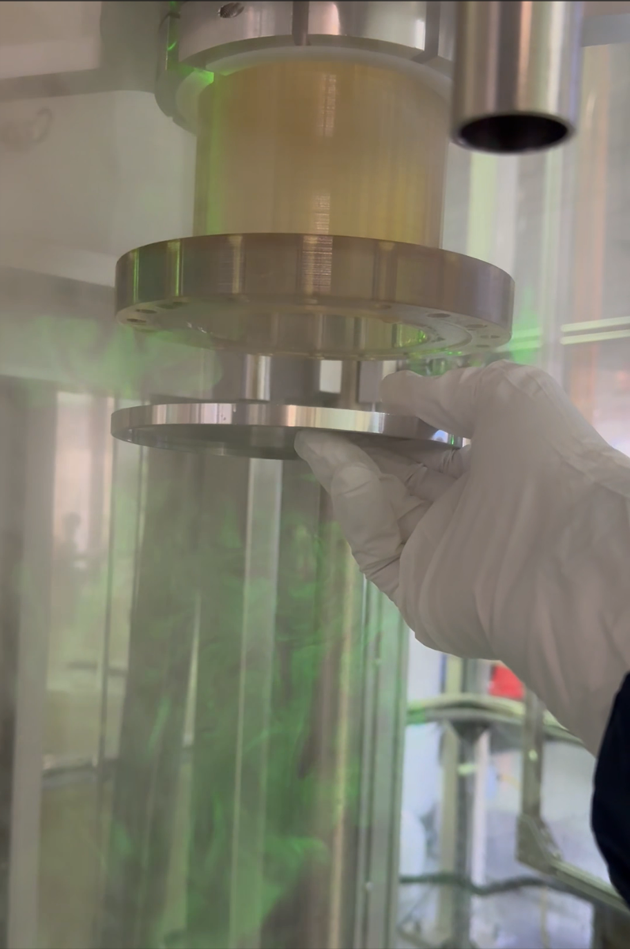
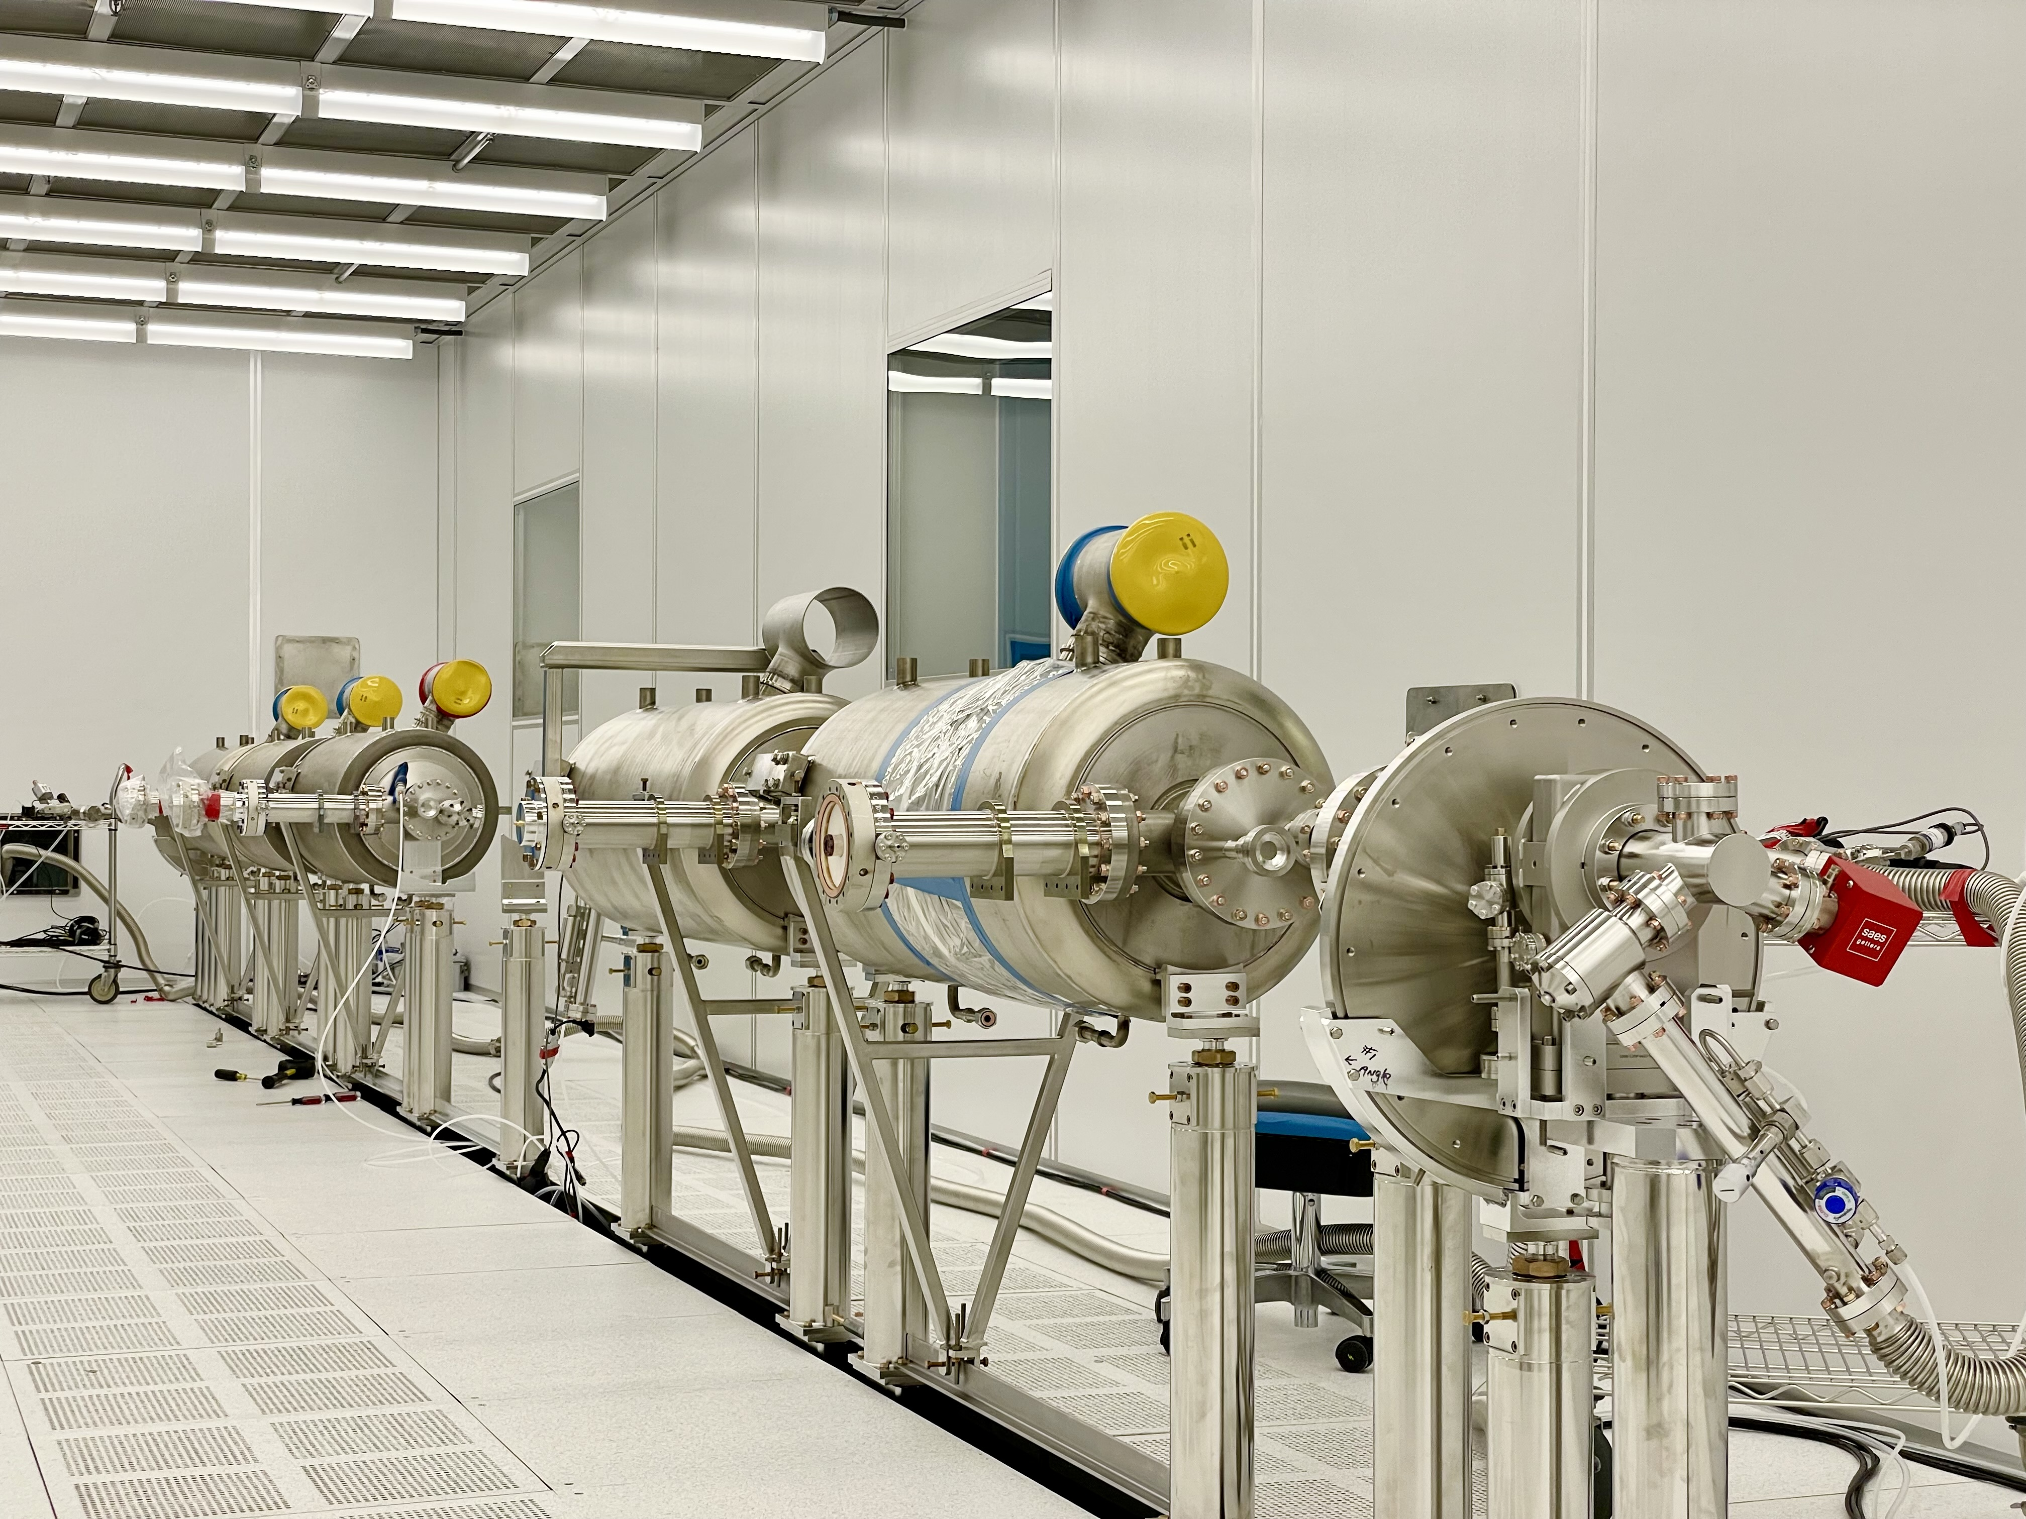
The purging rate
0.25 – 1 L/m std.
Purging rate needs to balance between preventing particles from migrating into the cavity through openings and migrating from joint area to cavity cells.
cavity top port covered
cavity top port open

Slide 12
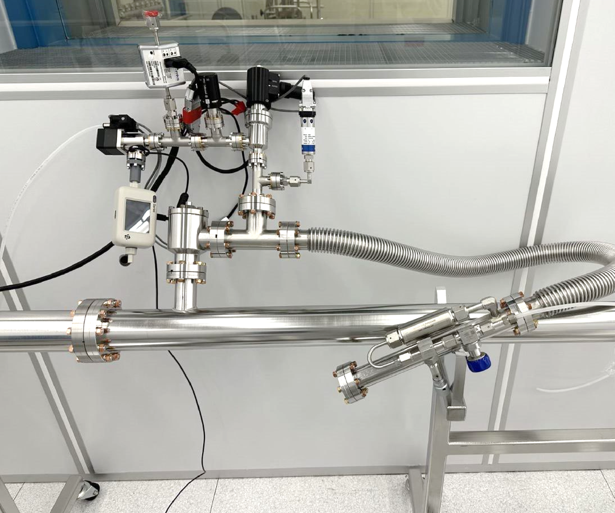
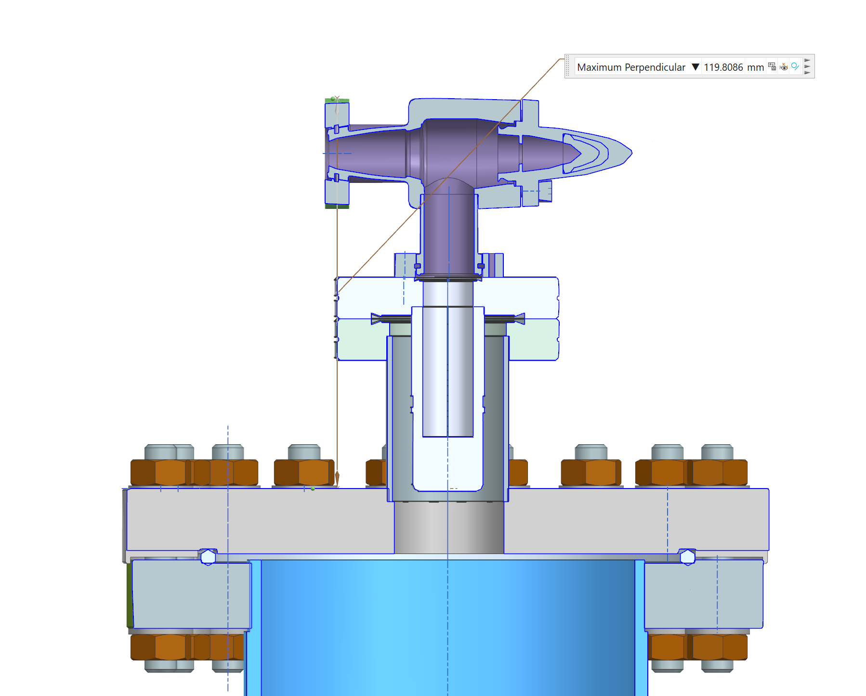
Purging to bypass particulate area
New LCLS-II (HE) and PIP-II string assembly purging/backfill bypassed flexible vacuum hose
In the future, a cold filter diffuser would bypass the right-angle valve

Slide 13
Large size cavity over pressure consideration
A standard 50 millibar overpressure would cause high-speed flow when released during cavity flange removal. The mass flow increases when cavity volume increases. 650 MHz and spoke cavities have a substantial risk of uncontrolled pressure change.
1.3 GHz string assembly has the potential risk of pressure surge for the last several connections.
Avoid the potential pressure wave that could have moved the particulates in the string assembly
A much lower overpressure, such as 5 mbar instead of 50 mbar, would reduce this risk significantly. A precise pressure measurement, controllable overpressure, and fast detection of pressure drops are required for a new system

Slide 14
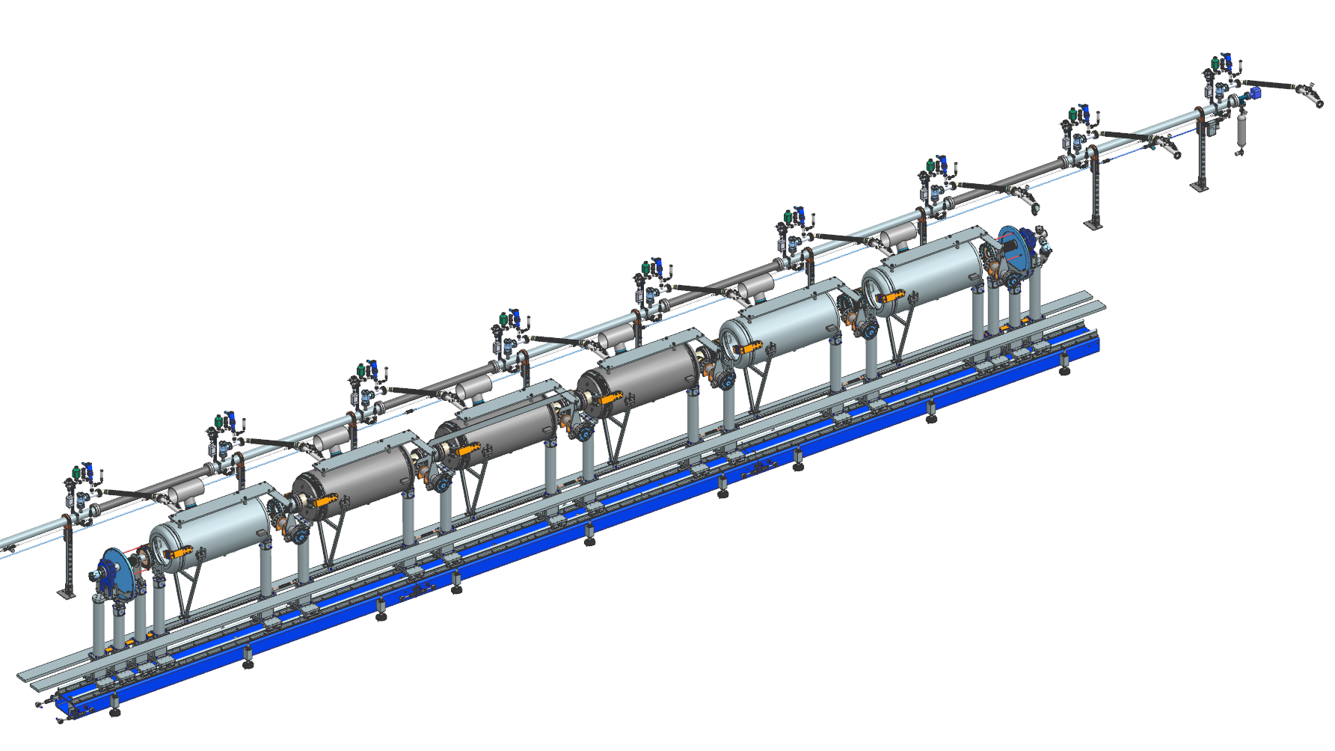
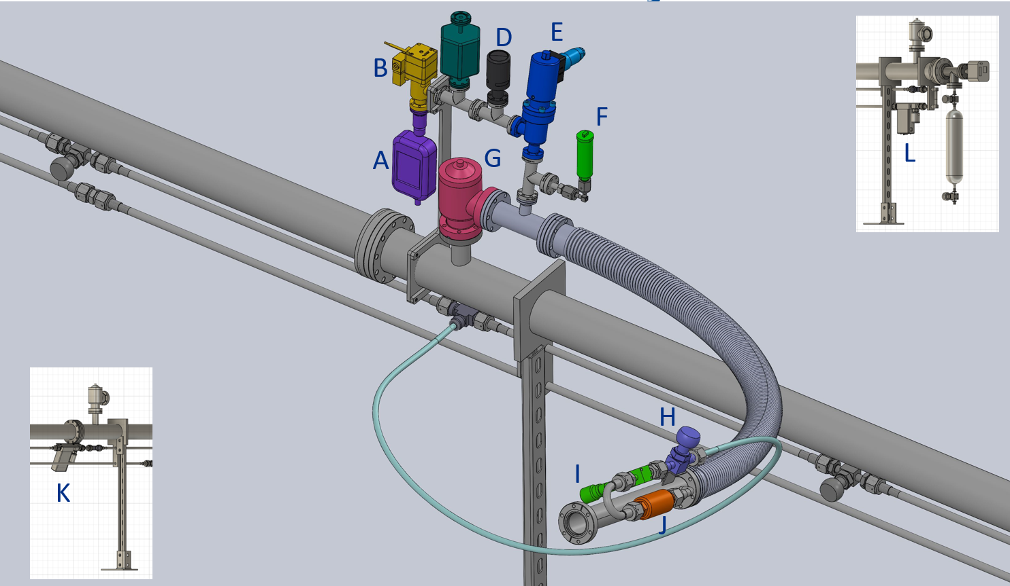
Special purging configuration at Fermilab
A | Flow meter – Vent
B | Electric RAV for opening vent
C | Differential pressure transducer
D | 1 psi blow-off safety valve
E | Manual RAV to isolate vent purge system
F | Absolute pressure sensor – UHV rated
G | RAV vacuum system isolation
H | ¼ turn valve
I | Manual flow control needle valve
J | Filter
K | Upstream MFC with shut off
L | Downstream MFC with shut off

Slide 15
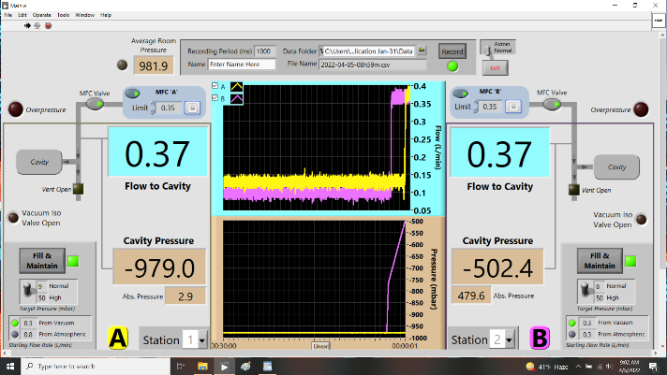
Special purging configuration at Fermilab

Slide 16
Purging has to be customized for different aperture: example of a HB650 string assembly purging rate
Aperture | ID [mm] | MFC (LCLS-II) [L/m] | Double flow rate to HB650 [L/m] | HB650 Adopted [L/m] | Note
1.3 GHz | 78 | 0.25 | 0.5
HB650 B92 | 118 | 0.38 | 0.76 | 0.85
HB650 B90 | 100 | 0.32 | 0.64 | 0.64
HB650 beampipe | 61.4 | 0.2 | 0.39 | 0.32
The LCLS-II scaled flow rate was below the minimum 0.32 L/m of the temporary MFC unit.
In discussion with Stephane and Olivier, we tentatively doubled the purging rates of the LCLS-II.
To avoid the uncertainty of the counter flow at the non-symmetric aperture connections,
Lowered the two beampipe rate to the MFC minimum, 0.32 L/m. Our hypothesis was the flow to the end sub-assembly is safer than the potential flow to the cavity.
Increased the B92 flow to 0.85 during the two B92 cavities to bellows joints.
Flow rate was adjusted for each connection according to the table
Purging system should have a range of 0.25 – 3 L/m. (Fermilab R&D purging system had 0.32 – 12 L/m.)

Slide 17
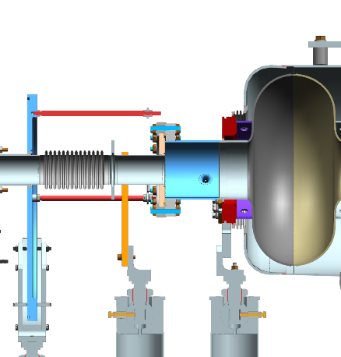
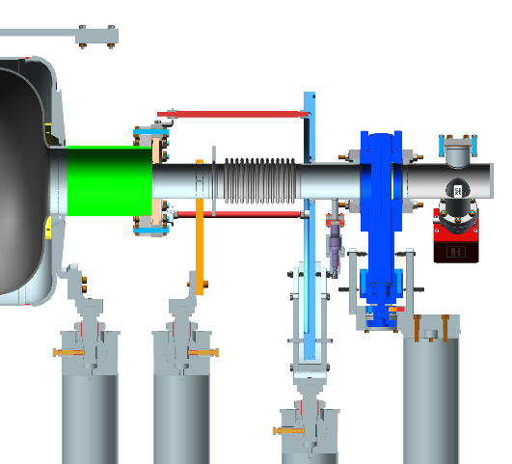
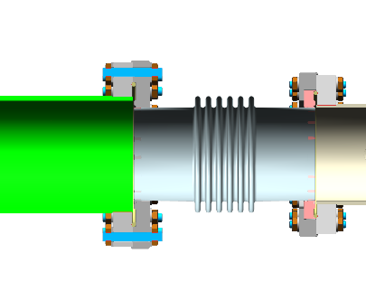
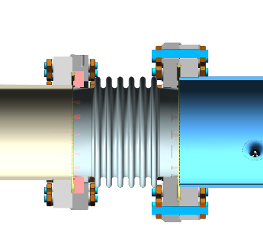
String assembly – four connections have non-symmetric purging

Slide 18
Flow dynamics at the non-symmetric connections Work in progress
2 mm
Flow rate
0.39 L/m
Flow rate
0.76 L/m
61.4 mm
118 mm
198 mm
Need to know the local turbulence
Need to know if there is flow going inside of either beam pipe

Slide 19
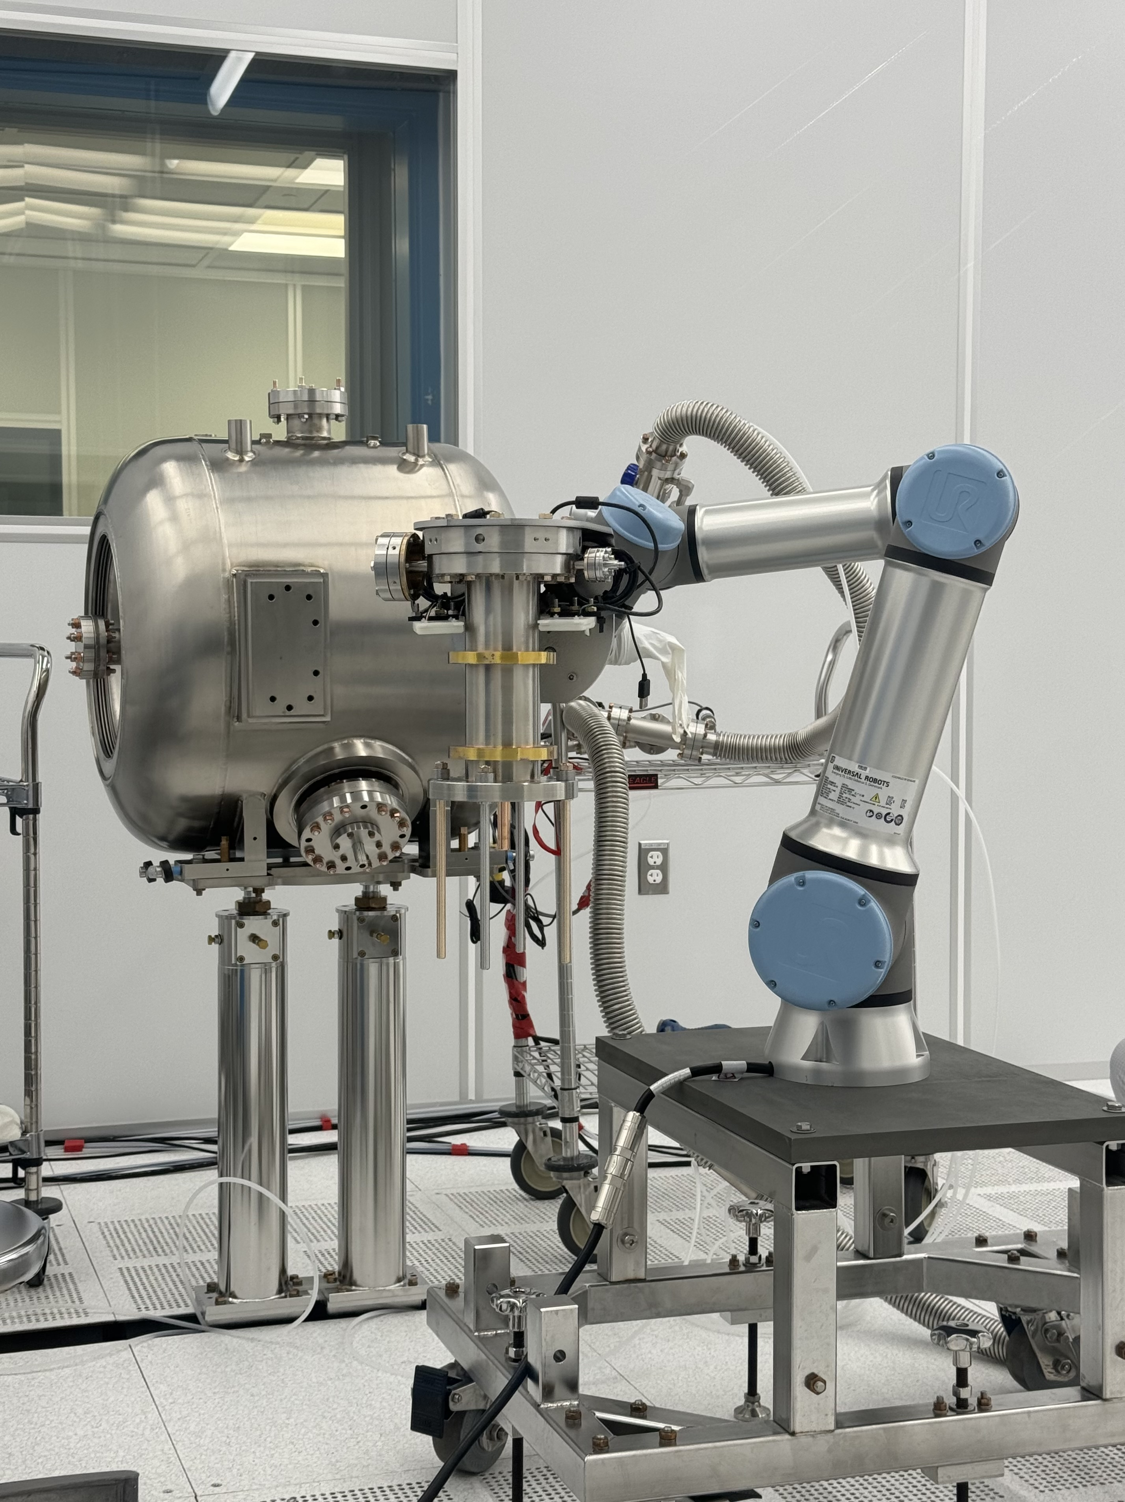
Future improvements
Dedicated purging port
Robotic-assisted clean assembly
Low particulate generation fasteners
C. Narug, TTC’2023, Fermilab

Slide 20
Summary
Fermilab has assembled thousands of cavities and ~38 CM.
The particulate control remains a challenge from time to time.
Many lessons learned and improved over the years.
Fermilab has developed and implemented a mature design of the vacuum operations of SRF cavity and strings.
Future improvements were identified and planned to be implemented.

Slide 21
Backup

Slide 22
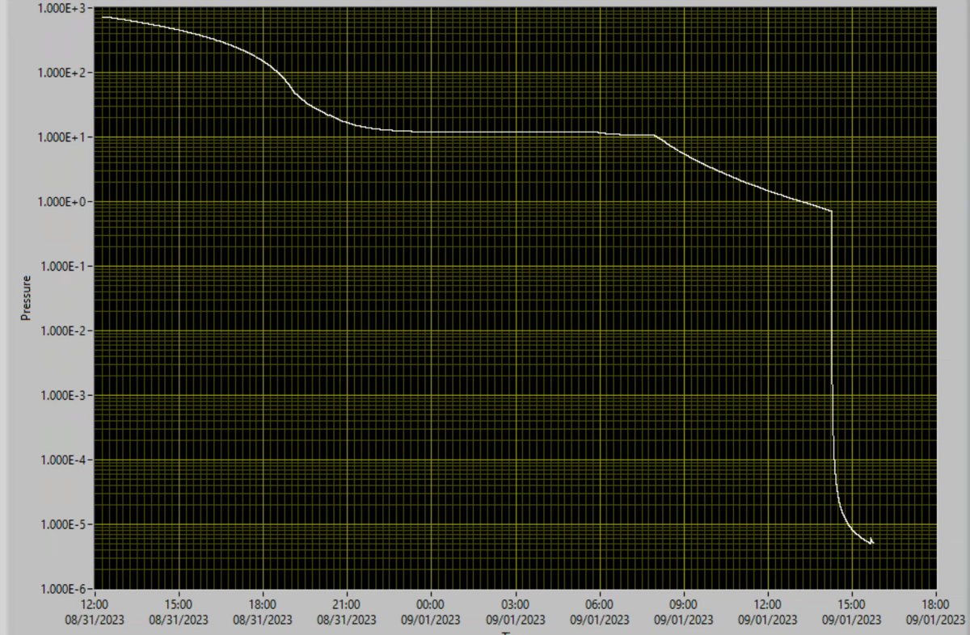
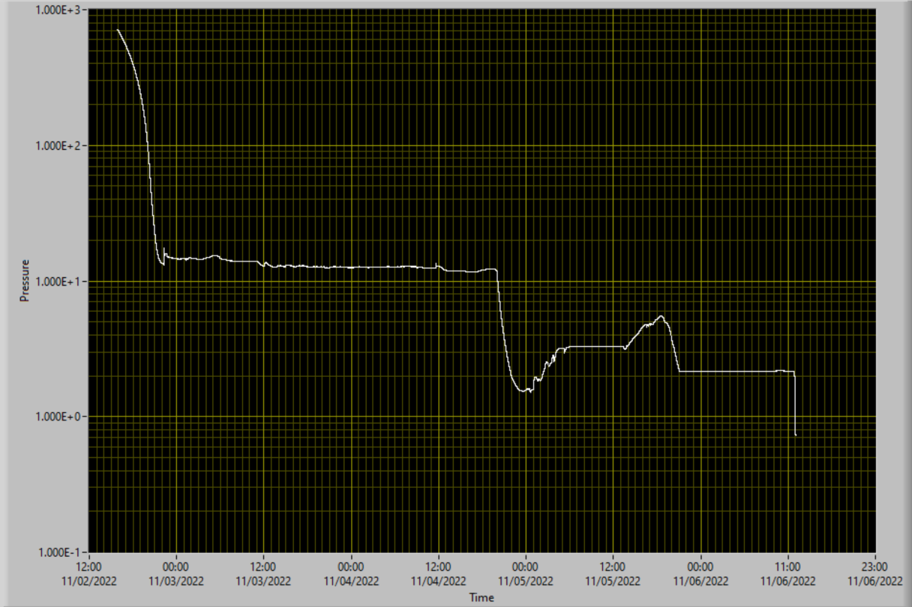
Particle source – Processing and Assembly: Vacuum pump
Particle movement can be hard to mitigate

