Slide 1
Status of PIP-II Vacuum Systems
Raul Campos, PIP-II Vacuum Systems Project Manager, on behalf of the PIP-II Vacuum Team
OLAV VI
April 16, 2024

Slide 2
Outline
PIP-II Overview and PIP-II Vacuum Sections
PIP-II Vacuum Systems Requirements
Vacuum Systems Design
Analysis and validation
Fast acting valves and interlocks
Integration with other systems
Current Status

Slide 3
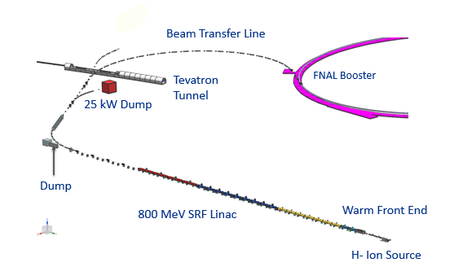
PIP-II Mission
PIP-II is an essential upgrade to Fermilab accelerator complex to enable the world’s most intense beam of neutrinos to LBNF/DUNE, and a broad physics research program for decades to come.
PIP-II Capabilities
Beam Power
1.2 MW proton beam
Upgradeable to multi-MW
Flexibility, multi-user capability
CW-compatible
Customized beams
Multi-user delivery
Reliability
Modernizes Fermilab accel complex
PIP-II Scope
800 MeV H− SRF linac
  CW RF Operations
Linac-to-Booster transfer line
Accelerator Complex Upgrades
  Booster
  Recycler
  Main Injector
Conventional Facilities
  Space reserved for two CMs for 1 GeV Upgrade
The PIP-II scope enables the accelerator complex to reach 1.2 MW proton beam on LBNF target

Slide 4
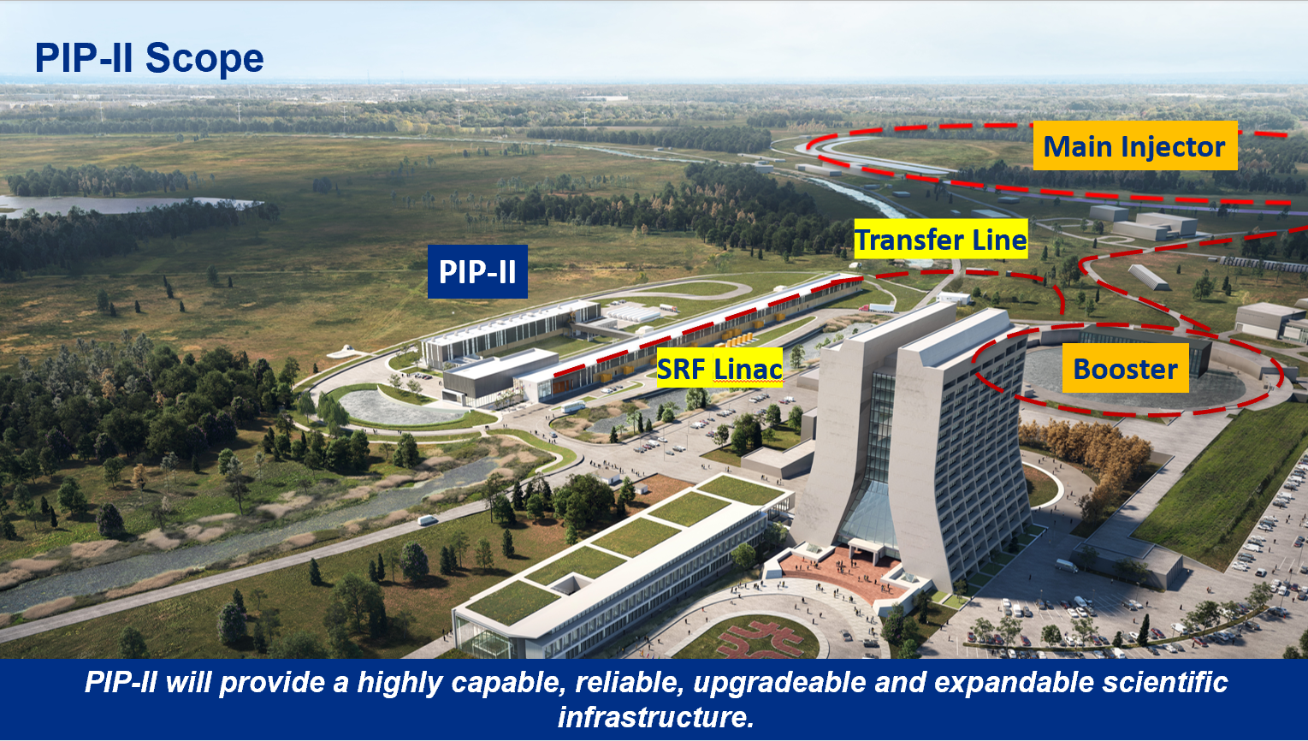

Slide 5
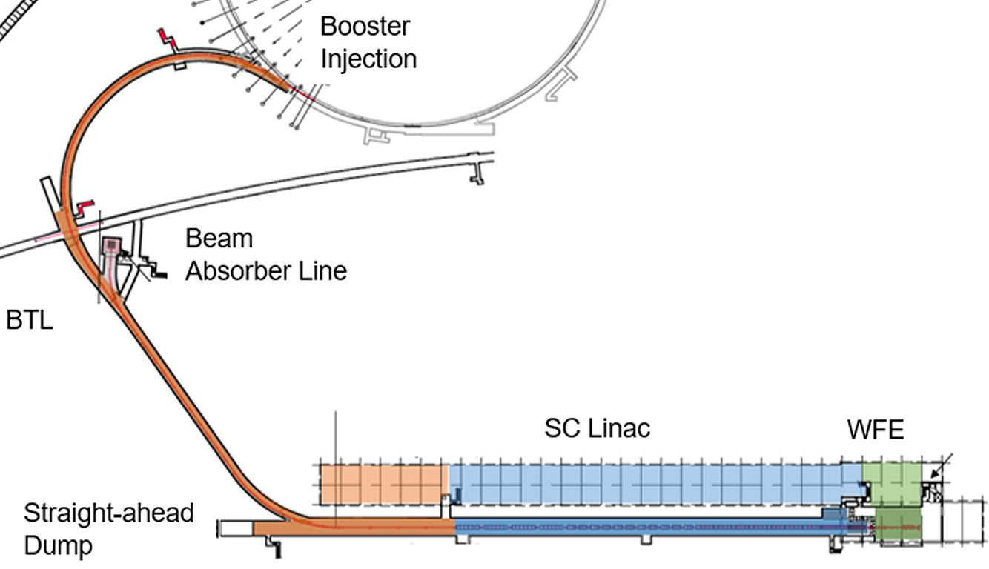
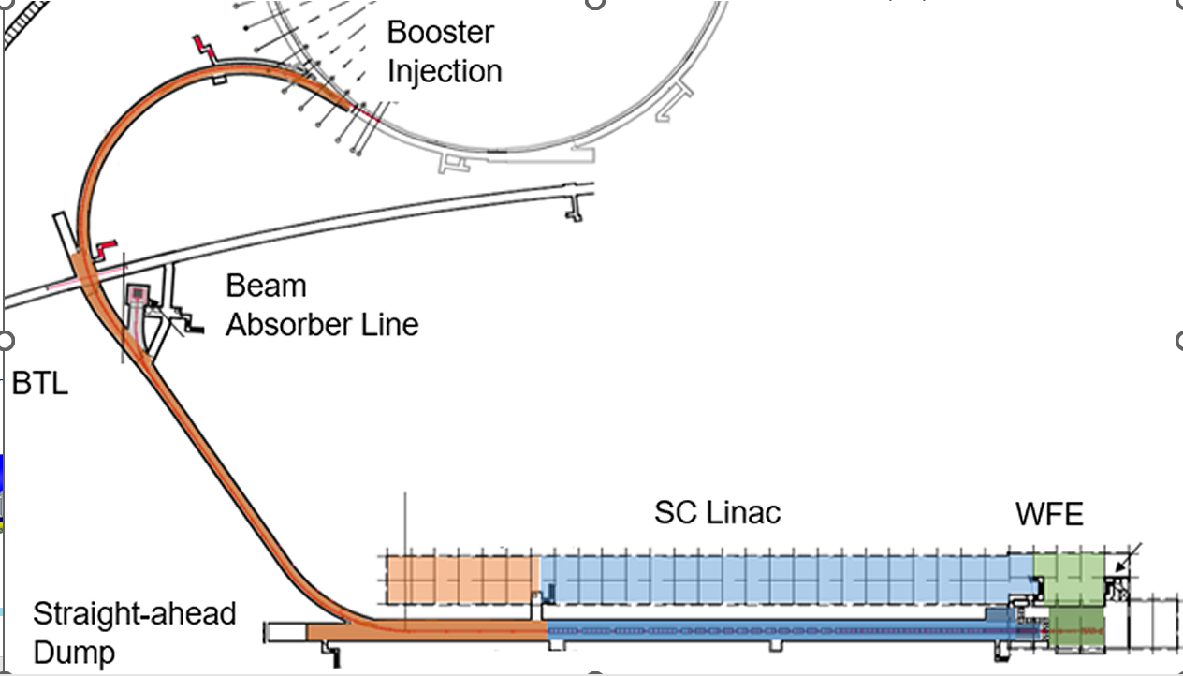
PIP-II Vacuum Systems Sections
PIP-II Vacuum Sections:
Warm Front End (WFE)
Superconducting Linac (SCL)
Beam transfer line and Beam absorber line (BTL/BAL)

Slide 6
Performance Requirements
 | Ion Source | LEBT | RFQ | MEBT | MEBT-DS | CMs* | Warm Units** | Trans. Section | BTL
Pressure (torr) | <10^{-2***} | <5x10⁻⁷ | <5x10⁻⁷ | <5x10⁻⁷ | <1x10⁻⁹ | <10⁻¹⁰ | <1x10⁻⁹ | <5x10⁻⁸ | <5x10⁻⁸
Leak check sensitivity (mbar-l/s) | 2x10⁻⁹ | 2x10⁻⁹ | 2x10⁻⁹ | 2x10⁻⁹ | 2x10⁻¹⁰ | 2x10⁻¹⁰ | 2x10⁻¹⁰ | 2x10⁻¹⁰ | 2x10⁻¹⁰
Vacuum seals joints | Metal gasket or elastomer, CF or KF |  |  |  | CF only: metal gasket only | CF only: metal gasket only |  | Weld or Metal gasket | Weld or Metal gasket
Parts cleaning | UHV procedure
Gauging | CC gauge + Pirani |  |  |  |  | CC gauge + Pirani |  | CC gauge + Pirani
Low Particulate practice | No | No | No | No | Yes | Yes | Yes | Yes | No
Controllers | Equipped with RS485 to communicate with control system via a PLC
Particle Free Regions

Slide 7
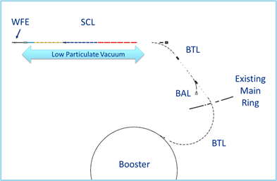
Warm Front End

Slide 8
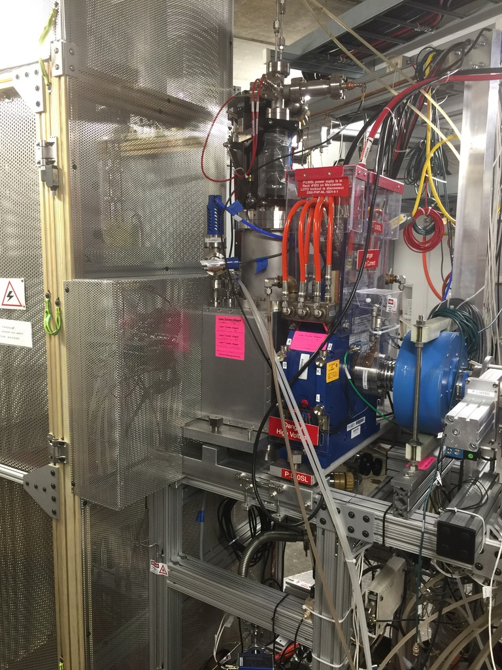
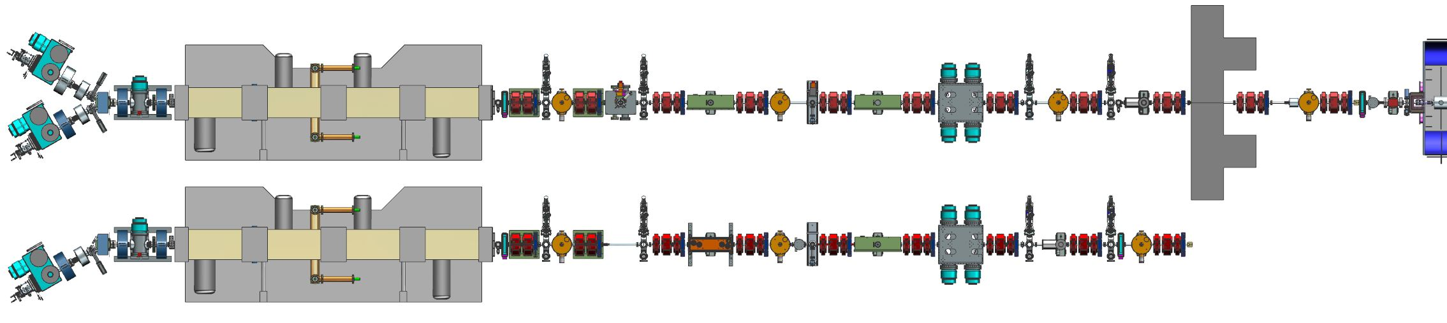
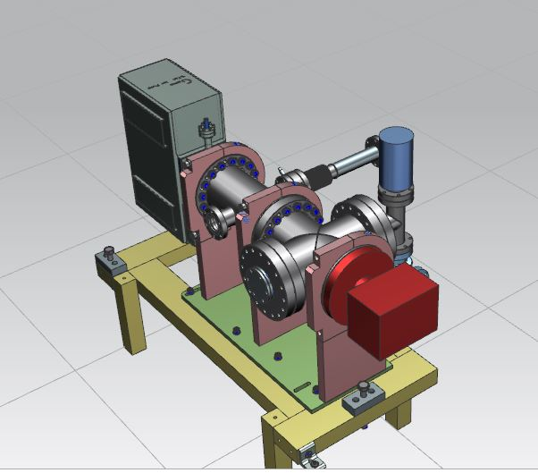
Warm Front End
Addition of a second ion source for PIP2 design
MEBT
PIP-II
PIP2IT – built and tested
Protection for superconducting linac tested here
IS&LEBT
RFQ

Slide 9
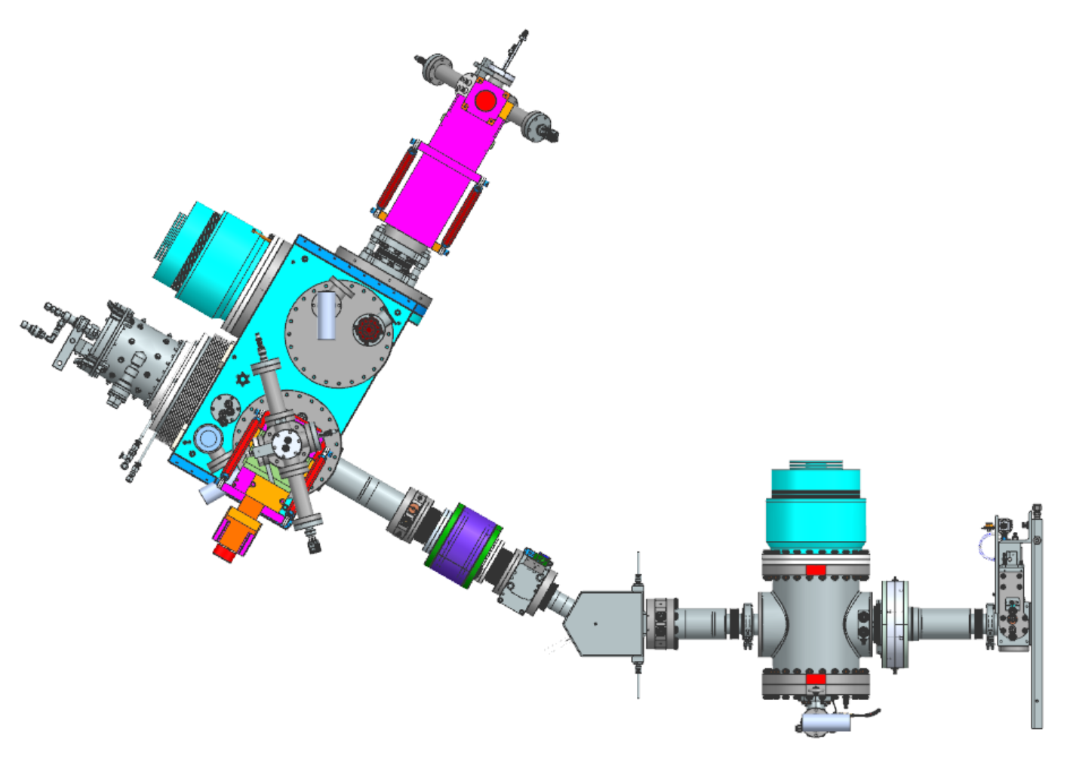
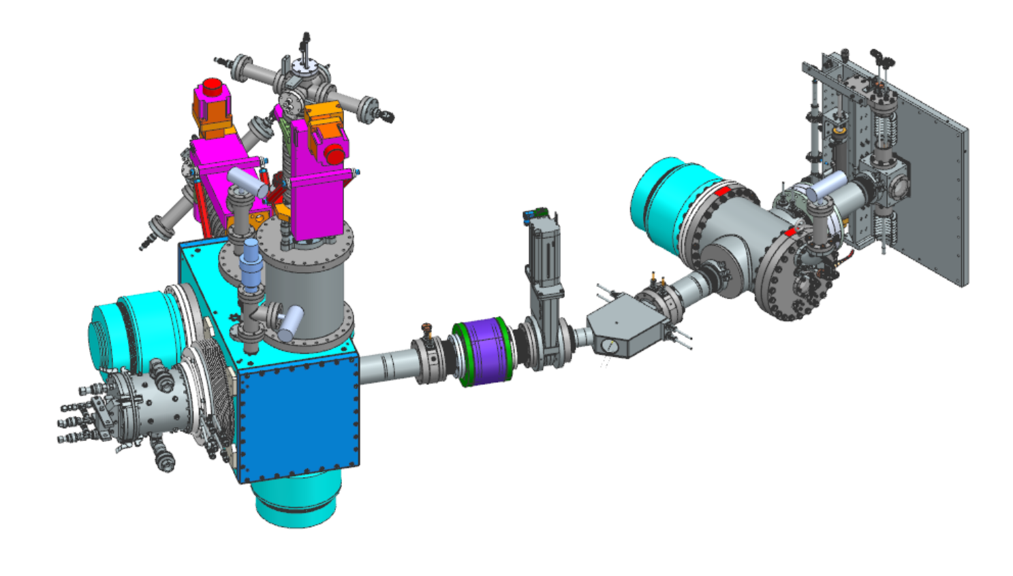
Warm Front End Ion Sources and LEBT
End plate of RFQ
Turbo Sets
Ion Source (H2)

Slide 10
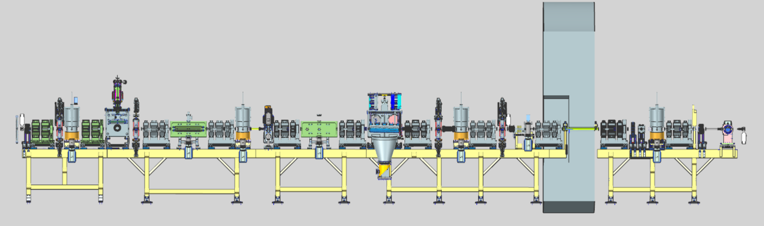
Warm Front End : MEBT
Fast Gate Valves
NEG: to improve vacuum for the entry to CM
Gate Valves
Kicker
Absorber
Gauges on the top of same devices as Ion Pumps at
Ion Pumps
Low Particulate Region
Turbo Pumps @ Beam Absorber, high gas load due to beam lose
Differential Pumping Insert, with gate valve upstream

Slide 11
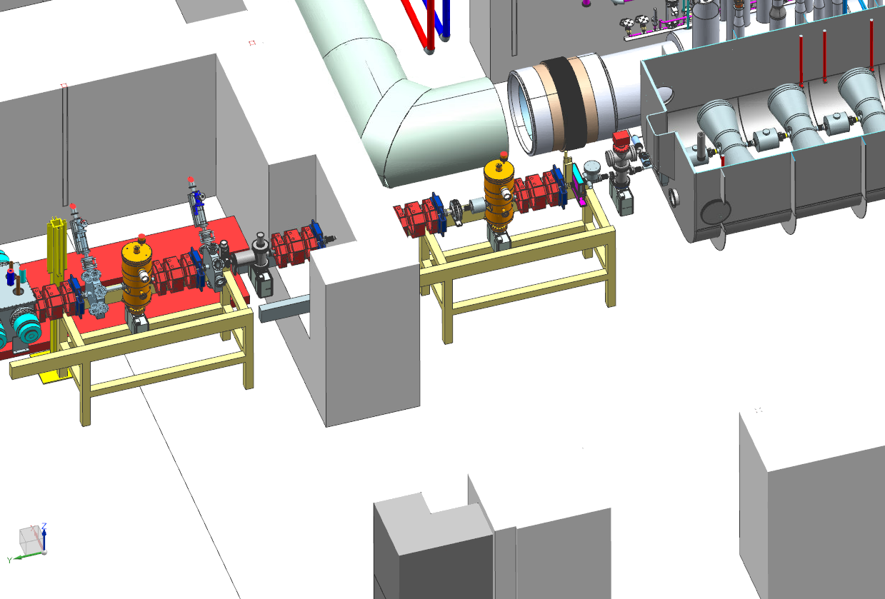
Transition to Low-Particulate Zone
Fast Acting Valve
Differential pumping insert
Beam absorber
HWR
Pneumatic valve
Low-particulate vacuum field connections
Refer to Curtis Baffes’ presentation for details of field installation
Conventional UHV
Pre-assembled section inserted through wall

Slide 12
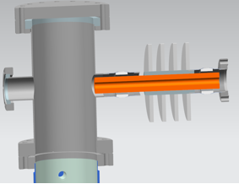
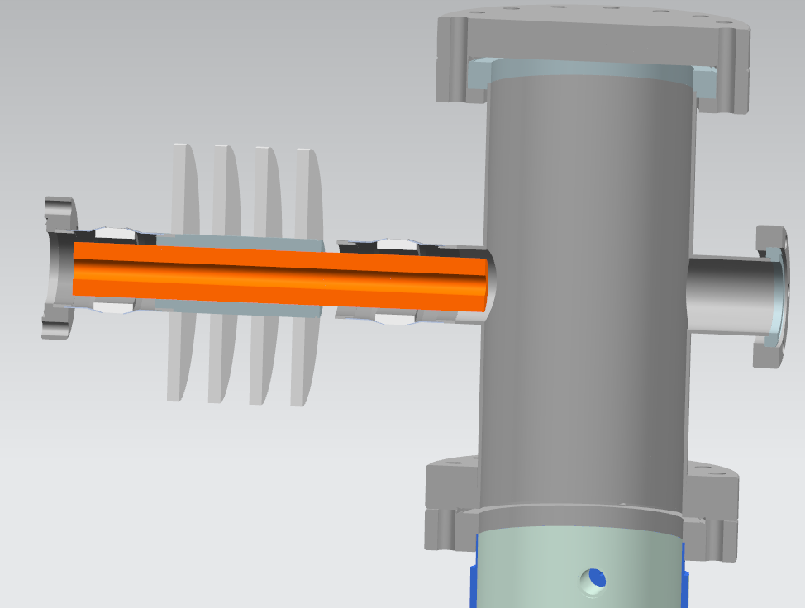
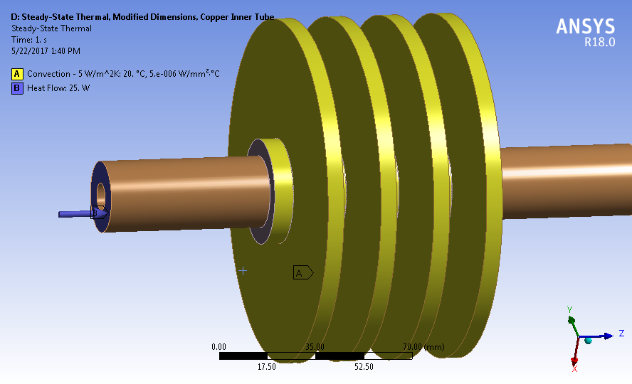
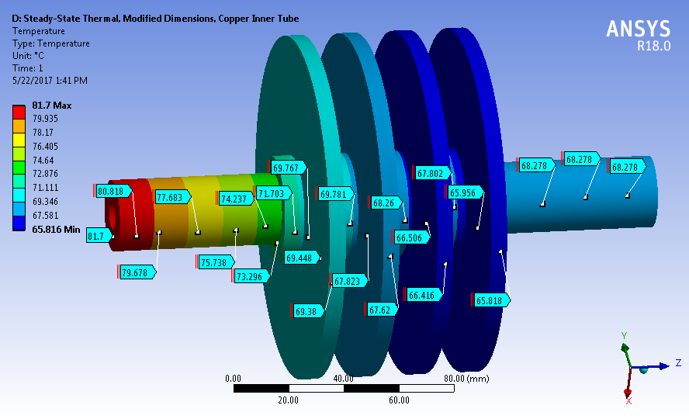
Differential Pumping Insert (DPI)
Reduction of conductance between UHV and particle free UHV
Construction of DPI
Copper – 200mm long, 10mm ID (from 1.25in ID)
Ceramic isolation – for electrical isolation for lost beam current – monitored by Machine Protection Systems (MPS)
Fins/disks (aluminum) shrink fit on stainless for thermal cooling

Slide 13
Superconducting Linac

Slide 14
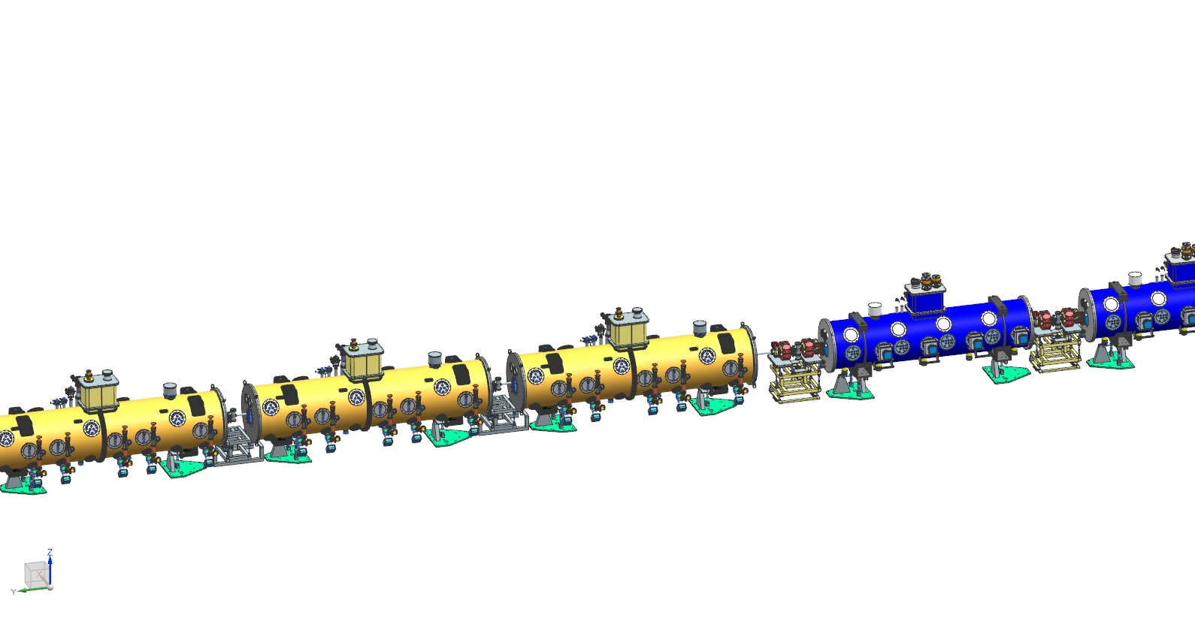
SCL (HWR-SSR1-SSR2-LB650-HB650)+ Warm Units
Warm units: Room-temperature beamline between each PIP-II Cryomodule
  Qty 10 325MHz Warm Units (including HWR-SSR WU)
  Qty 13 650MHz Warm Unit (including units downstream of HB650)
325MHz Warm Units
Vacuum
Instrumentation
325MHz SSR cryomodule
(SSR2 shown)
650MHz Warm Units
Vacuum
Instrumentation
Magnets
650MHz cryomodule
(LB650 shown)

Slide 15
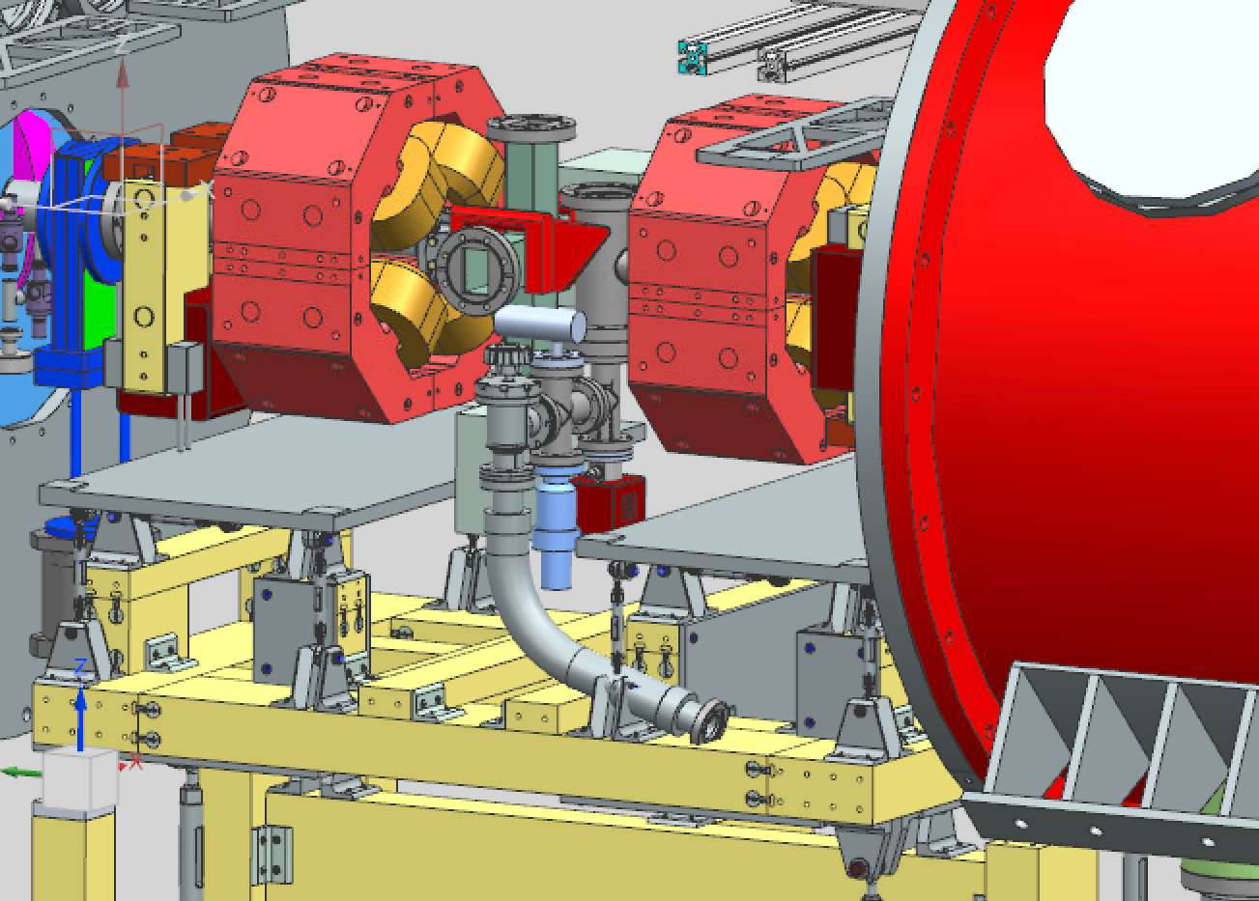
Warm Units and Integration
Warm units vacuum systems are integrated with warm magnets and beam instrumentation devices
Selected a combined ion pump/NEG as the pumping technology for warm units. Benefits include:
  Less particle generation
  Lighter than other options (2.3kg vs. 43 kg); does not require a structural support
  Smaller, which benefits integration with beam instrumentation

Slide 16
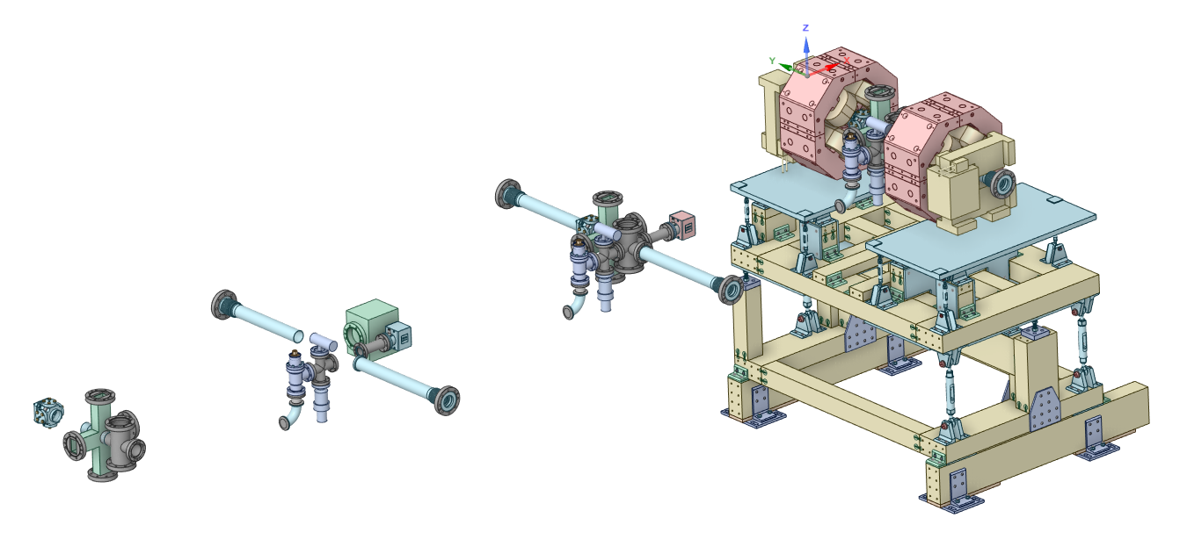
Warm Units Hand-Offs and Integration
Integrated Warm Unit
Vacuum-certified warm unit vacuum assembly
VAC Hand-off to LI
Vacuum-cleaned vacuum equipment, spools, fittings, bellows
VAC integrates and Vacuum- certifies assembly
Vacuum-cleaned BPM
BI Hand-off to VAC
Vacuum certified laser wire vacuum chamber

Slide 17
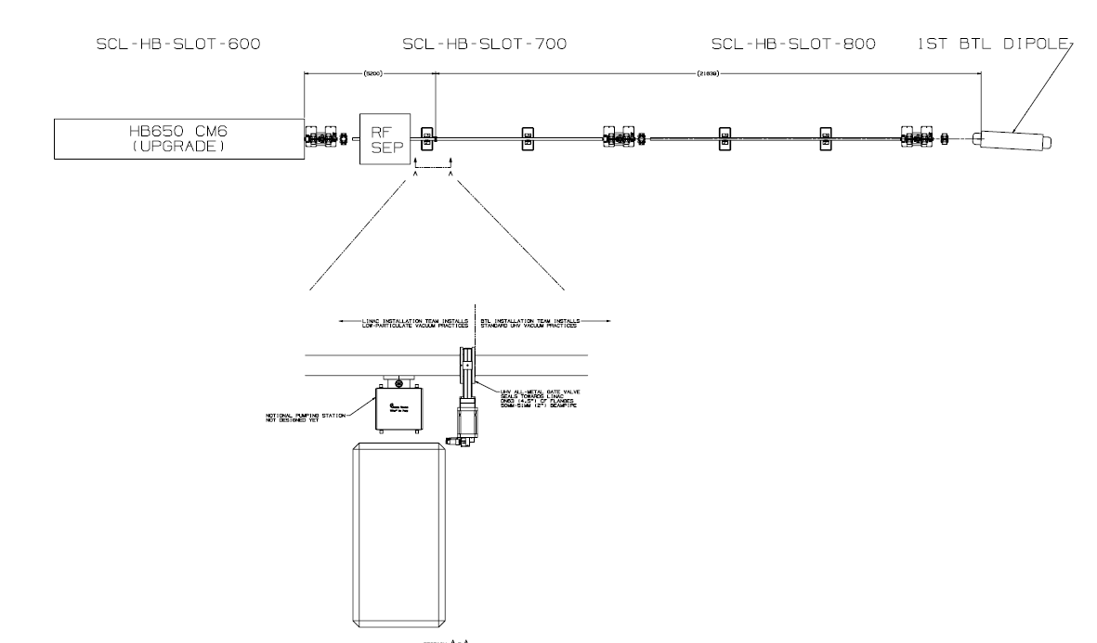
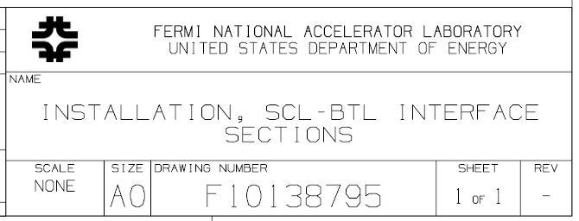
Transition from Low-Particulate Zones
Gauges (special sensors for FAV set) for valve are downstream
First Dipole
Conventional UHV
FAV
Straight ahead dump
Low-particulate vacuum
field connections
Refer to Alex Chen’s presentation for details of FAV operation

Slide 18
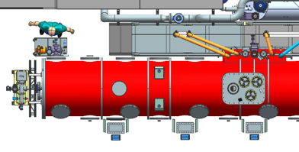
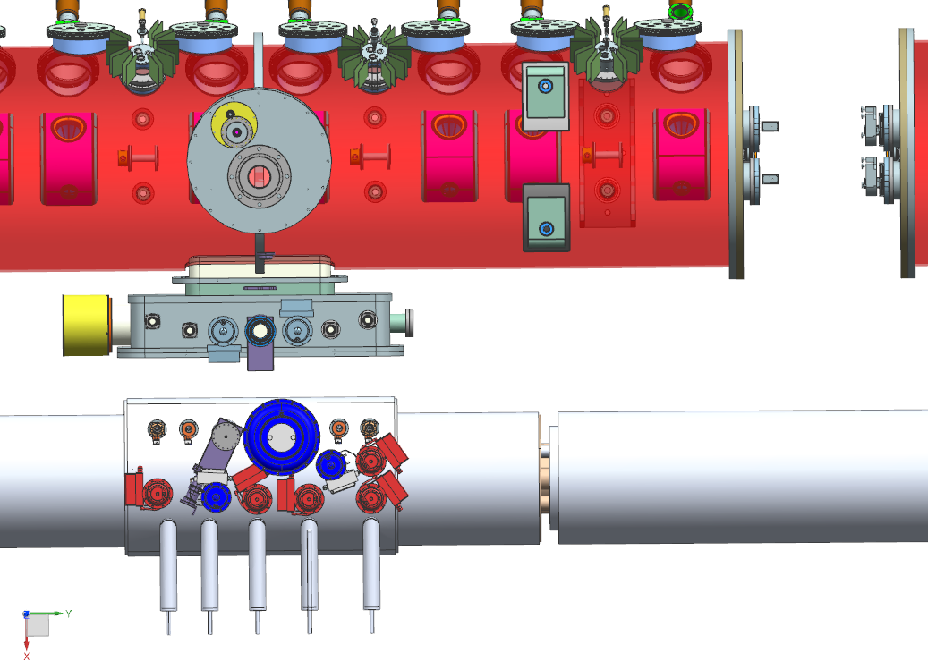
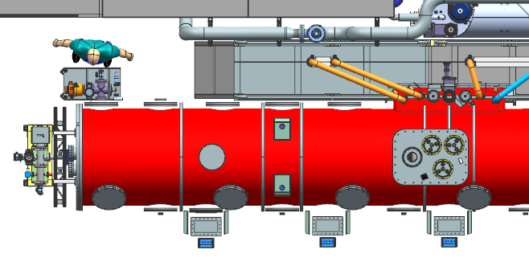
Insulating Vacuum of Cryomodules
Insulating Vacuum Pumpout Port
Insulating Vacuum Pumpout Port
HB650
SSR

Slide 19
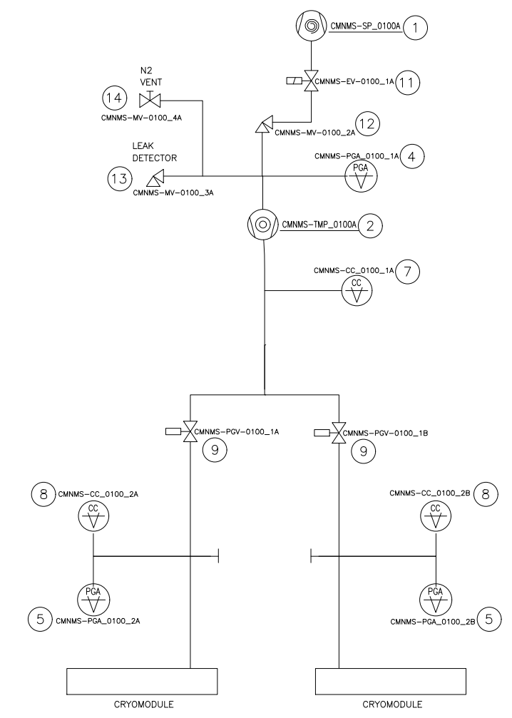
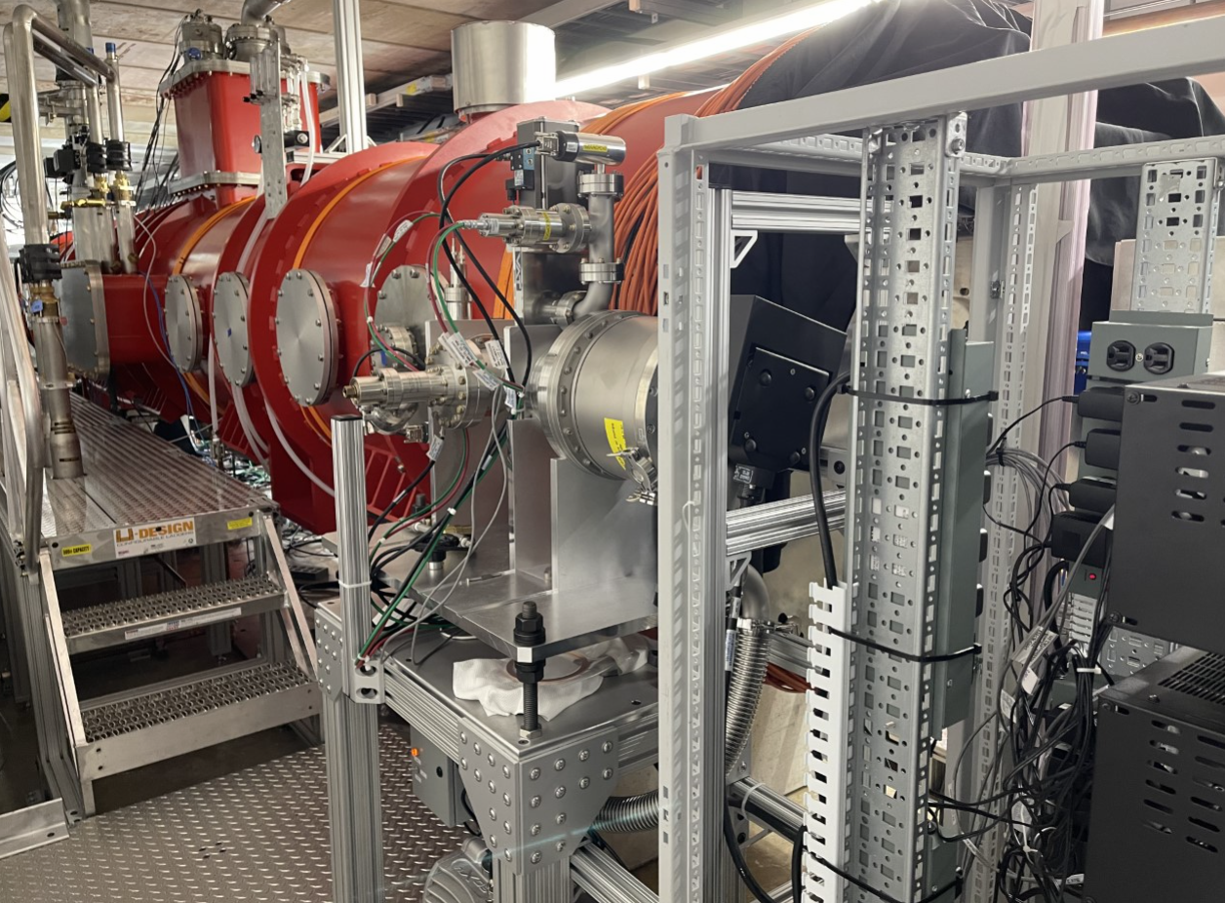
Insulating Vacuum
After cooldown, insulating vacuum does not require active pumping

Slide 20
PIP2IT Beam Valve Control Schematic for Interlocks
Beam Valve
Controlling
Gauge
Fast Valve Kit
IS
LEBT
RFQ
MEBT
HWR
SSR1
HEBT
P:L01GIP
P:L20GIP
P:L10VSO
P:R10VGP
P:R40VGP
P:R50VSO
P:M03WRP
P:M52WRP
P:M92WRP
P:M81VSO
P:HWRBVACPCC1
P:HWRBVACBVD
P:HBTVACFSTVFS
P:HBTVACPCV2
P:HBTVACBV
P:M61VSO
P:HWRBVACBVU
P:SSRBVACCC2
P:SSRVACBVD
P:HBTVACPCC1
ACNET NAMES
P:SSRVACBVU
P:HBTVACPCV3
Permit Criteria:
<5E-9 torr for HWR, SSR1
<1E-5 torr for others
<1E-4 torr for Fast Valve
P:SSRVACBVD Stays open due to burst disc at downstream
All gate valves are interlocked with vacuum status
Regular valves closure
PIP-II CM&WU

Slide 21
Vacuum Analysis

Slide 22
IS, LEBT, RFQ Vacuum Pressures

Slide 23
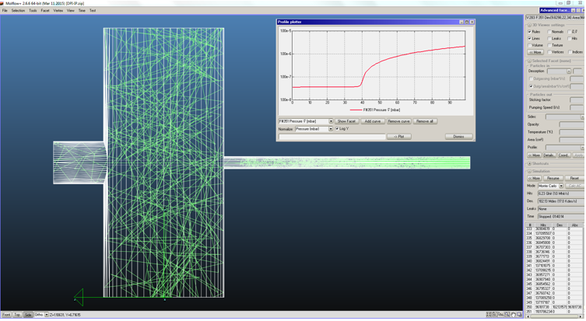
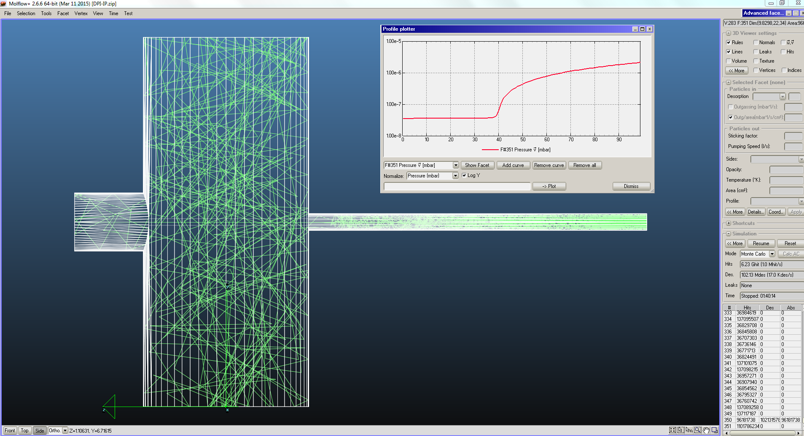
Differential Pumping Insert

Slide 24
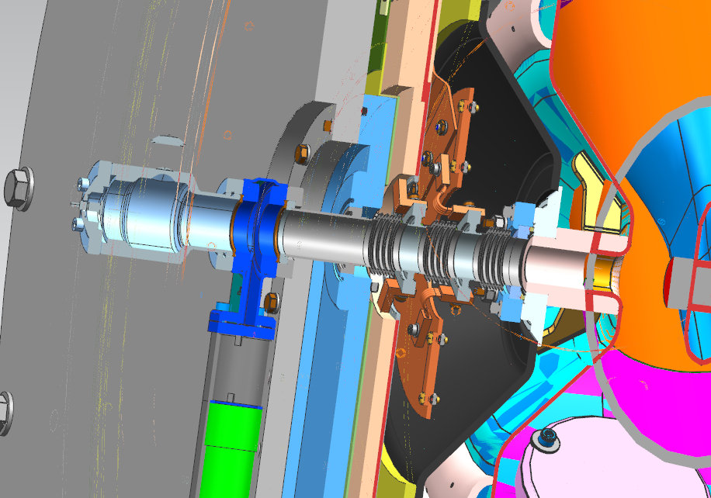

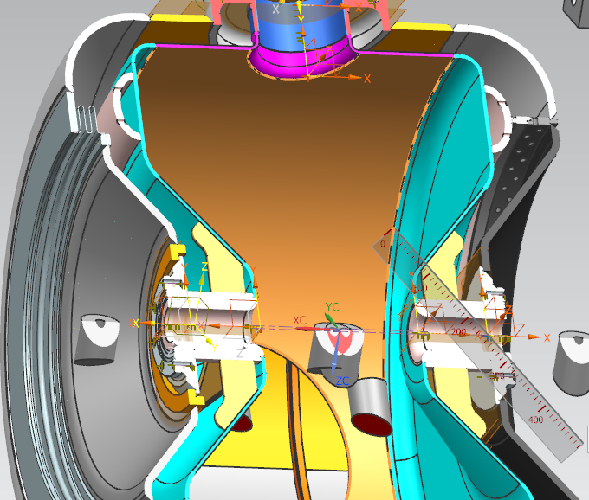
SSR1 MolFlow Simulation
Transition:
300K-50K-5K-2K
pump3

Slide 25
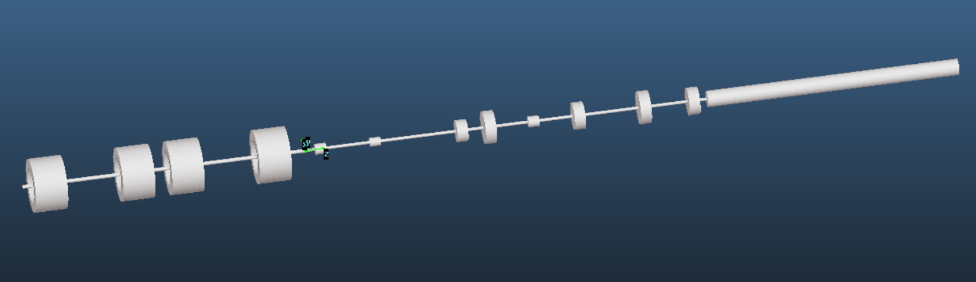
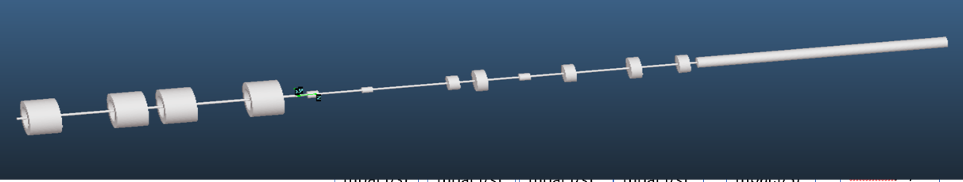
SSR1-HEBT VACUUM Simulation
CM: 2K, 0.99 Stick factor
Transition:
2-5K (0.7)
5-50K(0.1)
50-300K, (0.0)
Hydrogen outgassing rate on all inner surfaces All 2.E-10 mbar.L/s.cm²
2.77E-6 mbar.L/s
@Dump
2mA, 1.1%
Ion Pumps 200 L/s
LPM
(2.4E-7 mbar.l/s)
SLIT1
(4.6E-7 mbar.l/s)
F.C
(3.5E-7 mbar.l/s)
SLIT2
(4.6E-7 mbar.l/s)
F.C.
(3.5E-7 mbar.l/s)
Lg Tube
(2.2E-6 mbar.l/s)
2nd Half SSR1 Cavity String (COLD)
HEBT
Dump

Slide 26
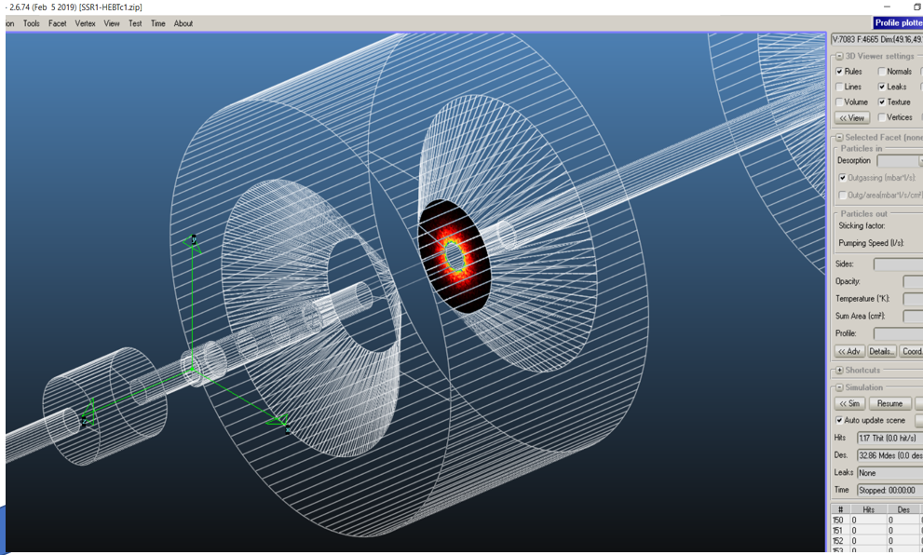
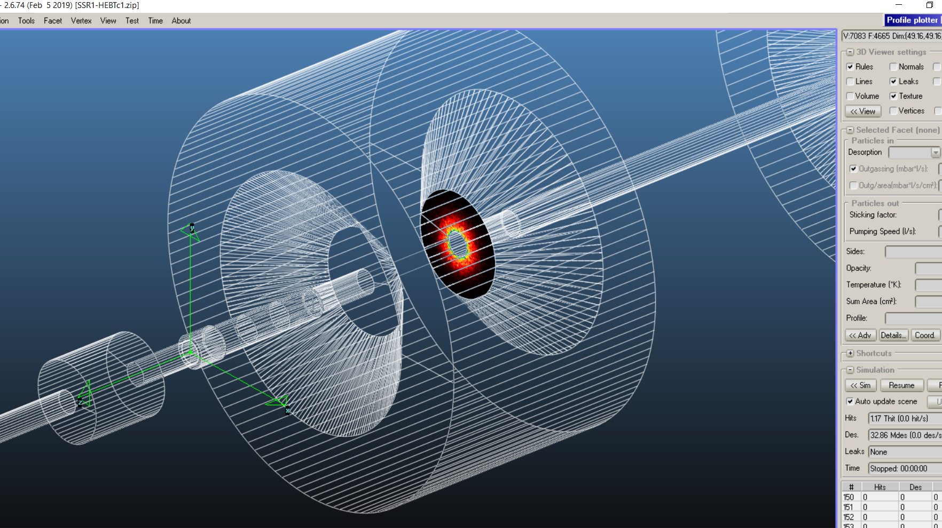
SSR1-HEBT VACUUM Simulation
The sticking factors of hydrogen for the three transitions region 2-5K, 5-50K, 50-300K are 0, 0.1, 0.7
Entire cavity was under 2K, sticking factor 0.99 was assigned
Most significant hydrogen flux arrived on the face of downstream wall
It takes 1.5 week to buildup one monolayer on the face, however, on 1st cavity, H2 will diffuse on the other surfaces due to beam induced desorption
Entire Cavity under 2K, 0.99 sticking factor, surface 8900cm²
5-50K
(0.1)
2-5K
(0.7)
50-300K
(0.0)
Gas Flux

Slide 27
SSR1-HEBT VACUUM Simulation (Hydrogen pressure profile)
End of cavity

Slide 28
Testing and Validation at PIP2IT and Test Stand
Critical technologies tested at PIP2IT

Slide 29
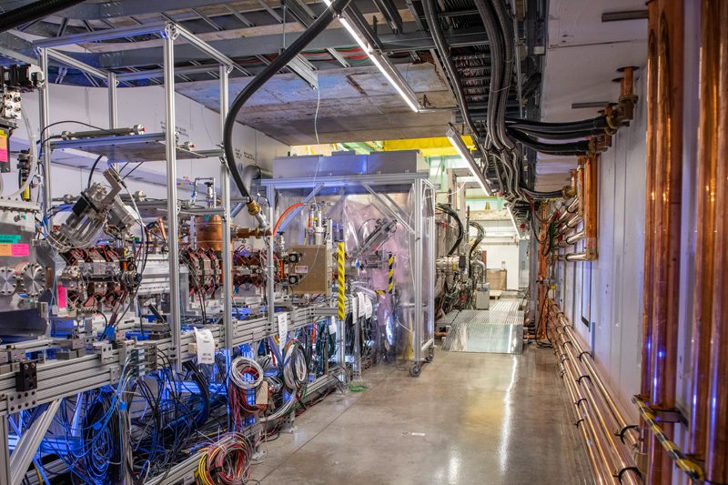
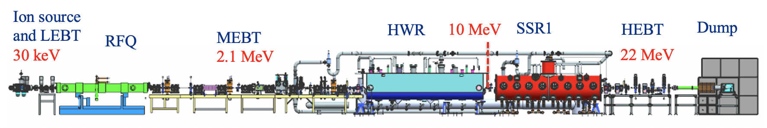
PIP-II Injector Test (PIP2IT)

Slide 30
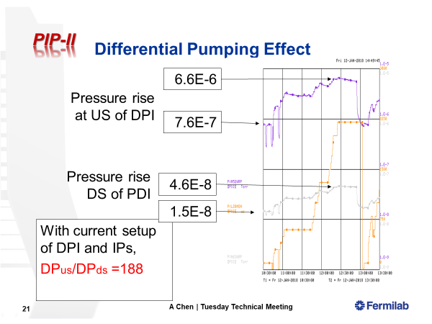
Differential Pumping Insert

Slide 31
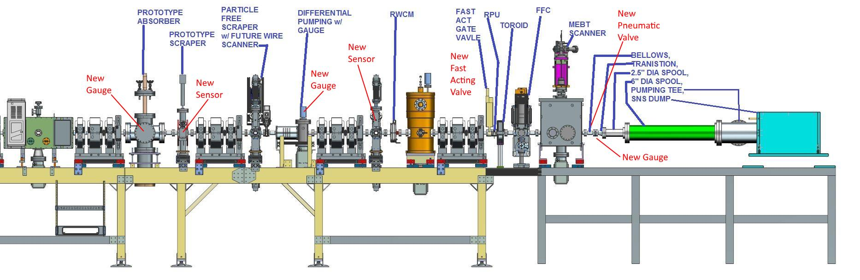
1st Test on MEBT DPI-FV
Refer to Alex Chen’s presentation for details of test
M71S2P
M81VFC
M61VSO
M72WRP
M63WRP
M92WRP
M52WRP
M63DIP
M72PIO
M11PIP
V1=36.5 liters(M61VSO-FV)
V2=95.1 liters(POST FV)
Permeation rate from Scanner O-Ring is about 6E-7 torr.l/s
Leaker Volume=0.29 liter
PG
LD

Slide 32
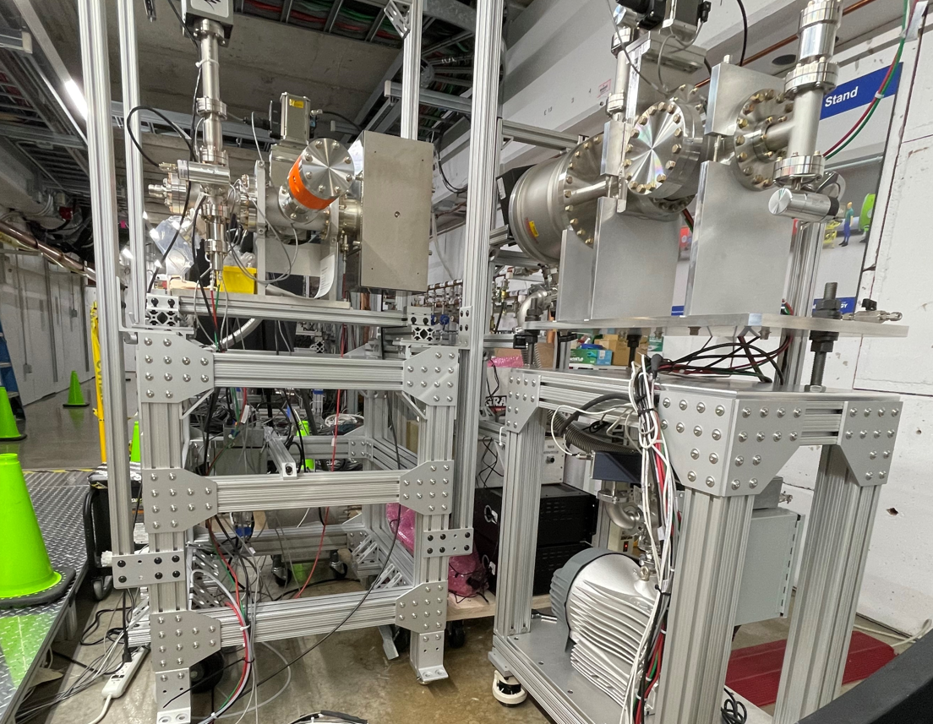
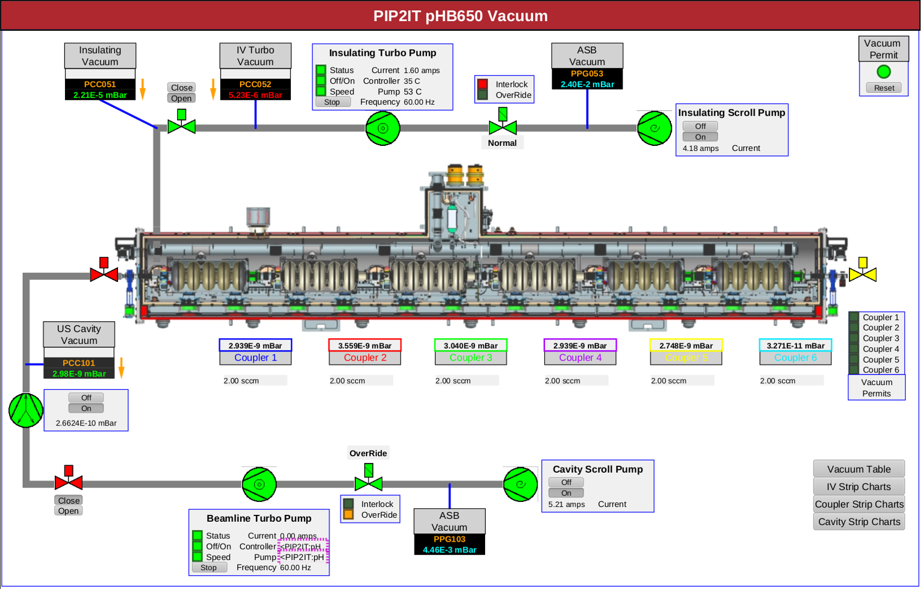
PIP-II Test Stand
Beamline and Insulating vacuum stations assembled and tested
Pressures meet PIP-II vacuum requirements
  Beamline vacuum
    2e⁻¹⁰ mbar (requirement <1e⁻⁹ mbar)
  Insulating vacuum
    2e⁻⁵ mbar before cooldown (requirement <5e⁻⁵ mbar)
    <1e-8 mbar cold

Slide 33
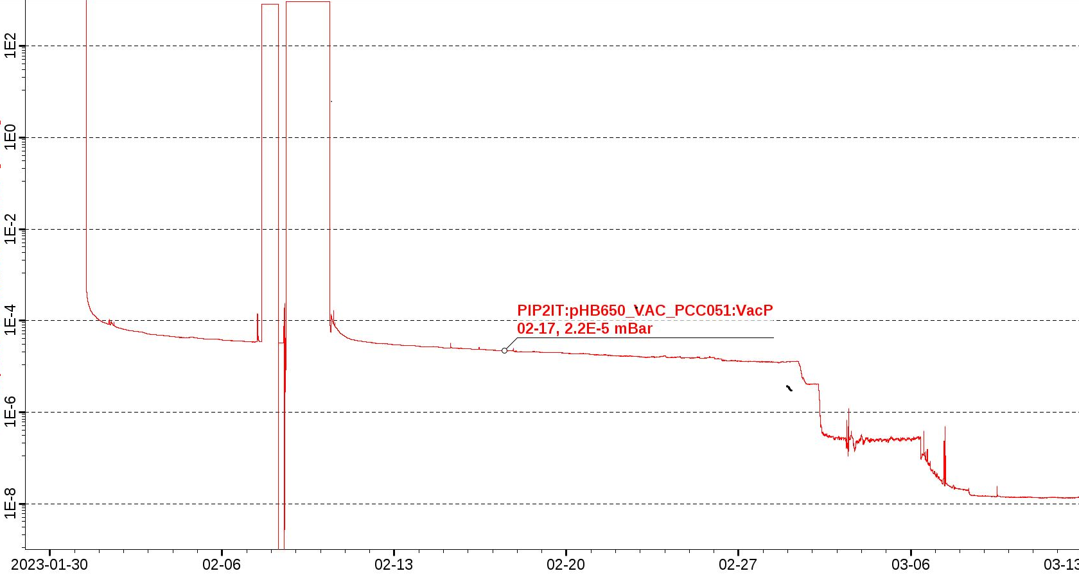
PIP2IT (650 Test Stand)
EPICS vacuum interface is developed and realized
HB650 Insulating Vacuum Pumpdown
initial pumpdown
Vent for leak repair
1 day to reach 5E-5 mbar, qualification of cooldown
mbar
Begin cooldown

Slide 34
Beam Transfer Line and Beam Absorber Line

Slide 35
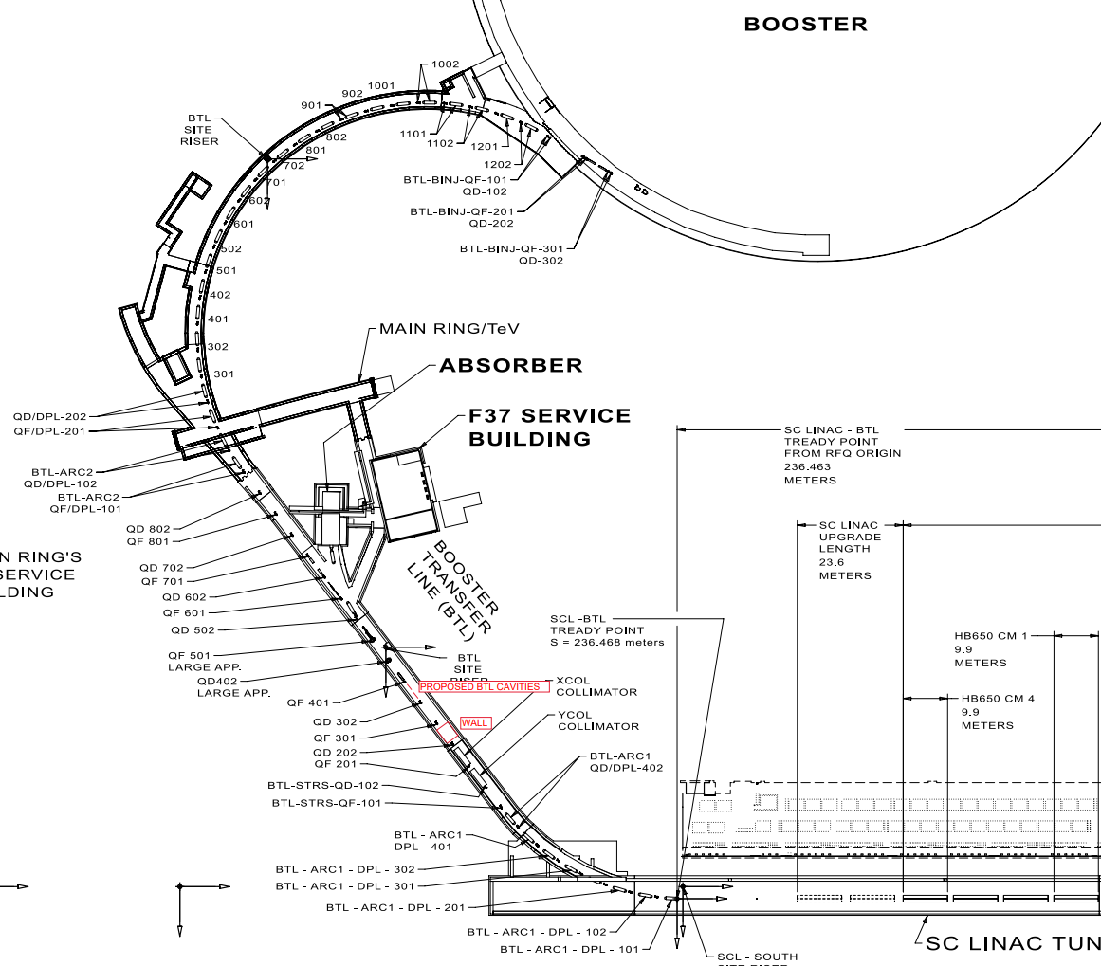
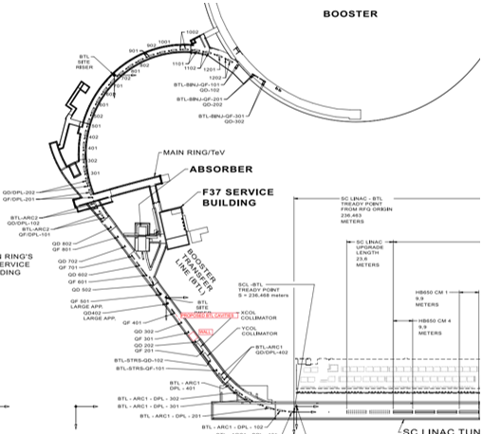
PIP-II BTL/BAL Layout
BTL-BOOST
BTL-ARC2
BTL-STRAIGHT, BAL2(25kW)
BTL-ARC1
BTL-STRAIGHT, BAL1(2kW)

Slide 36
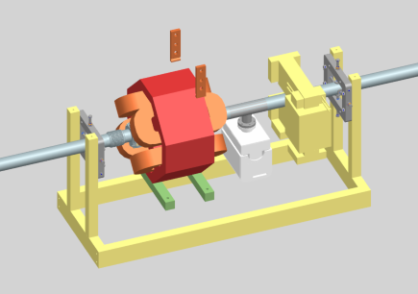
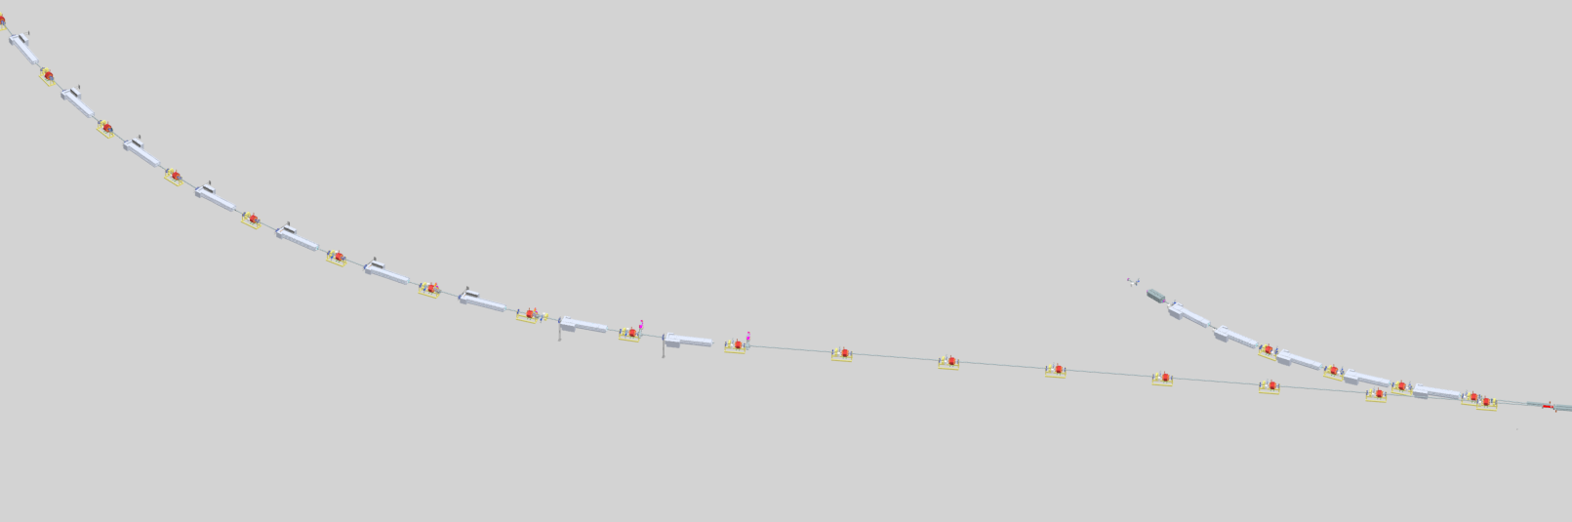
BAL(25kW), BTL STRAIGHT2 & ARC2
Typical vacuum cell
Gate valves: 2
Roughing/Gauge Ports:2
Ion Pumps:14
Quads:14
Dipole:7
Bellows: xx
Stands: xx
2” beamtube length: xx
Gate Valve: divided long arc2
Gate Valve: segmentation of SCL- BTL
BAL2 (25kW)
BTL Straight2
BTL ARC2
Gate Valve: divided BTL
BEAM

Slide 37
BTL/BAL Vacuum Sections and Components
 | SCL-BTL ARC1 | BAL1 | BAL2 | BTL STAIGHT | BTL ARC2 | BTL-BOOST | Total
Section Length (m) | 116m | 41m | 32m | 82m | 110m | 16m | 397m
Ion Pumps | 17 | 3 | 7 | 14 | 18 | 4 | 63
Gauge/Ports | 2 | 1(2) | 1(2) | 2 | 2 | 1 | 9(11)
Bellows | 61 | 13 | 4 | 36 | 52 | 9 | 175
Quads | 17 | 2 | 4 | 14 | 19 | 4 | 57
Dipoles | 8 | 0 | 5 | 14 | 17 | 2 | 46
Special tube | 2 Collimators 2 Large Quad 1 Separator 8 Dipoles | 1 Window | 1 Window 5 Dipoles | 14 Dipoles | 17 Dipoles | 2 Dipoles
2” Beamtube Length | 51m | 41m | 10m | 68m | 57m | 13m | 240m
Stand/Girders | 25 | 8? | 9 | 14 | 18 | 3 | 78

Slide 38
PIP2 BTL/BAL Valve Control Scheme
Beam Valve
Controlling
Gauge
Fast Valve Kit
SCL-BTL ARC1
BTL Strt2
BTL ARC2
BTL-BOOST
BAL-L
BAL-S
Gate Valves are controlled by vacuum level( average readings of gauges in the section) at both sides
All gate valves are interlocked with vacuum status via PLC
Permit Criteria:
<1E-5 torr for gate valve
<1E-4 torr for Fast Valve
Gate valve stays closed at power off

Slide 39
Summary
Final design reviews are complete
PIP-II Vacuum will have its final Integration review soon
Procurement is starting now, followed by fabrication and hand-offs to installation teams
PIP-II completion scheduled for 2029

Slide 40
Thank you for your attention!
This work has been authored by Fermi Research Alliance, LLC under Contract No. DE-AC02-07CH11359 with the U.S. Department of Energy, Office of Science, Office of High Energy Physics

