Slide 1
Field Installation of Cryomodule Vacuum Systems at Fermilab
Curt Baffes (Fermilab)
OLAV VI
16 April 2024
FERMILAB-SLIDES-24-0087-AD-PIP2

Slide 2
Cryomodules Built, Tested, and/or Operated at Fermilab
1.3GHz cryomodules
“ILC style” cryomodules incorporated in FAST/IOTA accelerator
Fermi-design cryomodules built for LCLS-II project at SLAC
Fermilab-Style Cryomodules
325MHz Single Spoke Resonator Cavity Cryomodules for Fermilab’s PIP-II Linac
650HMz Elliptical Cavity Cryomodules for PIP-II
Others
ATLAS-style 162.5MHz Half Wave Resonator provided by ANL
1.3GHz single-cell cryomodules in collaboration with DESY
See Tug Arkan’s Talk
PIP-II HB650 Cryomodule

Slide 3
Cryomodule Characteristic Vacuum
Beamline
E-9 range warm
Cryostat
E-5 range warm
Beamline
E-10 range cold
Cryostat
E-7 range cold
PIP-II HB650 Cryomodule Shield Cooldown

Slide 4
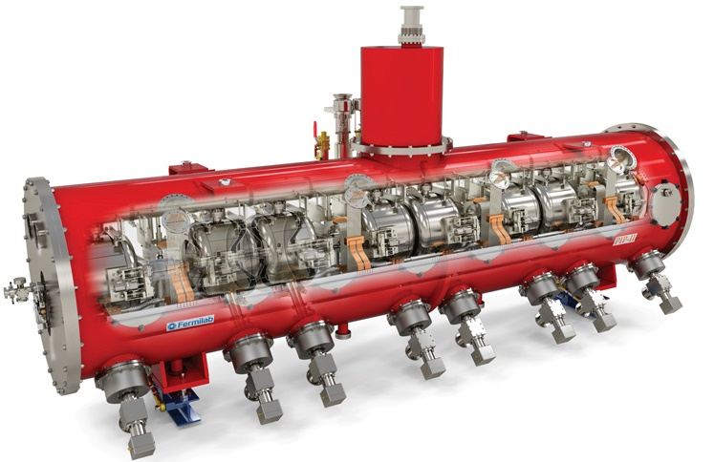
Field Installation Scope
Installation in Cryomodule Qualification Test Stands
CMTS1 Test stand for LCLS-II 1.3GHz Cryomodules
PIP-II Integrated Test Stand for PIP-II 325 and 650MHz Cryomodules
Installation in Accelerators
FAST/IOTA
PIP-II Injection Test Accelerator
PIP-II Linac (installations in 2025+)
Cryostat Vacuum Connection:
Single-CM pumping stations
Beamline Vacuum Connection(s):
Low-Particulate UHV
Softwall Cleanroom/Cleanbox
PIP-II SSR1
Cryomodule

Slide 5
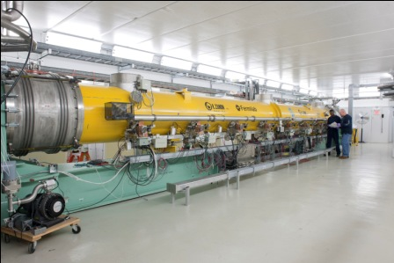
FAST/IOTA
Talk To:
Lucy Nobrega
Fermilab’s Accelerator R&D Facility
SRF accelerator chain supporting Integrable Optics Test Accelerator (IOTA) ring
300MeV e- Linac
Two single-cavity 1.3GHz Cryomodules
One eight-cavity 1.3GHz ILC-style Cryomodule
Conservative Vacuum Strategy
Cryomodules are stand-alone
Brute force ion pumping for beamline
Long low-particulate section lengths
Ion pumped coupler vacuum
Redundant turbopump stations for cryostat
Extensive diagnostics
ILC-Style Cryomodule

Slide 6
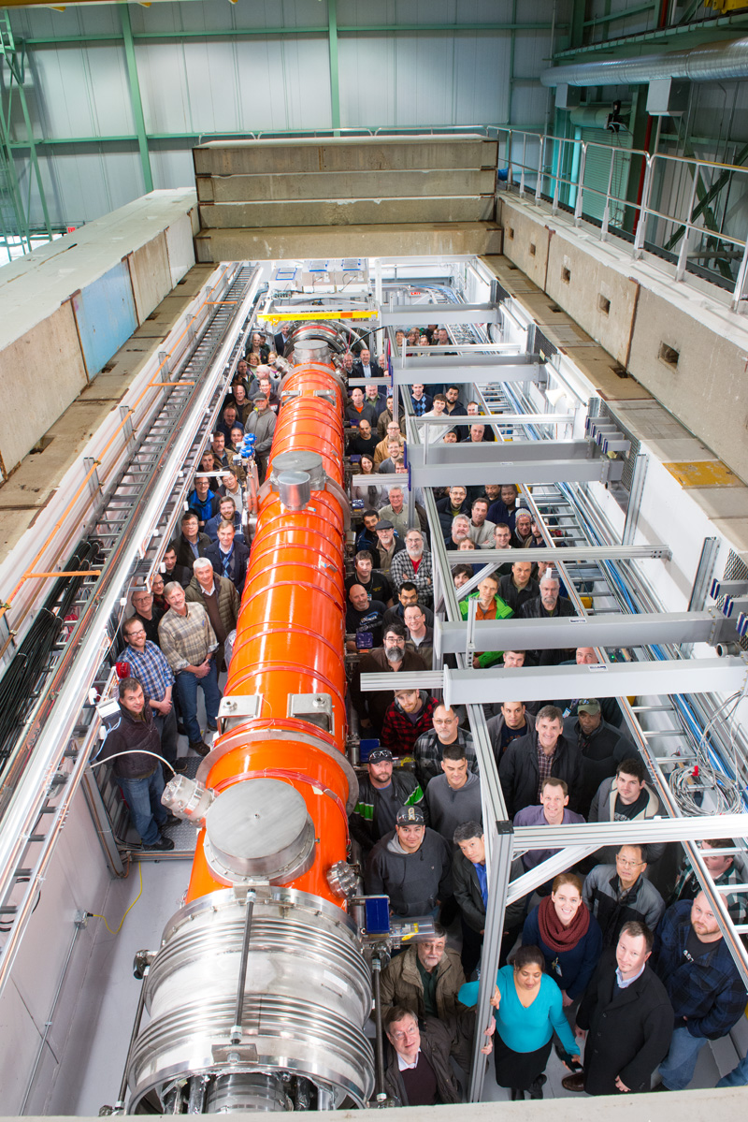
Cryomodule Test Stand 1 (CMTS1)
Fermilab is building and testing cryomodules for LCLS-II at SLAC
At CMTS1, they are cooled down and powered
Cryomodules installed/tested on 1 month cycle
Vacuum design informed by lessons-learned from FAST/IOTA
Some simplifications relative to FAST/IOTA
Beamline vacuum connection at 1 side only
Simplified cryostat vacuum logic
Very clean interfaces to enable quick turnaround
See Brian Hartsell’s Talk
CMTS1

Slide 7
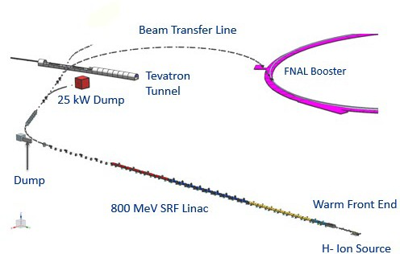
PIP-II Linac
PIP-II is an essential upgrade to Fermilab accelerator complex to enable the world’s most intense beam of neutrinos to LBNF/DUNE, and a broad physics research program for decades to come
Construction underway, completion in 2029
PIP-II Capabilities
800MeV/1GeV H- Linac
25 Cryomodules of 5 styles
All cryomodules are stand-alone (rather than strings)
See Raul Campos’sTalk
25 Cryomodules
~200m

Slide 8
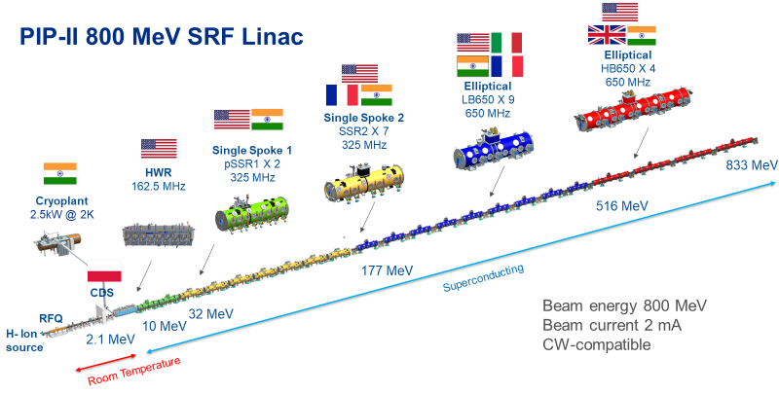
PIP-II Linac Cryomodules
Prototype cryomodule –
first phase of cold RF testing completed
PIP2IT
First cryomodules tested with beam, demonstrated PIP-II beam parameters

Slide 9
PIP-II Injection Test Accelerator
See Alex Chen’s Talk
A full-up build of the upstream portion of PIP-II from the Warm Front End through the second cryomodule
Allowed investigation of vacuum architecture for PIP-II
HWR Cryomodules unique vacuum systems
Beamline interlock and fast-closing valve implementation
More aggressive low-particulate lengths
Combination NEG/Ion Pumps (though not yet near the cryomodules in this system)
HWR 162.5 MHz Cryomodule
SSR1 325MHz Cryomodule

Slide 10
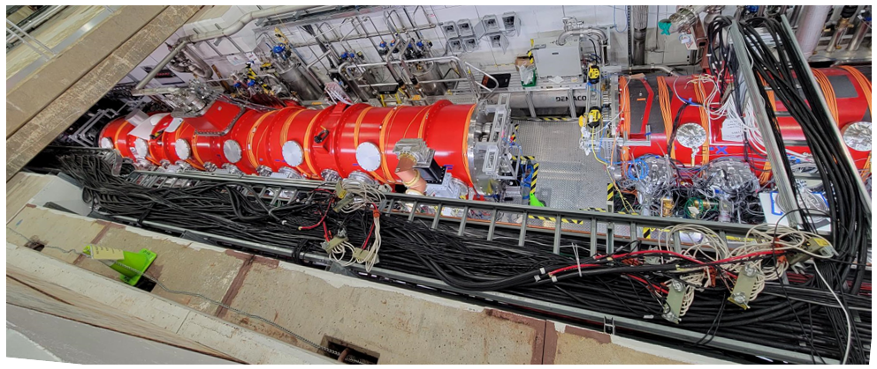
PIP-II Integrated Test Stand
The same physical space was repurposed as a cryomodule test stand
Testing for prototype and production PIP-II Cryomodules
One test stand for 325MHz cryomodules, One test stand for 650MHz cryomodules
Testing ongoing now, continues until 2029
Test stands have independent vacuum systems
HB650 650MHz Cryomodule
SSR1 325MHz Cryomodule

Slide 11
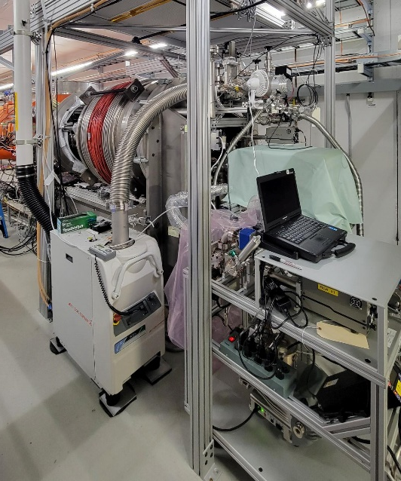
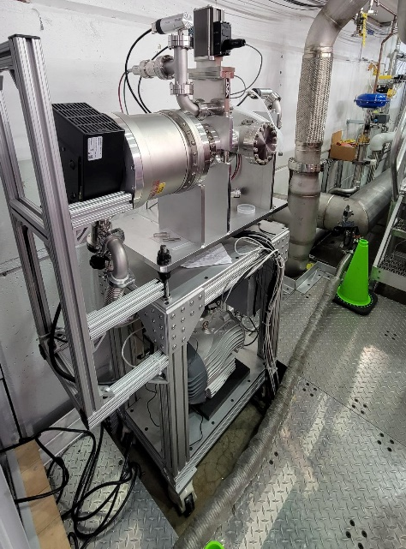
Cryostat Vacuum Field Installation
Conventional High Vacuum Systems (~1E-5 mbar while warm)
Dry screw rougher for new “wet” installations
Turbopump stations for each cryomodule to achieve ultimate warm vacuum
Typically left on during cryomodule operation
PIP-II Integrated Test Sand – station interface is field connection
CMTS1 – station interface is permanent and cryostat bellows is field connection
To cryostat
Permanently installed rougher at CMTS1
Portable turbo station for
650MHz cryomodule test stand

Slide 12
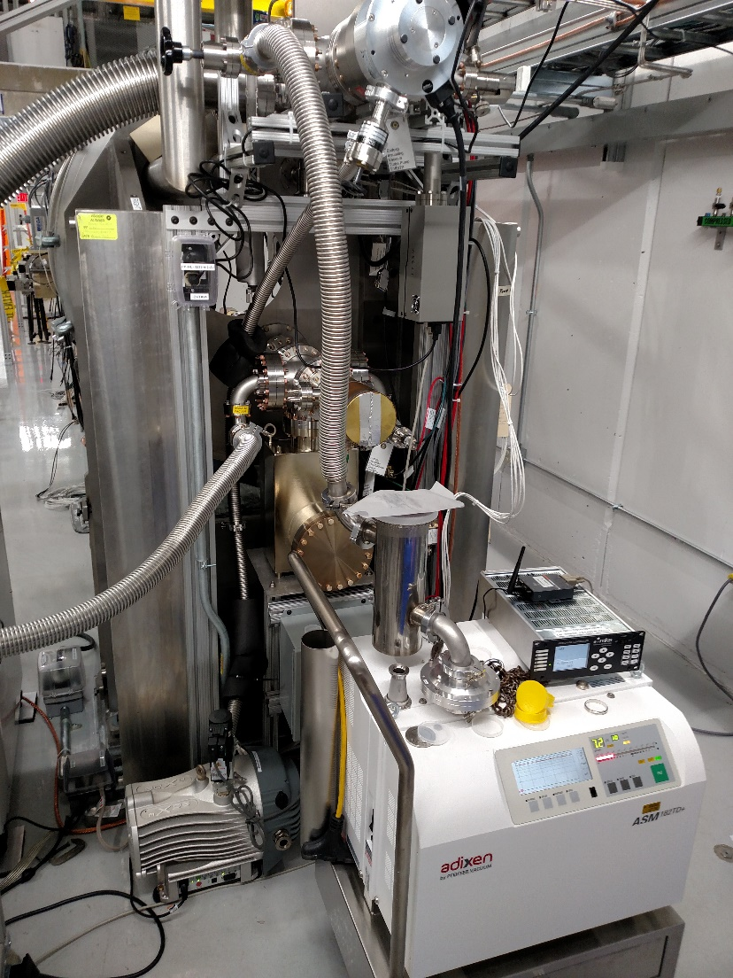
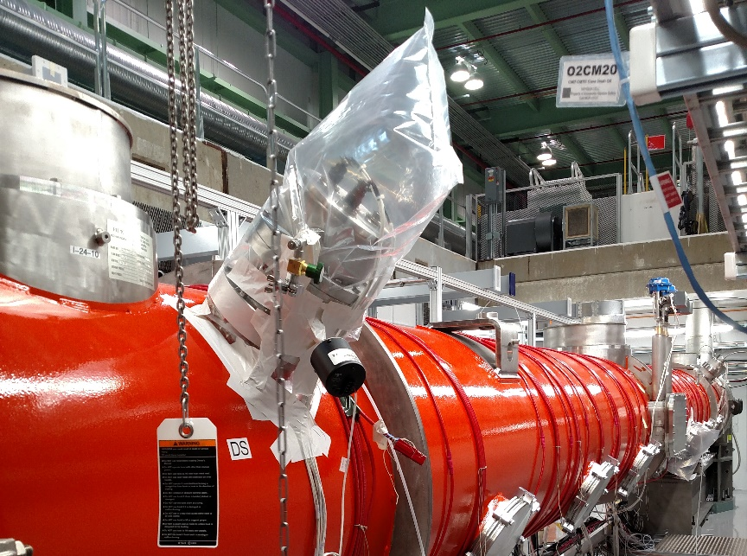
Cryostat Vacuum Field Installation
Talk To:
Ron Kellett
Leak detection
Standard He Mass Spectrometer leak detection
High background / O-ring permeation
Troubleshooting via conventional bag of tricks
Cryo-to-vacuum leak check via pressurized cryogenic circuits
Rough localization via time of flight techniques
N2 bagged flange
Direct cryostat connection example

Slide 13
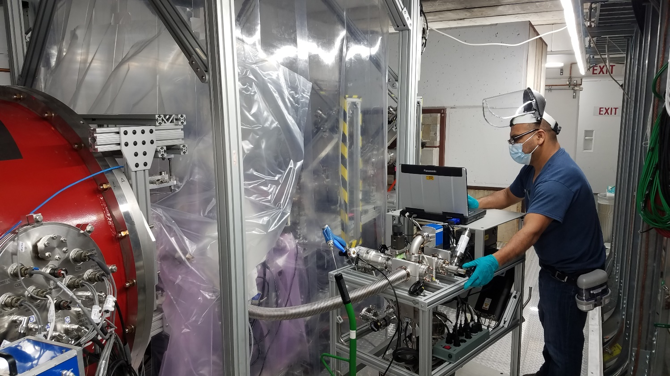
Beamline Vacuum Field Installation: Clean Volumes
Talk To:
Dan Lambert
Temporary clean volumes of various sizes are set up to connect at cryomodule beamline gate valves
Training and experience critical to setup of volume, QC particle counter, and performance of work
Roll-around softwall cleanroom
Particle-safe vacuum pumping cart

Slide 14
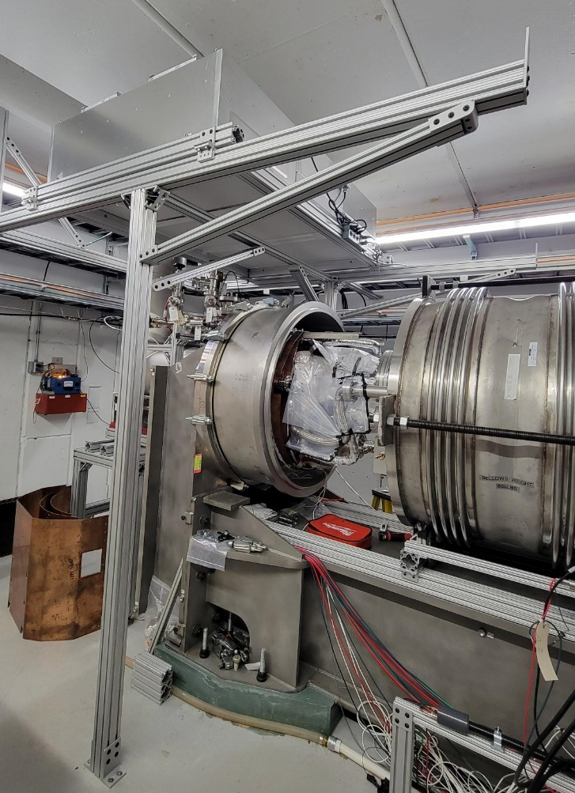
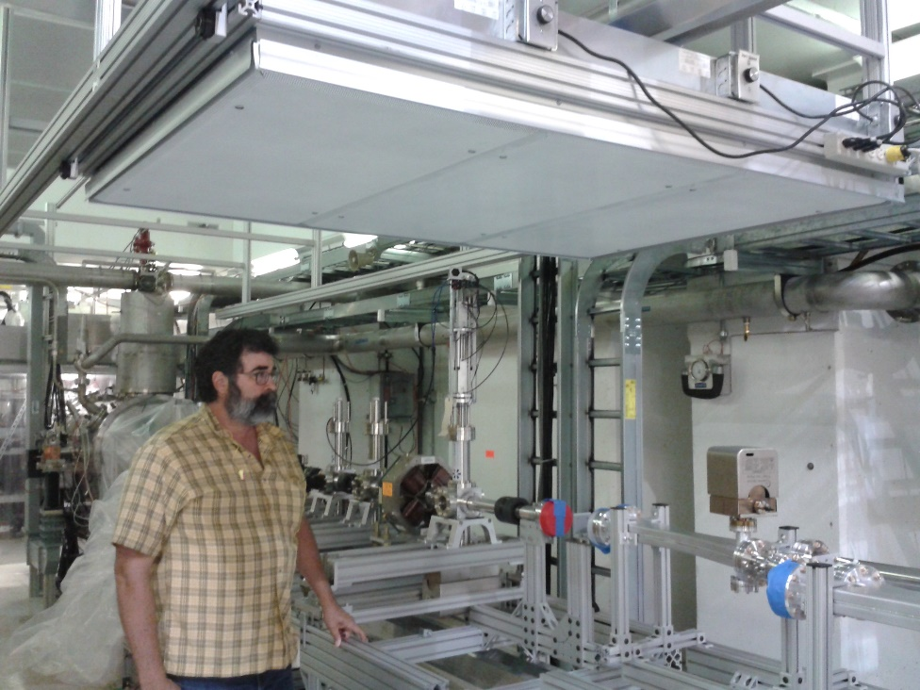
Beamline Vacuum Field Installation: Clean Volumes
More ergonomic
We have used
Permanent overhead filter units
Roll-around soft-wall cleanrooms
Glovebox setups
More flexible
Overhead filter carriage at FAST/IOTA
Overhead filter carriage at CMTS1

Slide 15
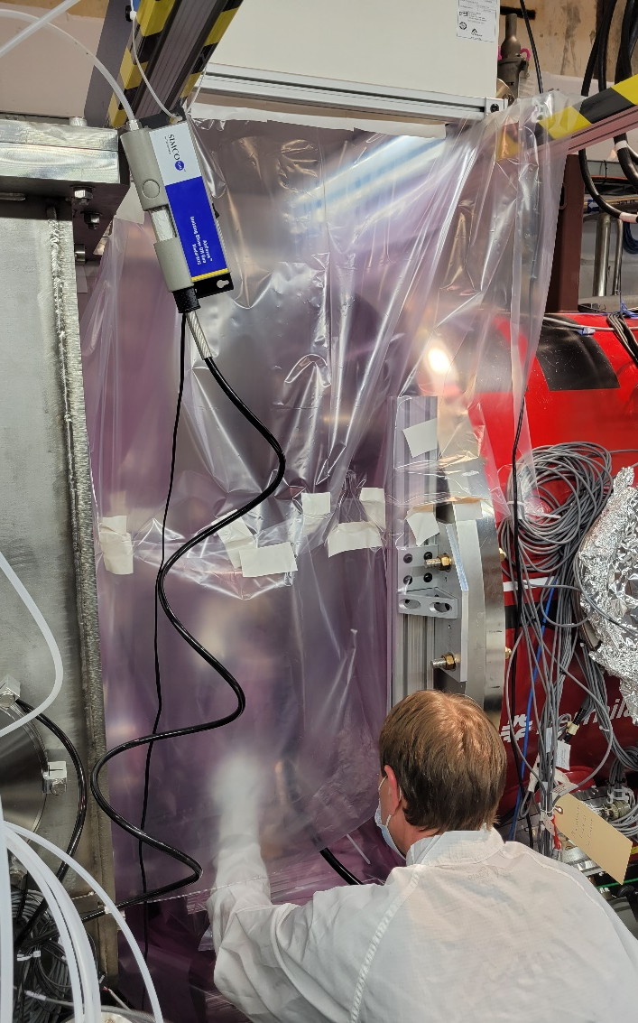
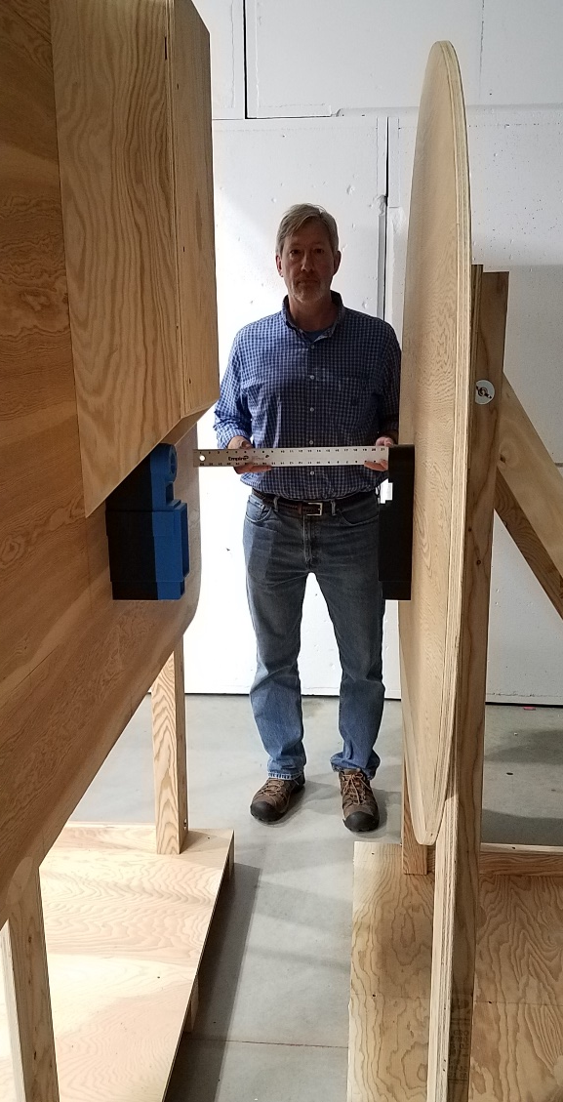
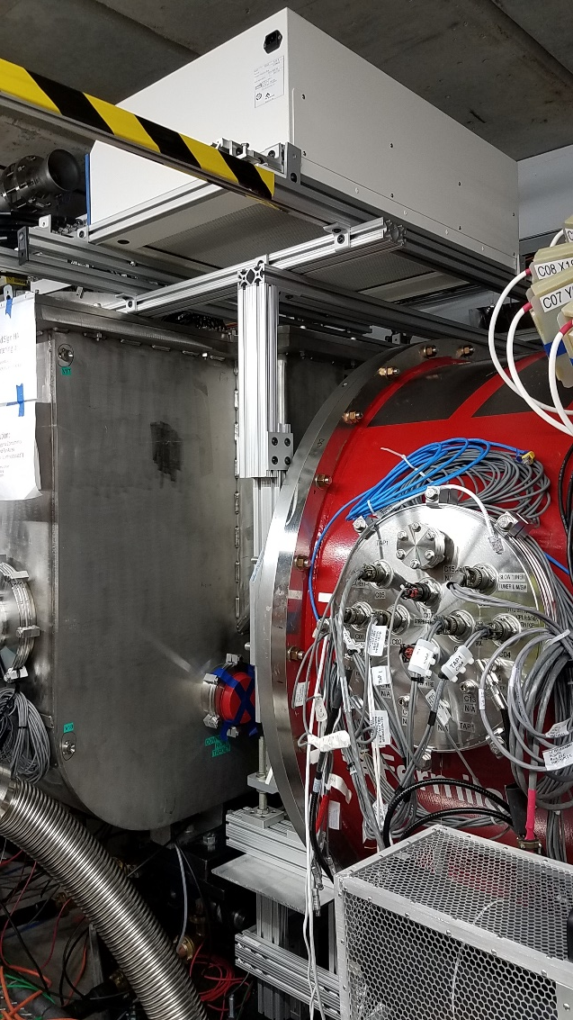
Glovebox Approaches: PIP-II HWR-SSR1 Connection
Connection Mockup
Filter setup
Installation

Slide 16
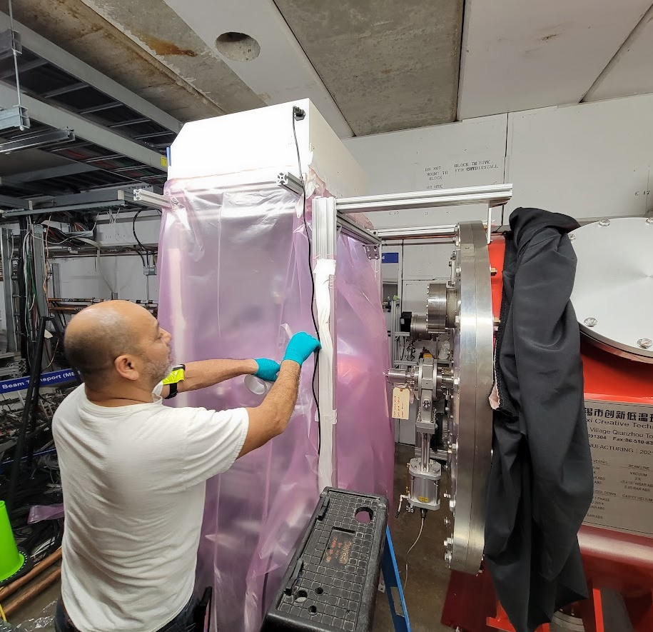
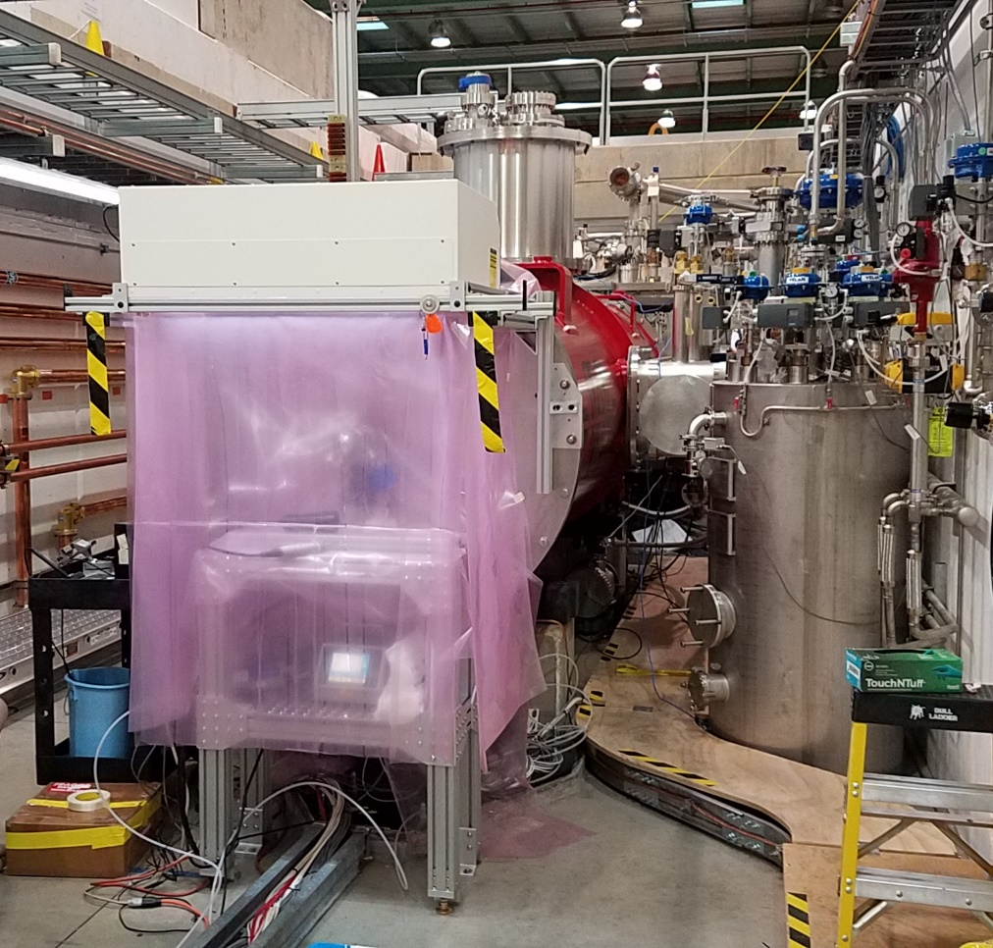
Glovebox approaches: PIP-II Integrated Test Stand
Talk To:
Elias Lopez
Kyle Kendziora
HB650 Connection to Test Beamline Vacuum Station
SSR1 Connection to Test Stand Beamline Vacuum Station

Slide 17
Clean Volumes for PIP-II
For the PIP-II Linac, a mix of these approaches will be necessary
We are studying RAON’s T-shaped Clean Booth Concept
J. Kwon, Institute for Rare Isotope Science, TTC 2023
HB650 Connection to Test Beamline Vacuum Station

Slide 18
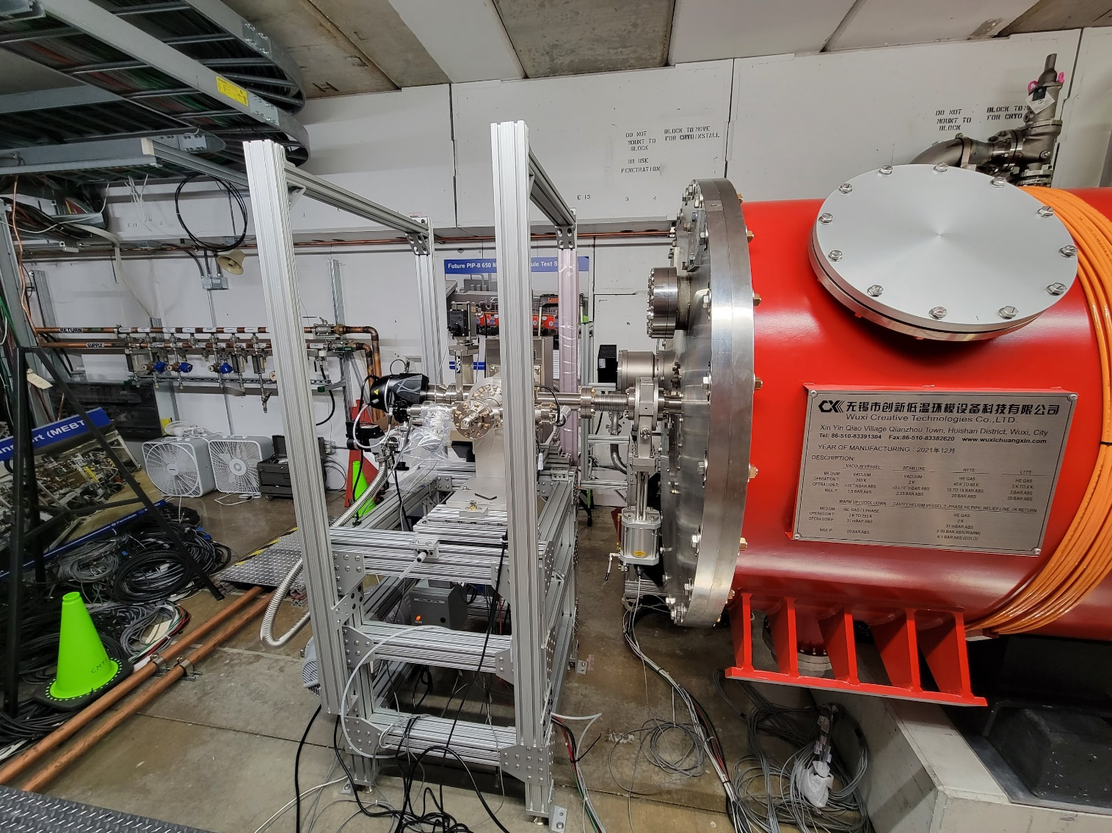
Beamline Vacuum Field Work
We try to minimize scope of field work
HB650 Connection to Test Beamline Vacuum Station

Slide 19
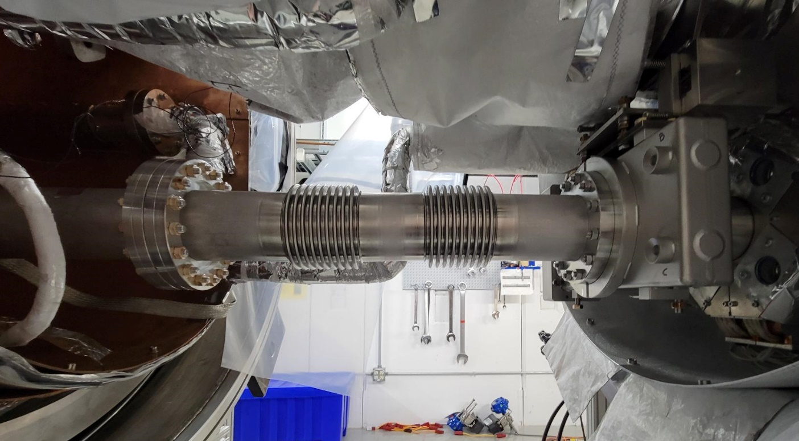
Cryomodule Connection In Test Stands
Talk To:
Brian Hartsell
We avoid the field connection if possible
CMTS1 Beamline Vacuum
To Beamline Pumping Station
To Cryomodule
Field Connection Spool

Slide 20
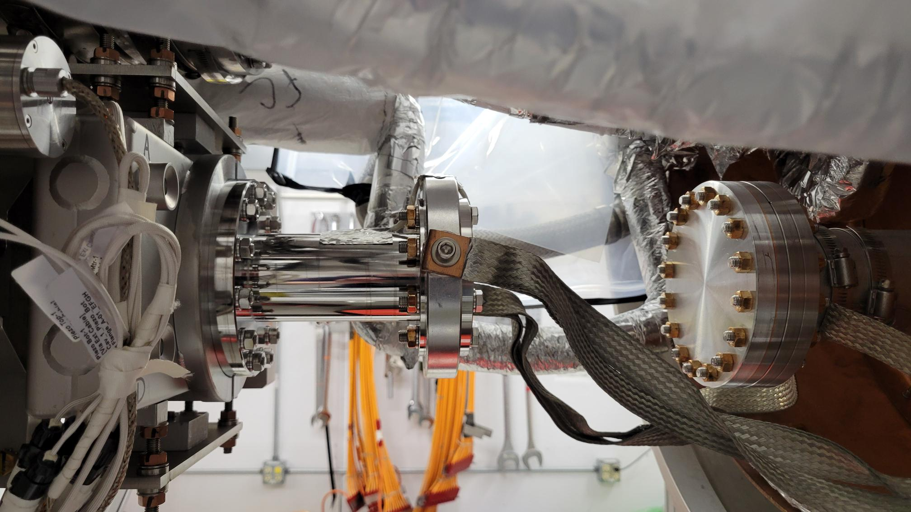
Cryomodule Connection In Test Stands
Talk To:
Brian Hartsell
Pumping a cryomodule from one end has been sufficient
CMTS1 Beamline Vacuum
Dark current
To Faraday cup
To cryomodule
Thin SS window
Thin AL window
Window manifold connected in cavity string assembly cleanroom

Slide 21
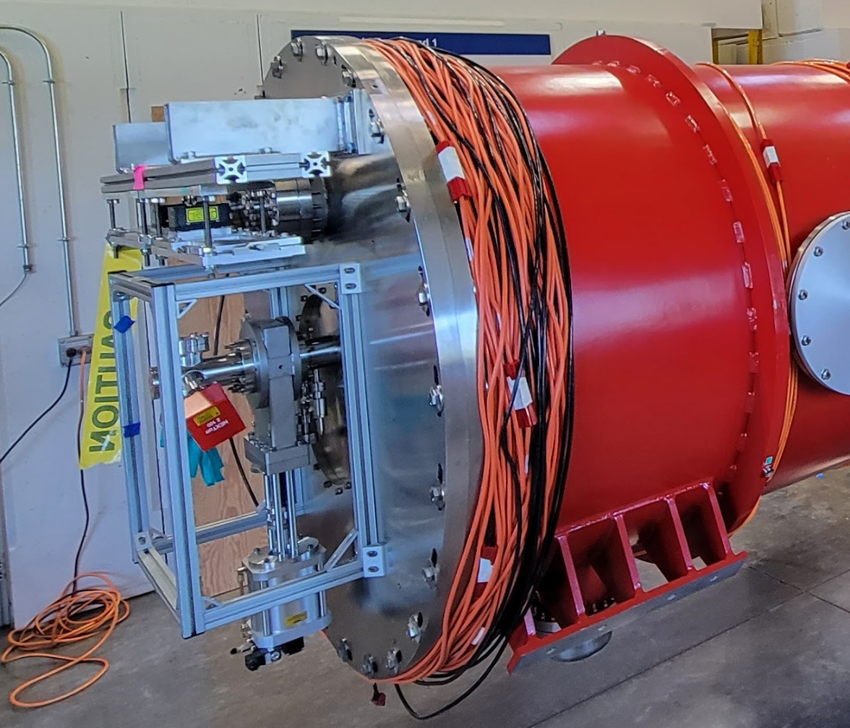
Cryomodule Connection In Test Stands
Talk To:
Genfa Wu
Jacopo Bernardini
Use of small NEG/IP pumps in low-particulate service has opened the door to reasonably-sized room-temperature pumping manifolds
PIP-II HB650 Cryomodule
Pump/Gauge manifold installed in cavity string assembly cleanroom
Rides along for
Assembly
Transport to test
RF test
Transport to PIP-II
Installation of cryomdule
Thin SS window
Thin AL window

Slide 22
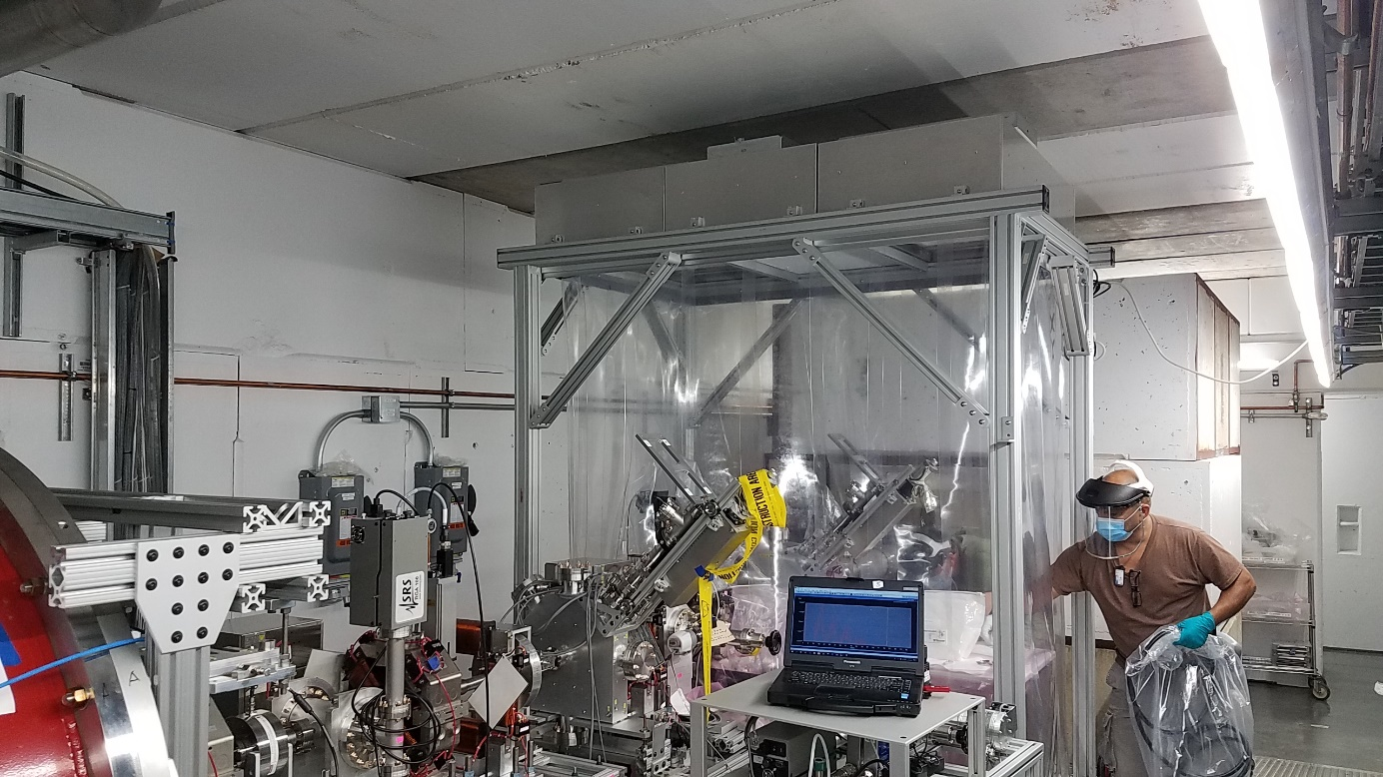
Adjacent Warm Beamlines
Talk To:
Alex Chen
Low-particulate handling of adjacent warm beamlines has been trending less conservative
Many 10s of meters in FAST/IOTA
Just a few meters in PIP-II Injection Test Accelerator
See Alex Chen’s talk
Thin SS window
Thin AL window
PIP-II Injector Test Accelerator

Slide 23
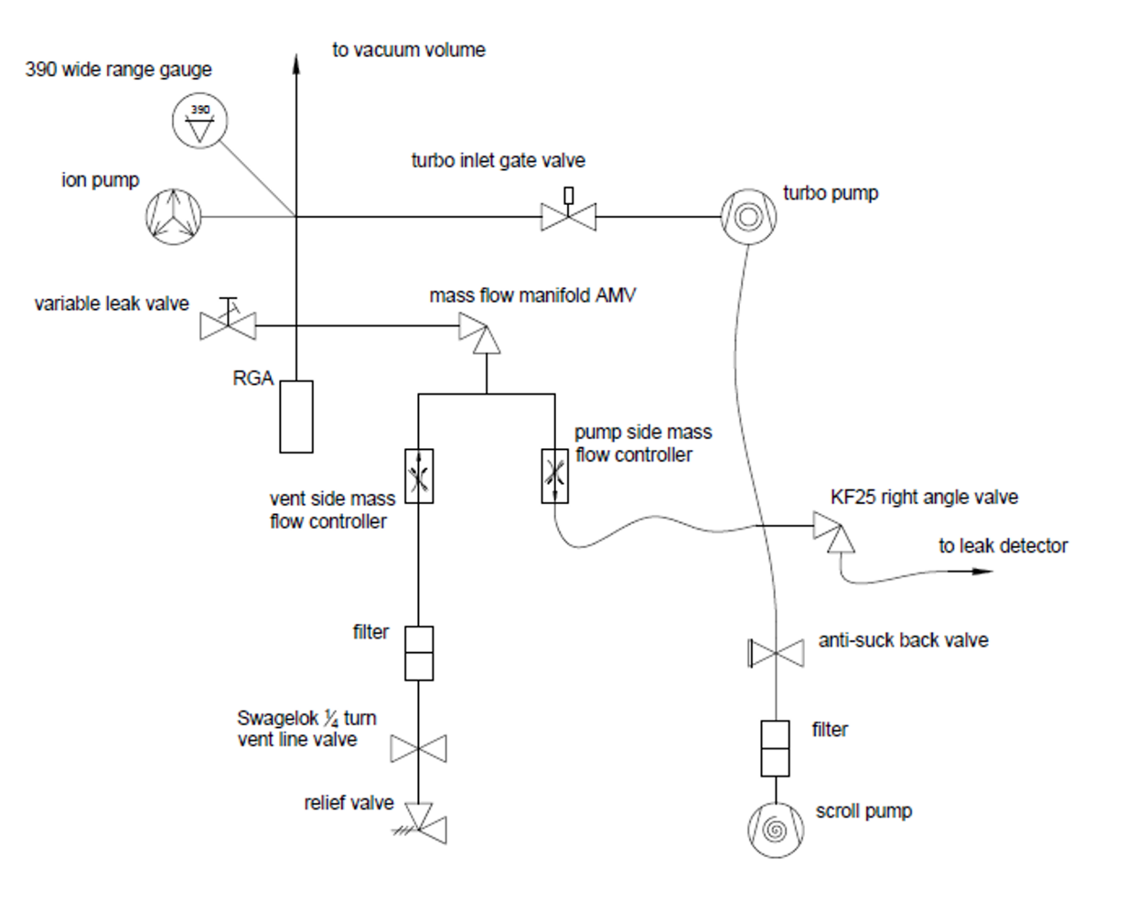
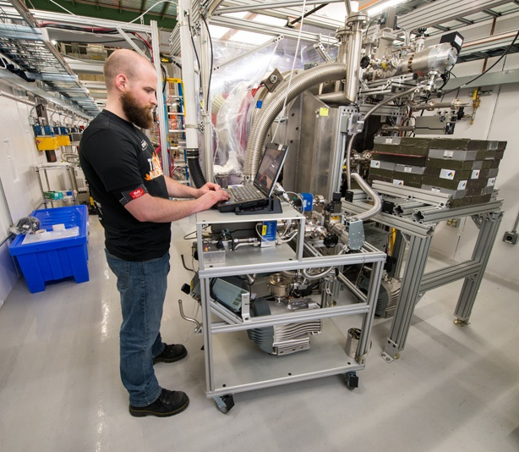
Particle Safe Vacuum Cart
Talk To:
Lucy Nobrega
Mass Flow Control for slow pumping/backfilling in high pressure regime where particulate transport is more likely
Standard design deployed across Fermilab
Cart design includes
Mass flow controllers
Scroll, Turbo and Ion pumping
Gauges and Diagnostics

Slide 24
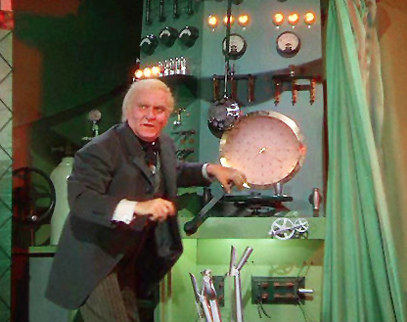
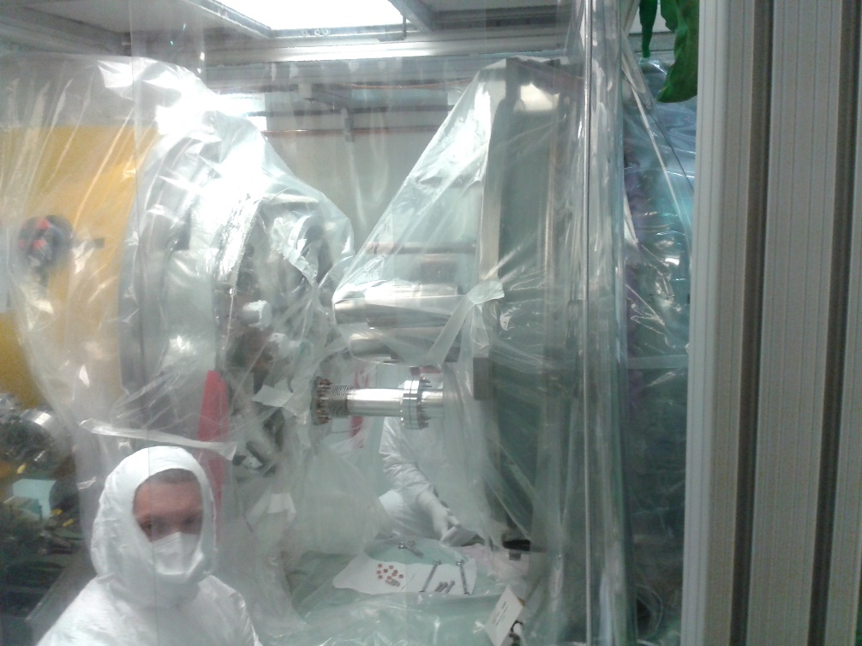
A skilled workforce is the key to success
Skilled and dedicated technicians are essential to this work
Developing and continuously improving these skills is a “must’
Thanks to the OLAV organizers for this opportunity to cross-pollinate
Pay no attention to the man behind the curtain!
Do pay attention to the man or woman behind the curtain!

Slide 25
This work has been authored by Fermi Research Alliance, LLC under Contract No. DE-AC02-07CH11359 with the U.S. Department of Energy, Office of Science, Office of High Energy Physics

