Slide 1
LCLS-II Vacuum System
Requirements and Performance
Giulia Lanza and Robert Coy
OLAV - April 2024

Slide 2
LCLS-II Vacuum Systems
3
1
2
LCSL-II vacuum system consists of 3 independent systems:
Beam line system
RF Coupler vacuum system
Thermal isolation system within Cryomodule
Notes:
There are multiple stages: the injector gun, L0 CM, laser heater, L1 CM, first bunch compressor, L2, second bunch compressor, L3 which accelerate the beam up to the final energy of 4GeV. Then 2km of transport line. The beam get separated in three lines: one is the dump, one is the Soft X-Ray line and one is the Hard X-Ray line.

Slide 3
Beam Line Vacuum System
>3.5km from Gun/Injector to the Experimental Stations.
LCLS-II
  Requirement is Ultrahigh Vacuum (UHV) cleanliness along full length (though pressures may not be operationally achievable)
  Adjacent particle free cryo and ambient sections.
Beam line parts came from SLAC, Argonne, LBNL, FNAL, JLab

Slide 4
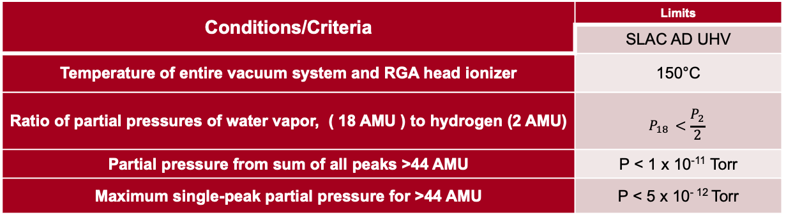
SLAC UHV Acceptance Test Criteria
FP-202-631-14-REV8
Leak Tight: Helium leakage rate of < 2x10⁻¹⁰ std. cc/sec helium.
RGA Acceptance: Mass spectrometer scan performed at 150°C on each lot of components in the same test chamber
Conditions/Criteria | Limits
 | SLAC AD UHV
Temperature of entire vacuum system and RGA head ionizer | 150°C
Ratio of partial pressures of water vapor, ( 18 AMU ) to hydrogen (2 AMU) | $$P_{18 }<\frac{P_{2}}{2}$$
Partial pressure from sum of all peaks >44 AMU | P < 1 x 10⁻¹¹ Torr
Maximum single-peak partial pressure for >44 AMU | P < 5 x 10⁻ ¹² Torr

Slide 5
SLAC’s Process for UHV Assembly and Verification
If executed properly, this sequence has many SLAC years’ proof of success to achieve < 1x10⁻⁸ Torr levels.
Verify Outgassing
Spot checks & vendor qualifications
Fabricate & Clean Parts: Per UHV spec FP-14
Assemble: UHV best practices that keep UHV Parts clean!
Bake:
250C
48 hrs
RFI
Verify Hydrocarbons
RGA @150C
PF cleaning
For LCLS-II there wasn’t any beamline in-situ bakeout after installation
(Except the VHF Gun)

Slide 6
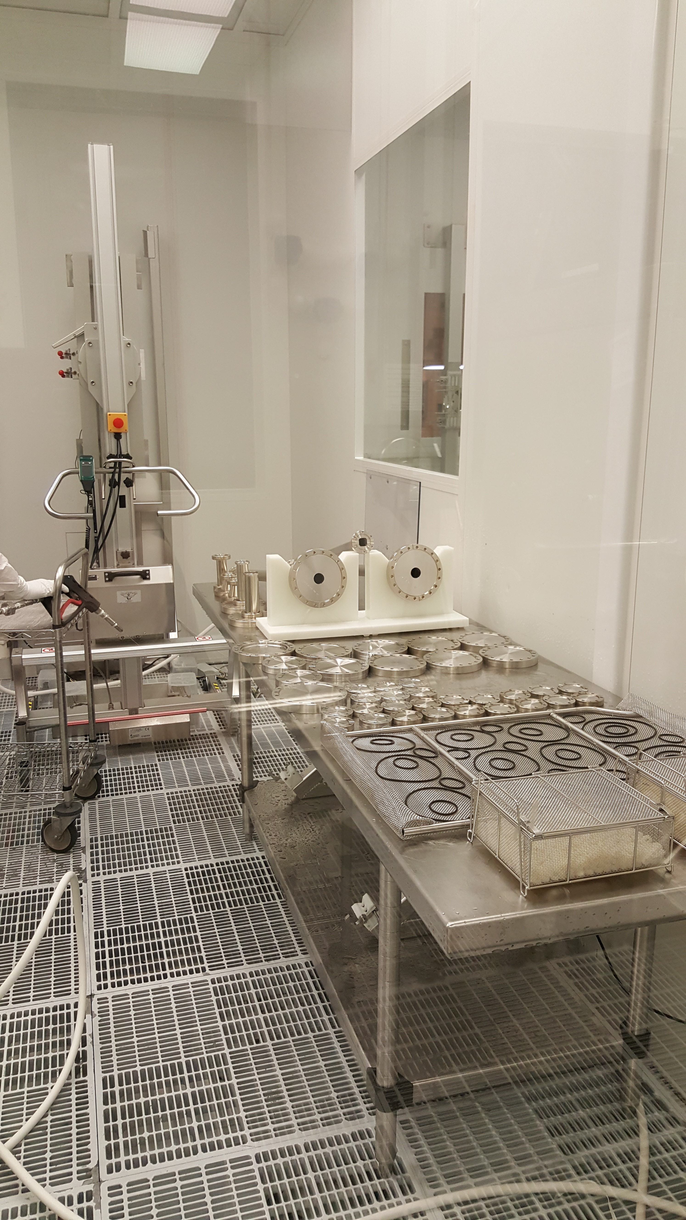
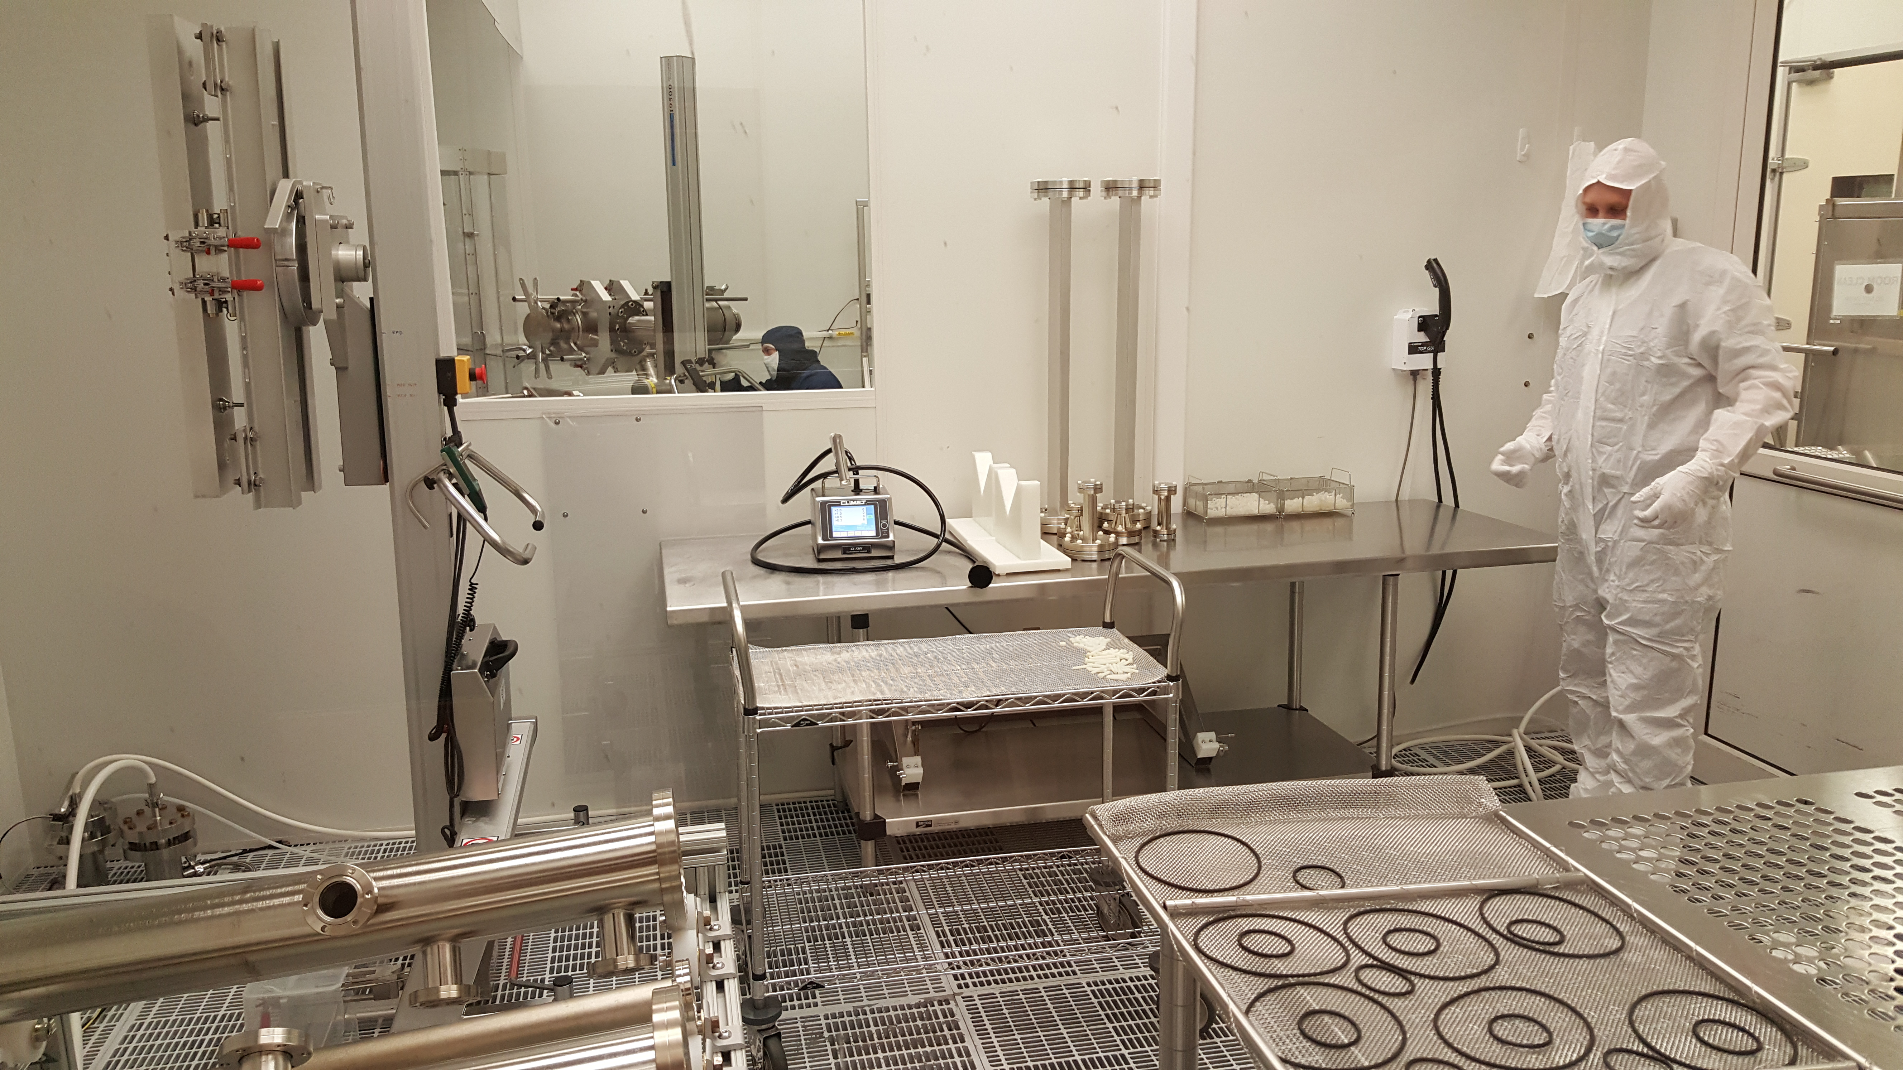
Argonne National Laboratory collaboration for Particle Free cleaning
High pressure rinsing
mechanical particles displacement
No hydrocarbon contamination
Bake:
250C
48 hrs
PF cleaning
Needs a periodical check of the quality of the DI water

Slide 7
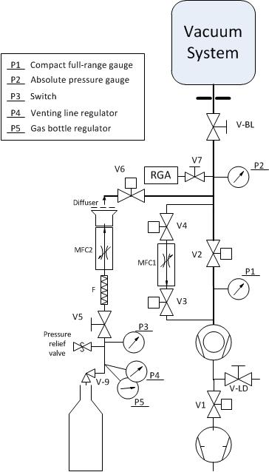
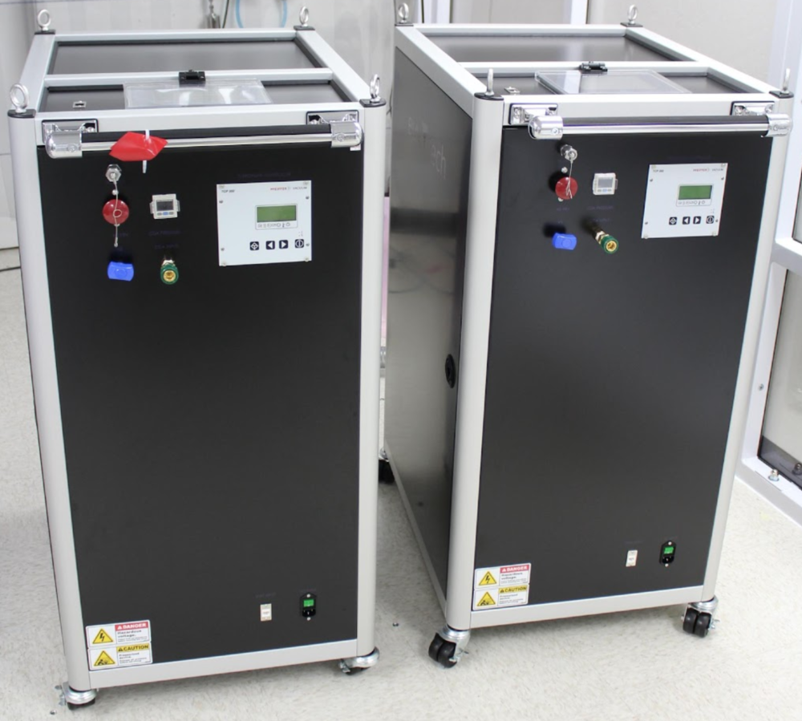
LCLS-II: Particle Free Pump Carts
LCLS-II installation Particle Free zones:
  Venting
  Pumping
  Leak detection
For pumping and venting the Mass Flow Controller is set up at 3 l_{N}/min (40 Torr l/s)
Soft start mass flow controller
Automatic valves and interlocks to minimize human errors

Slide 8
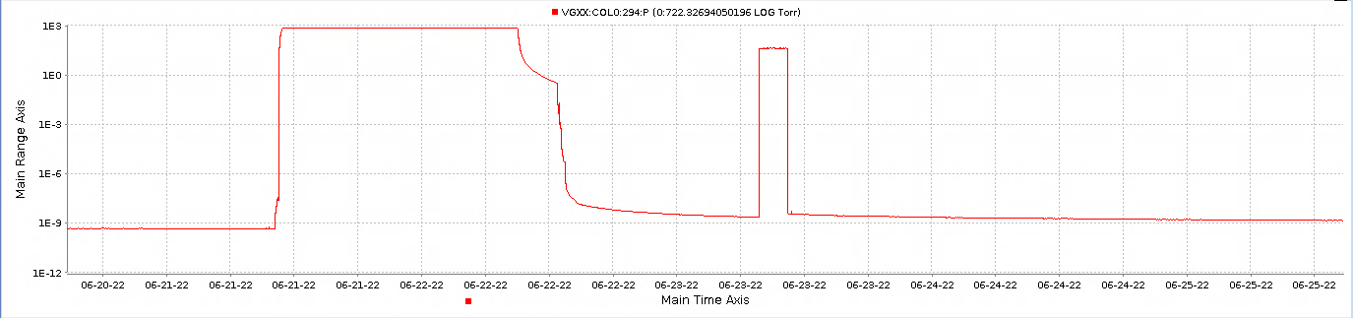
Actual pressure and pump down time
Venting and activity
Gauge off and on
  On 06/22/2023
  09:00AM atmospheric pressure, start slow pump down
  12:40PM switch to fast pump down
  01:30PM start ion pumps
  09:00PM pressure 4.3x10⁻⁹ Torr
  on 08/18/2022 pressure 4.5x10⁻¹⁰ Torr up to now

Slide 9
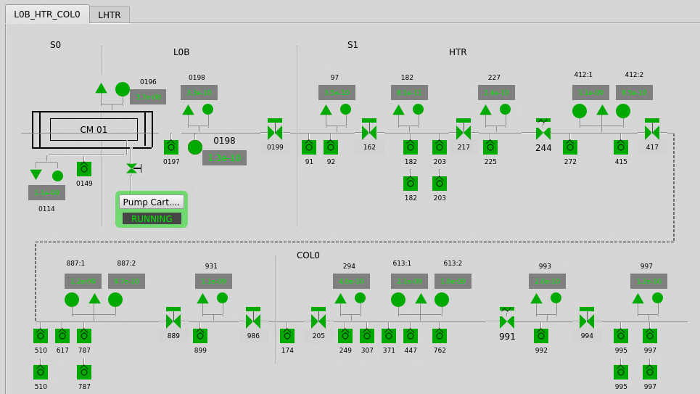
Actual pressure and pump down time

Slide 10
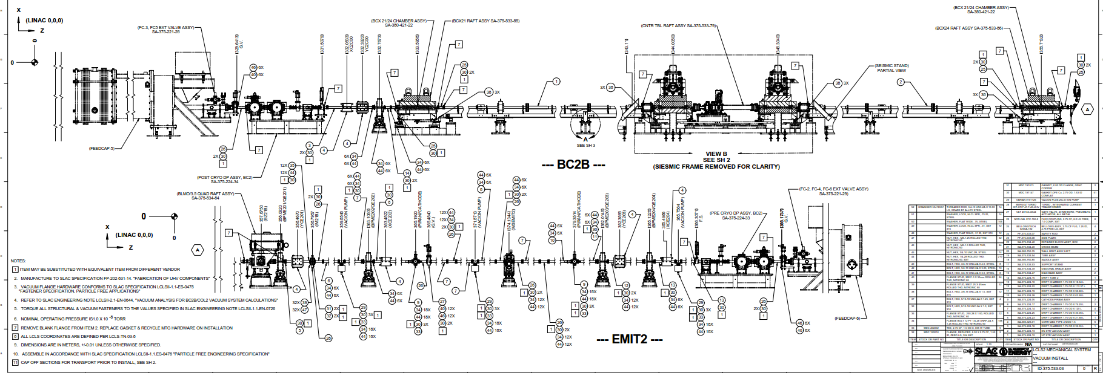
Beam Line Vacuum System
Cold
Room temperature
Differential pumping system

Slide 11
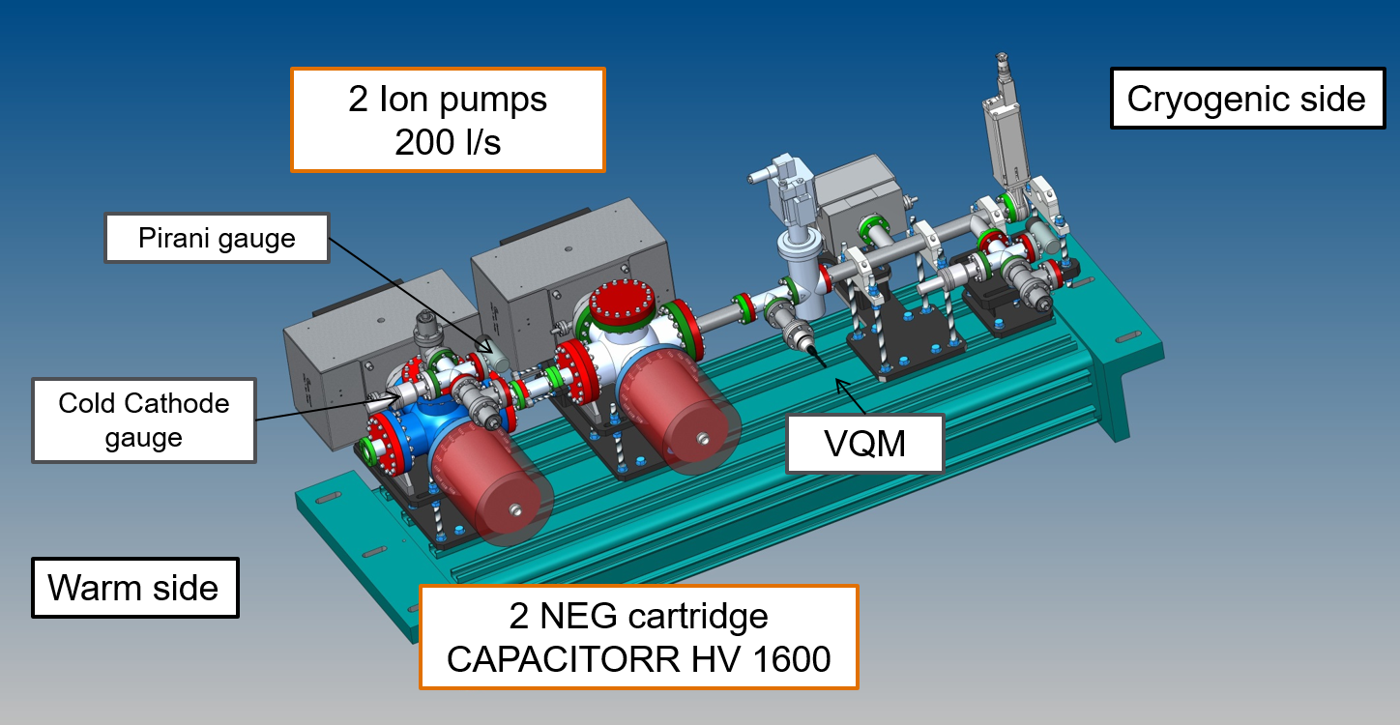
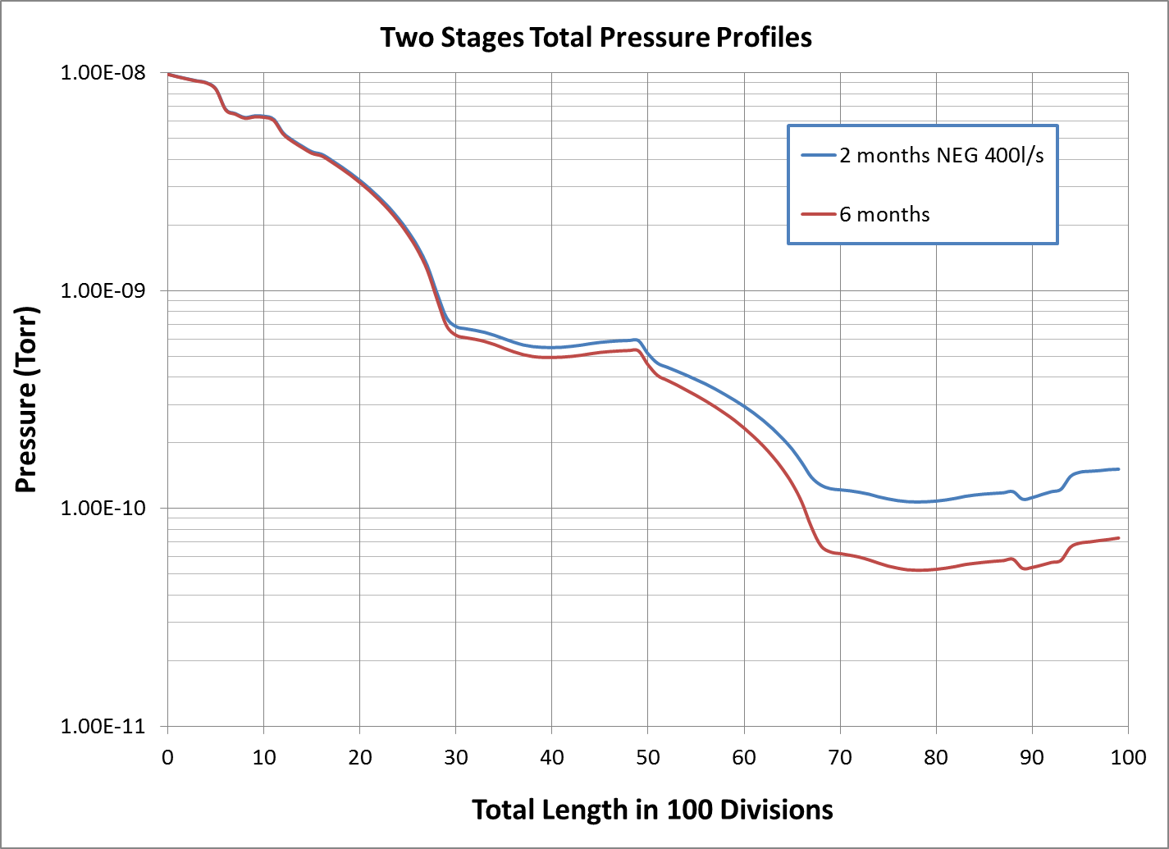
LCLS-II: Differential Pumping System
To comply with the vacuum requirements described in the LCLS-II Vacuum Engineering Specifications (LCLSII-1.1-ES-0231-R0)
pressure should drop from 1x10⁻⁸Torr to 1x10⁻¹⁰Torr passing from the room temperature region to the cold region.
Engineering Note: LCLSII-1.1-EN-0658: A differential pumping system for LCLS-II beam pipe cold-warm transitions

Slide 12
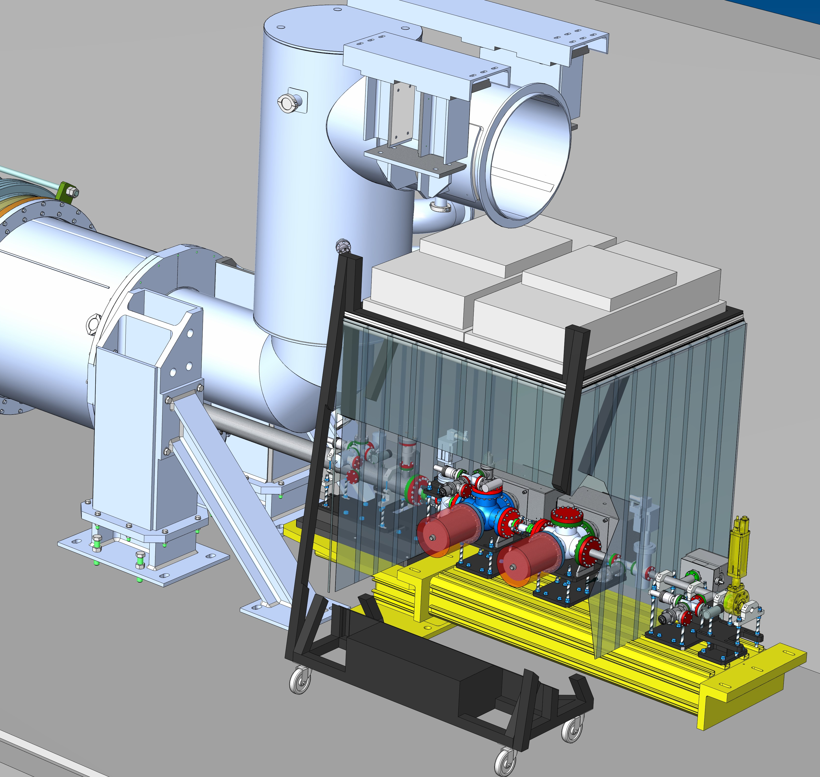
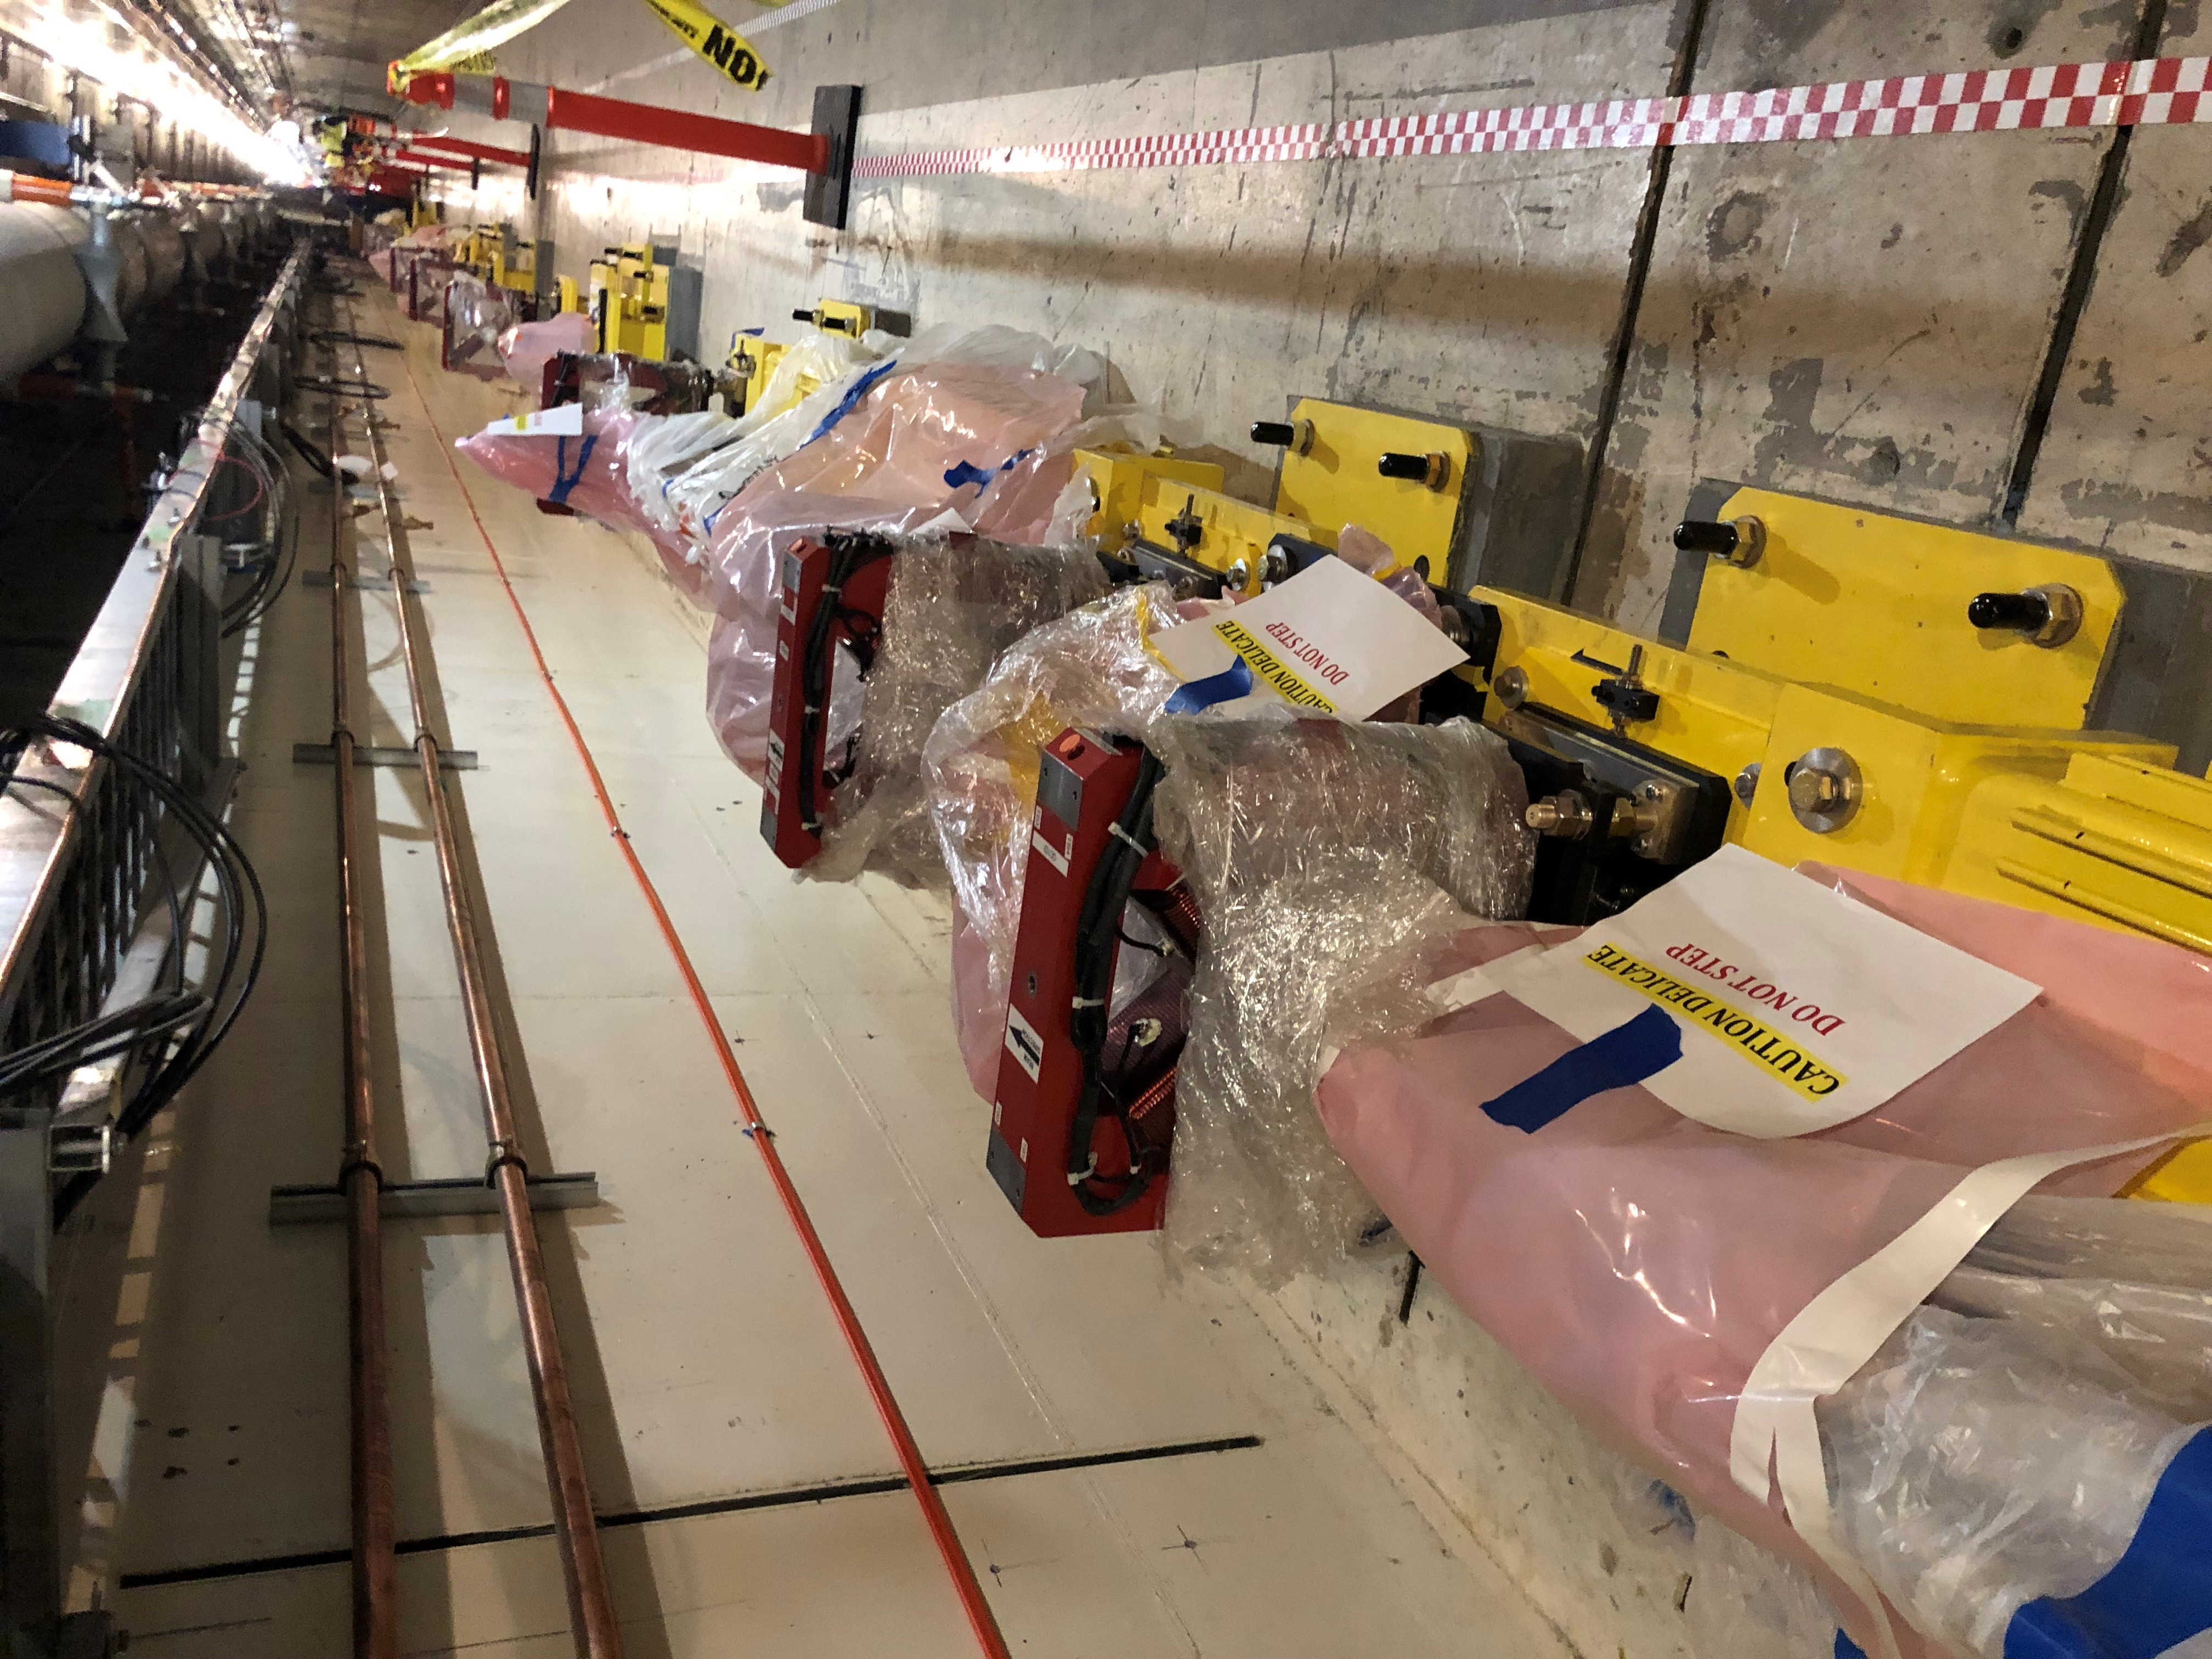
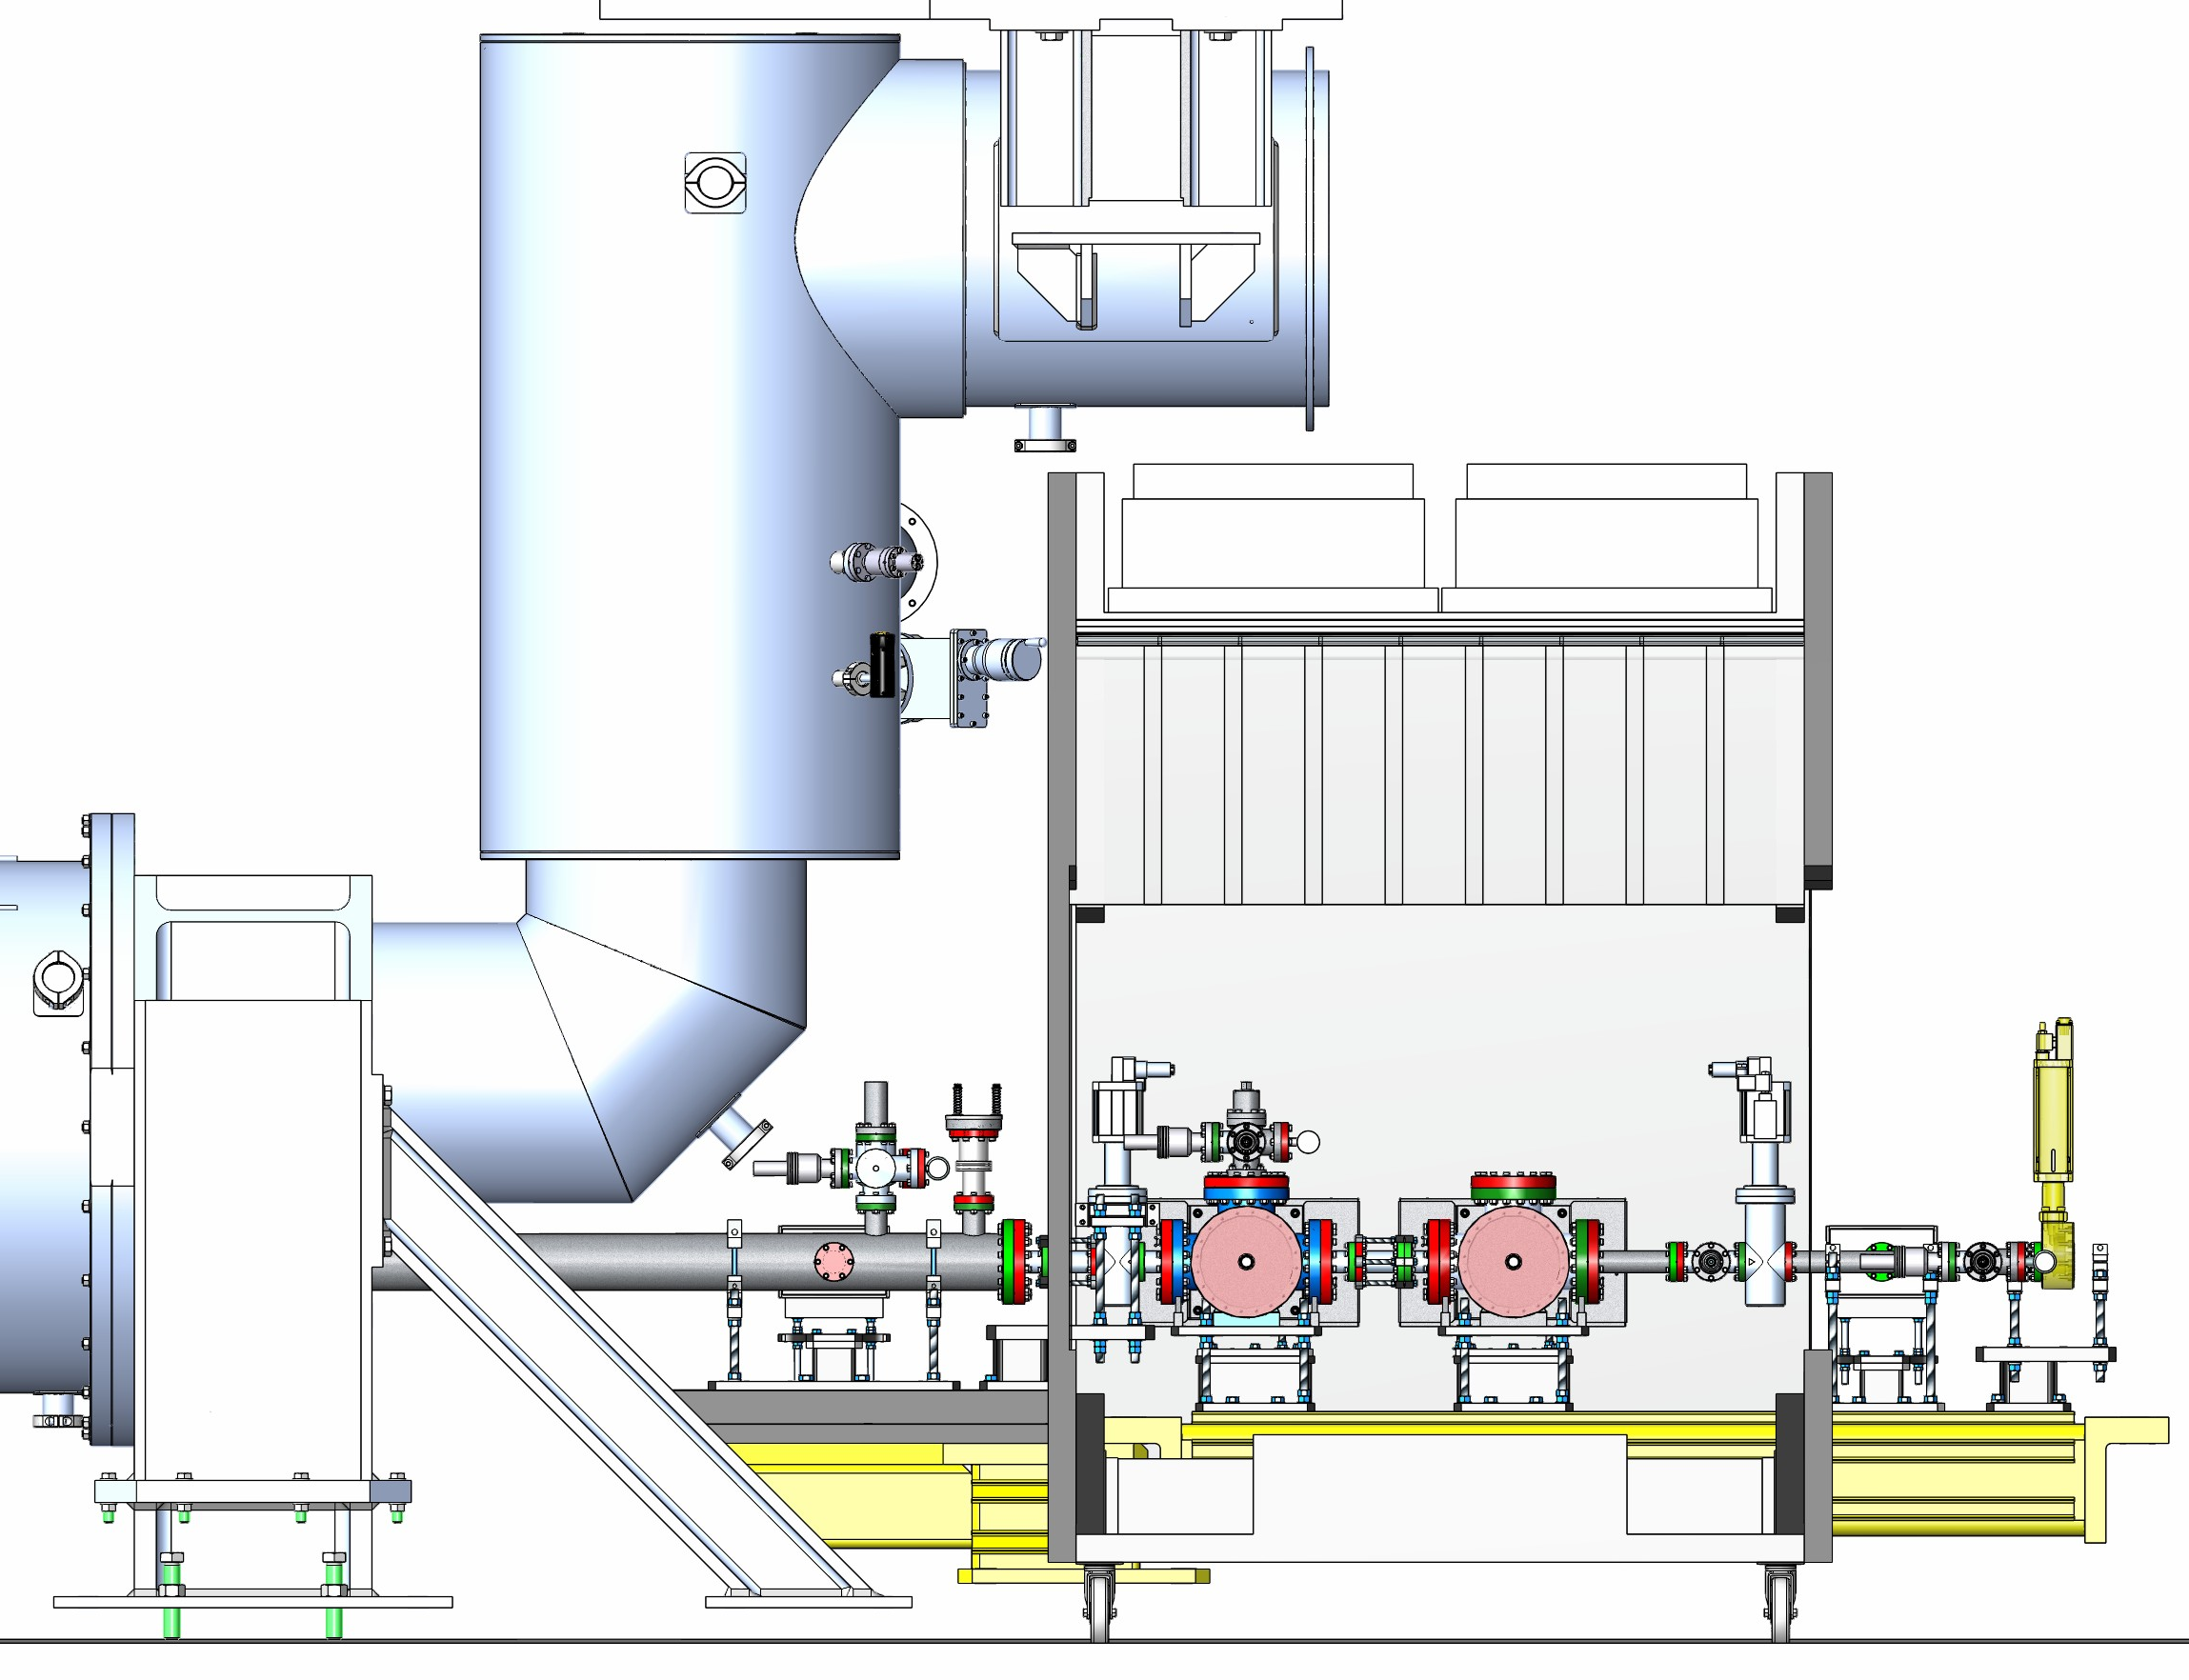
LCLS-II Field Installation: Portable Overhead Clean Room
Portable cleanrooms are used to connect the rafts.
Estimated time for two adjacent connection is 2 days.
3 days for additional pump down, leak check and venting (slow flow to avoid particle displacement).

Slide 13
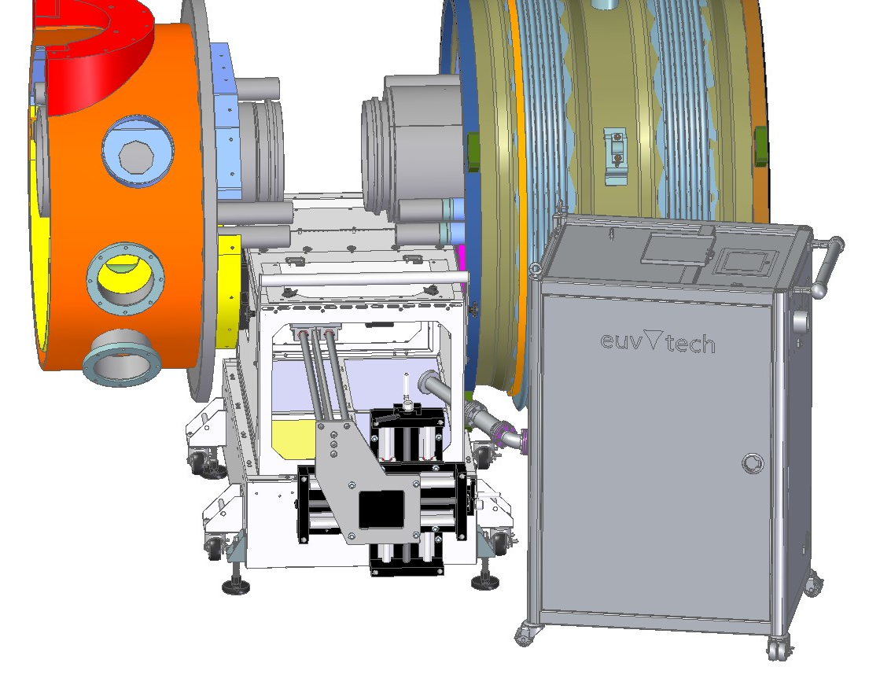
LCLS-II Field Installation: Portable BLA Clean Room
BLA
Interconnect bellow
Cryomodule
BLA
Portable Clean Room
Particle Free Cart

Slide 14
Beam Line Vacuum System
Particle free areas
A region of warm beam line in the neighborhood of Cryomodules designed, fabricated, and installed following best practices for minimizing particle contamination in order to reduce the risk of degrading SRF cavity performance.
Recommended Particle Free Length is 20 m.
Base upon Fast Valve Response Time and mean speed for Nitrogen at 35 C.
(Defined in Engineering Note: LCLSII-4.1-EN-0337)

Slide 15
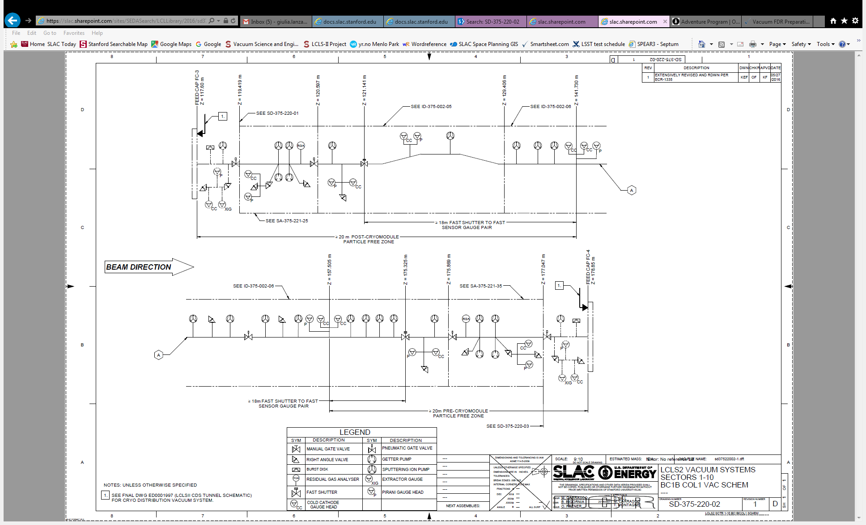
Example of leak in BC2
Moving parts – weak point for possible leak
1.
Interlock
2.
Fast shutter closes
3.
Gate valves close

Slide 16
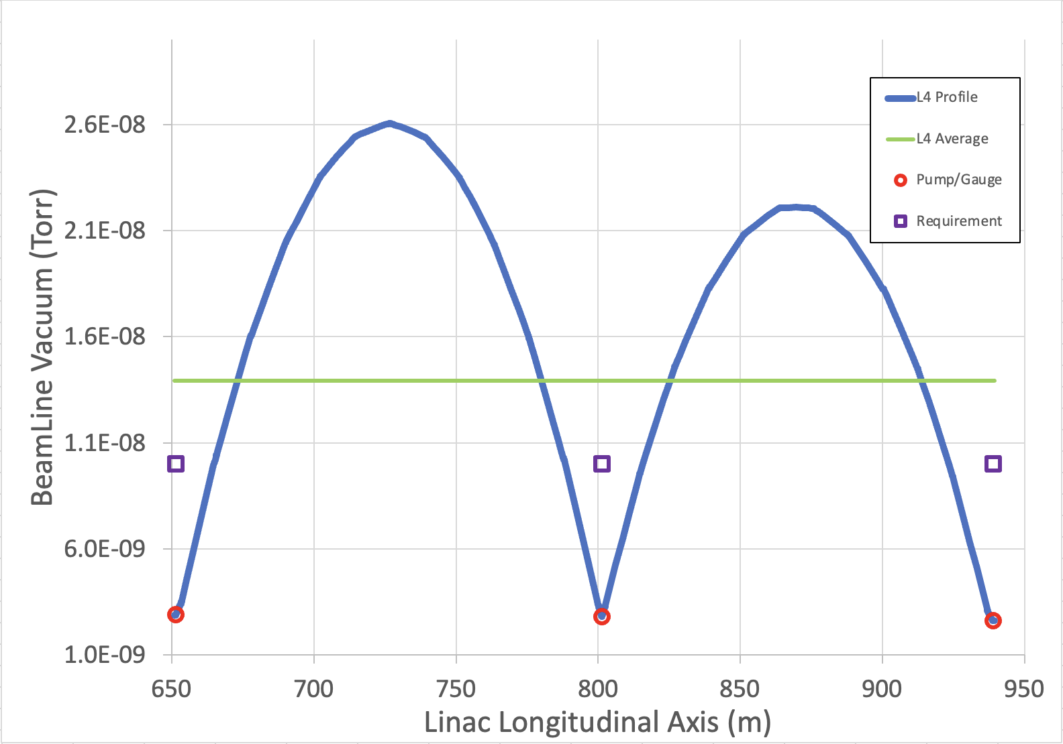
Cryomodule Outgassing
Cryomodule Vacuum – L4B String (Warm)
CM outgassing performance metrics updated for HE based on LCLS-II delivery and installation data
Outgassing reduced to 4.4x10⁻⁹
Torr-L/sec per CM
Determined LCLS-II modeling
(prior to fabrication) was too conservative by about 50X
Outgassing result similar to modeling Niobium at zero and Copper-coated Stainless per SLAC spec

Slide 17
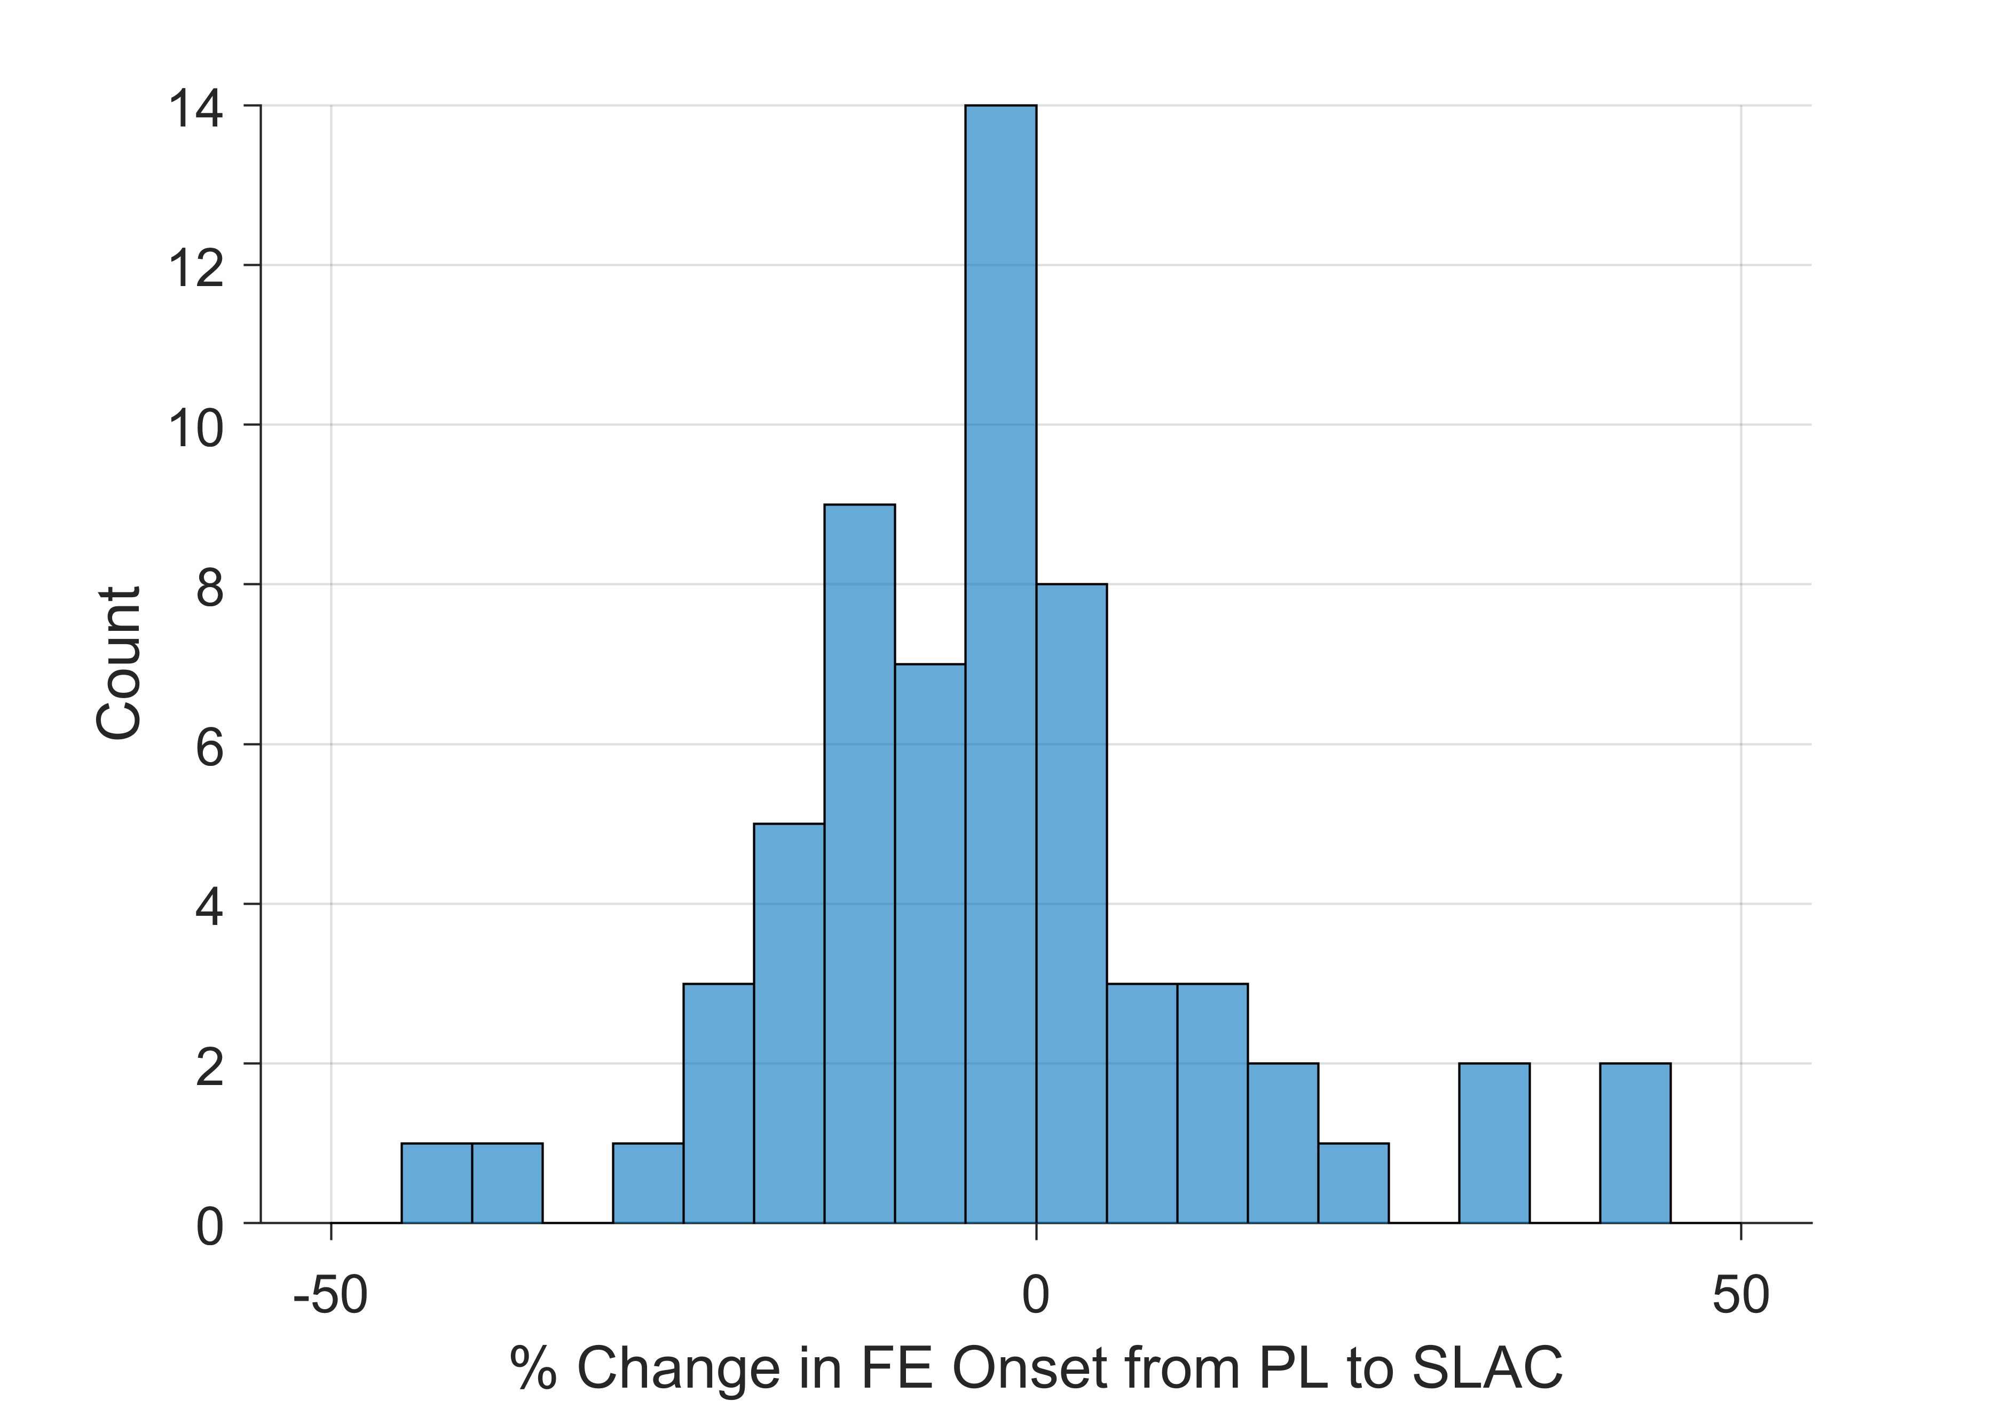

LCLS-II Cryomodule Installation Performance
Change in FE Onset
Gradient performance is in line with CM acceptance test measurements at FNAL and JLab
No observable change in Field Emission onsets or magnitude from installation
Attribute result to production quality and best-in-class installation techniques, including
Particle-Free processes
$$\overline{Δ}=\left(−1±18\right)\%$$

Slide 18
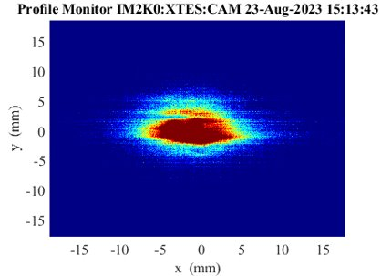
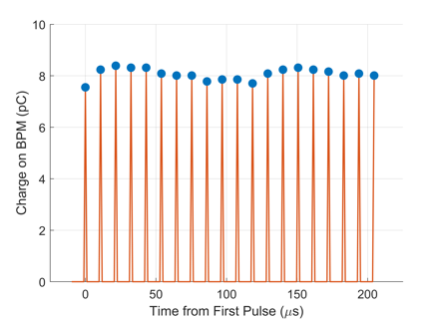
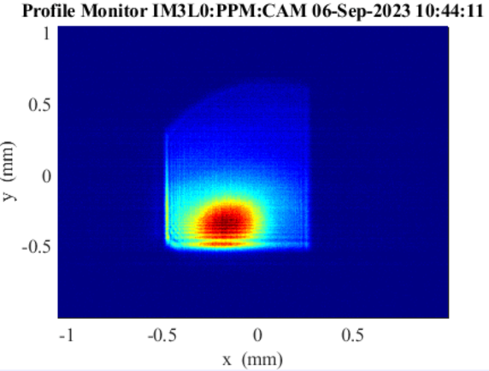
LCLS-II – Soft and Hard X-Ray ”First Light” in 2023
CD-4 Project Milestone completed October 18, 2023
All LCLS-II Threshold KPPs have been Verified
Project had more than a decade of work, including 4.5 M hours from
5 DOE National Laboratories and many collaborators
Work continues at SLAC to support user science with LCLS-II
First SXR Lasing - 450 eV
93 kHz e⁻ beam rate
First HXR Lasing - 1050 eV

Slide 19

Questions?

