Slide 1


The vacuum systems of LIGO
Janos Csizmazia
Lead vacuum engineer, Hanford
General overview, current enhancements
Document G2400921

Slide 2
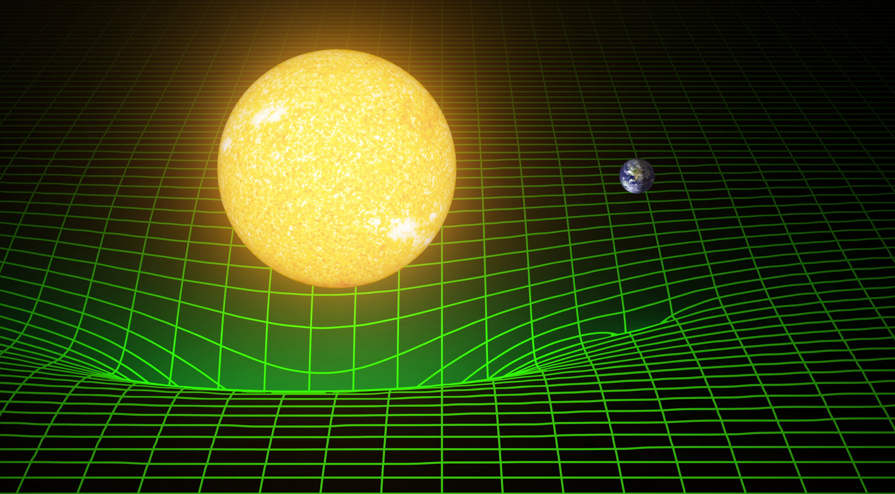
“Matter tells space how to curve, space tells matter how to move.”
~ John A.Wheeler
Document G2400921

Slide 3
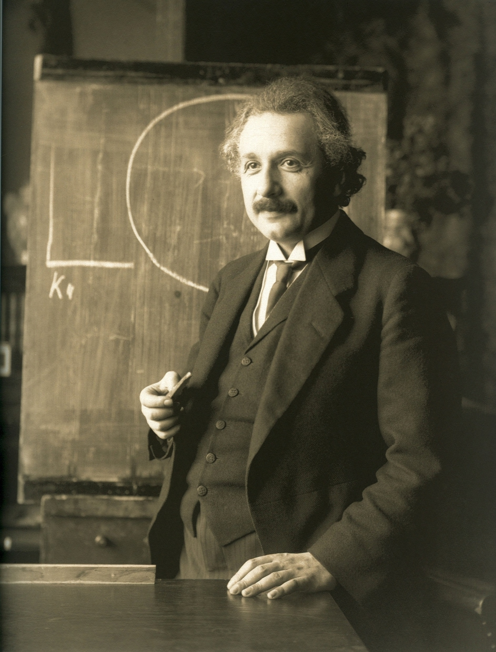
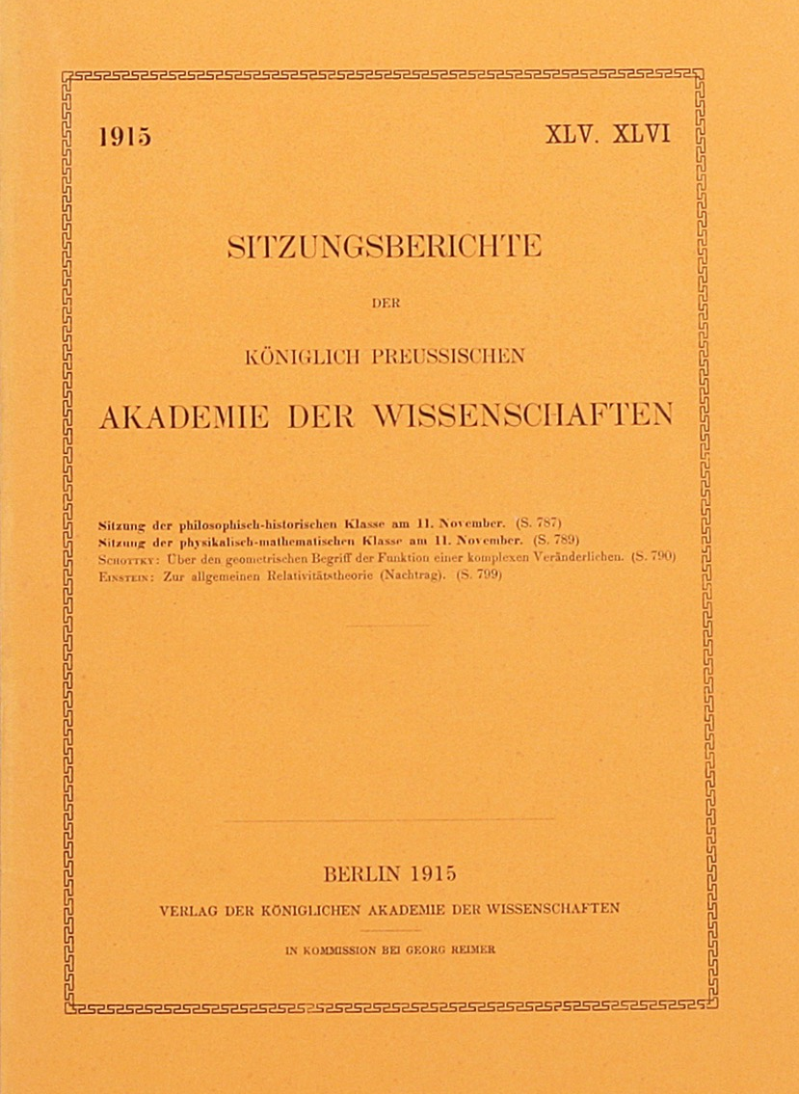
Albert Einstein
1915
The General
Theory
Of
Relativity
Image courtesy of The Manhattan Rare Book Company
Document G2400921
Notes:
REMEMBER: 1915!!!!!!
MATRIX!

Slide 4
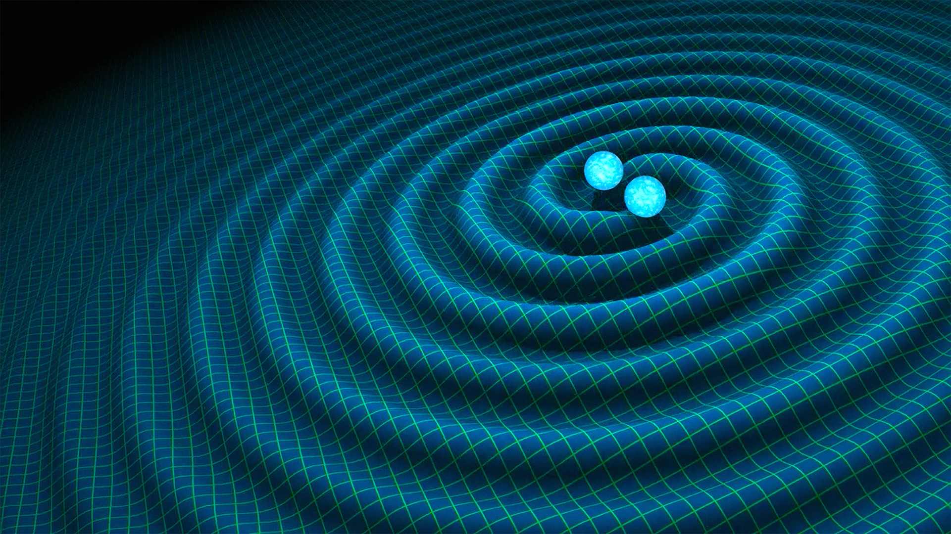
Document G2400921

Slide 5
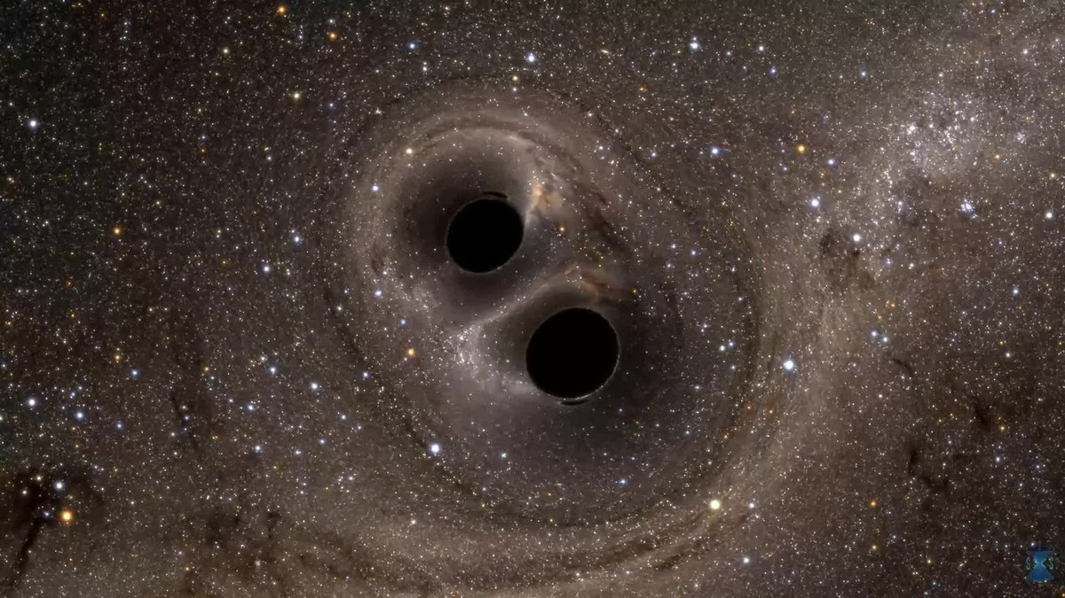
Document G2400921

Slide 6
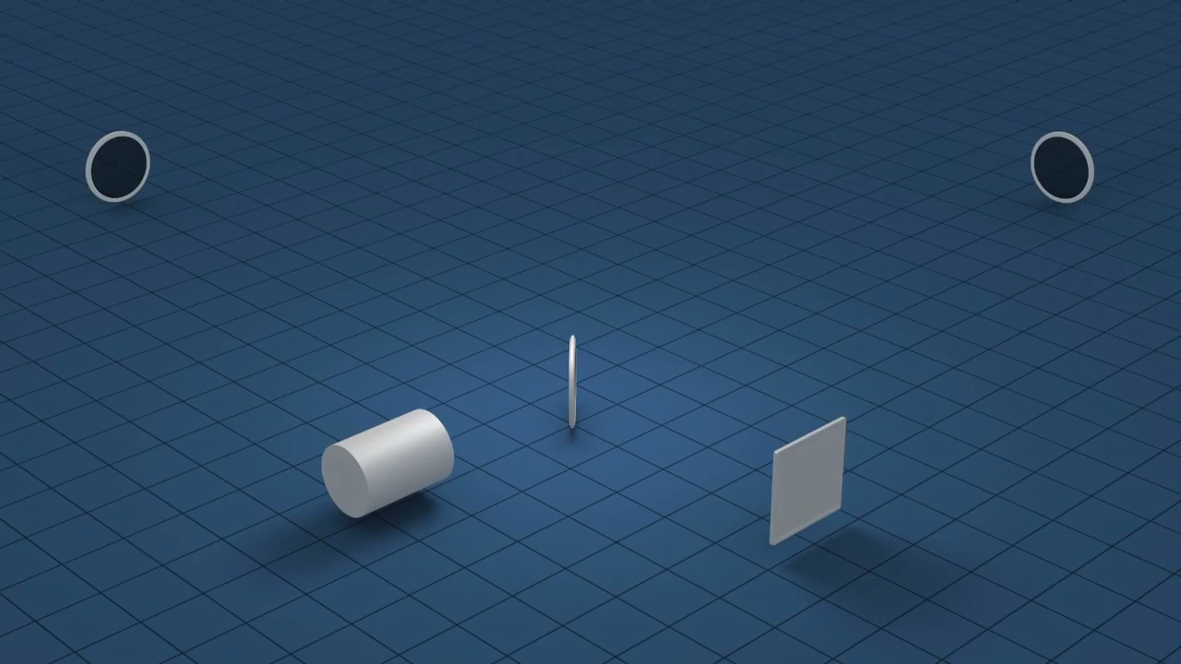
The Most Sensitive “Ruler”!
Document G2400921
Notes:
1000x smaller than diameter of a proton!!!

Slide 7
Precision of measurement
E-19 – E-20 m in 4 km (2.5 mi)
Analogy: human hair thickness distance change between Earth and Alpha Centauri (~4 LYs)
Why?
“Stiffness” of spacetime: freq. dependent, at 100 Hz: 10^20 times of steel stiffness
Document G2400921

Slide 8
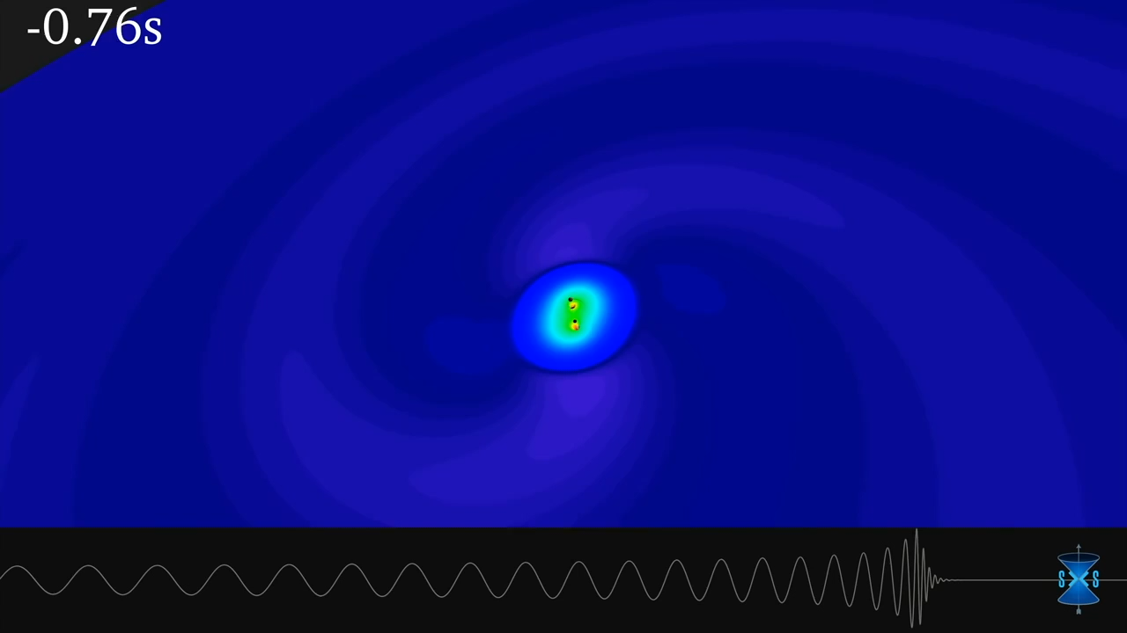
Document G2400921

Slide 9
Vacuum system overview
2nd and 3rd biggest vacuum systems in the world
Pressure: high E-8 – high E-10 Torr. Why?
  Thermal / sound insulation – rough vacuum
  Minimizing light scattering – E-4 Torr
  Contamination tracing (RGA useability) – E-7 Torr
  “Silent” pumps shall be used: Ion pump, cryogenic getter pumps: E-8 Torr and beyond
  Contamination control: as high vacuum as it can be
Document G2400921

Slide 10
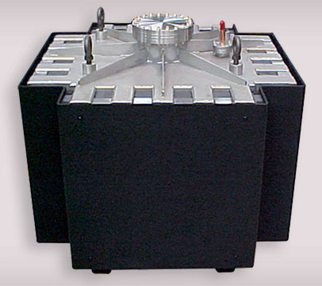
Vacuum processes 1 – maintaining vacuum
Biggest sections have not been vented since 2000! – during vents, separated by 40-44” GVs
“Silent” pumps:
Ion pumps
Cryotraps
Getters
Enhancements: more NEGs, Ion – getter pump tandems
Document G2400921

Slide 11
Vacuum processes 2 – pumping down to UHV vacuum
Tools: oil-free scrolls + Turbos (later Ion-pumps)
Enhancements: boost speed (reduce pumpdown time), clean system. 2 major projects:
1. Gas-cleaning
2. Getting rid of pump downtime → ADAM
Document G2400921

Slide 12
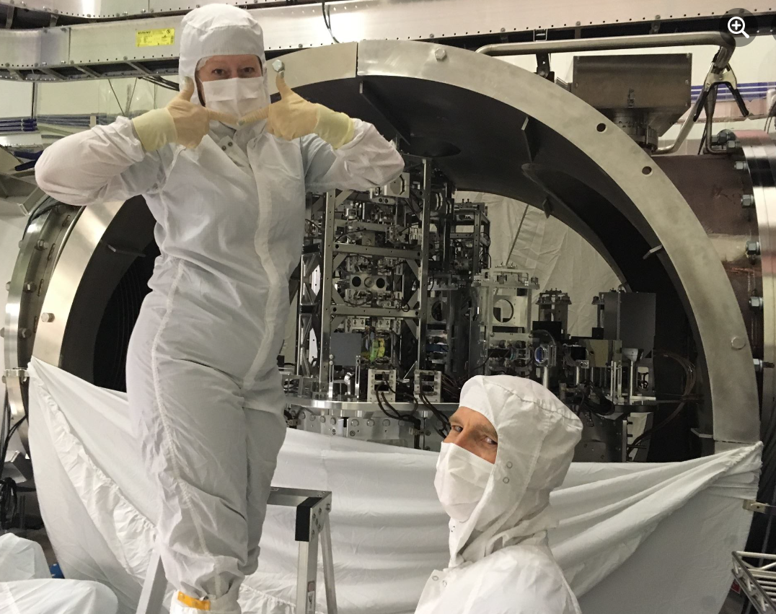
Gas cleaning – a brief overview
Problem: opening up system during a vent → water adsorption (no bakeout)
Our problem is not the particle contamination, it is the molecular contamination
Document G2400921

Slide 13
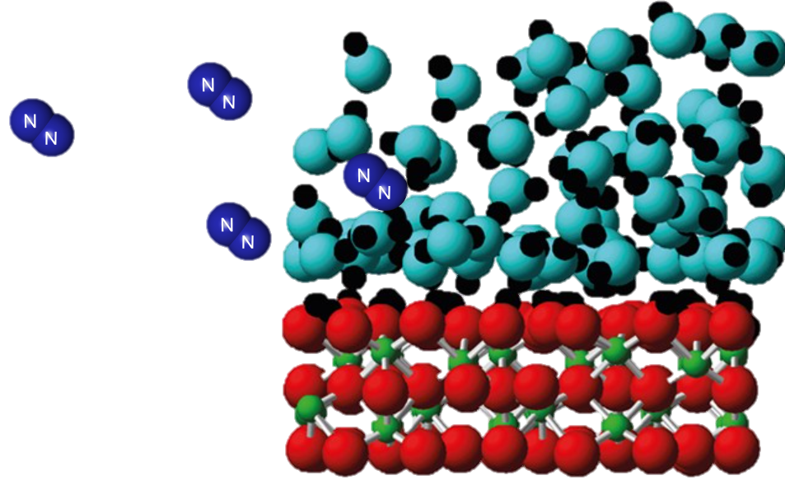

Gas cleaning – a thorough analysis
Main goal: get rid of the vast majority of contamination before HV pumping
Cleaning of: main volume; circulation lines; beamtube regeneration
Very delicate technological window, and a very complicated set of variables:
Type of gas: N2, Ar, O3, etc…
Flow rate increases: pressure (number of molecules) increases, desorption rate decreases
Huge sizes → Re number big – linear speed of molecules decreases
Finite time – ideally ~8 hrs
$Re=\frac{density ∙ velocity ∙ charateristic size}{viscosity}$
💥
💥
Document G2400921

Slide 14
Evacuation of Large Volumes
Adam K Branch
Vacuum engineer, Livingston
Improving system pump down times
Document G2400921

Slide 15
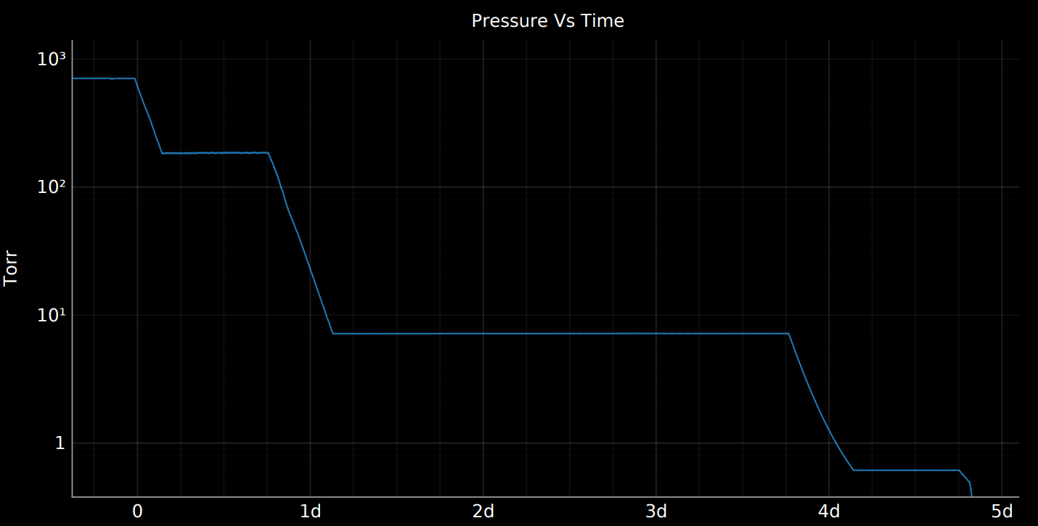
Start
Resume
EOD
WEEKEND
Resume
EOD
Resume
EOD
Document G2400921

Slide 16
System Configuration
Pumps
  Pfeiffer ATH2303M – Turbo – 2150 l/s
  Pfeiffer HEPTA 100P – Screw – 36 l/s
  Anest Iwata ISP 250 – Scroll – 5 l/s
Controls
  TPG-362 Dual Gauge Controller
  PKR-361 Full Range Gauge
  TPR-270 Pirani Gauge
Document G2400921

Slide 17
Current Operational Experience
Setpoint requires personnel present to update
Slow reaction time to various failures
Possibility to not detect a gauge failure
Mitigation Goals
Automate setpoint in relation to changing pressures
Reduce reaction time
Monitor for erroneous gauge activity
Document G2400921

Slide 18




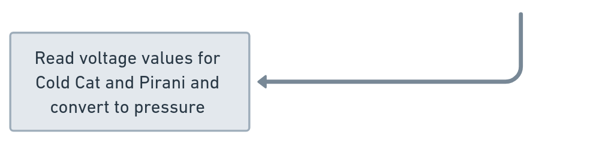
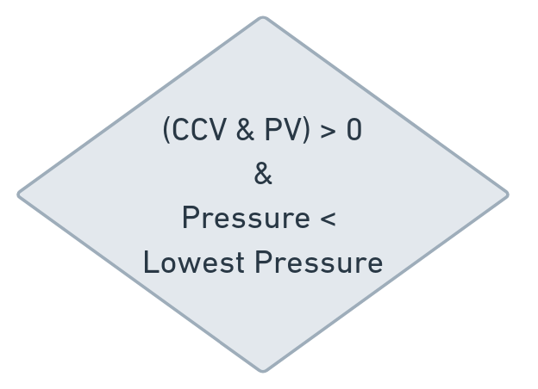
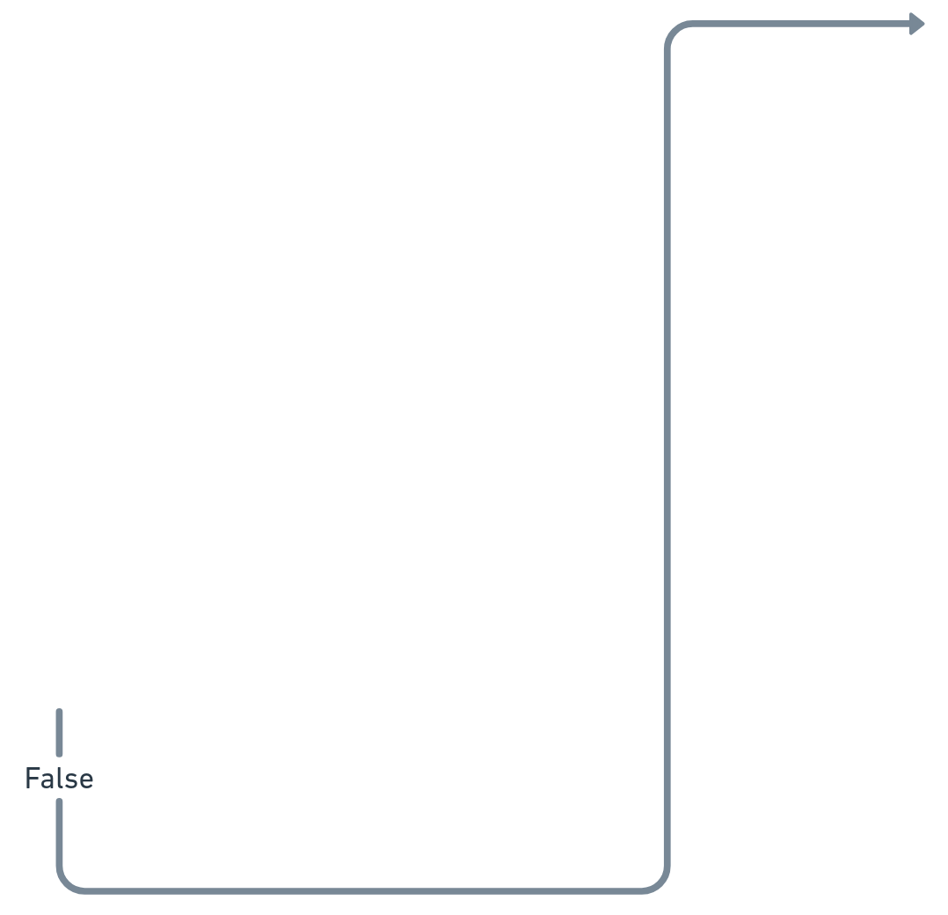
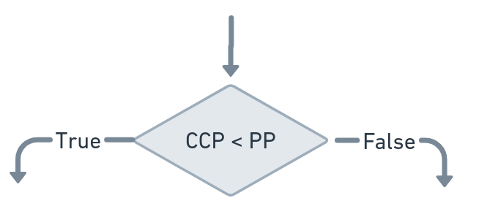
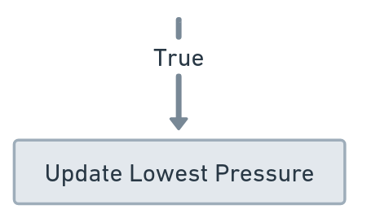

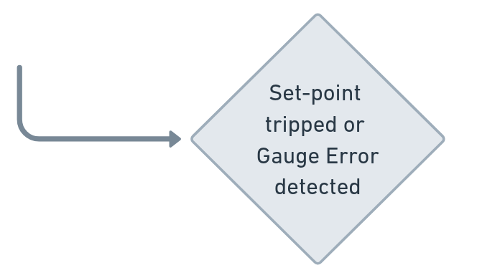
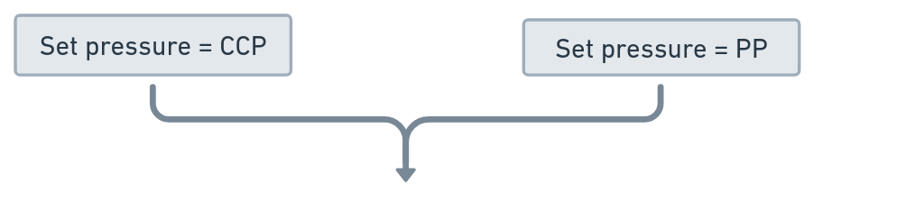
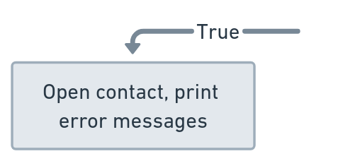
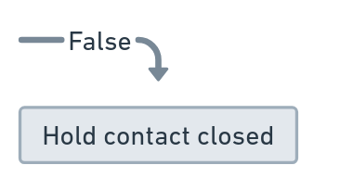
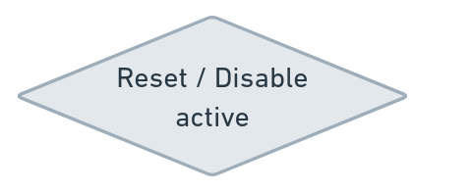
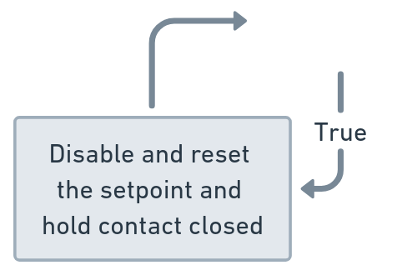

Document G2400921

Slide 19

Estimated Benefit
Possible Risks
Reduced time to achieve desired pressure
  760 torr to 5$e^{−1}$ torr in 24 hours
    Time spent valved out 93 hours
    Total time elapsed 116 hours
Consistent safety valve reaction times
  Reduce loss of progress
  Reduce chance of contamination
Introduction of new failure modes
Unexpected erroneous outcomes
I automate myself out of a job.
Document G2400921

Slide 20
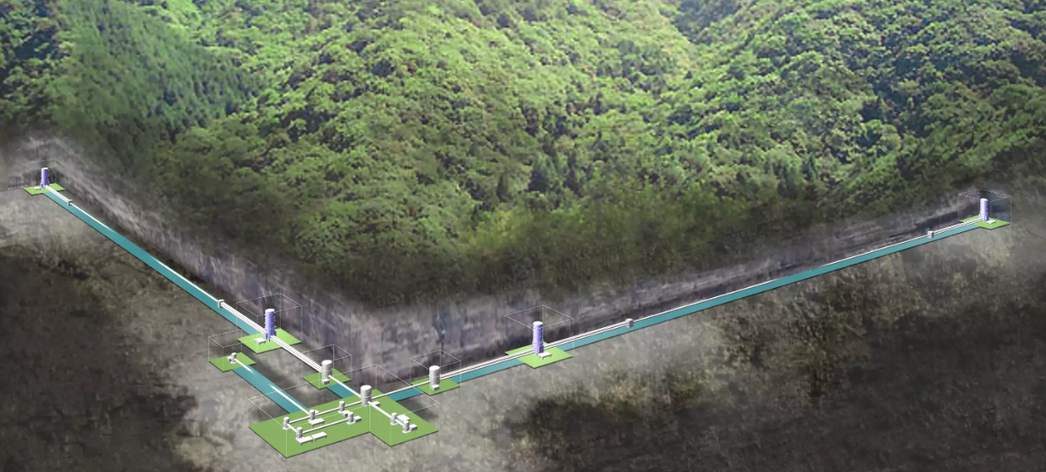
Present of Gravitational Wave Astronomy
LIGO, LIV
VIRGO, Italy
LIGO, HAN
KAGRA, Japan
Document G2400921

Slide 21
Future of Gravitational Wave Astronomy
LIGO India – 3rd leg of LIGO
CE – Cosmic explorer
ET – Einstein Telescope
LISA – Laser Interferometer Space Antenna
Document G2400921

