Slide 1
LCLS-II-HE Cryomodules Production
at Fermilab
6th Workshop on the Operation of Large Vacuum Systems (OLAV-IV)
Tug Arkan
15-19 April 2024

Slide 2
Outline
What is LCLS, LCLS-II, LCLS-II-HE?
What is a Cryomodule?
Cryomodule production infrastructure at Fermilab
LCLS-II-HE Cryomodules production
Summary

Slide 3
LCLS, LCLS-II, LCLS-II-HE

Slide 4
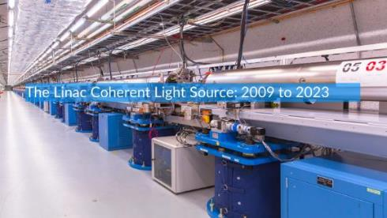
LCLS – Linear Coherent Light Source
Thanks to Greg Hays for his input
LCLS at SLAC takes X-ray snapshots of atoms and molecules at work, revealing fundamental processes in materials, technology and living things. LCLS, the world’s first hard XFEL, produced its first light in April 2009, generating X-ray pulses a billion times brighter than anything that had come before. It accelerates electrons through a copper pipe at room temperature, which limits its rate to 120 X-ray pulses per second.

Slide 5
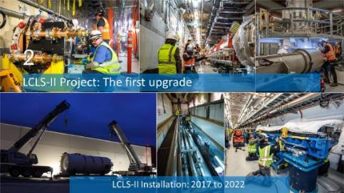
LCLS-II
Thanks to Greg Hays for his input
The LCLS-II upgrade takes X-ray science to a whole new level: It can produce up to a million X-ray pulses per second, 8,000 times more than LCLS, and produce an almost continuous X-ray beam that on average will be 10,000 times brighter than its predecessor – a world record for today’s most powerful X-ray light sources.
Central to LCLS-II’s enhanced capabilities is its revolutionary superconducting accelerator. It comprises 37 cryogenic modules that are cooled to minus 456 degrees Fahrenheit (2 degrees Kelvin) – colder than outer space – a temperature at which it can boost electrons to high energies with nearly zero energy loss.
Fermilab and the Thomas Jefferson National Accelerator Facility played pivotal roles in designing and building these cryomodules (CM). Fermilab led the cryomodule design, pioneered the SRF cavity performance R&D, and has successfully delivered 20 (seventeen 1.3 GHz and three 3.9 GHz cryomodules).

Slide 6
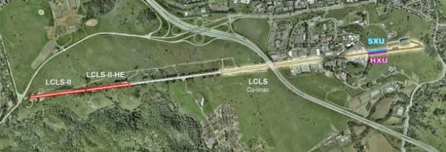
LCLS-II-HE
Thanks to Sam Posen for his input
LCLS-II has dramatically higher repetition rate than LCLS, but as built, it is limited to lower photon energies, meaning that it can’t probe the same things that LCLS could. The LCLS-II-HE project will double the energy of the SRF linac (Fermilab is building 14 of the 24 CMs) to 8 GeV, making it possible to generate photons at higher energies. This increased x-ray energy will make it possible to explore new regimes not reachable with LCLS-II alone. LCLS-II-HE will probe materials that LCLS-II could not, it will study structural dynamics on the atomic scale, and it will enable new studies in biology and quantum materials. These will provide fundamentally new capabilities for discovery science.

Slide 7
Cryomodule (CM)

Slide 8
Cryomodule - Wikipedia
A cryomodule is a section of a modern particle accelerator composed of superconducting RF (SRF) acceleration cavities, which need very low operating temperatures, often around 2 Kelvin. The cryomodule is a complex, state-of-the-art supercooled component in which particle beams are accelerated for scientific research. The superconducting cavities are cooled with liquid helium.

Slide 9
1.3 GHz CM
Thanks to Yuriy Orlov for all the CAD pics
1.3 GHz CM design stems from Tesla Technology Collaboration (TTC). LCLS-II and LCLS-II-HE 1.3 CMs are modified design per the requirements.

Slide 10
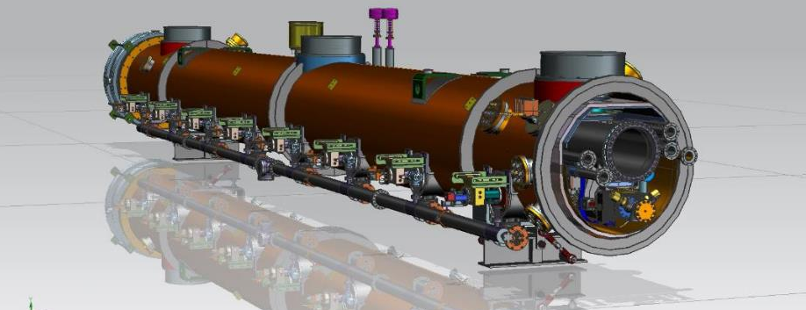
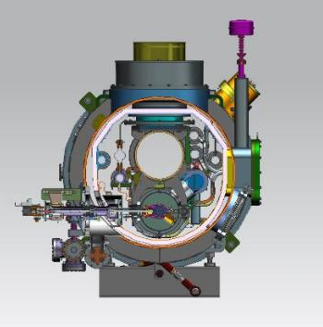
1.3 GHz CM
3 vacuum systems:
Particle free UHV beamline vacuum
UHV fundamental coupler vacuum
Insulating vacuum

Slide 11
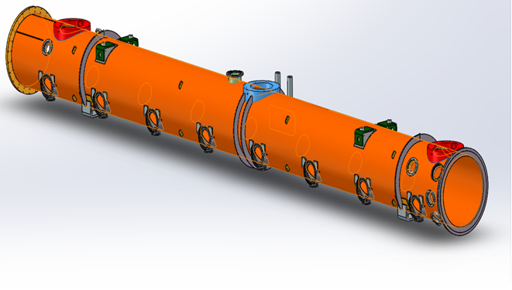
1.3 GHz CM Components – Vacuum Vessel
Carbon steel body with stainless steel flanges
Vacuum vessel provides a barrier where vacuum can be pumped down to provide the needed conditions for a cold cryomodule
At room temperature
Insulating vacuum inside

Slide 12
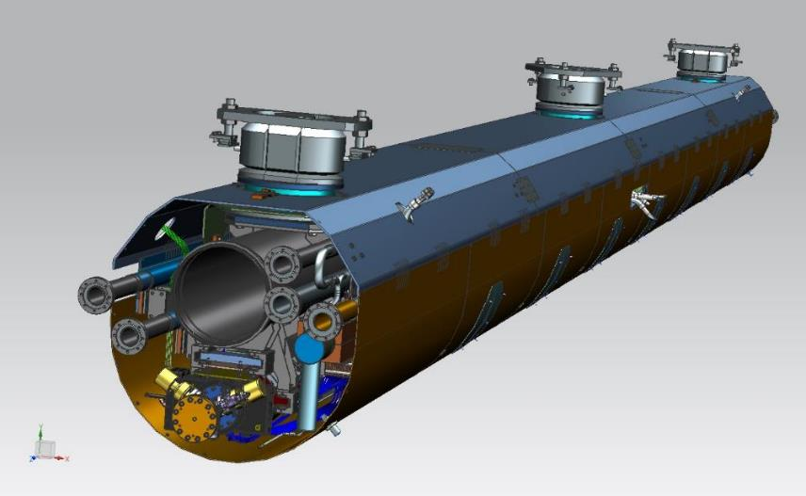
1.3 GHz CM Components - Coldmass
Thermal design:
Minimize thermal loss
Typically uses multi-layer insulation and intermediate temperature boundary
in a vacuum chamber
50~55K
2K
With top and bottom thermal shields

Slide 13
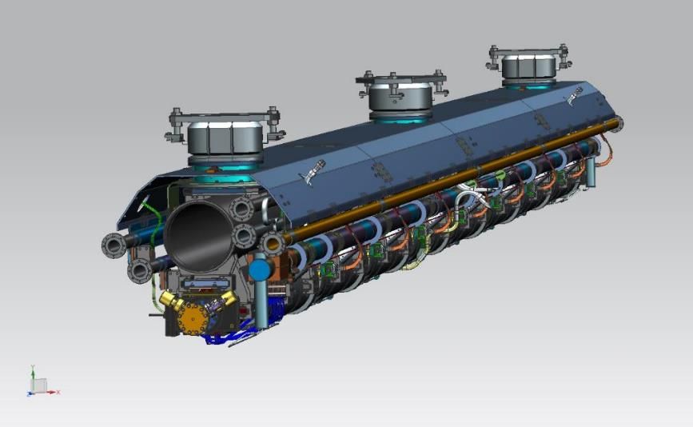
1.3 GHz CM Components – Coldmass
Without lower heat shields

Slide 14
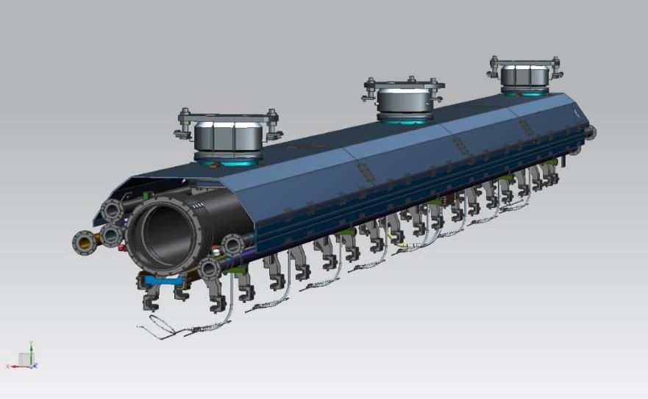
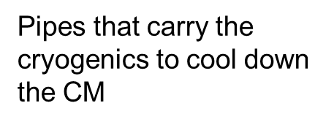
1.3 GHz CM Components – Upper Cold Mass
-Upper cold mass also serves a structure to carry the cavity string

Slide 15
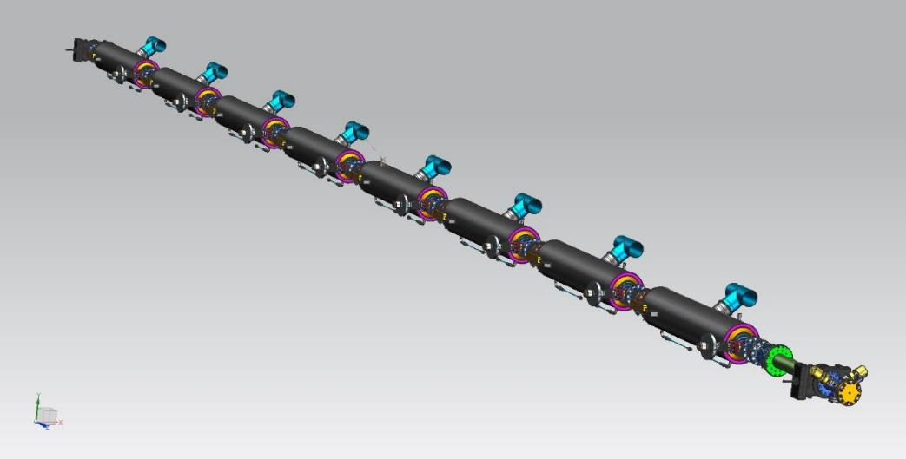
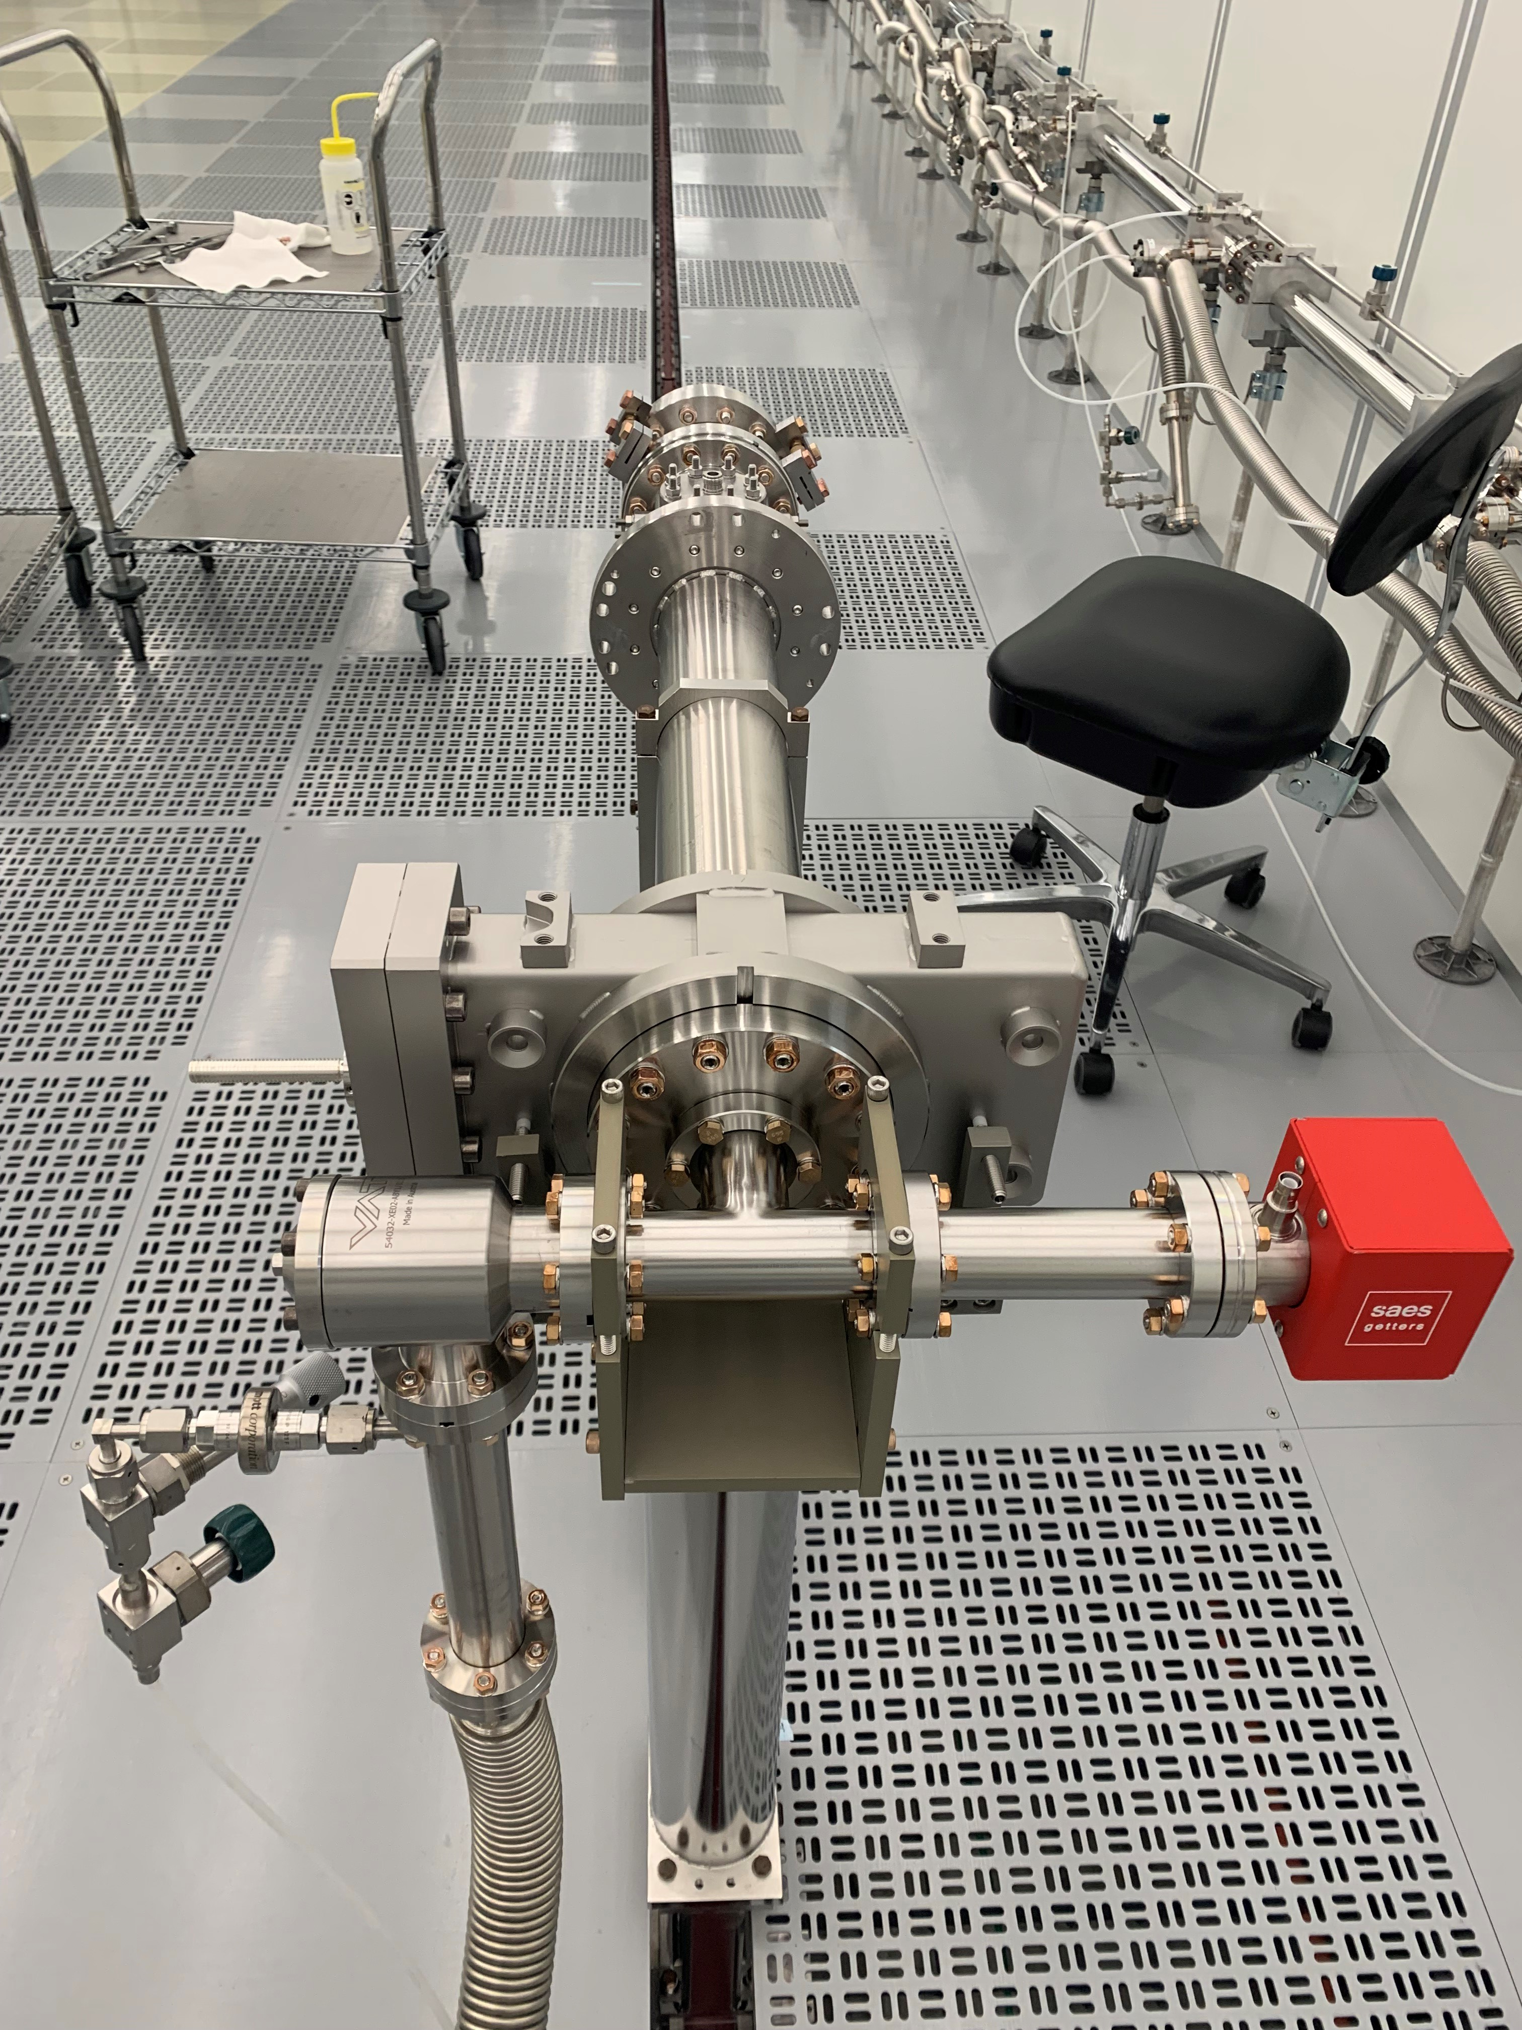
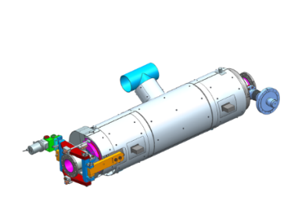
1.3 GHz CM Components – SRF Cavities String
Jacketed cavity
Bare cavity
NEG/ion pump to keep the beamline under vacuum
Magnetic shielding: Reduces ambient magnetic field

Slide 16
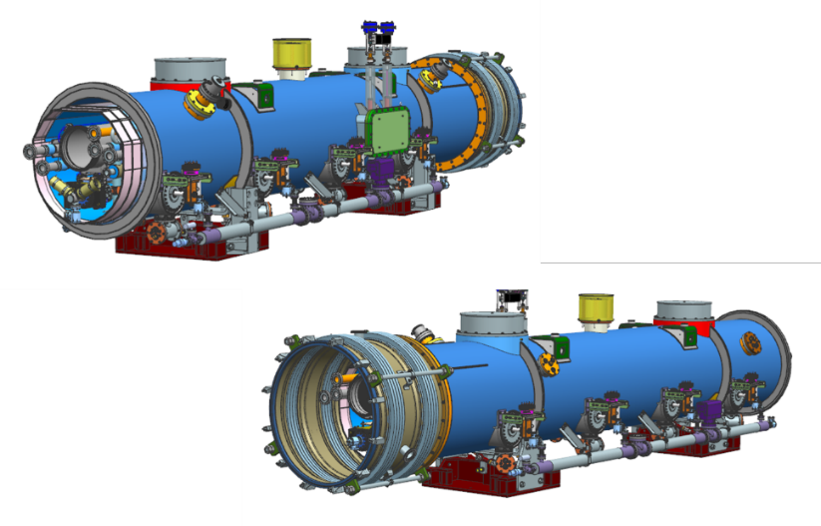
3.9 GHz CM
Two 3.9 GHz CMs are used at LCLS-II in the beginning of the Linac to linearize the electron beam.
Design of this CM stems from CM that Fermilab has successfully designed and built in 2008 for DESY FLASH accelerator.

Slide 17
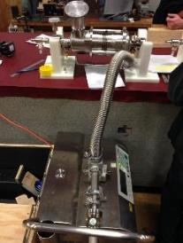
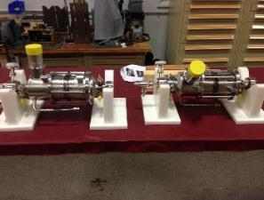
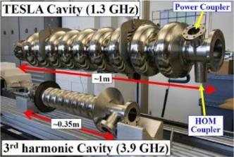
3.9 GHz CM Components
cavities

Slide 18
1.3 GHz Cryomodule Production Facilities
at Fermilab

Slide 19
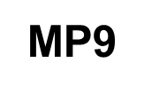
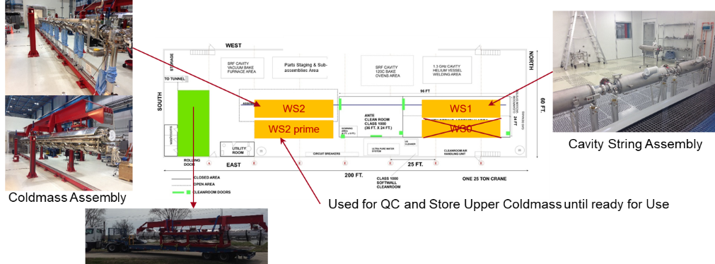
MP9 Production Floor
C. Grimm
PIP-II CM assembly

Slide 20
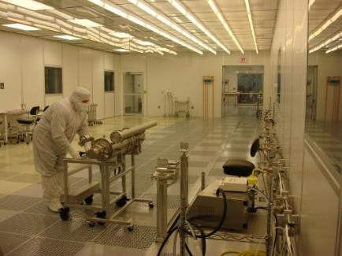
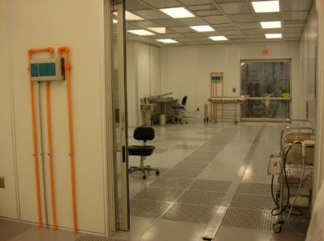
MP9 Cleanroom-I
Class 100
Cavity String Assembly Cleanroom ~2500 square feet (ISO 4-5-6)
A cleanroom is an engineered space, which maintains a very low concentration of airborne particulates​
A cleanroom is designed to keep everything from dust, to airborne organisms, or vaporized particles, away from it, and so from whatever material is being handled inside it.
Working on SRF cavities internal surfaces requires contamination free standards to achieve and preserve the performance specification
Working with Cleanroom and ultra high vacuum protocols facilitate particle (dust, metal, linen etc.) free and oils/unwanted chemicals free SRF surfaces.
Class 10
Class 1000
Rail

Slide 21
ICB Production Floor
C. Grimm

Slide 22
LCLS-II-HE Cryomodules Production

Slide 23
LCLS-II-HE Production CMs Workflow at Fermilab – workstations
Design/Engineering/Drafting - Procurements - Incoming Quality Control - Parts/Components Inventory management
Receive SRF cavities, ready to be tested in VTS (vertical test stand) cavities from the vendor
Incoming Inspection at IB4
Test SRF cavities in VTS at IB1
Cavity String Assembly at MP9 Cleanroom-I (WS1)
Cold Mass Assembly at MP9 (WS2 / WS2 prime)
Cold Mass Assembly at ICB (WS3 /WS3 prime & WS4)
Final Assembly (WS5) and prep for transport to CMTS (WS6) at ICB
Cryomodule Test at CMTS
Prep & Ship to SLAC at ICB (WS6 & WS6 prime)

Slide 24
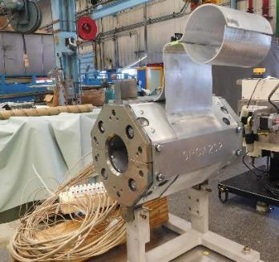
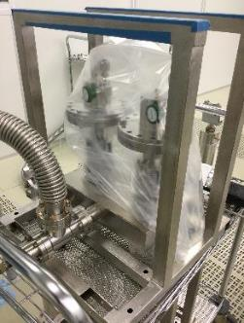
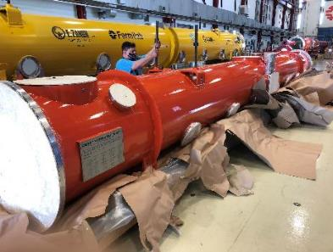
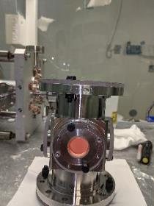
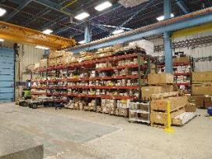
Receiving – Incoming QC – Inventory Management
Vacuum vessel
Magnet
Power coupler
BPM
~50,000 parts in a 1.3 GHz CM. Need to be ordered, QC, stored-inventoried, kitted and provided timely to the CM production workstations
Components storage at IB2

Slide 25
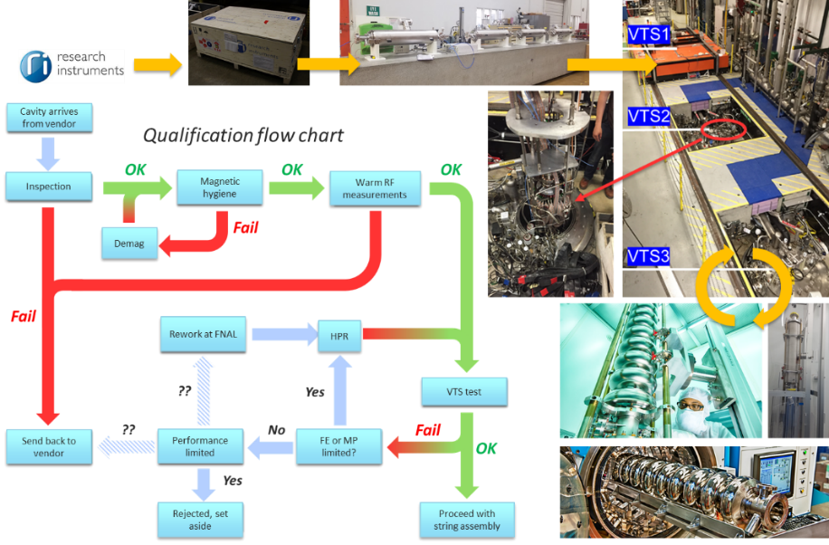
SRF Cavities Qualification
IB1
IB4
ANL SCSPF
IB4 CPL

Slide 26
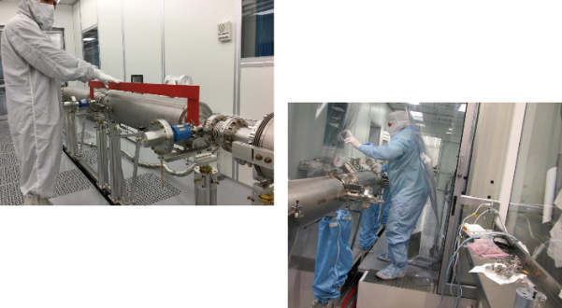
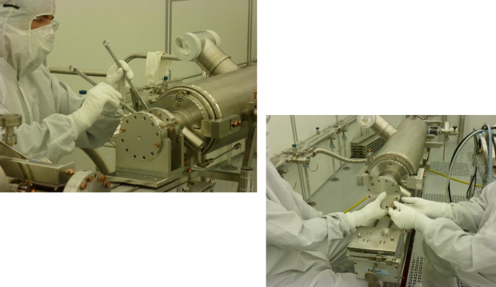
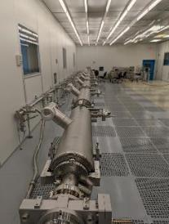
SRF Cavity String Assembly at WS1 – MP9 Cleanroom #1
See Genfa Wu talk: Low Particulates Vacuum Operation in SRF Cavity and String Assembly
Particle free ultra high vacuum quality assembly work. Challenge is to assemble qualified cavities into a string and still preserve the performance of individual cavities

Slide 27
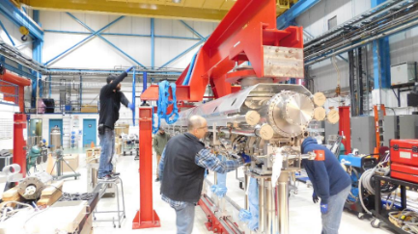
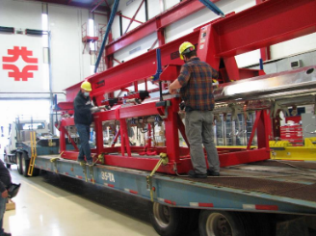
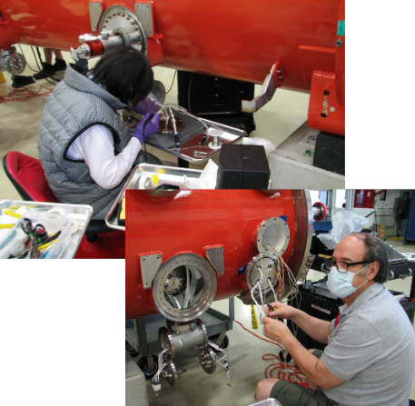
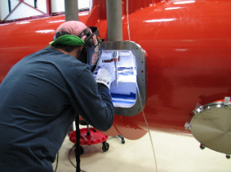
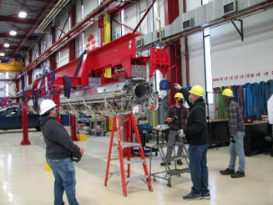
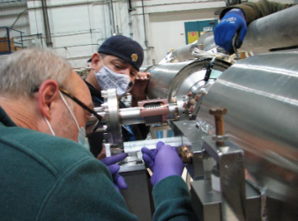
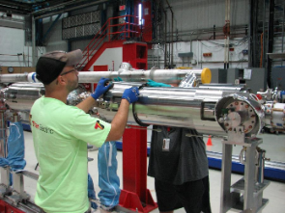
CM assembly WS2~WS5 – MP9/ICB Production Floors
Amazing work of technicians, welder, engineers, scientists and support personnel

Slide 28
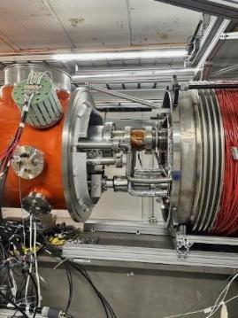
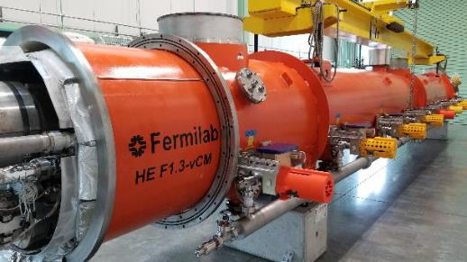
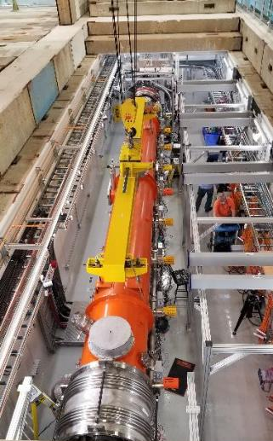
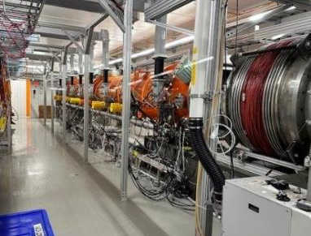
CM test at CMTS
See Brian Hartsell talk Operational Experience of a Cryomodule Test Stand for LCLS-II Cryomodules
All cryomodules that are produced are transported to CMTS (CryoModule Test Stand) at CMTF (CryoModule Test Facility) for cold testing at full power. This characterizes integrated cavity and full cryomodule performance.

Slide 29
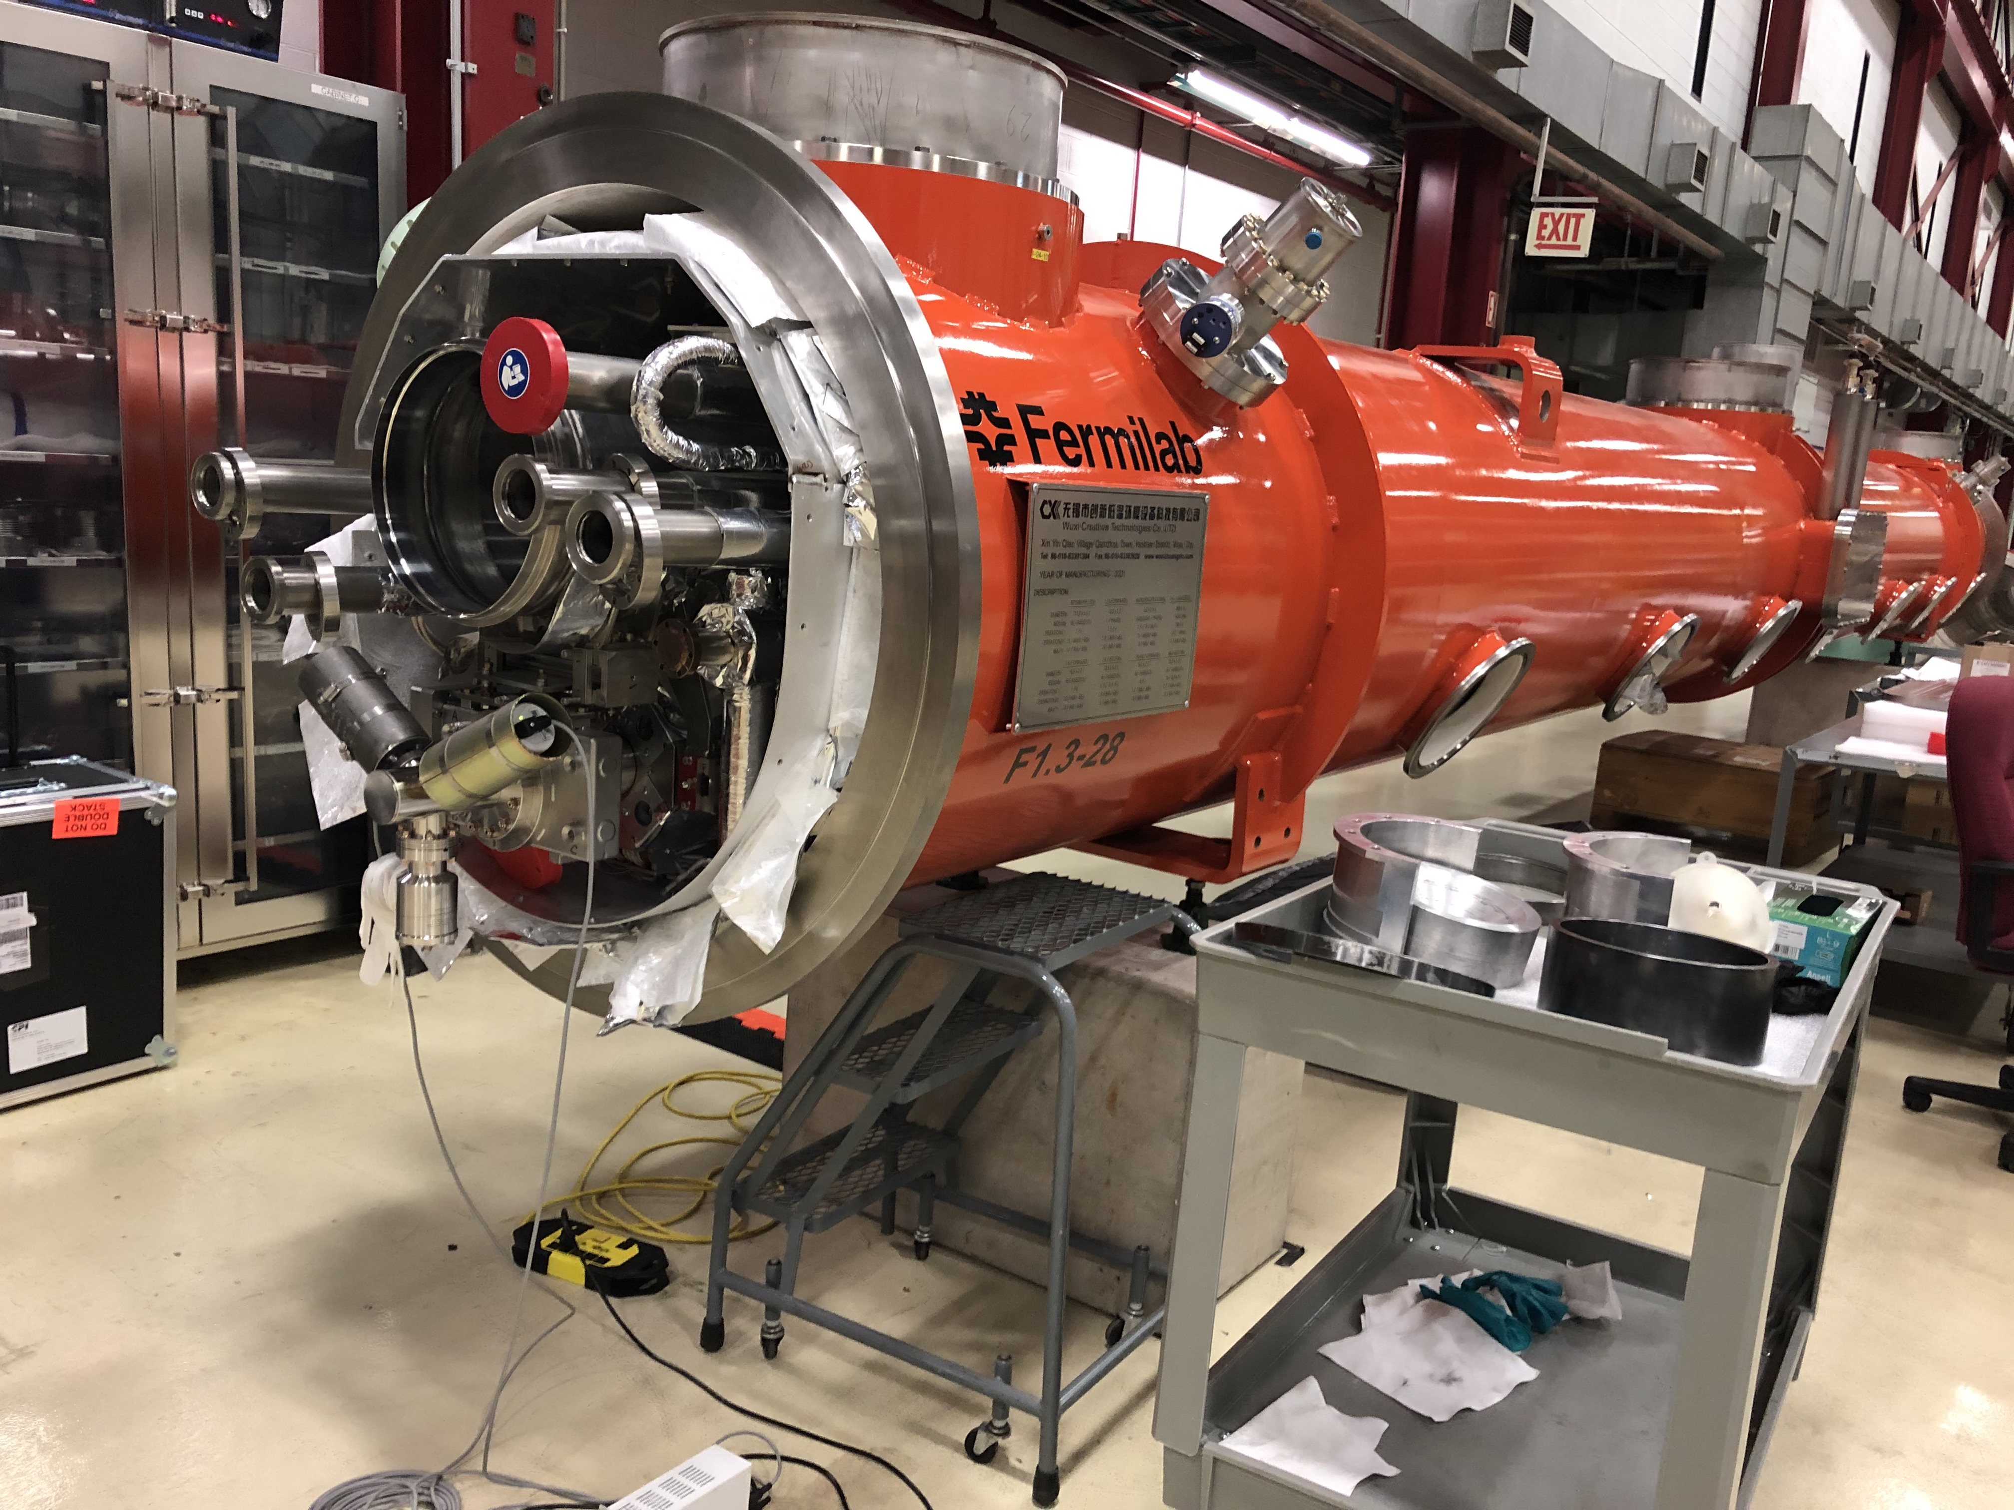
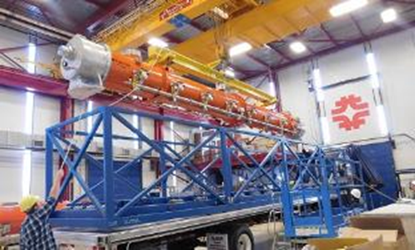
CM shipping to SLAC
Beamline under vacuum, monitored with cold cathode gauges
Coupler warm under vacuum
Insulating vacuum space vented, slightly pressurized with nitrogen

Slide 30
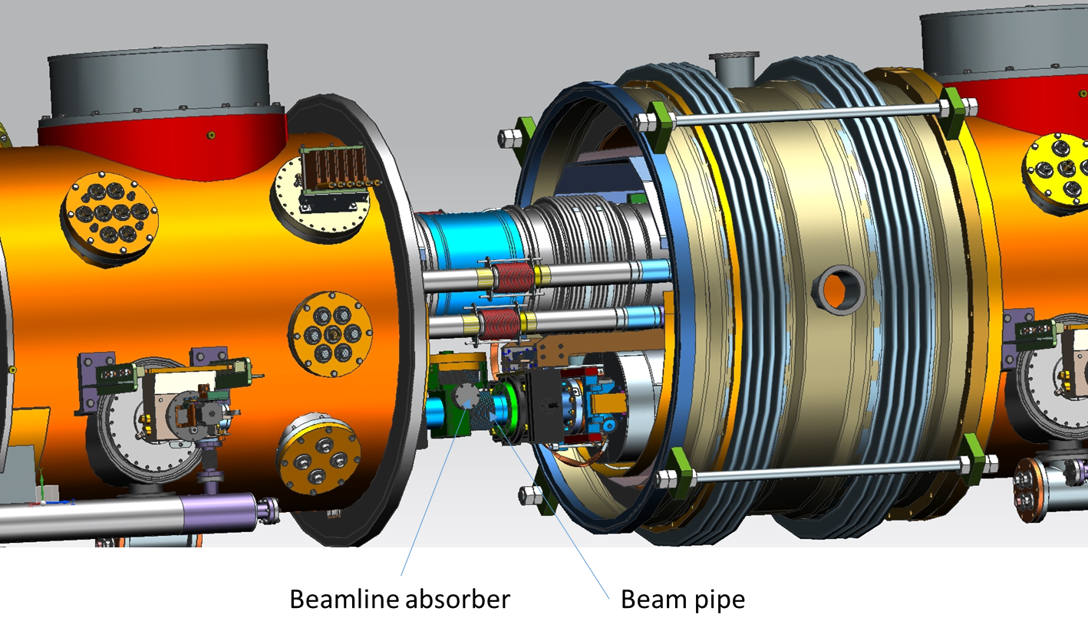
From LCLS-II to LCLS-II-HE CM Production
Fermilab has successfully completed its scope for LCLS-II in 2019. See next talk by Giulia Lanza & Robert Coy LCLS-II Particle Free Vacuum System: assembly and commissioning
LCLS-II CM production at Fermilab was a great learning experience. We have leveraged from the best practices and some of the unwanted outcomes. LCLS-II-HE is built upon this strong foundation!
DOE and SLAC made a good decision to start the LCLS-II-HE CM production right after the end of LCLS-II. This is a great strategy to keep the momentum of knowledge, experience at partners and in industry.
Very minimal CM design change from LCLS-II to LCLS-II-HE. Mainly SRF cavities preparation recipe has changed for higher performance specs. We also made some changes to the CM assembly procedures to preserve the higher performance specs.
For LCLS-II-HE, we have built a verification CM in 2020~2021 to verify that the changes made are validated. Great success, a world record CM is produced and tested at Fermilab. vCM performance gave peace of mind and green light to embark into the series CMs production

Slide 31
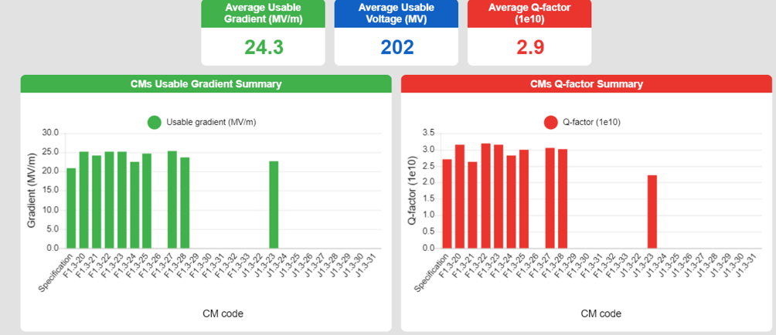
LCLS-II-HE Cryomodules Production Status
1.3 GHz CM design work is 100% complete
Fermilab has successfully produced and delivered 8 cryomodules
Production of the remaining 6 cryomodules is going well
World class performance results of cryomodules tested to date prove that Fermilab consistently produces high quality work

Slide 32
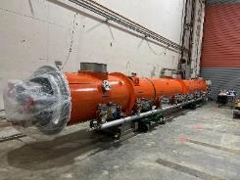
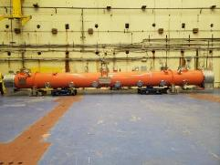
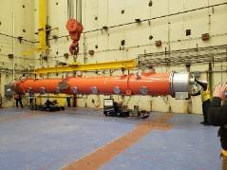
Technical Highlights-I
F25 at SLAC
F27 at SLAC
F28 at SLAC

Slide 33
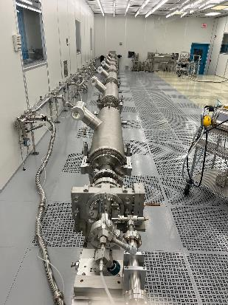
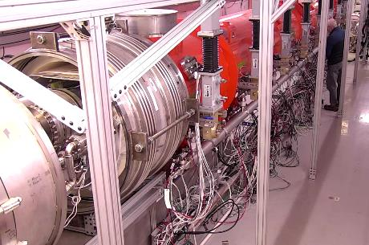
Technical Highlights-II
F1.3-29, cryomodule test in progress
F1.3-30, coldmass assembly in progress
F1.3-31, cavity string assembly in progress

Slide 34
Quality Assurance
Quality culture is in place
We follow established Fermilab and project QA processes
We have experienced some high impact non-conformance - Chipped fundamental power coupler ceramic on F1.3-26
Relevant to this workshop:
Warm coupler pumping line hydrocarbon contamination
Leaky interconnect bellows replacement during string assembly caused FE and performance degradation
Cryogenic pipe leak found at test stand with pressurized cryo lines and insulating vacuum pumped down.
CM assembly is challenging, and we are continually learning and improving

Slide 35
Summary
Fermilab remains fully committed. LCLS-II-HE is a high priority, high visibility project at the Lab to ensure that proper resources are allocated to complete the remaining scope.
To date, Fermilab has successfully produced and delivered 8 world class cryomodules to SLAC.
Remaining scope is going well. Fermilab plans to deliver its last cryomodule in April 2025
Our mission is to continue producing world class cryomodules. Our motto is to maintain focus. Safety and Quality are paramount to our continued success.

Slide 36
Backup

Slide 37
SRF at Fermilab: Brief Summary
G. Eremeev
Fermilab capabilities in SRF include a complete technological cycle:
RF design of various cavity shapes (spoke resonators, elliptical cavities, compact crab cavities, SRF guns)
Developing innovative cavity treatment recipes to increase cavity Q and/or gradient specific to project demands
Design of cryomodules and auxiliary components
Testing for design verification, e.g. horizontal teste of fully dressed cavities
Procurement and fabrication of components
Component preparation, e.g. cavity treatment (EP/BCP, HPR at FNAL and joint ANL/FNAL facility; doping/baking at FNAL), and testing, e.g. vertical cavity testing, FPC testing
Cryomodule assembly: two large clean room for cavity string assembly, two high-bay cryomodule assembly areas
Shipping cryomodules to final destination
Frontier projects which build upon our SRF facilities + experience include the following:
PIP-II, LCLS-II, LCLS-II-HE, HL-LHC AUP

Slide 38
Cavity String on cleanroom assembly tooling rolled to WS2
Split Magnet Installation
Instrumentation
Magnetic Shielding
2-phase Pipe Welding
Upper Cold Mass to string alignment
Cold Mass Upper and cavity string coupled

Slide 39
Tuner Assembly
Thermal Intercepts Assembly
Magnet Current Leads
Lower Heat Shielding Welding

Slide 40
Magnet current leads soldering to the flange
Instrumentation flanges
Warm end coupler Installation
Insulating Vacuum Leak Check

