Slide 1
Proposal of OLAV VII
Yasunori Tanimoto, KEK, Japan
Junichiro Kamiya, JAEA/J-PARC, Japan
OLAV VI, Fermilab, April 18, 2024

Slide 2

History of OLAV
OLAV I 2005/4/11-12, CERN, Switzerland
OLAV II 2008/3/10-12, Daresbury Lab., UK
OLAV III 2011/7/11-14, ORNL, USA
OLAV IV 2014/4/1-4, NSRRC, Taiwan
OLAV V 2017/5/9-12, DESY, Germany
OLAV VI 2024/4/14-19, Fermilab, USA
OLAV VII 2026 or 2027, KEK/J-PARC, Japan ?
OLAV
September will be a good candidate for OLAV in KEK.
Long shutdown is scheduled every year from July to September.

Slide 4
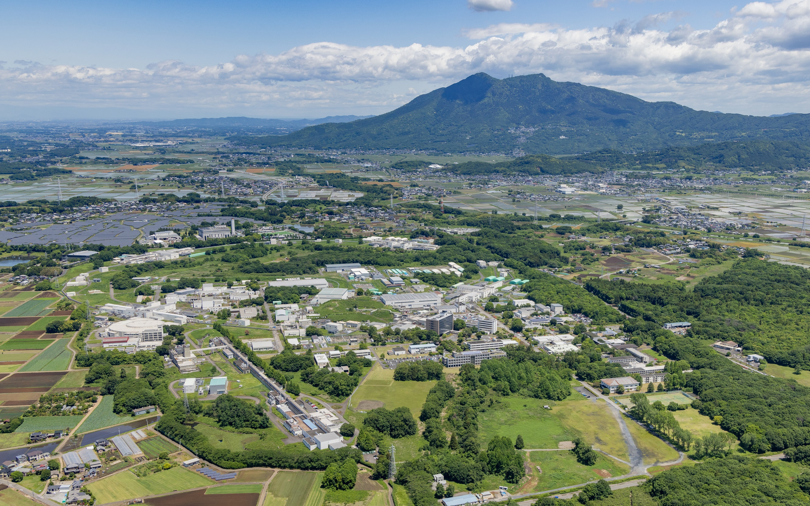





Tsukuba Campus
KEK - High Energy Accelerator Research Organization
Mt. Tsukuba
SuperKEKB
PF-AR
ATF
STF
cERL
PF-ring
e⁻/e⁺ Linac

Slide 5
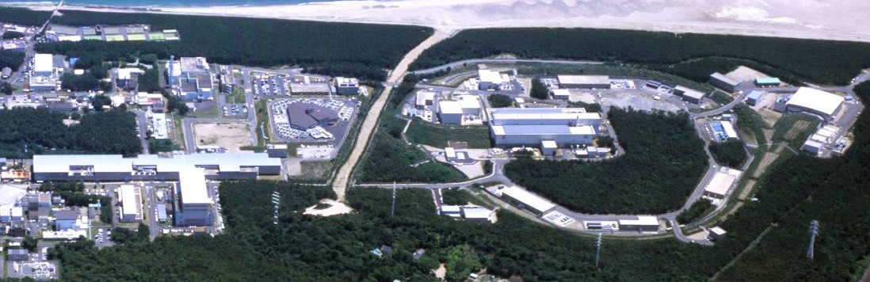
Japan Proton Accelerator Research Complex
Material structure, mechanism and industrial application with neutron and muons
Transmutation Experimental Facility
(Phase II)
Materials and Life Science Experimental Facility
Hadron Experimental Facility
R&D for nuclear transmutation with neutrons
Neutrino Experimental Facility
1 km
Nuclera and particle physics with K-mesons
area : 65 ha
Neutrino oscillation
neutrino beam
500 m
3-GeV Synchrotron
→ 99.95％ of
light speed
Linac
→ 71% of light speed
→ 97% of
light speed
Super-Kamiokande
50-GeV Synchrotron
3 proton accelerators
and (3+1) experimental facilities

Slide 7
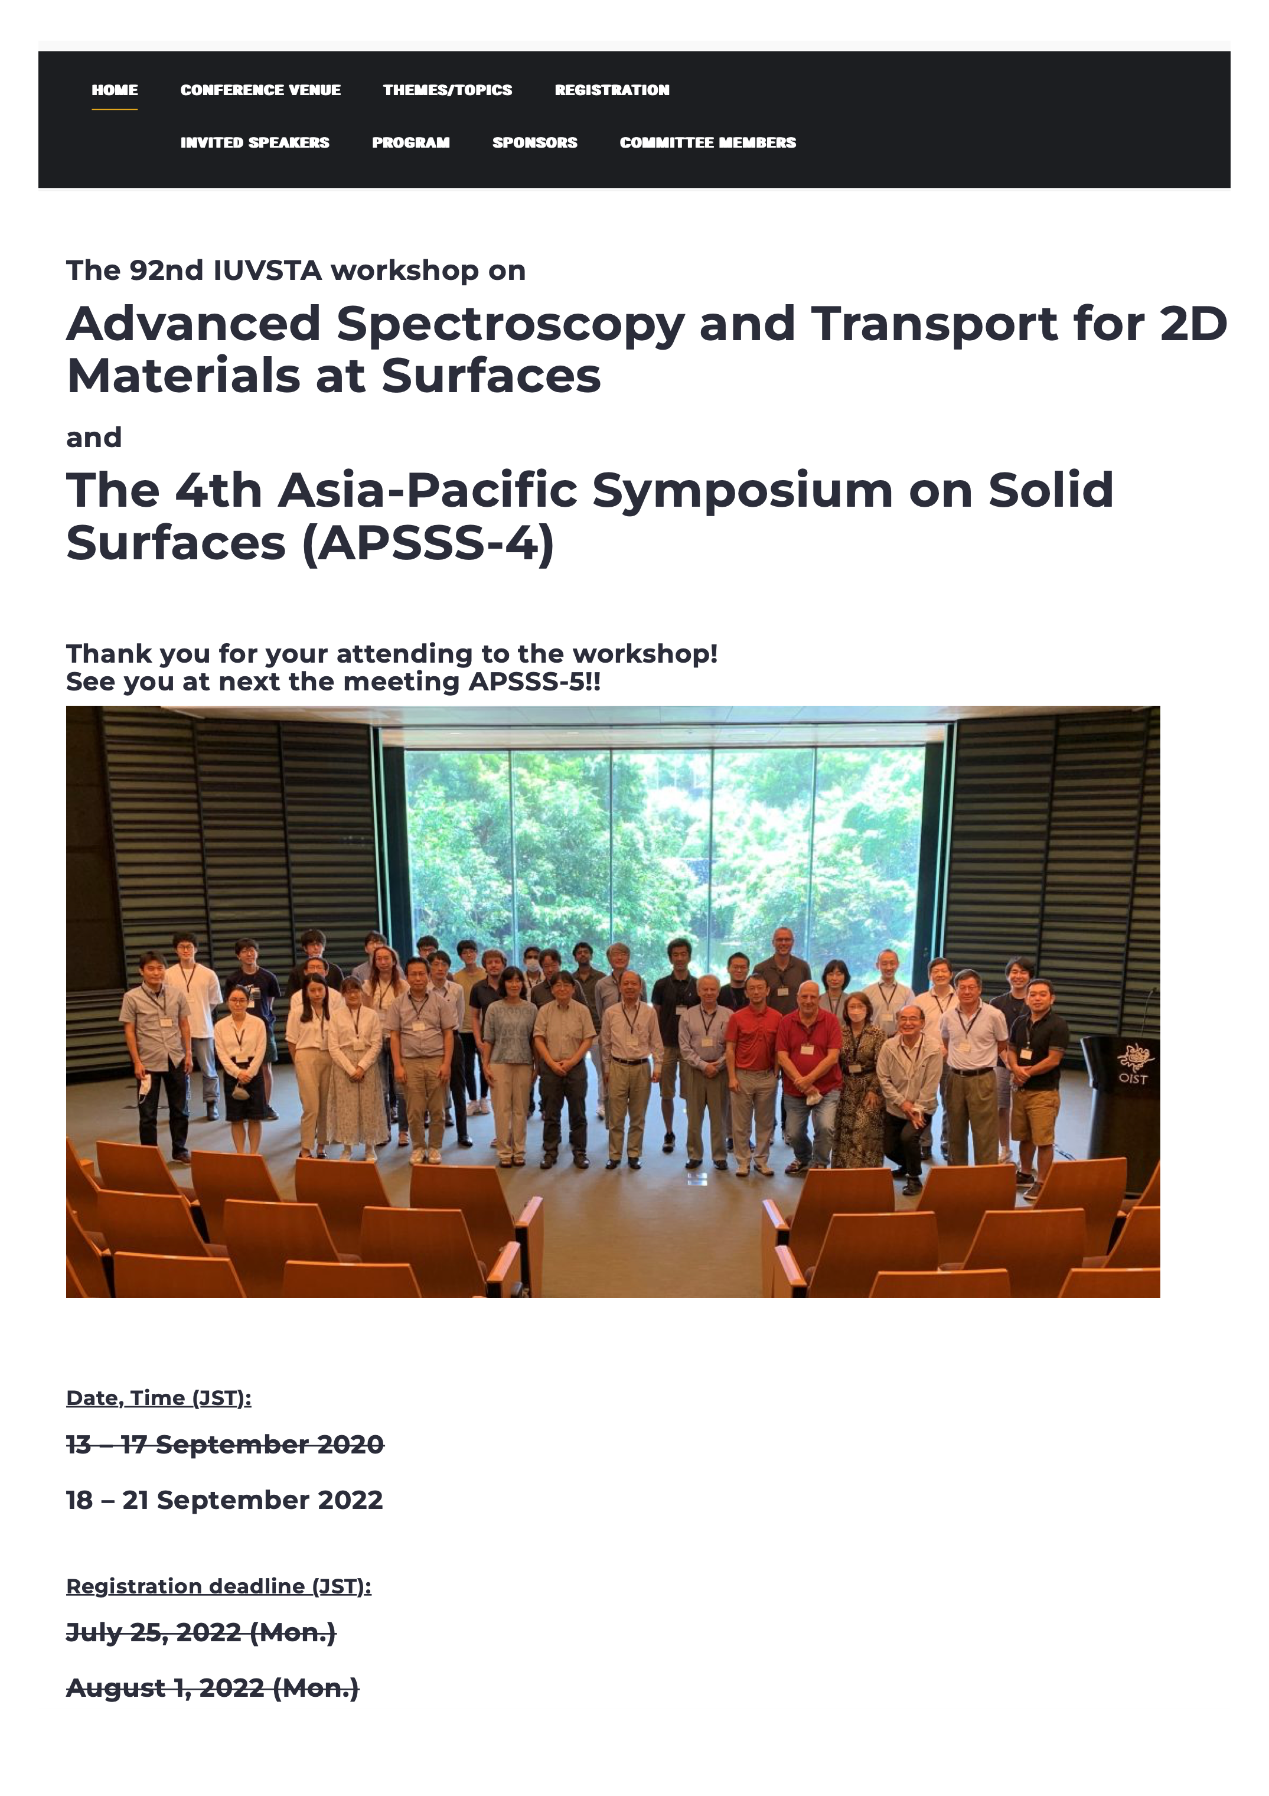

Slide 8
Possible Highlight Topics
for IUVSTA Workshop
· Computer Simulations
Synrad & Molflow, Structural analysis, Particle interactions …
· Outgassing from Surface
Thermal desorption, Photon stimulated desorption (PSD),
Surface treatments, Functional coatings, Vacuum firing,
Standardization …
· New Technologies
3D printing, Machine learning, Artificial intelligence,
Robots, Sustainable technologies …

