Slide 1
Welcome to Fermilab
OLAV-VI: the 6th Workshop on the Operation of Large Vacuum Systems
April 15 - April 19, 2024

Slide 2
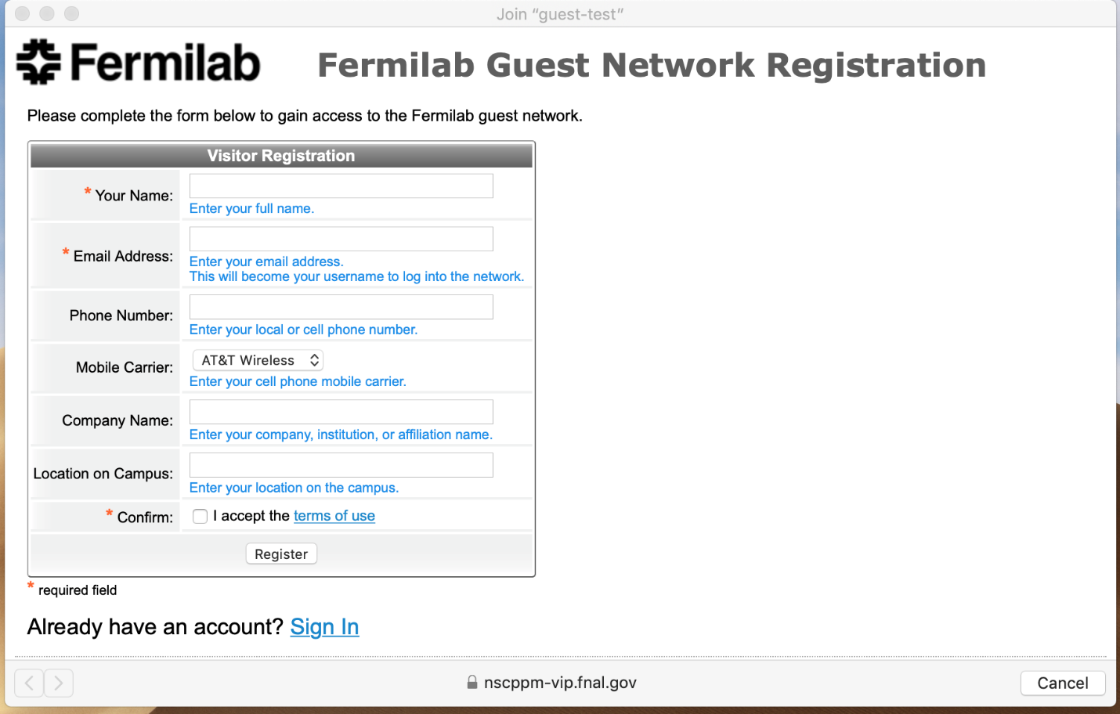
Fermilab Guest Wi-Fi Network Registration
All electronic devices connecting to the Fermilab Visitors wireless network must go through a self-registration process.
Below are the steps to self-register:
Associate your device with the “guest” network.
Complete the required fields marked by an * in the self-registration portal form.
After submitting the form, click the “log-in” button to connect to the network for 8 hours of access.
For access up to 1 week, check your e-mail with the subject “Confirmation Required” to confirm your registration. Use the credentials provided for future logins during that time.

Slide 3
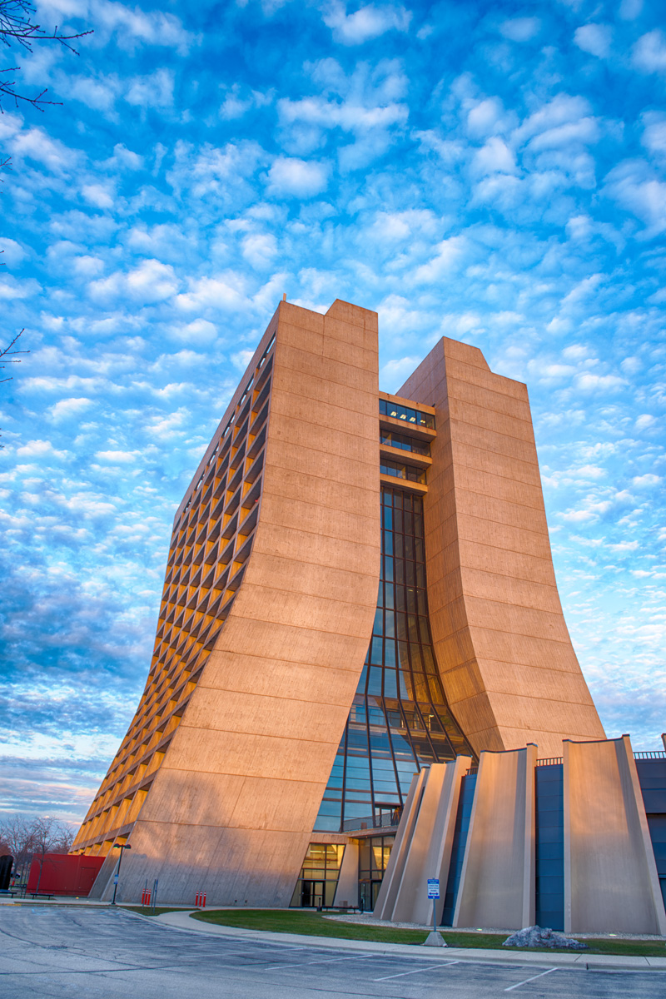
Your safety and security are our top priority!
Listen to the instructions on loudspeakers as they will guide you on what to do in case of an emergency.
If tornado sirens/alarms go off, proceed to basement to shelter (signs are posted on the nearest basement stairwell). Do not leave the shelter until instructed to do so by emergency response personnel.
If fire alarm sounds or strobes, evacuate and move away from the building. Do not leave or reenter until Fermi Fire Department clears the area.
Hold the handrail when climbing or descending stairs.
Follow all traffic rules on site and keep an eye out for pedestrians.
Stay within the following areas of Wilson Hall (WH): Ramsey Auditorium, 1st floor, ground floor, and 2nd floor gallery area – other areas in WH require escort from badged personnel.
Welcome, and enjoy your visit!
For emergencies, call
630-840-3131
OLAV-VI: 6th Workshop on the Operation of Large Vacuum Systems – April 15-19 2024

Slide 4
Fermilab Access Days 2+
Visitors may enter through Kirk Road/Pine Street or Batavia Road/Rt 59 entrances.
Present your Real ID and visitor badge* at the security gate.
Proceed directly to Wilson Hall.
*If the visitor badge is misplaced, it is strongly recommended that visitors arrive at the Batavia Road/Rt 59 entrance, present their Real ID and QR code, and proceed to the Aspen East Welcome and Access Center.
If needed, Alex Chen, Lucy Nobrega, or Hannah Fee to coordinate rideshare service Campus Access.

Slide 5
Schedule
Start @ 9:00 Tues; 8:30 Wed and Thurs – see indico site for timetable
Group Photo: 10:30 am on Tuesday
One hour lunch each day (on your own) – see indico site for details
Tuesday Reception @ 6:15 pm, Wilson Hall15XO.
Meet by Atrium elevators. 1 Fermilab escort : 10 non-Fermilab folks
Wednesday: Dinner @ 6:00 pm, Two Brothers Roundhouse, Aurora, IL
Wednesday: Indico downtime 7-7:30 am – you will not be able to upload presentations during this time
Friday Argonne Tour @ 9:00 am – must already be registered.
Meet at Aspen East Welcome Center @ 8:00 am
Or drive directly to Argonne
Fermilab Souvenirs: visit the Lederman Science Center (5 min walk)
Open 9:00 am–5:00 pm; https://ed.fnal.gov/lsc/
See OLAV-VI Indico site for additional details: https://indico.fnal.gov/event/23500/

Slide 6
The meeting will begin shortly:
9:00 am – Tuesday
8:30 am – Wednesday
8:30 am – Thursday
*For assistance, please contact Hannah Fee: hfee@fnal.gov or 630-840-5217

