Slide 1
Welcome to Fermilab and the Fermilab Accelerator Complex
Robert Zwaska
16 April 2024
Workshop on the Operation of Large Vacuum Systems (OLAV)

Slide 2
Outline
Fermilab Science Overview
Accelerator Complex
The push for power:
NuMI Neutrino Beam & Experiments (400 kW)
ANU Upgrade (700 kW)
PIP Upgrade (700+ kW)
Megawatt Upgrade (1 MW)
The new machines
LBNF/DUNE (1.2 – 2.4 MW)
PIP-II (1.2 MW + 1.6 MW)
Accelerator Complex Enhancement (ACE) (Multiple, Multi-MW “spigots”)
Main Injector Cycle Acceleration
Booster Replacement

Slide 3
Fermilab at a Glance
America's particle physics and accelerator laboratory
Operates the largest US particle accelerator complex
~1,900 staff and ~$600M/year budget
6,800 acres of federal land
Facilities used by 4,000 scientists from >50 countries
As Fermilab moves into its second 50 years, its vision remains to solve the mysteries of matter, energy, space, and time for the benefit of all.

Slide 4
“Final Exam” form of Fermilab’s Mission
Define the Universe
Be Specific
Give two examples

Slide 5
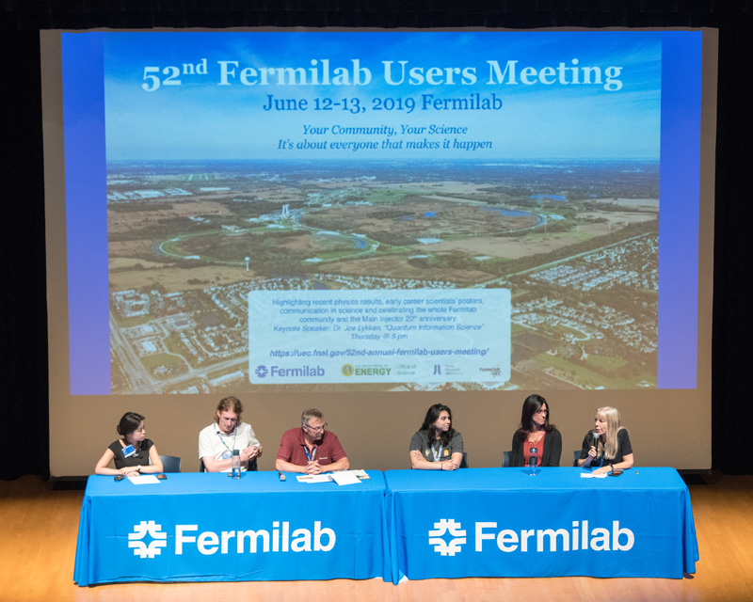
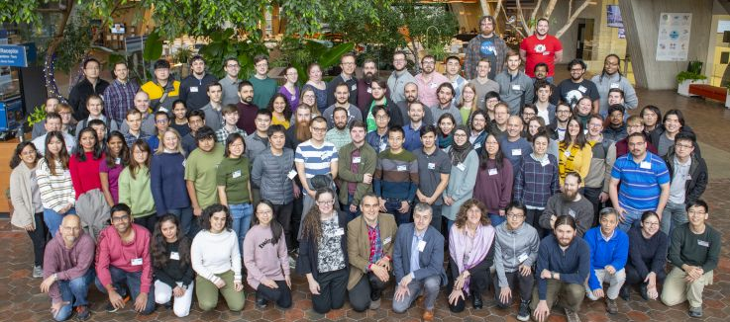
The Fermilab research community
More than 4,000 scientists in 55 countries use Fermilab and its particle accelerators, detectors and computers for their research
More than 2,200 scientists from 175 U.S. universities and labs in 41 states
Fermilab is attracting and training the next generation of a diverse HEP scientific workforce: 114 postdocs, 273 graduate students, 52 undergraduate interns
Fermilab scientists also work at CERN, Sanford Underground Research Facility (SURF), SNOLAB, Cerro Tololo Inter-American Observatory, South Pole Telescope, NOvA Ash River Laboratory, Matter-wave Atomic Gradiometer Interferometric Sensor

Slide 6
Fermilab follows the P5 strategy
The flagship projects LBNF/DUNE/PIP-II, HL-LHC anchor the program but take many years to realize
Fermilab simultaneously pursues a broad research effort in HEP
The goal is a continuous stream of exciting results that attract/build/retain a diverse user community and scientific workforce
2014 → 2023

Slide 7
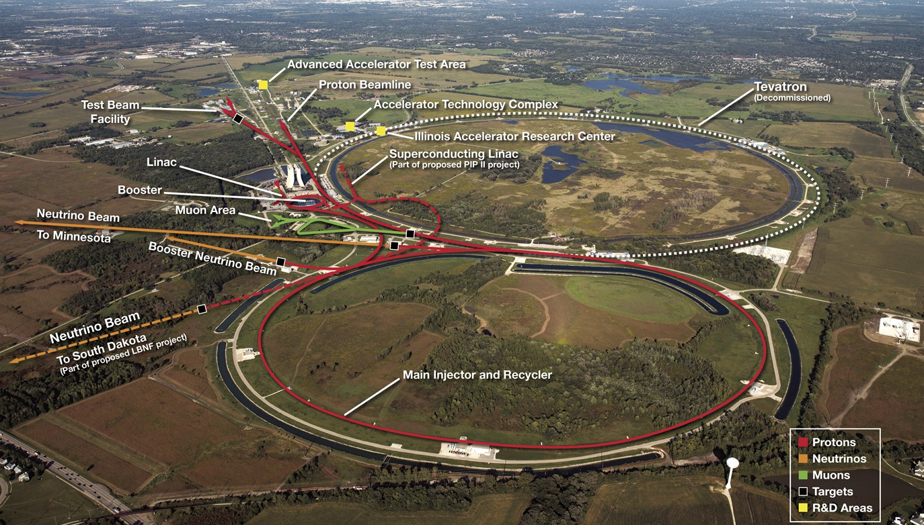
Fermilab Accelerator Complex

Slide 8
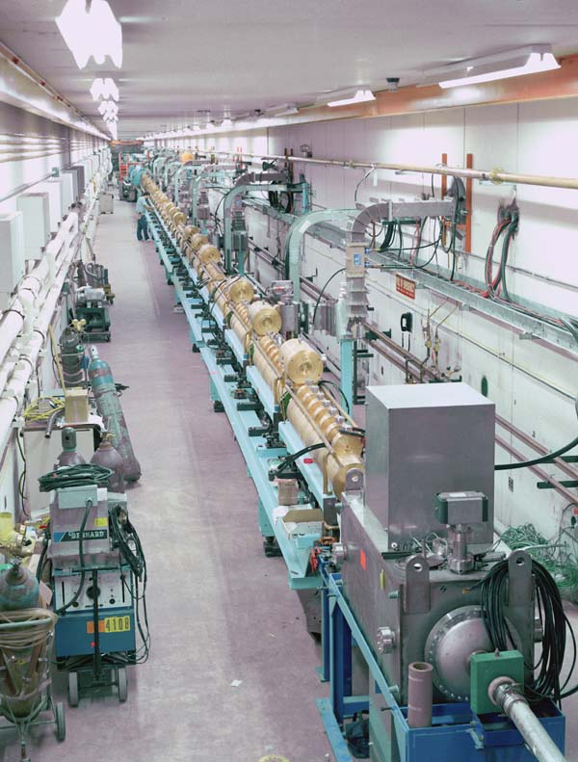
The Fermilab Linac
Linear (copper) Accelerator
Accelerates H⁻ ions
750 keV → 400 MeV
Thousands to millions of volts
Beam bunched at 200 MHz
~ 1.5 Billion ions / bunch
RF of 200 & 800 MHz
Distance between drift tubes changes with beam velocity
Pulse length of ~ 80 μs
Many particles for short periods of time – more efficient operation

Slide 9
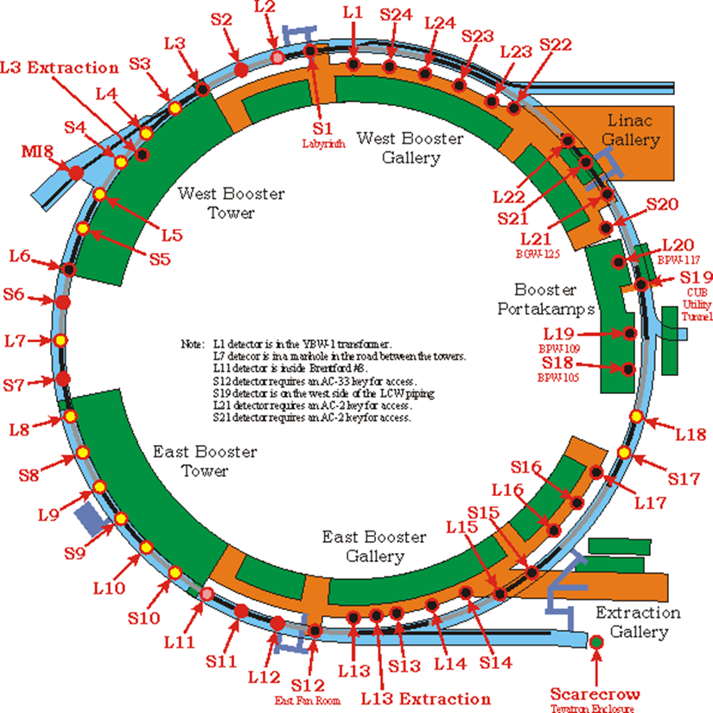
Booster Overview
H⁻ ions are stripped and multi-turn injected onto the Booster
Protons are accelerated from 400 MeV to 8 GeV in 33 msec
Fast cycling synchrotron
Fast magnet ramping
Frequency of 15 Hz
Single turn extraction
Many pulsed devices requiring upgrade
Booster
Booster
Circumference (m) | 474
Harmonic Number | 84
Kinetic Energy (GeV) | 0.4 - 8
Momentum (GeV/c) | 0.954 - 8.9
Revolution period (μsec) | τ_{(inj)} 2.77 – τ_{(ext)} 1.57
Frequency (MHz) | 37.9 - 52.8
Batch size | 4.5 E12
Focussing period | FDooDFo (24 total)
Combined Function Magnets
No failures after initial phase…
but 8 spares have been refurbished as part of PIP…

Slide 10
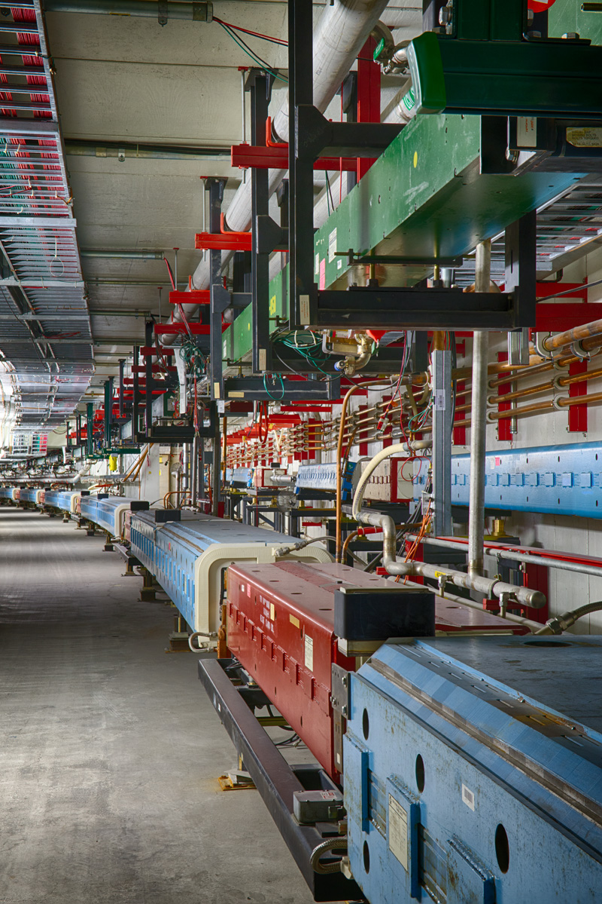
Main Injector & Recycler
Main Injector: 120 GeV Fast-cycling synchrotron
360 main dipole magnets
200 main quadrupole magnets
108 sextupoles, 66 octupoles, corrector dipoles/ quads, specialty injection and extraction magnets
Twenty 53-MHz RF cavities to accelerate beam
170 DC and 360 ramped magnet supplies with total of 140 MVA, 40 specialty pulsed magnet supplies
Recycler: 8 GeV Storage Ring
Originally built for antiproton storage, repurposed for proton stacking
Combined function, permanent magnets
RF cavities for stacking proton beams

Slide 11
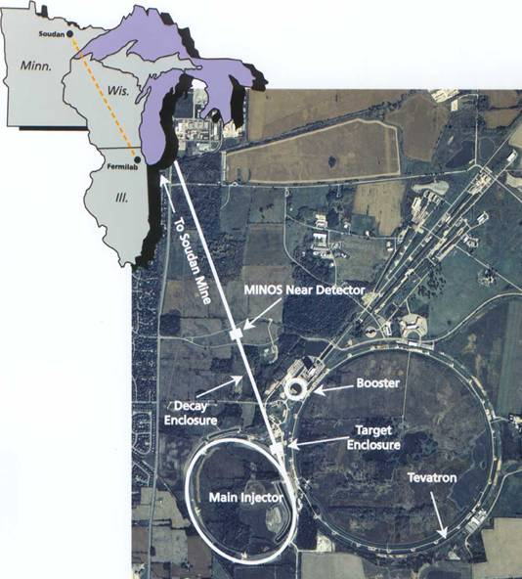
The NuMI Facility: “Neutrinos (ν –> Nu) at the Main Injector”
Intense muon-neutrino beam directed towards Minnesota
Main Injector supplies 50–70e12 120GeV protons every 1.2 seconds
Designed for 400 kW, operated up to 900 kW
Multiple upgrade projects to 1 MW
Each pulse produces about 2x10¹⁴ ν _{μ}
~ 20,000,000 Pulses per year
Direct beam 3º down
Commissioned in 2005, expect to run to ~ 2027
“Long-baseline”
Neutrino beam
Near Detectors
Far Detectors: 5400 tons & 14000 tons
5

Slide 12
Multiple Experiments Simultaneously in the NuMI Beam
Long-baseline oscillation experiments
Neutrino scattering experiments

Slide 13
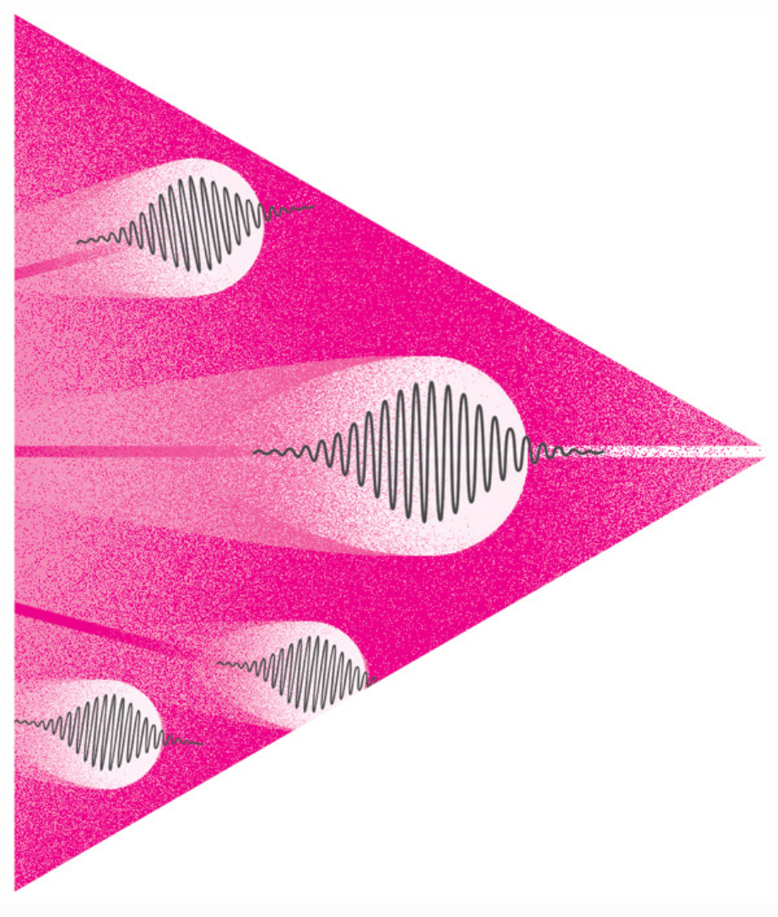
Neutrino oscillations: Big picture questions
What are the masses of neutrinos?
What is the mass ordering of neutrinos? If inverted, might a new symmetry be needed to account for two heavier neutrinos having similar masses?
Are neutrinos their own antiparticles? Can this help us explain the matter-dominated universe we are in?
Do antineutrinos oscillate differently than neutrinos? (Is CP symmetry violated?) Can this explain the matter-dominated universe we are in?
What astrophysical phenomena can neutrinos open to us?

Slide 14
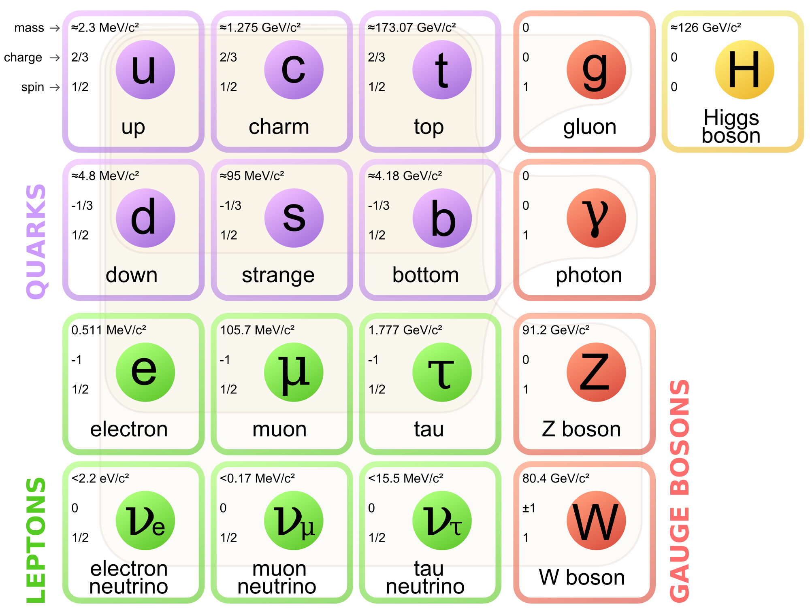
Why a Beam of Neutrinos? – Controlled Laboratory Experiment
Natural sources of neutrinos exist – but they are weak and not necessarily well understood
Solar and atmospheric neutrinos were only understood once oscillations were established and well measured
Moving from observation to experiment
Supernovae (for neutrinos) are rare events, though very interesting
Artificial beams are controlled and intense ➩ Precision!
Decide when, where, and how the beam is generated
Detectors are placed strategically
Beams can be controlled with precision – vital as measurements approach 1%
Most all our neutrinos come from pion decays
Convert the kinetic energy of the accelerator beam into new massive particles (pions), which decay to neutrinos
A “simple” decay (at first)
Pion mass ~ 140 MeV/c², Muon mass ~ 105 MeV/c²

Slide 15
Neutrino Beam in a Nutshell (NuMI)
Absorbs ~ 40 % of beam power
Allows high-energy muons to penetrate
2 m diameter
Roughly decay length for 10 GeV π⁺
He-filled
2 interaction length, C target
Produces π⁺, K⁺ mesons
400 kW design average power
700 kW upgrade for NOvA
1 MW upgrade just complete
σ ∼ 1-1.5 mm
Pulsed focusing horns @ 200 kA
Toroidal magnetic field
Parabolic inner conductor profile
Focuses meson momentum band
Measure hadron & muon fluxes
Arrays measure distributions

Slide 16
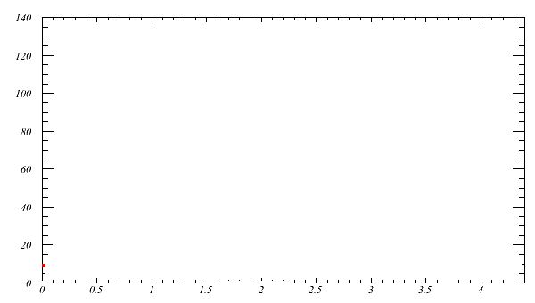
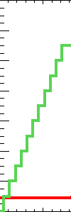
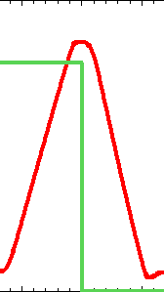
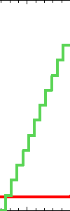
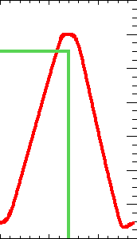
NOvA Accelerator & NuMI Upgrades (ANU): the 700 kW Upgrade
Previous Stacking operation (~ 380 kW in 2011):
H⁻ linac at ~35 mA
H⁻ stripping into Booster 10-11 turns: 4.3e12 protond
11 pulses (at 15 Hz) into Main Injector with RF slip stacking
Ramp to 120 GeV at 204 GeV/s and extract to NuMI target

Slide 17
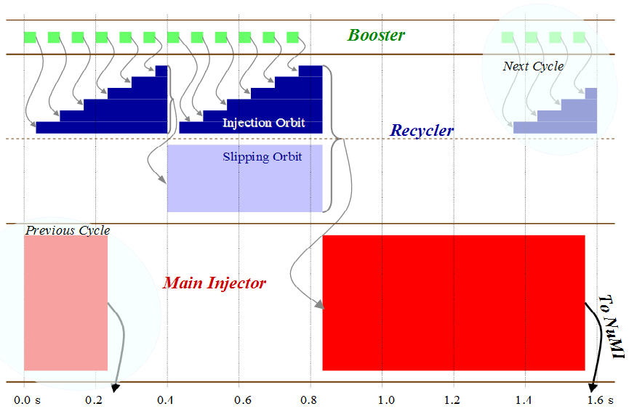
Increasing Beam Power to 700 kW
15 Hz Booster sets fundamental clock (“tick”)
“slip-stacking” cleverly gets around limits on Booster batch size
Employ Recycler ring to load 12 slip-stacked Booster batches while the Main Injector was ramping
The installation of a direct injection line from the Booster to the Recycler to eliminate Main Injector loading time was the key component of the “ANU” improvement campaign for NOνA (400 kW->700 kW) available by 2015

Slide 18
Proton Improvement Plan (2011-2018) for Linac And Booster
The Proton Improvement Plan should enable Linac/Booster operation capable of
Delivering 2.3E17 protons/hour (at 15 Hz) x2 previous
while
Maintaining Linac/Booster availability > 85%, and
Maintaining residual activation at acceptable levels
and also ensuring a useful operating life of the linac through 2023, and Booster through 2030 or later
The scope of the Proton Improvement Plan included
Upgrading (or replacing) components to increase the Booster repetition rate
Replacing components that have (or will have) poor reliability
Replacing components that are (or will soon become) obsolete
Studying beam dynamics to diagnose performance limitations
Implementing operational changes to reduce beam loss

Slide 19
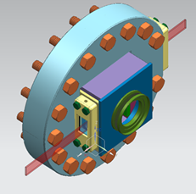
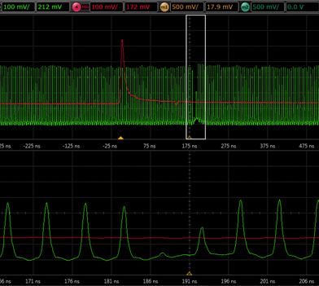
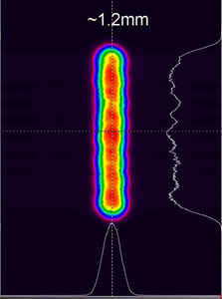
Booster loss and Linac laser notch
Doubling the beam repetition rate requires cutting the losses per Booster cycle in half
Addressing each of the three main areas of Booster beam loss:
Injection
Notching the beam to create a gap for extraction kickers to fire
Transition, related to RF during acceleration
Phased improvements to notch creation
New cogging system which allowed notching at 400 MeV instead of 700 MeV → lower energy losses into an absorber
Final phase was a laser notcher in Linac MEBT
Laser Neutralization of H⁻ with zero space
Unique laser with micro, meso, and macro timescales, and vertical spatial profile
Optical cavity
(attached end of RFQ)
Successful test of Linac notch Dec 2014
Laser profile

Slide 20
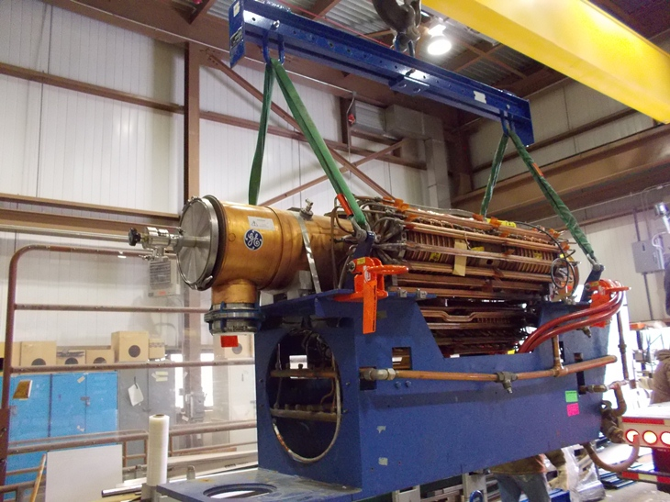
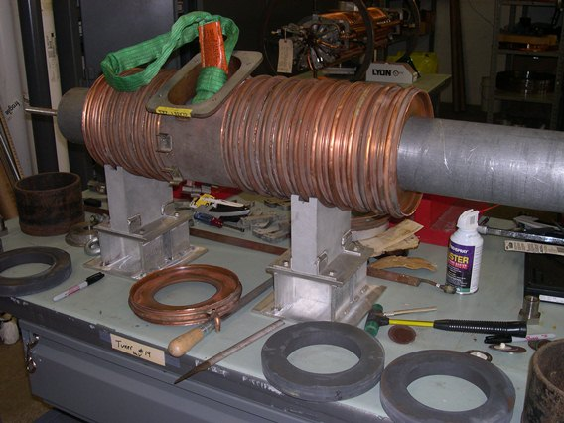
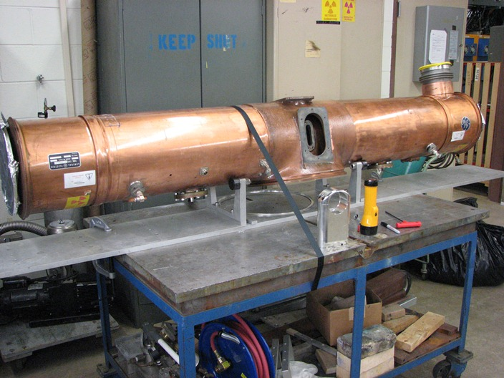
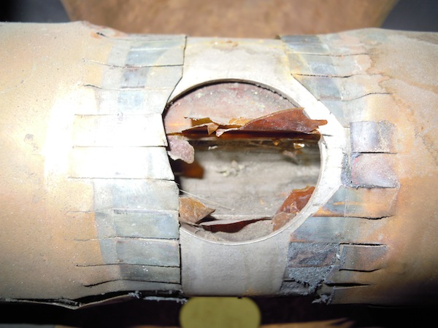
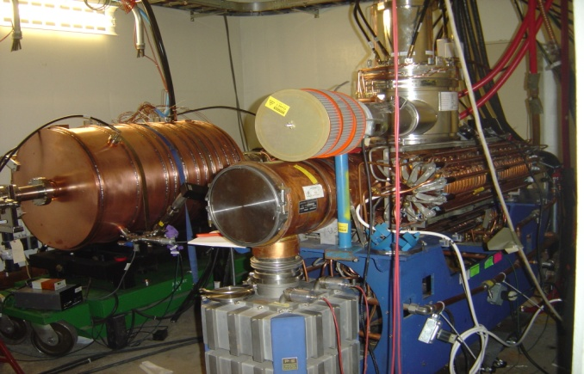
Booster PIP - Refurbishment of 40 year old cavities
(Weeks)
Cool-down
Rebuild - Cones & Tuners
Re-Assemble
Remove Tuners
Rebuild Stems/Flanges
Testing
Cavity Removal
Cavity Removal - Stripping
Tuners Rebuild
Rebuild and Test

Slide 21
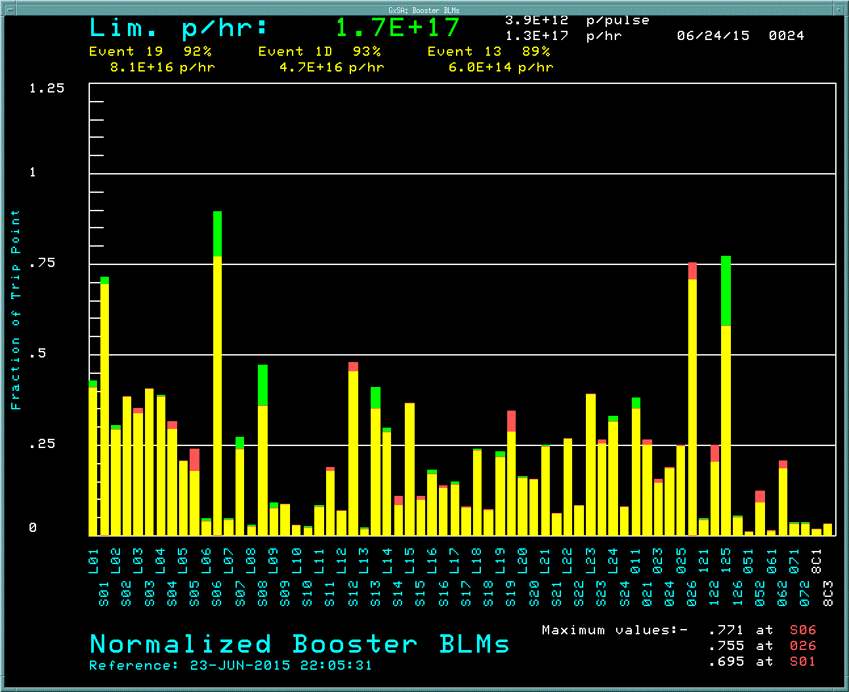
Booster 15 Hz – A significant achievement for PIP/FNAL
TLG with 13 (fixed target event) beam events & 2 pre-pulses, $17 (Booster event) then replaced the pre-pulses for full 15 Hz beam operation – record intensity >2.1E17/hr !
$19 (NoVA event) or $1D Boone Event) cycles at reduced intensity allowed for 15 Hz beam and some overhead
PIPs success led to the possibility to increase Main Injector beam to close to 1 MW with modest upgrades in other parts of the accelerator chain

Slide 22
NuMI Megawatt Accelerator Improvement Project (AIP): 2018-2021
Originally designed for 400 kW beam power, then upgraded to 700 kW with NOvA/ANU
Megawatt AIP (Accelerator Improvement Project)
Upgrade of target, horns, and supporting systems to be capable of accepting 1 MW beam power through 2025
Completed in 2021 after 3 annual accelerator shutdowns to replace components
Record 959 kW beam power achieved in May 2023
 | NuMI Design | NOvA | 1 MW upgrade
Proton beam energy | 120 GeV
Beam power (kW) | 400 | 700 | 1 MW
Energy Spectrum | Low Energy | Medium Energy
Cycle time (s) | 1.87 | 1.33 | 1.2
Protons per spill | 4.0 x 10¹³ | 4.9 x 10¹³ | 6.5 x 10¹³
Spot Size (mm) | 1.0 | 1.3 | 1.5
Beam pulse width | 10 microsec
Notes:
700 kW in 2012

Slide 23
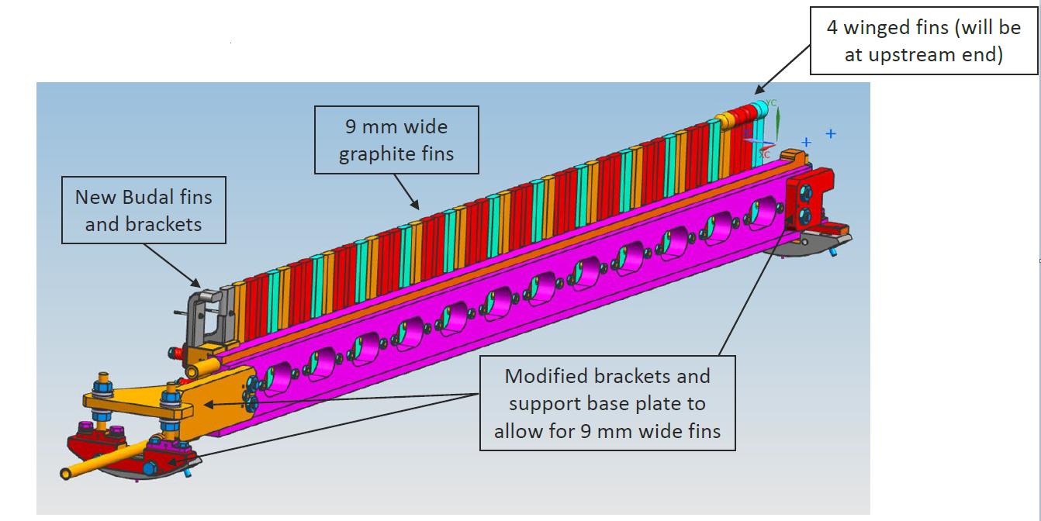
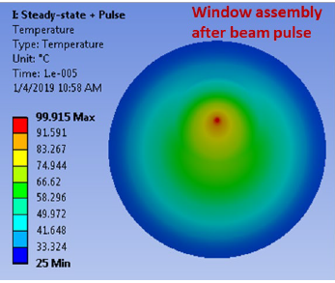
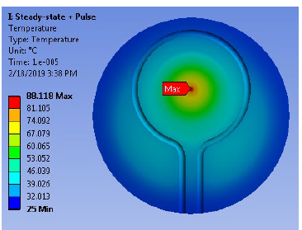
NuMI AIP – 1 MW Target Upgrade
Core redesigned for increased beam spot size from original 1.3 mm to 1.5 mm
Graphite fins width increased from 7.4 mm to 9 mm
Winged fins added upstream in case of beam mis-steering
Cooling loop added on downstream Beryllium window
 | $$T_{grahite,max}$$
700 kW design | 913 $℃$
1 MW design | 890 $℃$
Former Be window design temperature immediately after beam spill
1 MW Be window design with cooling loop temperature immediately after beam spill

Slide 24
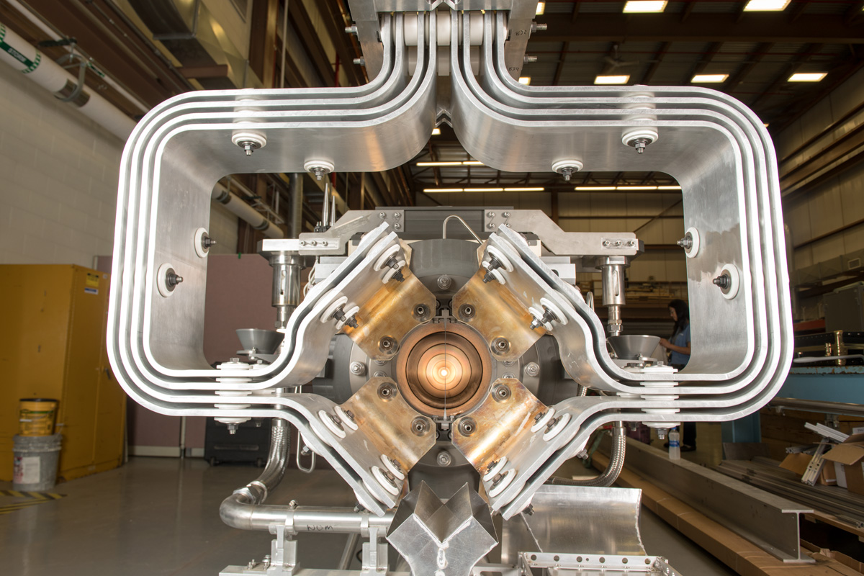
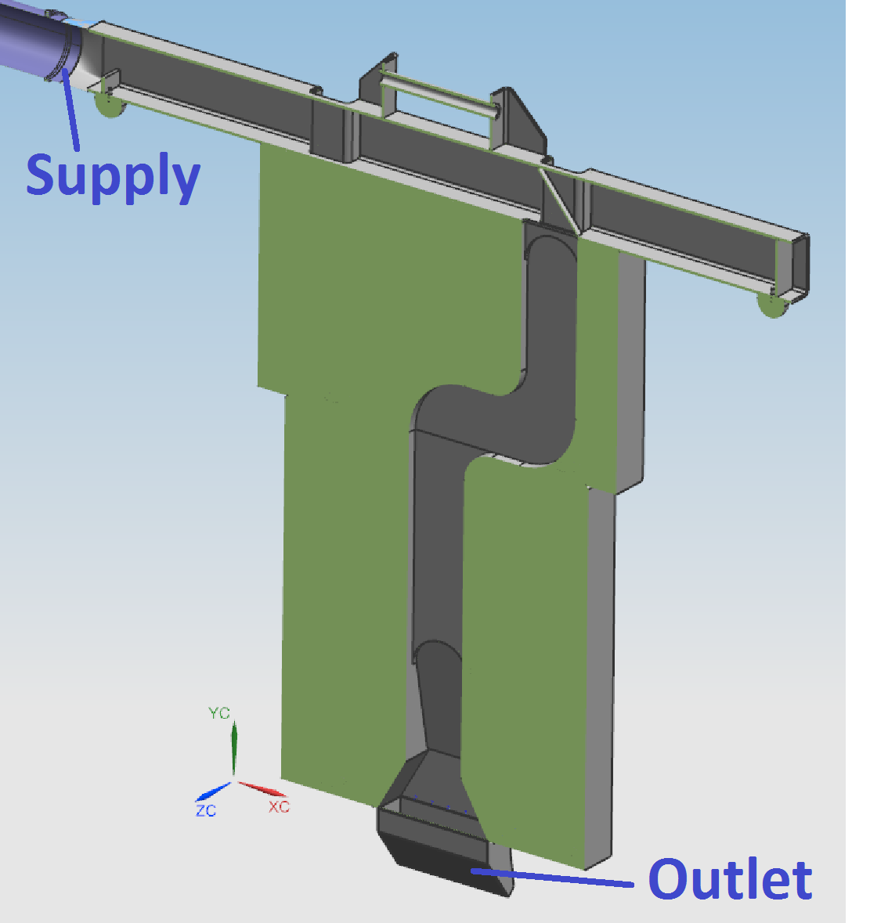
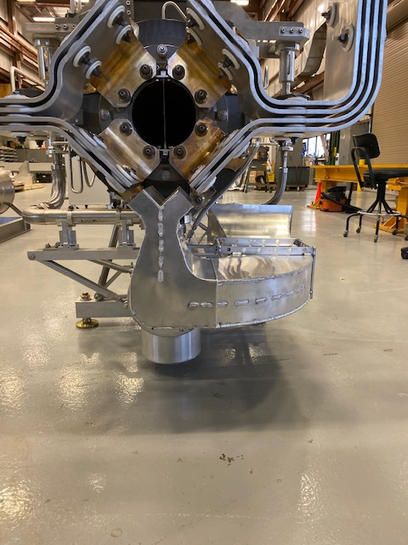
NuMI AIP – 1 MW Horn Upgrade
Design changes to increase cooling to keep stripline < 100 $℃$
Re-design of air diverter at base of stripline for improved air flow
T-Block air cooling
Stripline modified for 1 MW
Changed material from Al 6101-T61 to 6013-T651 in key sections
Higher yield strength and increased fatigue life
NuMI 1 MW horn stripline
Horn stripline air diverter
T-block air diverter

Slide 25
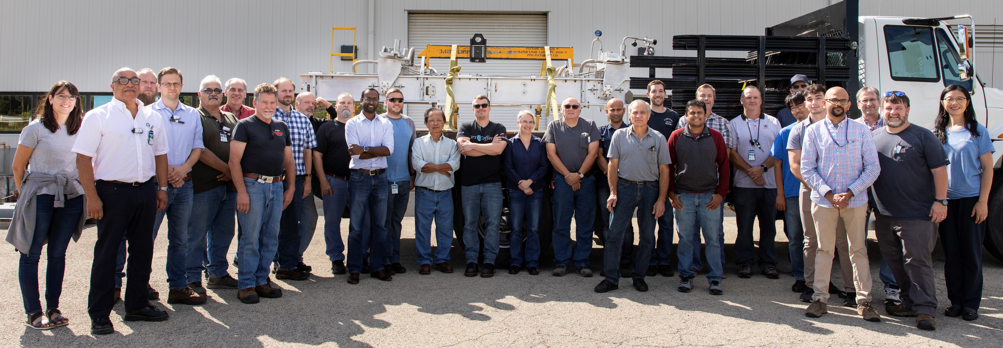
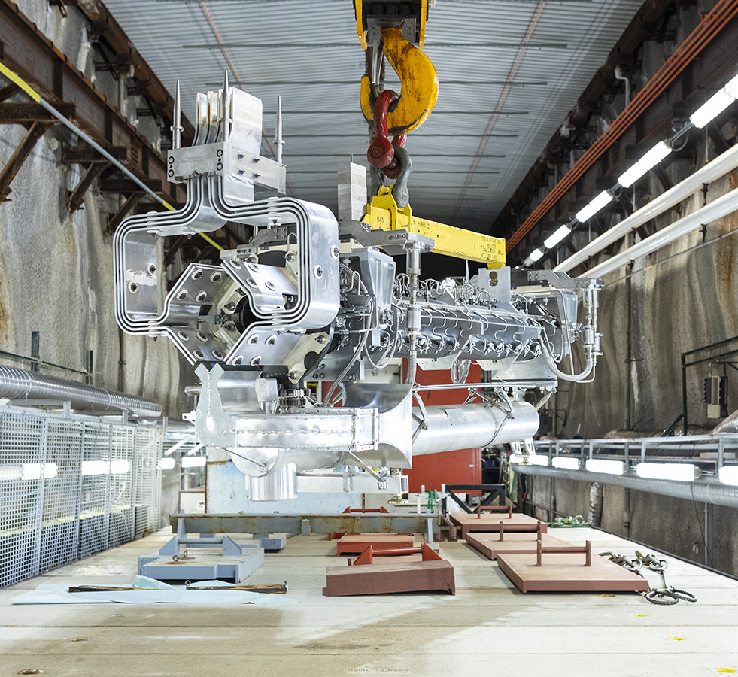
NuMI Target Systems Accelerator Improvement Plan (AIP): Target Station Upgraded for 1-MW Beam Operation
Objective reached: capable of accepting 6.5E13 protons/spill at 120 GeV, 1.2 sec cycle time
Project scope: improve and replace Target Hall components / support systems
Tasks completed in 2019 – 2022
Upgrade for 1 MW | Reliability / Lifetime Extension
MARS / FEA simulations for all beamline components 1 MW target 1 MW horn 1 Stripline air diverter T-block & HVAC ductwork Target & Horn 1 RAW system Target chase cooling and air handling system | Horn 1 module drive mechanism changeout Absorber intermediate cooling system HX MI-65 condensate rerouting Target chase supplemental shielding Hadron monitor and gas system Target module drive mechanism MINOS surface dry cooler
NuMI Team
1-MW Horn-1 Installation

Slide 26
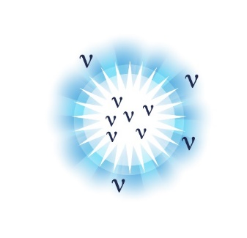
DUNE Deep Underground Neutrino Experiment
Origin of matter. Investigate leptonic CP violation. Are neutrinos the reason the universe is made of matter?
Neutron star and black hole formation. Ability to observe neutrinos from supernovae events and perhaps watch formation of black holes in real time.
Unification of forces. Investigate nucleon decay, advance unified theory of energy and matter.
The LBNF/DUNE project will be the first internationally conceived, constructed, and operated mega-science project hosted by the Department of Energy in the United States” – DOE

Slide 27
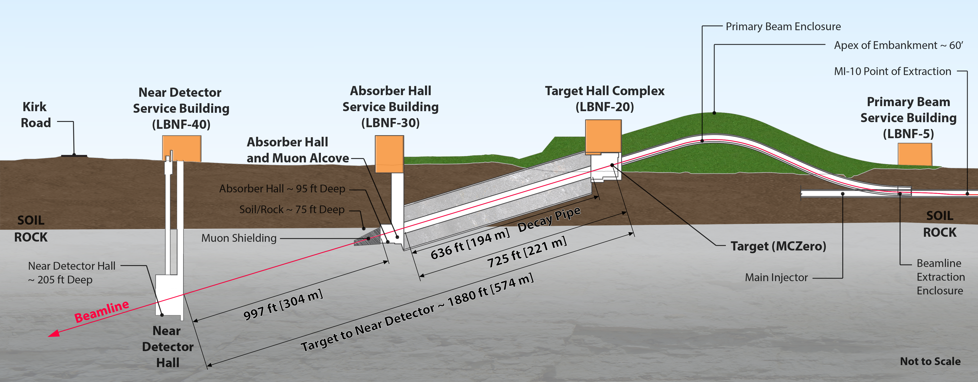
The LBNF Beam
Facility designed for initial beam power of 1.2 MW, upgradeable to 2.4 MW

Slide 28
Section View of Target Complex – Target Hall
Target Hall
Work Cell
Hatch Covers
←Beam
Primary Beam Enclosure
N₂ Gas
He Gas
Decay Pipe
Primary Beam Window
Decay Pipe Upstream Window
Horn A with Target
Cooling
Panels
Steel Shielding
Horn B
Baffle
Horn C

Slide 29
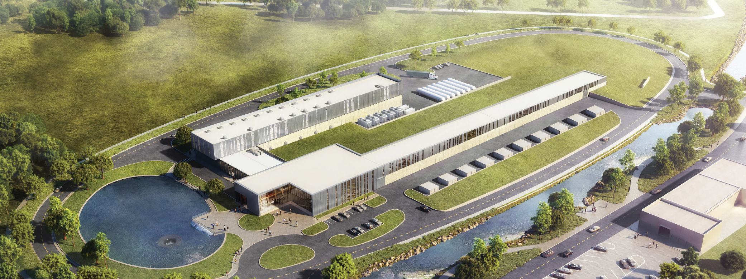
Proton Improvement Plan II (PIP-II)
Increase Main Injector beam power to 1.2 MW.
Replace the existing 400 MeV linac with a new 800 MeV superconducting linac => increase in Booster intensity.
Provide a platform to increase LBNF power to 2.4 MW
Provide path for a 100 kW Mu2e-II
Provide capability for 1.6 MW at 800 MeV, CW beam
Platform for high duty-factor / power operations to multiple experiments

Slide 30
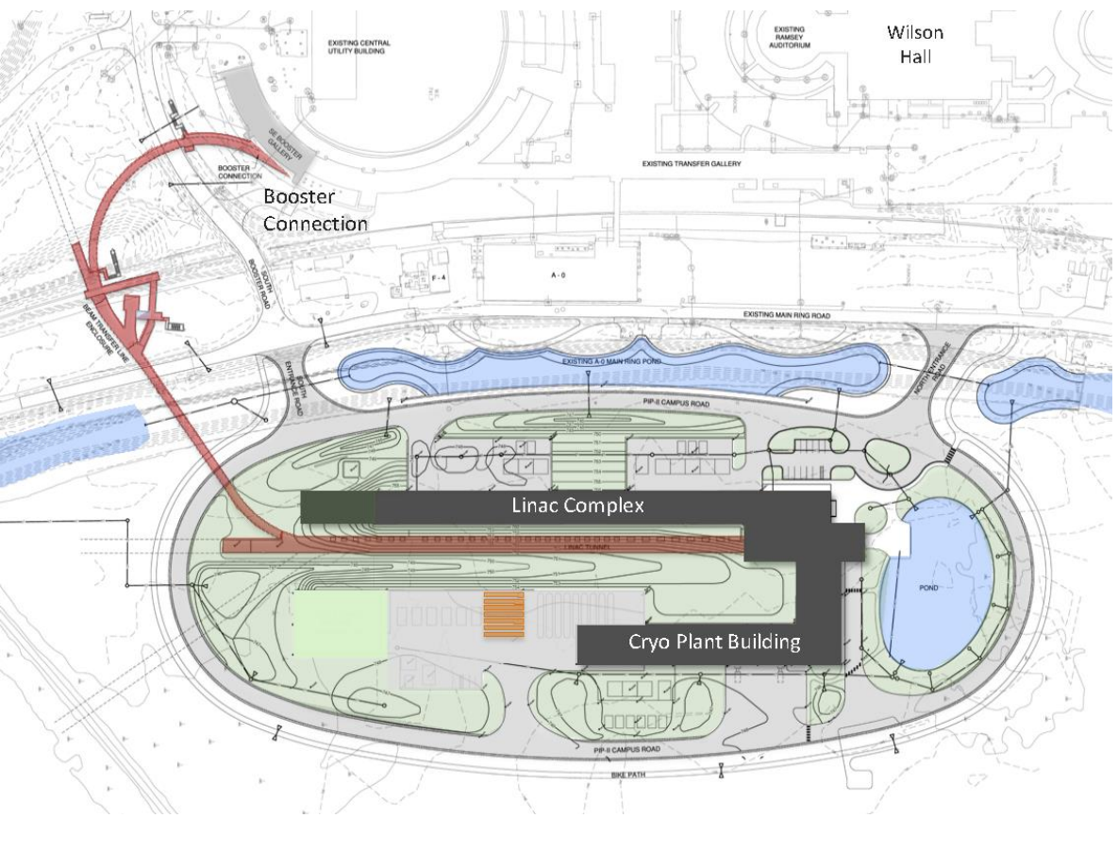
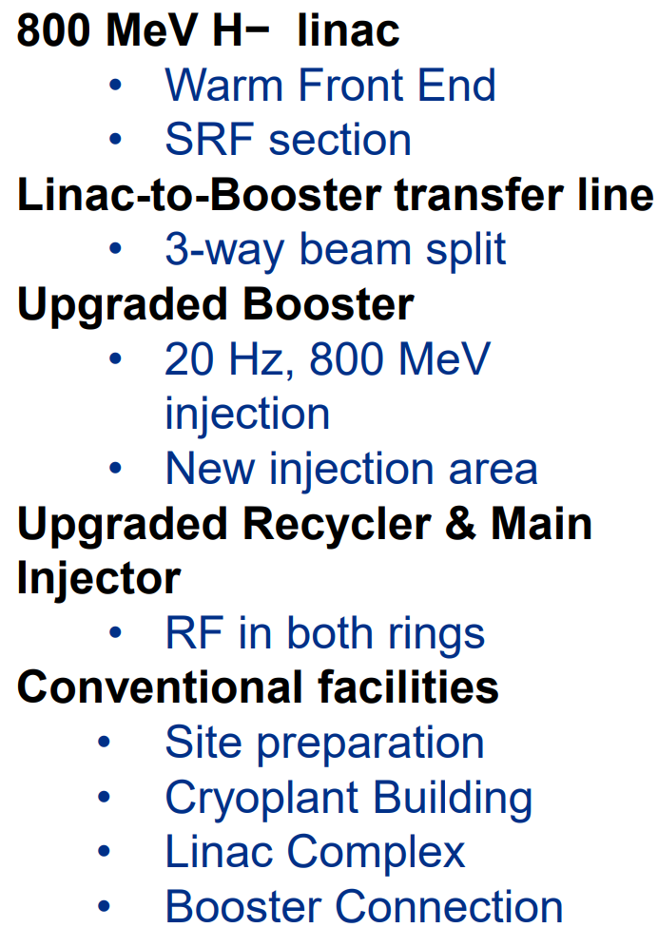
30
30
PIP-II Linac & Upgrades (1.2 MW power on target)
E. Pozdeyev, SpaceCharge19
Project started in 2016 (CD0)
First beam in Booster: 2028 (plan)
MI 1.2 MW beam on target: 2031 (projection)
Notes:
30
30
30
30
30
30

Slide 31
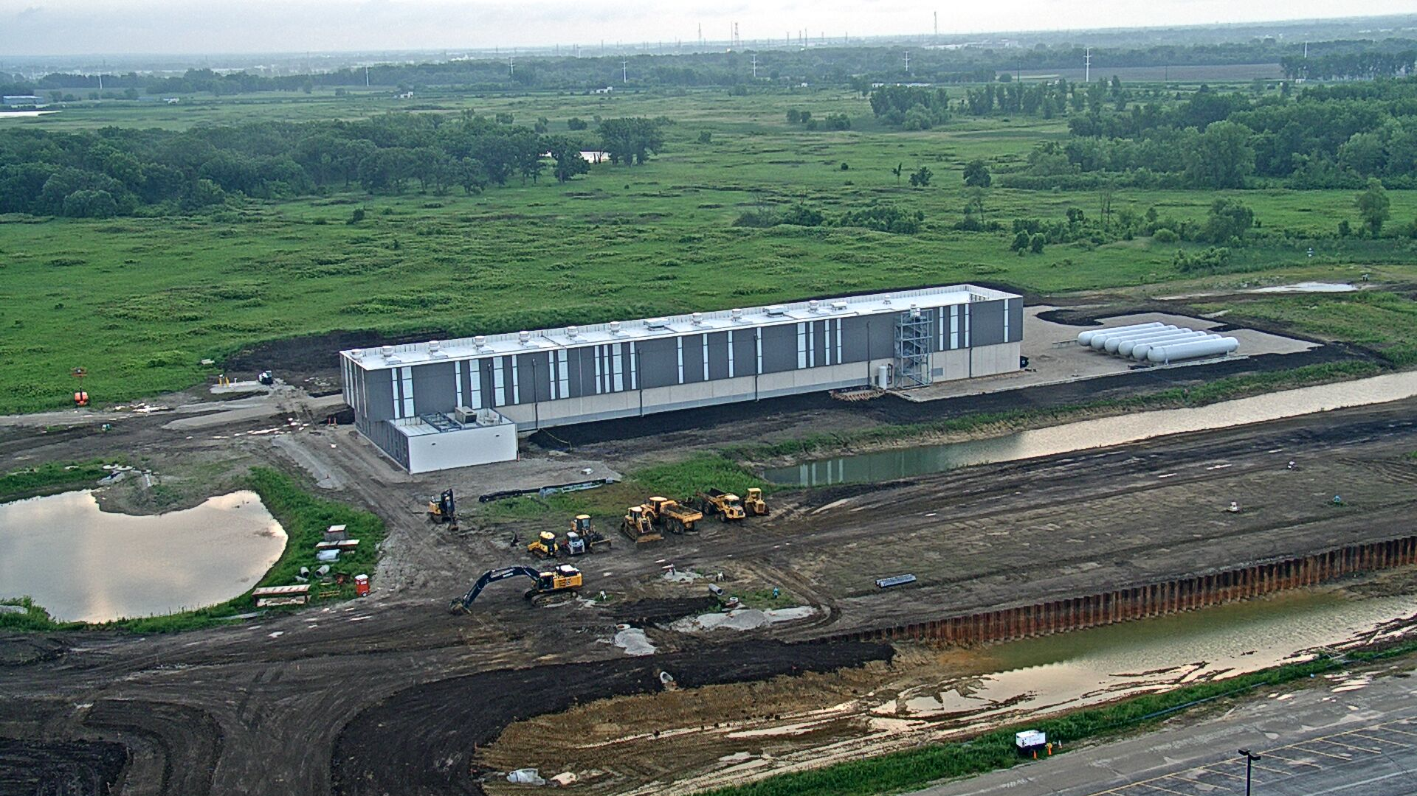
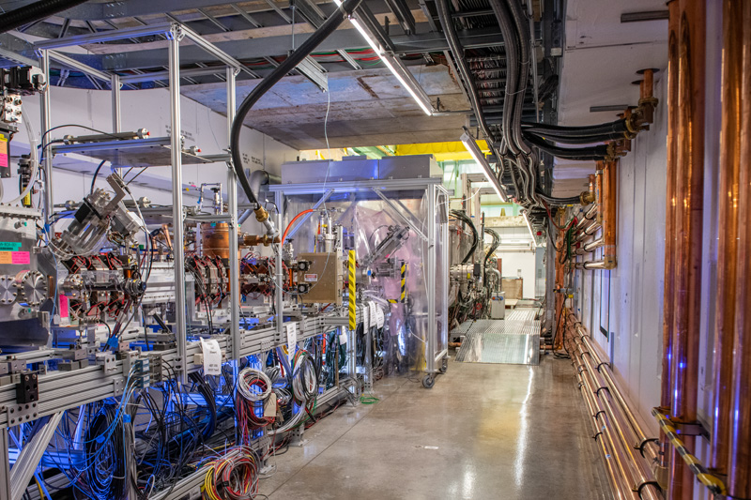
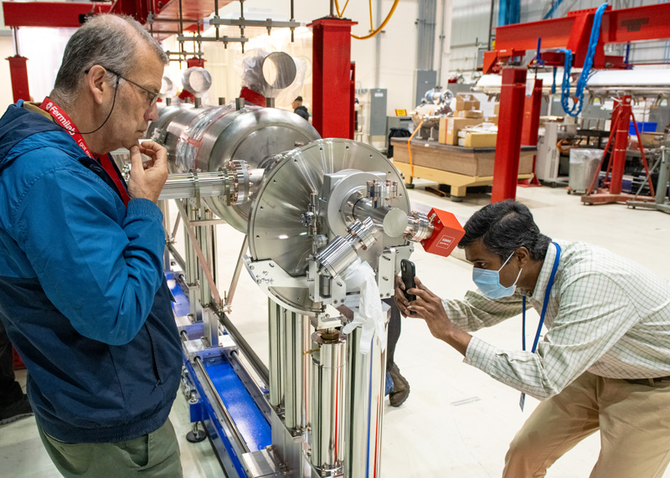
PIP-II Project construction begins!
PIP-II received DOE CD-3 approval for start of construction/execution on April 18
Linac complex RFP issued
Front end of PIP-II linac constructed and successfully tested with beam
PIP-II cryoplant building 98% complete
HB650 prototype cryomodule in assembly – first of its kind
Magnets provided by
PIP-II is the first particle accelerator built in the U.S. with significant international contributions

Slide 32
LBNF/DUNE/PIP-II in-kind contributions $1.1B with growth potential
LBNF/DUNE-US
$262M in-kind contributions to LBNF (does not include private @ $70M or State of SD @ $93M to support SURF)
$310M in contributions to DUNE detectors
$84M in CERN contributions to protoDUNE efforts (does not include French contributions to protoDUNE R&D)
Additionally, LBNF powered by PIP-II, which has secured $310M in international contributions
All in-kind contributions are expressed in DOE TPC units
Numbers do not include other IKCs received in support of Fermilab’s short-baseline neutrino program
In-kind contributions supported by 10 Government-to-Government agreements and 17 I-CRADAS

Slide 33
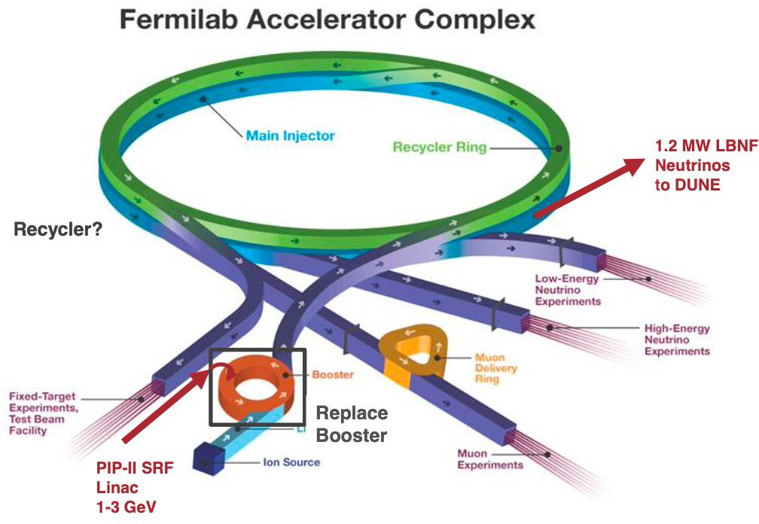
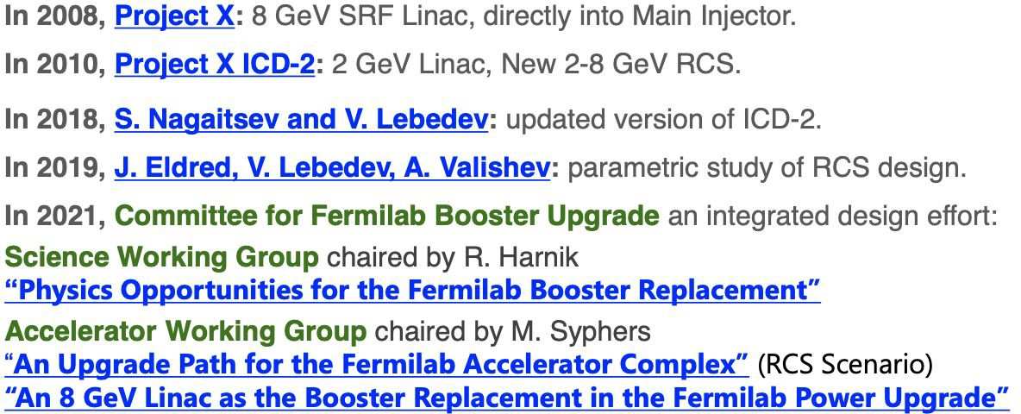
Replacing the Booster
2014 P5 Recommendation: Provide 2.4 MW to DUNE
Now ~ 0.9 MW max
With PIP-II can reach ~ 1.2 MW
Main bottleneck is the Booster synchrotron
Intensity can be improved but not enough to reach 2.4 MW
Many studies, going back almost 25 years.
Luciano Ristori presentation to PAC June 2021
White Papers for Snowmass describe design options and potential for rich low energy science program
Recent PIU and ACE studies
2023 P5 Recommendation: accelerate realization of 2+ MW with “MIRT”
Plan for future complex evolution

Slide 34
Accelerator Complex Evolution (ACE) plan
$$P=\frac{eN_{p}E_{p}}{t}$$
Increase protons on target to DUNE by
Shortening the Main Injector cycle time to increase beam power
Upgrading target systems for up to 2.4 MW
Improving reliability of the Complex
MIRT: Main Injector Ramp and Targetry
To shorten the MI cycle from 1.2-1.4s to 0.65s, the ramp needs to be ~twice as fast
Requires more voltage and electrical power
Power supplies, transformers, feeders, service building size, additional tunnel penetrations, additional cooling
RF accelerating system
Replace cavities with newer design (more volts per cavity) or add cavities of current design
Regulation, control & instrumentation
New low-level RF, new power supply regulation/control system
Beam dynamics, losses and shielding
Upgrade MI collimators, upgrade abort line, add shielding

Slide 35
Shortening the Main Injector cycle time
Advantages over increasing the per-pulse intensity – reduces likelihood of space charge effects and instabilities, and reduces impact of limited aperture
To shorten the MI cycle from 1.2-1.4s to 0.65s, the ramp needs to be ~twice as fast
Requires more voltage and electrical power
Power supplies, transformers, feeders, service building size, additional tunnel penetrations, additional cooling
RF accelerating system
Replace cavities with newer design (more volts per cavity) or add cavities of current design
Regulation, control & instrumentation
New low-level RF, new power supply regulation/control system
Beam dynamics, losses and shielding
Upgrade MI collimators, upgrade abort line, add shielding

Slide 36
Summary
Fermilab has successfully delivered several modest projects to significantly increase beam power:
NOvA/ANU -> 700kW
PIP -> 700+ kW and better throughput / reliability
NuMI Megawatt AIP -> 1 MW capability
Major Projects are underway
LBNF 1.2 – 2.4 MW capability
PIP-II -> 1.2 MW + 1.6 MW
Planning for successor projects to PIP-II: ACE: Accelerator Complex Evolution
MIRT to bring 2+ MW to LBNF/DUNE
Future Complex evolution and demonstrators for future experiments
Start conceiving of future colliders

Slide 37
Welcome to Fermilab and the Fermilab Accelerator Complex
Robert Zwaska
24 April 2023
EPICS Collaboration Meeting

