Slide 1
IOTA/FAST Startup/Run Report
Darren Crawford

Slide 2
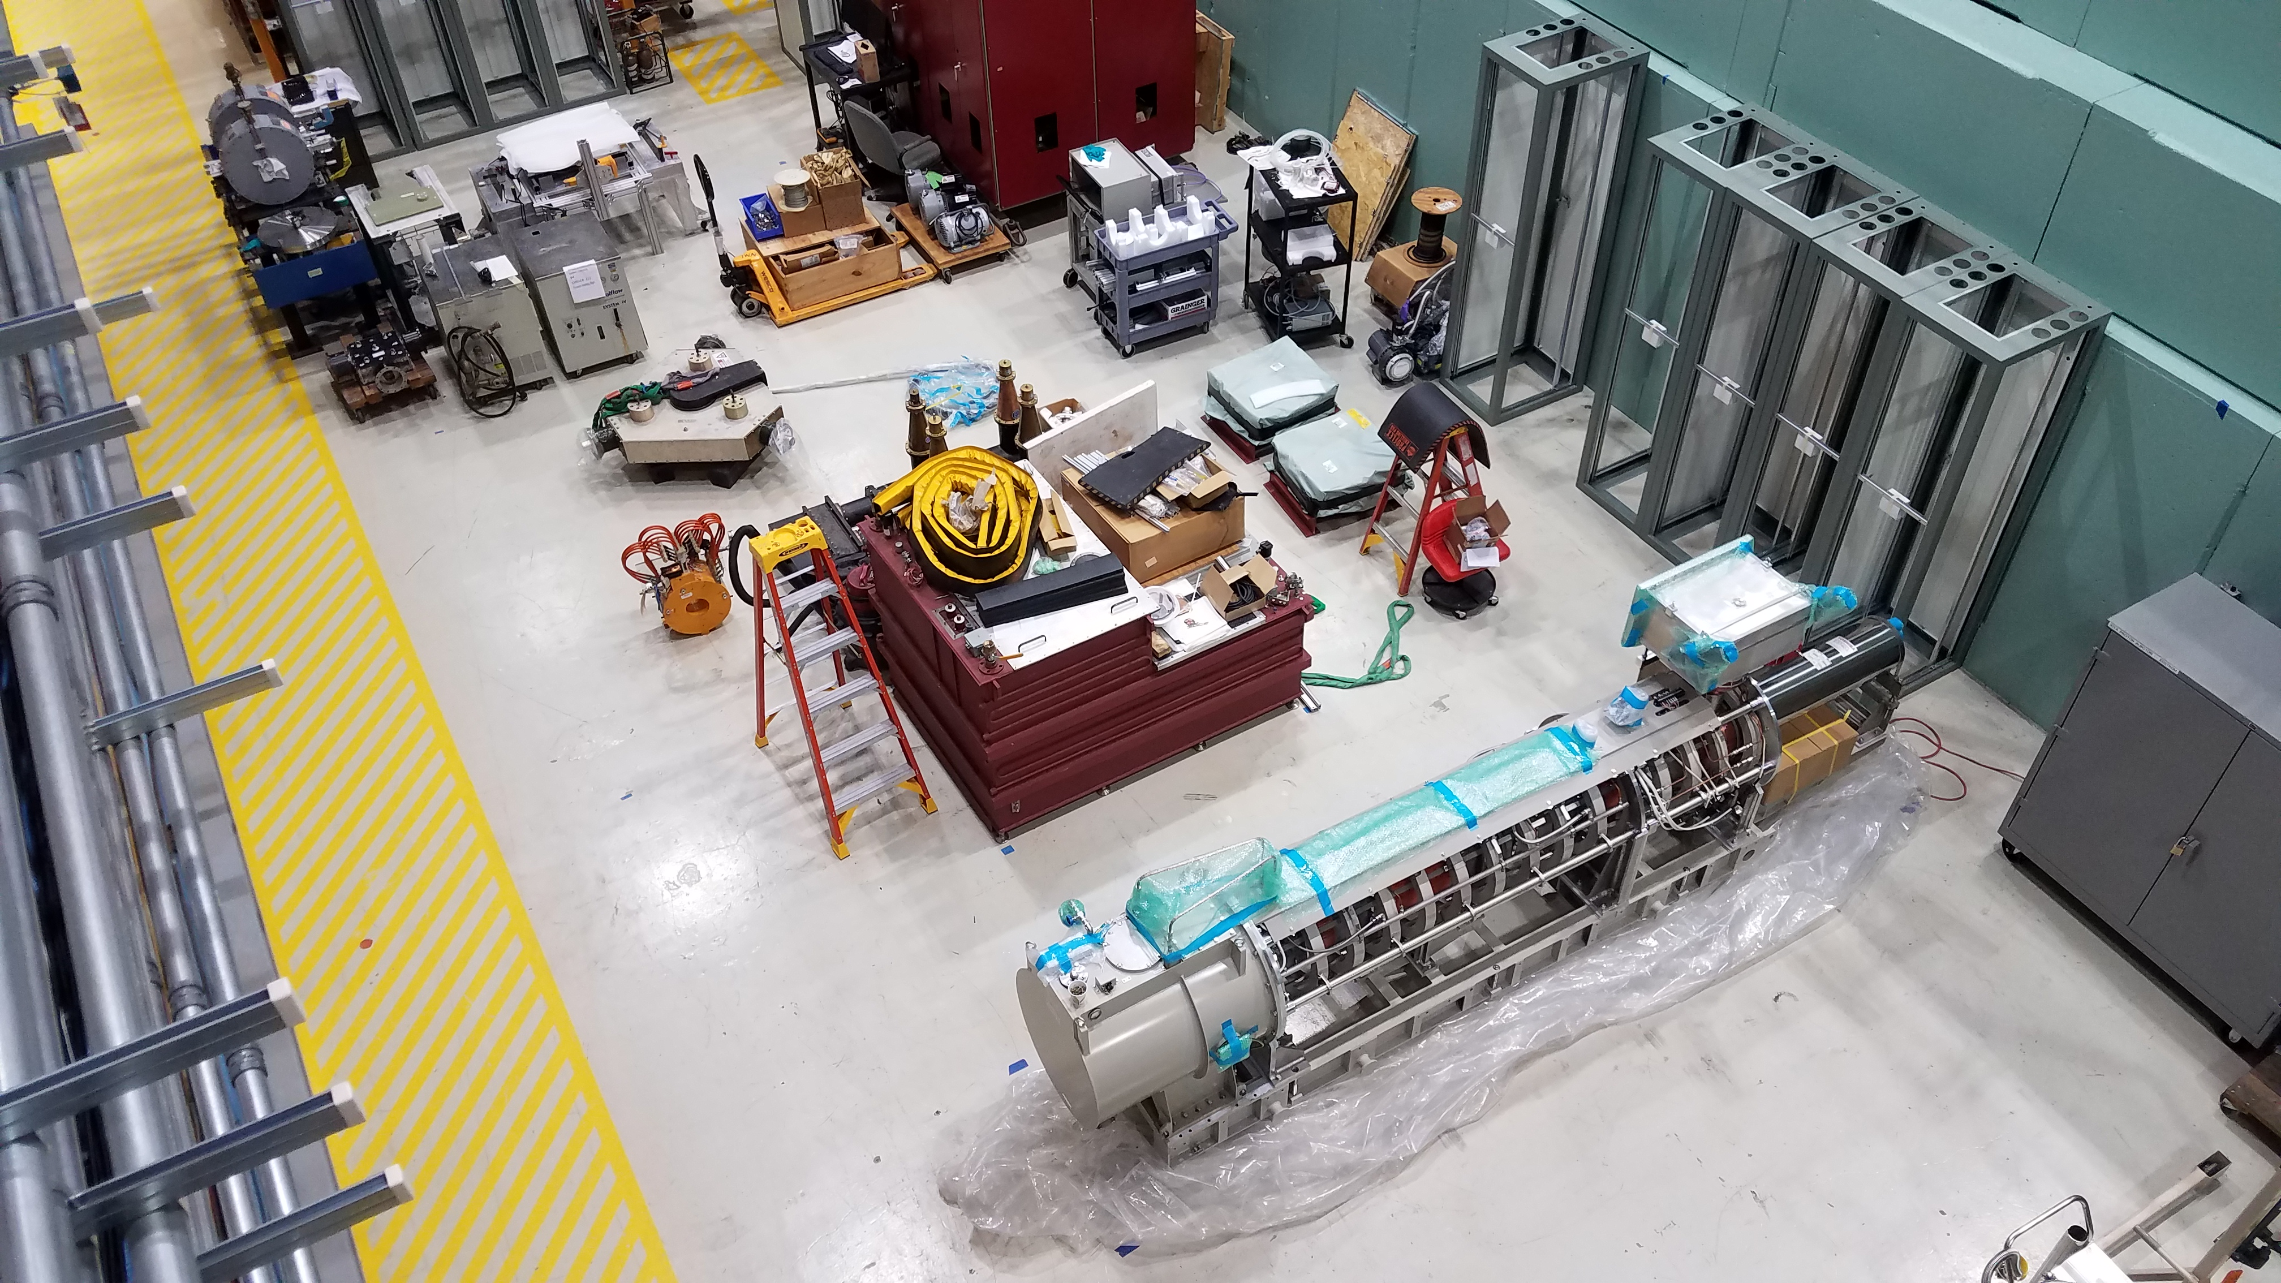
This week
MagBeam studies
LRW/SRW studies
NIO studies

Slide 3
February schedule

Slide 4
March schedule

Slide 5
Current Status
AMPUR studies now
URSSE on evening shift

