Slide 1
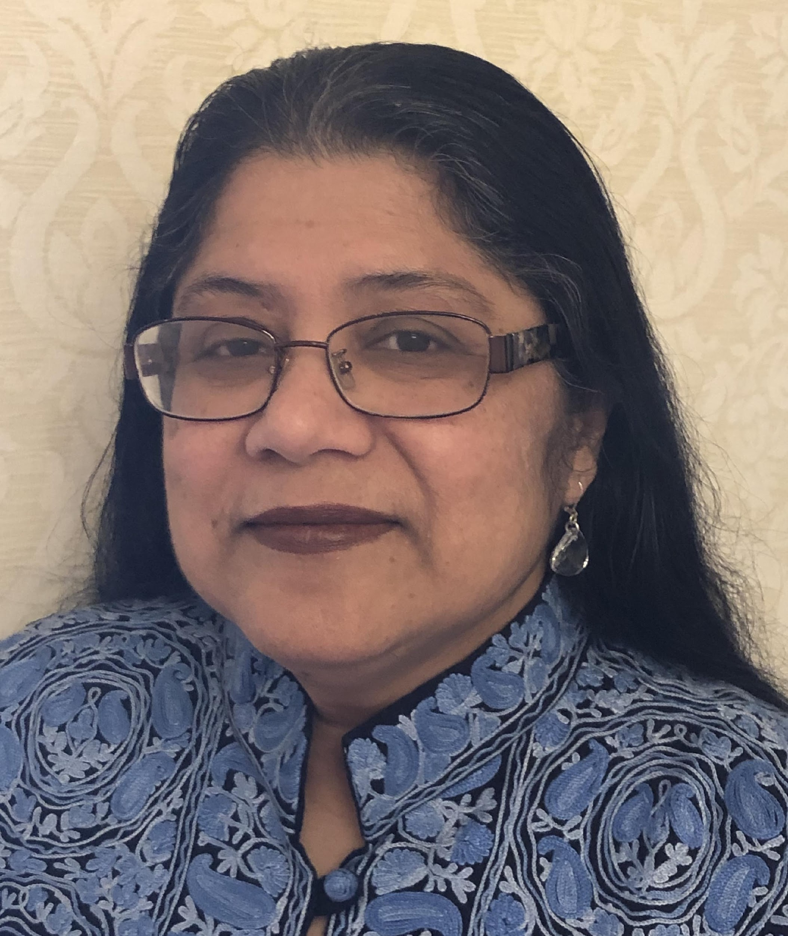
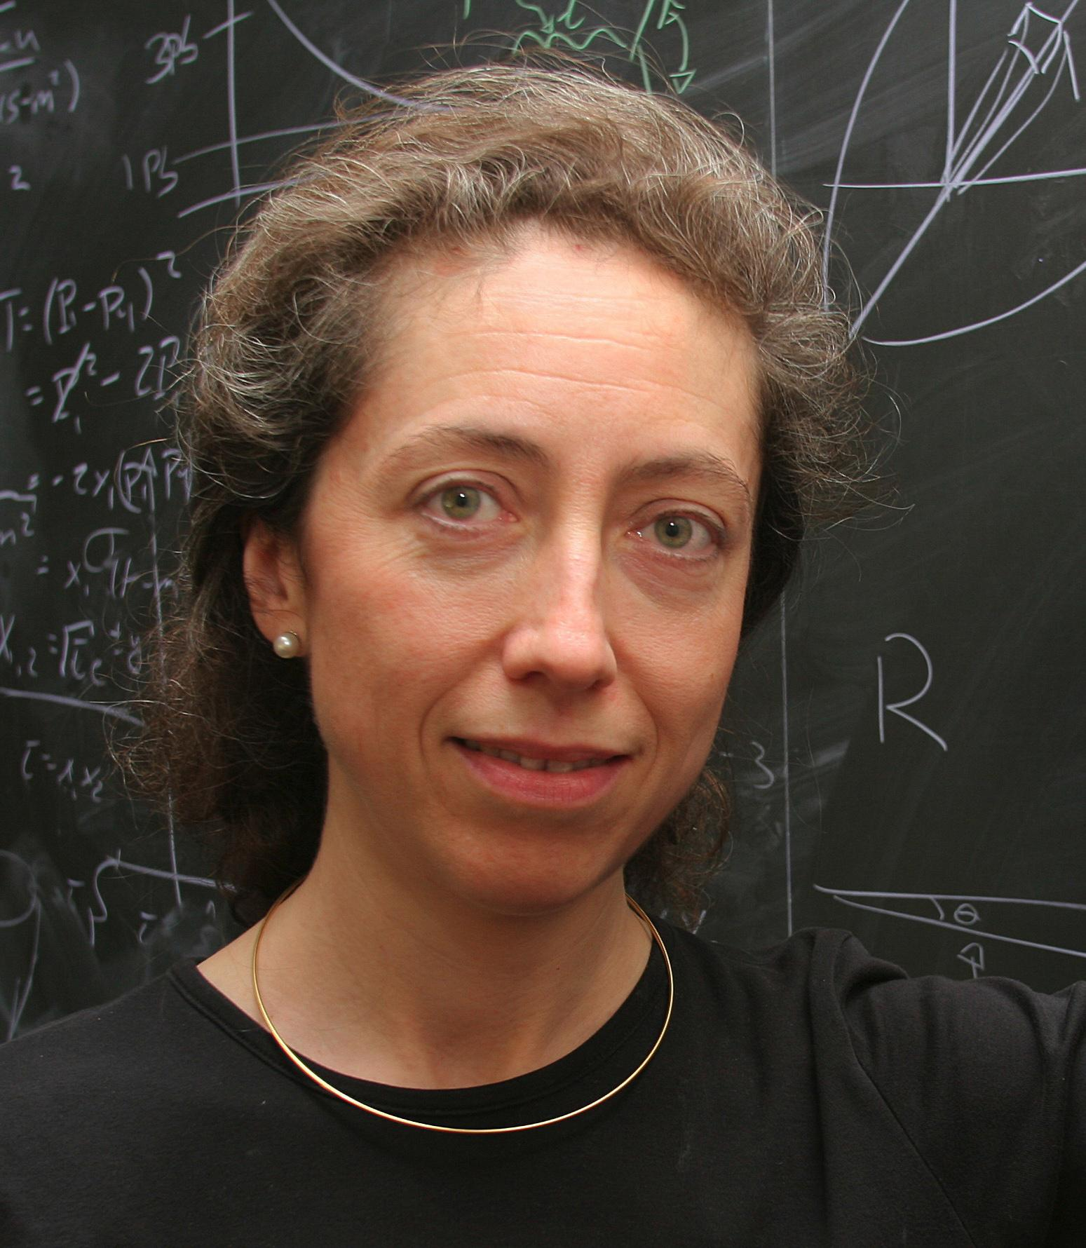
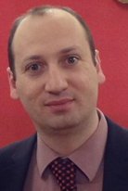
Energy Frontier
Co-Conveners
The Energy Frontier (EF) group will explore the TeV energy scale and beyond. Our sharply focused agenda includes understanding the heaviest particles of the Standard Model (SM), as well as exploring physics beyond the SM to discover new particles and interactions, including unraveling the mystery of dark matter. In this context, the EF group will carry out (and compile) detailed studies of Electroweak (EW) physics, QCD and strong interactions, and Beyond-Standard-Model (BSM) physics under different future accelerator scenarios, including lepton-lepton, hadron-hadron, and lepton-hadron colliders.
Alessandro Tricoli
(BNL)
Meenakshi Narain
(Brown U)
Laura Reina
(FSU)

Slide 2
Energy Frontier
Topical Groups and Co-Conveners (all confirmed)
Topical Group |  |  | Co-Conveners
EF01 | EW Physics | Higgs Boson properties and couplings | Sally Dawson (BNL) | Andrey Korytov (U Florida) | Caterina Vernieri (SLAC)
EF02 |  | Higgs Boson as a portal to new physics | Patrick Meade (Stony Brook) | Isobel Ojalvo (Princeton)
EF03 |  | Heavy flavor and top quark physics | Reinhard Schwienhorst (MSU) | Doreen Wackeroth (Buffalo)
EF04 |  | EW Precision Physics and constraining new physics | Alberto Belloni (Maryland) | Ayres Freitas (Pittsburgh) | Junping Tian (Tokyo)
EF05 | QCD and strong interactions | Precision QCD | Michael Begel (BNL) | Stefan Hoeche (FNAL) | Michael Schmitt (Northwestern)
EF06 |  | Hadronic structure and forward QCD | Huey-Wen Lin (MSU) | Pavel Nadolsky (SMU) | Christophe Royon (Kansas)
EF07 |  | Heavy Ions | Yen-Jie Lee (MIT) | Swagato Mukherjee (BNL)
EF08 | BSM | Model specific explorations | Jim Hirschauer (FNAL) | Elliott Lipeles (UPenn) | Nausheen Shah (Wayne State)
EF09 |  | More general explorations | Tulika Bose (U Wisconsin-Madison) | Zhen Liu (Maryland) | Simone Griso (LBL)
EF10 |  | Dark Matter at colliders | Caterina Doglioni (Lund) | LianTao Wang (Chicago)

Slide 3
Energy Frontier
Organizational plans
Meetings with topical group conveners
bi-weekly on Mondays, 13:00-15:00 (EST)
starting on Monday April 13, 2020
Probably will add another meeting to accommodate Asian time zone.
Meetings with other frontiers
Will plan meetings mid April with Frontier conveners
Propose to hold joint sessions at the EF workshops with the community (see next bullet) and also the “general workshops” in Nov 2020, July 2021 etc).
Workshops with the community
Kick-off Meeting: Thursday May 21, 2020 (full day)
EF Workshop: July 9-10, 2020 (two full days)

Slide 4
Energy Frontier
Organizational plans
Initial setup of the wiki complete
Prior to April Town Hall meeting, plan to update the topical group wiki pages by the respective conveners
When can we add the names of the topical group conveners to the wiki pages?
Email lists for communication [all archived]
with EF conveners by anyone
SNOWMASS-EF-CONVENERS@fnal.gov
with topical group conveners by anyone
SNOWMASS-EF-TOPICAL-GP-CONVENERS@fnal.gov
with the EF community by EF conveners
SNOWMASS-ENERGY-FRONTIER-GROUP@fnal.gov
Considering emails for each of the 10 topical groups

