Slide 1
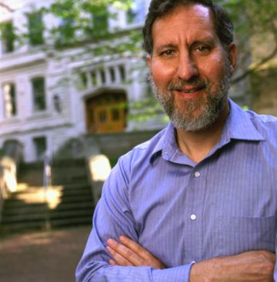
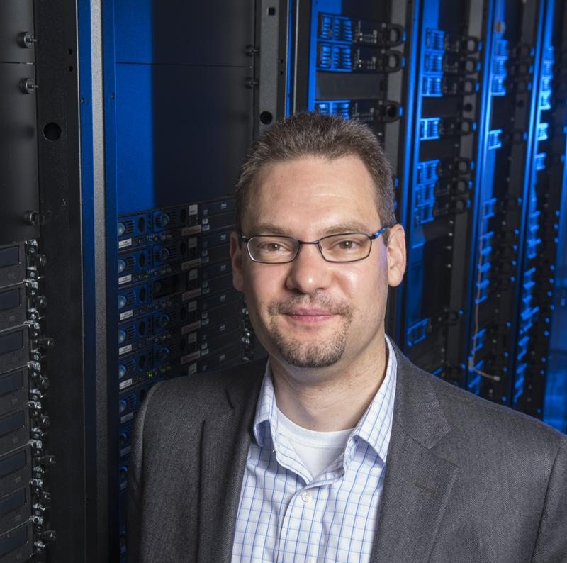
Computational Frontier
Co-Conveners
Software and Computing are an integral part of the science process.
High Energy Physics traditionally had the largest computing resource needs and subsequently most complex software stack in science. This is not true anymore, with many other science domains predicting equal or larger resource needs.
We want to gain an overall understanding of the community's needs and discuss common solutions to them in the context of current and future solutions from the HEP community, other science disciplines and industry solutions.
Topical Groups and Co-Conveners
Steven Gottlieb
U Indiana
Ben Nachman
LBL
Oliver Gutsche
FNAL
Topical Group | Co-Conveners
Experimental Algorithm Parallelization | Giuseppe Cerati (FNAL) | Katrin Heitmann (ANL) | Walter Hopkins (BNL)
Theoretical Calculations and Simulation | Peter Boyle (BNL) | Daniel Elvira (FNAL) | Ji Qiang (LBNL)
Machine Learning | Phiala Shanahan (MIT) | Kazu Terao (SLAC) | Daniel Whiteson (Irvine)
Storage and processing resource access (Facility and Infrastructure R&D) | Wahid Bhimji (NERSC) | Rob Gardner (U Chicago) | Frank Würthwein (UCSD)
End user analysis | Gavin Davies (U Mississippi) | Peter Onyisi (U Texas at Austin) | Amy Roberts (UC Denver)
Quantum computing | Travis Humble (ORNL) | Gabriel Perdue (FNAL) | Martin Savage (U Washington)
Reinterpretation and long-term preservation of data and code | Kyle Cramner (NYU) | Mike Hildreth (U Notre Dame) | TBD

Slide 2
Computational Frontier
Coordination with other frontiers
Software & computing is important for almost all other frontiers, so close coordination is needed
Have asked other frontiers to dedicate a liaison to the computational frontier
Topical Working groups conveners
Plan to meet monthly
Maybe include liaisons for coordination or have separate meetings with the liaisons
Workshops - two prong strategy
Considering dedicated workshop for software & computing
Asking other frontiers to attach software & computing sessions to their workshops
Whitepapers and surveys
Will follow the Snowmass 2021 white paper process, and will ask working group conveners to ask for specific white papers from groups/individuals to write their reports
Planning to design a survey with questions from the working groups to experiments/larger science collaborations to gather initial input for Snowmass 2021 process

