Slide 1
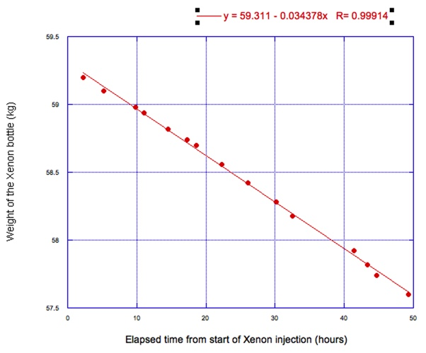
Xenon doping in NP04
On Friday 28th at 5pm, the second phase of Xenon injection was stopped
1.66 kg of Xenon injected in 49 hours at a rate of 34 g/h (from flow meter and Xe bottle weight):
A total of 2.23 kg of Xenon is now dissolved in ~ 720 ton of Argon: 3.1 ppm in mass ( 0.94 ppm in atoms/atoms)

Slide 2
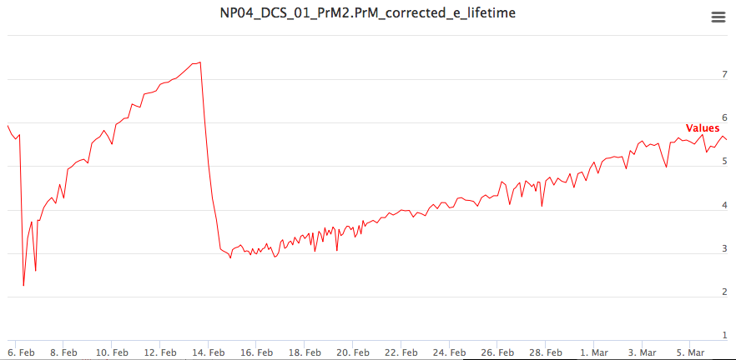
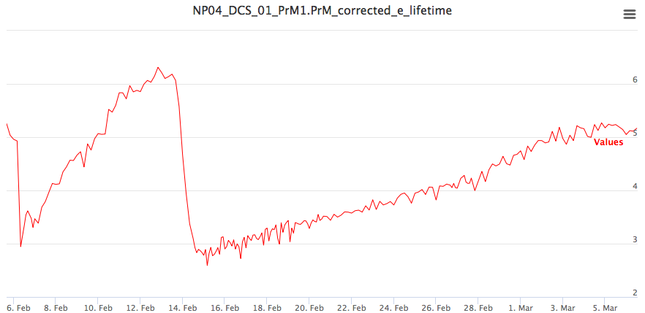
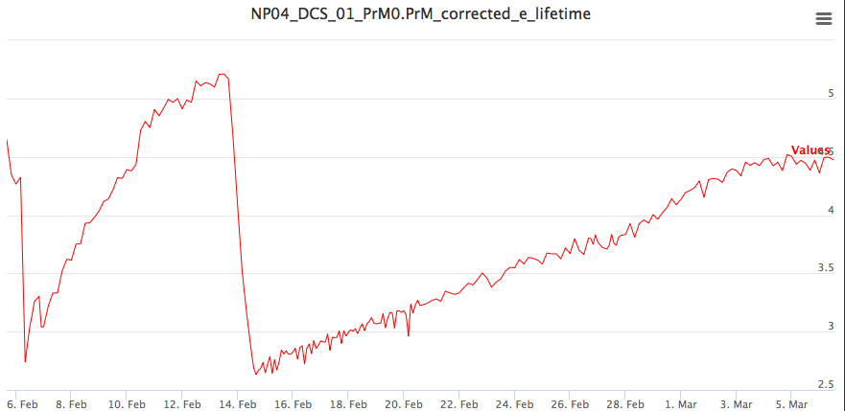
LAr Purity
top
Electron lifetime continuously monitored (purity monitors)
Steadily increasing with stable time constant of ~ 25/30 days
Xe injection not affecting the trend
It was then decided to postpone the filter regeneration
In the past few days, there is maybe a sign of purity saturation:
If so, we should probably regenerate next week
middle
bottom

Slide 3
Data Taking
Level is steadily increasing;
DUNE nominal level (17 cm above GP) reached on Wednesday
LAr-TPC gradually switched on and DAQ started with CRT and telescope trigger starting from Monday
Data taken at 250 V/cm, 300V/cm and now at 400V/cm
We can go to the nominal 500 V/cm this evening or Monday
Stand alone SSP taking data with vertical hodoscope and internal trigger alternatively.
Data also acquired with hodoscope for direct comparison of SIpM arrays and X-Arapucas

