Slide 1
IOTA/FAST Startup/Run Report
Darren Crawford

Slide 2
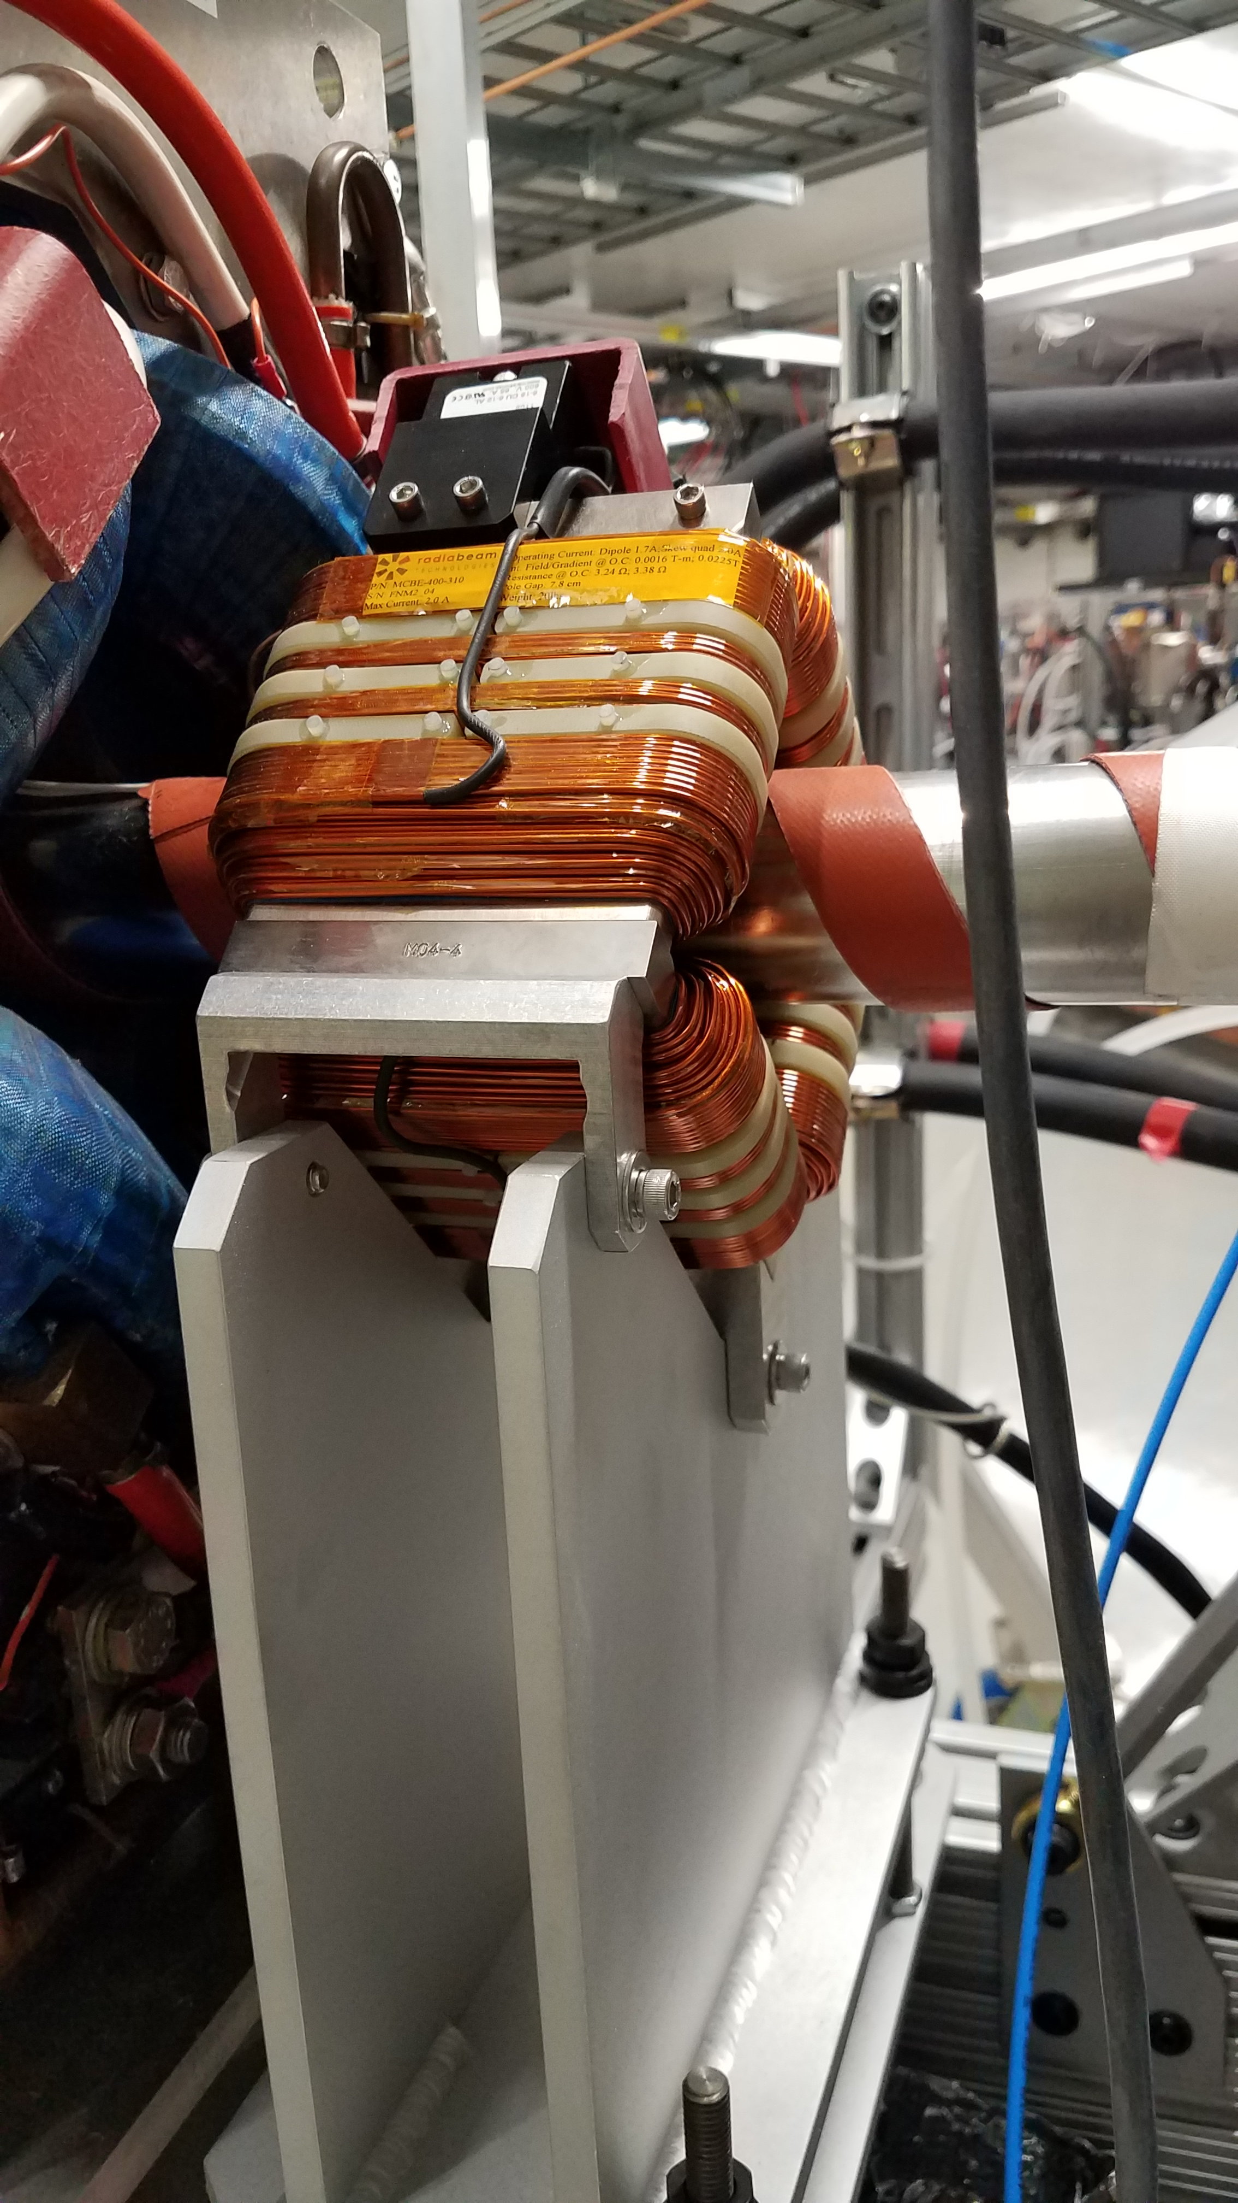
This week
URSSE studies
AMPUR studies
NIO studies
NL OMC studies
Controlled accesses to investigate
multiple IOTA quadrupole electrical and mechanical connections
octupole string alignment
octupole #5 electrical short
SQA1R – Wire connections loose on the magnet side of the terminal block. SQA2R – Wire connections loose on the magnet side of the terminal block. SQB2R – Mechanically unstable. Tightened stand to the 80/20 support on the girder. SQD1R – Mechanically loose at the magnet to stand interface. All screws were loose by several turns. SQD2R – Mechanically unstable at the girder. Tightened to 80/20 support on the girder. SQC2L – Wire connections required ½ turn on magnet side of terminal block. SQC1L – Wire connections loose on magnet side of terminal block. SQB1L – Wire connections loose on the magnet side of the terminal block, stand mechanically unstable on the inside of the ring, mechanically loose at the magnet to stand interface. SQA1L – Wire connections loose on the magnet side of the terminal block. SQA2L – Wire connections loose on the magnet side of the terminal block.
QE1L – wire connections loose on cable side of the terminal block QD3R - wire connections loose on coil and cable side of the terminal block QD2R – wire connections loose on coil and cable side of terminal block, full turn was required on the jumper and cable connections The beamtube support stand was found loose at the ER girder 80/20 support. We secured the beamtube support.

Slide 3
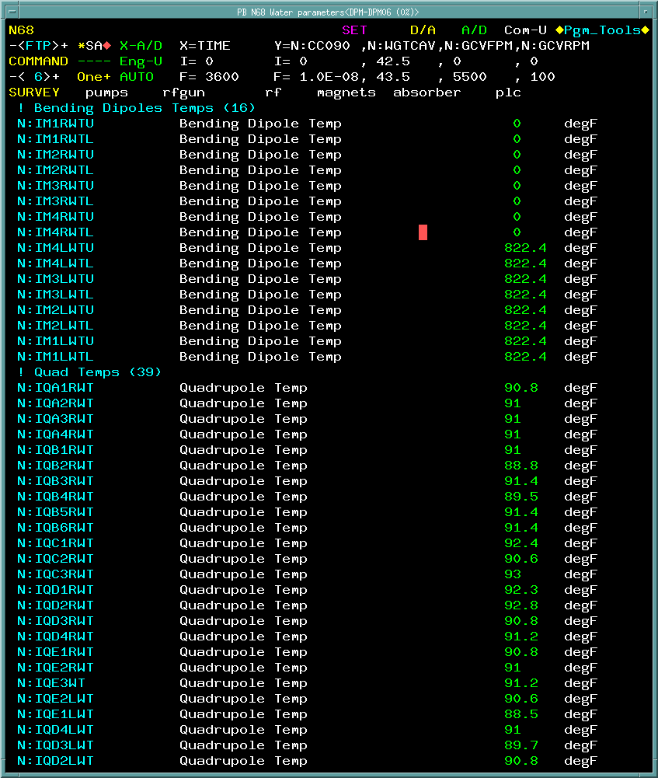
Downtime: 4.3 hours out of 104 hours (13 shifts)
RF Gun modulator control power chassis
IOTA LCW PLC module failure
Nuisance trips
CC1 VP Mod trip
CM2 RTDT trip
H103 regulator trip

Slide 4
March schedule

Slide 5
Monday Morning Controlled Access 08:00 – 12:00
Refocus camera at X107
Refocus camera at X118
Investigate object blocking the optics path at TPM111
Connect new sextupole power supplies
Octupole #5 electrical short investigation

Slide 6
Current Status
NIO studies now
IBS on evening shift

