Slide 1
Overview
Utility Plant (WBS 121.06.04)
E. Alcaraz
Requirements and Specifications Review
07 April 2020

Slide 2
Outline
Scope
Requirements Basis
Functional Requirements Specification
Technical Requirements Specification
Room Data Sheets

Slide 3
Scope
The PIP-II Utility Plant will provide the mechanical infrastructure to support the installation, commissioning and operation of the process water equipment for the PIP-II accelerator components.

Slide 4
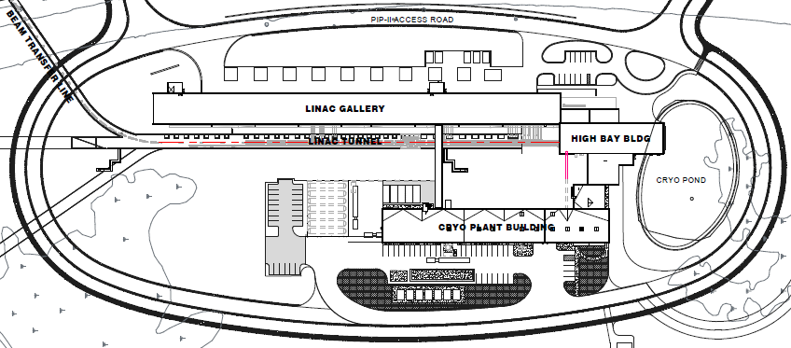
Scope
Utility Plant

Slide 5
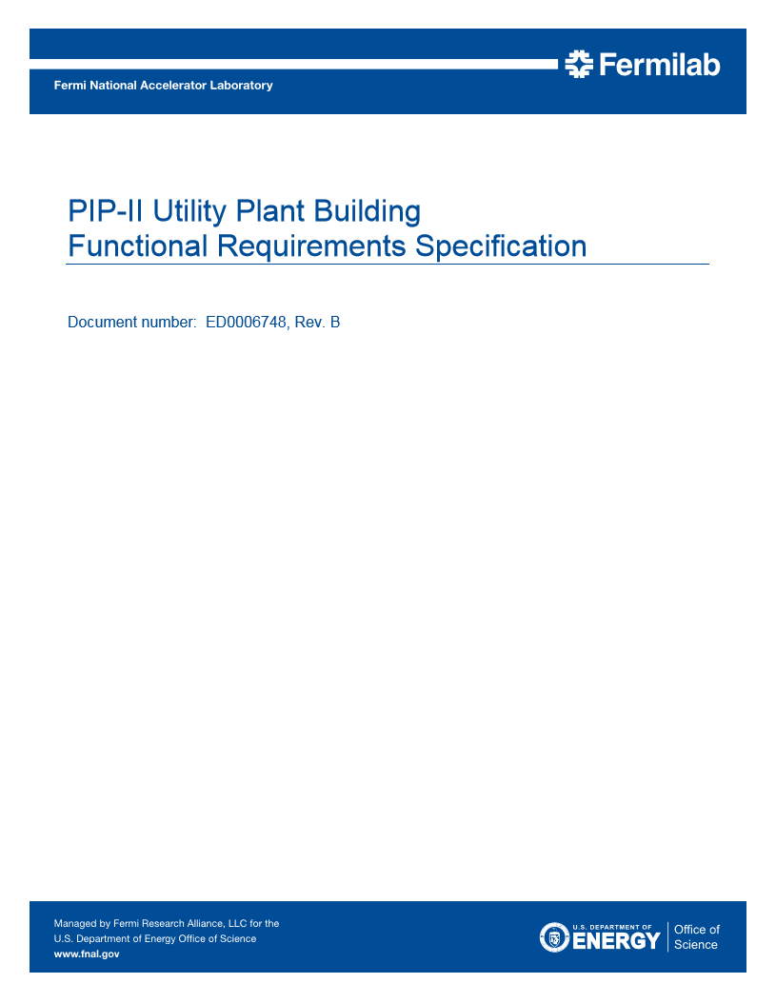
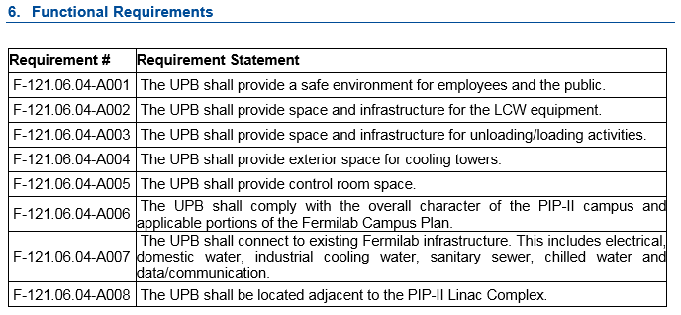
Requirement Basis
Functional Requirements Specification
Teamcenter ED0006748

Slide 6
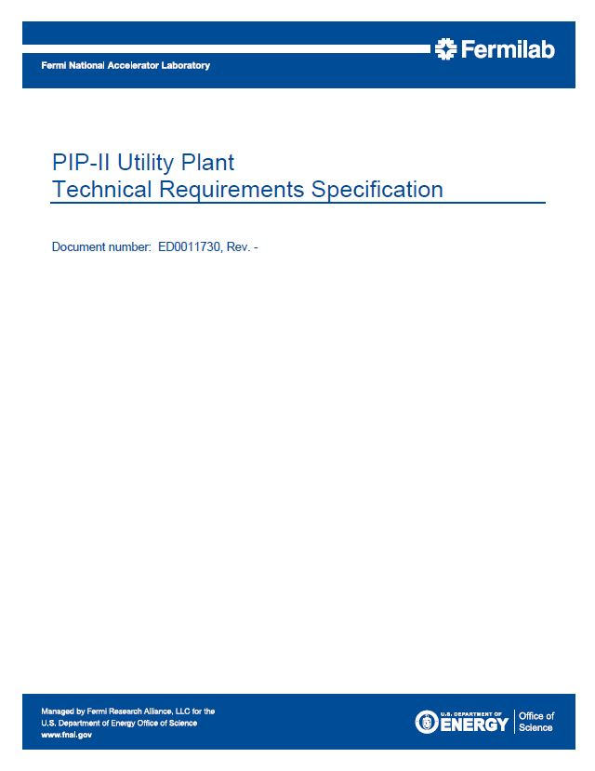
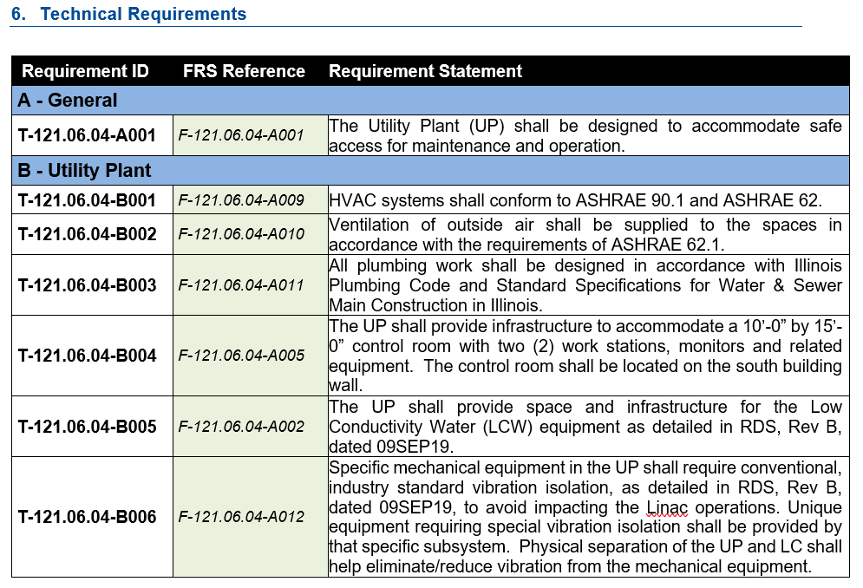
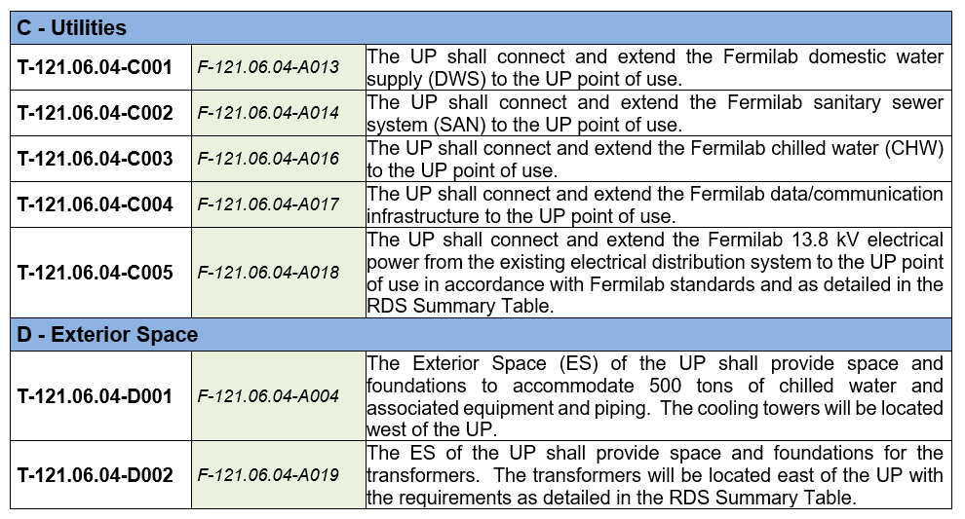
Requirement Basis
Technical Requirements Specification
Teamcenter ED0011730

Slide 7
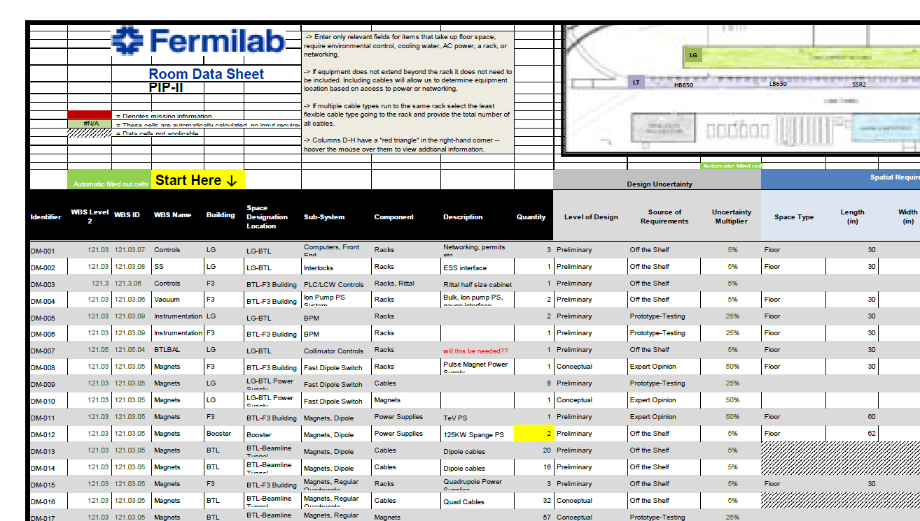
Requirement Basis
Room Data Sheets
Teamcenter ED0009544

Slide 8
End

