Slide 1
Introduction
Utility Plant (WBS 121.06.04)
E. Alcaraz
Requirements and Specifications Review
7 April 2020

Slide 2
Outline
Logistics
Introductions
Review Agenda
Review Charge

Slide 3
Logistics
Safety
Exits
Severe Weather
Rally Point
Bathrooms
Links:
Requirements and Specification Review: ED0011746
Functional Requirements Specifications: ED0006748
Technical Requirements Specifications: ED0011730
Room Data Sheets: ED0009544
Indico Site: https://indico.fnal.gov/event/23660/

Slide 4
Review Committee
A. Martinez, PIP-II
S. Dixon, PIP-II
E. Alcaraz, PIP-II
M. Ball, FESS/E
R. Crawford, AD
J. Czajkowski, AD

Slide 5
Review Agenda

Slide 6
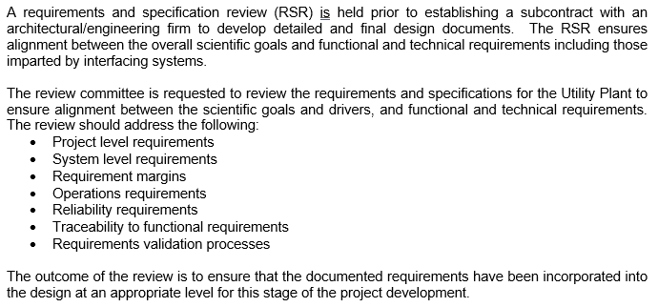
Review Charge

Slide 7
End

