Slide 1
LBNF Target Integration Meeting
N. Agbo, M. Campbell, C. Crowley
03/11/2020

Slide 2
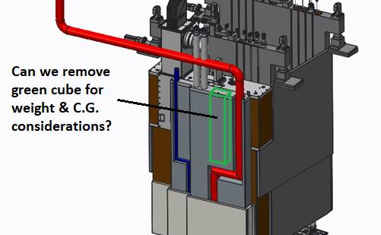
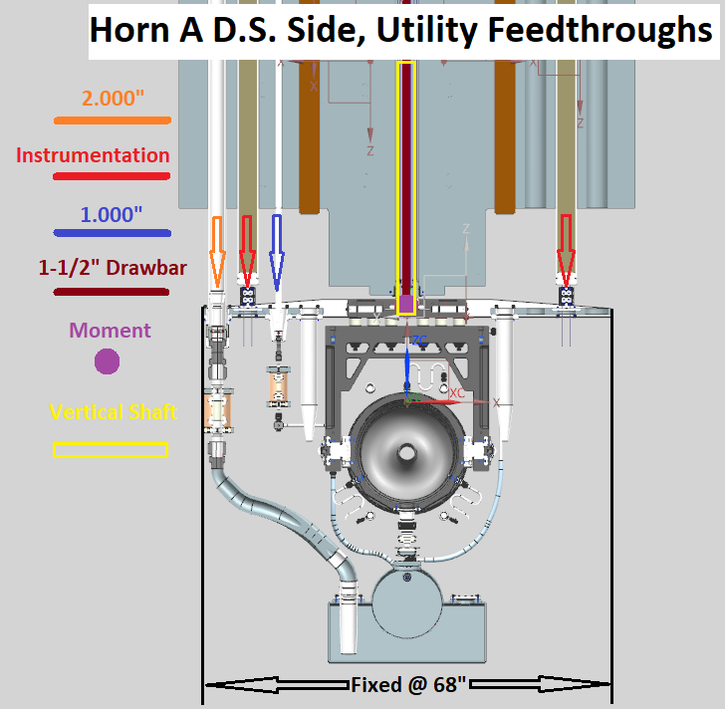
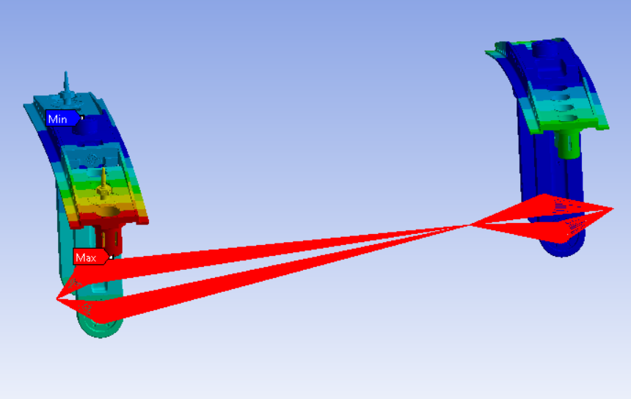
Horn + Module Modeling Status
Schedule integration.
TUB weight & labyrinth input.
Module & hanger interface revisions.
LBNF / RAL Target Integration Meeting
03/11/20

Slide 3
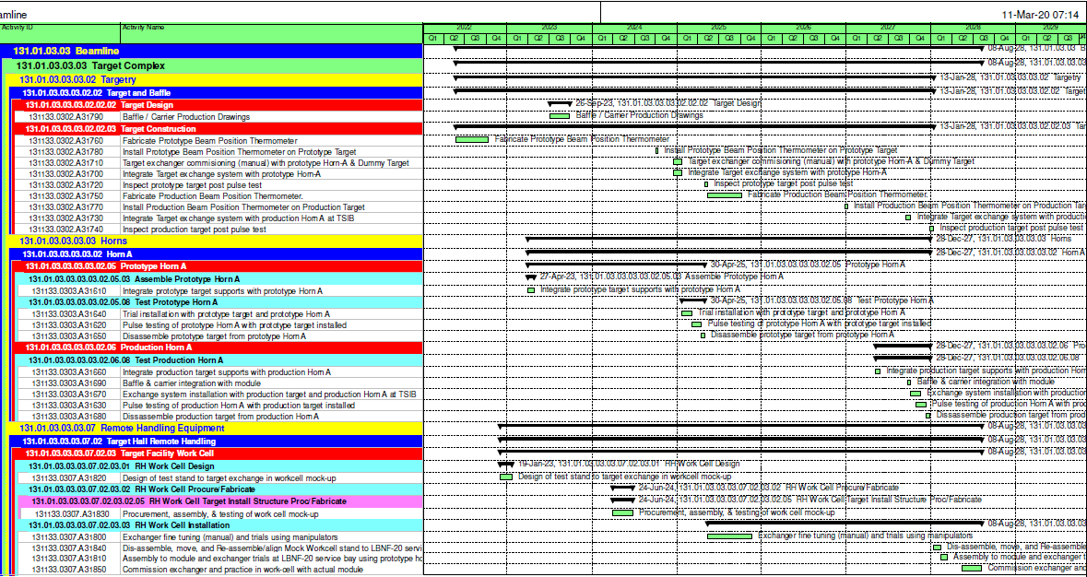
Integrated Schedule
Schedule in good shape for FNAL Director’s Review.
Available in DUNE-doc-18252; will update draft as required.
LBNF / RAL Target Integration Meeting
03/11/20

Slide 4
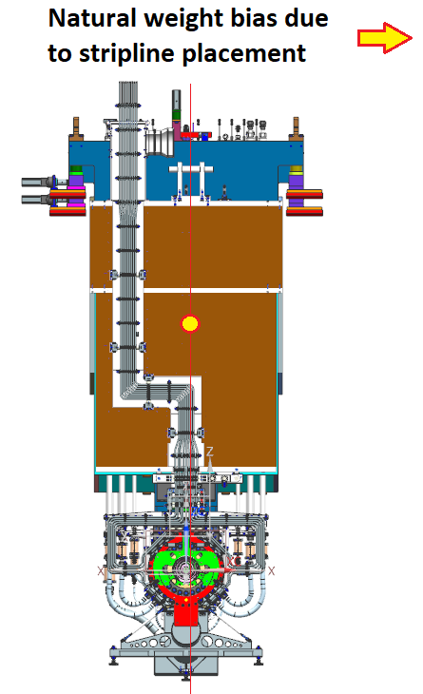
TUB Input
TUB geometry should allow the adjacent T-block to be lifted directly up.
Generally the bottom of the TUB wants to be larger than the top of the TUB due to labyrinths with the T-block.
Is there some way to:
Keep instrumentation lines centered?
Provide dogleg for both helium lines?
Hold C.G. of TUB / SLB block as an assembly where it stood prior to revisions?
LBNF / RAL Target Integration Meeting
03/11/20

Slide 5
TUB Input
We are planning on shrinking target instrumentation lines.
May have to raise target helium return line slightly.
Possibly remove excess TUB material?
Possible to shift TUB material to beam left to help balance C.G.?
LBNF / RAL Target Integration Meeting
03/11/20

Slide 6
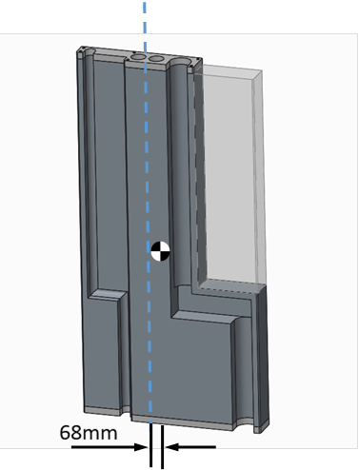
Just in From Mike Parkin!
LBNF / RAL Target Integration Meeting
03/11/20

Slide 7
Module Hanger & Interface Revisions
Potential issue with horn / module interface identified late January.
Utility & instrumentation line loads are double those in NuMI
Increased shielding depth.
Increased diameters.
Loads are asymmetric and on longer lever arm.
Thinner end-walls necessitate stacking lines side by side.
Too many varying needs to fully balance loads.
Single drawbar connection thought to be a weak link in kinematic system.
LBNF / RAL Target Integration Meeting
03/11/20

Slide 8
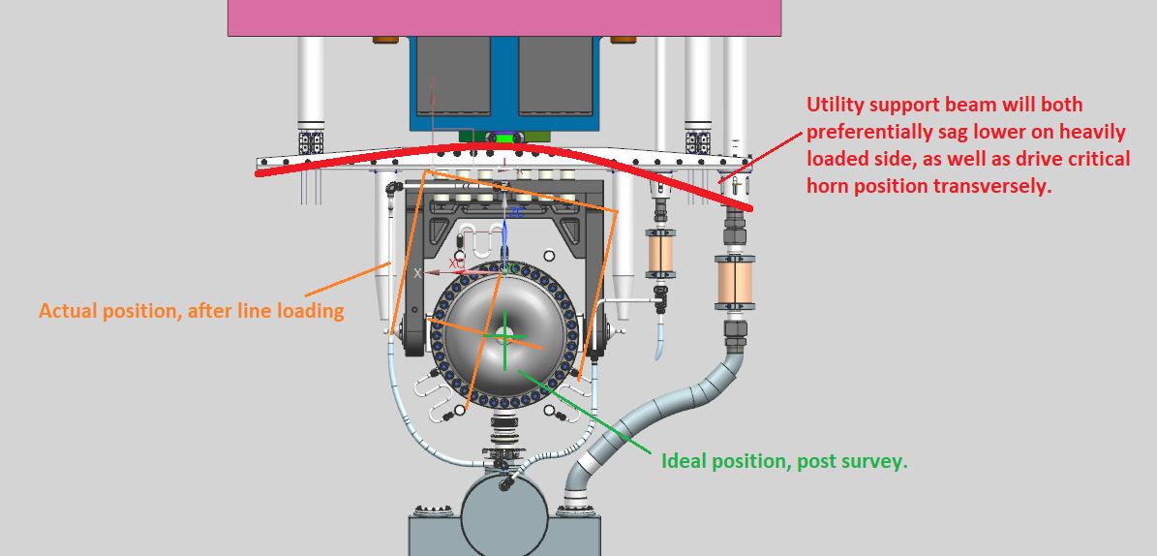
Module Hanger & Interface Revisions
Rough guess was that some sort of bending & translation was going to occur, most notably at D.S. end.
Would affect horn + target alignment.
LBNF / RAL Target Integration Meeting
03/11/20

Slide 9
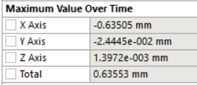
Remote Points Deformation
Credit: Nnamdi A.
Utility line weights and current module connection as design is causing unacceptable translation of horn position.
0.025”
03/11/20

Slide 10
Solution
Dual draw-bar design to improve force-couple.
Will space out on 8-10” centers.
Becomes mostly a tension & compression relationship with drawbars & reduces very high moment loading at single drawbar connection.
We Will:
Revise Horn hanger supports to accept dual draw-bar support.
Give final update in ~4 weeks time confirming smaller lateral translation.
This Affects:
Baffle carrier design connection to module.
Module designs are standardized, so ideally the baffle carrier will want to use the same connection points to a dual draw-bar system.
Baffle could potentially have similar asymmetry, so trying to prevent alignment issues everywhere.
03/11/20

Slide 11
Integration Work for Next 2 Weeks
Revise Horn A hanger & module connection (no impact to target, impact to Baffle carrier confirmed).
Detailed design continues, analysis continues…
Still must forward completed layout drawing of inner conductor to RAL for reference. Catching up with drafting resources & will push to get drawing set forwarded before end of March.
LBNF / RAL Target Integration Meeting
03/11/20

