Slide 1
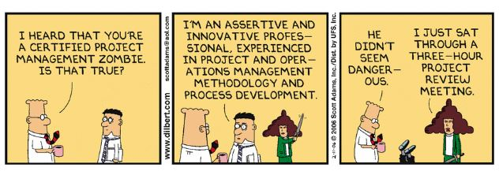
APS-TD/MS/MSD/M&A Group Meeting
3/12/2020

Slide 2
MSD news
No safety issues last month
A requisition for Helen’s replacement is approved
  Interviews complete, candidates are selected
Requisitions for IB2 floor manager and IB3 technician approved
  4 new Contractors in IB3 (HL-LHC AUP)
Colin Narug hired in SRF Development department (Y. Orlov)
Preparation for 2020 Summer student program
  10 students budgeted within APS-TD
  Please send requests
COVID-19 prevention plans
Organizational changes in MSD

Slide 3
HQ

Slide 4
COVID-19 prevention and planning
New Fermilab webpage has been established for you to keep up with COVID-19 at Fermilab. Please see www.fnal.gov/covid19
No travel to or visits from or transiting through nations designated by the Centers for Disease Control and Prevention as Level 2 or Level 3. Fermilab is asking all users and visitors who have traveled from or through a foreign country for which the CDC has issued a Warning Level 2 or 3 notice to reschedule their visits until a later date or connect remotely. These nations currently include:
  China, Iran, South Korea, Italy (all Level 3)
  Japan (Level 2)
We should start communicating with our employees about what needs to be done to prepare for a 14-day (or longer) absence from Fermilab site and to ensure continuity of operation
  Modified Min Safe Plan, Instructions for managers are available
  Proposed actions at APS-TD are available

Slide 5
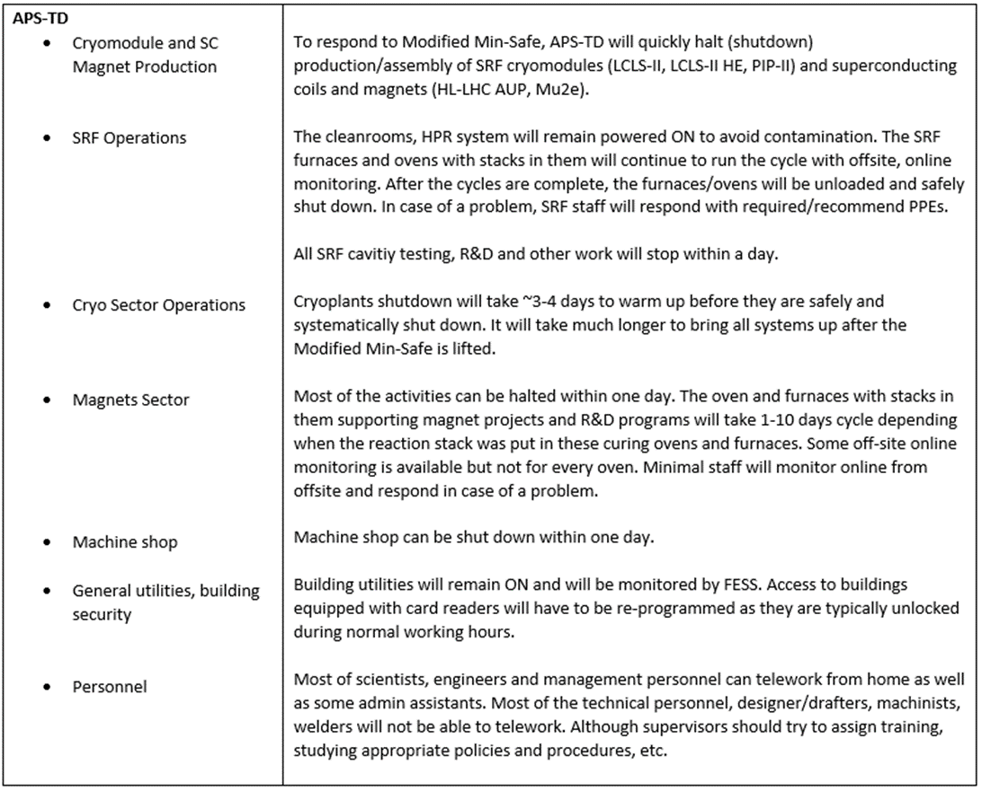
Proposed actions at APS-TD

Slide 6
Modified Min Safe Plan
Develop an all-hands email list(s) for your area if necessary
  Daily communication with employees, discuss work progress. Email and phone lists.
With your employees, discuss and document what needs to be shutdown/brought to a safe state, which documents move to shared directories on APS-TD servers, etc. Assume that Fermilab will be closed for at least 14 days.
Prepare a list of essential personnel that might need access to the Fermilab site to take care about equipment, emergency repairs, etc.
  IB2, IB3 list of essential persons
  Backup plan if employees are unavailable
  Remote work plans
While at this point we are not aware about any events, meetings, etc. hosted by our Division over the next 60 days, please inform us about such events ASAP. It is very likely that we will have to cancel such events.
  Italian students
There was recent all-hands communication from Nigel about travel. Please discuss it with your employees. The travel office will assist with any travel arrangements that should be canceled.

Slide 7
Modified Min Safe Plan
Communicate with your employees regarding what steps are needed to ensure efficient telecommuting. Discuss remote work plans with supervisors and employees. Request that employees take needed materials home each night.
Review and understand the leave reporting and pay code types. If the Lab is closed, everybody will have to complete their timecards and supervisors will have to review absences daily. Regardless of whether employees could and could not telework, they will have to complete their timecards using appropriate task codes to be paid. More details on this will be provided soon.
These telework and leave provisions apply to non-bargaining unit employees only. Information for union employees will be coming soon.

Slide 8
Multifactor authentication for email off-site
Beginning Apr. 30, the lab will require multifactor authentication (MFA) to access your Fermilab email account from off-site.
  If you are on site at the lab, or if you use VPN, you will be able to access your email as usual
If you access your email offsite and are not using the lab’s VPN system, then in addition to entering your Services account username and password to access your email, you will be required to also enter your PIN and passcode generated by your RSA token.
  If you access email offsite and are not using VPN, you must obtain an RSA token before Apr. 30.
  The software token (“soft token”) is an app that you install on your mobile device.
  The hardware token (“hard token”) is a small hardware device that you can attach to a keychain.
For more details visit https://news.fnal.gov/2020/02/mfa-for-offsite-email/

Slide 9
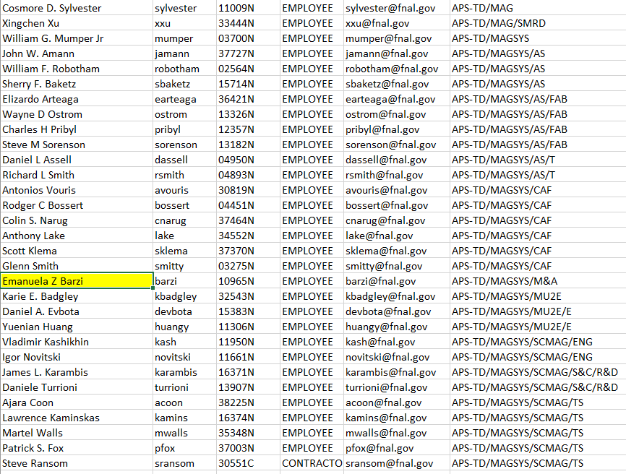
Multifactor authentication for email off-site (2)
MSD personnel w/o the hardware RSA token

Slide 10
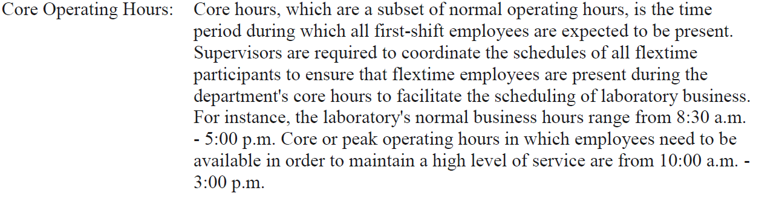
Reminder
Lab Status (Bullets)
  Needed by the end of Each Friday – submitted during the weekend or very early on Monday
  If on vacation, make sure to submit it before you leave for vacation
Planning vacation days
  One day is OK to notify Laura and/or Sandor
  More than one day need to submit and official “vacation request” form at least two weeks before and to be signed by Sandor and Guram and give a copy to Laura (she is keeping track of who is where)
Fermilab policy:

Slide 11
PROJECT STATUS/PLAN SUMMARIES
near term/year term
HiLumi SF, SS, TS, MB, JD
HFM SS/EB
PIP-II SS
MU2E SF/TS
MAGMEAS
  HiLumi TS, JD, MB
  HFM JD, SS
  Probe development JD
  FMS for Mu2e
Around the Table

