Slide 1
IOTA/FAST Run Report
Darren Crawford

Slide 2
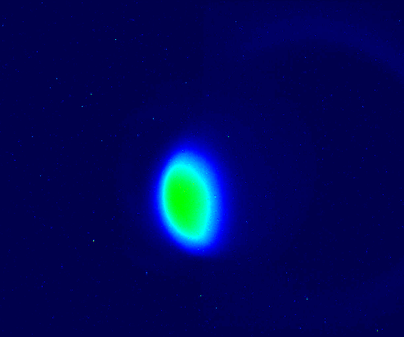
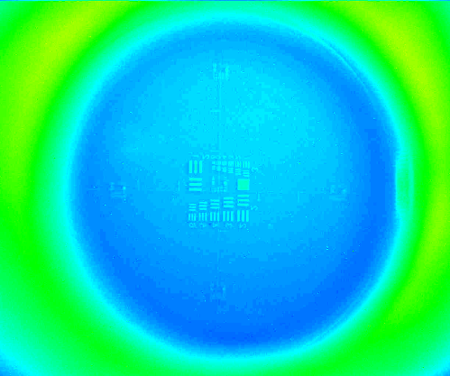
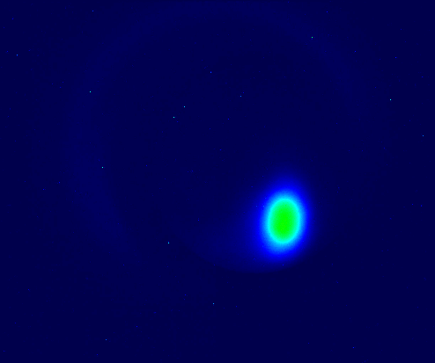
This week
X107
Monday Morning Controlled Access
Refocused camera at X107
Refocused camera at X118
Investigated object blocking the optics path at TPM111
Connected new sextupole power supplies
Octupole #5 electrical ground fault cleared
URSSE studies
AMPUR studies
NIO studies
NL OMC studies
Controlled access to investigate
multiple IOTA Dubna quadrupole electrical connections
octupole string alignment
TPM111
X118

Slide 3
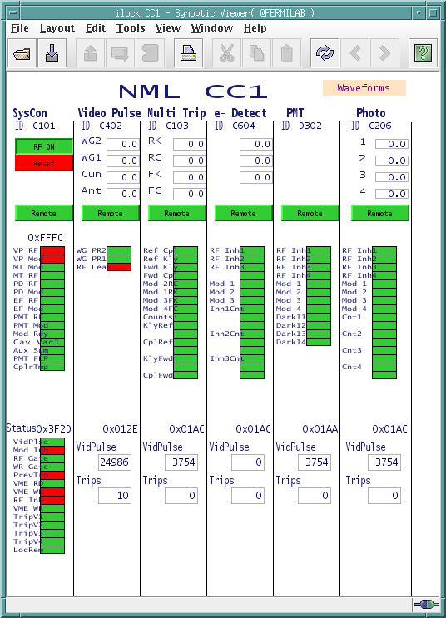
Downtime: 1.5 hours out of 88 hours (11 shifts)
RF Gun modulator control power chassis (1.5 hr)
Controls issue with CNS61
Nuisance trips
CC1 RF Leak detected
CM2 RTDT trip

Slide 4
March schedule

Slide 5
Current Status
FAST Linac and IOTA Ring turned on without issues this morning
An adjustment to the CM2 energy was needed to inject electrons into IOTA
NIO studies

